Slide 1
Project Perspective
Plant Phenological Modeling
Based on meteorological/
environmental variables
using ground based and/or
remote sensing timeseries for training.
Mangement
Optimal Adaptation
Support Climate Based Agricultural Services
Under Future warming, olive phenological stages may experience advances, leading to climate risks (Fraga et al., 2019) in the Mediterranean.
Under Future Climate Change

Slide 2
Workflow Chart
Step 1
Step 2
Step 3
Large Scale Phenological Model implement Historical
(1976-2005)
Phenological Modeling; CAC_GDD vs. PhenoFlex
Model Calibration, Parameterization and validation
Climate change projections/scenarios
Phenological Based Future Climate Risk Assessment
Towards Strategic Planning for olive Cultivation
Large Scale Phenological Model implement Future
(2036-2065)

Slide 3
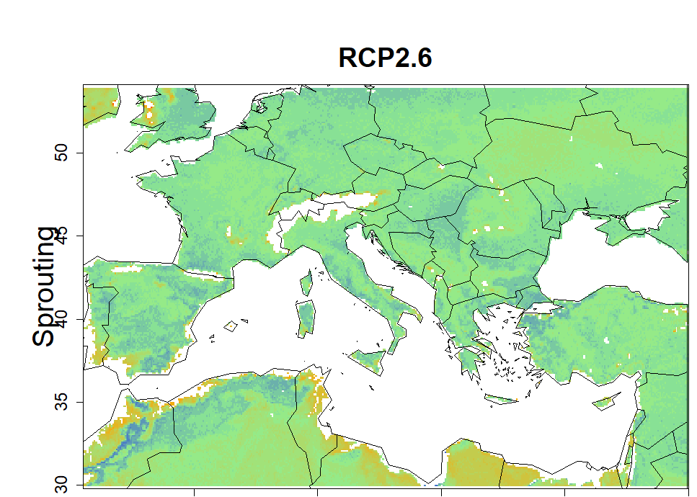
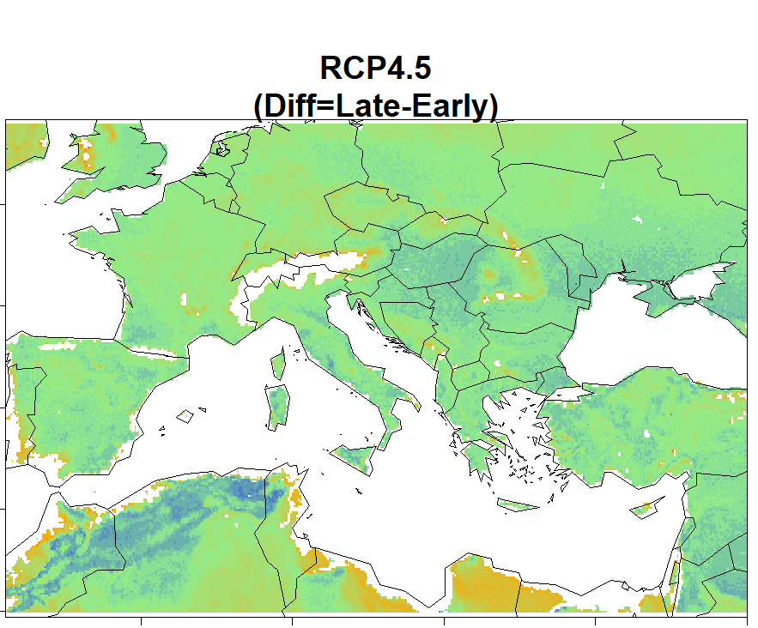
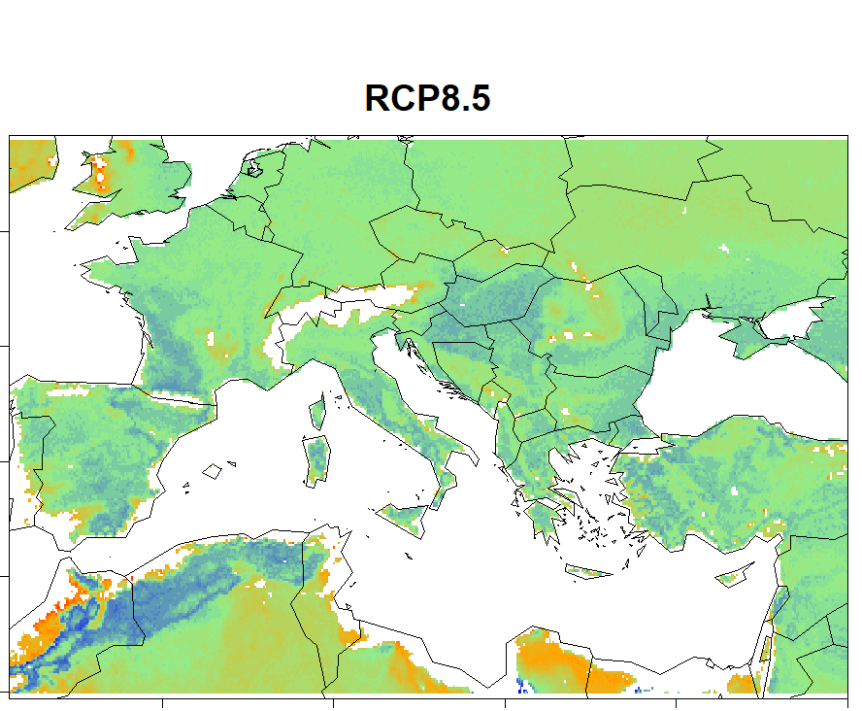
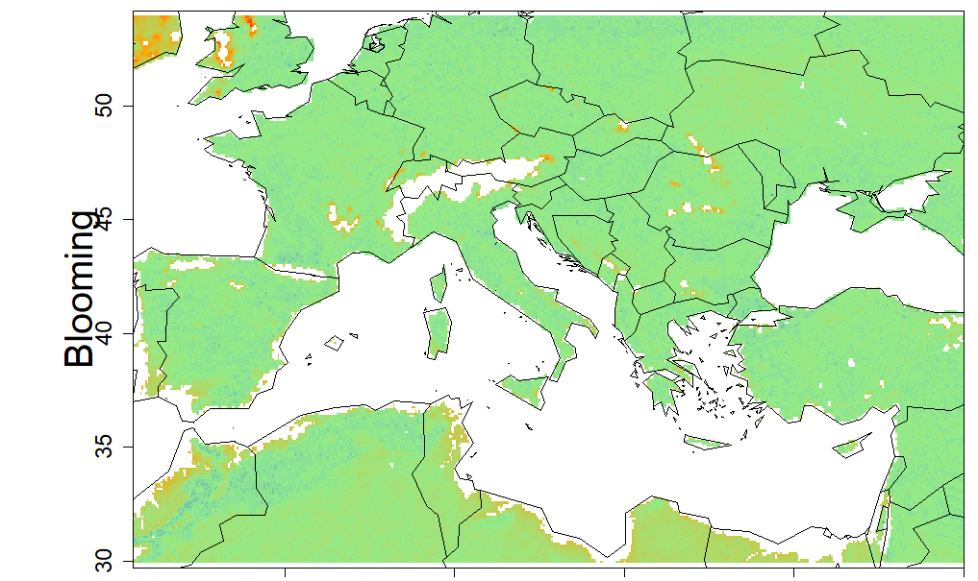
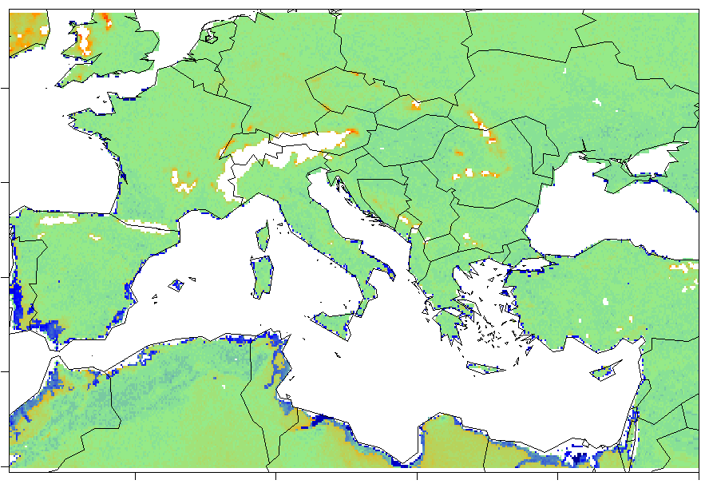
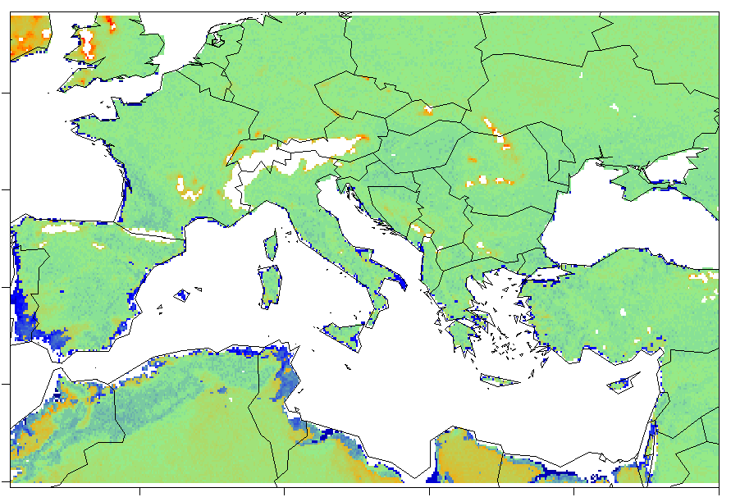
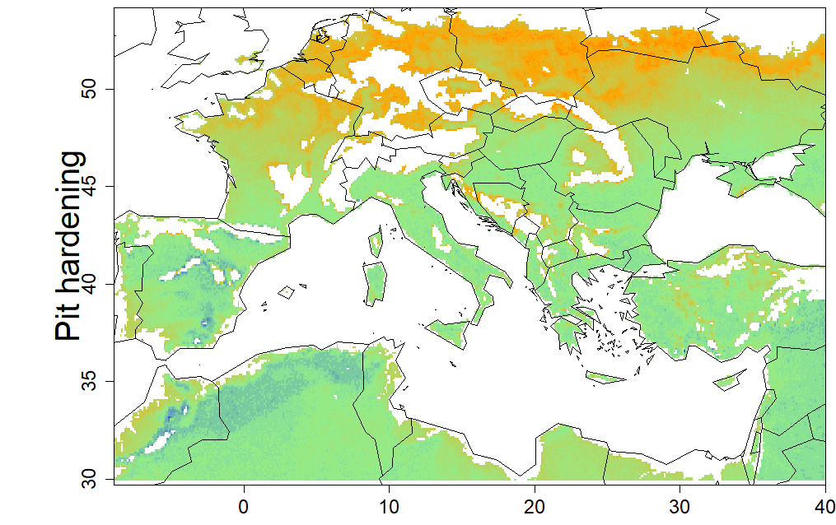
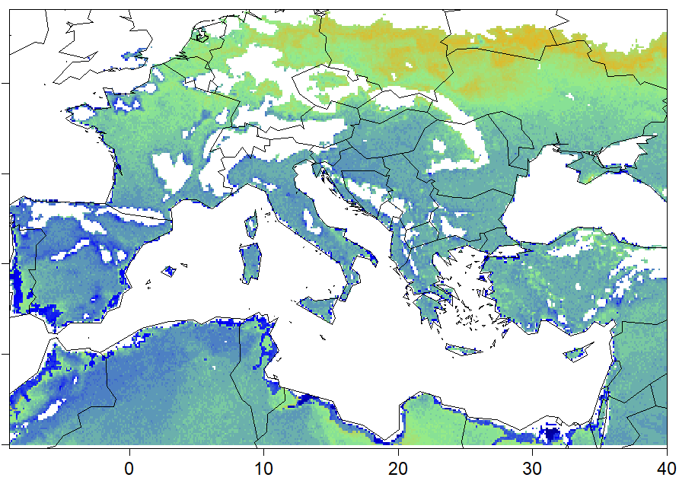
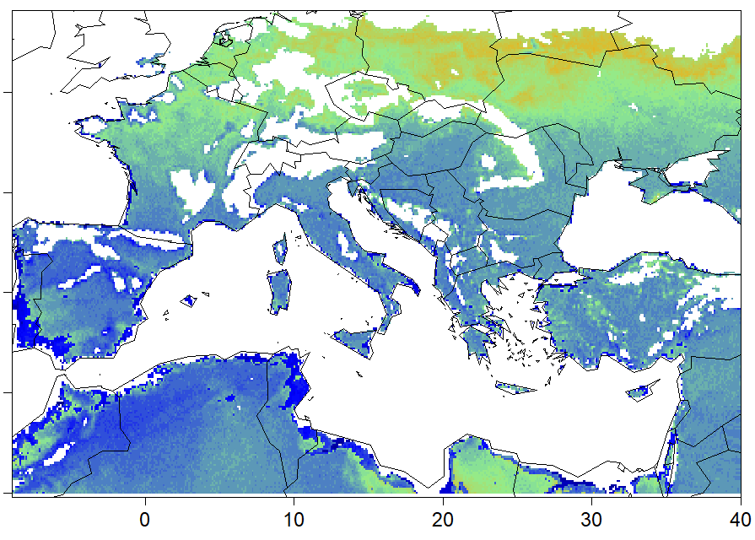
Difference in future changes between Late and Early cultivars
Difference= Late - Early
Late cultivar: greater sprouting earliness in southern zone with continental climate and
in colder regions.
RCP2.6
RCP4.5
RCP8.5
Late cultivar: greater blooming earliness in colder regions
Early cultivar: greater earliness in humid costal regions
Late cultivar: greater Pit hardening earliness in Northern Europe
Colder regions: more suitability for late cultivars . The Med region unsuitability for early cultivar

Slide 4
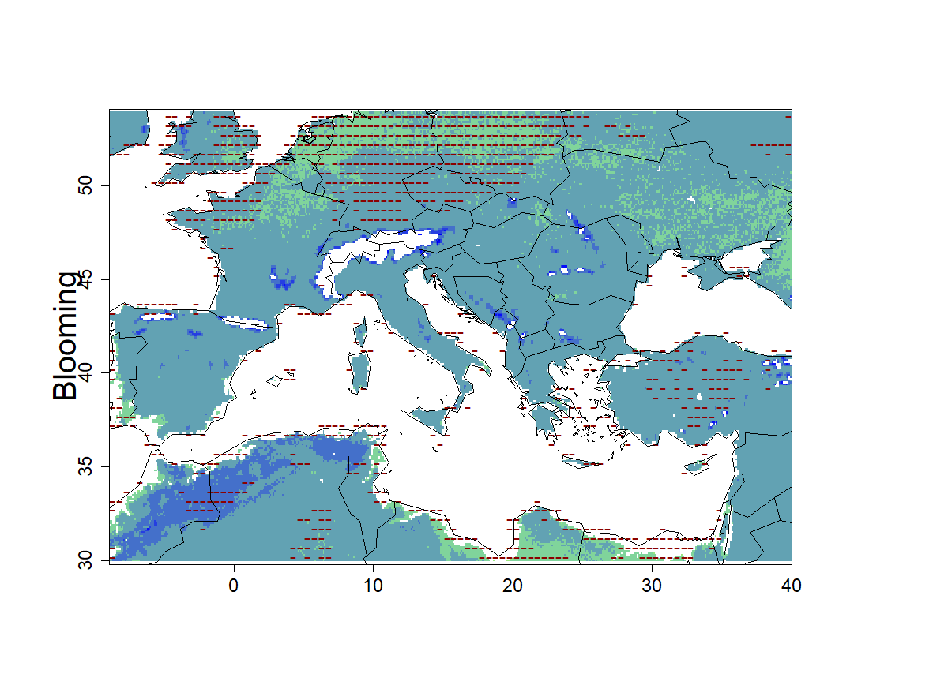
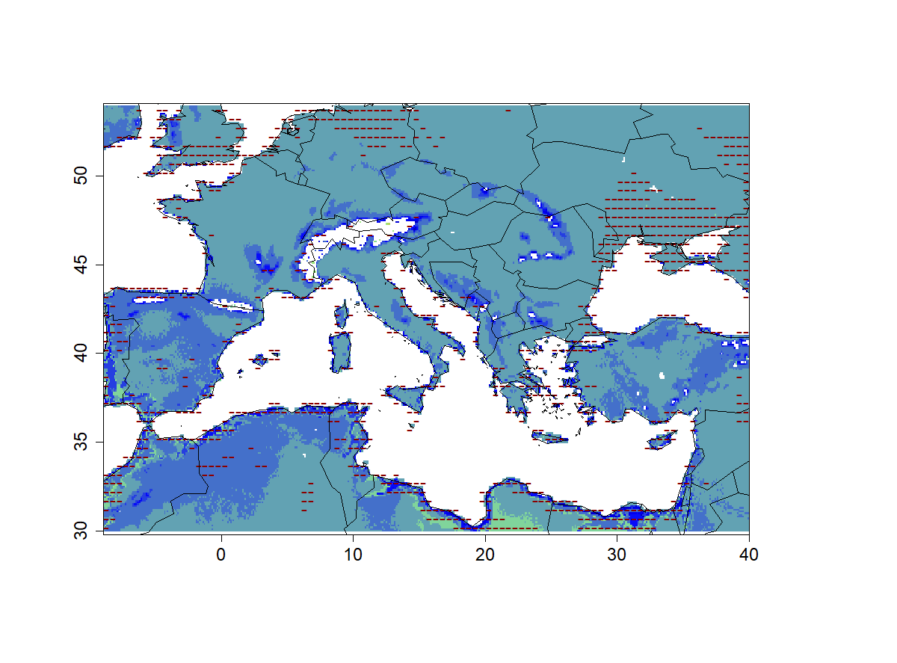
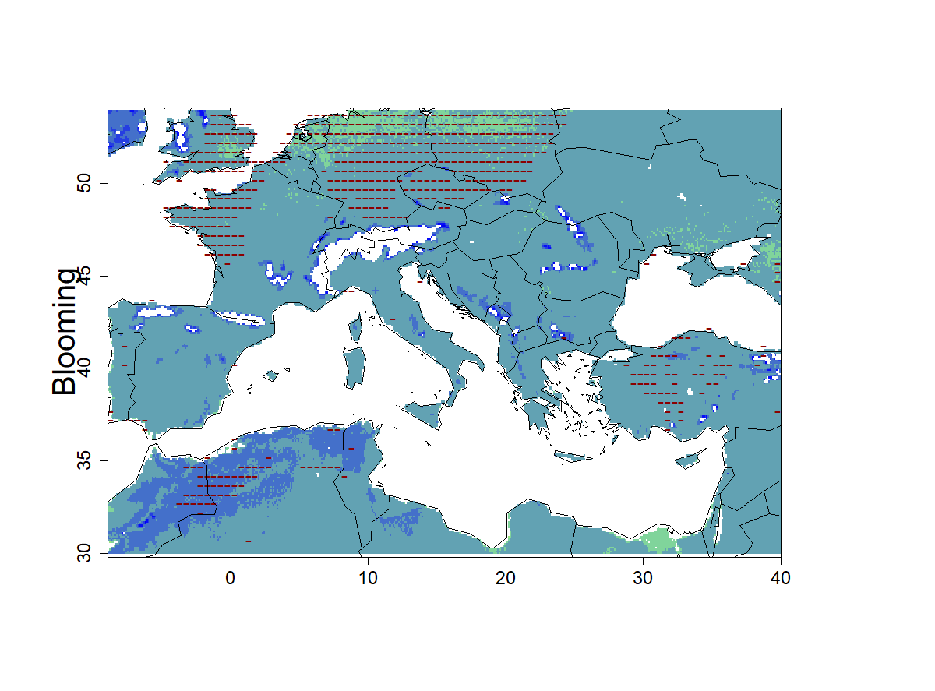
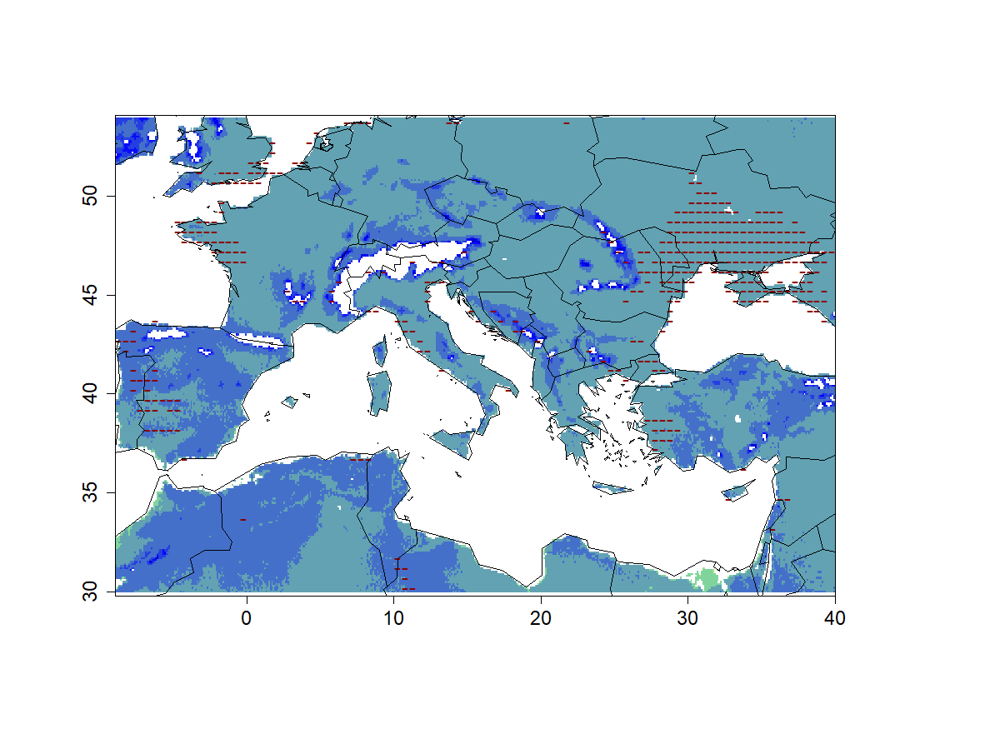
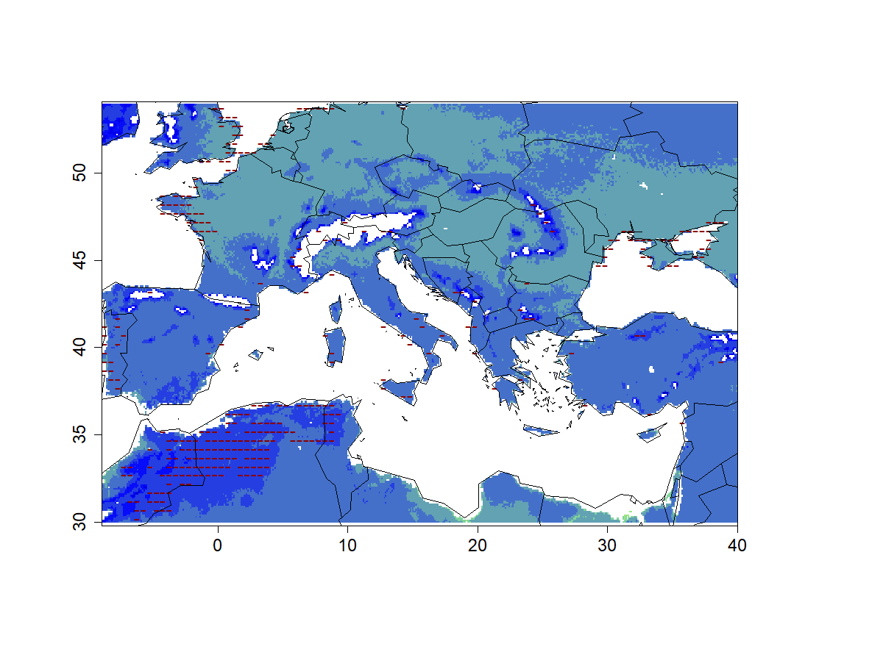
Early Phenology
RCP2.6
RCP4.5
RCP8.5
Late Phenology
Anomaly (in days)
Enhanced expansion of phenological earliness
Southern areas, mountains and northeastern regions, higher earliness

