Slide 1


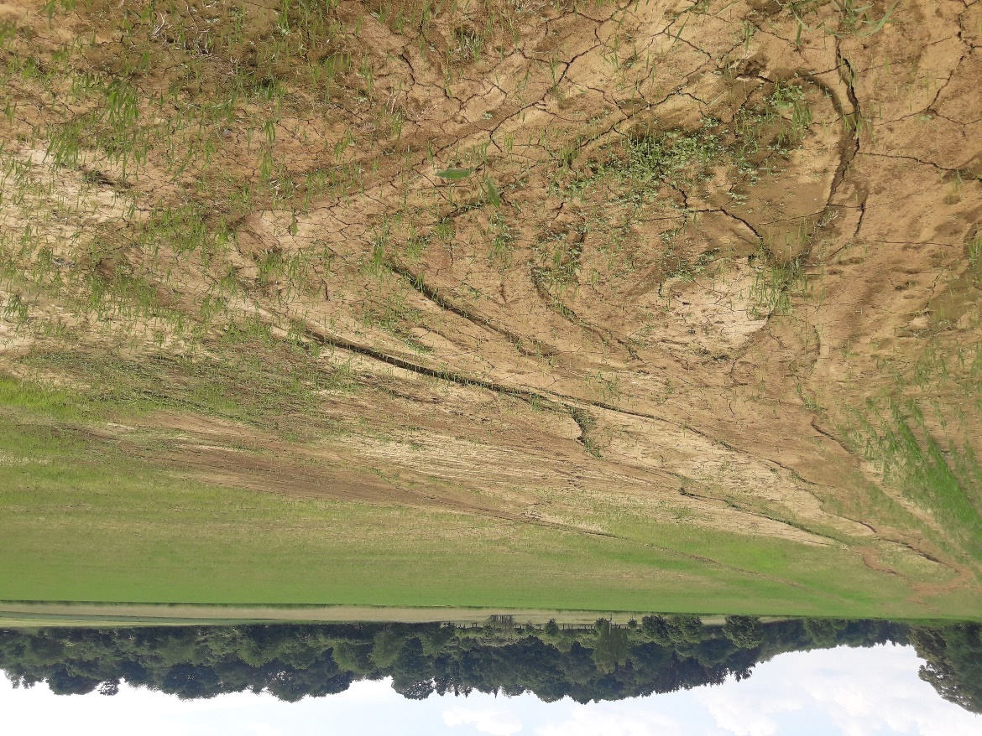


Evaluating Vegetation-Influenced Roughness Estimation Methods to Improve Hydrological Modelling
Azam Masoodi, Philipp Kraft
Landscape, Water and Biogeochemical Cycles, Justus Liebig University Giessen, Germany
Azam.Masoodi@umwelt.uni-giessen.de , Philipp.Kraft@umwelt.uni-giessen.de

Slide 2
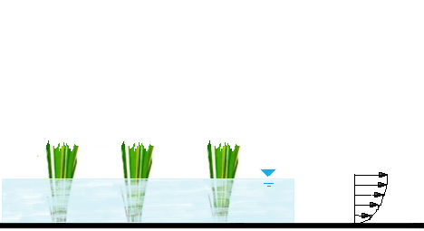
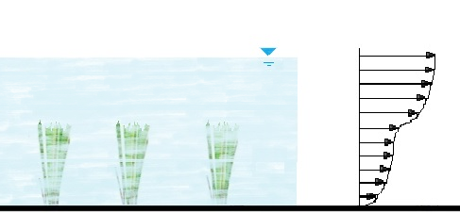
Unknown Effect of Protection Activity
Project Objectives
Emergent Vegetation
U
Investigation of vegetation effects on overland flow
Modelling the overland flow to comparison and validation of different approach of Manning’s coefficient estimation
Submerged Vegetation
U₂
U₁
Notes:
Flow-vegetation interactions effect on the runoff by increasing the roughness and modifying flow patterns. As you can see in this picture, the velocity profile is typically consistent throughout the depth in cases of emergent vegetation, but for submerged vegetation, the velocity profile exhibits an approximately S-shaped pattern. In presence of vegetation, roughness coefficient values varied with different water depths.
Previous studies proposed different methods to estimate roughness in the presence of vegetation however it needs to evaluate these methods.
So, our objectives in this study are to investigate vegetation effect on overland flow. Also modeling the overland flow to comparison and validation of different approaches of Manning’s coefficients estimation.

Slide 3
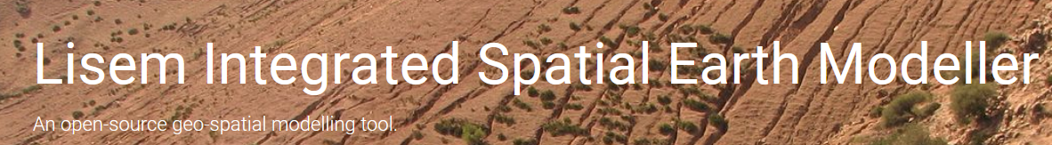
Model Base
Review of existing models :
2D Kinematic wave / Dynamic flow equation
Open Source
Central European Validation
Notes:
To address this challenge, we conducted a review of various runoff models and selected OpenLISEM because it is an opensource software and we can develop it based on our purpose. This model uses 2D Kinematic wave equation for overland flow. It has used in several studies for central Europe.

Slide 4
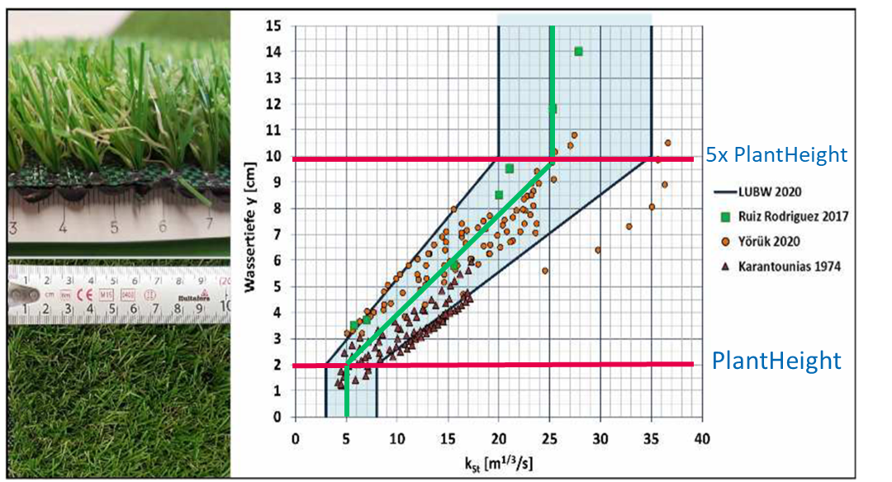
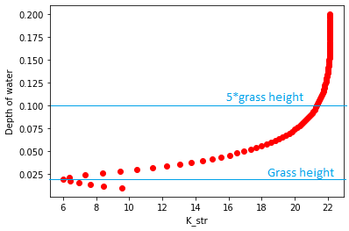

Surface Roughness Methods
Constant Manning’s coefficients
(Chow, 1959)
Linear method
(Ruiz Rodriguez, 2017; Oberle et al., 2021; Hinsberger et al., 2022 )
Luhar and Nepf (2013)
Oberle et al., (2021)
H<=h , Bx<0.8
H<=h , Bx=>0.8
H>h
Oberle, P., et al., Diskussionsbeitrag zur Fließwiderstandsparametrisierung zur Simulation von Oberflächenabflüssen infolge Starkregen, in: Dresdner Wasserbauliche Mitteilungen 65, Technische Universität Dresden, Institut für Wasserbau und technische Hydromechanik (Hg.): Wasserbau zwischen Hochwasser und Wassermangel, 129–139, 2021.
Notes:
Various roughness method is utilized in our study including:
Constant n, which is suggested by Chow.
Another one is Linear method. several studies like Oberle and Hinsberger found a linear relationship for roughness when the depth of water is between plant height and 5 times of plant height. In the upper picture is shown experimental data of various studies for Strikler coefficient against water depth.
Another method is proposed by Luhar and Nepf. This equation shows different Manning’s n for different value of water depth and blockage ratio. The below picture shows the trend of Strikler values against depth of water using this equation.

Slide 5

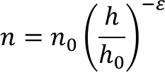
Surface Roughness Methods
Feldmann et al., (2023)
Constant Manning’s coefficients
Exponential method
Kadlec’s method
Fu’s equation
Notes:
Recently, Feldmann et al. developed a framework to found most robustness Manning’s n. Notably, their framework is based on the falling limb of hydrograph which assumed infiltration rate is constant. They applied their framework for a constant value and these three equations.

Slide 6
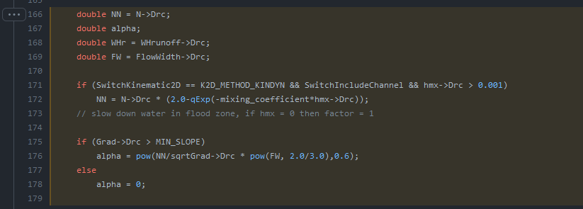
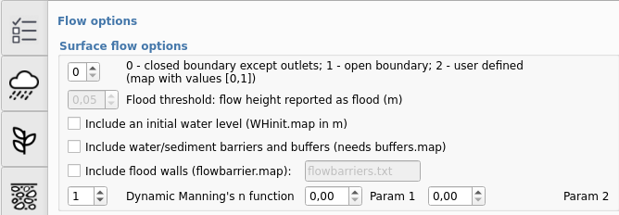
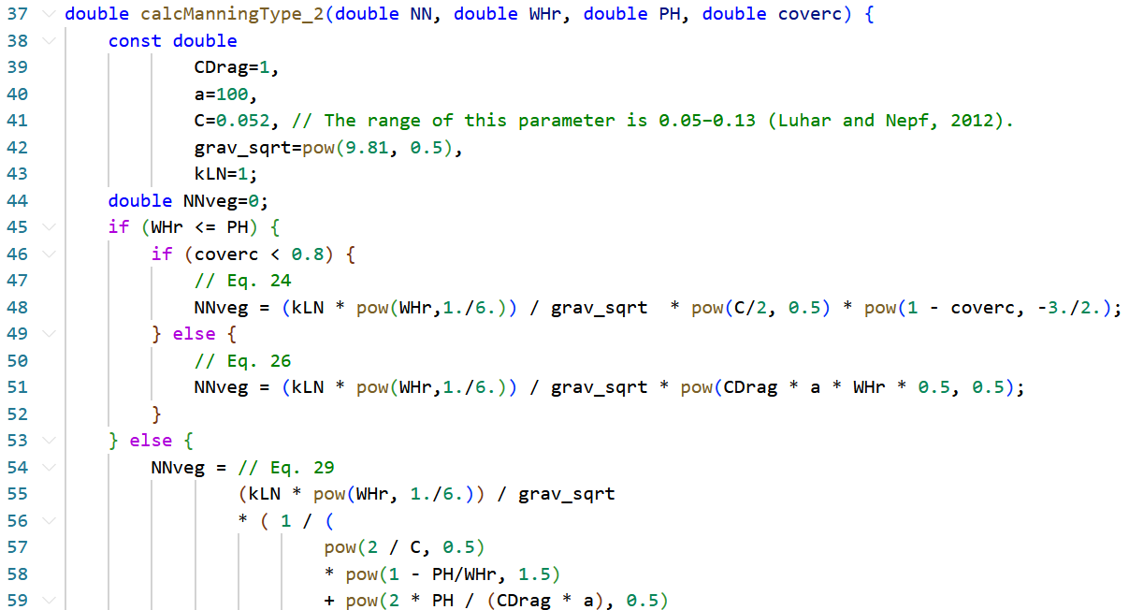
Model Adjustment
OpenLISEM Source-Code
https://github.com/vjetten/openlisem/blob/main_C/lisOverlandflow.cpp#L166-L179
https://github.com/philippkraft/openlisem/tree/modified_manning_console
Notes:
To incorporate these roughness estimation methods, we developed OpenLISEM by introducing a dynamic Manning's n function, enabling users to select the roughness method. Detailed information about these extensions can be found in this link.

Slide 7
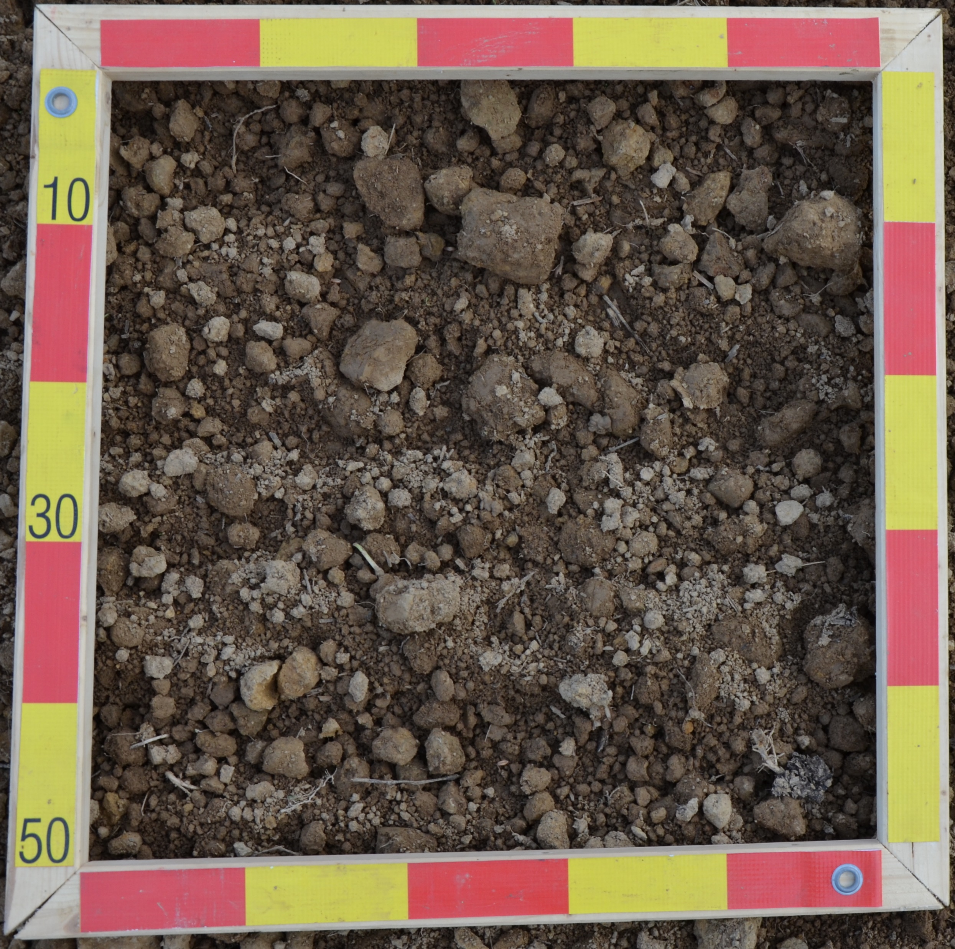
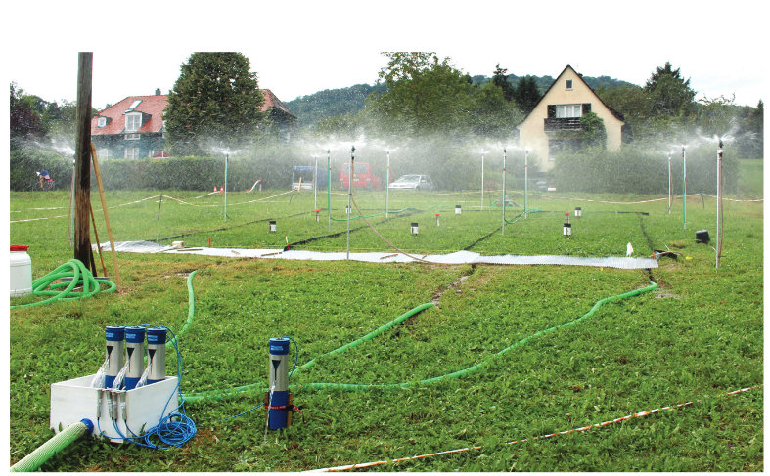
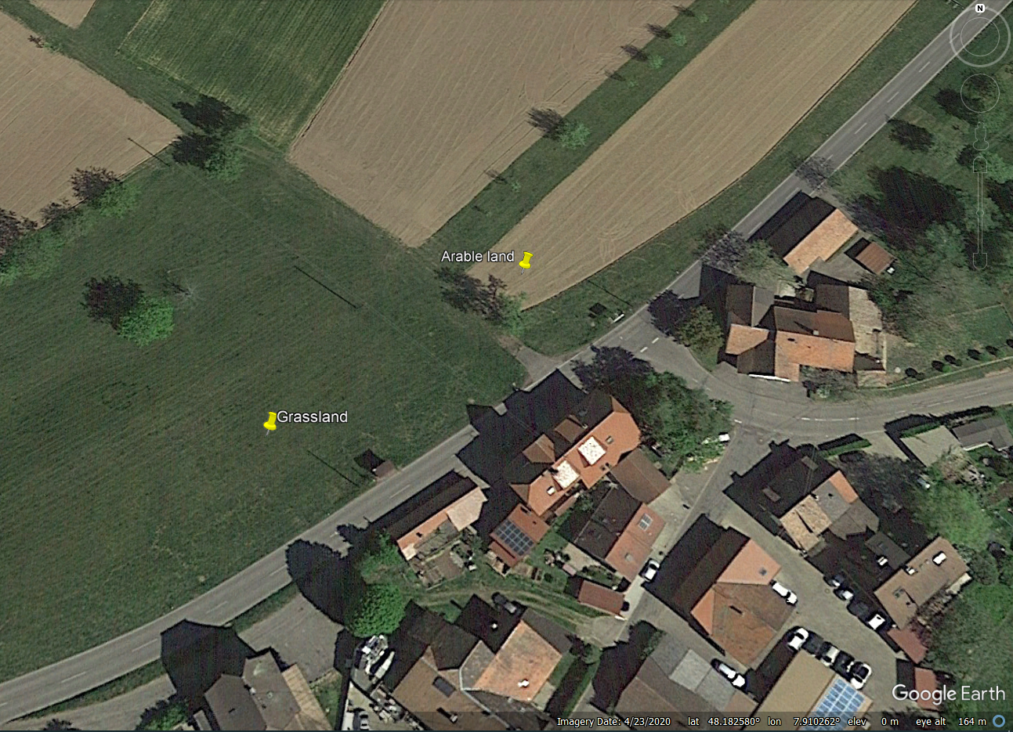
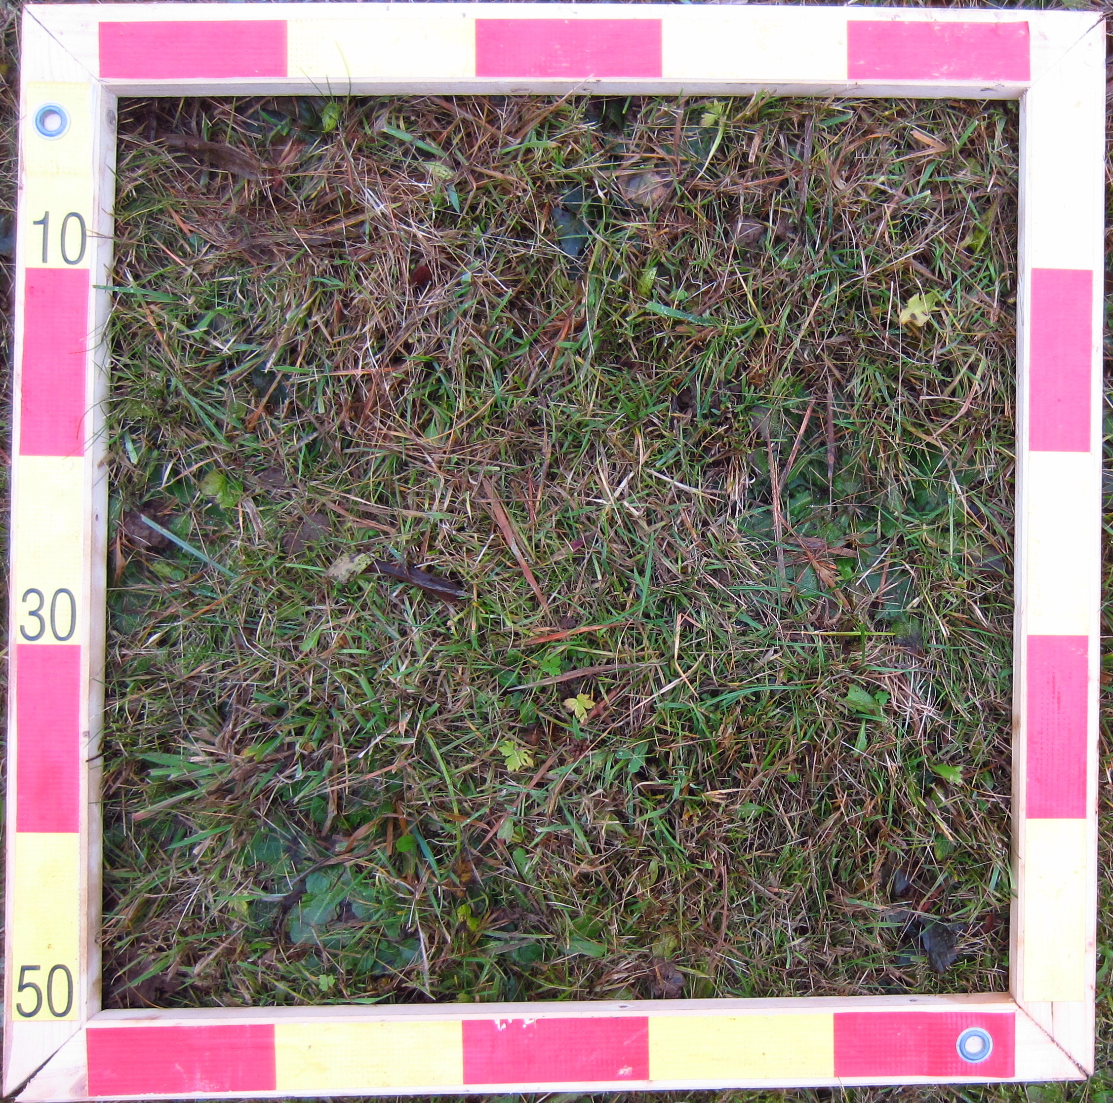
Study Site (Ries et al. 2020)
Artificial rainfall experiments in SW-Germany
Site | No. of Exp. for each Site | Slope (%) | Veg. Height (m) | Veg. Coverage
 |  |  |  | (%)
22 | 6 | 9-32 | 0-0.3 | 0-100
Ries, F., et al., Runoff reaction from extreme rainfall events on natural hillslopes: a data set from 132 large-scale sprinkling experiments in south-western Germany, Earth Syst. Sci. Data, 12, 245–255, 2020.
Notes:
We used the data set of some experiments by rainfall simulator in south west of Germany. These experiments were simulated on the 100 square meters area and included 22 sites. The slope and vegetation cover are various and 6 experiments were conducted for each site. 12 sites of these 22 sites are pair. That means the distance between them is short and soil characteristic is similar. It allows us to compare the vegetation effect by comparing the pair sites.

Slide 8
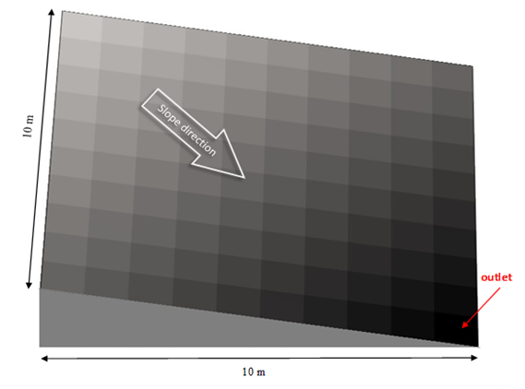
Model Calibration
Calibration
Run 2
Ksat , Psi
Max(NSE)
Validation
Run 1, 3-6
NSE , Bias
Notes:
Specifically, we utilized Run 2 to calibrate models for saturated hydraulic conductivity and soil suction, while other runs were reserved for validation purposes.
On the right side, you can observe the digital elevation model employed in OpenLISEM.

Slide 9
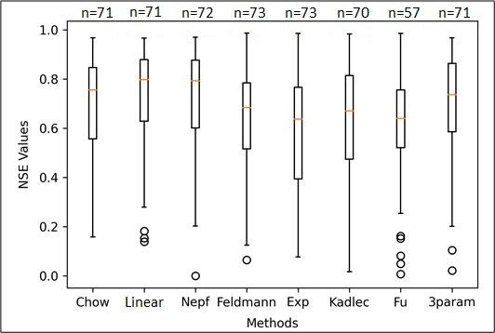
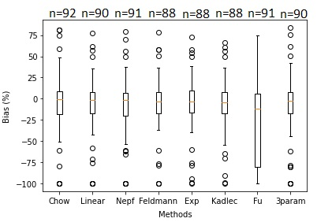
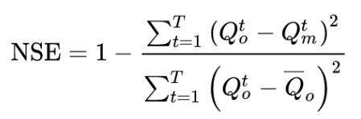
Model Validation
Notes:
Our results of model validation, focusing on the distribution of NSE and Bias values for different methods, show that the linear method has higher values of NSE.
The Linear method stands out with the maximum number of models, having NSE greater than 0.8. Nepf and Chow stand in second and third place, respectively. In these cases, the model has performed excellently.
Additionally, bias value for linear method is closer to zero compared to other methods. It demonstrate particularly robust performance.
On the other side ,the models constructed using Fu's function display weaker simulation results compared to alternative methods.

Slide 10
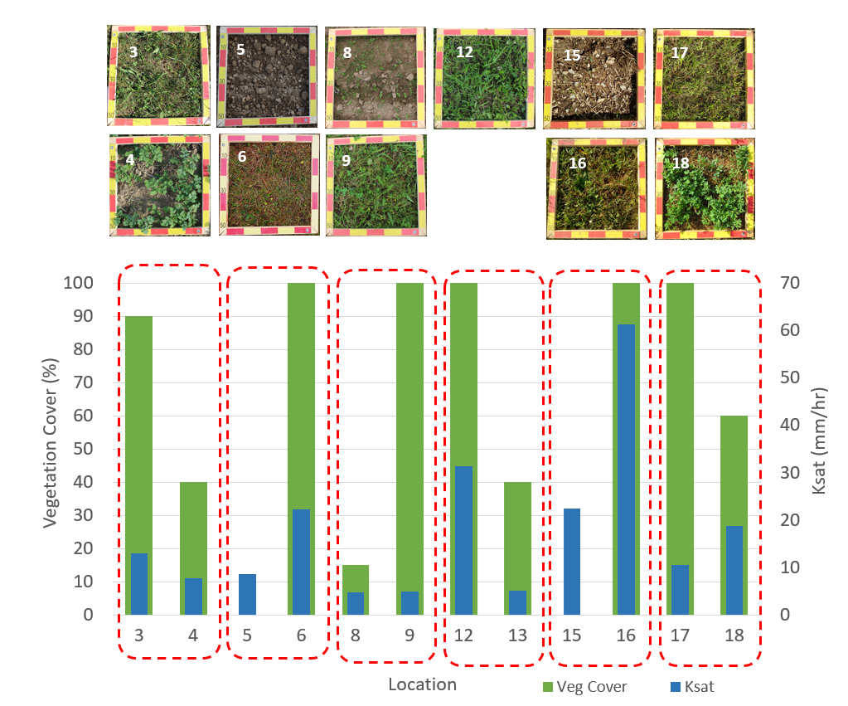
Different Vegetation Cover
(Ries et al. 2020)
Notes:
A comparative analysis between vegetation cover and Ksat, is presented here. Except for sites 17 and 18, which have different soil types, making them non-comparable, the remaining pairs reveal an increase in Ksat corresponding to more vegetation coverage. It seems, that due to the root growth and consequent improvement in soil pore connectivity, there is an increase in Ksat.
We concluded that in the presence of vegetation, surface roughness is not the sole factor influencing hydrological processes; the increase in Ksat also plays a role in the response of hydrological models to runoff.

Slide 11

Thanks!
Conclusion
The Linear method demonstrates most favorable performance in estimating roughness.
Significant differences exist in near-surface saturated hydraulic conductivity among various land covers.
However vegetation is an important regulator of infiltration, yet this effect is not well represented in current models.
Notes:
Based on the result we concluded that the Linear method demonstrates most favorable performance in estimating roughness.
We highlighted there are notable variations in near-surface saturated hydraulic conductivity across different types of land covers.
Vegetation plays a crucial role in regulating infiltration; however, current models do not adequately capture this effect.

Slide 12
Model Calibration
Latin Hypercube Sampling
(LHS)
Notes:
We utilized this calibration and validation framework for our models. Specifically, we utilized Run 2 to calibrate models for saturated hydraulic conductivity and soil suction, while other runs were reserved for validation purposes.

