Slide 1
Glaciers – an overlooked water balance component in global hydrological modelling
Sarah Hanus, Lilian Schuster, Peter Burek, Fabien Maussion, Yoshihide Wada, Daniel Viviroli
sarah.hanus@geo.uzh.ch
© Daniel Viviroli
Notes:
10 minute presentation
Intro 3 minutes
Methods 2 minutes
Results 3 minutes
Teaser PICO 2 minutes
Thanks for inviting me Hannes
Present part of my PhD work
I want to talk about a water balance component that we often overlook in regional to global hydro modelling: Glaciers

Slide 2
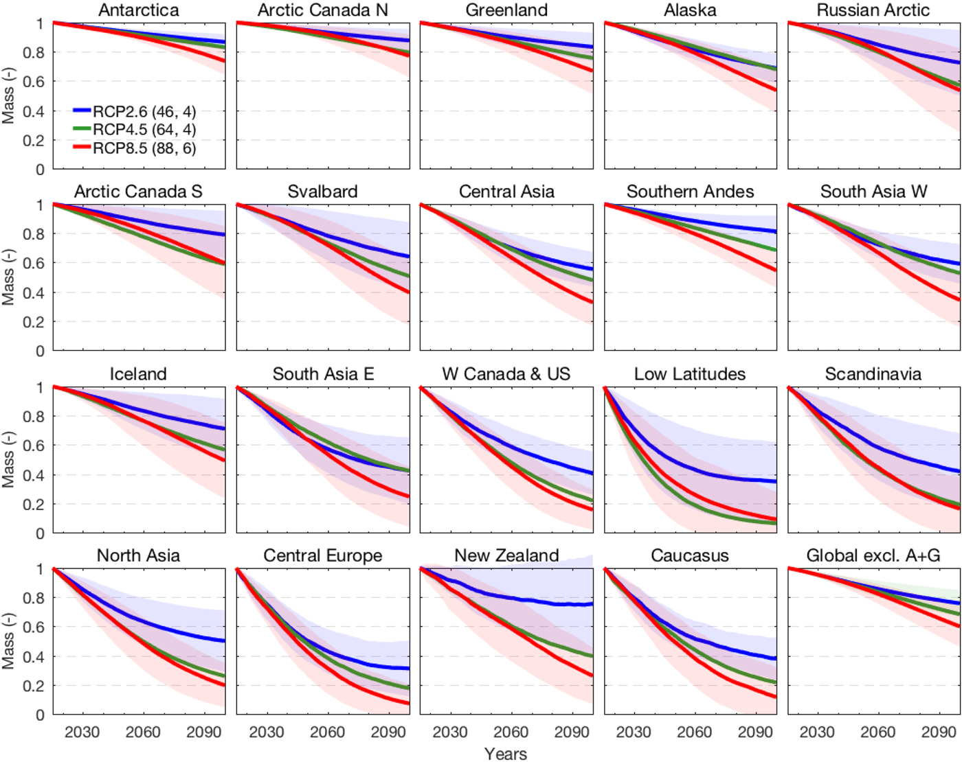
Glaciers
Strong runoff seasonality
Strong volume decreases during this century
Strong glacier runoff changes during this century
(Hock et al., 2019)
Notes:
Rounce et al 2023: “Glaciers are also a crit- ical water resource for ~1.9 billion people (3)”
Strong runoff seasonality
Accumulate mass in winter months, loose mass in summer months (at least in our latitudes)
Glacier contribution in some months much higher than looking at annual averages
Strong volume decrease
Figure from Glacier model intercomparison project
Decrease in mass until the end of the century compared to 2015 by different regions - some regions are less relevant for hydrological modelling, regions with strong decline interesting for hydro modelling
E.g. Europe also under low emission scenario 70% of mass is lost
Glaciers are a depleting water storage
This also leads to change in the water flux or the glacier runoff
…

Slide 3
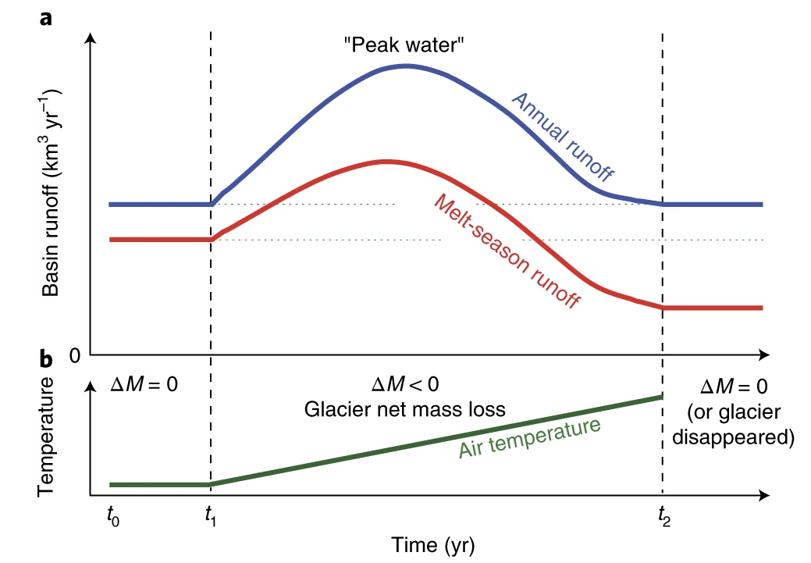
Glaciers
Strong runoff seasonality
Strong volume decreases during this century
Strong glacier runoff changes during this century
(Huss and Hock, 2018)
Notes:
… as glaciers loose mass first increase in runoff then decrease, leading
Strong volume decrease
Especially in regions where more humans live
Strong runoff changes during this century
Depleting storage

Slide 4
Glaciers in large river basins
Rhine: 0.2% glacier area
4% ice melt contributions in September at Lobith (Stahl et al. 2016)
Dry year (2003): 13% ice melt in September (Stahl et al. 2016)
Glaciers not considered in global hydrological models, except in some specific studies (Caceres et al. 2020)
Better model performance in strongly glacierized basins (Wiersma et al. 2022)
Notes:
Furthest downstream gauging station at Lobith
Stahl (2017): 6% glacier contribution at Basel 4% at Lobith in September, annual avg. 1 / 2% for Lobith/Basel
- Maximum daily 2003 16%/20%
- 2003: annual average 1.7%, September 12.9%, daily max 17.3%

Slide 5
Research Aim
Large-scale hydrological modelling framework which explicitly incorporates glacier runoff
Focus on future changes in streamflow
Estimate glacier contributions to streamflow
Assess challenges and limitations
Foster collaboration between the glacier and hydrological modelling communities

Slide 6
Methods
Runoff from glaciers
Changes in glacier area
(Maussion et al., 2019)
CWatM
(Burek et al., 2020)
Challenges
Precipitation correction
Different spatial resolution
…
Evaluation
4 large river basins (5 arcmin)
Global simulations (30 arcmin)
Notes:
Idea
Do not change the individual models, allow for a sequential coupling
Take the best of both worlds, glaciologists know how to model glaciers, hydrologists know how to model water
Open-source models
Turns out it is trickier than expected
7:30 min

Slide 7
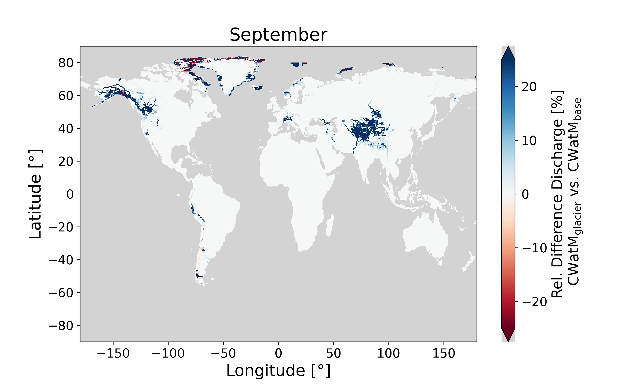
Results – Discharge differences
Notes:
First result
Relative difference in discharge between the model setup with explicit glacier inclusion and the standard model setup
Larger discharge in summer (because additional runoff from glacier melt)
Difference larger than 50% close to glacier locations
Further downstream influence decreases but is still noticeable (e.g. 15% Rhone, 26% Gloma)
Now you can see it for all months
Negative difference in winter months (lower runoff with glaciers included)
- Relative difference tricky because time of year with lowest discharge often
- Probably due to different snow representations

Slide 8
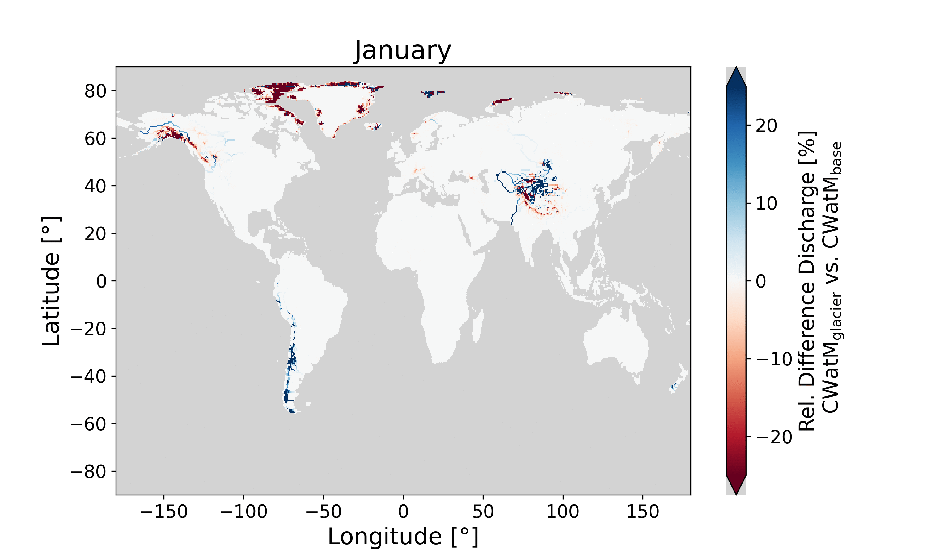
Results – Discharge differences
CWatM_{glacier}
Larger discharge in summer & autumn months
Smaller discharge in winter & spring
Notes:
First result
Relative difference in discharge between the model setup with explicit glacier inclusion and the standard model setup
Larger discharge in summer (because additional runoff from glacier melt)
Difference larger than 50% close to glacier locations
Further downstream influence decreases but is still noticeable (e.g. 15% Rhone, 26% Gloma)
Now you can see it for all months
Negative difference in winter months (lower runoff with glaciers included)
- Relative difference tricky because time of year with lowest discharge often
- Probably due to different snow representations

Slide 9
Challenges
Model differences
Spatial resolution
Snow simulation
Limitations of glacier model
Calibration limited by data availability
Choice of precipitation correction highly affects glacier runoff
Limitations of hydrological model
global scale calibration and evaluation
Notes:
Model Differences
Was reduced by adapting both models
Nevertheless inherent differences remain
Spatial resolution: affecting temperature and therefore rain/snow and snow melt
Temperature resolved differently influences snow simulations
OGGM 30m height differences
CWatM subgrid variability in elevation still much coarser
This effects especially snow representation
Higher elevations better represented in OGGM than in CWatM
Earlier snow melt of base model than model including glacier
Differences between models do not only encompass glacier but also differences in representation of mountainous terrain
These differences small on the long term compared to differences resulting from glaciers
Snow representation
The version of OGGM does not differentiate between snow and ice
Single melt factor calibrated for each glacier
Melt factor calibrated together with other parameters in CWatM
Glacier:
Calibration on mass balance, unclear how much input and output
- Relevance can be improved by improving performance of large-scale hydro models at global scale
Grid cells vs real basin outlines

Slide 10
Is it relevant to represent glaciers?
For future change projections in discharge
Especially with a focus on summer months or extreme years
Otherwise, future discharge changes are likely underestimated in glacierized river basins
Notes:
For projecting future changes in discharge especially for specific months, including glaciers in our modelling is relevant

Slide 11
More results and discussion at PICO spot A.1!
Find out more in our preprint on EGUsphere
Contact me
sarah.hanus@geo.uzh.ch

Slide 12
Glaciers – an overlooked water balance component in global hydrological modelling
Sarah Hanus, Lilian Schuster, Peter Burek, Fabien Maussion, Yoshihide Wada, Daniel Viviroli
Find out more in the preprint on EGUsphere
Let’s keep in touch!
Teaser
Why glaciers?
Coupling method
Results (Basins)
Results (Global)
Challenges

Slide 13
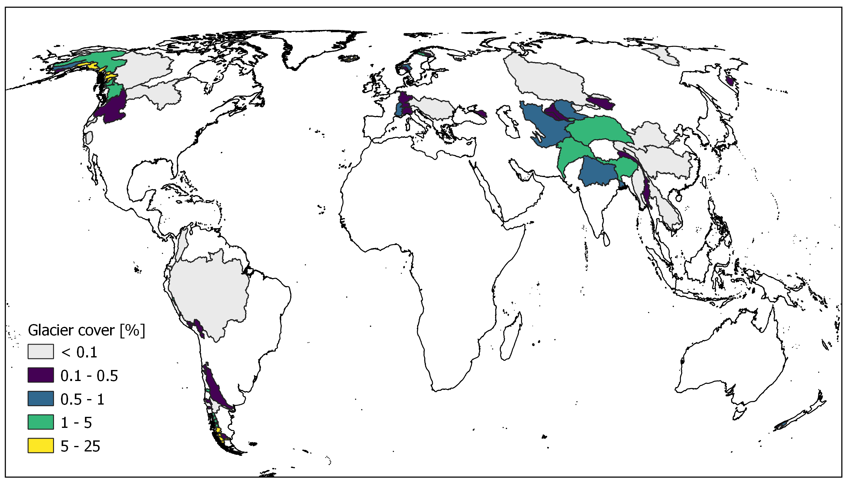
Why glaciers?
Strong runoff seasonality
Strong volume decreases during this century
Rhine: 0.2% glacier area
4% ice melt contributions in September at Lobith (Stahl et al. 2016)
Dry year (2003): 13% ice melt in September (Stahl et al. 2016)
(Hock et al., 2019)
Why glaciers?
Coupling method
Results (Basins)
Results (Global)
Challenges

Slide 14
Coupling Method
Sequential Coupling
Global Glacier Model: Open Global Glacier Model (Maussion et al., 2019)
Large-scale hydrological and water resources model: Community Water Model (Burek et al., 2020)
More about global glacier modelling
More about large-scale hydrological modelling
Why glaciers?
Coupling method
Results (Basins)
Results (Global)
Challenges
Notes:
Methods: we sequentially coupled the global glacier model OGGM
Idea: take the best out of both worlds, glaciologists know how to model glaciers, we know how to model water -> turns out that it is trickier than expected
OGGM: models … and …
CWatM: water availability and water demand

Slide 15
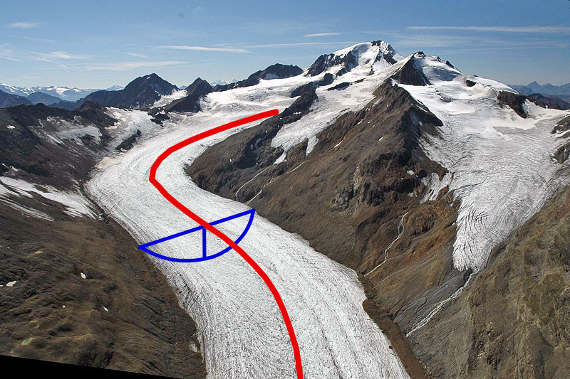
OGGM: Global glacier modelling
community-driven, open-source modelling framework
“glacier-centric”: Simulation of each glacier individually
Glacier outlines from Randolph Glacier Inventory (Pfeffer et al., 2014)
Elevation-band flowlines from DEM (e.g., Huss and Farinotti, 2012; Werder et al., 2020)
1D shallow-ice flowline model
Temperature index mass-balance model
At each elevation band
Limited possibility of modelling past (earliest 1979)
Can be run on a personal laptop for a few hundred glaciers
Glacier Model Intercomparison Project (Marzeion et al. 2020)
(Maussion et al., 2019)
Figure from https://docs.oggm.org/en/stable/flowlines.html
Check out the extensive documentation: https://docs.oggm.org/
Why glaciers?
Coupling method
Results (Basins)
Results (Global)
Challenges
Notes:
How do global glacier models work
Explain mass balance:
How to calibrate? Which data is used, which data is missing?
Precipitation correction

Slide 16
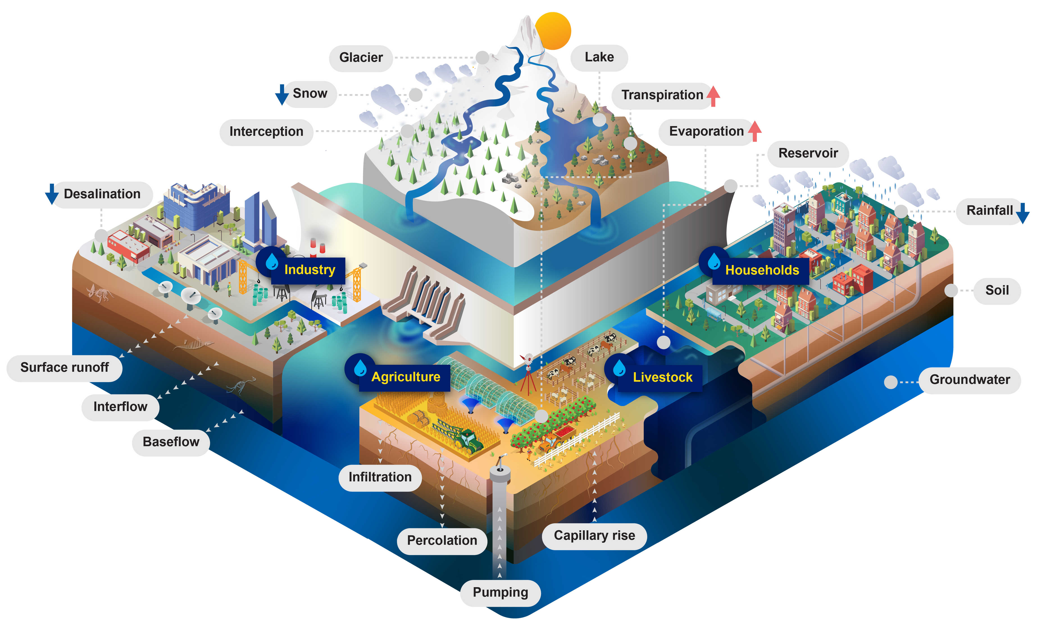
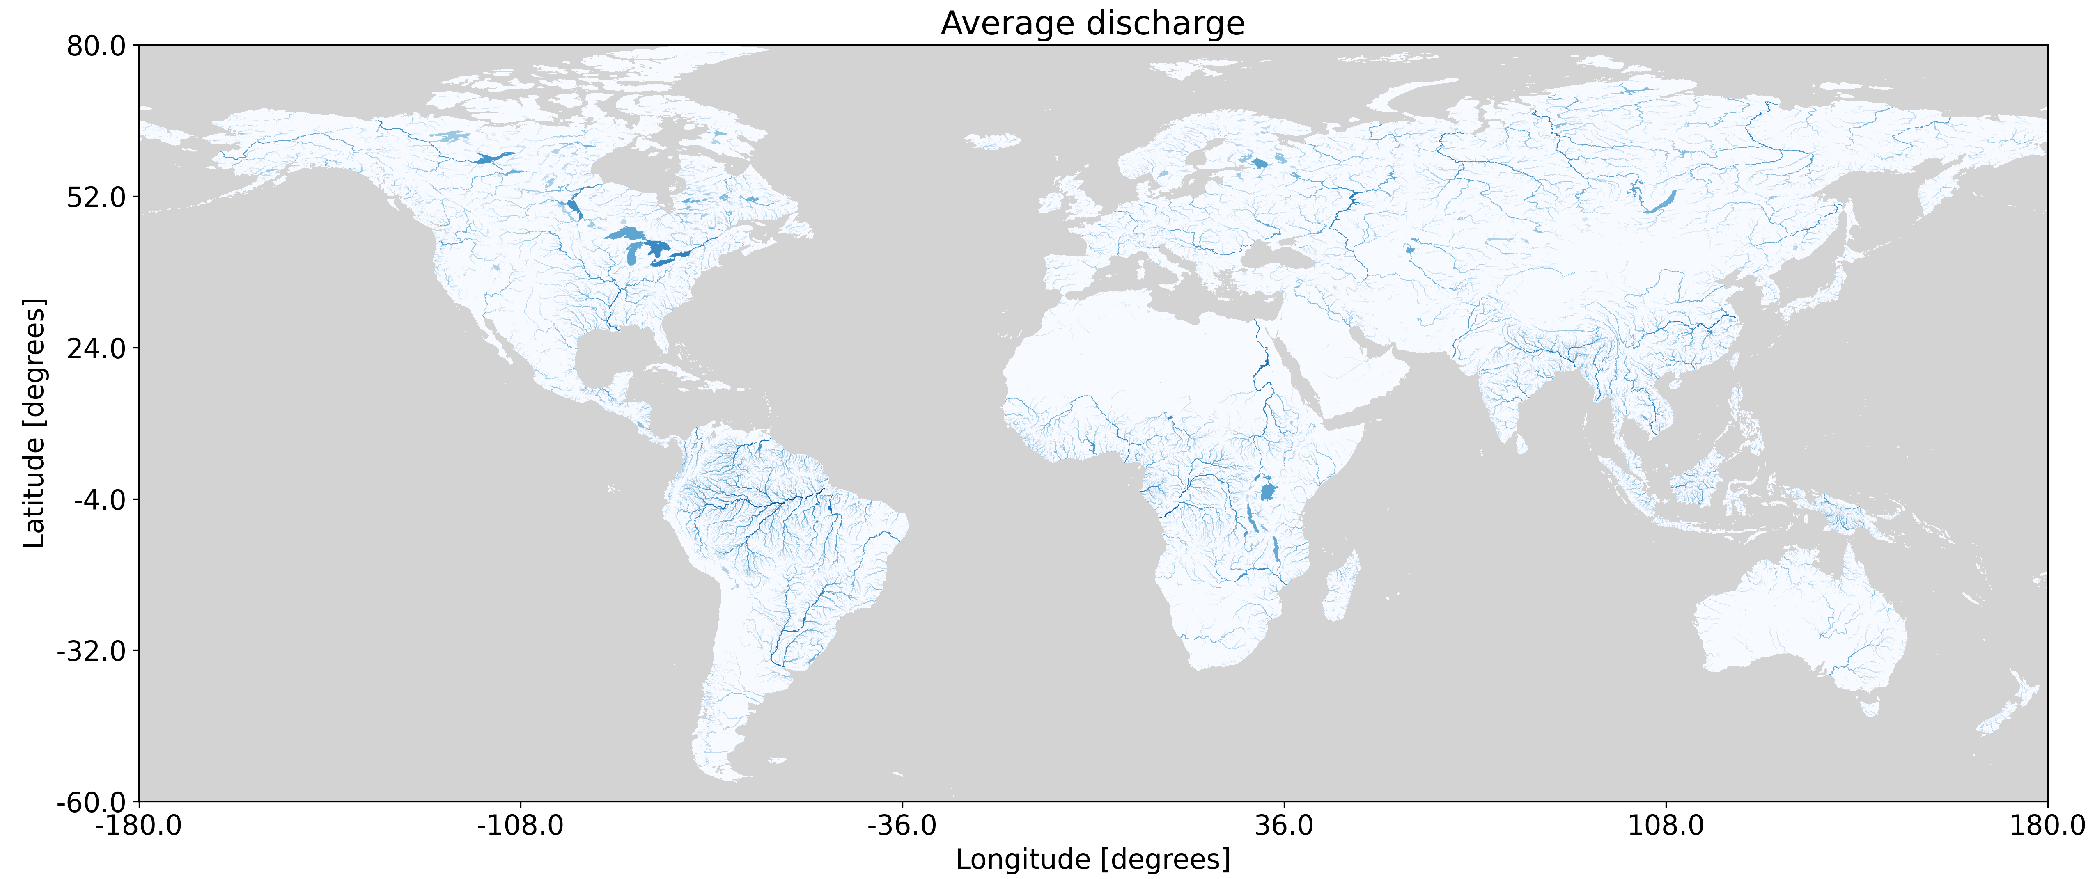
CWatM: Large-scale hydrological modelling
Open-source model
Simulates hydrological storages and processes
Includes human impacts: reservoirs, water use
Grid-based model (30 arcmin, 5 arcmin, 1 arcmin)
Often only simplistic calibration at global scale
Comparison of global hydrological models in the Inter-Sectoral Impact Model Intercomparison Project (ISIMIP)
Why glaciers?
Coupling method
Results (Basins)
Results (Global)
Challenges
Notes:
Which processes are used, calibration? - Which spatial scale?
What is represented?
Water use
Reservoirs

Slide 17
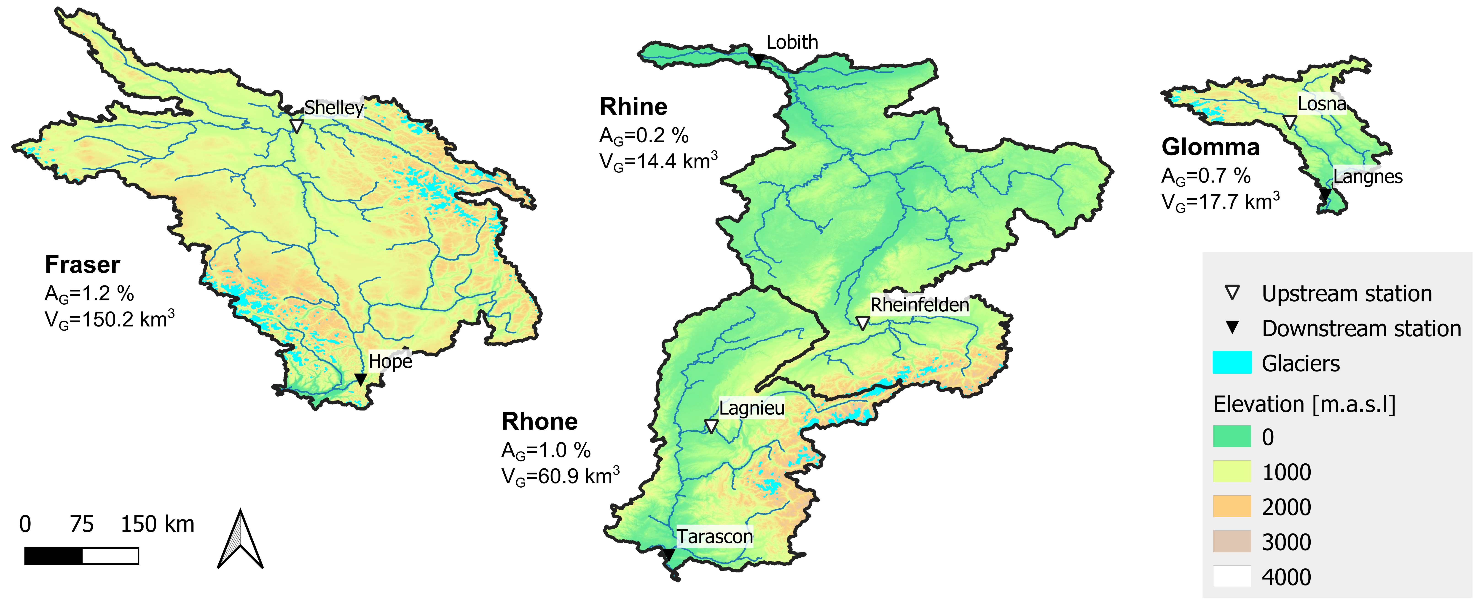
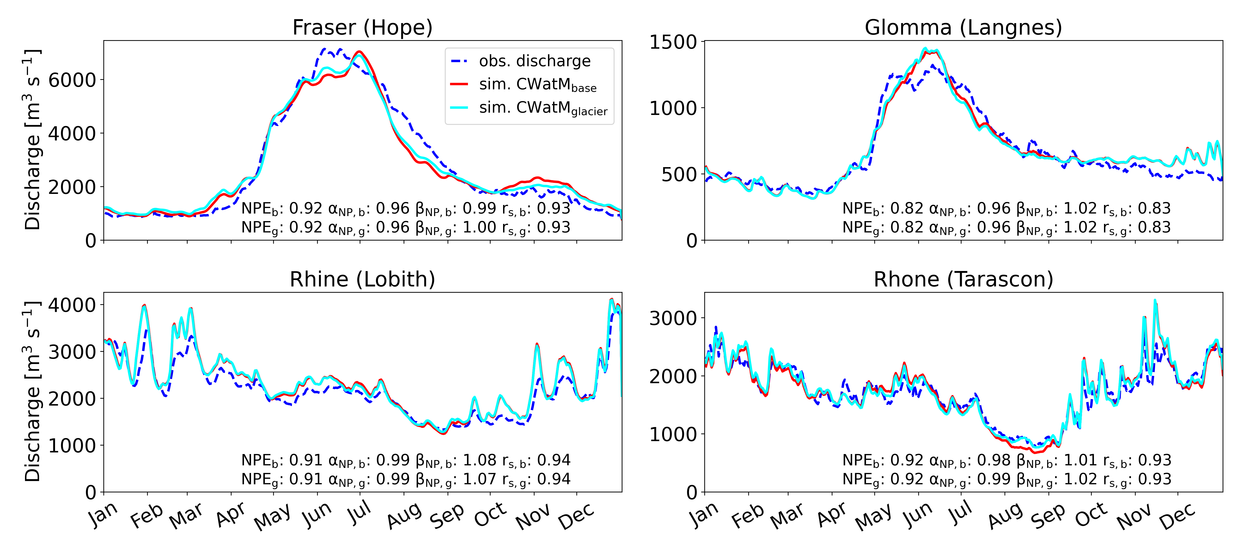
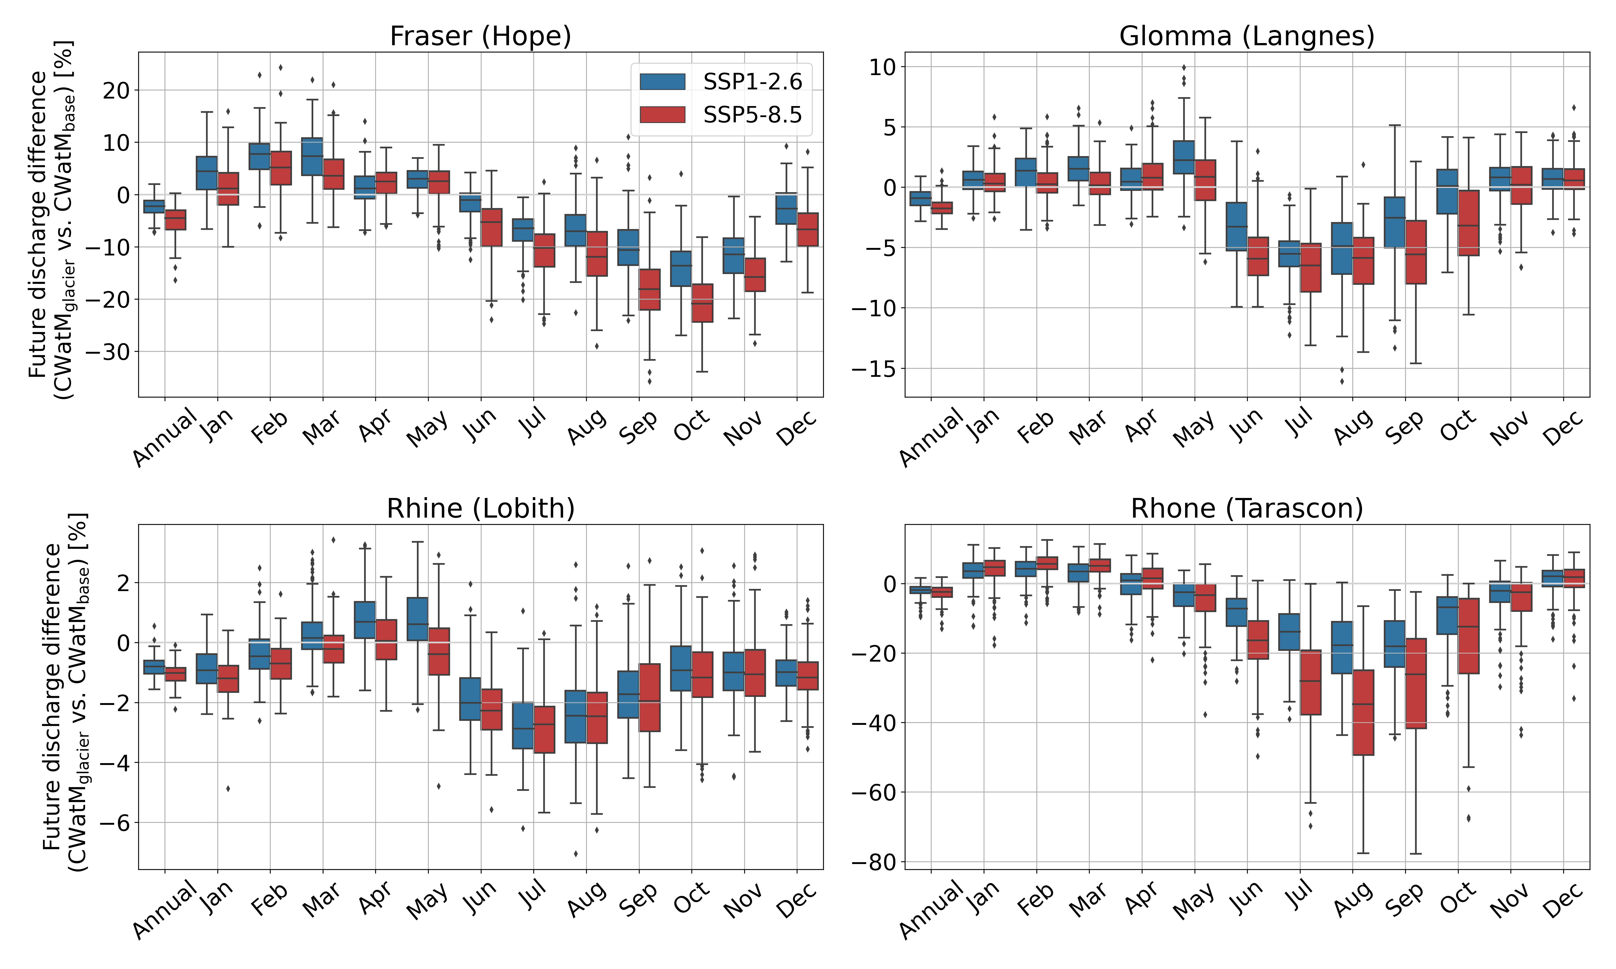
Results (Basins)
①
②
Calibration leads to comparable past model performance for baseline and coupled model
Four study basins
③
Coupled model projects lower future summer discharge
④
Even under a low-emission scenario strong future decrease in glacier-sourced contribution to discharge
Why glaciers?
Coupling method
Results (Basins)
Results (Global)
Challenges

Slide 18
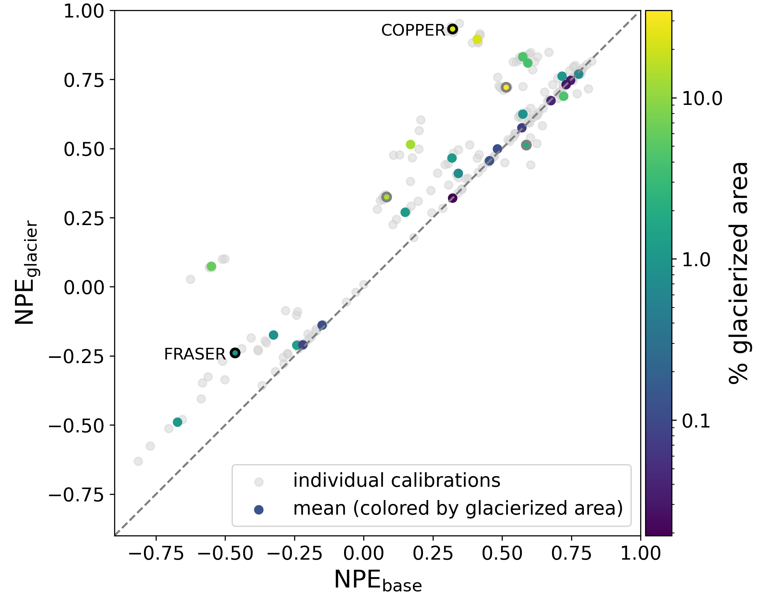
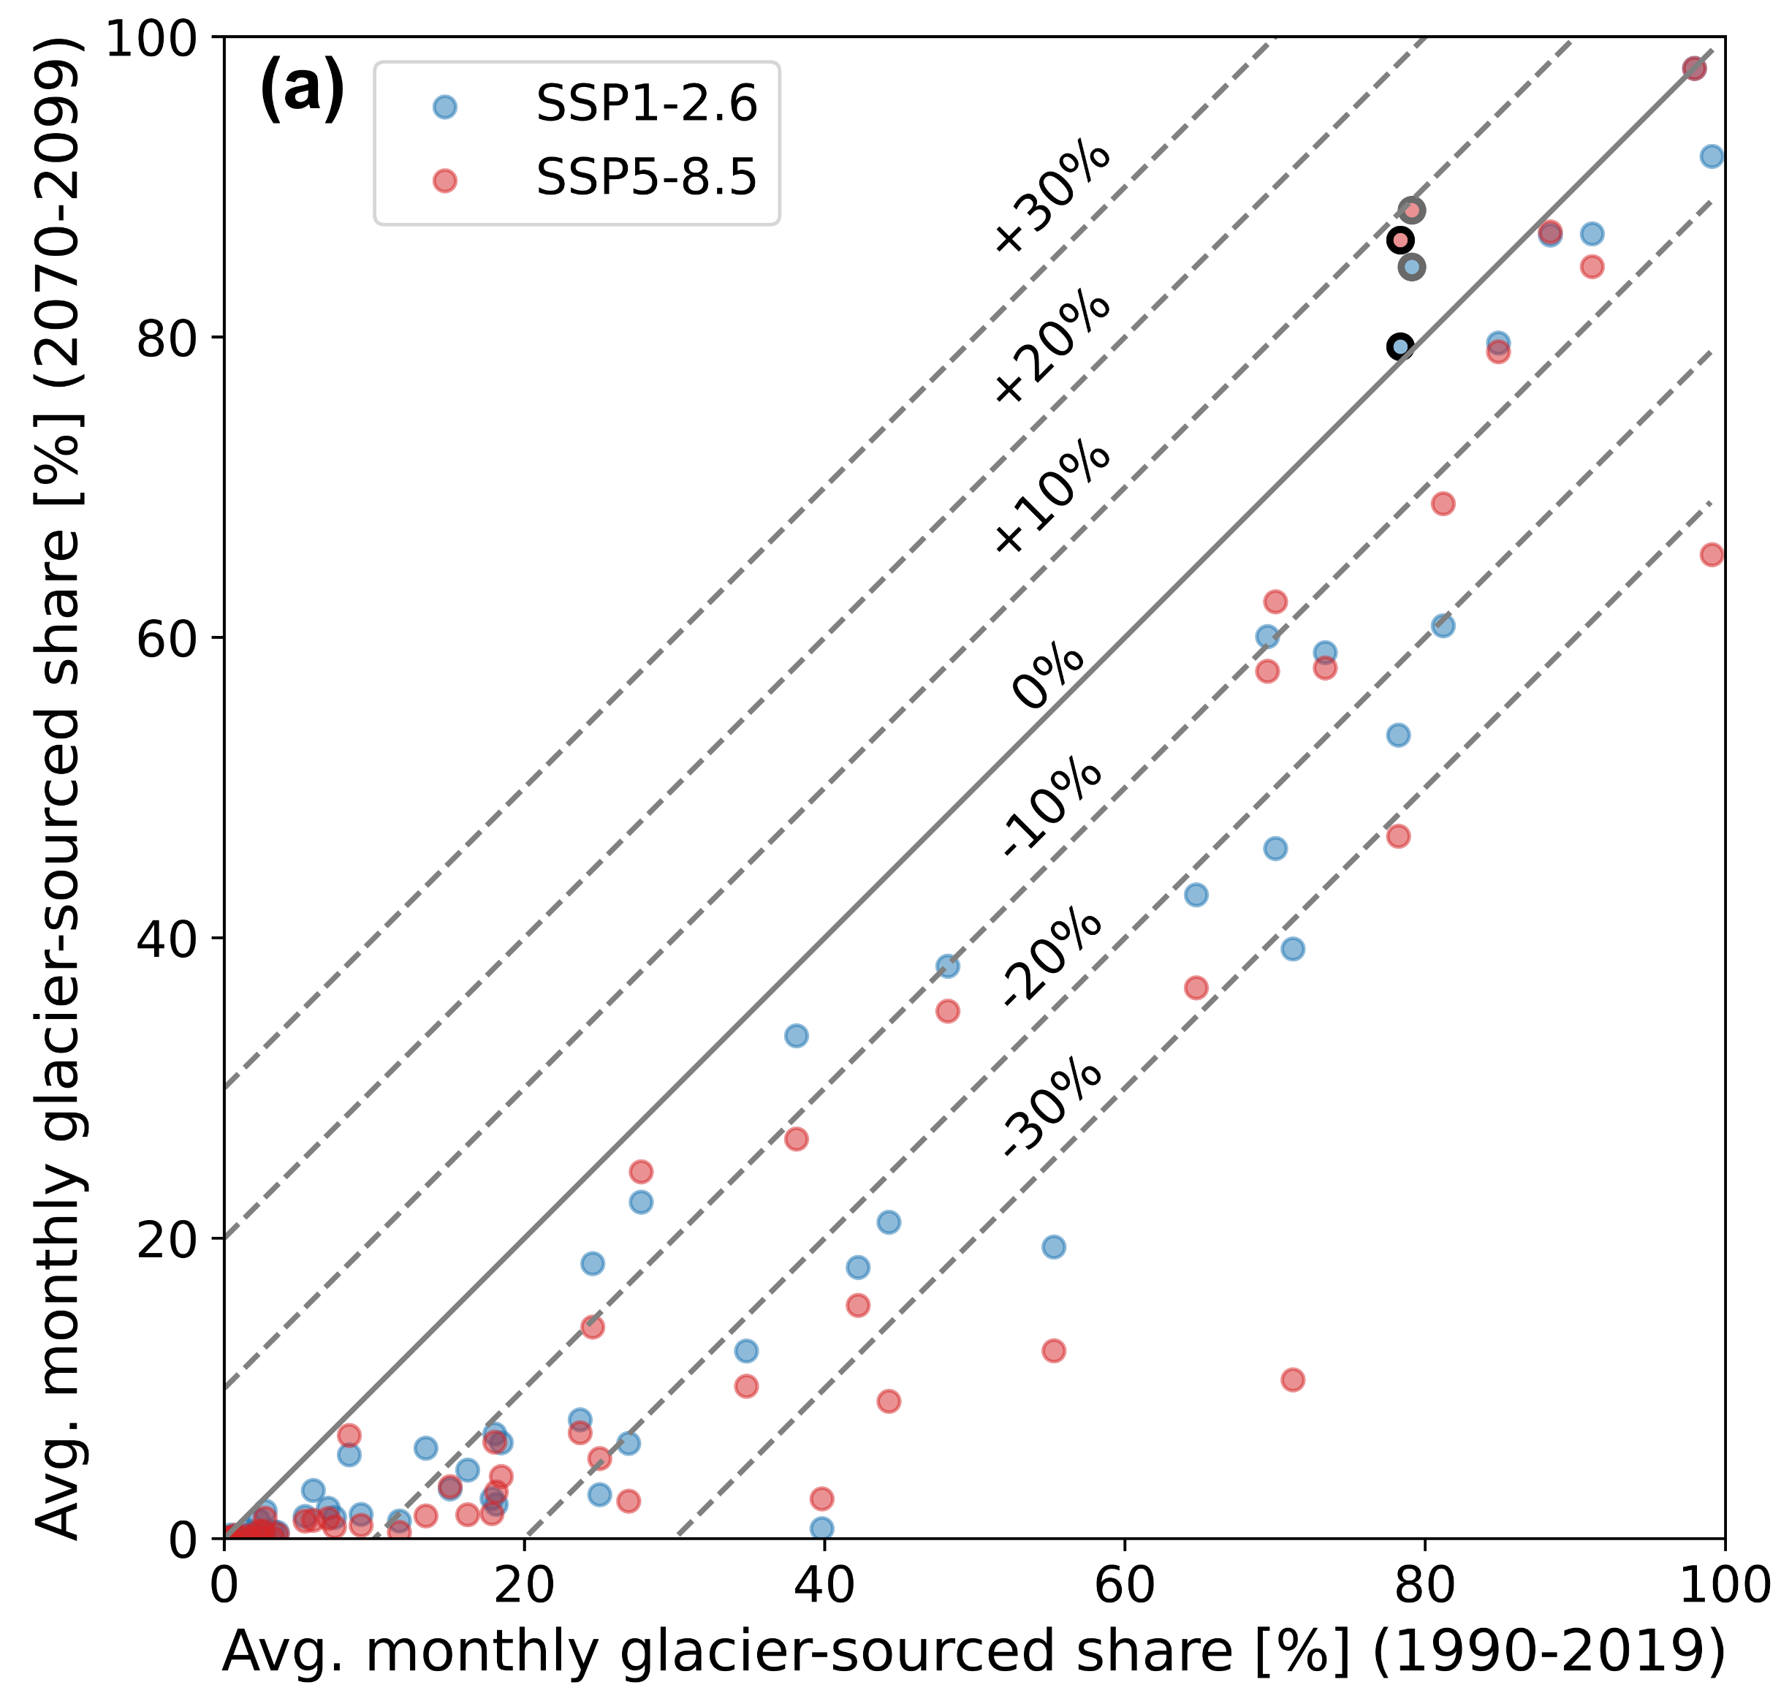
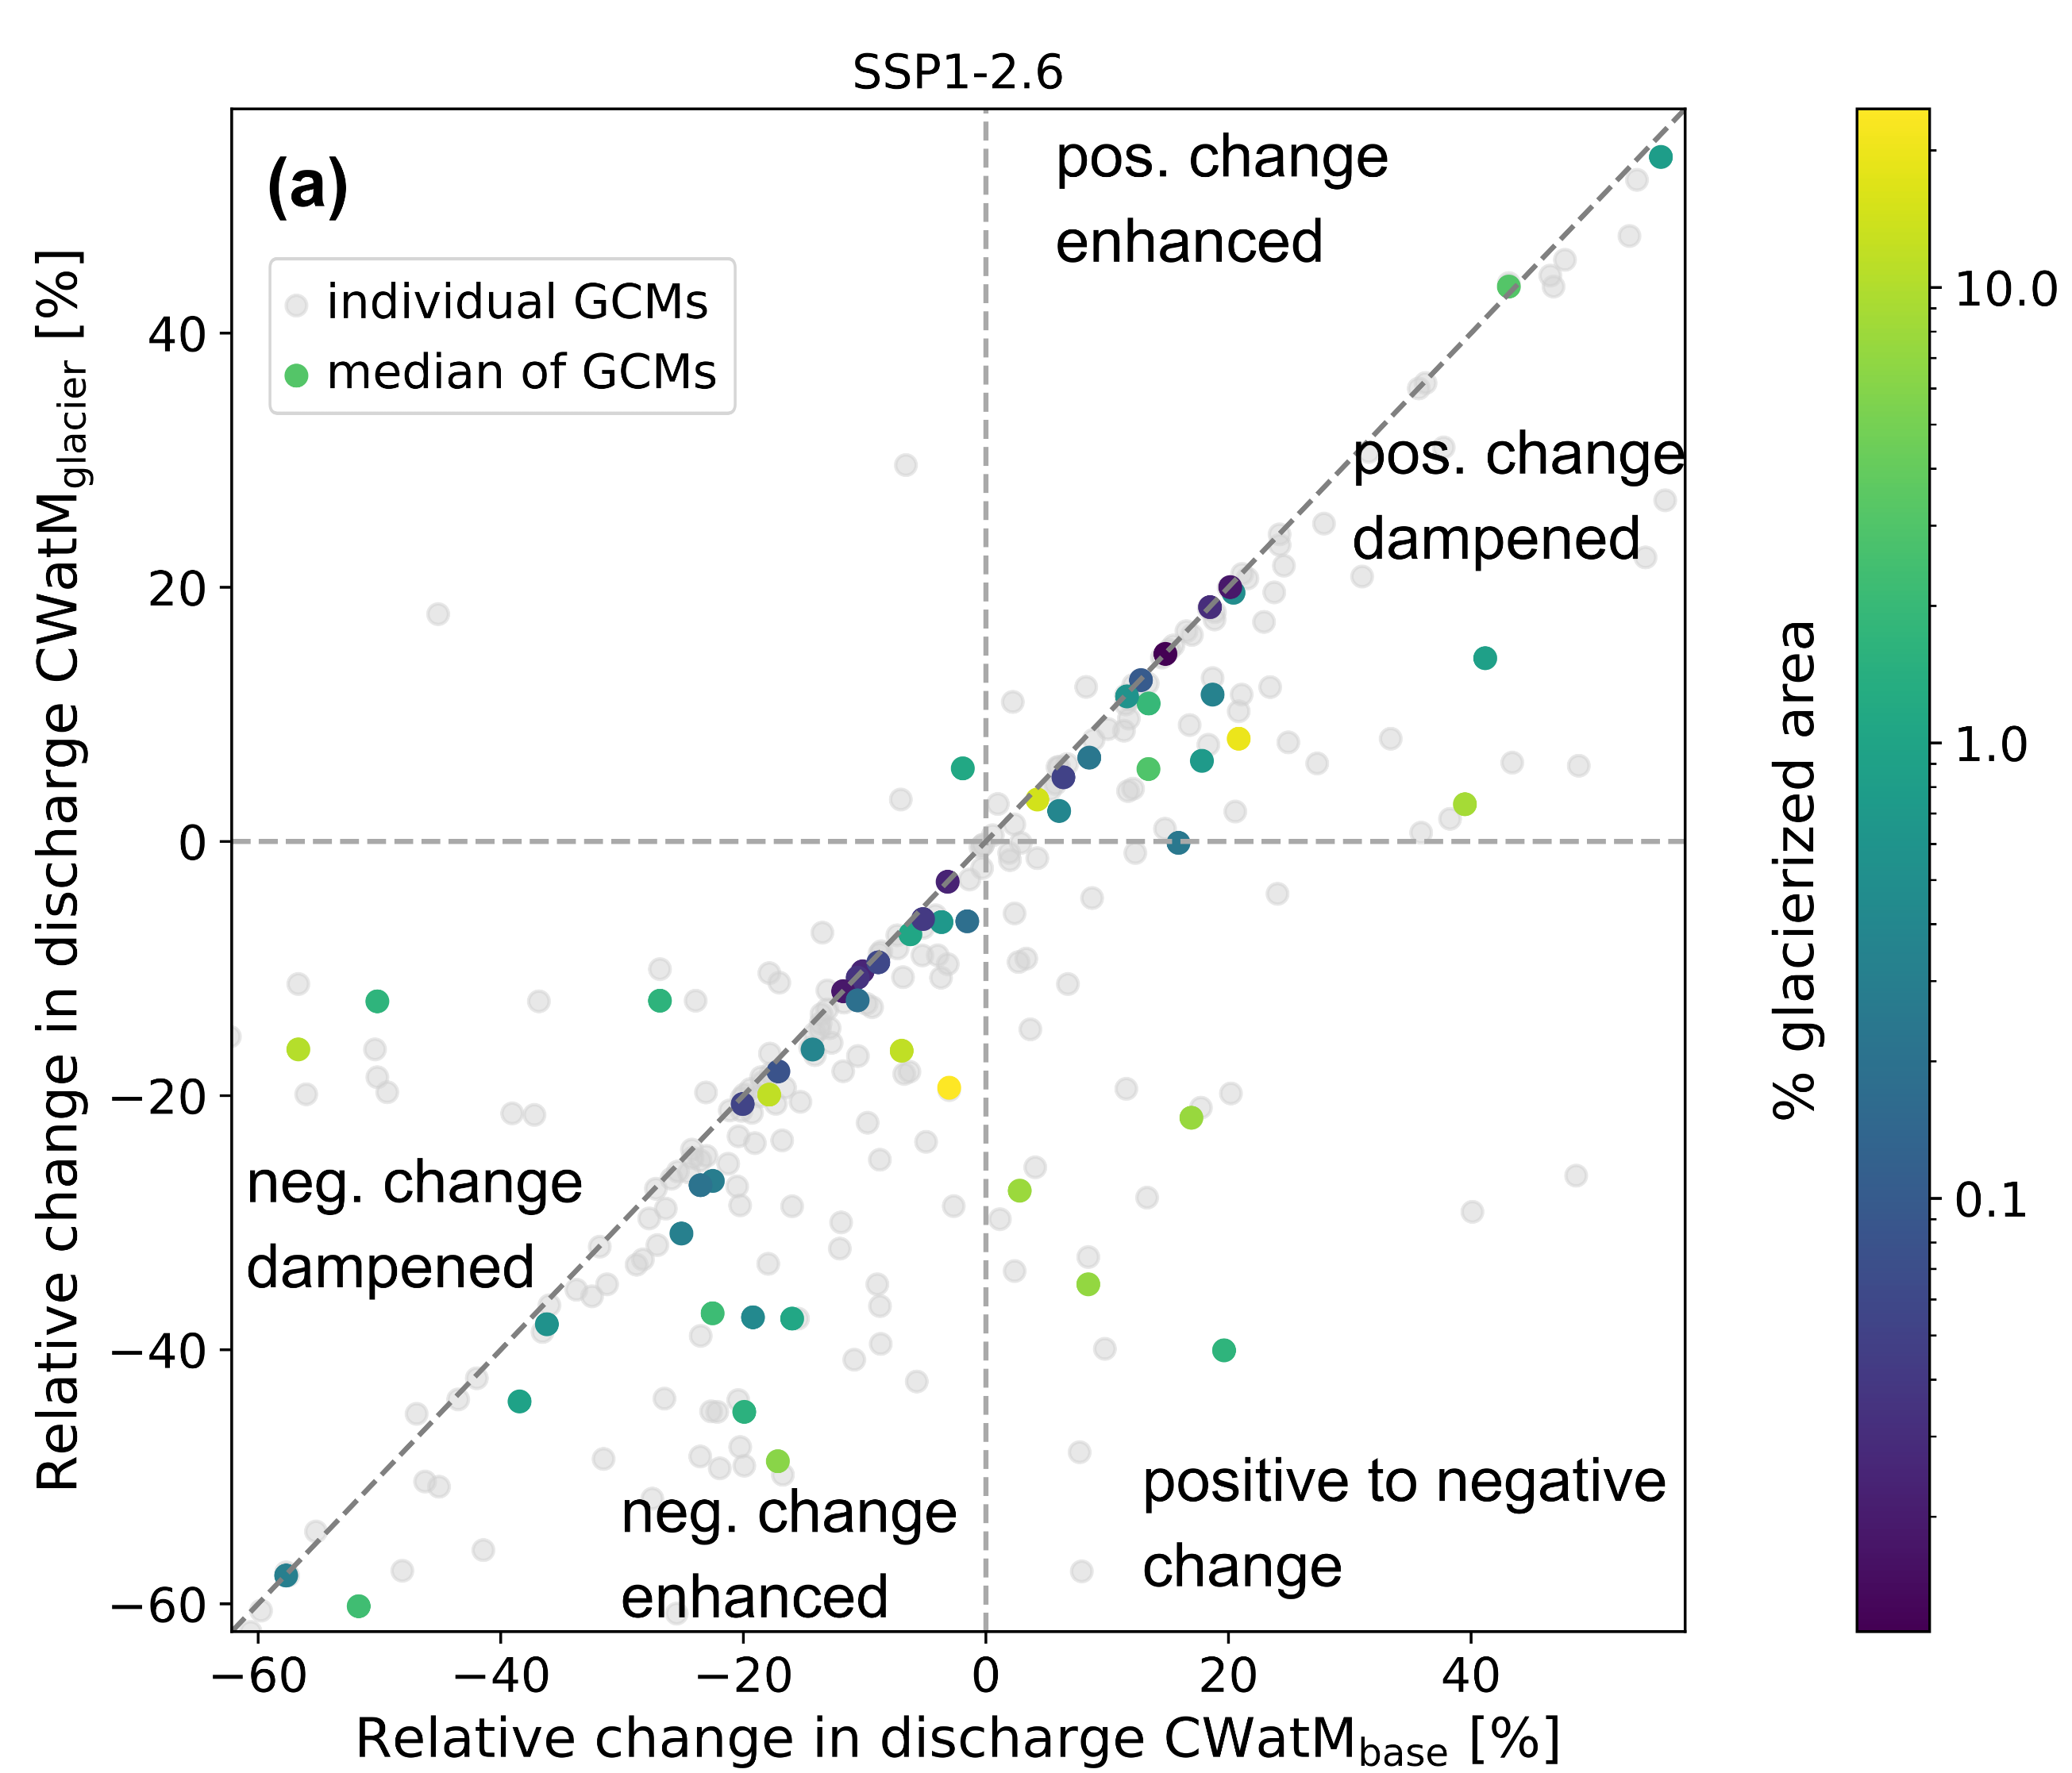
Results (Global)
Performance improves or is similar
for coupled model
Glacier-sourced melt contribution to discharge at river basin outlet decreases in future
Future positive streamflow changes are dampened and negative changes exacerbated when including glaciers
Discharge differences of the coupled model vs. baseline model
Why glaciers?
Coupling method
Results (Basins)
Results (Global)
Challenges
Notes:
1) By clicking on it also show plots of Fraser and Copper

Slide 19
Results (Global) – Discharge differences
CWatM_{glacier}
Larger discharge in summer & autumn months
Smaller discharge in winter & spring
Why glaciers?
Coupling method
Results (Basins)
Results (Global)
Challenges
Notes:
8. Relative difference in average discharge for September between CWatMglacier and CWatMbase during the period 1990–2019. Positive
values indicate a larger discharge of CWatMglacier. The outlines of large-scale glacierized river basins according to Huss and Hock (2018)
(basin area > 5000 km2, glacier coverage >0.01%) are shown in black. Note the difference in degree intervals.
Differences between past simulations of CWatMglacier and CWatMbase can be seen worldwide in large glacierized river basins
(Fig. 8). The relative difference in monthly discharge between the two model setups can exceed 50% close to the glaciers
and decreases further downstream. Nevertheless, differences between the model setups can also be detected downstream. For
example, in September, the CWatMglacier simulations show 15% higher discharge in the Rhone basin, 26% higher discharge in
the Glomma basin, and 17% higher discharge in the Amu Darya basin.
In winter, no glacier-sourced melt is expected; thus the change in model setup should not influence the winter discharge. However,
a decrease in discharge is simulated for winter and spring months in CWatMglacier compared to CWatMbase (see Fig. S5.3). The
reason behind this is likely, the lack of glacier representation in CWatMbase where other runoff processes occur on the glacier
area. Another explanation is the finer spatial resolution of elevations in OGGM (see Table 1) and therefore a later snow melt
370 occurrence in OGGM than in the same areas in CWatM.

Slide 20
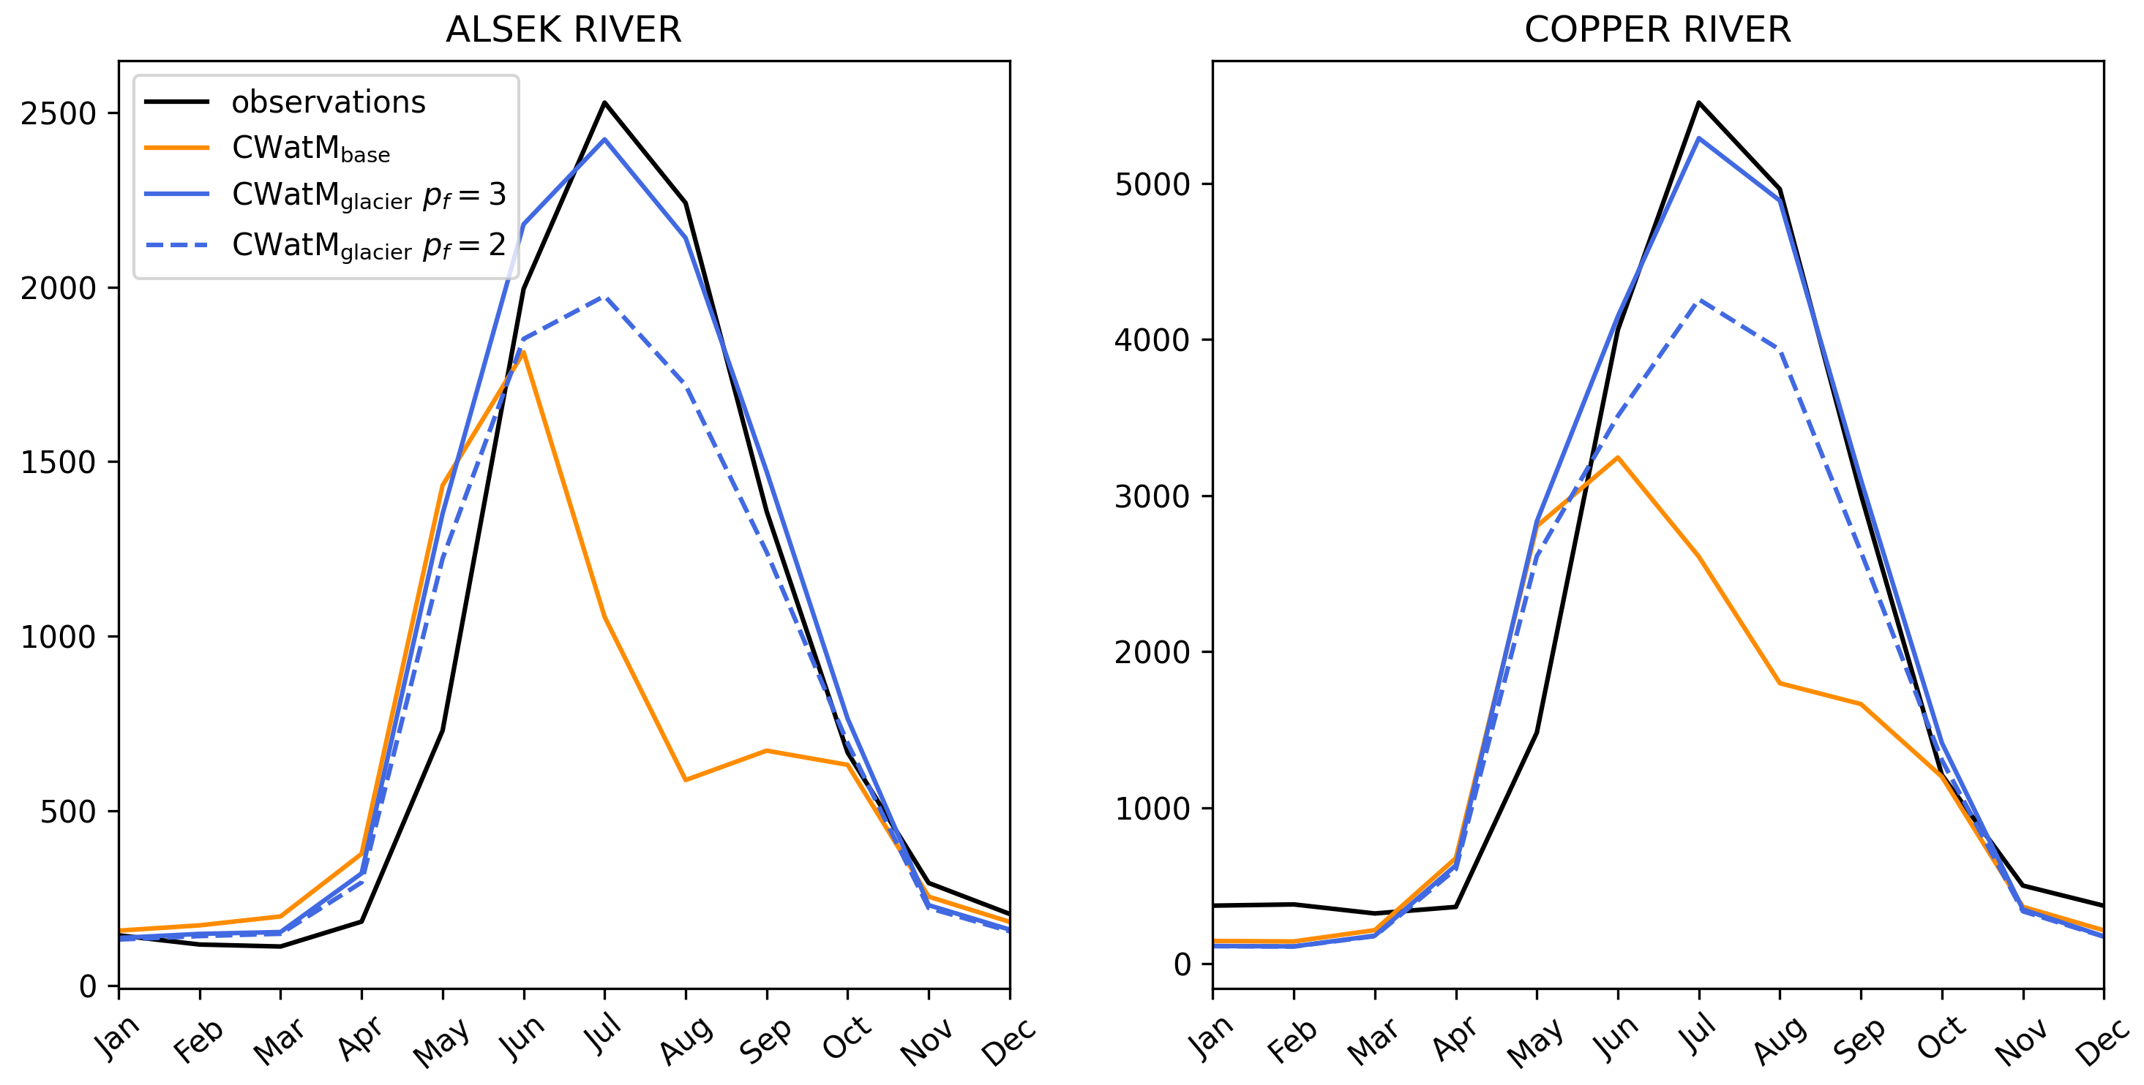
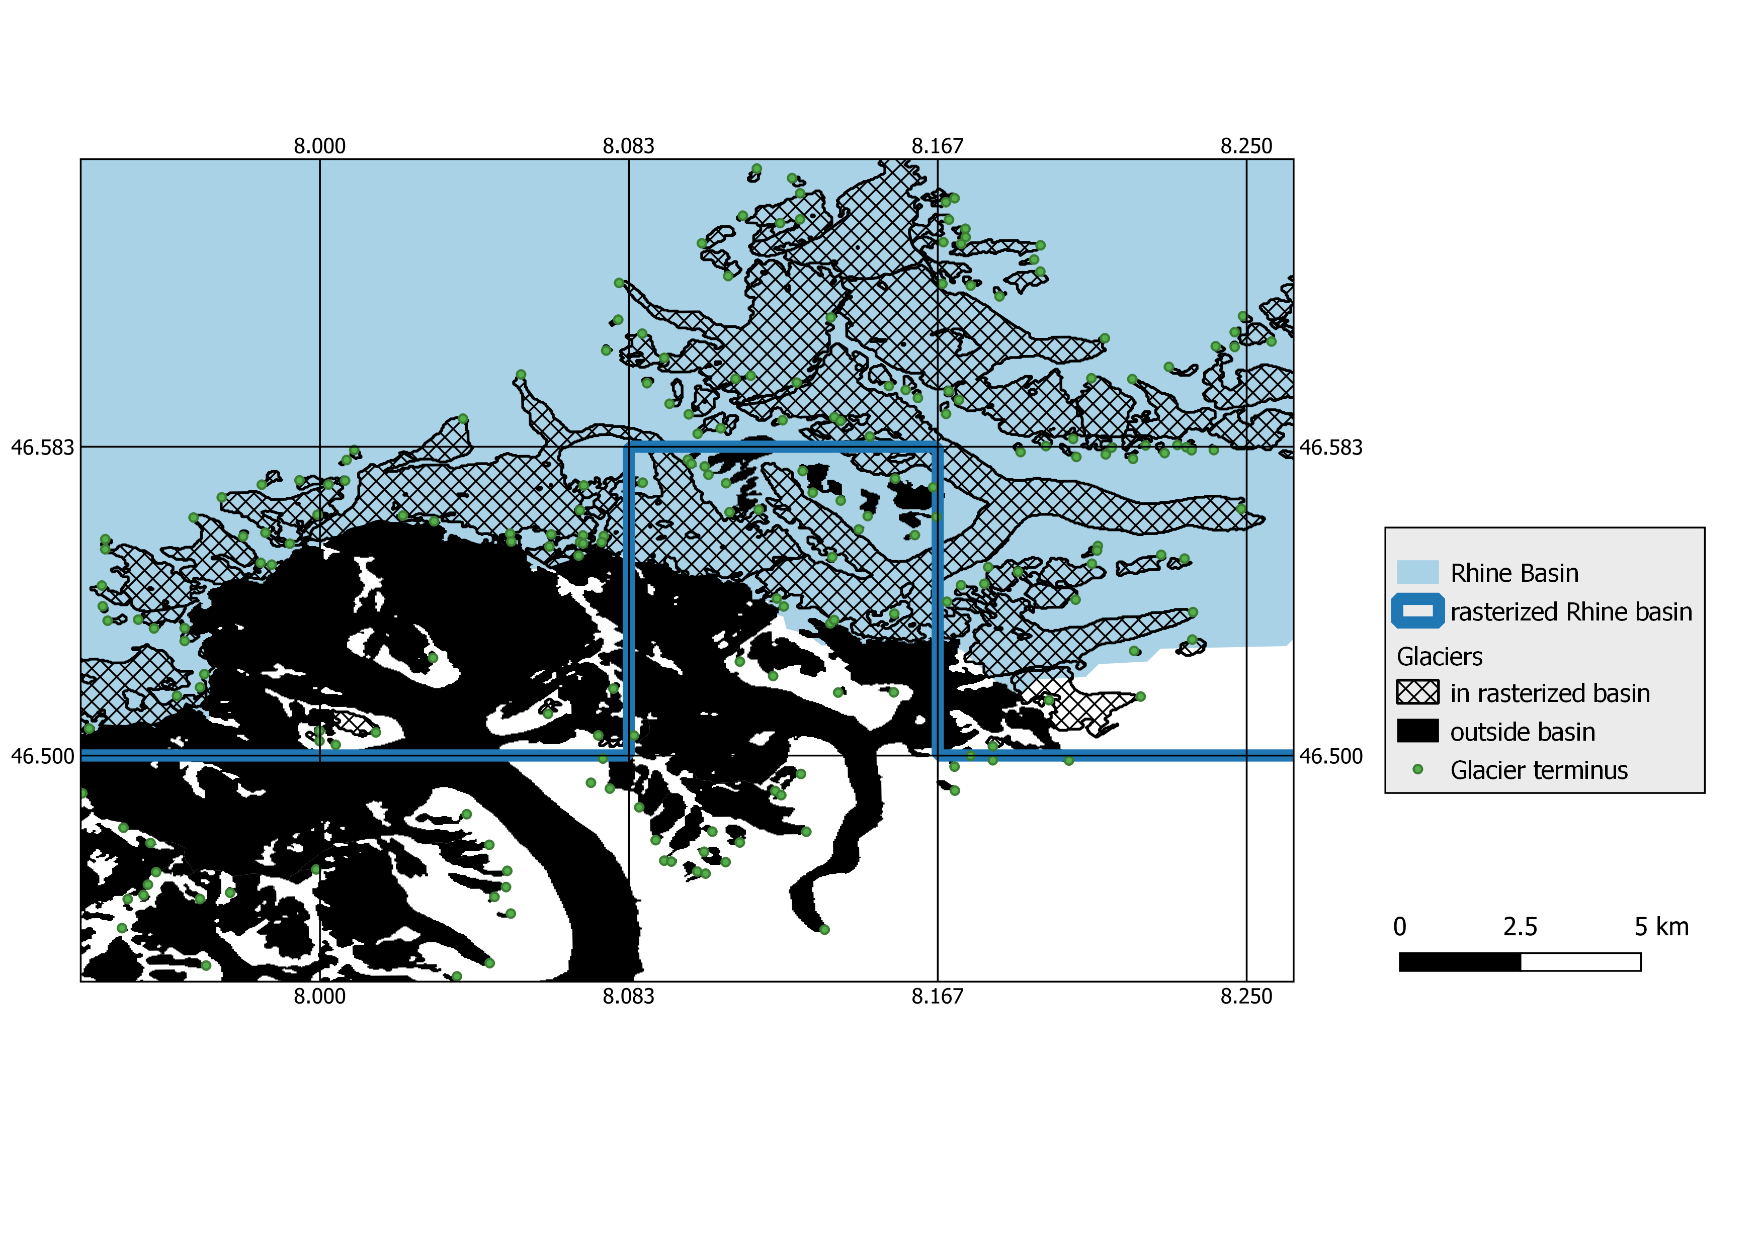
Challenges …
Precipitation correction highly impacts glacier runoff results
Glacier location in modelling grid
Calibration of global hydrological models
Differences in snow melt representation
Glacier melt ≠ Ice melt?
Let’s keep in touch!
Find out more in the preprint
Click here
Find synergies with the glacier modelling community
Continuous collaboration between glacier and hydrological community
… and benefits
Next slide
References
Why glaciers?
Coupling method
Results (Basins)
Results (Global)
Challenges
Notes:
Prcp Correction
- Show only 1 basins

Slide 21
Benefits
Inclusion of glaciers for future change assessments
Especially relevant when studies focus on summer months or extreme years
Step towards better understanding the relevance of glaciers for water availability
Opens the possibility to contrast glacier-sourced runoff with other streamflow components
Bridging the gap between assessments of environmental changes and their potential impacts on societies (water use)
Why glaciers?
Coupling method
Results (Basins)
Results (Global)
Challenges
Notes:
Simulation differences were mainly present in the summer months, a period where water availability is especially
relevant for irrigated agriculture. In specific years or months, the effect of including glaciers is likely larger than shown in this
analysis, for which 30-year average values were used. This is potentially relevant for climate impact assessments with a focus
on summer months or extreme years.
You could e.g. not use water use and thus see how high the contribution of glaciers to natural flow is (often it is criticized that glacier contribution is assessed compared to observed discharge, which includes water demand and thus overestimates glacier contribution, Gascoin et al 2024)
E.g. 5/ 100 = 5% glacier, but maybe 10 m3/s where abstracted, so it would be 5/110 = 4.5%, but I take the discharge with withdrawal, so I have a larger estimation of glacier contribution, because water is withdrawn anyway
Conclusions
- larger future discharge changes when glaciers
are explicitly considered.
- Including glaciers globally without explicit calibration increases discharge in summer months, also at the outlet of large river basins.
Performance improved in highly glacierized river basins and did not deteriorate in weakly glacierized basins.
positive future changes in discharge are attenuated and negative future changes are exacerbated when glacier representation is improved.
Otherwise, climate change impacts on river discharge in glacierized river basins, even near the basin outlet, are likely to be underestimated. Such studies are relevant because seasonal and interannual variability potentially impact societies, the economy and the environment stronger than changes in the long-term annual averages.

Slide 22
Study Basins
Why glaciers?
Coupling method
Results (Basins)
Results (Global)
Challenges

Slide 23
Performance: Calibrated basins
Downstream discharge stations
Upstream stations
Why glaciers?
Coupling method
Results (Basins)
Results (Global)
Challenges

Slide 24
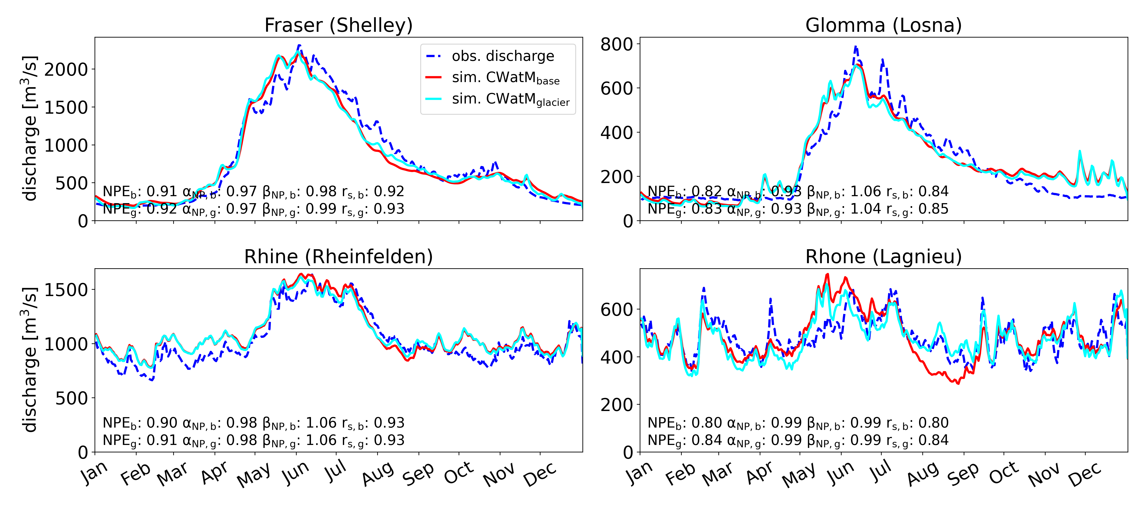
Performance: Calibrated basins
Upstream discharge stations
Why glaciers?
Coupling method
Results (Basins)
Results (Global)
Challenges

Slide 25
Future discharge
2070 – 2099
Change in discharge
Why glaciers?
Coupling method
Results (Basins)
Results (Global)
Challenges

Slide 26
Future change in discharge
2070 – 2099 vs 1990 – 2019
Why glaciers?
Coupling method
Results (Basins)
Results (Global)
Challenges

Slide 27
Glacier-sourced discharge contributions
Future: 2070 – 2099
Why glaciers?
Coupling method
Results (Basins)
Results (Global)
Challenges

Slide 28
Performance: global simulations
Performance improved for 23 out of 30 basins
Individual calibration of river basins would likely enhance the advantages of glacier inclusion
Why glaciers?
Coupling method
Results (Basins)
Results (Global)
Challenges
Notes:
This is likely due to using global parameter sets which were not adjusted for each basin individually and inaccurate precipitation input.
For example, the glacier inclusion improved the simulations of the Fraser river basin, but simulations were still unsatisfactory
because discharge was highly underestimated (Fig. 7c). Thus, further effort in calibration is likely to enhance the advantages
of CWatMglacier for global simulations. However, improving the global performance of large-scale hydrological models is a
research field in itself and beyond the scope of this study.

Slide 29
Future discharge changes at basin outlets
Month with largest absolute glacier-sourced melt contribution in the past
Positive future change dampened for CWatM_{glacier} vs. CWatM_{base}
Negative future change exacerbated for CWatM_{glacier} vs. CWatM_{base}
Decreased glacier runoff at end of 21st century
Why glaciers?
Coupling method
Results (Basins)
Results (Global)
Challenges
Notes:
Comparison of relative future discharge change for the month with largest absolute glacier-sourced melt contribution in the past, at
end of the 21st century, considering both CWatMbase and CWatMglacier, across 56 glacierized river basins for SSP1-2.6. (a) Colored dots show
the median of all GCMs and grey dots show individual GCMs. (b) Boxplots show the relative future change of all basins for CWatMbase and
CWatMglacier and the difference between the two.
At the outlets of the 56 glacierized river basins, negative changes are exacerbated
380 when glaciers are included explicitly in large-scale hydrological modelling, whereas positive changes are attenuated
(Fig. 9). The reason is that simulated glacier-sourced melt is smaller at the end of the century than in the past and this negative
change is included in CWatMglacier. This pattern holds for the majority of river basins, with the exception of a few basins where
simulated glacier-sourced runoff is greater or similar at the end of the century compared to the past because glacier peak water
is reached later, most notably Santa Cruz, Tarim, Amu Darya and Jokulsa (Fig. S4.4)

Slide 30
Glacier-sourced melt contributions
Relative glacier-sourced melt contributions are projected to be lower at the end of the century
Uncertainty in relative glacier-sourced melt contributions due to inaccurate representation of observed discharge in simulations
Spatial plot of past glacier-sourced melt contributions to discharge
Future annual glacier-sourced melt volumes
Why glaciers?
Coupling method
Results (Basins)
Results (Global)
Challenges
Notes:
Figure 10. (a) Simulated glacier contribution to total basin discharge in the past (1990–2019) and end of the century (2070–2099) for the
month with the highest relative glacier-sourced melt contribution to discharge in past. (b) The difference between the two periods, i.e. the
simulated future change in glacier contribution. The outlined circles in (a) show the Amu Darya / Tarim basin (black/grey)
The simulated relative glacier-sourced melt contributions to discharge decreased for future periods at the outlets of all glacierized
river basins, except for the Amu Darya and Tarim basins, both, on an annual average and during the month with the largest
390 glacier-sourced melt contribution (Fig. 10). In the Amu Darya and Tarim basins, the projected future glacier-sourced melt is
either larger or similar to the past. This, combined with projected decreased discharge, increases relative glacier-sourced melt
contributions. The decrease in glacier-sourced melt contribution to discharge is large in many basins. The highest monthly
glacier contribution decreased by more than 10% in 22 river basins for SSP1-2.6 and 26 river basins for SSP5-8.5. It decreased
by more than 20% in 12 river basins for SSP1-2.6 and 10 river basins for SSP5-8.5, respectively.
However, 395 it should be noted that deriving glacier-sourced melt contributions can be highly uncertain if observed stream
flow is not accurately represented in discharge simulations. An underestimation in discharge would result in an overestimation
of relative glacier-sourced melt contributions, whereas an overestimation of discharge would result in an underestimation of
relative glacier-sourced melt contributions.

Slide 31
Future annual glacier-sourced melt
Why glaciers?
Coupling method
Results (Basins)
Results (Global)
Challenges

Slide 32
Past annual glacier-sourced melt
Why glaciers?
Coupling method
Results (Basins)
Results (Global)
Challenges
Notes:
Figure S4.5: Relative mean glacier contribution to annual discharge for the period 1990–2019. Glacier melt comprises
all melt on glaciers. Glacier contribution is estimated by subtracting CWatMglacier,bare from CWatMglacier.

Slide 33
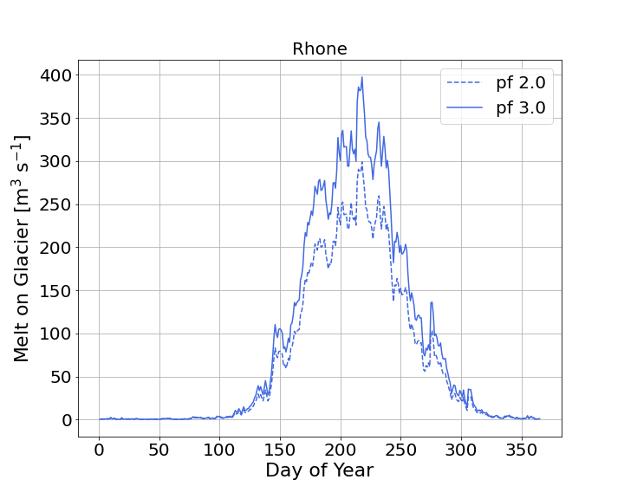
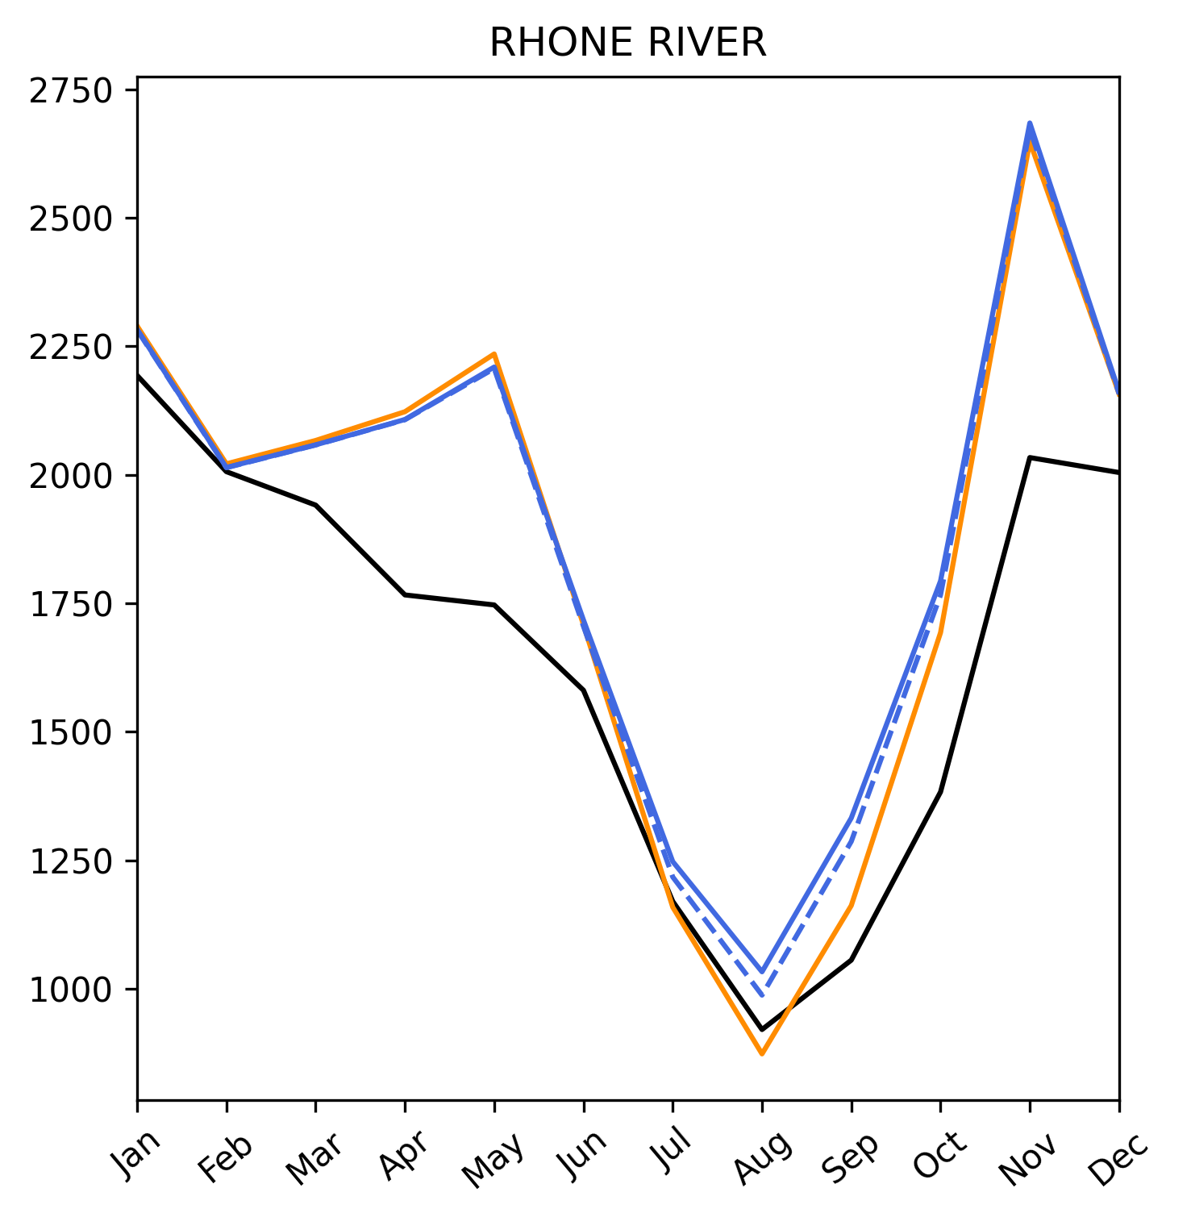
Precipitation correction
Precipitation correction in glacier models to correct for errors in snow input
Different combinations of precipitation correction factor and degree-day factor can represent mass balance of glaciers equally well (Rounce et al, 2020; Schuster et al. 2023)
Using the same precipitation correction in both models resulted in unrealistic calibration and deterioration in model performance
Precipitation correction is higher for the glacier model than for the hydrological model
Why glaciers?
Coupling method
Results (Basins)
Results (Global)
Challenges
Notes:
Glacier models use a precipitation factor to correct for measurement errors and additional errors in snow input, such as
those caused by avalanches, thereby allowing for better alignment with mass balance data (Hock et al., 2019; Rounce et al.,
2020). In CWatM, a multiplicative factor for snowfall correction is implemented as an optional calibration parameter following
the rationale that snowfall has a larger error range than rainfall (Beck et al., 2020). Following the same rationale, we applied
140 the precipitation factor in OGGM only to snow and not to rain. However, efforts to further harmonize the two models by using
the same precipitation correction factor resulted in unrealistic calibration and a deterioration in model performance. Therefore,
we decided to retain the snow correction procedures of each model, although this leads to disparities between the two models.
Different parameter combinations of precipitation factor (pf ), temperature bias and degree-day factor can represent the
mass balance of a glacier equally well (Rounce et al., 2020). However, the precipitation factor has a strong impact on the
simulated glacier-sourced runoff (Schuster et al., 2023). Here, it was chosen to best match the interannual variability of in-situ
glacier mass balance data at the global scale (pf = 3) and in the selected river basins (pf = 3, for the Rhine pf = 2). Thus,
precipitation correction is generally higher for the glacier model than for the hydrological model. One possible explanation is
455 the higher elevation of glaciers where precipitation data are often less accurate. Another explanation is that the precipitation
correction in OGGM accounts for processes that increase the snow input on glaciers such as avalanches or wind-blown snow
but are not explicitly simulated (Rounce et al., 2020).
Across the 56 glacierized river basins, the mean difference was +5% for total precipitation and
460 +17% for snowfall for the past period. Thus, differences between the model setups likely partly stem from the differences in
precipitation correction. An extended analysis is presented in the supplements. CWatMglacier also outperforms CWatMbase if
precipitation input correction is equalized in both setups

Slide 34
Glacier location in modelling grid
Glacier-sourced melt 13% / 6% lower on 30 / 5 arcmin resolution than for 100 m basin outline for the Rhine
Grid resolution: 5arcmin (6 x 9 km)
Why glaciers?
Coupling method
Results (Basins)
Results (Global)
Challenges
Notes:
For example, in the Rhine river basin the average annual glacier-sourced melt
volumes are 13%/6% lower on 30/5 arcmin resolution than for real basin outlines, for the Rhone they are 33%/5% lower. For
simulations at 30 arcmin, attributing glacier-sourced melt to the correct river basin independent of grid cell resolution would
enhance the glacier coupling. However, such an implementation is not straightforward and has its own limitations, i.e. the
480 change of the total basin area (Wiersma et al., 2022).

Slide 35
Differences in snow melt representation
OGGM: 30m elevation zones on each glacier
Degree-day factor as calibration parameter -> calibrated against glacier mass-balance
CWatM: up to 10 equally sized elevation zones per grid cell
Degree-day factor as calibration parameter -> calibrated against discharge
Snow simulations are not identical
Why glaciers?
Coupling method
Results (Basins)
Results (Global)
Challenges
Notes:
It’s likely that
glaciers are not precisely located at the elevation represented by the elevation zones in CWatM. Moreover, melt coefficients
are not the same in the two models but calibrated to glacier (OGGM) and discharge (CwatM) characteristics, respectively.
Thus, snow simulations are not identical in the models, leading to differences between CWatMbase and CWatMglacier outside
the glacier melt season.
It is difficult to investigate the effect of different snow representations on model results because the
applied OGGM version does not differentiate between snow and ice, making it impossible to disentangle the snow and ice
contributions. Nevertheless, due to the finer model resolution, the OGGM results are likely more realistic.

Slide 36
Glacier melt ≠ Ice melt ?
What is glacier melt?
Glacier-sourced melt (snow melt + glacier melt)? (e.g. Hanus et al., 2024; Wiersma et al., 2022; Huss and Hock, 2018)
Ice melt? (e.g. Stahl et al., 2016; Stahl et al., 2022)
Future glacier melt
Melt from changing glacier-covered area? (e.g. Hanus et al., 2024 ; Stahl et al., 2022)
Melt from past glacier-covered area? (e.g. Wiersma et al., 2022; Huss and Hock, 2018)
Glacier melt contributions
Compared to observed discharge? (e.g. Huss and Hock, 2018)
Comparing different simulations? (e.g. Hanus et al., 2024)
Effect tracking? (e.g. Stahl et al., 2016; Stahl et al., 2022)
Why glaciers?
Coupling method
Results (Basins)
Results (Global)
Challenges
Notes:
Glacier-sourced melt
Ice melt
Glacier melt (snow + ice melt)
The definition of glacier melt varies among different studies (Gascoin, 2024). In
this study, we use the term "glacier-sourced melt" for the combination of ice and snow melt on glaciers to distinguish it from
the sole ice melt.
Gascoin et al. 2024: “Regarding the denominator, it is not advisable to use river discharge measurements if the catchment of interest is
large. […] A proper quantification of the icemelt component in river discharge is actually a complex hydrological
question. [….] In the meantime,we as scientists should communicate accurately on what exactly is considered as glacier contribution: does it include snowmelt? Which period of the year is considered? Is it a drought period? Which hydrological components are neglected (groundwater discharge, reservoir management…)?”

Slide 37
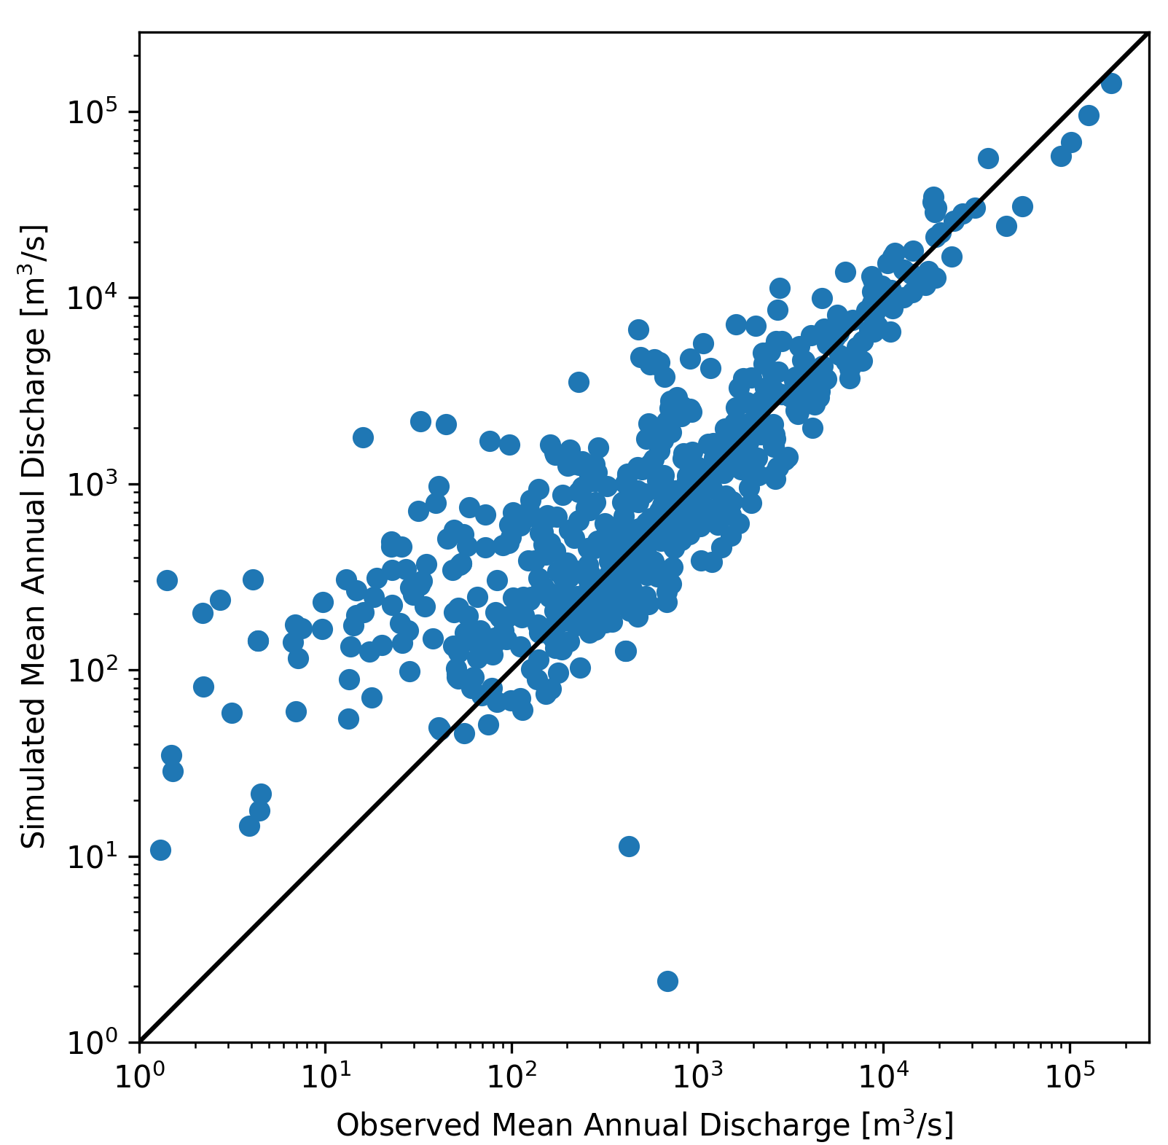
Calibration of global hydrological models
601 GRDC stations
Why glaciers?
Coupling method
Results (Basins)
Results (Global)
Challenges

Slide 38
References
Burek, P., Satoh, Y., Kahil, T., Tang, T., Greve, P., Smilovic, M., . . . Wada, Y. (2020). Development of the community water model (CWatM v1. 04) a high-resolution hydrological model for global and regional assessment of integrated water resources management. Geoscientfiic Model Development, 13 (7), 3267-3298.
Caceres, D., Marzeion, B., Malles, J. H., Gutknecht, B. D., Müller Schmied, H., & Döll, P. (2020). Assessing global water mass transfers from continents to oceans over the period 1948{2016. Hydrology and Earth System Sciences, 24 (10), 4831-4851.
Hock, R., Bliss, A., Marzeion, B., Giesen, R. H., Hirabayashi, Y., Huss, M., Radi´c, V., and Slangen, A. B.: GlacierMIP–A model intercomparison
of global-scale glacier mass-balance models and projections, J. Glaciol., 65, 453–467, 2019.
Hanus, S., Schuster, L., Burek, P., Maussion, F., Wada, Y., & Viviroli, D. (2024). Coupling a large-scale glacier and hydrological model (oggm v1.5.3 and cwatm v1.08) – towards an improved representation of mountain water resources in global assessments. EGUsphere, 2024 , 1–31. Retrieved from https://egusphere.copernicus.org/preprints/2024/egusphere-2023-2562/ doi: 10.5194/egusphere-2023-2562
Huss, M. and Farinotti, D.: Distributed ice thickness and volume of all glaciers around the globe, J. Geophys. Res-Earth, 117, 2012.
Huss, M., & Hock, R. (2018). Global-scale hydrological response to future glacier mass loss. Nature Climate Change, 8 (2), 135-140.
Marzeion, B., Hock, R., Anderson, B., Bliss, A., Champollion, N., Fujita, K., Huss, M., Immerzeel, W. W., Kraaijenbrink, P., Malles, J.-H., et al.: Partitioning the uncertainty of ensemble projections of global glacier mass change, Earth’s Future, 8, e2019EF001 470, 2020.
Maussion, F., Butenko, A., Champollion, N., Dusch, M., Eis, J., Fourteau, K., . . . others (2019). The open global glacier model (oggm) v1. 1. Geoscientific Model Development, 12 (3), 909-931.
Pfeffer, W. T., Arendt, A. A., Bliss, A., Bolch, T., Cogley, J. G., Gardner, A. S., Hagen, J.-O., Hock, R., Kaser, G., Kienholz, C., et al.: The Randolph Glacier Inventory: a globally complete inventory of glaciers, J. Glaciol., 60, 537–552, 2014.
Rounce, D. R., Khurana, T., Short, M. B., Hock, R., Shean, D. E., and Brinkerhoff, D. J.: Quantifying parameter uncertainty in a large-scale glacier evolution model using Bayesian inference: application to High Mountain Asia, J. Glaciol., 66, 175–187, 2020.
Schuster, L., Rounce, D. R., and Maussion, F.: Glacier projections sensitivity to temperature-index model choices and calibration strategies, Ann. Glaciol., p. 1–16, https://doi.org/10.1017/aog.2023.57, 2023.
Stahl, K., Weiler, M., Kohn, I., Freudiger, D., Seibert, J., Vis, M., ... & Bohm, M. (2016). The snow and glacier melt components of streamflow of the river Rhine and its tributaries considering the influence of climate change. Synthesis Report I-25, International Commission for the Hydrology of the Rhine Basin, Lelystad.
Stahl, K., Weiler, M., van Tiel, M., Kohn, I., Hänsler, A., Freudiger, D., ... & Moretti, G. (2022). Impact of climate change on the rain, snow and glacier melt components of streamflow of the river Rhine and its tributaries. CHR report n I-28. International Commission for the Hydrology of the Rhine basin (CHR), Lelystad.
Werder, M. A., Huss, M., Paul, F., Dehecq, A., and Farinotti, D.: A Bayesian ice thickness estimation model for large-scale applications, J. Glaciol., 66, 137–152, 2020.
Wiersma, P., Aerts, J., Zekollari, H., Hrachowitz, M., Drost, N., Huss, M., Sutanudjaja, E. H., and Hut, R.: Coupling a global glacier model to a global hydrological model prevents underestimation of glacier runoff, Hydrol. Earth Syst. Sci., 26, 5971–5986, https://doi.org/10.5194/hess-26-5971-2022, 2022.
Why glaciers?
Coupling method
Results (Basins)
Results (Global)
Challenges

