Slide 1
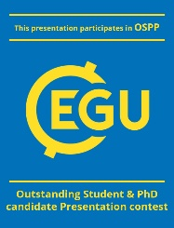
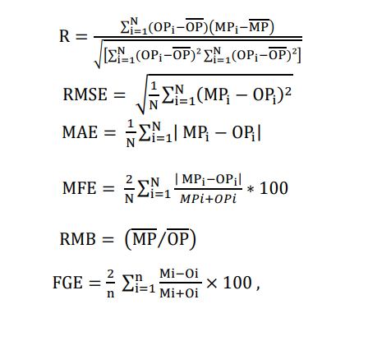
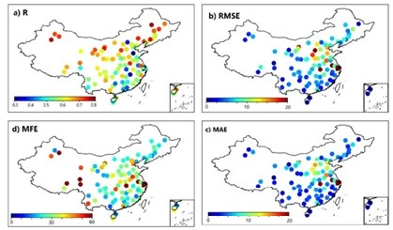
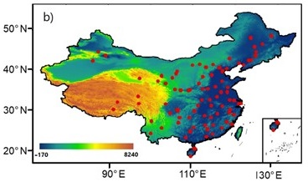
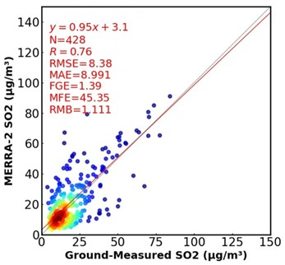
Evaluation of MERRA-2 reanalysis for Sulfur dioxide aerosol in China
Abdallah Shaheen1, Robabeh Yousefi1, Fang Wang1, Quansheng Ge1 and Renguang Wu2
1University of Chinese Academy of Sciences, Institute of Geographic Sciences and Natural Resources Research, China
2 School of Earth Sciences, Zhejiang University, Hangzhou, China
The MERRA-2 SO2 concentrations exhibit a high correlation with ground-based SO2 measurements. In terms of RMSE, MFE and MAE, small biases (≤ 5 μg m-3) were found mainly for extensive regions (about 80%) of China, which confirm the high accuracy of the MERRA-2 SO2 datasets.
Monthly SO2 datasets during the years 2013–2021 were used to evaluate the monthly MERRA-2 SO2 data. The retrieval errors of SO2 measurements were estimated using the Pearson correlation coefficient (R), root mean square error (RMSE), mean absolute error (MAE), mean fractional error (MFE), relative mean bias (RMB), and fractional gross error (FGE)
A good performance of the yearly-mean MERRA-2 SO2 with a significant spatial agreement was achieved. Acceptable correlation coefficient (R = 0.76) values and biases were obtained (RMSE = 8.3 µg m-3, MAE = 8.9 µg m-3, FGE = 1.39, MFE = 45.3% and RMB = 1.11)
The RMB and FGE showed values greater than 1 and 0% in the eastern China, which indicates that MERRA-2 overestimates the SO2 measurements. This could be due to the relatively high ambient SO2 loadings in these highly populated and polluted regions, while underestimation of MERRA-2 SO2 was found in other regions.
April 2024

