Slide 1
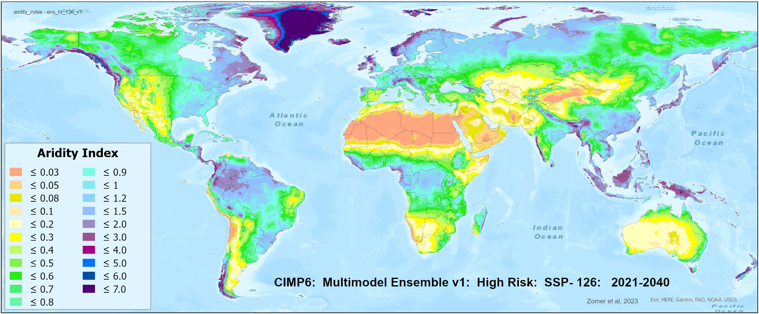





Future Global Aridity Index and Potential Evaporation Database
CIMP_6 Based Future Projections of Aridity Index and PET
Robert Zomer, Jianchu Xu, Donatella Spano, Antonio Trabucco
Robert Zomer, Ph.D
Center on Euro-Mediterranean Climate Change
Sardinia, Italy
Presidential Fellow
Center for Mountain Futures
Kunming Institute of Botany
Chinese Academy of Science
robert.zomer@ccmc.it

Slide 2
CIMP6-Based Global Projections of
Future Aridity Index and Potential Evapotranspiration
The Future_Global_AI_PET Database provides:
High-resolution (30 arc-seconds ; ~ 1km²) global raster dataset
For each of 22 bias-corrected downscaled CIMP_6 Earth System Models
  Potential evapotransipation (PET)
  Aridity Index (AI)
    Average monthly and annual estimates
Two historical (1960-1990; 1970-2000) time periods
Two future (2021-2040; 2041-2060) time periods
Four Shared Socio-economic Pathways (SSP) emission scenarios:
  (SSP: 126, 245, 370, 585)

Slide 3
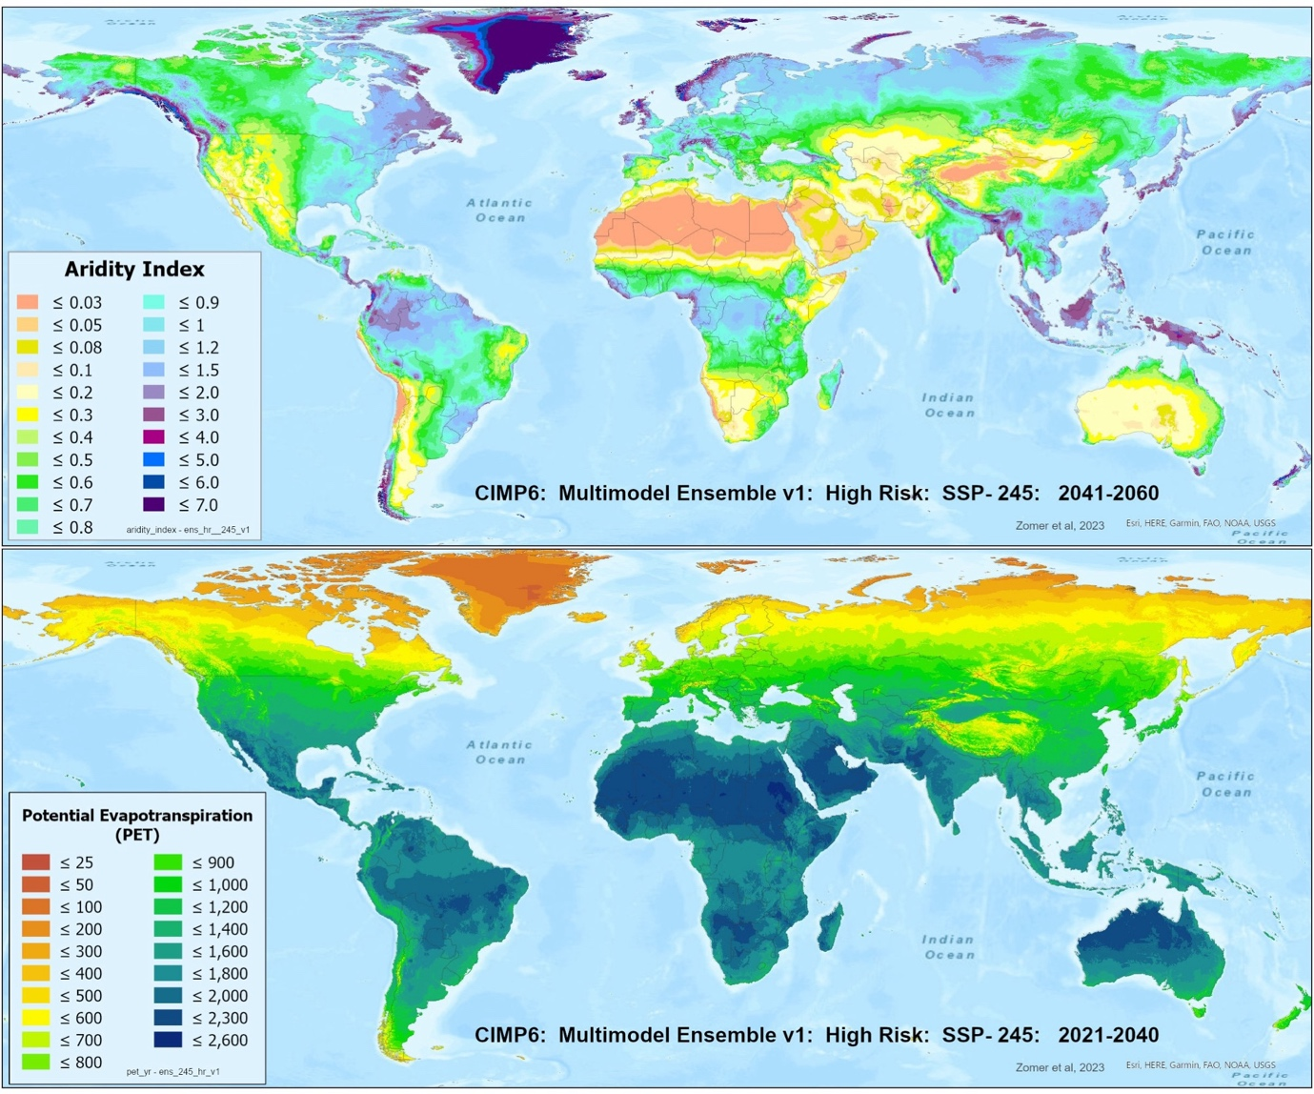
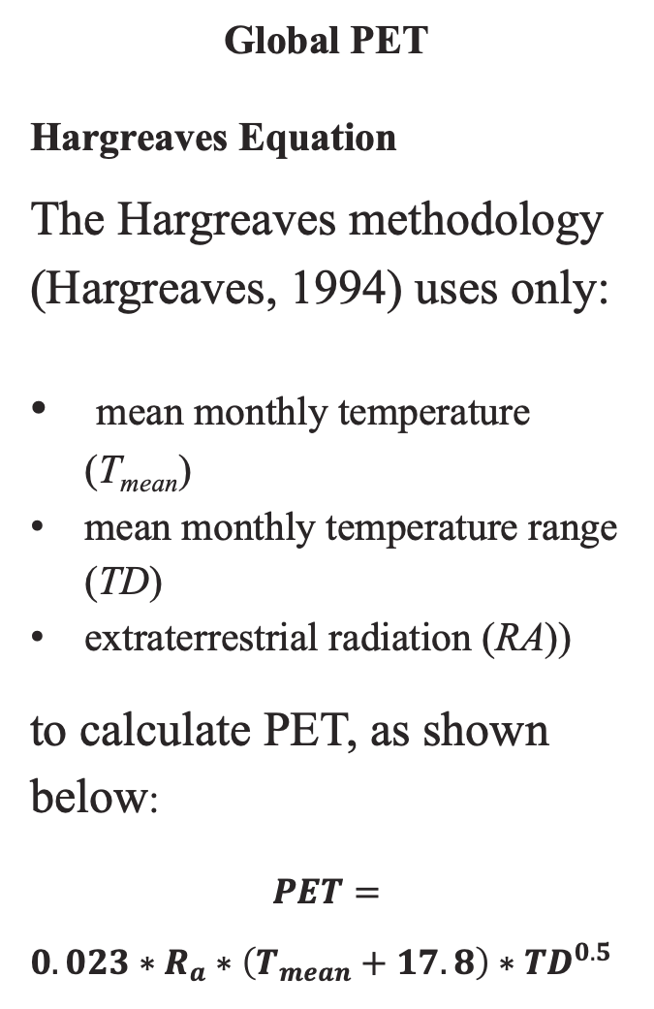
Global PET
Hargreaves Equation
The Hargreaves methodology (Hargreaves, 1994) uses only:
mean monthly temperature (T_{mean})
mean monthly temperature range (TD)
extraterrestrial radiation (RA))
to calculate PET, as shown below:
$$PET=$$
$0.023∗R_{a}∗\left(T_{mean}+17.8\right)∗{TD}^{0.5}$

Slide 4
Global Aridity Index
The Aridity Index (AI) is expressed as the ratio of precipitation over PET
The AI quantifies water availability for plant growth and is a measure of available precipitation relative to water demand for plant growth.
The AI for the averaged time periods has been calculated on a per grid cell basis, as:
𝐴𝐼 = 𝑀𝐴_𝑃𝑟𝑒𝑐/𝑀𝐴_𝑃𝐸𝑇
where:
MA_Prec = Mean Annual Precipitation
MA_PET = Mean Annual PET

Slide 5
CIMP6-Based Global Projections of
Future Aridity Index and Potential Evapotranspiration
The Future_Global_AI_PET Database also includes:
PET and AI estimates for Three Averaged Multi-Model Ensembles:
  All: includes all 22 ESM
  High Risk: includes 5 ESM with higher (more extreme) projections
  Majority Consensus: 17 ESM (All minus the 5 High Risk ESM)
** For each of the four emission scenarios

Slide 6
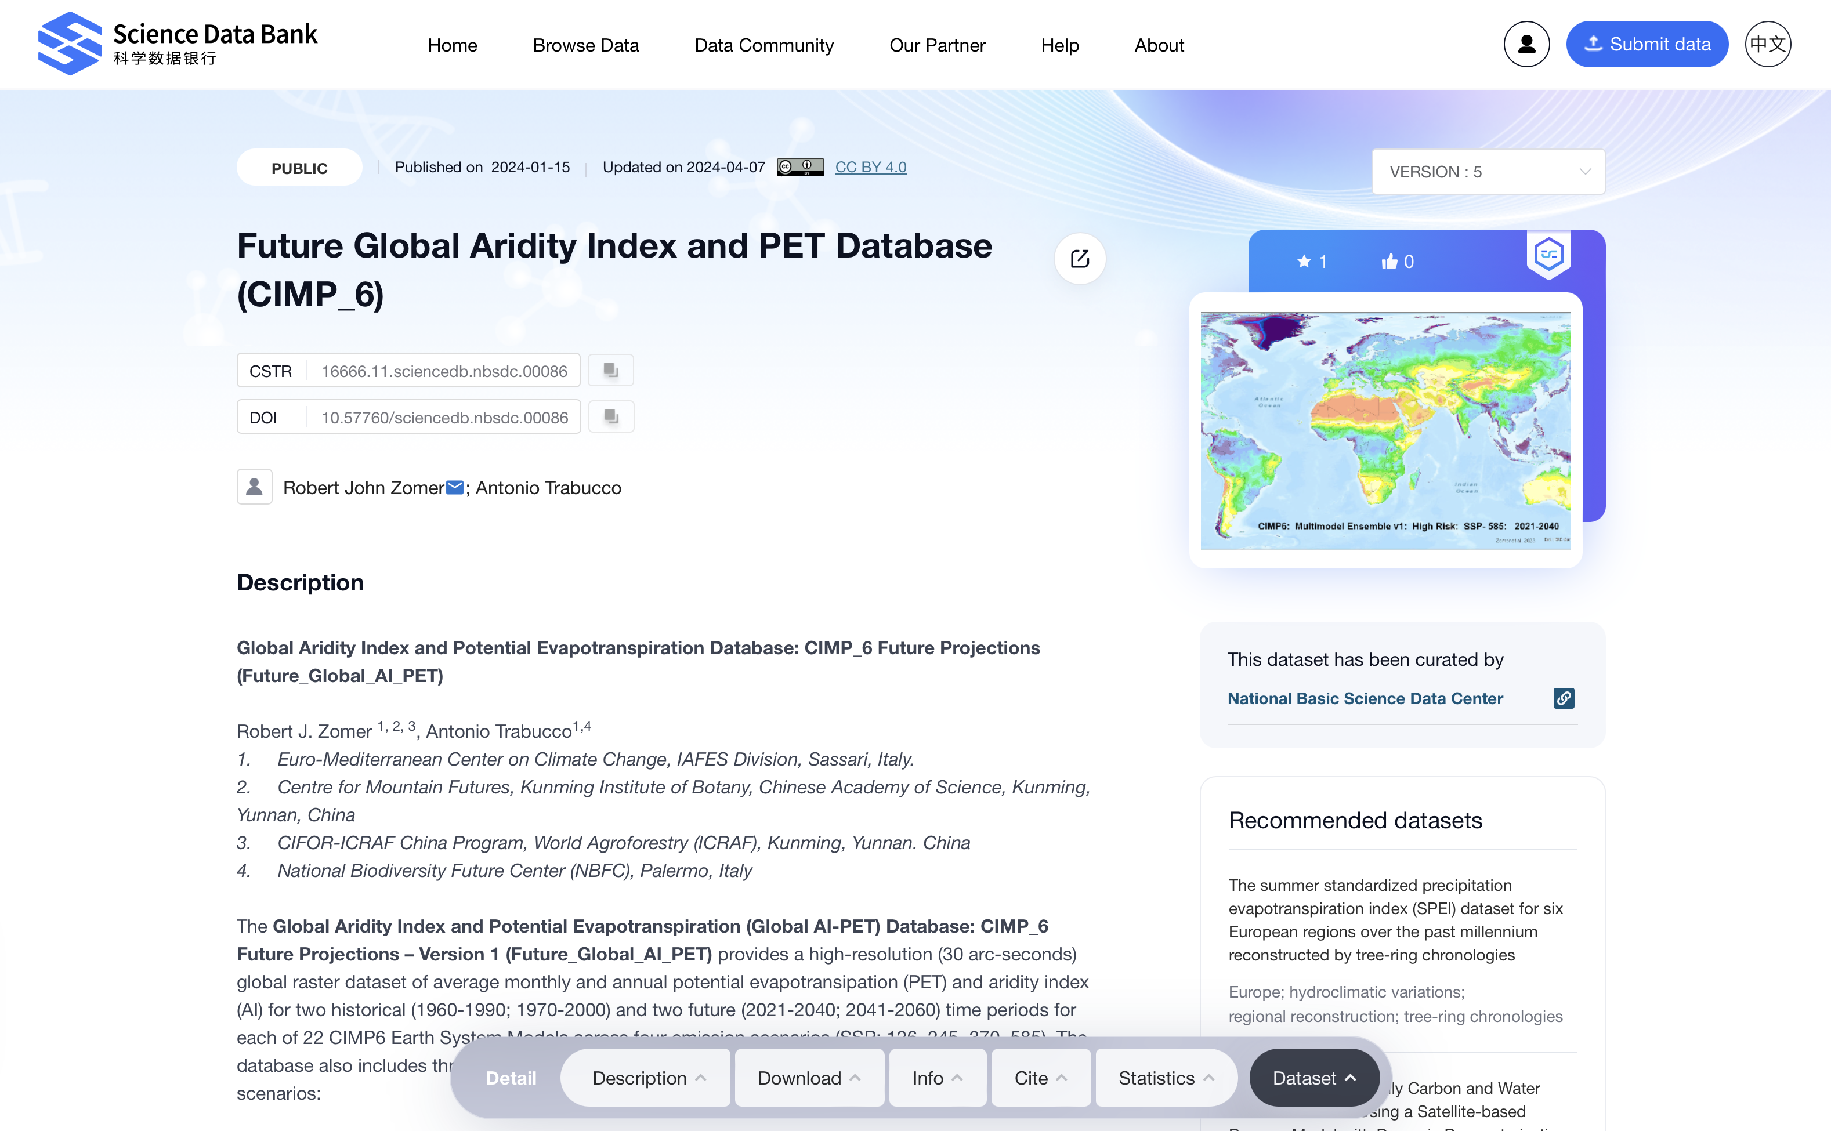
https://doi.org/10.57760/sciencedb.nbsdc.00086

Slide 7
Available datasets in the Future_Global_AI_PET Database, including two historical datasets, 22 ESM models calculated for each of their respective SSP, for two time periods, and 3 averaged multimodel ensembles.

Slide 8
Distribution of average global mean annual temperature and mean annual precipitation of
22 CIMP6 ESM for four SSP for the time period 2021-2040 and 2041-2060.

Slide 9
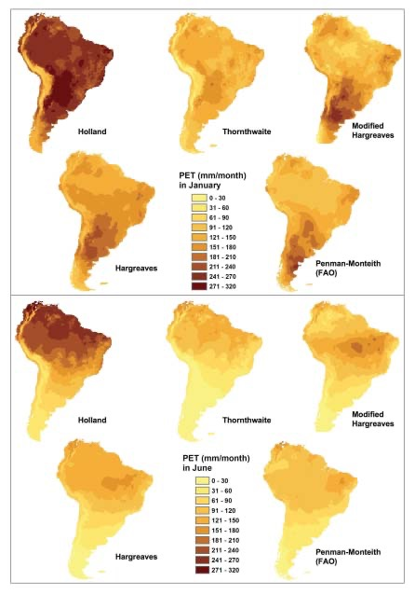
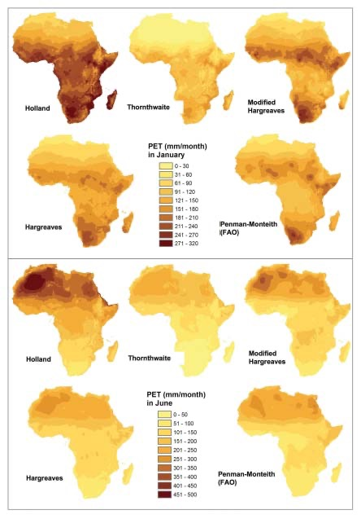
Comparison of five different methods of calculating PET: Thornthwaite, Thornthwaite modified by Holland, Hargreaves, Hargreaves Modified by Droogers and Allen, and the FAO Global Penman–Monteith Spatial Dataset.

Slide 10
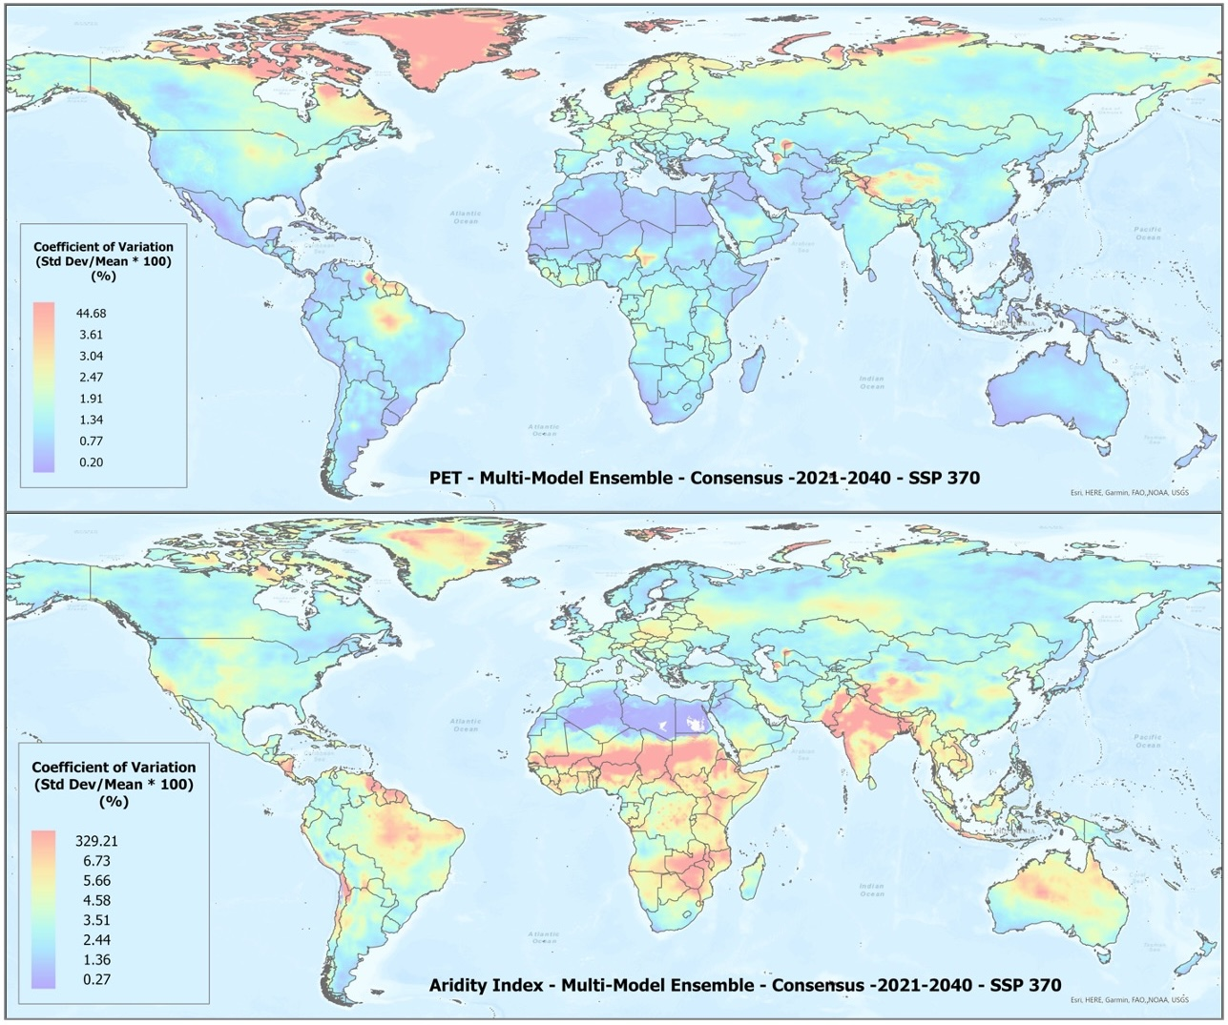
Coefficient of variation showing agreement amongst CIMP_6 Earth System Models (ESM) included with each of three averaged multimodel ensembles, for each of four shared socio-economic pathways (SSP: Scenario).
Coefficient of variation of PET and Aridity Index of the “Consensus” multimodel ensemble average for the SPP 370 scenario, shown here to illustrate variation in agreement across the various global regions.

Slide 11
Comparison of five different methods of calculating PET: Thornthwaite, Thornthwaite modified by Holland, Hargreaves, Hargreaves Modified by Droogers and Allen, and the FAO Global Penman–Monteith Spatial Dataset.

Slide 12
Validation and comparison of input data used in the analysis and results, current and previous, including the validation of the:
(a.) elevation data (Elev);
(b.) annual mean temperature (Tmean);
(c.) annual mean precipitation (Prec);
and the comparison of results for the
(d.) Hargreaves PET the CLIMWAT dataset
(e.) Aridity Index with the CLIMWAT dataset
Validation and comparison of results for the Hargreaves PET and the Aridity Index with the CRU_TS dataset.

Slide 13
Distribution of historical and projected global averaged annual temperature (°C) and annual precipitation (mm) of three averaged multimodel ensembles, across four shared socio-economic pathways (SSP: 126; 245; 370; 585).

Slide 14
Distribution of historical and projected global averaged PET (mm) and the aridity index (AI) of three averaged multimodel ensembles, across four shared socio-economic pathways (SSP: 126; 245; 370; 585). Higher AI values indicate wetter conditions, lower values indicate drier conditions.

Slide 15
Previous versions of the Global Aridity Index and PET Database
Global-AI_PET_v1. (Trabucco and Zomer, 2008),
  WorldClim 1.4: 1960-1990
  Calculated using the Hargreaves Equation (Hargreaves, 1994)
  Available online since 2009
Global-AI_PET_v2 (Trabucco and Zomer, 2019)
  Full Implementing of the Penman-Monteith Equation
  WorldClim 2.0: 1970-2000,
  Available online since 2019
Global-AI_PET_v3 (Zomer et al., 2022)
  Full Implementing of the Penman-Monteith Equation
  WorldClim 2.1: 1970-2000,
  Available online since 2022
** These datasets have been shown to have wide utility across a wide range of disciplines and have been downloaded more than 65,000 times with more than 2500 citations in academic journals.

Slide 16
References
Zomer, R.J.; Xu, J.; Spano, D., Trabucco, Submitted.. CIMP6-Based Global Projections of Future Aridity Index and Potential Evapotranspiration. Earth System Science Data,. Submitted March 28, 2024
Zomer, R.J.; Xu, J.; Trabucco, A. 2022. Version 3 of the Global Aridity Index and Potential Evapotranspiration Database. Scientific Data 9, 409.
Zomer, R. J; Bossio, D. A.; Trabucco, A.; van Straaten, O.; Verchot, L.V. 2008. Climate Change Mitigation: A Spatial Analysis of Global Land Suitability for Clean Development Mechanism Afforestation and Reforestation. Agric. Ecosystems and Environment. 126:67-80.
Trabucco, A.; Zomer, R. J.; Bossio, D. A.; van Straaten, O.; Verchot, L.V. 2008. Climate Change Mitigation through Afforestation / Reforestation: A global analysis of hydrologic impacts with four case studies. Agric. Ecosystems and Environment. 126: 81-97.
Zomer, R. J.; Trabucco, A.; van Straaten, O.; Bossio, D. A. 2006. Carbon, land and water: A global analysis of the hydrologic dimensions of climate change mitigation through afforestation/reforestation and the Kyoto Protocol Clean Development Mechanism. Colombo, Sri Lanka: International Water Management Institute. pp 48 . (IWMI Research Report 101).

