Slide 1
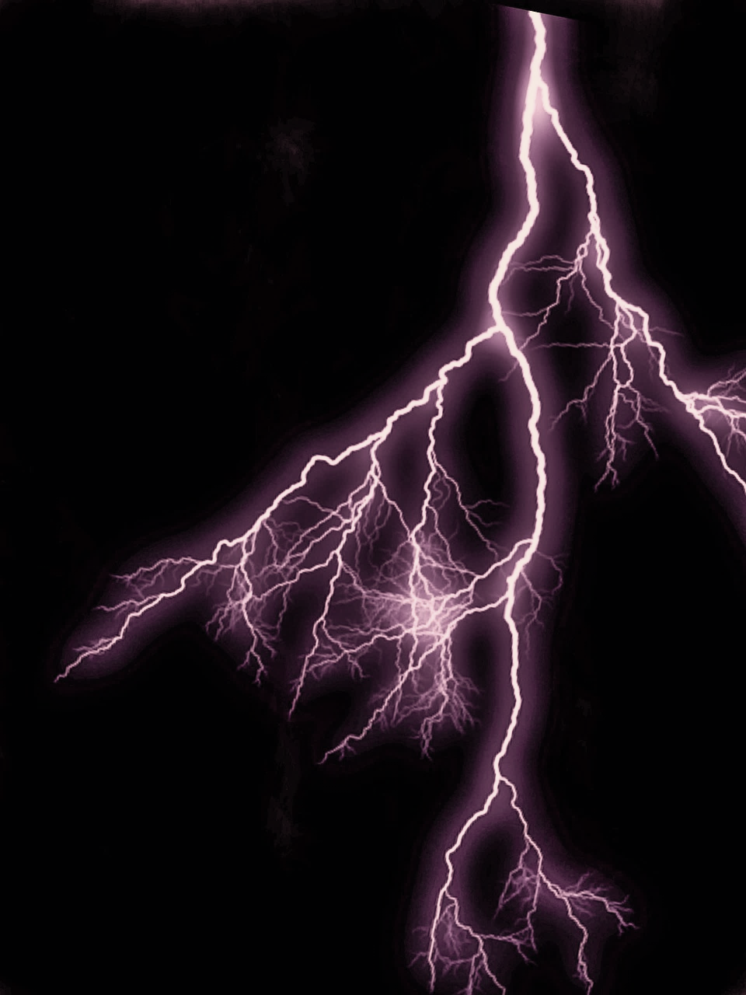
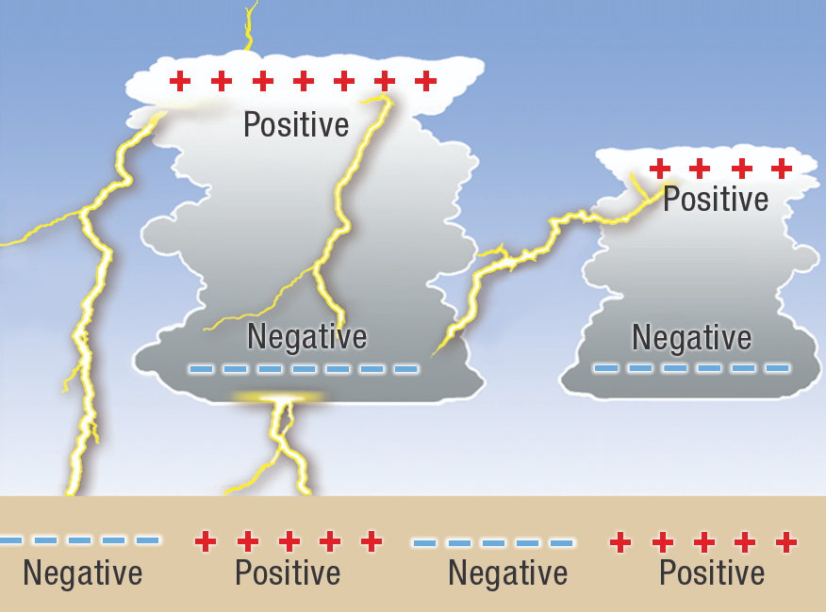
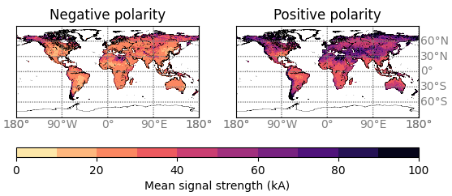
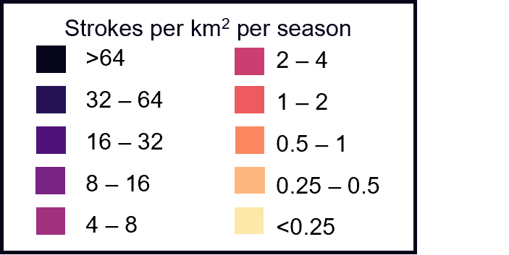
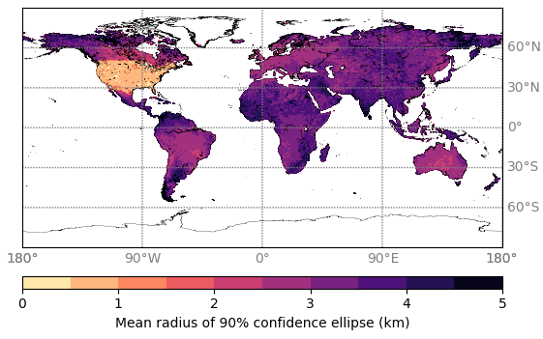
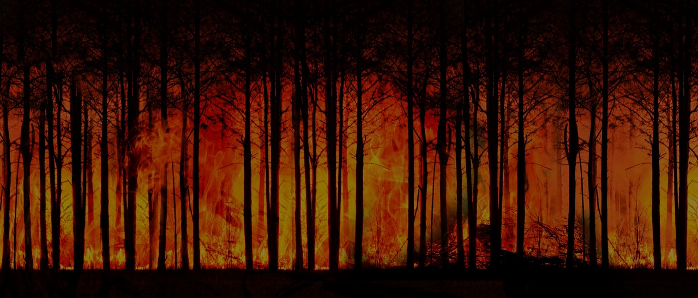
GLOBAL CLOUD-TO-GROUND LIGHTNING DATA TO INFORM WILDFIRE IGNITION PATTERNS
Esther Brambleby¹, Sander Veraverbeke^{1,2}, Guilherme Mataveli^{1,3},
Manoj Joshi¹, Matthew Jones¹
1 University of East Anglia; 2 Vrije Universiteit Amsterdam; 3 National Institute for Space Research (INPE)
e.brambleby@uea.ac.uk
BACKGROUND
Lightning is recognised as a crucial wildfire ignition source worldwide, especially in remote regions including boreal and temperate forests.¹
Lightning occurrence is projected to increase in these areas under climate change.
Robust assessments of lightning contribution to wildfire risk have been restricted to selected regions due to the narrow spatial extent of cloud-to-ground lightning records, and global studies have been limited to considering total lightning.²
SEASONAL CLOUD-TO-GROUND LIGHTNING STROKE DENSITY
Reference period December 2018 – August 2023.
The timing of high-density cloud-to-ground lightning corresponds with fire season in many lightning-fire prone regions. This dataset also reports a 43% cloud-to-ground lightning fraction over land, with a higher fraction in high latitudes.
LOCATION ACCURACY
Reference period January 2019 – December 2023.
The higher location accuracy across contiguous USA is due to a merging of the GLD360 dataset with Vaisala’s National Lightning Detection Network (NLDN).
SIGNAL STRENGTH PEAK CURRENT
Reference period January 2019 – December 2023.
Globally over land, ~14% strikes from January 2019 – December 2023 have positive polarity. Positive cloud-to-ground lightning are more likely to experience long continuing currents which is linked to wildfire ignition.⁴
Source: https://media.bom.gov.au/social/blog/1478/a-bolt-from-the-blue-what-is-lightning/
+
VAISALA GLOBAL LIGHTNING DETECTION NETWORK GLD360
GLD360 is a global lightning location system consisting of ground-based sensors which detect very low frequency radio waves.³ Observations are classified as cloud or cloud-to-ground strokes.
VARIABLES TO BE PUBLISHED
NEXT STEPS
Use point data to match individual cloud-to-ground lightning strokes to wildfire ignition points from the Global Fire Atlas.
Combine this lightning-ignited wildfire database with meteorological variables to improve understanding of the climatic drivers of natural wildfire ignition potential.
Cloud-to-ground stroke data, split by polarity
Stroke count
Signal Strength
Peak Current (kA)
Location accuracy
Mean radius of confidence ellipse (km)
Duration
Time associated with stroke (ns)
+
REFERENCES
1 Jones, M. W., Abatzoglou, J. T., Veraverbeke, S., Andela, N., Lasslop, G., Forkel, M., et al. (2022). Global and regional trends and drivers of fire under climate change. Reviews of Geophysics, 60, e2020RG000726.
2 T Janssen, T.A.J., Jones, M.W., Finney, D. et al. (2023) Extratropical forests increasingly at risk due to lightning fires. Nat. Geosci. 16, 1136–1144.
3 Said, R. K., U. S. Inan, and K. L. Cummins. (2010). Long-range lightning geolocation using a VLF radio atmospheric waveform bank, J. Geophys. Res., 115, D23108.
4 Bitzer, P. M. (2017), Global distribution and properties of continuing current in lightning, J. Geophys. Res. Atmos., 122, 1033–1041
ACKNOWLEDGEMENTS
This work was supported by the Natural Environment Research Council and the ARIES Doctoral Training Partnership [grant number NE/S007334/1].
Notes:
-Advertise paper that is coming
-Clearer take home message -> first globally consistent, usable network.
************************
Add email address and nerc logo, fix INPE logo
Add in next steps of combining raw point data with the GFA
Try white background for red boxes
Increase size of colour scheme
Lightning background box, link an objective & split final sentence into 2

