Slide 1
Photo: Marx, privat
Water management is a success story:
How water quality changed based on historical development and mid-term hydroclimate
Christian Marx | Dörthe Tetzlaff | Reinhard Hinkelmann | Chris Soulsby
c.marx@tu-berllin.de
Effects of 66 years of water management and hydroclimatic change on the urban hydrology and water quality of the Panke catchment, Berlin, Germany, Science of The Total Environment, 900, 165764.

Slide 2
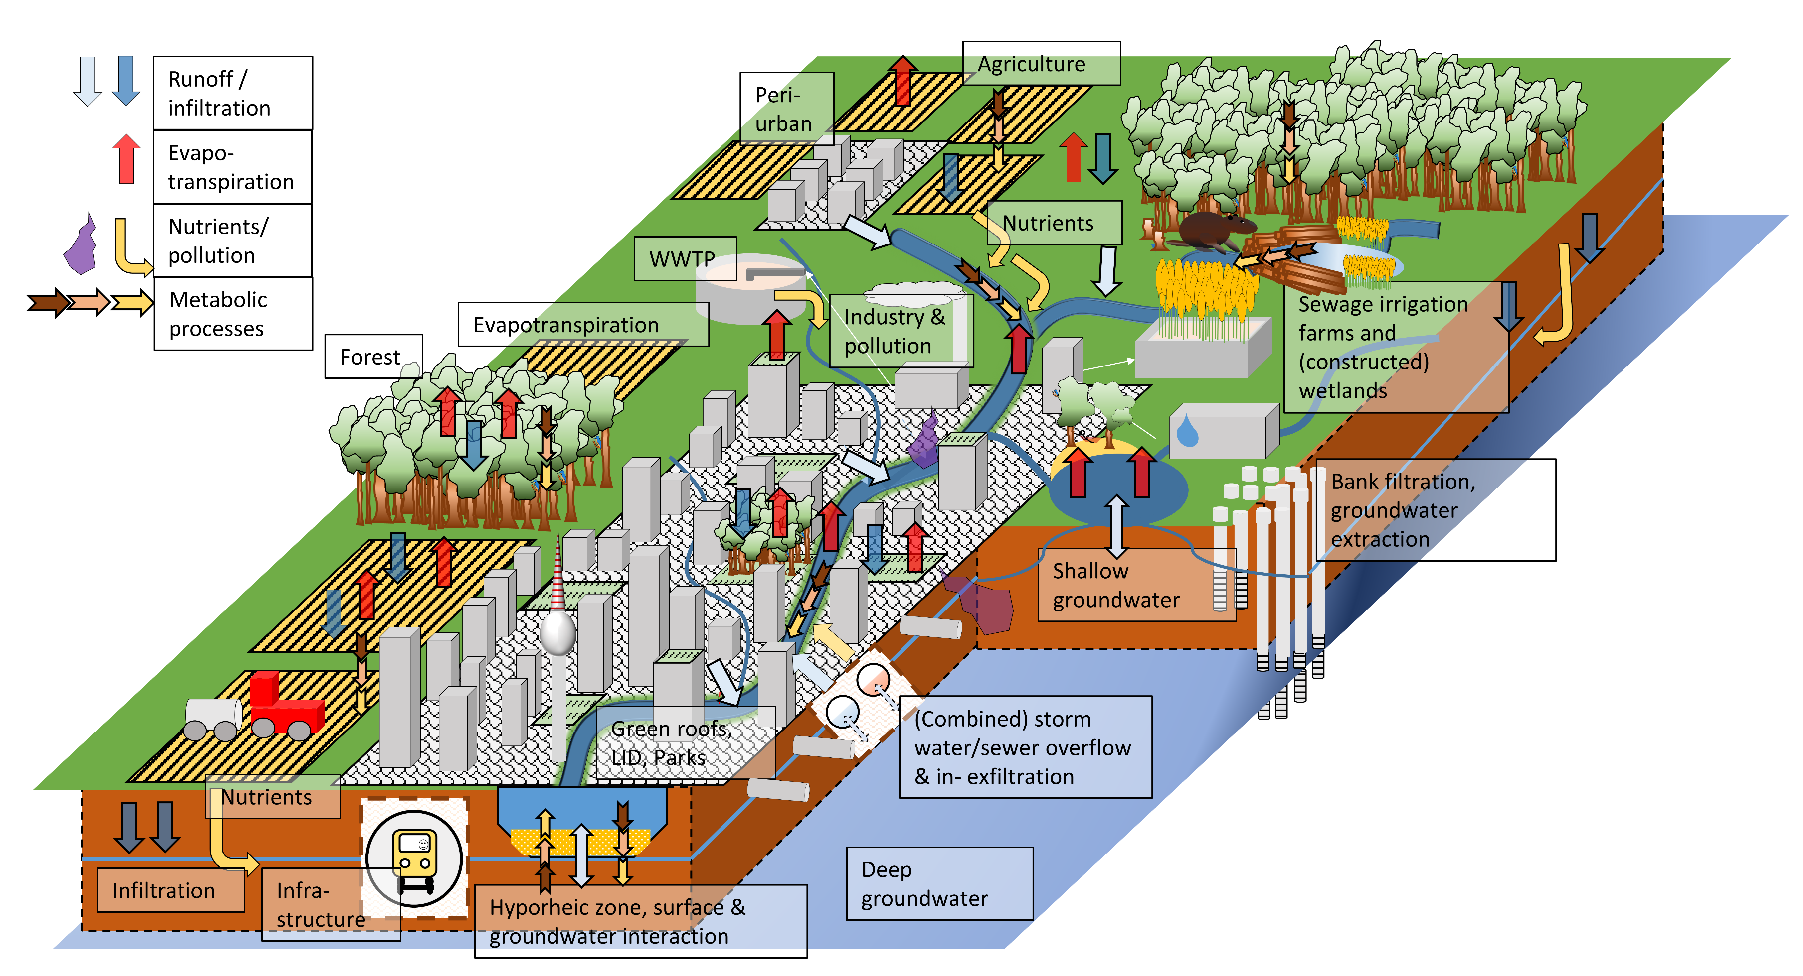
Motivation | Study site & development | Methods | Results | Discussion
Motivation
Understanding the urban hydrological cycle, pathways and their consequences
Influence of hydroclimate on urban water quality
Marx, C., 2023. Insights from stable water isotopes and long-term water quality data on urban hydrology. TU Berlin PhD Thesis. https://doi.org/10.14279/depositonce-18518

Slide 3
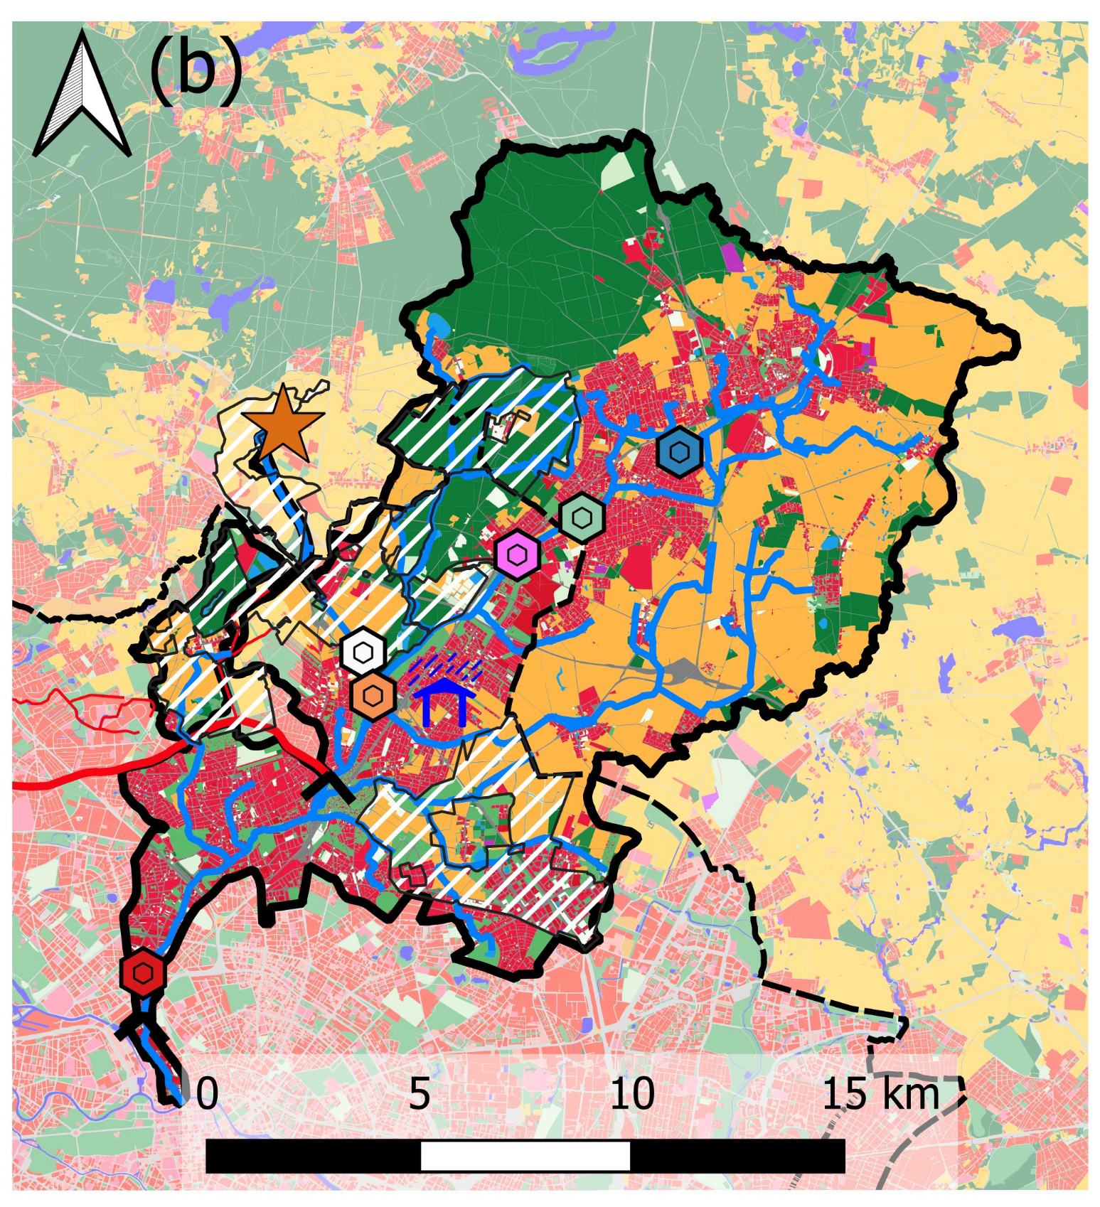
Motivation | Study site & development | Methods | Results | Discussion
Study site: Berlin & the Panke catchment
Upstream
Waste water treatment plant (WWTP, 1985+)
Sewage Irrigation farm
until 1985
Site | Urban + Streets [%] | Forest[%] | Agriculture [%]
UP1 | 30.3 | 9.0 | 55.9
UP2 | 41.5 | 7.5 | 47.1
Buch | 42.4 | 7.7 | 45.7
OL | 34.1 | 22.8 | 34.6
Area: ~220 km²
Upstream:
Groundwater dominated
Downstream :
Waste water dominated
Marx C., Tetzlaff D., Hinkelmann R., Soulsby C. (2021). Isotope hydrology and water sources in a heavily urbanized stream. Hydrological Processes, 35(10). https://doi.org/10.1002/hyp.14377
Upstream
Those values are cumulative based on the nested catchment

Slide 4
Motivation | Study site & development | Methods | Results | Discussion
Methods & Data
Ø
Extr. drought
Extr. wet
Marx et al, 2023, STOTEN
SPI
(Standard Precipitation Index)
Hydroclimate:
Standard Precipitation Index (SPI):
< -2 extreme drought, +1 - -1 „average years“,
>+2 extreme wet years
Stream Quality: NH4-N, NO3-N, oPO4-P, Cl
Multiplicative trend decomposition
Multiple breakpoint analysis (trend stability)
Classification after German standards (LAWA)
Longterm data: Water quality 66 years; fertilizer 70 years, 66 years of hydroclimate,
30 years water quantity and 20 years of groundwater quality, changes in water management
<-2
1
>+2
-1
0
Time Series
Long term
trend
Saisonal and
random effects

Slide 5
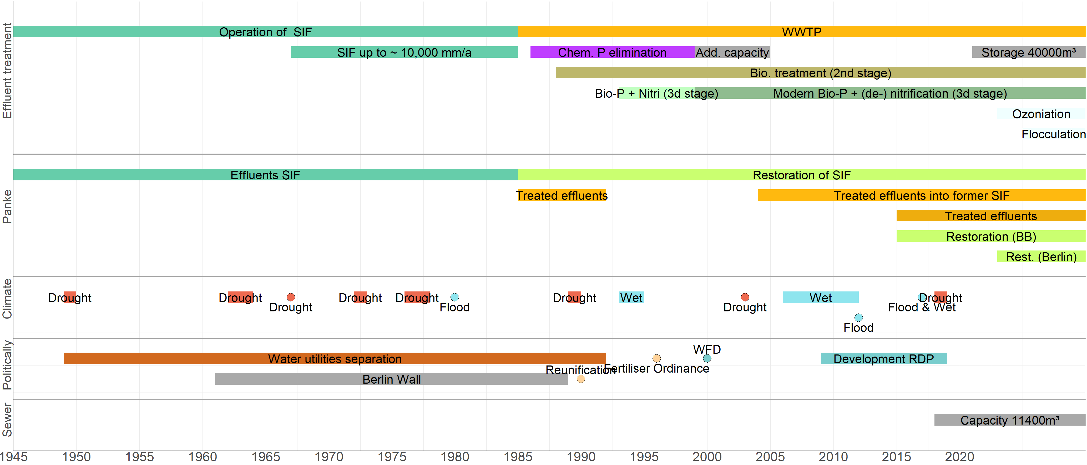
Motivation | Methods | Study site & hydroclimate | Results | Discussion
Wasserwirtschaftliche Entwicklung
Mech. Reinigung (1985)
Chem. P Eliminierung (1986)
BioP (1993)
Komb. Nitri + Denitri (1999-2000)
Kläranlage
(2015 - heute)
Rieselfelder (bis 1985)
Rieselanlagen bis 10,000 mm/a (Ende 1960er -1985)
Kläranlage
(1985 - Mitte 90er)
Gewässer-renaturierung
(2015 - heute)
Feuchte- periode
1964-1967
Trocken-periode
1970-1976
Trocken-periode
1996-2001
Feuchte- periode
2007-2013
Trocken-periode
2018-2021
13 Jahre: übergreifende Dürren
8 Jahre: übergreifende Feuchte-perioden

Slide 6
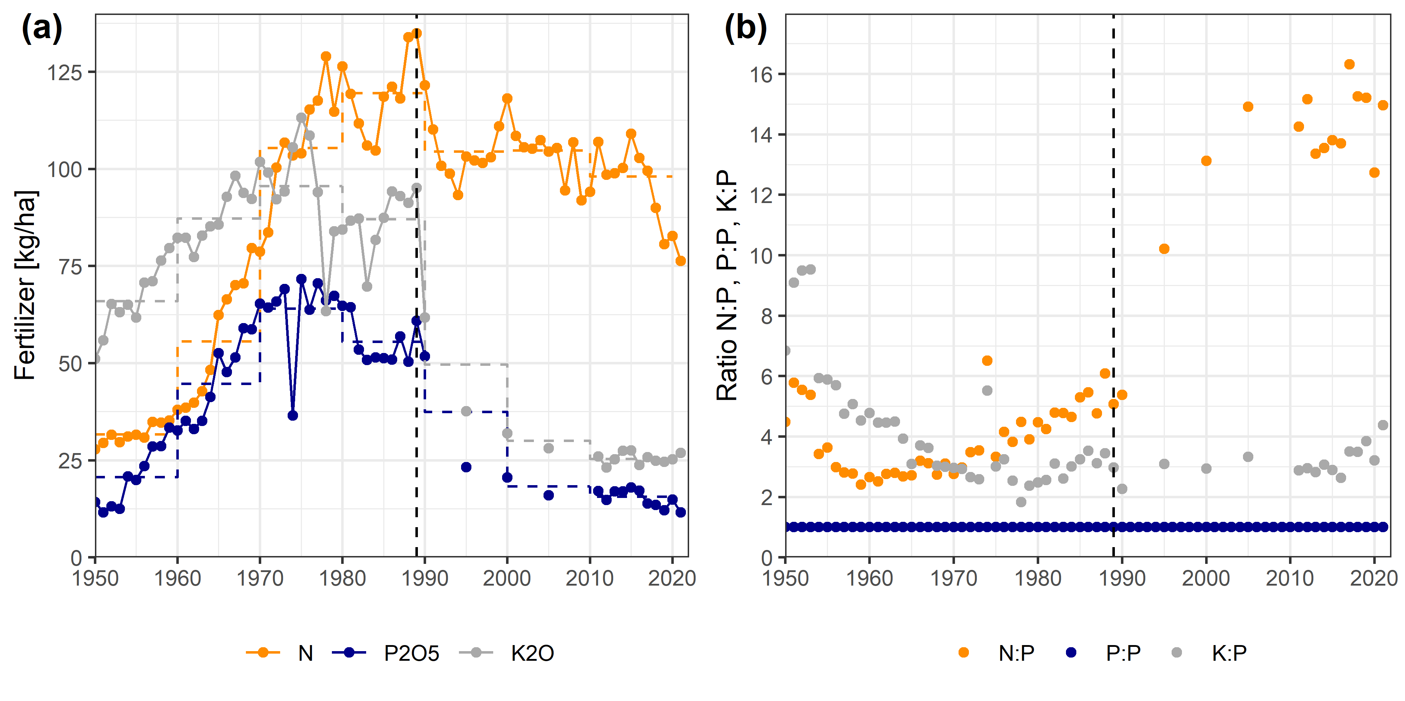
Motivation | Methods | Study site & hydroclimate | Results | Discussion
Düngemittelausbringung (Ost- und wiedervereinigtes Deutschland)
(Datensatz als Supplementary tables): https://doi.org/10.1016/j.scitotenv.2023.165764
P2O5 Plateau 1970-1980
Since 1990: P2O5 -33%/Decade reduction
Nitrogen: except after reunification no major decline (~6%/Decade)
Nitrogen only since 2015/17 reduced application
Strong increase N:P-ratio (from 2.5:1 to 15:1)
Data sources:
DDR: (1950–1989): Statistisches Amt der DDR, 1990; BRD: (1989–2021): BMEL, 2022; Statistisches Bundesamt (Destatis) 2022a; Ackerfläche: Statistisches Bundesamt (Destatis), 2022b
-6%/Decade
5:1
15:1
-33%/Decade
2.5:1
Statistics could be created differently
Only mineral fertilizer
Statistic after 1990 is biased towards West-Germanys fertilization practices (Areal normalisation)

Slide 7
Motivation | Study site & development | Methods | Results | Discussion
Water quality & influence of water management
Marx et al, 2023, STOTEN
Generally decreasing nutrient concentration
particular after abandonment of the SIF (1985) at all sites
Similar dynamics between UP1,UP2, Buch and Outlet
Dynamics in upstream sites stabilized in late 1990ies/early 2000
Upstream sites reached “good” to “very good” water quality in the following decades
The urban UP2 has the best water quality
SIF
SIF
SIF
WWTP
WWTP
WWTP
SIF
SIF
WWTP
WWTP

Slide 8
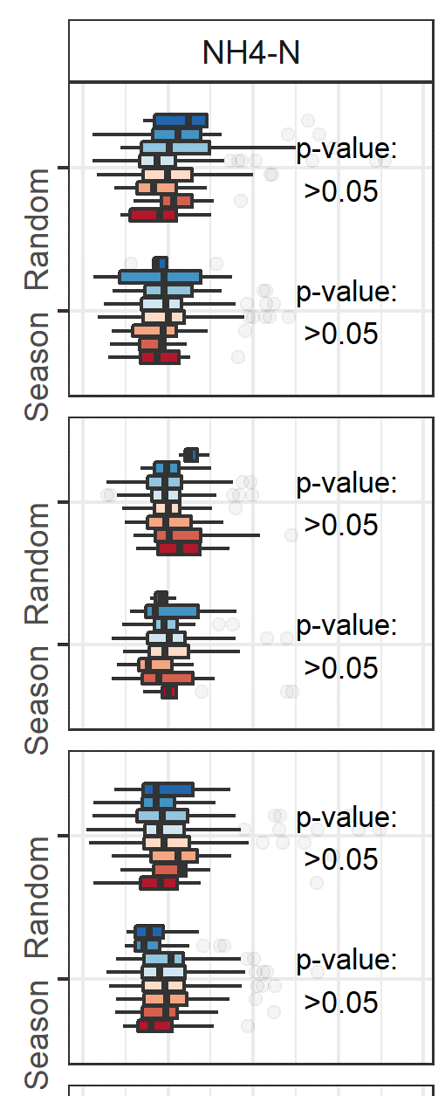
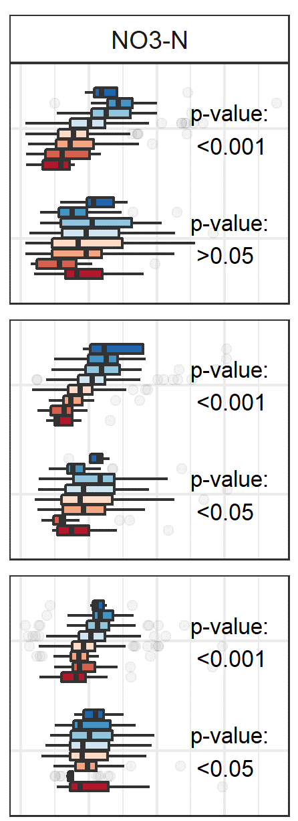
Motivation | Study site & development | Methods | Results | Discussion
Nitrogen as a function of hydroclimate (upstream sites)
Marx et al, 2023, STOTEN
Better hydrologic connectivity of the agricultural dominated areas during wet periods
Under circumstances: accumulation of fertilizer during droughts, because of less infiltration/bio-production?
Ø
Extr. drought
Extr.
wet
Normalized concentration (0 = low, 4 = high)
Normalized concentration (0 = low, 4 = high)

Slide 9
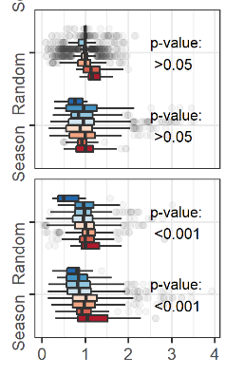
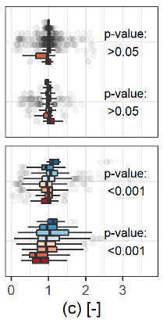
Motivation | Study site & development | Methods | Results | Discussion
Nitrogen as a function of hydroclimate (downstream sites)
Marx et al, 2023, STOTEN
Ø
Extr. drought
Extr.
wet
Normalized concentration (0 = low, 4 = high)
WWTP concentration independent of hydroclimate (as it is threshold controlled)
Outlet concentration is statistically significant impacted by hydroclimate in terms of seasonal and random effects
Ammonium concentration is low.
Normalized concentration (0 = low, 4 = high)

Slide 10
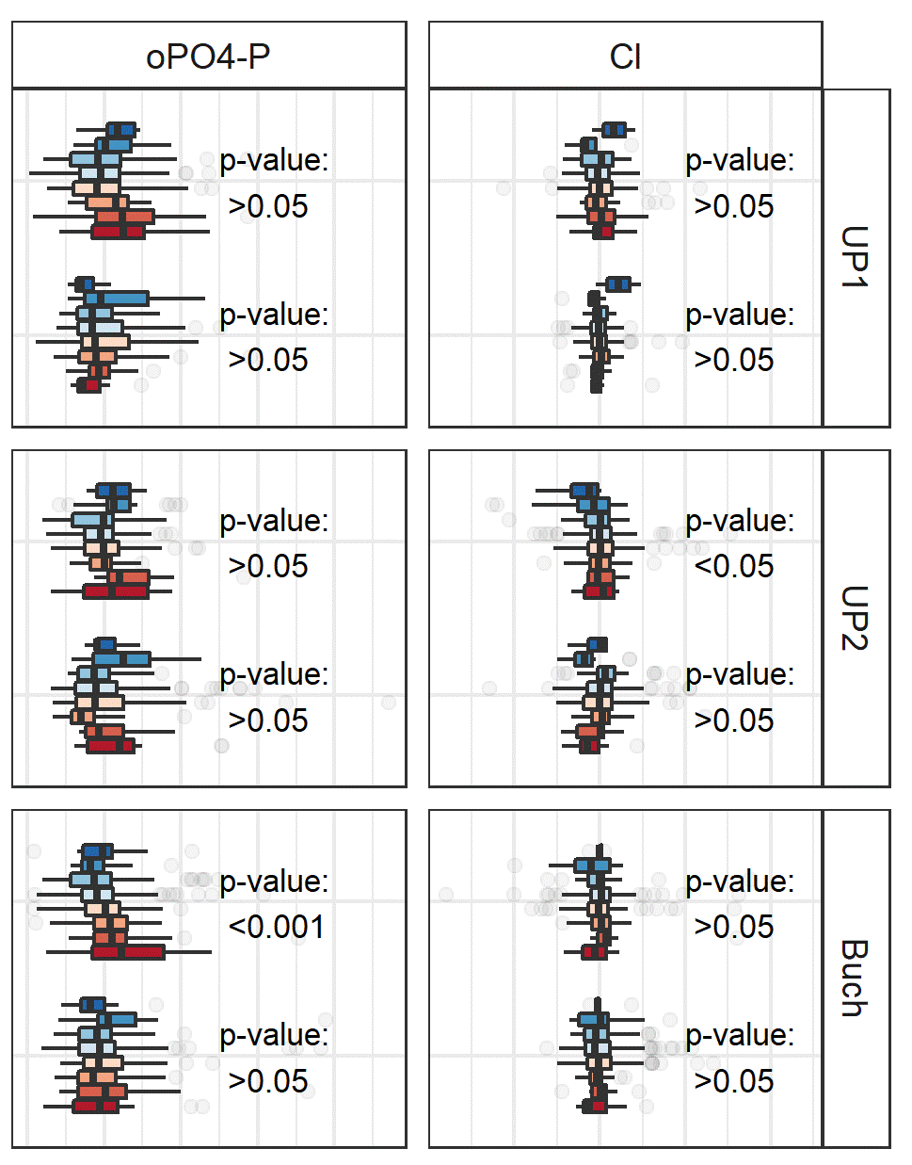
Motivation | Study site & development | Methods | Results | Discussion
Ortho-phosphate & chloride as a function of hydroclima (upstream sites)
Marx et al, 2023, STOTEN
Only minimal hydroclimatic impact of oPO4-P & Cl in the upstream sites
Ø
Extr. drought
Extr.
wet
Normalized concentration (0 = low, 4 = high)
Normalized concentration (0 = low, 4 = high)

Slide 11
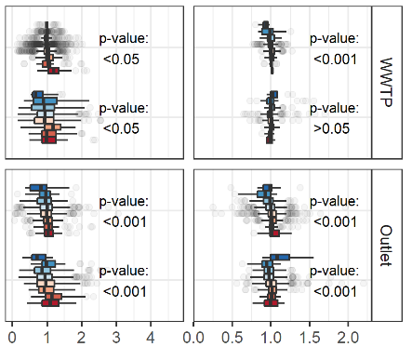
Motivation | Study site & development | Methods | Results | Discussion
Ortho-phosphate & chloride as a function of hydroclimate (downstream sites)
Marx et al, 2023, STOTEN
Ø
Extr. drought
Extr.
wet
Normalized concentration (0 = low, 4 = high)
oPO4-P: increase during droughts, in particular with increasing urbanization
Chloride is usually independent of hydroclimate (“conservative tracer”); snow rich winter have an impact, due to de-icing of streets
Normalized concentration (0 = low, 4 = high)

Slide 12
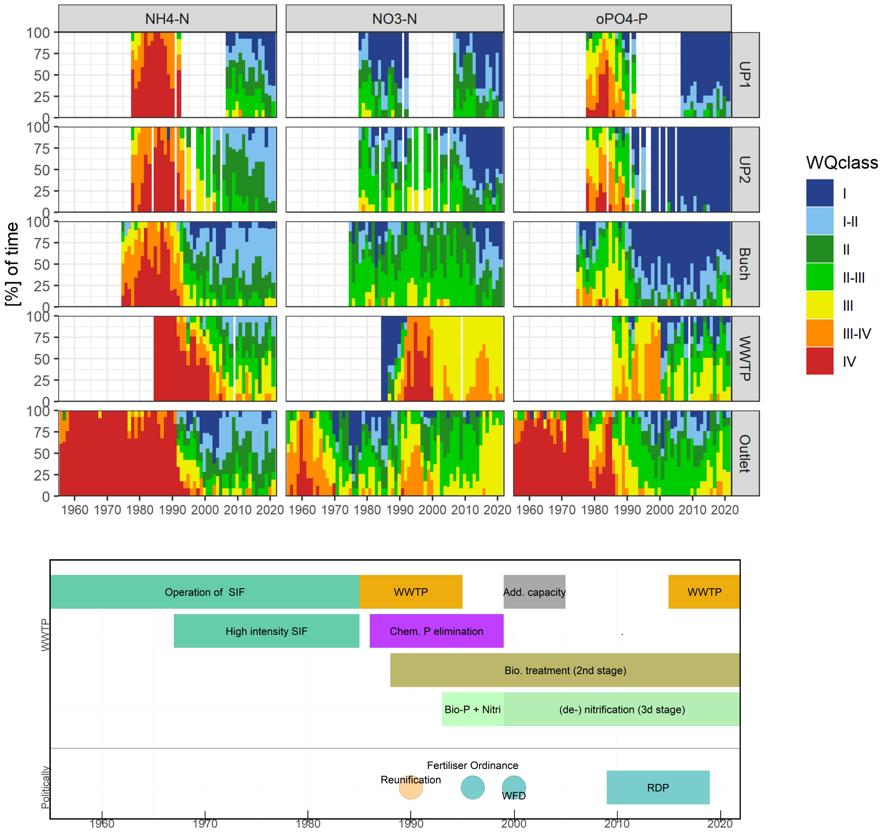
Motivation | Methods | Study site & hydroclimate | Results | Discussion
Water quality classes
Historically: Ammonium is “the greatest issue”, within the catchment
Indirect influence of the former sewage irrigation farm on upstream sites?
Since 2000: upstream sites between “good” and “very good”
The urban site UP2 has even the “best water quality
Only since the reintroduction of effluents to the Outlet (2015), deminshed water quality
But: enough flows to avoid intermittency

Slide 13
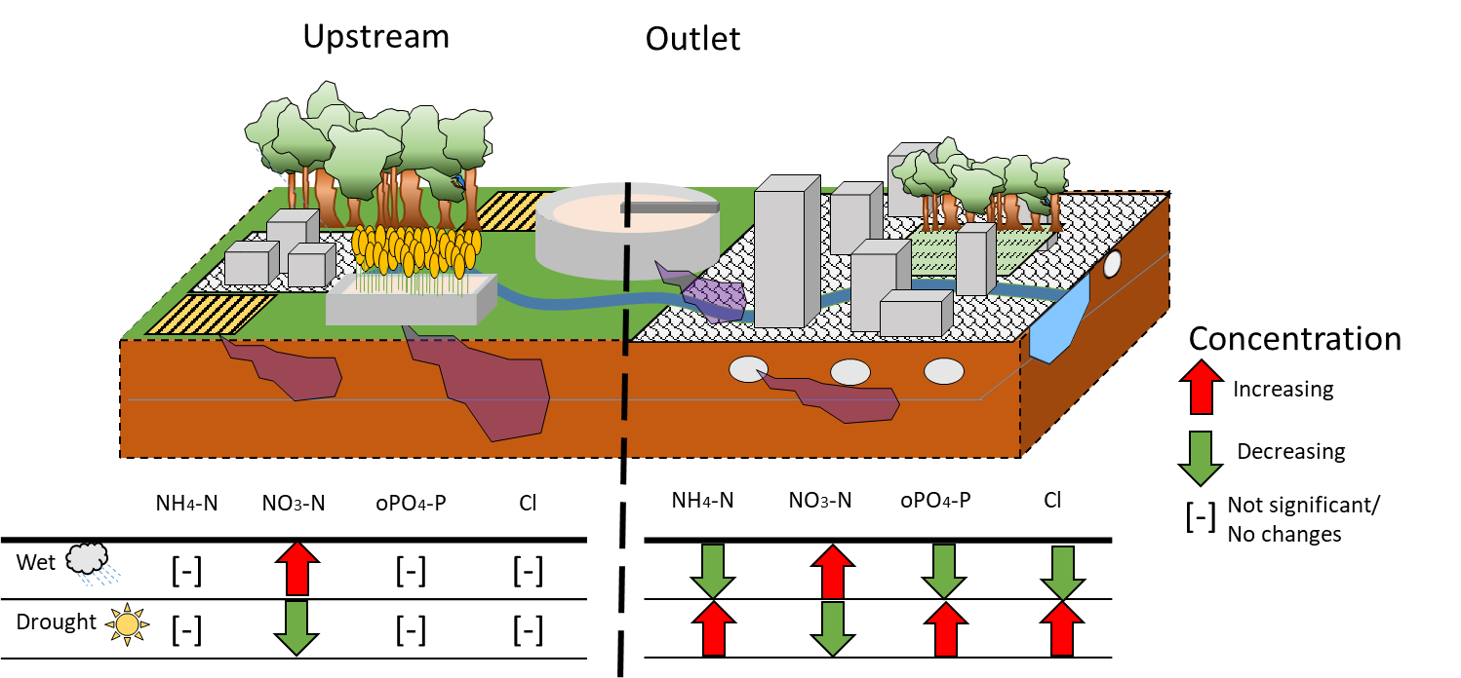
Motivation | Study site & development | Methods | Results | Discussion
Summary: Hydroclimate
Marx et al, 2023, STOTEN
NH4-N: Increase during drought conditions, lower during wet periods
NO3-N: Decrease during drought conditions, higher during wet periods
Potential source limitation (wet)
oPO4-P: Increase for dry and wet periods in upstream sites, higher during droughts (Outlet)
Chloride, no midterm influence
Snow rich winter have a significant, short-term effect
Influence of hydroclimate on water quality is significantly increasing with urbanization, independently of WWTP
Hydrologic connectivity is probably causing relation between hydroclimate and water quality changes

Slide 14
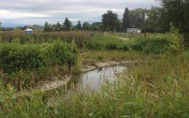
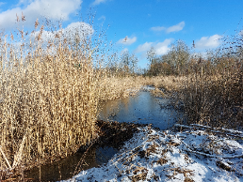
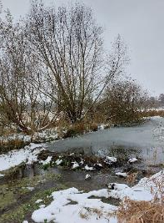
Motivation | Study site & development | Methods | Results | Discussion
Take home messages:
Water quantity & -quality:
Improving due to active water management
Urban water quality is depending on hydroclimate
Hydrologic connectivity as well as urban influence are relevant
Ecology is returning (bird-, beaver- & otter habitat)
Resilience is increased
No exceedance beyond good water quality classes in the upstream sites during hydroclimatic extremes
Flow in downstream sites is maintained by WWTP effluents during droughts
Beaver dam, former SIF
River restoration
Beaver dam, former SIF
Marx et al, 2023, STOTEN

Slide 15
Thank you very much!
Motivation | Study site & development | Methods | Results | Discussion
Original Publication
Marx C., Tetzlaff D., Hinkelmann R., Soulsby C. 2023. Effects of 66 years of water management and hydroclimatic change on the urban hydrology and water quality of the Panke catchment, Berlin, Germany, Science of The Total Environment, 900, 165764. https://doi.org/10.1016/j.scitotenv.2023.165764
Prof. Soulsby
Prof. Tetzlaff
Prof. Hinkelmann
_{Contact:}
_{Dr. Christian Marx}
_{c.marx@tu-berlin.de}
_{Gustav-Meyer-Allee 25}
_{13355 Berlin, Germany}
_{Building 13b,}
_{Room 517}
Funding:
+++ Call for Papers: Special Issue +++
Hydrological processes in urban systems
Other exciting upcoming talks from our group:
In: Hydrological Processes (HP)
https://onlinelibrary.wiley.com/page/journal/10991085/homepage/call-for-papers/si-2024-000191
Prof. Dr. Dörthe Tetzlaff
HS2.2.1/EGU24-4416 (Fri 15:25-15:35) Room B
Zhengtao Ying,
HS8.2/EGU24-602 (Wed, 17 Apr, 16:25-16:35) Room 2.44
Dr. Maria Magdalena Warter
HS10.8/EGU24-383 (Thur, 18 Apr, 14:25–14:35) Room 2.15
Famin Wang
PICO (Fri, 19 Apr, 08:53-08:55) PICO Spot A
Hanwu Zheng
GM6.3/SSP3.8/EGU24-140 (Fri, 19 Apr, 16:20–16:30) Room 2.91
Hyekyeng Jung
HS3.4/EGU24-811 (Fri, 19 Apr, 17:38–17:48) Room 2.31

