Slide 1
Kinetic Monte Carlo algorithm
University of Bremen
Department 05 GEO
Start
Reading input stricture file
Making a list of neighbor configurations presented in the system
Calculating reaction rated and probabilities
Choosing one reaction
Removing an atom by calling subroutine
Reading neighbors configuration file
Starting iterative loop
itr = 1, num_itr
Making running sum
Calling random number
Updating local neighbors and configurations list
Generating supercell and initializing the surface
No
Itr = num_itr ?
Generating output
Calculating all possible neighbors configurations
Yes
Finish!

Slide 2
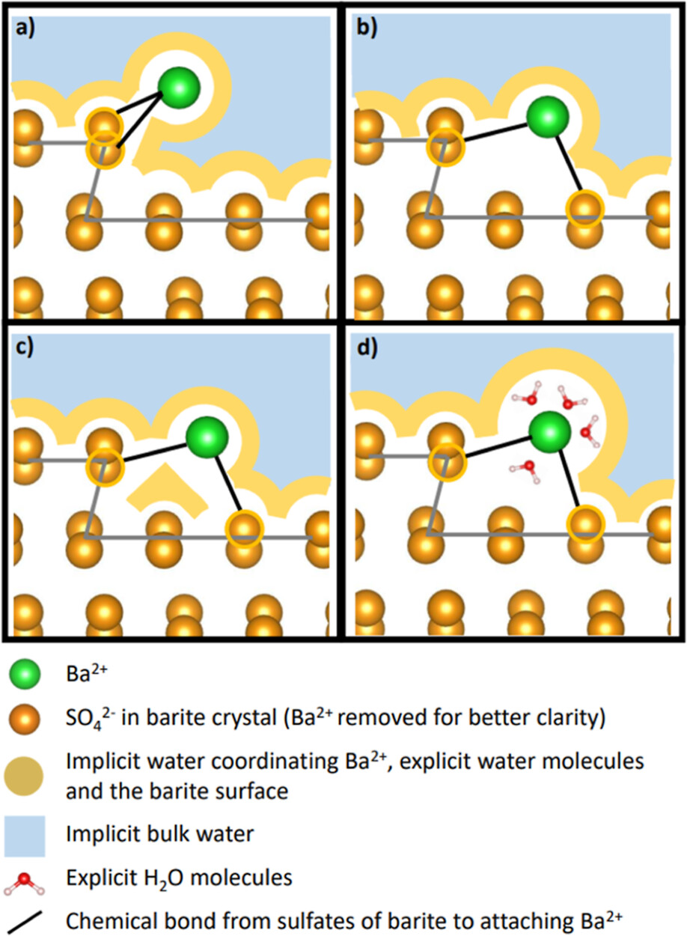
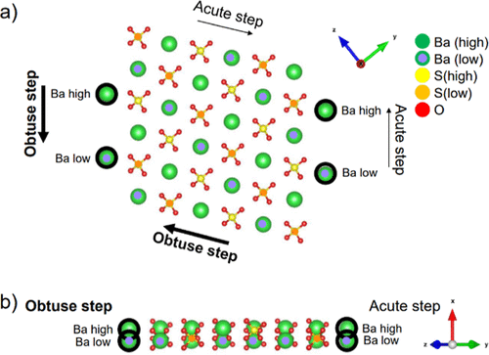
Parameterization by DFT
University of Bremen
Department 05 GEO
Rudin, S., Kowalski, P. M., Klinkenberg, M., Bornhake, T., Bosbach, D., & Brandt, F. (2023). Simulation of Crystal Growth by an Innovative Hybrid Density Functional Theory Continuum Solvation Approach: Kink Site Formation on Barite (001). Crystal Growth & Design, 24(1), 159-170.

