Slide 1
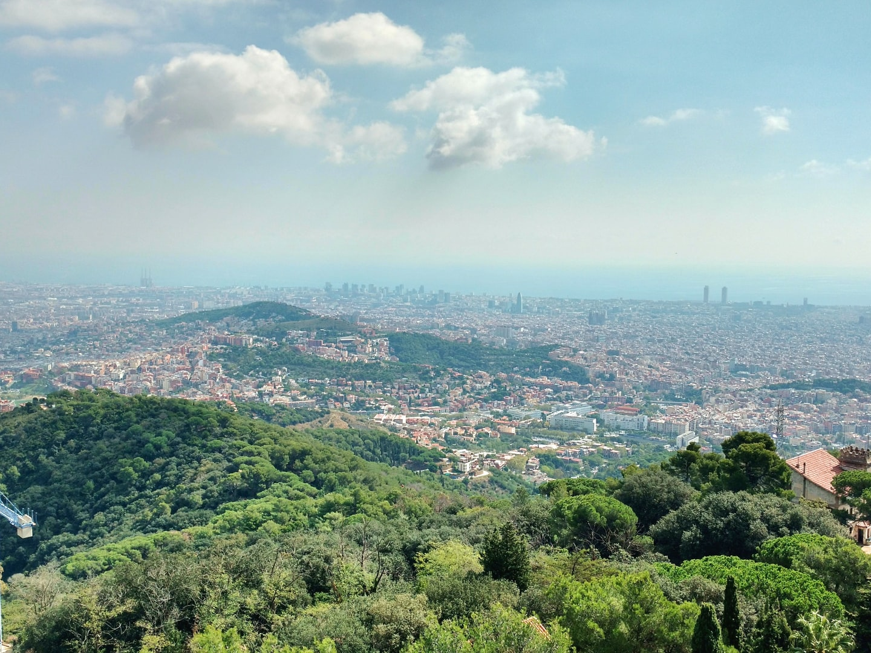
The food-water-climate nexus of green infrastructure: Examining ecosystem services trade-offs of peri-urban agriculture
Ricard Segura-Barrero, Johannes Langemeyer, Alba Badia, Sergi Ventura, Jaime Vila-Traver, and Gara Villalba

Slide 2
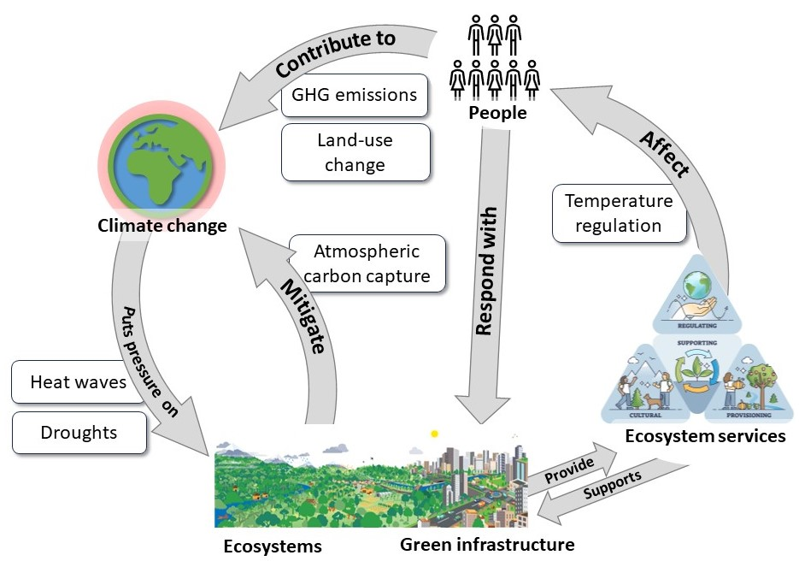
Introduction
1/10
Urban areas are challenged with providing access to water and food provision, greenhouse gases emission reductions and heat mitigation in the context of global climate change adaptation and mitigation.
Nature-based solutions as green infrastructure emerge as a multifunctional tool for the provision of ecosystem services, while also requiring resources as water.
Food provision
Irrigation
Water
Understanding these trade-offs between benefits and costs of ecosystem services is found necessary to design more sustainable and resilient strategies.

Slide 3
Introduction
2/10
Peri-urban agriculture aims to provide locally grown crops, while promoting circular economies, and reduced environmental impacts within the food supply chain.
Irrigated agriculture can contribute to temperature reductions in dry regions, although presenting an impact on the water balance. It also disrupts the atmospheric carbon balance if it is at expense of natural forests.
Food provision
Irrigation water use
Temperature regulation
Synergies and
trade-offs
Aim: Explore the impacts of land-use changes resulting from expanding peri-urban agriculture analysing the trade-offs in the food-water-climate nexus.
Atmospheric carbon capture and retention

Slide 4
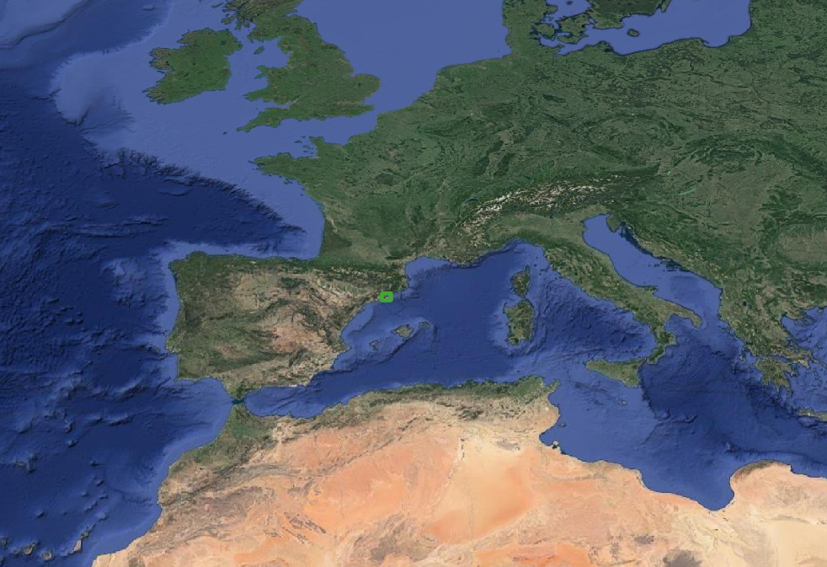
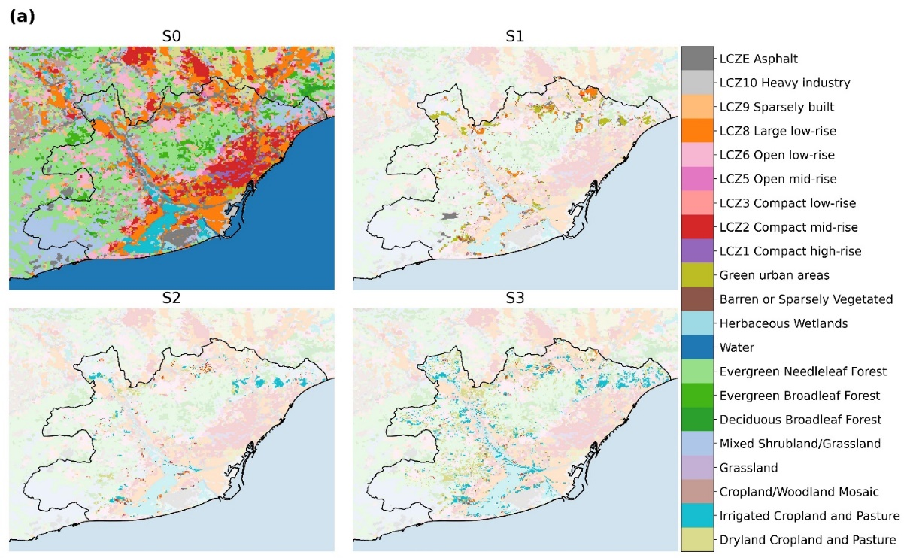
Case study: the AMB
3/10
The Metropolitan Area of Barcelona (AMB)
Current scenario
(2015)
Trending scenario
Agriculture alternative
Agriculture potential

Slide 5
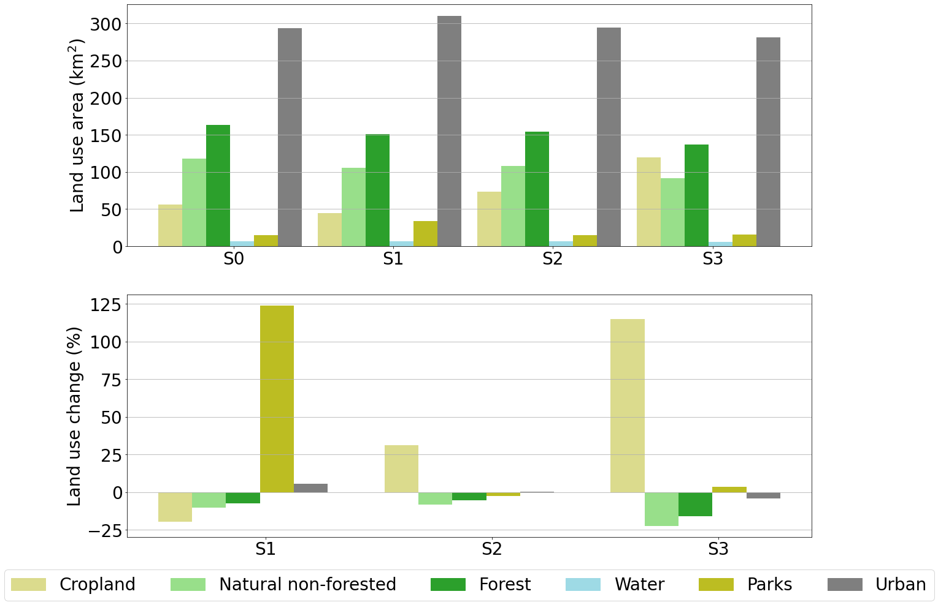
Case study: the AMB
3/10
The Metropolitan Area of Barcelona (AMB)
Current scenario
(2015)
Trending scenario
Agriculture alternative
Agriculture potential

Slide 6
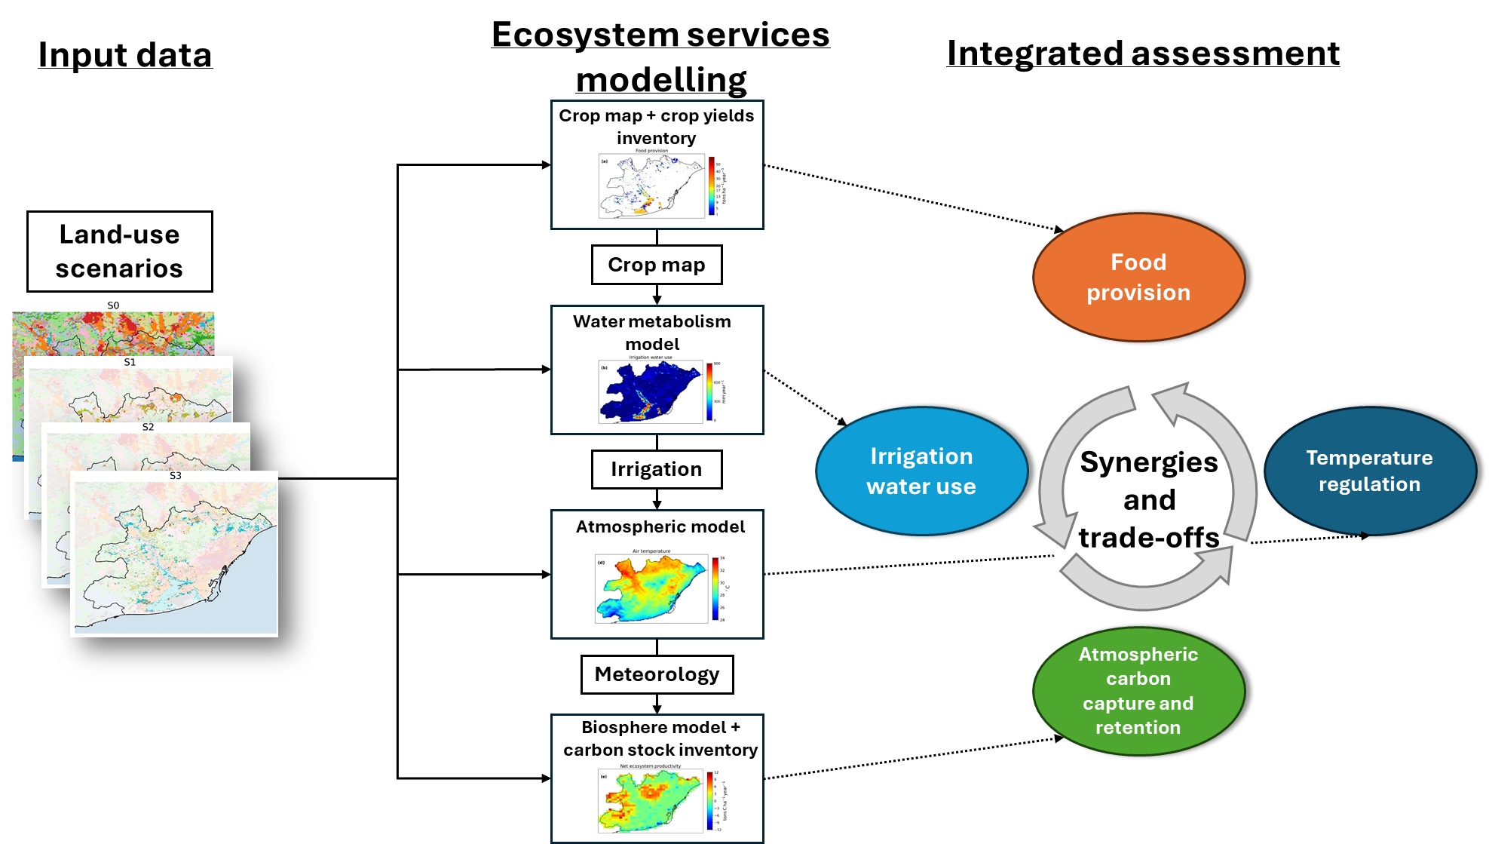
Methodological approach
4/10

Slide 7
Methodological approach
4/10
Weather Research and Forecasting (WRF) with the Building Effect Parameterization and Building Energy Model (BEP-BEM)
Vegetation Photosynthesis and Respiration Model (VPRM)

Slide 8
Temperature regulation
5/10
WRF BEP-BEM simulations at 333 m resolution between 25 June and 25 July 2015.

Slide 9
Temperature regulation
6/10
Trending - Current
Alternative - Current
Potential - Current
-4.0 mm/day
+2.5 mm/day
+0.9 °C
-0.7 °C

Slide 10
Biogenic carbon balance
7/10
Trending - Current
Alternative - Current
Potential - Current
-4.6 tons C ha⁻¹ year⁻¹
-7.0 tons C ha⁻¹ year⁻¹
-152 tons C ha⁻¹

Slide 11
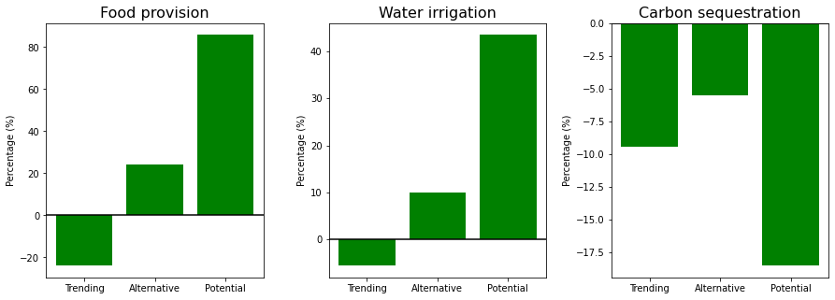
Other trade-offs
8/10
85.8
43.5
-5.5
-9.4
24.0
10.0
-24.0
-5.6
-18.5
The potential scenario increase the provision of fresh fruits with respect to the AMB demand from 2.7 % to 6.7%, and the provision of vegetables from 11.6 % to 19.3 %.
Green infrastructure in the AMB would reduce the offset anthropogenic CO2 emissions from 4.66 % of the total emissions in the current scenario to a 3.80 % in the potential.

Slide 12
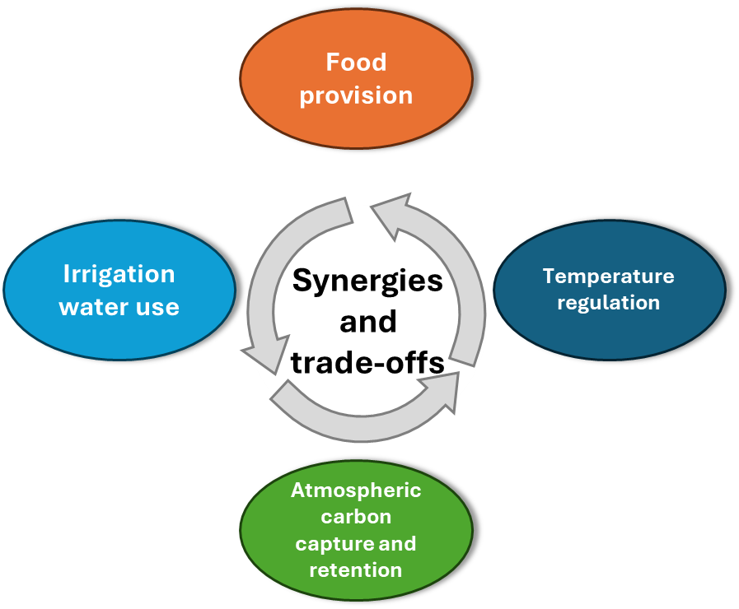
Conclusions
9/10
Peri-urban agriculture can contribute to local temperature regulation in dry regions during summer months especially when irrigated, although its expansion in the AMB presents low cooling on densest urban regions and arise trade-offs with increasing water demand.
Peri-urban agriculture can be a potential source of local food provision. However, trade-offs with water consumption and carbon sequestration must be considered, especially in the AMB.
This holistic methodological approach appears to be a promising framework for informing land-use decision-making in the context of urban climate adaptation and mitigation. It could be similarly applied for the assessment of peri-urban agriculture or alternative nature-based solutions strategies in other Mediterranean climate cities.

Slide 13
THANK YOU!
Contact: ricard.segura@uab.cat
Follow the news about the H2020 ERC URBAG project in urbag.eu

