Slide 1
Glyoxal Yields from Selected Hydrocarbons Oxidations (Supplementary Information)
Danny McConnell, Lola McAuley, William Warman, Moira Hutchinson, Graham Boustead, Daniel Stone, Dwayne Heard, Paul Seakins
cm17dlm@leeds.ac.uk school of Chemistry, University of Leeds, Leeds, LS2 9JT, UK

Slide 2
Acetaldehyde + OH reaction in the HIRAC chamber
Part of the acetaldehyde oxidation mechanism. The colour coding matches the graph to show how each species is detected. Species coloured brown have been detected before in HIRAC but were not being measured for this experiment.

Slide 3
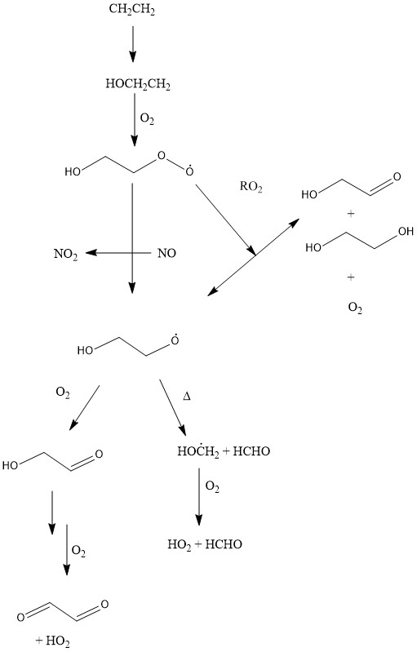
Ethene + OH reaction in the HIRAC chamber
Part of the mechanism for glyoxal formation from ethene oxidation. It shows how glyoxal can be formed through multiple channels including peroxy radical reactions with NO, HO₂ and RO₂.

Slide 4
Estimating the glyoxal yield from ethene oxidation under high No_{x}.
Previous chamber studies have focused on the branching ratio of ethyl alkoxy radicals (RO) in high NO_{x} conditions into glycolaldehyde and formaldehyde.
Other studies have looked at glyoxal yields from glycolaldehyde oxidation. Therefore, an estimated glyoxal yield can be calculated.
No such ethene studies have been conducted in low NO_{x} conditions.
High NO_{x} and low NO_{x} refers to whether the RO₂ + NO reactions will dominate over other RO₂ + RO₂ or RO₂ + HO₂.

Slide 5
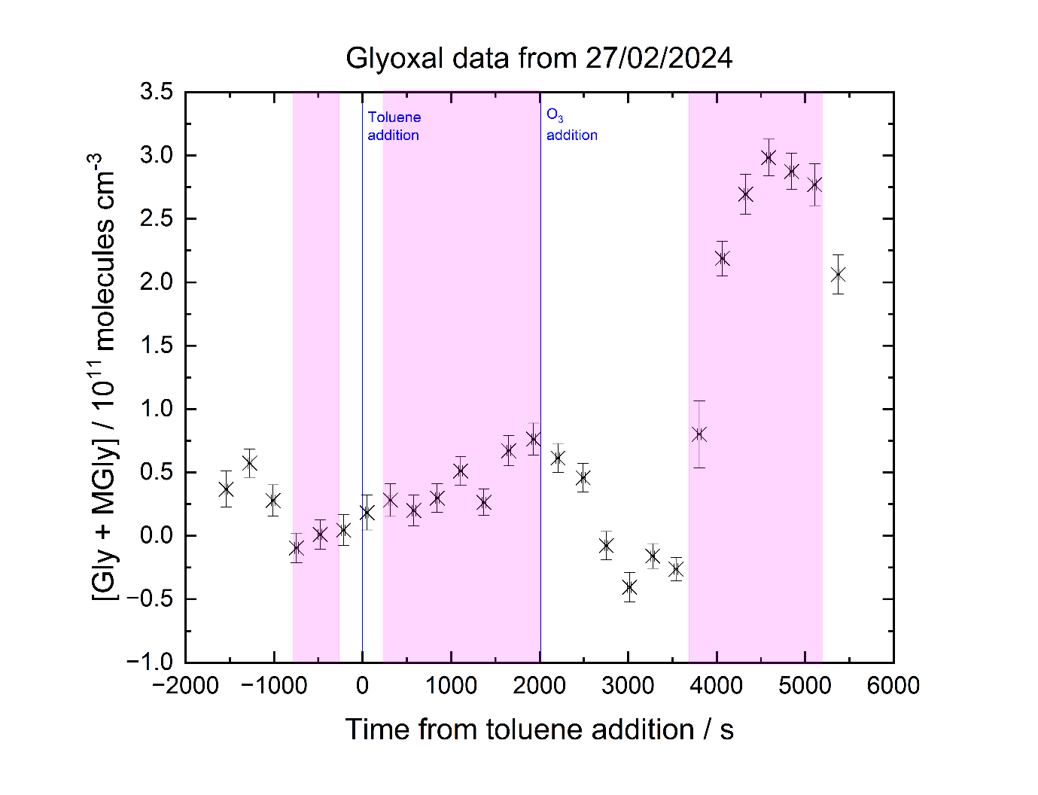
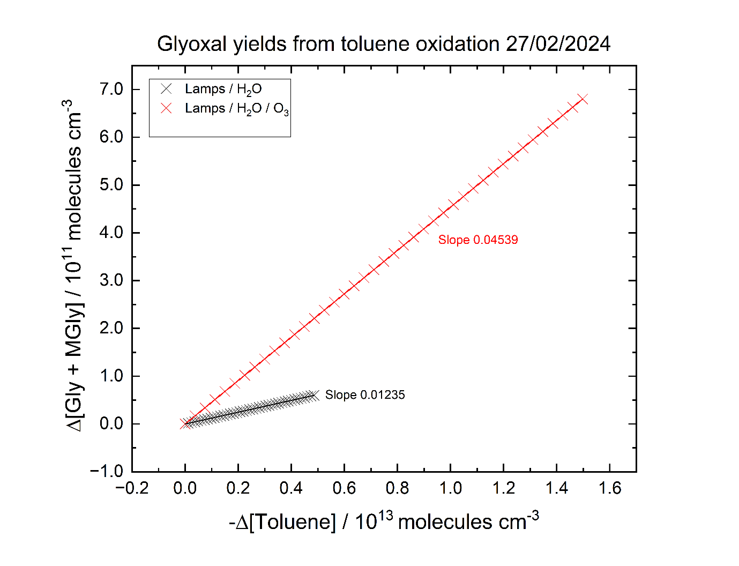
Glyoxal formation from toluene oxidation
In this experiment N₂, O₂ and water were present throughout the experiment with O₃ and toluene added at their respective blue lines (left graph).
The presence of 150 ppb O₃ has a large effect on the glyoxal production when 154 nm λ lamps are switched on (purple shading).
Comparing the glyoxal production to the toluene decay before and after the O₃ addition shows a bigger glyoxal yield in the presence of toluene.
This shows the presence of O₃ does not merely increase the rate of reaction but actually reacts with an oxidation product to form glyoxal.

