Slide 1




Trends in snow persistence at the Central Pyrenees derived from 40 years of Landsat satellite images
Martí Navarro Planes¹, Cristina Cea López², Xavier Pons², Lluís Pesquer Mayos¹, and Lluís Gómez Gener¹
¹Centre for Ecological Research and Forestry Applications (CREAF), Bellaterra, Spain. ²Dep Geografia, Universitat Autònoma de Barcelona, Bellaterra, Spain
Context
Methods
Results
Snow presence or absence
Intermittently snow-covered zones
Database construction
Snow persistence
Snow persistence and data analysis
Snow cover long-term trend and seasonality
Spatial distribution of SP
5-year SP trend
Changes in SP between 1984-93 and 2014-23
Study site
Limitations
Aigüestortes I Estany de sant Maurici National Park
Snow detection in shadow areas
Differences in Surface Reflectance Processing Algorithms
Current approaches
Other snow products
Radiometric correction
Snow detection with KNN image classification
EGU24-11542
Notes:
Section title. Choose this template if you need to use a panoramic picture. We recommend very short and clear titles.

Slide 2
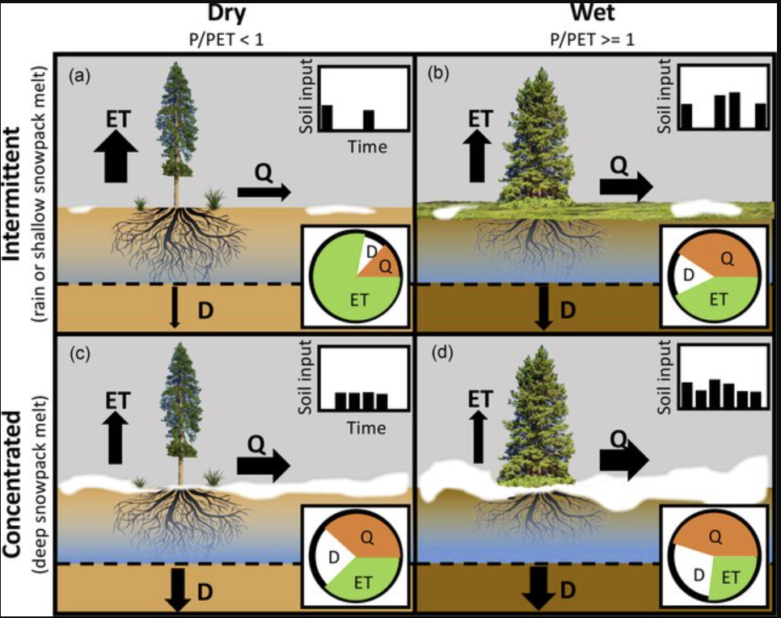
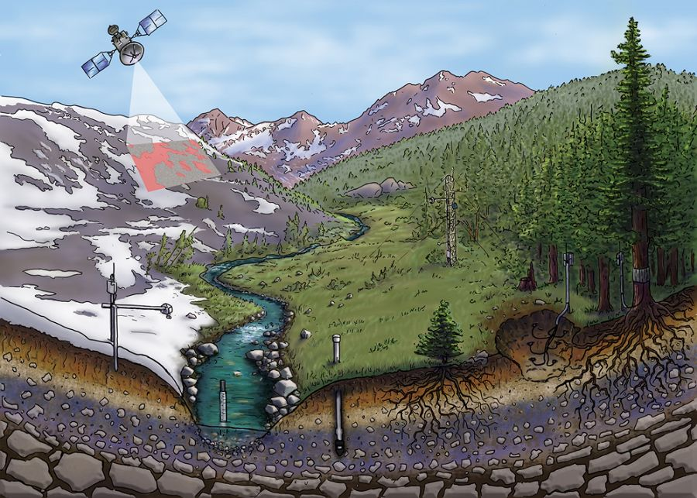
Snow presence or absence: Key for catchment hydrological functioning
The presence or absence of snow on a landscape control the land surface energy budget, which in turn affects hydrologic response and ecosystem function.
Seasonally intermittent
Seasonally persistent
Hammond et al., 2018. PhD Dissertation
EGU24-11542

Slide 3
Snow presence or absence: implications for hydrological regimes
Snow-covered
Snowmelt
Open season
Short term thawing episodes before the snowmelt onset
C
Earlier snowmelt peaks in spring
C. Lower discharge during the spring snowmelt
Morán-Tejada et al., 2017
EGU24-11542

Slide 4
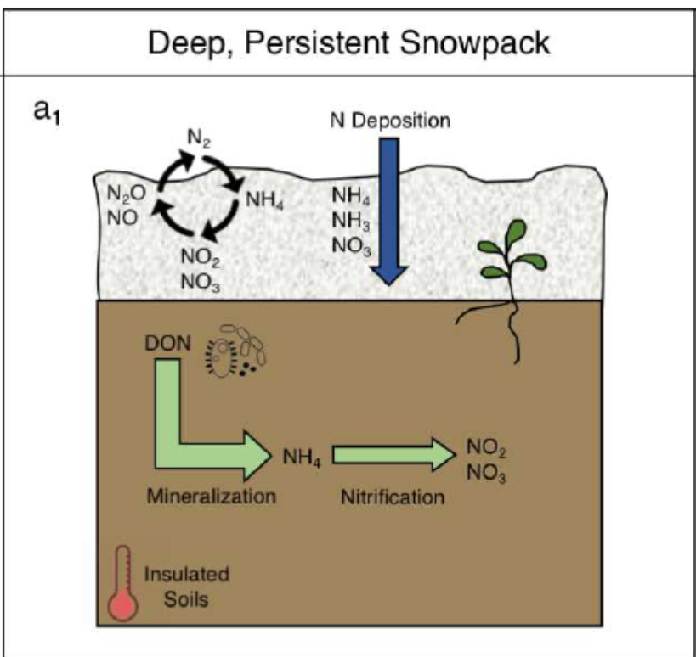


Snow presence or absence: implications for downstream water quality
Snow-covered
Snowmelt
Open season
Influence the core of biogeochemical functioning/cycles of mountain watersheds
Conceptual model nitrogen cycling within soils in regions with persistent (a1) and intermittent (b1) snowpacks.
EGU24-11542

Slide 5
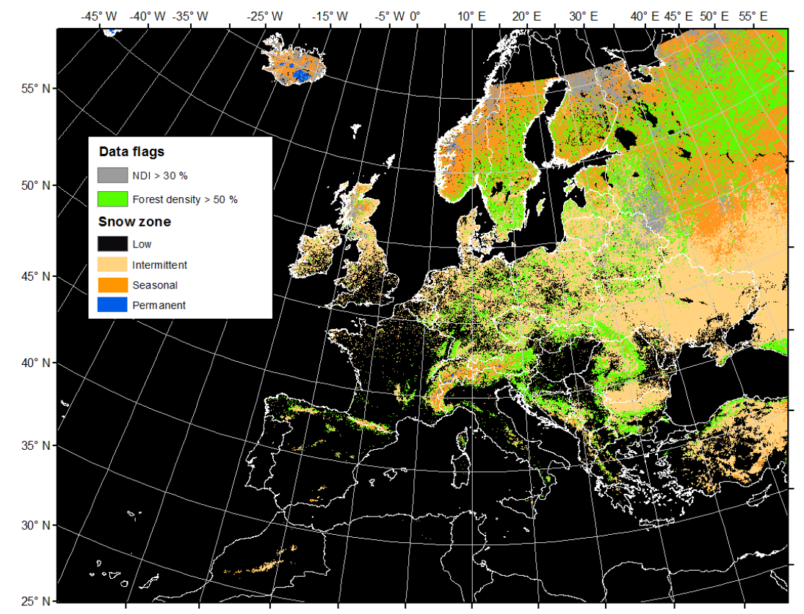
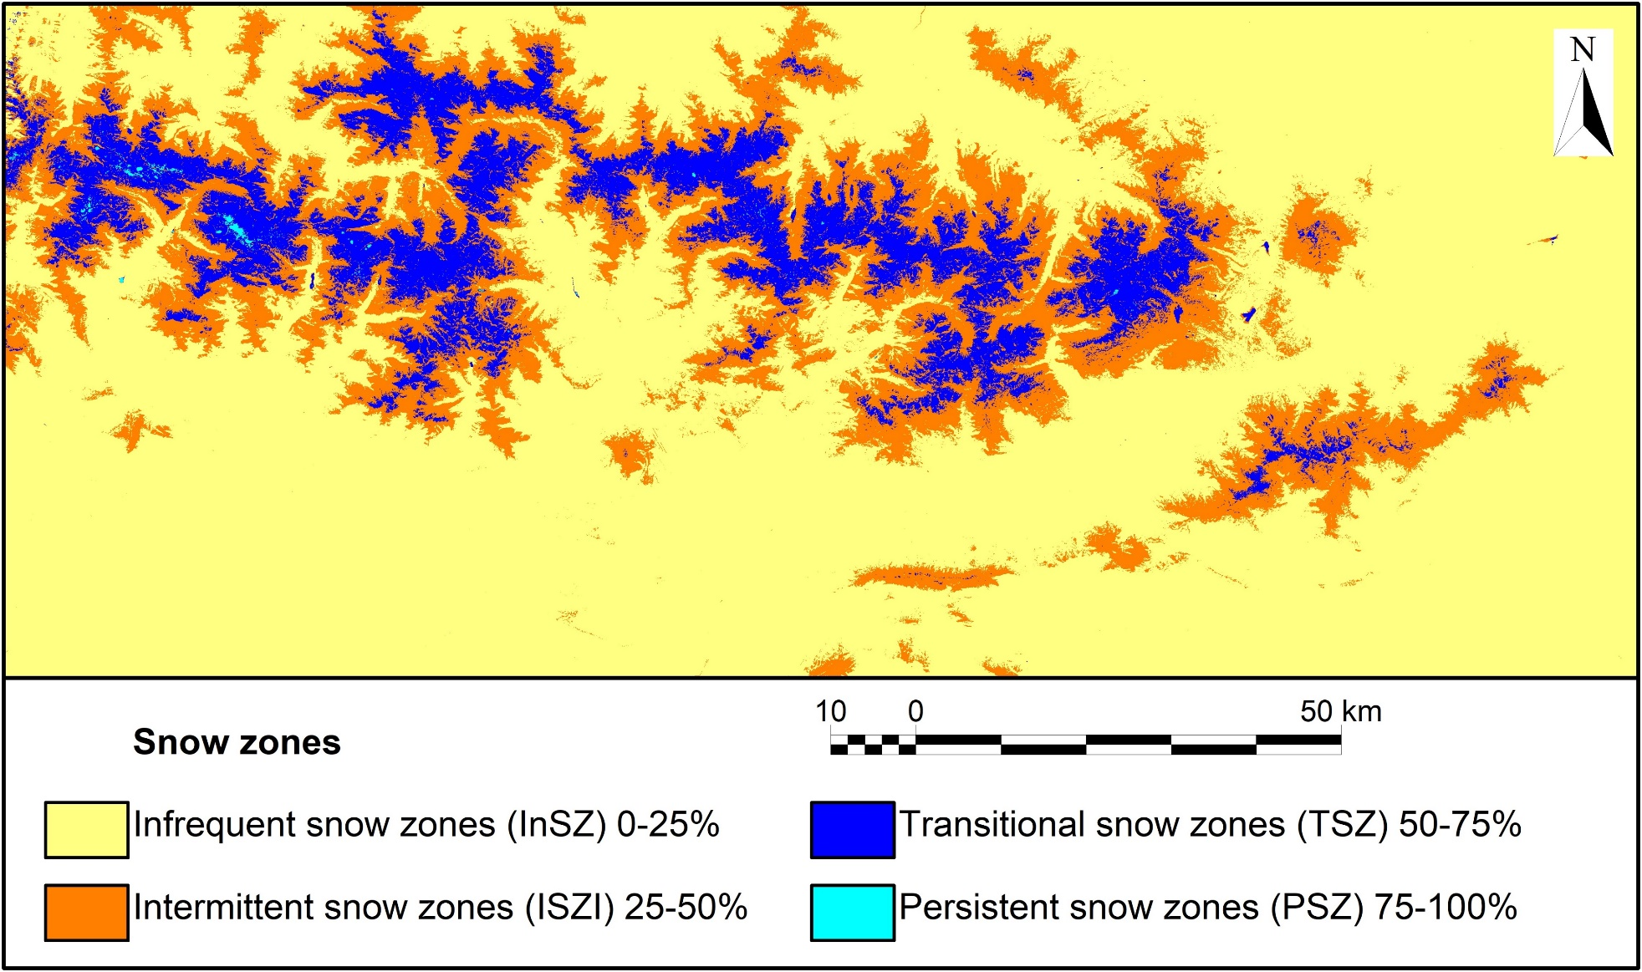
Intermittently snow-covered zones are very common
Hydrological research often focuses on seasonally snow-covered zones. However, in many basins worldwide the majority of the land surface area is intermittently snow-covered.
Little or no snow zones (NSZ): 0-25%
Intermittent snow zones (ISZ): 25-50%
Seasonal snow zones (NSZ): 0-25%
Persistent snow zones (ISZ): 25-50%
Hammond et al., 2018. PhD Dissertation
Snow zones persistence in middle Pyrenees
EGU24-11542

Slide 6
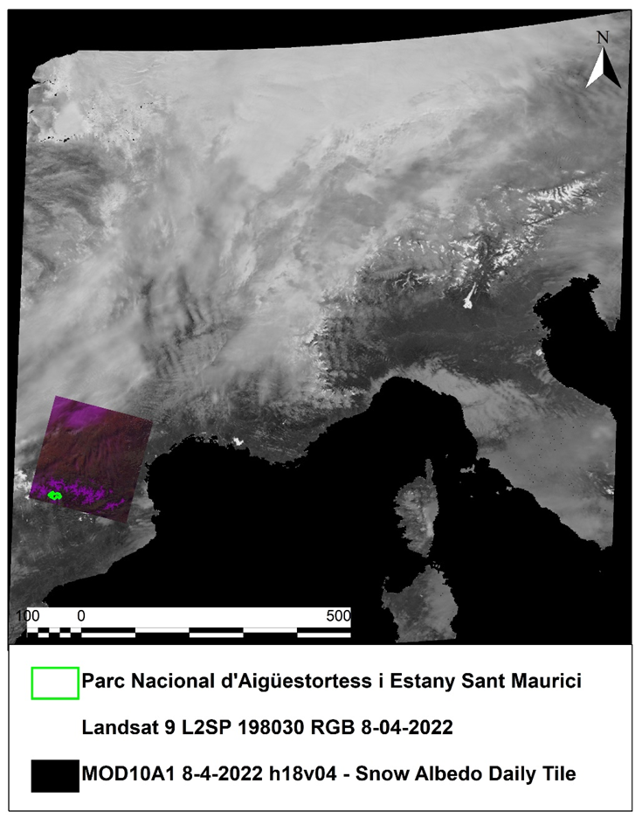
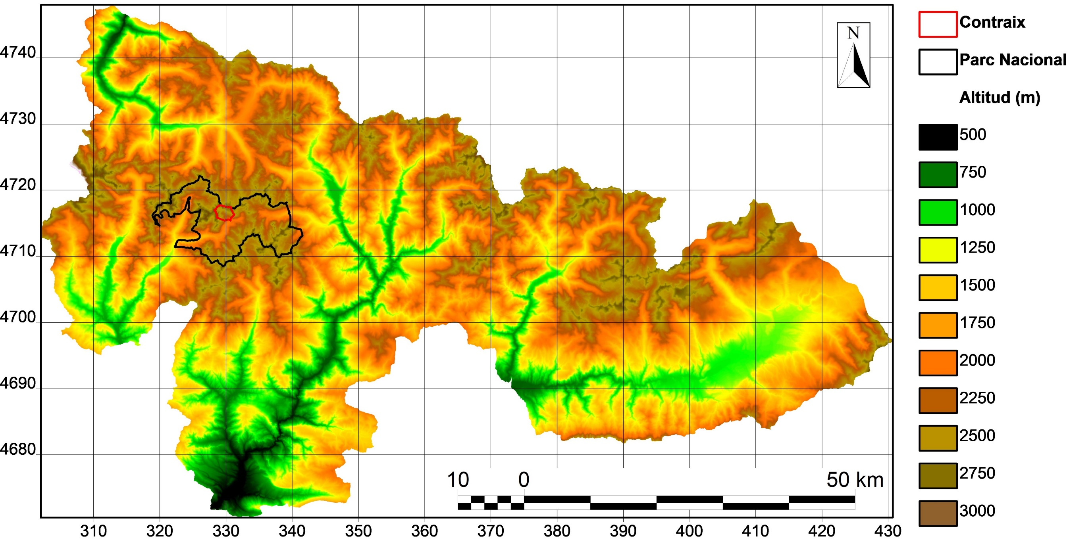
Study area
Aigüestortes i Estany de Sant Maurici National Park. 13900 ha, minimum 1300 m, maximum 3013 m
Contraix hydrographic basin. 476 ha, minimum 498 m, maximum 2958 m. Sub-basin scale inside the National Park, for monitoring water flow and chemical regime with sensors along the watershed.
Contraix basin
National Park
Altitude (m)
EGU24-11542

Slide 7
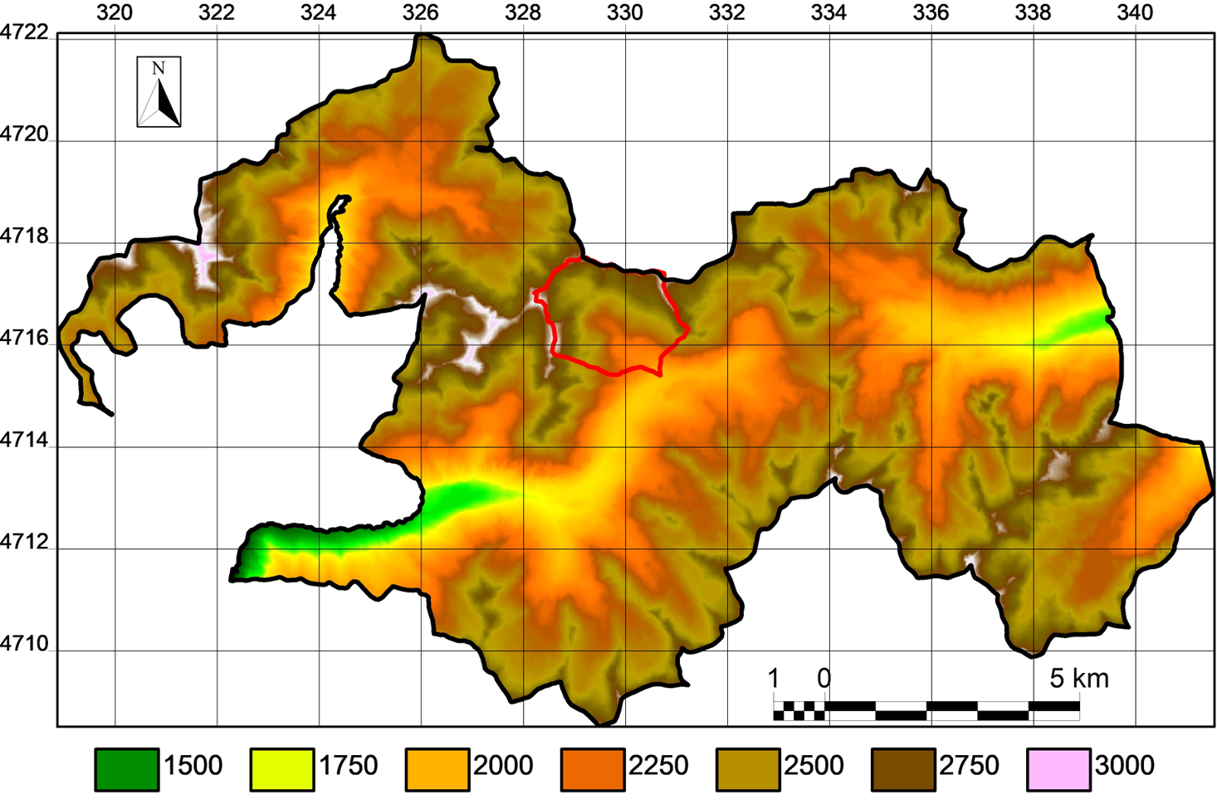

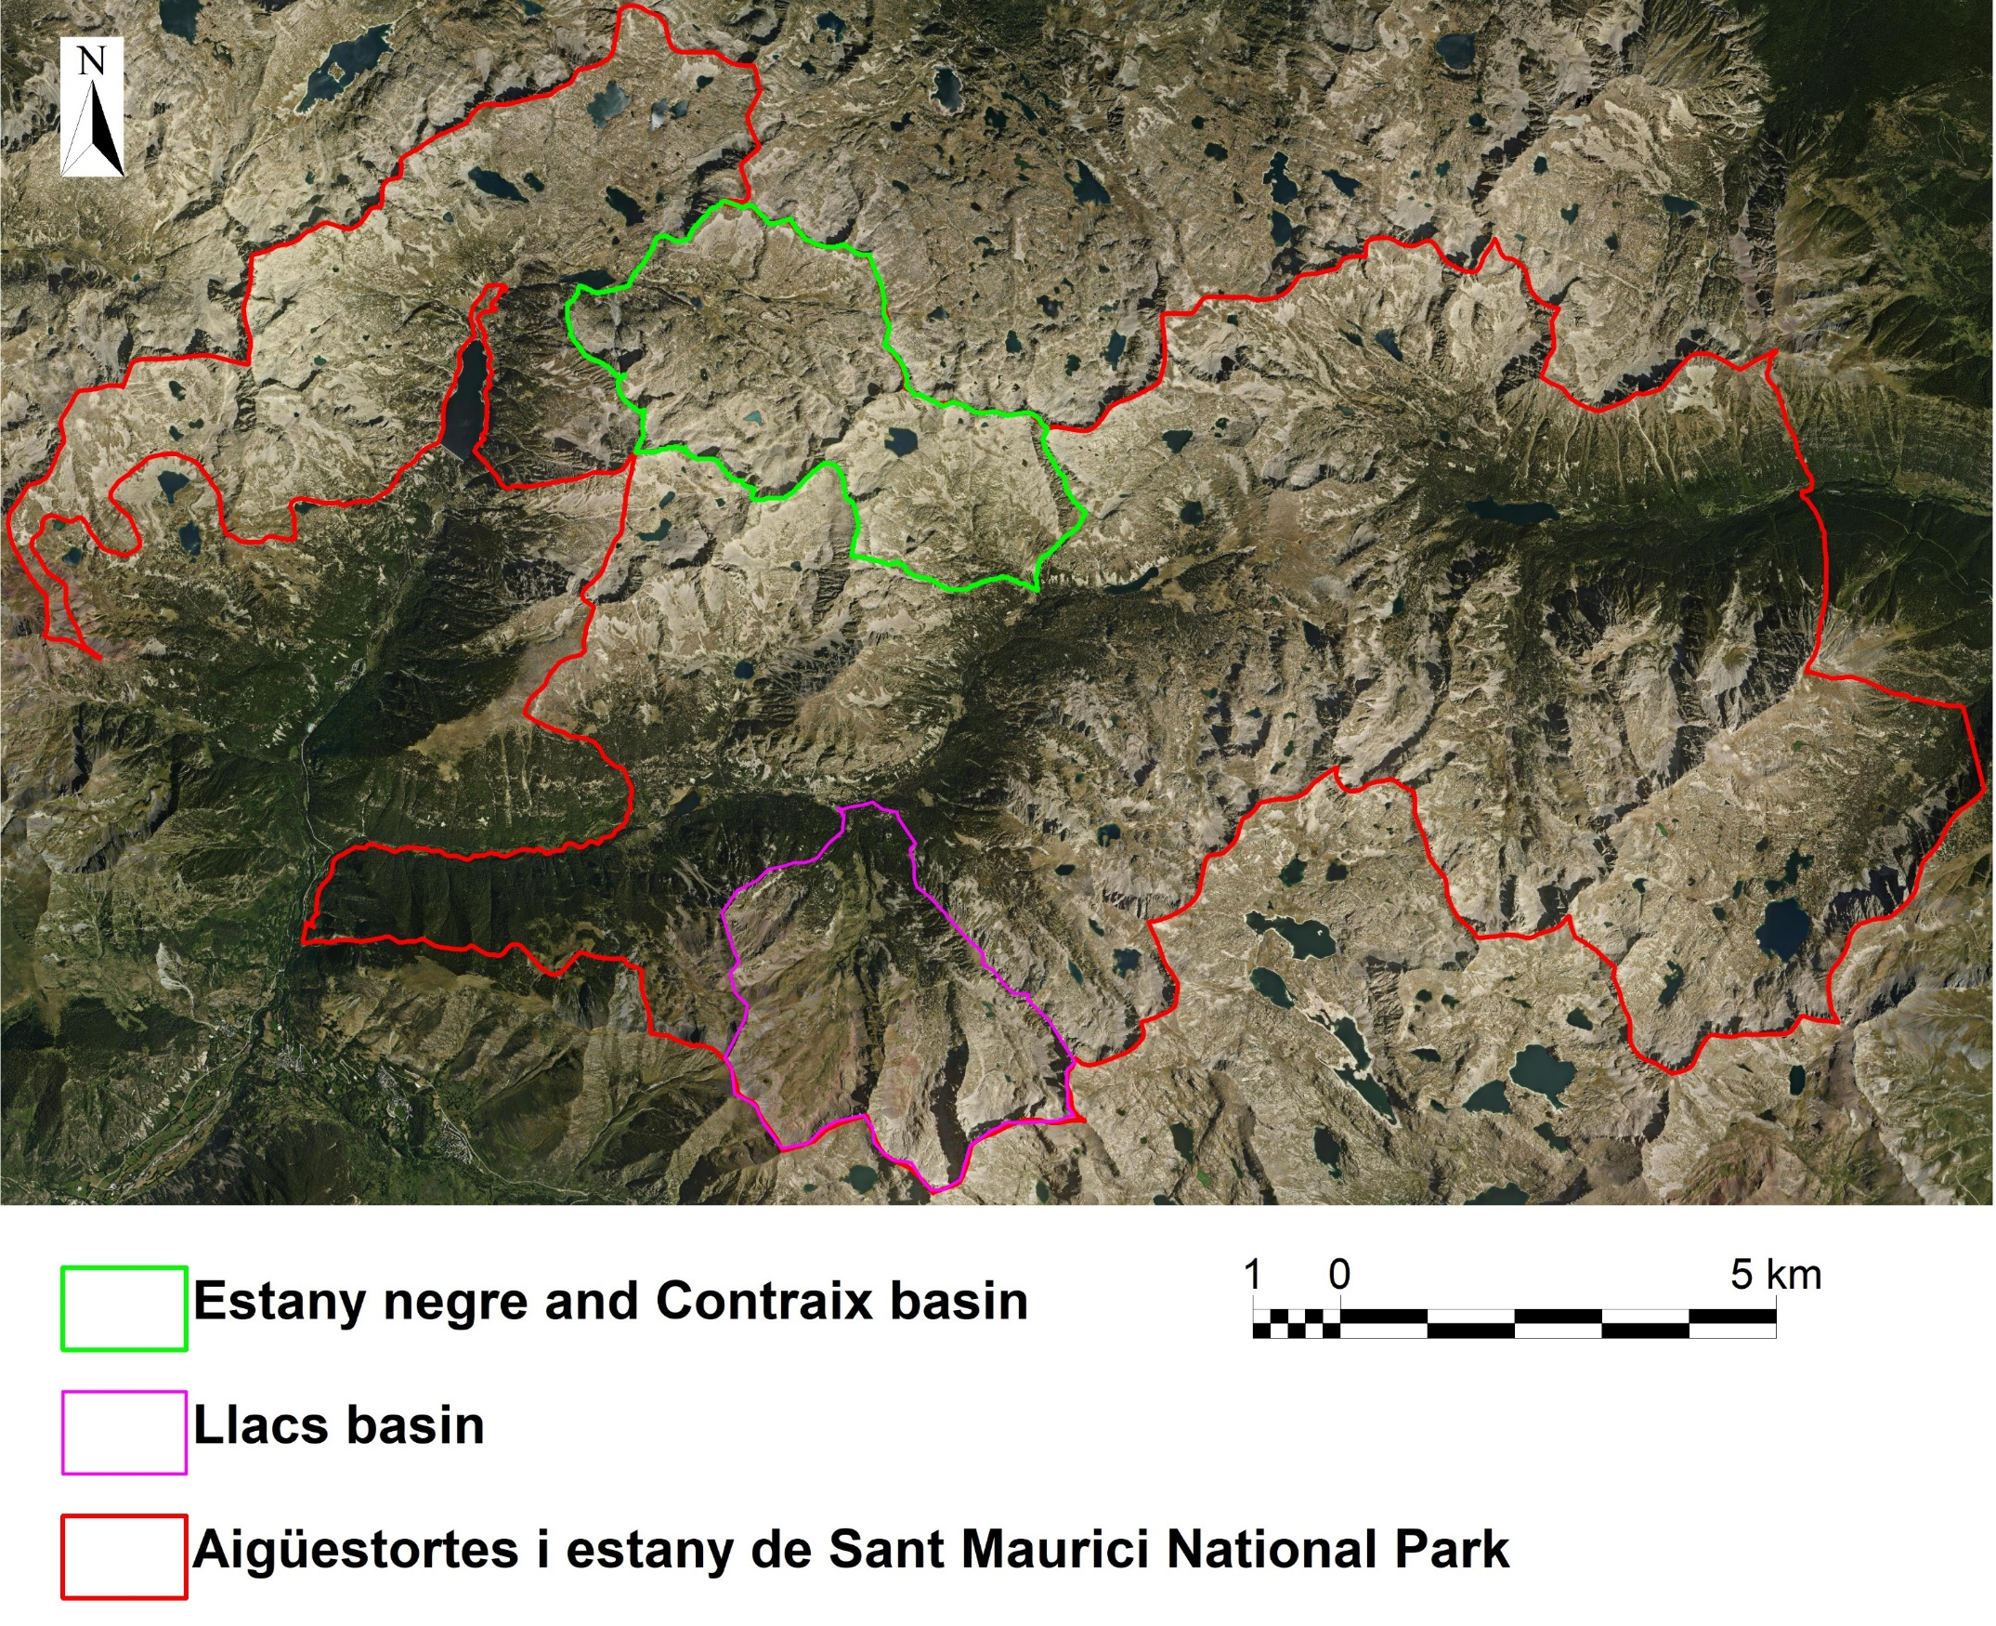
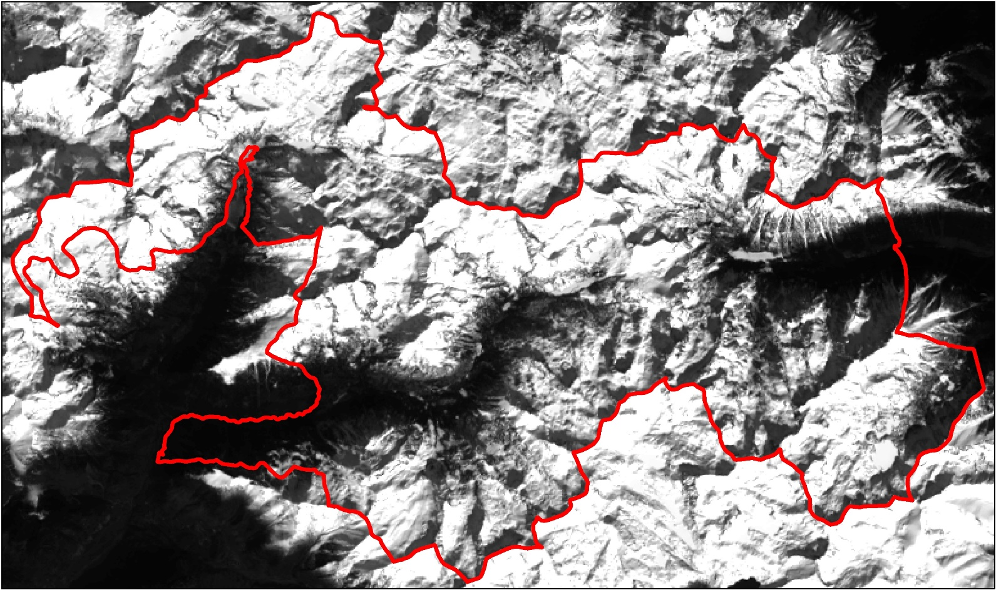
Study area: National Park
Aigüestortes i Estany de Sant Maurici National Park
Contraix basin
EGU24-11542

Slide 8
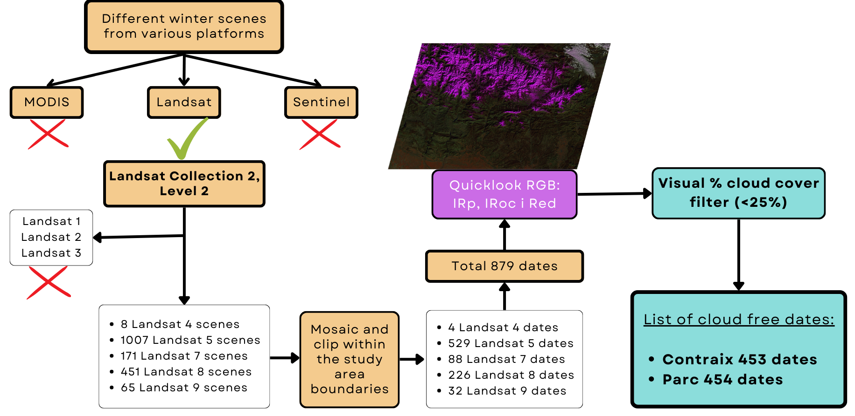
Methodology: Database construction
Number of good dates every 5 years:
EGU24-11542

Slide 9
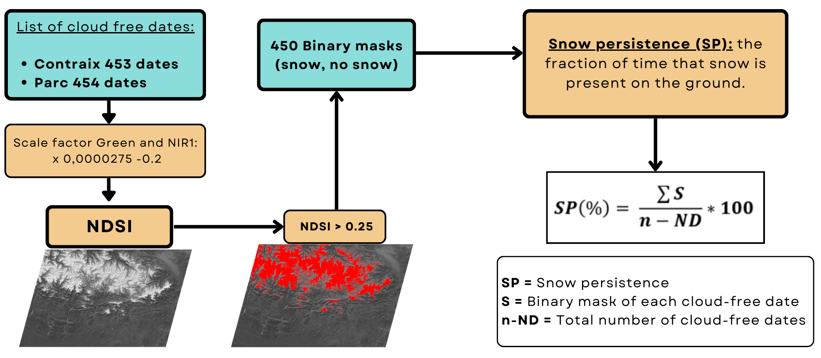
Methodology: Snow persistence
EGU24-11542

Slide 10
Methodology: Snow persistence and data analysis
Snow persistence (SP)
Snow cover long-term trend and seasonality
Spatial distribution of snow persistence:
Persistent snow zones (PSZ): 75% < SP < 100%
Seasonal snow zones (SSZ): 50% < SP < 75%
Intermittent snow zones (ISZ): 25% < SP < 50%
Little or no snow zones (NSZ): 0% < SP < 25%
Temporal variation of snow persistence by zones
Patterns of orientation and altitude in snow persistence changes
Moore et al., 2014. Snow zone map showing average SP from 1 January to 3 July for 2000–2010 derived from MODIS SCA data
EGU24-11542

Slide 11
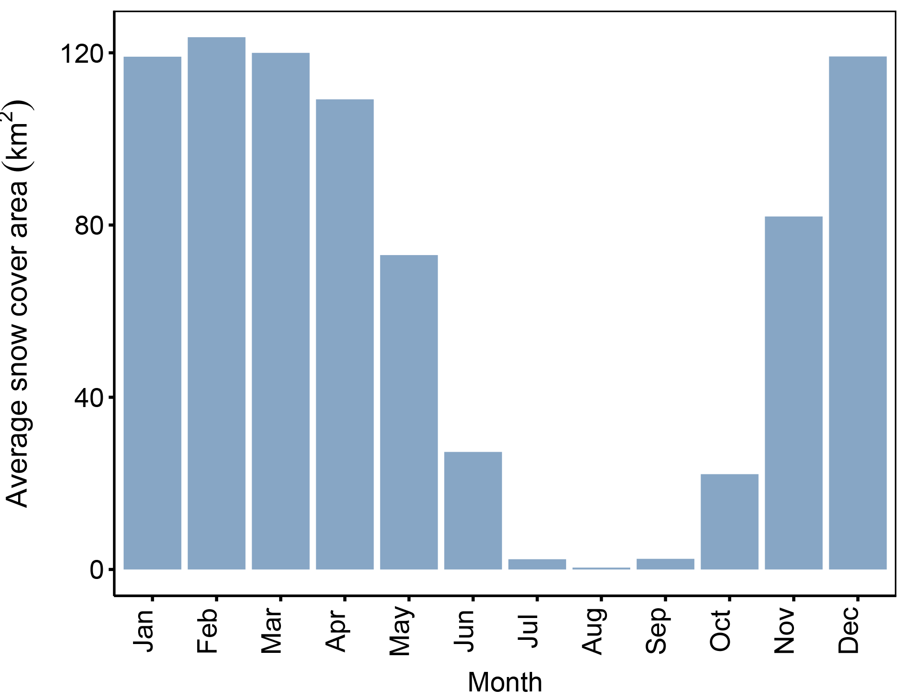
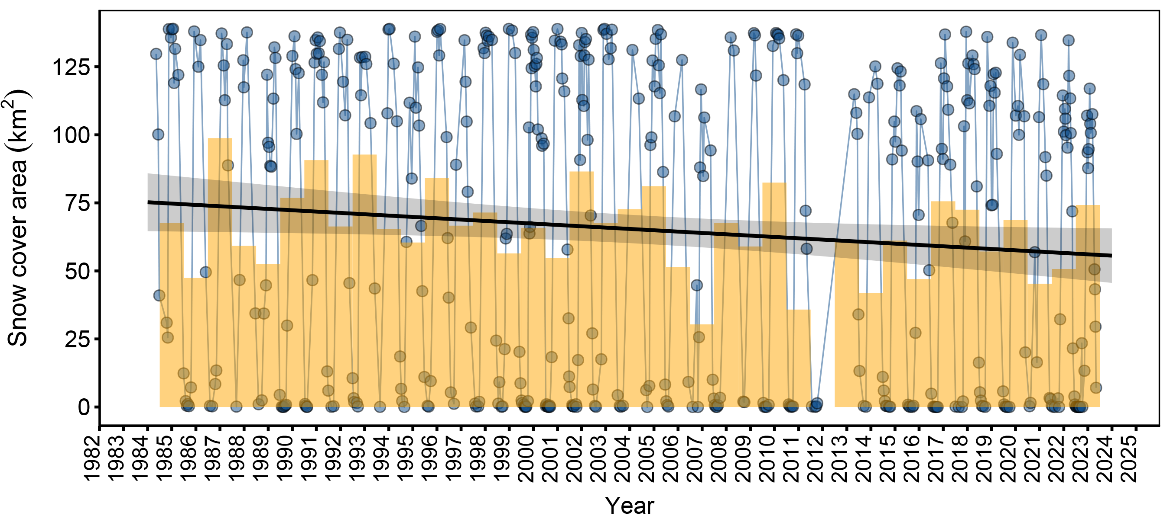
Results: Snow cover long-term trend and seasonality
B
Primary results of snow cover in Aigüestortes i Estany de Sant Maurici National Park. The total observed surface area in km² and the average per year (A), the sum of surface areas per month (B).
A
Full snow covered area in the national park for the winter months, January, February, March and December.
EGU24-11542

Slide 12
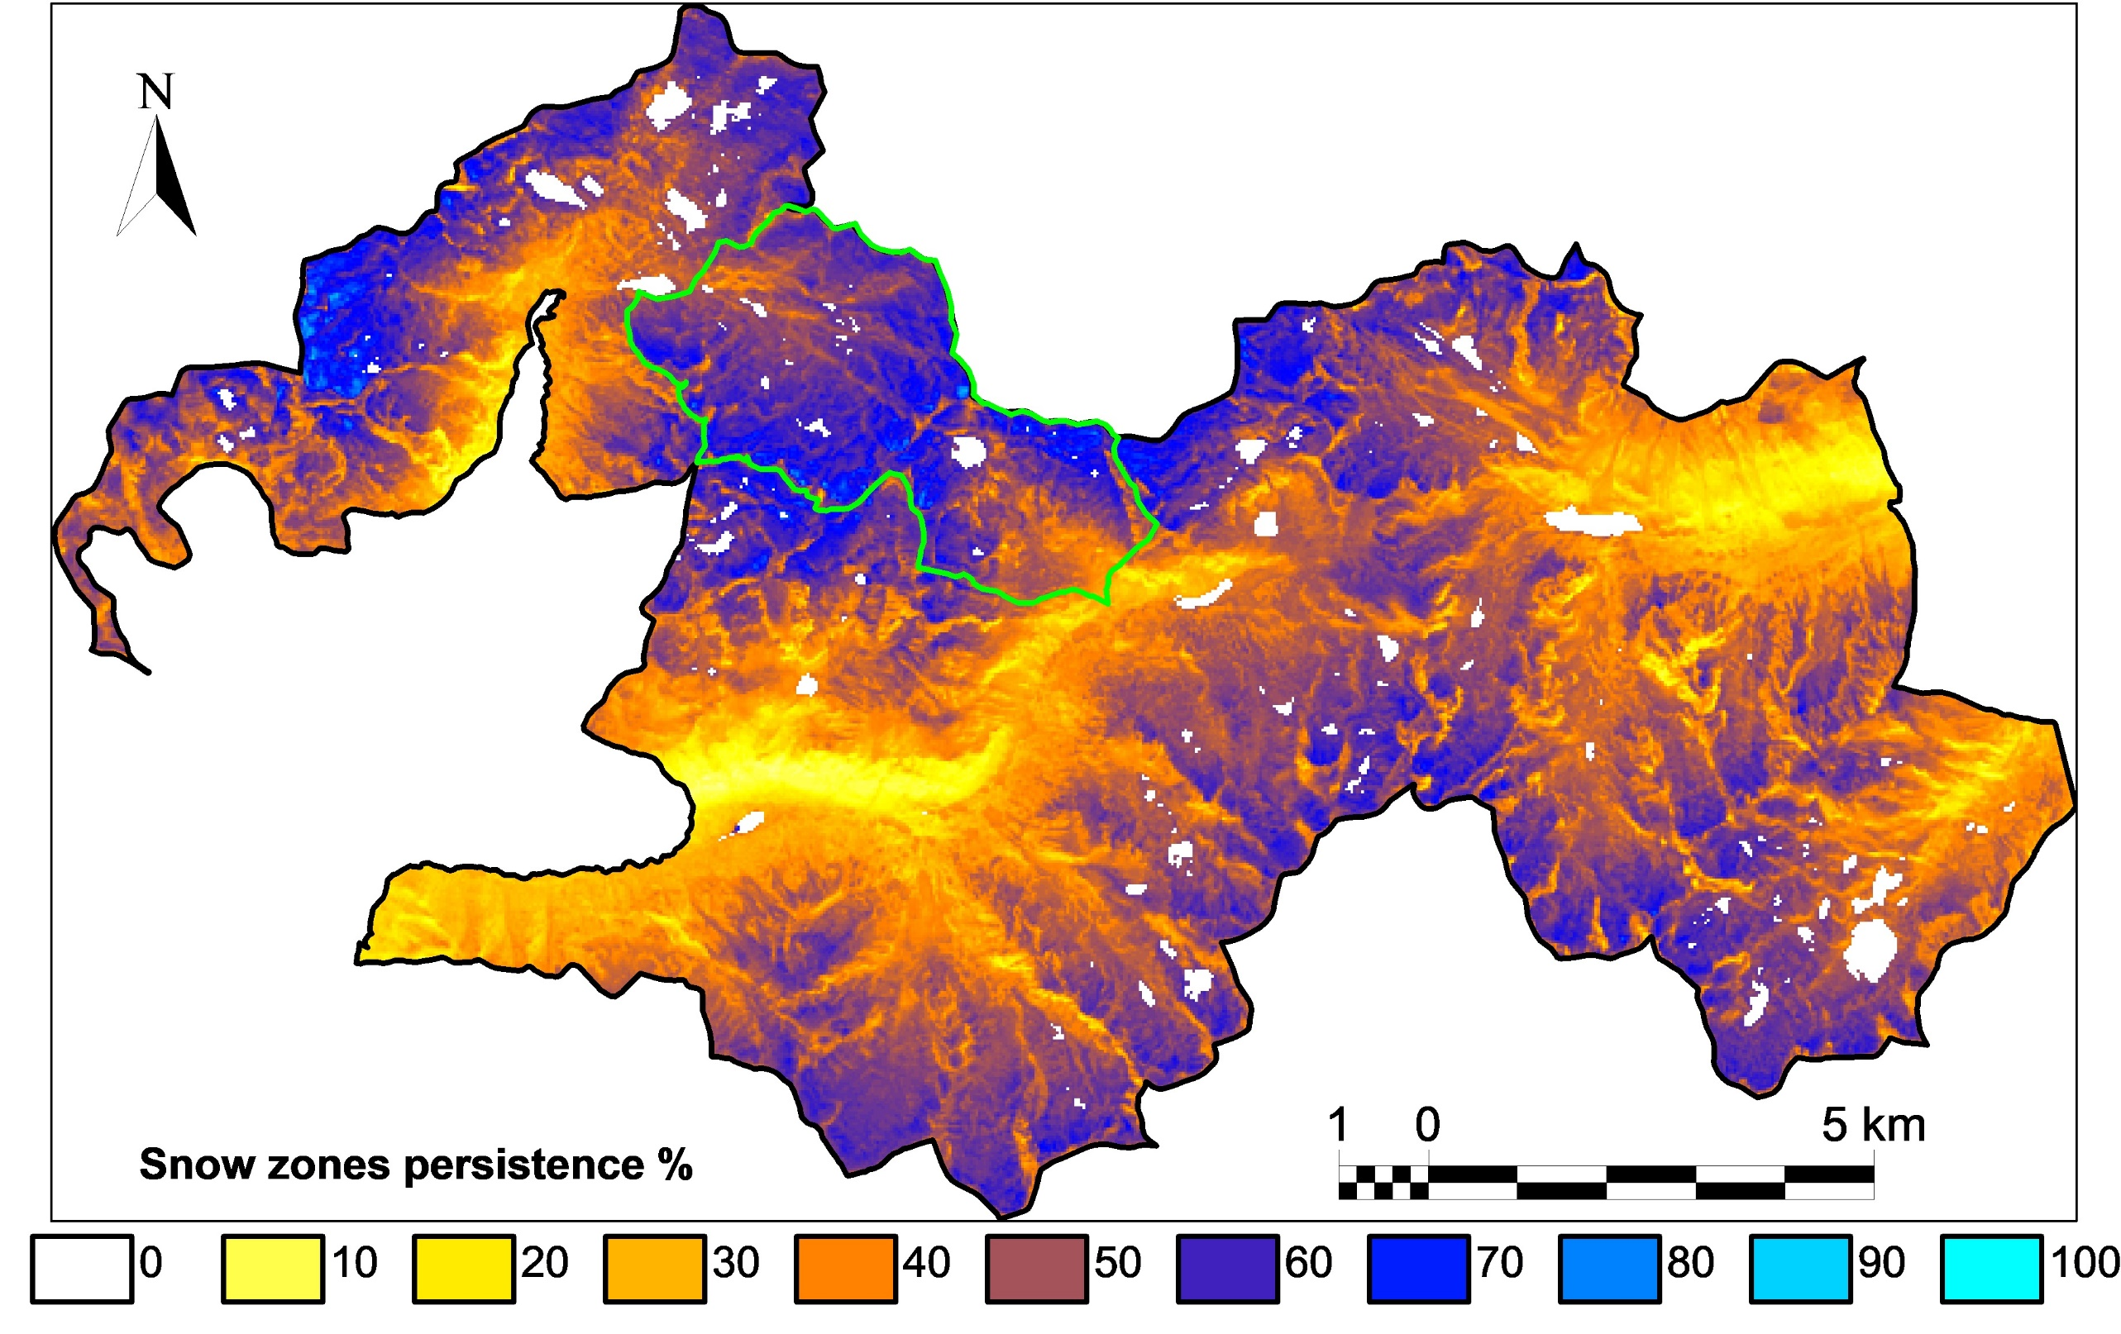
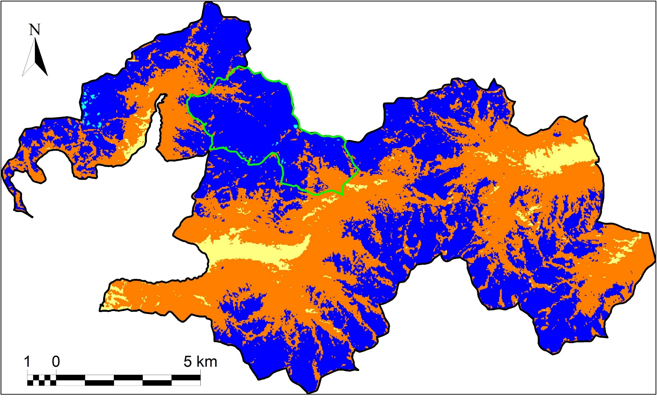
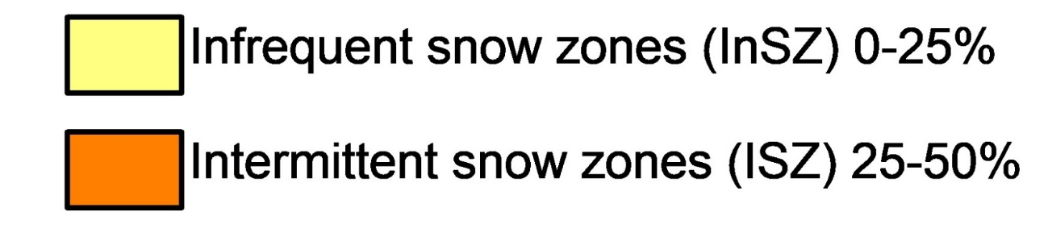
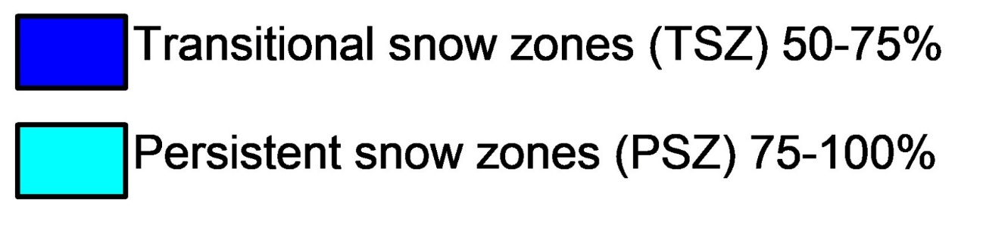
Results: Spatial distribution of SP
Spatial distribution of SP in the National Park (1984-2023)
Spatial distribution of SP in the National Park (1984-2023) classified by snow zones
Little or no snow zones (NSZ): 0-25%
Intermittent snow zones (ISZ): 25-50%
Seasonal snow zones (SSZ): 50-75%
Persistent snow zones (PSZ): 75-100%
EGU24-11542

Slide 13
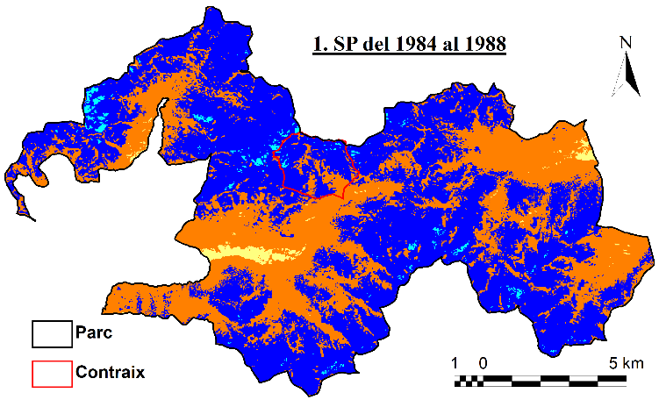
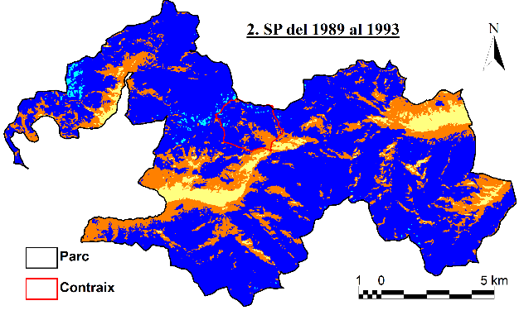
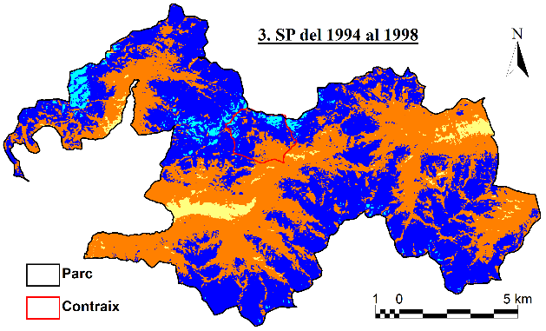
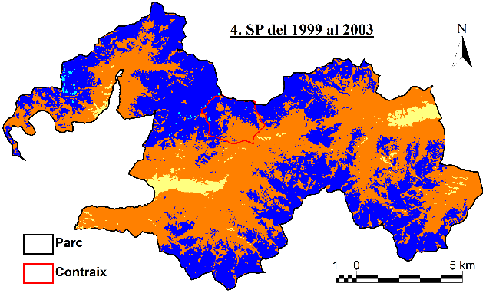
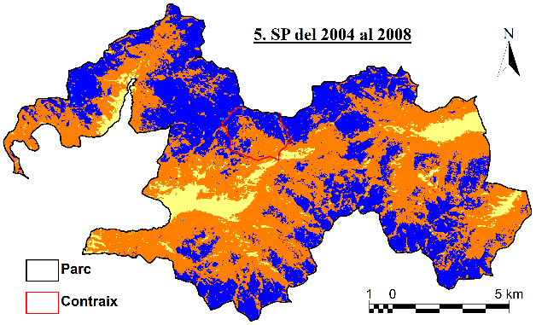
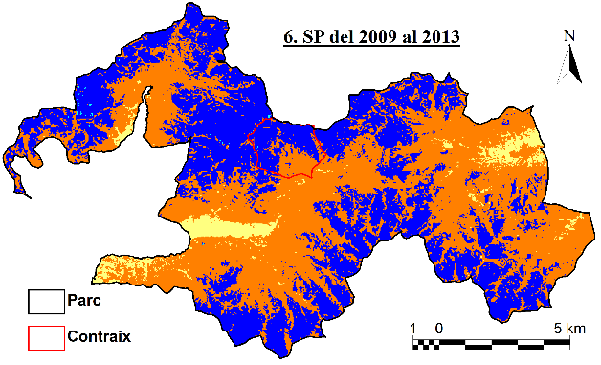
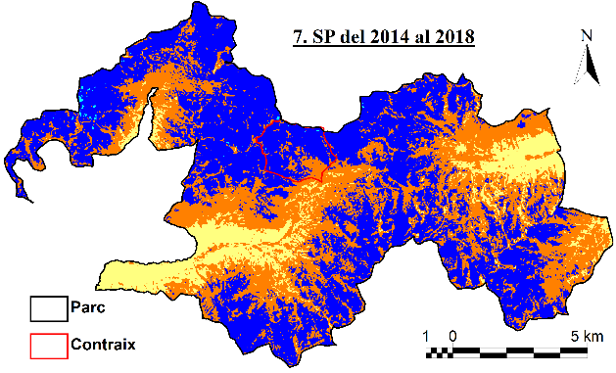
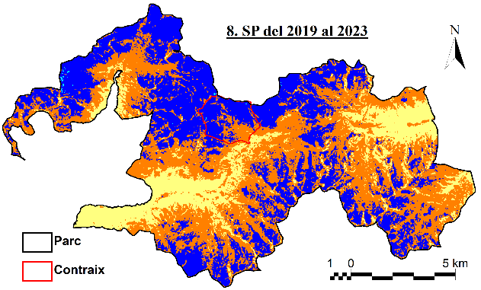
Results: 5-year SP trend
NSZ
ISZ
SSZ
PSZ
EGU24-11542

Slide 14
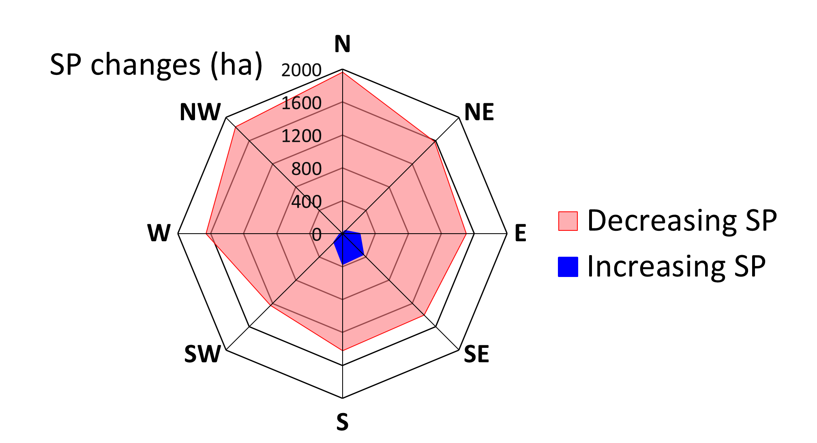
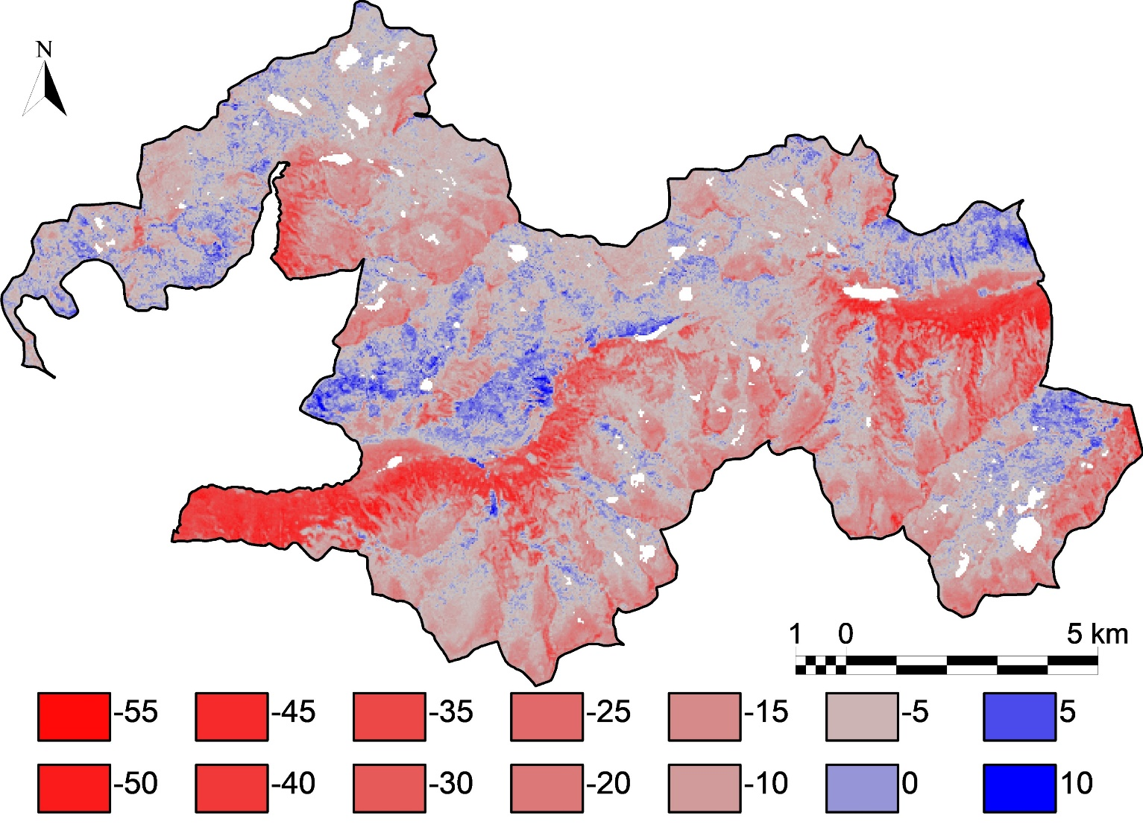
Results: Changes in SP between the decades 1984-93 and 2014-23
Changes in SP (%) 1984/93 – 2014/23
Change in SP (%)
EGU24-11542

Slide 15
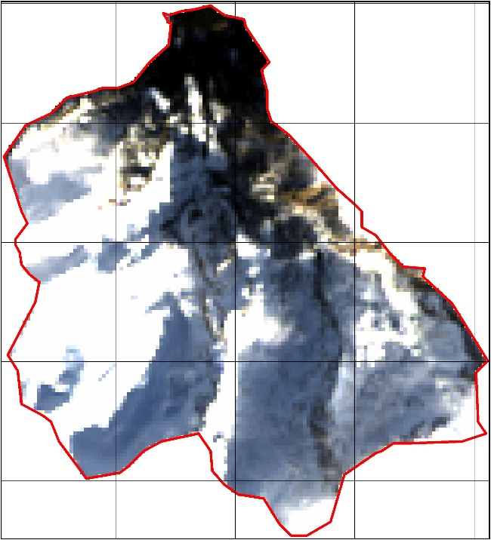
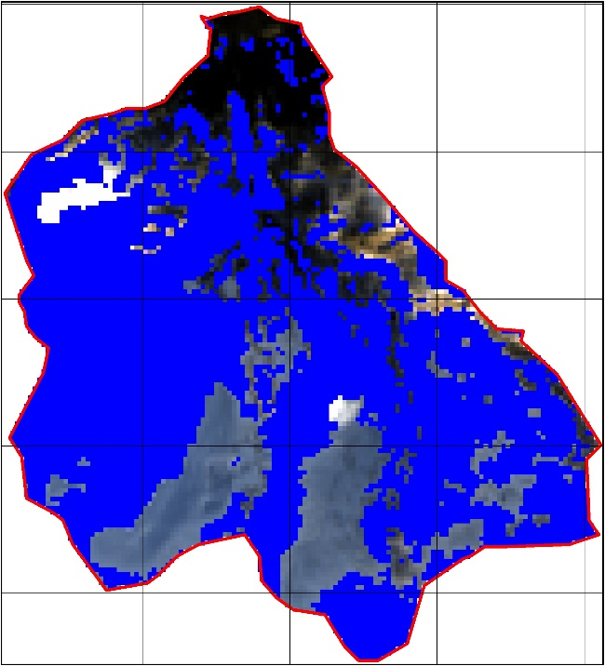
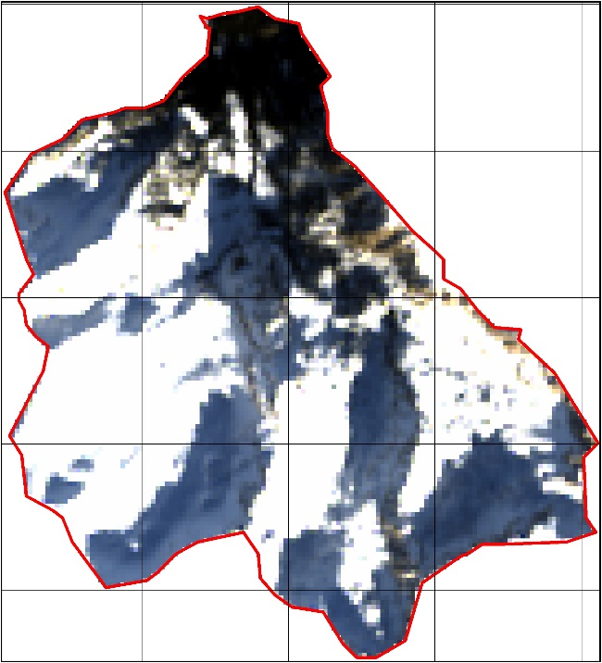
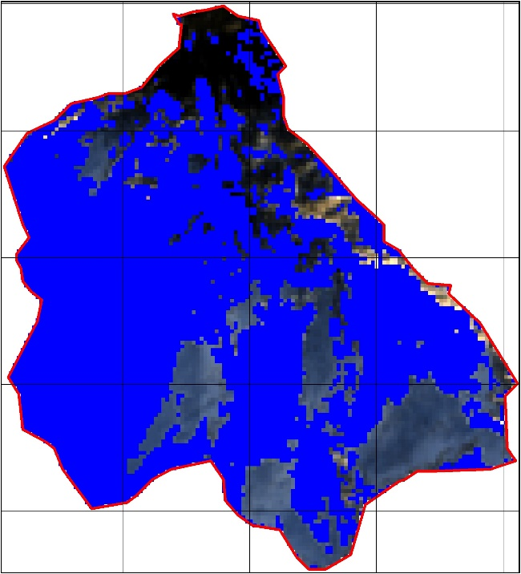
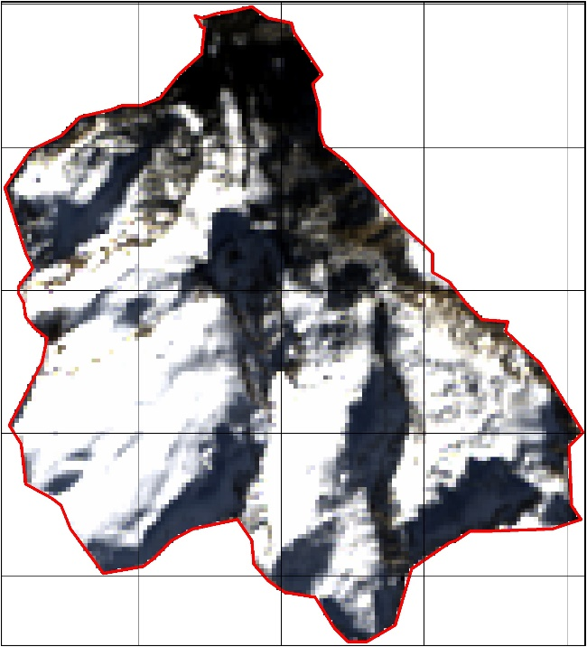
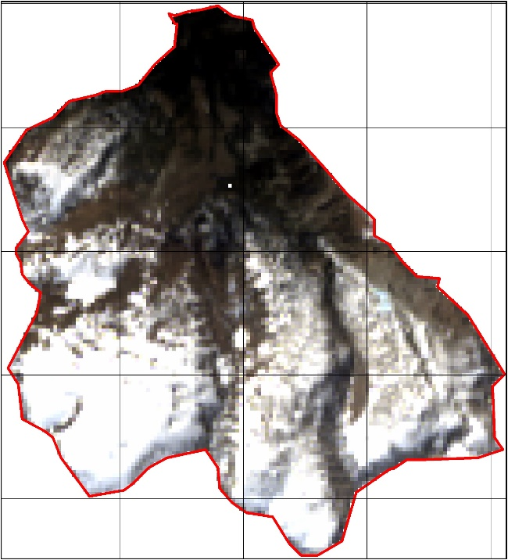
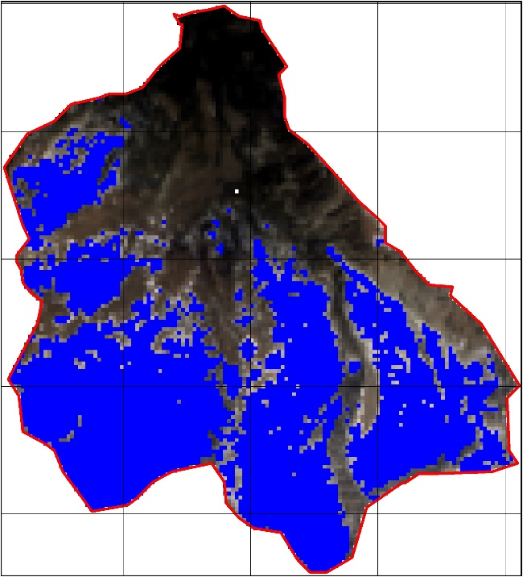
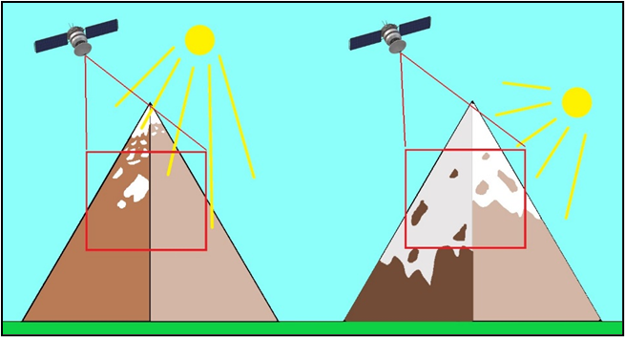
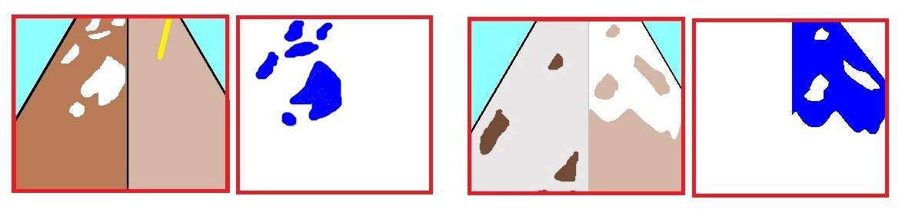
Limitations: Snow detection in shadow areas
Evolution of snow-covered area due to the lack of radiometric correction for shadows in the Llacs basin (2022-23 winter)
*
28/12/2022
*
13/01/2023
*
*
*
*
*
14/02/2023
*
11/04/2023
EGU24-11542

Slide 16
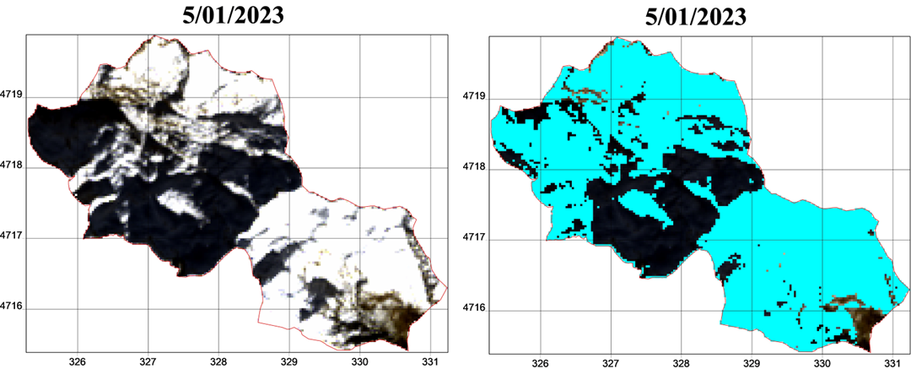
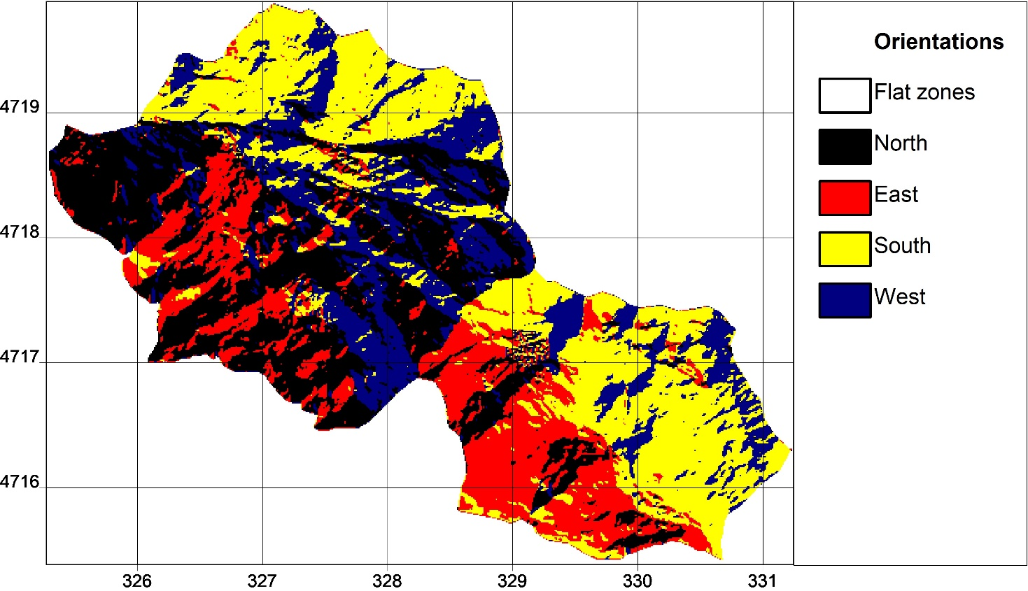
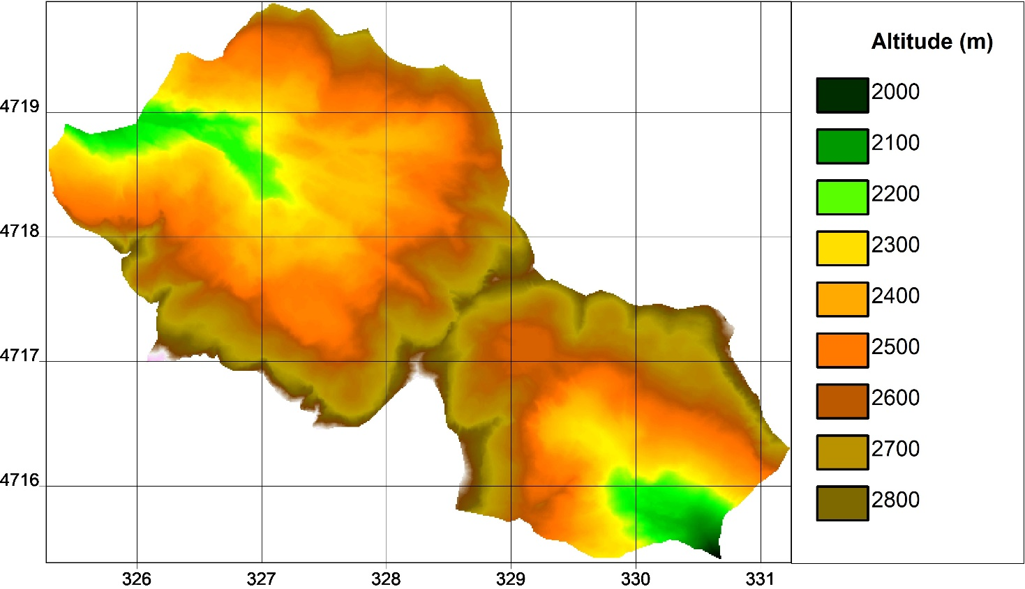
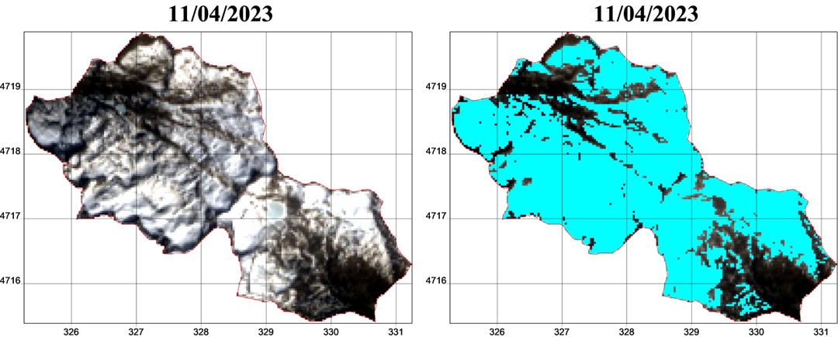
Limitations: Snow detection in shadow areas
Comparison of snow detection in the Estany Negre and Contraix basins between winter and spring
05/01/2023 Snow surface: 918.18 ha
11/04/2023 Snow surface: 924.93 ha
EGU24-11542

Slide 17
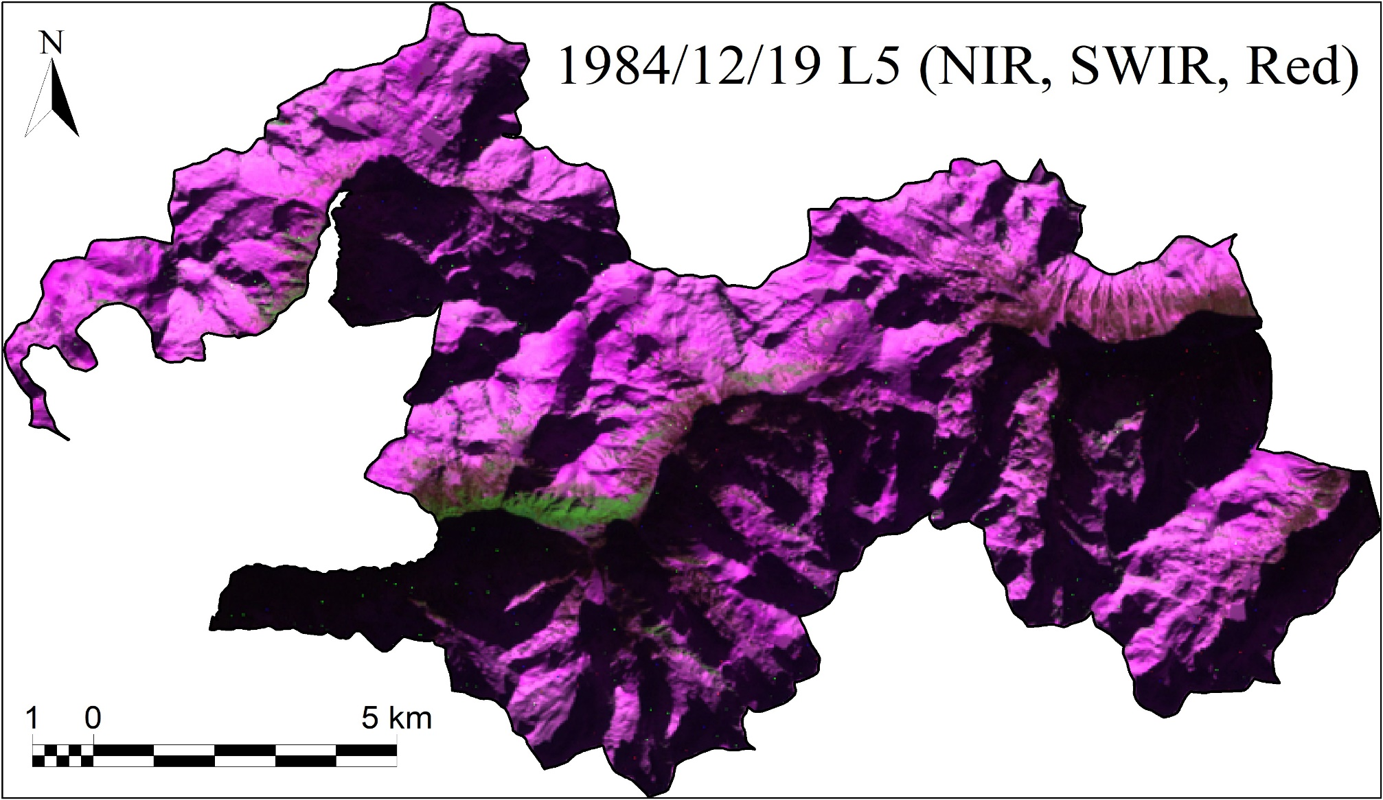
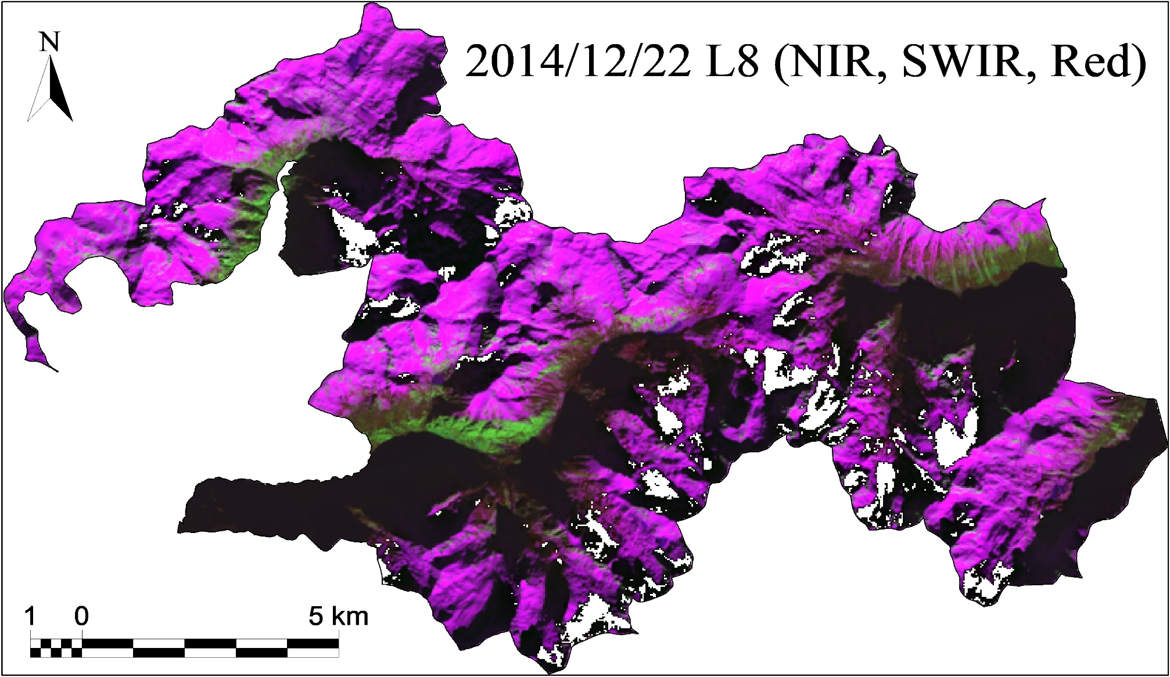
Limitations: Differences in Surface Reflectance Processing Algorithms
Comparison of two cloud-free images of the national park with similar snow-covered areas near the winter solstice.
Landsat 4-5, Landsat 7 (LEDAPS)
LEDAPS laid the groundwork for atmospheric correction and radiometric calibration of Landsat data, LaSRC represents a significant advancement with tailored algorithms optimized for Landsat 8 and 9 sensors.
LaSRC generally provides higher accuracy and precision in surface reflectance estimates compared to LEDAPS.
Landsat 8-9 (LaSRC)
Landsat 8 and Landsat 9 C2 Surface Reflectance products may contain 'NoData’ pixels on the edges of clouds. This artifact is more frequent at the shorter wavelengths and usually occurs over dark water pixels and shadowed land pixels under low solar illumination conditions.
EGU24-11542

Slide 18
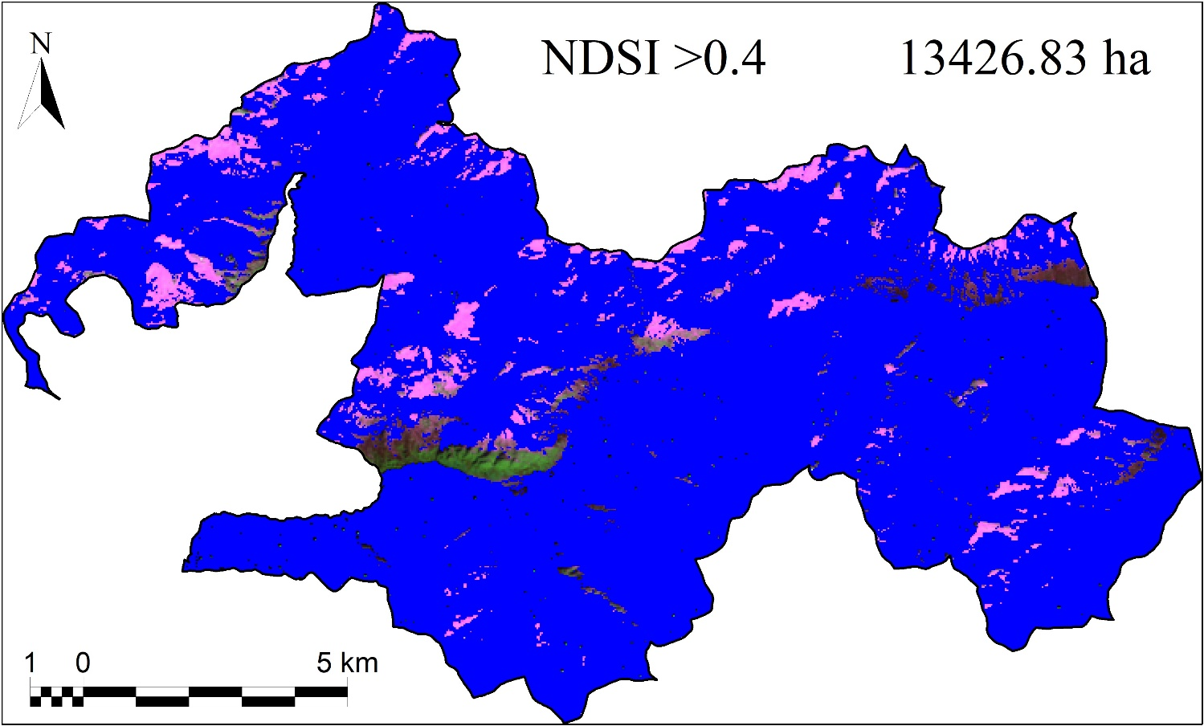
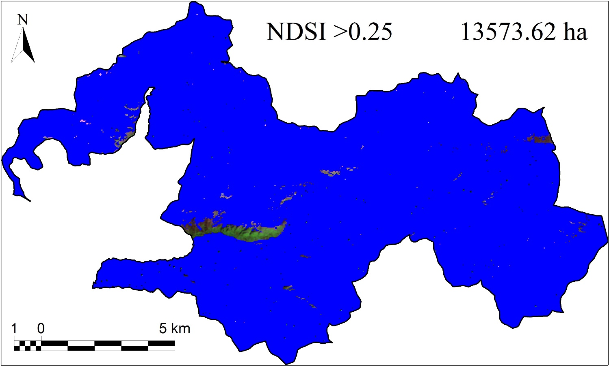
Limitations: 0.4 threshold on the NDSI
1984/12/19 Landsat 5
Test of different thresholds through visual inspection of the images:
0.4 threshold detects less snow but there are no issues with cloud confusion. It can lead to omission errors.
0.25 threshold detects snow better in boundary areas or in shadows, but it can be confused with clouds. It can lead to commission errors.
EGU24-11542

Slide 19
Outlook: MODIS, Landsat and Sentinel snow products
MODIS:
Pros:
High revisit frequency (1 to 2 days at nadir)
Wide spatial coverage.
2000 to present day.
Useful for large-scale change monitoring.
Cons:
Low spatial resolution (250, 500 or 1000).
Pixel dimension grows at either end of the scan. 500 m at nadir is approximately 2.4 x 1 km at the edges of the scan swath
Landsat:
Pros:
Moderate to high spatial resolution (30 m).
Extensive data archive (1972 to present day).
Useful for detailed analysis of land surface changes or snow changes.
Cons:
Lower revisit frequency than MODIS (approximately 16 days).
Differences between the radiometric correction algorithm for Landsat 4, 5, and 7 (TM, ETM+) versus Landsat 8 and 9 (OLI, TIRS).
Sentinel:
Pros:
High spatial resolution (10 m, 20 m, 60 m).
Regular revisit frequency (5 days).
Useful for small areas studies.
Cons:
Time series of Sentinel data (2016 to present) too short to study snow cover compared to Landsat.
EGU24-11542

Slide 20
Outlook: MODIS, Landsat and Sentinel snow products
08/04/2022
Snow-covered areas calculated from the NDSI for the same dates
10/04/2022
Between 1200 and 2000 ha difference in snow cover calculated with MODIS compared to Landsat and Sentinel at the same date.
EGU24-11542

Slide 21
Outlook: Landsat and Sentinel snow products
The different snow products from Sentinel and Landsat have been analysed and compared with the snow product generated from the Normalized Difference Snow Index (NDSI) using level 2 images that have already been radiometrically corrected.
Date | Landsat |  | Sentinel
 | Snow product | 0.25 NDSI | FSCOG | 0.25 NDSI
2016/12/27* | 3096.63 ha | 9109.71 ha | 6550.76 ha | 10747.60 ha
2020/01/05/06 | 6637.23 ha | 10706.22 ha | 8587.12 ha | 11405.76 ha
2021/02/24 | 8882.01 ha | 11862.18 ha | 8681.32 ha | 12687.52 ha
2022/01/26/25 | 5002.65 ha | 10594.17 ha | 8648.84 ha | 10994.96 ha
Differences in surface area between snow products from Landsat and Sentinel for the same dates
On the four different dates, a significant difference is observed between the automatically generated snow products and those calculated from the NDSI and applying the threshold of 0.25.
EGU24-11542

Slide 22
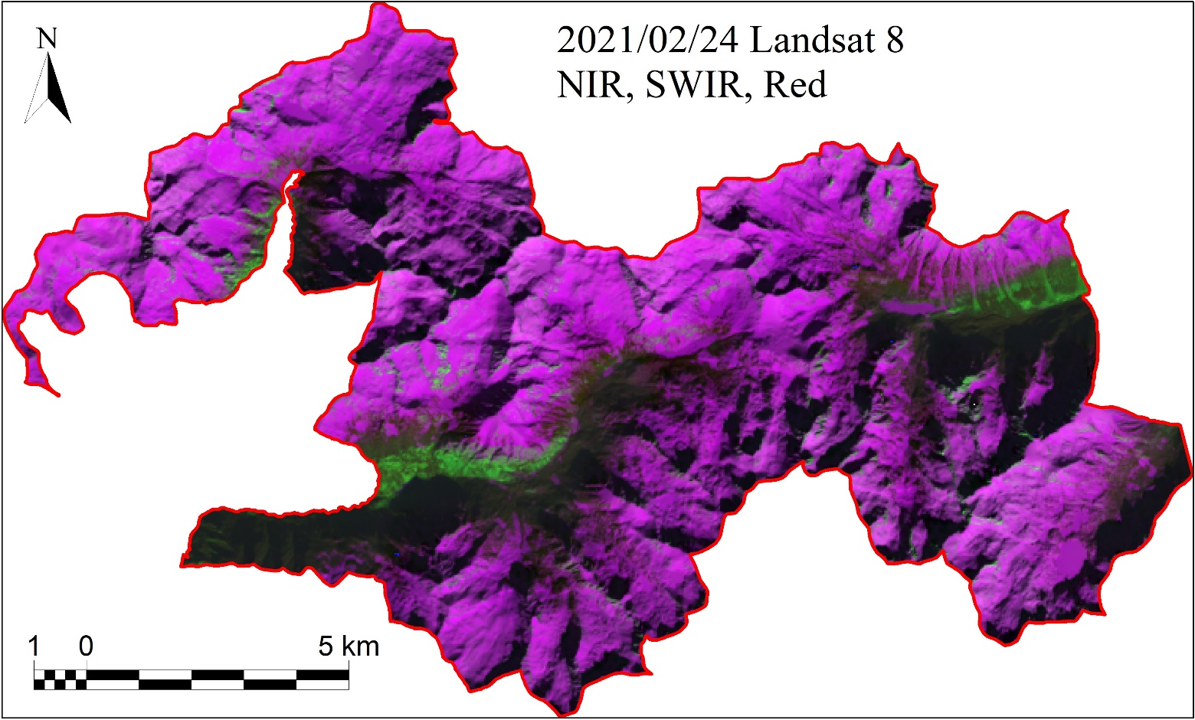
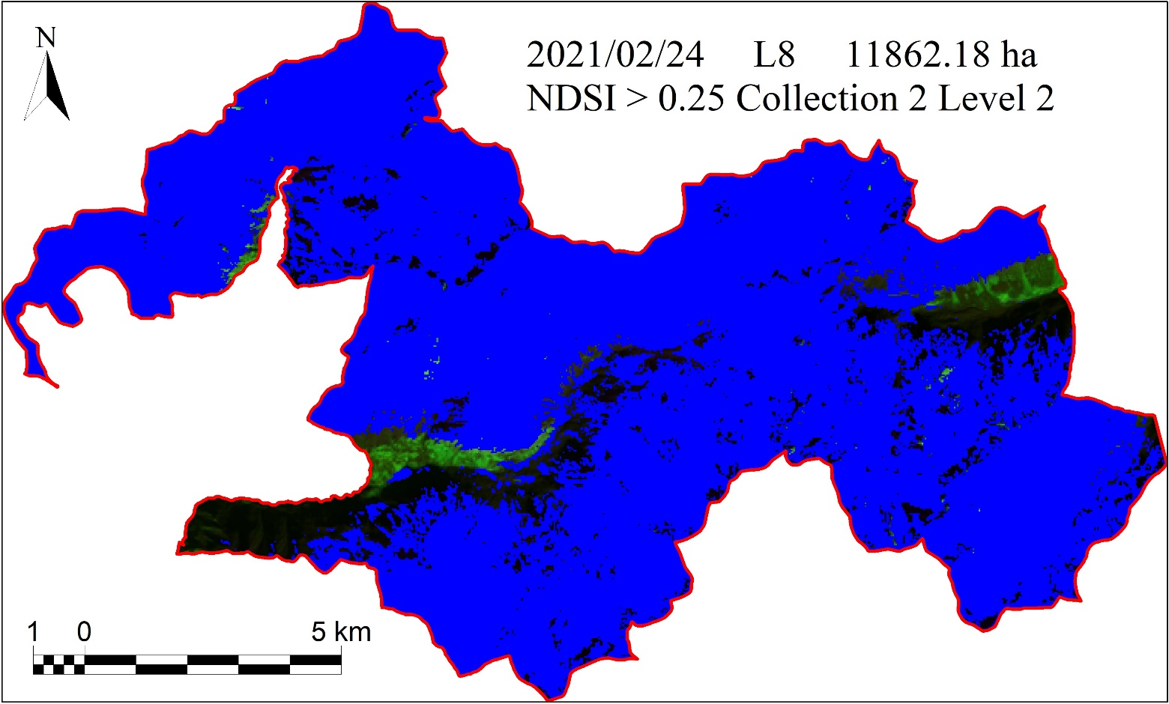
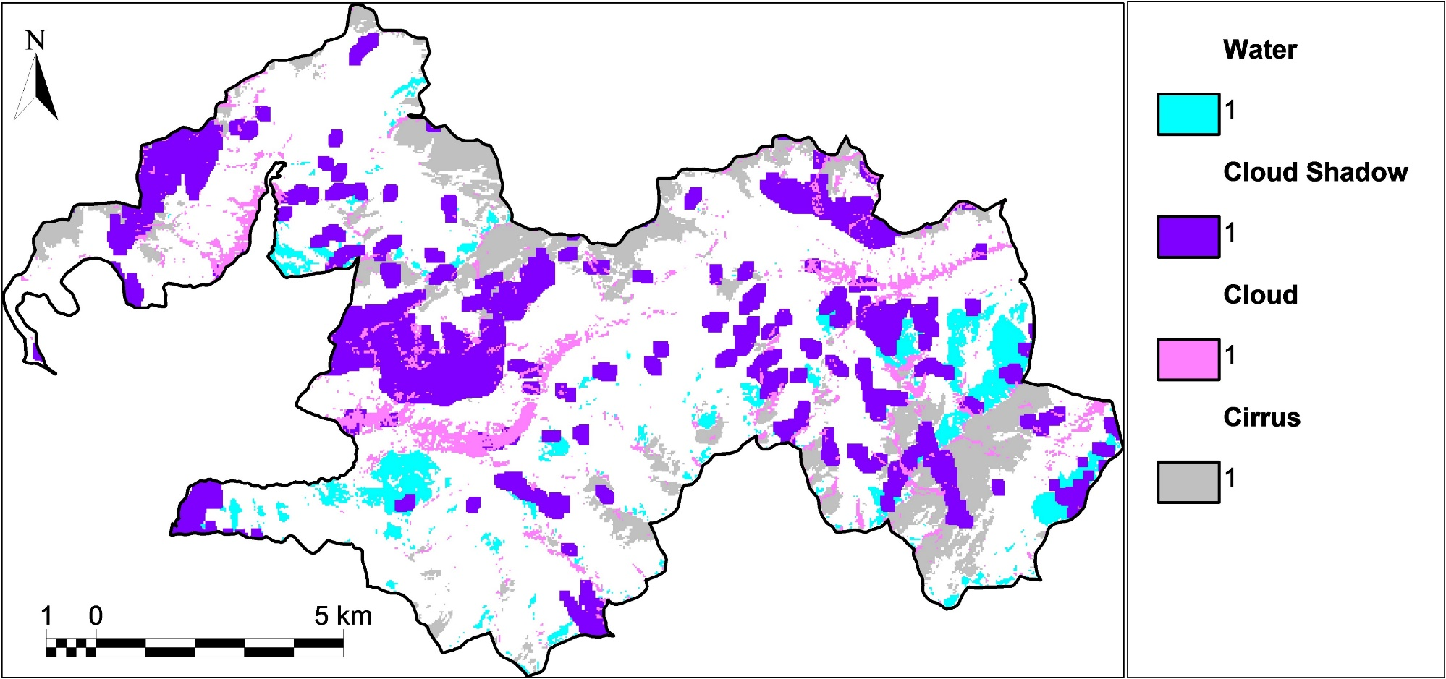
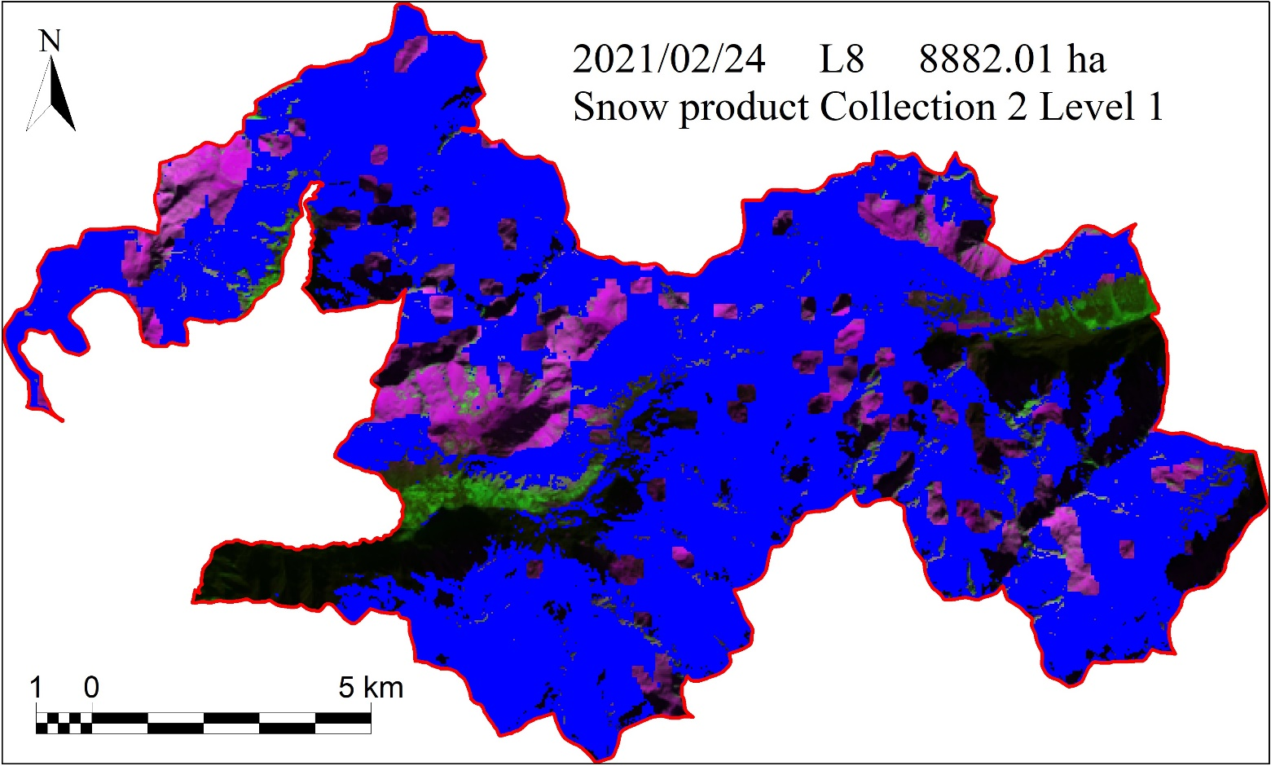
Outlook: Landsat snow product
A
Comparison of a Landsat 8 image on a cloud-free date (A) with good snow cover. In B, the automatically generated FLAGS from Landsat 8 it is observed how snow-covered surfaces or areas in shadow are confused with clouds, their own shadows, or water.
C
B
Difference between snow surface detected with NDSI (C) and the Landsat 9 snow product (D) for the same date
D
EGU24-11542

Slide 23
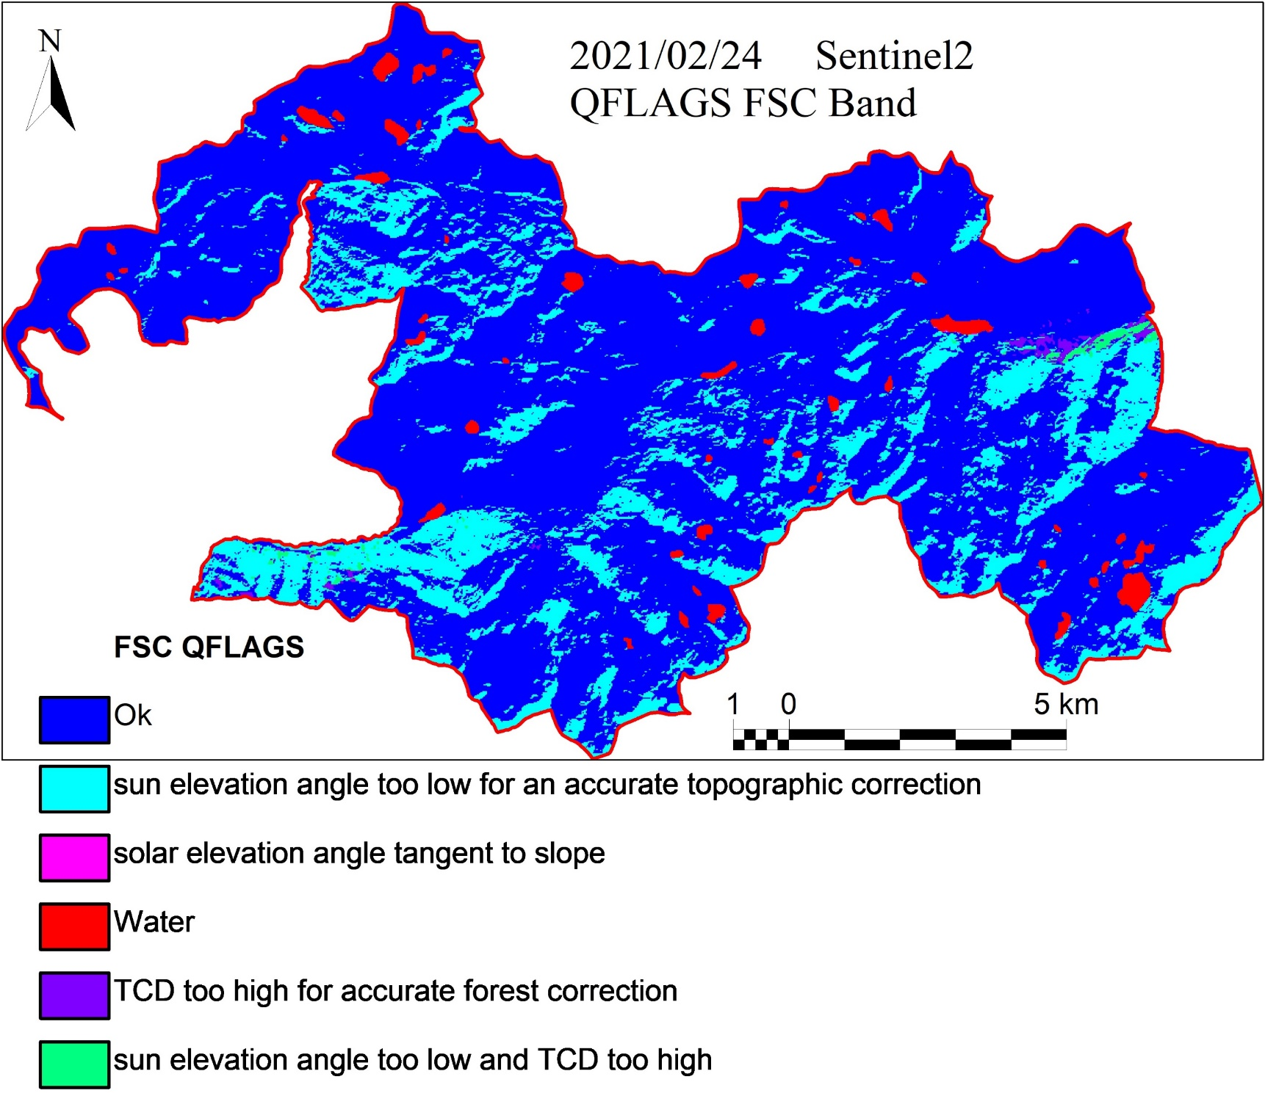



Outlook: Sentinel snow product (FSC)
B
Image without clouds from Sentinel (A)
A
With the Sentinel FSC snow product, snow is not confused with water or cloud shadows, but it often confuses snow with clouds, as shown by the gaps in image C. In D, is the snow detected with NDSI > 0.25.
C
D
There are areas coinciding with hard shadows on north-facing slopes, labelled as areas with too low solar angle for accurate topographic correction (B).
EGU24-11542

Slide 24



Current approaches: Radiometric correction
10m DEM + 10 m D.IllumM + 10 m D.ShadowM + PIA
PIA
+
+
+
DIlumM = Digilital Illumination Model
DShadowM = Digital Shadows Model
PIA =Zones Pseudo-Invariants: Known reflectance in reference zones. Polygon file with reference radiometric values for automatic correction.
The radiometric correction allows to reduce the number of undesired artifacts caused by atmospheric effects or differential illumination, which in turn is influenced by factors such as the time of day, location on Earth, and relief, areas that are more illuminated than others, shadows, etc.
Pons, X., Solé-Sugrañes, L. (1994) A Simple Radiometric Correction Model to Improve Automatic Mapping of Vegetation from Multispectral Satellite Data.
Pons, X., Pesquer, L., Cristóbal, J., González-Guerrero, Ò. (2014) Automatic and improved radiometric correction of Landsat imagery using reference values from MODIS surface reflectance images.
EGU24-11542

Slide 25


Current approaches: Snow detection with KNN image classification
K-Nearest Neighbours (k-NN) is a supervised machine learning algorithm. Supervised classification of an image using the kNN method assumes that it is plausible that the pixels that are close to each other in the statistical space belong to the same informational class. For each pixel of the image to be classified, the Euclidean distance is calculated to each pixel of the training areas.
https://spotintelligence.com/2023/08/22/k-nearest-neighbours/
Training Phase + Prediction Phase
EGU24-11542

Slide 26



Thank you very much
for your attention
Martí Navarro Planes
m.navarro@creaf.uab.cat
Tel. +34 683173689
CREAF
Campus de Bellaterra (UAB). Edificio C.
08193 Cerdanyola del Vallès. BARCELONA
You can follow us on:
www.creaf.cat blog.creaf.cat
EGU24-11542
Notes:
Last slide.

