Slide 1
Data integration and simple water balance analysis of the Sopron Botanical Garden’s hydrometeorological station data
By: Lili Muraközy, Péter Kalicz, Márton Kiss, Zoltán Gribovszki
University of Sopron, Faculty of Forestry

Slide 2
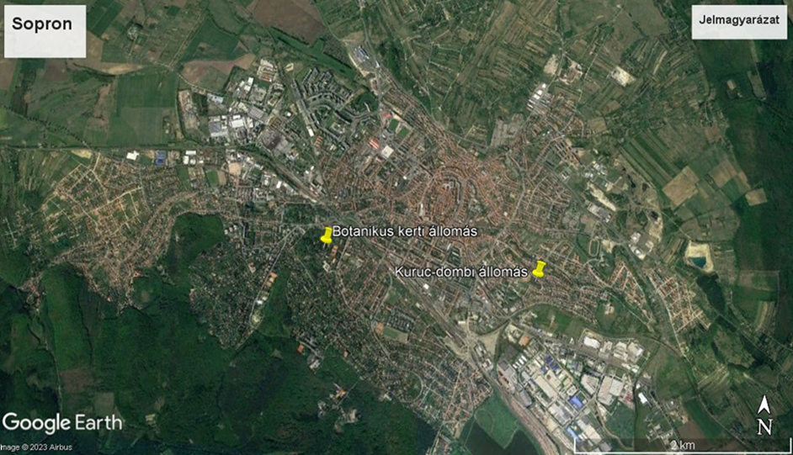
Introduction
Station name | Latitude | Longitude | Begining of period | End of period
Sopron Oedenburg, Vízimalom | 47°41’06” | 16°33’25” | 1870.01.01. | 1882.01.30.
Sopron Laehne Intézet | 47°41’32” | 16°35’15” | 1885.11.21. | 1918.11.30.
Sopron Leány-gimnázium | 47°41’02” | 16°34’24” | 1918.12.01. | 1925.05.31.
University of Forestry, Botanical garden | 47°40’42” | 16°34’18” | 1925.06.01. | 1974.04.24.
Kuruc-domb Szélmalom | 47°42’53” | 16°39’57” | 1974.04.25. | 2019.12.31.
Fertőrákos EDUVIZIG Kutató Bázis (pótlóállomás) | 47°41’06” | 47°41’06” | 2004.03.17. | 2005.07.27.
Objectives:
Data unification of the Botanical Garden meteorological station, error analysis, hydrometeorological data processing

Slide 3
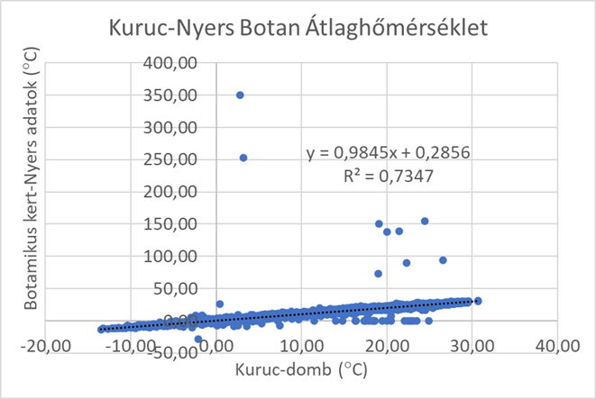
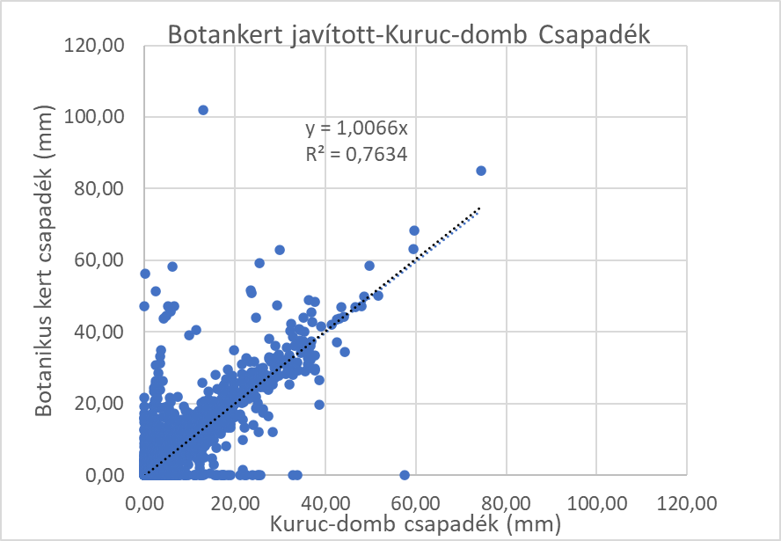
Methods
Corrected data (average temperature)
Examples for minimum errors:
1988-07-09 1505.0
1997-07-24 152.0
2003-07-21 155.0
2017-06-04 115.2
Examples for maximum errors:
1997-08-16 263.0
2000-04-21 262.0
2001-07-01 285.8
2001-07-30 292.0
Error analysis:
Corrected data ( precipitation sum)

Slide 4
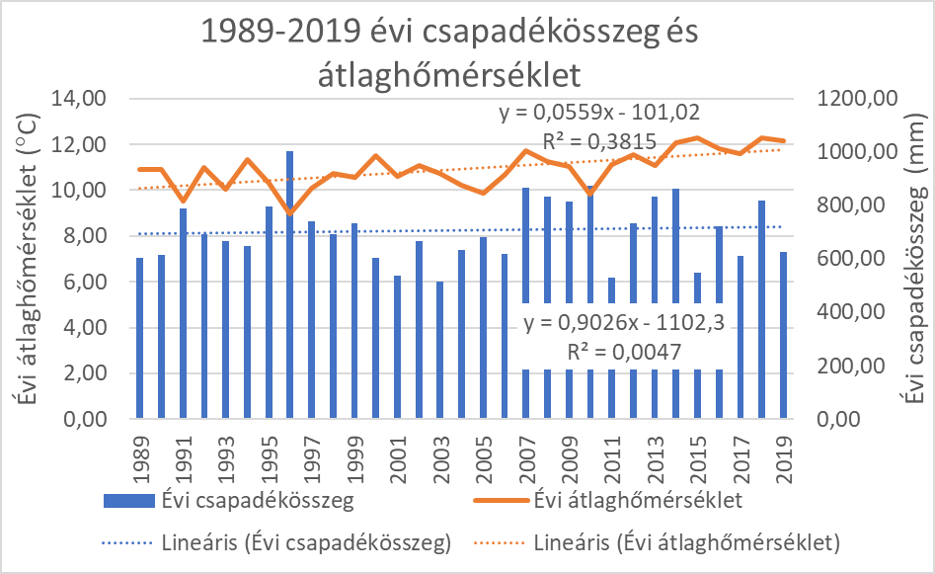
Results
Comparison of the 1930-1960 and 1989-2019 periods of the Botanical Garden:
1930-1960 yearly precipitation sum and average temperature
1989-2019 yearly precipitation sum and average temperature
Temperature rise of the 1930-1960 data series:
0.10°C/30 years, this trend is not significant
Temperature rise of the 1989-2019 data series:
1.68 ° C/30 years

Slide 5
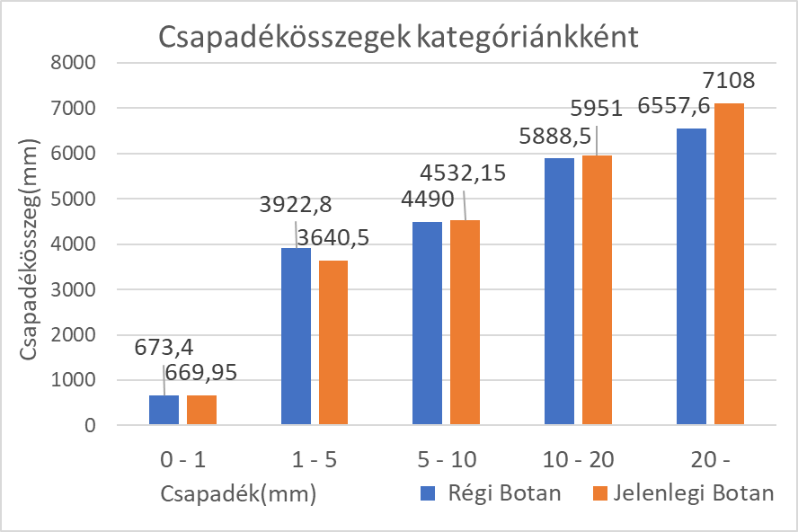
Results
Precipitation sum per category
Number of precipitation events per category
 | 1930-1960 Old Botan | 1989-2019 Present Botan | Changes (%) | Changes (db)
0-1 | 8559 | 8666 | 1,3% | 107
1-5 | 1485 | 1374 | -7,5% | -111
5-10 | 622 | 629 | 1,1% | 7
10-20 | 466 | 425 | -8,8% | -41
20- | 191 | 228 | 19,4% | 37
Total | 11323 | 11322 | 0% | -1
 | 1930-1960 Old Botan | 1989-2019 Present Botan | Changes (%) | Changes (mm)
0-1 | 673,4 | 669,95 | -0,5% | -3,5
1-5 | 3922,8 | 3640,5 | -7,2% | -282,3
5-10 | 4490 | 4532,15 | 0,9% | 42,1
10-20 | 5888,5 | 5951 | 1,1% | 62,5
20- | 6557,6 | 7108 | 8,4% | 550,4
Prec. sum | 21532,3 | 21901,6 | 1,7% | 369,3

Slide 6
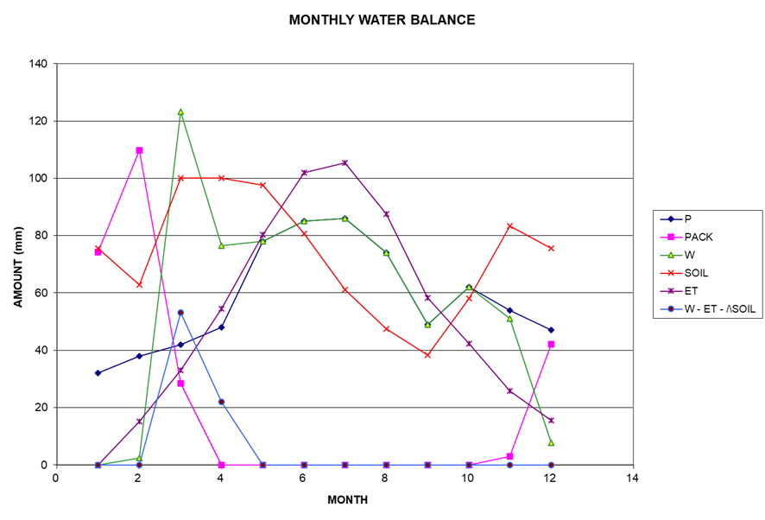
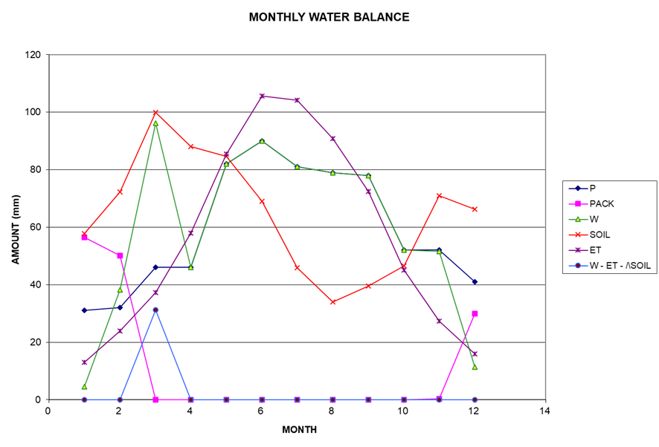
Results
Botanical garden from 1930 to 1960
Botanical garden from 1989 to 2019
 | W | ET | W-ET-∆SOIL
1930-1960 | 695 | 620 | 75
1989-2019 | 710 | 679 | 31
∆ in mmm | -15 | -59 | 44
∆ in % | +2,2% | +9,5% | -58,7%

Slide 7
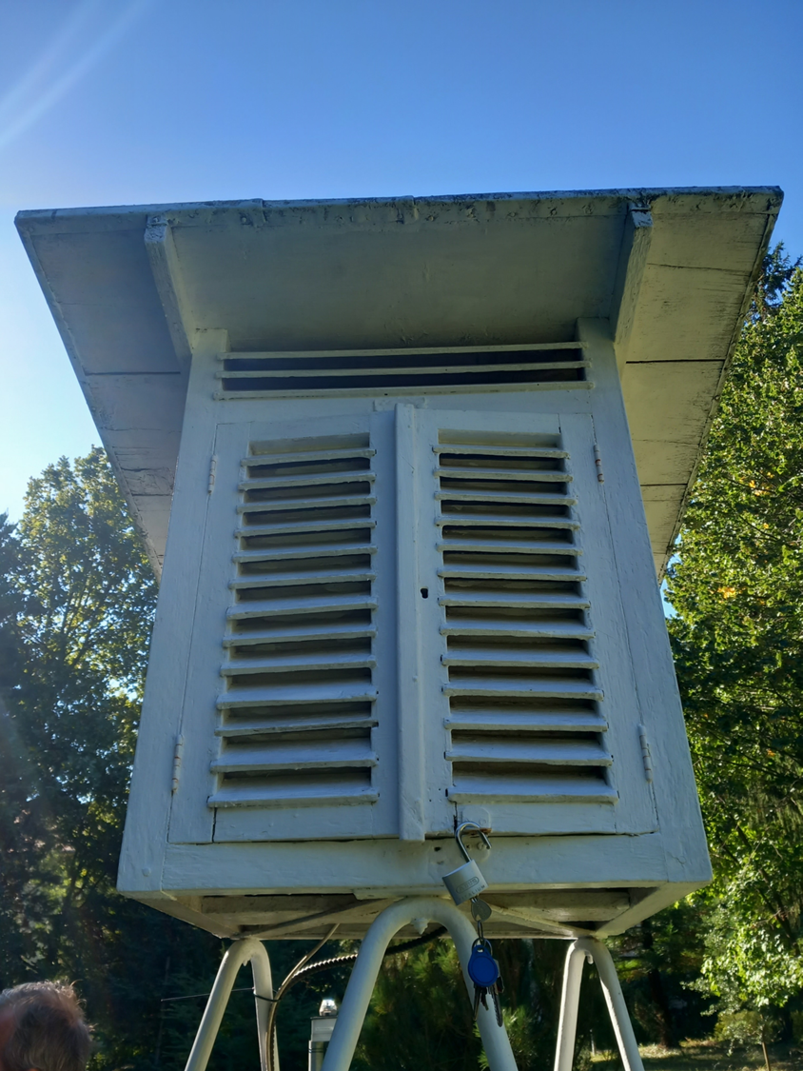
Thank you for your attention!
The following joint projects (OTKA 143972SNN project and the TKP2021-NKTA-43 project) supported the preparation of this paper. TKP2021-NKTA-43 has been implemented with the support provided by the Ministry of Innovation and Technology of Hungary (successor: Ministry of Culture and Innovation of Hungary) from the National Research, Development and Innovation Fund, financed under the TKP2021-NKTA funding scheme.
Supported by the ÚNKP-23-2-III-SOE-176 New National Excellence Program of the Ministry for Culture and Innovation from the source of the National Research, Development and Innovation Fund.

Slide 8
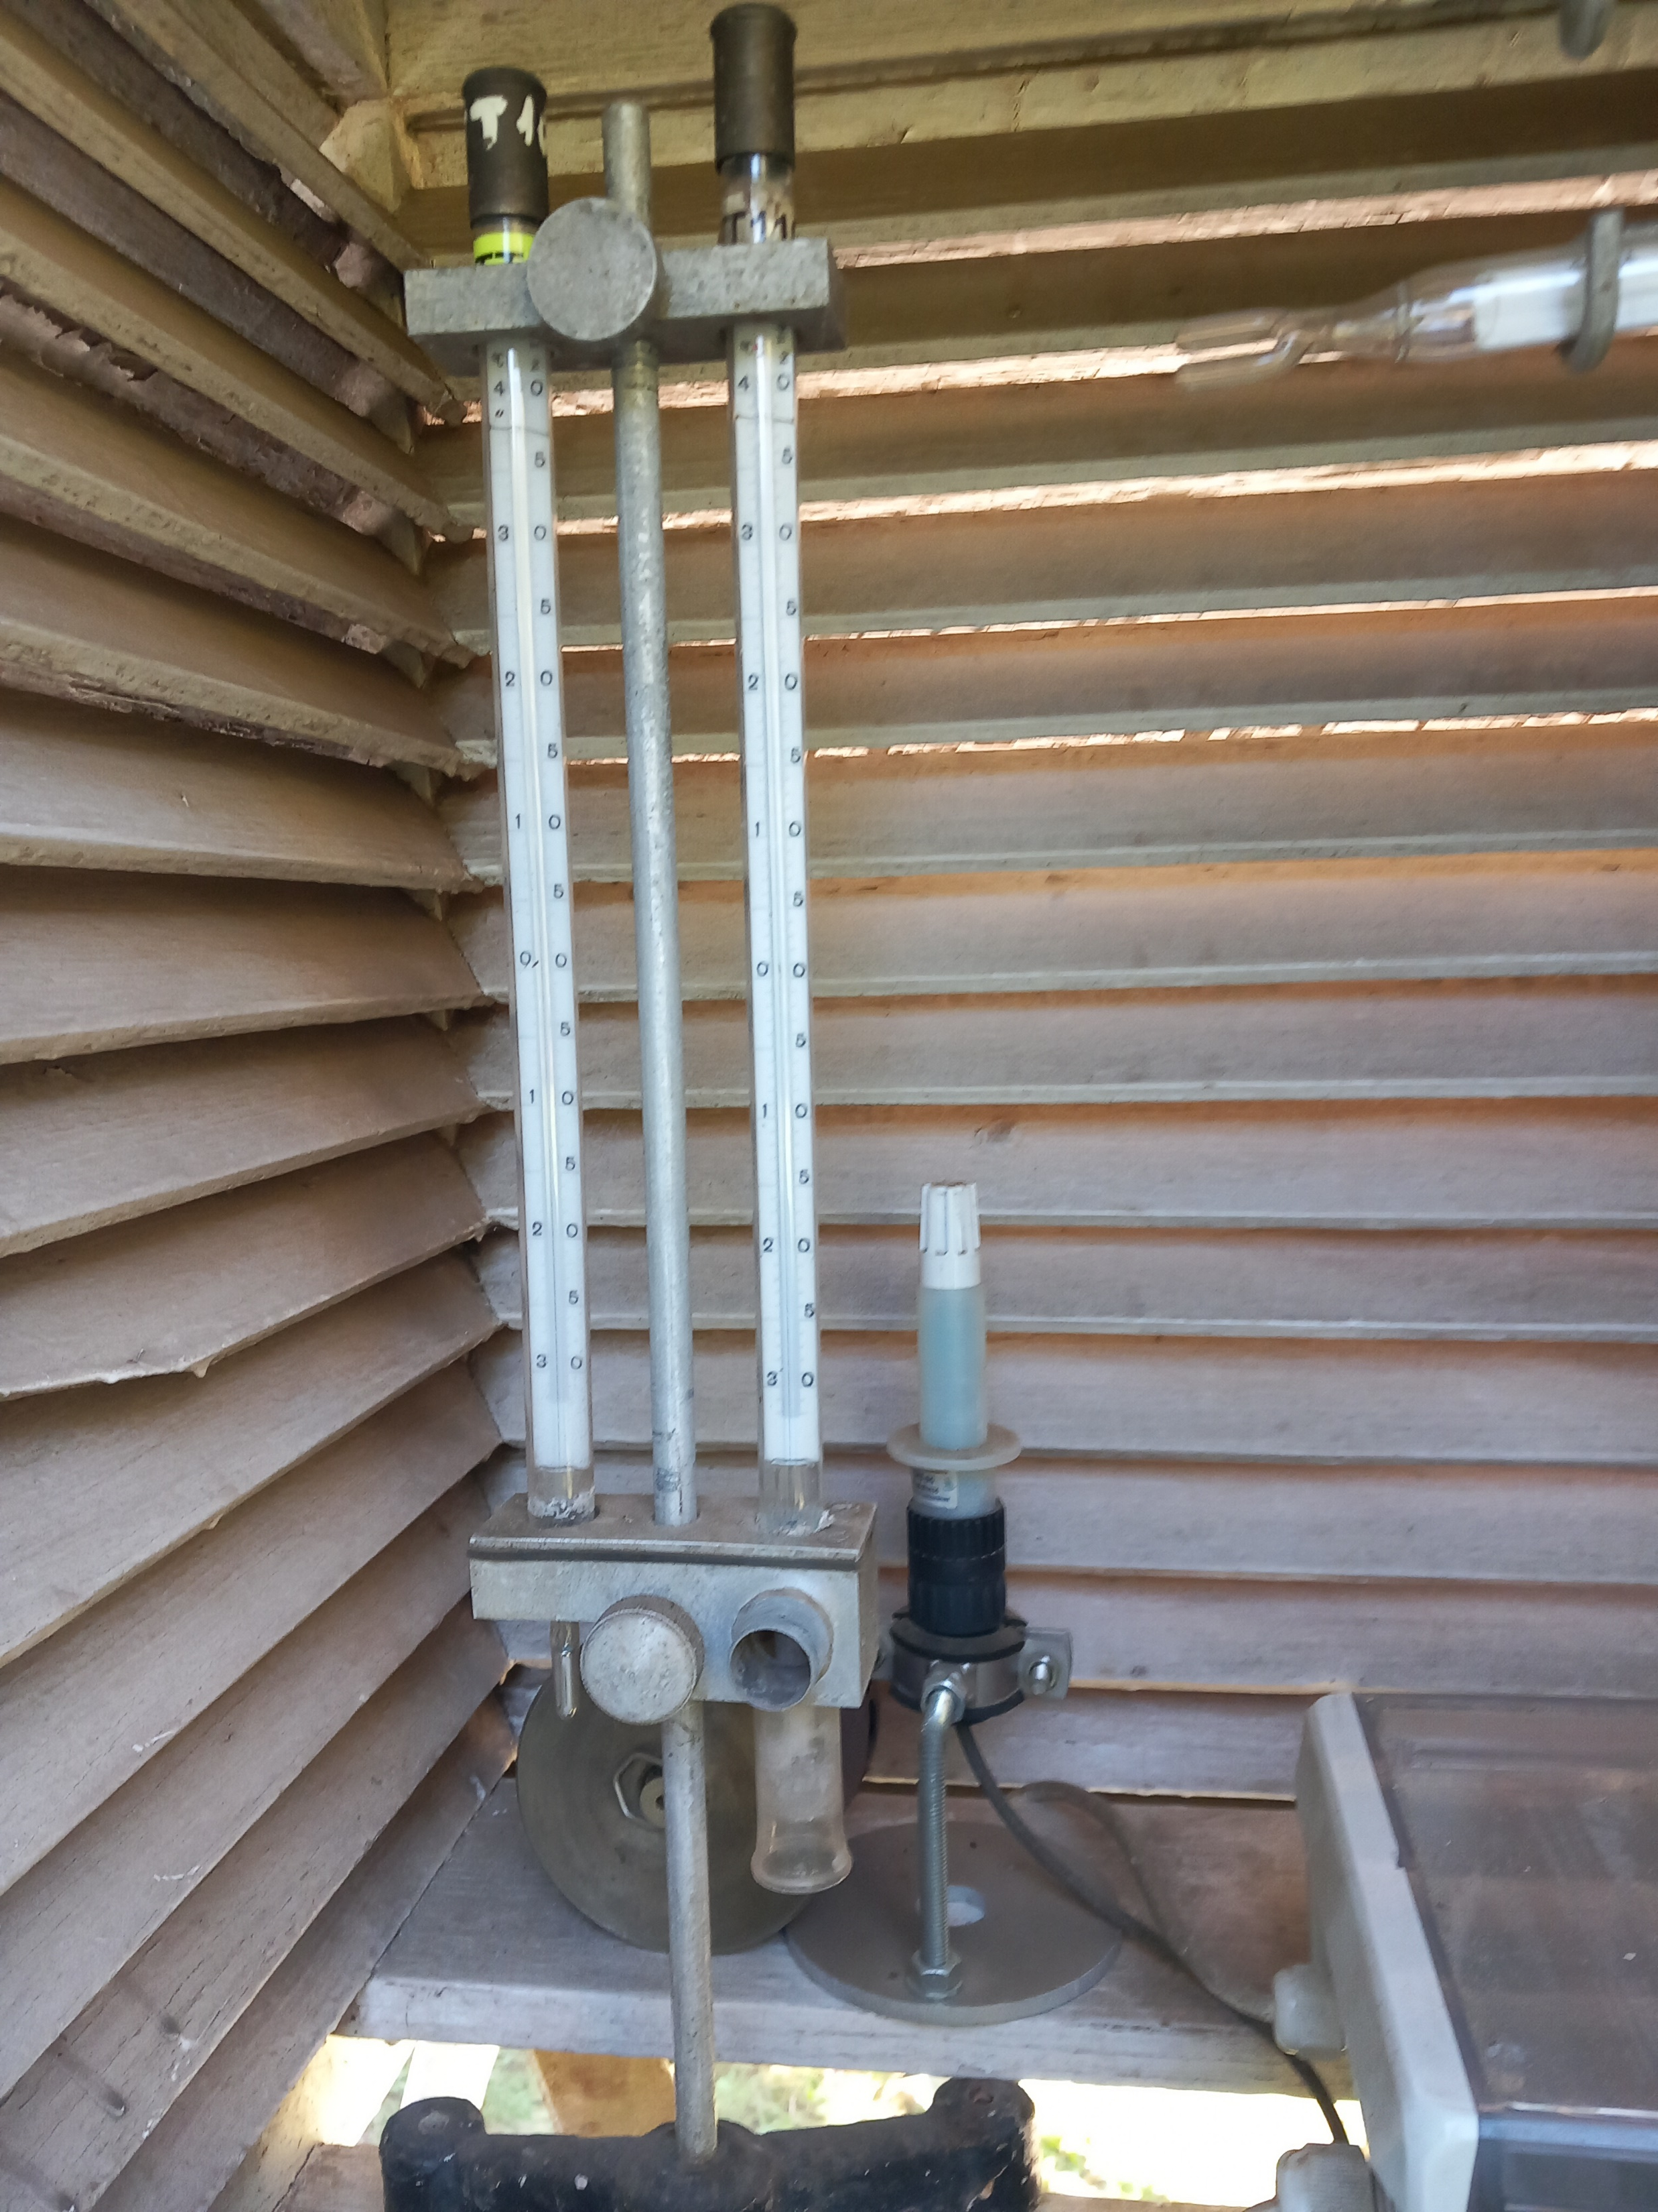
Instruments and methods
Instruments:
Precipitation: with Hellmann rain gauge
Temperature extremes: maximum with mercury thermometer, minimum with alcohol thermometer
Temperature and humidity: with a pair of dry-wet aspiration thermometers (after november 2019, BOREAS automatic)
Methods:
Precipitation, temperature (humidity, radiation minimum, vapor pressure, wind speed, snow layer) measurement data processing (trend lines, correlation, graphic representation), evaluation (diagrams, FAI)

Slide 9
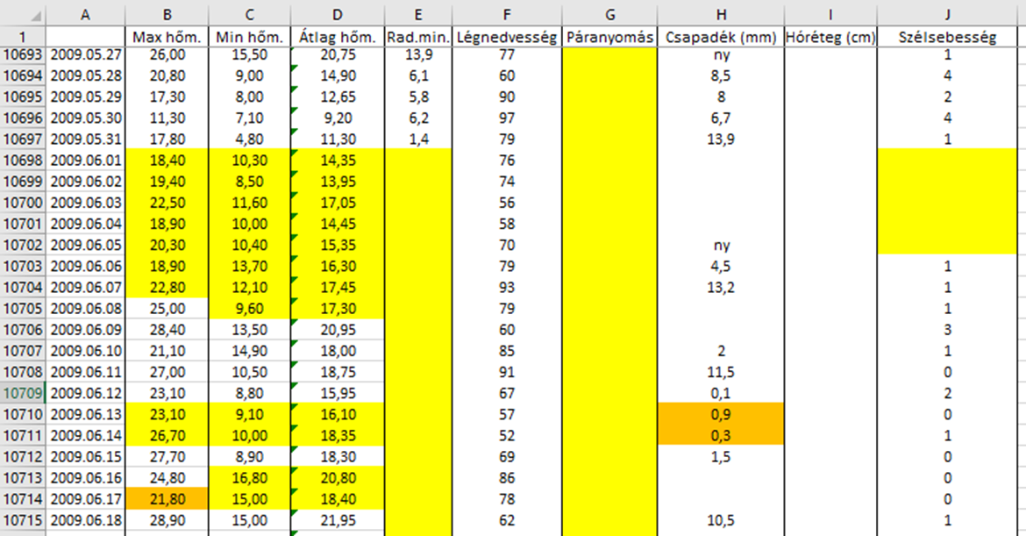
Instruments and methods
Data:
From the National Meteorological Service
I processed the data of the botanical garden measuring station from 1980.02.18. to 2023.07.31. partly from excel and partly from climate curves
Kuruc-domb station’s raw and homogenised data from 1870 to comparison

Slide 10
Results
Filtering out the gross and subtle errors using R:
Examples for maximum errors:
1997-08-16 263.0
2000-04-21 262.0
2001-07-01 285.8
2001-07-30 292.0
Examples for minimum errors:
1988-07-09 1505.0
1997-07-24 152.0
2003-07-21 155.0
2017-06-04 115.2

Slide 11
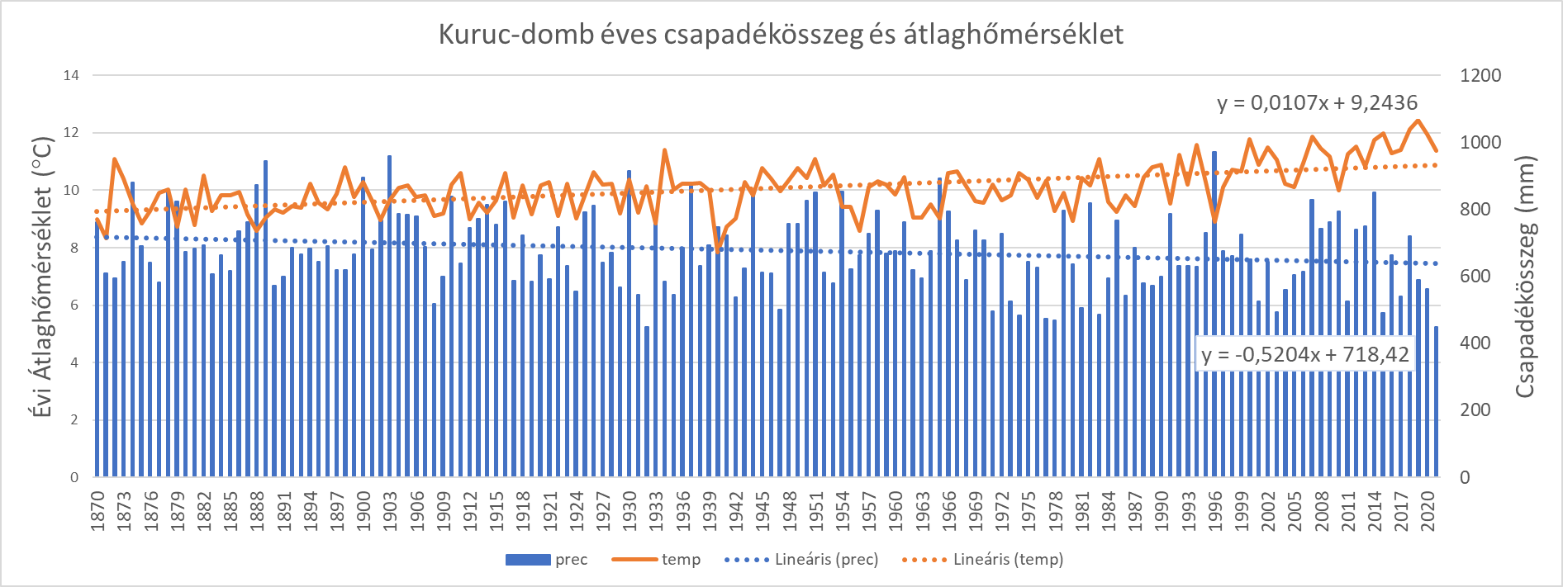
Results
Average annual temperature trend: 1.61 ° C/150 years
The trend of the amount of precipitation: -79mm/150 years.
A significant rise in temperature can be observed after 1990, so this is our selected 30-year period.
Kuruc-hill’s yearly precipitation sum and average temperature
Precipitation sum
Yearly average temperature

Slide 12
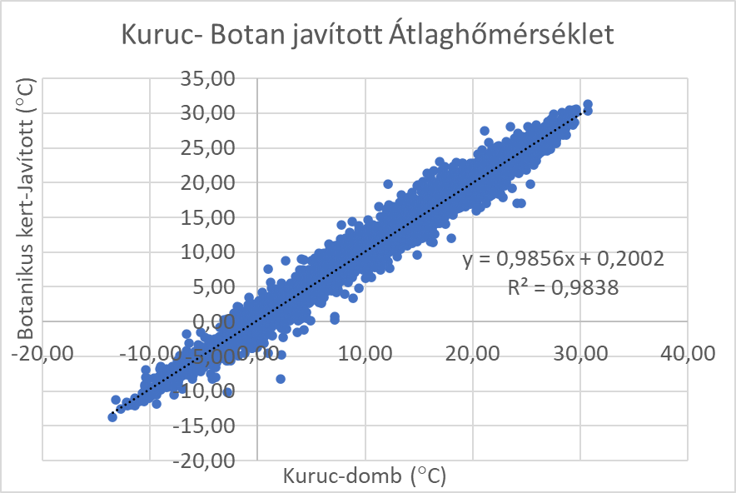
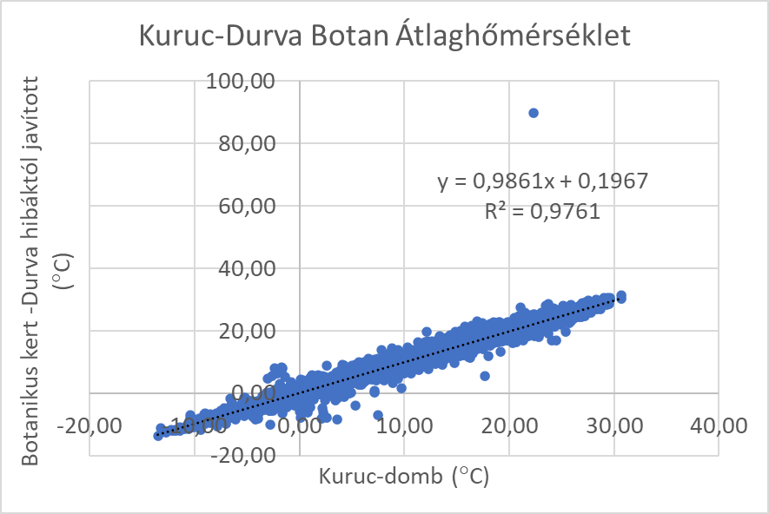
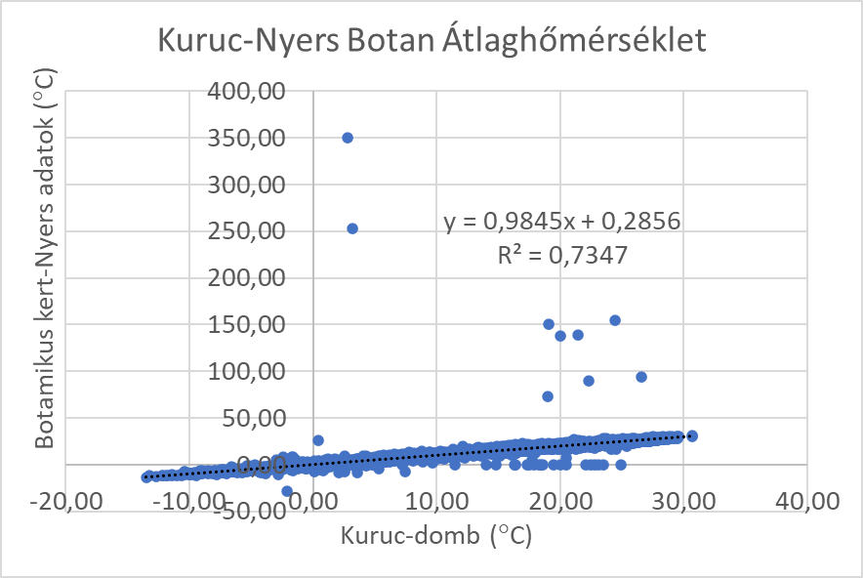
Results
Comparison of the average temperature of the 3 work phases of the Botanic Garden (raw data, data corrected for gross errors, and corrected data) with the Kuruc-domb data:
Corrected data
Gross errors
Raw data

Slide 13
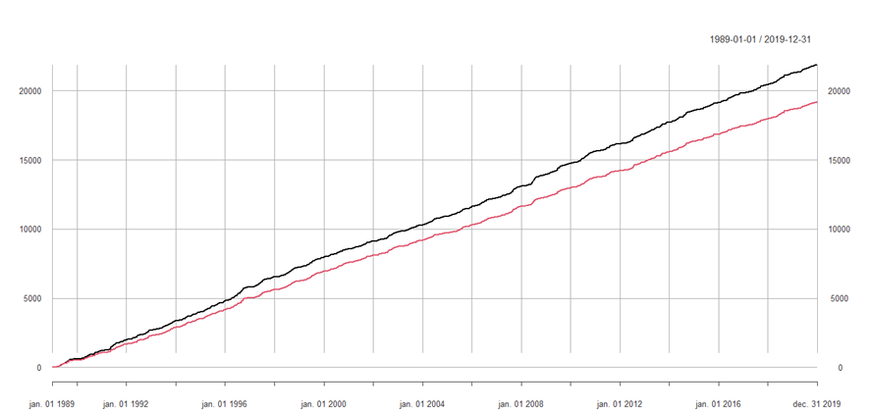
Results
Precipitation sum 1989-2019
Corrected Botanical garden and Kuruc hill precipitation
20000
15000
Botanical garden
10000
Kuruc-hill
5000
1989
2019
Precipitation sum for Kuruc Hill (red) and the Botanical Garden (black) (1989-2019)
Differences that can be traced back to the time of precipitation detection:
14.06.2003 Kuruc Hill: 32.80mm, Botanical Garden: 0.00mm, 15.06.2003. Kuruc Hill: 0.20mm, Botanical Garden: 56.20mm

Slide 14
Results
Amount of precipitation per category
Precipitation sum per category
 | 1930-1960 Old Botan | 1989-2019 Present Botan | Changes (%) | Changes (db)
0-1 | 8559 | 8666 | 1,3% | 107
1-5 | 1485 | 1374 | -7,5% | -111
5-10 | 622 | 629 | 1,1% | 7
10-20 | 466 | 425 | -8,8% | -41
20- | 191 | 228 | 19,4% | 37
Total | 11323 | 11322 | 0% | -1
 | 1930-1960 Old Botan | 1989-2019 Present Botan | Changes (%) | Changes (mm)
0-1 | 673,4 | 669,95 | -0,5% | -3,5
1-5 | 3922,8 | 3640,5 | -7,2% | -282,3
5-10 | 4490 | 4532,15 | 0,9% | 42,1
10-20 | 5888,5 | 5951 | 1,1% | 62,5
20- | 6557,6 | 7108 | 8,4% | 550,4
Prec. sum | 21532,3 | 21901,6 | 1,7% | 369,3

Slide 15
Results
Comparison of the 1930-1960 and 1989-2019 periods of the Botanical Garden:
1930-1960 yearly precipitation sum and average temperature
1989-2019 yearly precipitation sum and average temperature
Temperature rise of the 1930-1960 data series:
0.10°C/30 years, this trend is not significant
Temperature rise of the 1989-2019 data series:
1.68 ° C/30 years

Slide 16
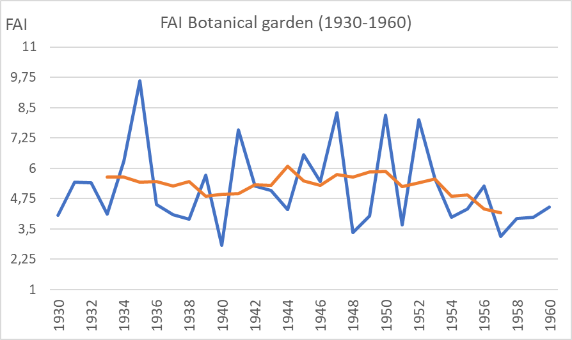
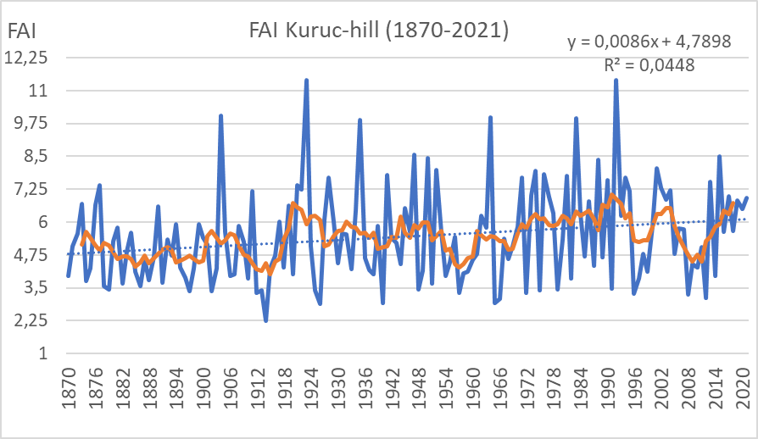
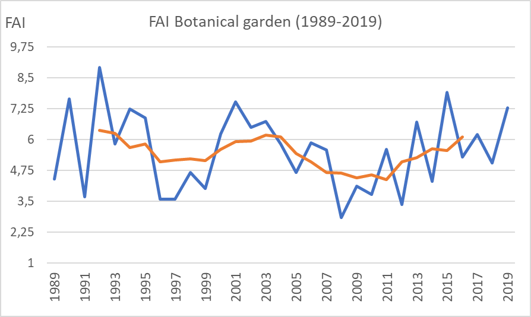
Results
Beech climate (B) | FAI≤4,75
Hornbeam oak climate (GYT) | 4,75<FAI≤6,00
Sessile oak/turkey oak climate (KTT/CS) | 6,00<FAI≤7,25
Forest-steppe climate (ESZTY) | 7,25<FAI≤8,50
Steppe climate (SZTY) | 8,50<FAI
Spruce destruction

Slide 17
Results
Botanical garden from 1930 to 1960
Botanical garden from 1989 to 2019
 | W | ET | W-ET-∆SOIL
1930-1960 | 695 | 620 | 75
1989-2019 | 710 | 679 | 31
∆ in mmm | -15 | -59 | 44
∆ in % | +2,2% | +9,5% | -58,7%

Slide 18
Summary
Database creation, Error correction, Continuity of measurements
Usability of database:
FAI (forestry aridity index), interception, evapotranspiration, snow development, water balance, analyzes from a forestry perspective (e.g.: in connection with afforestation, tree species exchange during plant planning negotiations)

Slide 19
Thank you for your attention!
The following joint projects (143972SNN project and the TKP2021-NKTA-43 project) supported the preparation of this paper. TKP2021-NKTA-43 has been implemented with the support provided by the Ministry of Innovation and Technology of Hungary (successor: Ministry of Culture and Innovation of Hungary) from the National Research, Development and Innovation Fund, financed under the TKP2021-NKTA funding scheme.
Supported by the ÚNKP-23-2-III-SOE-176 New National Excellence Program of the Ministry for Culture and Innovation from the source of the National Research, Development and Innovation Fund.

