Slide 1
Attributing the role of stratospheric variability in surface weather extremes and their impacts:
Insights from SNAPSI WG2
Will Seviour
Department of Mathematics and Statistics, University of Exeter
+
Amy Butler, Chaim Garfinkel, Peter Hitchcock
+
Blanca Ayarzagüena, Hannah Bloomfield, Andrew Dowdy, Natalia Calvo, Justin Finkel, Gerbrand Koren, Richard Leeding, Eun-Pa Lim, Daniel de Maeseneire, Gabriele Messori, Regan Mudhar, Philip Rupp, Masakazu Taguchi, James Anstey, Dong-Chan Hong, Viatcheslav Kharin, Hera Kim, Jeff Knight, Daniele Mastrangelo, Michael Sigmond, Isla Simpson, Damien Specq, Tim Stockdale
Photo: UK snow following the 2018 “Beast from the East”

Slide 2
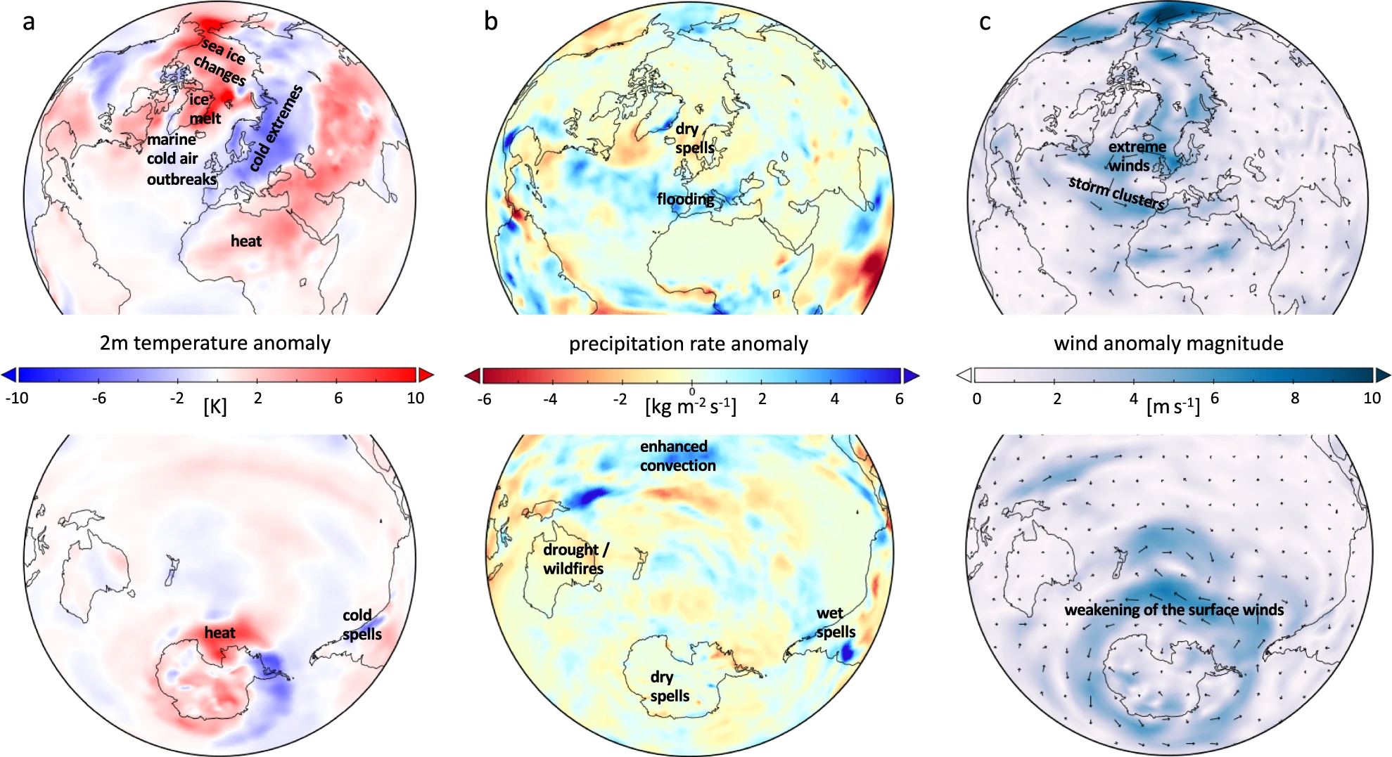
A variety of extreme weather events have been observed to follow sudden stratospheric warmings (SSWs).
Domeisen and Butler, 2020

Slide 3
SNAPSI WG2 research question
How does the occurrence (or non-occurrence) of an SSW impact the risk of a given weather extreme and its associated impacts?
… or, more practically
(How much) can improved forecasts of the stratospheric state lead to earlier accurate forecasts of a given extreme event and its impacts?

Slide 4
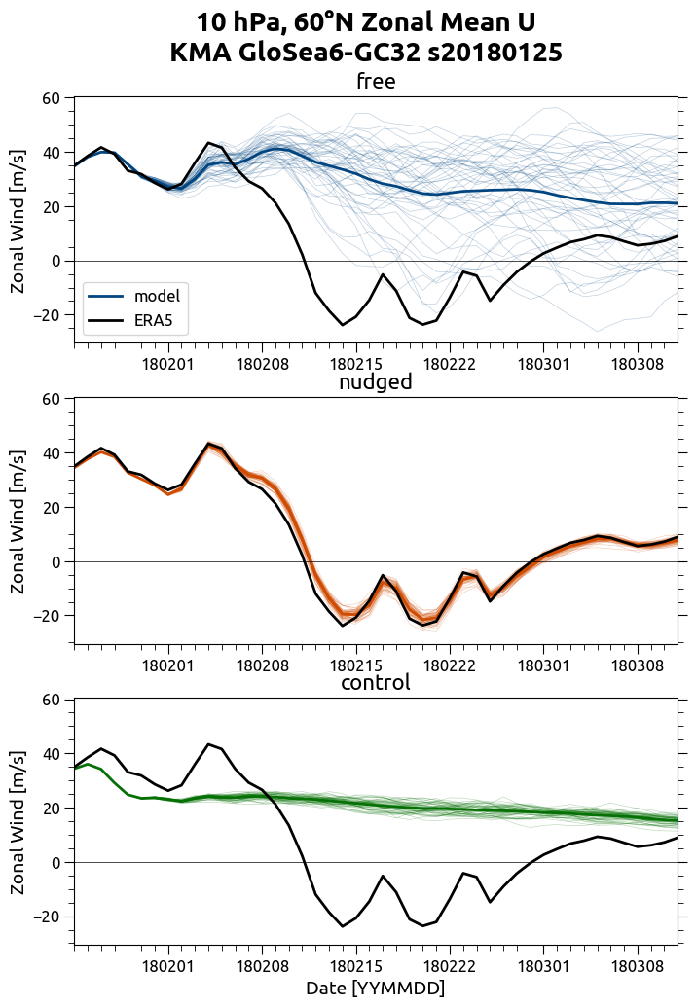
SNAPSI experimental design
The SNAPSI protocol defines three core types of ensemble forecasts
Free: Free running ensemble forecast
Nudged: Zonally symmetric component of stratosphere nudged to observed evolution
Control: Zonally symmetric component of stratosphere nudged to climatology
We requested >50 member ensembles with 11 models participating.
Forecasts have been made of three recent events. There are two initialisation dates for each event.

Slide 5
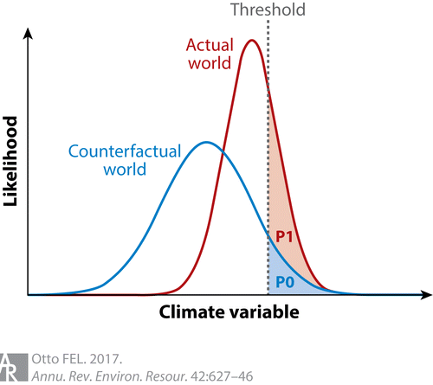
Extreme event attribution
Event attribution is most often seen as a scenario-based attribution (counterfactual taken to be a climate scenario) but within SNAPSI we will perform a process-based attribution (counterfactual taken to be a scenario with a particular physical process—a SSW—prescribed).
‘Actual (forecast) world’
$p(A)$: probability of extreme event A (from free)
‘Counterfactual worlds’
$p(A|V^{−})$: probability given weakened polar vortex (from nudged)
$p(A|V^{0})$: probability given climatological polar vortex (from control)

Slide 6
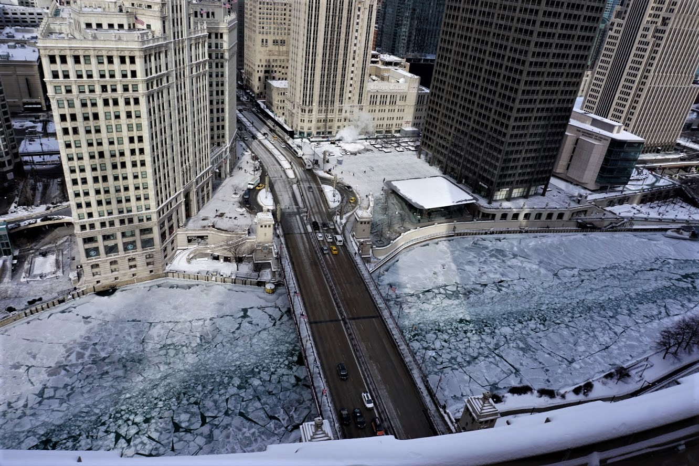
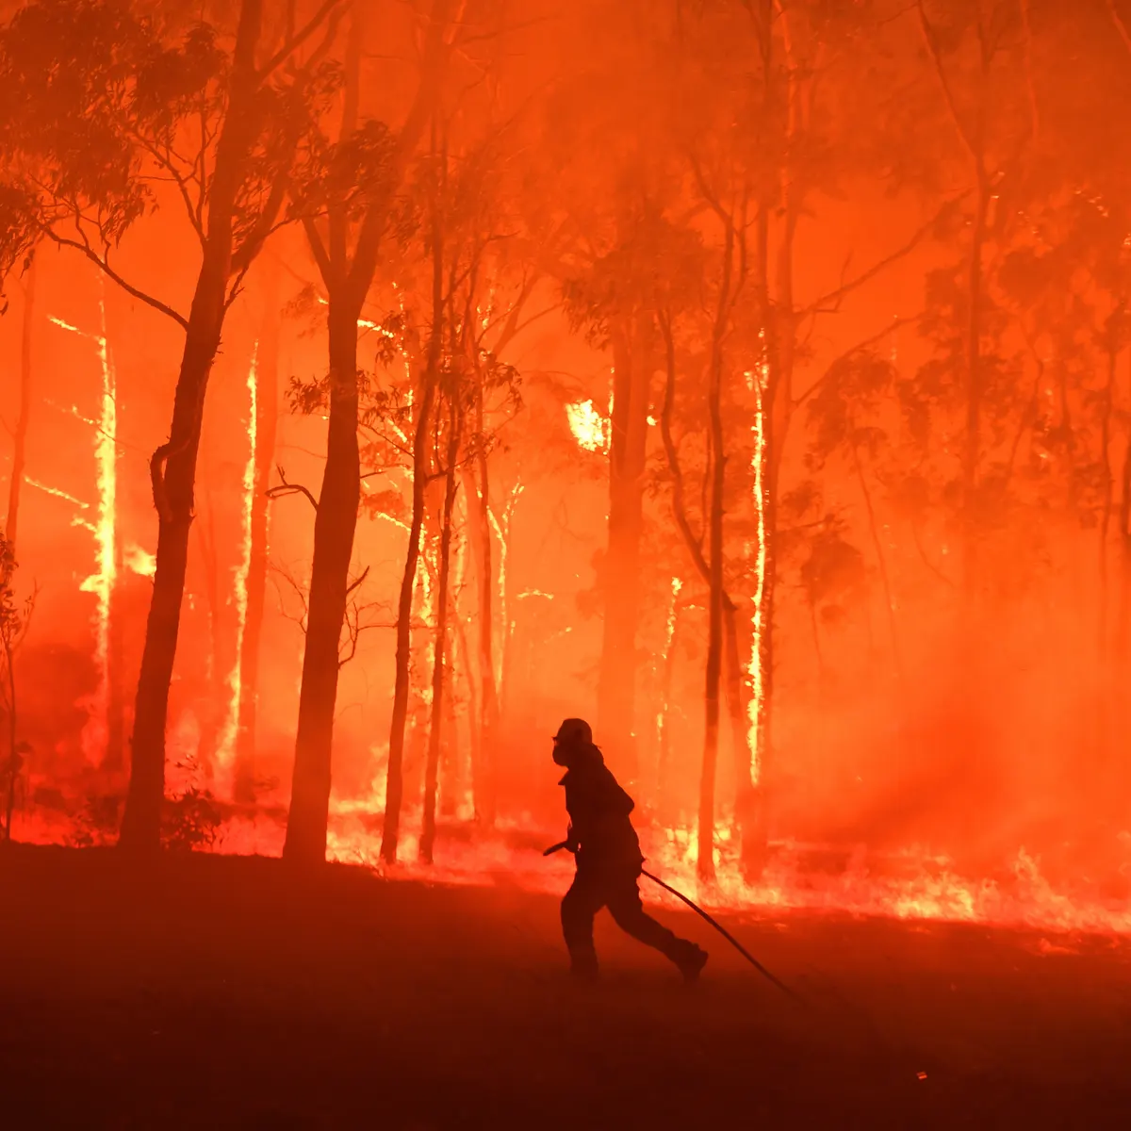
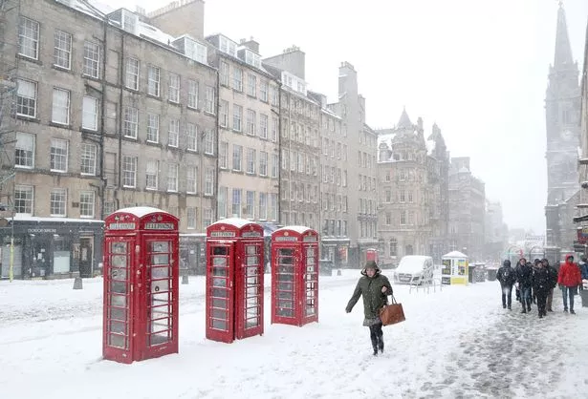
SNAPSI case study extremes
CS1: NH SSW, Feb 2018
CS2: NH SSW, Jan 2019
CS3: SH minor SSW, Sep 2019
Cold weather in Europe and Northern Asia (“Beast from the East”)
Warm Northeastern North America/Greenland (polynya)
End of Iberian drought
European windstorm
North American cold air outbreak, Jan-Feb
Hot and dry anomalies in Australia from Oct-Nov
Severe Australian wildfires in Dec
e.g. Kautz et al. 2020, Knight et al. 2020, Lim et al. 2019

Slide 7
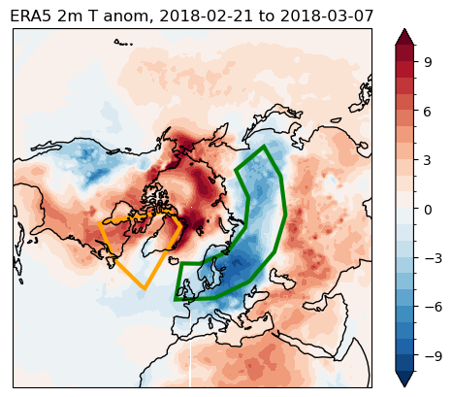
CS1: Observed and ensemble-mean temperature
nudged-free
initialised 18 days pre-SSW
nudged-free
initialised 4 days pre-SSW
IFS
IFS
Nudged forecasts better capture cold Eurasia and warm North America at long lead times.
At short lead times SSW is well-forecast by free forecasts, and there is little difference between nudged and free ensemble means.

Slide 8
CS1: Extreme Eurasian temperature risk (IFS)
For long-lead forecasts, risk of extreme cold is ~3x higher in nudged than free, but for short leads risks are roughly equivalent.
However, nudged risk is higher than control for both initialisations, indicating a continuing role for the stratosphere in driving cold spell risk.
Extreme cold
Figure: Justin Finkel

Slide 9
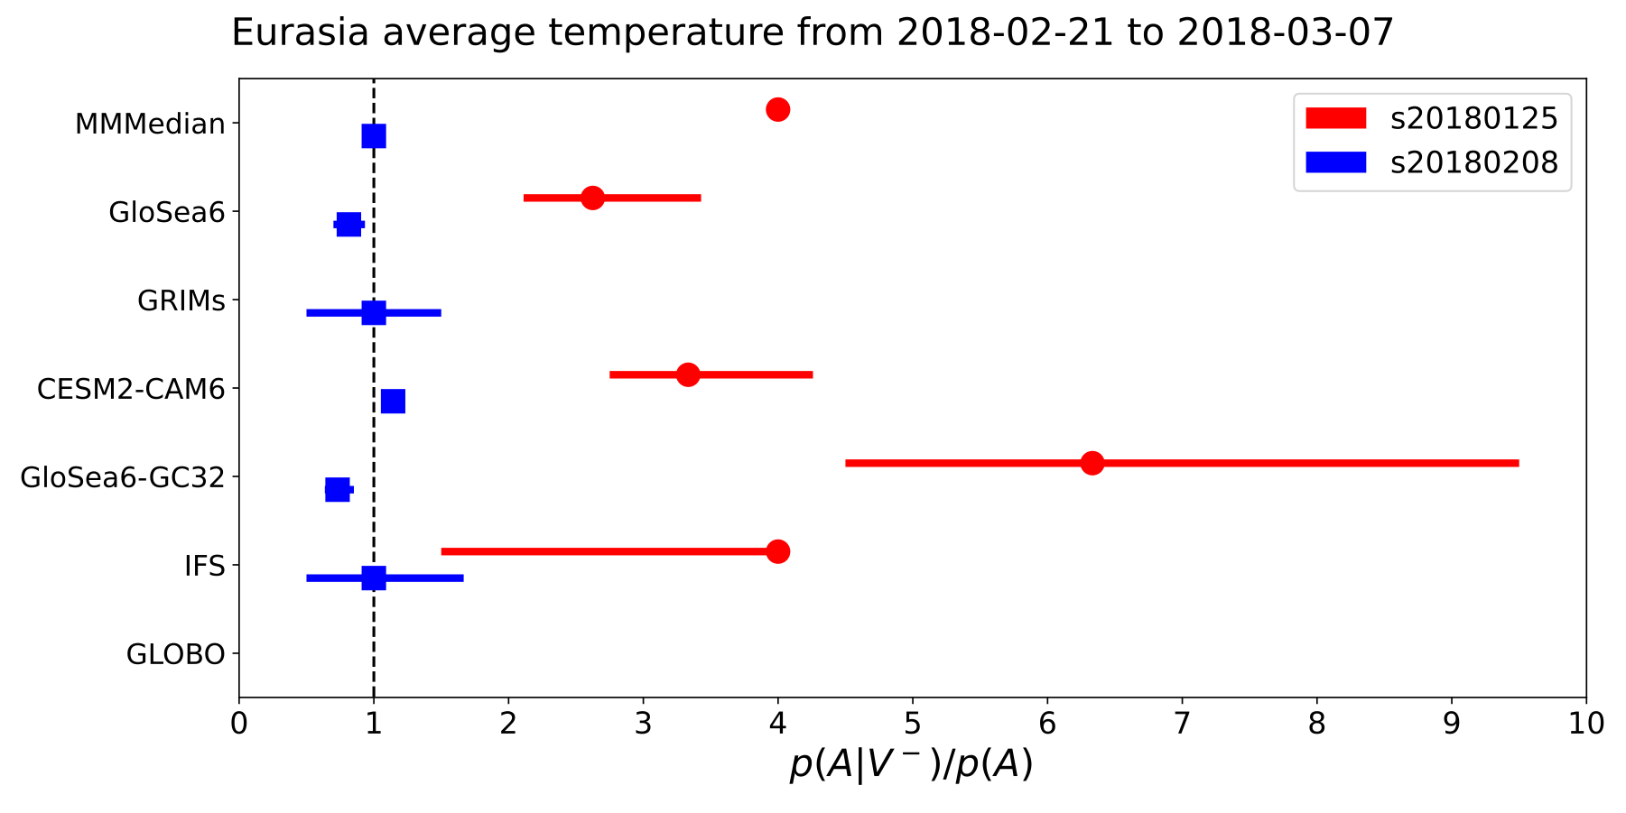
CS1: Extreme temperature risk: multi-model
Across multiple models, relative risk of extreme Eurasian cold is ~2-6x higher in nudged than in free experiments for the long-lead forecasts.
$\frac{nudged}{free}$ relative risk

Slide 10
SNAPSI case study extremes
CS1: NH SSW, Feb 2018
CS2: NH SSW, Jan 2019
CS3: SH minor SSW, Sep 2019
Cold weather in Europe and Northern Asia (“Beast from the East”)
Warm Northeastern North America/Greenland (polynya)
End of Iberian drought
European windstorm
North American cold air outbreak, Jan-Feb
Hot and dry anomalies in Australia from Oct-Nov
Severe Australian wildfires in Dec
e.g. Kautz et al. 2020, Knight et al. 2020, Lim et al. 2019

Slide 11
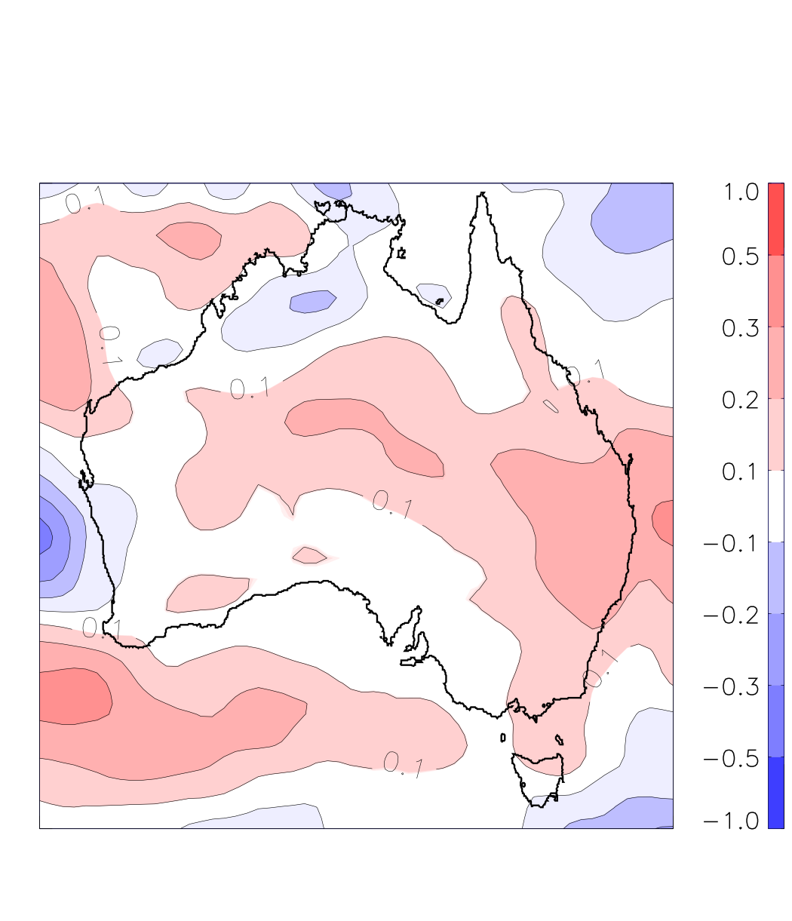
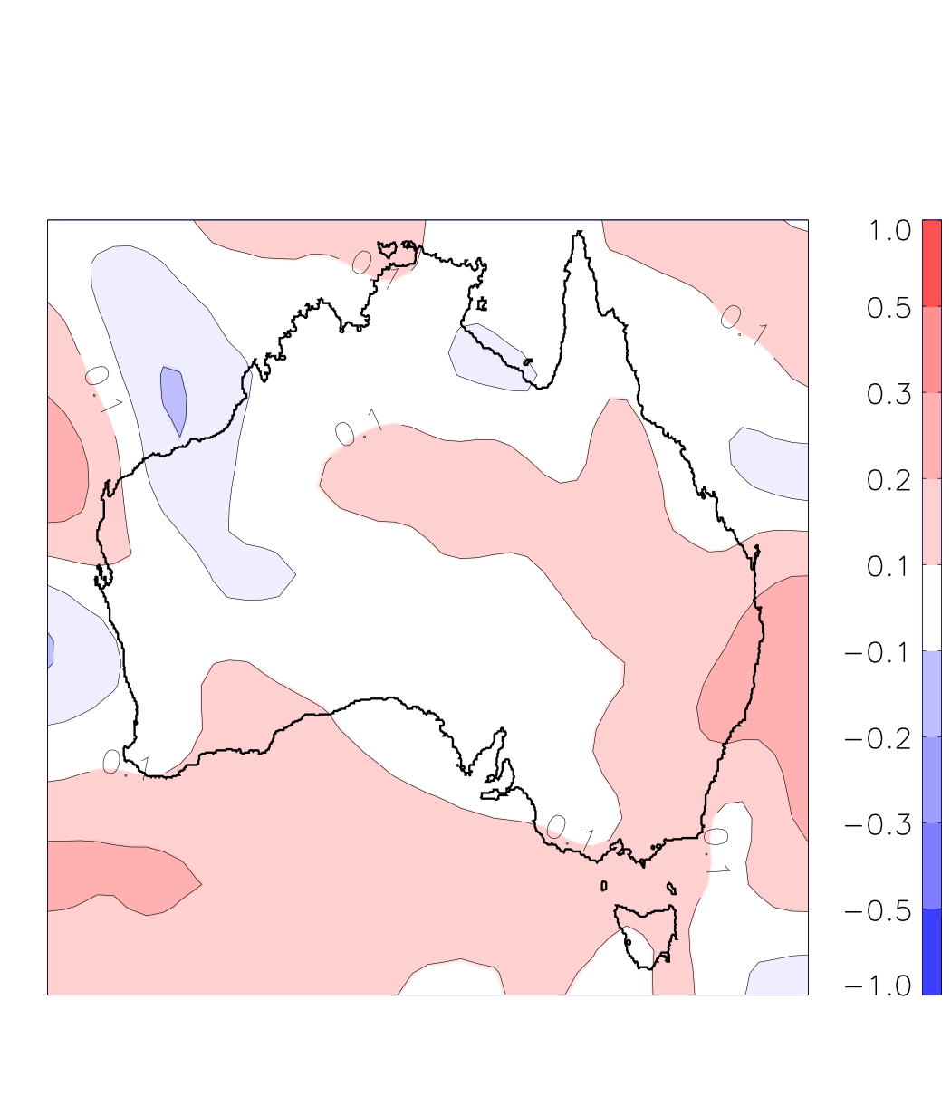
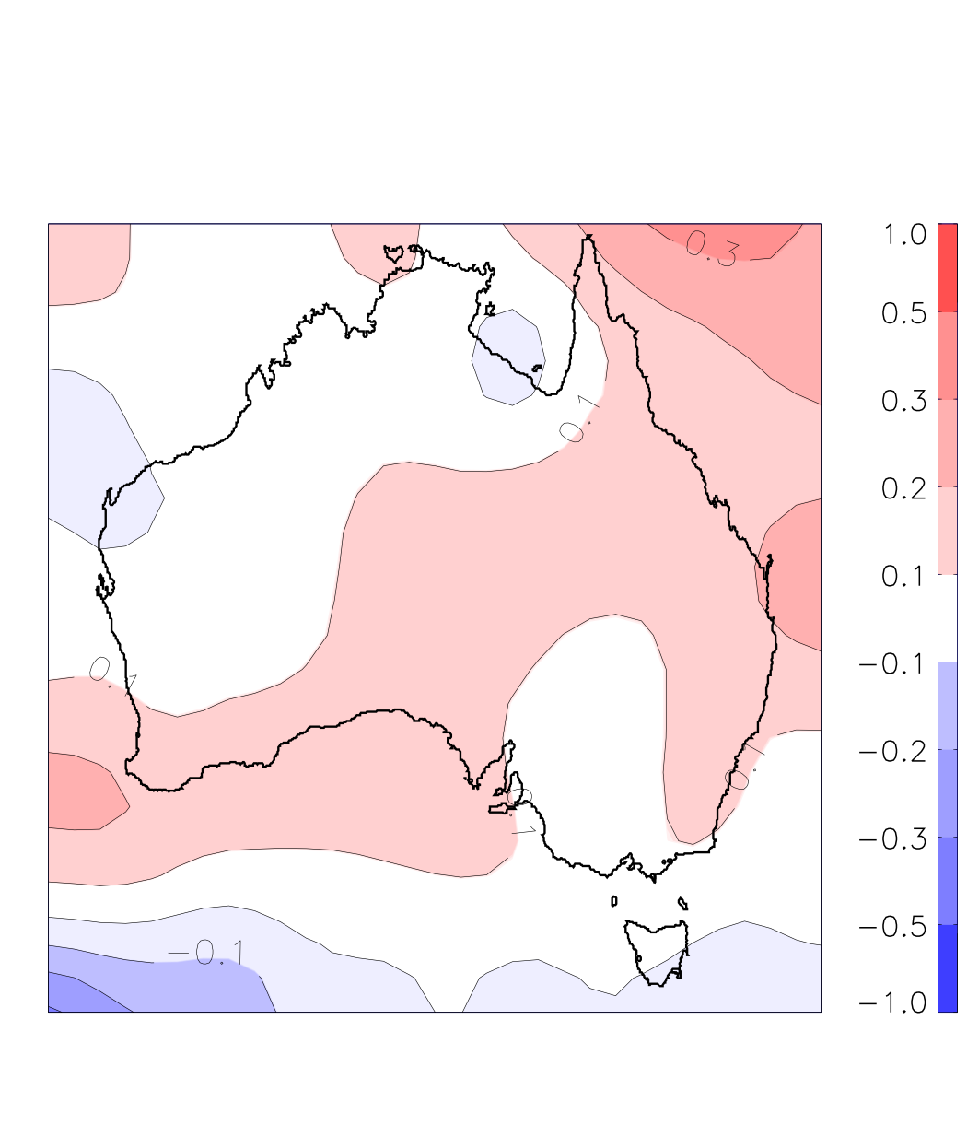
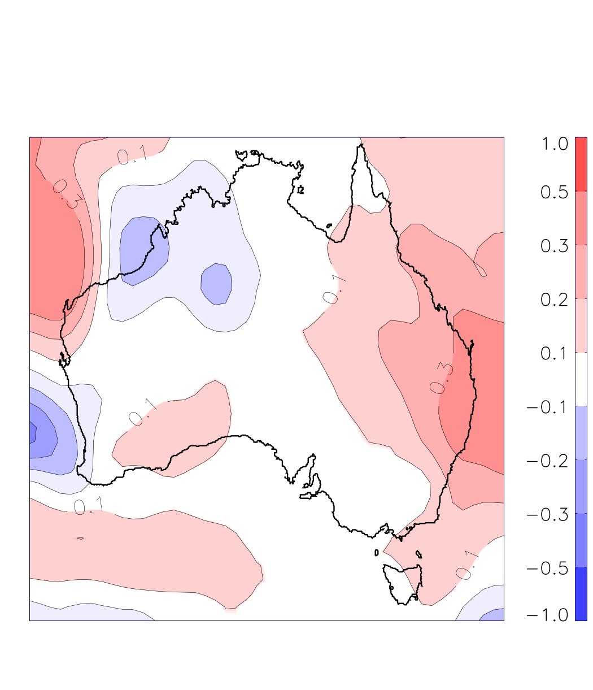
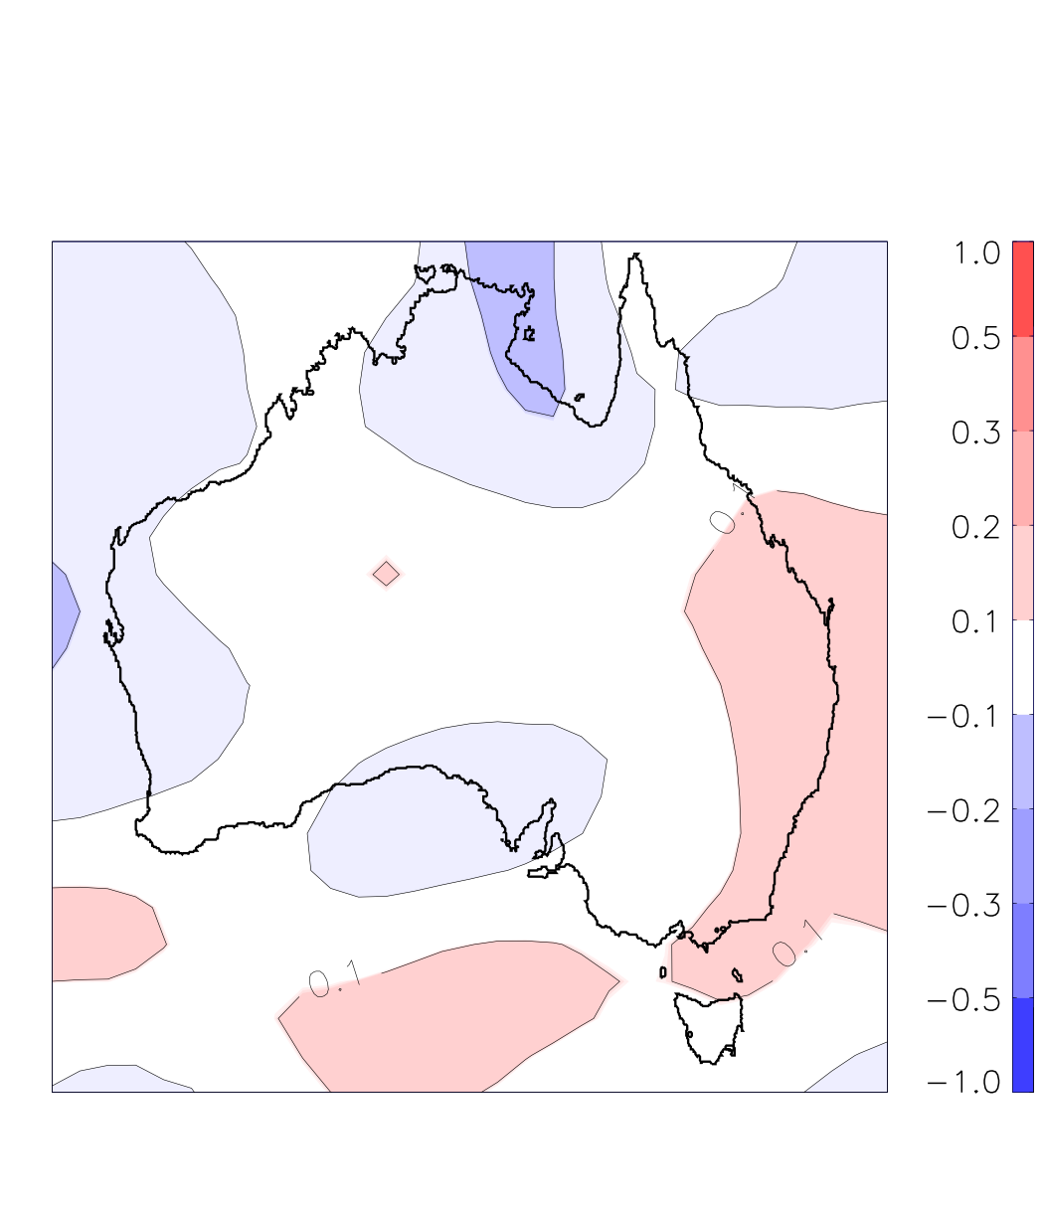
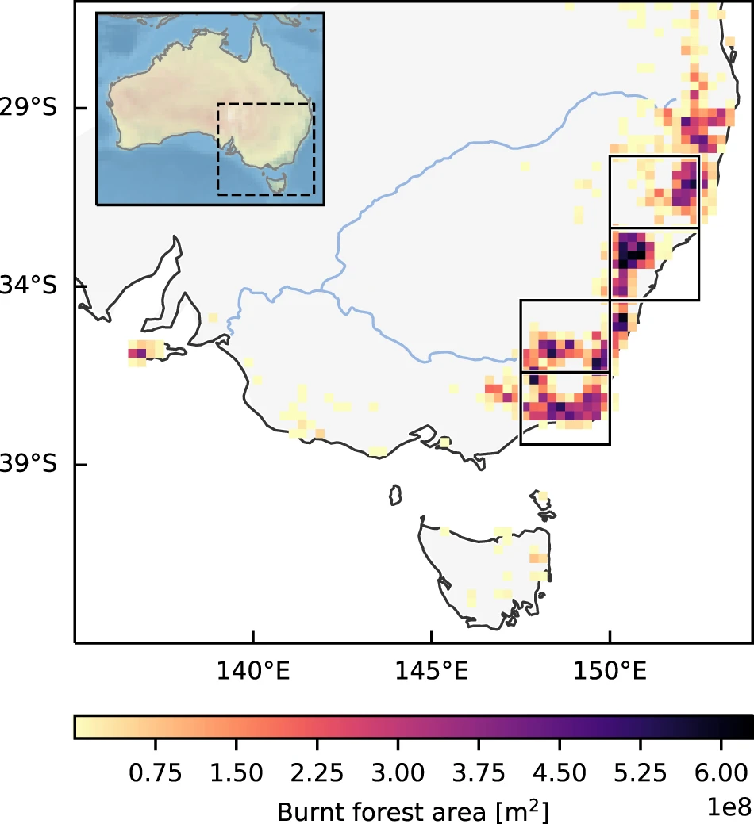
CS3: Australian Hot-Dry-Windy wildfire risk
$FAR=1−\frac{control risk}{nudged risk}$
GloSea6
IFS
GRIMs
CNRM
GloSea6-GC32
FAR
Models consistently show increase in extreme wildfire risk (FAR>0) from mid Oct-mid Nov of 10-30% in nudged relative to control experiments (long lead times).
Region of increased risk aligns with region of observed wildfires (Squire et al. 2021).
Figure: Andrew Dowdy
(HDW index: Srock et al. 2019)

Slide 12
Summary
Using nudged subseasonal forecasts we are performing a process attribution for extreme events.
Risk of an extreme Eurasian cold spell in 2018 is several times larger in forecasts with the stratosphere nudged to its observed evolution at long (2-3 week) lead times.
Extreme SE Australian wildfire risk index is ~10-30% more likely in forecasts with nudged stratosphere.
There’s a lot still to look at; additional participants would be very welcome.
Please check out our poster in X5.97 on Wednesday from 10:45-12:30 for another SNAP project!
Get in touch:
Will Seviour
w.seviour@exeter.ac.uk
Amy Butler
amy.butler@noaa.gov
Chaim Garfinkel
chaim.garfinkel@mail.huji.ac.il
Peter Hitchcock
aph28@cornell.edu

Slide 13
GloSea6
IFS
GRIMs
CNRM
GloSea6-GC32
FAR

