Slide 1
Paired plot water balance experiment setup in the botanic garden of the University of Sopron
Kamilla Orosz,
András Herceg, Péter Kalicz, Katalin Anita Zagyvai-Kiss, Klaudija Lebar, Katarina Zabret, Nejc Bezak, Gábor Keve, Dániel Koch, Alivio Mark, Zoltán Gribovszki
Notes:
In our research we set up a paired-plot-based water balance experiment in the botanic garden of the University of Sopron.
This experiment was conducted as part of an international Slovenian-Hungarian international project.

Slide 2
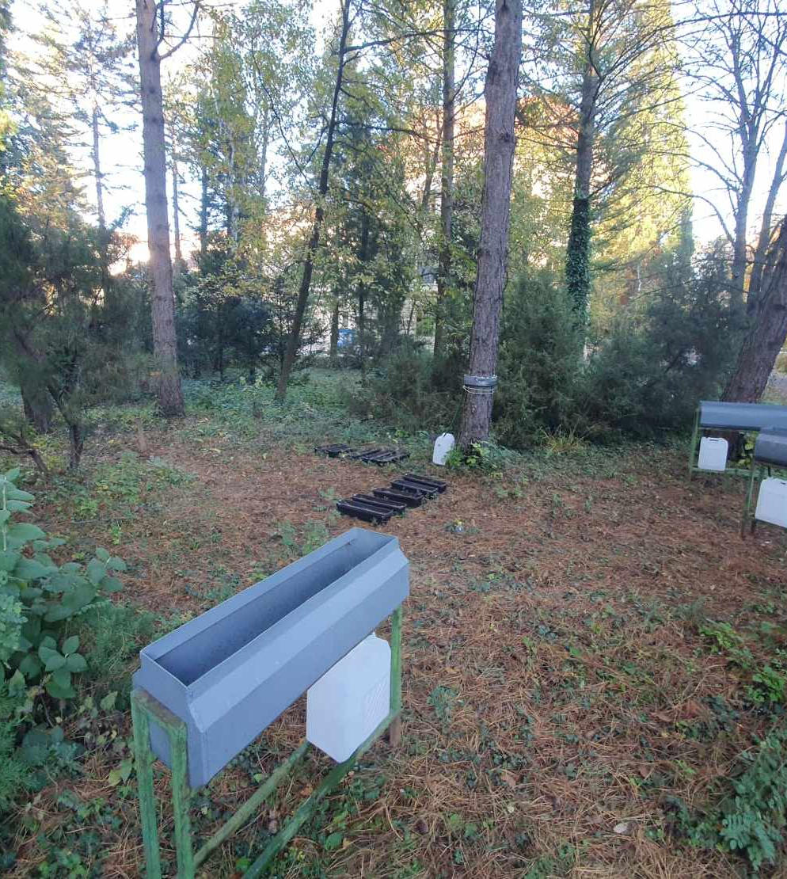
Paired plot sites
Water balance comparison of different surface covers
Established weather station
Experimental site under pine trees
Notes:
For comparative purposes, we designated an open-air plot as a control site, positioned approximately 50 meters away from he pine trees.
The research benefited from a well-established weather station, which had been collecting data over an extensive period.
The first set of experiments is suitable for analysing rainfall distribution in a forest, and for comparing the soil moisture and groundwater dynamics of grass and forest plots.

Slide 3
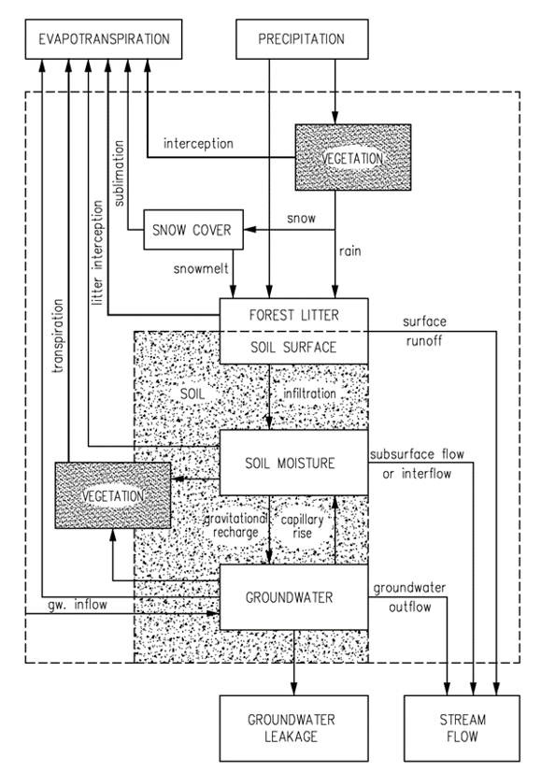
Method
Precipitation and interception
Forest litter
Soil moisture
Groundwater level
Complex water balance
Notes:
To determine the water balance of the test area, we measured the outdoor precipitation in the meteorological garden, and in the experimental area under the pines, the amount of precipitation falling through the canopy, runoff from the trunk of the tree, as well as the amount of precipitation retained by and seeped through the forest litter.
We also monitored the fluctuations in water levels and analyzed how precipitation events impacted the area's water resources.
The focus of our research was to gain a better understanding of the complex water dynamics within the research site under the black pine tree canopy.
The primary goal was to quantify water volumes at various stages of precipitation to establish a water balance model for this ecosystem.

Slide 4
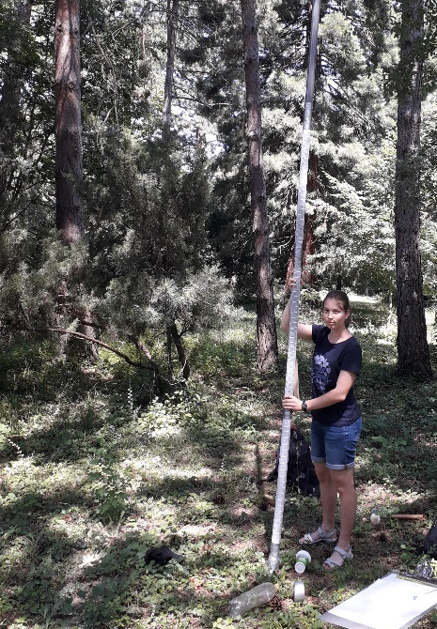
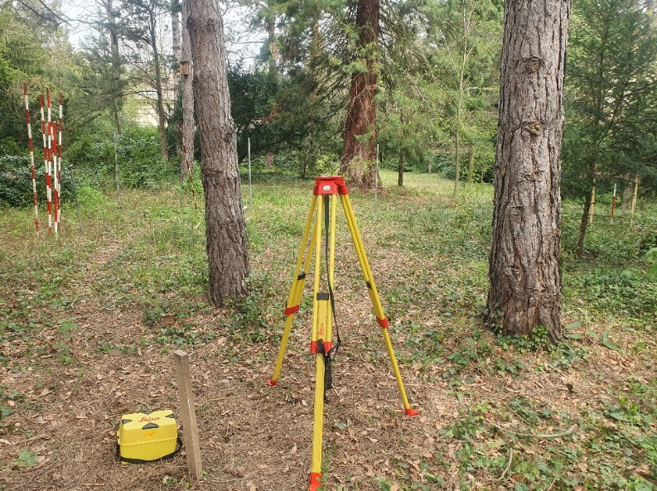
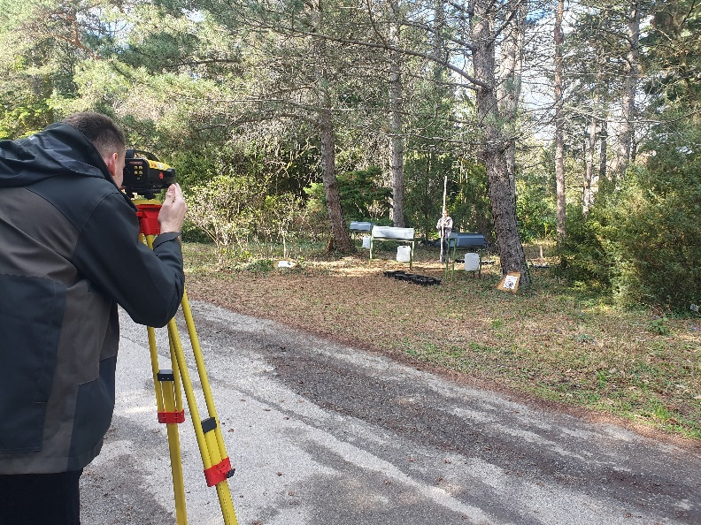
groundwater wells
Black pine tree plot: constructed in April – 5 m
Control site: July – 6,2 m
Installed PVC pipes with a diameter of 5 cm were inserted into holes with a diameter of 7 cm.
Filtration at the bottom 3 and 4 meters, respectively.
Difference in elevation ~1,5m – 228,24m; 229,55m above sea level
Notes:
Water levels were reached at 3 and 4.7 meters respectively during drilling.

Slide 5
Soil layers
Pine plot →
Control
 | 1. 0,0 – 0,3 m | Humus; Sandy slit
 | 2. 0,3 – 0,75 m | Clay
 | 3. 0,75 – 1,15 m | Sandy slit
 | 4. 1,15 – 1,6 m | Fine slit
 | 5. 1,6 – 2,4 m | Clay (yellowish)
 | 6. 2,4 – 2,5 m | Sand
 | 7. 2,5 – 2,7 m | Clay (yellowish-grey)
 | 8. 2,7 – 2,8 m | Sand (w = 19,5%)
 | 9. 2,8 – 3,2 m | Clay (yellowish)
 |  | 3 m: groundwater level
 | 10. 3,2 – 5,0 m | Grey clay
 | 1. 0,0 – 0,4 m | Humus
 | 2. 0,4 – 0,8 m | Silty clay
 | 3. 0,8 – 1,2 m | Clay
 | 4. 1,2 – 2,1 m | Grey clay
 | 5. 2,1 – 2,5 m | Aleulit (clay)
 | 6. 2,5 – 2,9 m | Grey clay
 | 7. 2,9 – 3,0 m | Aleulit
 | 8. 3,0 – 3,6 m | Clay (yellowish-grey)
 | 9. 3,6 – 4,6 m | Clay (yellow)
 | 10. 4,6 – 4,85 m | Sand
 |  | 4,7 m: groundwater level
 | 11. 4,85 – 5,75 m | Aleulit (clay)
 | 12. 5,75 – 6,0 m | Wet sand
 | 13. 6,0 – 6,2 m | Wet clay
Notes:
soil particle size distribution; sieve analysis;
Mainly clay, sand + aleulit make up the soil
Clay-agyag, silt-iszap, sand-homok, gravel-kavics

Slide 6
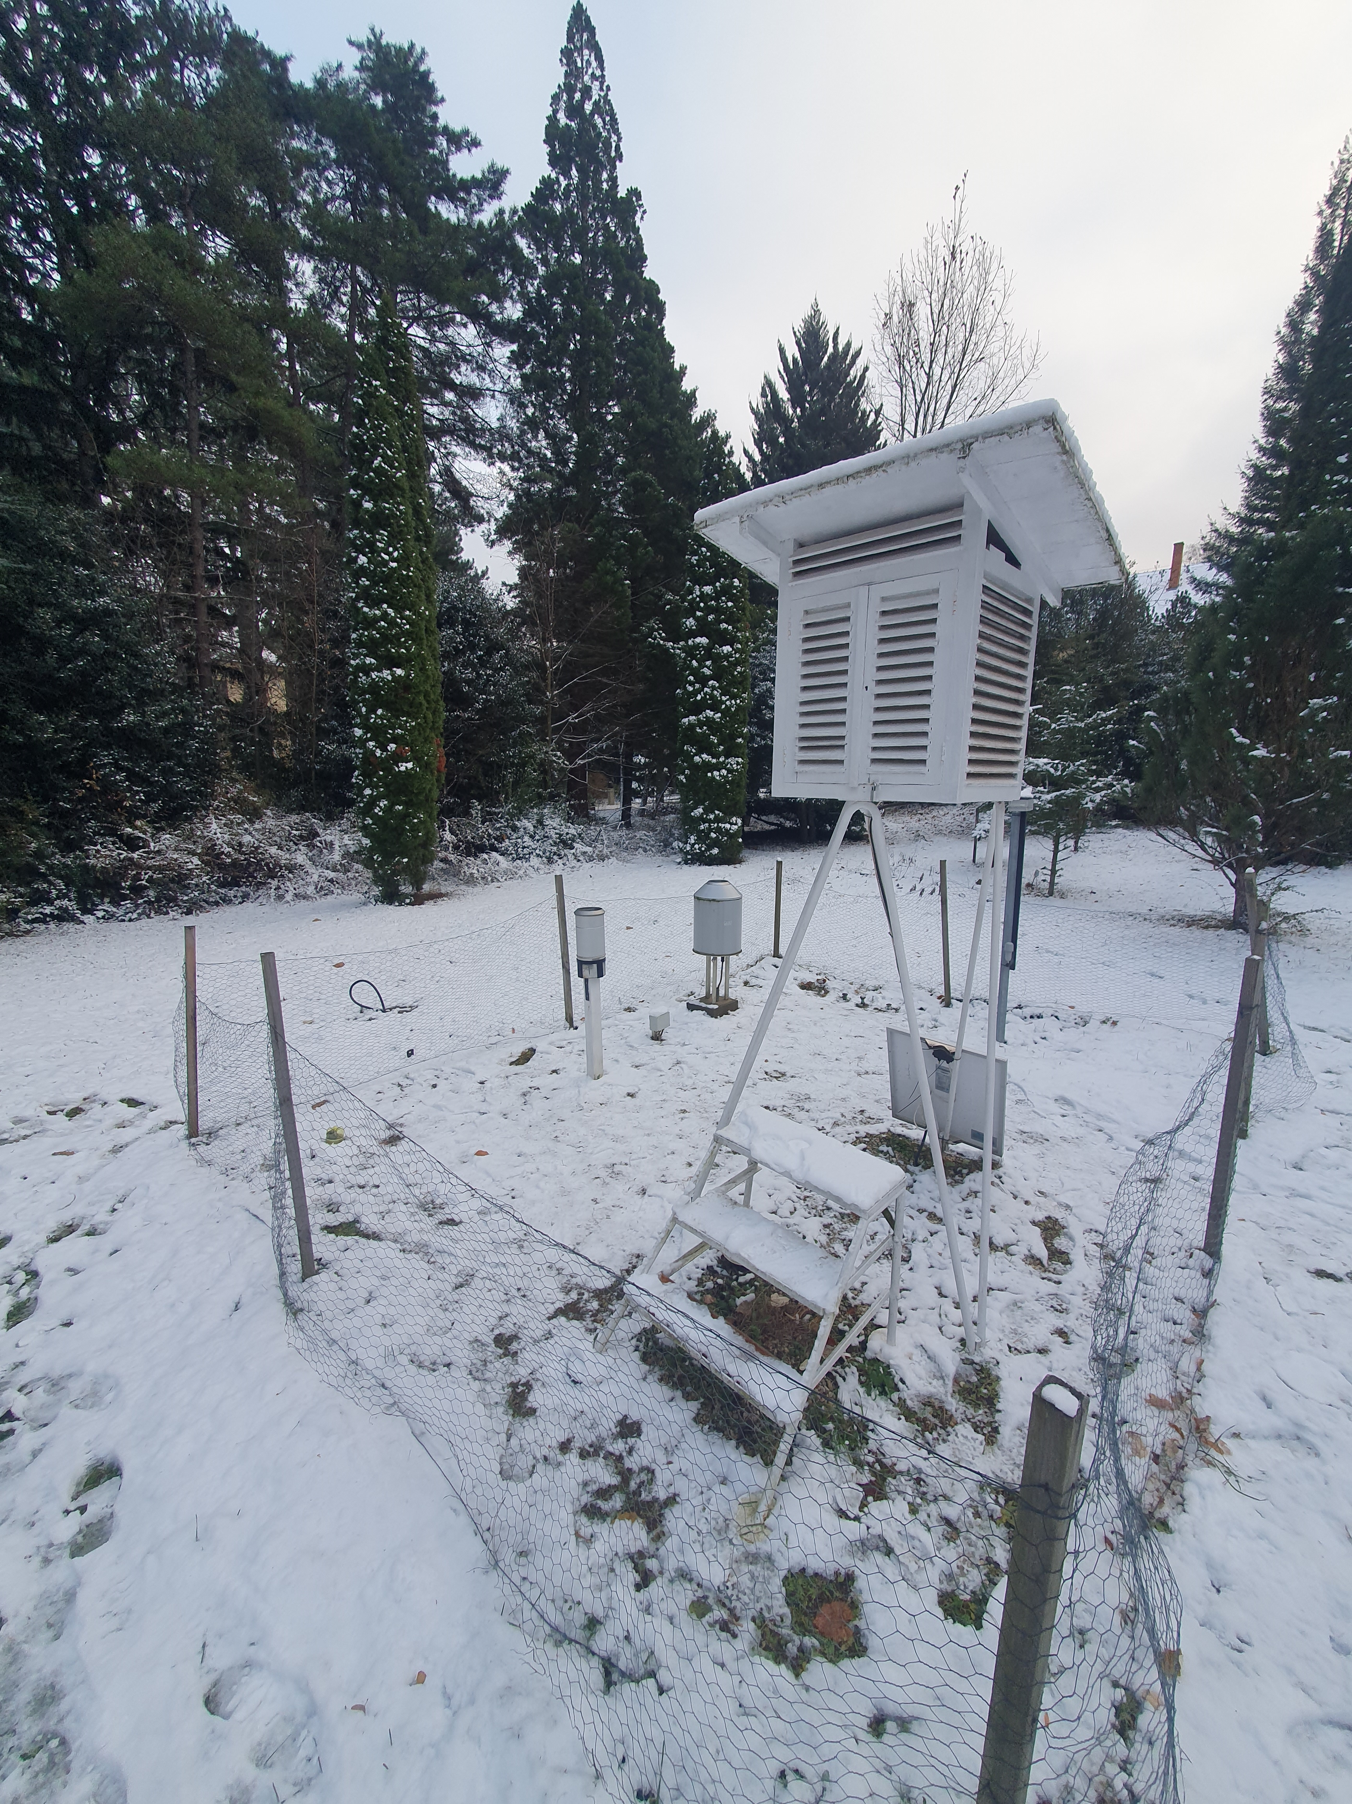
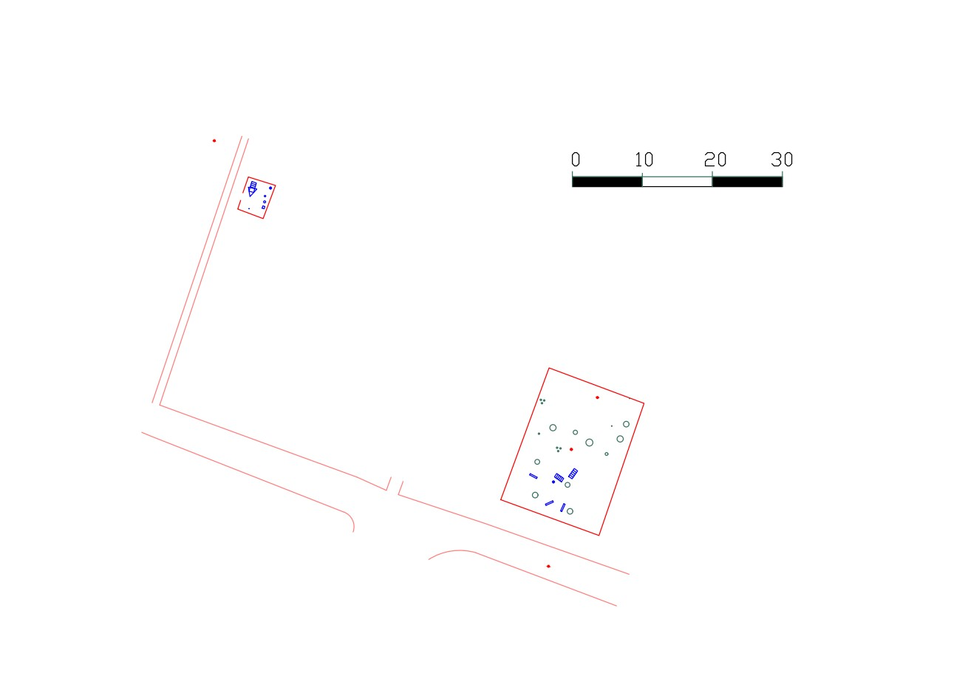
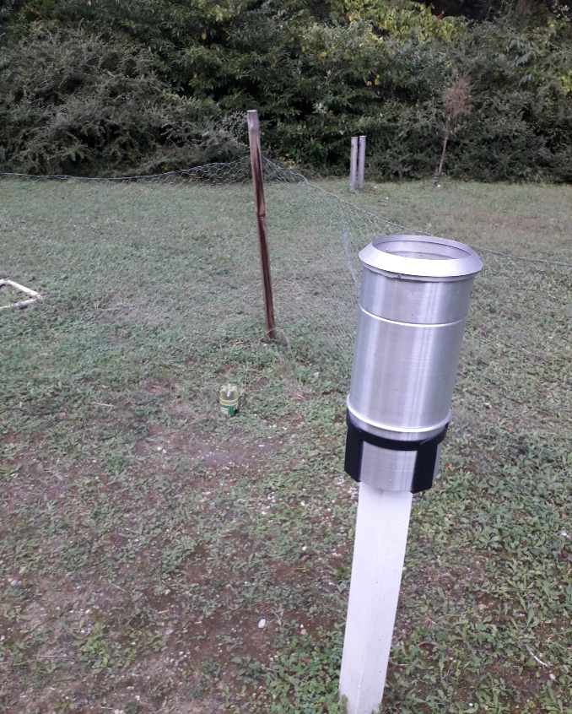
Precipitation
Hellmann double-walled aluminium rain gauge with a receiving area of 200 cm²
Notes:
We used a Hellmann rain gauge with a 200cm2 receving area to measure precipitation.

Slide 7
Interception
Crown interception
Troughfall (using troughs (0,2m²) )
Stemflow (using collars)
Litter interception
Measurement of forest-litter weight
Measurement of precipitation seeping through forest-litter
10 pots with a receiving area of 0.0834 m² (14.5*57.5)
+ Leaf fall dynamic
Notes:
Forest litter – a net is stretched at the bottom of the upper vessels, under which we can capture and measure the amount of effective precipitation allowed through the litter.
Trunk collars for the amount of water flowing down the trunks of trees, currently on 1 tree. (not significant)

Slide 8
Soil moisture
Instrument used for measurement: FieldScout TDR 300 soil moisture meter
Rod length: 7.6 cm
Determination of volumetric water content
Calibration equation:
VWC = (0.049 ∗ PERIOD) − 98.23
Notes:
To measure soil moisture…
The following equation was used:

Slide 9
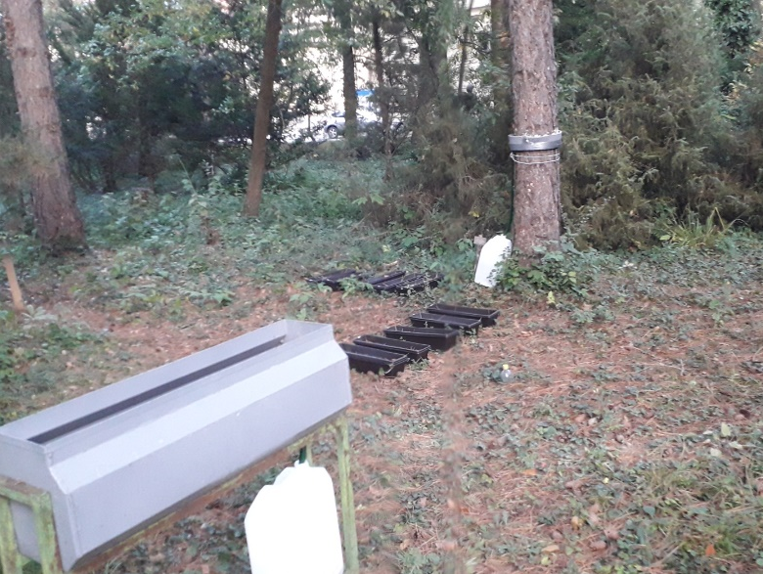
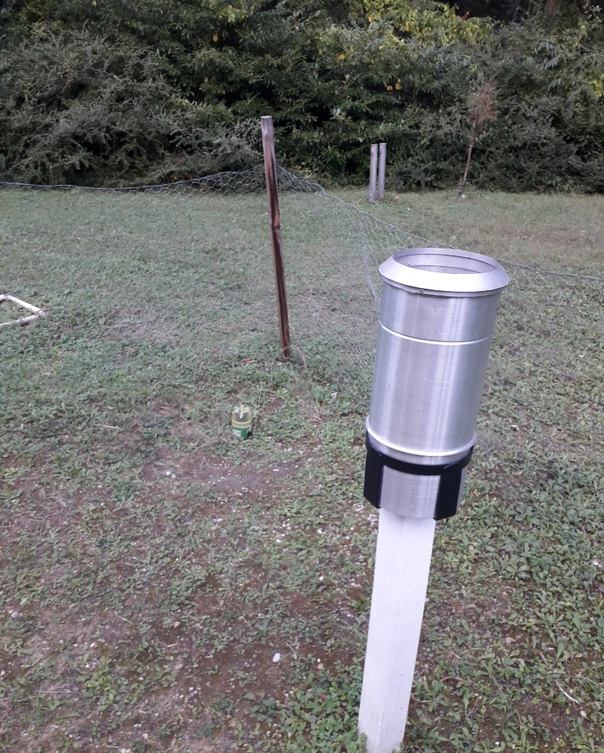
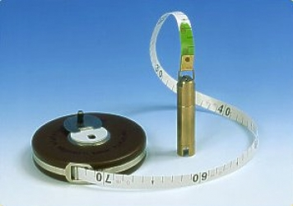
Groundwater levels
Black pine tree plot: 5 m
Control site: 6,2 m
Type DA-OP handheld water level meter
Notes:
To compare the water levels in each site, we used…

Slide 10
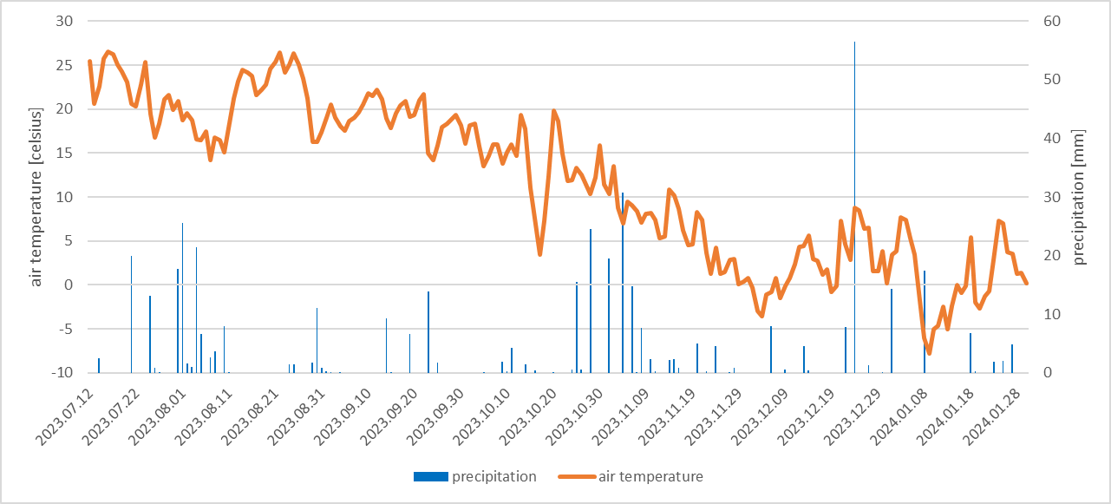
Precipitation, Interception
Relationship between precipitation and temperature
442.05 mm total
Relationship between effective and stock precipitation,
Frost in January
Notes:
A total of 442.05 mm of rainfall fell from July, more than in recent years.
Measurement was made difficult by frost in January
to estimate precipitation reaching soil and f. litter

Slide 11
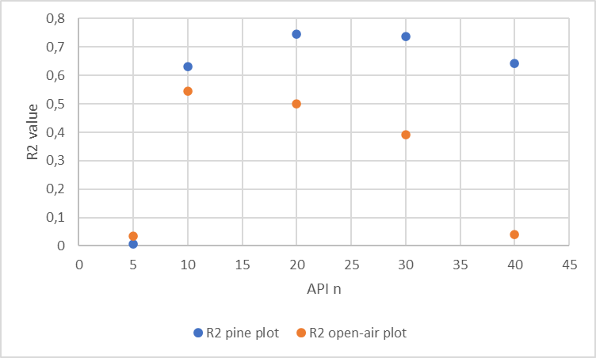
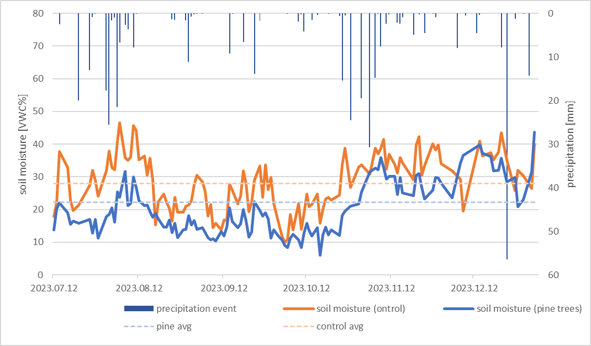
Soil moisture
$${API}_{n}=\sum_{i=1}^{n}{p_{i}∗h_{i}}$$
$${API}_{10}=\sum_{i=1}^{20}{p_{i}∗h_{i}=1,00∗h_{1}+0,90∗h_{2}+}…+0,10∗h_{10}$$

Slide 12
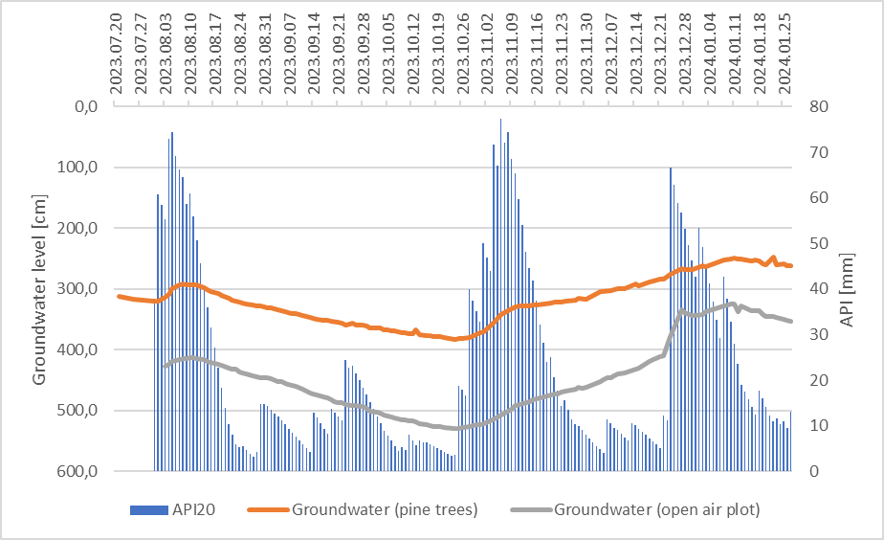
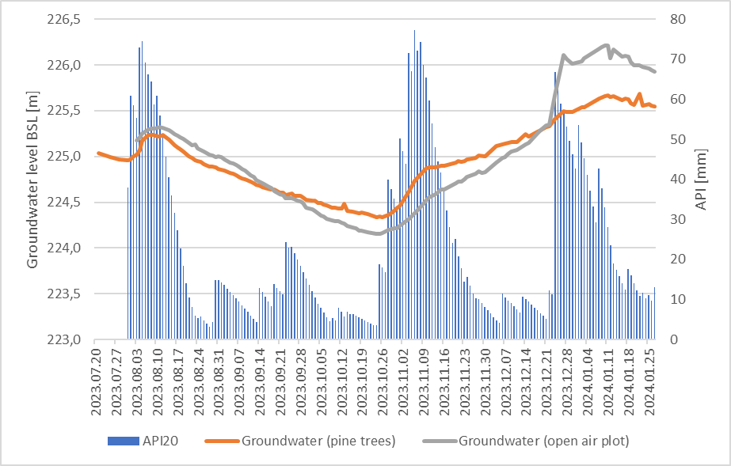
Groundwater levels
Changes in groundwater levels in the two areas with different surface covers.

Slide 13
Thank you for your attention!
Notes:
Labor adatokból táblázat mellékletnek, onedrive-ra link
Fordítás márc 15-ig (konzinak dolga van)
Hétfő részvételeket pályázatba írjanak be – pénzzel el tudjanak számolni
Hétfő 10 óra – kezdődik a térinformatikai ismeretek – itt beszélik meg mi lesz a tananyag

