Slide 1





Change in eruption location in Kerguelen hotspot and Kinematic Reconstruction of Rajmahal Trap: Implications for Cretaceous to present day Geodynamics of Indian plate
Simran Guleriya¹
simranguleriya@gmail.com
Anouk Beniest² , Sudheer Kumar Tiwari¹
1. Department of Earth Sciences, Indian Institute of Technology Roorkee, Uttarakhand 247667, India
2. Department of Earth Sciences, Vrije Universiteit Amsterdam, De Boelelaan 1085, 1081 HV, Amsterdam, the Netherlands
EGU24, 16 April 2024

Slide 2
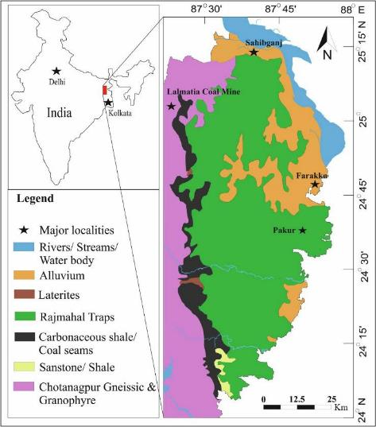
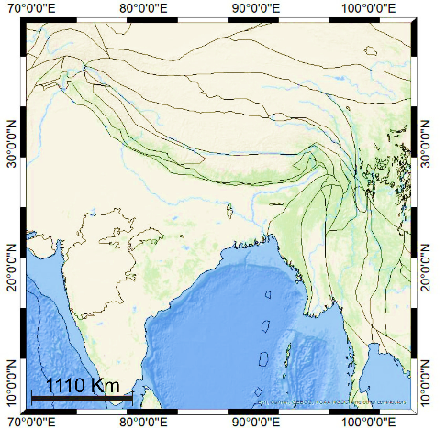
Introduction
Click here
Research Gaps
GPlates Reconstructions
Tomography Data
Kinematic Analysis
Inference & Tectonic Model
Conclusion
Geology of Rajmahal Trap
Fig. 1. Georeferenced Map of the Rajmahal Trap.
Fig. 2. Schematic geological map of the Rajmahal Traps (RT) basalts.
(modified after Kapawar et al. 2020)

Slide 3
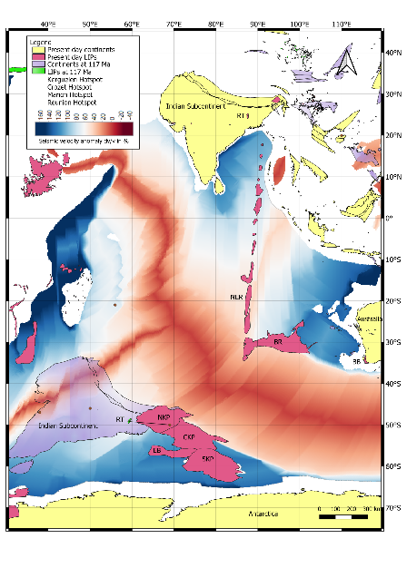
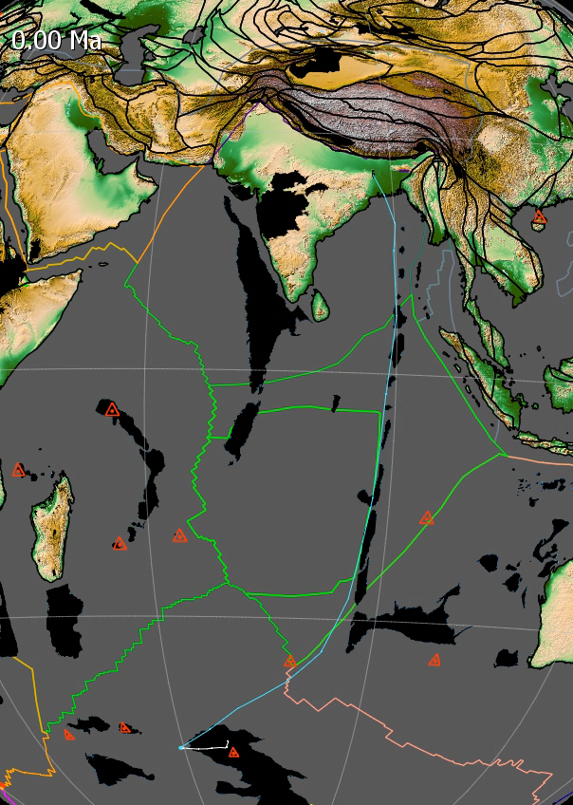
Research Gaps
GPlates Reconstructions
Tomography Data
Kinematic Analysis
Inference & Tectonic Model
Conclusion
60 ° E
90° E
Inconsistency between the paleolatitudes of the Rajmahal trap and Kerguelen hotspot plume.
Drastic changes in the velocity magnitude for the Rajmahal trap since cretaceous.
0 Ma
0°
Rajmahal trap eruption location at 117 Ma
30° S
117 Ma
Present-day location of Kerguelen Hotspot
Fig. 3. Tomography Map of Indian Ocean near to surface with Indian subcontinent at 117 Ma to 0 Ma.
Fig 4. Reconstruction of motion path followed by the Rajmahal Trap using Muller 2016 data in GPlates.

Slide 4
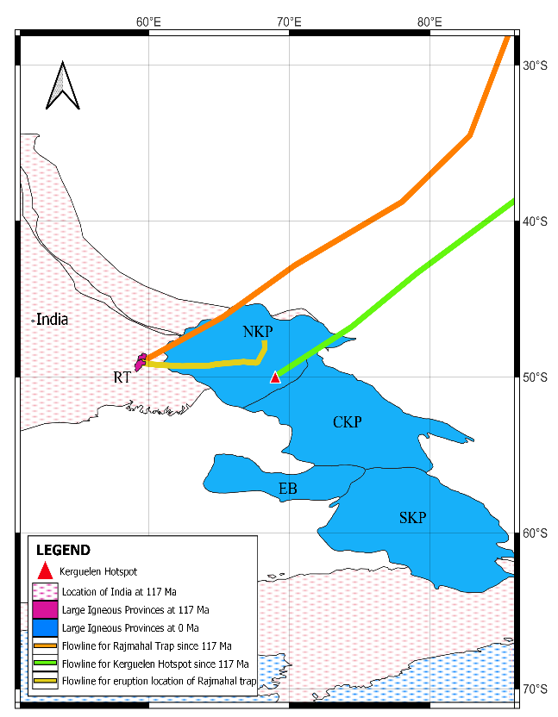
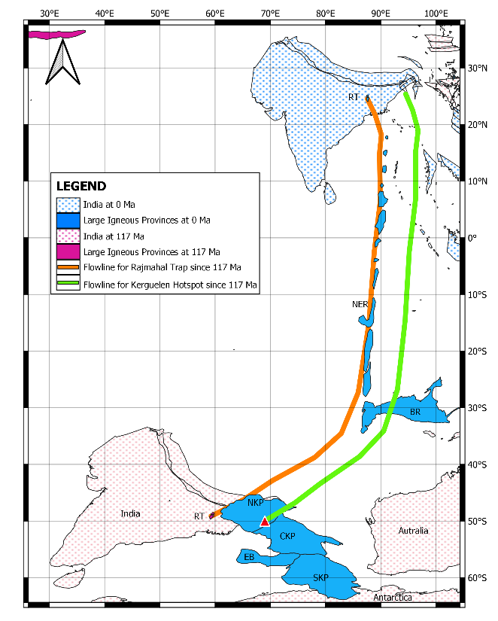

Results
Research Gaps
Tomography Data
Kinematic Analysis
Inference & Tectonic Model
Conclusion
GPlates Reconstruction: Hotspot Motion Path
Orange motion path: path taken by the Rajmahal trap
Ninety-East ridge following the same path.
Yellow motion path shows surficial shift from eruption location to present day location.
Fig 5. Hotspot motion path predicted for the Kerguelen Hotspot using GPlate.
Fig 6. Hotspot motion path predicted for the Rajmahal Traps from 117 Ma to 0 Ma.

Slide 5
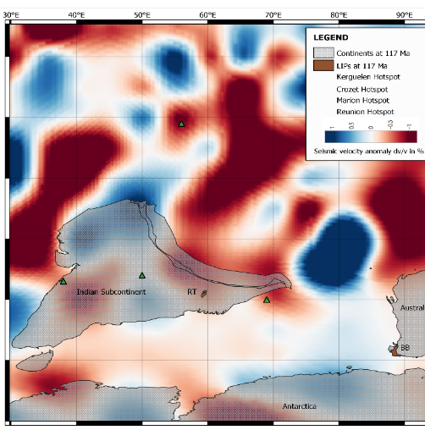
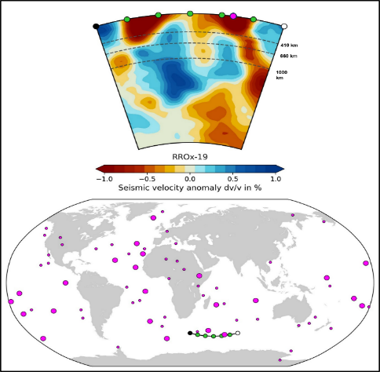
Results
Research Gaps
GPlates Reconstructions
Kinematic Analysis
Inference & Tectonic Model
Conclusion
P-Wave Tomography
Kerguelen Hotspot
W
E
117 Ma
W
E
Fig 7. P-wave tomographic depth-slice of the Indian ocean in the upper mantle across the line , from the open-source toolbox ‘SubMachine’ (Hosseini et al., 2018).
Fig 8. Georeferenced P- Wave Tomography at 400 km depth Map view of Indian Subcontinent at 117 Ma.

Slide 6
Results
Research Gaps
GPlates Reconstructions
Tomography Data
Inference & Tectonic Model
Conclusion
Kinematic Analysis
Velocity Magnitude of Rajmahal Trap
78 Ma: peak in the velocity
62 Ma: maximum velocity achieved.
Since 44 Ma: constant velocity.
Fig 9. Velocity magnitude of the Rajmahal Trap with respect to the geoid.

Slide 7
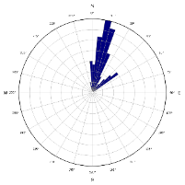
Results
Research Gaps
GPlates Reconstructions
Tomography Data
Inference & Tectonic Model
Conclusion
Kinematic Analysis
Velocity Azimuth of Rajmahal Trap
103-102 Ma: Velocity azimuth of 358 degrees.
Since 100 Ma: Velocity azimuth between 0-50 degrees, showing the North-eastern motion of the Indian plate.
Fig 10. Velocity azimuth for the Rajmahal Trap with respect to geoid (blue).
7

Slide 8
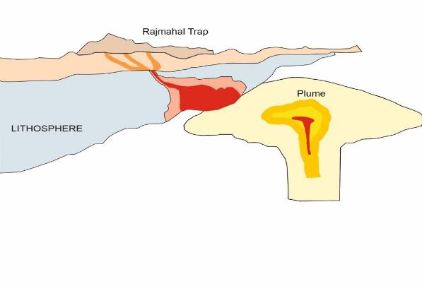
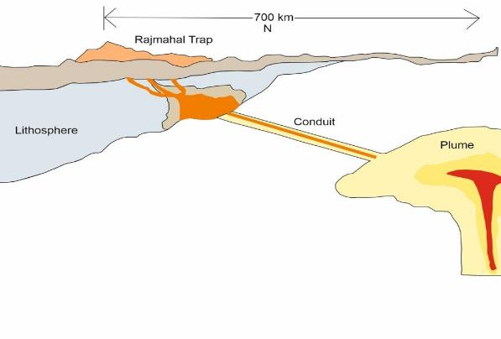
Inference
Research Gaps
GPlates Reconstructions
Tomography Data
Kinematic Analysis
Conclusion
Interpretation 1
Interpretation 2
Fig 11. Schematic diagram of Kerguelen hotspot plume near to the eruption location of Rajmahal Trap.
Fig 12. Schematic diagram of the Kerguelen hotspot Plume erupting through a conduit to form Rajmahal Trap.

Slide 9
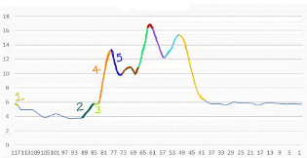
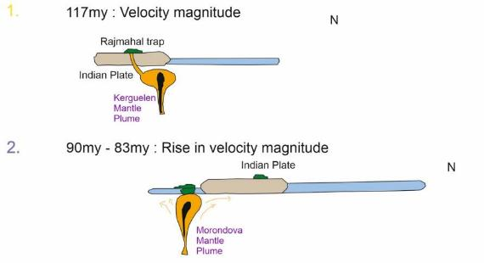
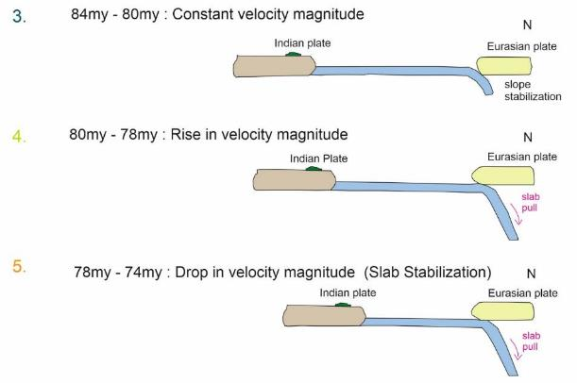
Inference
Research Gaps
GPlates Reconstructions
Tomography Data
Kinematic Analysis
Conclusion
Tectonic Model for the Indian subcontinent drift since Cretaceous (117 Ma) to present day
1.
~5 cm/yr
3.
~5.8cm/yr
4.
~5.8cm/yr-13.3 cm/yr
2.
~3.7 cm/yr to 5.8 cm/yr
5.
Fig, 13. Schematic diagram showing significant stages in Indian plate movement since the emplacement of the Rajmahal trap i.e., 117 Ma. The movement is shown from 90 Ma till the present day (modified after Pusog and Stegman, 2020).
~13.3cm/yr-9.7 cm/yr

Slide 10
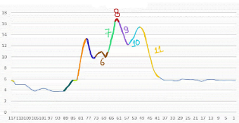
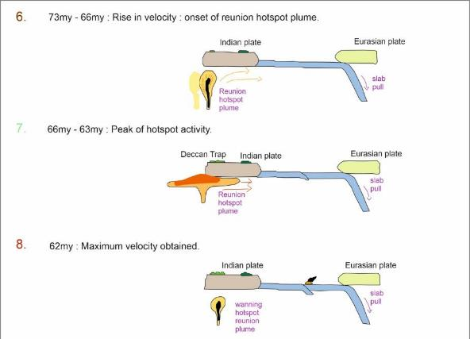
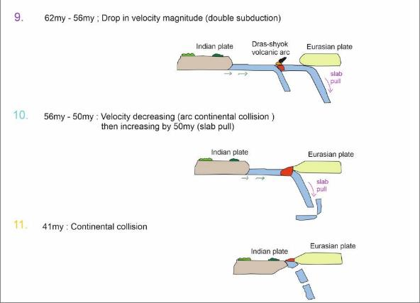
Inference continued…
Research Gaps
GPlates Reconstructions
Tomography Data
Kinematic Analysis
Conclusion
Tectonic Model for the Indian subcontinent drift since Cretaceous (117 Ma) to present day
~9.7cm/yr-11.7 cm/yr
~16.8 cm/yr-12.2 cm/yr
~11.7 cm/yr-16.3 cm/yr
~12.2 cm/yr-15.3 cm/yr
~16.8 cm/yr
~15.3 cm/yr-5 cm/yr

Slide 11
Summary & Conclusions
Research Gaps
GPlates Reconstructions
Tomography Data
Kinematic Analysis
Inference & Tectonic Model
The Kerguelen hotspot has a shift in its paleo-latitude location. This is due to the presence of several feeder zones attached to the main plume structure branching upwards from 410 km depth, defining a tree type structure.
The maximum velocity observed by Rajmahal trap is 16.87 cm/yr at 62 Ma and minimum velocity is 3.71 cm/yr at 95 Ma.
The change in absolute velocity magnitude using Kinematic analysis, at some point of time shows some drastic changes due to different tectonic activities.

Slide 12
References
Agarwal, A., Alva-Valdivia, L.M., Hernández-Cardona, A., Shukla, R.A., Joshi, G. and Agarwal, K.K., 2022. Tectonics, cooling rates and temperatures during emplacement of the Rajmahal traps, India. Journal of Volcanology and Geothermal Research, 424, p.107496.
Antretter, M., 2001. Moving hotspots: evidence from paleomagnetism and modelling (Doctoral dissertation, München, Univ., Diss., 2001).
Antretter, M., Steinberger, B., Heider, F. and Soffel, H., 2002. Paleolatitudes of the Kerguelen hotspot: new paleomagnetic results and dynamic modeling. Earth and Planetary Science Letters, 203(2), pp.635-650.
Baksi, A.K., 1995. Petrogenesis and timing of volcanism in the Rajmahal flood basalt province, northeastern India. Chemical Geology, 121(1-4), pp.73-90.
Baksi, A.K., 2022. Geochemistry and geochronology of the Rajmahal Flood Basalt Province, northeastern India: Genetic links to Kerguelen hotspot activity. Journal of Earth System Science, 131(3), p.157
Pusok, A.E. and Stegman, D.R., 2020. The convergence history of India-Eurasia records multiple subduction dynamics processes. Science Advances, 6(19), p.eaaz8681.
Tsekhmistrenko, M., Sigloch, K., Hosseini, K. and Barruol, G., 2021. A tree of Indo-African mantle plumes imaged by seismic tomography. Nature Geoscience, 14(8), pp.612-619.
van Hinsbergen, D.J., Steinberger, B., Doubrovine, P.V. and Gassmöller, R., 2011. Acceleration and deceleration of India‐Asia convergence since the Cretaceous: Roles of mantle plumes and continental collision. Journal of Geophysical Research: Solid Earth, 116(B6).

Slide 13
THANK YOU!
Questions and Suggestions?

