Slide 1
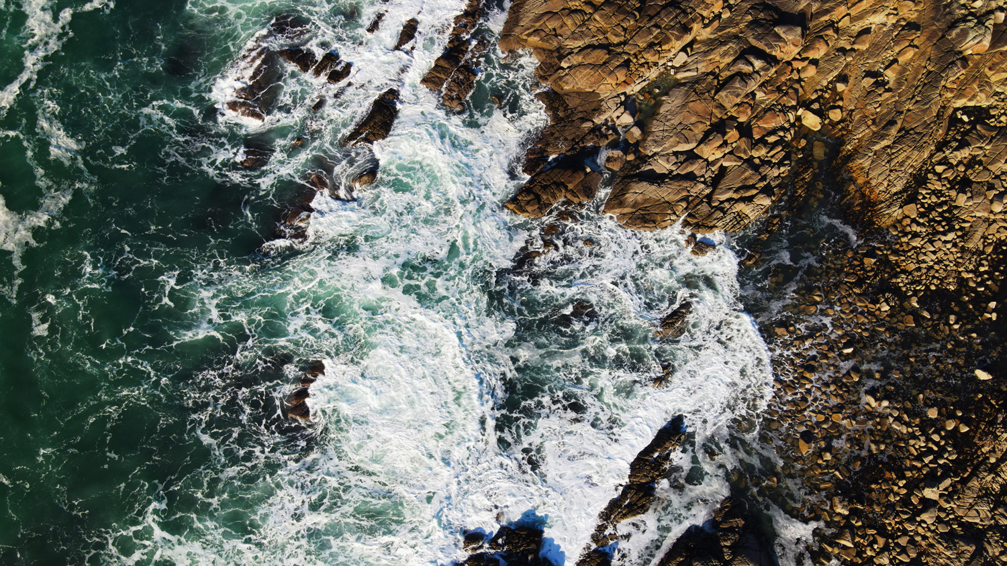
Deciphering local from global signals in Portimão Bank sedimentary dynamics
Presented by Mélinda Martins
Universidade do Algarve (UAlg)
Instituto Português do Mar e da Atmosfera (IPMA)

Slide 2
Unveiling Sedimentary Patterns
UNITS | STRUCTURES | MEAN GRAIN SIZE | TEXTURES | CARBONATES | MINERALOGY | INTERPRETATION
D | Low bioturbation | 3-4 μm | Very slightly sandy silty clay (up to 56% clay) | High (up to 40%) | B: Planktonic foraminifera (>50%), and nannofossils (>40%) | Microfossil-rich mud
C | Rare bioturbation, rare black lenticules | 5-6 μm | Very slightly sandy clayey silt (up to 59% silt) | Moderate (up to 25%) | T-A: Clay minerals (>30%), and pyrite (up to 25%), as well as OM (up to 25%) | Clay-rich mud
B | Rare bioturbation, several black lenticules | From 3 to 4.5 μm | Clayey silt (up to 57% silt) | Moderate (<30%) | OM (>20%), and A: pyrite (>20%) | Pyritic organic-rich mud
A | Rare bioturbation, dominated by black lenticules | Up to 6,3 μm | Very slightly sandy clayey silt (up to 64% silt) | Low to moderate (down to 17%) | T-B-A: Clay minerals (25%), nannofossils (30%), and pyrite (up to 40%) | Pyritic mud
PC06
Present days
B
11,5 kyr BP
21 kyr BP
T
34 kyr BP
49 kyr BP

Slide 3
Objectives and Future Directions
Key paleoenvironmental changes registered in the core identified
Nature and origin of the black lenticules identified
Depositional processes and sediment sources identified
NEW QUESTIONS

Slide 4
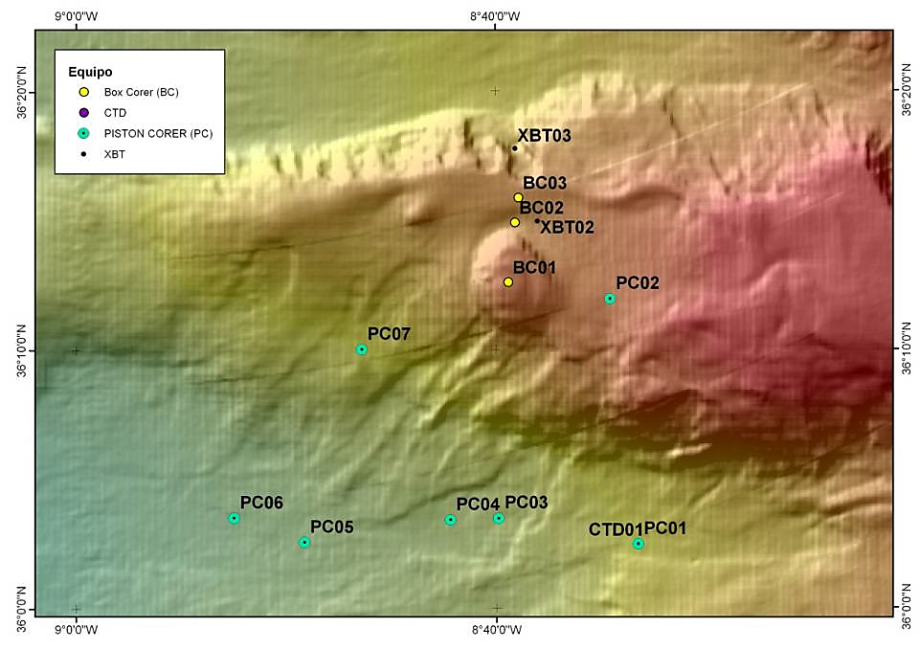
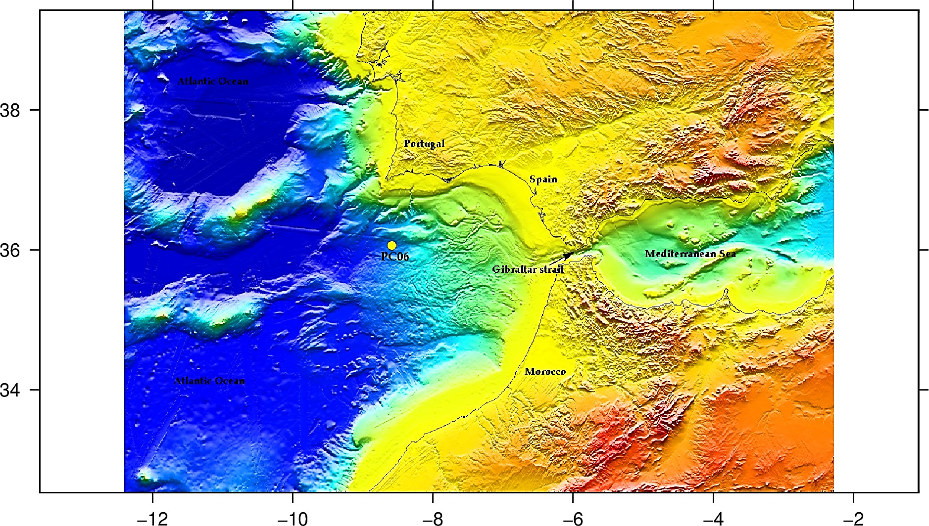
Study Area
Gulf of Cadiz
MONTERA (CTM 2009-14157-C02 CSIC) Spanish project
From Vázquez and Alonso 2012
36°03.52’ N, 8°52.47' W
Dynamic region, hub for paleoenvironmental research.
Portimão Bank (PB)

Slide 5
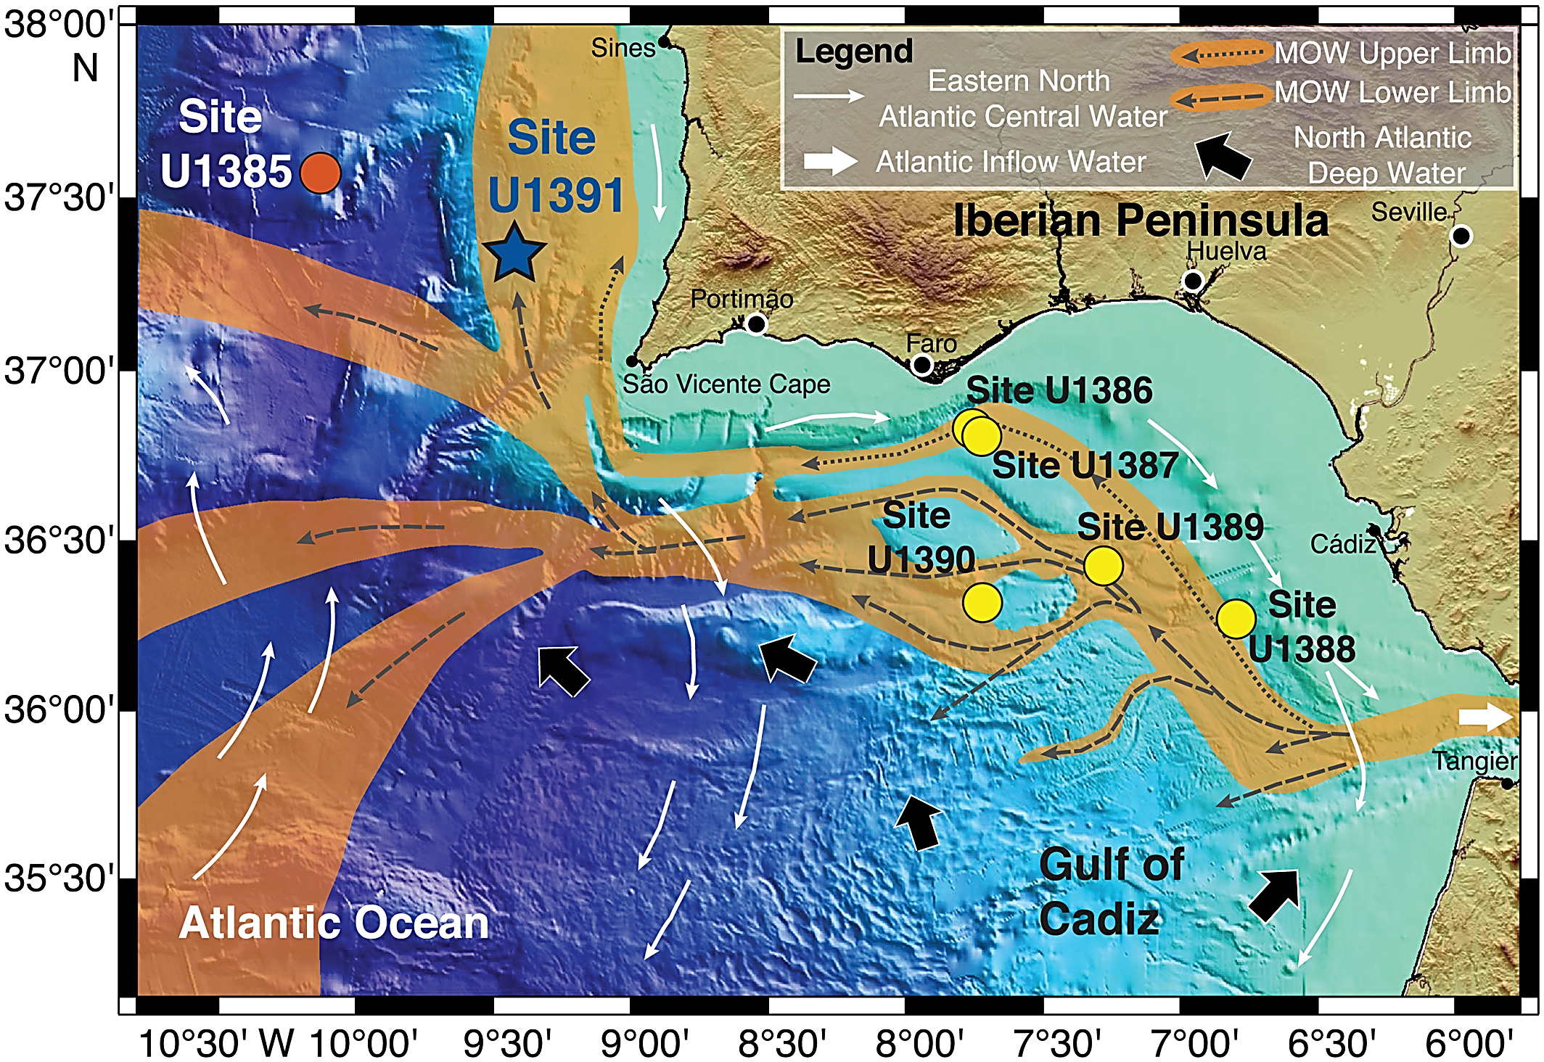
Study Area
From Vázquez and Alonso 2012
Atlantic Ocean / Mediterranean Sea
Current oceanographic pathways :
1- Eastern North Atlantic Central Water (ENACW)
2- Mediterranean Outflow Water (MOW)
3- North Atlantic Deep Water (NADW)
PB
From Nichols et al. 2020

Slide 6
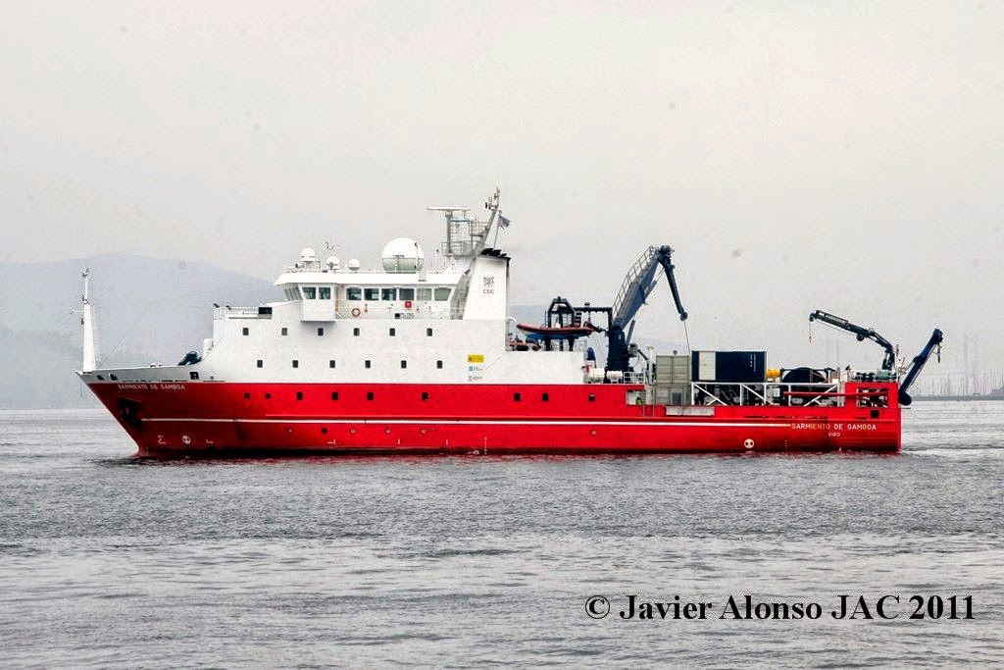
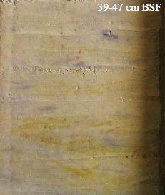
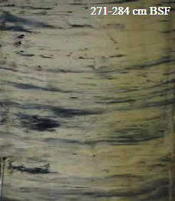
PC06 Deep-Sea Core
MONTERA‐0412 scientific cruise
B/O SARMIENTO DE GAMBOA
Retrieved at 3520 m water depth
Background sediments
Spans the last 49,000 years
324,5 cm long
Many parts with very intense black lenticules that had not previously been studied
Black lenticules

Slide 7
What’s Core For ?

Slide 8
Multidisciplinary Approach
Grain-size
Sand
Datations
Carbonates
Smear slides
Photos of the core
Organic Matter
Geochemical elements

Slide 9
Sedimentological Analyses
DATA | METHOD | SAMPLING RESOLUTION | LOCATIONS | TEAM IN CHARGE | PRESENT WORK
Grain-size | Laser diffraction | 55 samples | Institut de Ciències del Mar (ICM) Barcelona, Spain | MONTERA research team members | Statistical analysis, and interpretation
Carbonates | Volumetric method of Scheibler | 55 samples | Instituto Português do Mar e da Atmosfera (IPMA) Tavira, Portugal | IPMA | Interpretation
Organic matter | Loss on ignition | 55 samples
Smear slides | Sampled by hand | 42 samples |  |  | Grains counting, statistical analysis, and interpretation (20 samples)
Sand | Sampled by hand | 16 samples |  | Present work | Grains counting, statistical analysis, and interpretation

Slide 10
Sedimentological Analyses
Malvern Mastersizer 3000
Calcimeter-Eijekelkamp
Binocular Microscope
© EDUCOAST Tavira
© EDUCOAST Tavira
© EDUCOAST Tavira

Slide 11
Geochemical & Other Analyses
DATA | METHOD | SAMPLING RESOLUTION | LOCATIONS | TEAM IN CHARGE | PRESENT WORK
Photos | MSCL | High-resolution photographs | On board B/O SARMIENTO DE GAMBOA | MONTERA research team members | Imagery analysis, and interpretation
Geochemical contents | XRF | 4890 measurements | CORELAB Barcelona University, Spain |  | Interpretation
Datations | From ¹⁴C | 5 samples | Barcelona's Poznań Radiocarbon Laboratory | Age-depth model realised at IPMA Algés | Interpretation

Slide 12
Geochemical & Other Analyses
Geotek MSCL
XRF
© EDUCOAST Tavira
From Hoelzmann et al. 2017

Slide 13
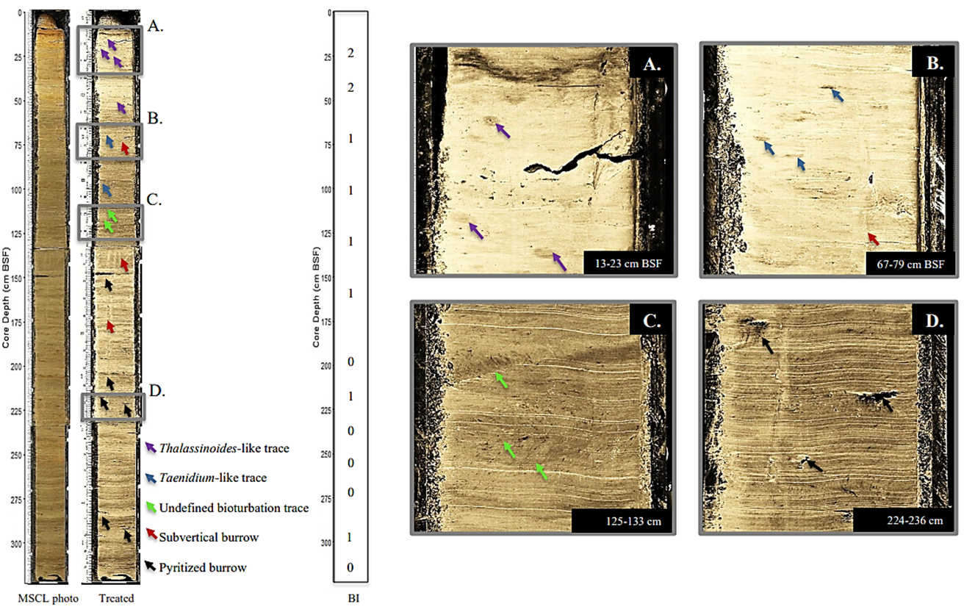
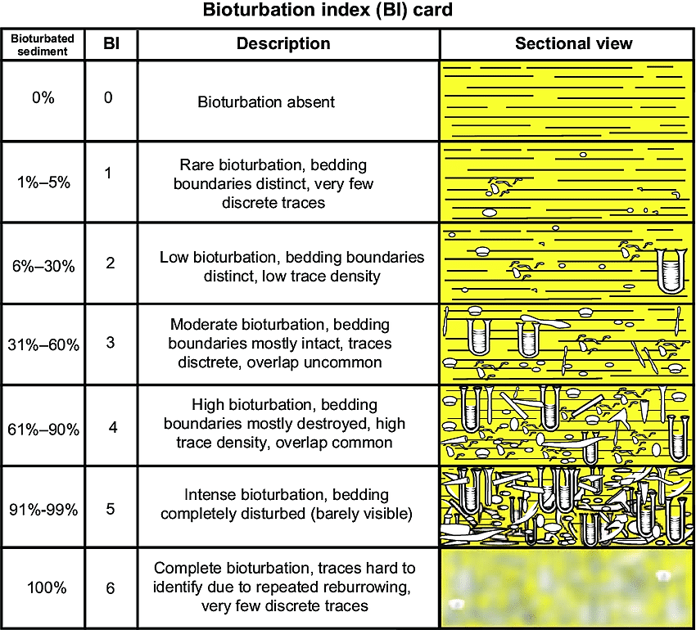
Key Findings
Trace fossils
From Gani 2020
Based on Dorador and Rodríguez-Tovar 2014

Slide 14
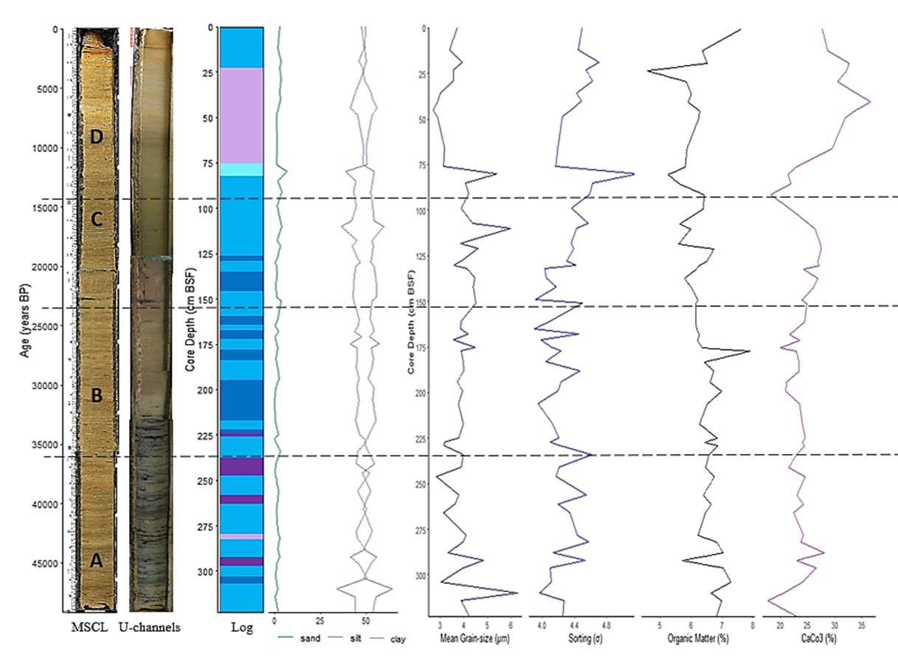
Key Findings
Organic matter
Sedimentological characteristics
Silt
Carbonates
Mean grain-size
Sorting
Sand
Clay
Average of the mean grain-size : 3,99 μm (clay size)
Made up of mud, 52% silt and 46% clay
e.g., “geometric method of moments” (in µm) and Blott and Pye (2012) particle size classification

Slide 15
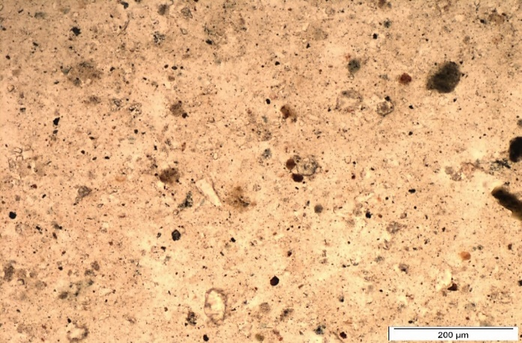
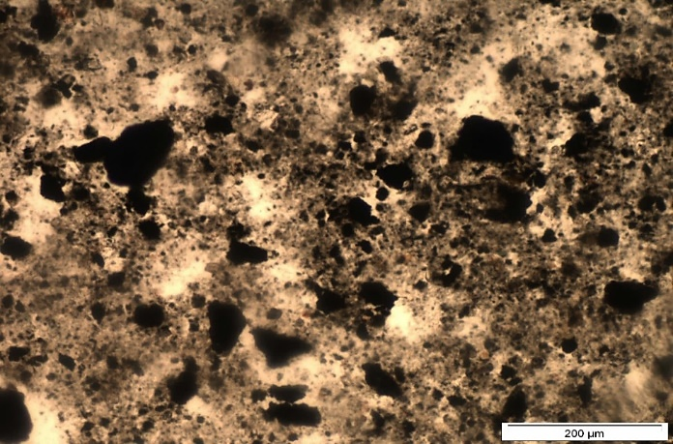
Key Findings
Nannofossils
Mineralogy - Smear slides
Components (smear slides) |  |  | Average (%)
 |  |  | Background sediments |  | Black lenticules
Terrigenous | Clay | Biotite | 29 | 48 | 13 | 32
 |  | Chlorite
 | Quartz |  | 10 |  | 7
 | Feldspar |  | 4 |  | 3
 | Opaque grains |  | 5 |  | 0
 | Heavy minerals |  | 0 |  | 9
Biogenic | Nannofossils |  | 44 | 46 | 10 | 15
 | Foraminifera |  | 2 |  | 5
 | Sponge spicule |  | 0 |  | 0
Authigenic | Pyrite |  | 1 | 1 | 26 | 34
 | Fe oxides |  | 0 |  | 6
 | Glauconite |  | 0 |  | 2
Organic matter |  |  | 5 |  | 19
64,6 cm
20 µm
Clay
Organic matter
228,5 cm
Pyrite

Slide 16
Key Findings
Nannofossils
Mineralogy - Smear slides
64,6 cm
Background sediments
Clustering analysis – k mean
20 µm
Black lenticules
Clay
Organic matter
228,5 cm
Pyrite

Slide 17
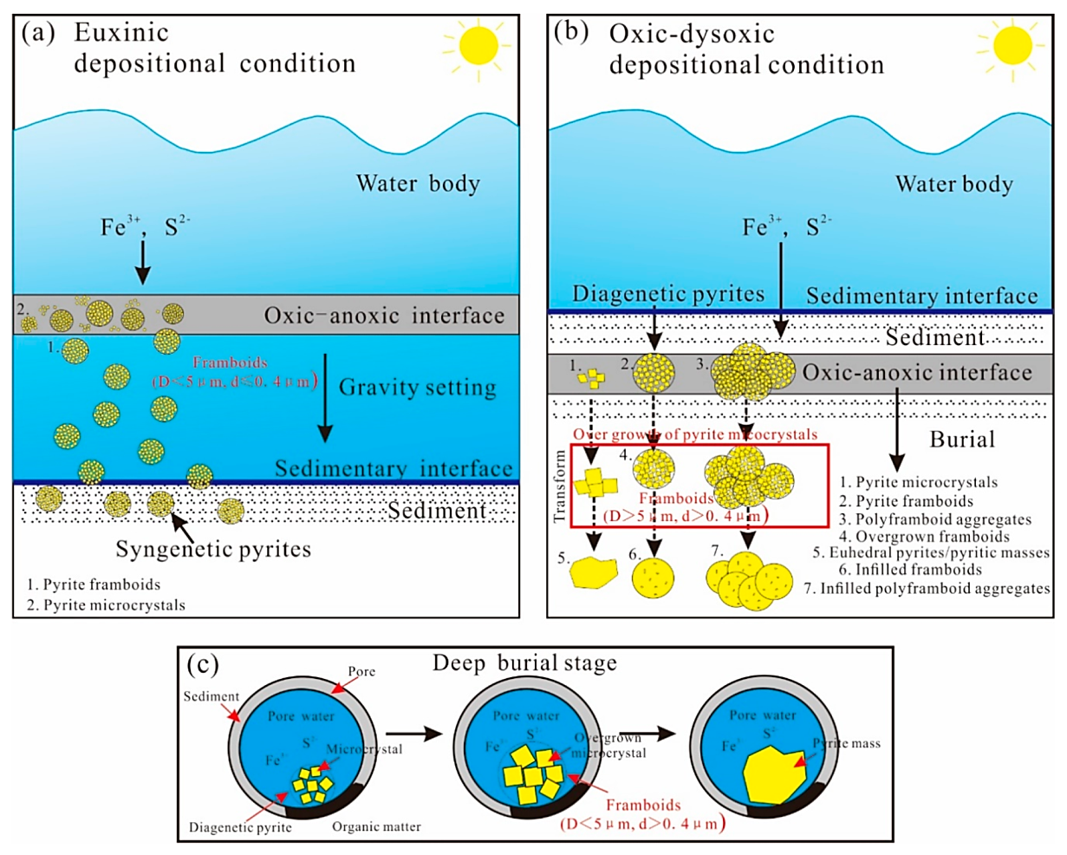
Key Findings
Presence of Euhedral Pyrite
1- Decomposition of organic matter
2- Generation of hydrogen sulphide
3- Pyrite precipitation
Low oxygen conditions
From Liu et al. 2019

Slide 18
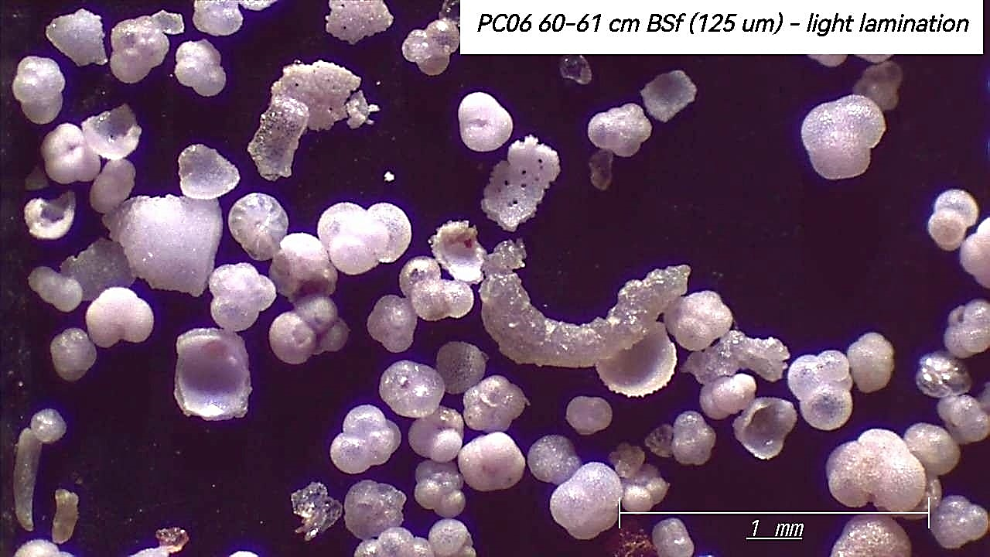
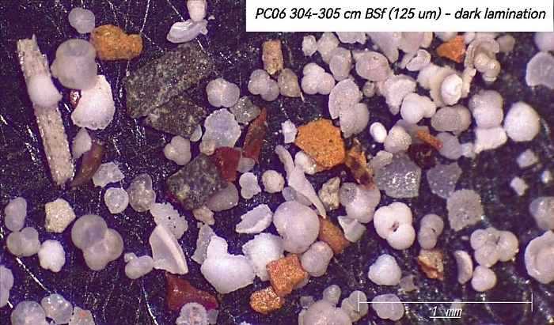
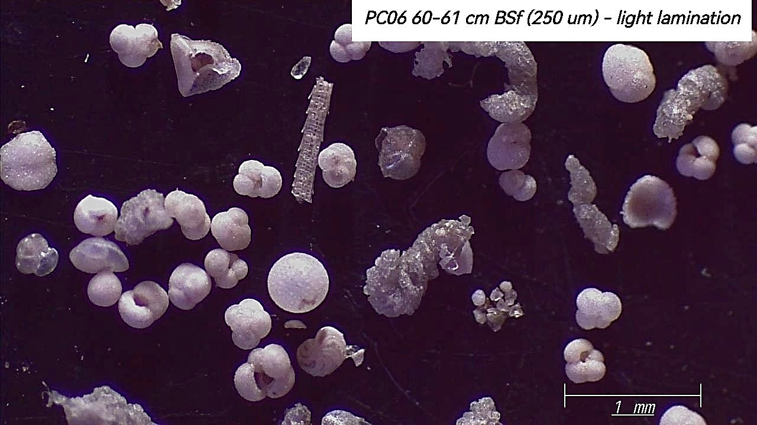
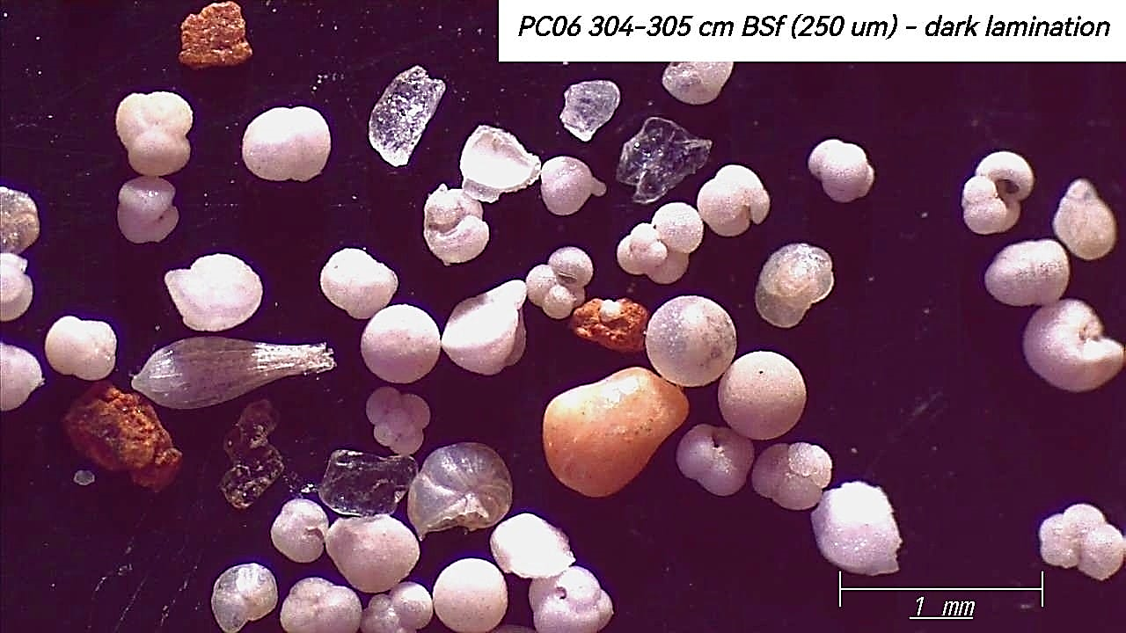
Key Findings
PC06 60-61 cm BSF (125 μm) – bgd
PC06 304-305 cm BSF (125 μm) – black
60-61 cm
Planktonic foraminifera
Other terrigenous
Oxidized minerals
Mineralogy
Sand
PC06 60-61 cm BSF (250 μm) – bgd
PC06 304-305 cm BSF (250 μm) – black
Planktonic foraminifera
Oxidized minerals
304-305 cm

Slide 19
Key Findings
Mineralogy - Sand
60-61 cm
102-103 cm
117-118 cm
139-140 cm
193-194 cm
218-219 cm
248-249 cm
304-305 cm
Background sediments
Black lenticules

Slide 20
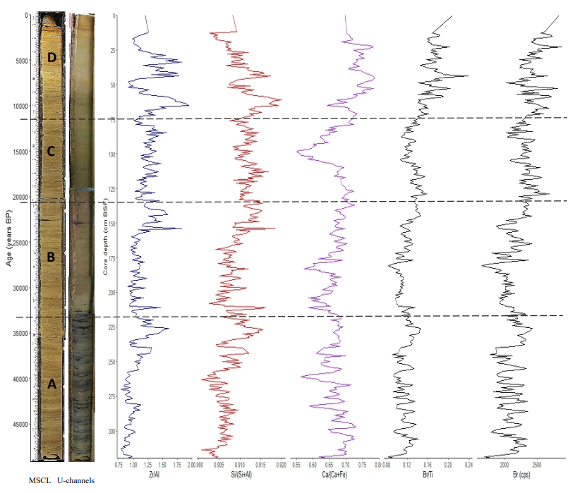
Key Findings
Zr/Al
Si/(Si+Al)
Ca/(Ca+Fe)
Br/Ti
Br
Geochemical proxies
Zr/Al ratio : bottom current indicator
Si/(Si+Al) ratio : dry/wet conditions
Ca/(Ca+Fe) ratio : paleoproductivity indicator
Br/Ti ratio : marine organic matter accumulation indicator
Br : marine organic carbon contents indicator
N.B. Al : Aluminium, Br : Bromine, Ca : Calcium, Fe : Iron, Ti: Titanium and Zr : Zirconium.
e.g., Moreno et al. 2005; Ziegler et al. 2008; Fink et al. 2013; López-González et al. 2013; Bahr et al. 2014; Rothwell and Croudace 2015; Stow et al. 2018

Slide 21
Unveiling Sedimentary Patterns
UNITS | STRUCTURES | MEAN GRAIN SIZE | TEXTURES | CARBONATES | MINERALOGY | INTERPRETATION
D | Low bioturbation | 3-4 μm | Very slightly sandy silty clay (up to 56% clay) | High (up to 40%) | B: Planktonic foraminifera (>50%), and nannofossils (>40%) | Microfossil-rich mud
C | Rare bioturbation, rare black lenticules | 5-6 μm | Very slightly sandy clayey silt (up to 59% silt) | Moderate (up to 25%) | T-A: Clay minerals (>30%), and pyrite (up to 25%), as well as OM (up to 25%) | Clay-rich mud
B | Rare bioturbation, several black lenticules | From 3 to 4.5 μm | Clayey silt (up to 57% silt) | Moderate (<30%) | OM (>20%), and A: pyrite (>20%) | Pyritic organic-rich mud
A | Rare bioturbation, dominated by black lenticules | Up to 6,3 μm | Very slightly sandy clayey silt (up to 64% silt) | Low to moderate (down to 17%) | T-B-A: Clay minerals (25%), nannofossils (30%), and pyrite (up to 40%) | Pyritic mud
PC06
Present days
B
11,5 kyr BP
21 kyr BP
T
34 kyr BP
49 kyr BP

Slide 22
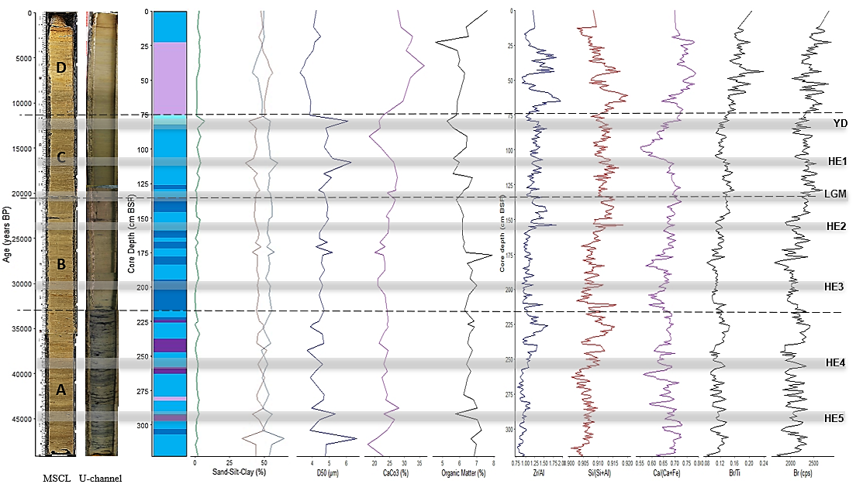
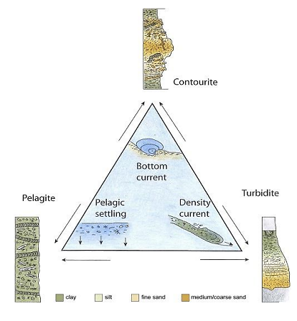
Unveiling Sedimentary Patterns
B
T
From Rogerson et al. 2014

Slide 23
Final Remarks
Variations in the environmental changes at two different temporal scales:
Limits ?
from the glacial (A to C) to interglacial (D) periods;
a short-scale local variations during the A to C unit sedimentation related to the presence of pyrite.
Time
NEW QUESTIONS !!
Resolution

Slide 24
Acknowledgements
To my supervisors, Profª. Dr. Cristina Veiga-Pires, Dr. Gemma Ercilla and Dr. Teresa Drago;
To all the scientists involved in this work, especially, Prof. Dr. Paulo Fernandes, Dr. Filipa Naughton and Dr. Cristina Roque;
To the Instituto Português do Mar e da Atmosfera (IPMA)
To the University of Algarve (UAlg);
This work has not been possible without the contribution of the MONTERA (CTM 2009-14157-C02 CSIC), EDUCOAST (PTINNOVATION-067) and EMSO-PT (PINFRA/22157/2016) projects.

