Slide 1
What happens when nitrogen is released into warming peat?
Climate warming speeds up decomposition.
This results in
increased respiration
release of nutrients into a nutrient-limited system
What effect does increased nitrogen availability have on microbial respiration in general?
a. adding N to an N - limited system should increase microbial activity and thus GHG production
b. increased carbon use efficiency reduces respiration
What are the effects of oxidized vs. reduced N?
cumulative amount of CH₄-C and CO₂-C
trajectory of production rates
in an anoxic system, NH₄ builds up and NO₃ is consumed quickly for its oxygen.
Reduced N not required, limited effect.
NO₃ will be consumed so quickly that NH₄ will have larger effects.
NO₃ is a terminal electron acceptor of better energy efficiency than CO₂, so it should
reduce methanogenesis.
delay methanogenesis

Slide 2
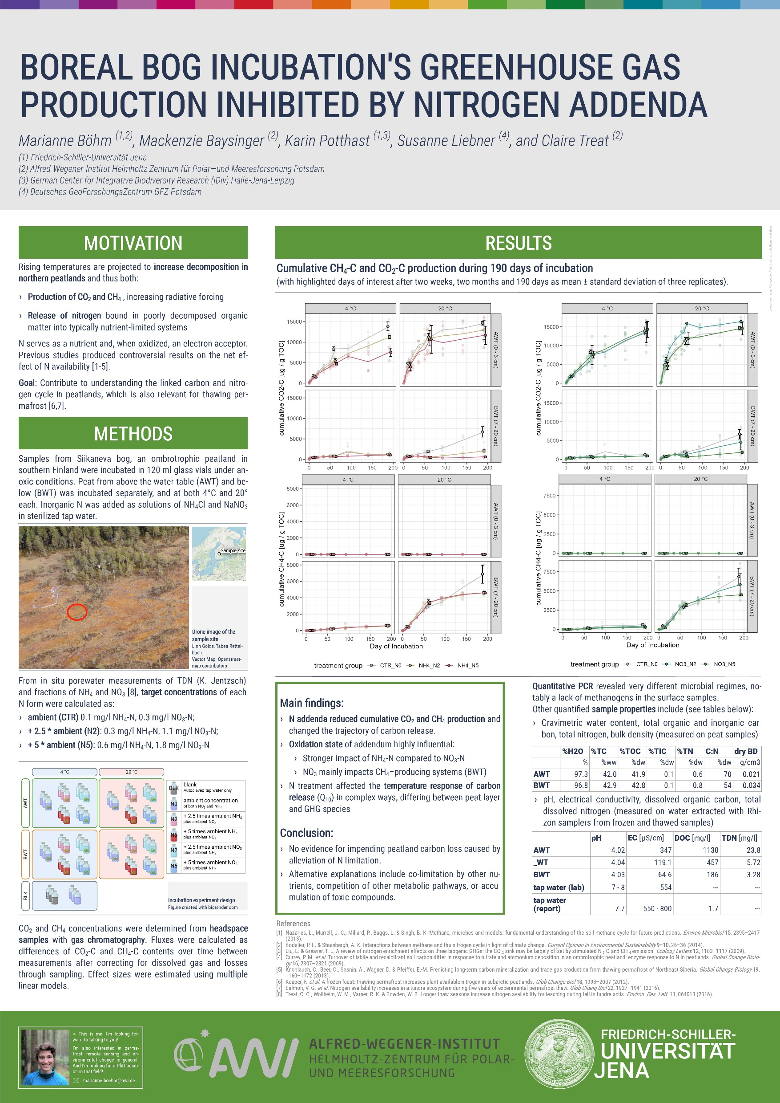
What happens when nitrogen is released into warming peat?
190 days

Slide 3
qPCR results

Slide 4
Q₁₀
(reaction of GHG production to 10 °C temperature increase)

Slide 5
CO2: CH4 ratio

Slide 6
Total C respired

Slide 7
Decomposition models‘ parameters
(SoilR, Sierra et al.)

