Slide 1
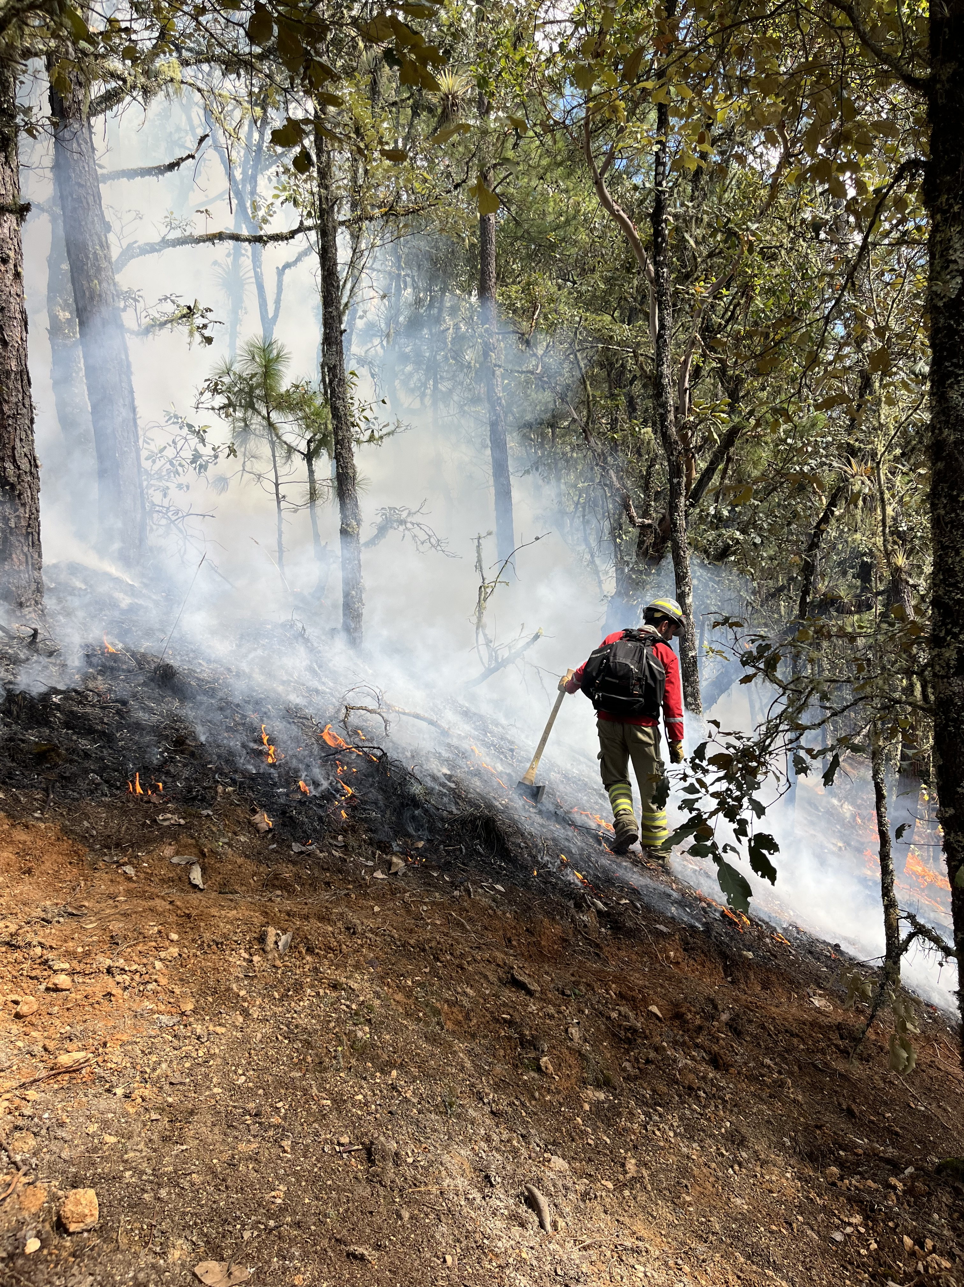
GlobalRx: A global assemblage of regional prescribed fire records for use in assessments of climate change
EGU General Assembly
April 15, 2024
Alice Hsu, University of East Anglia, United Kingdom
Matthew Jones, University of East Anglia, United Kingdom
With special thanks to the GlobalRx Consortium
Notes:
Today...GlobalRx: dataset of prescribed burns from around the world, I've been helping put together and analyzing for the past year
As well as its potential for assessing the impacts of climate change on prescribed burning
Thank my advisor, who originally conceptualized the idea, and all the collaborators and coauthors without whom this project and dataset would have been impossible

Slide 2
Introduction​
Prescribed (Rx) burning is a important land management tool used globally for wildfire hazard reduction, ecological conservation, pastoral management, and more.
Rx burns can only be conducted under certain weather conditions.
There is a lack of global harmonized data on Rx fires.
Rx burn windows may shift or change in length with climate change.
GlobalRx
Notes:
Prescribed burning is a very prominent land management tool used in nearly all parts of the world to do all sorts of things, from reducing hazardous fuel loads to mitigate wildfire risk, ecological conservation of (especially fire adapted species), renewing pastures, and also many other reason.
However, the use of Rx burns is limited by the weather conditions, since conditions for burning need to be selected such that the fire behavior is sufficient enough to accomplish the burn's objectives, but also not so extreme that it escapes or causes excessive damage.
And then with climate change in the picture, this complicates planning prescribed burns since this means that the optimal conditions for conducting burns can either change in frequency, or shift, occurring at earlier or later times of the typical burning season.
Lots of regional knowledge, but there's never been a global analysis yet of climate change effect on prescribed burning, nor (to our knowledge) a global harmonized dataset on prescribed burning to inform such an analysis.
And then so that's what inspired us then to put together this dataset.

Slide 3
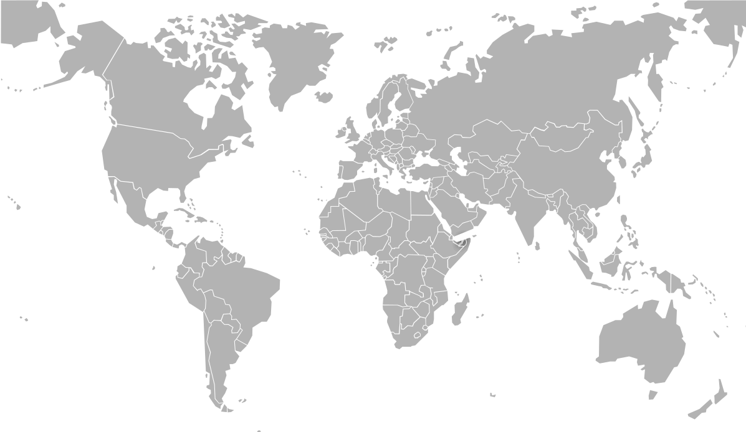
Methods
1
2
3
Data Collection
Data Cleaning
Feature Geolocation
Public repositories and databases
Minimum criteria for data point inclusion:
Personal communication with collaborators
Date
Latitude
Longitude
Eliminated or corrected data points falling into bodies of water or unexpected locations
For every burn, determine the ecosystem, land cover, and value of meteorological variable
Cold-contacting agencies, NGOs, and other institutions
Notes:
So putting together the dataset basically involved 3 steps.
The first was essentially just collecting any prescribed burning records we could find from as many sources as possible. And this involved first finding data from any public online databases and repositories (mostly government agency websites that keep records on fires)
Once we had exhausted that route, we then tapped into our existing network of collaborators to ask if they had any data they were willing to share, before moving on to just cold-contacting people from relevant agencies, NGOs, and other institutions who we thought might have data.
After we collected all the records, we then worked to standardize and clean the data, getting rid of or correcting any erroneous points (such as duplicates or those falling into bodies of water, and keeping just the points for which we had, at the minimum a date (consisting of the day, month, and year), the latitude, and the longitude.
Lastly, for each data point we collected, we determined (or geolocated) the ecosystem and land cover type the burn was conducted in, and also the values of several meteorological variables at the time and location of the burn used to measure fire behavior.
And I'll explain this in a bit more detail on the next slide

Slide 4
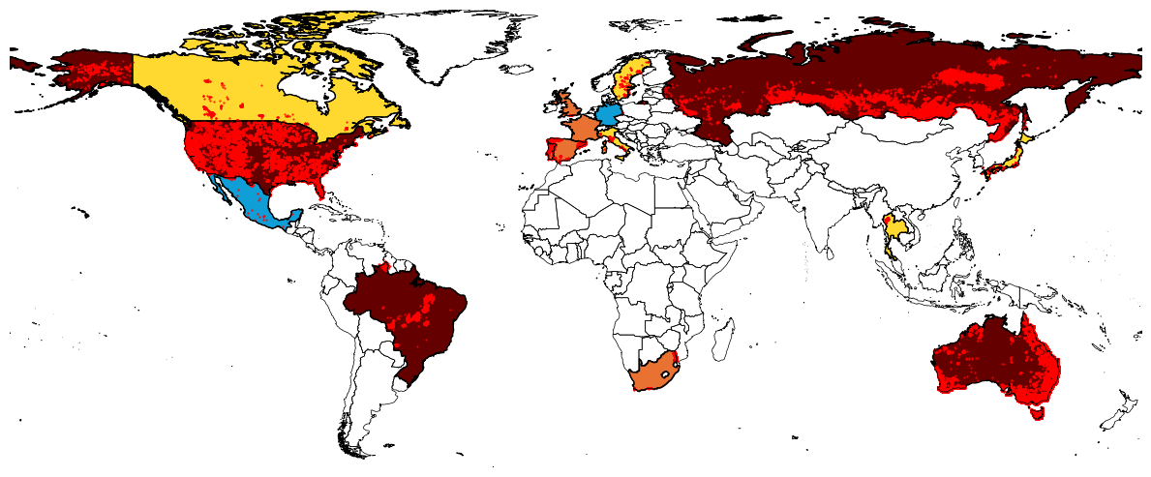
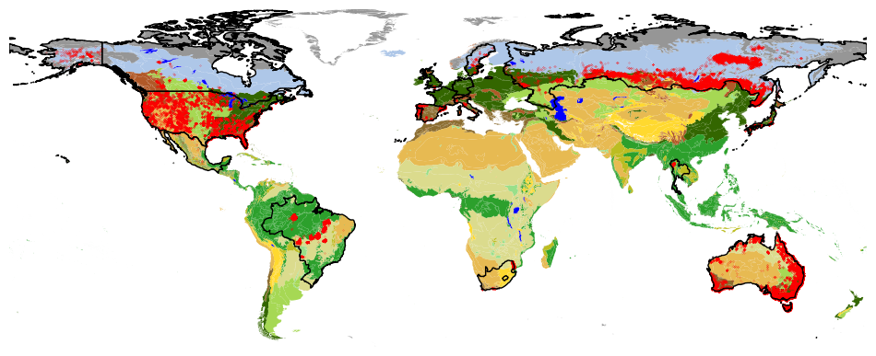
GlobalRx at a glance
Summary
0.5k
0.1k
22k
192,000 records
2k
1979-2023
<0.1k
36k
1k
0.1k
16 countries
3k
0.4k
<0.1k
1k
0.1k
Burn Info
Original burn record information
Rx Record
10k
Date (D, M, Y)
Citation
> 5,000 records
120k
1k
Location (Lat, Lon)
Agency/
Organization
1,000-4,999 records
100-999 records
Geolocated Features
1-99 records
Meteorology and Fire Weather Indices (ERA5)
Biome and Ecoregion (Olson)
Fuelbed Code (Pettinari and Chuvieco)
Köppen-Geiger Climate (Beck et al. 2023)
WDPA Name, Designation, IUCN Code
Variables extracted from other datasets at the date and location of the burn
Notes:
So hopefully this slide provides a slightly more concrete look at what our dataset actually looks like – if you look to the map the red dots represent the burn records, and the countries from which we have data are colored in according to the amount of data we have for that country
But so in total, we were able to collect a total of 190,000 records from 16 different countries, spanning the years from 1979 to 2023.
I do however want to point out that as you may have noticed already on the figure, the amount of data per country varies vastly, with Australia making up about 60% of the total dataset with 120,000 records. In addition to that, the spatial and temporal coverage also varies quite a bit within each country, since a lot of these records come from regional databases, and .
That being said, with the records we did have, we obtained the following information and features.
So the burn information, which includes the date, location, citation, and agency, was just extracted from the original burn record, so that for each record you can know where that record came from.
In addition to that info, for each record, we also extracted the value of several meteorological variables, such as Temperature, Relative Humidity, and Wind Speed, as well as some fire weather indices such as the MacArthur Forest Fire Index, all directly from or calculated from the ERA5 reanalysis dataset.
Then we also determined the ecosystem information, which we extracted from the Olson Biome and Ecoregion, land cover from the pettinari and chuvieco global fuel dataset, the Koppen-Geiger climate classification, and finally some information about whether the burn was conducted in world database of protected areas region.

Slide 5
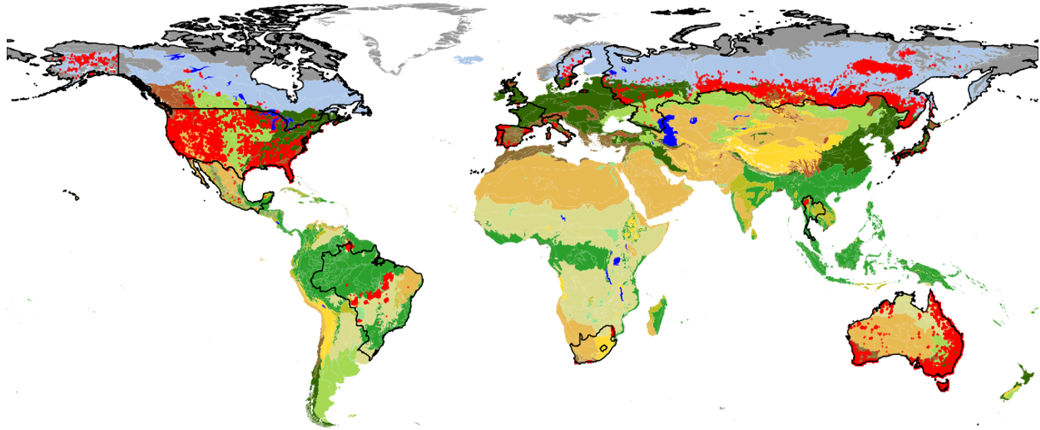
Seasonality of Rx Burns in GlobalRx
J | F | M | A | M | J | J | A | S | O | N | D
J | F | M | A | M | J | J | A | S | O | N | D
J | F | M | A | M | J | J | A | S | O | N | D
J | F | M | A | M | J | J | A | S | O | N | D
J | F | M | A | M | J | J | A | S | O | N | D
J | F | M | A | M | J | J | A | S | O | N | D
J | F | M | A | M | J | J | A | S | O | N | D
J | F | M | A | M | J | J | A | S | O | N | D
J | F | M | A | M | J | J | A | S | O | N | D
J | F | M | A | M | J | J | A | S | O | N | D
J | F | M | A | M | J | J | A | S | O | N | D
KEY
= GlobalRx countries
Biome Histogram
J | F | M | A | M | J | J | A | S | O | N | D
# Burns
Border color = biome
J | F | M | A | M | J | J | A | S | O | N | D
J | F | M | A | M | J | J | A | S | O | N | D
J | F | M | A | M | J | J | A | S | O | N | D
Month
Notes:
Despite the fact that coverage is heterogenous, with this data we can still start to get a nice idea of the seasonality of prescribed burns around the world in a range of different biomes and ecosystems.
So in this figure, the countries represented in the dataset are outlined in black and the red dots are each of the burn records.
The histograms will show how many records there are for a certain country and biome over the course of a year. The border color of the histogram indicates the biome, and the arrows are pointed in the general region from where the burn records used in the histogram are from.
And so from this preliminary analysis, we can see that in many places much of the burning is concentrated in the boreal or austral spring and fall, like in much of North America, Australia, and Russia, while in the regions of Brazil the burns are more patterned according to the dry and wet seasons.

Slide 6
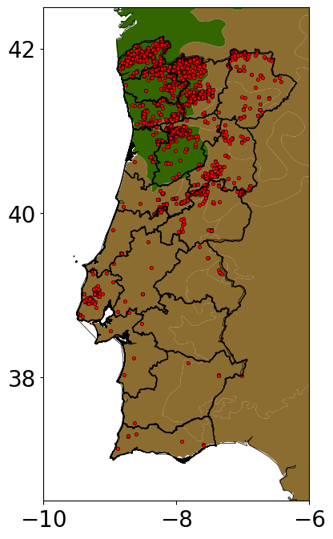
Meteorological Burn Windows
GlobalRx burns in Portugal
What meteorological conditions are the burns conducted under?
120
90
60
30
0
# burns
Notes:
In addition to the seasonality, we also wanted to analyze the meteorological conditions under which the burns were conducted, since this is what we can actually use to determine the impact of climate change on burn weather conditions. And this we do using the meteorological values we geolocated from the ERA5 dataset.
So for this example, we're going to zoom into the data from Portugal, which has about 2800 total records.
To start, we wanted to look at first the meteorological variables that are most commonly used in prescribed burn prescriptions, specifically temp, RH, and wind speed.
So these here are histograms of temperature, wind speed, and relative humidity conditions, so you can get an idea of the distribution of the burns conducted under a specific range of meteorological conditions. Then in the red lines are the actual ranges of RH, T, and wind that are recommended for burning in shrublands in Portugal, so we can actually get an idea what fraction of burns were conducted within the recommended guidelines.
And then the bigger square plots are 2D histograms, describing the frequency of burns conducted under a combination of either relative humidity and temperature conditions on the left, and relative humidity and wind conditions on the right.
And this is just a preliminary analysis, but this analysis does tell us that the ERA5 data seems to be a relatively good approximation of ground conditions, since it seems that most burns do fall within the recommended guidelines and then decrease in frequency at the more extreme weather conditions.
And so we can use not just the prescriptions, but also some percentiles of real burn data with model projections of future climate to determine how the frequency or timing of the conditions that the burns are conducted under will change. And that will hopefully be our next steps moving forward with this dataset.

Slide 7
Conclusions
1
192,000 records of prescribed burns spanning 1979-2023 collected from 16 countries
2
Meteorology, ecosystem, land cover, and other features extracted for each burn record
3
Extracted meteorological data can be used for assessing climate change impact on prescribed burning weather.
Notes:
So just to recap, we've put together this dataset of prescribed burns from 16 different countries with data spanning from 1979-2023
and to each of these data points we've added features describing the burn conditions, such as the meteorology, ecosystem, and land cover
And using the meteorological features, we can use model predictions of future climate to assess how climate change will impact the conditions that burns are conducted under.

