Slide 1
Contrasting Effects of Intensity and Organisation on the Structure and Lifecycle of Deep Convective Clouds
William Jones¹, Philip Stier¹
¹University of Oxford, UK

Slide 2
Anvil Structural Changes
?
More mass + less area = thickening = cooling
Less mass flux = thinning = warming
Berry & Mace, 2014; figure 12 [1]

Slide 3
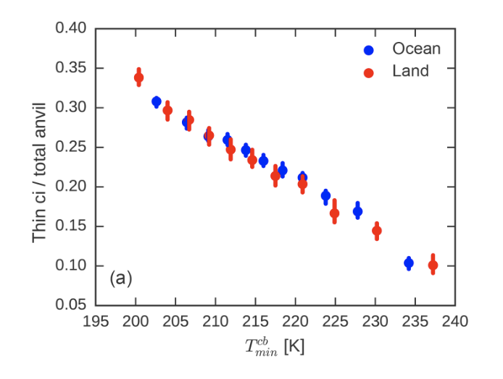
Relation of Anvil Structure to Convection
more intense
Protopapadaki et al., 2017; figure 12 [3]

Slide 4
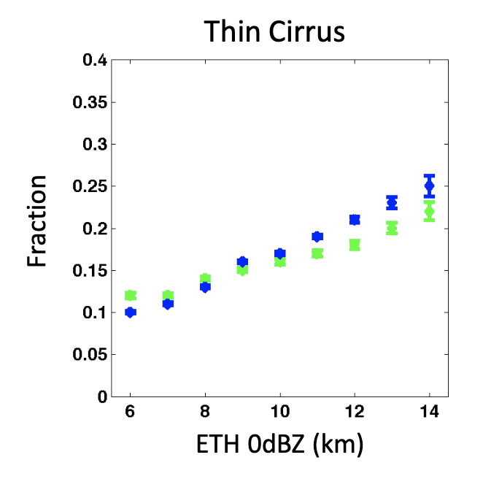
Relation of Anvil Structure to Convection
more intense
more intense
Protopapadaki et al., 2017; figure 12 [2]
Takahashi et al., 2017 [3]

Slide 5
Tracking Cores and Anvils
Core cooling rate:
$$\left(\frac{ΔT}{Δt}\right)$$
1 K/min ~ 2.5ms⁻¹
t₀
t₁
t₂
Jones et al., 2023 [4]

Slide 6
Tracking Cores and Anvils
Core cooling rate:
$$\left(\frac{ΔT}{Δt}\right)$$
1 K/min ~ 2.5ms⁻¹
t₀
t₁
t₂
Organisation:
Jones et al., 2023 [4]

Slide 7
Tracking Cores and Anvils
Core cooling rate:
$$\left(\frac{ΔT}{Δt}\right)$$
1 K/min ~ 2.5ms⁻¹
t₀
t₁
t₂
Organisation:
Anvils:
5 years (2018-2022)
>400,000 anvils
>800,000 cores
Thick ~ 1.5 𝜏
Thin ~ 0.3 𝜏
Jones et al., 2023 [4]

Slide 8
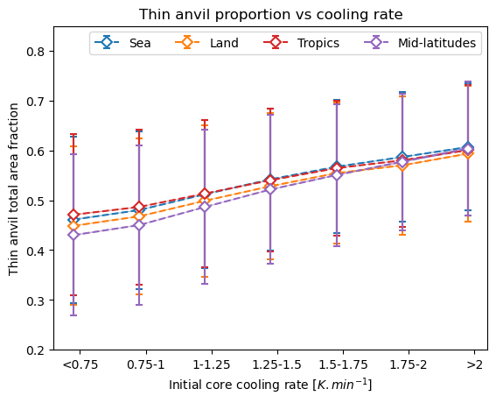
How does convection affect thin anvil fraction?
more intense

Slide 9
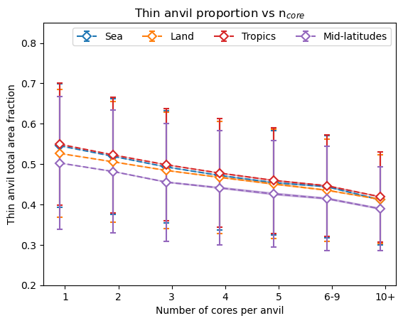
How does convection affect thin anvil fraction?
more intense
more organised

Slide 10
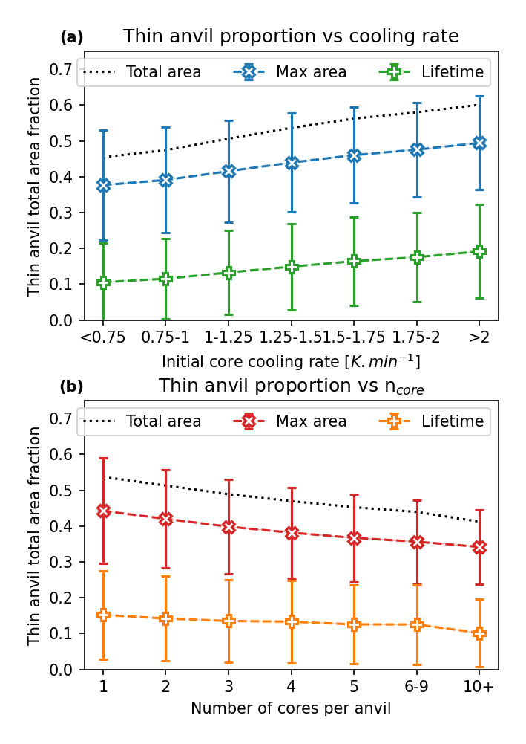
Changes in anvil properties
Intensification results in colder CTT, larger thin anvil area and longer thin anvil lifetime
Organisation results in colder CTT, larger area and longer lifetime for both thick and thin anvil
But, the change in maximum area and lifetime don’t explain differences alone

Slide 11
Composite analysis

Slide 12
Composite analysis
Growing

Slide 13
Composite analysis
Growing
Maturing

Slide 14
Composite analysis
Dissipating
Growing
Maturing

Slide 15
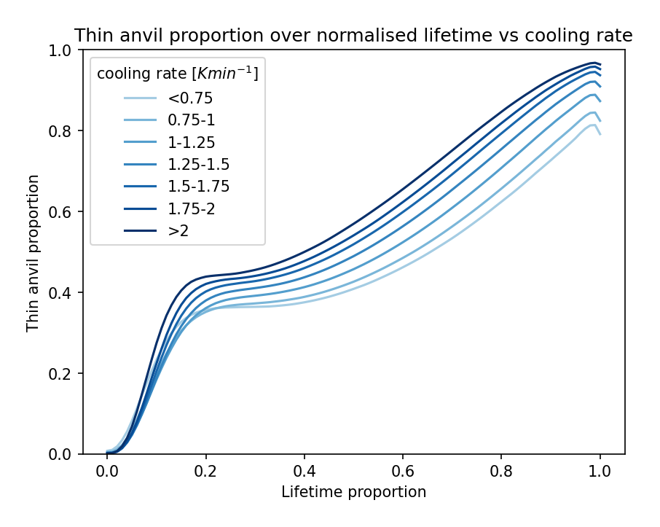
Lifecycle effects of intensity and organisation

Slide 16
Lifecycle effects of intensity and organisation

Slide 17
Lifecycle effects of intensity and organisation

Slide 18
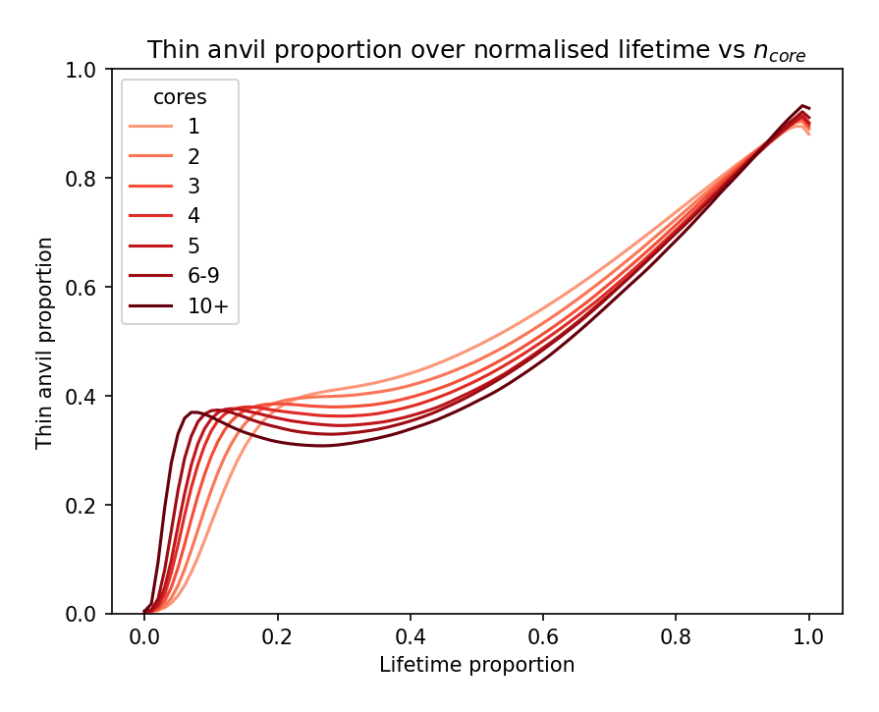
Lifecycle effects of intensity and organisation

Slide 19
Lifecycle effects of intensity and organisation

Slide 20
Conclusions
Intensification and organization have contrasting effects on anvil structure both directly and indirectly
Both processes also have different impacts on the lifecycle of DCCs
Does this affect CRE?

Slide 21
Conclusions
Intensification and organization have contrasting effects on anvil structure both directly and indirectly
Both processes also have different impacts on the lifecycle of DCCs
Does this affect CRE?
Future work to investigate secondary impact
on anvil CRE
Jones et al., 2024

Slide 22
References
[1] Berry, E. and Mace, G. G. (2014). Cloud properties and radiative effects of the Asian summer monsoon derived from A-Train data. Journal of Geophysical Research: Atmospheres
[2] Protopapadaki, S. E., Stubenrauch, C. J., and Feofilov, A. G. (2017). Upper tropospheric cloud systems derived from IR sounders: Properties of cirrus anvils in the tropics. Atmospheric Chemistry and Physics
[3] Takahashi, H., Protopapadaki, S., Stubenrauch, C., Luo, Z. J., and Stephens, G. L. (2017). Relationships between Convective Strength and Anvil Development based on AIRS-CloudSat Joint Dataset.
[4] Jones, W. K., Christensen, M. W., and Stier, P. (2023). A semi-Lagrangian method for detecting and tracking deep convective clouds in geostationary satellite observations. Atmospheric Measurement Techniques
[5] Jones, W. K., Stengel, M., and Stier, P. (2024). A Lagrangian Perspective on the Lifecycle and Cloud Radiative Effect of Deep Convective Clouds Over Africa. Atmospheric Chemistry and Physics (accepted)

Slide 23
Tracking Cores and Anvils
5 years (2018-2022) of DCCs tracked in GOES-16 ABI CONUS domain imagery using tobac-flow (Jones et al., 2023 [5])
2km, 5 minute
838,204 cores
402,191 anvils
Thin anvil COT ~ 0.3-1.5, thick anvil COT > 1.5
Two proxies for convective processes:
Core cooling rate (intensity)
1 K min⁻¹ ~1.25 ms⁻¹
Anvil core count (organization)

Slide 24
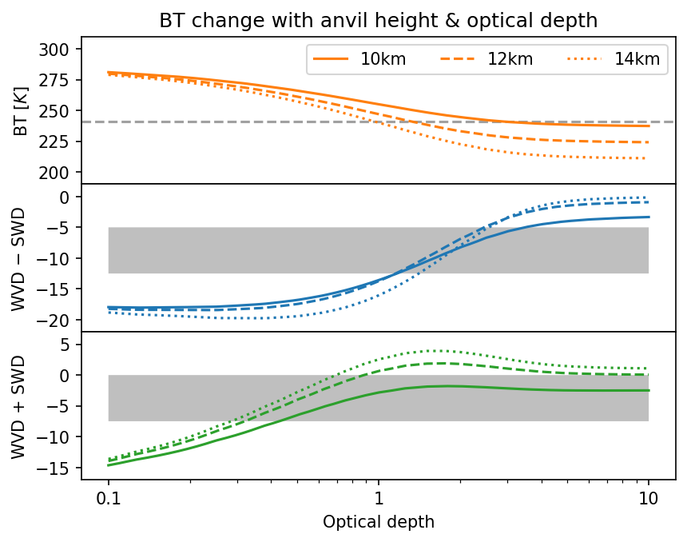
Tobac-flow thick/thin anvil sensitivity

Slide 25
How does convection affect thin anvil fraction?
more intense
more intense
more organised

Slide 26
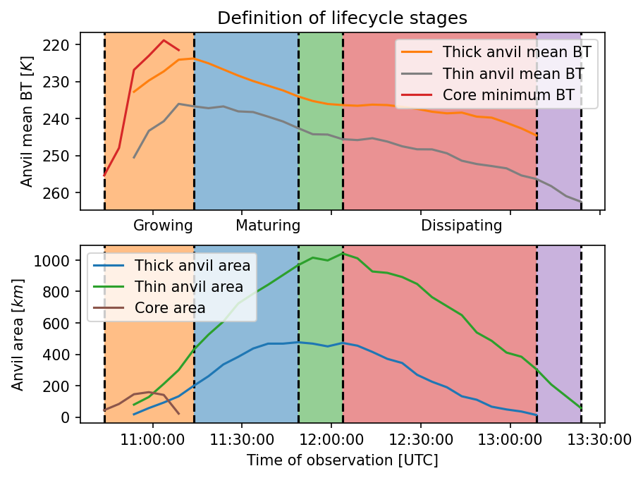
Lifecycle Stages
Based on Futyan & del Genio, 2007 [6]

Slide 27
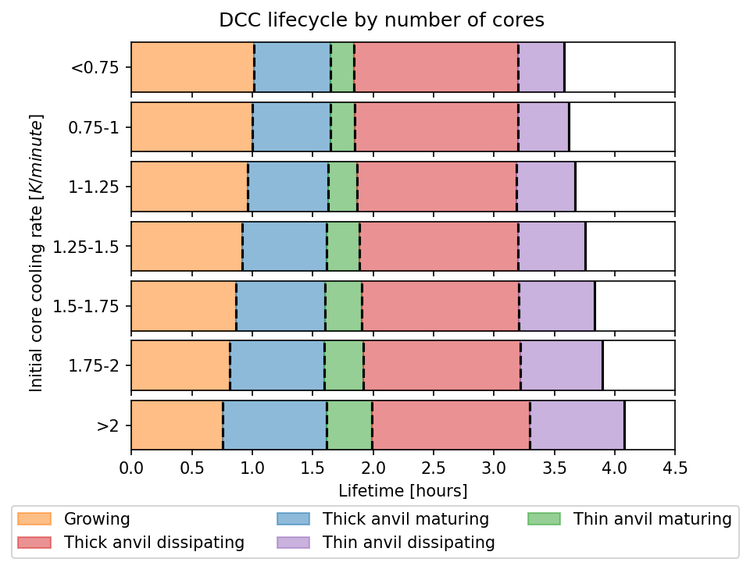
Impact of Intensification on Lifecycle

Slide 28
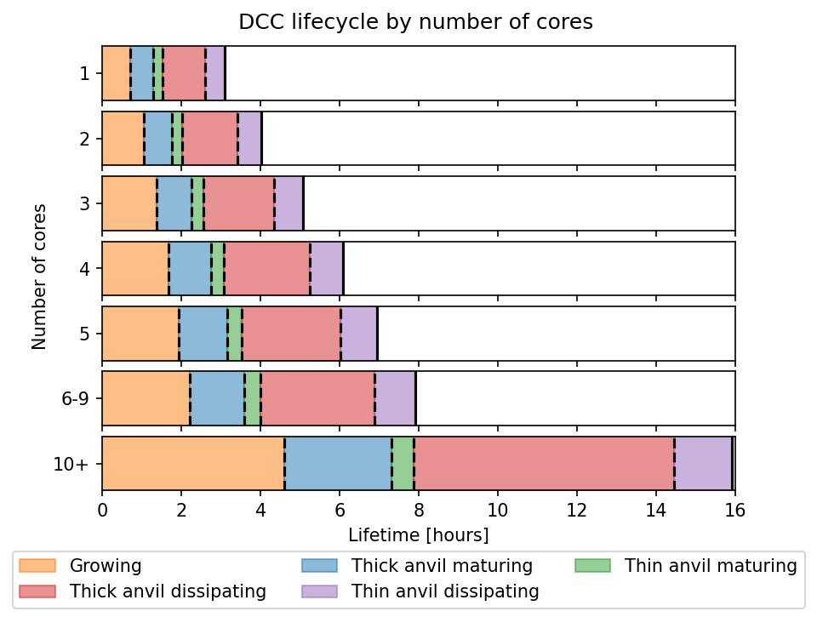
Impact of Organisation on Lifecycle

Slide 29
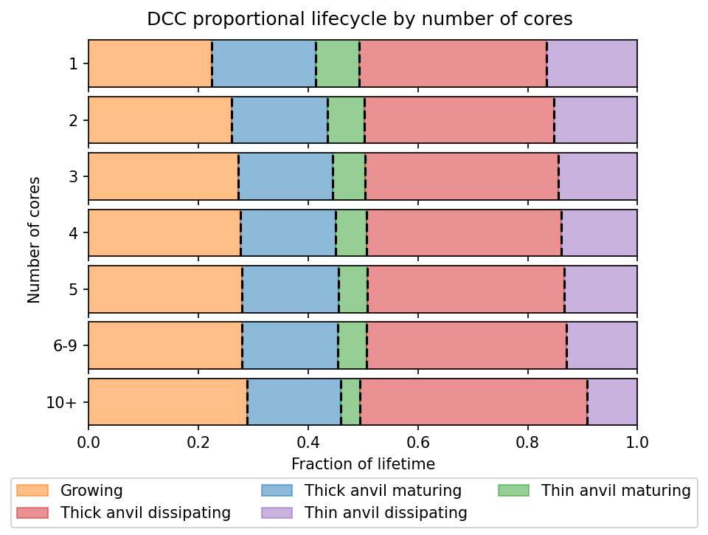
Impact of Organisation on Lifecycle

