Slide 1
Assessing the environmental benefits of biochar application in agriculture: Insights from lifecycle assessment Sirjana Adhikari, M A Parvez Mahmud, Ellen Moon, Wendy Timms Deakin University, Geelong, Australia EGU 2024 Session SSS5.2 Carbon sequestration in soils: organic and inorganic mechanisms of increasing soil carbon stocks as a pathway to net zero and improved soil functioning
Presented by
Sirjana Adhikari
BSc, MSc Environmental Science
MEng Environmental Engineering
Current PhD Scholar at Deakin University, Geelong, Australia

Slide 2
Contents
Introduction
Motivation
Objectives
Goal and Scope definition
Life cycle Inventory
System Boundary
Life cycle Impact Assessment
Interpretation
Perspective
Further agricultural benefits
Conclusion

Slide 3
Land is a carbon sink, but now turned to Carbon source
Impact of the combined effect of land system change and climate change boundary states on terrestrial carbon stocks and global climate change (Richardson et al., 2023)

Slide 4
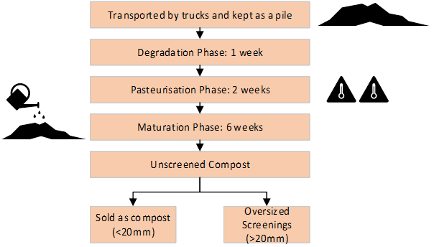
Introduction
Around 1.4 billion tonnes of organic waste is generated globally (Kaza et al., 2018) and of that 5 million tonnes is generated in Australia per year (DELWP, 2023)
One of the commonly used method is composting
Larger particles (> 20) mm cannot be composted and are regarded as waste
More than 97% of the emission are released to the atmosphere (Steiner et al., 2014)
Approximately half of the carbon pollutants present in the leachate and sludge during composting process are released In the environment through water and soil (Wen et al., 2019).
For every 1000kg of garden waste composted the emission released ranges from 67 to 150 kg CO₂ eq (Lu et al., 2020; Oviedo-Ocana et al., 2023; ten Hoeve et al., 2019)
Figure 1: Process of making compost and oversized screening

Slide 5
Biochar
product of thermal treatment of waste biomass that has multiple co-benefits to soil, water, and environment
It is considered as a negative emission technology (IPCC, 2018)
Provides opportunities to reduce, remove and avoid greenhouse gas emissions (Joseph et al., 2021).
Biochar typically has high pH, carbon content, cation exchange capacity (CEC) (Adhikari et al., 2023), and nutrient availability with high surface area and porosity (Adhikari, Mahmud, et al., 2023).
Depending on the future socioeconomic scenarios and temperature targets considered, biochar can provide from 10 to 35% of the required CDR deployment rate in 2050 (Tisserant and Cherubini, 2019).
The global biochar market size is estimated to reach $3.1 billion by 2025
Figure 2: Biochar production process using a flaming pyrolysis technology

Slide 6
Life cycle assessment
a technique to analyse and explore the potential environmental impacts (positive or negative) of any product.
Soil application of biochar produced from organic waste has the potential to reduce emissions equivalent to around -2 to -8 tonnes CO2 eq ha-1 yr-1 (Tisserant et al., 2022)

Slide 7
Motivation
High feedstock availability, well developed thermal treatment process, academic evidence that it works
Not enough work to compare different alternatives such as conversion of compost oversized screenings (otherwise considered waste) to biochar or garden waste to biochar
Technical and economic aspects of biochar production are extensively researched but lacking environmental effects of application and stability of biochar carbon (Lee et al., 2020; Luo et al., 2023; Matuštík et al., 2020).
Indicates need of management and valorization of this waste
understand and control emissions related to composting (Wen et al., 2019).
Need to integrate LCA results with holistic understanding of environmental impacts at national and global scale.

Slide 8
Objectives
Assessed climate change mitigation potential and environmental sustainability of different waste management technology, using a comprehensive evaluation:
To evaluate the potential environmental impacts of the composting process as a current best practice (CBP) and conversion of OS to biochar (AP I) or garden waste to biochar (AP II) as an alternative best practice,
To explore the influence of onsite production and use of biochar or production and transport at variable distances
To account for the holistic benefits of soil application of organic waste derived biochar.

Slide 9
Goal and scope definition
Current Best Practice = CBP
Alternative practice (I) = AP(I)
Alternative Practice (II) = AP(II)
Figure 3: Schematic diagram for evaluation of potential environmental impacts in different scenarios with distinct system boundary for 3 scenarios with input, output, and functional unit.

Slide 10
Life cycle Inventory
Data collection
Interviews, focused discussions with industry
Site visit to the composting site, and regional pyrolysis facility
LCA analysis
Open LCA 1.10
Ecoinvent database, reports and previous literatures
ReCipe 2016 midpoint impact assessment method and sensitivity to transport distance

Slide 11
System Boundary
The system boundary is cradle to gate.
However, the study is comprehensive because further evaluation of environmental benefits using alternative practices has also been discussed along with the results from LCA.
The functional unit applied in this research is the preparation of 1 tonne of biochar.

Slide 12
Life cycle impact assessment
Table 1: Environmental impacts for 3 different scenarios grouped according to impact to varying categories. CBP: current best practice, AP(I): Oversized screening of composting to biochar, and AP(II): organic waste to biochar.
Impact | Impact indicators | Unit | CBP | AP (I) | AP (II)
Emission | Fine particulate matter formation (FPMF) | kg PM_{2.5} eq | 1.3 | 1.6 | 0.8
 | Global warming (GW) | kg CO₂ eq | 675.4 | 1017.9 | 427.4
 | Ozone formation, Terrestrial ecosystems (OFTE) | kg NOx eq | 8.2 | 16.4 | 5.2
Water | Freshwater ecotoxicity (FE) | kg 1,4-DCB | 1.1 | -3.4 | 0.6
 | Marine ecotoxicity (ME) | kg 1,4-DCB | 2.1 | -3.1 | 1.3
 | Freshwater eutrophication (FEu) | kg P eq | 0.01 | -0.04 | 0.007
 | Water consumption(WC) | m³ | -1478 | -4352 | -2322
Land | Terrestrial acidification (TA) | kg SO₂ eq | 3.7 | 5.9 | 2.4
 | Land use (LU) | m²a crop eq | 13.2 | -3.0 | 3.2
 | Terrestrial ecotoxicity (TE) | kg 1,4-DCB | 834 | 1839 | 431

Slide 13
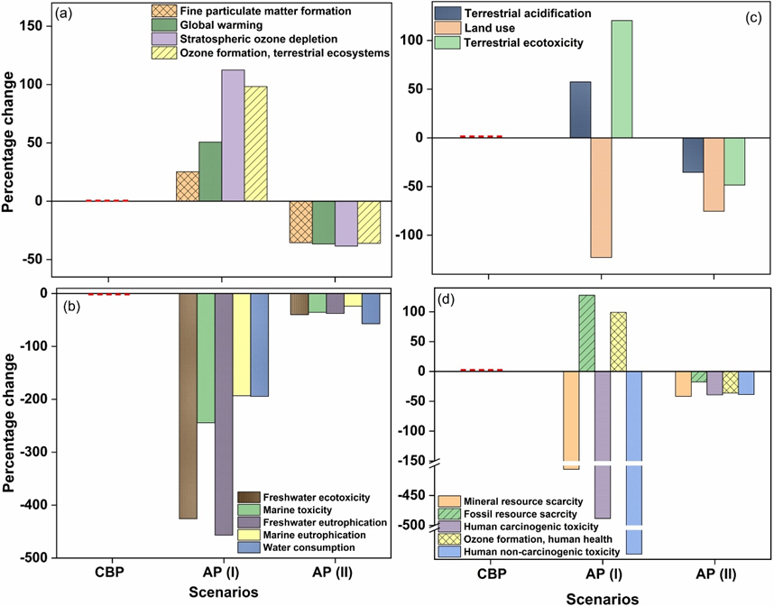
Interpretation
Figure : % change in impacts in each scenario shown by different impact indicators from LCIA; where (a) emissions, (b) water, (c) land and (d) other impacts to resources and human health.

Slide 14
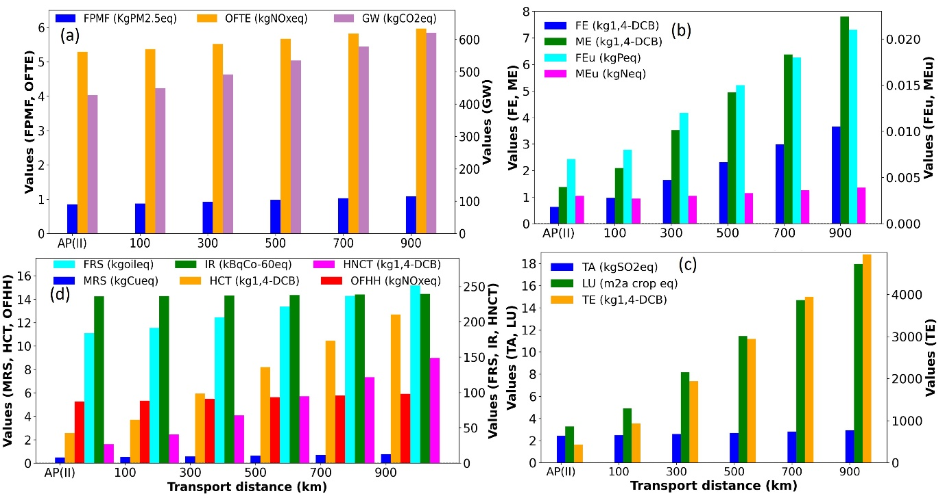
Interpretation
Figure : Sensitivity to transport distance for AP(II) with impact indicators

Slide 15
Interpretation
Table : schematic table showing how much transport distance can be leveraged to have same or less emissions compared to CBP after pyrolysis of the waste biomass
S.N. | Impact Indicators | Unit |  | Transport distance (km)
 |  |  | CBP | 100 | 300 | 500 | 700 | 900 | 1200 | 1400 | 1600
1 | Global warming (GW) | kg CO2 eq
2 | Freshwater ecotoxicity (FE) | kg 1,4-DCB
3 | Marine ecotoxicity (ME) | kg 1,4-DCB
4 | Freshwater eutrophication (FEu) | kg P eq
5 | Land use (LU) | m2a crop eq
6 | Terrestrial ecotoxicity (TE) | kg 1,4-DCB
7 | Fossil resource scarcity (FRS) | kg oil eq
8 | Human carcinogenic toxicity (HCT) | kg 1,4-DCB

Slide 16
Interpretation
Table : schematic table showing how much transport distance can be leveraged to have same or less emissions compared to CBP after pyrolysis of the waste biomass
Impact Indicators | Optimised transport distance(km)
 | 100 | 300 | 500 | 700 | 900 | 1200 | 1400
Global warming (GW)
Freshwater ecotoxicity (FE)
Marine ecotoxicity (Me)
Freshwater eutrophication(FEu)
Land use (LU)
Terrestrial ecotoxicity (TE)
Fossil resource scarcity (FRS)
Human carcinogenic toxicity (HCT)

Slide 17
Interpretation
Table : schematic table showing how much transport distance can be leveraged to have same or less emissions compared to CBP after pyrolysis of the waste biomass
S.N. | Impact Indicators | Unit |  | Transport distance (km)
 |  |  | CBP | 100 | 300 | 500 | 700 | 900 | 1200 | 1400 | 1600
1 | Fine particulate matter formation (FPMF) | kg PM2.5 eq
2 | Global warming (GW) | kg CO2 eq
3 | Ozone formation, Terrestrial ecosystems (OFTE) | kg NOx eq
4 | Freshwater ecotoxicity (FE) | kg 1,4-DCB
5 | Marine ecotoxicity (ME) | kg 1,4-DCB
6 | Freshwater eutrophication (FEu) | kg P eq
7 | Marine eutrophication (MEu) | kg N eq
8 | Land use (LU) | m2a crop eq
9 | Terrestrial ecotoxicity (TE) | kg 1,4-DCB
10 | Fossil resource scarcity (FRS) | kg oil eq
11 | Human carcinogenic toxicity (HCT) | kg 1,4-DCB
12 | Ozone formation, Human health (OFHH) | kg NOx eq

Slide 18
Perspective
Soil organic carbon by 25% in 8 year @ 10t/ha
Soil carbon mineralisation by 18%
>50% of biochar carbon (>100 years)
Biochar carbon is proven to be resistant to thermal and microbial degradation providing opportunities for large scale carbon sequestration.
Addition of biochar to soil provides opportunity of genuine transfer of carbon to the soil, reducing its emission to the atmosphere.
Notes:
(Weng et al., 2022) (Weng et al., 2022; Joseph et al., 2021)

Slide 19
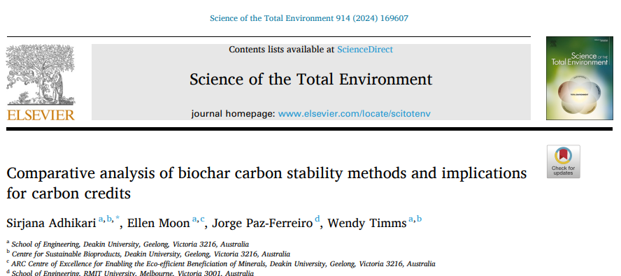
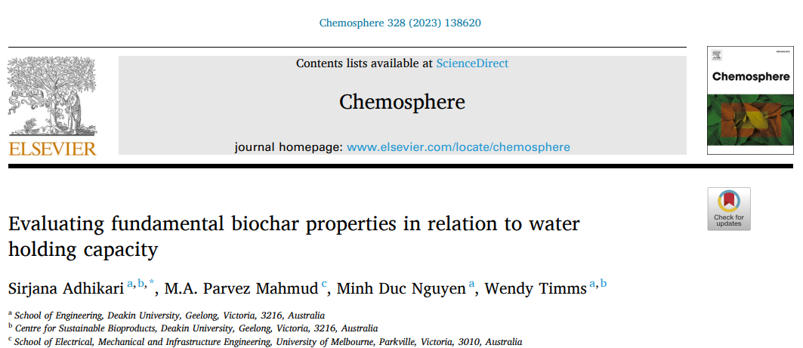
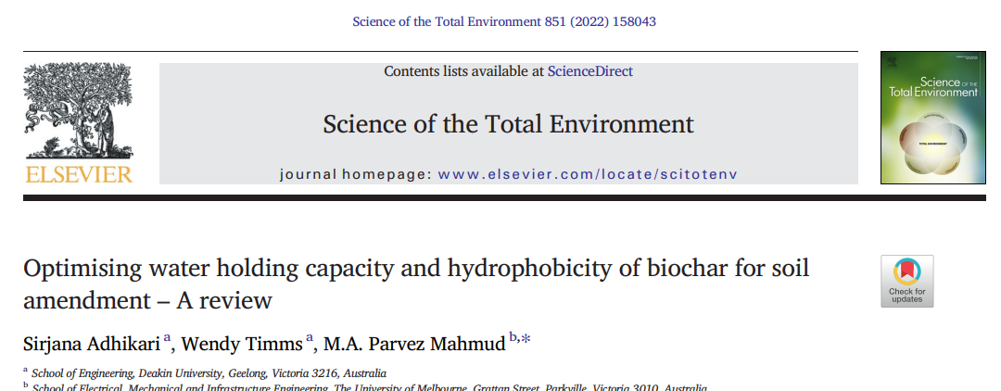
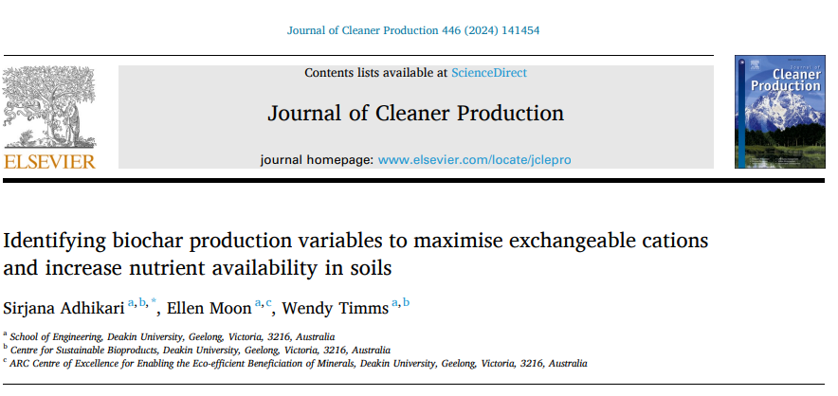
Recent publications

Slide 20
Further agricultural benefits
Help improve soil quality and increase productivity.
The results are always case specific and depend on the scope and system boundary as well as the life cycle inventory.
However, this can be increased to a large scale and applied to the overall composting industry or waste management scenarios.

Slide 21
Conclusions
Biochar application in agriculture is beneficial in every stage for GHG removal, reduction and avoidance
It provides additional benefits to agricultural soil such as enhanced water holding and cation exchange capacity
High availability of the oversized compost screening and lack of market for this makes this waste a great candidate for pyrolysis
Converting the garden organics directly to biochar has least potential environmental impacts compared to other alternatives studied
The pyrolysis plant can be placed up to 1200km away from the organic waste collection site and will still produce less emissions compared to the current scenario.

Slide 22
References
Adhikari, S., Gasco, G., Mendez, A., Surapaneni, A., Jegatheesan, V., Shah, K., & Paz-Ferreiro, J. (2019). Influence of pyrolysis parameters on phosphorus fractions of biosolids derived biochar. Science of the Total Environment, 695, 133846. https://doi.org/10.1016/j.scitotenv.2019.133846
Adhikari, S., Mahmud, M. A. P., Nguyen, M. D., & Timms, W. (2023). Evaluating fundamental biochar properties in relation to water holding capacity. Chemosphere, 328, 138620. https://doi.org/https://doi.org/10.1016/j.chemosphere.2023.138620
Adhikari, S., Moon, E., Paz-Ferreiro, J., & Timms, W. (2023a). Comparative analysis of biochar carbon stability methods and implications for carbon credits. Science of The Total Environment, 169607. https://doi.org/https://doi.org/10.1016/j.scitotenv.2023.169607
Adhikari, S., Timms, W., & Mahmud, M. A. P. (2022). Optimising water holding capacity and hydrophobicity of biochar for soil amendment - A review. Sci Total Environ, 851(Pt 1), 158043. https://doi.org/10.1016/j.scitotenv.2022.158043
et al., 2
Joseph, S., Cowie, A. L., Van Zwieten, L., Bolan, N., Budai, A., Buss, W., . . . Lehmann, J. (2021). How biochar works, and when it doesn't: A review of mechanisms controlling soil and plant responses to biochar. GCB Bioenergy. https://doi.org/10.1111/gcbb.12885
Weng, Z., Van Zwieten, L., Tavakkoli, E., Rose, M. T., Singh, B. P., Joseph, S., . . . Cowie, A. (2022). Microspectroscopic visualization of how biochar lifts the soil organic carbon ceiling. Nature Communications, 13(1), 5177. https://doi.org/10.1038/s41467-022-32819-7

