Slide 1
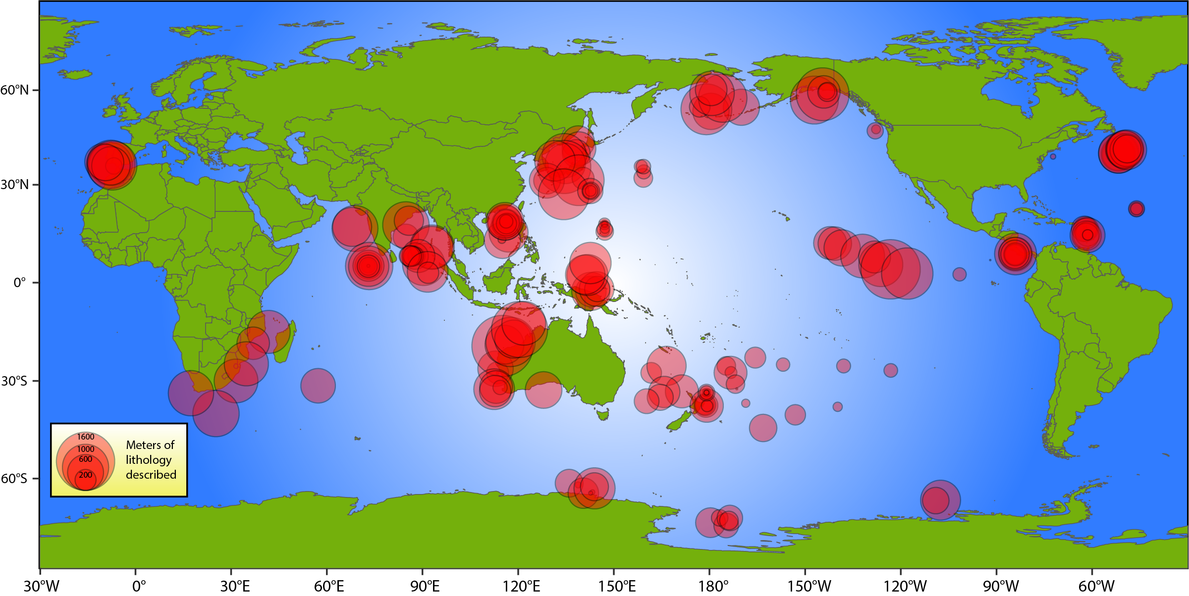
EGU Meeting 2024
Using the LIMS with Lithology (LILY) Database to Probe IODP Density, Porosity, and P-Wave Velocity Data
Gary Acton, Laurel Childress, and Vincent Percuoco
LILY contains over 34 million data from 42 International Ocean Discovery Program (IODP) expeditions
(Expeditions 318 through 379).
EGU24-13796
Tuesday 16 April 2024

Slide 2
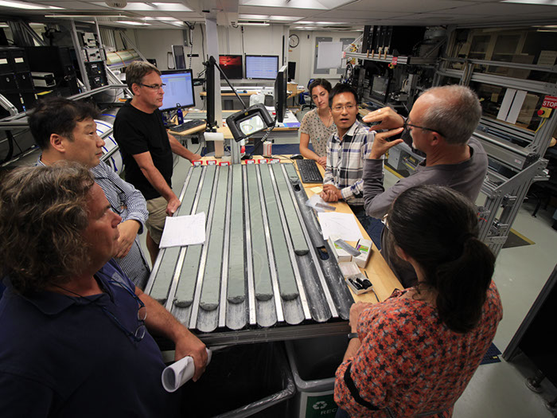
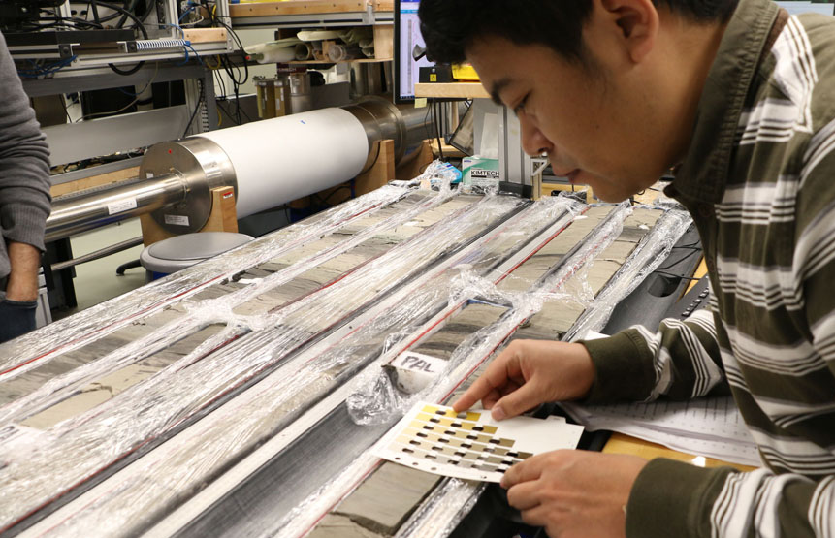
Overview
What I hope to convey in under 8 minutes
Briefly describe the LILY Database
Illustrate how having lithologic information linked to all the data can provide new insights and new information
Use density data in LILY to provide a new high-resolution porosity dataset, with over 3.7 million new porosity estimates
Show that the P-wave velocity data can resolve a significant anisotropy related to lithology
Core Description
Notes:
So, what do I hope to convey in under 8 minutes
First, I will briefly describe the LILY Database
I will then Illustrate how having lithologic information linked to all the data can provide new insights and new information.
I will use density data in LILY to provide a new high-resolution porosity dataset, with over 3.7 million new porosity estimates.
Unfortunately, I will not have time to show that the P-wave velocity data can resolve a significant anisotropy related to lithology
Photos are from IODP’s MerlinOne database.

Slide 3
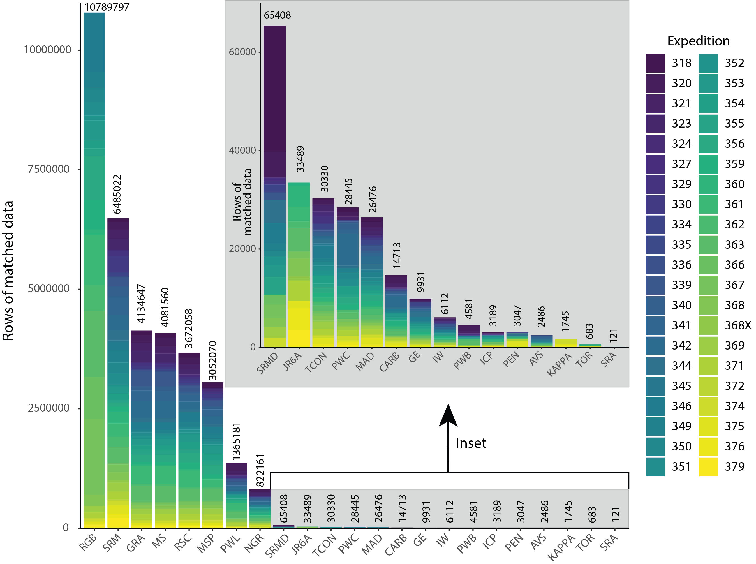
The LILY Database
LILY = LIMS with LithologY
LIMS is the Laboratory Information Management System that stores IODP’s data
LILY attaches the lithology (principal lithology, major & minor modifiers, and other meta data) to each datum in LIMS, for 42 expeditions that had lithologic descriptions stored in DESClogik workbooks.
Abundances of Data in LILY
IODP’s core description software used from 2009-2023, recently replaced by GEODESC
>26,000 MAD density/porosity data
>4 million GRA bulk density data
RGB = Red-Green-Blue color from the Section Half Imaging Logger (SHIL).
SRM = Superconducting Rock Magnetometer (SRM) measurements of split-core sections.
GRA = gamma ray attenuation bulk density from the Whole-Round Multisensor Logger (WRMSL).
MS = magnetic susceptibility from the WRMSL.
RSC = reflectance spectroscopy from the Section Half Multisensor Core Logger (SHMSL).
MSP = point magnetic susceptibility from the SHMSL
PWL = P-wave velocity from the WRMSL.
----- > 1 million data in each dataset above here ----------
NGR = natural gamma radiation from the Natural Gamma Radiation Logger (NGRL).
SRMD = SRM measurements of discrete samples.
JR6A = discrete magnetic measurements from the JR6A spinner magnetometer.
TCON = thermal conductivity measured with the Teka Berlin TK04 probe.
PWC = P-wave velocity from the caliper system.
MAD = moisture and density from discrete samples.
CARB = total carbon, hydrogen, nitrogen, and sulfur, inorganic carbon (carbonate), and organic carbon measured on
discrete samples.
GE = gas elements from gas chromatography.
PWB = P-wave velocity from the bayonet system.
IW = interstitial water chemistry.
ICP = Inductively-coupled plasma data.
Over 34 million measurements from IODP cores
Notes:
So, what is LILY?
LILY is LIMS with Lithology

Slide 4
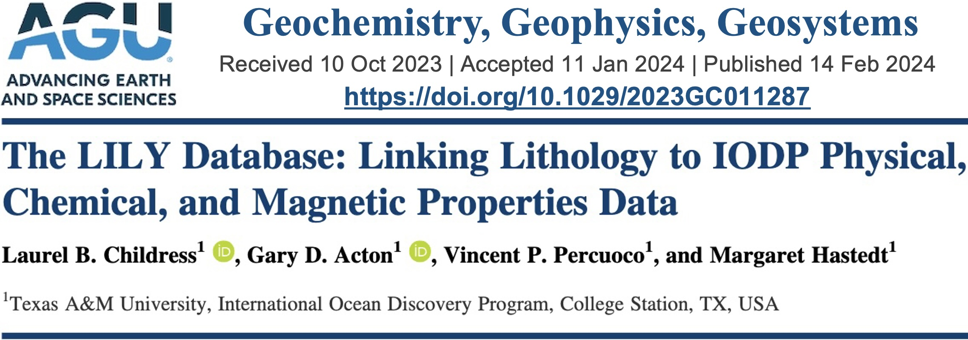
The LILY Database
Data availability
The LILY database paper is published G-cubed, as of February
https://doi.org/10.1029/2023GC011287
The full LILY database is on Zenodo, an open access data repository
https://zenodo.org/records/10425539
The corrected GRA densities and porosities derived from the LILY Database are also on Zenodo
https://zenodo.org/records/10001855
Notes:
When I submitted this abstract, the LILY paper was in review. I am happy to say that the paper was accepted by G-cubed in January and publish in February.
The full LILY database is on Zenodo, an open access data repository.
The density and porosity dataset I will be discussing is also available on Zenodo.

Slide 5
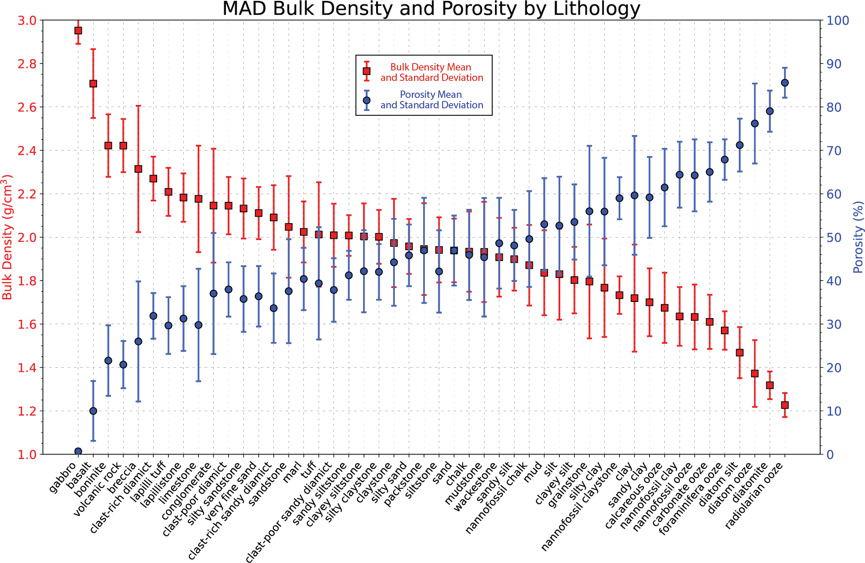
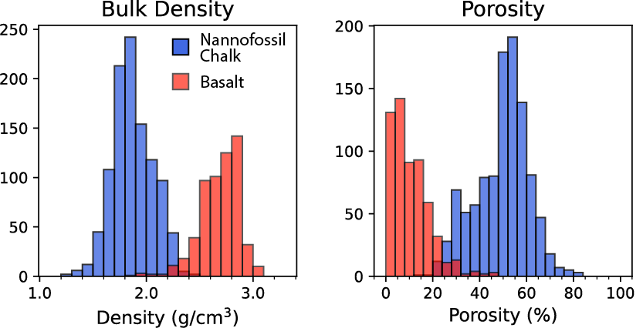
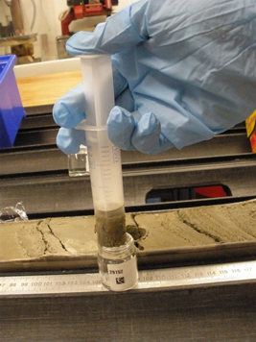
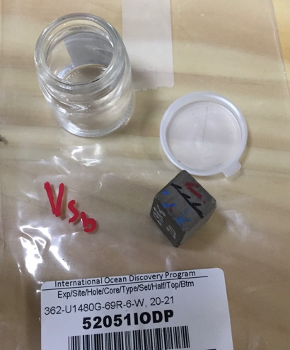
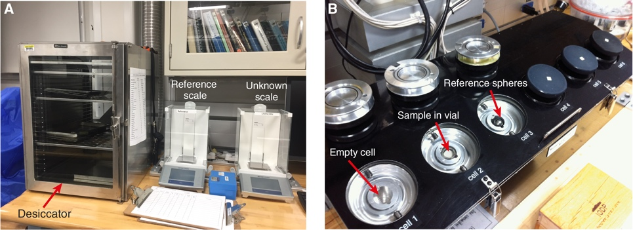
MAD Bulk Densities & Porosities
Excluding outliers, LILY has 25,335 bulk densities, grain densities, and porosities determined from discrete samples for 148 unique principal lithologies
Basalt
Nannofossil
Chalk
Discrete
Samples
Oven and balances for wet and dry mass determinations
Pycnometer for volume measurements
Notes:
For MAD measurements, the mass of a discrete sample, such as the sediment plugs and cubes shown here, is determined wet and dry, and the volume of the dried sample is measured in a pycnometer..
Those measurements allow the determination of bulk density, dry density, grain density, and porosity.
With LILY, we can determine the physical properties of any lithology. This is shown for the bulk density and porosity for some of the more common lithologies.
Histograms for a couple of the lithologies are shown as an example along with their associated mean bulk density and porosity.
Pycnometer/balance figure from http://publications.iodp.org/proceedings/379/102/379_102.html. Other photos from IODP’s MerlinOne database.

Slide 6
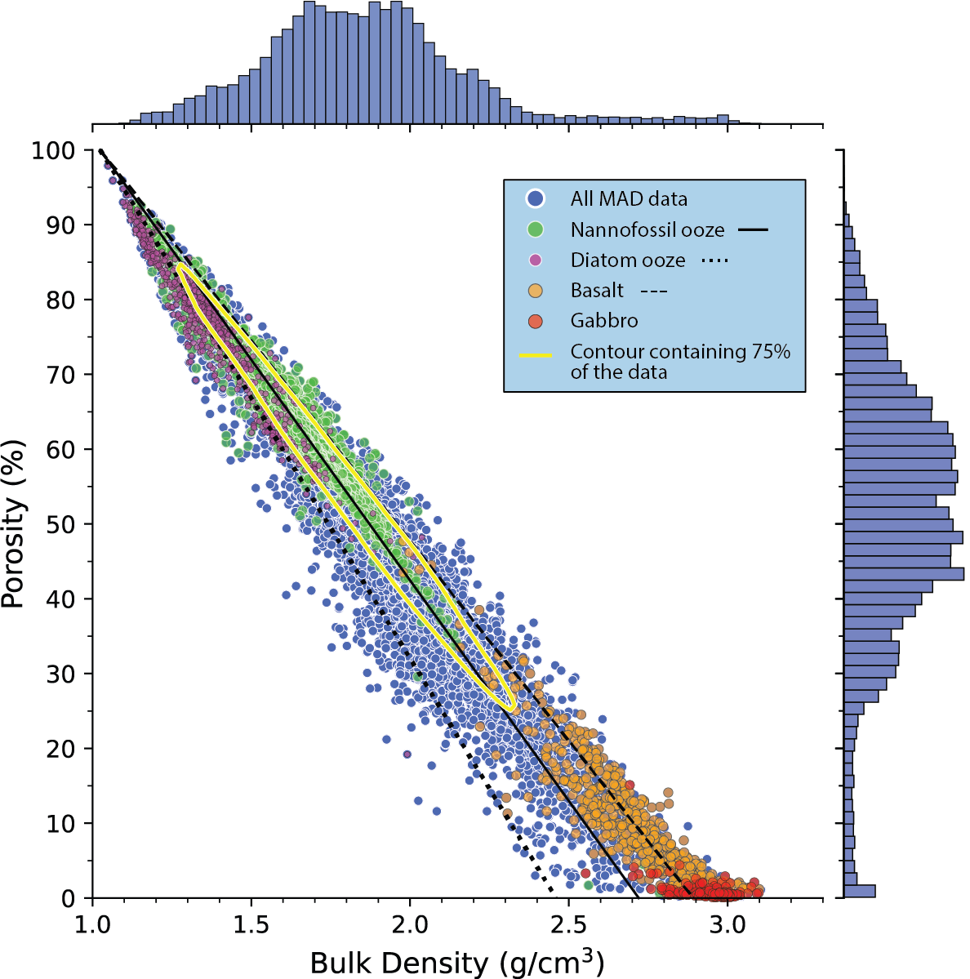
MAD Data
MAD Densities and Porosities
Porosity varies linearly with bulk density for a specific composition (lithology)
The lines are constrained at 100% porosity by the density of seawater and at 0% porosity (the X-axis intercept) by the grain density
Grain density is the density of the solid components, also referred to as the crystallographic density. Grain densities for those shown are
Basalt = 2.89 ± 0.018 g/cm³
Nannofossil Ooze = 2.721 ± 0.007 g/cm³
Diatom Ooze = 2.456 ± 0.049 g/cm³
Simple linear relationships
If the grain density for a specific lithology is known, the porosity can be estimated from the bulk density
>34,000 dots
${\text{B}\text{ulk} \text{density}=ρ}_{B}$ = ($ρ_{F}−ρ_{G}$) $υ$ + $ρ_{G}$
$P\text{orosity} = υ$= ($ρ_{B}−ρ_{G}$)/($ρ_{F}−ρ_{G}$)
$ρ_{G}$ = grain density
$ρ_{F}$ = fluid density
= 1.024 g/cm³ for seawater
Basalt grain density
Diatom ooze
grain density
Nannofossil
ooze
grain density
Notes:
For the MAD data, we already know the porosities for every sample with a bulk density. However, we have bulk densities for over 4 million whole round GRA measurements that have no porosities or grain densities, and we can now determine the grain densities for each lithology from the MAD data and use those with the GRA data.

Slide 7
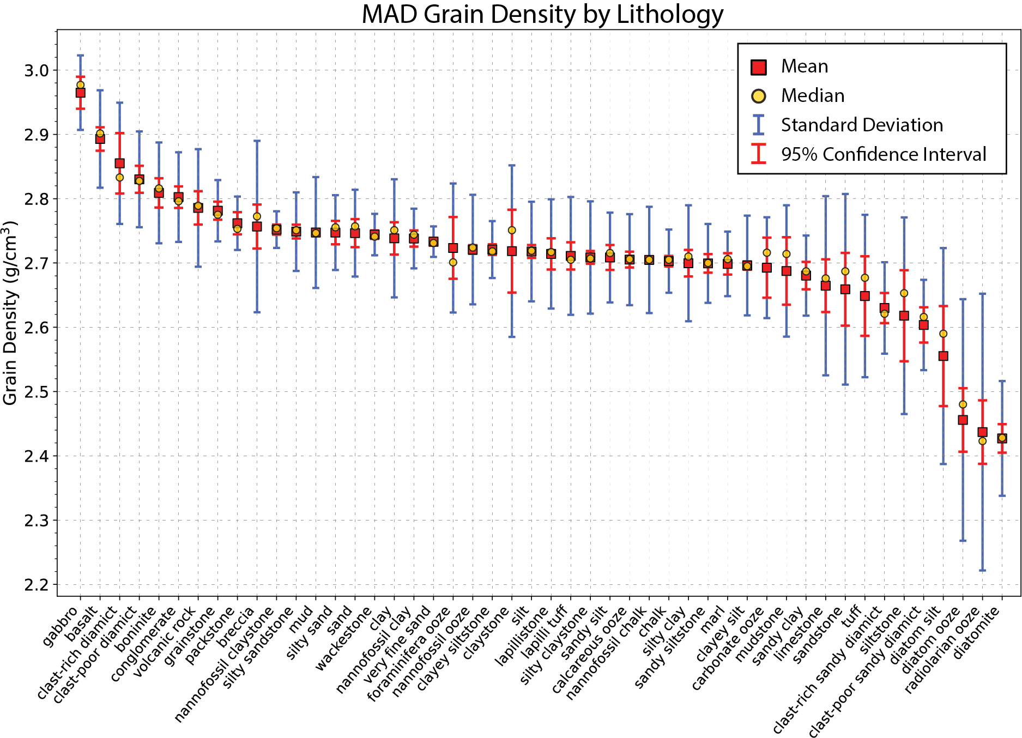
MAD Grain Densities
Basalt
Nannofossil
Chalk
After cleaning, LILY has 25,335 grain density estimates
Notes:
Here we have done exactly that. We have determined the grain densities for all the lithologies.
This plot shows only the more common lithologies.
After cleaning the MAD data, we had over 25,000 grain densities.
Again, we show the underlying distributions for a couple of the lithologies.
Now that we know the grain densities for all the lithologies, we can use the linear relationship between bulk density and porosity to determine the porosity from all the GRA densities.

Slide 8
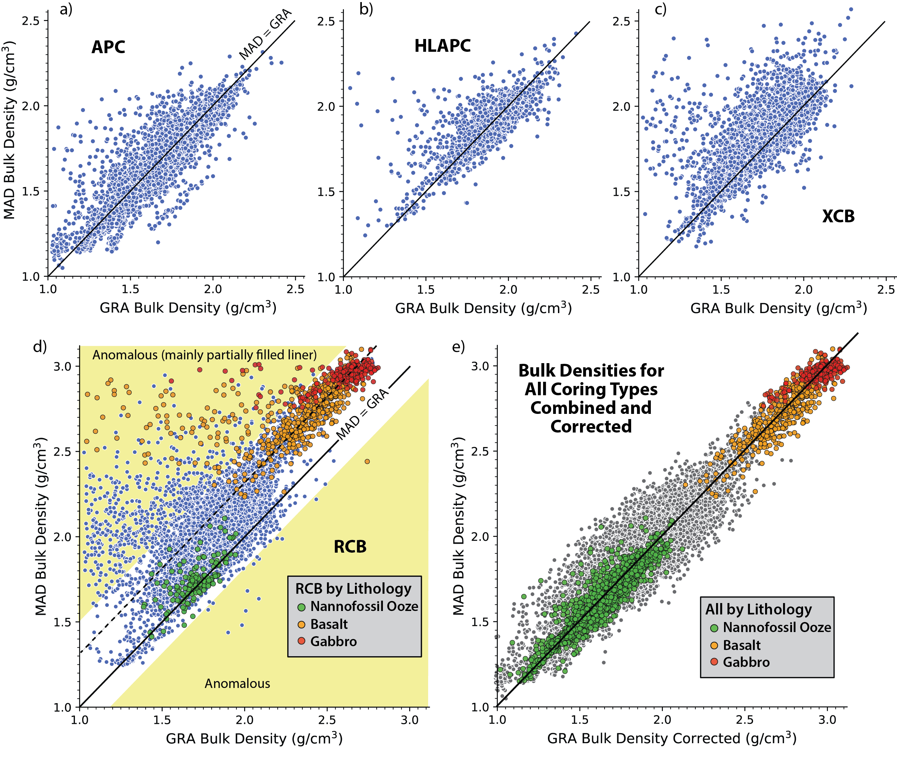
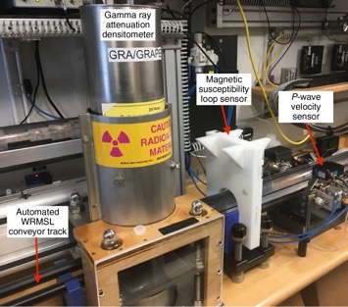
MAD and GRA Bulk Densities
Each MAD bulk density is merged with its nearest neighboring GRA bulk density to compare and then devise a way to correct the GRA data for core diameter variations. LILY facilitates this because the corrections are dependent on coring system and lithology.
Shift gabbro GRA density by +0.312 g/cm³
Shift basalt GRA density by +0.324 g/cm³
We also have detected intervals that give anomalous whole-round GRA Bulk Densities, and so we can avoid them when analyzing other whole-round data
LILY has over 3.7 million GRA bulk densities. After correcting them, they can be used to compute a high-resolution porosity dataset
Notes:
We have one more step that is needed. The whole round multi-sensor logger (WRMSL) assumes the diameter of the core is 6.6 cm but the XCB and RCB coring systems core smaller diameter cores, with the diameter also being dependent on lithology. For example, the throat of the RCB bit is 5.87 cm rather than 6.6 cm.
So, we need to correct for the coring system used and the lithology that was cored.
First, each MAD bulk density is merged with its nearest neighbor GRA bulk density to compare and then devise a way to correct the GRA data for core diameter variations. LILY facilitates this because the corrections are dependent on coring system and lithology, both of which LILY includes.
The plots show the comparison ...
Basalt RCB cores are corrected by shifting GRA density by +0.324 g/cm3, which equates to an average RCB core diameter of 5.81 cm rather than 6.6 cm. Note, the throat of the RCB bit is 5.87 cm and so the result agrees well with the difference in MAD and GRA values being caused by the smaller diameter of the RCB cores (and likewise for the XCB cores).
We toss out the anomalous data, which are mainly from intervals that are only partially filled with core (intervals with broken core fragments/pieces, voids, soupy sediments, etc.).
Photo from http://publications.iodp.org/proceedings/379/102/379_102.html..

Slide 9
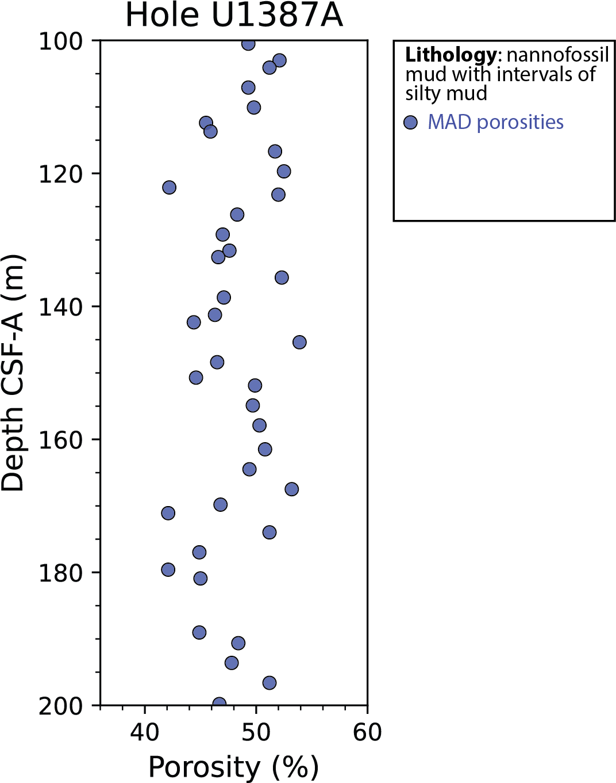
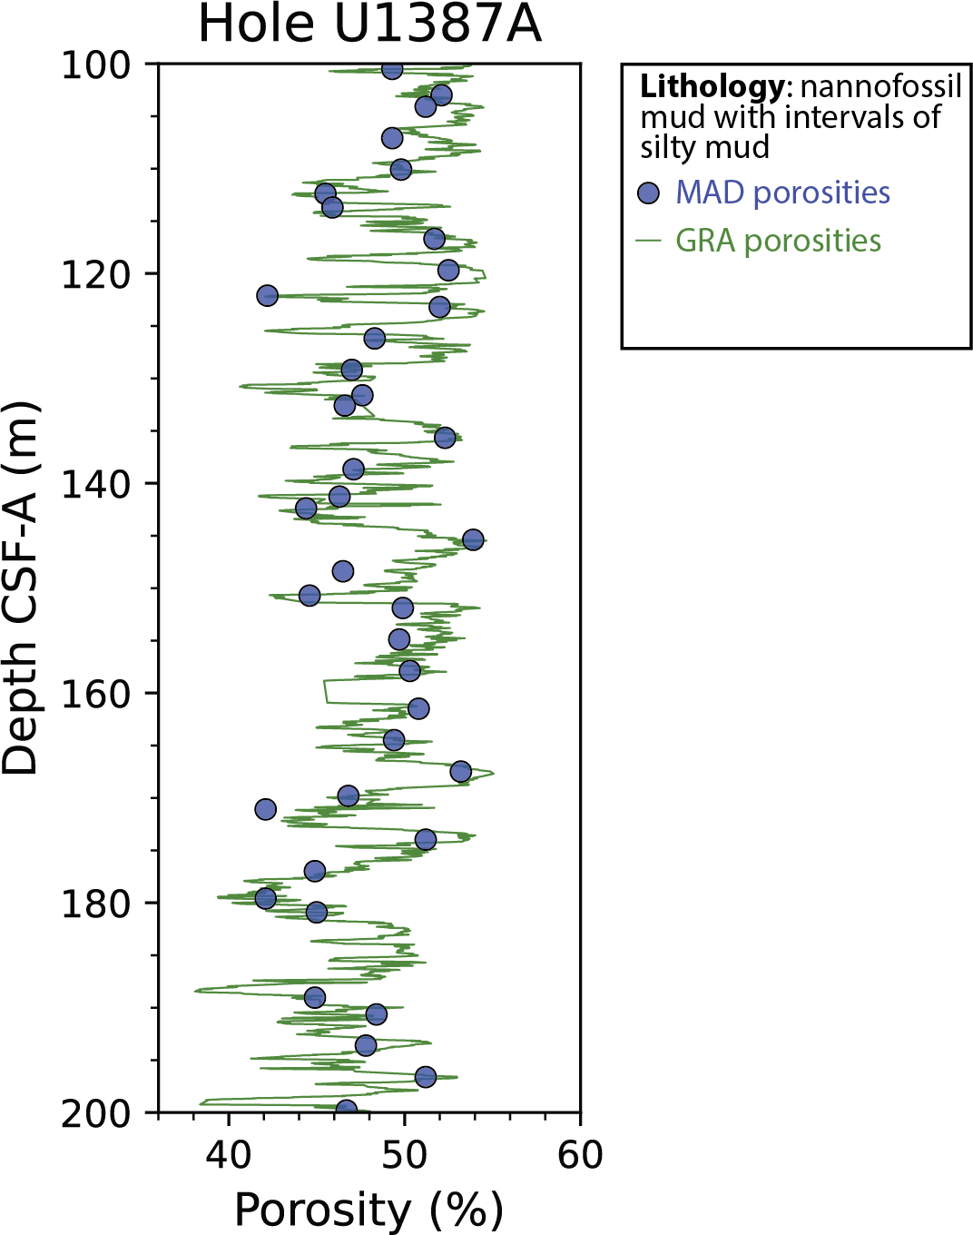
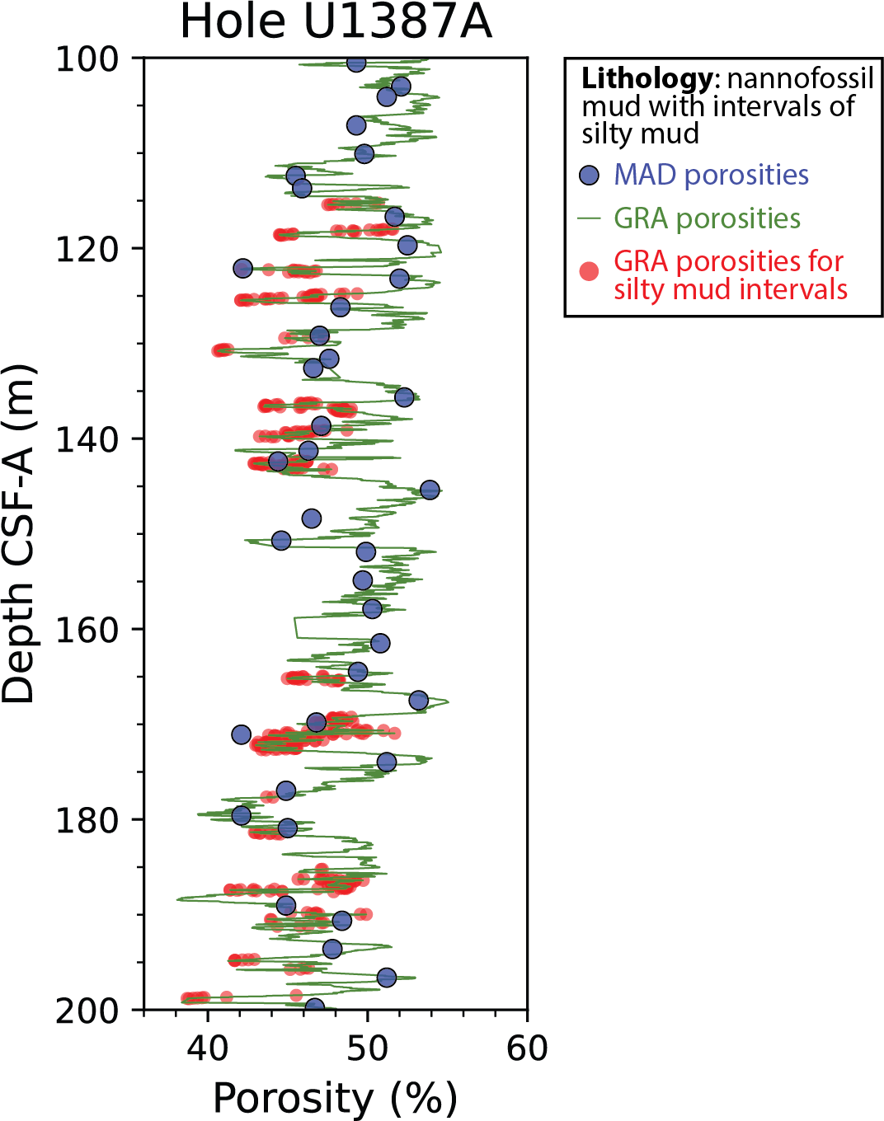
High-Resolution Porosities
An example of how the high-resolution porosity data agree very well with the carefully measured MAD porosity data, while also providing much more information, including astronomical cyclicity and lithologic control on porosity.
Site U1387, which was cored on Expedition 339, is about 20 km south of Southern Portugal and about 150 km NNW of the Straight of Gibraltar (Stow et al., 2011).
Notes:
The lithology was dominantly nannofossil mud with intervals of silty mud.
LILY allows one to determine that the lows are associated with silty mud intervals in a predominantly nannofossil mud.

Slide 10
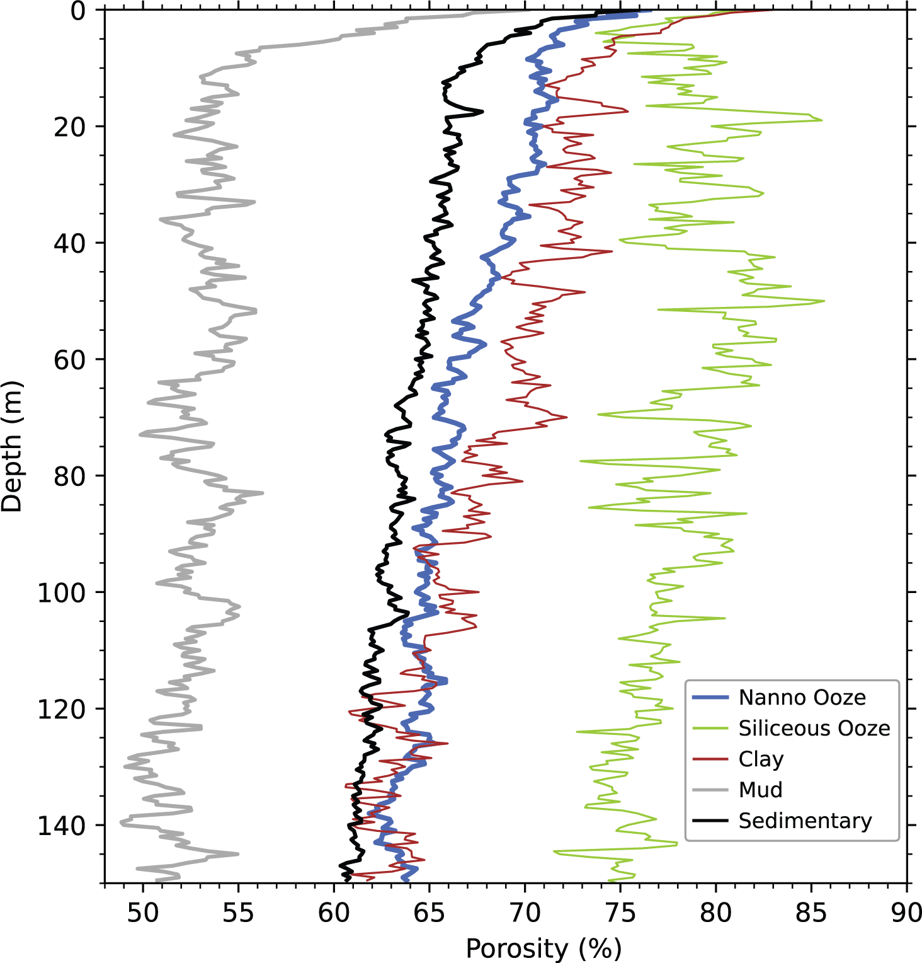
Porosity With Depth By Lithology
Porosity vs. Depth
Porosity vs depth is used in studies of:
Subsurface Fluid Flow
Reservoir assessment
Compaction studies, like those used model basin evolution
Seismic interpretation
Number of data used
Nannofossil Ooze: 555,468
Siliceous Ooze: 179,288
Clay: 263,732
Mud: 265,104
Sedimentary: 1,856,255
Notes:
The numbers of data used are only for the upper 150 mbsf.
LILY Queries used:
Sedimentary = Lithology type is sedimentary
Mud = Mud anywhere in the principal name
Clay = Principal name is clay
Nannofossil Ooze = Principal name is nannofossil ooze
Siliceous Ooze = Principal name is siliceous ooze, diatom ooze, or radiolarian ooze

Slide 11
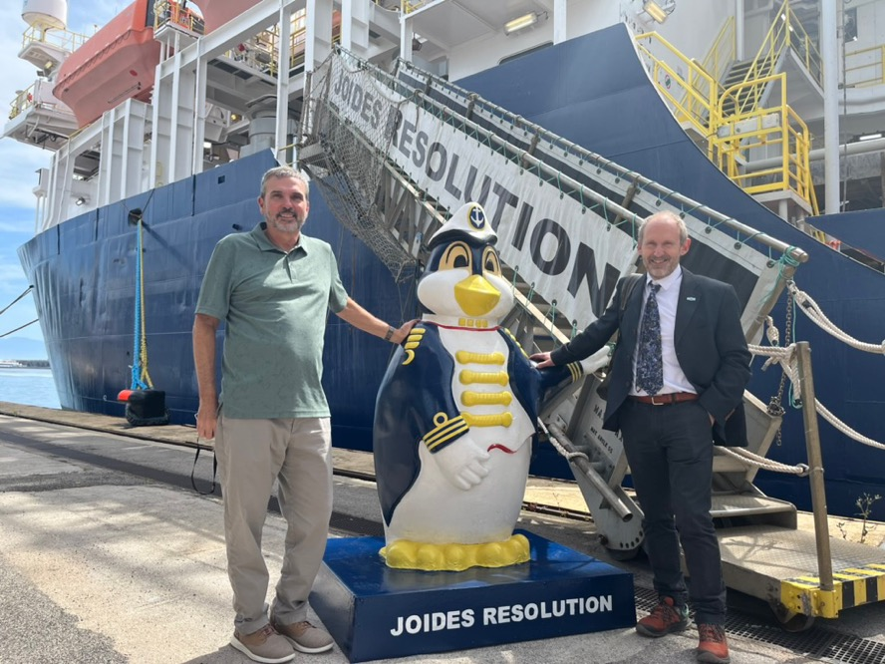
Conclusions
Pairing all the IODP measurements of physical, chemical, and magnetic properties with lithology opens the door to new research approaches, discoveries, and insights
Thanks to Angelo and colleagues for convening this session and thanks to all the scientists who have sailed on the JOIDES Resolution and collected the data used in this study.
Notes:
Photo from Acton’s iPhone.

Slide 12
The End

