Slide 1
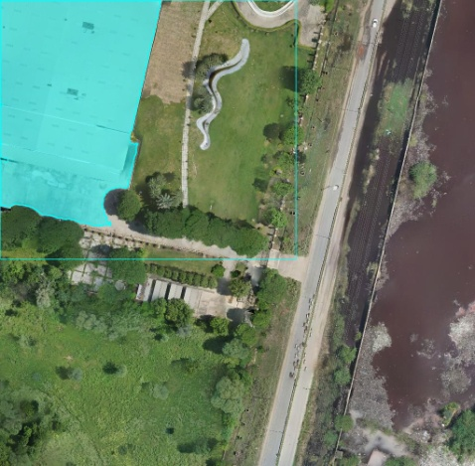
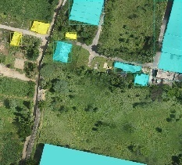
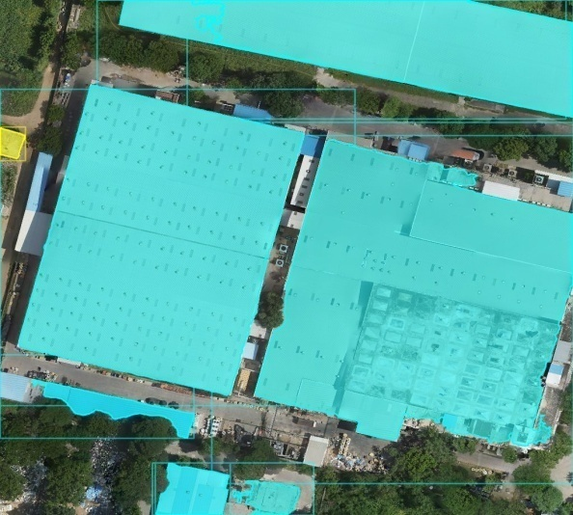
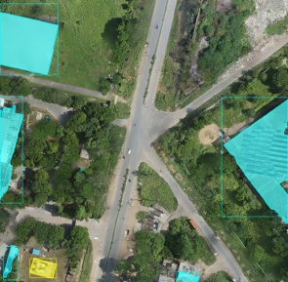
DEEP LEARNING BASED AUTOMATION IN ROOFTOP SOLAR POTENTIAL ESTIMATION
Poster Presentation by
APRATIM BHATTACHARYA
Ranbir And Chitra Gupta School Of Infrastructure Design And Management
Indian Institute Of Technology Kharagpur

Slide 2
Introduction
The global urban population growth has led to urban expansion, consequently increasing the demand for energy, thereby necessitating the assessment of suitable rooftop areas to estimate solar potential.
Urban Growth
Suitable rooftop area for solar potential estimation
Growing Urban Population
Growing energy demand

Slide 3
Introduction
The requirement to automate rooftop extraction using deep learning approach arises from the laborious and time-consuming nature of traditional manual digitization methods, along with the necessity to calculate rooftop potential referring building class information.
Traditionally manual digitization was used to extract rooftop
Need to Automate the process of rooftop extraction using deep learning
Traditional method is laborious and time consuming
Need to calculate the rooftop potential with building class information

Slide 4
Literature review
Deep learning methods are extensively utilized across diverse domains.
Deep learning, including recently developed methods like YOLOv8 and SAM, is used in fields like Medical Imaging and achieved higher accuracy.
Research gaps
There is a need for user-friendly solutions to enable decision-makers to leverage newly developed deep learning models in geospatial domain.
Need to develop a streamlined process where geospatial maps can be produced utilizing deep learning models.
These
techniques are
also applied to
automate
rooftop
extraction with class information, which is essential for geospatial applications, replacing laborious traditional methods.
These newly developed methods offer increased accuracy and efficiency, making the process less time-consuming.
Need to automate the process of estimating rooftop solar potential, incorporating building class information.

Slide 5
Aim and Objectives
To set up a pipeline to detect buildings and generate spatial datasets for real-world applications.
Utilize pre-trained deep learning models for building detection and classification using the annotated dataset.
Develop a GUI to auto-geolocate the model output and rooftop extraction in shapefile format.
Create geospatial maps for rooftop solar potential calculation.
1
2
3
Assumptions
Assumptions
Rooftop potential is calculated by taking all the rooftops as flat rooftops.
Buildings are classified into two classes
(a) residential & (b) non-residential

Slide 6
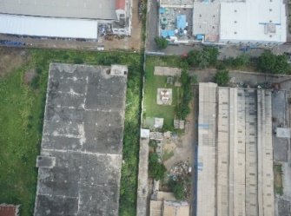
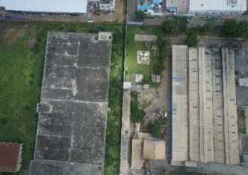
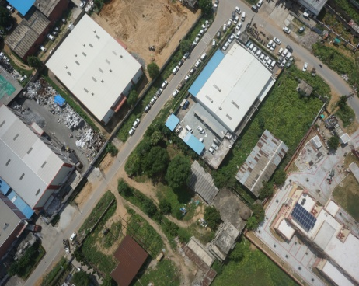
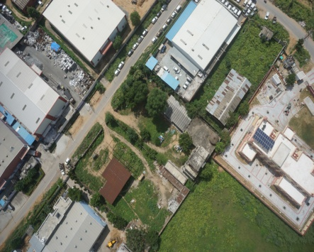
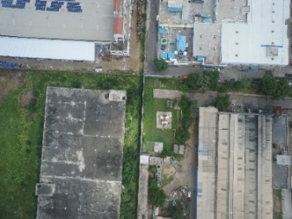
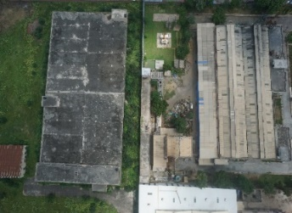
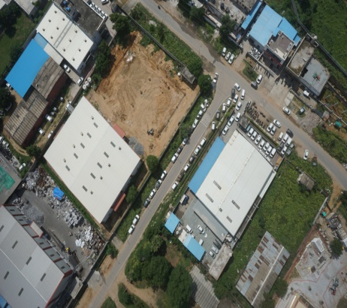
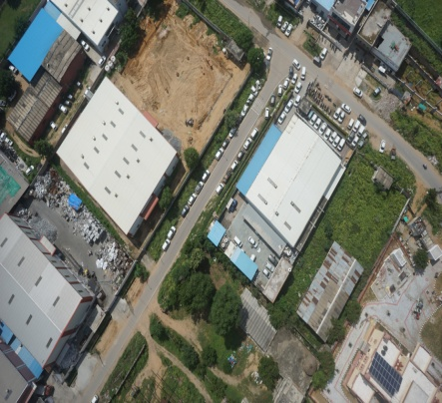
Data
High-resolution UAV data is used for the analysis work
Image details
Dimensions | 6000*4000
Width | 6000 pixels
Height | 4000 pixels
Horizontal resolution | 350 dpi
Vertical resolution | 350 dpi
Bit depth | 24
Color representation | RGB
Some example scenes collected using UAV

Slide 7
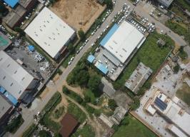
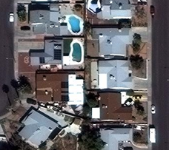
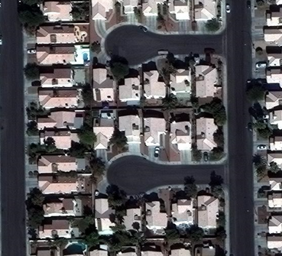
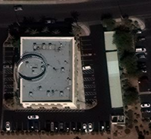
Methodology
Training data preparation
Model selection and Training
Raw UAV images
Photogrammetric Algorithm
DSM & Orthophoto
Deep learning models
Literature Evaluation
Accuracy assessment
No
Residential/ Non residential training class
Model training
Satellite images
Data preparation
Yes
Hillshade preparation
Install dependencies using installer.exe
Georeferenced model output with detected and segmented result
Images with geospatial information
Shadow area removal
Load Images
Building rooftop in shapefile format with type information
Sola rooftop potential calculation
Run
Developed UI in .exe format
Output generation
Methodology framework

Slide 8
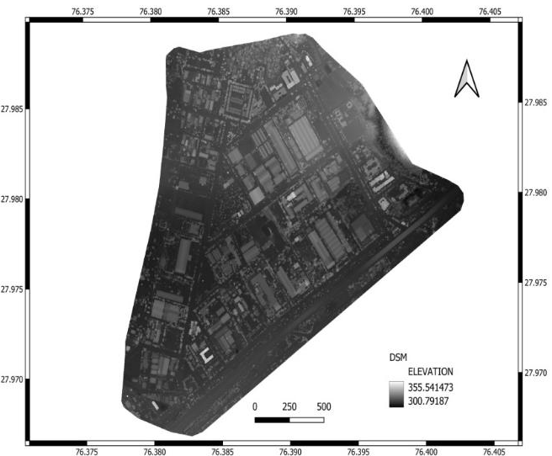
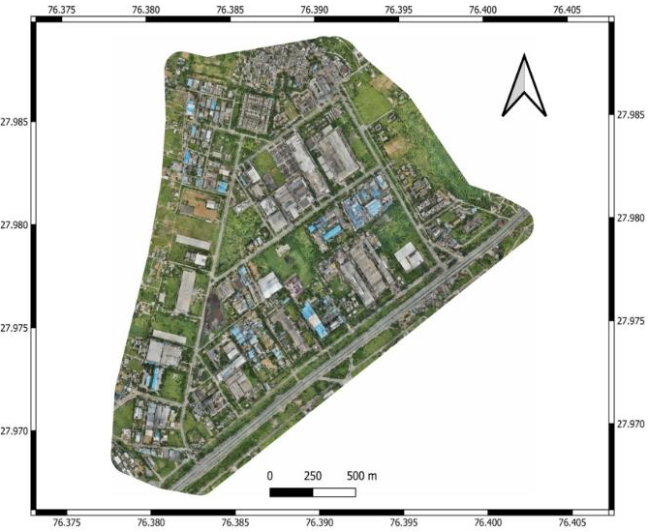
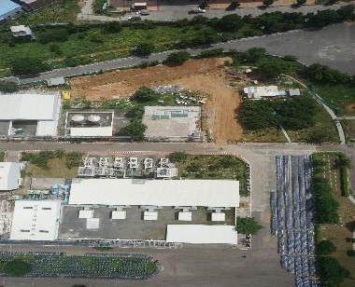
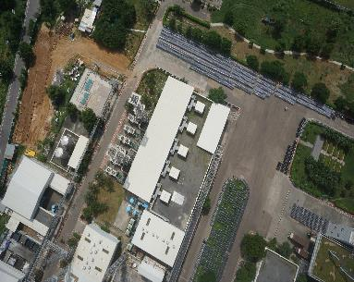
Training data preparation
SIFT-SFM-MVS
Algorithm
Extracted DSM
8
Raw UAV image data
Generated Ortho map

Slide 9
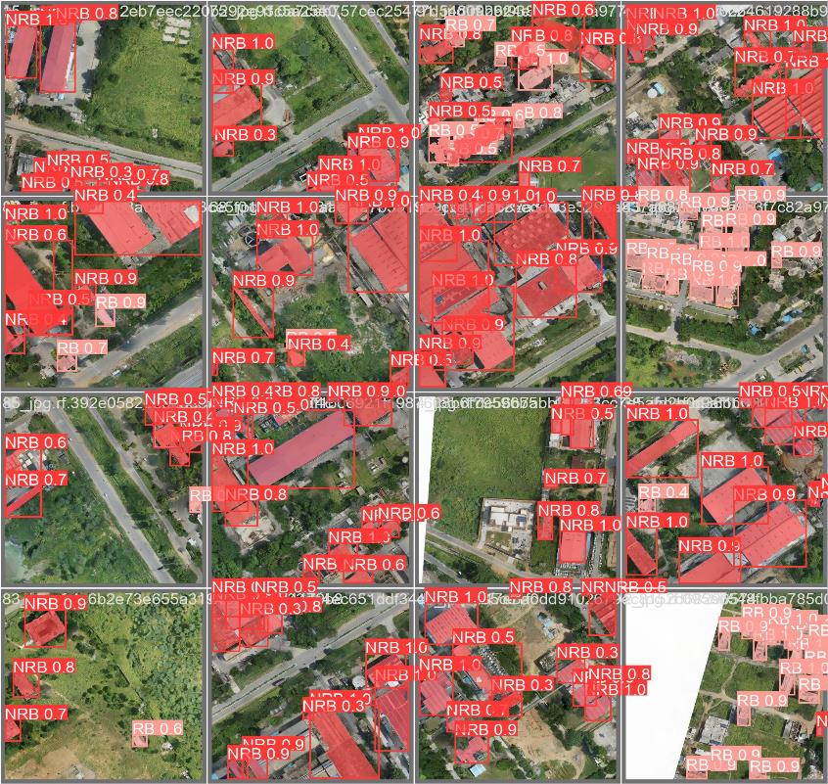
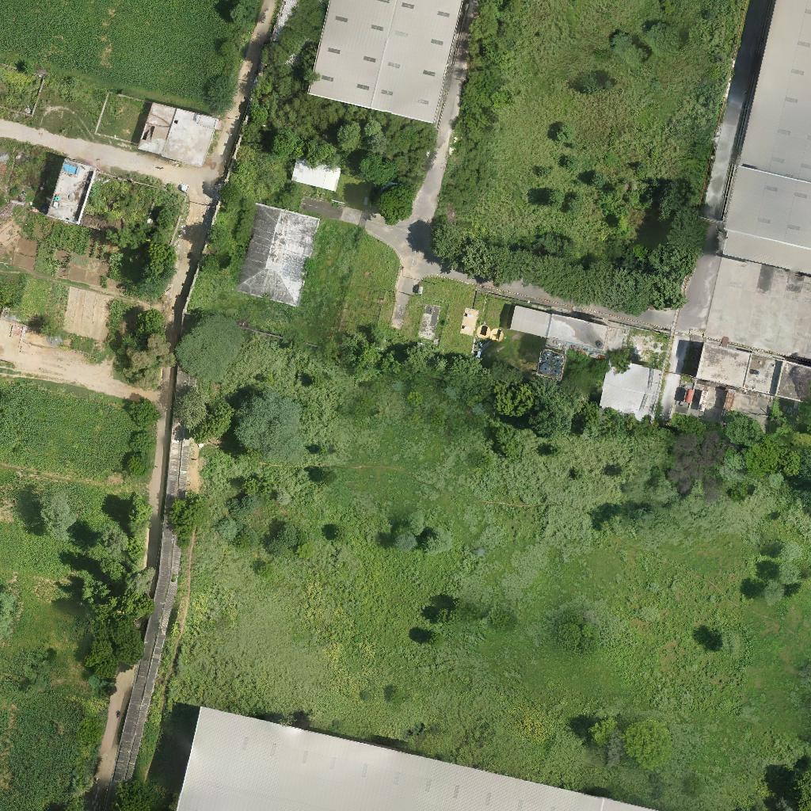
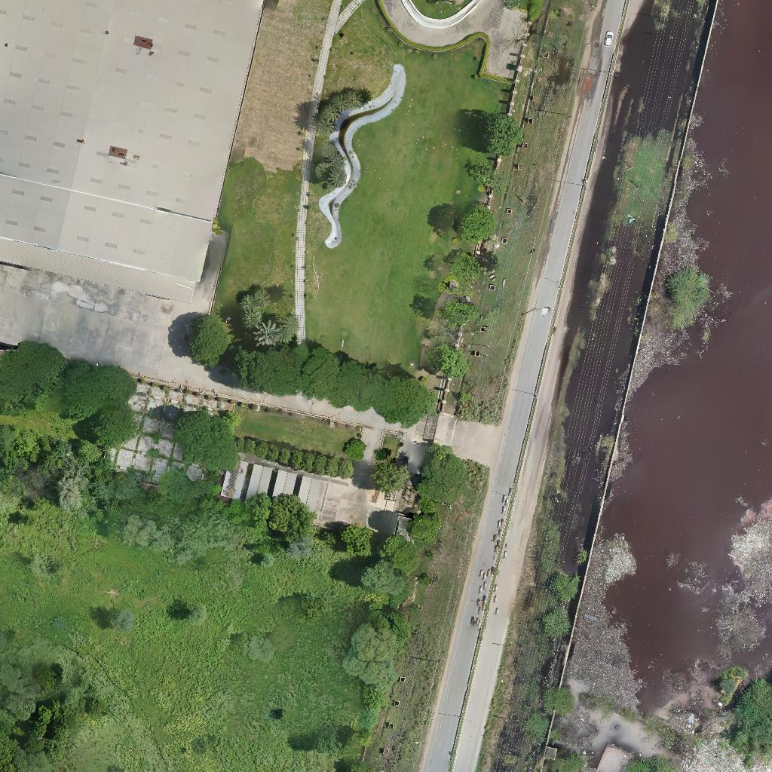
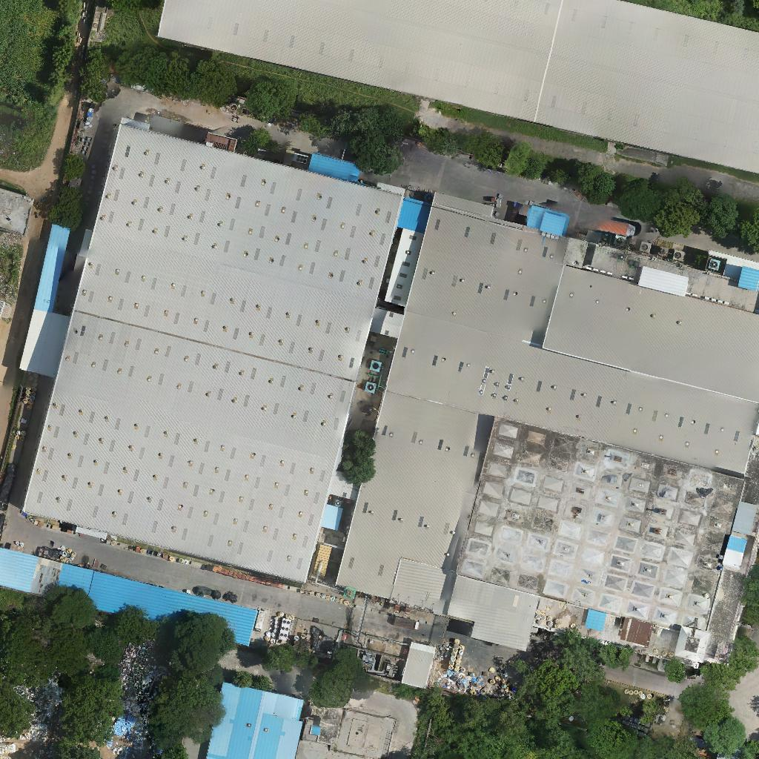
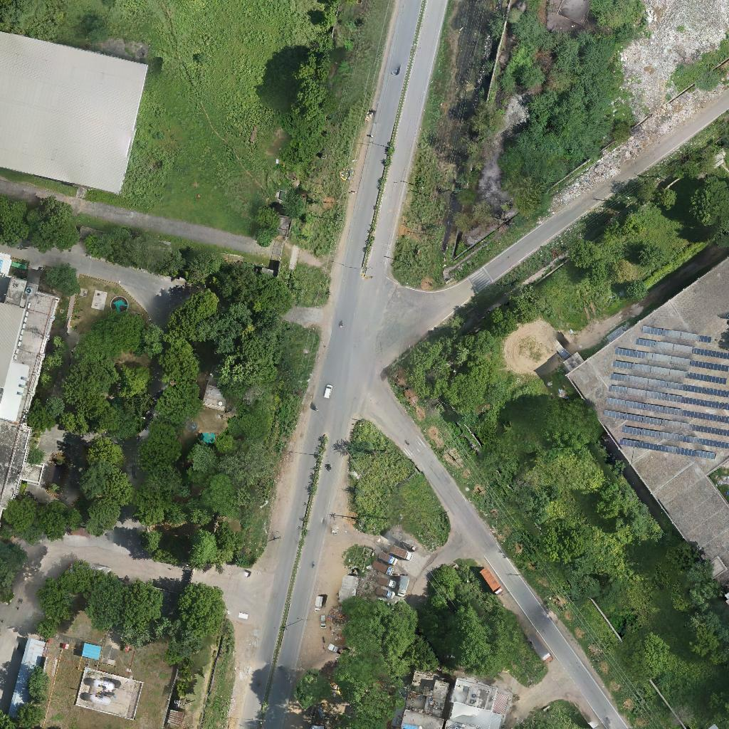
Model Implementation and process result
SL NO. | Metric | Equation | Bounding box | Mask
1 | Mean Average Precision(mAP) | mAP =$\frac{1}{n}\sum_{i=1}^{N}{AP_{i}}$ | 0.75078 | 0.7488
2 | Precision(P) | $$P=\frac{TP}{TP+FP}$$ | 0.7615 | 0.76151
3 | Recall(R) | $$R=\frac{TP}{TP+FP}$$ | 0.79382 | 0.80544

Slide 10
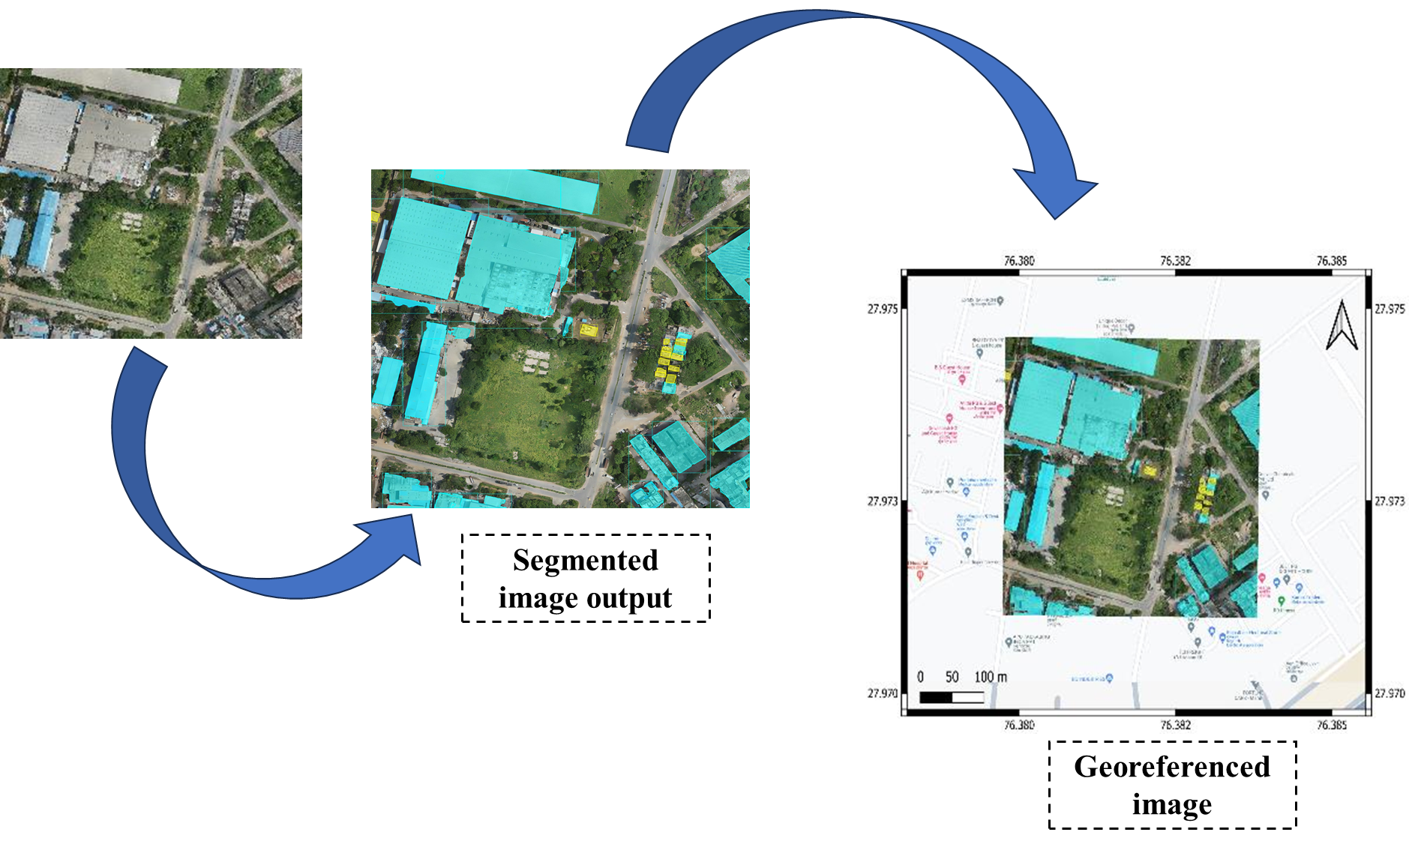
Model Implementation and process result
Segmented image output
Georeferenced image

Slide 11
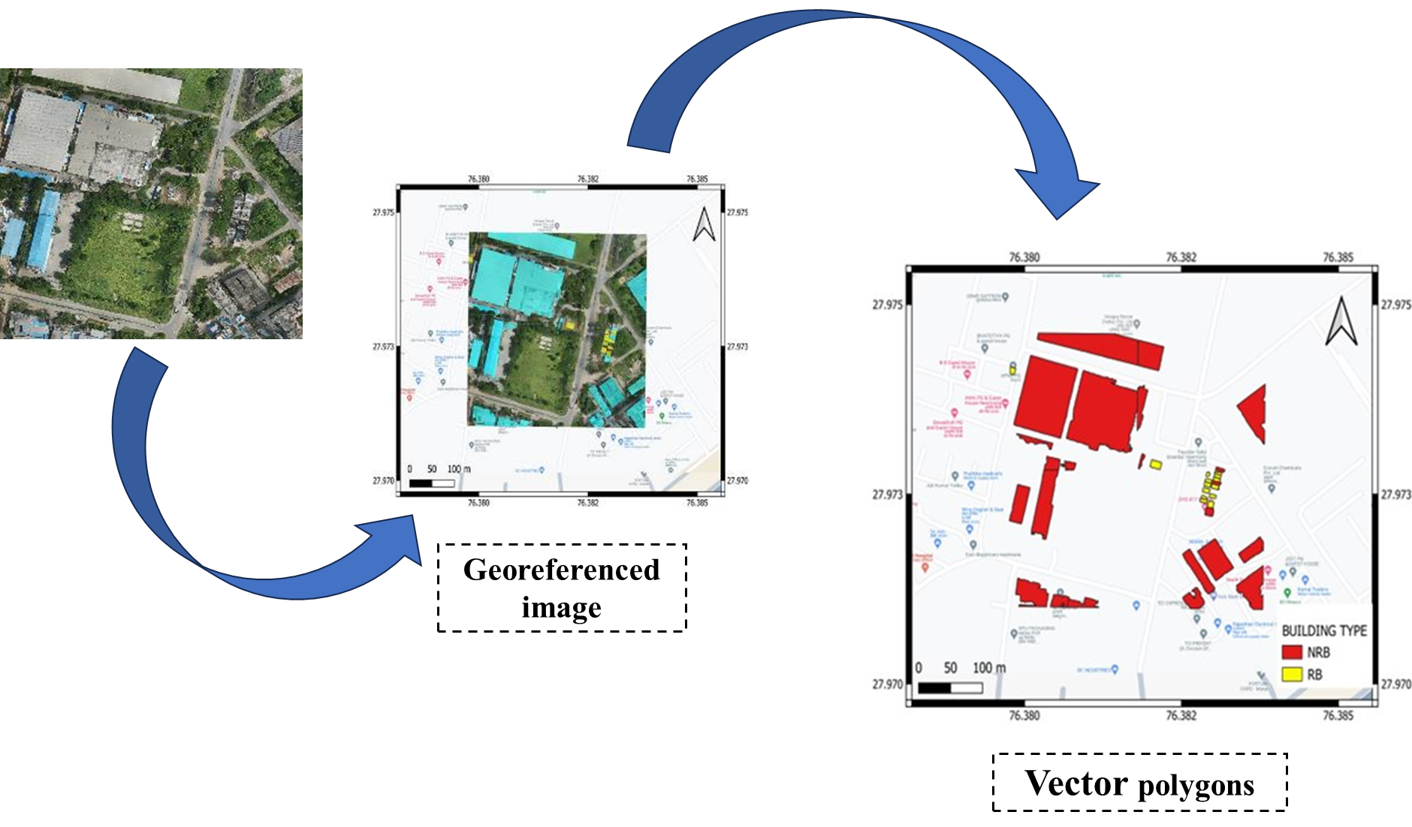
Model Implementation and process result
Georeferenced image
Vector polygons

Slide 12
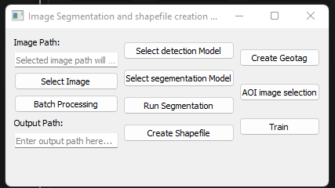
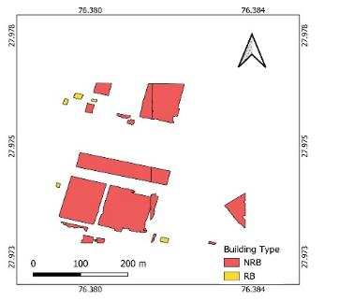
GUI Process automation
Detection & segmentation
Automatic georefferencing
GEOLOCATED SHAPEFILE
12

Slide 13
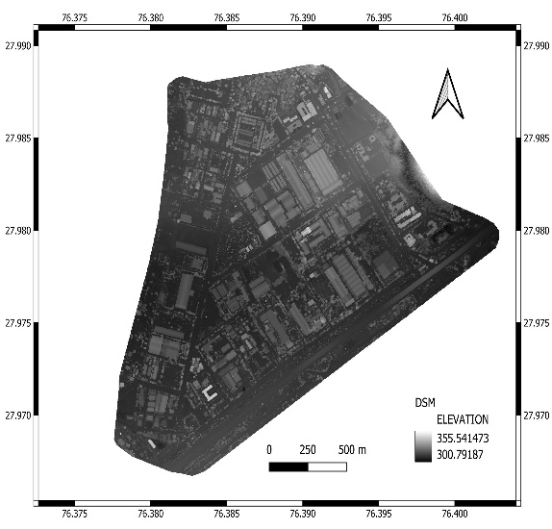
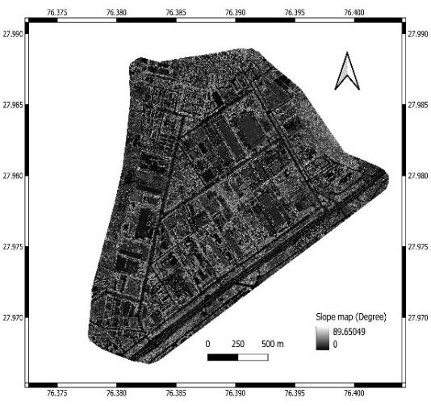
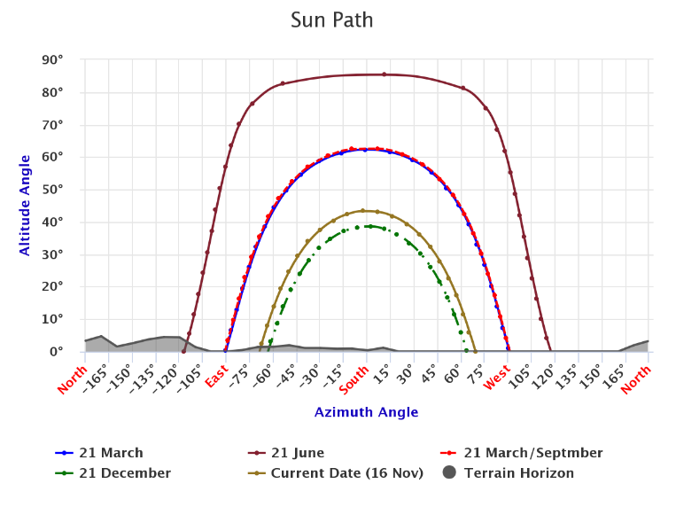
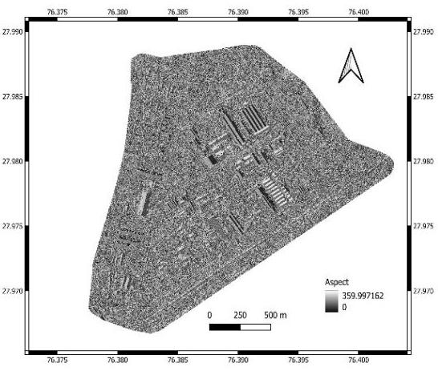
Generation of datasets for rooftop potential estimation
13
Extracted Slope and Aspect map
ISRO solar calculator data*
*https://vedas.sac.gov.in/solar-calculator/

Slide 14
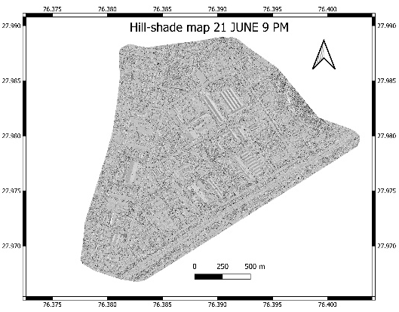
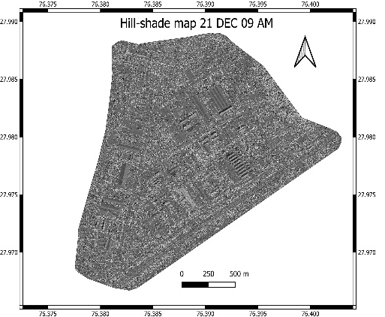
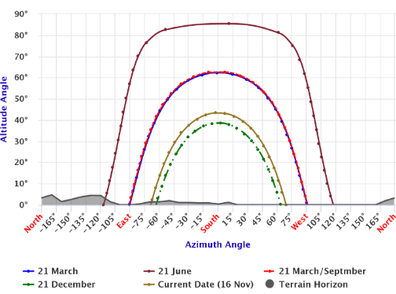
Hillshade preparation
Output
Input
Python scripting
DSM
SLOPE
Hill-shade extraction**
ASPECT
SUN PATH
**Hillshade = 255.0 * ((cos(Zenith_rad) * cos(Slope_rad)) + (sin(Zenith_rad) * sin(Slope_rad) * cos(Azimuth_rad - Aspect_rad)))

Slide 15
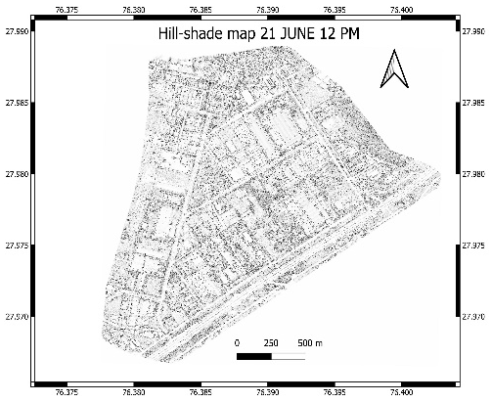
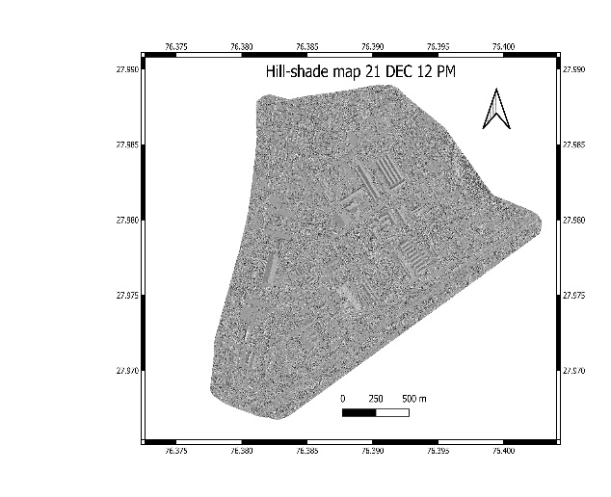
Extracted hillshdaes at different times (using Python)

Slide 16
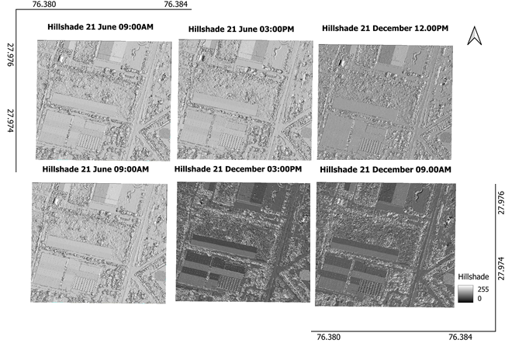
Rooftop Solar Potential estimation
Output
Input
Python scripting

Slide 17
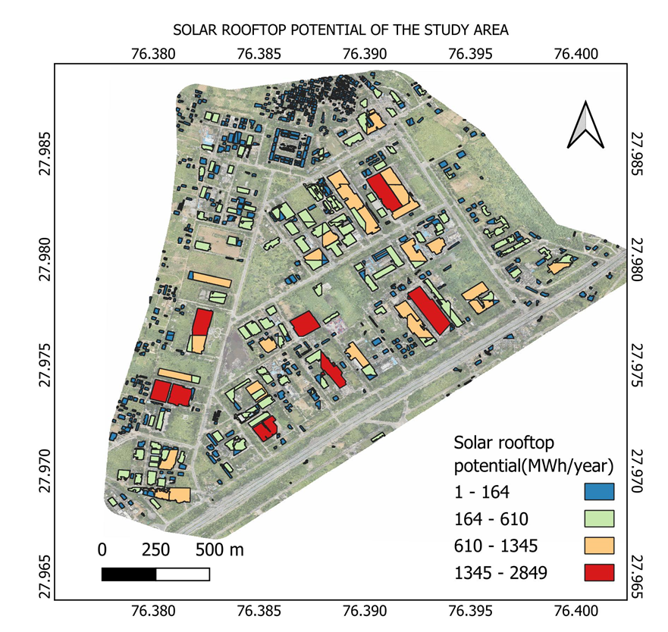
Rooftop Solar Potential estimation
Rooftop solar potential with building class information

Slide 18
Authors
THANK YOU
Prof. Bharath H. Aithal
Corresponding Author
Affiliated Institution: IIT Kharagpur
Apratim Bhattacharya
Author
Affiliated Institution: IIT Kharagpur
Aniruddha Khatua
CO-Author
Affiliated Institution: IIT Kharagpur

