Slide 1
Recent patterns of crop yield growth, stagnation and their drivers in China’s dryland
Shuangshuang Zi
Beijing Normal University, China
13462785750
shuangshuangzi@mail.bnu.edu.cn
2024/04/18

Slide 2
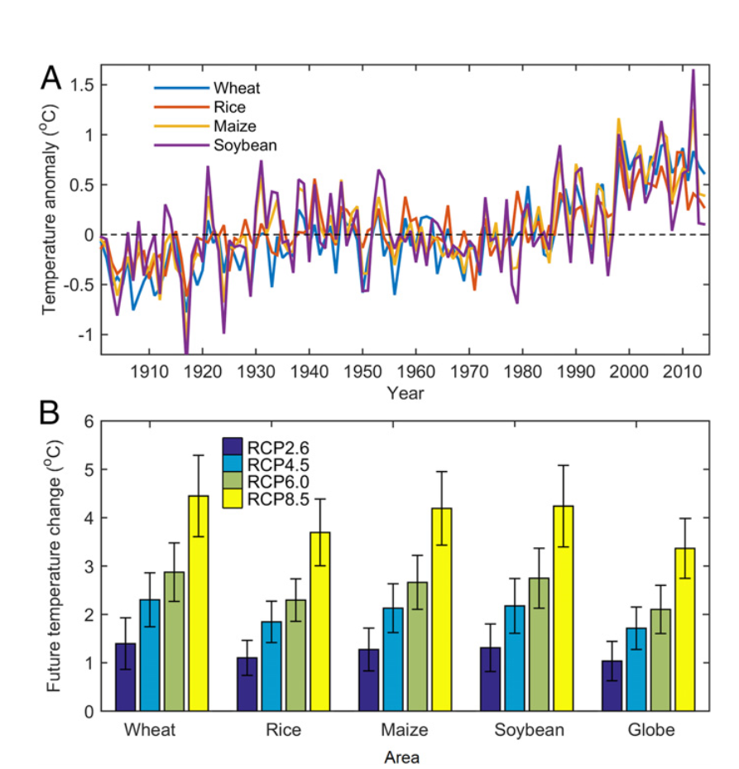
Introduction
The global demand for agricultural crops is expected to roughly double by 2050.
Climate change influences global food production.
Due to human management practices and technological advancements, global crop yields have increased significantly.
However, some authors have founded that yields for many important crops may be stagnating in some regions around the world.
The reasons for stagnation have not been quantified thoroughly.
(Chuang Zhao et al, PNAS, 2017)

Slide 3
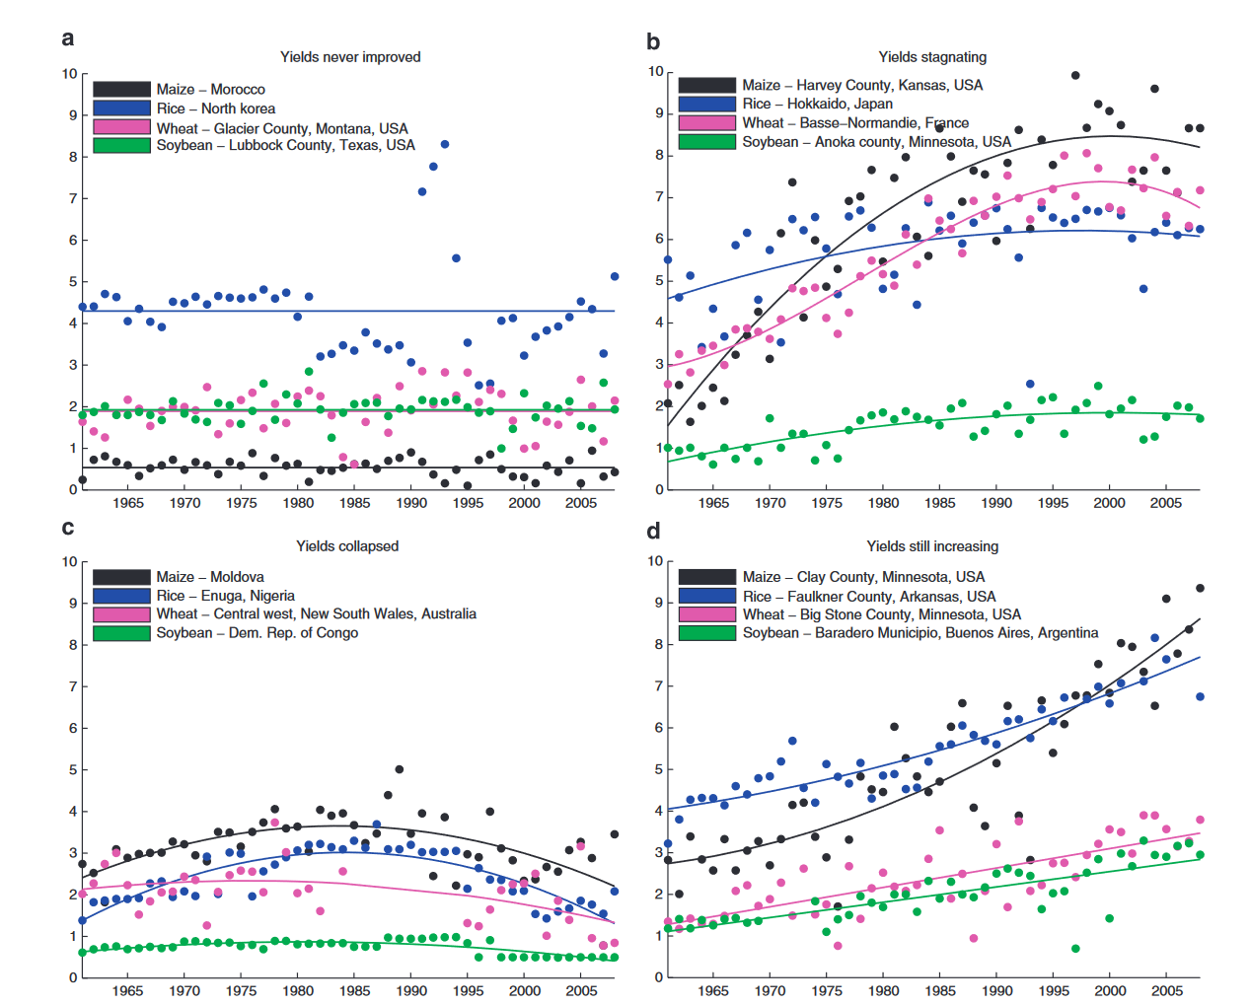
Methods
Data source:
Climate data: CN05 （1998-2018）
Statistical Data: statistical yearbooks and bulletins （1998-2018）
Study area: China’s drylands are highly sensitive to global climate change and human disturbances, and it is a vital grain crops areas such as wheat and maize in China.
‘Yields never improved’ are defined as areas that have witnessed no significant yield improvements to date.
‘Yields stagnated’—areas where yields previously improved, but now are stagnating or declining.
‘Yields collapsed’—areas where yields decreased since 1998s, or initially increased and then collapsed to the 1998s level.
‘Yields still increasing’—areas where yields are still increasing.
(Deepak K. Ray et al, Nature communications, 2012)

Slide 4
Result——The maps of current crop yield trends
Results showed that although yields continue to increase in many areas, we found that across 70% of maize- and 52% of wheat- growing prefectures or provinces, yields either never improved, stagnated or collapsed.

Slide 5
Result——Correlation between yields and human factors
Table 1. List of the average values of correlation coefficients between yields and some factors in China’s drylands.
Trend Yields
 | Fertilizer used | Irrigation Fraction | Irrigation area | Growing season CO2
Maize | 0.76 | 0.13 | 0.58 | ###
Wheat | 0.82 | 0.36 | 0.61 | 0.998

Slide 6
Result——Correlation between yields and temperature
Table 2. List of the average values of correlation coefficients between yields and growing season temperature in China’s drylands.
Yields Anomaly
 | 5-Tas | 6-Tas | 7-Tas | 8-Tas | 9-Tas |  |  |  | Growing-Tas
Maize | -0.05 | -0.1 | -0.1 | -0.15 | 0.03 |  |  |  | -0.12
 | 1-Tas | 2-Tas | 3-Tas | 4-Tas | 5-Tas | 10-Tas | 11-Tas | 12-Tas | Growing-Tas
Wheat | 0.05 | -0.03 | -0.01 | 0.04 | -0.19 | 0.06 | 0.1 | 0.1 | 0.07

Slide 7
Result——Correlation between yields and precipitation
Table 3. List of the average values of correlation coefficients between yields and growing season precipitation in China’s drylands.
Yields Anomaly
 | 5-Pre | 6-Pre | 7-Pre | 8-Pre | 9-Pre |  |  |  | Growing-Pre
Maize | 0.1 | 0.05 | 0.17 | 0.05 | 0.02 |  |  |  | 0.19
 | 1-Pre | 2-Pre | 3-Pre | 4-Pre | 5-Pre | 10-Pre | 11-Pre | 12-Pre | Growing-Pre
Wheat | 0.02 | 0.1 | -0.02 | 0.14 | 0.13 | 0.005 | 0.12 | 0.02 | 0.21
Notes:
Almost all of them are positively correlated.

Slide 8
Result——The dominants of climate factors
Variation of maize yield dominated by growing season precipitation.
Apart from the growing season precipitation, the temperature in May also dominated the change of wheat yield.

Slide 9
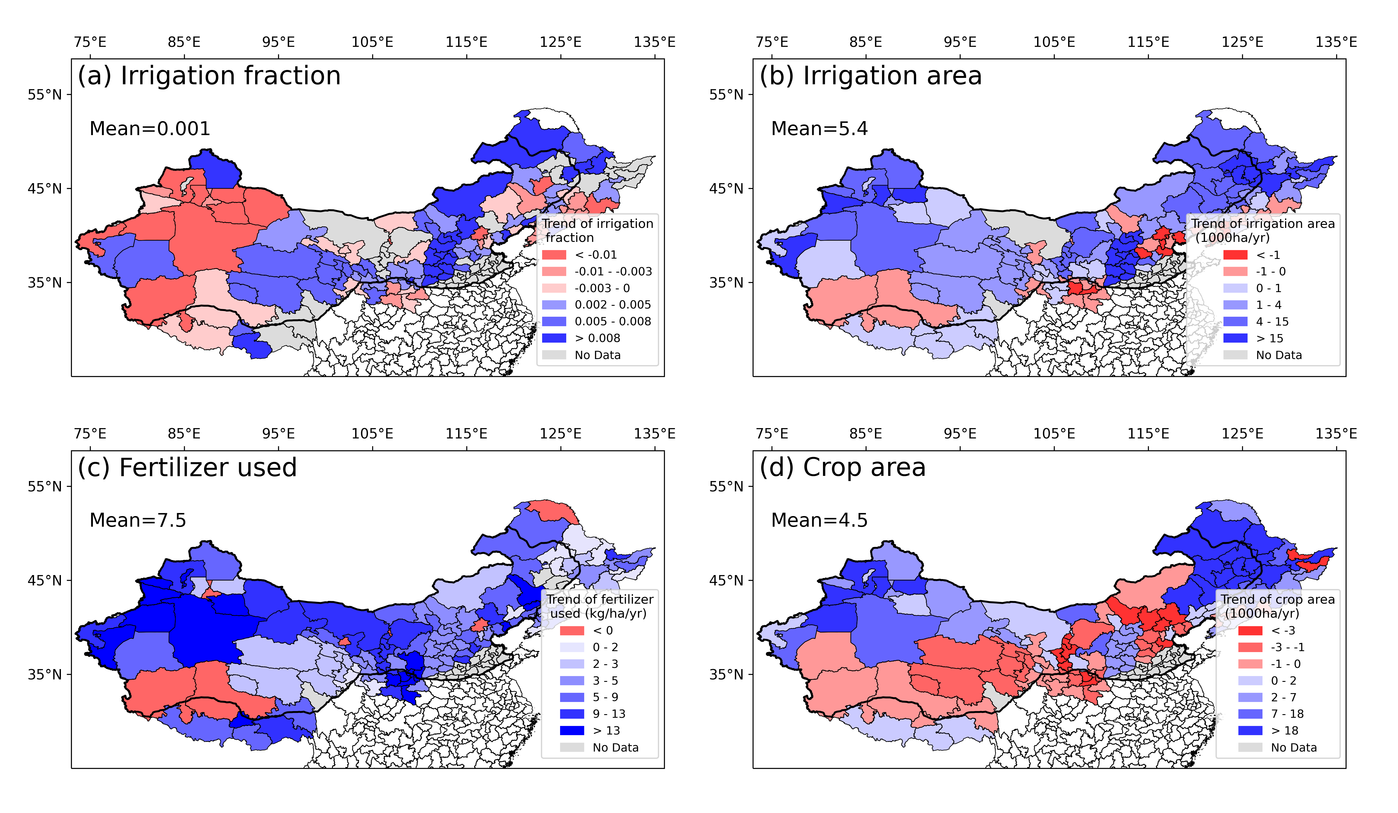
Discussion——Trends of human factors
The decrease of irrigation fraction may lead to the decline and stagnation of crop yield.

Slide 10
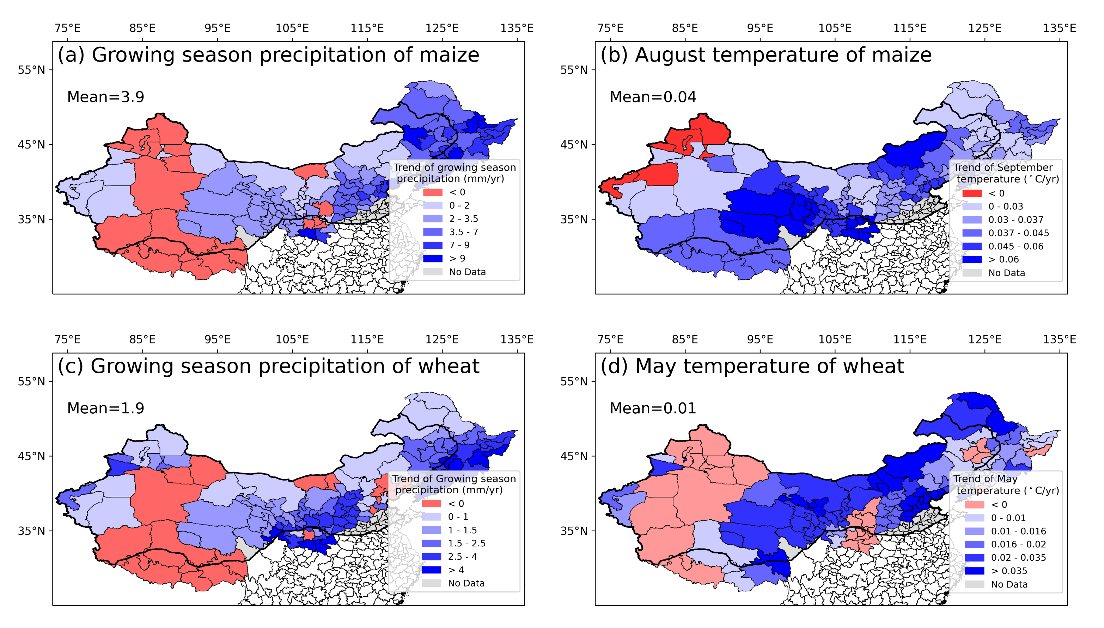
Discussion——Trends of climate factors
The decrease of growing season precipitation may lead to the decline and stagnation of crop yield.

Slide 11
Conclusion
70.2% of maize- and 51.9% of wheat- growing prefectures or provinces, yields either never improved, stagnated or collapsed.
The reasons for the decline and stagnation of crop yield were mainly caused by the change of growing season precipitation and irrigation fraction.
Shuangshuang Zi
Beijing Normal University, China
13462785750
shuangshuangzi@mail.bnu.edu.cn
2024/04/18
Notes:
In conclusion,

