Slide 1

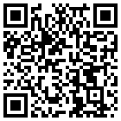


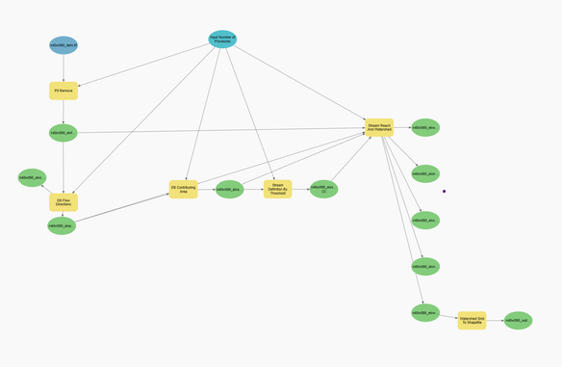
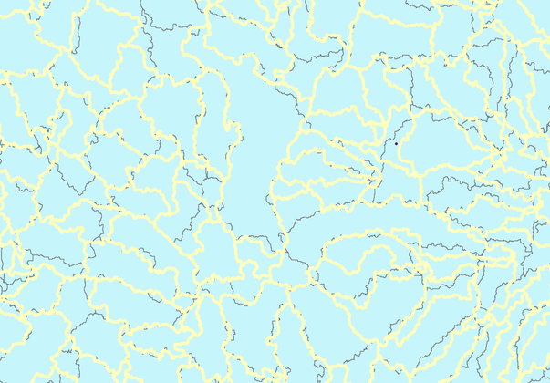
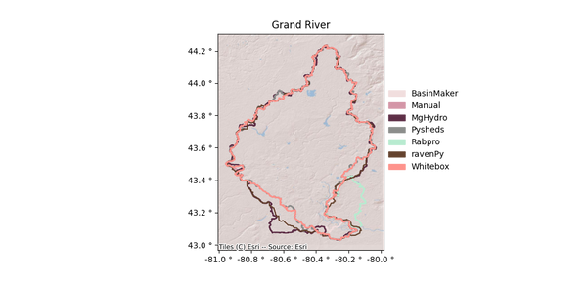
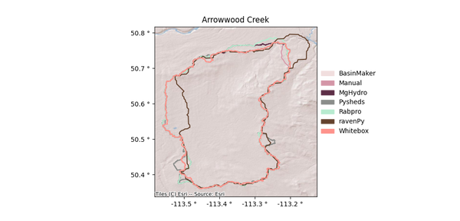
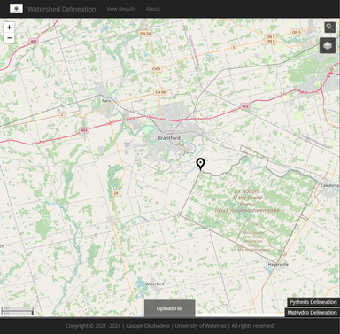
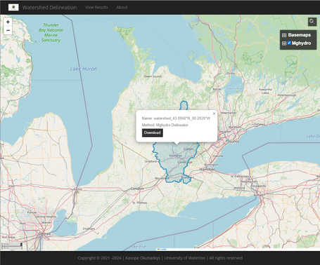
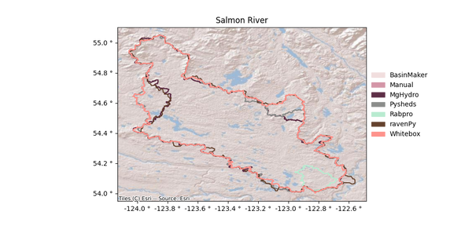
A WEB-BASED WATERSHED DELINEATION TOOL AND ITS APPLICATION TO DELINEATE 24,000 WATERSHEDS ACROSS CANADA
Kasope Okubadejo (kokubade@uwaterloo.ca)
Juliane Mai (juliane.mai@uwaterloo.ca)
Nandita B. Basu (nandita.basu@uwaterloo.ca)
Department of Geography and Enviromental Management
Department of Earth and Environmental Science
Introduction
Watershed Delineation Workflow
Current And Future Work
Watershed delineation is the identification of the boundary of a drainage basin, representing the contributing area for a specific outlet.
The automation of delineation provides faster and more consistent results which can be more accurate and reproducible definitions of borders compared to the results of the manual delineation.
These different tools and their results have been explored, addressing their similarities, contrasts, and complications. Using this analysis, selected methods have been included in a web application for watershed delineation for users to either delineate individual points selected on a web map or upload lists of points of interest
1. Fill DEM Sinks
2. Create Flow Direction Raster
3. Create Flow Accumulation Raster
Recreate Catchment Basins
MgHydro makes use of river and catchment basin vector files derived from the application of the TauDEM tools on Merit-Hydro products.
Fill all depressions, imperfections, and remove flat areas in the DEM.
Uses D8 algorithm to determine the direction water will flow in a given cell.
Calculates accumulated flow as the accumulated weight of all cells flowing into each downslope cell in the output raster
4. Snap Pour Points
5. Delineate Watershed
6. Vectorize Watershed
Snaps the outlet points to the nearest stream cell within a given radius
Determines the up-slope area that contributes flow to the specified outlet point
Transforms the delineated watershed raster into a polygon vector.
Watershed Delineation Tools
Results
MgHydro - Matthew Heberger
Pysheds - Matt Bartos
Whitebox Tools - Dr. John Lindsay
Delineation Webapp
Global Watersheds using a mix of vector and raster-based methods.
Time to run: ~ 28.6 seconds
Python-based delineation tool.
Time to run: ~ 3 minutes
Geospatial data analysis platform.
Time to run: ~ 10+ minutes
A web application to instantaneously delineate a point or batch of points for download according to selected method/tool.
RavenPy - David Huard
BasinMaker - Hydrology Research Group, UW
Rabpro
Python wrapper to setup and run Raven, which is a hydrologic modelling framework. It pulls watersheds from pre-delineated database.
Time to run: ~ 8.7 seconds
Provides methods to compute watershed basin geometries. It functions using two methods.
Time to run: ~ 6.3 seconds
Python-based GIS tools that support hydrologic processes.
Time to run: N/A
Notes:
Mghydro: It has a standalone script for batch delineation, a webapp, and uses Pysheds in its algorithm.
Rabpro: One of these follows RavenPy’s methods, and the other results in vastly different shapes compared to other tools.

Slide 2
