Slide 1




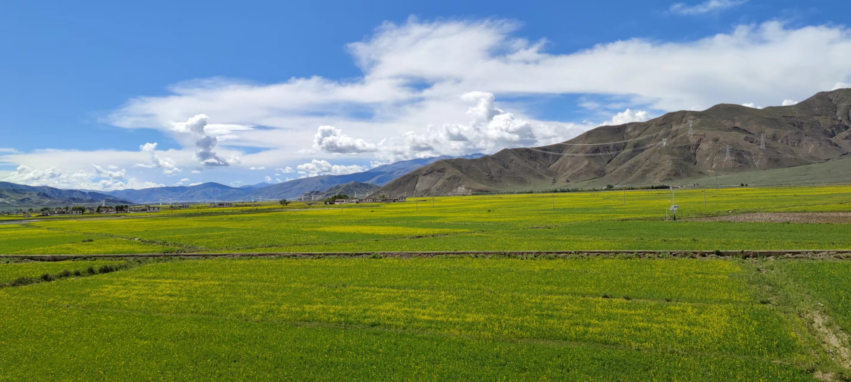
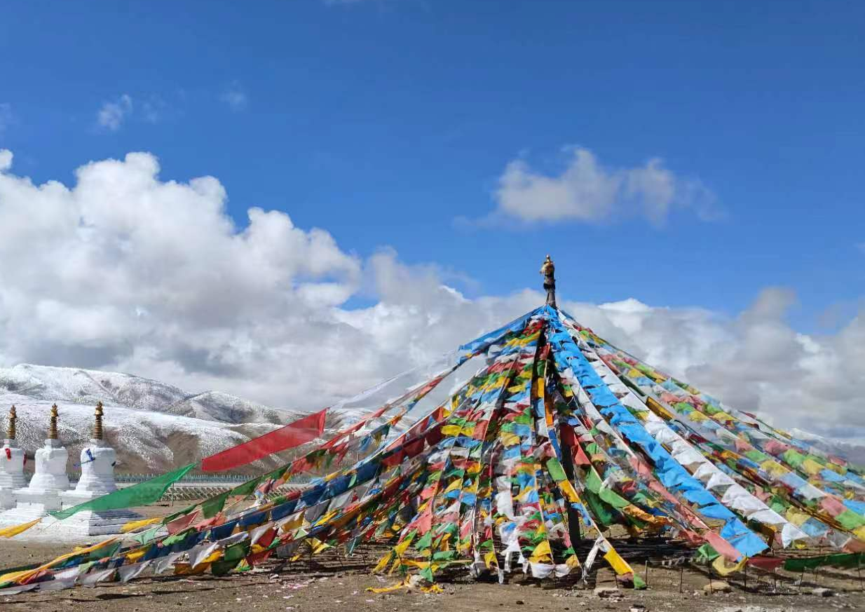
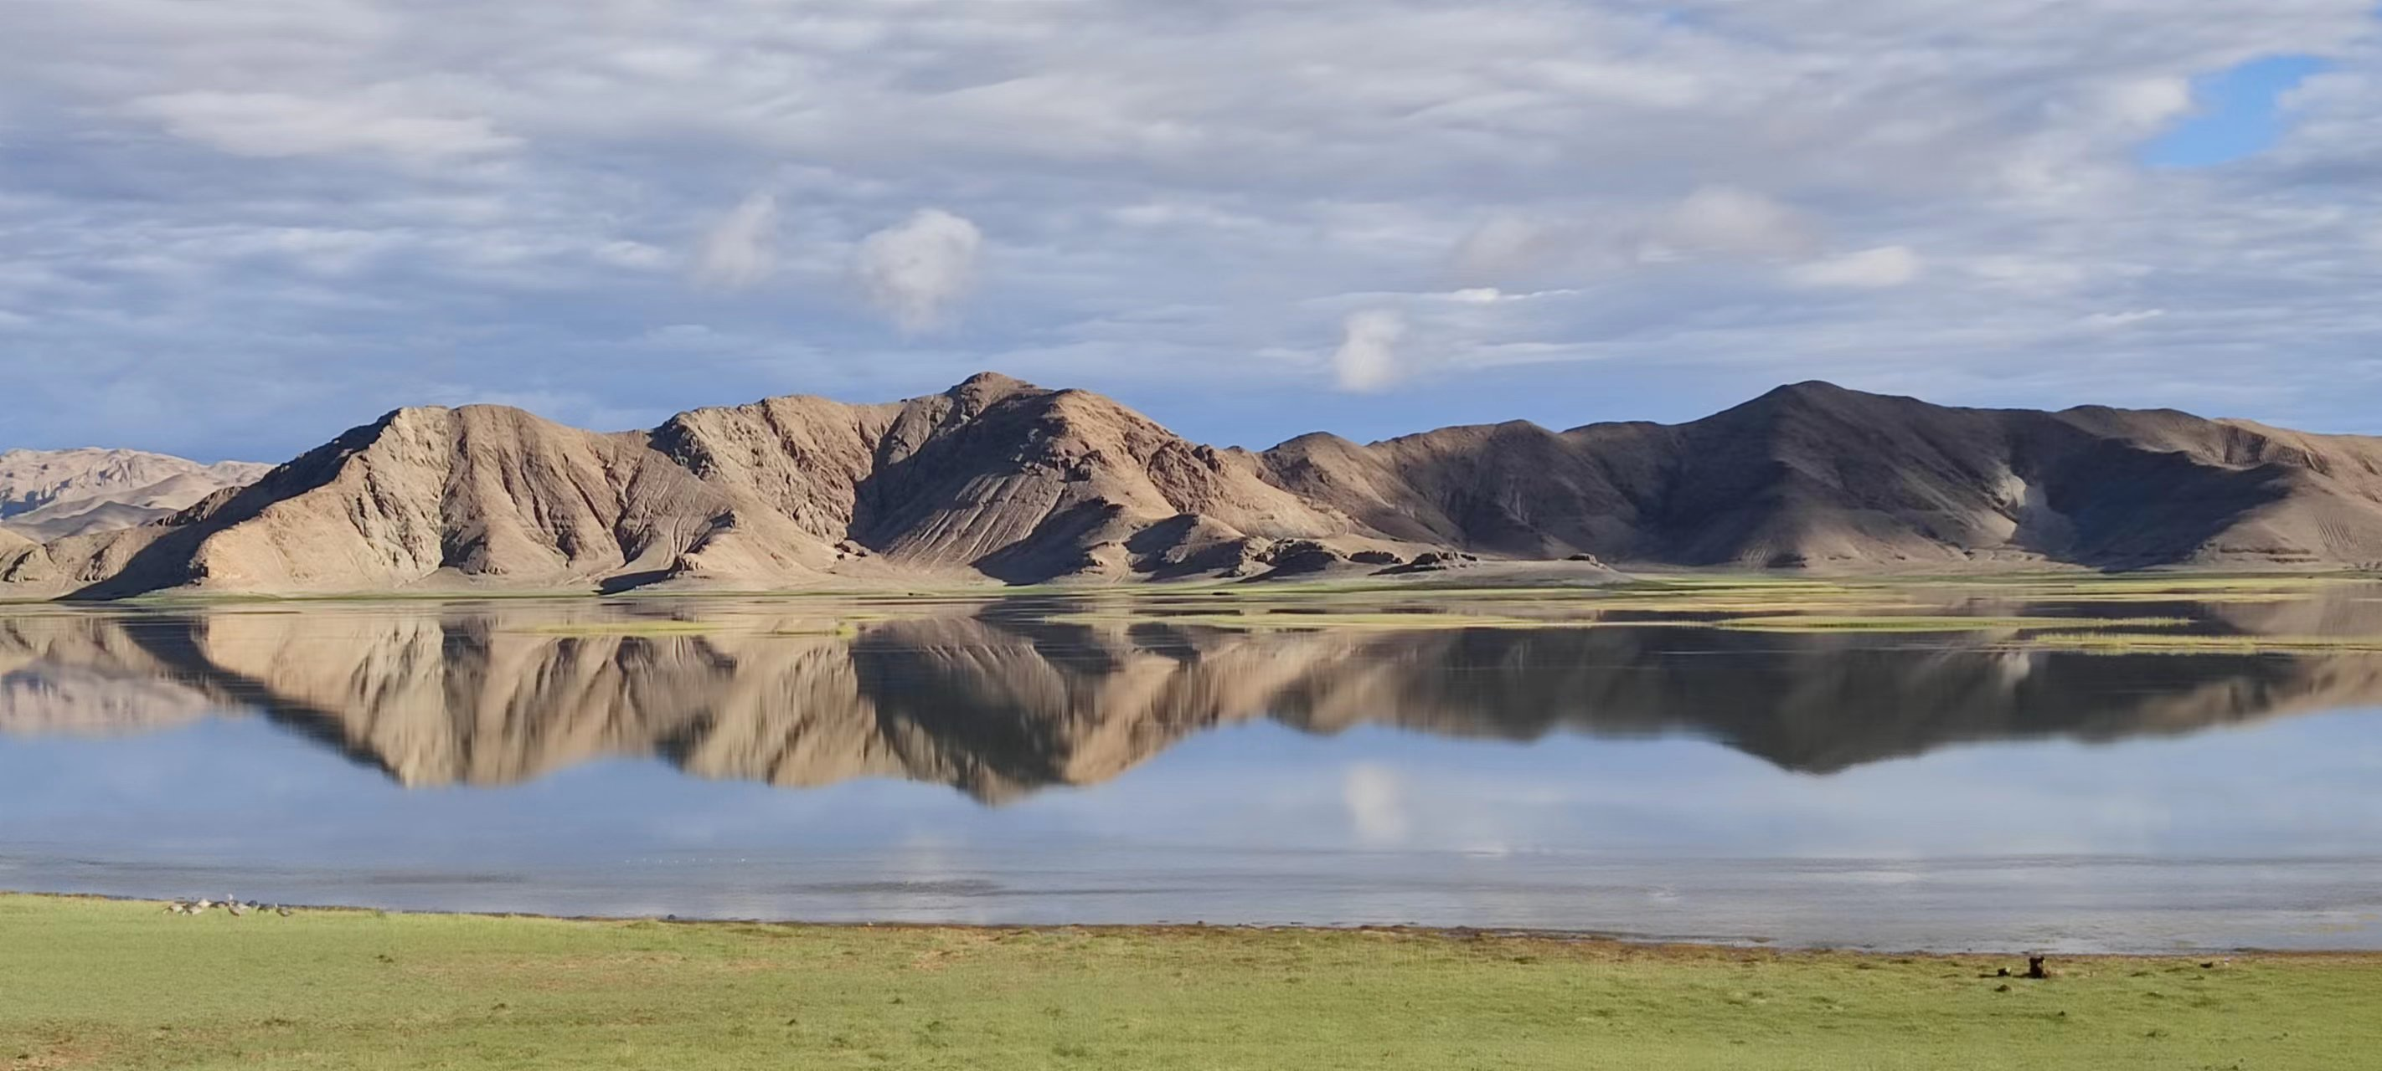
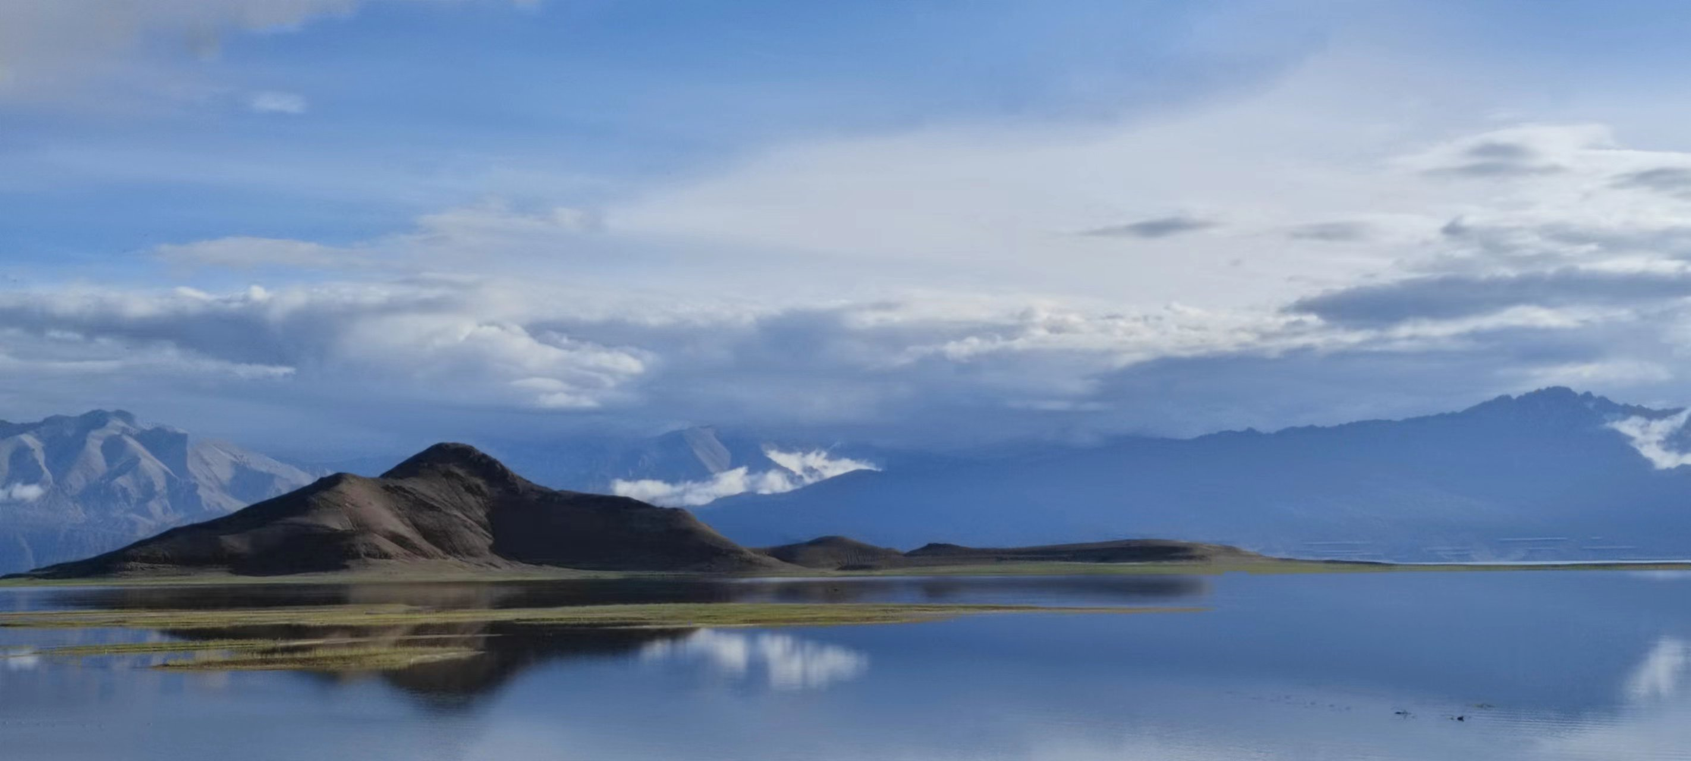
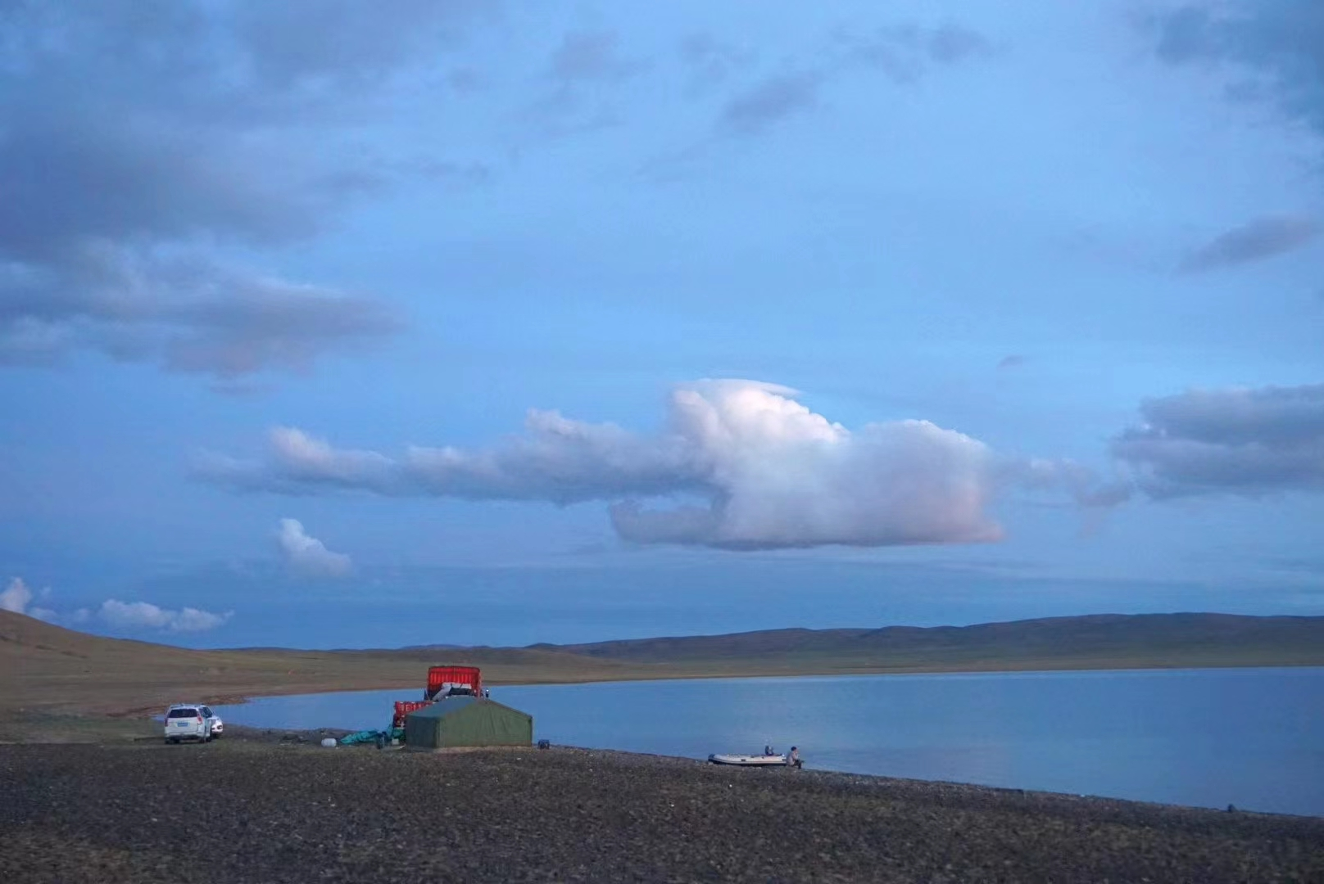
Supplementary Materials
BrGDGT-based seasonal paleotemperature reconstruction for the last 15 000 years from a shallow lake on the eastern Tibetan Plateau
Xiaohuan Hou
Institute of Tibetan Plateau Research, CAS
2024.04.16

Slide 2
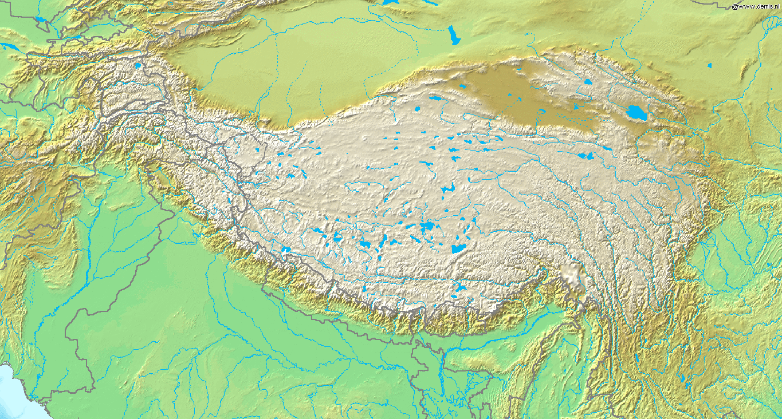
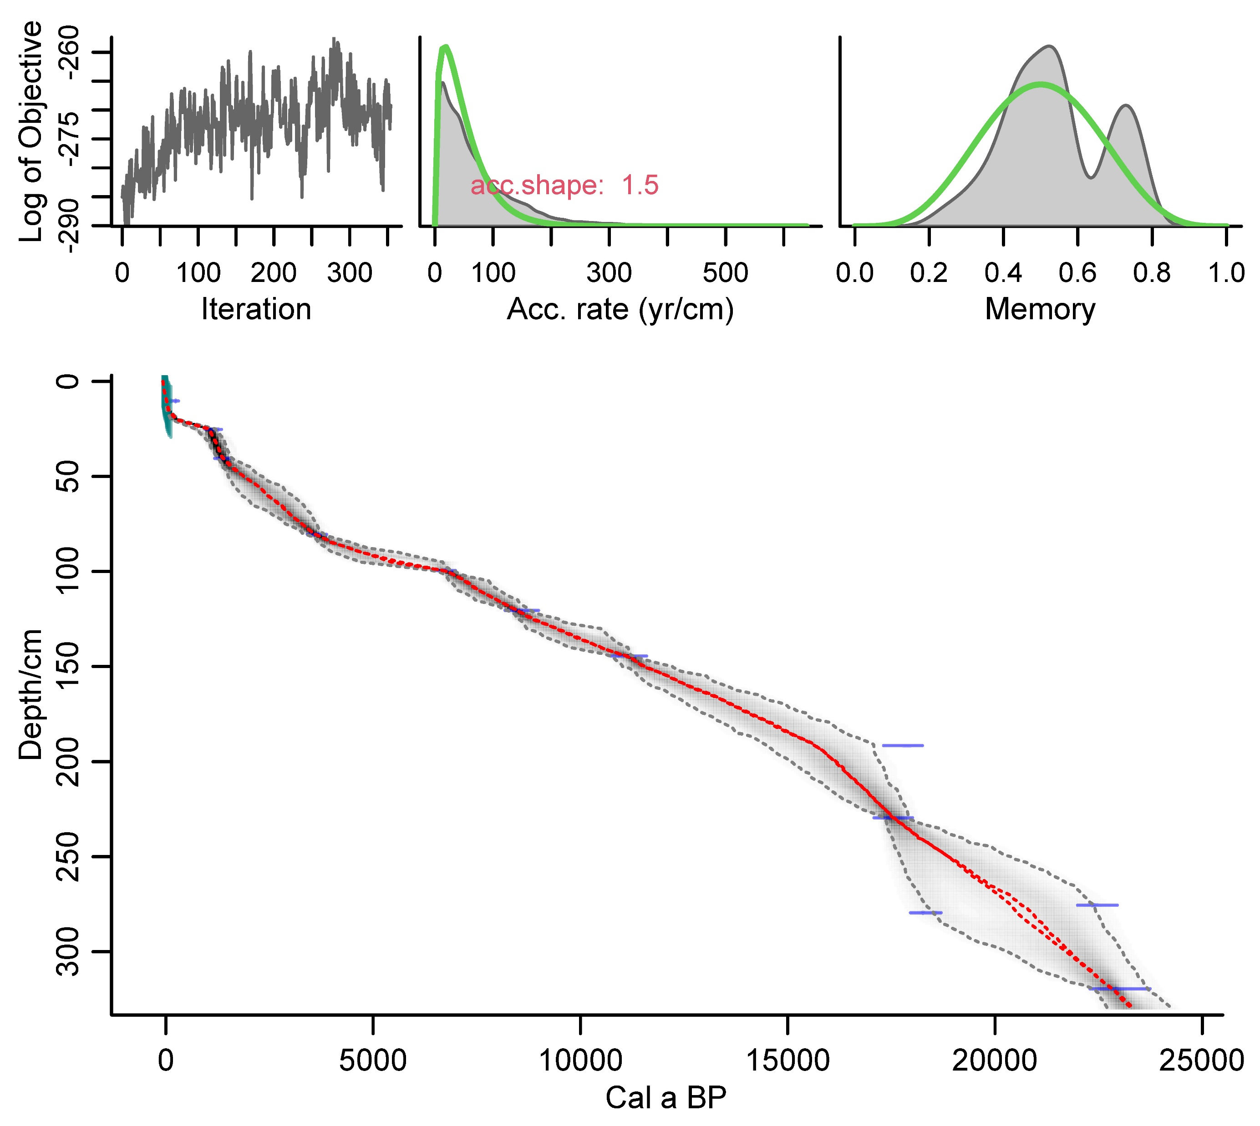
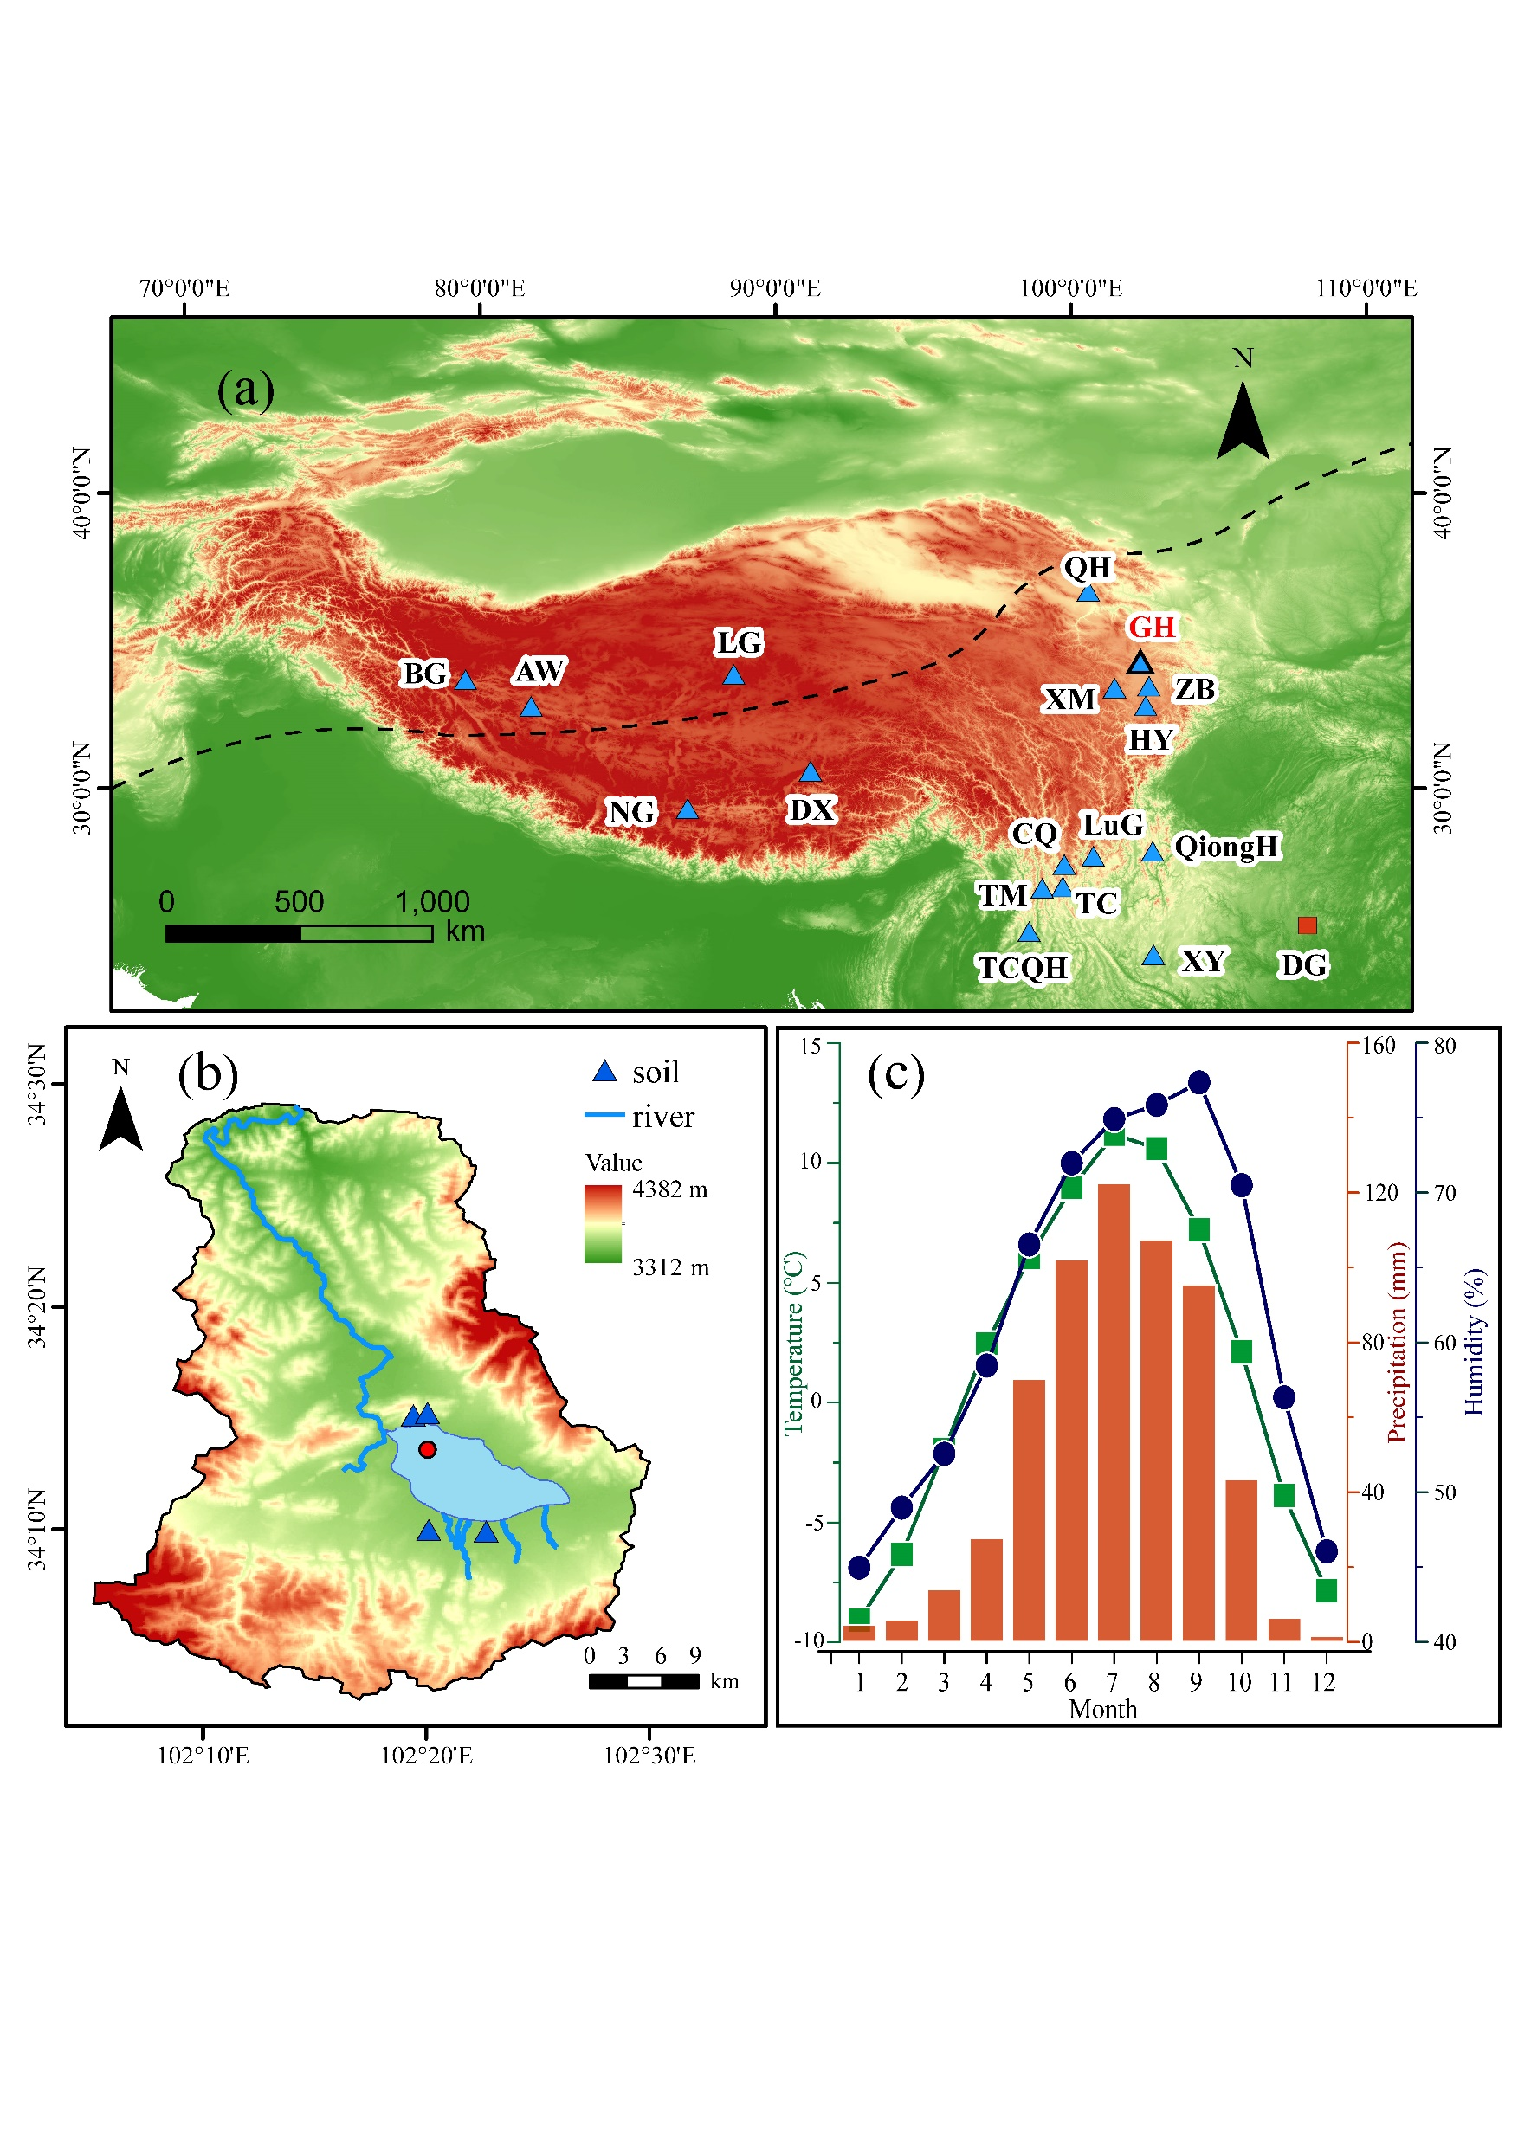

Gahai, a shallow, freshwater lake on the eastern TP
altitude：3444 m
Average water depth is ∼2 m, annual average precipitation is 781 mm, mean annual temperature is 1.2 ℃.
Freezing of the lake begins in October and thaws starting from May of next year
Weakened light penetration, decreased oxygen levels, and lack of nutrient replenishment during frozen period impact the growth of heterotrophic bacteria

Slide 3
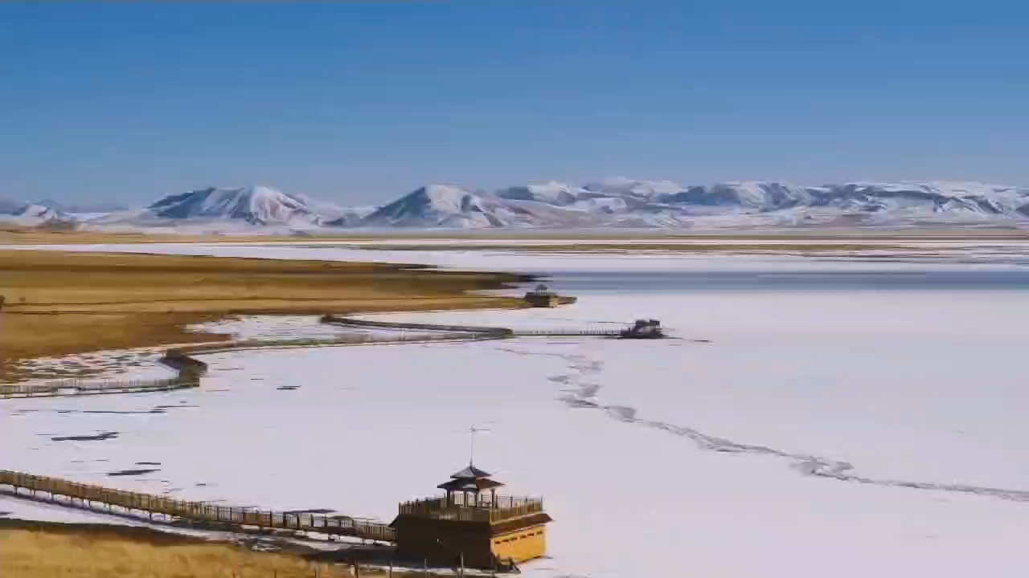
The winter scenery of Gahai

Slide 4
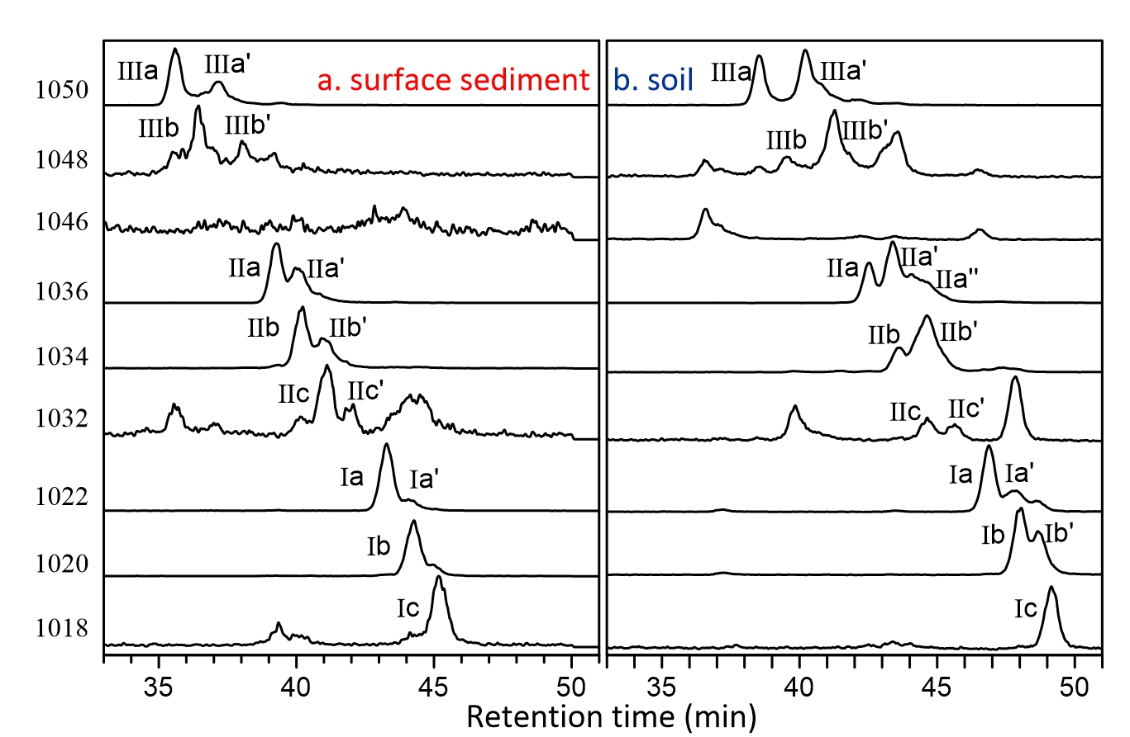
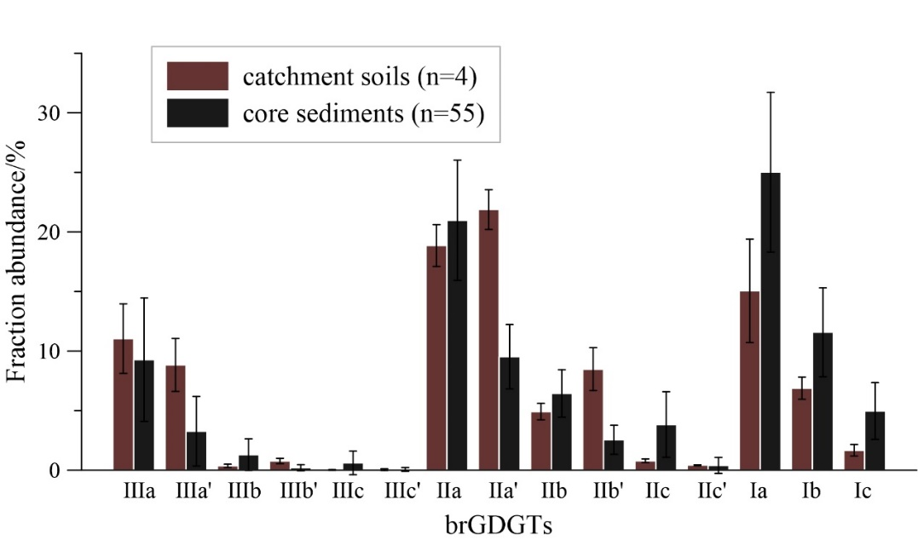
Distribution of brGDGTs in sediment core and catchment soils
We conclude that the brGDGTs in Gahai sediments are mainly of in situ origin.
Notes:
主要介绍一下我们尕海钻孔中brGDGTs的分布，我们对比了周边流域和湖芯沉积物中brGDGTs的分布特征、含量、以及一些相关的参数，我们主要认为尕海brGDGTs来源于湖泊自生，

Slide 5
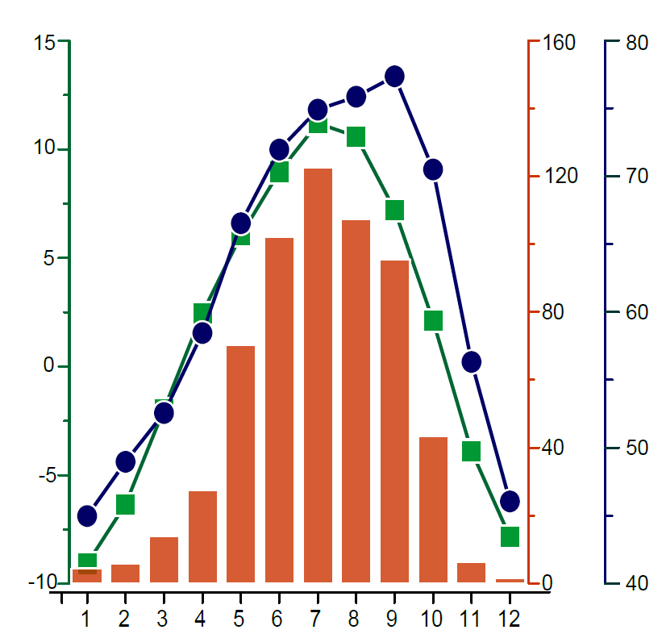

brGDGTs in Gahai recorded temperatures during ice-free seasons
Temperature（℃）
Precipitation (mm)
Humidity %
Cao et al., 2020
Local meteorological data indicate that the average snowfall period lasts for 269d, with ~50d of continuous snowfall in Gahai.
The frozen lake surface creates a thermal barrier, impeding the exchange of heat between the lake water and the atmosphere.
We prefer to use Gahai brGDGTs to reconstruct temperatures during ice-free seasons.

Slide 6
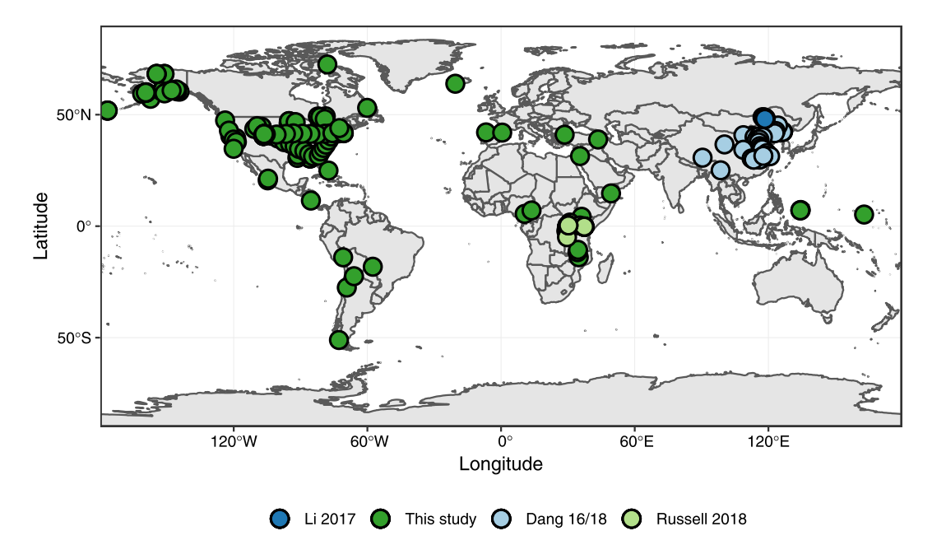
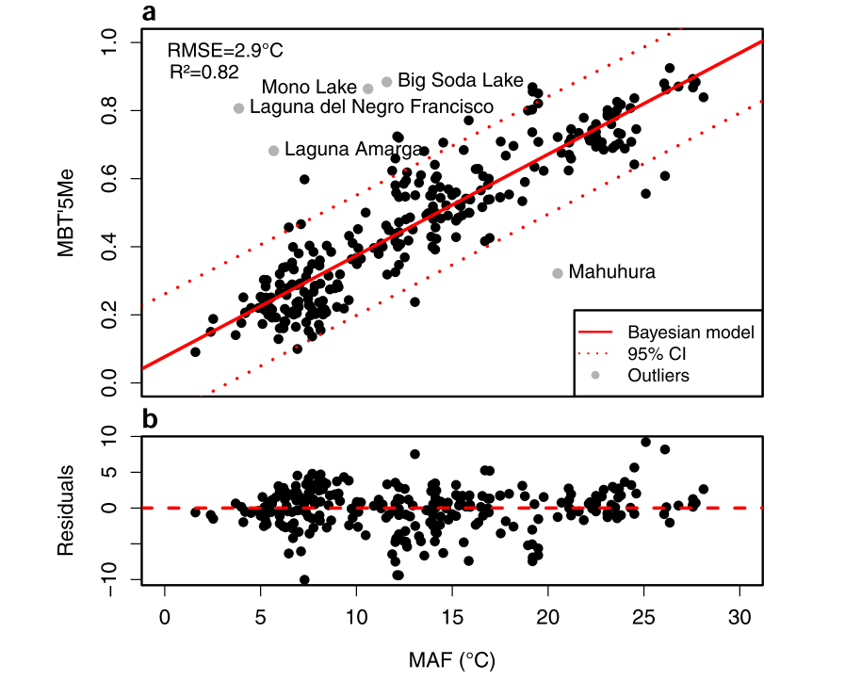
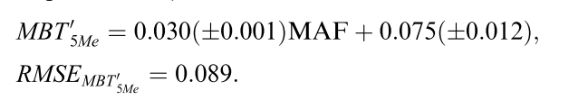
The brGDGT temperature calibration
mean average temperature above freezing months
Pablo Martínez-Sosa et al., 2021
Notes:
基于此，我们就选择了利用贝叶斯模型建立的全球湖泊沉积物brGDGT与无冰期温度建立的转换方程，

Slide 7
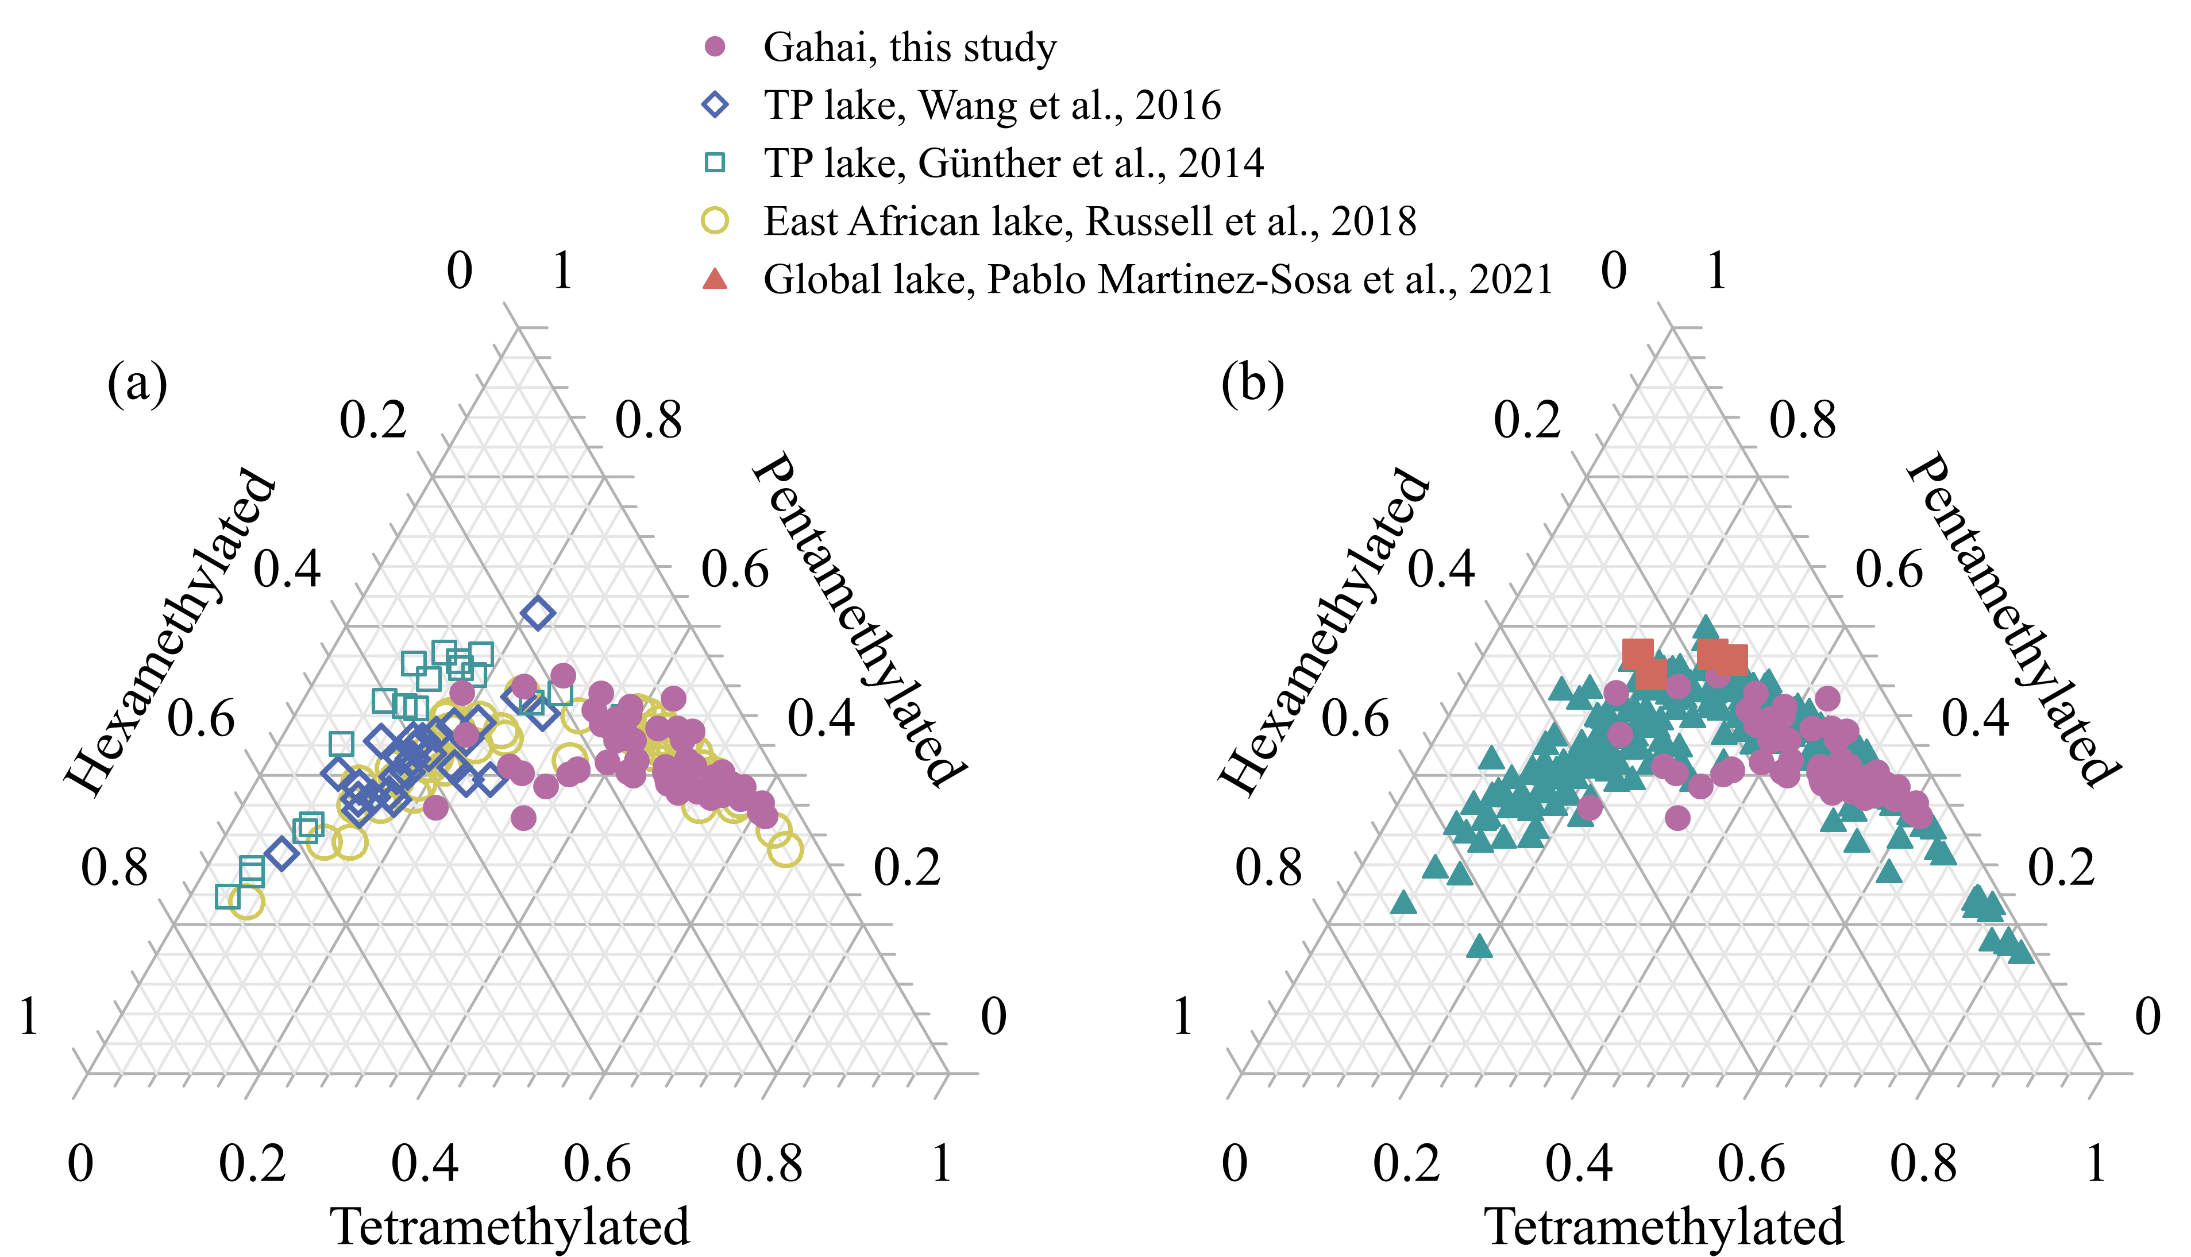
The brGDGT temperature calibration
Notes:
这张三角图也可以看出尕海GDGTs的分布与其他的几个方程也不太一致，因此也就选择了全球样品建立的转换方程。

Slide 8
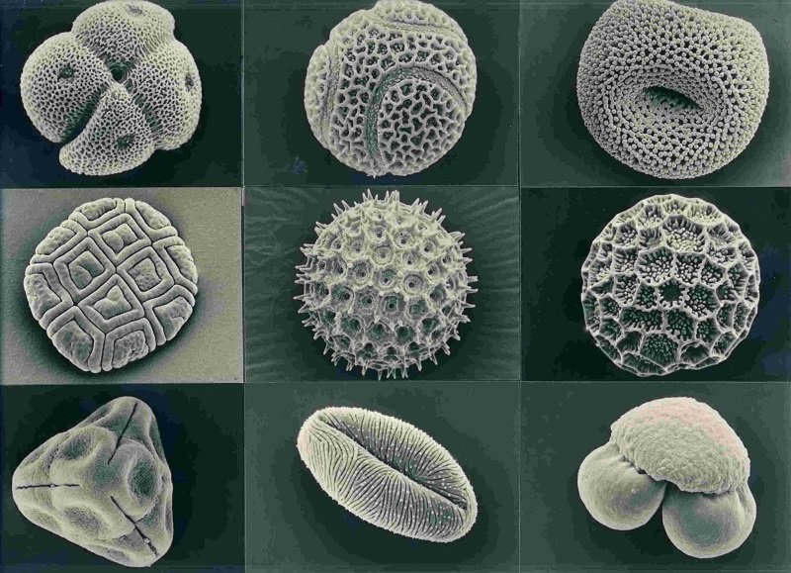
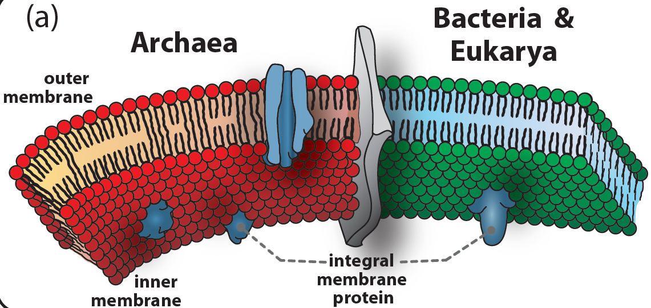
brGDGT-based Temperature VS pollen-based Temperature
BrGDGTs in Gahai:
ice-free season temperature
Pollen in Gahai:
the mean July temperature
Wang et al., 2022

Slide 9
brGDGT-based Temperature VS pollen-based Temperature
An ice-freeseason temperature record based on brGDGTs shows that the Holocene Thermal Maximum lags the pollen-based July temperature recorded in the same sediment core.
We conclude that the mismatch between the brGDGT-based and pollen-based temperatures is primarily the result of seasonal variations in solar irradiance.
Notes:
这就是我们重建的孢粉结果和brGDGTs结果对比，我们发现两者基本趋势是一致的，但大暖期，brGDGTs重建的大暖期要滞后于孢粉重建的结果，

Slide 10
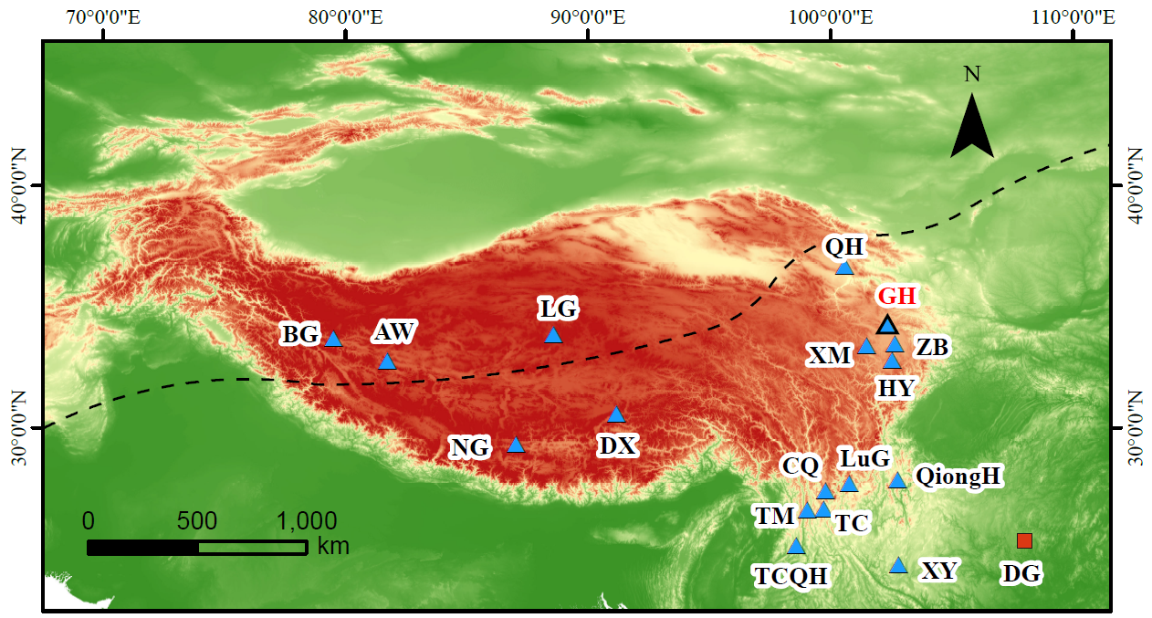
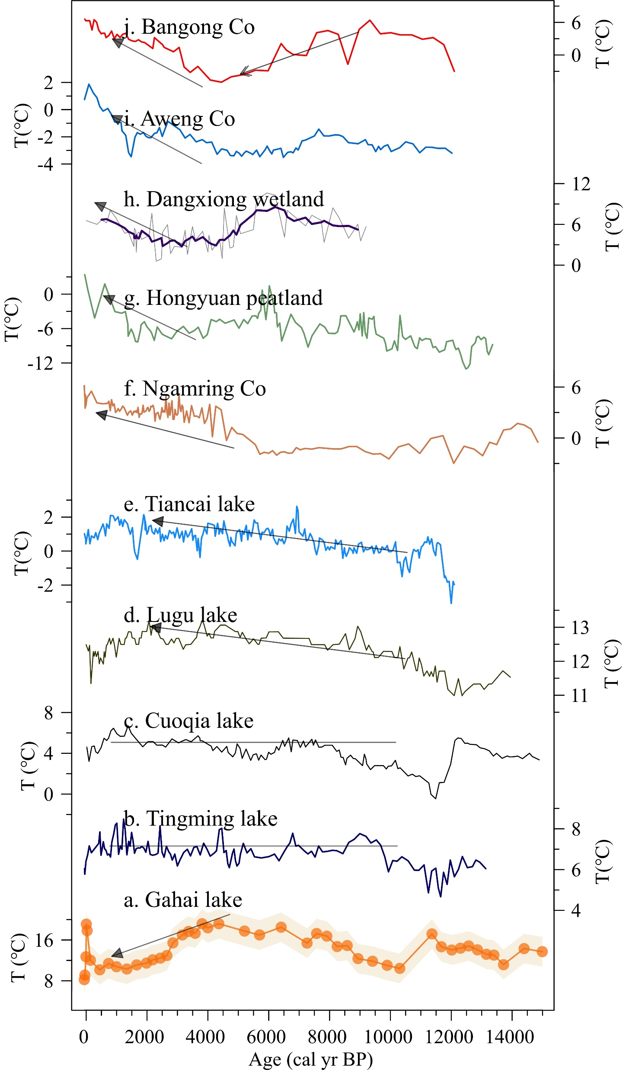
Spatiotemporal pattern of brGDGT-based TP temperatures
Wang et al., 2021
Li et al., 2017
Cheung et al., 2017
Yan et al., 2021
Sun et al., 2022
Higher temperatures in the early and late Holocene, and lower temperatures in the middle Holocene: Bangong Co, Aweng Co.
A warming trend throughout the Holocene: Tiancai lake, Lugu lake, Ngamring lake.
Temperature relatively stable during the Holocene: Cuoqia lake, Tingming lake.
Feng et al., 2022
Zhao et al., 2021
Zhang et al., 2022
Sun et al., 2021
Notes:
另外，我们梳理了高原上已有的利用湖泊brGDGTs重建的全新世温度记录。你会发现，青藏高原湖泊中只是该指标记录的温度差异就十分显著，存在全新世持续升温、中全新世低温和中全新世大暖期等几种不同模式。这可能的原因之一就是对brGDGTs代用指标的解释存在了了偏差。

Slide 11
The complexity of Holocene temperature patterns
The origin of brGDGTs in lakes remains an uncertain.
  It’s important to conduct detailed modern process studies to accurately assess the sources of brGDGTs in lakes, especially with regard to evaluating the proportion of autochthonous brGDGTs.
BrGDGTs may show a seasonal signal.
  It’s necessary to conduct continuous, high-resolution seasonal investigations of lakes to comprehensively elucidate the seasonal characteristics of brGDGTs.
Different brGDGT–temperature calibrations may lead to differences in both the amplitude and trend of temperature from the same dataset.
  Selecting an appropriate calibration and attempting to establish a brGDGTs–in situ temperature calibration are effective means.
Notes:
尤其是在所有的土壤样品中发现了IIIa’和Ib’，而在表层沉积物中却基本没有或者丰度很低，更证实了brGDGTs自生的结果，这也与刘老师他们EPSL今年发表的几十个公园湖泊brGDGTs土壤输入比较少的研究结果是一致的

Slide 12
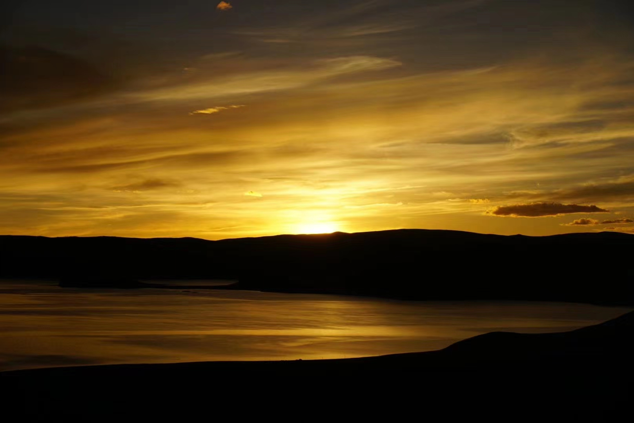
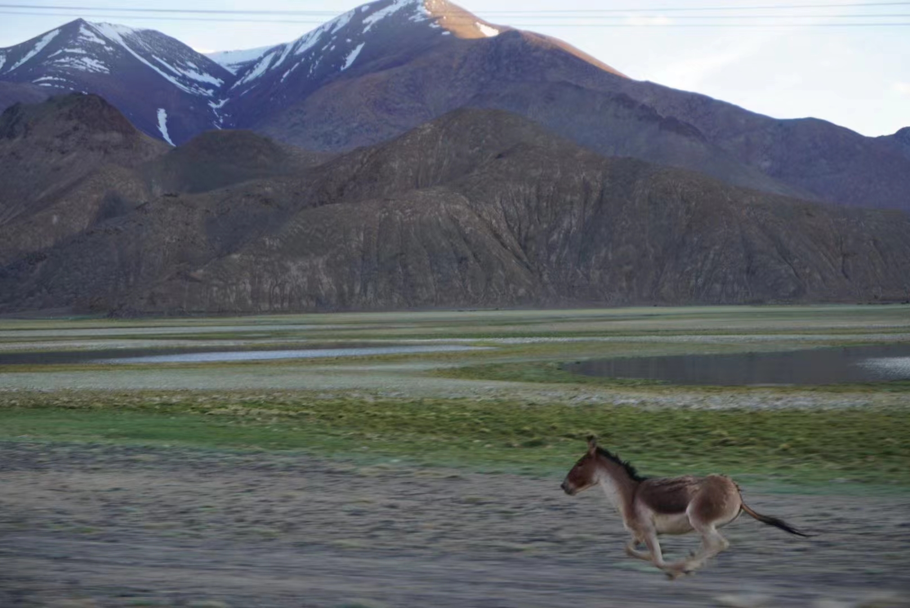
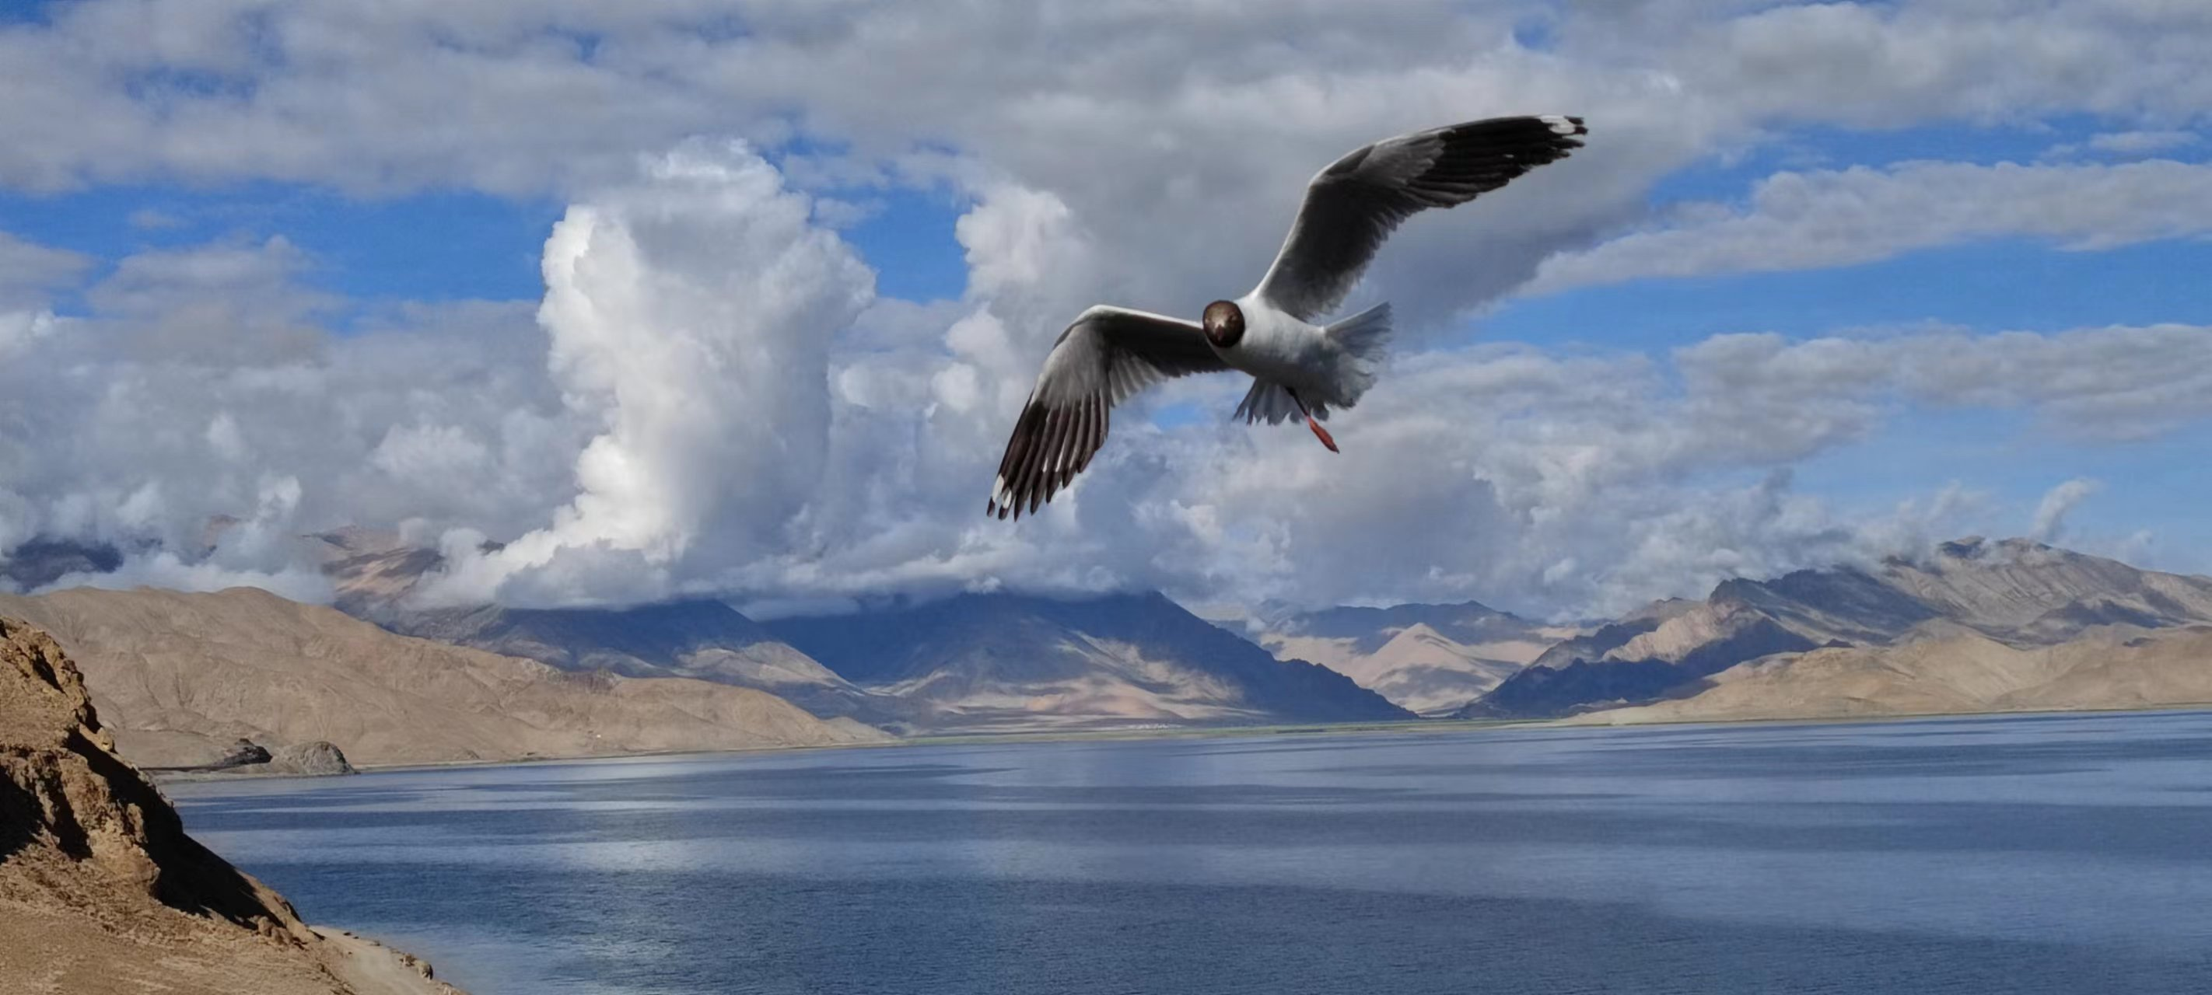
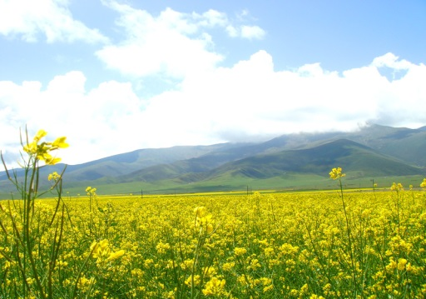
Thanks

