Slide 1
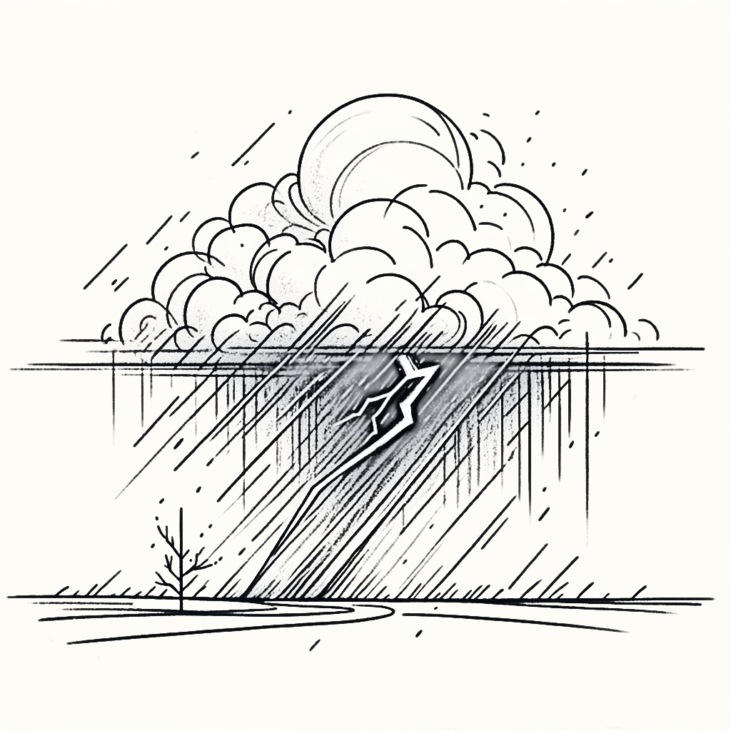
The impact of storms on European S2S forecast spread and their modulation by the stratosphere
Philip Rupp, Jonas Spaeth, Hilla Afargan-Gerstman, Dominik Büeler, Michael Sprenger and Thomas Birner

Slide 2
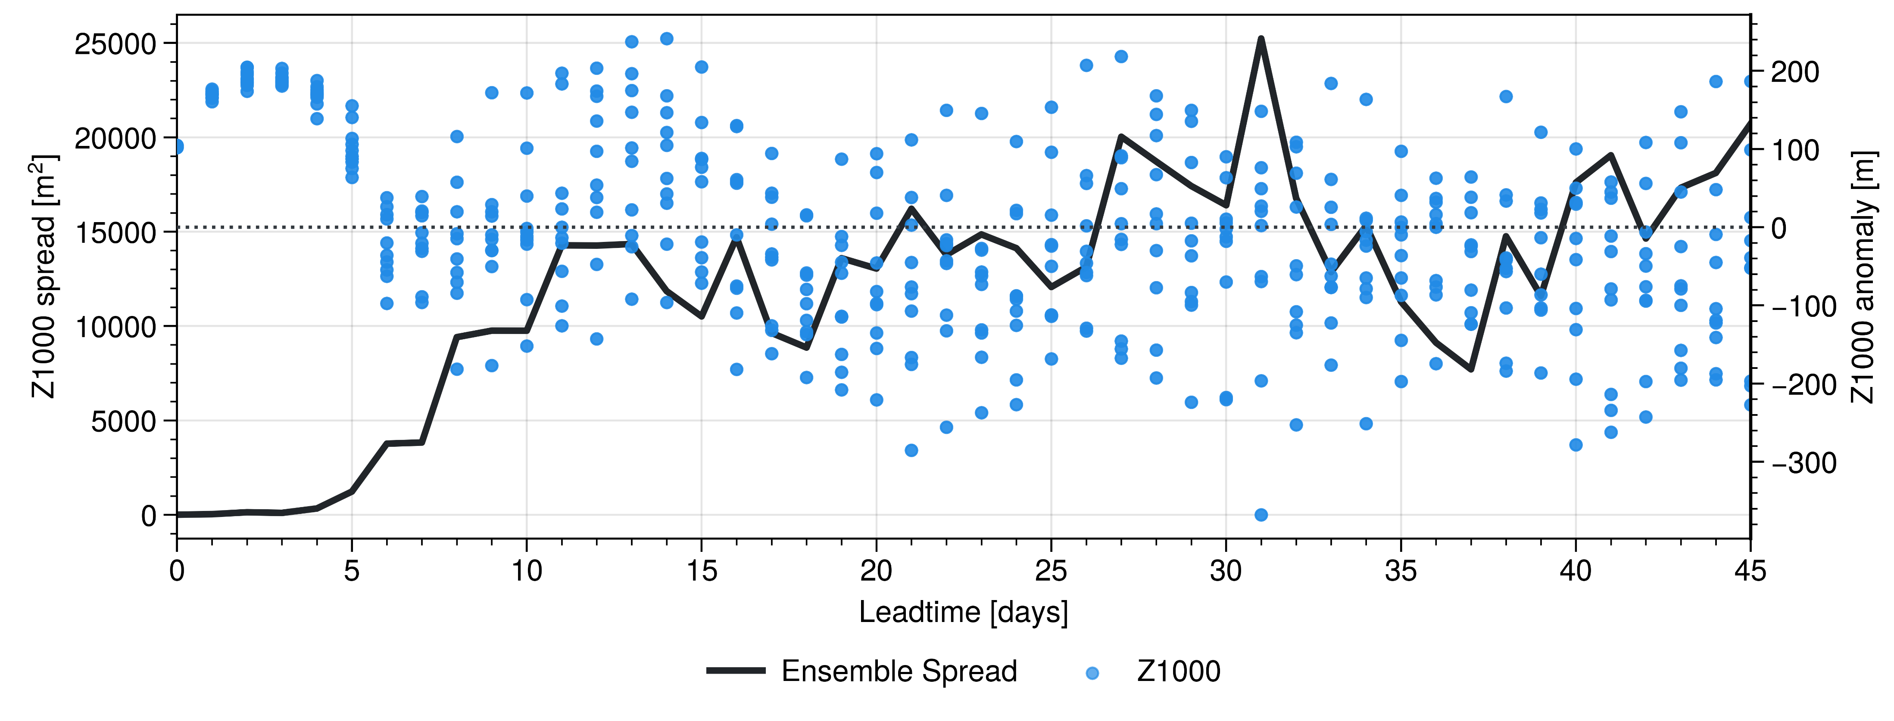
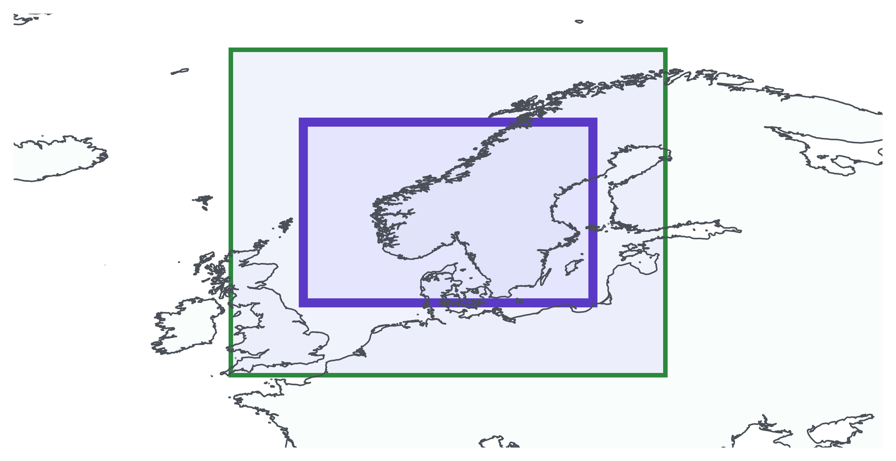
Increased spread
‘Arbitrary’ example hindcast
Extreme Z1000 in single member
Model details
ECMWF hindcasts
46day integrations
500 ensembles
Covering 20 DJF periods
10 members
1

Slide 3
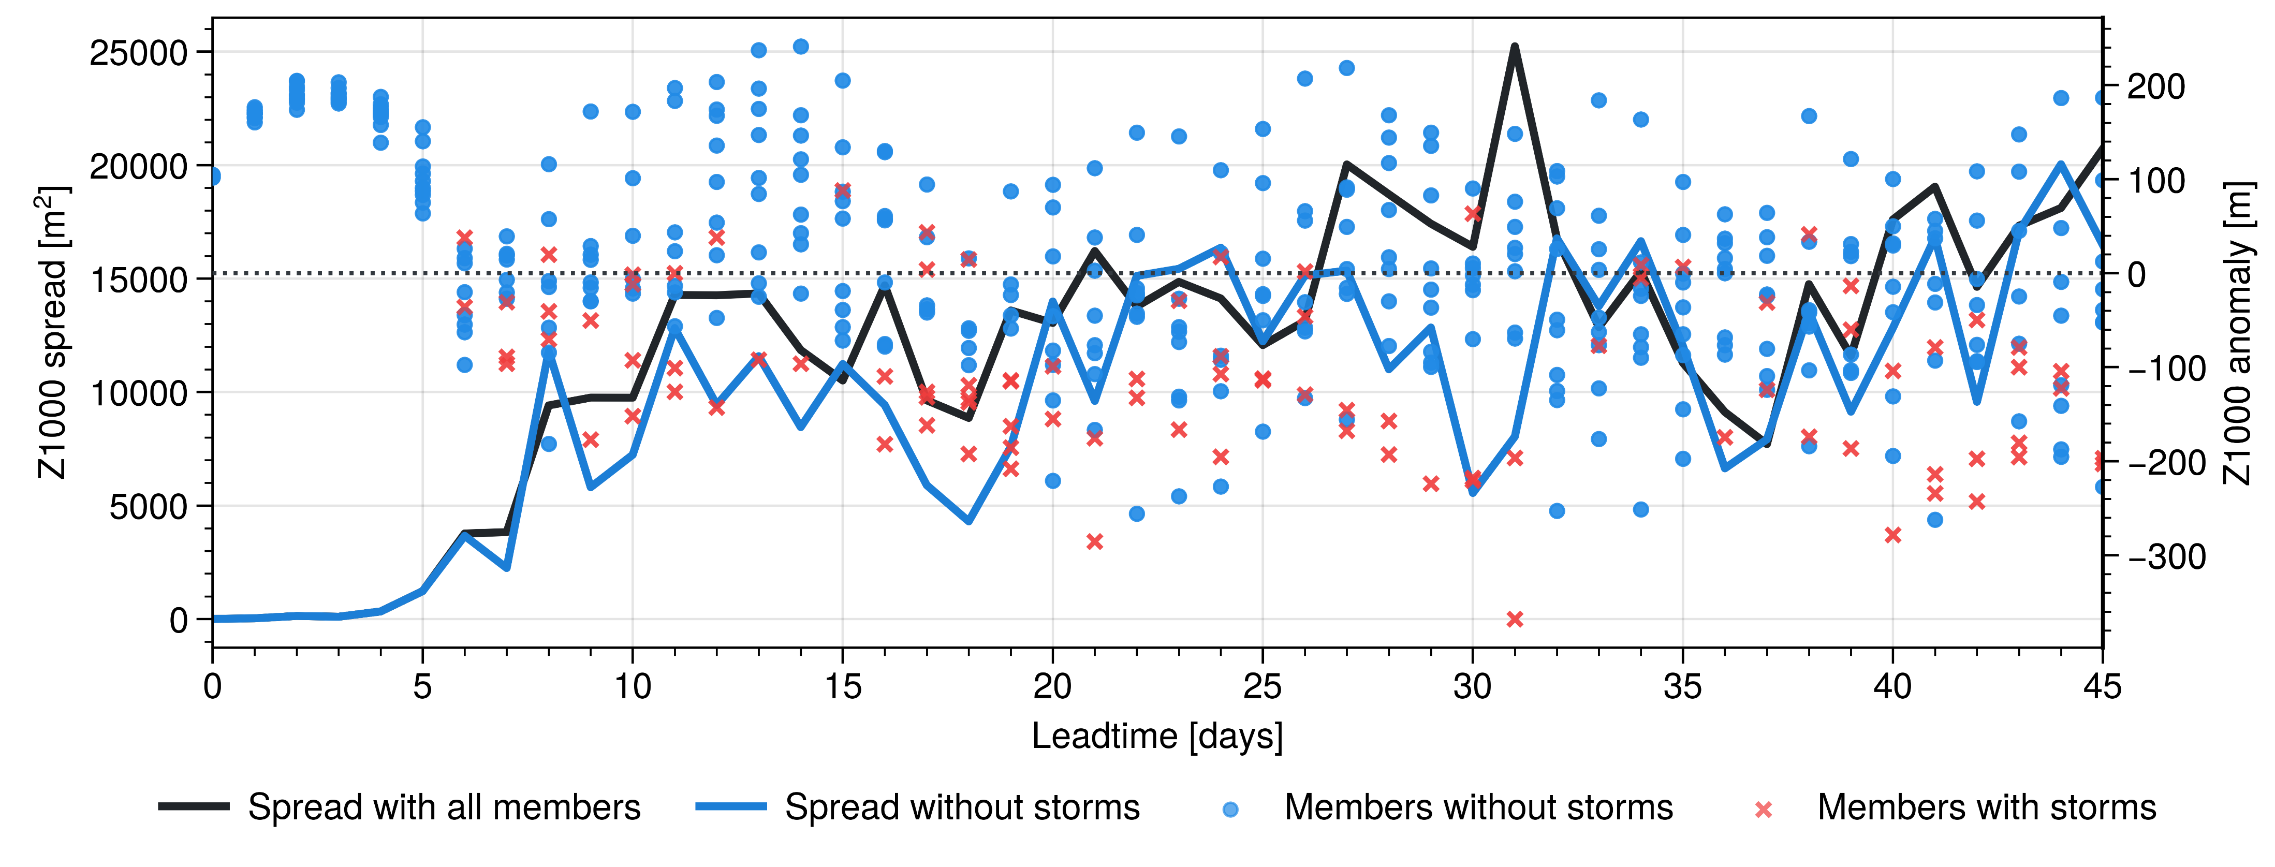
Increased spread
Removing storms reduces spread!
‘Arbitrary’ example hindcast
Extreme Z1000 in single member
Model details
ECMWF hindcasts
46day integrations
500 ensembles
Covering 20 DJF periods
10 members
1

Slide 4
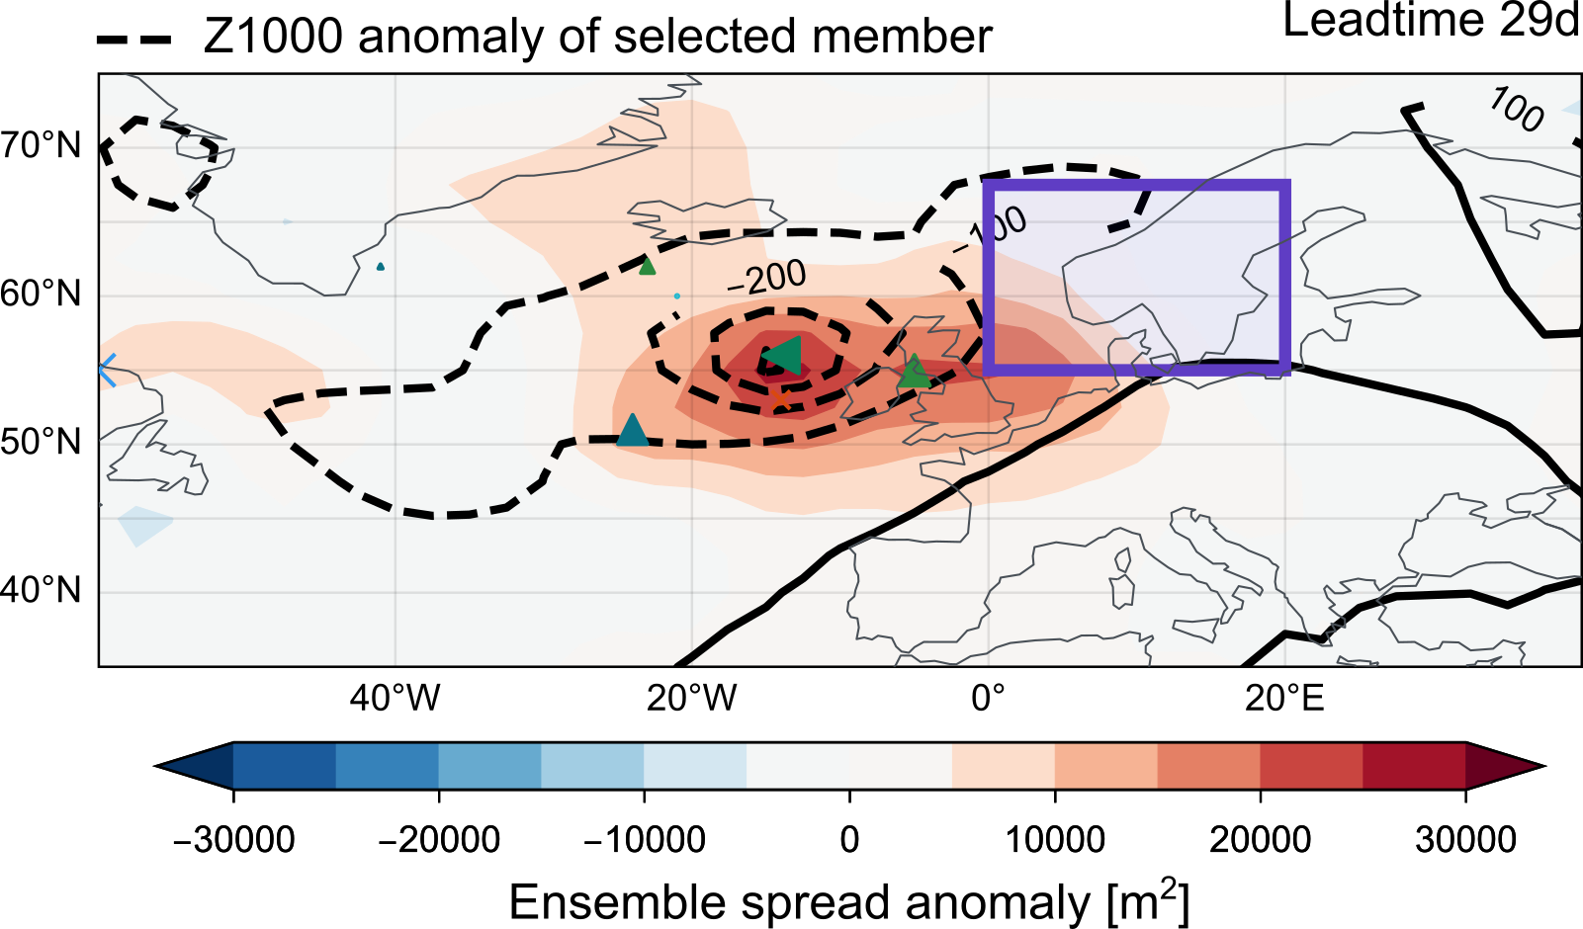
Storm
Ensemble spread signal
2

Slide 5
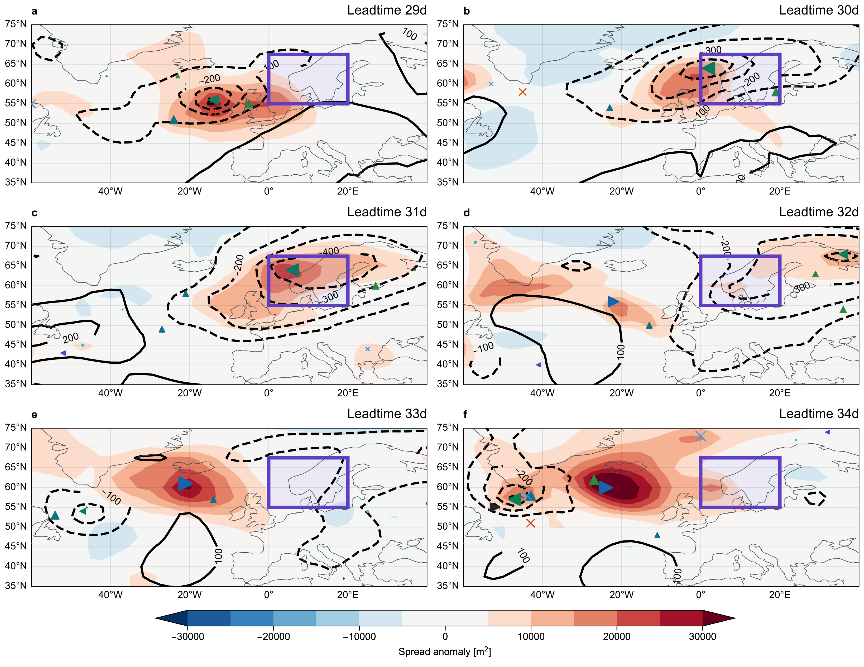
Spread signal follows storm
Storm developed in different member
2

Slide 6
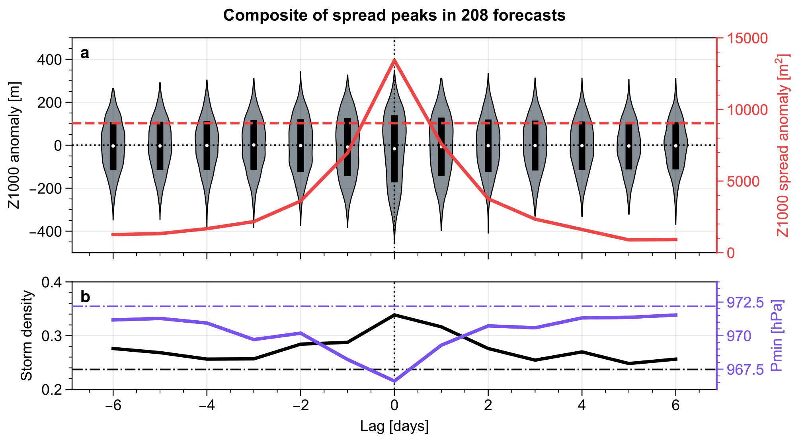
Spread peaks associated with heavy negative tail
Increased storm density and strength
3

Slide 7
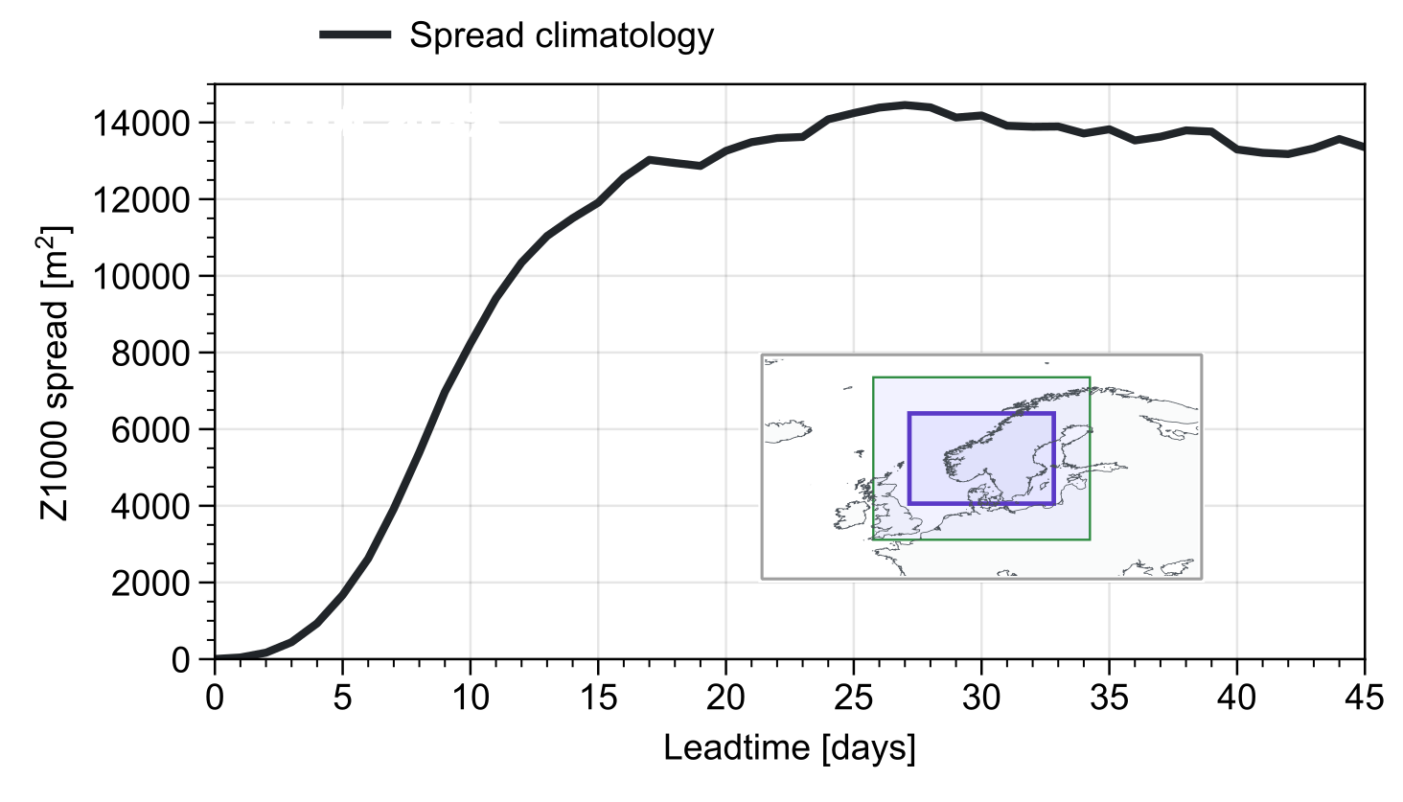
3

Slide 8
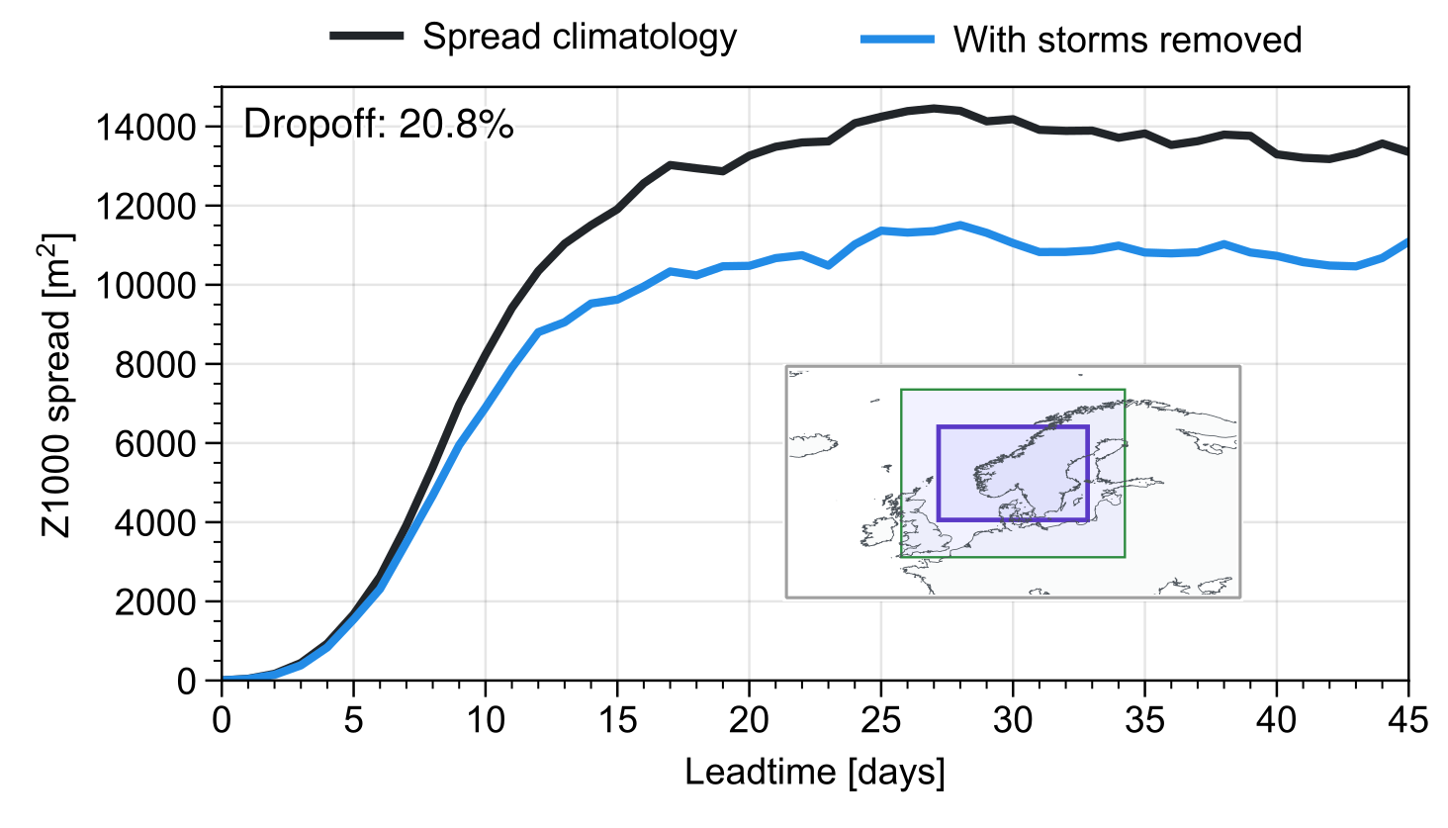
Spread reduced by 20% when removing storms!
Phenomena projecting onto the storm track should also have a spread signals:
Teleconnections
Climate change
Model errors
…
3

Slide 9
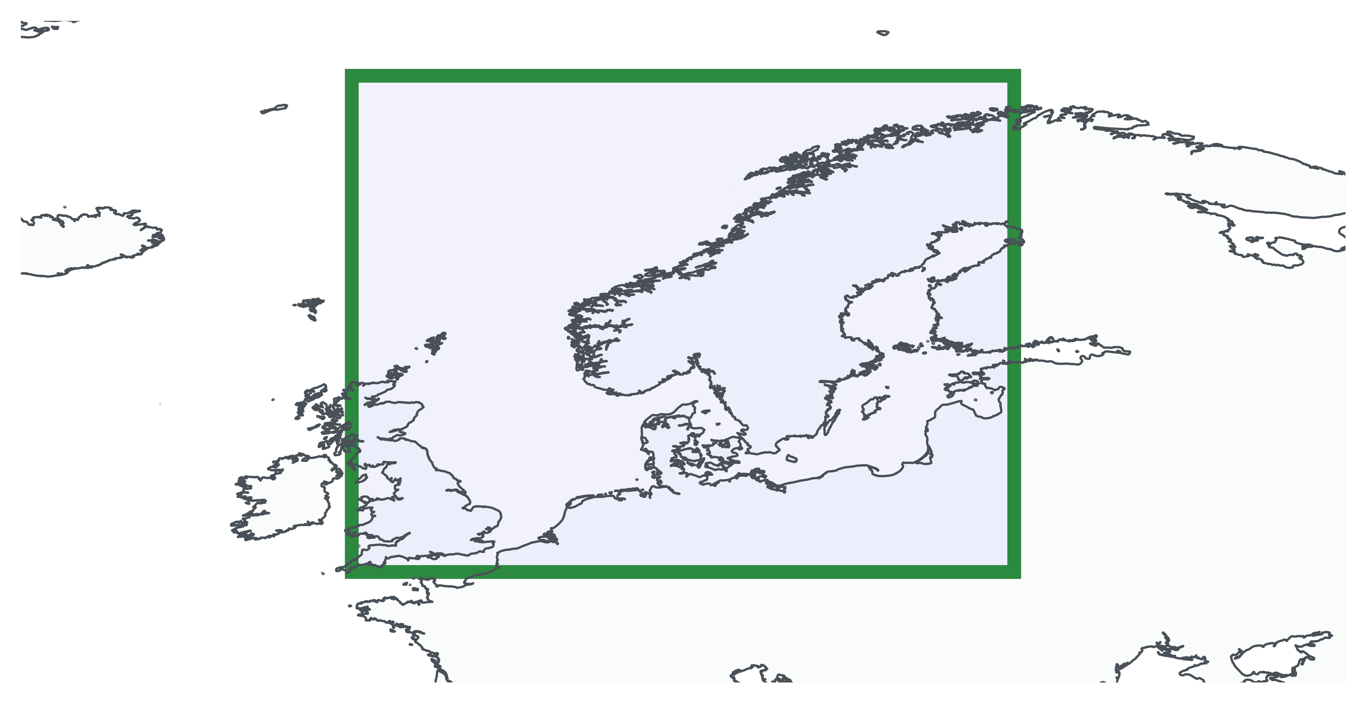
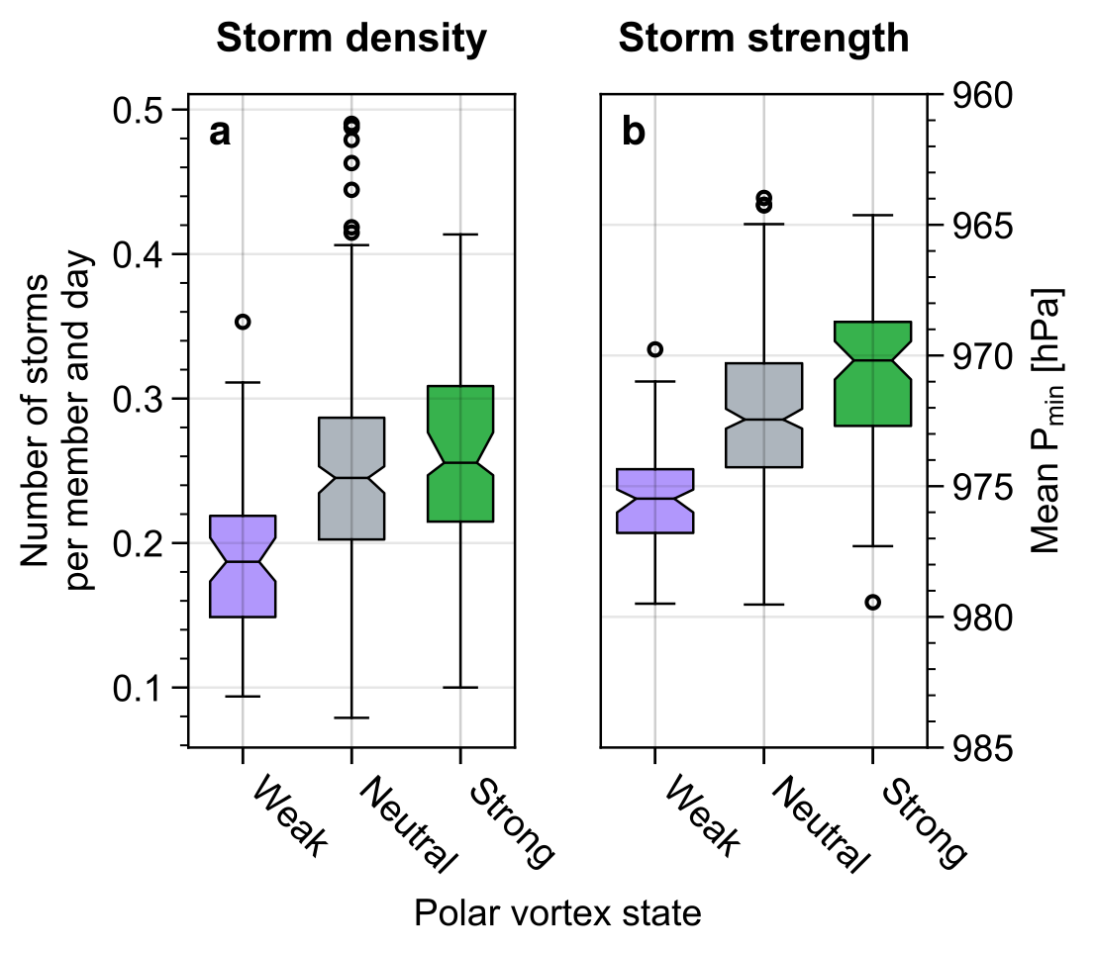
Example: Stratospheric polar vortex
Storm density and strength decreased following polar weak vortex!
4

Slide 10
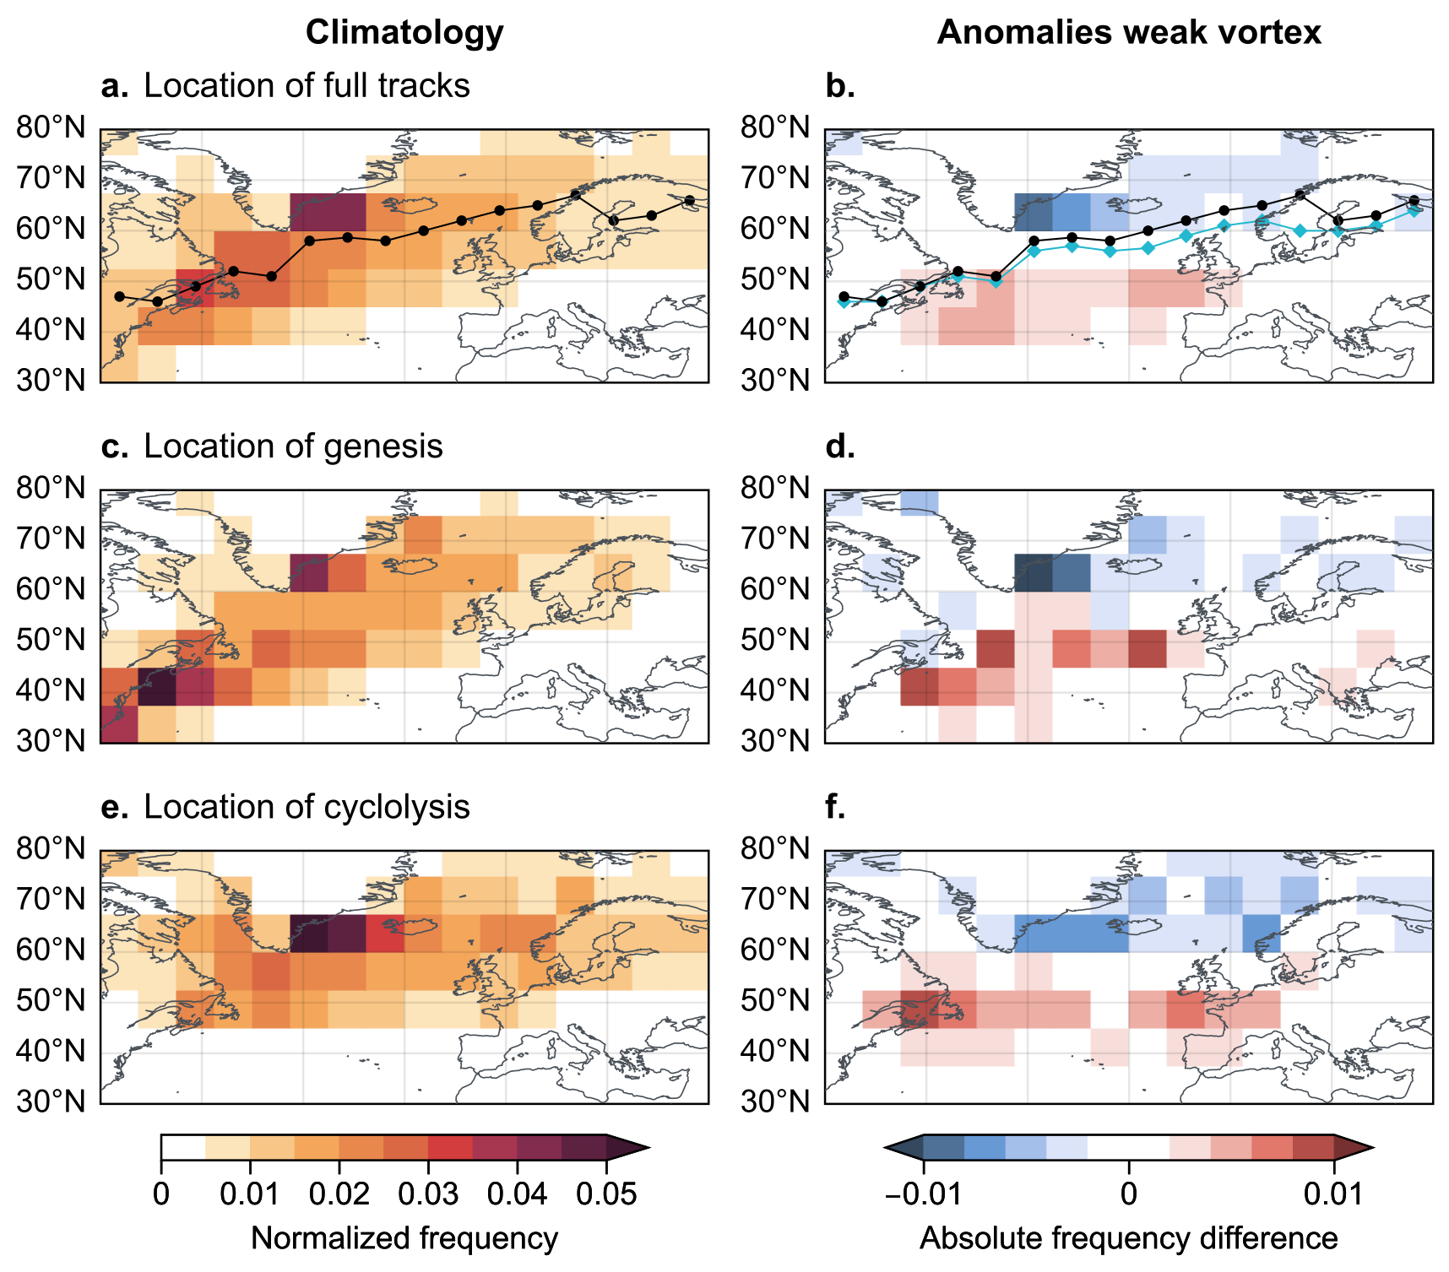
Southward shift of storm track
Fewer storms over Northern Europe
Reduced forecast uncertainty!!!
5

Slide 11
Occurrence of storms at S2S time scales is associated with increased ensemble spread
Northern-European storm density and strength decreased following weak polar vortex
Contribution of strong storms to S2S spread is about 20%
In preparation: manuscript for Weather and Climate Dynamics!
6

Slide 12
Storms generally associated with spread signal
Strong storms:
Euro-Atlantic sector
Leadtimes 20-40d
Minimum pressure < 985hPa
7

Slide 13
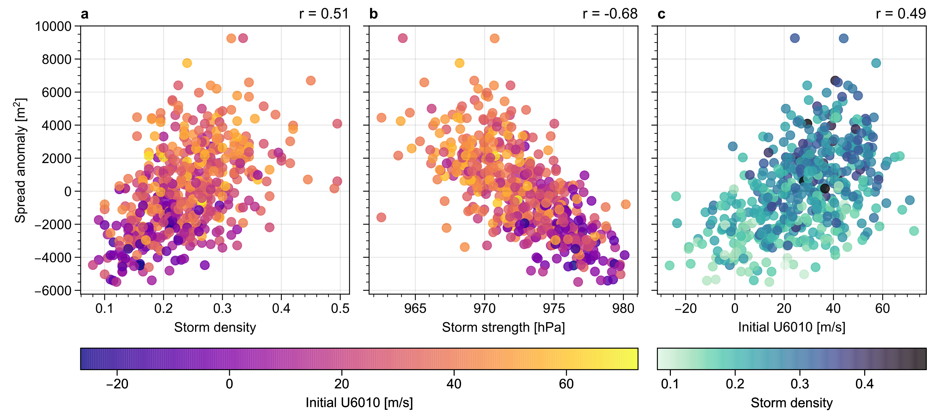
8

Slide 14
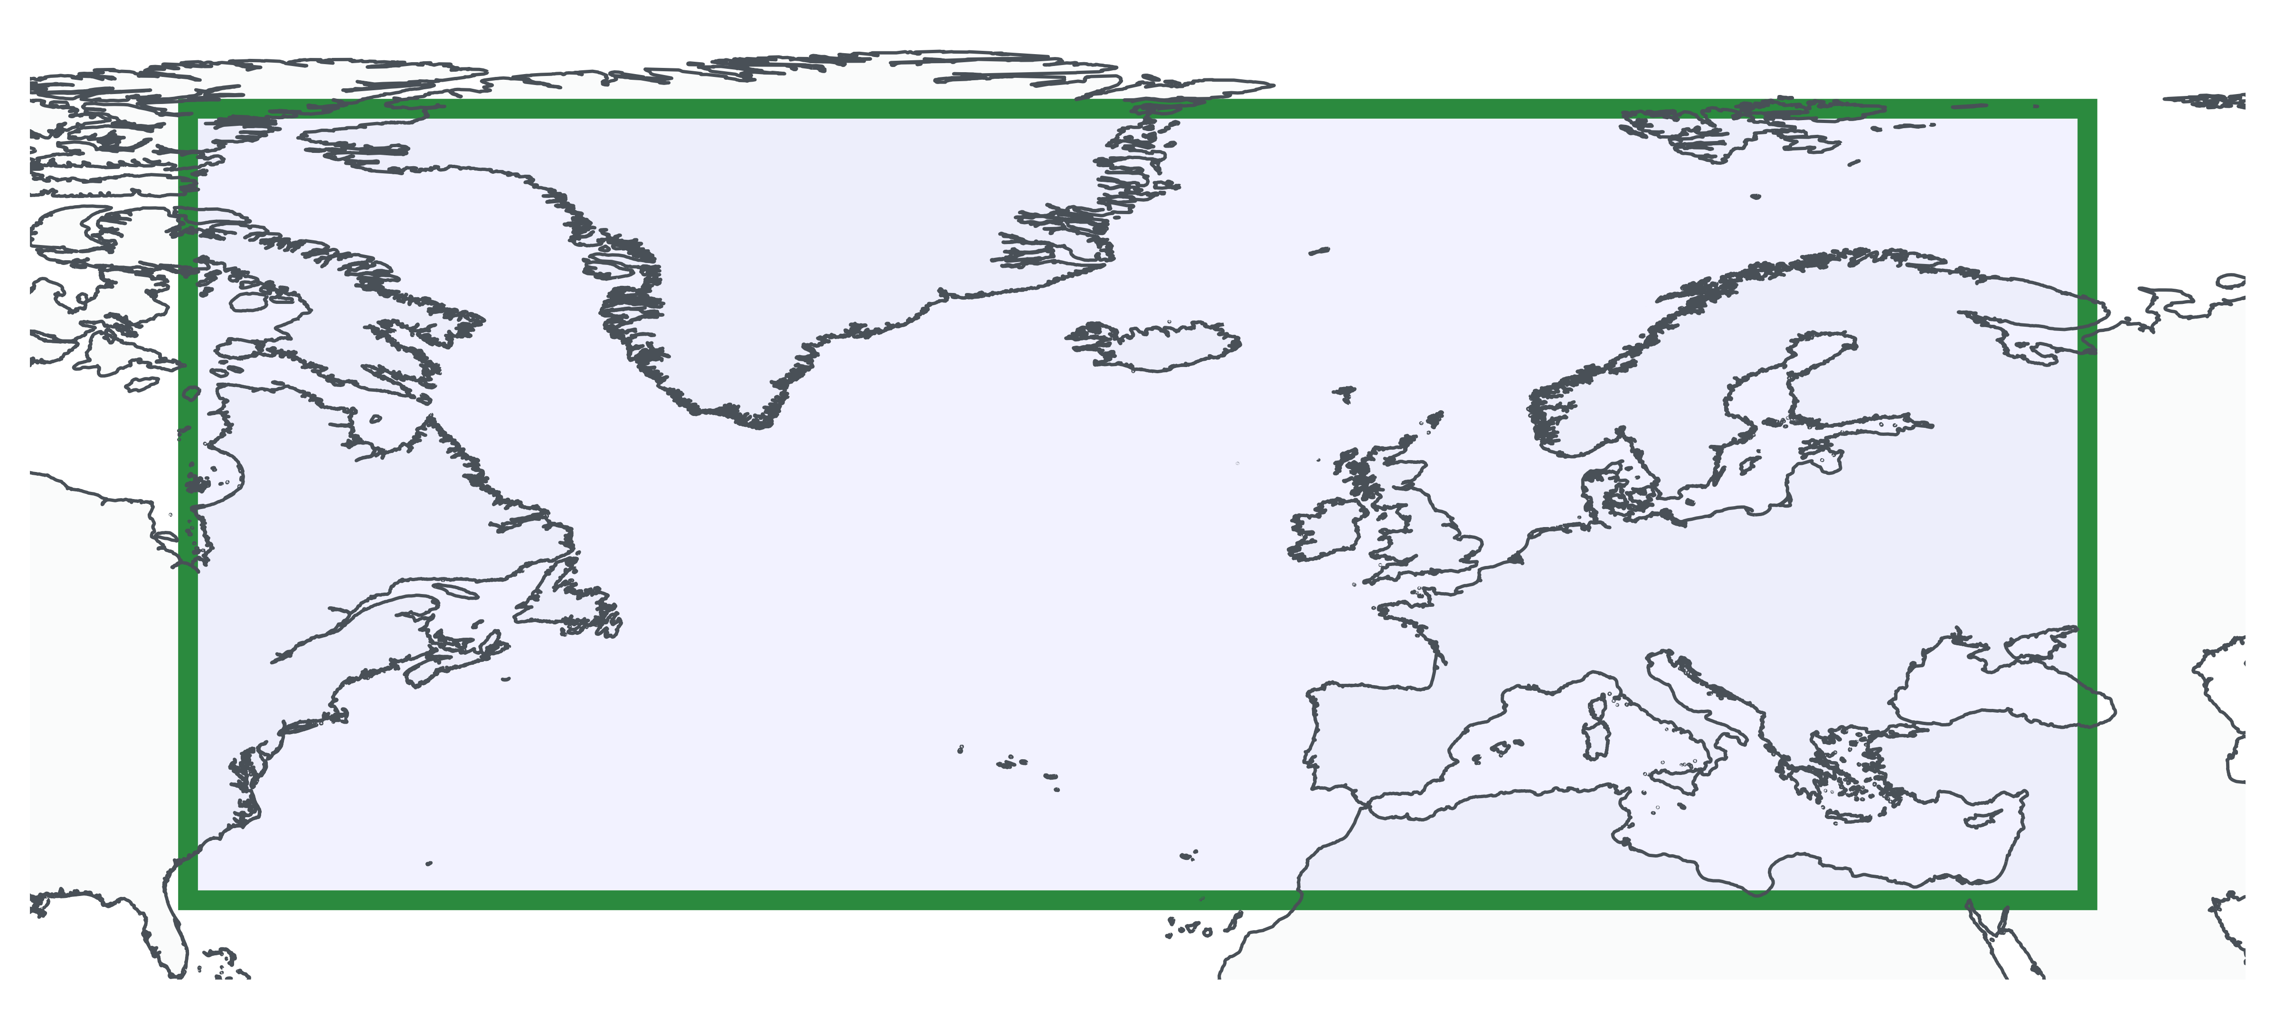
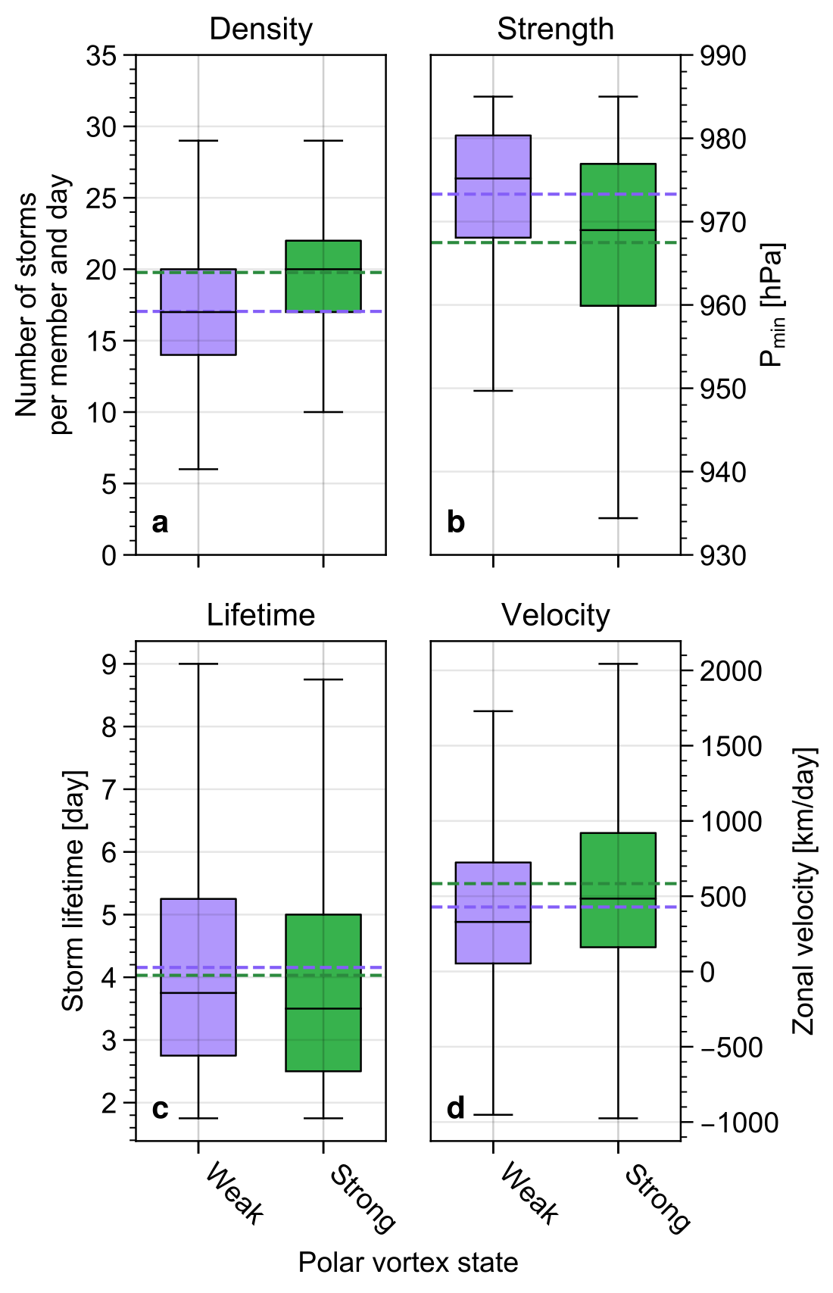
Weaker storm genesis
Earlier storm lysis?
9

Slide 15
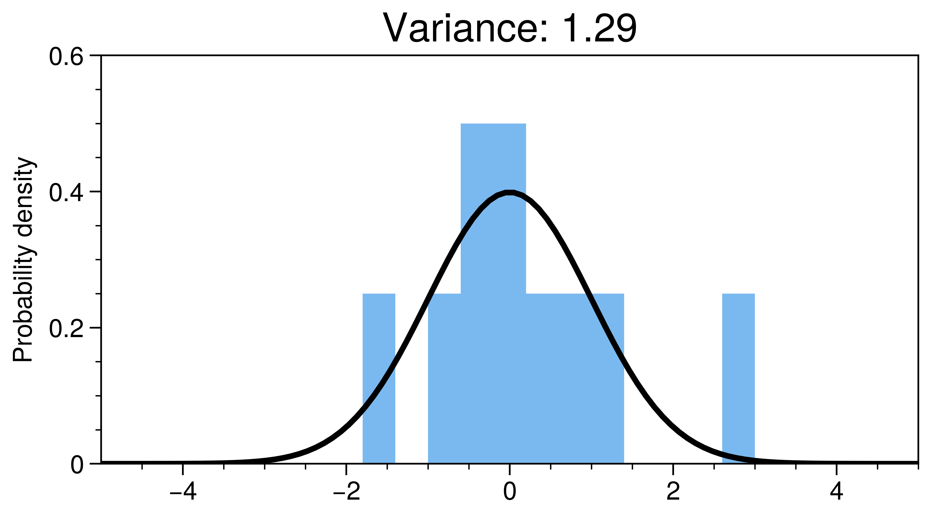
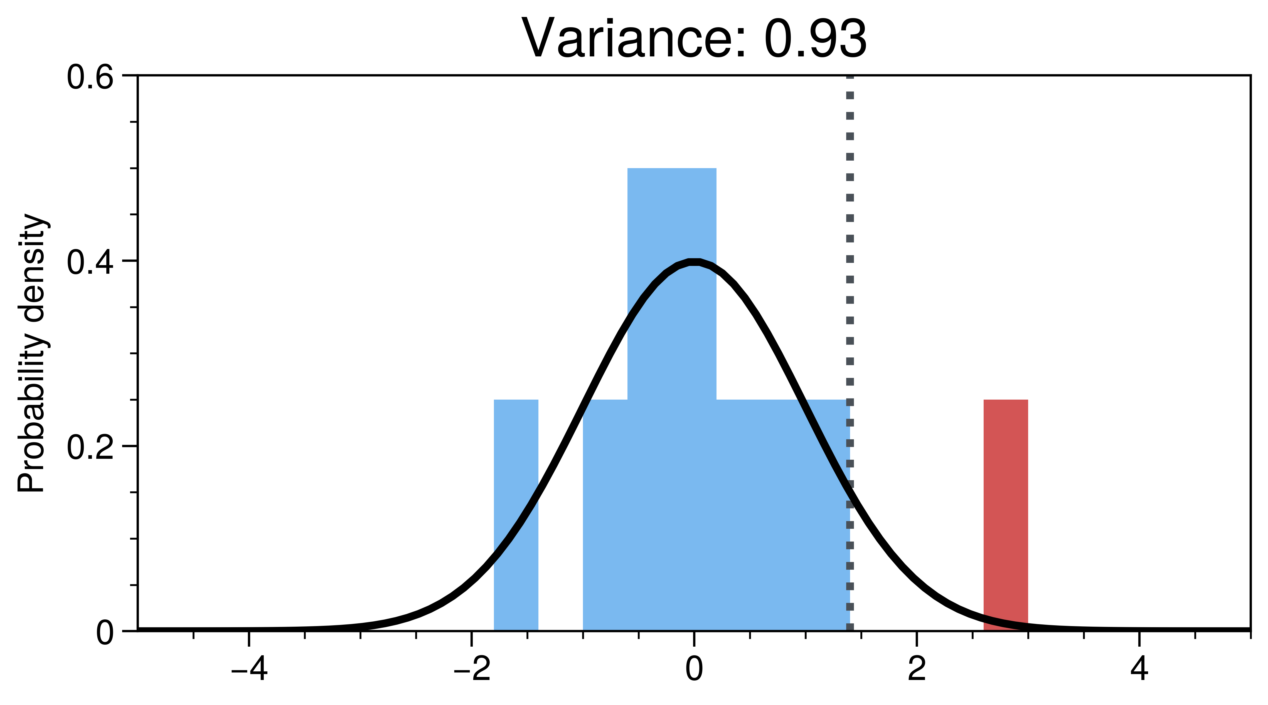
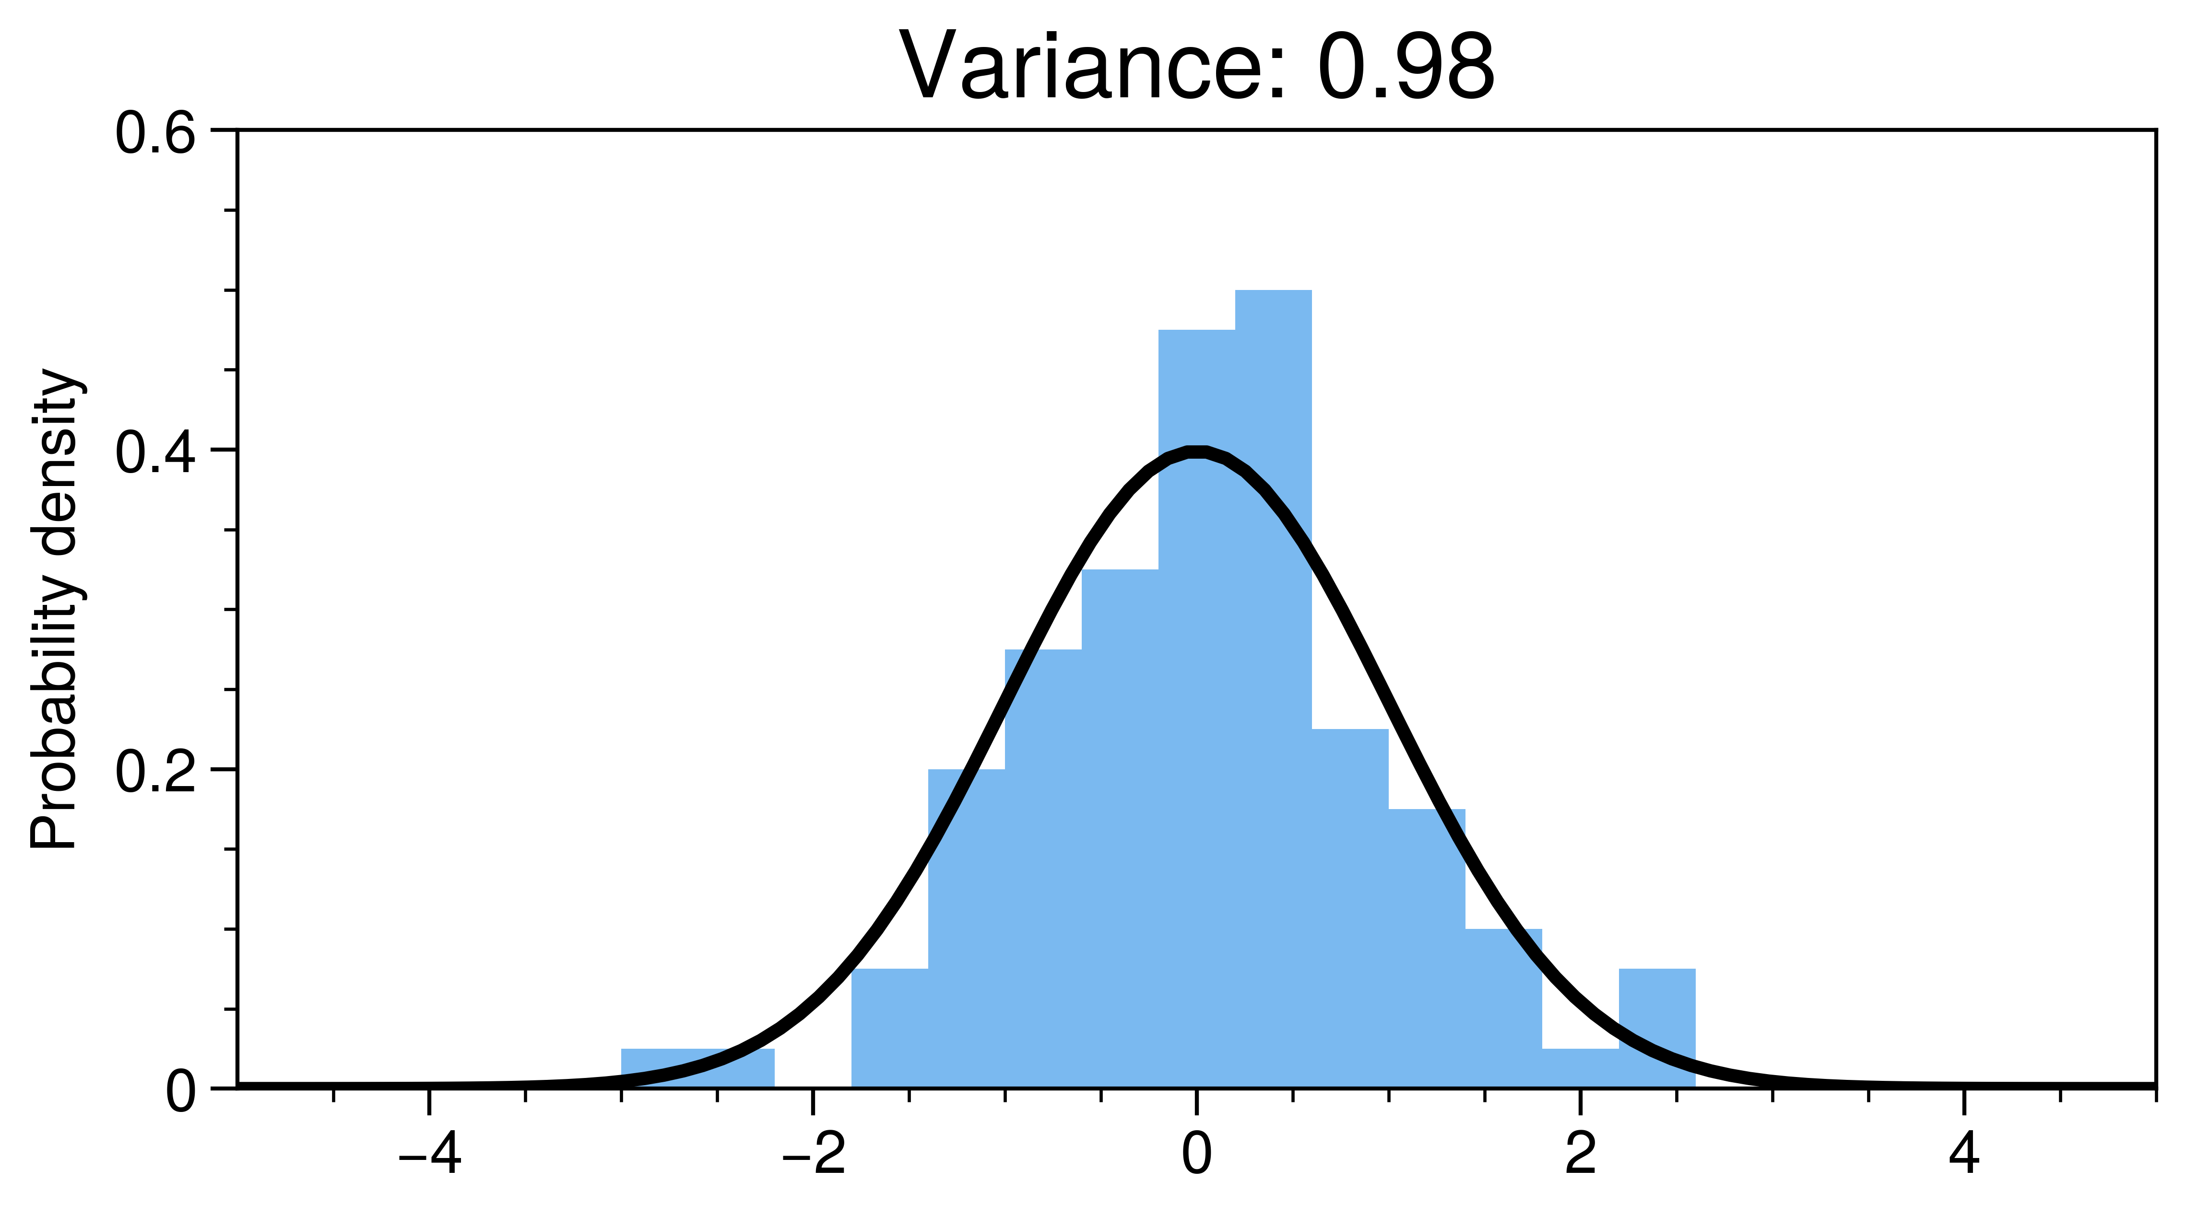
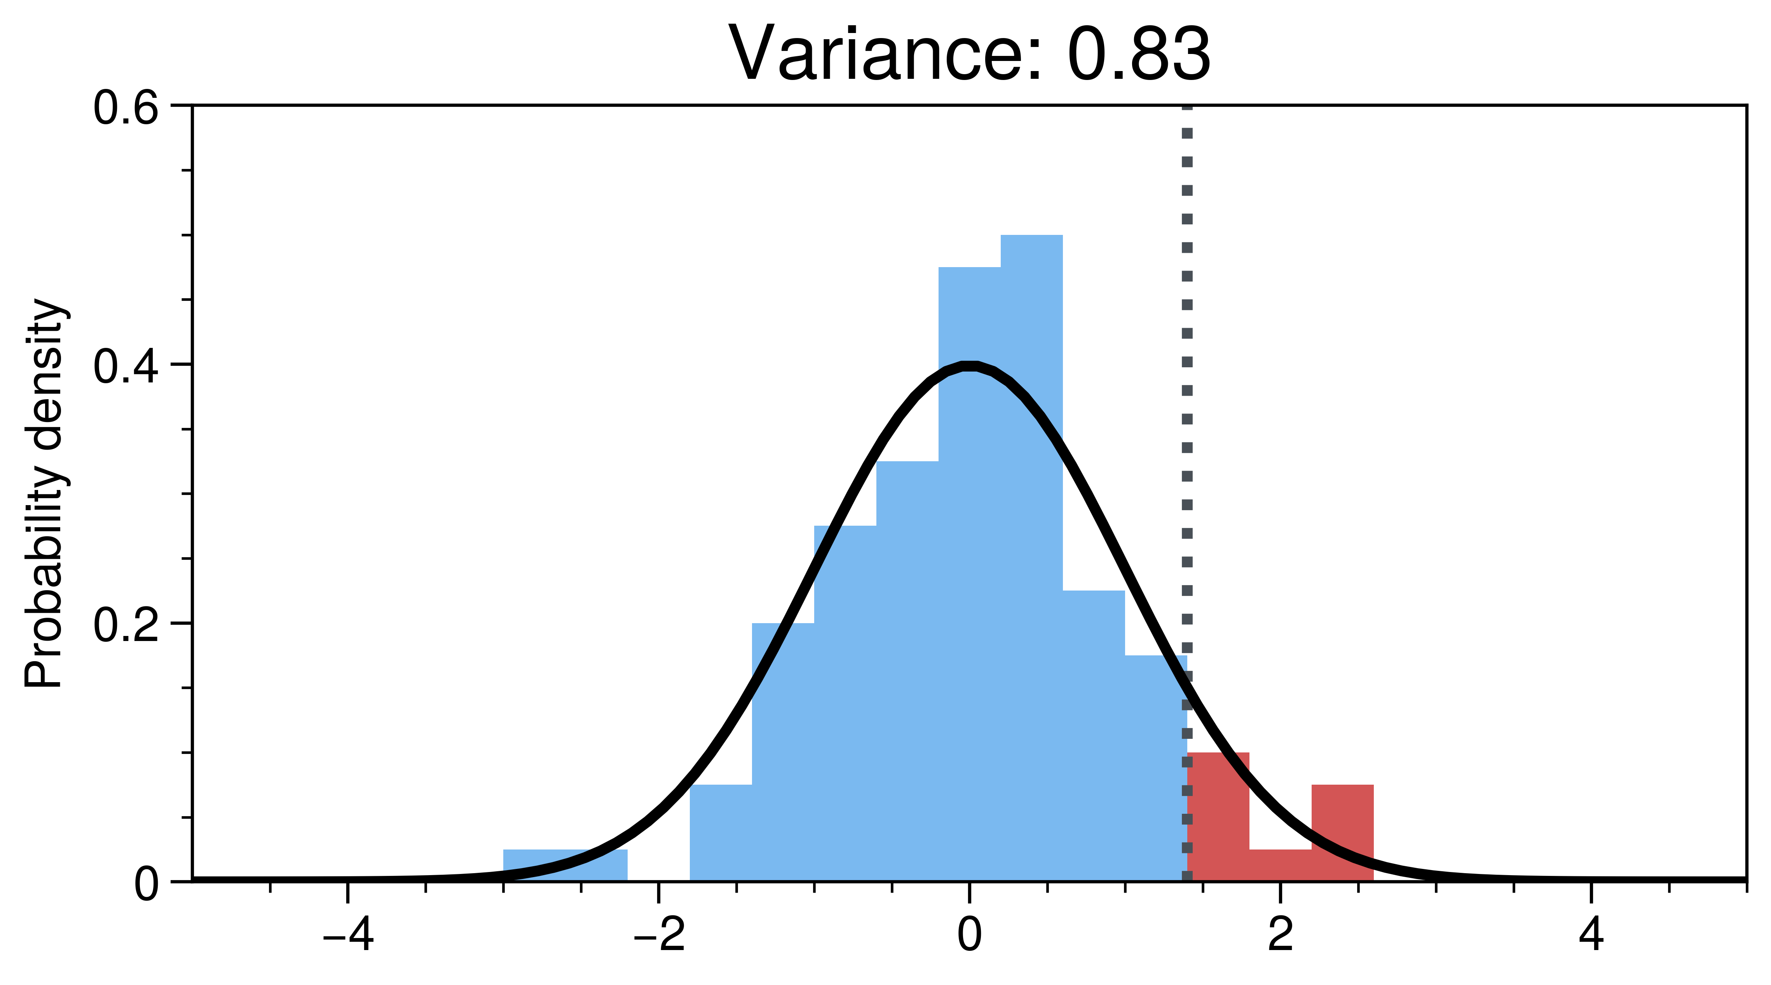
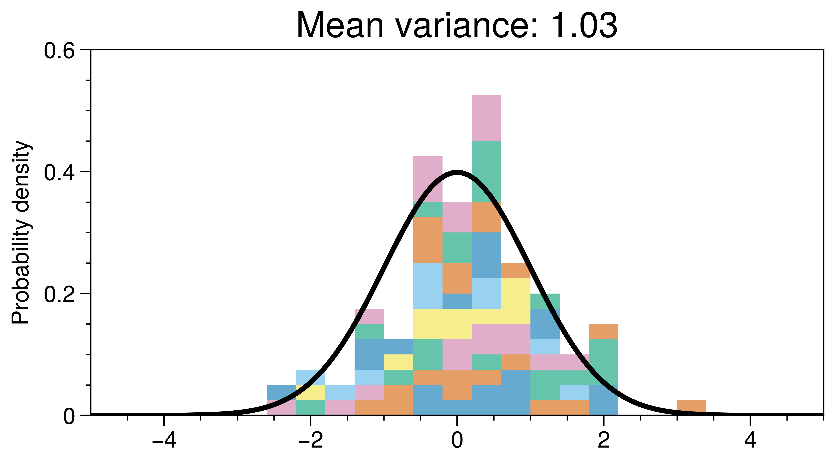
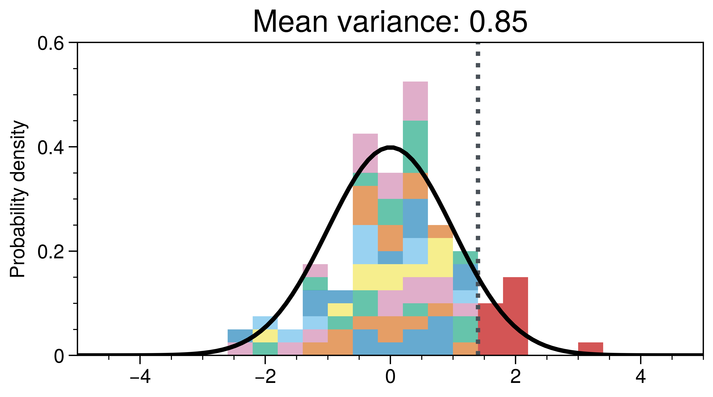
Removing extremes
10 Members
100 Members
10*10 Members
10

Slide 16
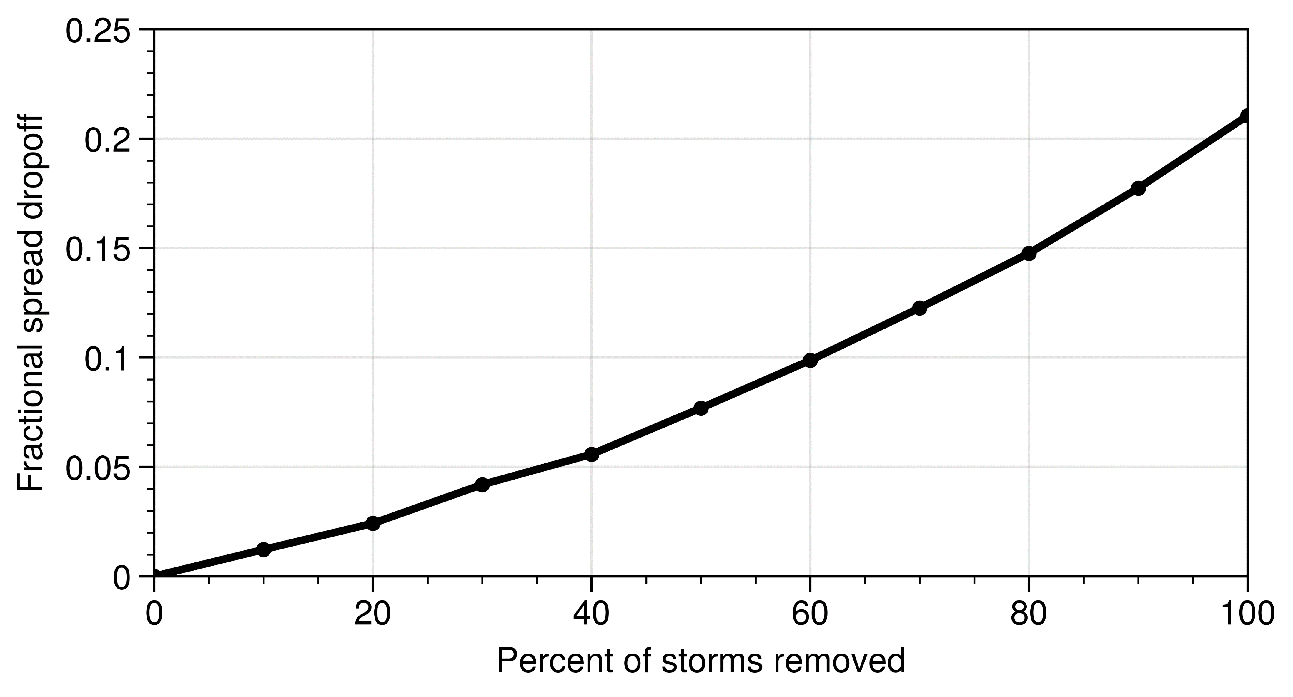
Non-linear relation!
11

