Slide 1



High-resolution seismic imaging of the sub-bottom Quaternary deposits revealed an active fault in the Vinodol-Velebit channel (Kvarner, Croatia)
Tvrtko Korbar¹, Ozren Hasan¹, Dea Brunović¹, Snježana Markušić²
¹ Croatian Geological Survey, Milana Sachsa 2, Zagreb, CROATIA
² Department of Geophysics, Faculty of Science, University of Zagreb, Horvatovac 95, Zagreb, CROATIA
Vienna, Austria ORAL - ON SITE, 15 April 2024 TS3.3

Slide 2


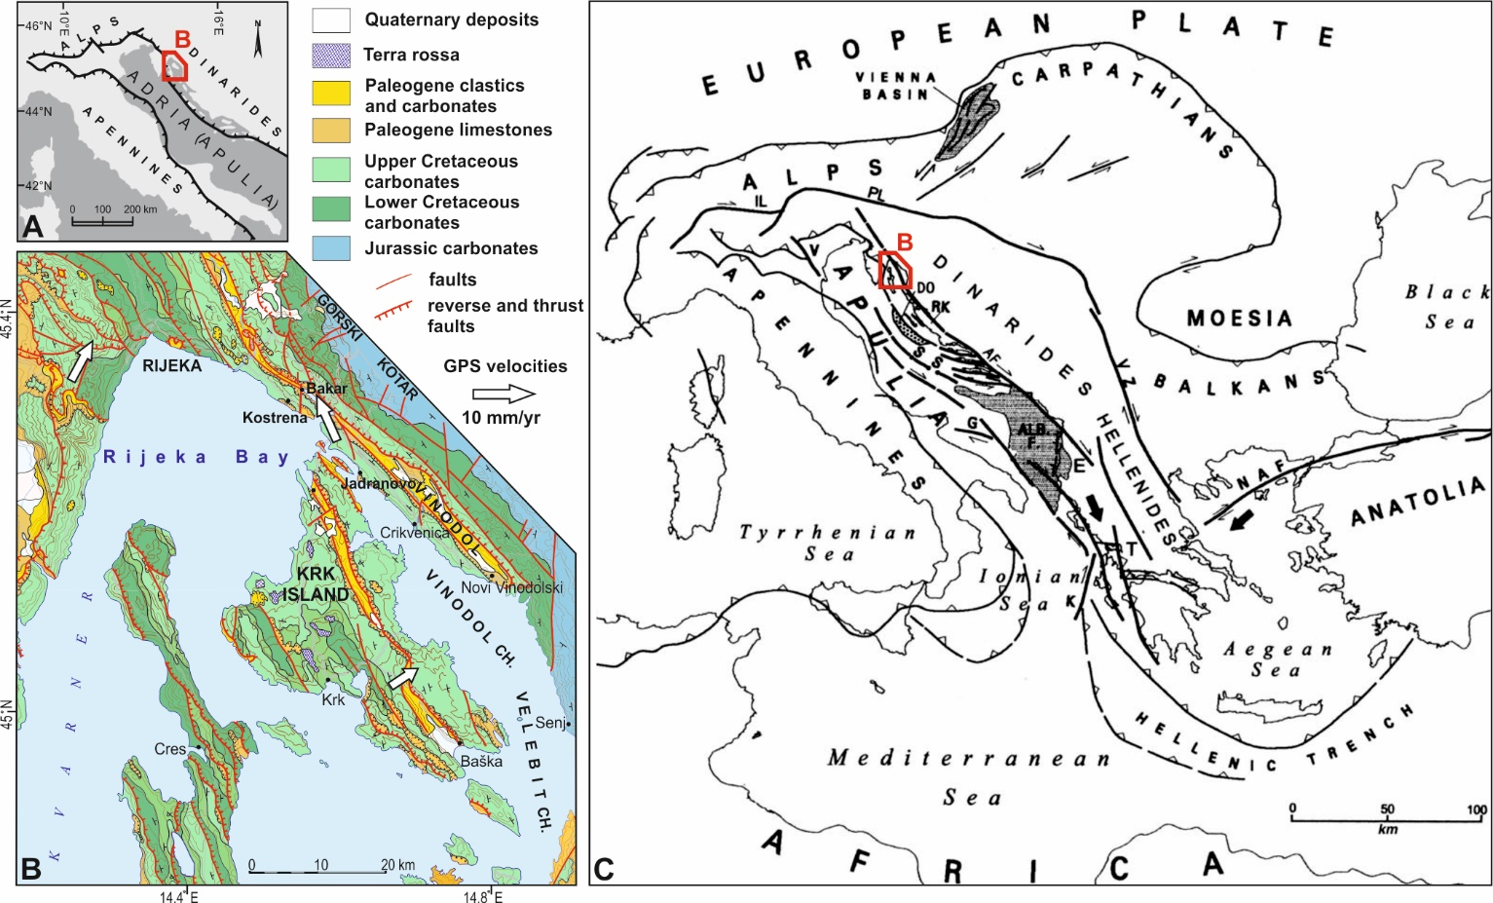
Location map of the NW part of the External Dinarides (Korbar, 2009),
overview geological map (HGI, 2009; Korbar et al., 2020), and regional tectonic scheme (Picha, 2002).

Slide 3
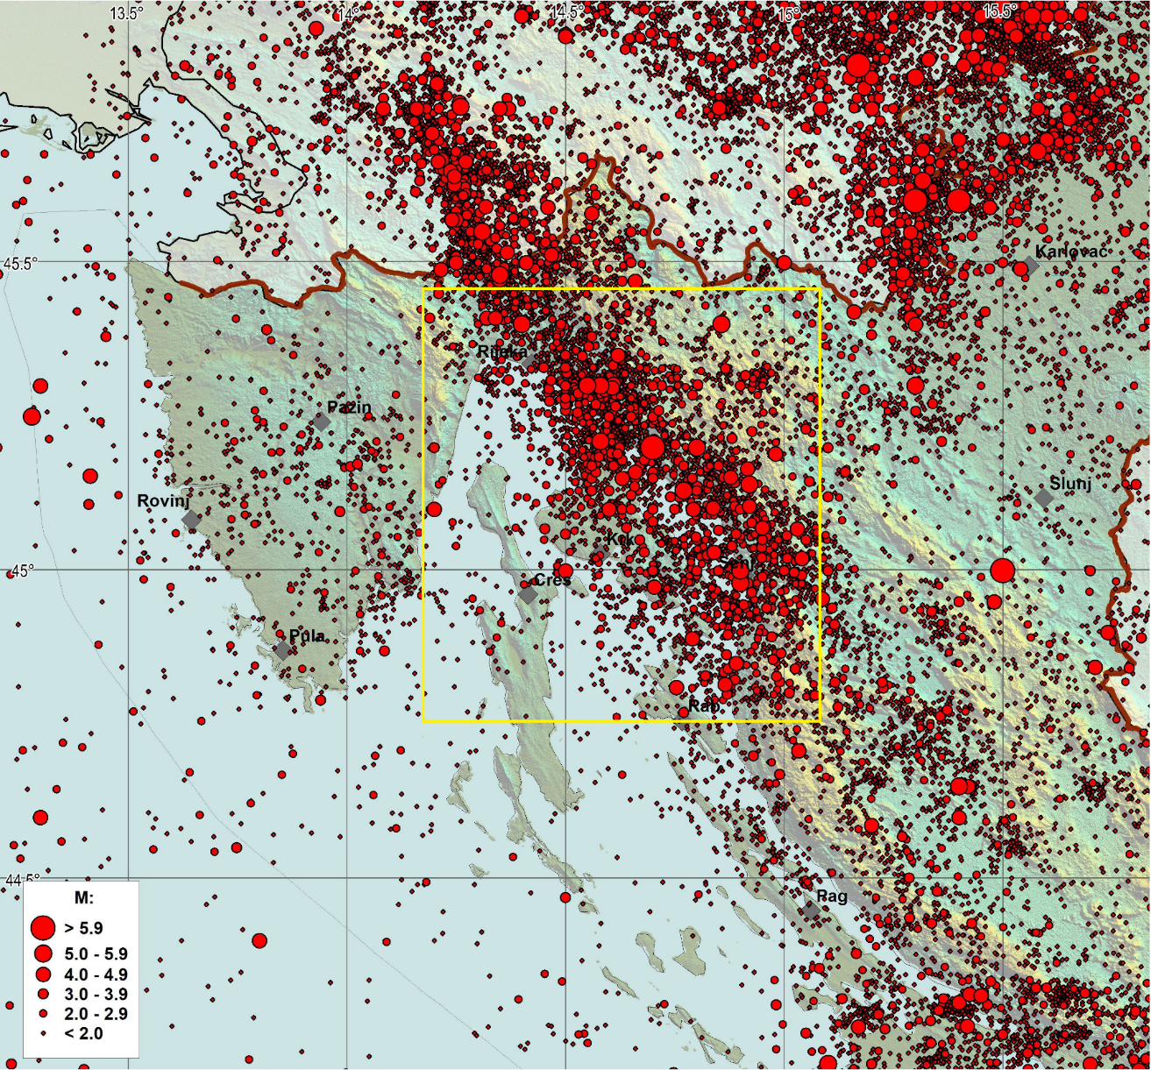
Regional seismicity (from Markušić et al., 2019) suggests that an active fault zone along NW part of the External Dinarides is generally striking NW-SE (Dinaric strike). We will focus on the NE Kvarner area (yellow frame).

Slide 4
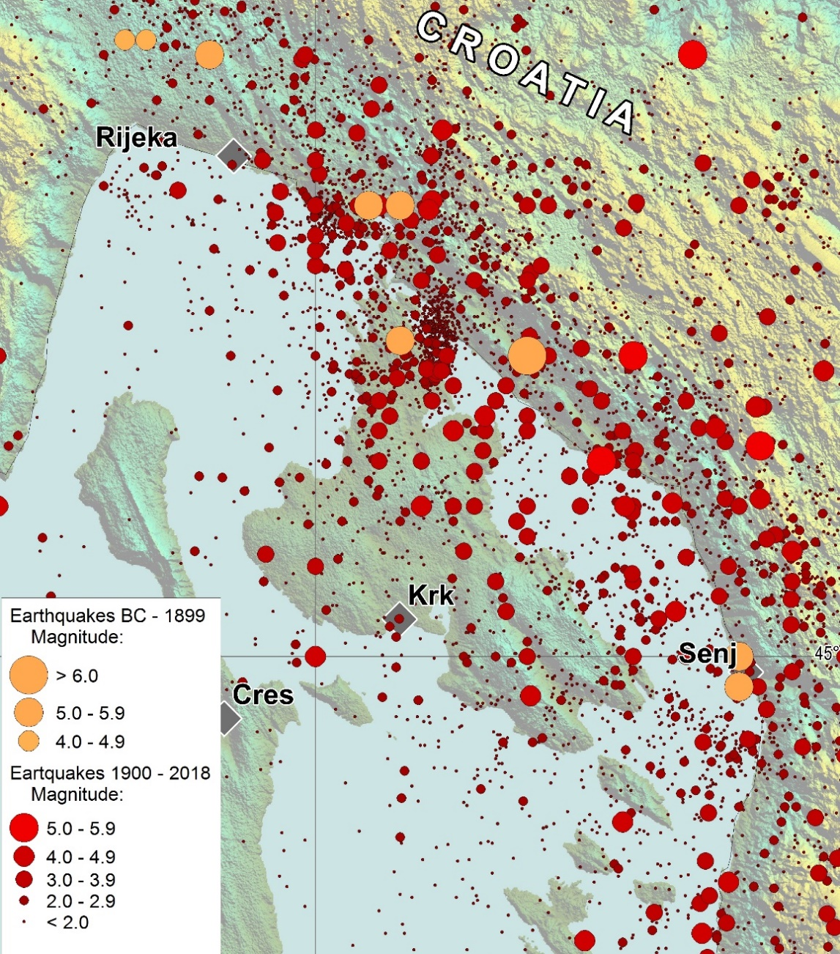
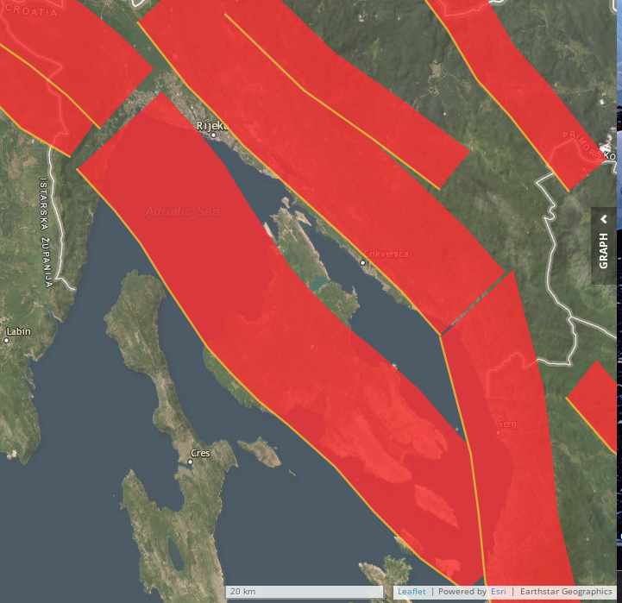
Local seismicity (from Korbar et al., 2020) and proposed composite seismogenic sources (EPOS; Kastelic et al., 2013). The latter (right picture) suggests NW-SE striking and NE dipping active faults in the area.

Slide 5
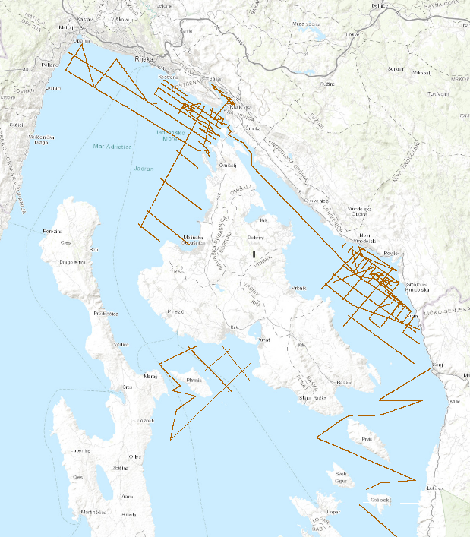
With the aim to check neotectonic deformations and possible surface faulting we acquired systematic shallow sub-bottom seismic survey (Hasan and Brunović, this paper) along the supposed active fault zones (tracklines).

Slide 6
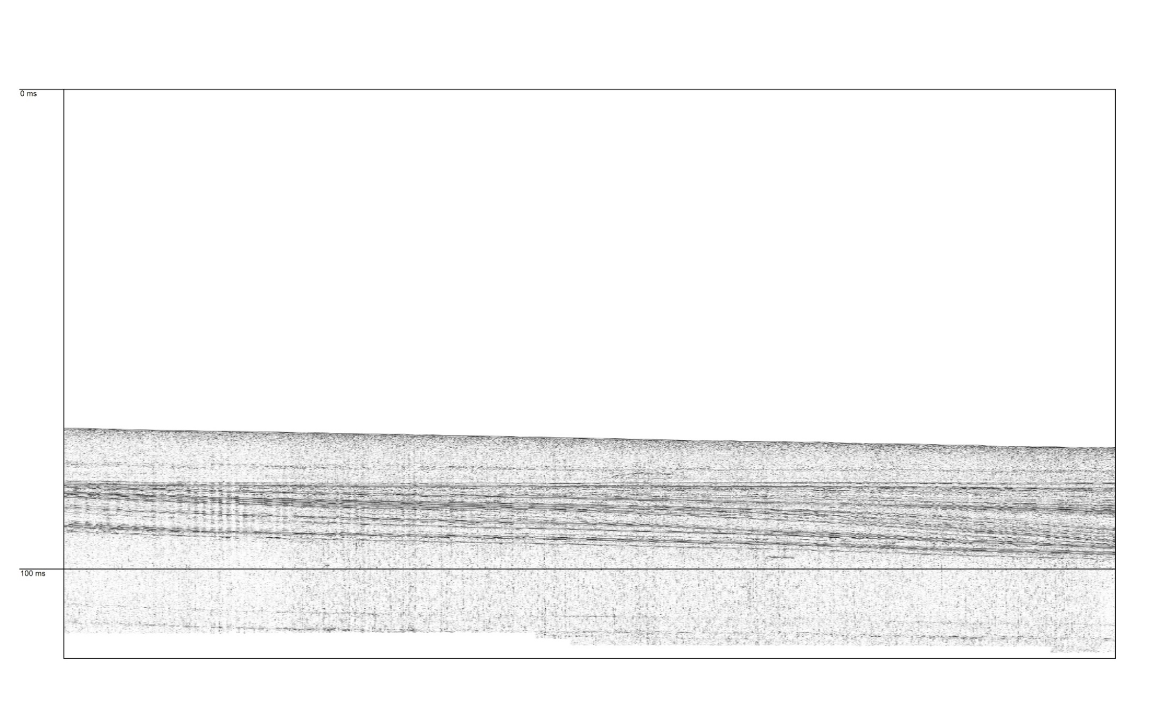
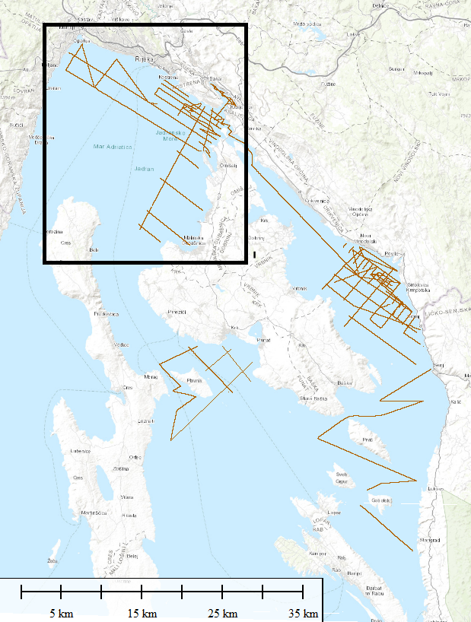
The Rijeka Bay seismic images have not revealed any active surface faulting (Hasan and Brunović, 2020 unpublished)...

Slide 7
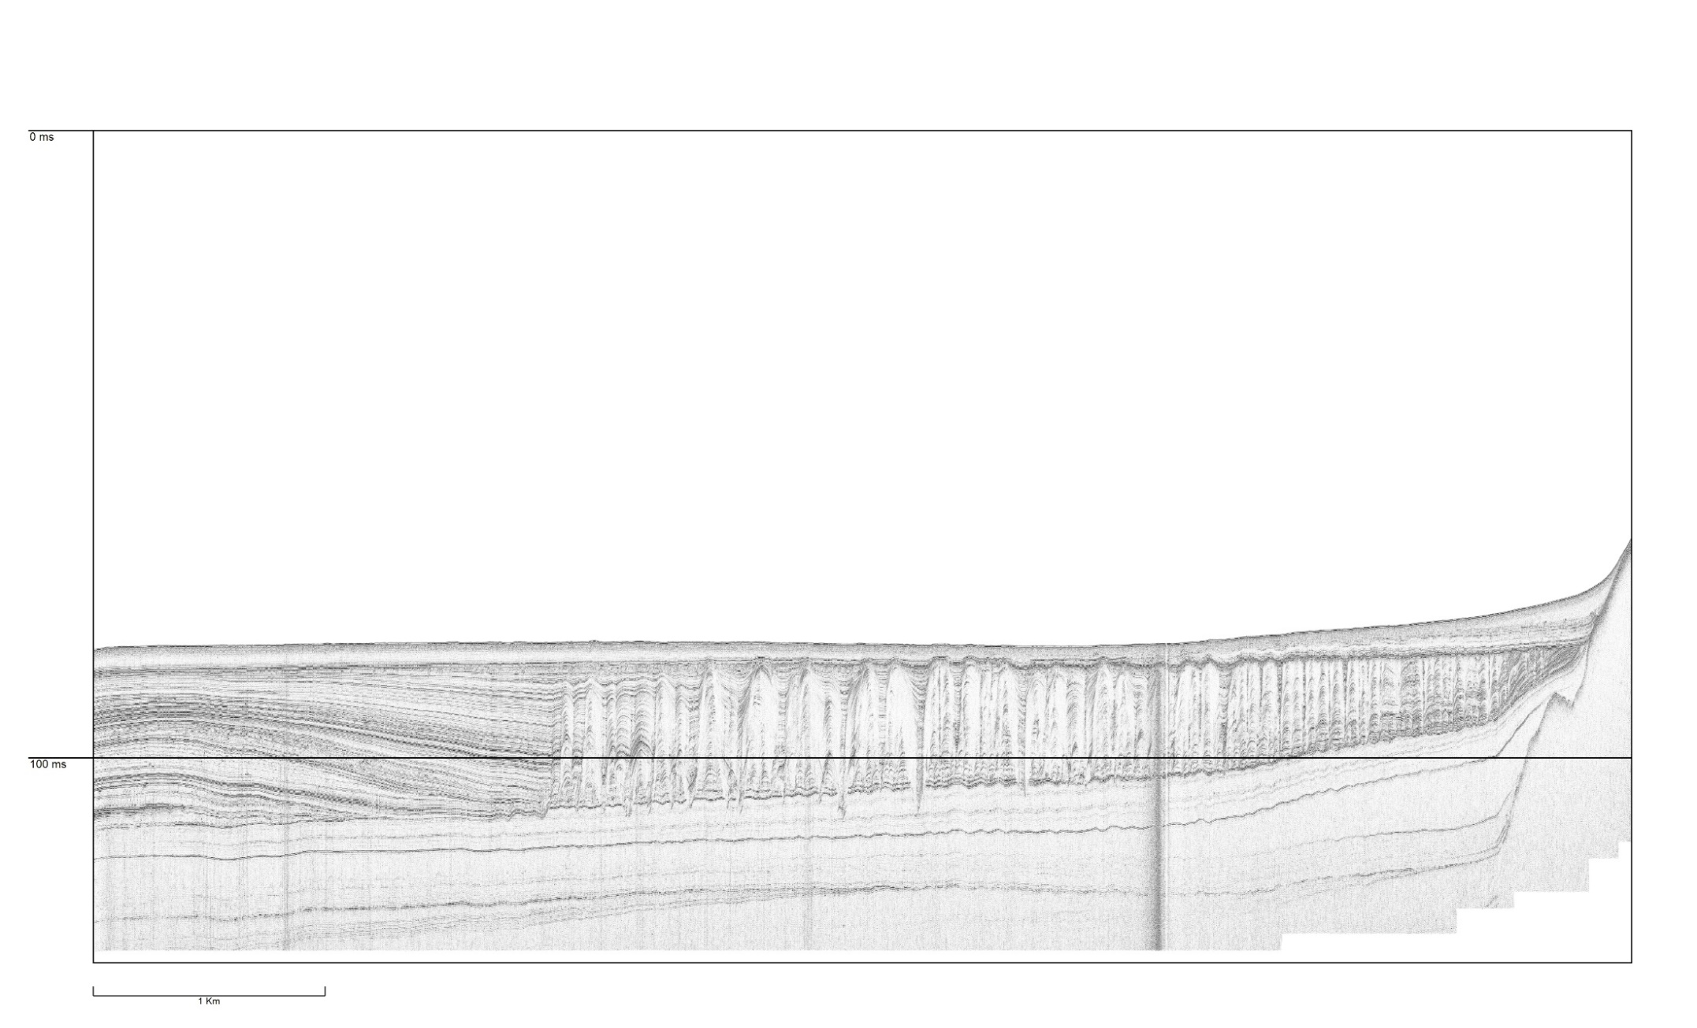
...but possible features related to LIQUEFACTION, OR!?...

Slide 8
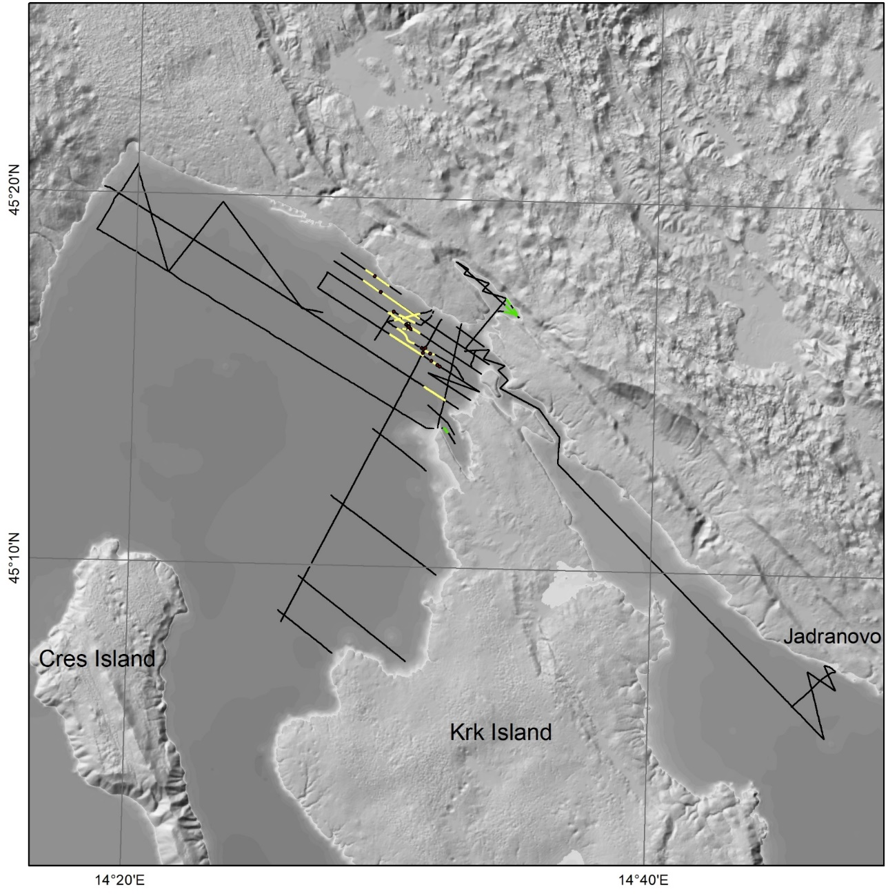
...along the Late Pleistocene Deformation Zone (yellow lines)...

Slide 9
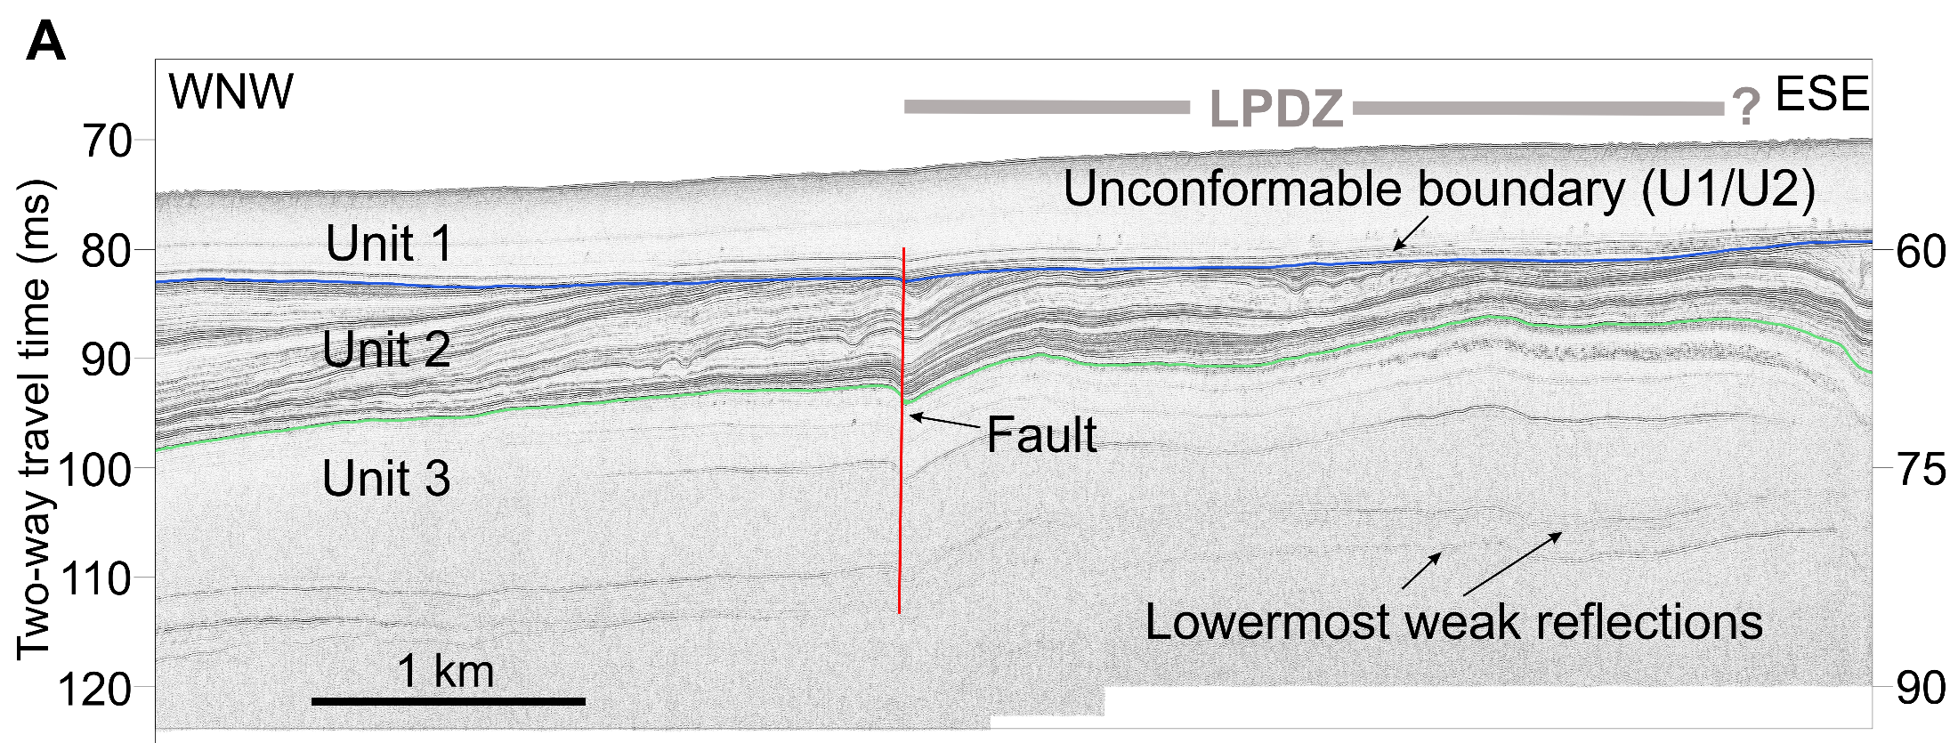
...that is characterized by Late Pleistocene faults that only partly affects older Holocene sediments and have no surface ruptures (Korbar et al., 2020), although muddy sediment can camuflage a small displacement the bottom.

Slide 10
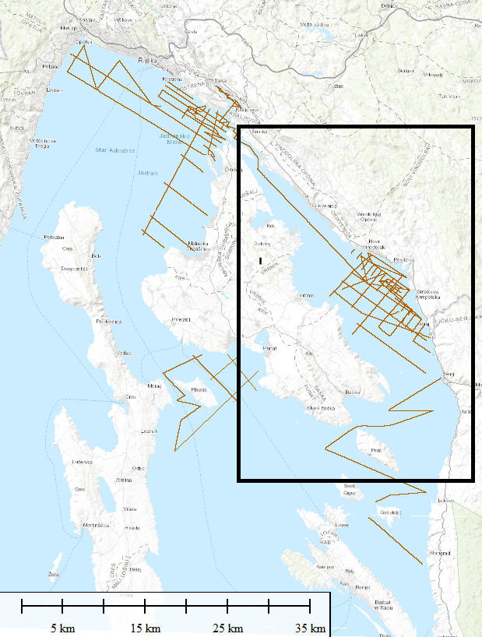
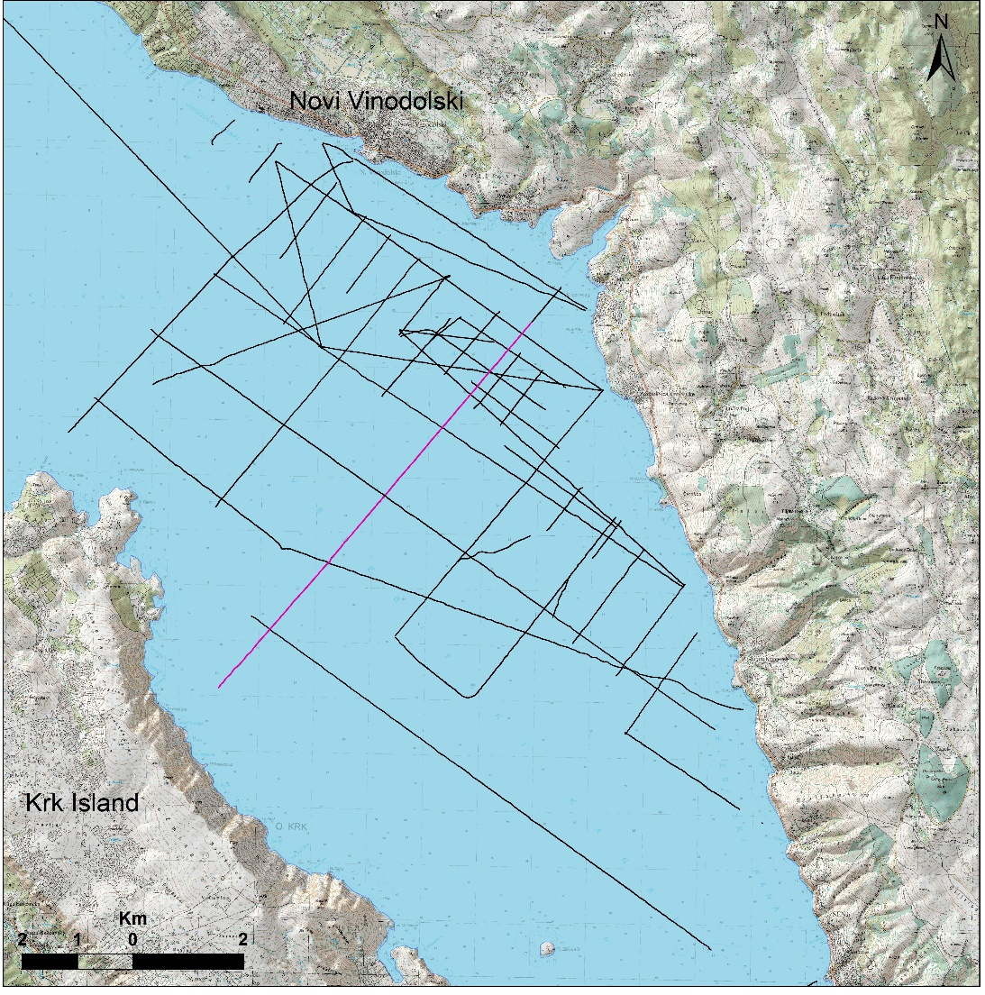
Thus, we focused on the Vinodol and Velebit channels that are characterized by detected bottom and sub-bottom faulting...

Slide 11
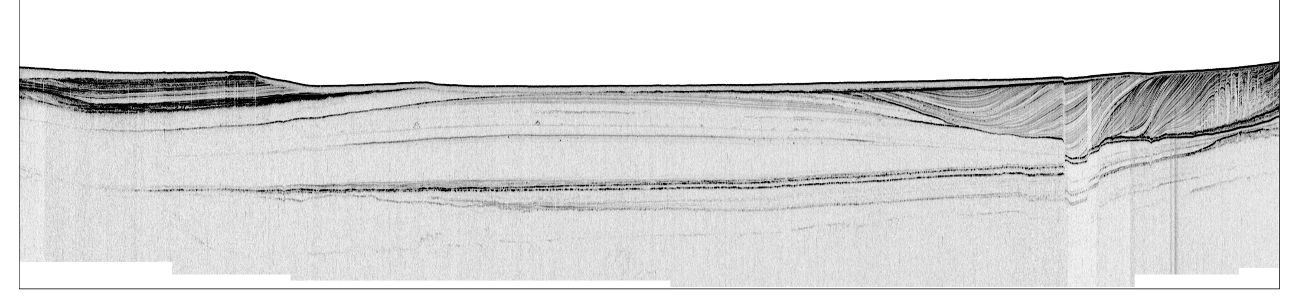
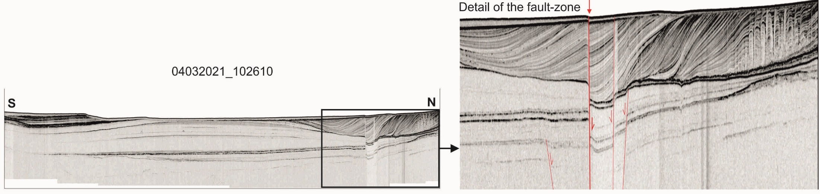
...along the fault zone up to a hundered meters wide...

Slide 12
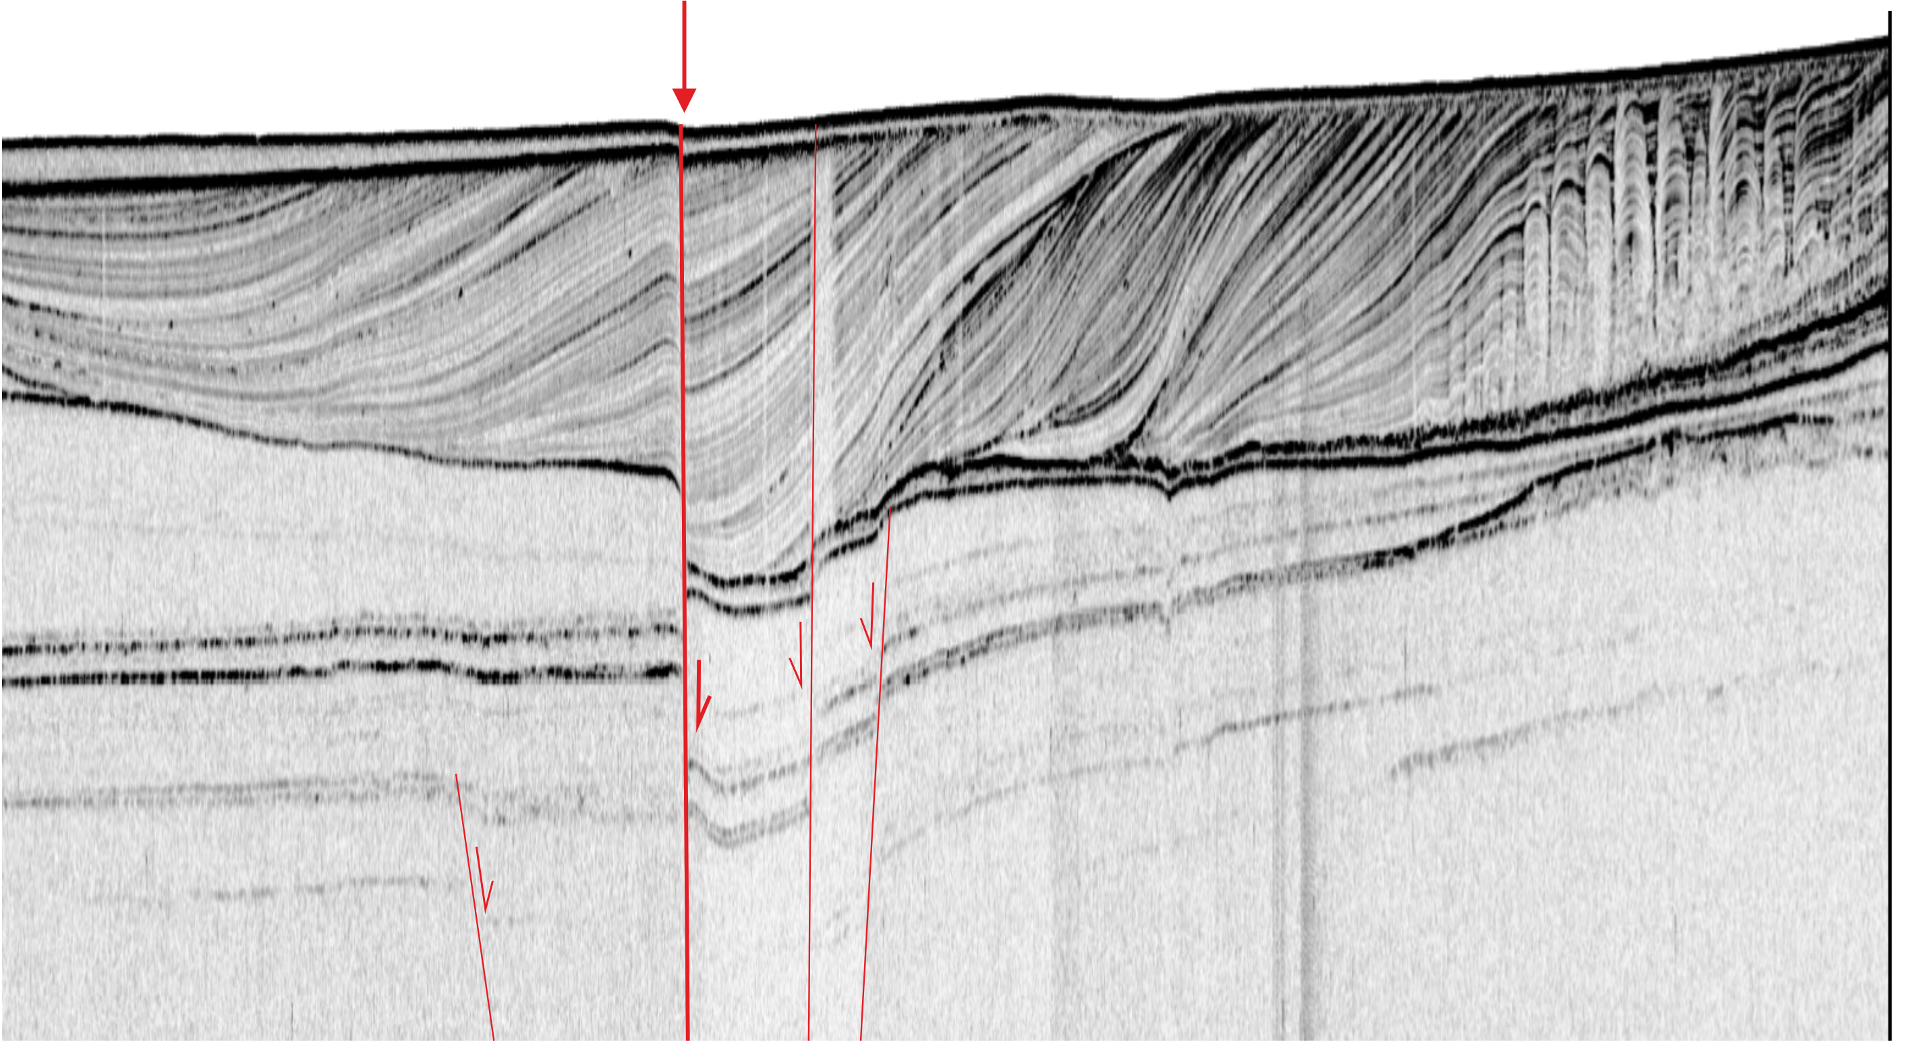
...and possible features related to LIQUEFACTION, i.e. high amplitude reflections within the Late Pleistocene topmost unit (on the right).

Slide 13
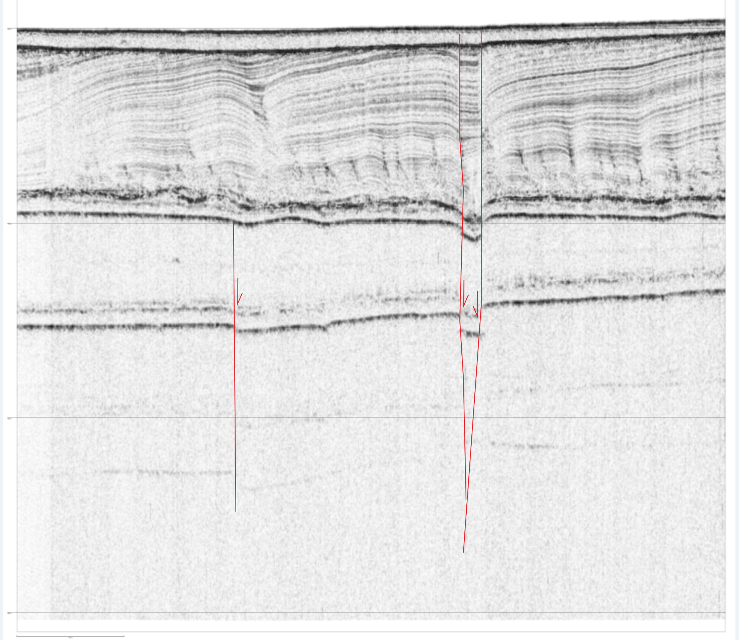
The fault zone is characterized mostly by downfaulted beds between the faults...

Slide 14
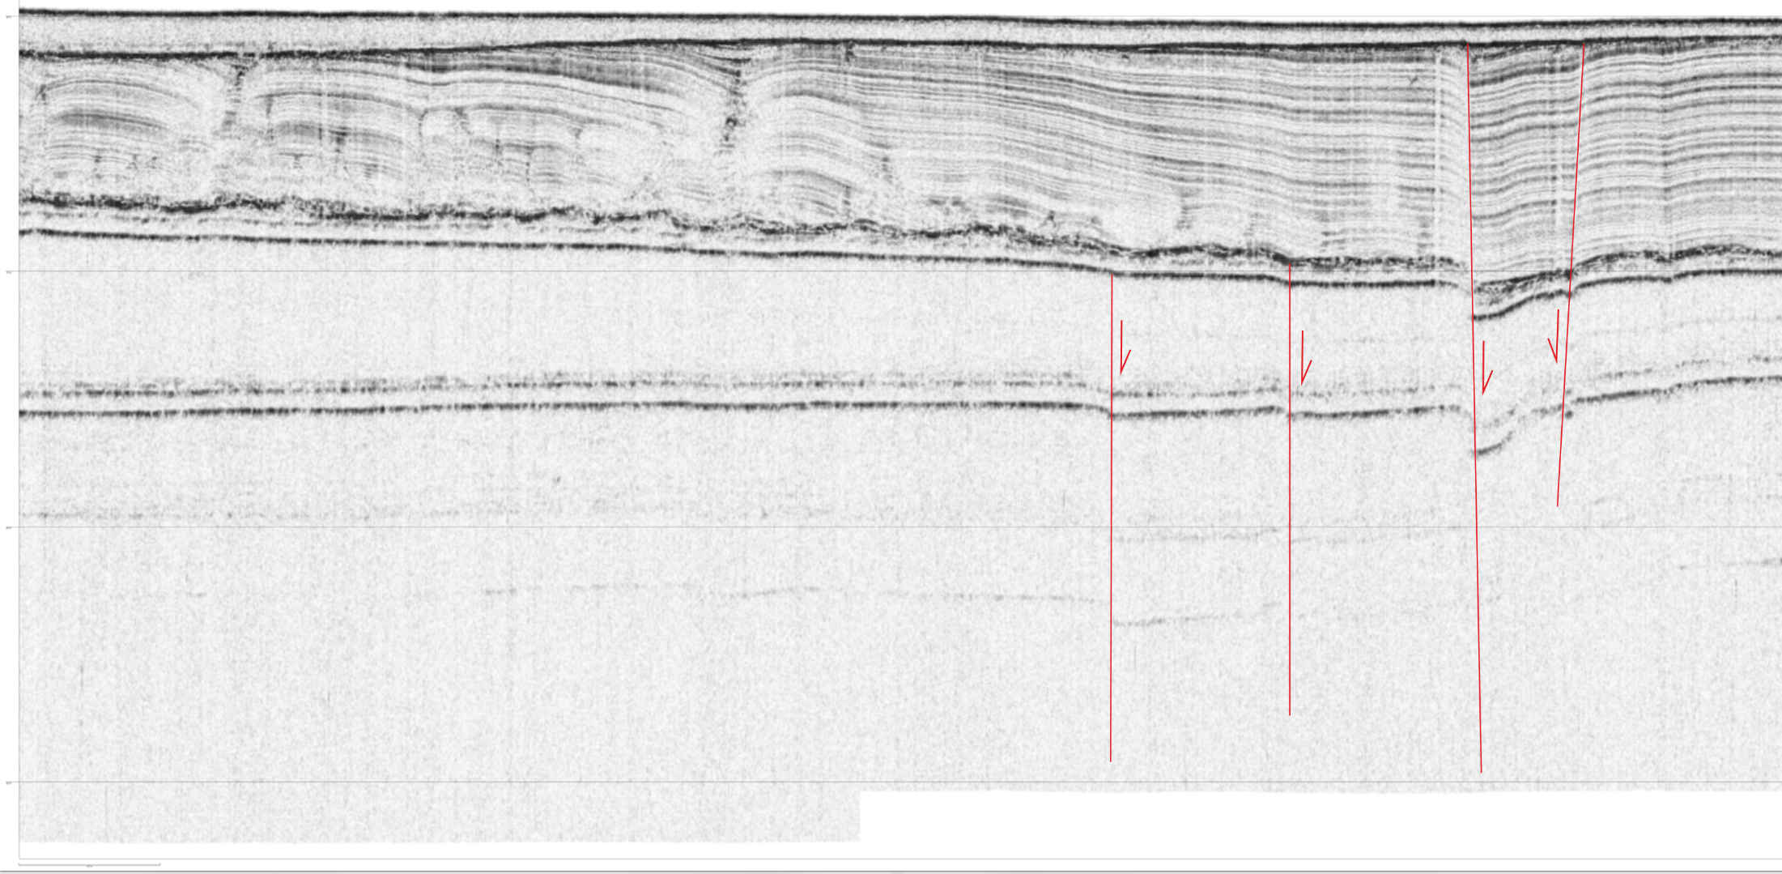
...since most profiles show downthrown beds between the faults...

Slide 15
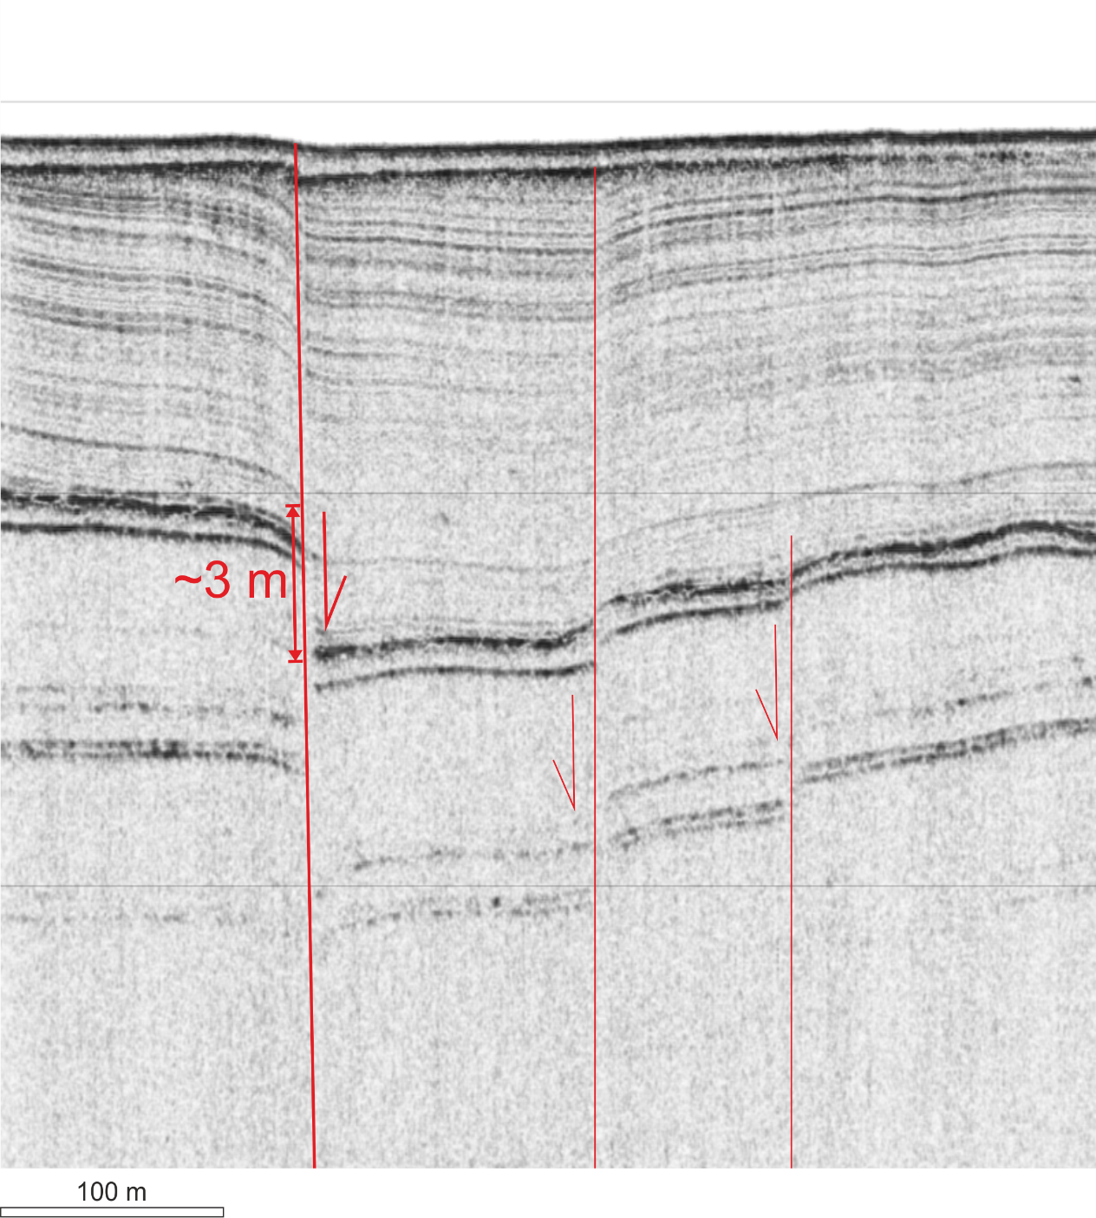
...and significant throw during the Late Pleistocene...

Slide 16
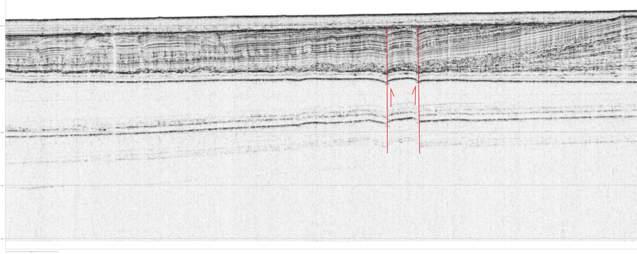
...but some also upthrown beds at the points along the zone where the faults cross-cut each other, that is typical for STRIKE-SLIP faults.

Slide 17
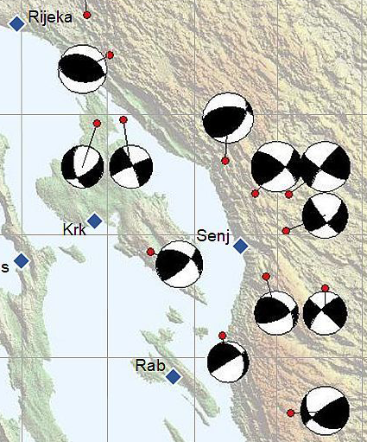
Fault mechanism solutions (FMS) in the area show NW-SE and NE-SW striking, predominantly strike-slip faults (Markušić et al., 2019).

Slide 18
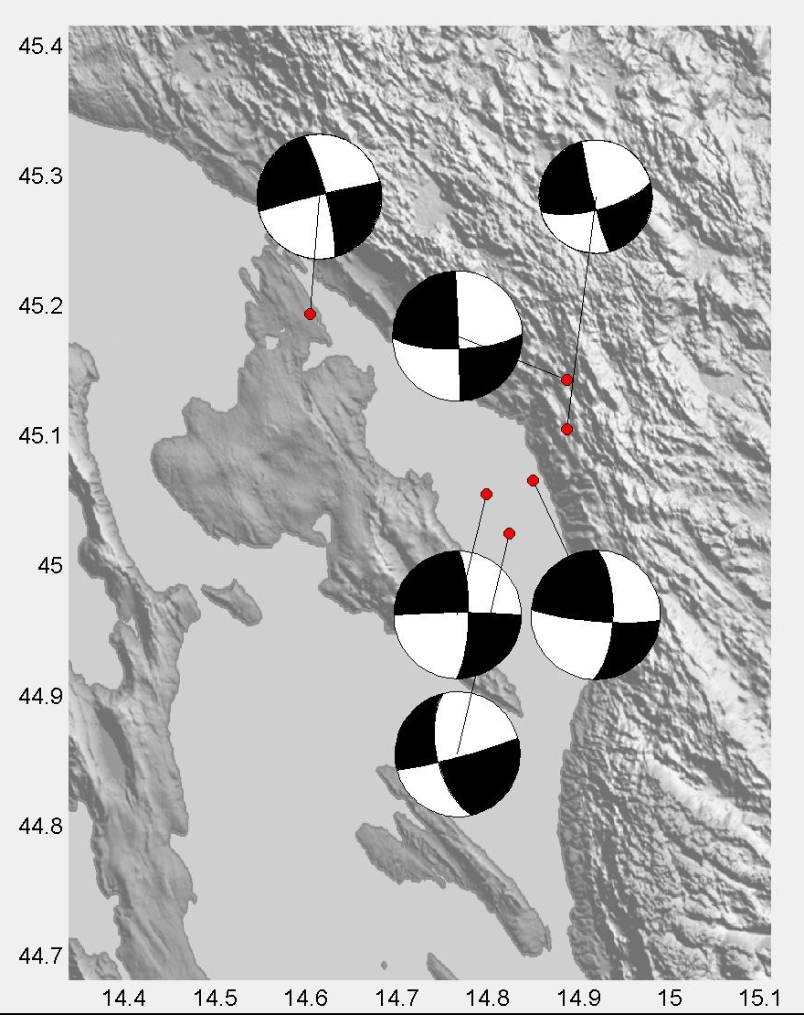
We focused on Vinodol-Velebit channels area, where updated FMS show only strike-slip faults characterized by strange NNW-SSE, N-S, W-E, and WSW-ENE strikes (Markušić, this paper)...

Slide 19
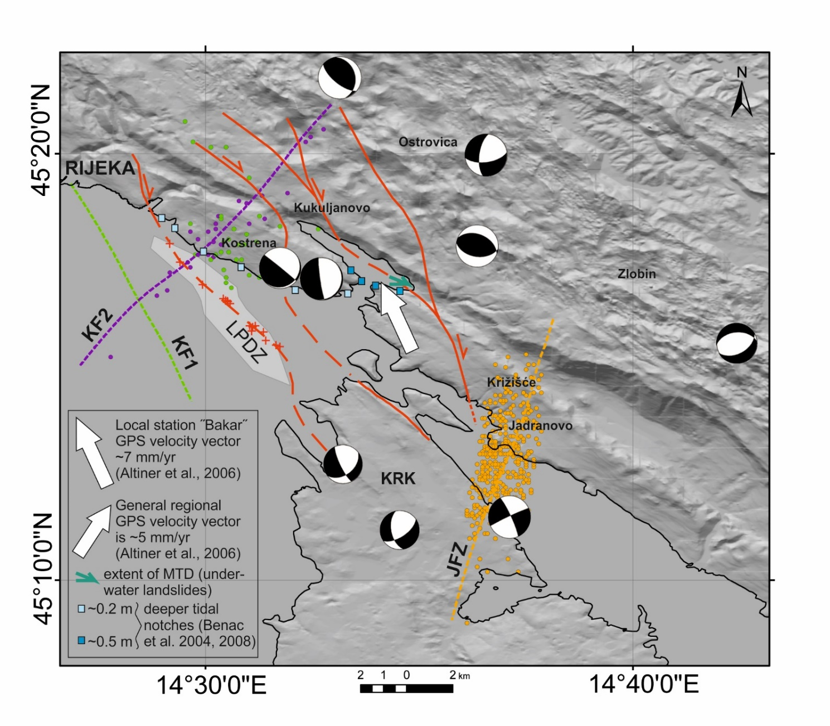
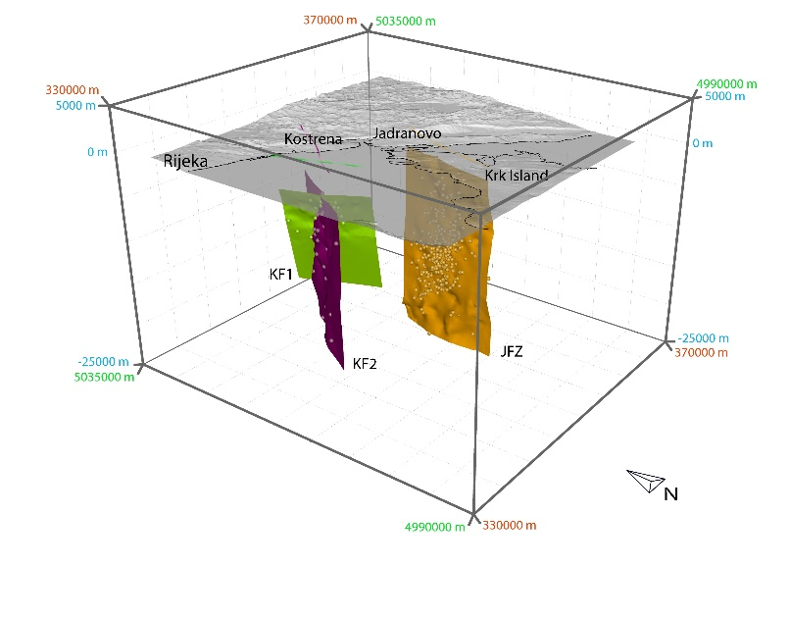
Thus, strike-slip fault detected in the Vinodol-Velebit channel could be SE continuation of the faults mapped in Jadranovo area. However, there is a discrepancy in the hypocenters, the faults, and FMSs (Korbar et al., 2020)...

Slide 20
...possibly due to deep crustal transversal faults recognized as the Kvarner fault zone, although the offshore data revealed its inactivity south of Istria (Kamenski and Korbar, 2023) while the faults in Vinodol-Velebit area are obviously active.

Slide 21
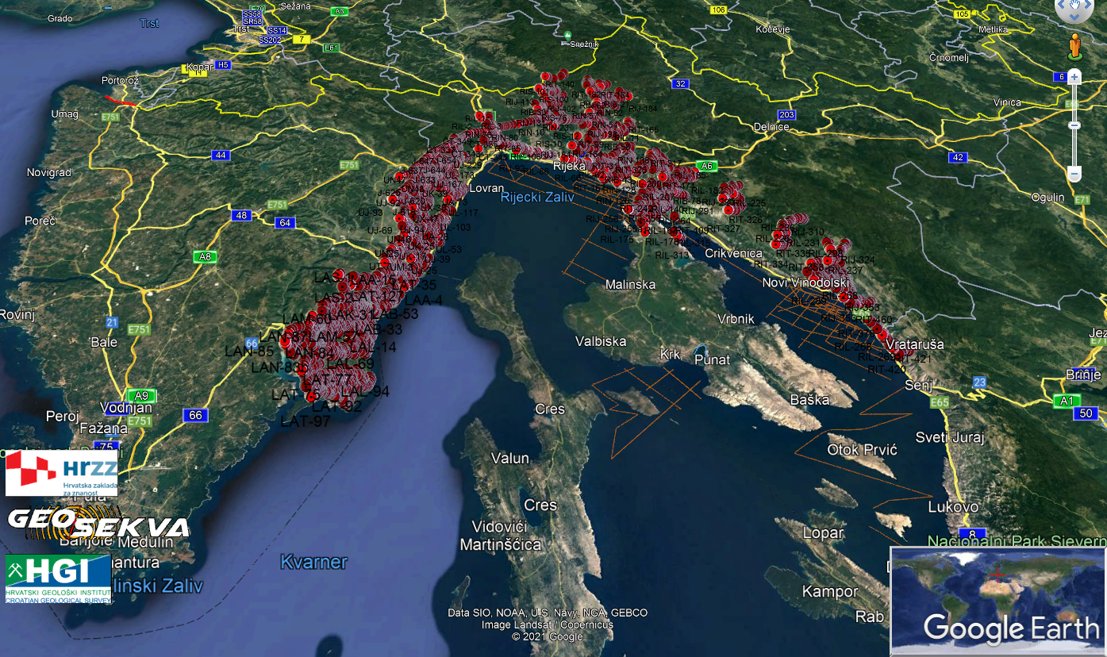
The presented results yield the first direct evidence of an active fault in this part of the External Dinarides (Korbar et al., in prep). This was part of a comprehensive research in the area within the past GEOSEKVA project.

Slide 22
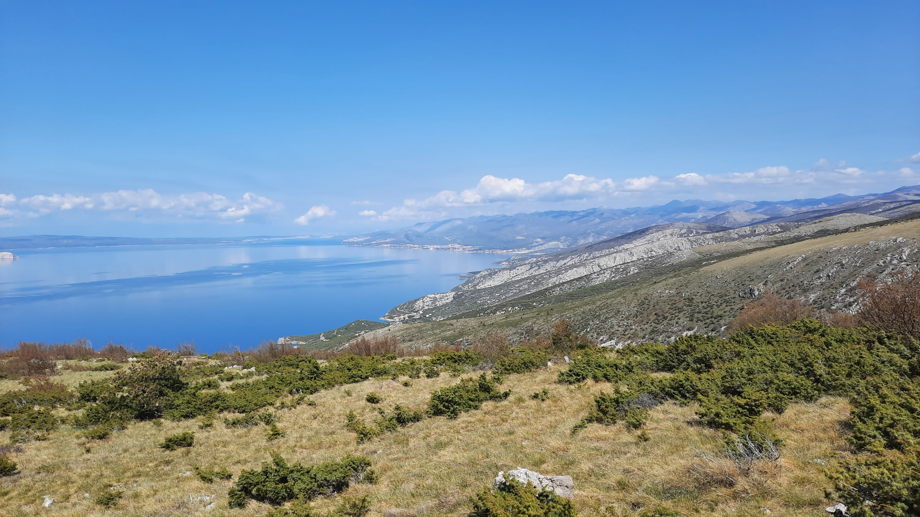
THANK YOU FOR YOUR ATTENTION AND POSSIBLE COMMENTS

Slide 23
HGI (2009). Geological map of the Republic of Croatia in scale 1:300.000. Hrvatski geološki institut - Croatian Geological Survey, available at http://webgis.hgi-cgs.hr/gk300/default.aspx
Kamenski A., Korbar T. (2023). Platform-to-Basin Evolution of a Tectonically Indistinct Part of a Multiple Foreland—Analysis of a 3D Seismic Block in the Northern Adriatic Sea (Croatian Offshore). Geosciences, 13(11):323. https://doi.org/10.3390/
Kastelic, V., Vannoli, P., Burrato, P., Fracassi, U., Tiberti, M.M. and Valensise, G. (2013). Seismogenic sources in the Adriatic Domain. Mar. Petrol. Geol. 42, 191–213. doi: 10.1016/j.marpetgeo.2012.08.002.
Korbar, T., 2009. Orogenic evolution of the External Dinarides in the NE Adriatic region: a model constrained by tectonostratigraphy of Upper Cretaceous to Paleogene carbonates. Earth-Science Reviews, 96, 4, 296-312. https://doi.org/10.1016/j.earscirev.2009.07.004
Korbar, T., Markušić, S., Hasan, O., Fuček, L., Brunović, D., Belić, N., Palenik, D., Kastelic, V. (2020). Active Tectonics in the Kvarner Region (External Dinarides, Croatia)—An Alternative Approach Based on Focused Geological Mapping, 3D Seismological, and Shallow Seismic Imaging Data. Front. Earth Sci. 8: 582797. https://doi.org/10.3389/feart.2020.582797.
Markušić, S., Stanko, D., Korbar, T. and Sović, I. (2019). Estimation of near-surface attenuation in the tectonically complex contact area of the northwestern External Dinarides and the Adriatic foreland. Nat. Hazards Earth Syst. Sci. 19, 2701–2714.
Picha, F.J. (2002). Late orogenic strike-slip faulting and escape tectonics in frontal Dinarides-Hellenides, Croatia, Yugoslavia, Albania and Greece. AAPG Bulletin 86/9, 1659–1671.
SELECTED REFERENCES

