Slide 1
Maximum depositional age and provenance of the Cretaceous Icheonri Formation in southeast Korea
using detrital zircon U-Pb dating
Ga-Yeon Kim¹, Yong-Un Chae^{1,2}, Young Ji Joo², Taejin Choi³, Hyoun Soo Lim¹
¹ Pusan National University
² Pukyong National University
³ Korea National University of Education

Slide 2
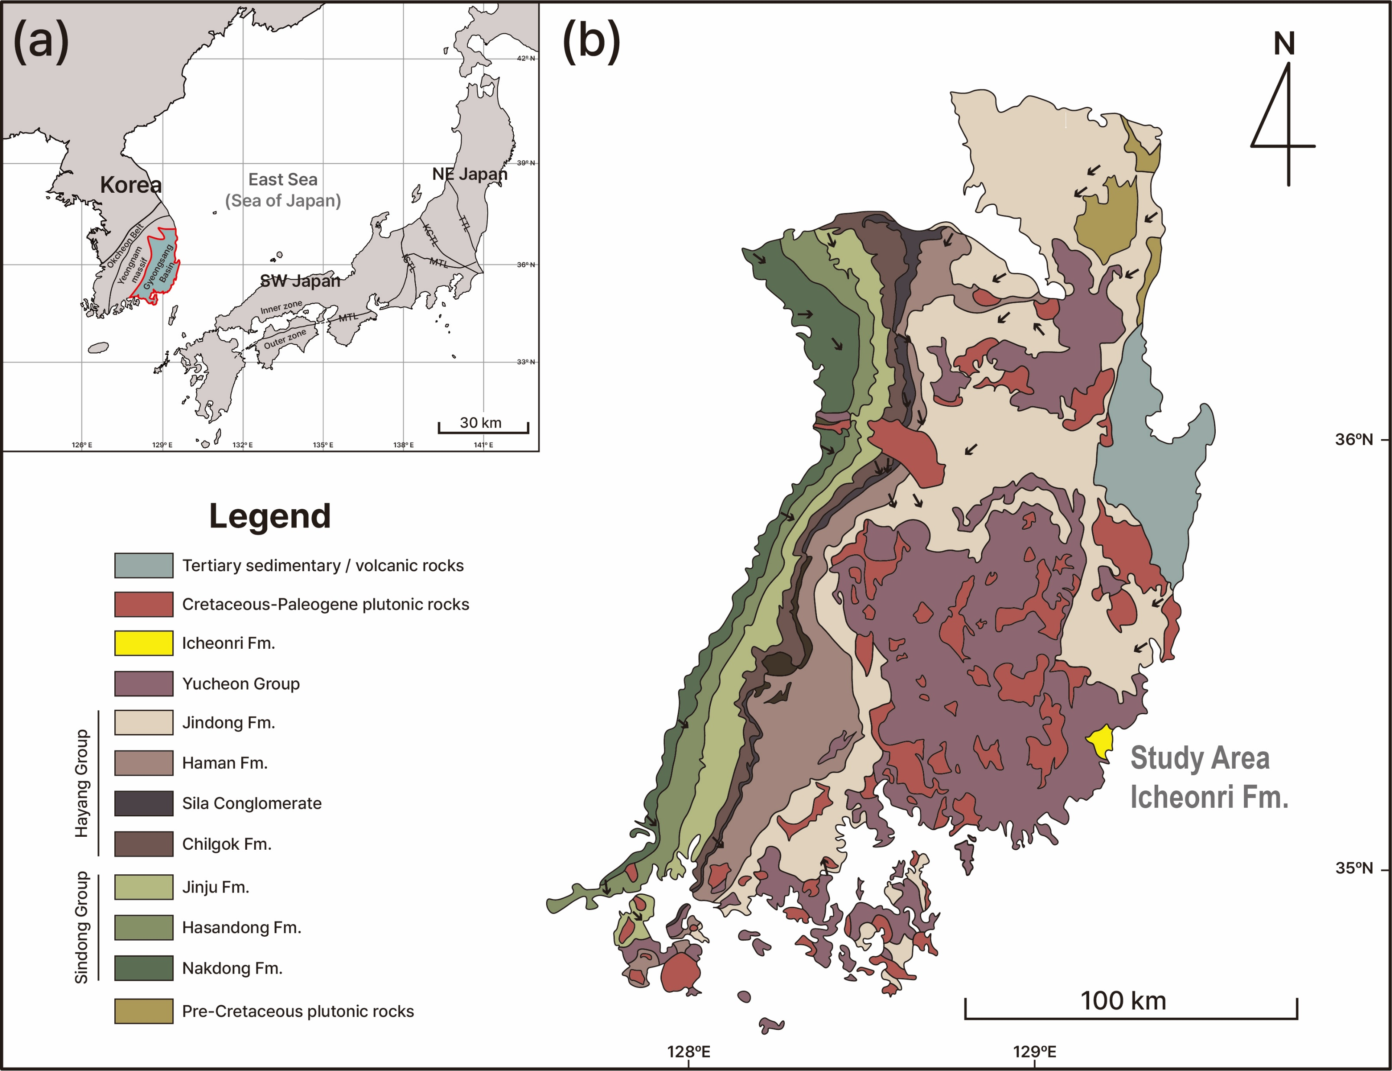
01. INTRODUCTION
지역 사회 개발 계획
The Gyeongsang Basin
A Cretaceous non-marine sedimentary basin
Stratigraphically divided into 4 Groups
중대재해 예방 추진체계 프로세스
The Yucheon Group
Chronostratigraphic correlation is difficult!
The Icheonri Formation is located in the region, limited research on age dating and a lack of correlation
Dominant volcanic materials
Some volcanic materials
Radiolarian-bearing chert pebbles (deep-sea environment)
Source rocks have not been reported in Korea -> SW Japan
increasing interest in its provenance
Few volcanic materials
Fig. 1. (a) The geographical location of East Asia. red line indicating the Gyeongsang Basin. (b) A simplified geological map of the Gyeongsang Basin. Arrows indicate the direction of paleocurrents (modified Lee et al., 2018; Lee et al., 2023).
Detrital zircon
U-Pb dating
calculate the maximum depositional age
interpret its provenance
AIMS
EGU24-15199

Slide 3
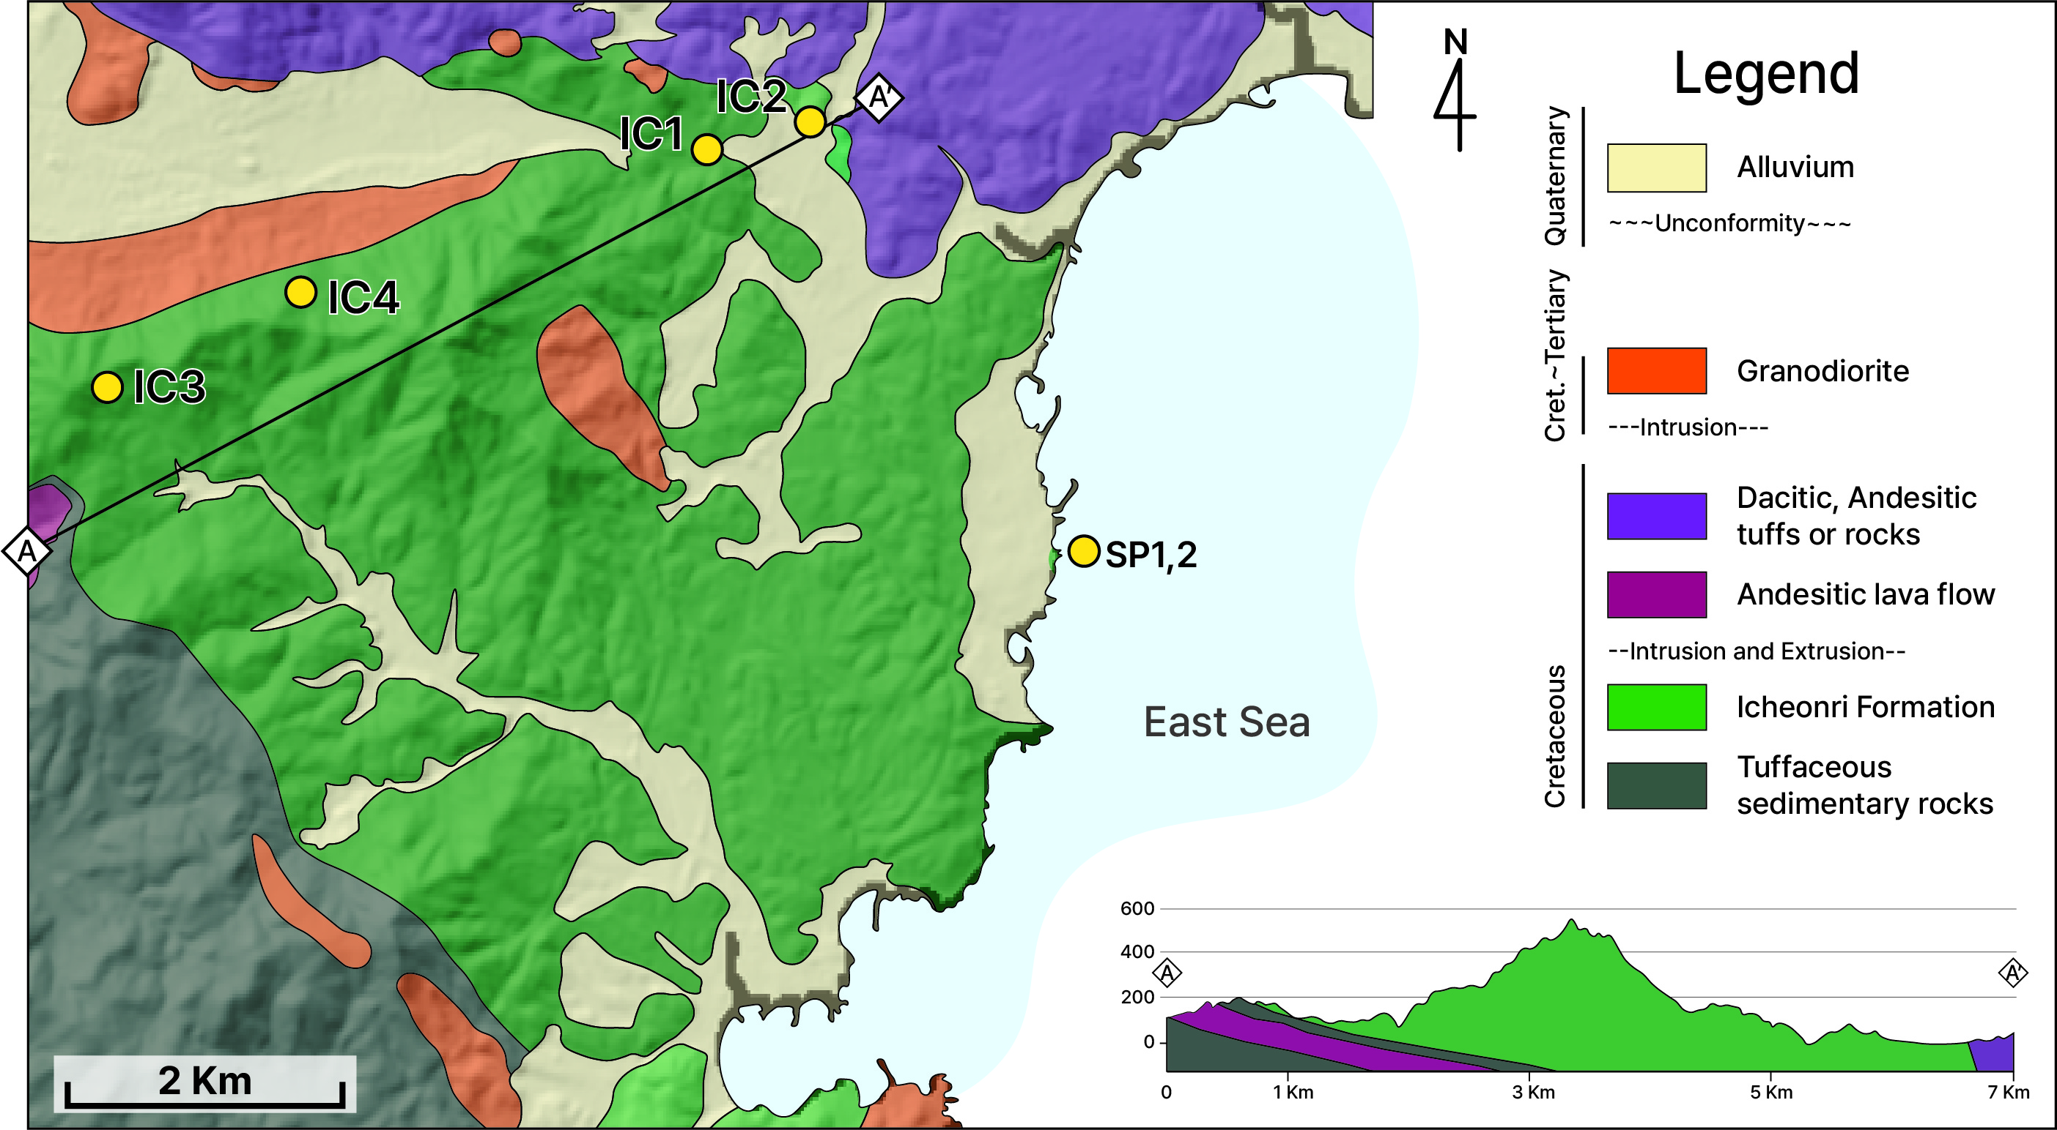
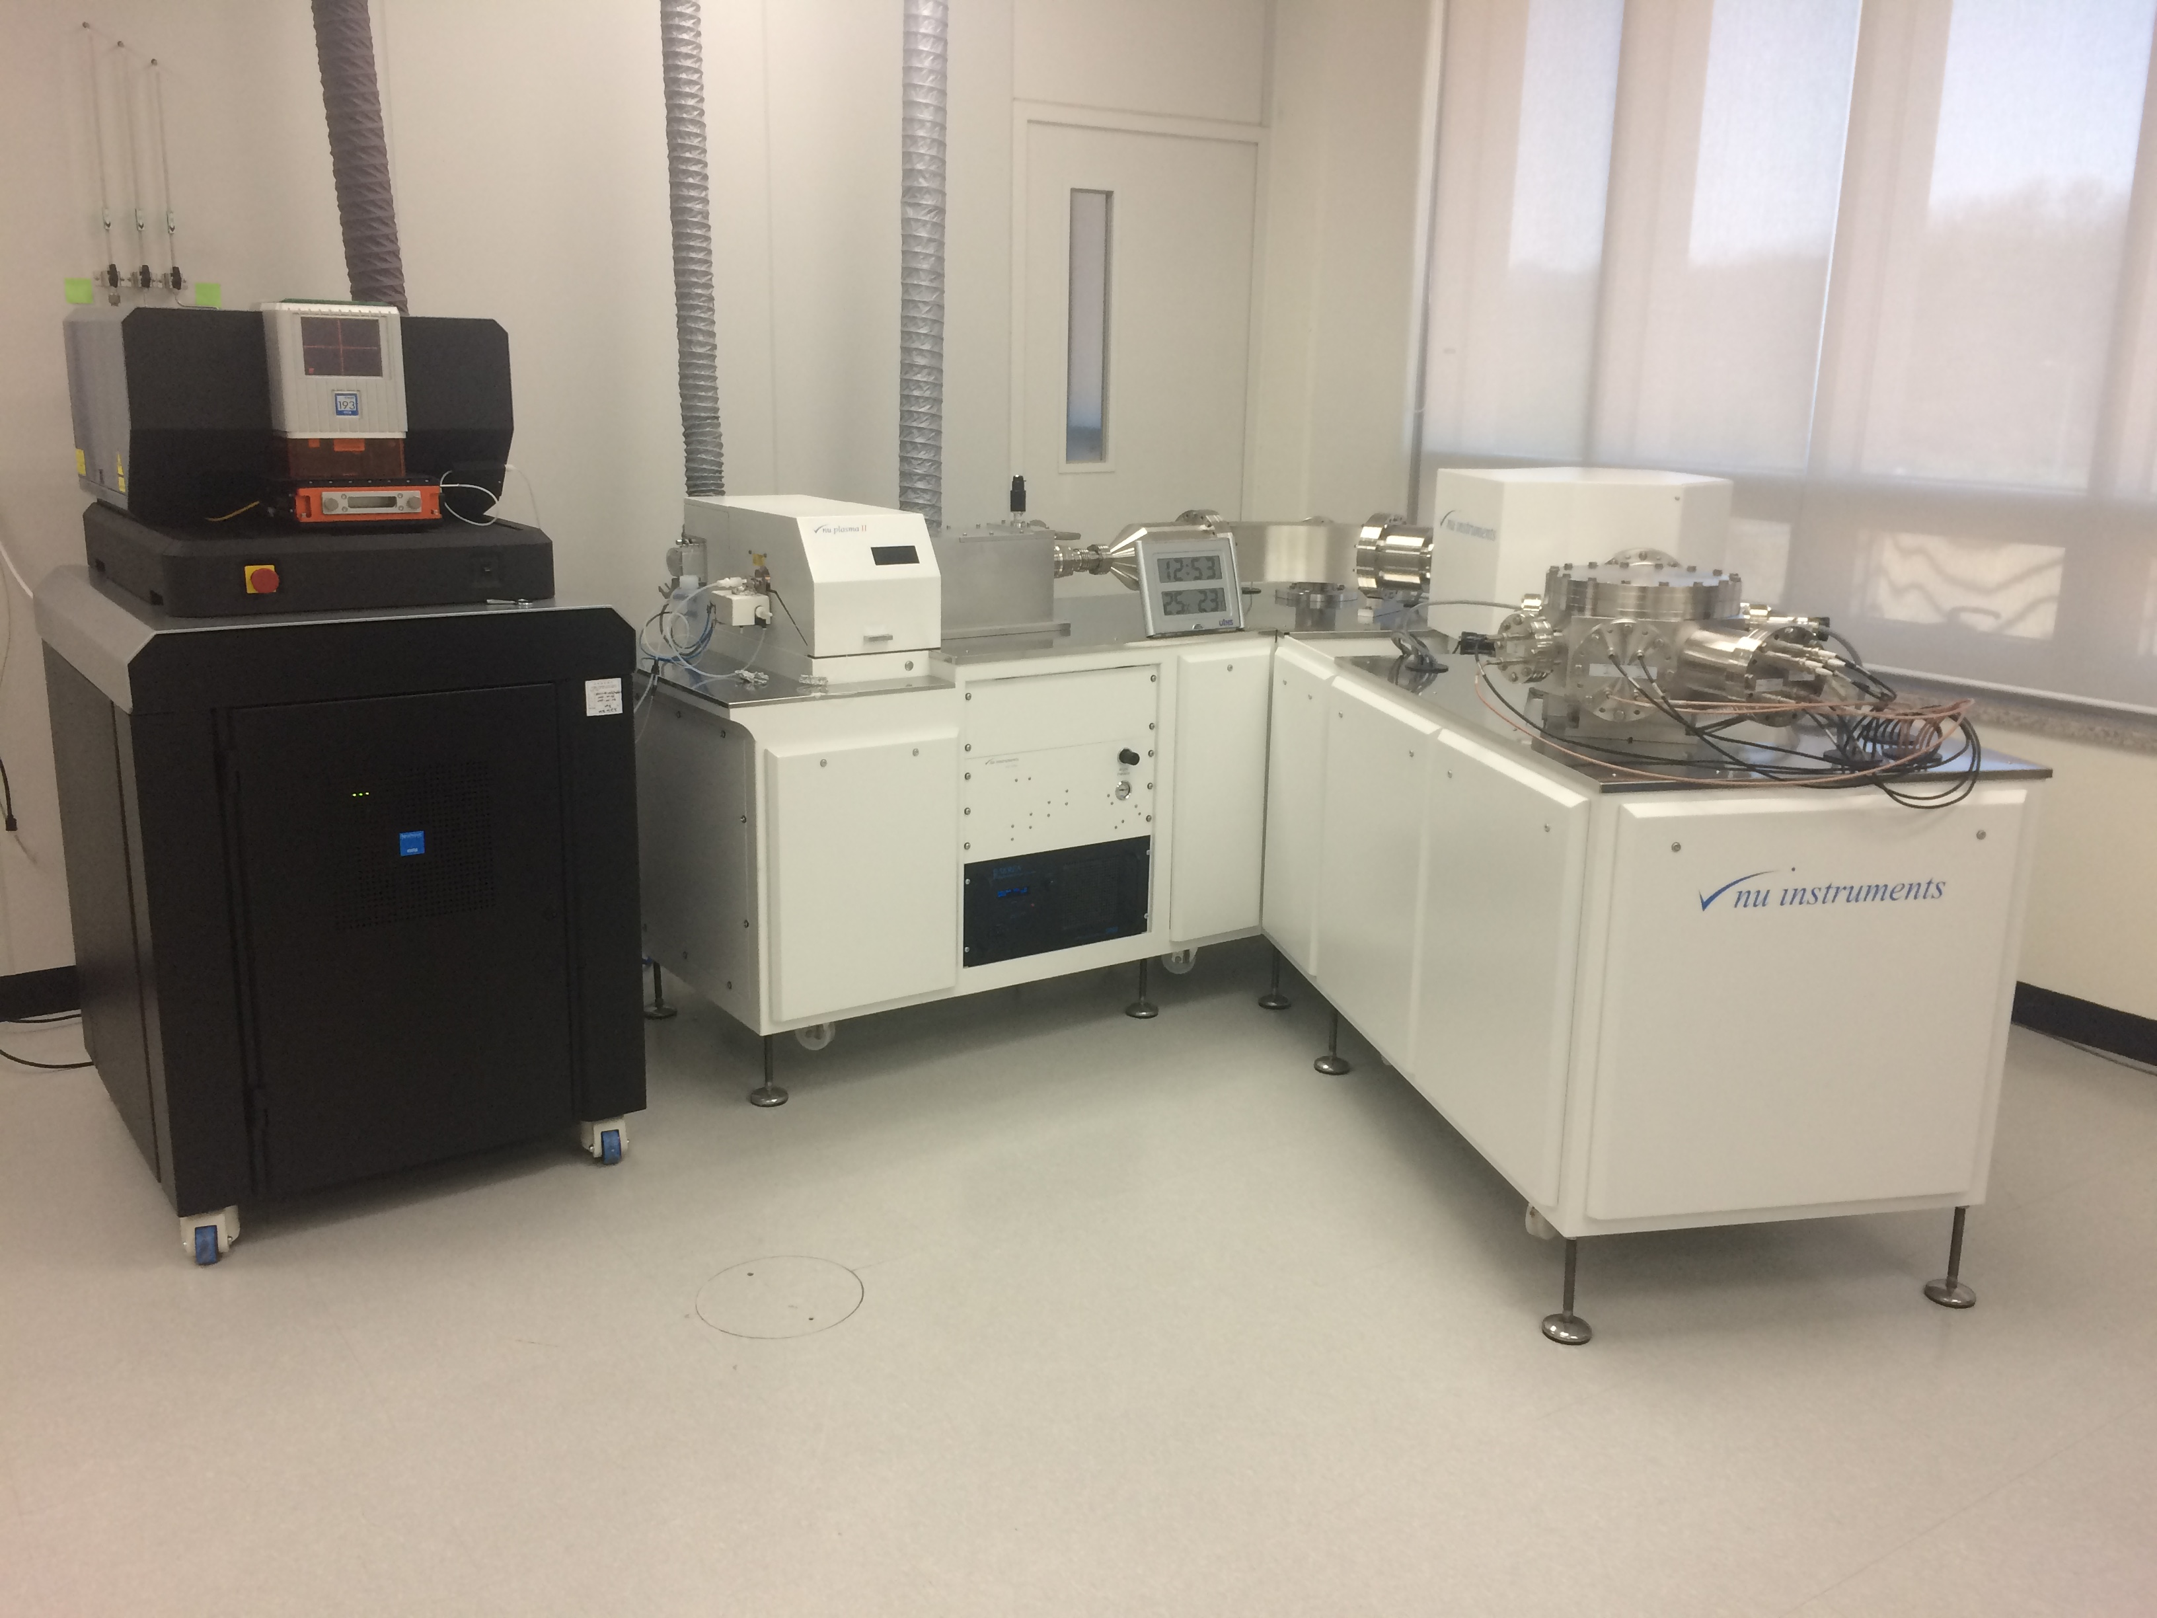
02. STUDY AREA & METHOD
지역 사회 개발 계획
The Icheonri Formation
shale, sandstone, and conglomerate with significant alteration (hornfels) by surrounding igneous rocks
Recent research focuses on coastal outcrops (lower part)
Previous study: around 96 Ma for one sample, but the age distribution is not published
중대재해 예방 추진체계 프로세스
(Sea of Japan)
Fig. 2. A geological map of the Icheonri Formation with cross-section. Yellow circles represent sampling spots (modified from Son et al., 1978; Kang, 2014a; Kang et al., 2014b).
We intend to conduct age dating in stratigraphically the middle and upper inland regions, including the lower coastal outcrops.
Total 6 samples
Age dating (5): SP1, 2 / IC1, IC2, IC3 (not yet)
XRD analysis : IC4 (uncertain lithology)
Sampling
Zircon separation
Mounting in epoxy and Polishing
SEM: CL, BSE (analysis spots)
LA-MC-ICPMS (U-Pb, 10㎛)
Processing raw data and Calculate ages
EGU24-15199

Slide 4
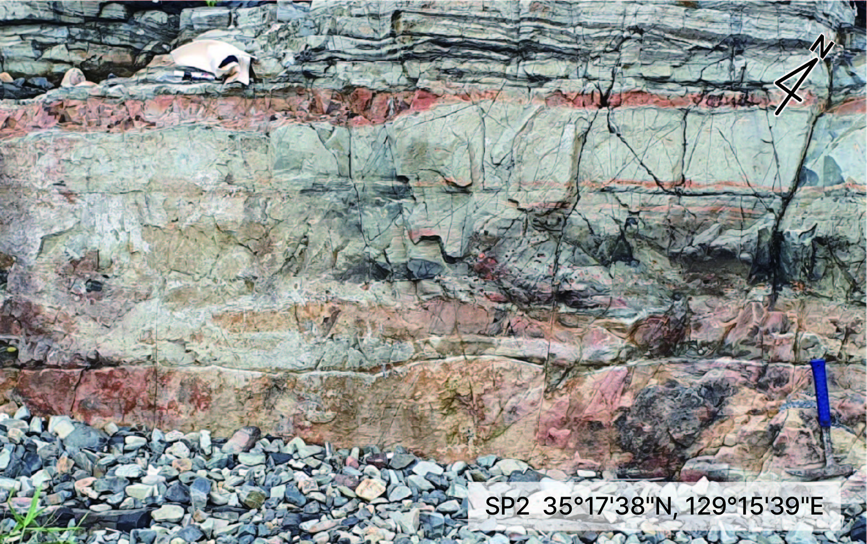
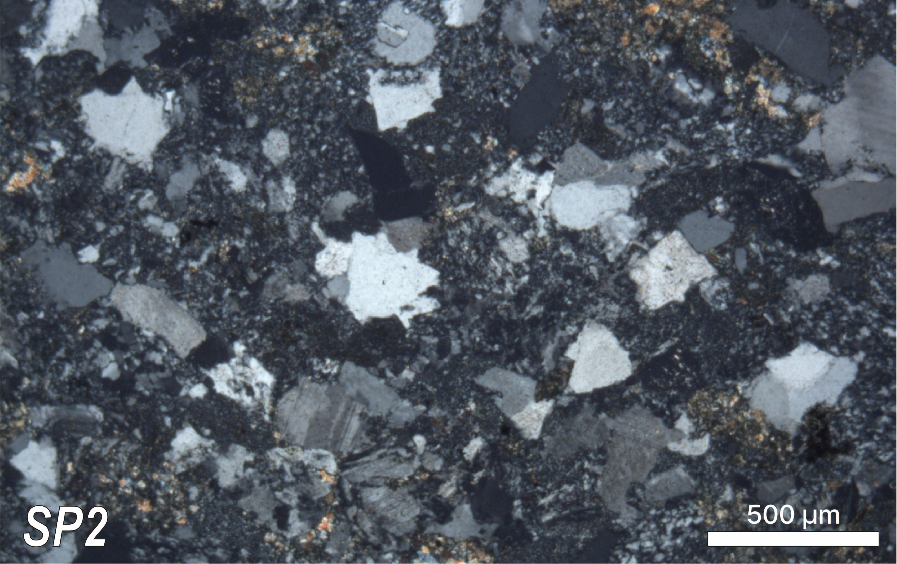
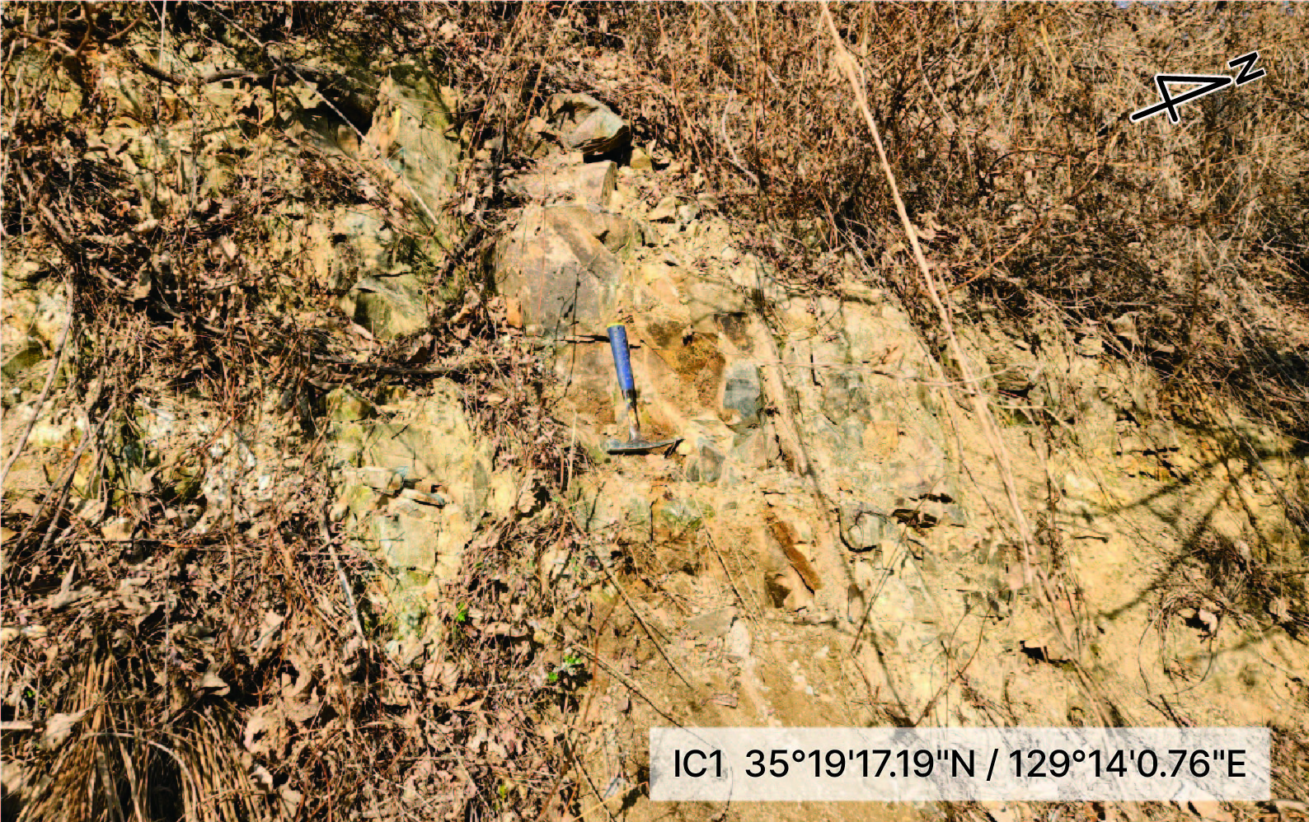
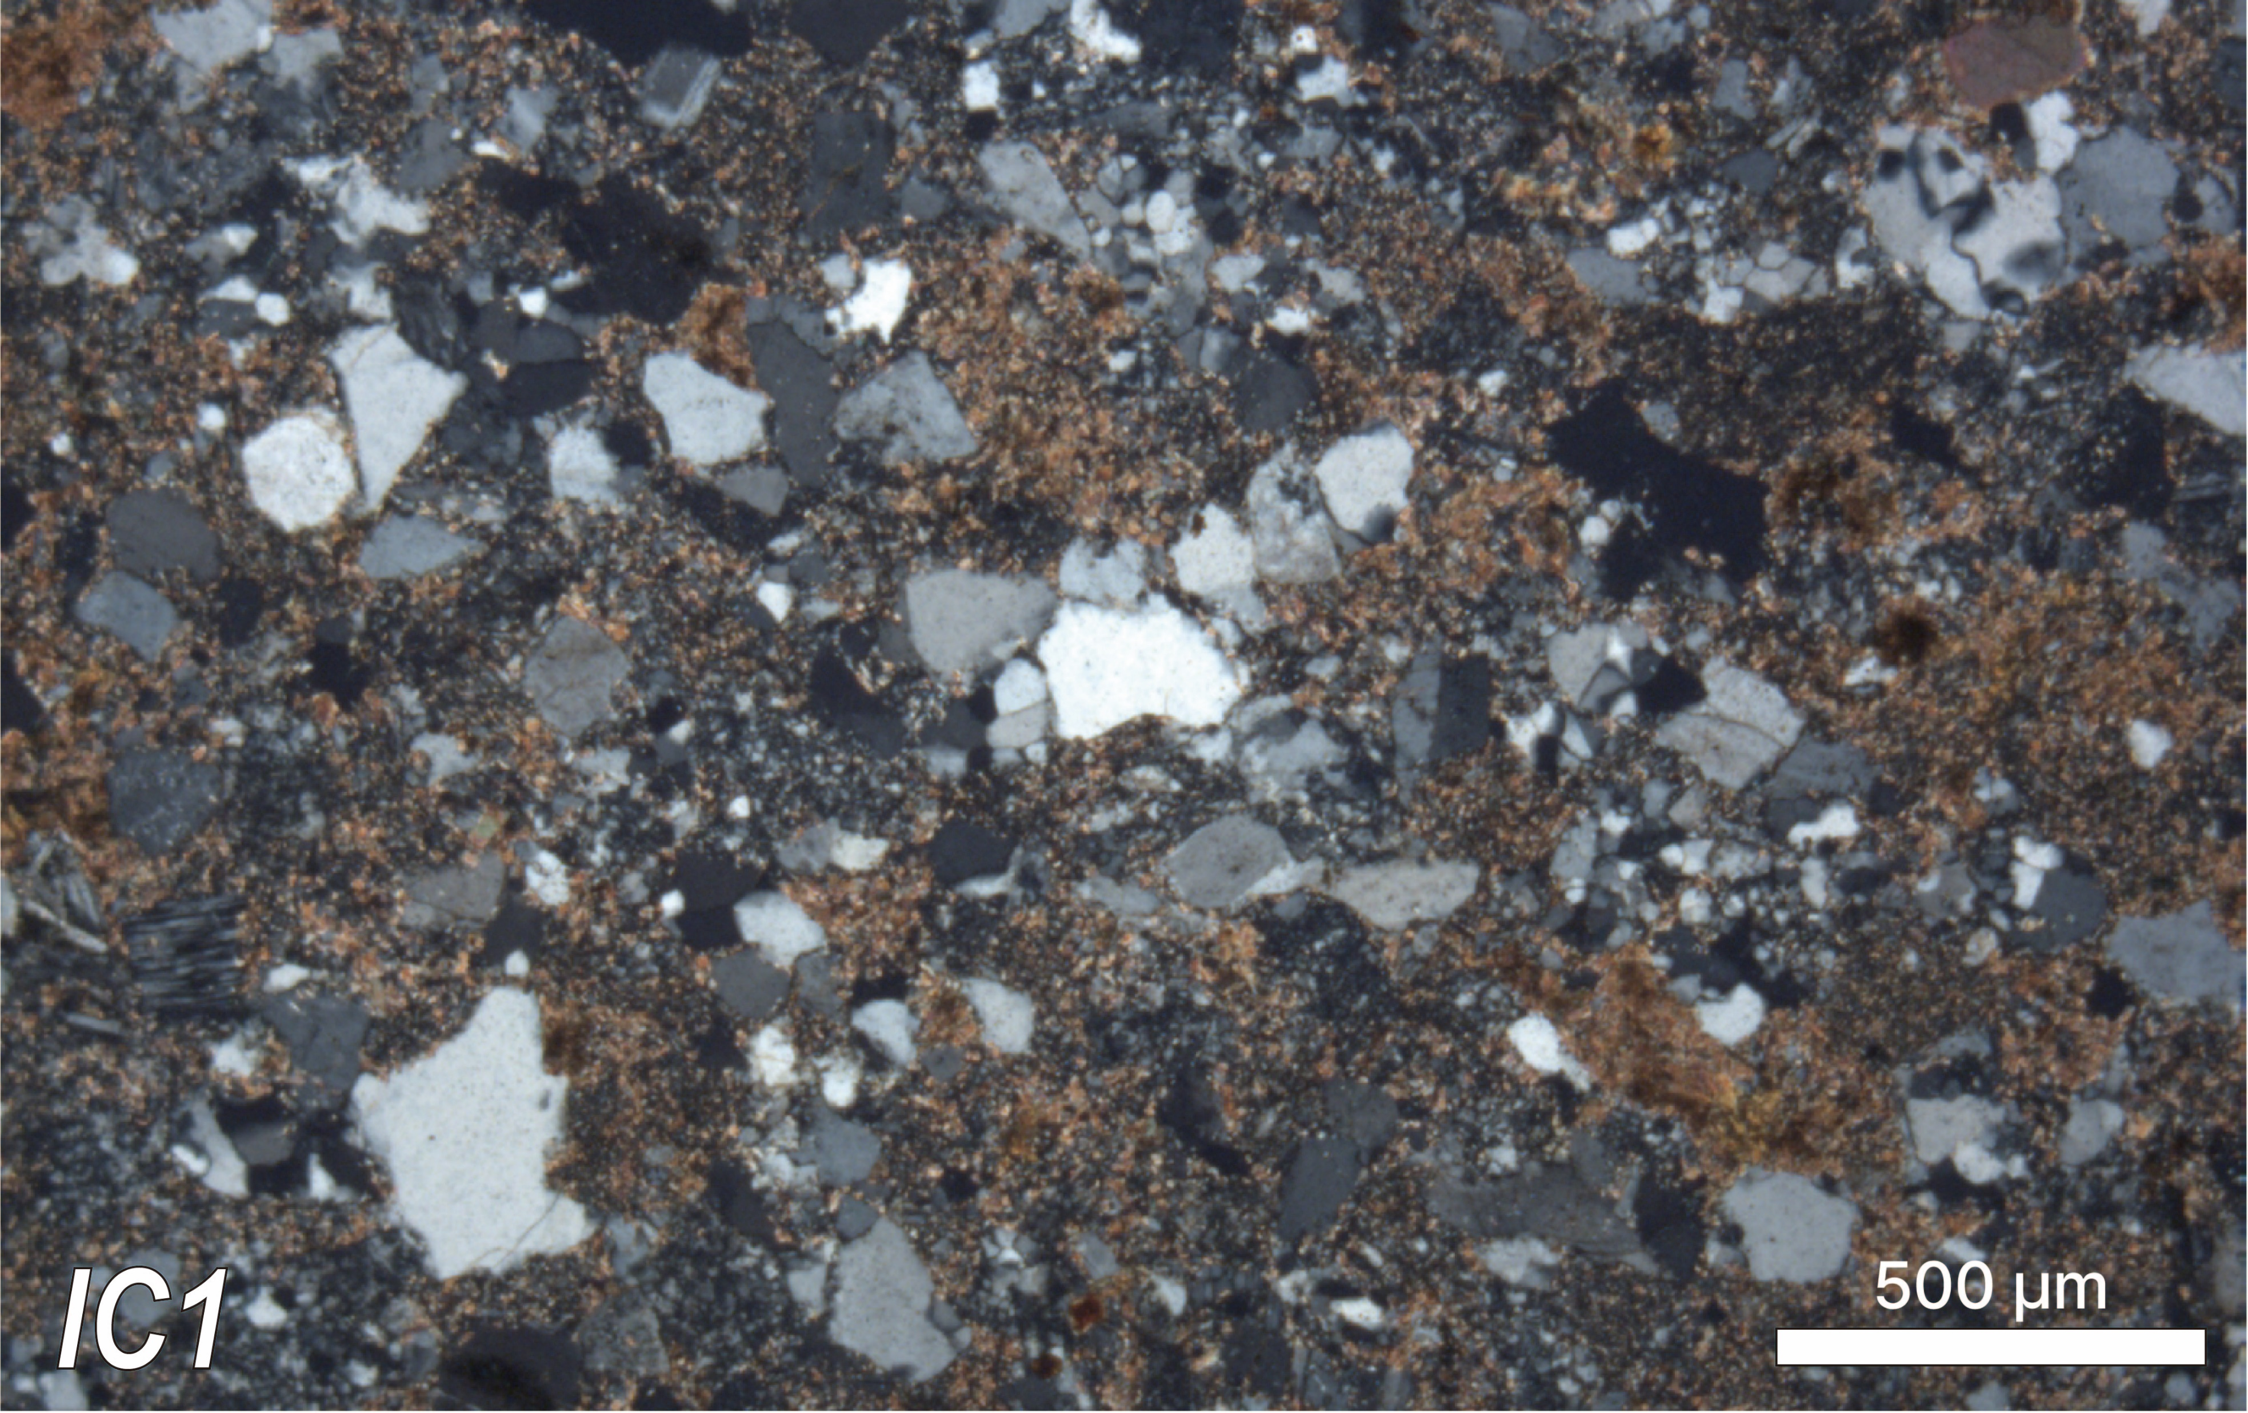
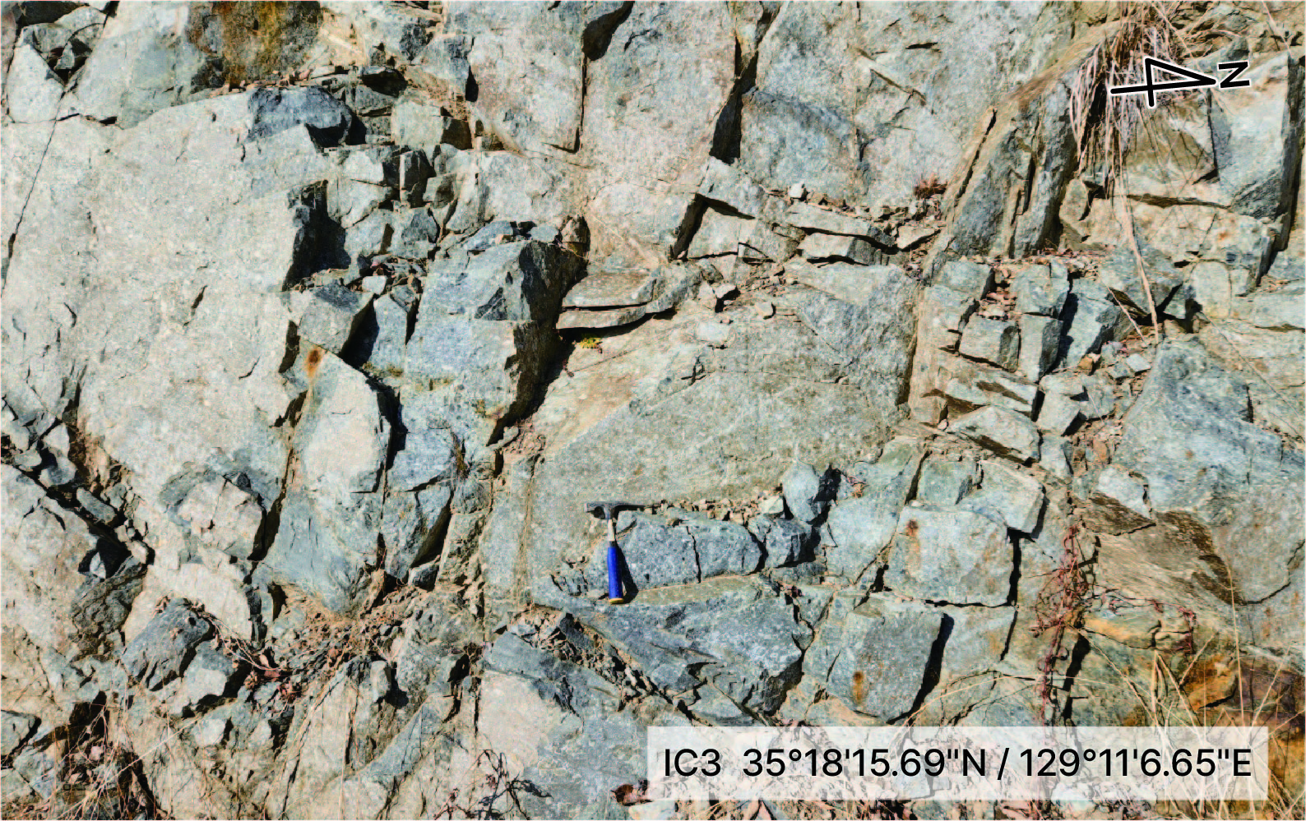
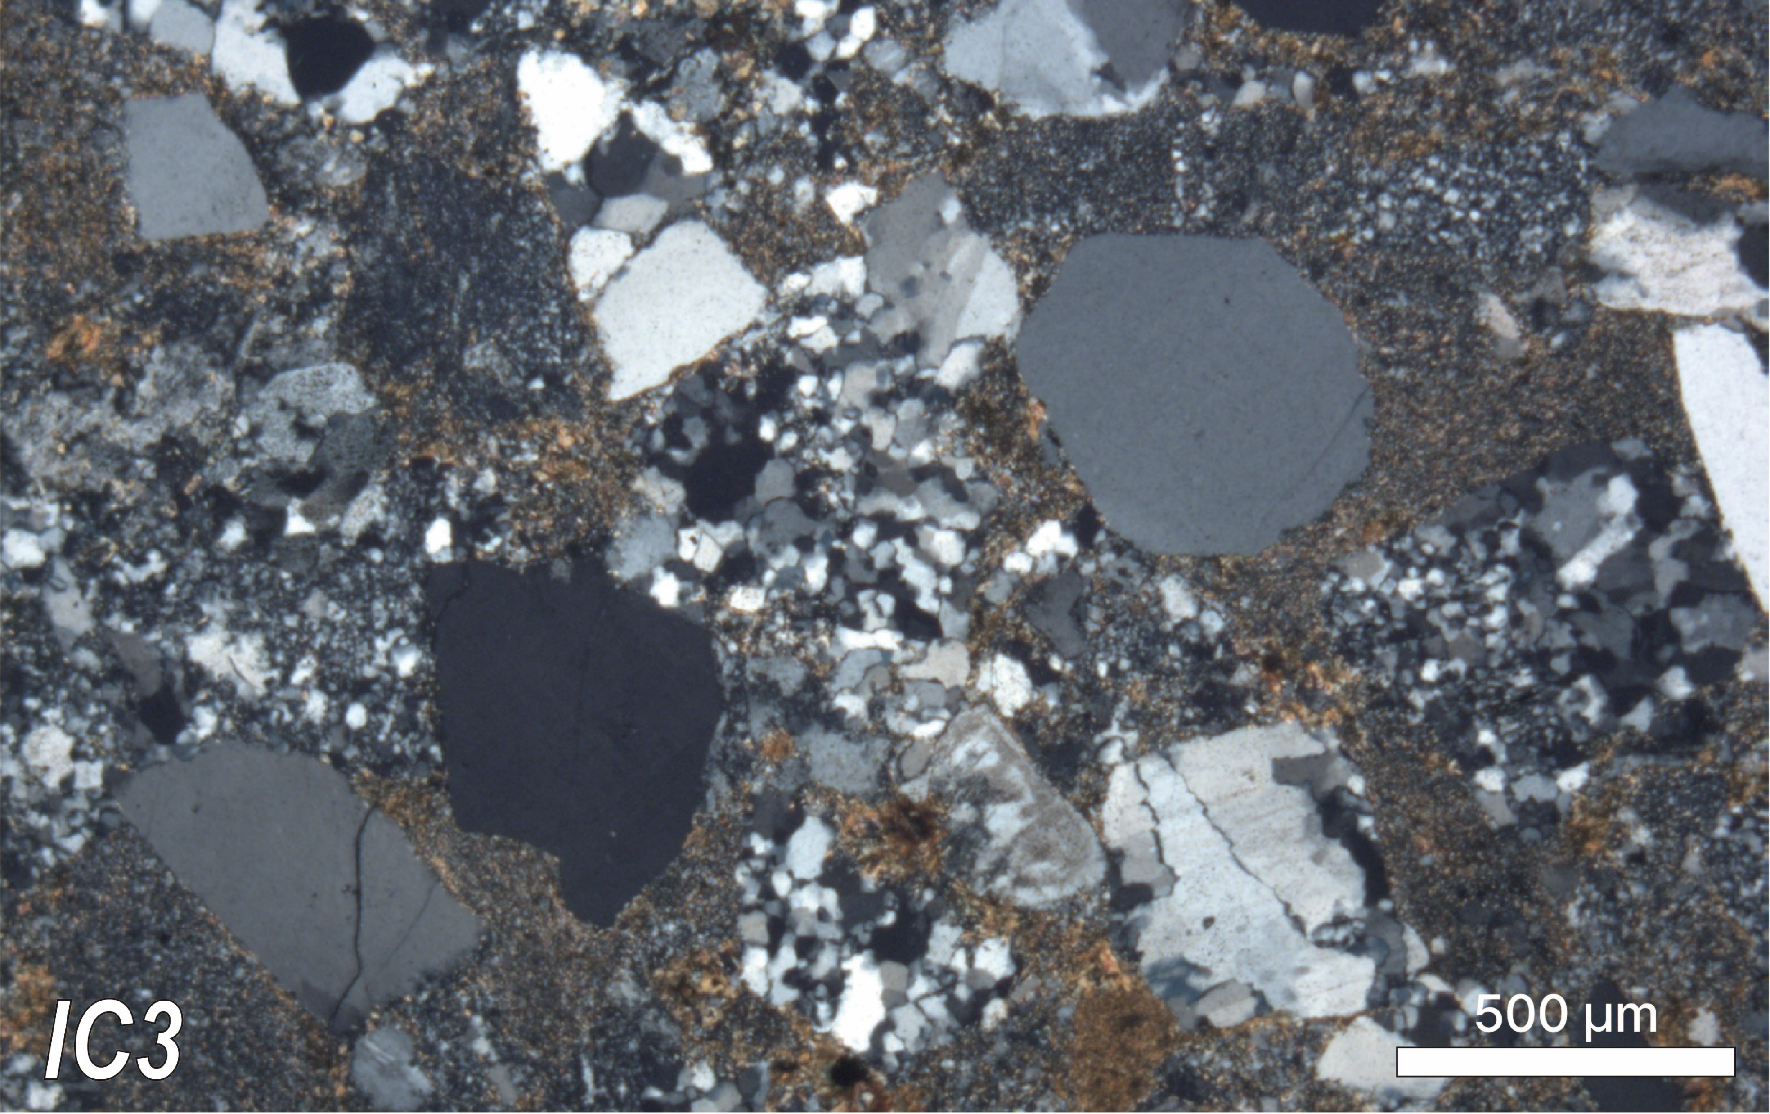
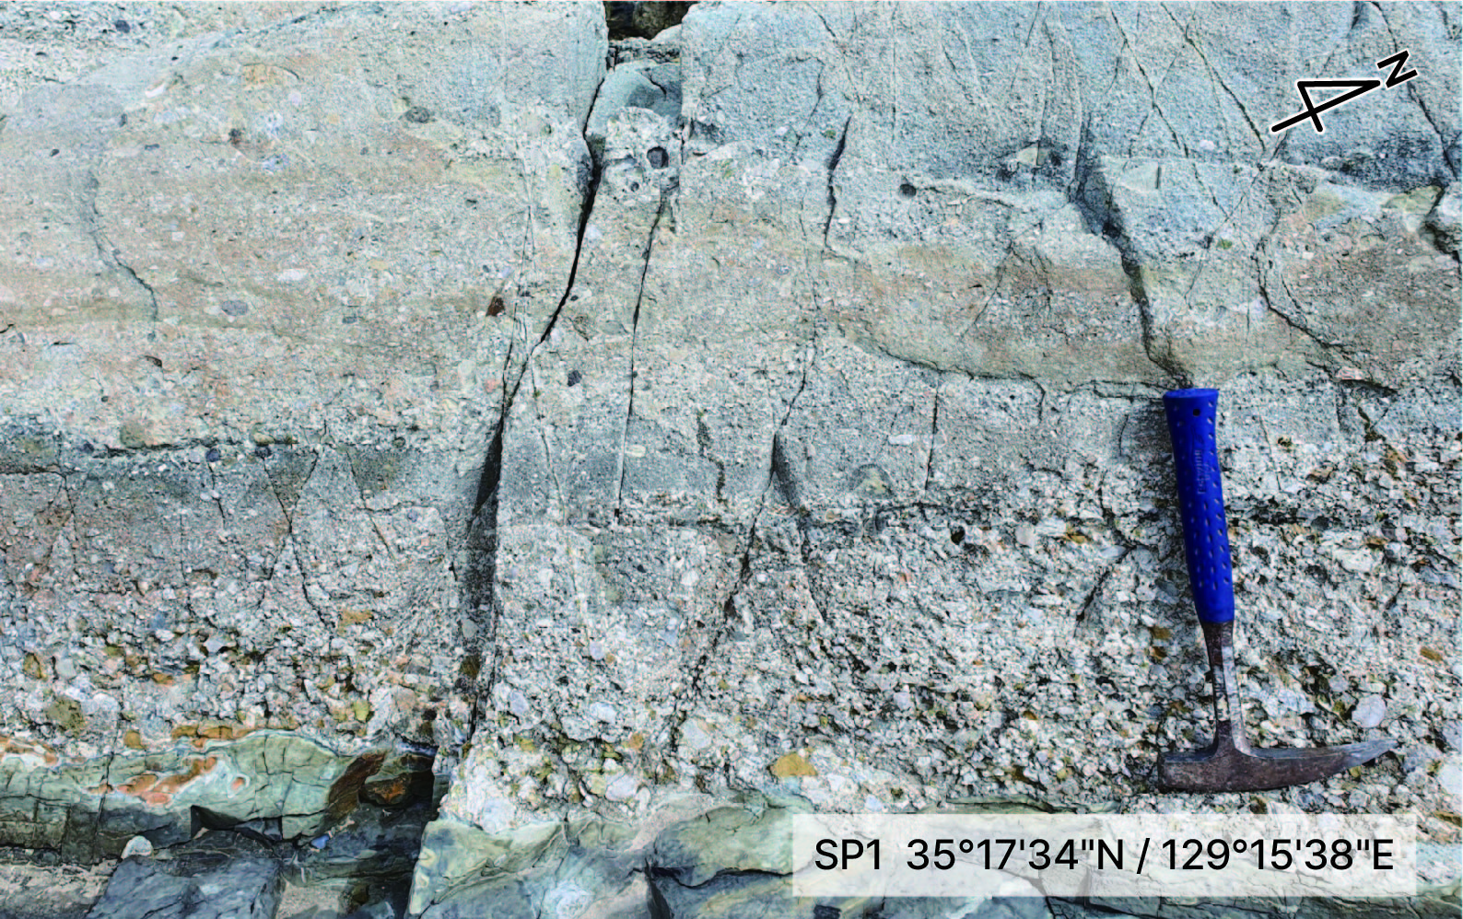
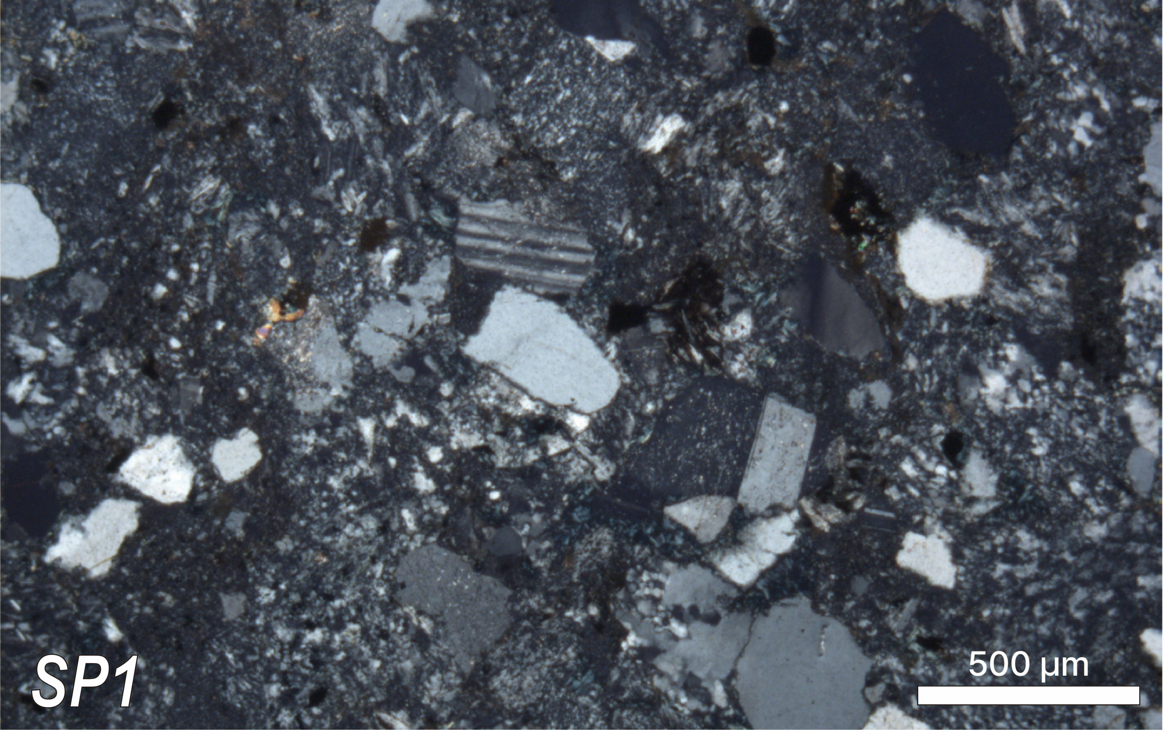
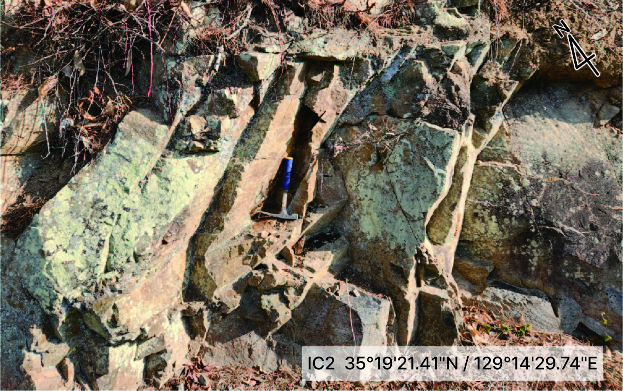
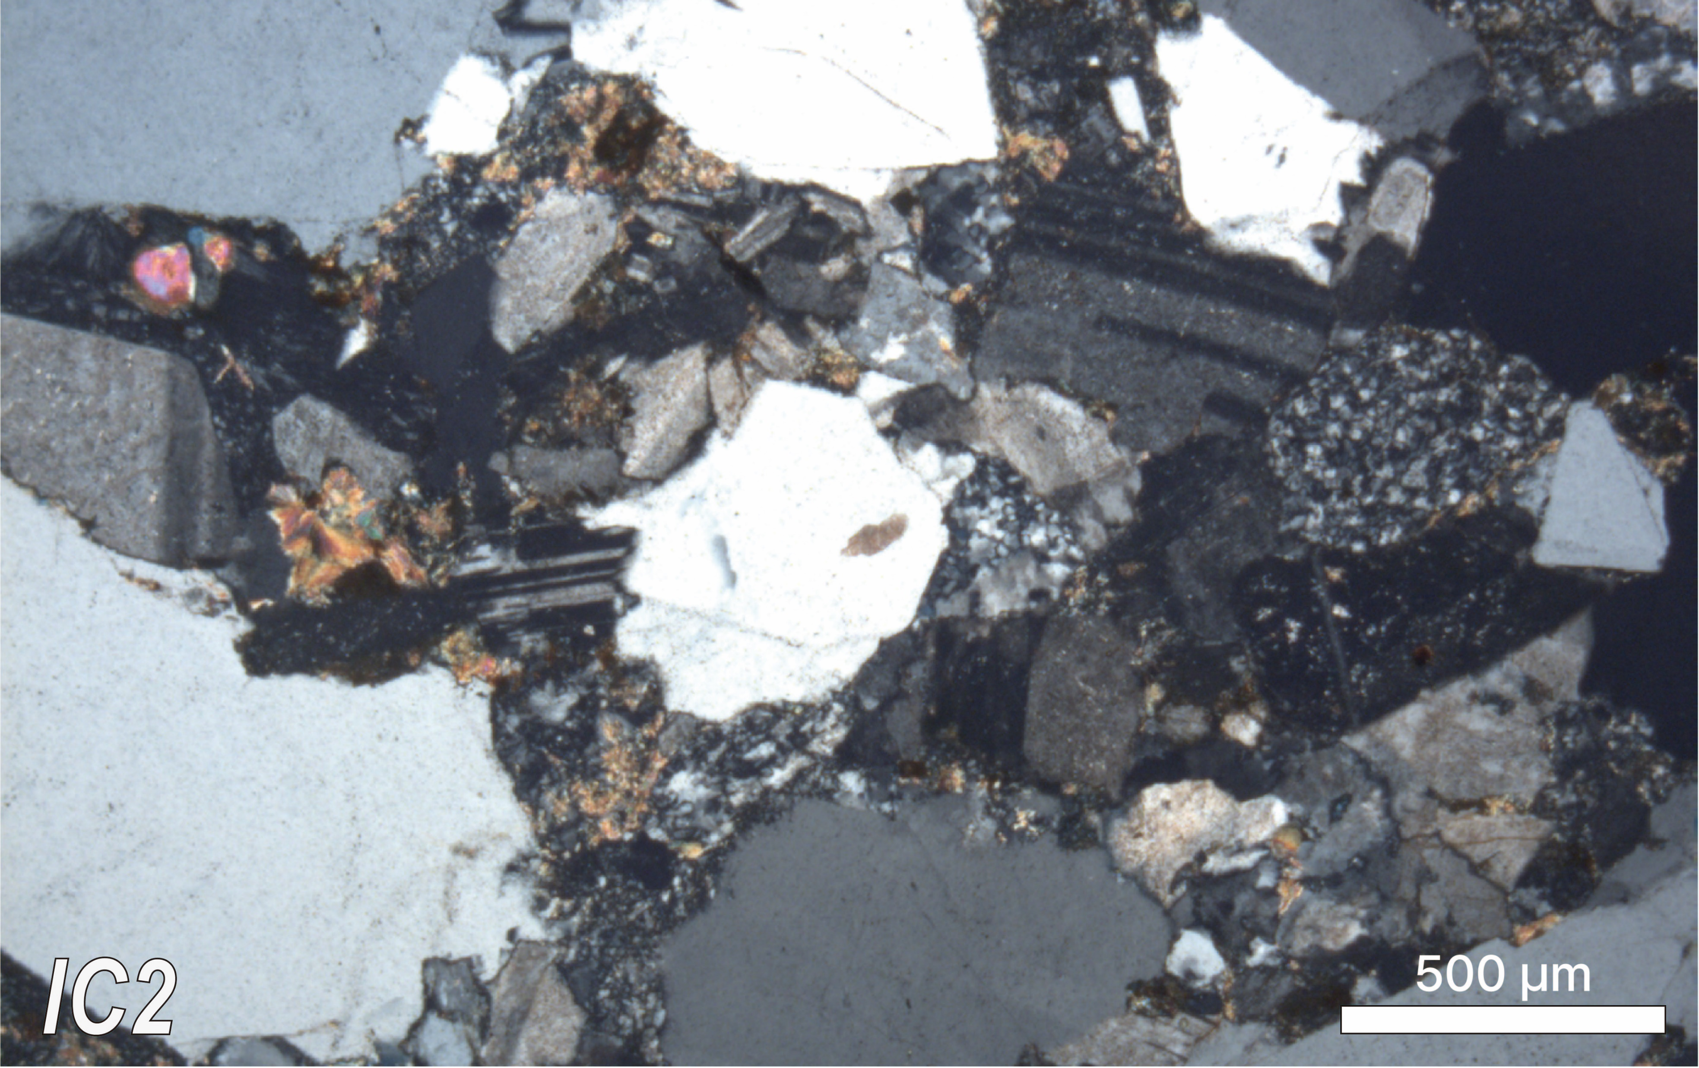
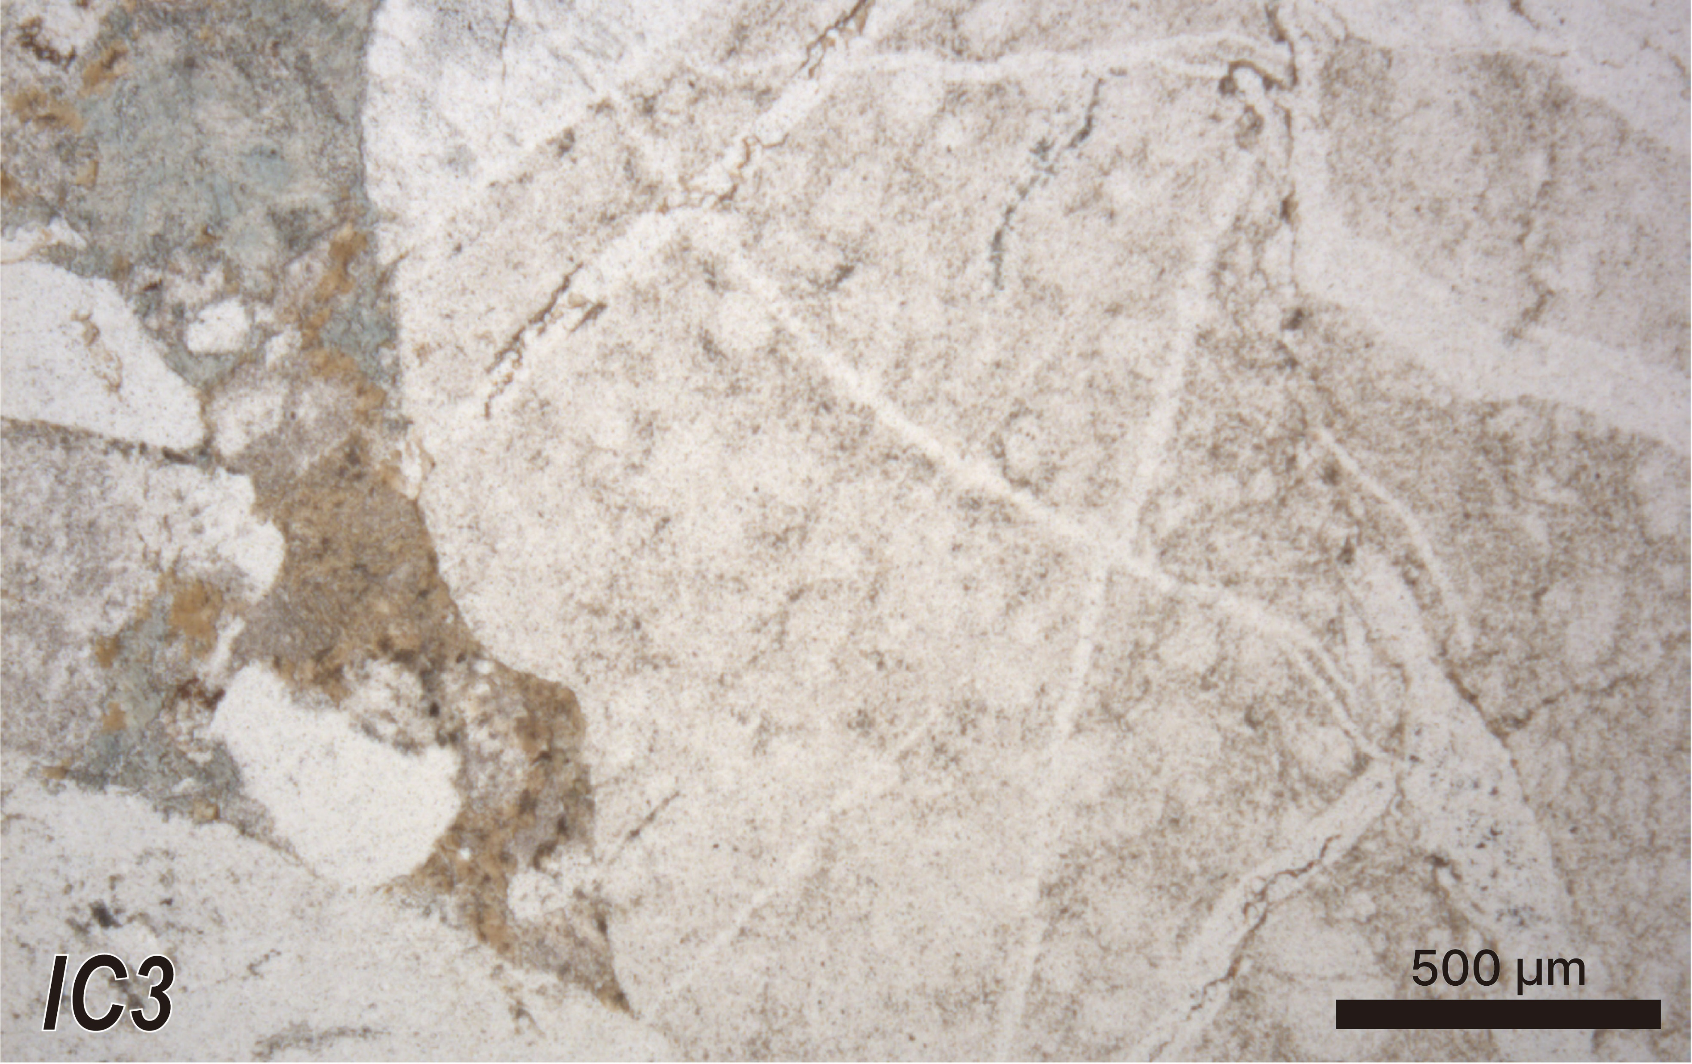
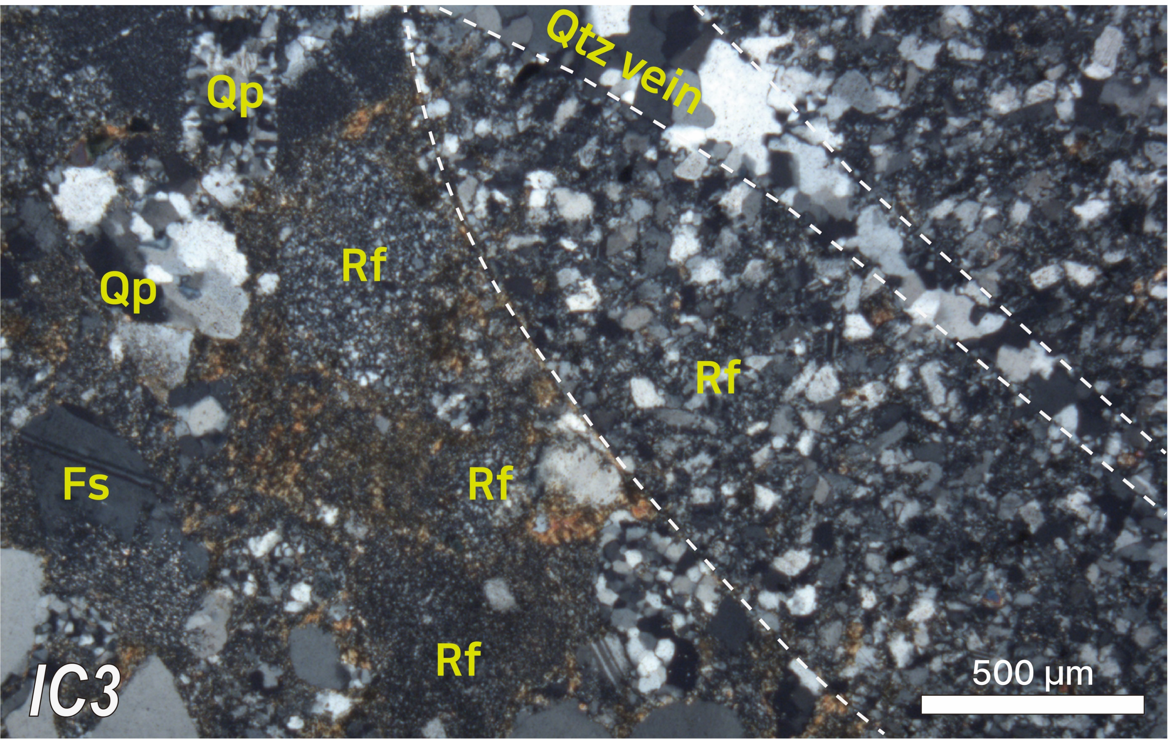
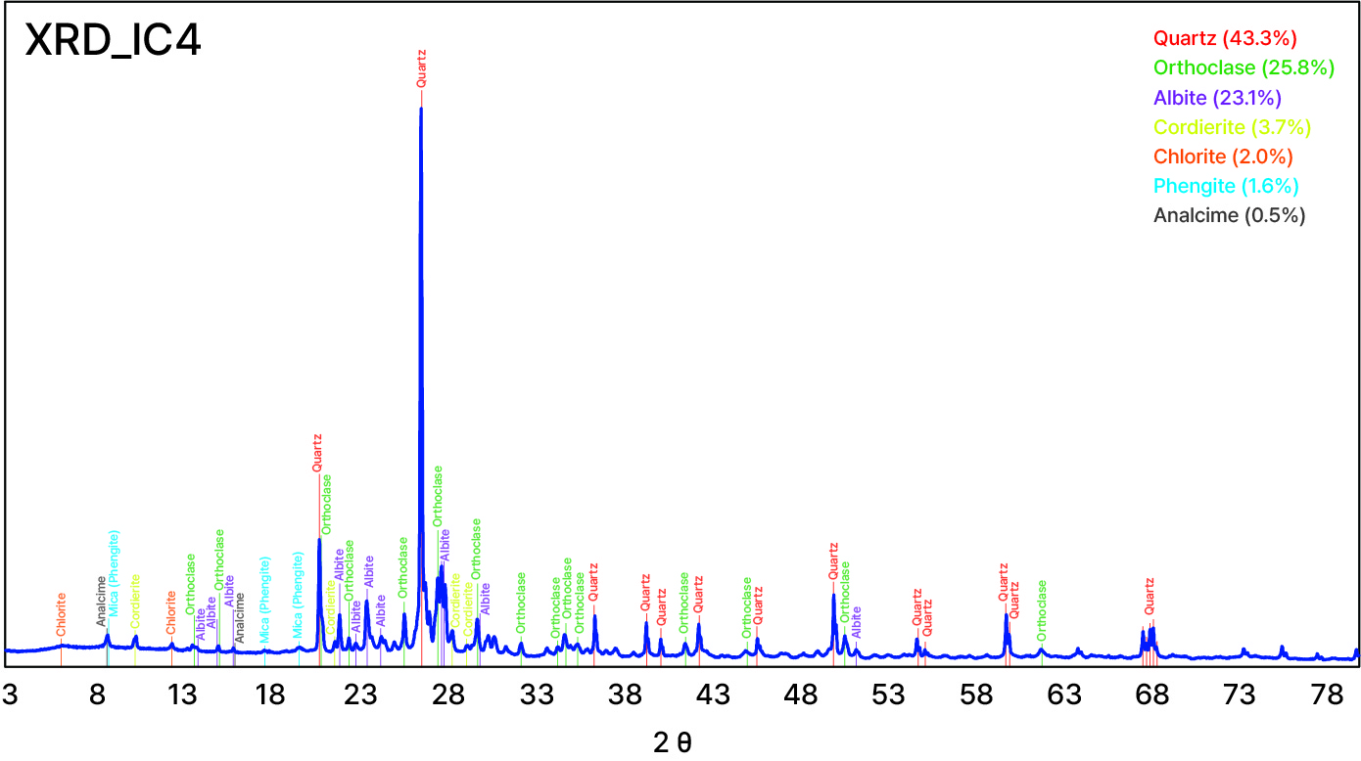
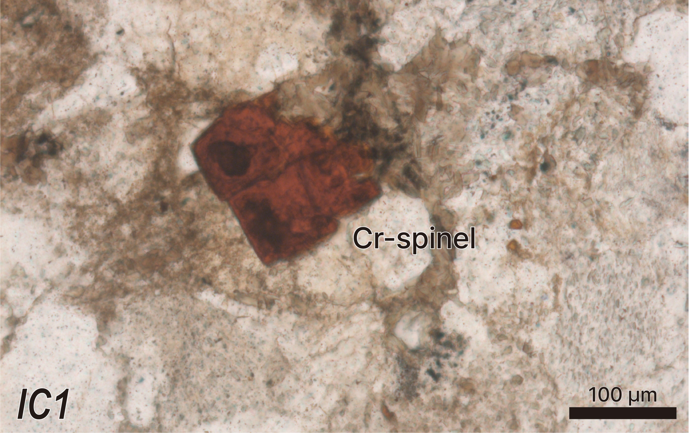
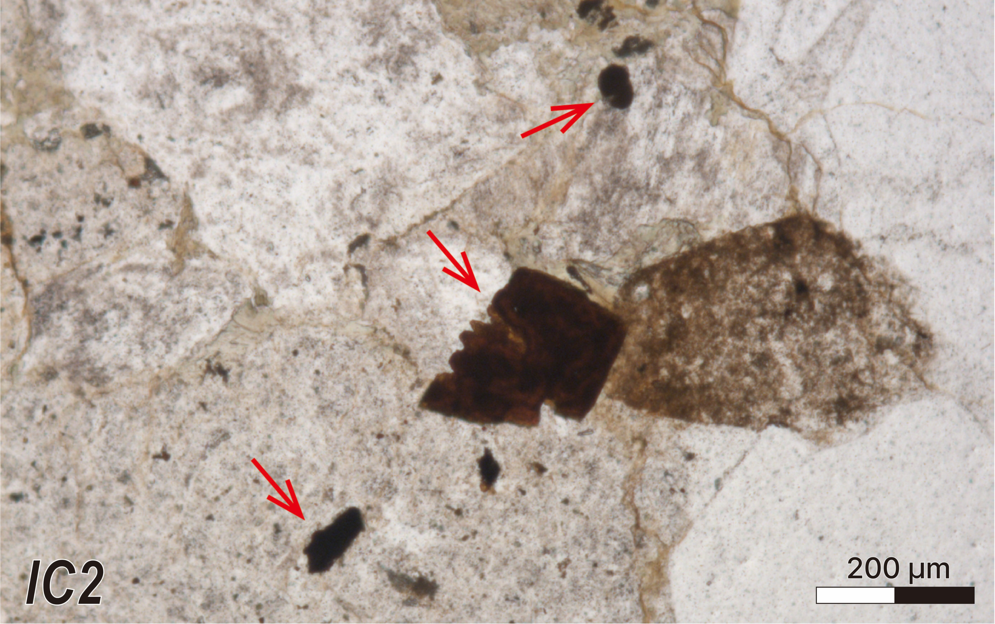
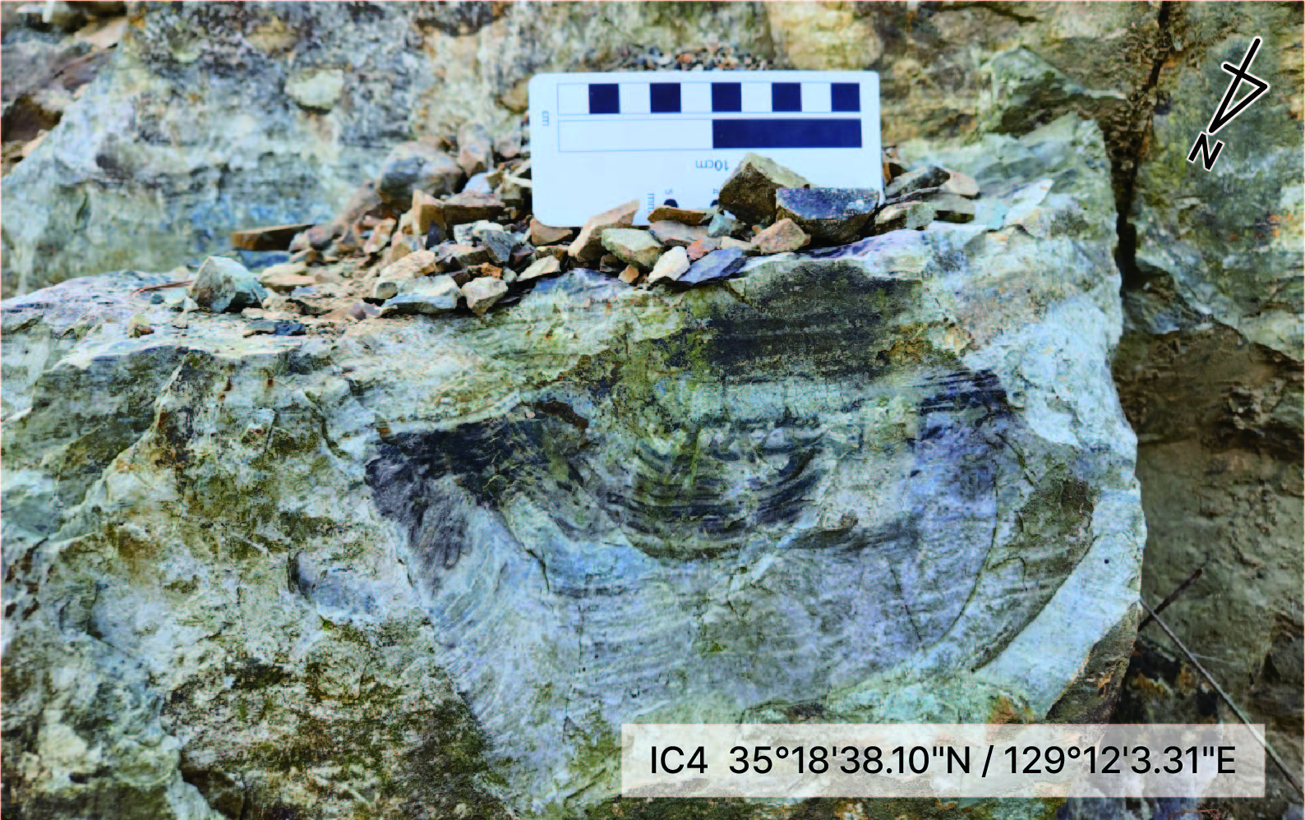
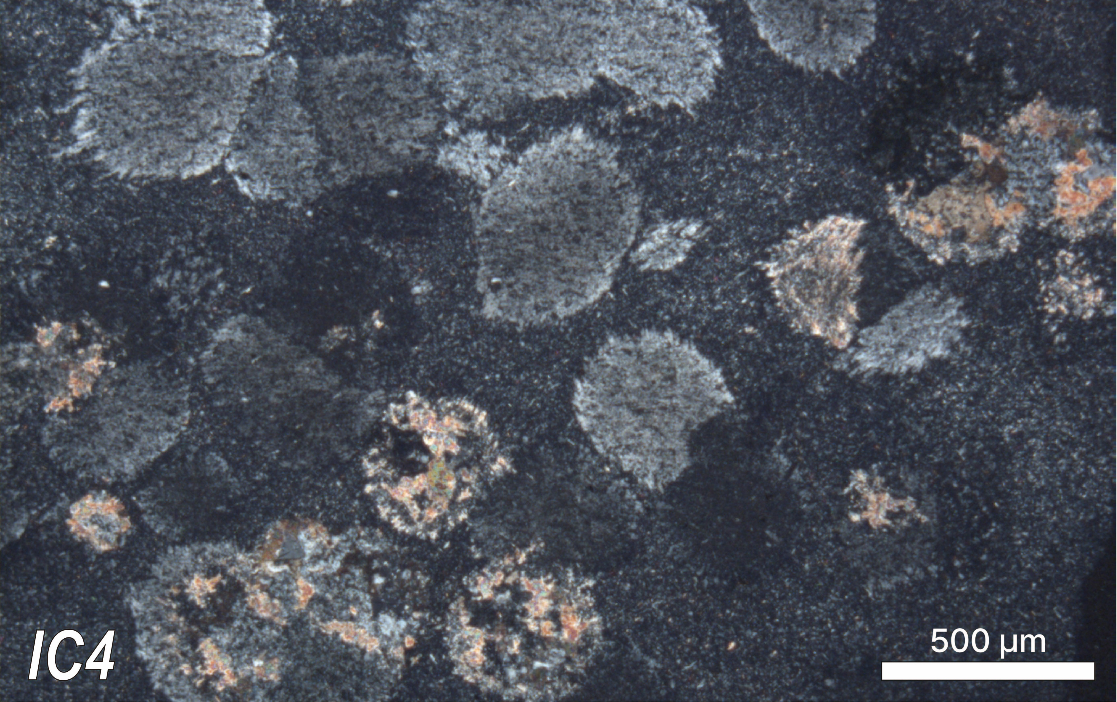
03. SAMPLE DISCRIPTIONS
지역 사회 개발 계획
Lower part
Middle part
Upper part
중대재해 예방 추진체계 프로세스
Fig. 3. Outcrops at the sampling point for detrital zircon U-Pb dating with photomicrographs (XPL). The framework of 5 samples consisted of quartz, feldspar (predominant albite twinning), and rock fragments (metamorphic or sedimentary rock fragments). In the upper part, two types of granules are observed: quartzite and chert. Notably, some of the chert samples contain radiolarian fossils. This indicates the influence of southwestern Japan throughout the deposition period of the Icheonri Formation. Qp: polycrystalline quartz, Fs: feldspar, Rf: rock fragment
Fig. 4. Photomicrographs of IC1 and 2. Minerals resembling Chromian spinel, indicative of ultramafic source rock, are observed. Subsequent chemical analysis will be necessary.
Fig. 5. Outcrop of the silicified cherty rock with unknown origin-spherical structure (XPL).
Fig. 6. The XRD analysis results of the IC4 sample.
EGU24-15199

Slide 5
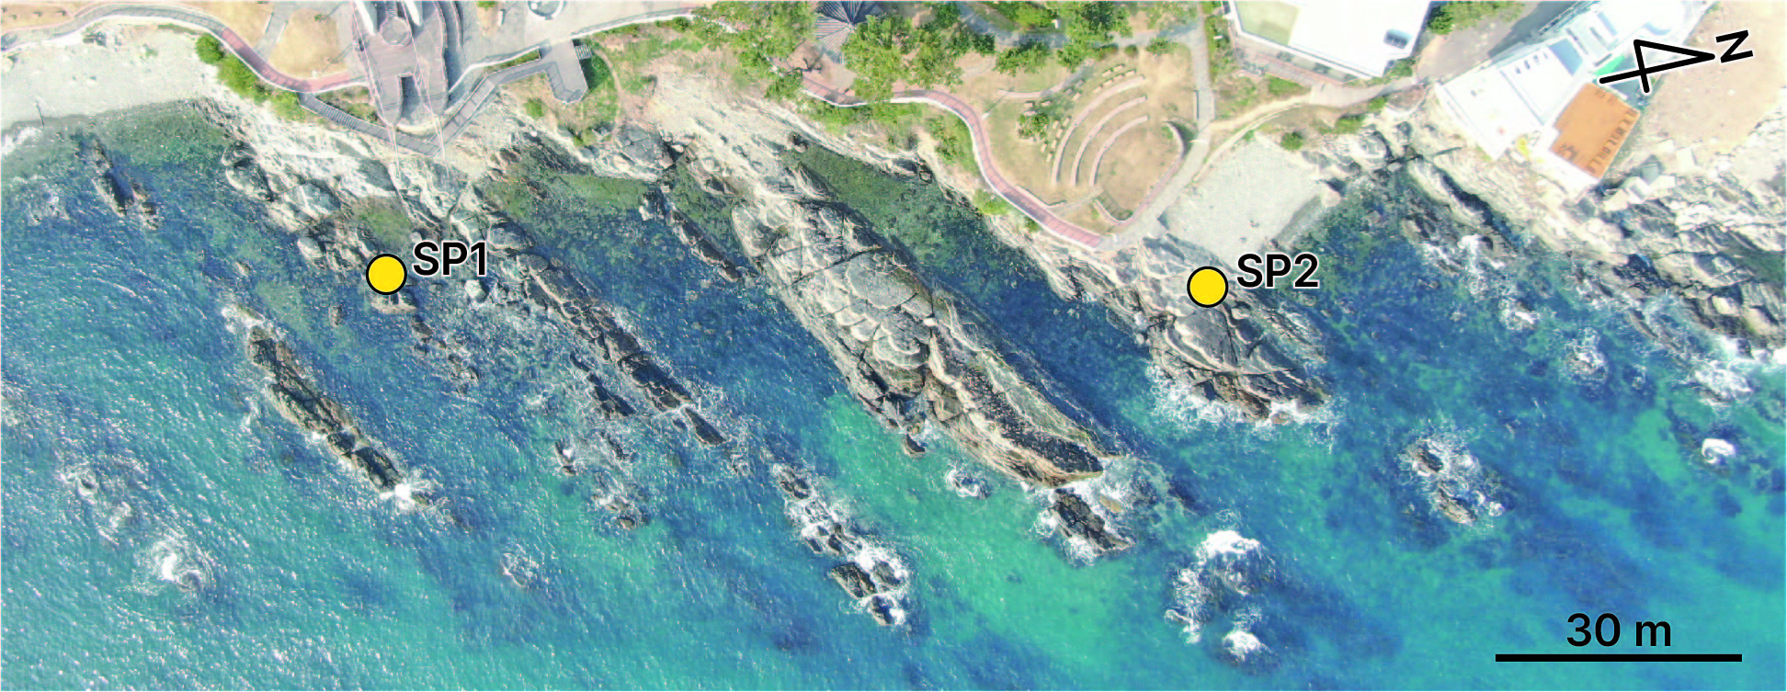
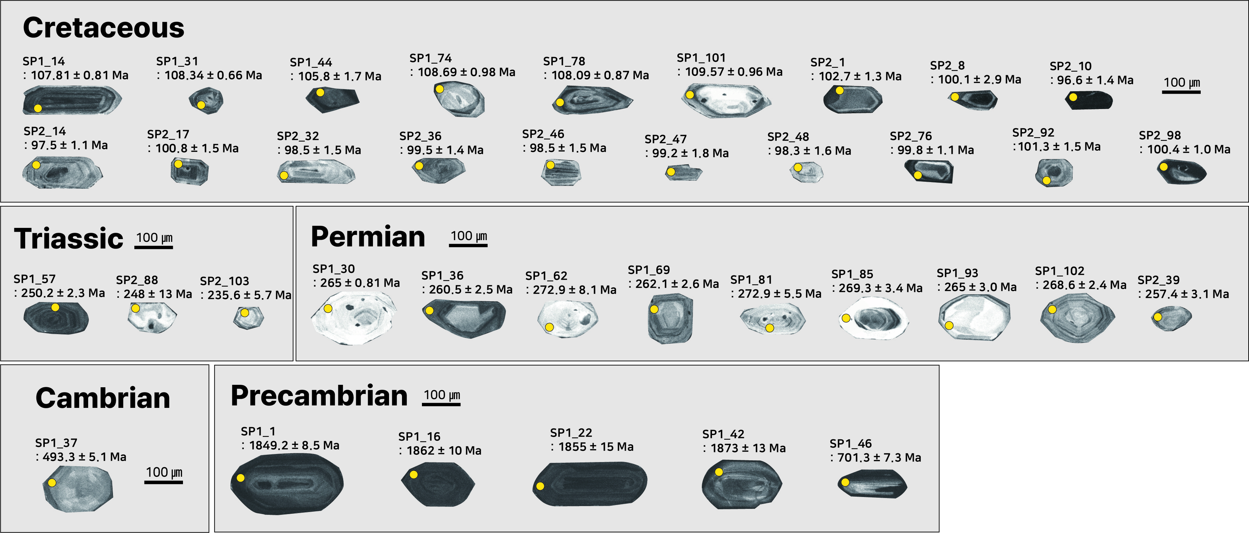
04. RESULTS
지역 사회 개발 계획
중대재해 예방 추진체계 프로세스
Age dating on the coastal outcrops (lower part)
euhedral ~ sub-euhedral, and fragmental grain
The average length and width - SP1: 188.5 ㎛, 100.7 ㎛ - SP2: 126.5 ㎛, 61.6 ㎛
The aspect ratio (length: width) of zircon cross-sections: 1:1 ~ 3:1
Fig. 7. SEM-CL images of samples SP1 and SP2, excluding the fragmented particles. Yellow circles indicate the analysis with the ages
EGU24-15199

Slide 6
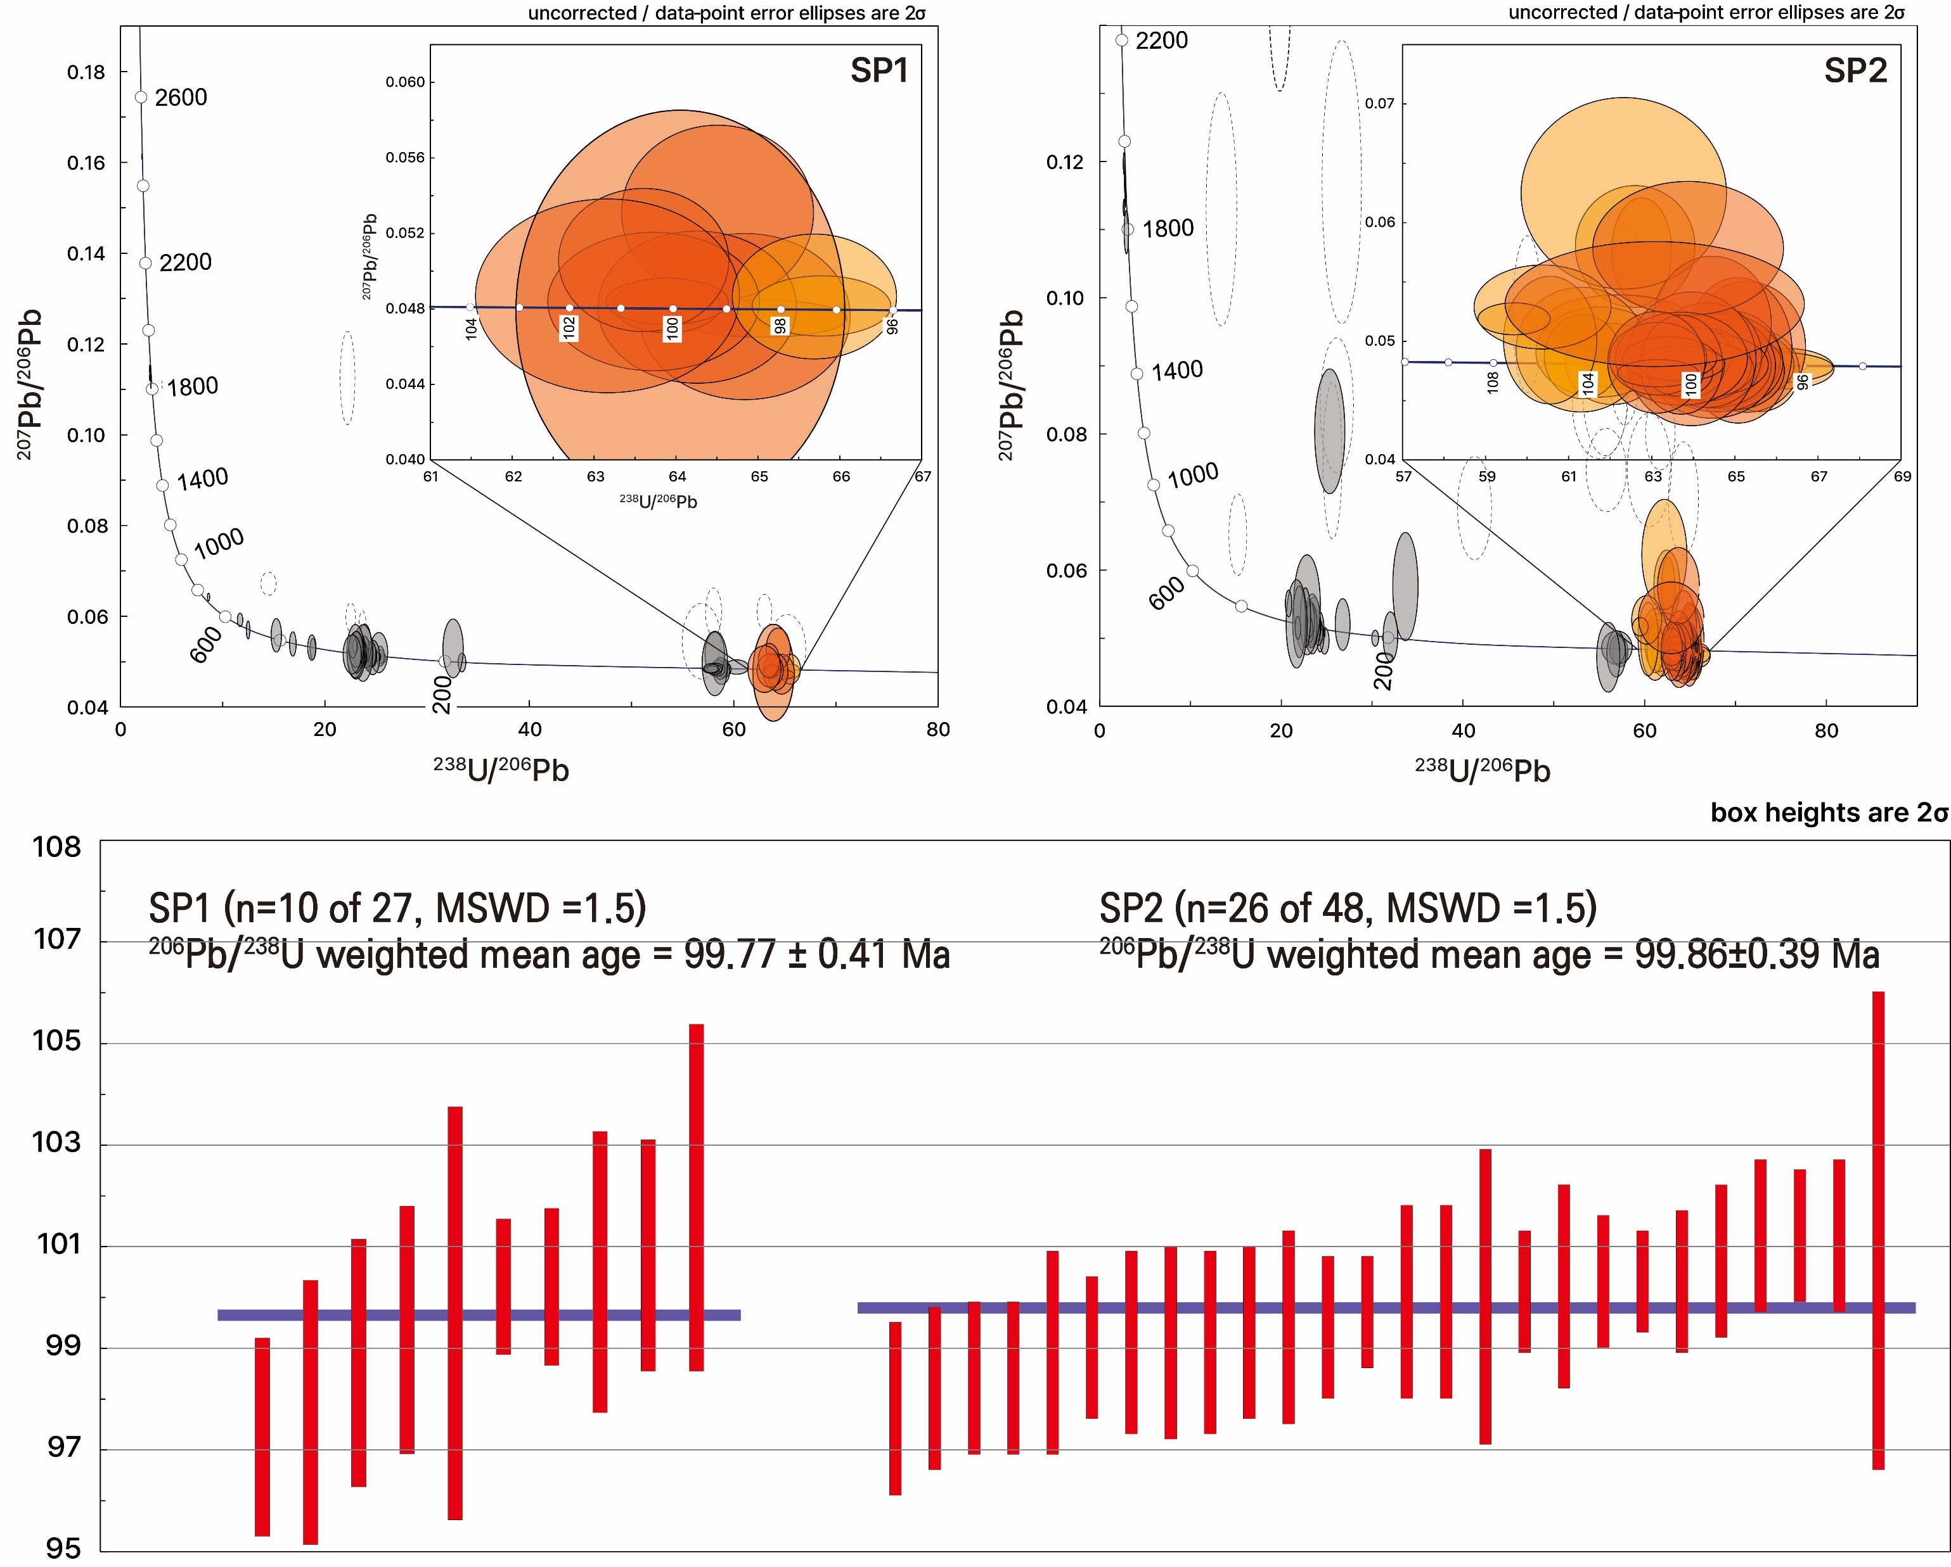
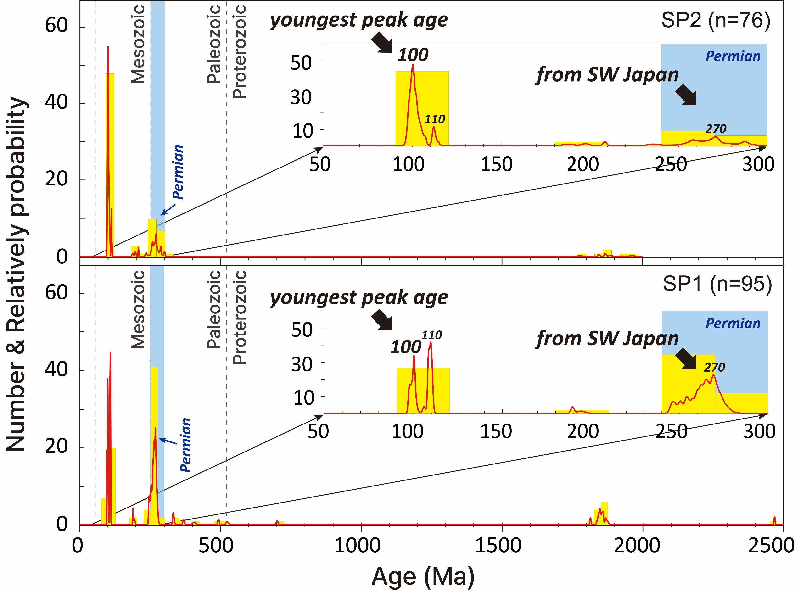
04. RESULTS
지역 사회 개발 계획
Age dating on the coastal outcrops (lower part)
Precambrian ~ Mesozoic: Cretaceous (44%), Permian (33%), Paleoproterozoic (11%)
The weighted mean ²⁰⁶Pb/²³⁸U ages of the youngest age clusters: ca. 100 Ma
중대재해 예방 추진체계 프로세스
Fig. 8. Probability density diagrams. An enlarged image of <300 Ma interval is shown in the upper right inset for each sample. The Cretaceous age shows an increasing trend, whereas the Permian age shows the opposite trend.
EGU24-15199
Fig.9. Tera-Wasserburg concordia diagrams with ²⁰⁶Pb/²³⁸U weighted mean ages.

Slide 7
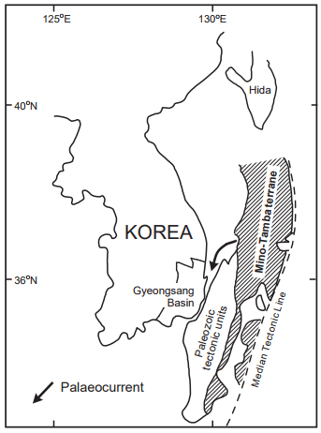
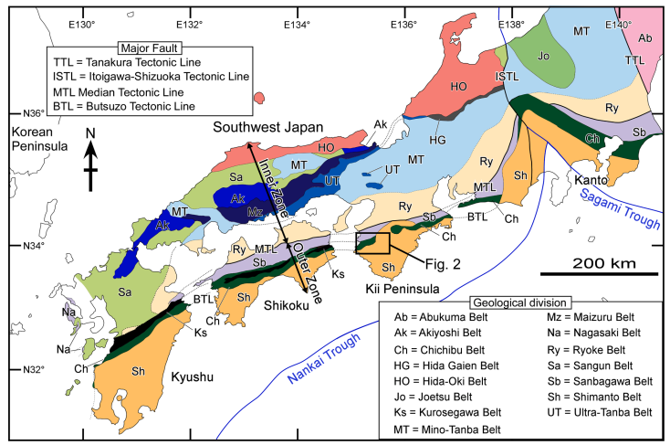
05. DISCUSSIONS
지역 사회 개발 계획
The maximum depositional age is early Cenomanian
radiolarian-bearing chert fragments and significant concentrations of Permian zircons -> A significant amount of sediment in the Icheonri Formation was supplied from SW Japan.
Lee, Y.I. and Kim, J.Y. (2005)
Tokiwa et al. (2021)
Potential provenance
Mino-Tamba
Jurassic accretionary complex
Maizuru belt
(paleozoic tectonic unit)
Kanmon Group
(Cretaceous sedimentary basin)
Lower Cretaceous Gyeonsang Basin’s palaeogeographic map of the East Asian continental margin.
Geology of southwestern Japan.
EGU24-15199

Slide 8
06. FURTHER STUDY
지역 사회 개발 계획
Additional age-dating analyses (IC1, IC2, IC3)
Statistical approach for provenance interpretation: Multidimensional scaling (MDS)
Chemical analysis for identifying Cr-spinel, an indicator mineral of ultramafic source rock
중대재해 예방 추진체계 프로세스
Thank you for your attention!
Ga-Yeon Kim gayeon0105@pusan.ac.kr

