Slide 1
AS1.11 – Mixed-phase and ice cloud observations and modelling The global distribution of ice-nucleating particles and their impacts on cirrus clouds and radiation derived from global model simulations
Christof Beer¹, Johannes Hendricks¹, Mattia Righi¹
¹ Deutsches Zentrum für Luft- und Raumfahrt (DLR), Institut für Physik der Atmosphäre, Oberpfaffenhofen, Germany 17 April, 2024

Slide 2
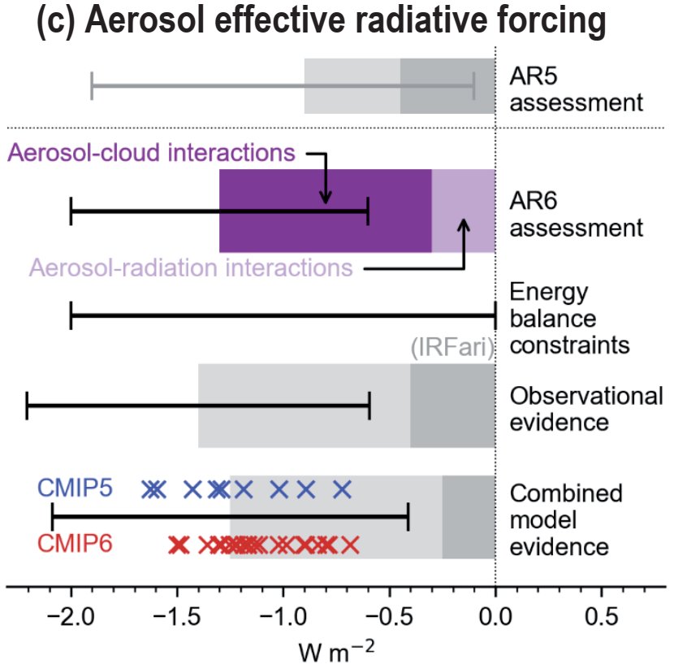
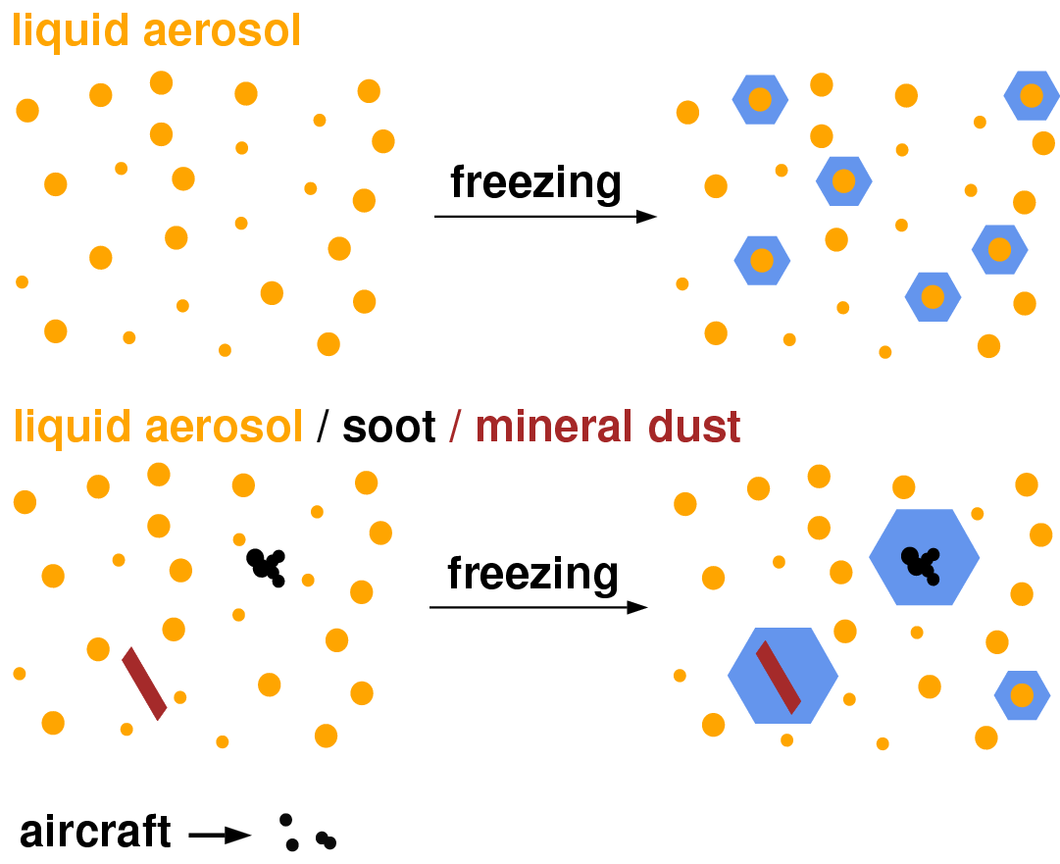
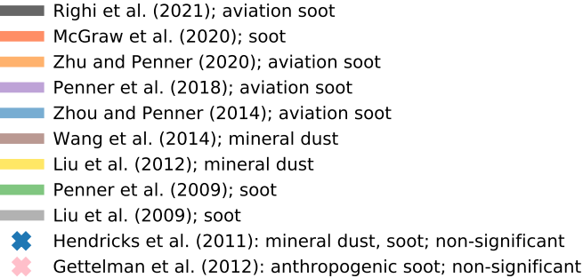
Motivation
Arias et al., IPCC AR6, 2021
Aerosol effective radiative forcing
Aerosol-induced cirrus formation
RH_{ice}
homogeneous
nucleation
150%
140%
Temperature
130%
heterogeneous
nucleation
120%
INP-effects from previous model studies (various INP-types)

Slide 3
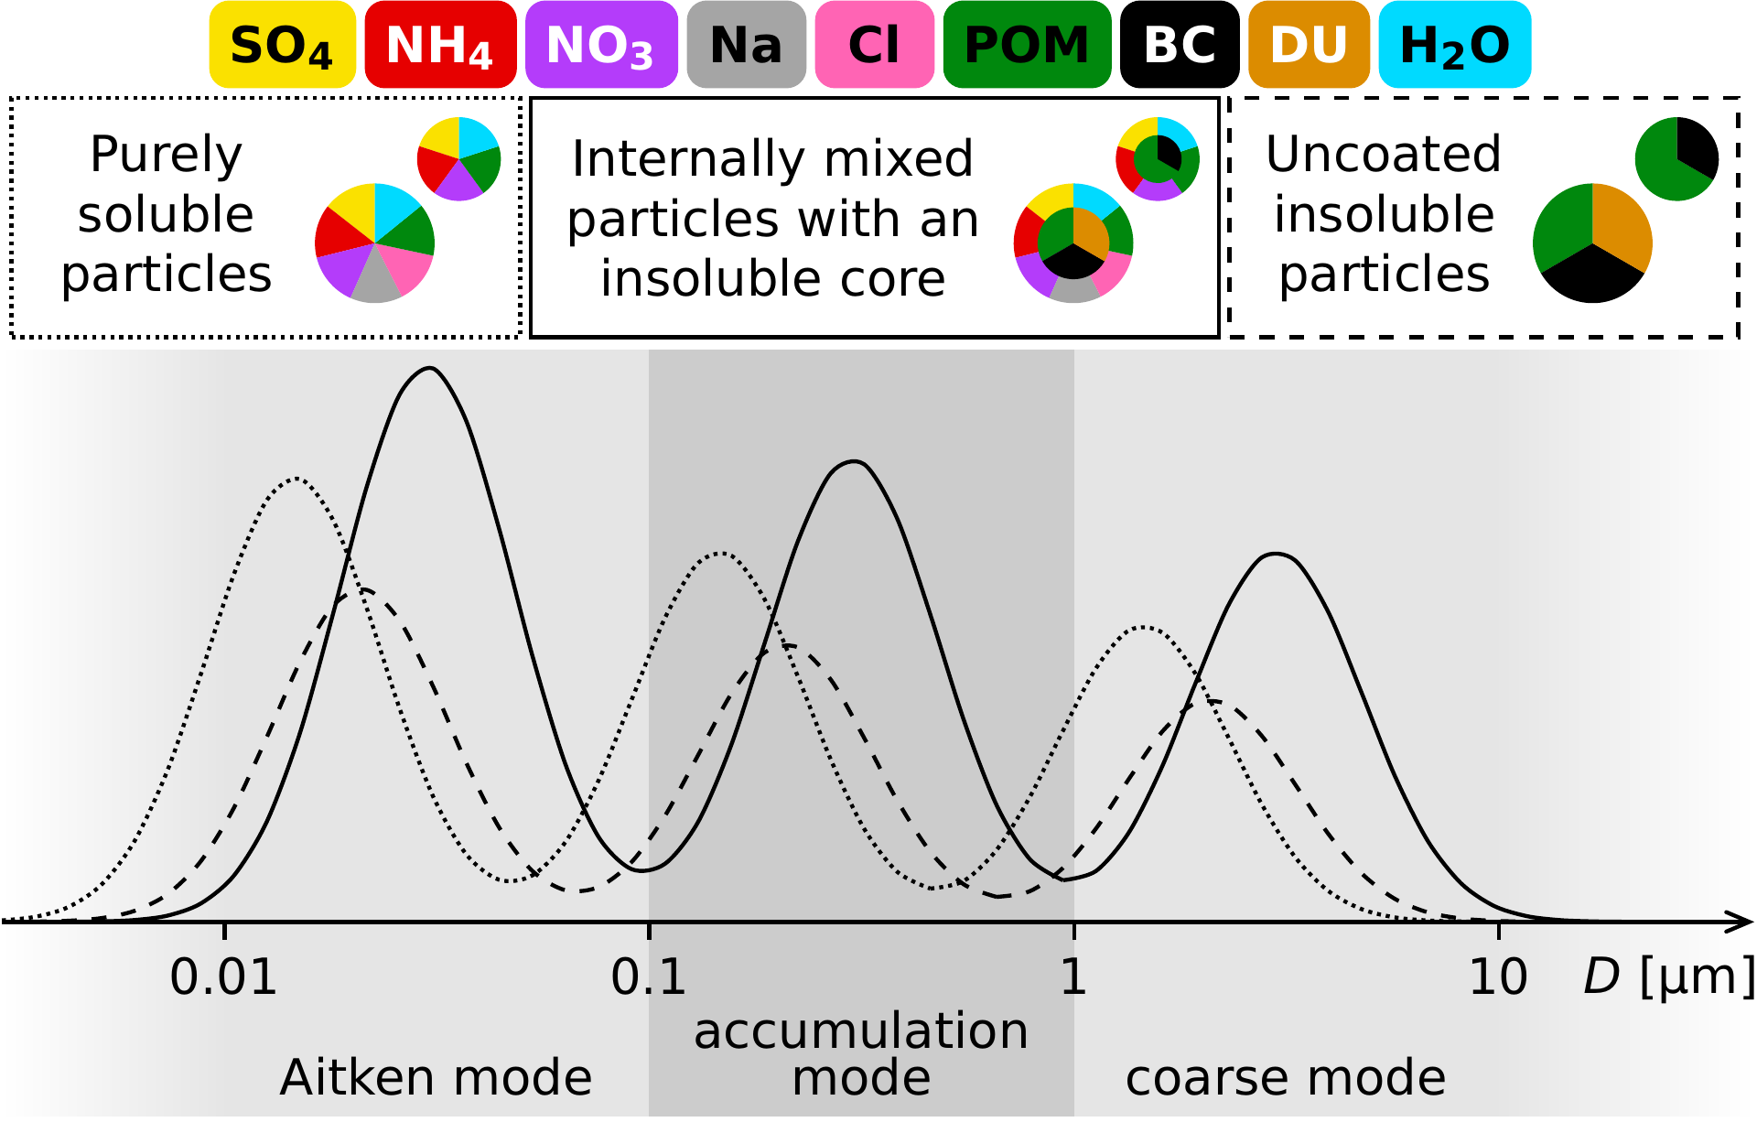
Aerosol-cirrus interactions in the climate model
BCtag
Insoluble
DU and BC
 deposition nucleation
Dynamical forcing
(updraft)
DU and BC
with soluble coating
 immersion freezing
COUPLING
Nucleation and growth of ice crystals
Ice formation processes
Competition for supersaturated water vapor
Supercooled
solution droplets
 homogeneous freezing
Pre-existing ice crystals
MADE3 aerosol submodel in EMAC
9 aerosol types
3 mixing states (soluble, insoluble and mixed) in 3 log-normal size modes ⇨ 9 modes
Explicit simulation of aerosol mass and number concentrations
Microphysical processes: new particle formation, coagulation, condensation and gas-aerosol partitioning
Additional
INPs:
Crystalline ammonium sulfate
Glassy organics
Cirrus parametrization
Competition between homogeneous and heterogeneous freezing
Consideration of pre-existing ice crystals
Ice nucleating particles: black carbon (BC) and mineral dust (DU), ammonium sulfate, glassy organics
Ice crystals
(number concentration and size)
Righi et al. (2020)
Beer et al. (2022)
Kaiser et al. (2014, 2019)
Kärcher et al. (2006), Hendricks et al. (2011), Kuebbeler et al. (2014)

Slide 4
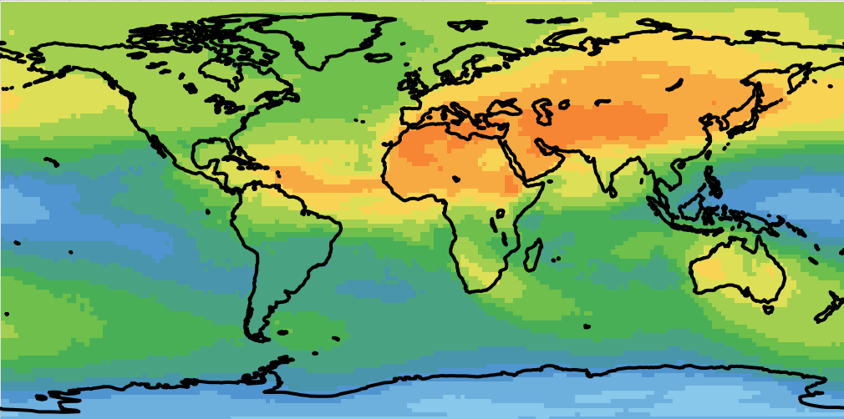
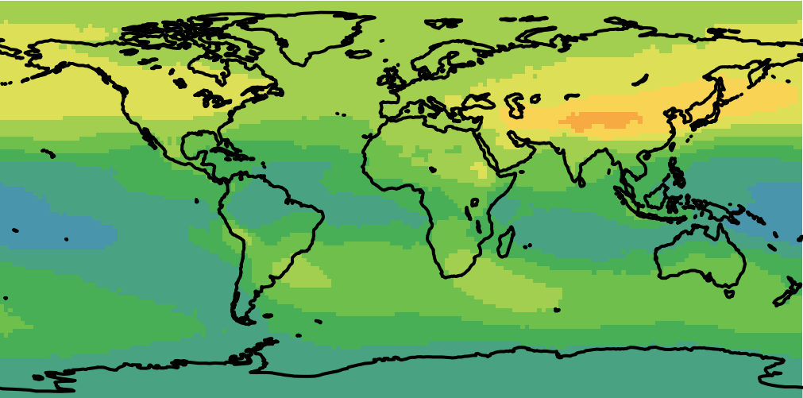
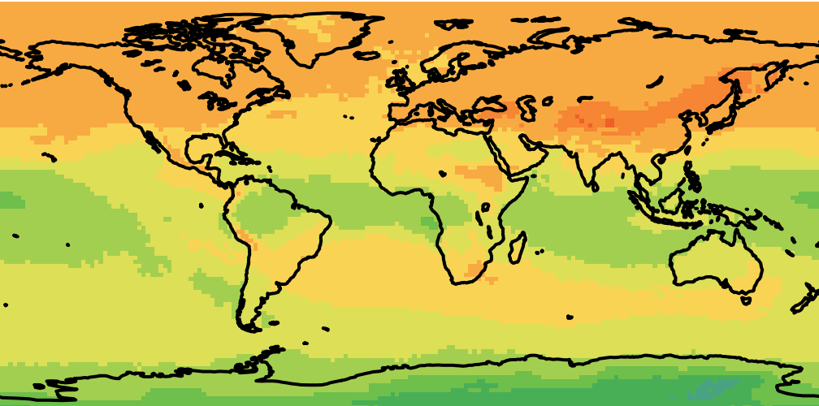
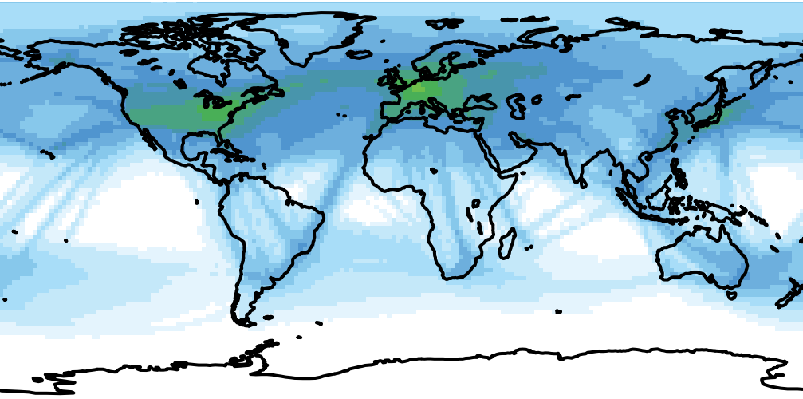
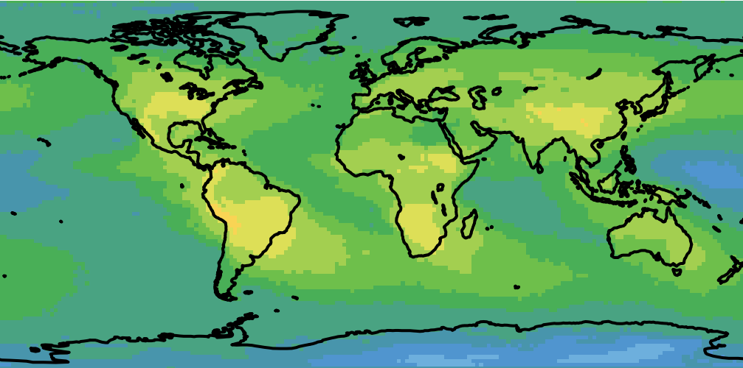
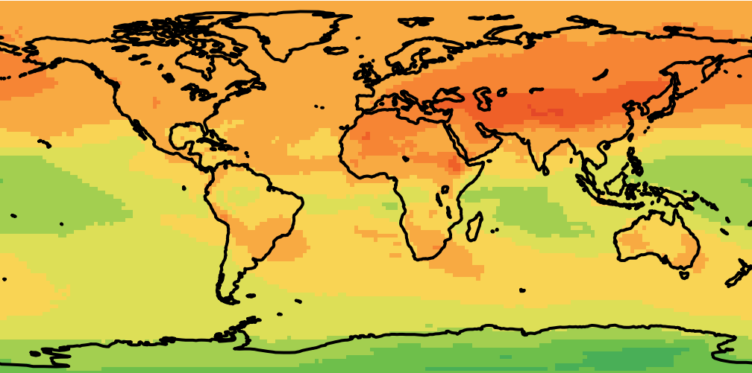
Global climatology of INPs under cirrus conditions
INP-types: mineral dust, soot from surface, aviation soot, crystalline ammonium sulfate, glassy organics
INP numbers weighted with freezing properties (f_{act})
Cirrus cloud cases selected (T < T_{hom}, IWC > 0.5 mg/kg)
Mineral dust
Black carbon from surface sources
RH_{ice}
homogeneous
nucleation
150%
Crystalline ammonium sulfate
Aviation BC
heterogeneous
nucleation
140%
130%
Glassy organics
Total
120%
L⁻¹
Beer et al., ACP, 2022

Slide 5
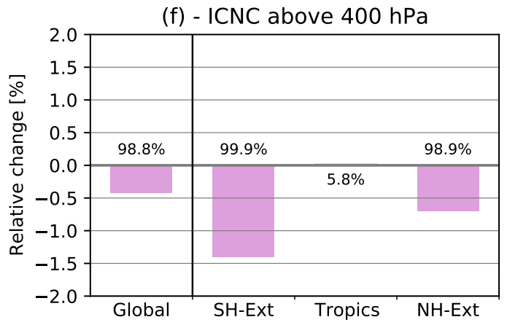
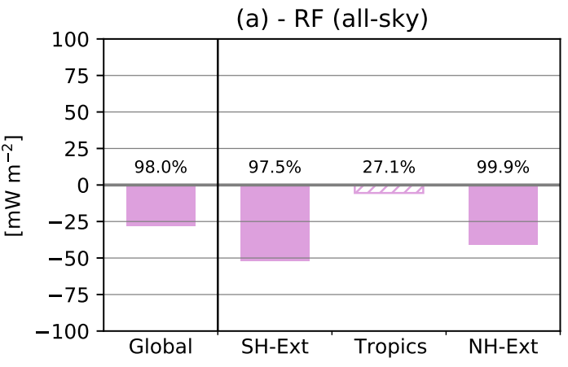
INP-cirrus effects
Total INP-cirrus effect (all INPs): Δ(with – without INPs)
INP-cirrus effect leads to reduction in ice crystal number concentrations, increased sedimentation of larger ice crystals, thinning of cirrus clouds
Resulting cooling effect of -28 ± 21 mW m⁻²
Beer et al., ACP, 2024

Slide 6
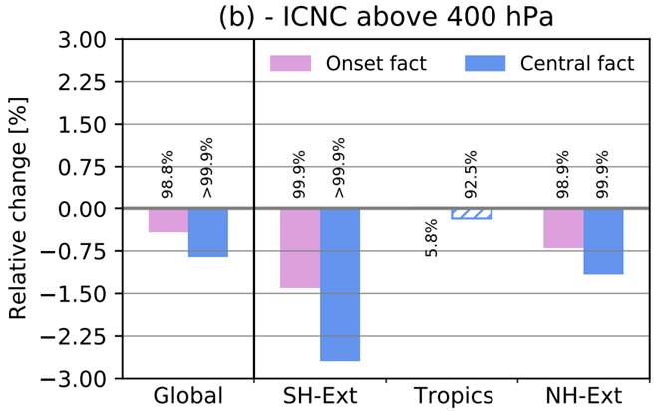
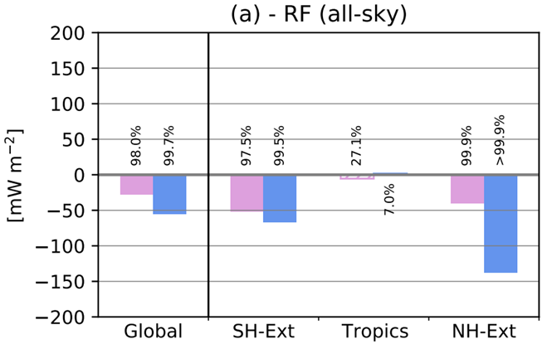
INP-cirrus effects: variation of freezing properties of INPs
Total INP-cirrus effect (all INPs): Δ(with – without INPs); lower, larger activated fraction of INPs
INP-cirrus effect leads to reduction in ice crystal number concentrations, increased sedimentation of larger ice crystals, thinning of cirrus clouds
Resulting cooling effect of -28 ± 21 mW m⁻²
Assuming an enhanced ice-nucleating potential of INPs leads to a factor of about 2 larger INP-cirrus effects: RF = -55 ± 31 mW m⁻².
The magnitude of this effect is similar to the aviation soot-cirrus effect reported in Righi et al. 2021 and is smaller compared to some previous studies.
Beer et al., ACP, 2024

Slide 7
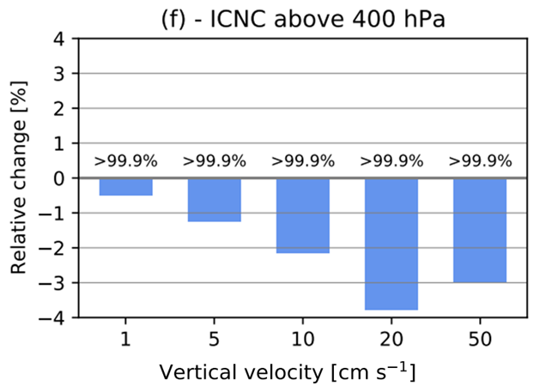
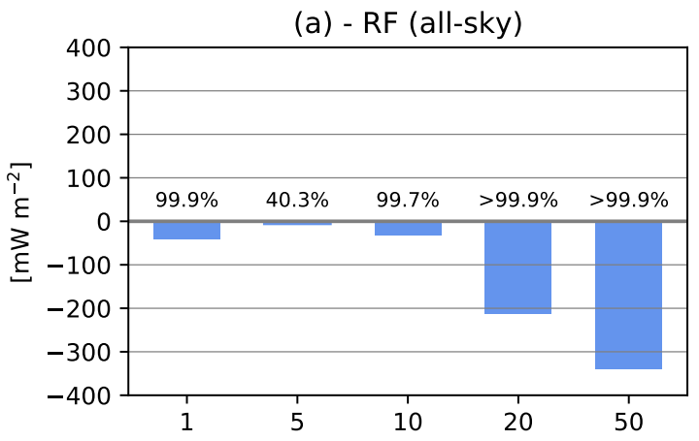
INP-cirrus effects: sensitivity to dynamical forcing (updrafts)
Total INP-cirrus effect (all INPs): Δ(with – without INPs); simplified representation for the updraft speed: prescribing constant vertical velocities
INP-cirrus effect leads to reduction in ice crystal number concentrations, increased sedimentation of larger ice crystals, thinning of cirrus clouds
Resulting cooling effect of -28 ± 21 mW m⁻²
Assuming an enhanced ice-nucleating potential of INPs leads to a factor of about 2 larger INP-cirrus effects: RF = -55 ± 31 mW m⁻²
increasing the vertical velocity results in larger simulated INP-cirrus effects, e.g. global RF of -42 mW m⁻² (at 1 cm s⁻¹) to -340 mW m⁻² (at 50 cm s⁻¹)
Beer et al., ACP, 2024

Slide 8
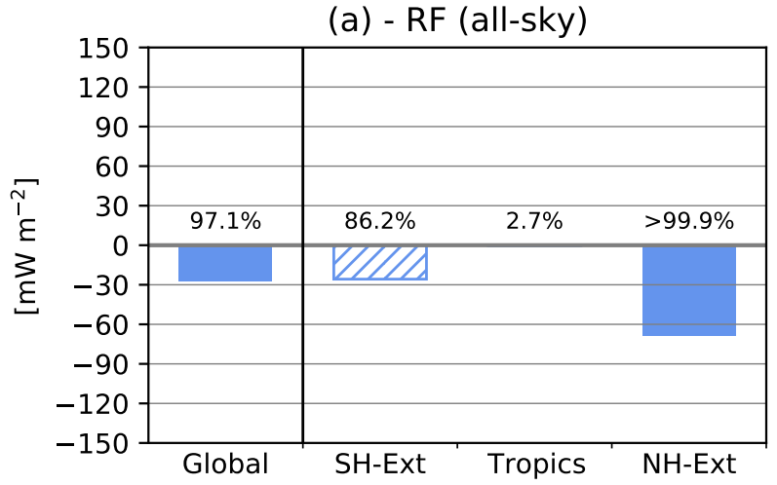
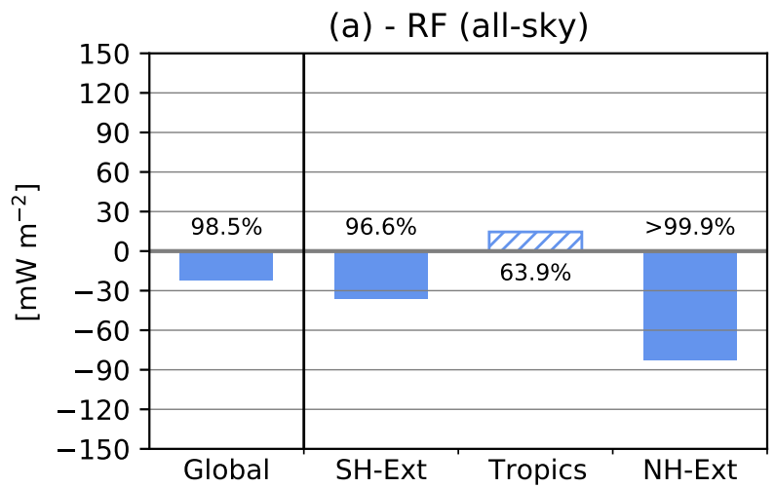
INP-cirrus effects: different INP-types
Mineral dust + BC effect
INP-cirrus effect leads to reduction in ice crystal number concentrations, increased sedimentation of larger ice crystals, thinning of cirrus clouds
Resulting cooling effect of -28 ± 21 mW m⁻²
Assuming an enhanced ice-nucleating potential of INPs leads to a factor of about 2 larger INP-cirrus effects: RF = -55 ± 31 mW m⁻²
increasing the vertical velocity results in larger simulated INP-cirrus effects, e.g. global RF of -42 mW m⁻² (at 1 cm s⁻¹) to -340 mW m⁻² (at 50 cm s⁻¹)
Ammonium sulfate INPs show a large effect, comparable to the combined effect of mineral dust and soot
Adding ammonium sulfate to DU + BC
Beer et al., ACP, 2024

Slide 9
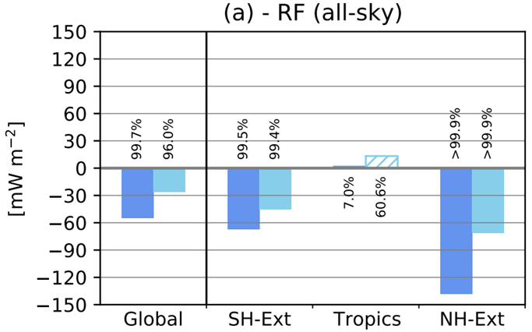
INP-cirrus effects: anthropogenic INPs
Total INP-cirrus effect: Present-day (2014) and pre-industrial (1750) aerosol conditions
INP-cirrus effect leads to reduction in ice crystal number concentrations, increased sedimentation of larger ice crystals, thinning of cirrus clouds
Resulting cooling effect of -28 ± 21 mW m⁻²
Assuming an enhanced ice-nucleating potential of INPs leads to a factor of about 2 larger INP-cirrus effects: RF = -55 ± 31 mW m⁻²
increasing the vertical velocity results in larger simulated INP-cirrus effects, e.g. global RF of -42 mW m⁻² (at 1 cm s⁻¹) to -340 mW m⁻² (at 50 cm s⁻¹)
Ammonium sulfate INPs show a large effect, comparable to the combined effect of mineral dust and soot
The anthropogenic INP-cirrus-forcing is -29 mW m⁻², which is small compared to the total ERF due to aerosol-cloud interactions (-1.0 ± 0.7 W m⁻², IPCC-AR6)
What’s next?
Combined analysis of model results and aircraft measurements (CIRRUS-HL campaign) to investigate INP-effects on cirrus clouds
Beer et al., ACP, 2024

Slide 10
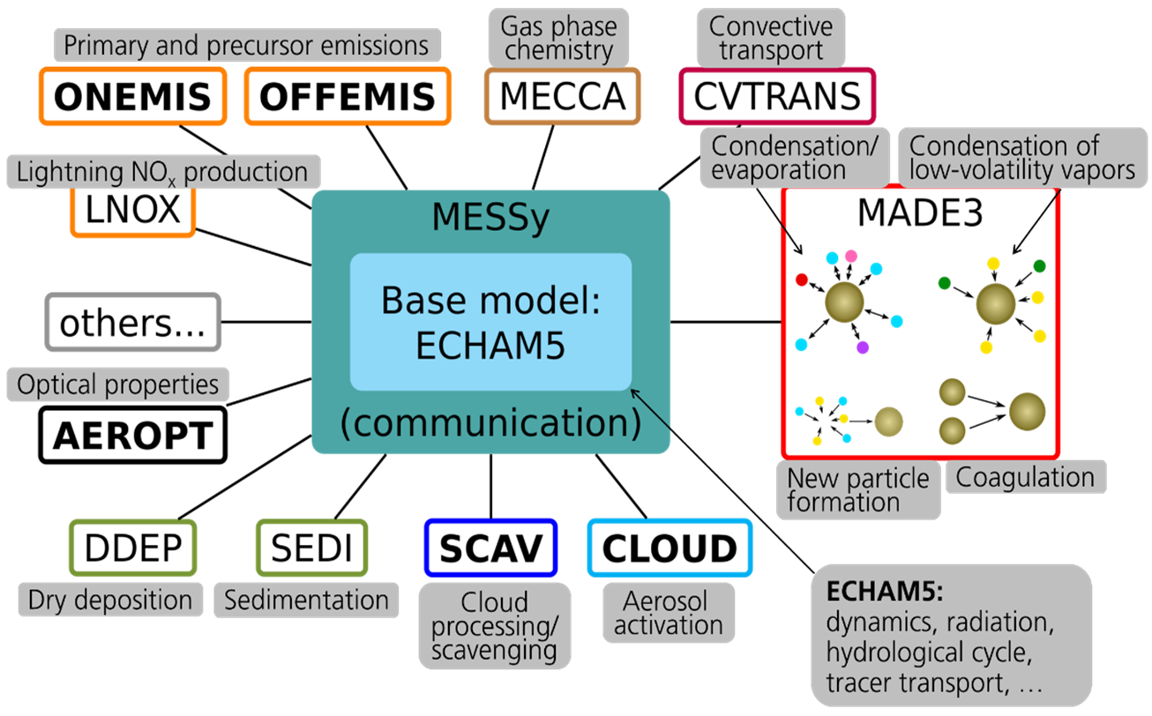
Backup: Global aerosol climate model: MADE3 in EMAC
Emissions
incl. aviation,
CMIP6, 2014
(Feng et al. GMD, 2020)
wind-driven mineral dust
(Beer et al., GMD, 2020)
Aerosol submodel MADE3
(Kaiser et al., GMD, 2019)
Clouds and
aerosol-cloud-coupling
incl. aerosol-cirrus interaction
(Righi et al., GMD, 2020)
2M scheme
ECHAM5: Roeckner et al. (2006); MESSy/EMAC: Jöckel et al. (2005, 2006, 2010);
EMAC with MADE: Lauer et al. (2007), Aquila et al. (2011), Righi et al. (2011, 2013, 2015), Kaiser (2016), Kaiser et al. (2019), Beer et al. (2020), Righi et al. (2020, 2021), Beer (2021), Beer et al. (2022, 2024)
The model simulations and data analysis for this work used the resources of the Deutsches Klimarechen-zentrum (DKRZ) granted by its Scientific Steering Committee (WLA) under project ID bd0080.

Slide 11
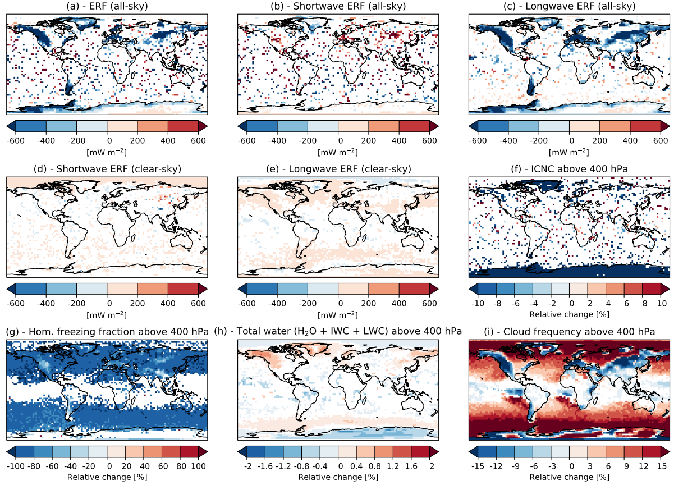
Backup: INP-cirrus effects; geographical distributions
geographic distribution of the simulated total INP-cirrus effect on the different radiation and cloud variables considering all INP types and an increased freezing potential of INPs. Panels (a-e) represent effective radiative forcings at the top of the atmosphere, panels (f-i) show averaged cloud properties above 400hPa.
Beer et al., ACP, 2024

Slide 12
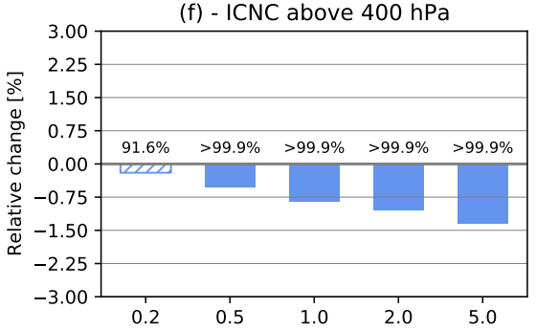
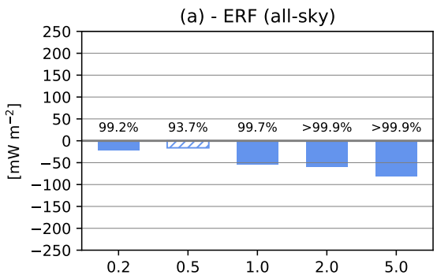
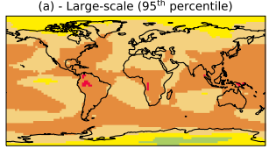
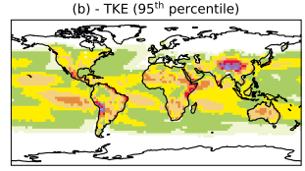
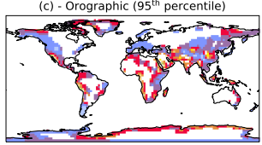
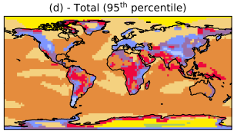
Backup: Variation of parametrized vertical velocity
vertical velocity v = v_{largescale} + v_{turbulent} + v_{orographic} _{gravitywaves}
Beer et al., ACP, 2024

Slide 13
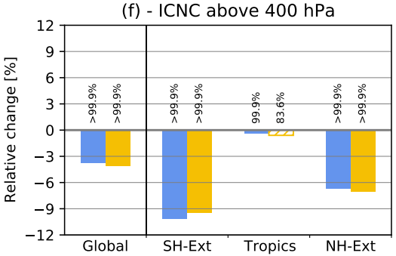
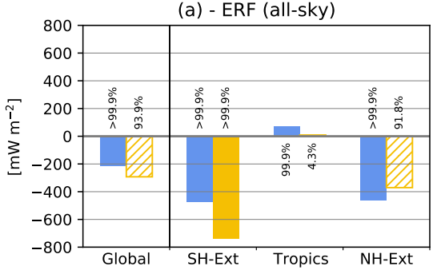
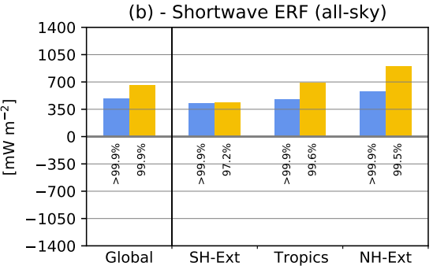
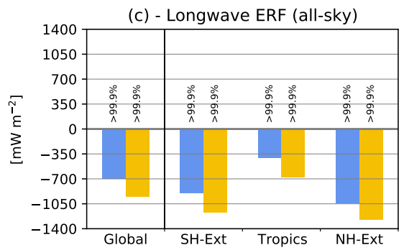
Backup: Impact of model nudging
Beer et al., ACP, 2024

