Slide 1




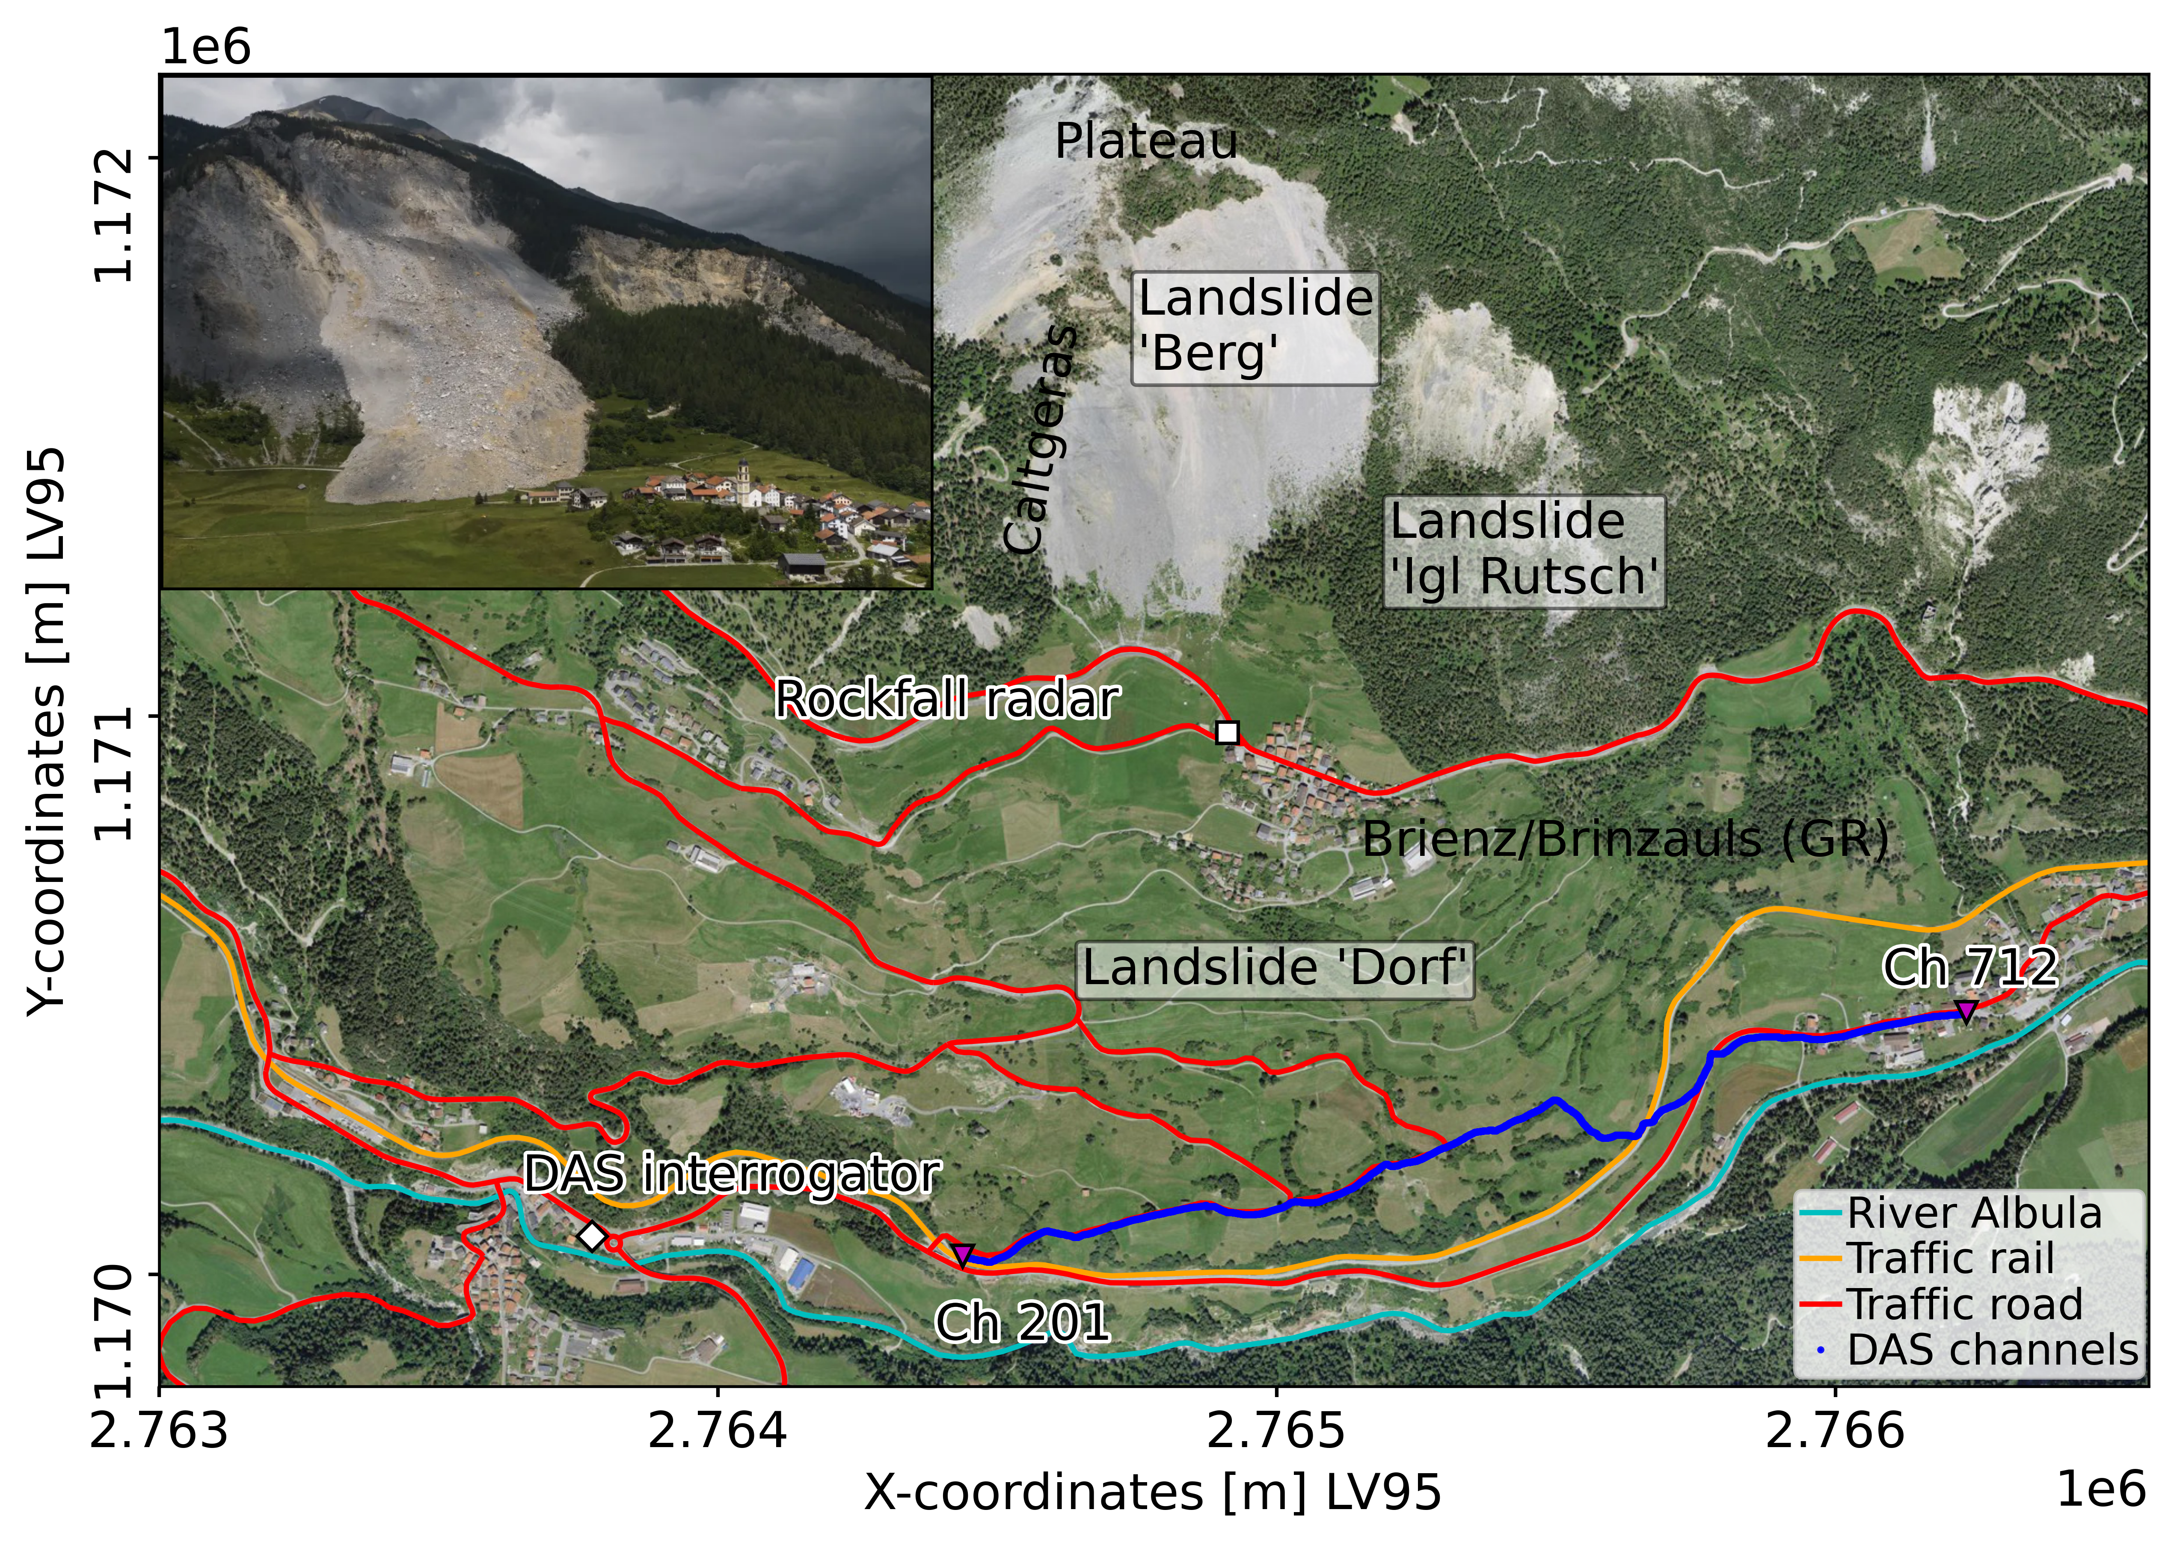
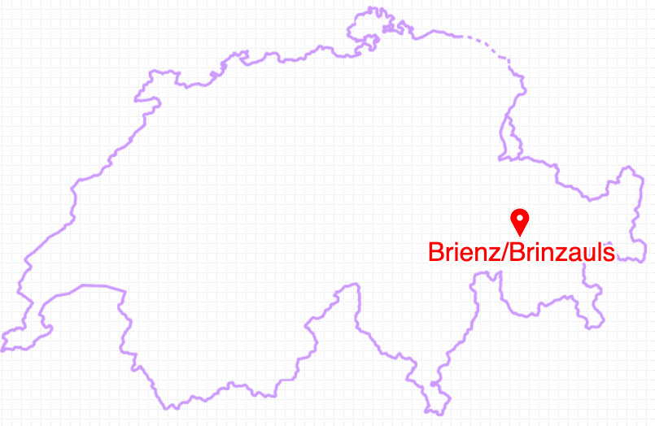
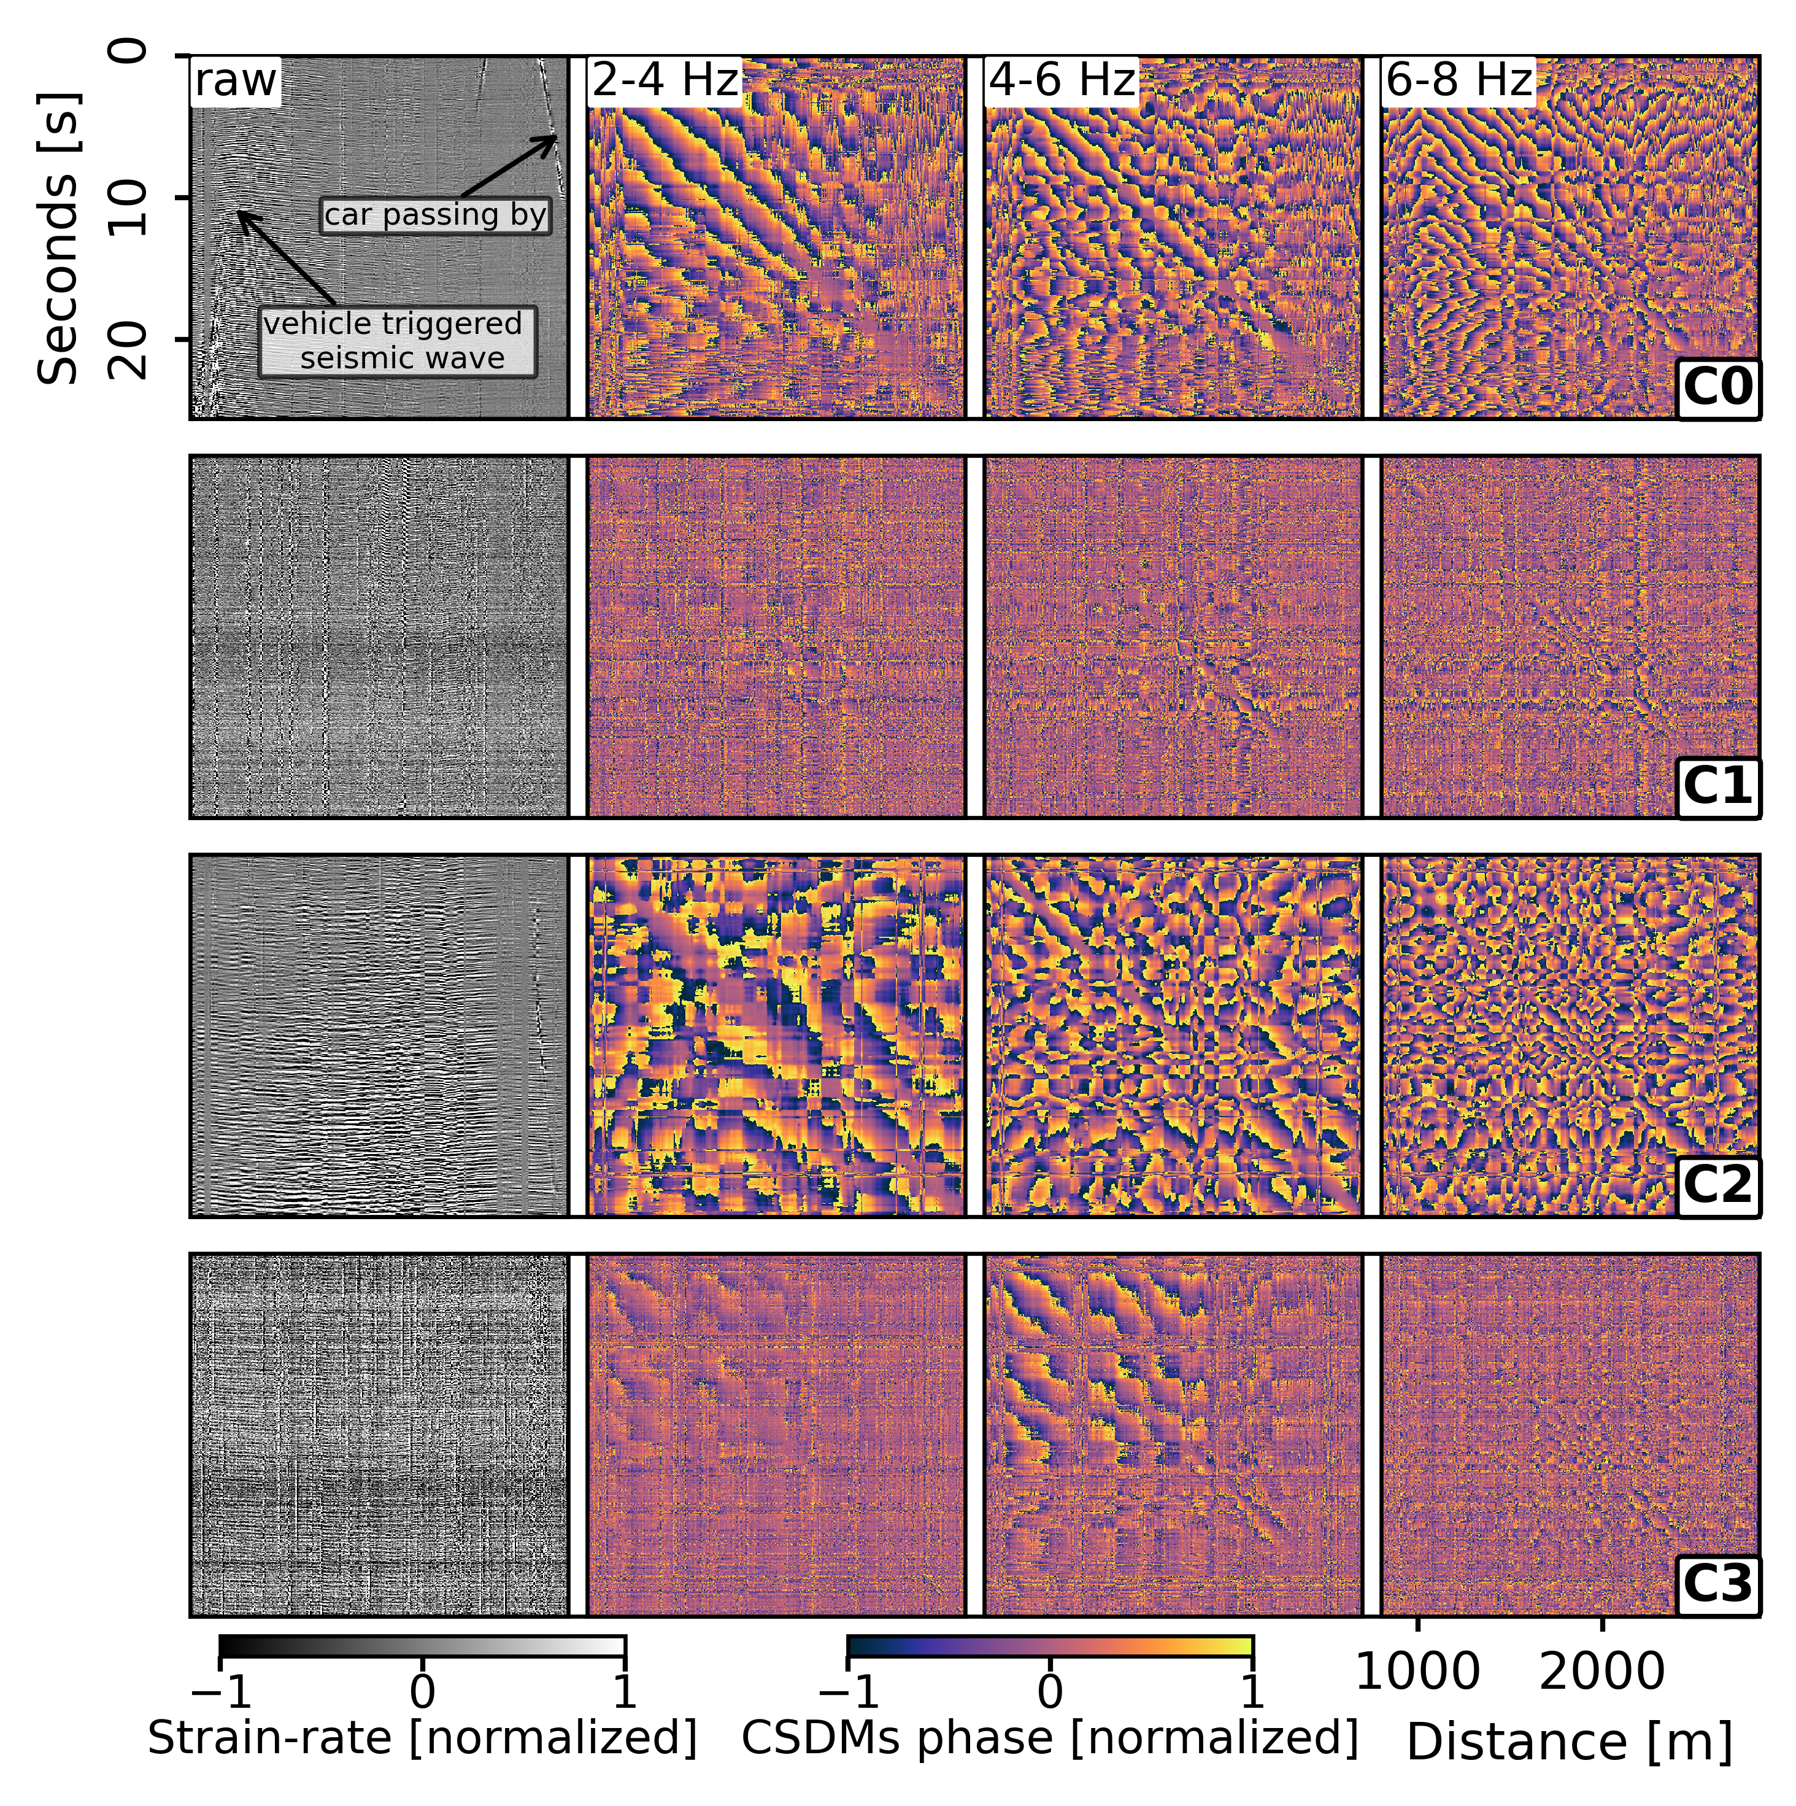









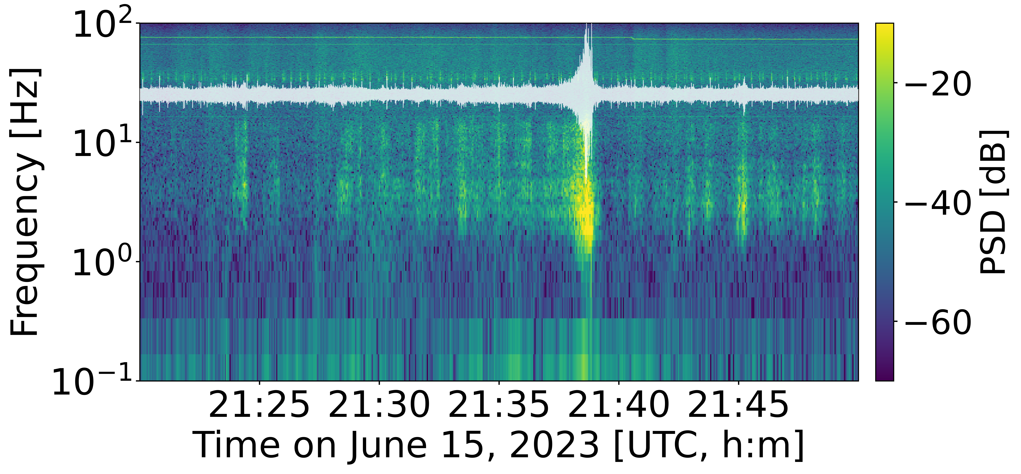
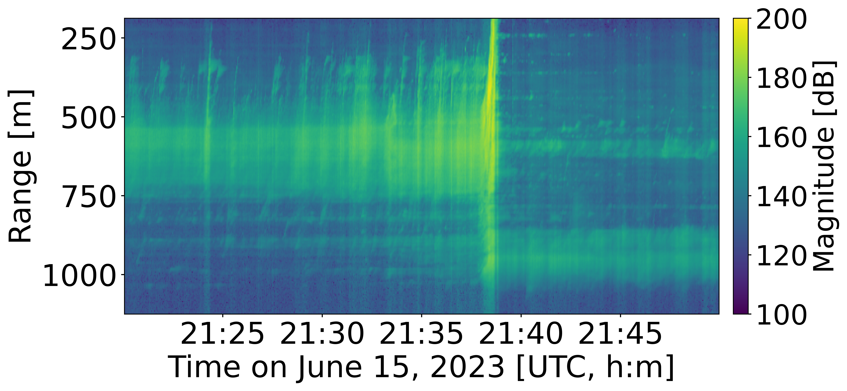


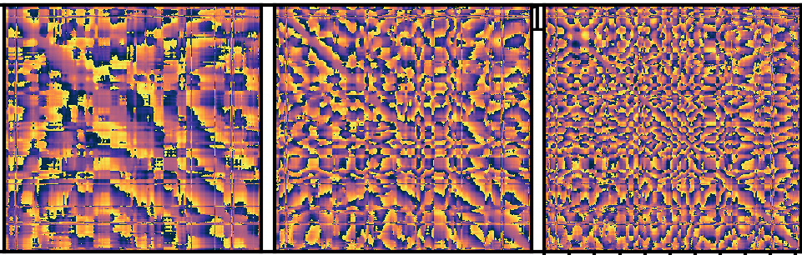
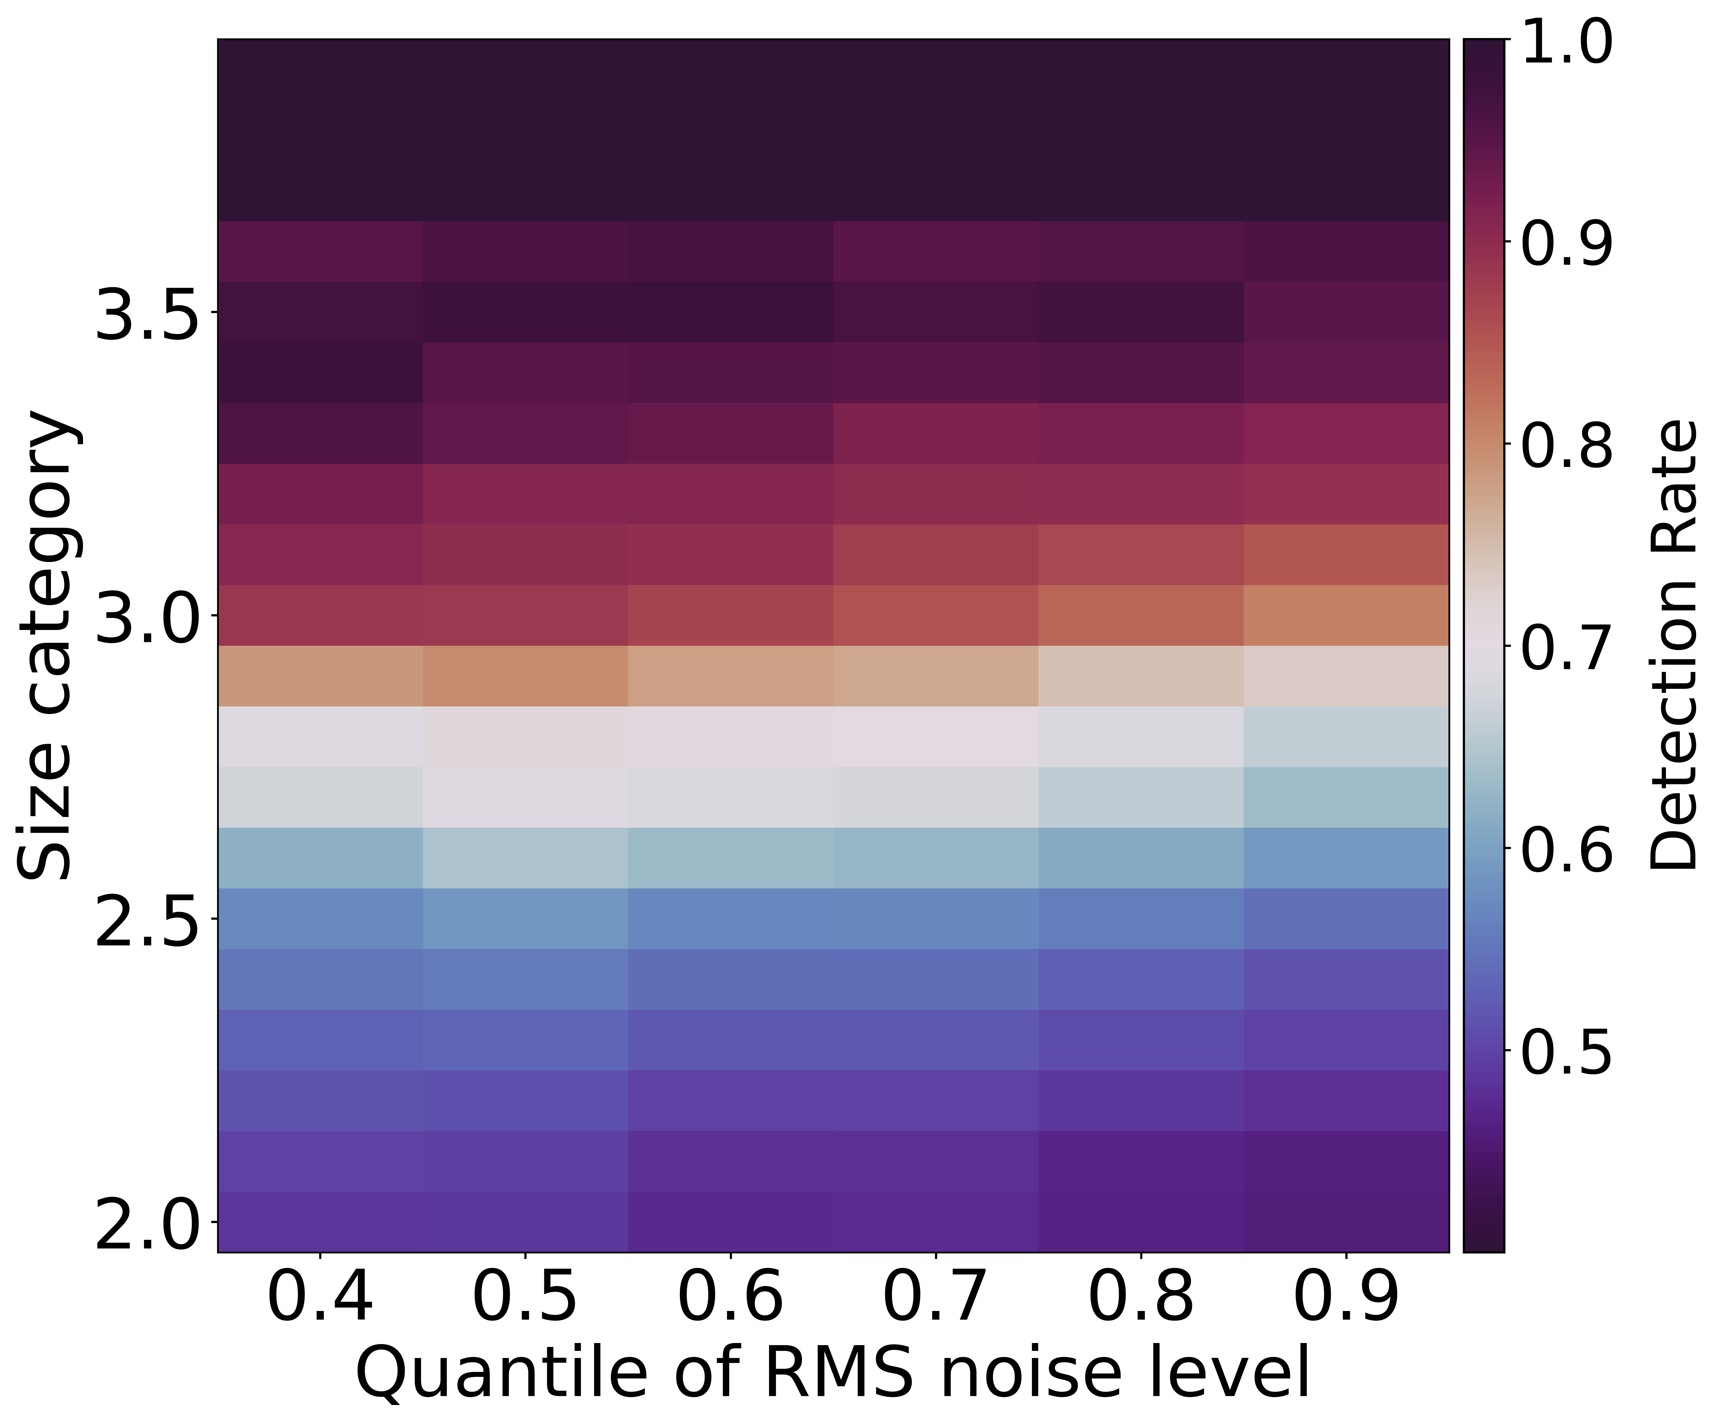
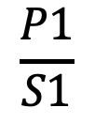
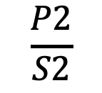
Auto-Detection of Rock Slope Failures at Brienz (Switzerland)
Using Distributed Acoustic Sensing and Semi-Supervised Learning
¹⁾
²⁾
³⁾
⁴⁾
⁵⁾
Jiahui Kang¹⁾⁴⁾⁵⁾, Fabian Walter¹⁾, Patrick Paitz¹⁾, Johannes Aichele²⁾, Pascal Edme²⁾, Andreas Fichtner²⁾ and Lorenz Meier³⁾ jiahui.kang@wsl.ch
Introduction
Motivation : Deliver early warnings for impending major collapses of rock-slope failures in mountainous areas
Challenges?
Methods
C0-Vehicle Noise
C1-Ambient Noise
With coherence along channels of more consistent texture
C2-Rock-slope failures
With minimal or no inter-channel coherence
C3-Special Noise
With more complex and scattered coherence patterns
With predominant energy around 4 Hz
TRIP
MACHINE LEARNING
Timely alerts
RADAR
Reliable detection
Insufficiently instrumented areas
Physical processes
Distributed Acoustic Sensing (DAS)
Brienz Rockslide 2023
Study site
  Brienz/Brinzauls village in Switzerland's Grisons canton faces a dynamic landslide complex, with landslide "Dorf” and "Berg”. Landslide "Berg" above the village, features talus-like sediment deposits and rock outcrops, including the "Insel" rock mass. Landslide "Dorf," housing the village lies between the foot of "Berg" and the Albula River.
  May 2023: Accelerated activity in landslide "Berg” prompts village evacuation due to mass movements.
  June 2023: "Insel" rock formation collapses (about 1.2 million cubic meters) overnight between June 15 and 16 (major collapse).
Data
  May 16 – June 30, 2023
  DAS measures strain rate along the cable at a sampling frequency of 200 Hz, and a channel spacing of 4 m.
  Doppler radar measures the velocity and range of moving targets and serves as a partially reliable ground truth.
Figure 1. The orthophoto mosaic SWISSIMAGE 10 cm of Brienz (Federal Office of Topography swisstopo, 2024). The DAS interrogator is near the Albula River to the southwest of the village and the cable runs adjacent to the cantonal traffic road and a train line. The DAS records capture both slope failures and traffic noise. The Doppler radar is attached to the wall of the former school and continuously monitors the rockfall area from about 1 km away.
Figure 4. Normalized labeled subset input for downstream classification. CSDMs images depict various textures, indicating different coherence patterns.
Semi-supervised model
Channel coherence
Unsupervised learning
Supervised classification
VQ-VAE ^{[2]}
Vector-Quantized Variational Autoencoder
XGBOOST^{[3]}
eXtreme Gradient Boosting
DAS
RADAR
Cross-Spectral Density Matrices (CSDMs)^{[1]} averaged over three frequency bands: 2-4 Hz, 4-6 Hz, and 6-8 Hz
Dimensionality reduction
Feature extraction
Event detection
Interpretability
Figure 2. Fourier spectrogram and waveform at Ch510 over 5-second windows around the major collapse.
Figure 3. Range activity radar spectrum by summing velocity bins for the same period. Higher magnitudes suggest a broader velocity spectrum or elevated amplitudes in select bins, or both.
Results
Take home message:
  Machine learning revolutionizes rock-slope failure detection by capitalizing on the spatial-temporal information within DAS records.
  Our algorithm provides early warnings of major collapses by analysing detection number changes.
  Key dependencies of our model include event size and SNR, with interfering waves from traffic presenting a significant challenge.
  This approach advances continuous real-time hazard monitoring, especially in the presence of interfering waves from noisy DAS data
Vehicle Noise (C0). Our algorithm doesn’t differentiate between cars and trains
Accelerating DAS and radar detection prior to major collapse
Detection precision : 93%, Detection rate : 42.9%
Diurnal Pattern
 | Positive (P) | Negative (N) | Sum
DAS | 1006 (P1) | 136 (N1) | 1142 (S1)
RADAR | 312 (P2) | 415 (N2) | 727 (S2)
*Positive: The radar detection windows were extended by 1 minute on two sides. This holds true when a DAS detection overlaps with a radar detection. One radar event can correspond to multiple DAS detections.
Refer to Radar detection:
DAS detection rate: 42.9%
DAS precision: 88.1% 93%
$$\frac{P2}{S2}$$
$$\frac{P1}{S1}$$
Mislabeled rock-slope failures:
C1 22% Event Magnitude
C0 65% Signal to Noise Ratio
References:
[1] Welch, P. (1967). The use of fast fourier transform for the estimation of power spectra: A method based on time averaging over short, modified periodograms. IEEE Transactions on Audio and Electroacoustics, 15 (2), 70-73. doi: 10.1109/TAU.1967.1161901
[2] van den Oord, A., Vinyals, O., & Kavukcuoglu, K. (2017). Neural discrete learning. In Proceedings of the 31st international conference on neural information processing systems (p. 6309–6318). Red Hook, NY, USA: Curran Associates Inc.
[3] Chen, T., & Guestrin, C. (2016). Xgboost: A scalable tree boosting system. In Proceedings of the 22nd acm sigkdd international conference on knowledge discovery and data mining (p. 785–794). New York, NY, USA: Association for Computing Machinery. doi: 10.1145/2939672.2939785
Figure 5. Overview of DAS detections. Each detection represents a time window of 25.6 s. Event classes are color-coded (legend).
Figure 6. Detection results for slope failures incorporating DAS and radar data by binary values, with cumulative detection numbers on a secondary y-axis. The blue boxes represent a highlighted detection period observed between 20:00 and 23:59 [UTC], shown in an enlarged view above.
Figure 7. Heatmap illustrating grouped detection rate, with x-axis representing RMS noise level quantile (step size 0.1) and y-axis indicating size category (step size 0.1). As the noise level increases, the detection rate decreases, whereas as the size category increases, the detection rate rises.

