Slide 1
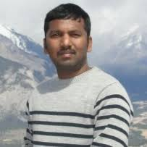
An Integrated Hydrological Modeling Framework for Enhancing Water-Energy Nexus in the Godavari River Basin, India
Kasiviswanathan KS, Chandni Thakur
Prof. Kasiviswanathan KS
Associate Professor, IIT Roorkee, India
Mobile: +91 9952 199 196
Email: k.kasiviswanathan@wr.iitr.ac.in

Slide 2
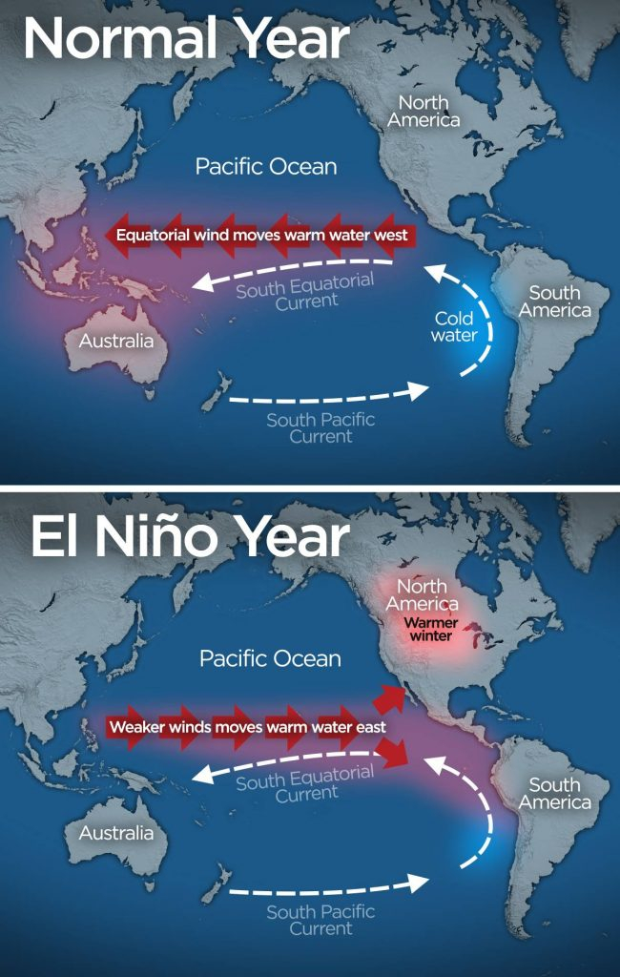
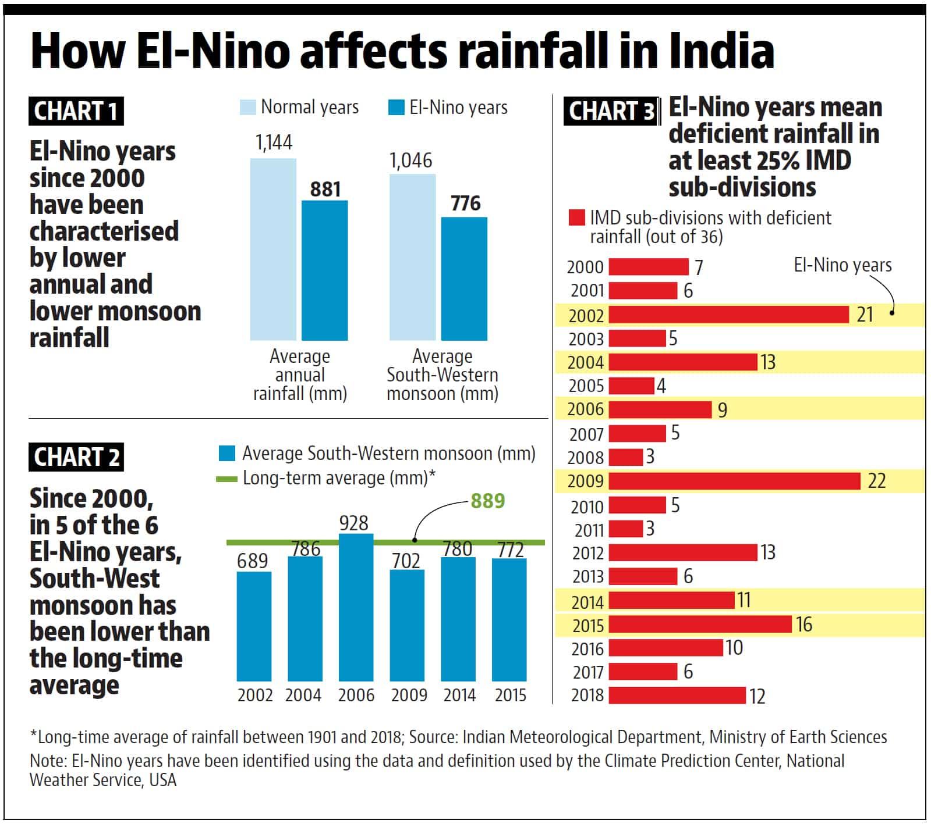
Background

Slide 3
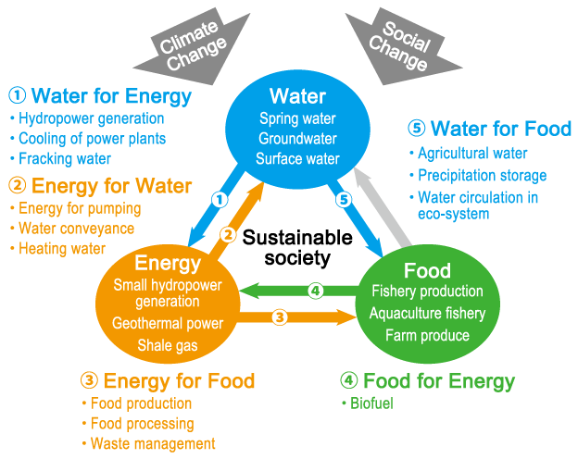
Water-Energy-Food Nexus
How does El Niño impact India’s water resources, agricultural output and energy production???
6
Food for Water
Agricultural runoff and water quality

Slide 4
Water-Energy Nexus

Slide 5
Introduction
El Niño
El Niño:
Impacts Indian summer monsoon rainfall
Historical droughts and rainfall deficits
Implications on streamflow and hydropower
Affects water resources, economy and stakeholders
Water-Energy Nexus
El Niño Impacts:
On ISMR are bound to affect water-energy nexus
Water and energy security during El Niño
Mitigating El Niño impacts on hydro-energy vulnerability
Resilient run-of-river small hydropower sites
Hydrological Modelling
Hydrological models:
To assess the impacts of El Niño on water-energy nexus
Limitations:
Uncertainty in the model simulations
Single site calibration
Equifinality
Local optimization
Enhanced Calibration
Hydrological models:
Strengthen the accuracy of hydrological modelling
Decrease the uncertainty in El Niño impact assessment on water-energy nexus

Slide 6
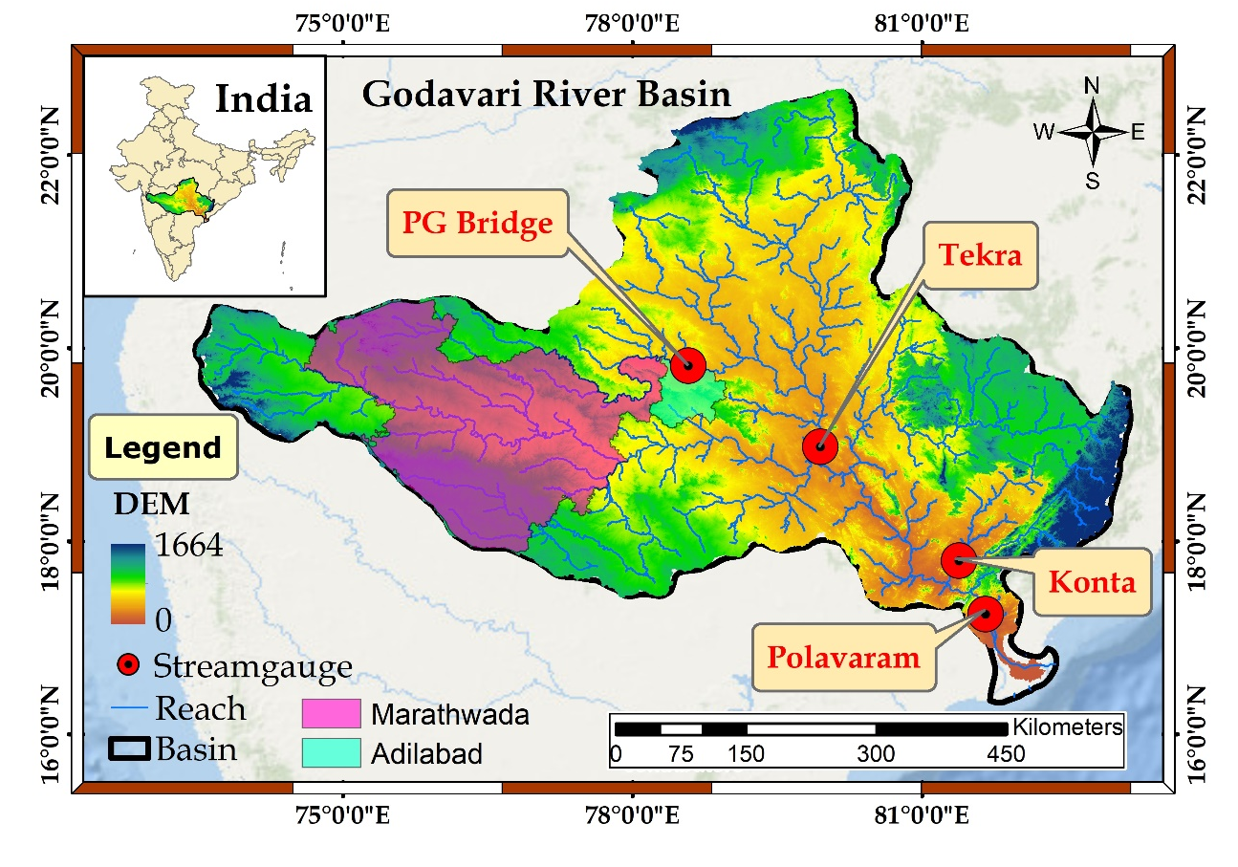
Godavari River Basin (GRB)
Geographical Location: covers approximately 9.5% of the country’s geographical area i.e. 312,812 km²
Climate: experiences a tropical climate and ISMR accounts for approximately 85% of the annual rainfall
Water Infrastructures: More than 15 major dams and reservoirs, with a combined storage capacity exceeding 21 billion m³ and installed hydropower generation capacity exceeds 2.7 GW
Vulnerability: A significant reduction in annual water discharge due to declining annual rainfall, leading to frequent agricultural and hydrological droughts
Future Projections: An increase in the frequency of droughts from 2053 to 2099

Slide 7
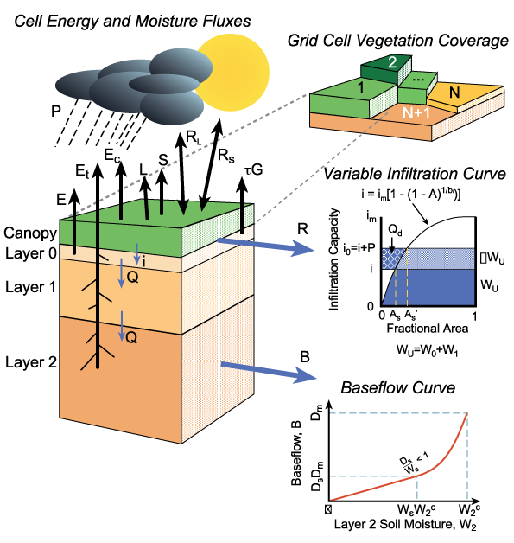
Introduction to the VIC Model
The Variable Infiltration Capacity Model
A large-scale, semi-distributed hydrological model (Liang et al.1994)
Sub-grid heterogeneity (e.g. elevation, land cover) is handled via statistical distributions
Developed for coupled Land Surface Model (LSM) – Global Circulation Model (GCM) simulations
Open-source development

Slide 8
Workflow of the VIC Model
Note: The VIC model has been developed for use on Linux platforms and requires pre-processing of input data in an ASCII format at each grid level: a time consuming process

Slide 9
Need to Improve VIC Calibration Process?
Manual Calibration (Hengade et al. 2018;Shah and Mishra 2016; Mishra et al. 2020)
Time-consuming
Subjectivity
Automatic optimization algorithms (Downhill simplex method, Genetic algorithm)
Poor parametrization: unable to handle high dimensionality
Computationally inefficient: large number of model runs required
Equifinality: various parameter sets reproducing identical output
Need of an automatic calibration framework providing more realistic model parameter estimates and is computationally more efficient

Slide 10
Calibration Framework
Chandni Thakur, Venkatesh Budamala, KS Kasiviswanathan, Claudia Teuschbein, Bankaru-Swamy Soundharajan (2024). Advancing the Calibration of Macroscale Hydrological Models by Integrating Sensitivity Analysis, Adaptive Pseudo-modeling Optimization and Multi-site Calibration. (Revision is under review, Water Resources Research)

Slide 11
Datasets
Data Parameter | Source/Product Name | Spatial Resolution | Temporal Resolution | VIC Requirement
Precipitation | IMD | 0.25° × 0.25° | Daily | Daily
Minimum and Maximum Temperature | IMD | 1° × 1° | Daily | Daily
Elevation Data | SRTM DEM | 30 m | - | -
Soil Data | FAO-HWSD | 30 arc-second (~1 km) | - | -
LULC Data | NASA’s ORNL DAAC Portal | 100 m | - | Annual
Leaf Area Index (LAI) | MCD15A3H (MODIS Terra + Aqua Combined) | 500 m | 4 Days | Monthly
Shortwave Albedo | MCD43A3 | 500 m | Daily | Monthly
Observed Streamflow | CWC | PG Bridge, Konta, Tekra and Polavaram | Daily | Daily
Oceanic Niño Index | NOAA | - | 3 Months | -

Slide 12
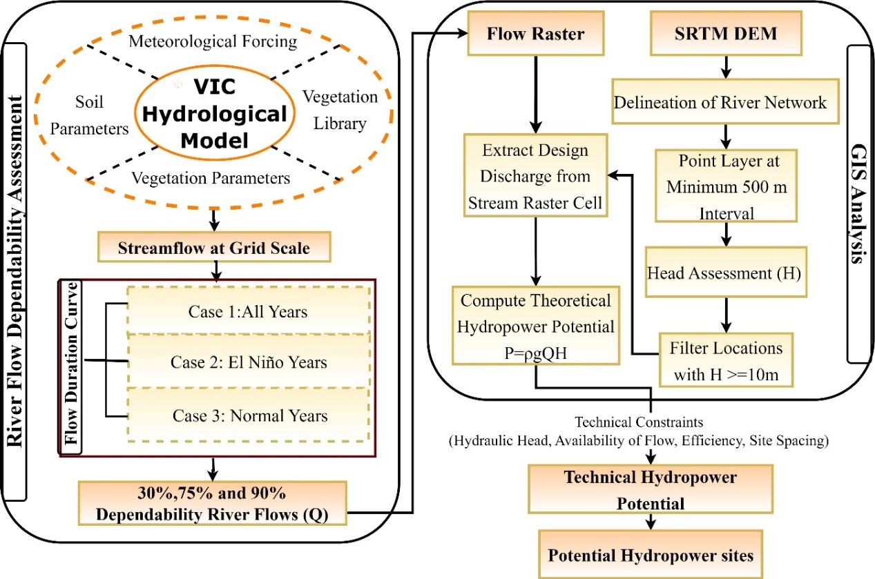
Methodological Framework

Slide 13
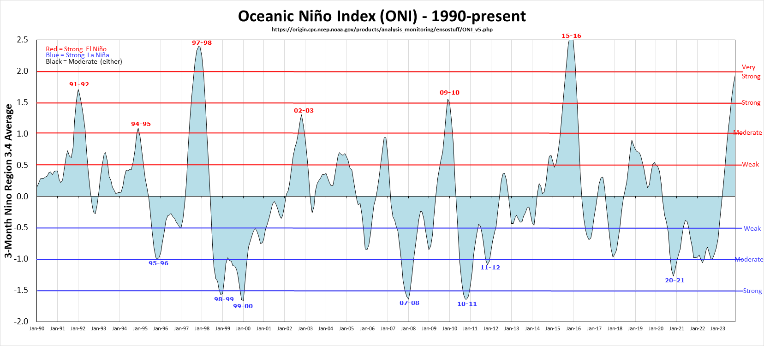
El Niño Years
El Niño events were classified based on the mean monthly ONI values from National Oceanic and Atmospheric Administration (NOAA) during 1950-2020.
Source: http://www.cpc.noaa.gov/data/indices/
Event | Years
El Niño (19) | 1951, 1953, 1957, 1958, 1963, 1965, 1969, 1972, 1982, 1983, 1987, 1991, 1992, 1997, 2002, 2004, 2009, 2015, 2019
Normal (8) | 1960, 1961, 1962, 1967, 1981, 1990, 1993, 2013

Slide 14
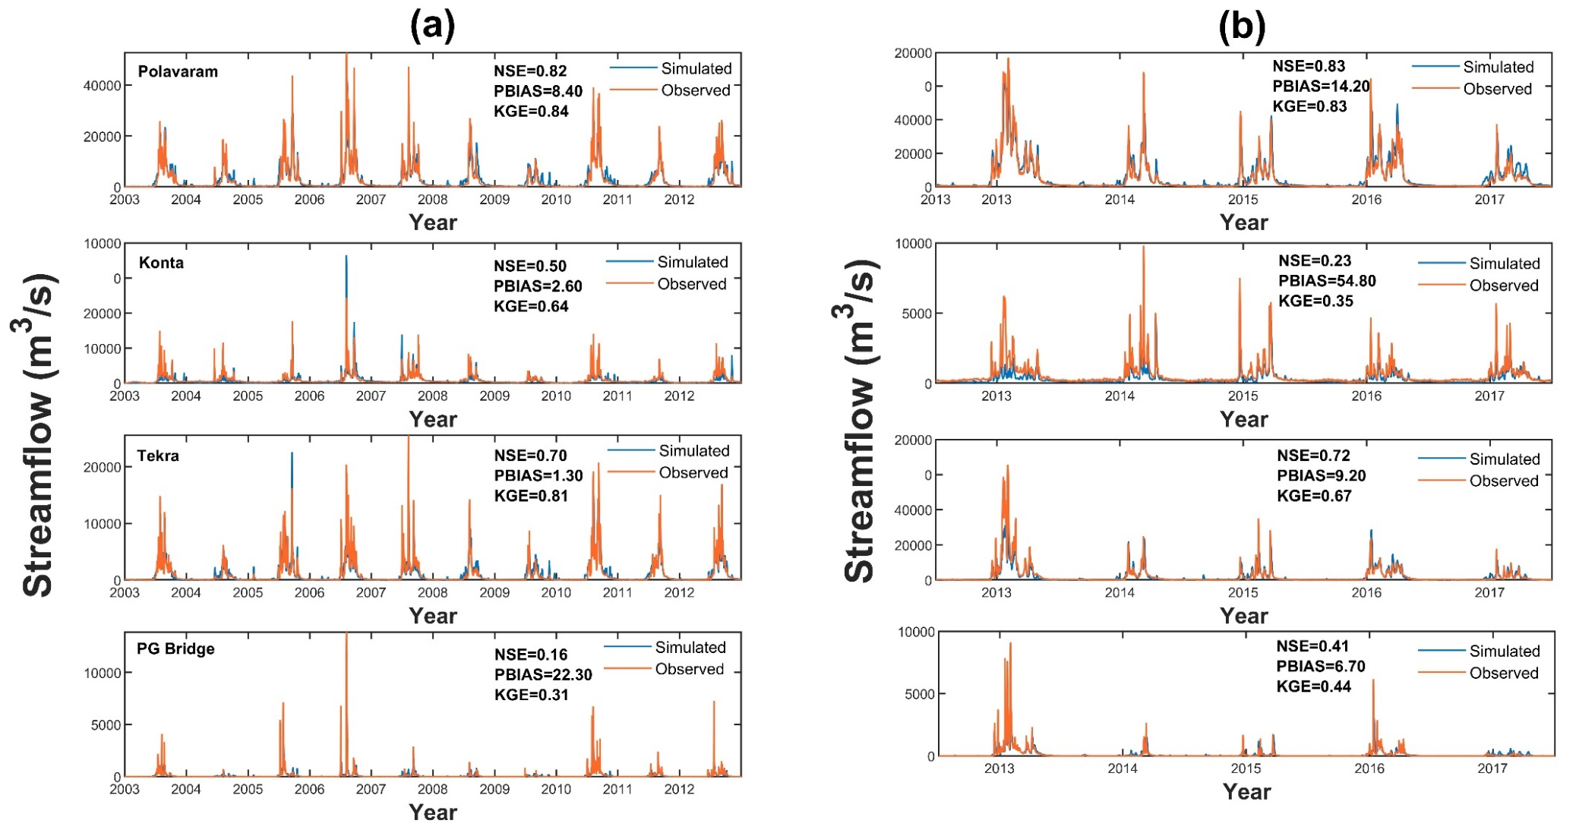
Model Performance
Calibration
Validation
Comparison of daily observed (red) and the VIC simulated (blue) streamflow (m³/s) for the (a) Calibration (2003-2012), (b) Validation (2013-2017) periods at the selected gauge stations Polavaram, Konta, Tekra and PG Bridge

Slide 15
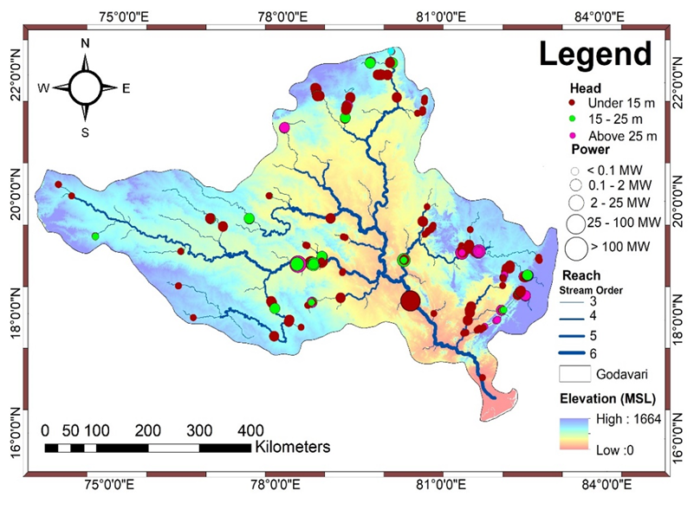
GIS Analysis for Head Assessment
Stream Network Generation:
Utilized SRTM 30 m x 30 m resolution DEM
Hydraulic Head and Waterway Length Determination:
Points densified at 500 m intervals (Backwater from downstream)
Maximum waterway length set at 3000 m (minimize the overall cost of penstock)
Additional point layers generated at intervals of 1000 m to 3000 m
500m point layer was prioritized to select/remove any intersecting points with other layers
Criteria for Technical Potential Assessment:
POS_{H} meeting head threshold equal to or greater than 10 m
Spatial distribution of potential RoR-SHP sites that satisfied the criteria for head (H ≥10m)

Slide 16
Selected Run-of-river Small Hydropower Sites
Site | Head (m) | Waterway Length(m) | Flow (m³/s) |  |  | Power (MW) |  |  | Energy (TWh/yr)
 |  |  | Q30 | Q75 | Q90 | P30 | P75 | P90 | E30 | E75 | E90
POS_{H,MW1} | 10 | 3000 | 338 | 36 | 26 | 26 | 3 | 2 | 0.10 | 0.01 | 0.01
POS_{H,MW2} | 40 | 2500 | 115 | 15 | 12 | 36 | 5 | 4 | 0.12 | 0.02 | 0.02
POS_{H,MW3} | 27 | 2500 | 326 | 35 | 25 | 69 | 7 | 5 | 0.25 | 0.03 | 0.02
POS_{H,MW4} | 26 | 2000 | 130 | 17 | 14 | 27 | 3 | 3 | 0.09 | 0.02 | 0.01
POS_{H,MW5} | 11 | 2000 | 338 | 36 | 26 | 29 | 3 | 2 | 0.11 | 0.01 | 0.01
POS_{H,MW6} | 16 | 2000 | 260 | 32 | 23 | 33 | 4 | 3 | 0.10 | 0.02 | 0.01
POS_{H,MW7} | 10 | 1500 | 338 | 36 | 26 | 26 | 3 | 2 | 0.10 | 0.01 | 0.01
POS_{H,MW8} | 11 | 1500 | 1530 | 181 | 144 | 132 | 16 | 12 | 0.46 | 0.07 | 0.05
POS_{H,MW9} | 15 | 1000 | 338 | 36 | 26 | 40 | 4 | 3 | 0.15 | 0.02 | 0.01
POS_{H,MW10} | 29 | 500 | 115 | 15 | 12 | 26 | 3 | 3 | 0.22 | 0.02 | 0.01
POS_{H,MW11} | 24 | 500 | 326 | 35 | 25 | 61 | 7 | 5 | 0.06 | 0.03 | 0.02

Slide 17
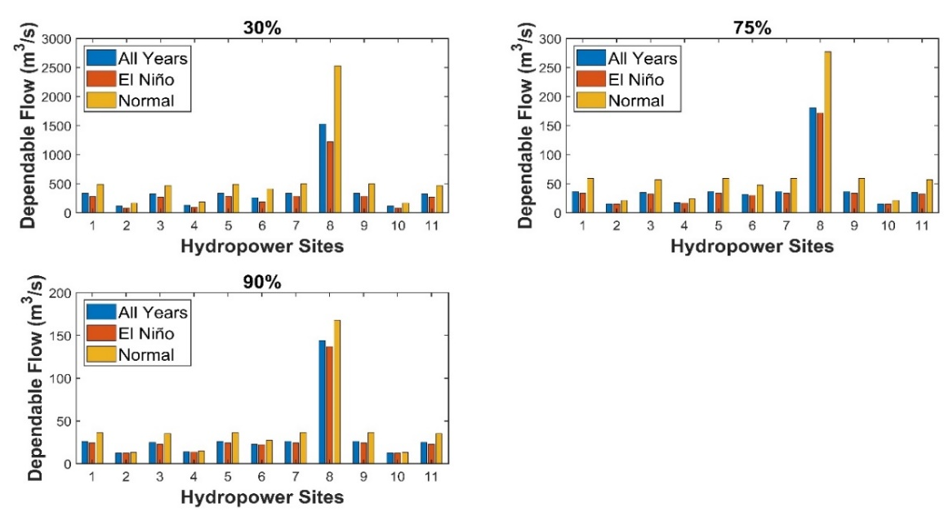
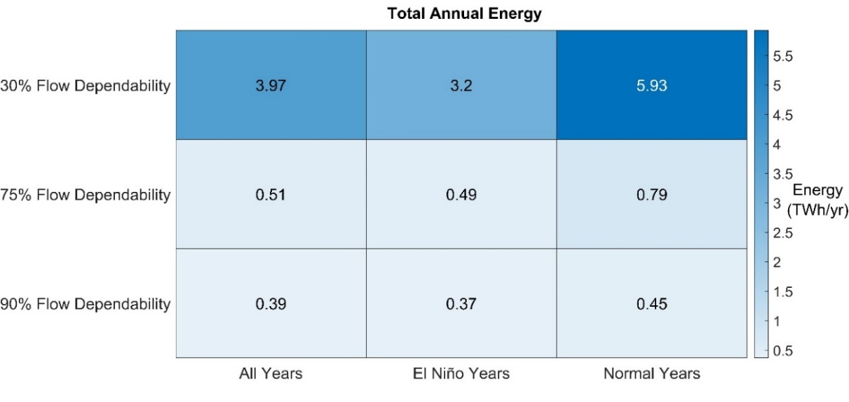
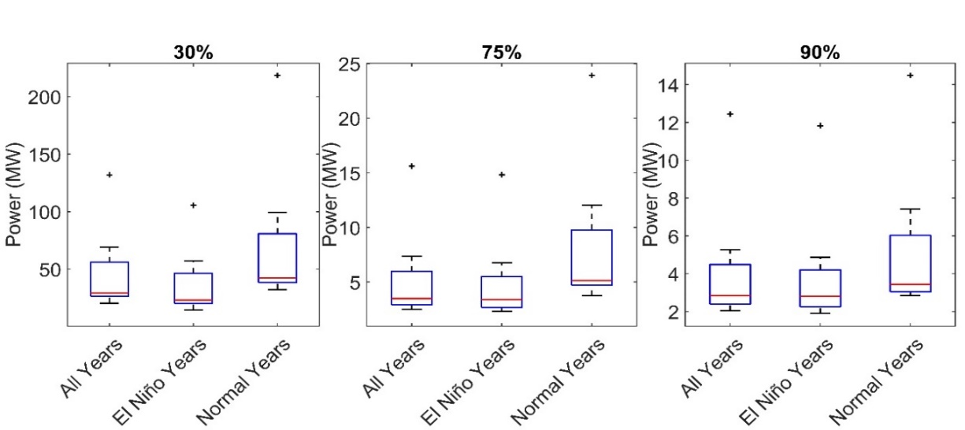
El Niño Impacts
Flow, Power and Energy during El Niño, normal and all years for 11 filtered sites
Power
Energy
Flow

Slide 18
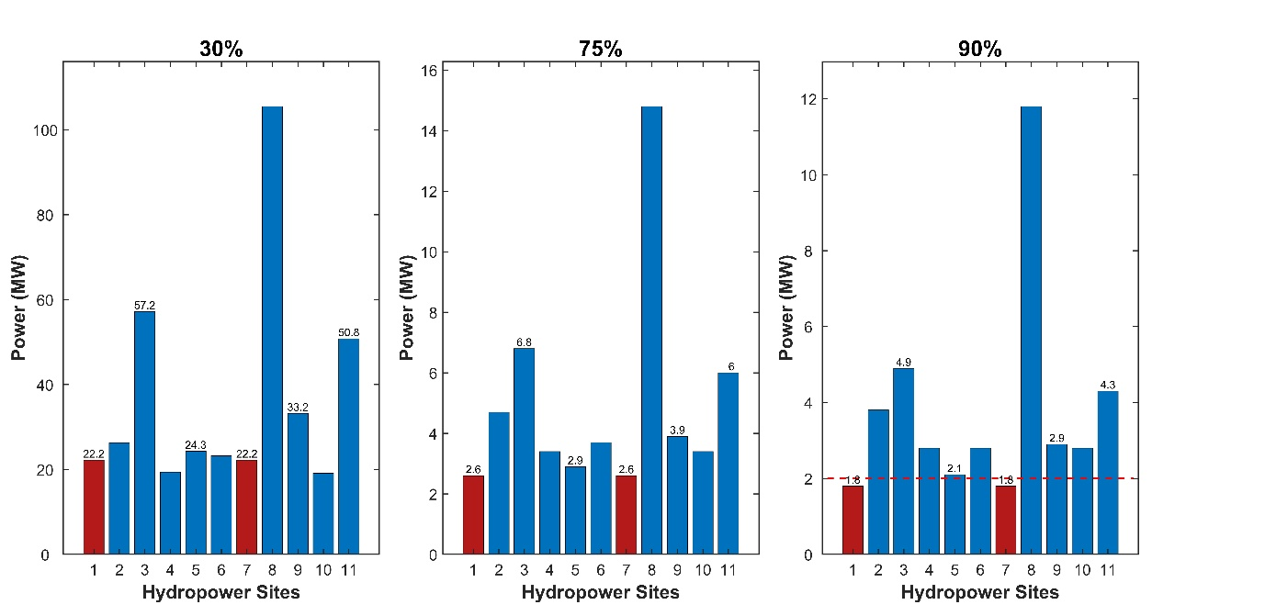
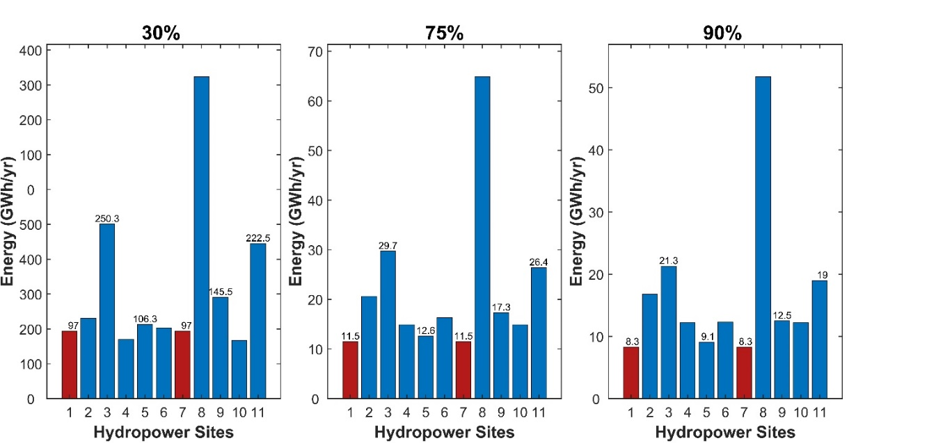
Resilient Hydropower Sites during El Niño
Annual technical hydropower potential and annual energy (GWh/yr) for potential sites under El Niño
Power
Energy

Slide 19
Conclusions
The GRB demonstrated the significant collective technical potential (226 POS_{H}) for RoR-SHP hydropower generation, capable of producing approximately 4.09 TWh/yr, 0.53 TWh/yr, and 0.4 TWh/yr with 30%, 75%, and 90% flow dependability
11 potential sites for Run-of-river small hydropower (RoR-SHP) were identified based on the threshold for annual technical power (2-25 MW) with 90% flow dependability (computed across the period 1951-2020, considering all years)
A decline of 46%, 38%, and 18% in annual energy at 30%, 75%, and 90% flow dependability in El Niño years compared to normal years
Potential sites maintaining the firm power (90% flow dependability) even during El Niño years (computed across the period 1951-2020, considering El Niño years only) were proposed
The integration of the VIC model and GIS provided a thorough assessment of the potential of RoR-SHP in the GRB, particularly in mitigating energy vulnerability during El Niño events
The finding underscored the increased risk of power shortages during El Niño years and emphasized the need to develop appropriate strategies to cope with the risks associated with El Niño events

Slide 20
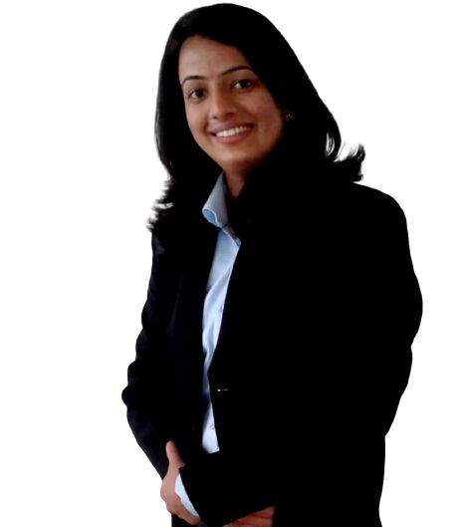
Acknowledgement
Chandni Thakur
Ph.D. Scholar
WRD&M Department
IIT Roorkee
Mobile: +91 8894 046 468
Email: chandnithakur2@gmail.com
The authors are thankful to Swedish Research Council (Vetenskapsrådet, VR) for providing financial support for carrying out this study (Grant Number: 2018-05848)

Slide 21
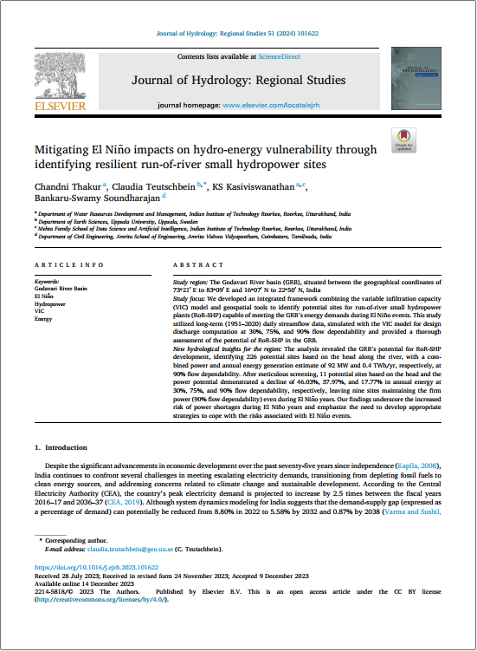
Suggestions/Feedback
THANK YOU!

