Slide 1
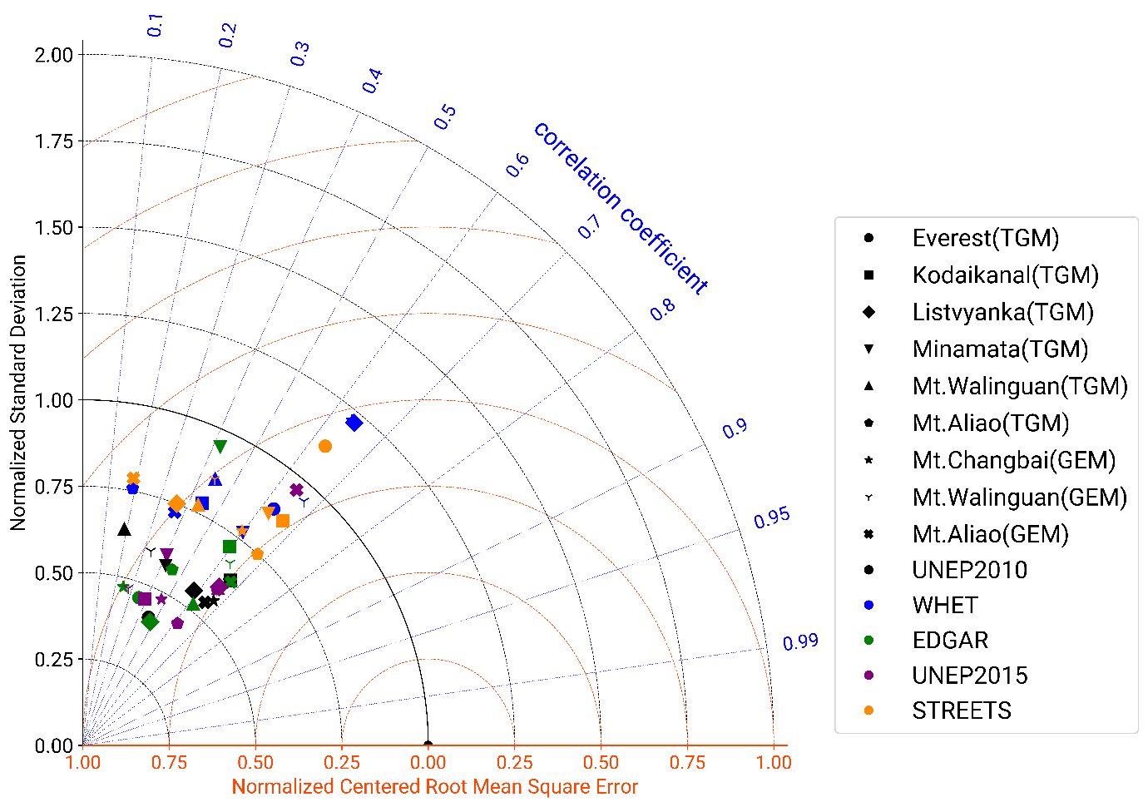
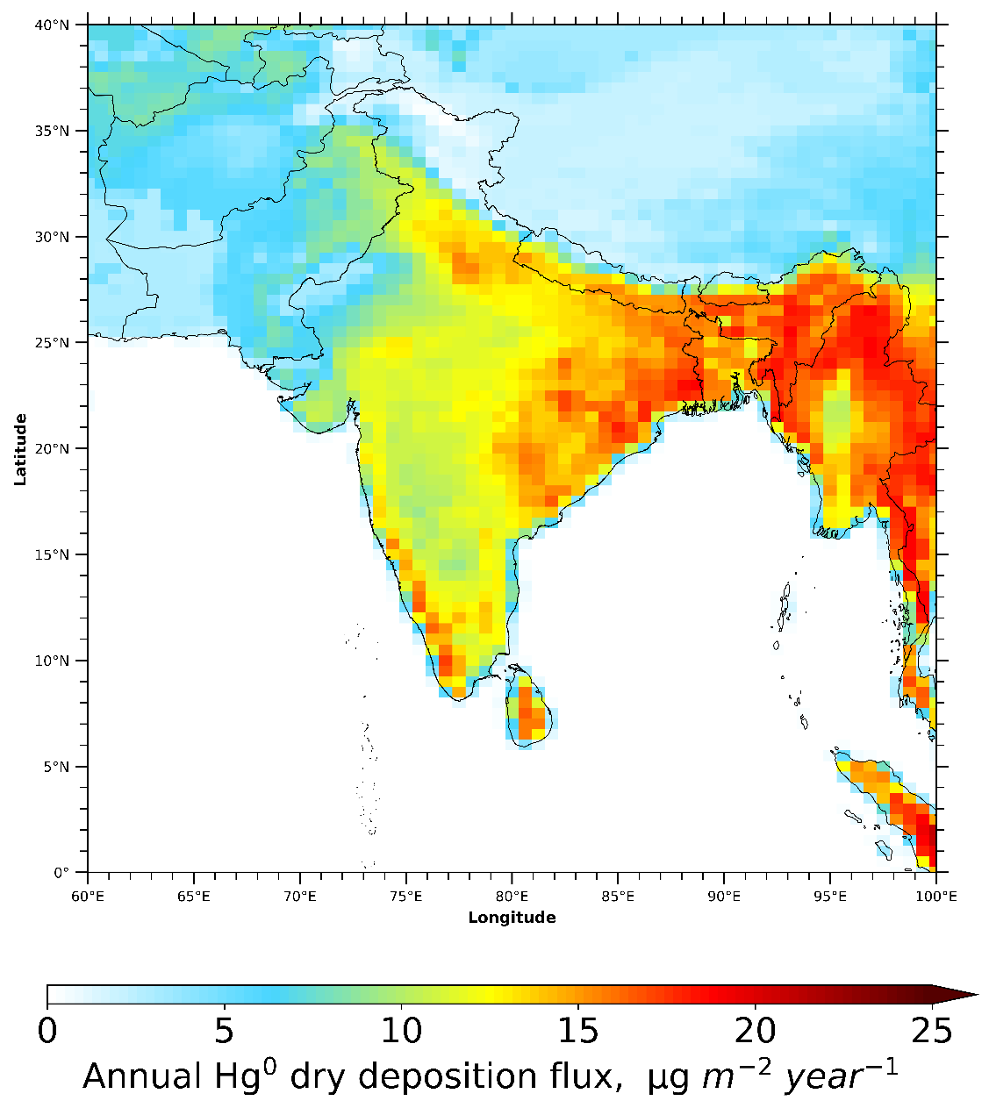
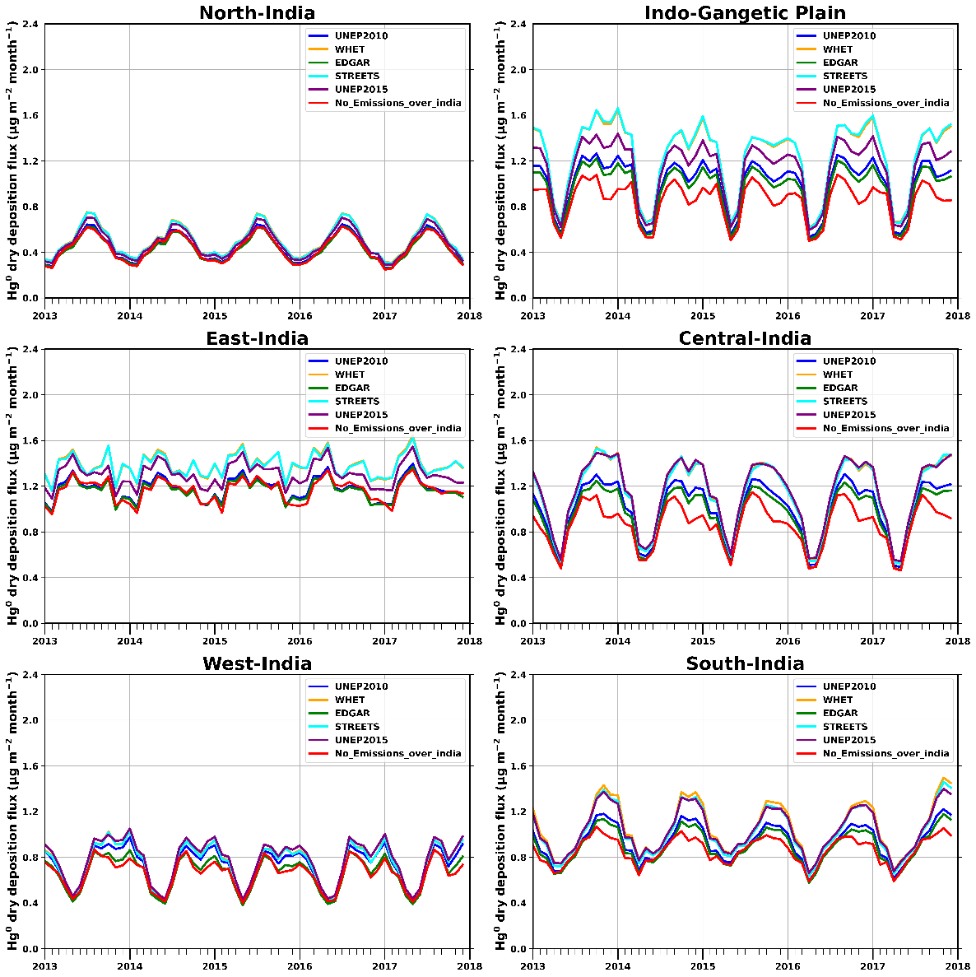
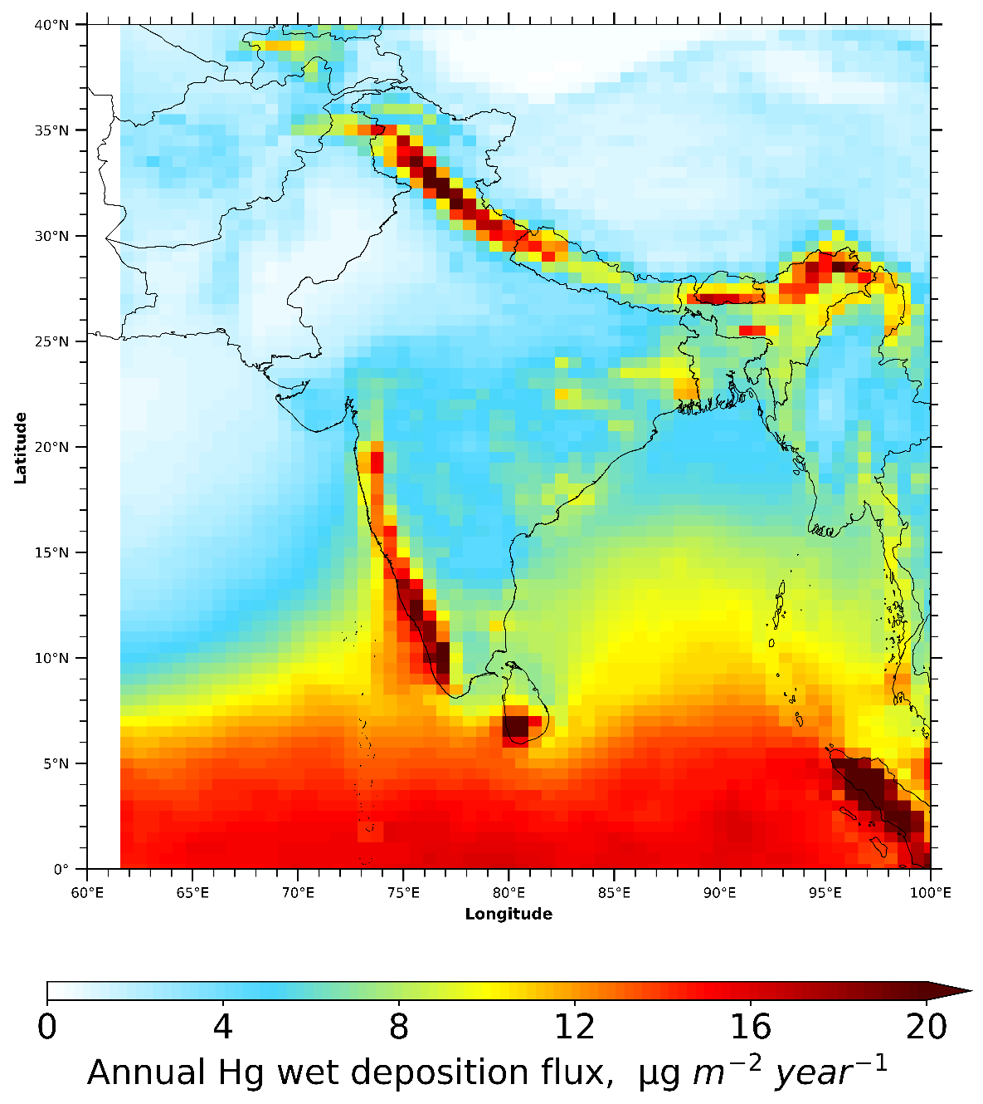
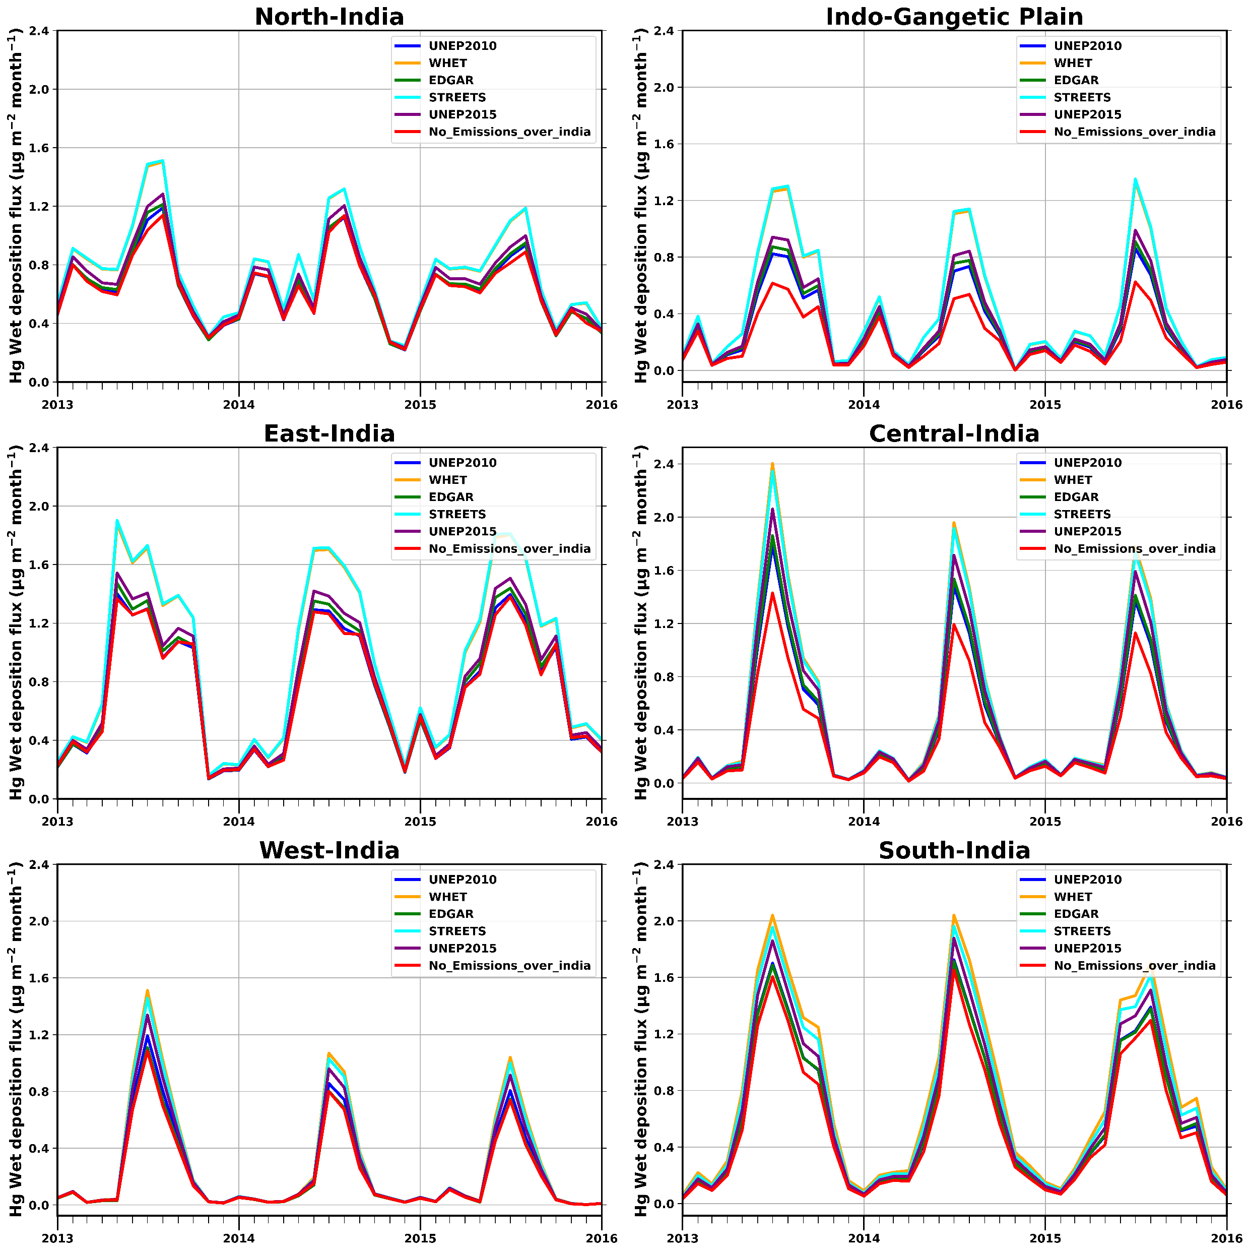
Assessing Atmospheric Mercury Dynamics: Evaluating current Anthropogenic Emissions Inventories and their Implications for Concentration and Deposition in India
Chakradhar Reddy Malasani^{1,2}, Basudev Swain³, Ankit patel^{1,2} , Yaswanth Pulipati¹, Marco Vountas³, Amit Sharma⁴ , Pengfei Liu⁵, Sachin S. Gunthe^{1,2}
¹Indian Institute of Technology Madras, Chennai, India ⁴Indian Institute of Technology Jodhpur, Jodhpur, India
²Centre for Atmospheric and Climate Sciences, Indian Institute of Technology Madras, Chennai, India
³University of Bremen, Bremen, Germany ⁵Georgia Institute of Technology, Atlanta, GA, USA
ID: EGU24-15704
Introduction
Model Validation
Results – Hg Dry Deposition
Mercury is a toxic pollutant that accumulates in the food chain, posing significant health risks.
India, the second-largest mercury emitter, ratified the 2018 Minamata Convention, committing to curb atmospheric emissions and reduce environmental mercury pollution.
An India-specific understanding of mercury sources and sinks is needed.
Annual mean TGM concentrations are 1.31-1.57 ng/m³.
Concentrations are highest in the Indo-Gangetic plain where the emissions are also higher
RGM and PBM concentrations are very sensitive to changes in emissions.
Indian Emissions account for 78% of Reactive Mercury Concentrations
Fig 3: Taylor diagram with summary statistics for daily simulated and observed data at GMOS stations.
Fig 1: Spatial distribution of Hg anthropogenic emission fluxes in different emission inventories (UNEP2010, WHET, EDGAR, UNEP2015, and STREETS). The title shows the total emissions in tonnes in India.
Results – Hg Wet Deposition
Fig 5: (a) Spatial Distribution of Annual Average Dry Hg⁰ Deposition Flux in India (2013-2017), (b) Monthly Variations of Dry Hg⁰ Deposition Flux in Different Indian Regions.
GEOS-Chem Model Setup
Dry deposition flux is highest in Indo-Gangetic Plain and eastern India
Indian emissions account for 39.4% and 37.8% of dry deposition in Indo-Gangetic Plain and central India.
Hg⁰ dry deposition flux accounts for 64-87% of the total dry deposition flux.
The peak of Hg⁰ dry deposition in India during the monsoon season is primarily due to the meteorological parameters and Leaf Area Index.
During post-monsoon, Hg⁰ dry deposition flux is highest in central India and the Indo-Gangetic plain owing to higher Hg⁰ concentrations during this period.
GEOS-Chem model: v12.5.0, driven by MERRA-2.
Redox chemistry - Horowitz et al., 2017 Br as the main oxidant for Hg⁰.
Nested simulation: 0.5x0.625º horizontal resolution and 47 vertical levels Asian region from 2013-2017 with a 6-month spin-up time.
Boundary conditions - global simulation saved every three hours. Cm
Natural emissions are land re-emissions (26.6 Mg yr⁻¹ ), soil emissions (3.41 Mg yr⁻¹ ), and biomass burning (0.79 Mg yr⁻¹ ).
Simulations were conducted with different emission inventories and another simulation in which Indian emissions were turned off.
.
Conclusion
Fig 4: (a) Spatial Distribution of Annual Average Wet Mercury Deposition Flux in India (2013-2017), (b) Monthly Variations of Wet Mercury Deposition Flux in Different Indian Regions.
Emission Inventories vary in performance across GMOS observational stations
Wet deposition fluxes follow precipitation patterns. However, due to local emissions, the Indo-Gangetic Plain and central India have high values.
Dry deposition flux is more than wet deposition flux over India in all seasons.
Indian anthropogenic sources account for 19 % of wet deposition and 30.9% of dry deposition in the contiguous India
Highest wet deposition is observed over the Himalayas, eastern India, and the windward side of western ghats
65 – 69 % of the total annual wet deposition flux occurs in Monsoon.
Indian anthropogenic emissions account for 33.4% and 29.5 of wet deposition over the Indo-Gangetic plain and central India, respectively.
Acknowledgment: Max Planck Computing and Data Facility, Garching, Germany
References:
Horowitz, Hannah M., et al. "A new mechanism for atmospheric mercury redox chemistry: implications for the global mercury budget." Atmospheric Chemistry and Physics 17.10 (2017): 6353-6371.
David, Liji Mary, et al. "Aerosol optical depth over India." Journal of Geophysical Research: Atmospheres 123.7 (2018): 3688-3703.
Contact me:
Official: chakradhar.m@cacs.iitm.ac.in Personal: chakri6023@gmail.com
our group website
Access the paper abstract
Fig 2: Anthropogenic Hg emissions for different emission inventories regardless of the nominal reference year of each inventory over different regions of India. These regions are based on geographical and meteorological conditions as shown in David et al 2018

