Slide 1
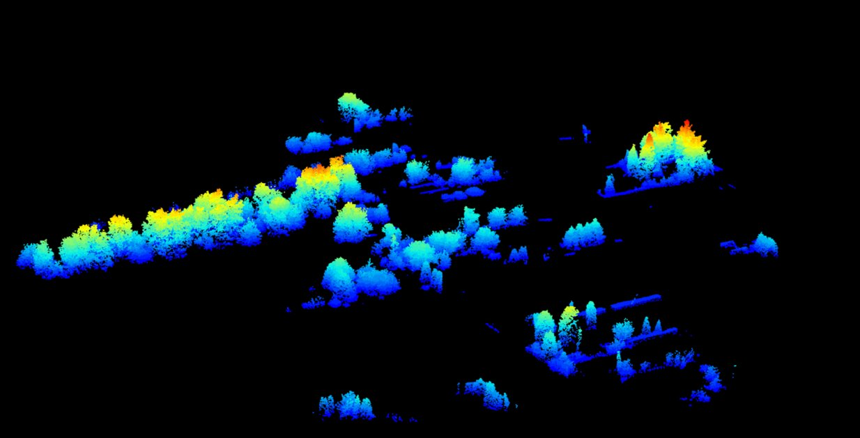


The Role of Gardens:
LiDAR-based Assessment of Urban Tree Benefits from a OneHealth perspective
EGU 2024 – 19th of April
Kelly Wittemans, Janne Teerlinck, Valerie Dewaelheyns,
Stien Heremans, Ben Somers

Slide 2
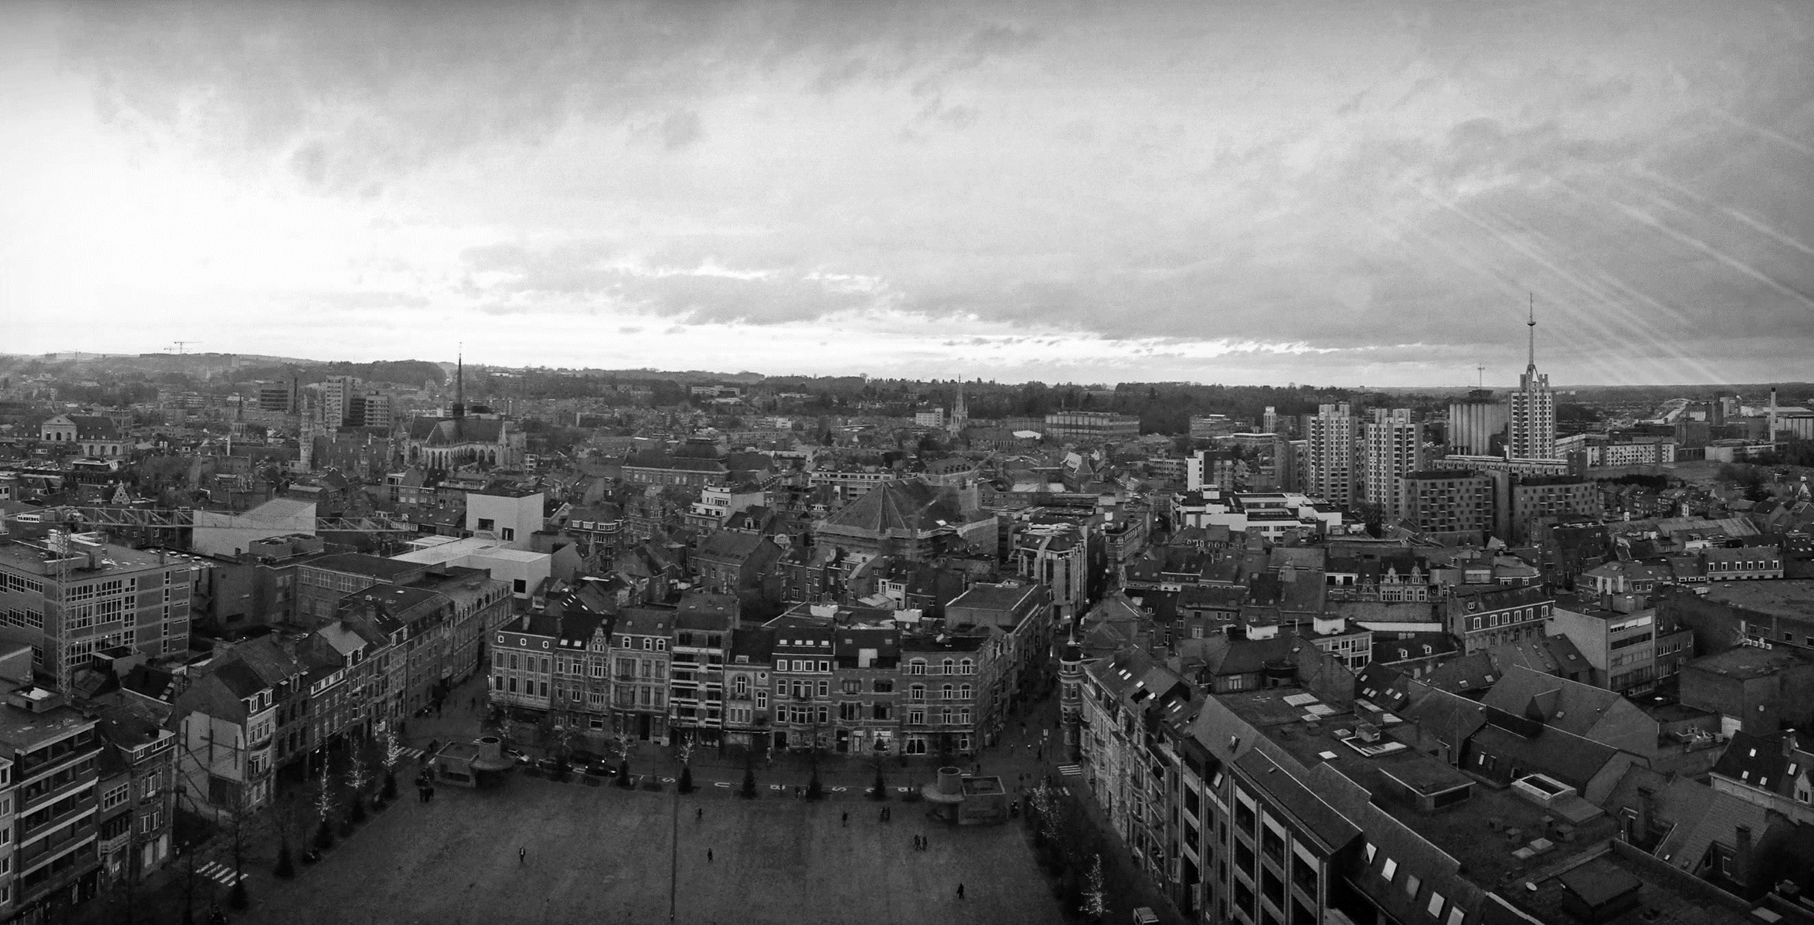
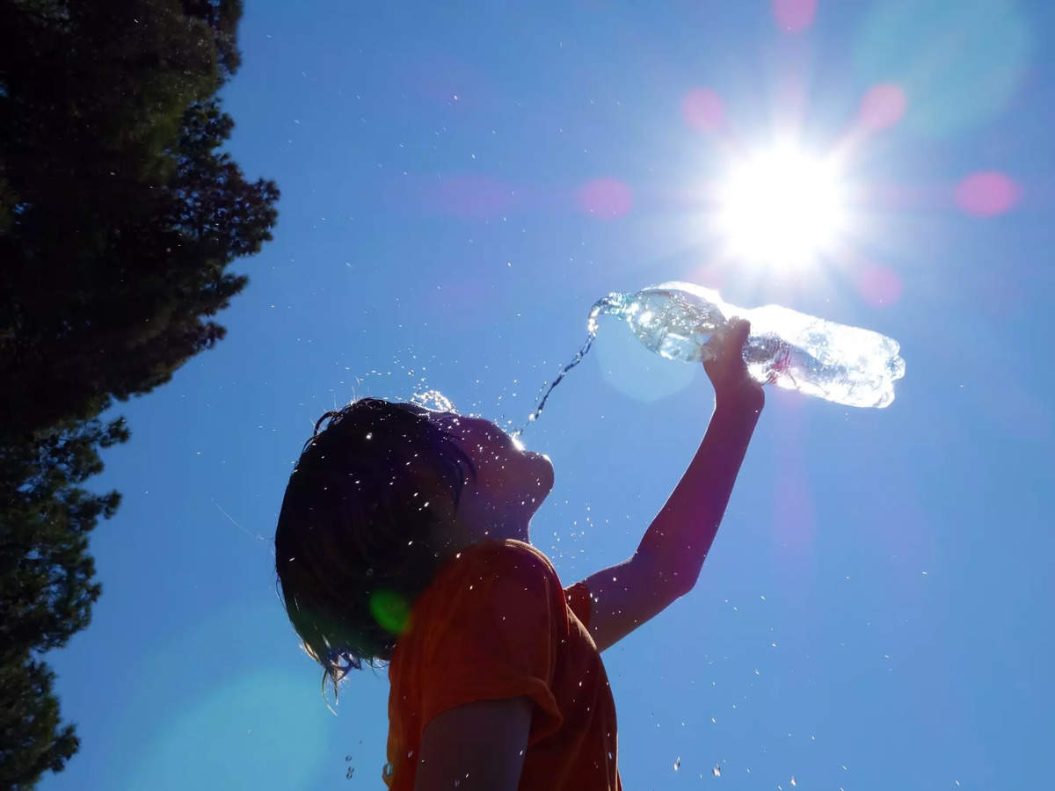
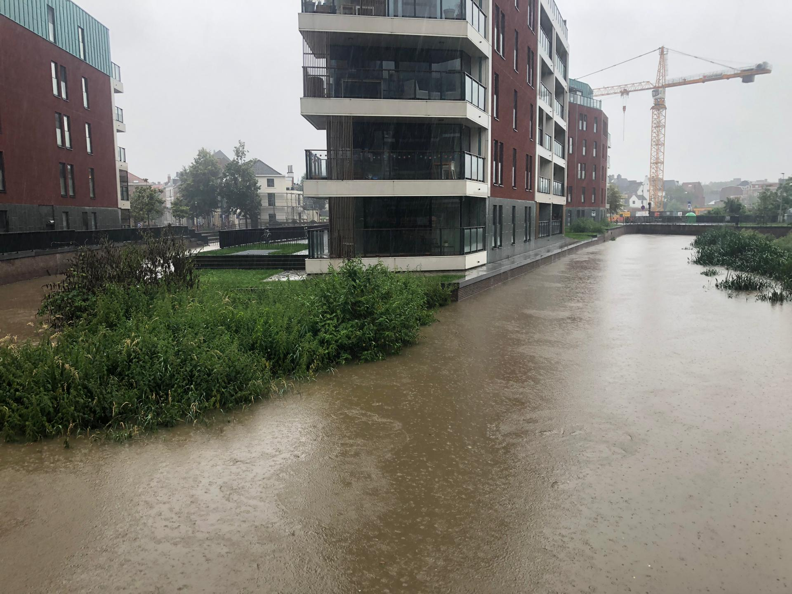

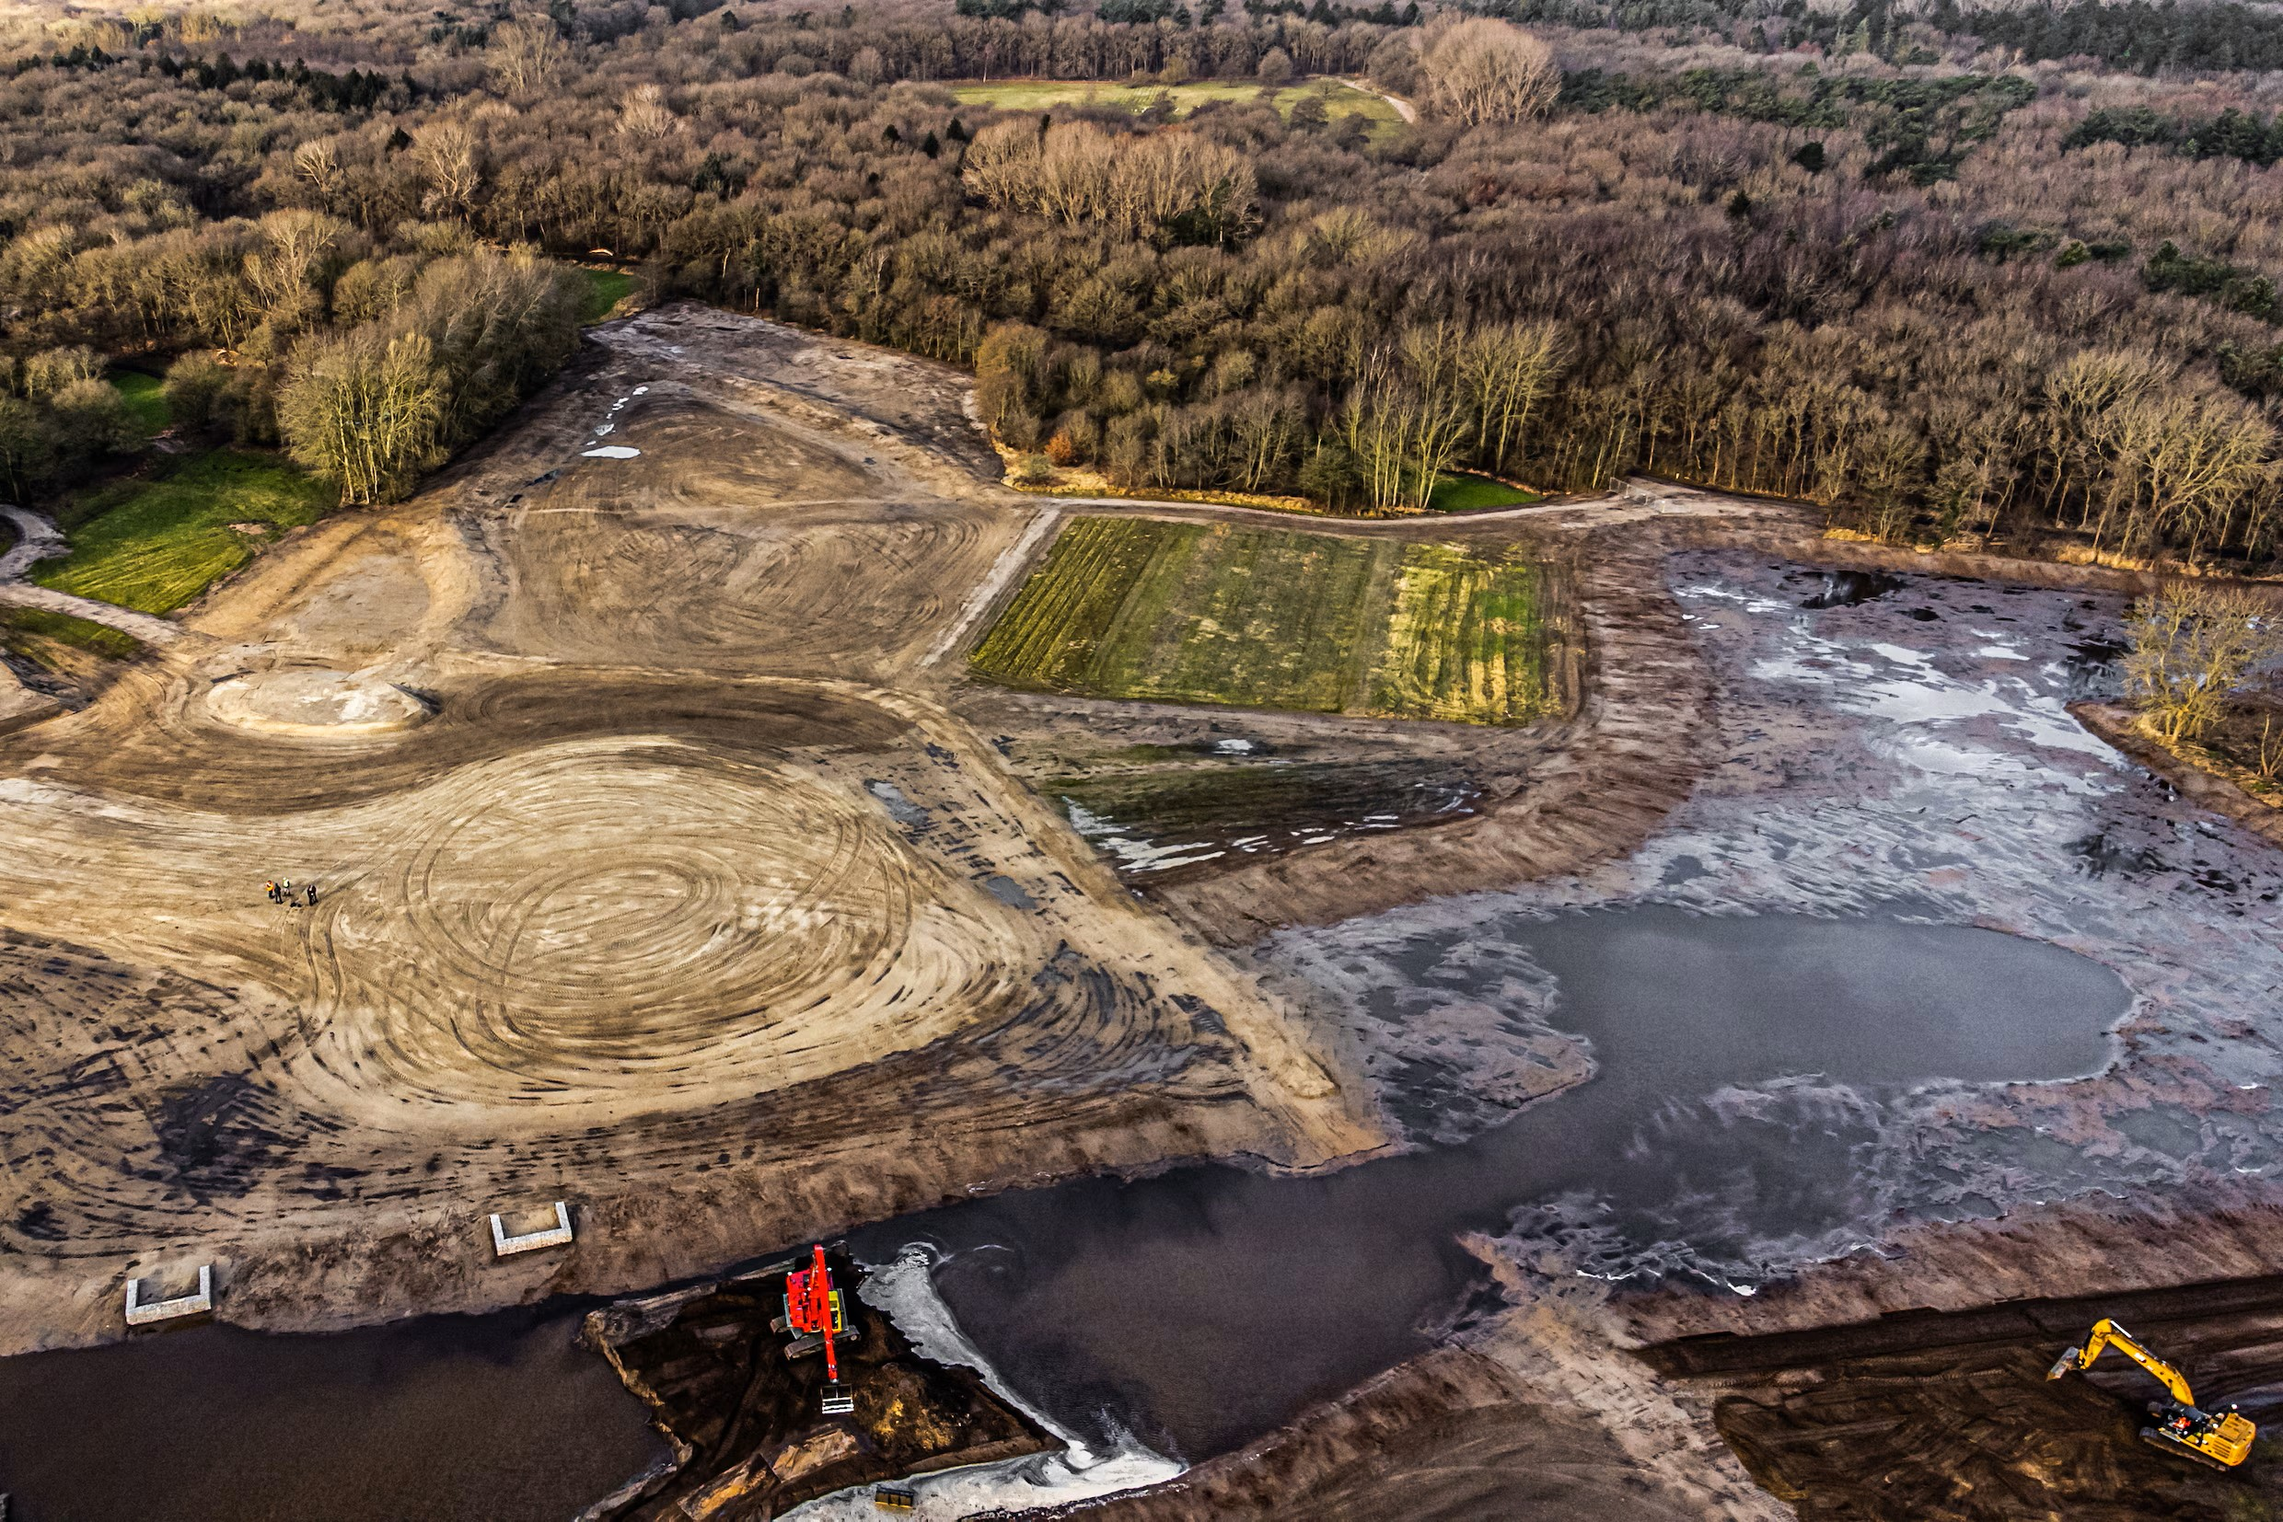
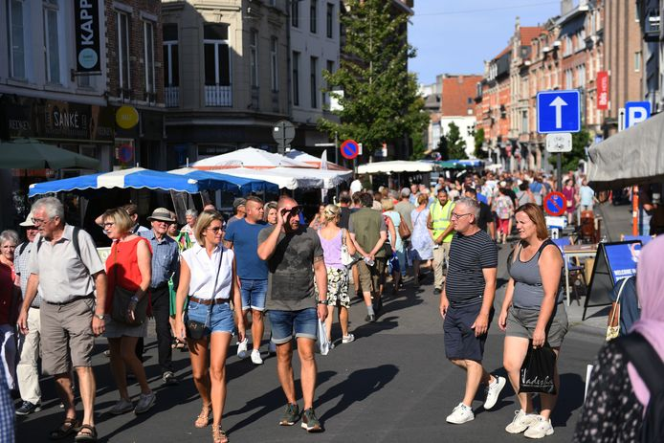
Urbanisation challenges humans, animals and ecosystems
© iStock
© hsb
© 123RF
© Joris van Gennip
© Vertommen
© KU Leuven Pinterest
kelly.wittemans@kuleuven.be

Slide 3
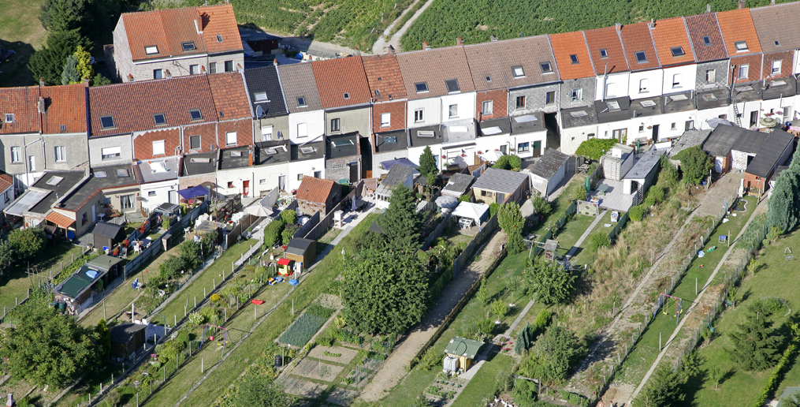
Hidden potential in gardens to combat these challenges
© vzw De Rand, picture Karel Tomeï
kelly.wittemans@kuleuven.be

Slide 4



How much do garden trees contribute to One Health?
Human health
VS PUBLIC &
STREET TREES
1
Ecosystem health
Animal health
ONE HEALTH
2
ACROSS URBAN SPRAWL TYPOLOGIES
kelly.wittemans@kuleuven.be

Slide 5

How much do garden trees contribute to One Health?
Human health
1
CLIMATE SERVICES
Carbon sequestration
Carbon storage
Run off reduction
Air temperature regulation
Ecosystem health
Animal health
ONE HEALTH
2
BIODIVERSITY SUPPORT
Spatial configuration
Connectivity
3
WELL-BEING
Visibility of tree volume
Air pollution removal
kelly.wittemans@kuleuven.be

Slide 6
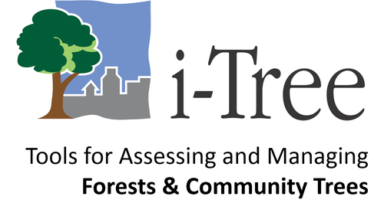
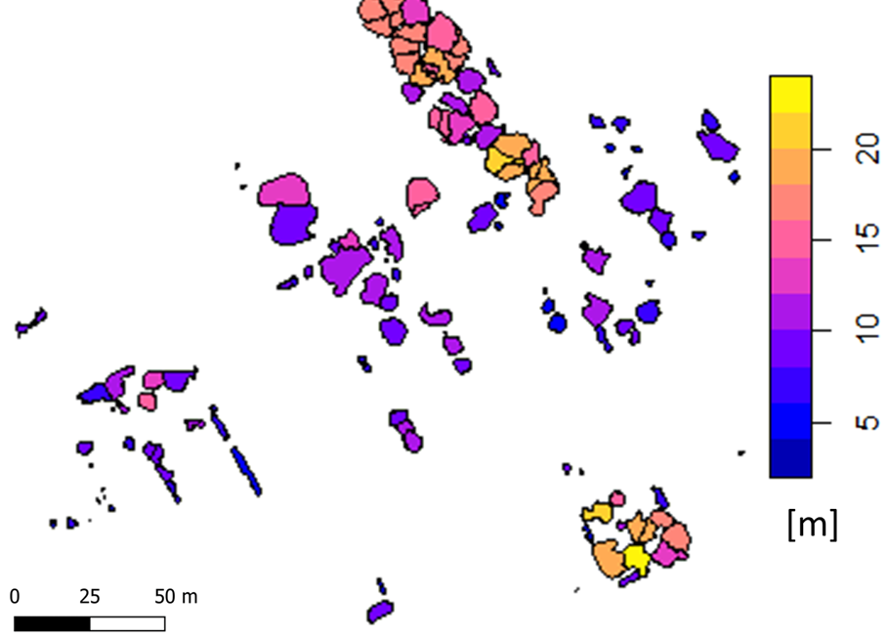
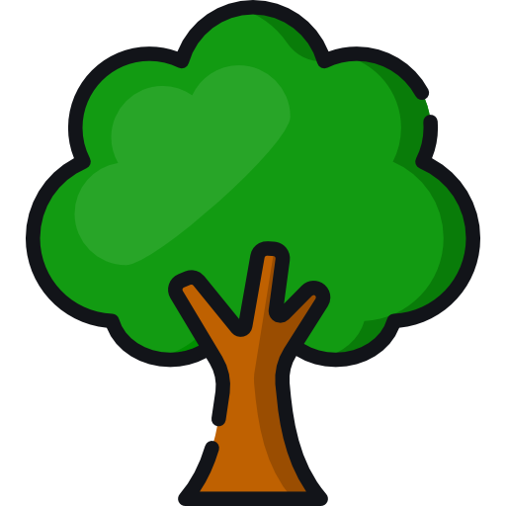

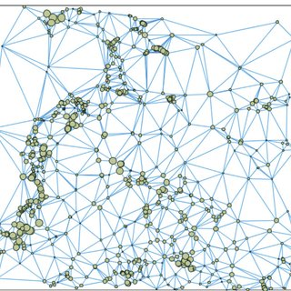
LiDAR-based assessment of urban tree benefits
LiDAR data
Vegetation metrics
Allometric model
Buffer
Tree outline, height, crown area, DBH
Connectivity analysis
Climate services
Visible tree volume
Landscape metrics
kelly.wittemans@kuleuven.be

Slide 7
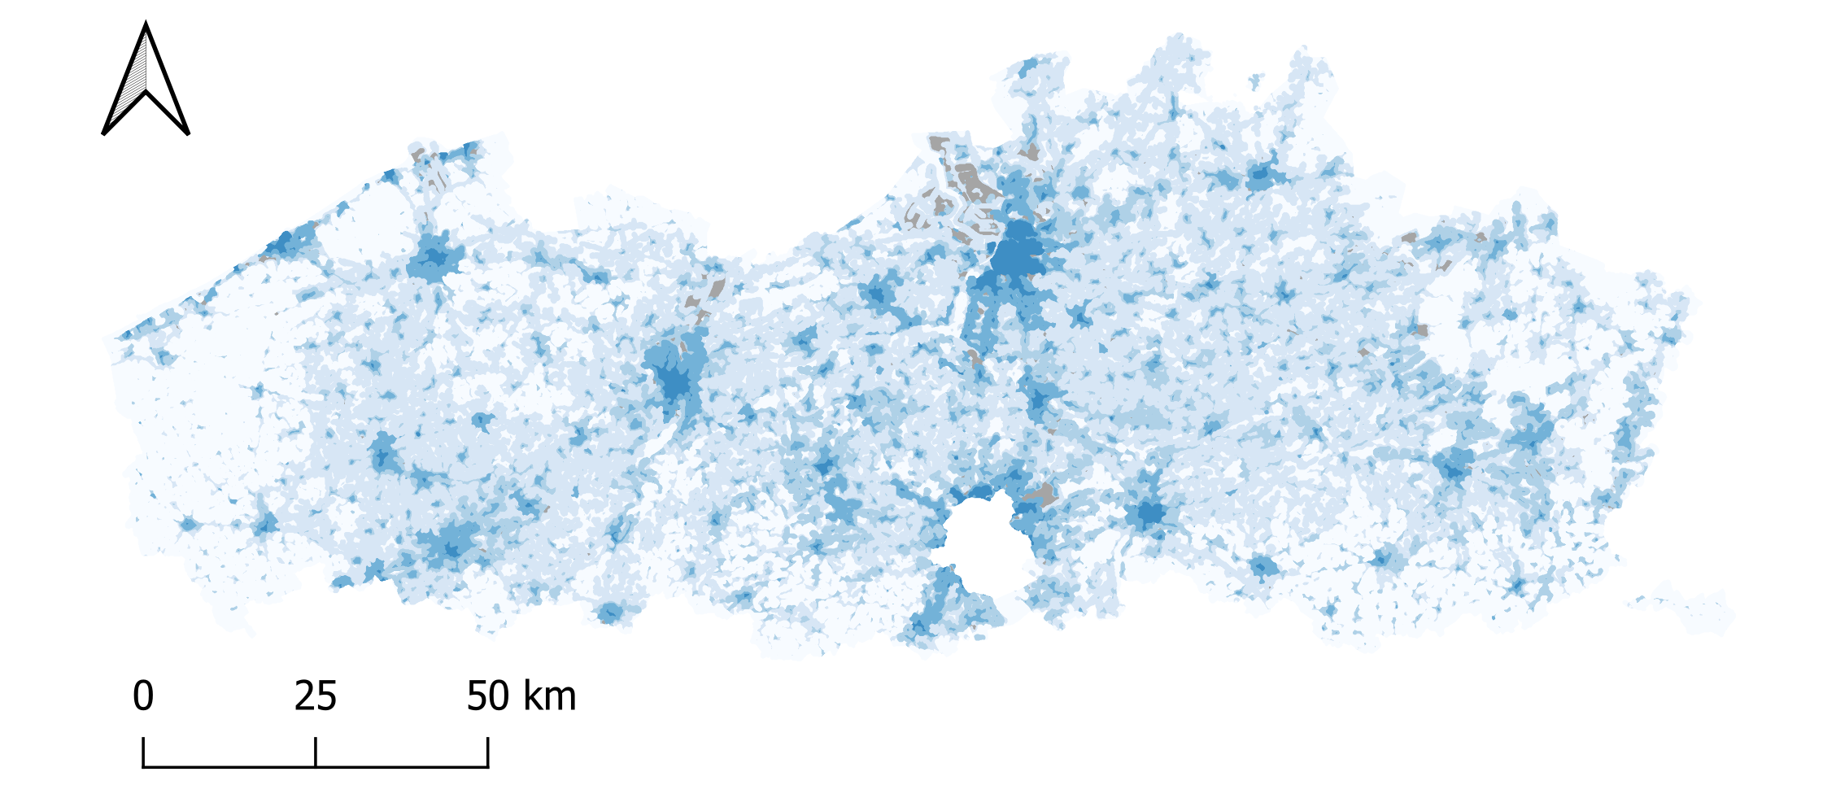


Where are gardens the most important?
Where can we unlock the full garden potential?
kelly.wittemans@kuleuven.be
Division Forest, Nature and Landscape
7

Slide 8
The Role of Gardens:
LiDAR-based Assessment of Urban Tree Benefits from a OneHealth perspective
EGU 2024 – 19th of April
Kelly Wittemans, Janne Teerlinck, Valerie Dewaelheyns,
Stien Heremans, Ben Somers

Slide 9
Urbanisation challenges humans, animals and ecosystems
© iStock
© hsb
© 123RF
© Joris van Gennip
© Vertommen
© KU Leuven Pinterest
kelly.wittemans@kuleuven.be

Slide 10
Hidden potential in gardens to combat these challenges
© vzw De Rand, picture Karel Tomeï
kelly.wittemans@kuleuven.be

Slide 11

Healthy Trees, Healthy People
Human health
Trees can enhance biodiversity which can facilitate stress recovery (Marselle et al., 2021)
e.g.
Animal health
Ecosystem health
Trees provide many ecosystem services that affect the local physical and social environments,
and consequently human health
and well-being.
e.g.
More and healtier trees are local climate controllers which reduce heat stress
© By Freepik
kelly.wittemans@kuleuven.be

Slide 12
How much do garden trees contribute to One Health?
Human health
VS PUBLIC &
STREET TREES
1
Animal health
Ecosystem health
2
ACROSS URBAN SPRAWL TYPOLOGIES
3
WITHIN CITIES
© By Freepik
kelly.wittemans@kuleuven.be

Slide 13
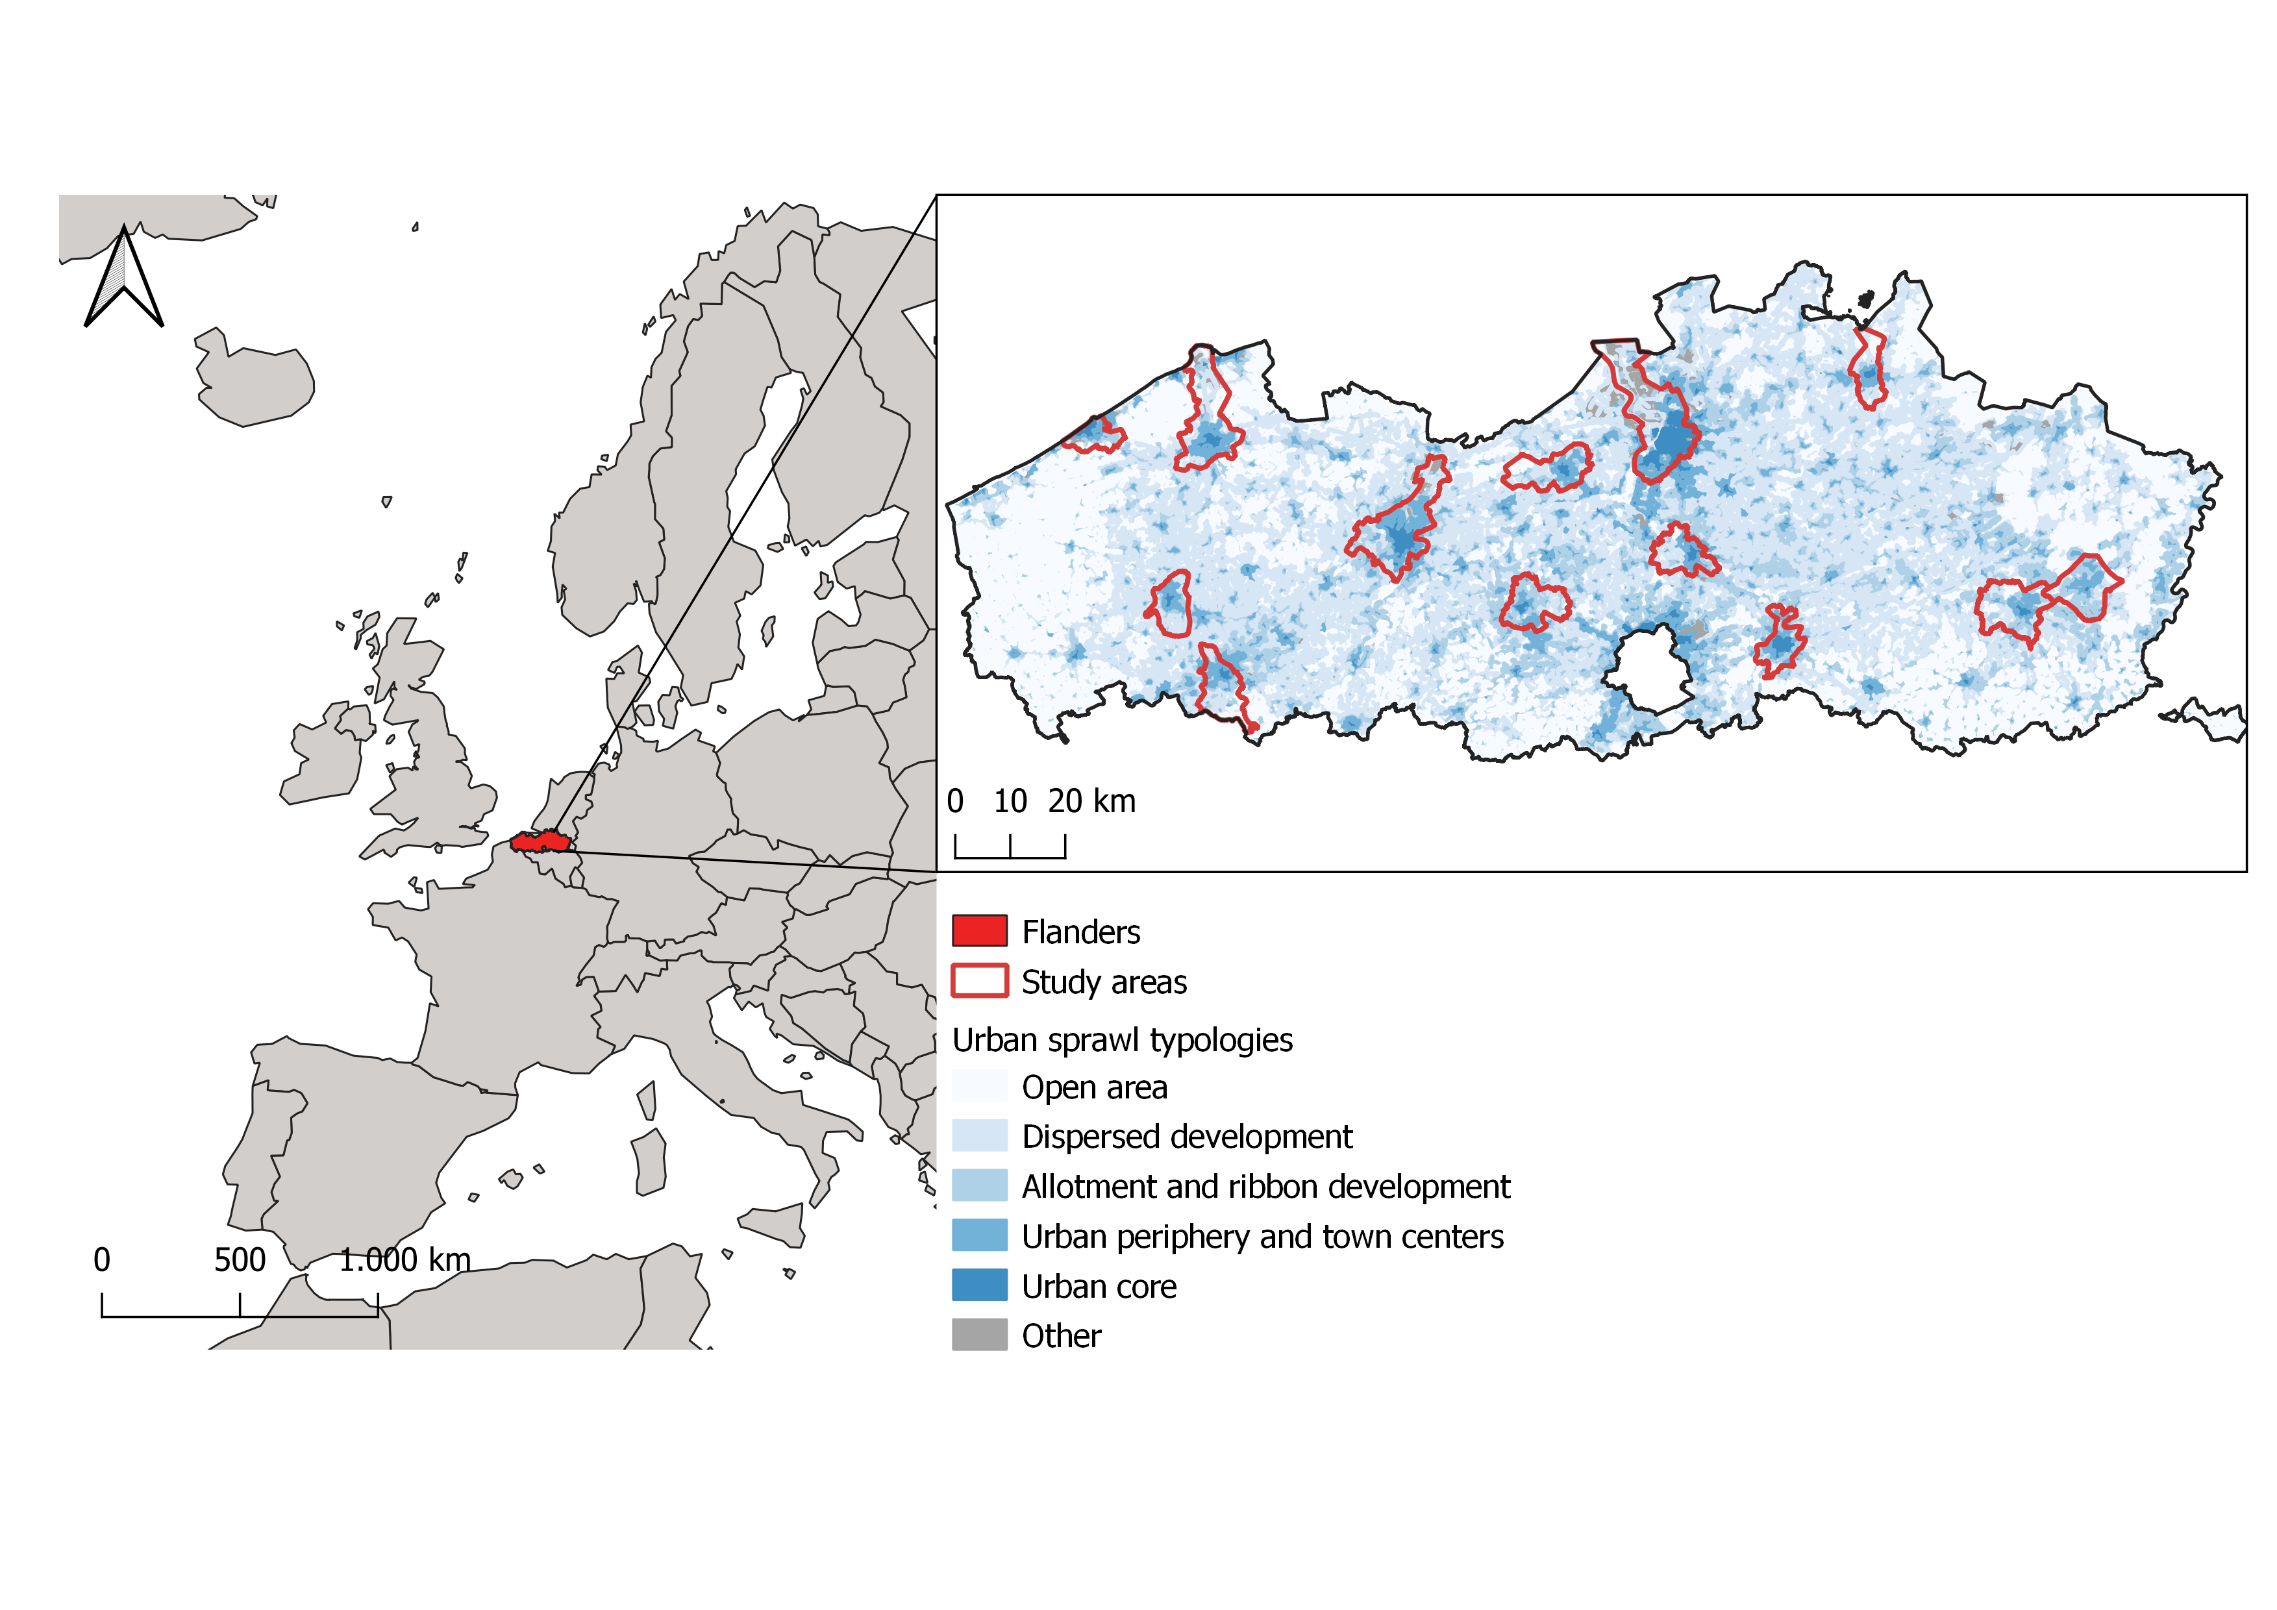
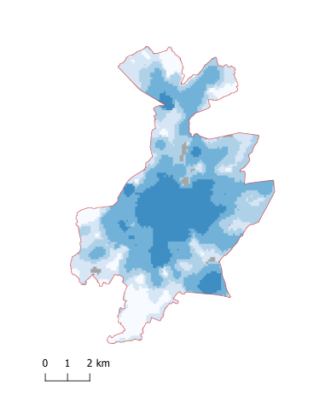
Urbanized area in the northern part of Belgium
Leuven
kelly.wittemans@kuleuven.be

Slide 14
How much do garden trees contribute to One Health?
Human health
1
CLIMATE SERVICES
Carbon sequestration
Carbon storage
Run off reduction
Air temperature regulation
Ecosystem health
Animal health
ONE HEALTH
2
BIODIVERSITY SUPPORT
Spatial configuration
Connectivity
3
WELL-BEING
Visibility of tree volume
Air pollution removal
kelly.wittemans@kuleuven.be

Slide 15
LiDAR-based assessment of urban tree benefits
LiDAR data
Vegetation metrics
Allometric model
Buffer
Tree outline, height, crown area, DBH
Connectivity analysis
Climate services
Visible tree volume
Landscape metrics
kelly.wittemans@kuleuven.be

Slide 16
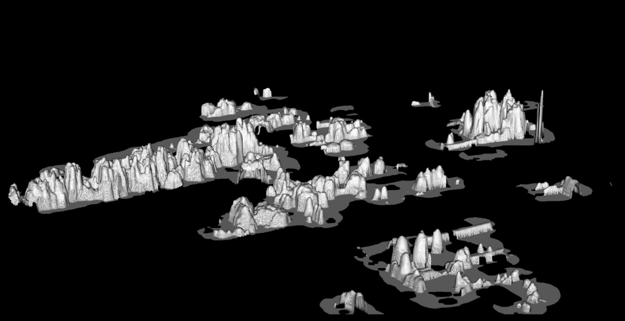
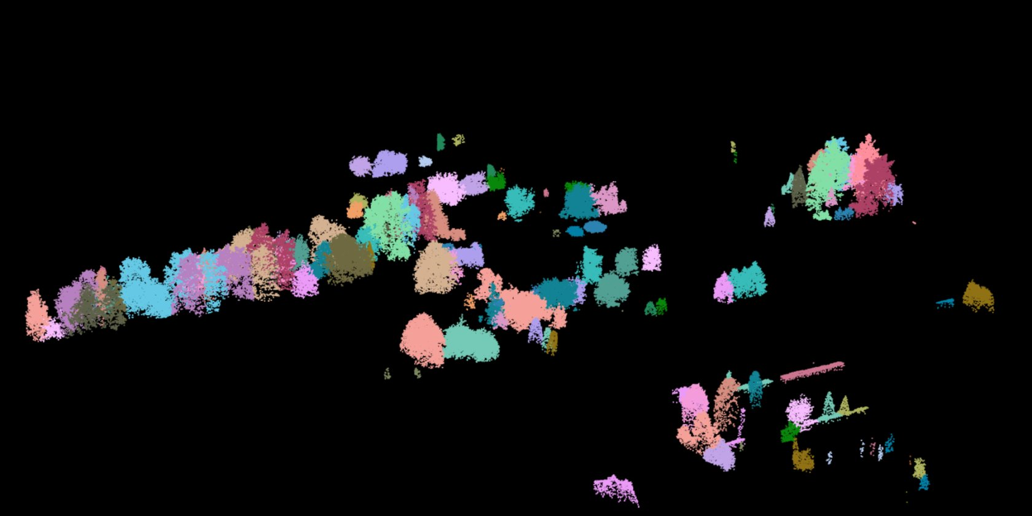
Workflow
LiDAR data
Canopy Height Model
Tree outline
Tree identification & segmentation
Pre-processing
kelly.wittemans@kuleuven.be
16

Slide 17
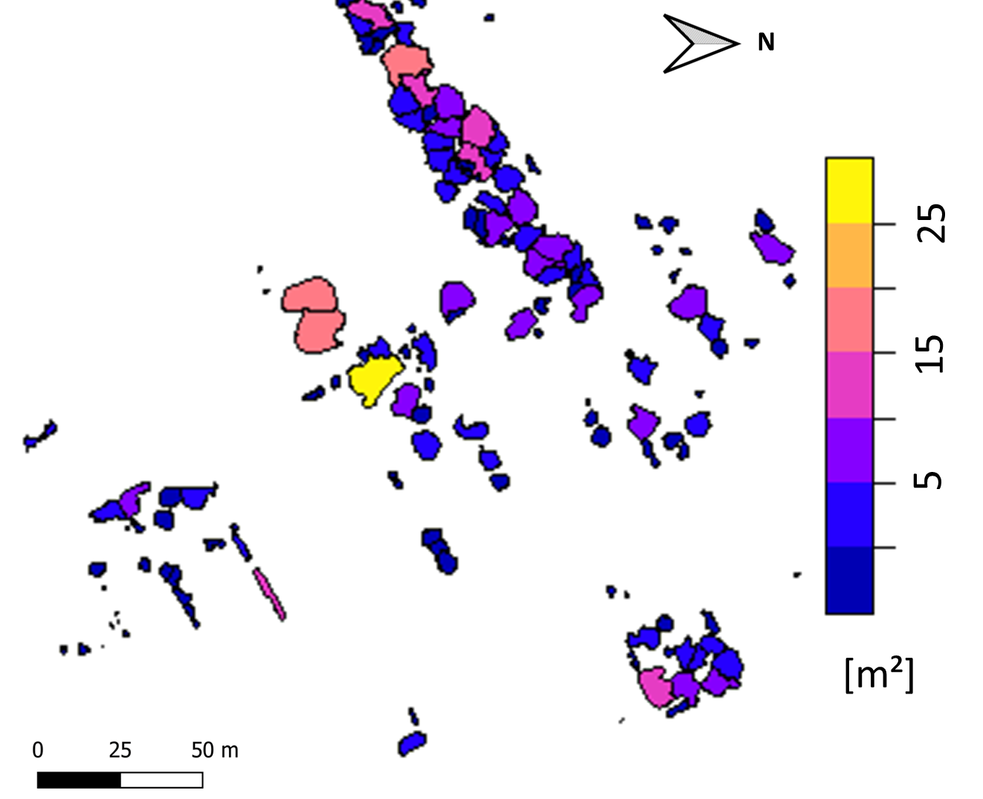
Workflow
Tree outline
Tree feature
extraction
Vegetation metrics (1)
Vegetation metrics (2)
Tree height
Crown area
Diameter at Breast Height
Crown Base Height
LiDAR data
modelling
kelly.wittemans@kuleuven.be
17

Slide 18
Workflow
Tree outline
Landscape metrics
Connectivity analysis
kelly.wittemans@kuleuven.be
18

Slide 19

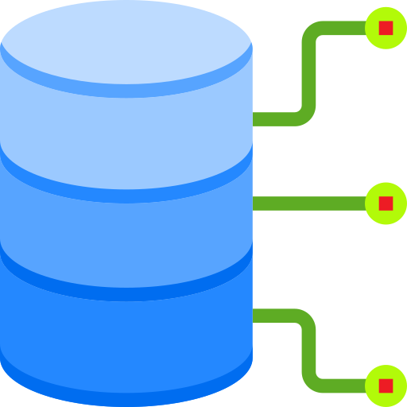
Workflow
Survey
Open data
© By Freepik
© Srip
Vegetation metrics
Species information
Tree height
Crown area
Diameter at Breast Height
Crown Base Height
Assign randomly
3x repeat
Climate services
Water runoff
Air Pollution
UV effects & air temperature
Carbon stock & sequestration
kelly.wittemans@kuleuven.be
19

Slide 20
Workflow
Carbon stock
Visible tree volume
Buffering 30m
kelly.wittemans@kuleuven.be
20

Slide 21

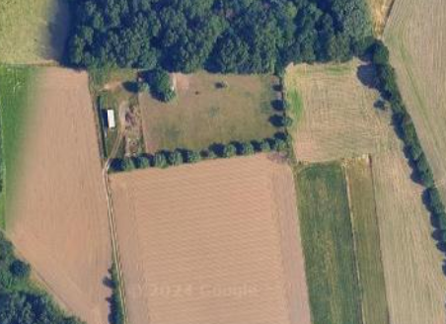
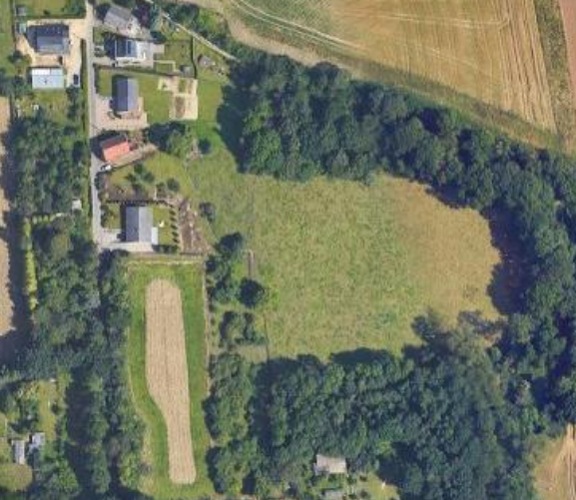
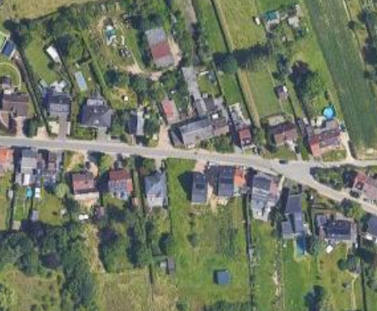
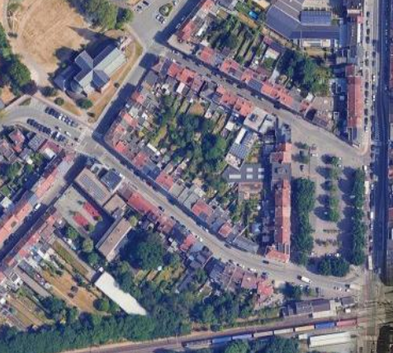
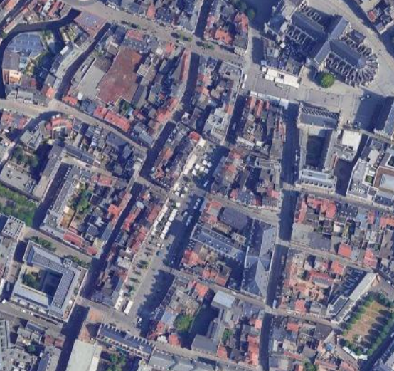
Characteristics: current situation
© Google Earth Images
OPEN AREA
DISPERSED DEVELOPMENT
ALLOTMENT AND RIBBON DEVELOPMENT
URBAN PERIPHERY AND TOWN CENTERS
URBAN CORE
GARDEN
2.4 ha
89 trees
7.6 ton/tree
104.7 ha
3,940 trees
5.6 ton/tree
378.2 ha
13,995 trees
5.1 ton/tree
951.1 ha
27,779 trees
3.5 ton/tree
544.5 ha
13,192 trees
2.6 ton/tree
STREET
2,720 trees
9.9 ton/tree
4,582 trees
5.7 ton/tree
3,337 trees
4.0 ton/tree
4,214 trees
3.7 ton/tree
2,417 trees
2.6 ton/tree
PUBLIC
1,770 trees
7.6 ton/tree
8,428 trees
6.5 ton/tree
14,676 trees
5.9 ton/tree
25,948 trees
5.5 ton/tree
11,730 trees
4.2 ton/tree
kelly.wittemans@kuleuven.be
21

Slide 22
Climate services: contribution of gardens
© Google Earth Images
OPEN AREA
DISPERSED DEVELOPMENT
ALLOTMENT AND RIBBON DEVELOPMENT
URBAN PERIPHERY AND TOWN CENTERS
URBAN CORE
Carbon Storage |  | 2% |  |  | 21% |  |  |  |  | 42% |  |  |  |  | 38% |  |  |  |  | 38%
Gross Carbon Seq. |  | 1% |  | 14% |  |  |  | 27% |  |  |  | 32% |  |  |  | 33%
Avoided Runoff |  | 1% |  |  |  | 29% |  |  |  |  |  | 49% |  |  |  |  | 43% |  |  |  |  | 44%
Pollution Removal |  | 1% |  |  |  | 26% |  |  |  |  |  | 45% |  |  |  |  | 39% |  |  |  |  | 41%
PET |  | 1% |  |  |  | 27% |  |  |  |  |  | 46% |  |  |  |  | 40%
42-68%
Evapotranspiration |  | 1% |  |  |  | 28% |  |  |  |  |  | 48% |  |  |  |  | 42% |  |  |  |  | 44%
Transpiration |  | 1% |  |  |  | 31% |  |  |  |  |  | 50% |  |  |  |  | 44% |  |  |  |  |  | 47%
UV Effects |  |  | 25% reduction |  |  |  | 30% |  |  |  |  | 40% |  |  |  |  | 38% |  |  |  |  | 36%
kelly.wittemans@kuleuven.be
22

Slide 23
Connectivity: ∆ mean ENN
© Google Earth Images
OPEN AREA
DISPERSED DEVELOPMENT
ALLOTMENT AND RIBBON DEVELOPMENT
URBAN PERIPHERY AND TOWN CENTERS
URBAN CORE
GARDEN
0.00 m
0.02 m
0.26 m
0.78 m
1.51 m
STREET
0.03 m
0.11 m
0.08 m
0.06 m
0.90 m
PUBLIC
0.01 m
0.07 m
0.36 m
0.80 m
0.98 m
ENN = Euclidean nearest-neighbor distance
kelly.wittemans@kuleuven.be
23

Slide 24
Mean visible tree volume
© Google Earth Images
OPEN AREA
DISPERSED DEVELOPMENT
ALLOTMENT AND RIBBON DEVELOPMENT
URBAN PERIPHERY AND TOWN CENTERS
URBAN CORE
GARDEN
5.1 ton
37.3 ton
40.1 ton
20.0 ton
12.5 ton
STREET
0.2 ton
4.7 ton
3.8 ton
2.6 ton
2.1 ton
PUBLIC
9.4 ton
15.1 ton
10.1 ton
10.9 ton
7.7 ton
ENN = Euclidean nearest-neighbor distance
kelly.wittemans@kuleuven.be
24

Slide 25
Total visible tree volume
© Google Earth Images
OPEN AREA
DISPERSED DEVELOPMENT
ALLOTMENT AND RIBBON DEVELOPMENT
URBAN PERIPHERY AND TOWN CENTERS
URBAN CORE
GARDEN
60.5 ton
16,311.6 ton
107,562.8 ton
246,228.8 ton
243,374.5 ton
STREET
2.3 ton
2,044.2 ton
10,132.45 ton
32,350.9 ton
40,903.2 ton
PUBLIC
11.2 ton
6,606.0 ton
27,031.6 ton
133,962.8 ton
149,617.4 ton
ENN = Euclidean nearest-neighbor distance
kelly.wittemans@kuleuven.be
25

Slide 26
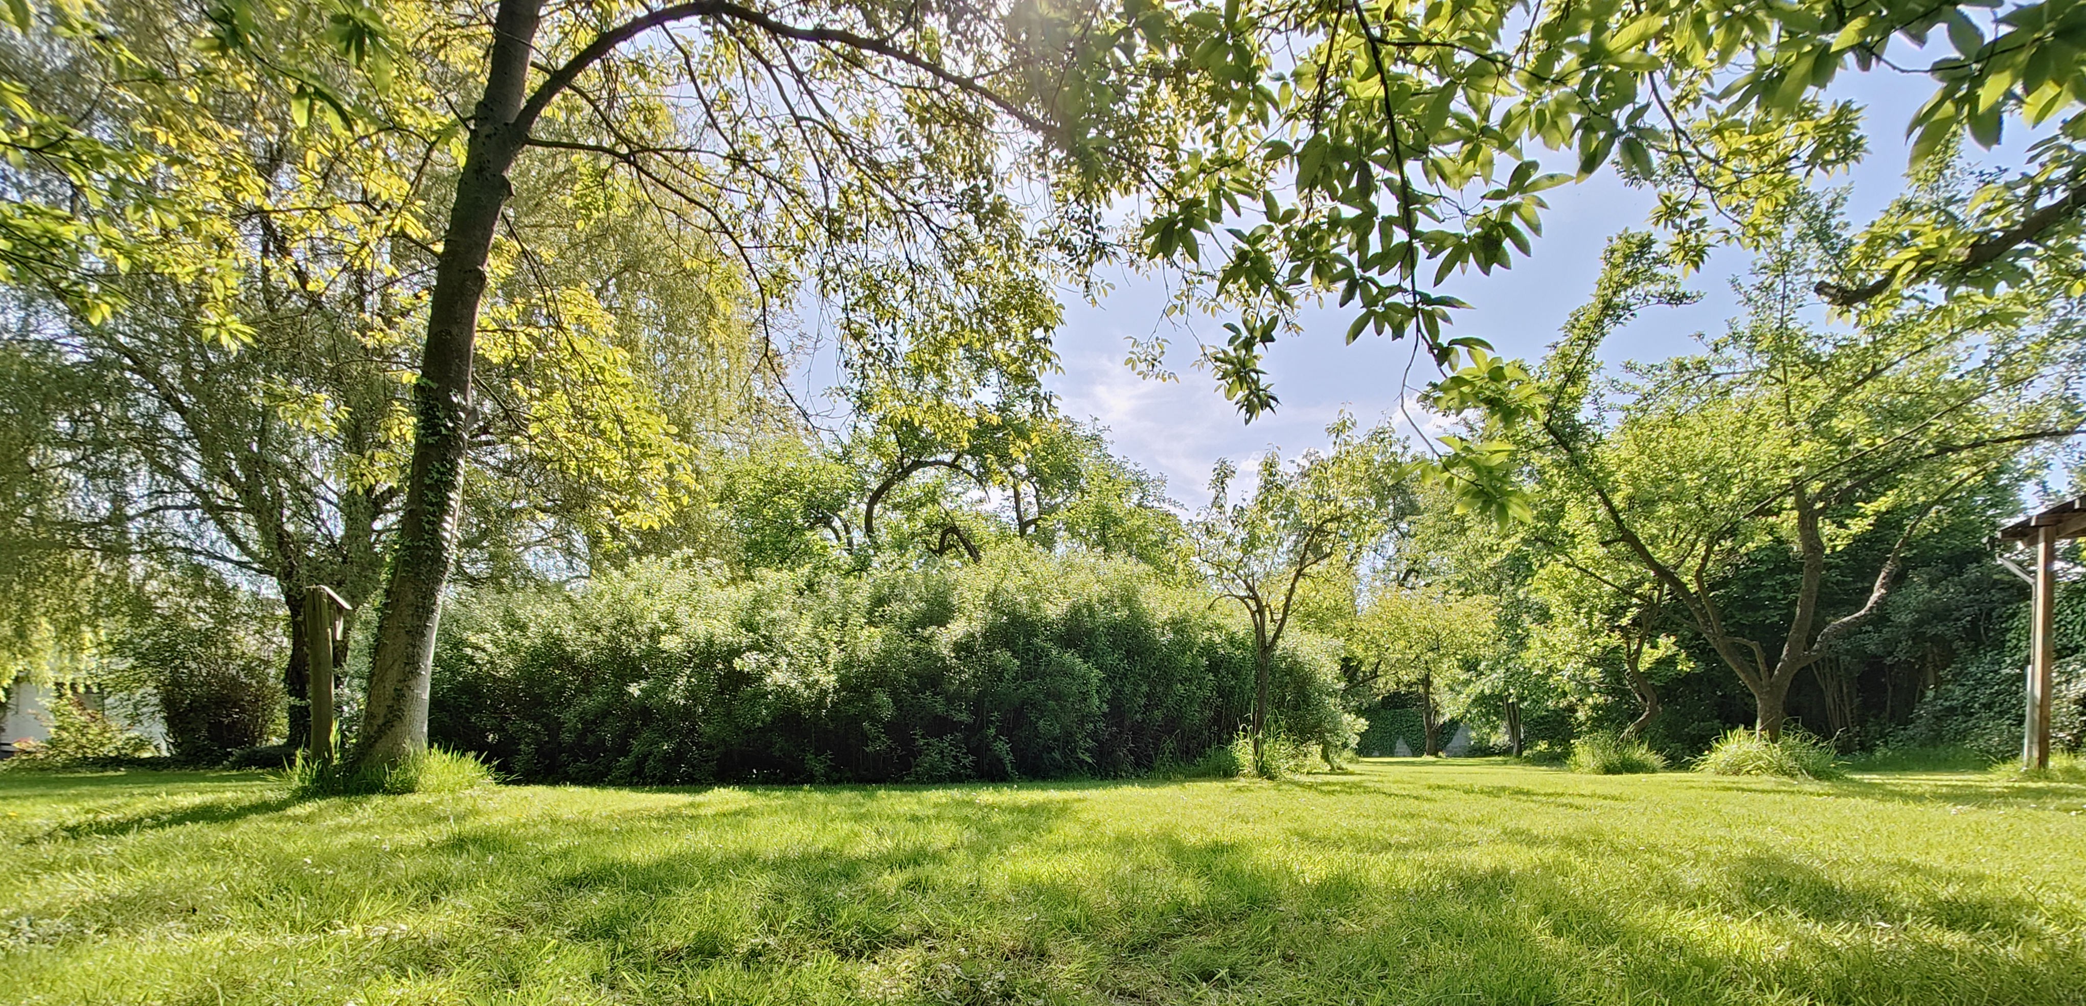
Unlock the full potential of the garden landscape
© Robin Binon
Contact: kelly.wittemans@kuleuven.be

Slide 27
Supplementary material

Slide 28
Validation: Individual tree detection
Results of individual tree detection validation based on the strategy of Wan Mohd Jaafar et al. (2018), using a validation dataset of in total 324 manually segmented trees in Leuven.
Metric | Value
True positive | 195
False negative | 88
False positive | 53
Recall | 0.69
Precision | 0.79
F-score | 0.74
kelly.wittemans@kuleuven.be
28

Slide 29
Validation: Individual tree crown detection
Results of individual tree crown segmentation validation, based on the validation approach of Degerickx et al. (2018). Each tree was classified into an accuracy class based on the overlap percentages.
Accuracy class | Overlap % (x) (reference perspective) | Overlap % (x) (results perspective) | Percentage of trees classified as…
Good match | 90% < x | 90% < x | 29.25%
Low overestimation | 90% < x | 75% < x < 90% | 1.19%
Low underestimation | 75% < x < 90% | 90% < x | -
Medium overestimation | 90% < x | 25% < x < 75% | -
Medium underestimation | 25% < x < 75% | 90% < x | 5.14%
Severe overestimation | 90% < x | x < 25% | -
Severe underestimation | x < 25% | 90% < x | 10.28%
Low mismatch | 75% < x < 90% | 75% < x < 90% | 9.88%
Medium mismatch | 25% < x < 75% | 25% < x < 75% | 28.46%
Severe mismatch | x < 25% | x < 25% | -
Other |  |  | 15.81%
kelly.wittemans@kuleuven.be
29

Slide 30
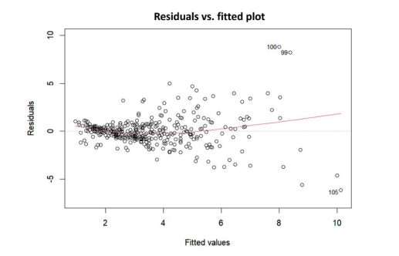
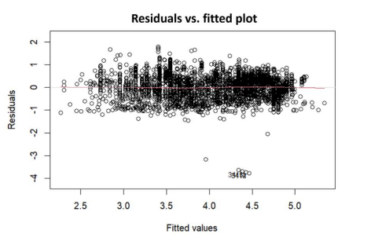
CBH & DBH Model
𝐶𝐵𝐻 = 0.557 ∗ (𝐻) 0.756 − 0.315
𝐷𝐵𝐻 = 𝑒𝑥𝑝 (−8.306 ∗ (𝐻) 0.156 + 1.147 ∗ (𝐶𝑊) 0.141 − 8.160)
R²=0.56
RMSE=1.3m
R²=0.64
RMSE=0.49m
kelly.wittemans@kuleuven.be
30

