Slide 1
Investigating dispersion of air pollution in the stable Arctic boundary layer
Natalie Brett^{1,2}, K. S. Law¹, S. R. Arnold² and ALPACA/EPA
1. Sorbonne Université, UVSQ, CNRS, LATMOS, Paris, France;
2. Institute for Climate and Atmospheric Science, School of Earth & Environment, University of Leeds, UK
Data: Met, CTC - Meeta Cesla-Maloney/Bill Simpson (UAF);
Met Station & Helikite Measurements at UAF Farm: Roman Pohorsky, Andrea Baccarini, Julia Schmale (EPFL);
Micromegas Vertical Profiles, Farm: B.Barret (LAERO)
ALPACA/EPA: J. Fochesatto³, J.C. Raut¹, T. Onishi¹, R. Gilliam⁴, K. Fahey⁴, D. Huff⁵, G. Pouliot⁴, B. Barret⁶, E. Dieudonne⁷, R. Pohorsky⁸, J. Schmale⁸, A. Baccarini^{8,9}, S. Bekki¹, G. Pappaccogli¹⁰, F. Scoto¹⁰, S. Decesari¹¹, A. Donateo¹⁰, M. Cesler-Maloney¹², W. Simpson¹², P. Medina⁶, B. D’Anna¹³, B. Temime-Roussel¹³, J. Savarino¹⁴, S. Albertin^{14,1}, J. Mao¹², P. F DeCarlo¹⁵, V. Selimovic¹⁶, R. Yokelson¹⁷ and E. S. Robinson¹⁵
Email: natalie.brett@latmos.ipsl.fr
EGU Session: AS3.21 – Air Pollution Modelling → 17 April 2024
Photo credit: Brice Temime-Roussel
Photo credit: Brice Temime-Roussel

Slide 2
Supplementary Information
2

Slide 3
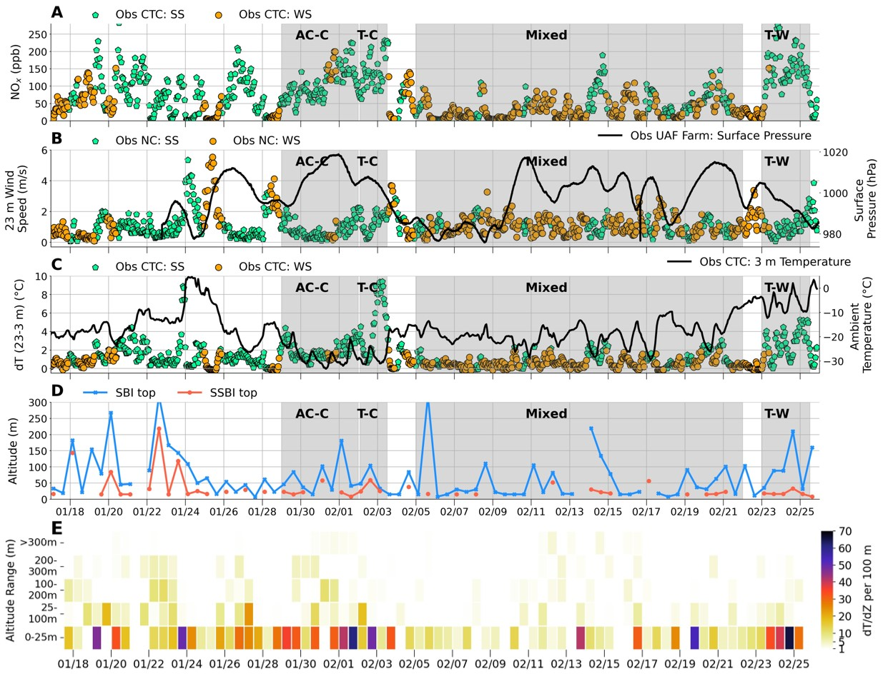
ALPACA Observations and Classifications
3 different meteorological periods:
Cold polluted - Anticyclonic-Cold (AC-C) and Transient-Cold (T-C)
Mixed - transient, cyclonic and AC
Warm polluted - Transient-Warm (T-W)
Surface Stability based on radiosonde data dT/dZ per 100m and 23m – 3m dT. Strongly stable (SS) and weakly stable (WS)
SSBIs, SBIs and EIs diagnosed from radiosoundings.
→ Stability strengths above the surface layer (up to 300m).

Slide 4
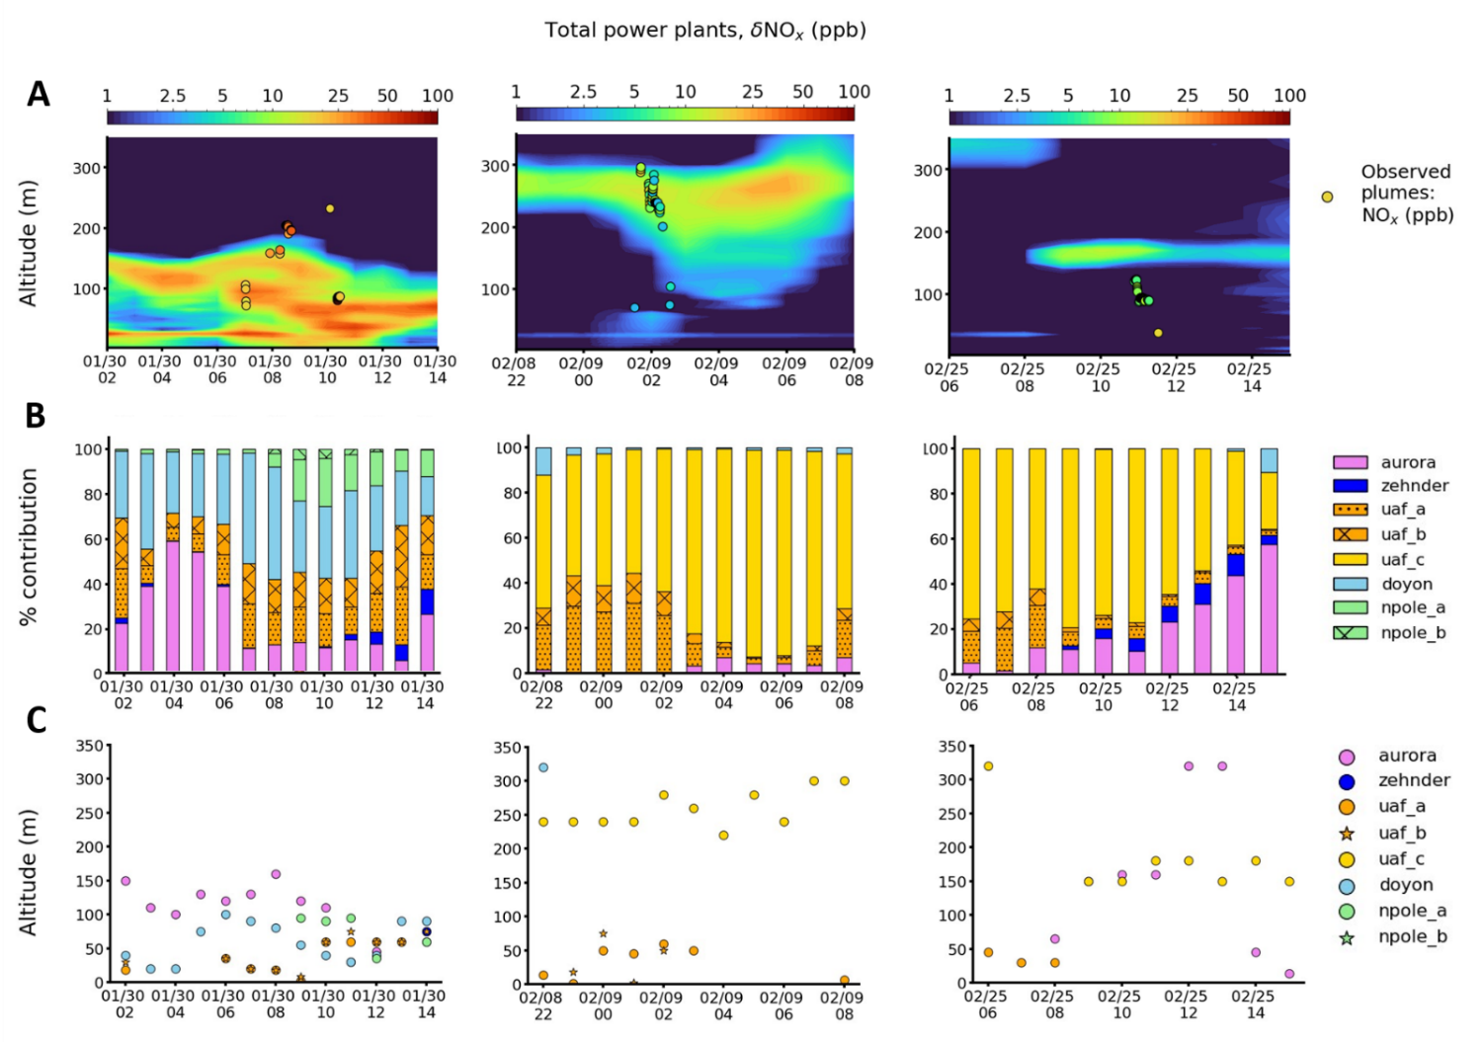
CASE 1
CASE 3
CASE 2
4

Slide 5
Model Evaluation against Helikite Observations 8-9 Feb
Location = UAF Farm
Downward transport of observed plume is simulated.
CTRL improved over NOCAP & NORISE
Altitude corresponding to 90th percentile of stack contribution

Slide 6
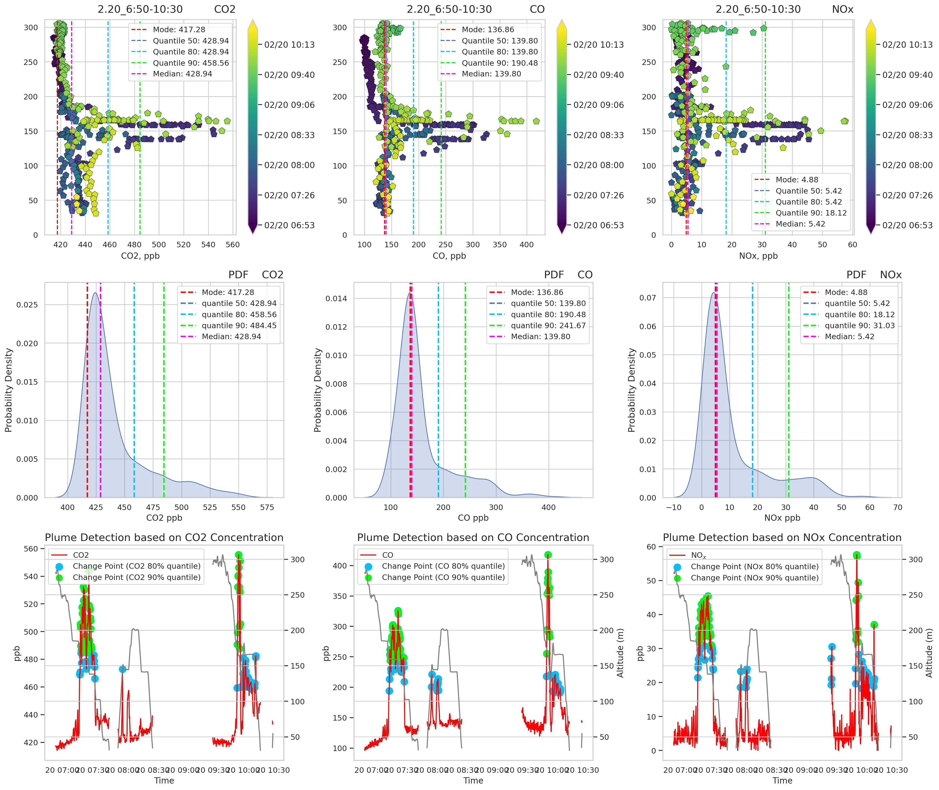
Plume Identification Method (enhancement over background)
Plume = 90th percentile
Polluted background = modal concentration of flight
Plume enhancement = Plume – polluted background

Slide 7
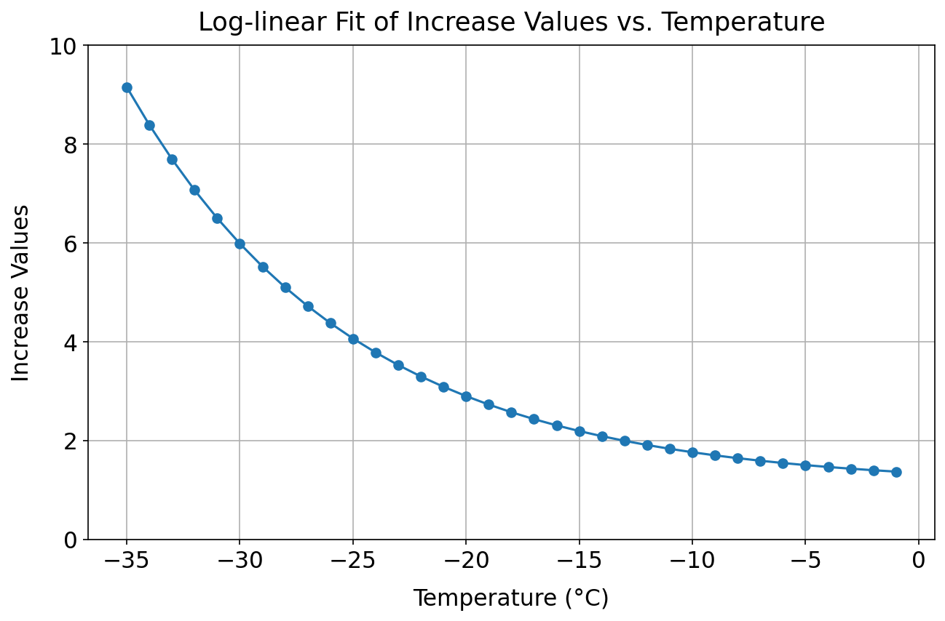
Cold Temperature Dependence of NO_{x} on-road emissions
Estimated NO_{x} (ppb) downtown (0-10m) from EPA emissions
EPA emission inventory vs observations, averaged over 3°C temperature bins.
Large underestimate of NO_{x} in cold polluted period.
EPA emissions – MOVES3 does not include significant cold-temperature increase for NO_{x} on-road emissions (predominantly diesel vehicle NOx, even though only 9% Fairbanks fleet)
observations
Log-linear increment for NO_{x} on-road mobile emissions: x1.5 (0°C) to x10 (-40°C) to based on Norwegian study of diesel vehicles (Wærsted et al., 2022). (factor of x6 in cold polluted period).
7

Slide 8
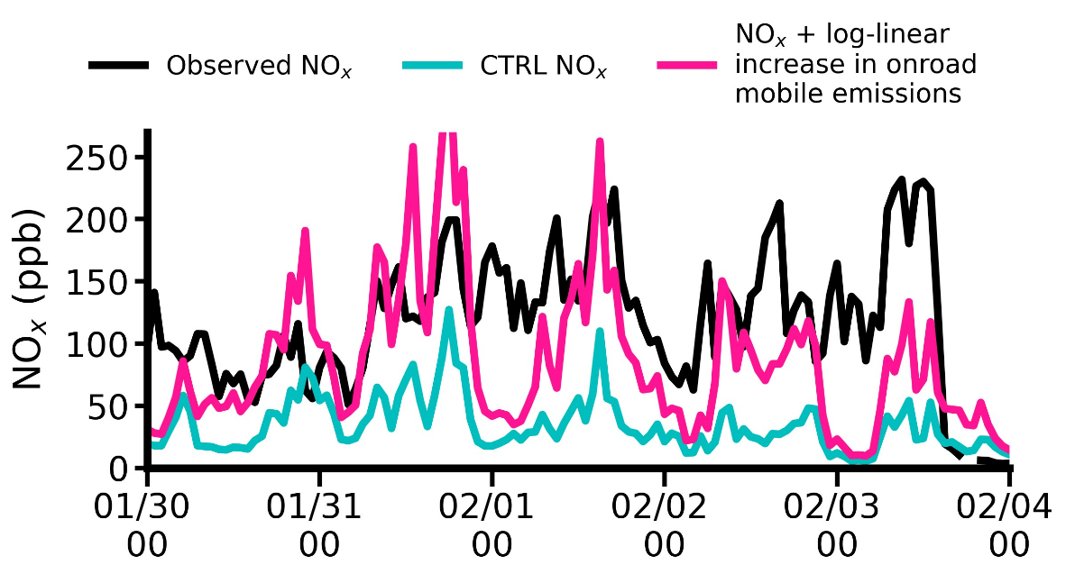
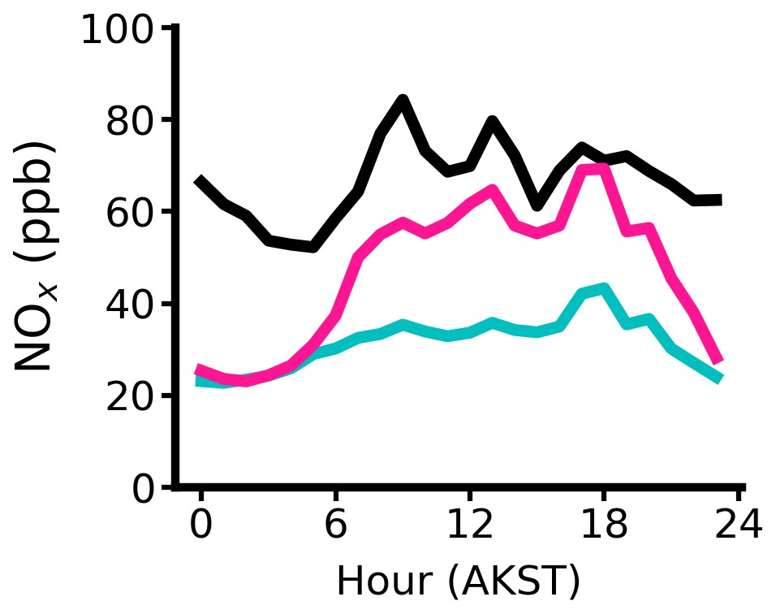
Model Evaluation against Surface Observations
Location = Downtown
Cold Polluted Period (30 Jan – 3 Feb)
Full campaign
(18 Jan – 25 Feb)
Log-linear increase in NO_{x} onroad mobile emissions x1.5 (0°C) → x6 (-30°C) due to cold-temperature dependence, may explain daytime underestimate. Based on Wærsted et al. 2022 (x 3 at -13°C in Norway).
Underestimate a nighttime → underestimate in heating emissions requires investigation?
8

Slide 9
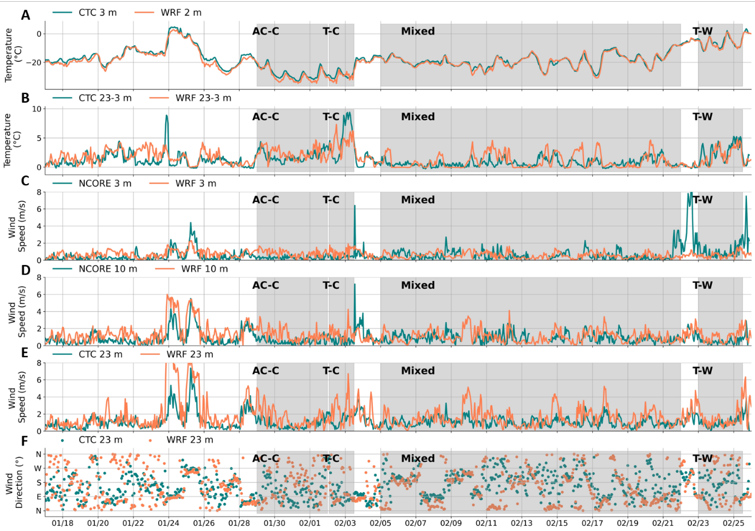
EPA-WRF Model against observations (Downtown)

Slide 10
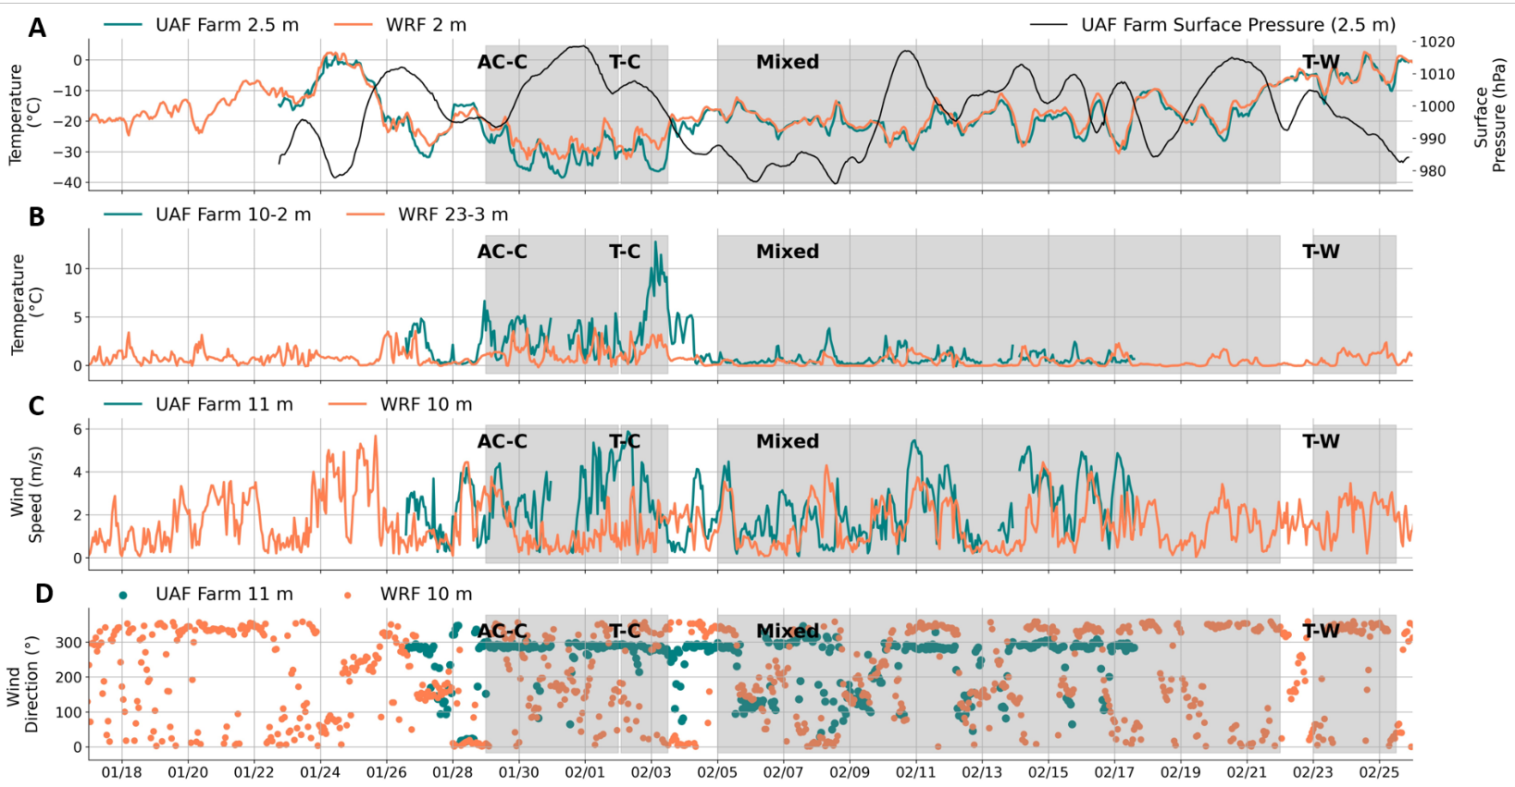
EPA-WRF Model against observations (UAF Farm)

Slide 11
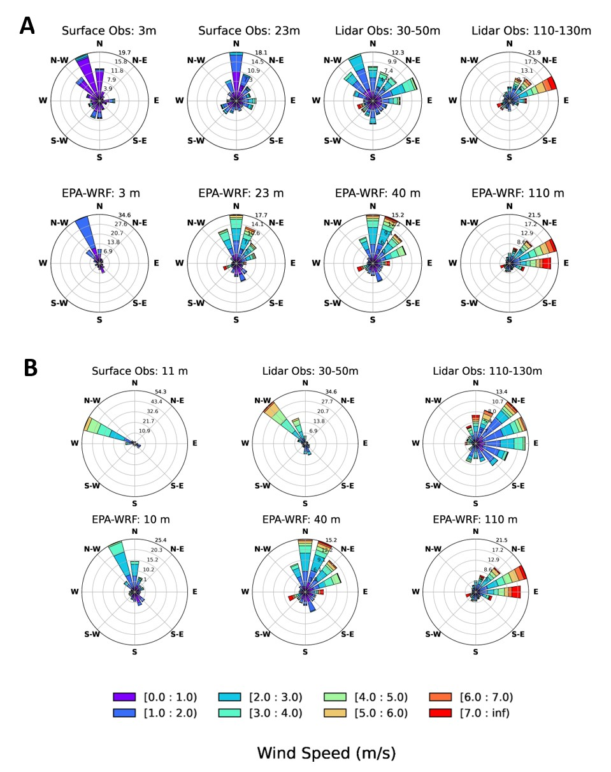
Observed and EPA-WRF Wind Roses
CTC
UAF Farm

