Slide 1
Assessment of the Indian Meteorological Ensemble Dataset (IMED) Performance in Identifying Cloudbursts Events Over the Northwest Himalayas (NWH)
Anagha Peringiyil¹, Manabendra Saharia^{1,2}, Sreejith OP³
¹Department of Civil Engineering, IIT Delhi, India
²Yardi School of Artificial Intelligence, IIT Delhi, India
³Climate Research and Services, India Meteorological Department, Pune, India

Slide 2
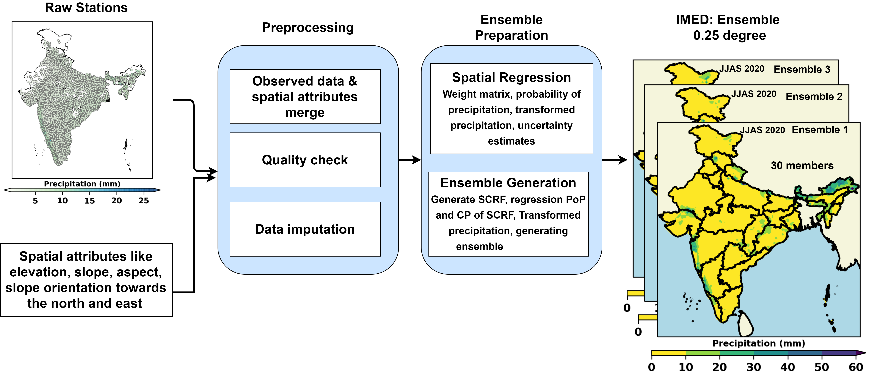
Indian Meteorological Ensemble Dataset (IMED)
Objective
To Evaluate the Performance of developed Ensemble Precipitation Product for Detecting Cloudburst over NWH
The precipitation dataset is essential for its vital role in numerous applications, including flood research, extreme event analysis, irrigation planning, and water requirement assessment.
The IMED ensemble meteorological dataset allows the estimation of precipitation uncertainty.
Probabilistic datasets are useful for determining uncertainty and capturing extremes.
30 years (1991 -2020)
30 Ensembles per day
Resolution- 0.25⁰
Existing datasets are deterministic in nature and do not incorporate any error information. These errors propagate into any application that may utilize data.
In recent years, cloudbursts happened more frequently over the NWH. The uncertainty of available gridded data due to the sparse station network over NWH encouraged us to use IMED data, which is an ensemble-based dataset well known for capturing extreme precipitation.
Methodology Diagram
Anagha Peringiyil, IIT Delhi

Slide 3
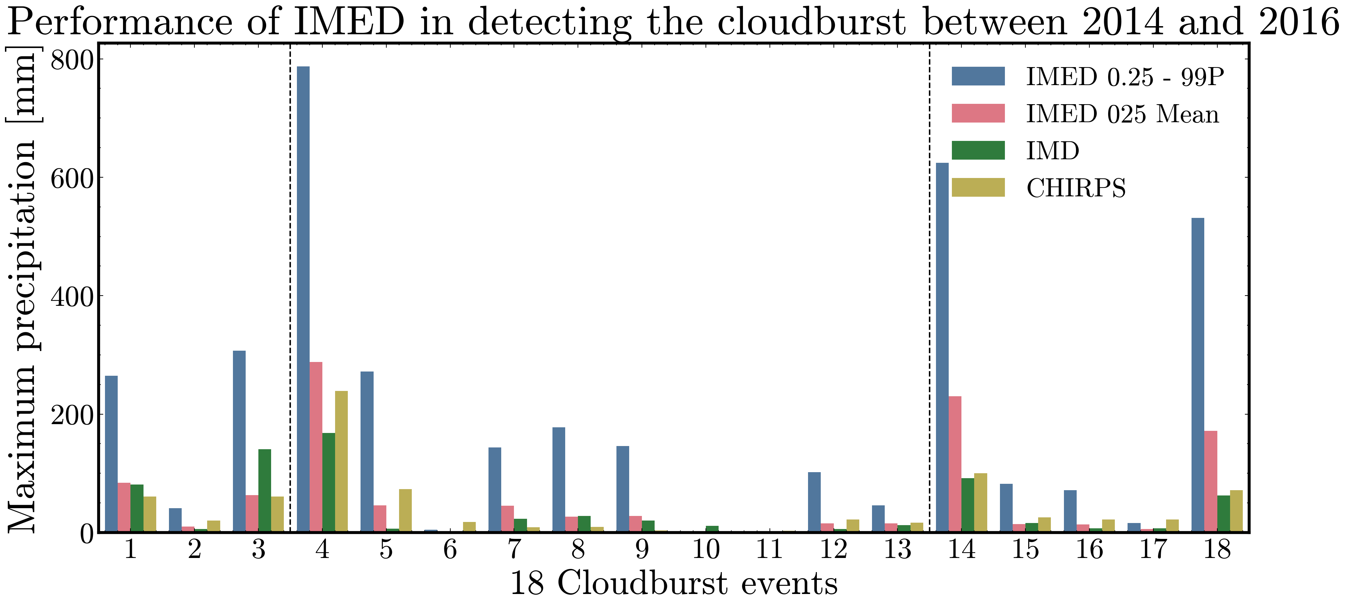
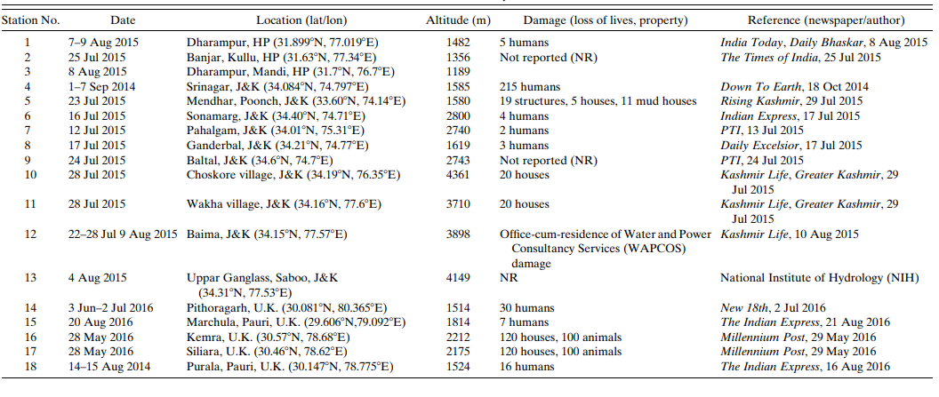
IMED can better identify Extreme Events between 2014 and 2016 over Northwest Himalayan Region
Highlight
Location of Cloudburst events
IMED can represent higher values than the near by observed station data.
Maximum rainfall during the cloudburst event period
Source:Jena, P., Garg, S., & Azad, S. (2020). Performance analysis of IMD high-resolution gridded rainfall (0.25°× 0.25°) and satellite estimates for detecting cloudburst events over the northwest Himalayas. Journal of Hydrometeorology, 21(7), 1549-1569.
Cloudburst event [05 Sep 2014]. Maximum Rainfall Over Srinagar, J&K (Event no. 4).
Anagha Peringiyil, IIT Delhi
3

Slide 4
REFERNCES
Jena, P., Garg, S., Azad, S., 2020. Performance Analysis of IMD High-Resolution Gridded Rainfall (0.25° × 0.25°) and Satellite Estimates for Detecting Cloudburst Events over the Northwest Himalayas. Journal of Hydrometeorology 21, 1549–1569. https://doi.org/10.1175/JHM-D-19-0287.1
Newman, A.J., Clark, M.P., Longman, R.J., Gilleland, E., Giambelluca, T.W., Arnold, J.R., 2019. Use of Daily Station Observations to Produce High-Resolution Gridded Probabilistic Precipitation and Temperature Time Series for the Hawaiian Islands. Journal of Hydrometeorology 20, 509–529. https://doi.org/10.1175/JHM-D-18-0113.1
Mishra, P.K., Thayyen, R.J., Singh, H., Das, S., Nema, M.K., Kumar, P., 2022. Assessment of cloudbursts, extreme rainfall and vulnerable regions in the Upper Ganga basin, Uttarakhand, India. International Journal of Disaster Risk Reduction 69, 102744. https://doi.org/10.1016/j.ijdrr.2021.102744
Garg, S., Jena, P., Devi, U., Azad, S., 2023. Performance evaluation of high‐resolution IMDAA and IMERG for detecting cloudburst events over the Northwest Himalayas. Intl Journal of Climatology 43, 3730–3748. https://doi.org/10.1002/joc.8055.
Garg, S., Jena, P., Devi, U., & Azad, S. (2023). Performance evaluation of high‐resolution IMDAA and IMERG for detecting cloudburst events over the Northwest Himalayas.International Journal of Climatology,43(8), 3730-3748.
Anagha Peringiyil, IIT Delhi
4

