Slide 1
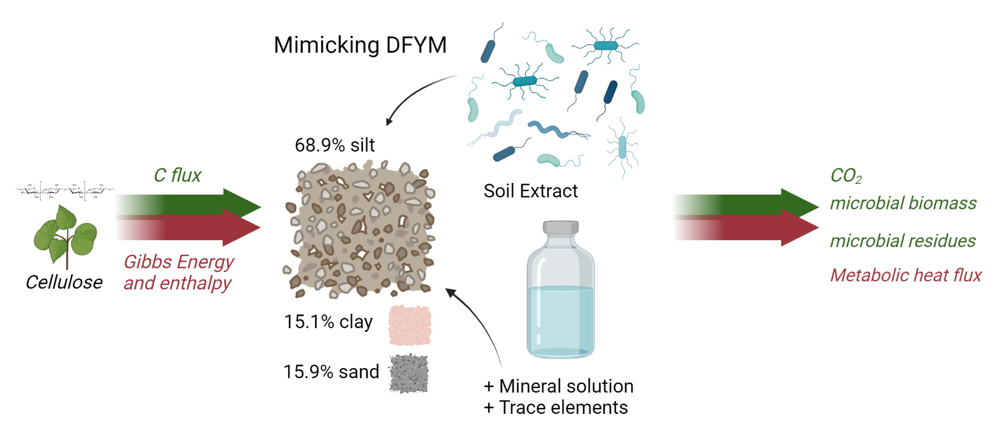
Experimental Setup
Artificial Soil
Blank
x 5
Cellulose
x 5
Destructive soil sampling on 5 days
Blank
Moist = 10%
Moist = 14.4%
Moist = 19%
T = 7 ℃
T = 20 ℃
N
C/N = 18
C/N = 9
Cellulose
N
TAM Air
Continuous calorimetric measurements
Notes:
- AS: simple
- how we prepare it

Slide 2
Experimental Setup - sampling schedule
Artificial Soil
Continuous calorimetry (45/76 DAYS incubation)
CO₂
+ CO₂
+ CO₂
+ CO₂
+ CO₂
+ CO₂
Day 0 | Day 7 | Day 15 | Day 20 | Day 28 | Day 45 | Day 76
Heat Production rate [μW g⁻¹] / CO₂ [mmol g⁻¹]
Time [day]
Notes:
According to expected heat and CO2 flux, we set five sampling days from starting, two times near and peak time and three more after peak time. CO2 will be sampled once more. Calorimetry will continuously ran with regular aeration according to the sampling schedule. The whole incubation will last for 76 days
- 45/76 days going to baseline
- CO2 sampling one day more, 5 sampling days

Slide 3
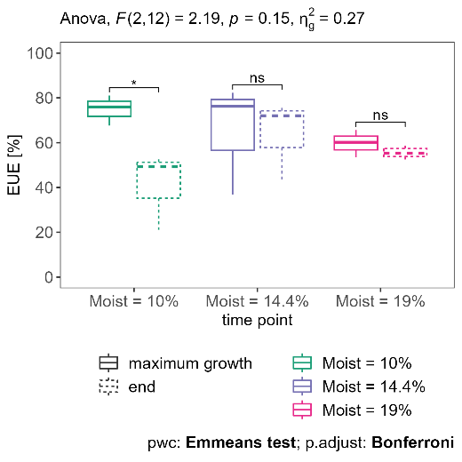
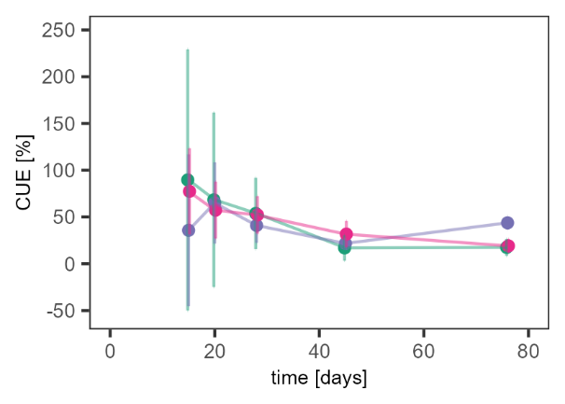
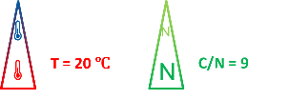
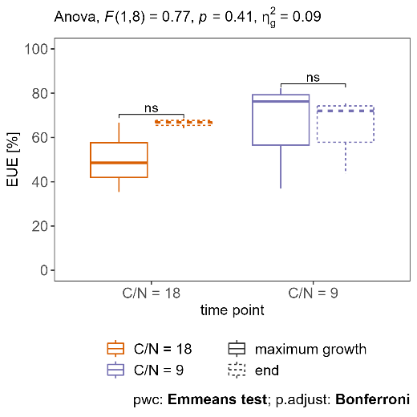
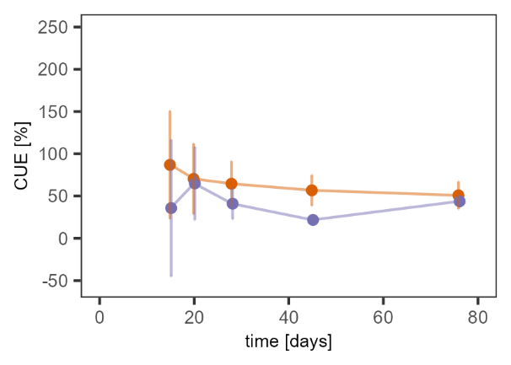
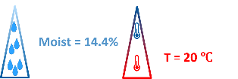
Results & Discussion – the effect of moisture and C/N on CUE and EUE in artificial soil
Notes:
CUE and EUE calculated based on assumption that degraded cellulose either incorporated in biomass or mineralized to CO2
CUE exhibits gradual decline with all in all incubations. At end of period between ~20 (moist and dry) and ~50 % (middle moist and high C/N). Very high error ranges in beginning due to low comsumption and production numbers. EUE fall in the range of 40%-70%

Slide 4
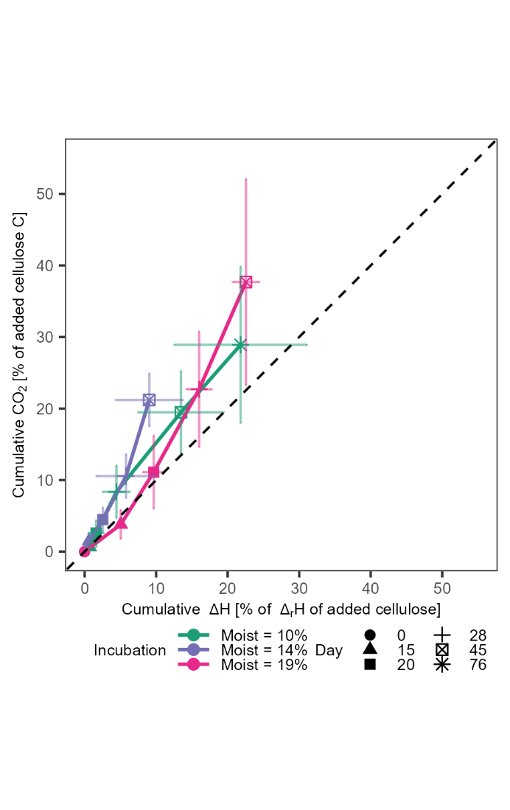
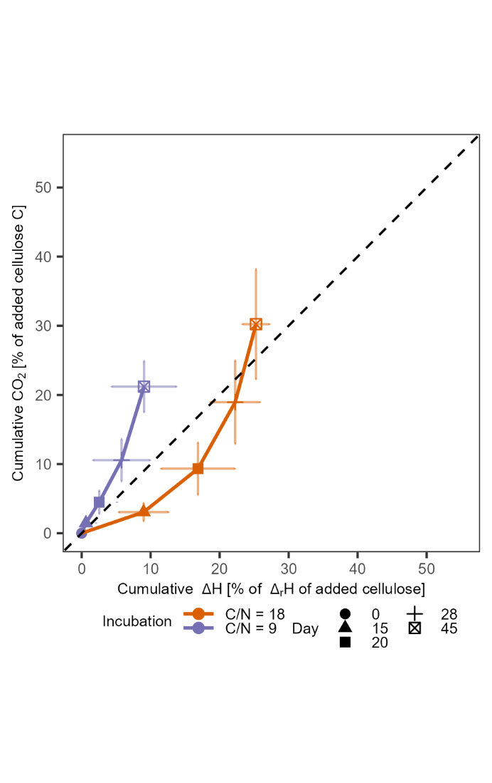
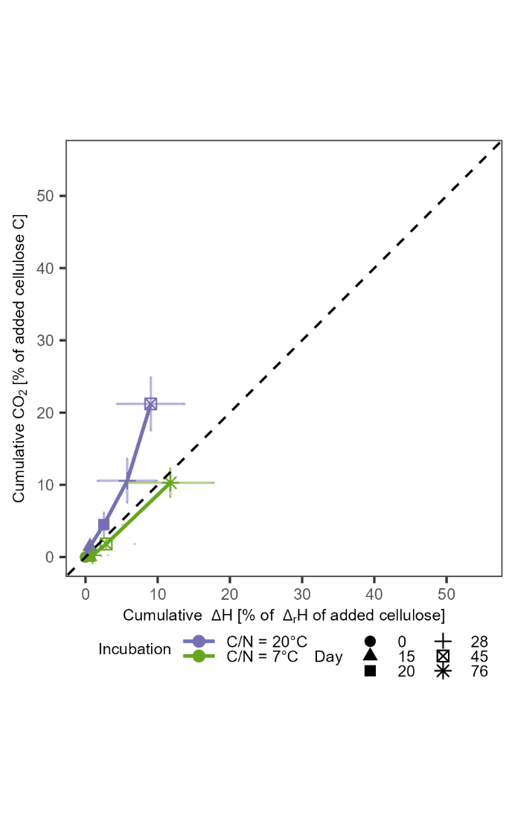
Results & Discussion – link between heat and CO₂ in artificial soil
Moisture
N supply
Temperature
$$\frac{∆{CO}_{2} }{∆H}$$
$$\frac{∆{CO}_{2} }{∆H}$$
No apparent differences
relative CO₂ > heat
Moisture
N supply
Biomass production?
Temperature
Biomass production?
Energy investment
in anabolism per CO₂?
linearity
Notes:
Next step, to link energy and carbon turnover together. We calculate the cumulative heat release per reaction enthalpy of added cellulose as well as the cumulative CO2 production per added cellulose carbon.
Data set updated compared to ehat some might have seen at DBG.
In moisture treatments, we tend to observe higher relative CO2 release compaored to relative heat release, but comparison inbetween treatments shows strongly overlapping error bars so that evaluation of differences between treatments difficult
In C/N comparison, decreased N supply leads to stronger relative heat release compared to relative CO2 release which we interpret as potentially decreased biomass production as E investment for N assimilation necessary.
In temperature comparison, relative CO2/heat decreases, lower biomass production, 1:1 CO2/heat, longer incubation

Slide 5
T = 20 ℃
N
C/N = 9
N
Moist = 14.4%
T = 20 ℃
Moist = 14.4%
N
C/N = 9
N

