Slide 1
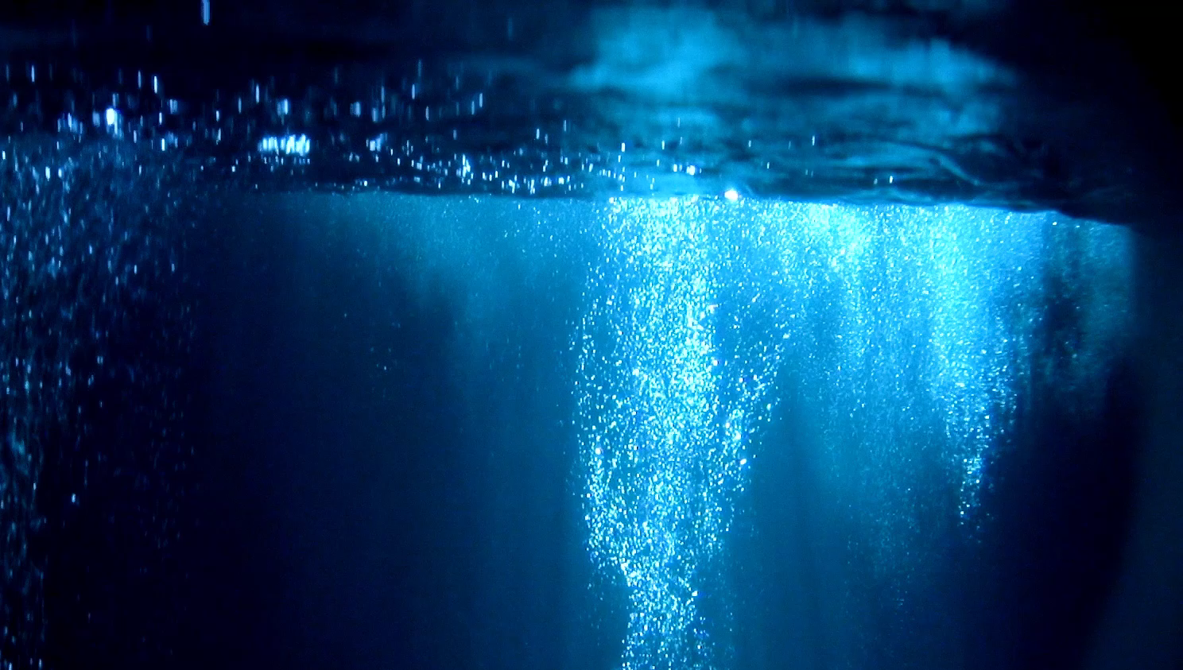
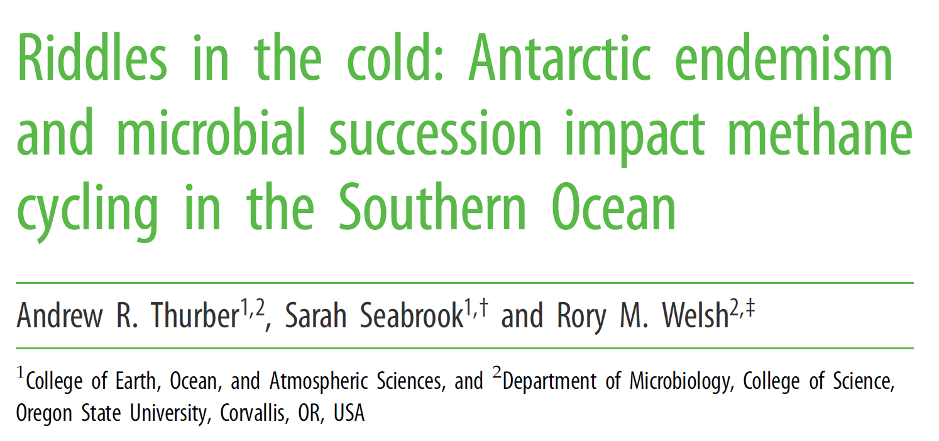

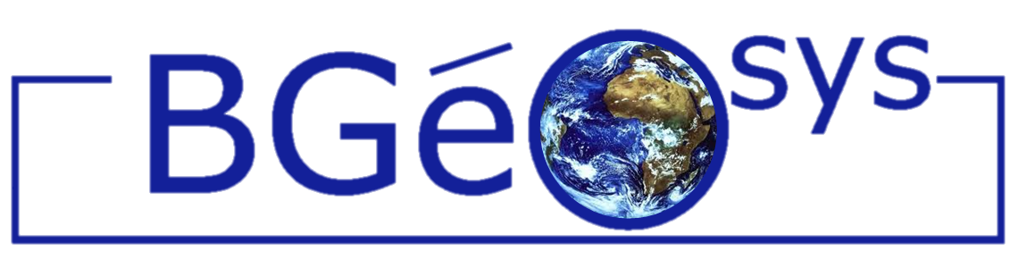



Exploring the efficiency of anaerobic oxidation of methane as a sink to hydrate-sourced methane
Maria De La Fuente Ruiz, Sandra Arndt, Héctor Marín-Moreno, Tim A. Minshull, and Jean Vaunat
BGeosys, Biogeochemistry and Modelling of the Earth System - Department of Geosciences, Environment and Society, Faculty of Sciences (ULB) maria.de.la.fuente.ruiz@ulb.be
AOM benthic biofilter:
At a global scale, the AOM bio-filter:
Consumes a total of ∼45–61 Tg of methane per year (~cumulative production of methane by methanogenesis in marine sediments)
Can consume up to 100% of the dissolved methane transported upwards in diffusive dominated systems
Its efficiency can be reduced to up to 20% at cold seep and advective dominated systems
Its efficiency is estimated less than 10% where methanotrophic fauna and bacterial mats are absent
Up to 5 years for microorganisms to be capable of forming an efficient methane ‘sediment filter’. In this period continued release of methane to the ocean was observed
:EGU 2024 - Vienna, Austria & Online | 14–19 April 2024
Affiliations and Funding:
Notes:
The current version of the numerical model focuses on modelling how gas transport and bioenergetic limitations and biomass dynamics influence the efficiency of the AOM

Slide 2
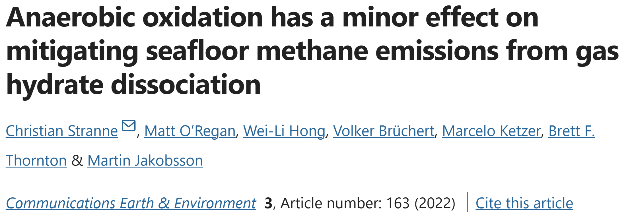
Exploring the efficiency of anaerobic oxidation of methane as a sink to hydrate-sourced methane
Maria De La Fuente Ruiz, Sandra Arndt, Héctor Marín-Moreno, Tim A. Minshull, and Jean Vaunat
BGeosys, Biogeochemistry and Modelling of the Earth System - Department of Geosciences, Environment and Society, Faculty of Sciences (ULB) maria.de.la.fuente.ruiz@ulb.be
AOM benthic biofilter:
At a global scale, the AOM bio-filter:
Consumes a total of ∼45–61 Tg of methane per year (~cumulative production of methane by methanogenesis in marine sediments)
Can consume up to 100% of the dissolved methane transported upwards in diffusive dominated systems
Its efficiency can be reduced to up to 20% at cold seep and advective dominated systems
Its efficiency is estimated less than 10% where methanotrophic fauna and bacterial mats are absent
The AOM filter becomes particularly inefficient (<5%) when overpressure leads to hydraulic fracturing and rapid CH4 release, which is expected to be the dominant CH4 transport mode in hydrate-bearing slope sediments.
:EGU 2024 - Vienna, Austria & Online | 14–19 April 2024
Affiliations and Funding:
Notes:
The current version of the numerical model focuses on modelling how gas transport and bioenergetic limitations and biomass dynamics influence the efficiency of the AOM

Slide 3
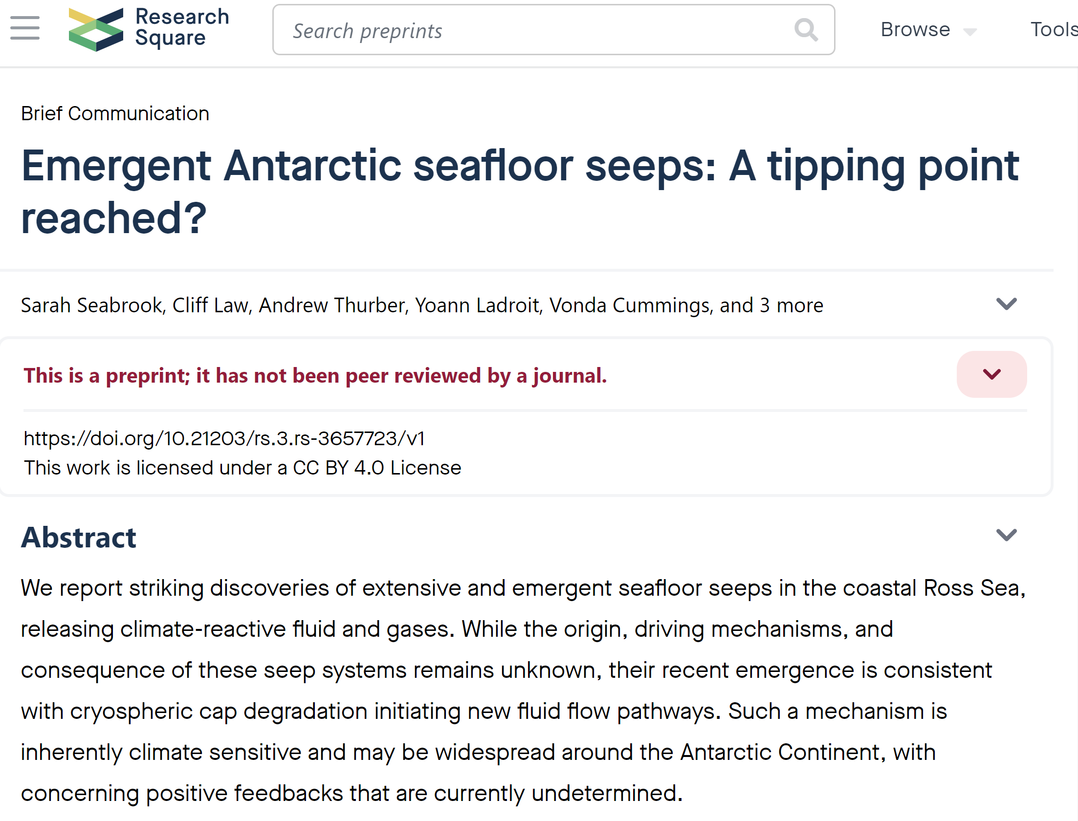
Exploring the efficiency of anaerobic oxidation of methane as a sink to hydrate-sourced methane
Maria De La Fuente Ruiz, Sandra Arndt, Héctor Marín-Moreno, Tim A. Minshull, and Jean Vaunat
BGeosys, Biogeochemistry and Modelling of the Earth System - Department of Geosciences, Environment and Society, Faculty of Sciences (ULB) maria.de.la.fuente.ruiz@ulb.be
AOM benthic biofilter:
At a global scale, the AOM bio-filter:
Consumes a total of ∼45–61 Tg of methane per year (~cumulative production of methane by methanogenesis in marine sediments)
Can consume up to 100% of the dissolved methane transported upwards in diffusive dominated systems
Its efficiency can be reduced to up to 20% at cold seep and advective dominated systems
Its efficiency is estimated less than 10% where methanotrophic fauna and bacterial mats are absent
:EGU 2024 - Vienna, Austria & Online | 14–19 April 2024
Affiliations and Funding:
Notes:
The current version of the numerical model focuses on modelling how gas transport and bioenergetic limitations and biomass dynamics influence the efficiency of the AOM

Slide 4
Exploring the efficiency of anaerobic oxidation of methane as a sink to hydrate-sourced methane
Maria De La Fuente Ruiz, Sandra Arndt, Héctor Marín-Moreno, Tim A. Minshull, and Jean Vaunat
BGeosys, Biogeochemistry and Modelling of the Earth System - Department of Geosciences, Environment and Society, Faculty of Sciences (ULB) maria.de.la.fuente.ruiz@ulb.be
AOM variable efficiency and potential windows of opportunity for methane emissions:
Upward migration of the SMTZ:
Steepening of the solute gradients
At the new SMTZ location, the resident AOM community might first have to build up sufficient biomass to operate at full capacity
AOM consortia cannot access methane in its gaseous phase
Fracture generation and propagation due to pore fluid over-pressure may favor both dissolved and gas methane to by-pass the benthic sink
Sulfate and methane fate within the sediment column for different flux-dominated settings (De La Fuente et. al. 2022)
:EGU 2024 - Vienna, Austria & Online | 14–19 April 2024
Affiliations and Funding:
Notes:
The current version of the numerical model focuses on modelling how gas transport and bioenergetic limitations and biomass dynamics influence the efficiency of the AOM

Slide 5

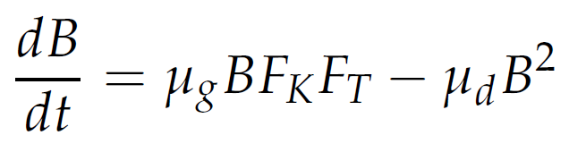
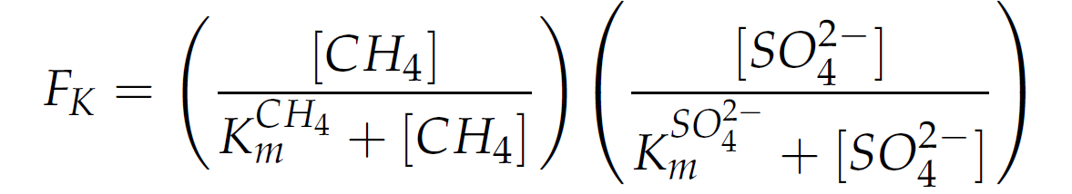
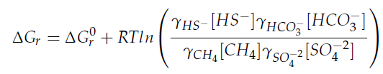
Exploring the efficiency of anaerobic oxidation of methane as a sink to hydrate-sourced methane
Maria De La Fuente Ruiz, Sandra Arndt, Héctor Marín-Moreno, Tim A. Minshull, and Jean Vaunat
BGeosys, Biogeochemistry and Modelling of the Earth System - Department of Geosciences, Environment and Society, Faculty of Sciences (ULB) maria.de.la.fuente.ruiz@ulb.be
AOM variable efficiency and potential windows of opportunity for methane emissions:
AOM considering microbial growth dynamics
Window of opportunity for methane escape due to slow AOM biomass growth (Puglini et. al. 2020)
Window of opportunity
:EGU 2024 - Vienna, Austria & Online | 14–19 April 2024
Affiliations and Funding:
Notes:
The current version of the numerical model focuses on modelling how gas transport and bioenergetic limitations and biomass dynamics influence the efficiency of the AOM

Slide 6
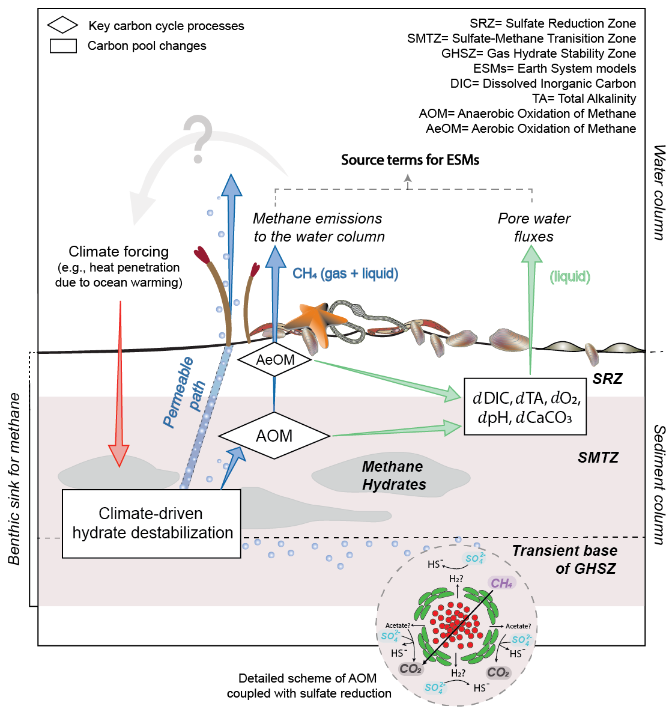


Exploring the efficiency of anaerobic oxidation of methane as a sink to hydrate-sourced methane
Maria De La Fuente Ruiz, Sandra Arndt, Héctor Marín-Moreno, Tim A. Minshull, and Jean Vaunat
BGeosys, Biogeochemistry and Modelling of the Earth System - Department of Geosciences, Environment and Society, Faculty of Sciences (ULB) maria.de.la.fuente.ruiz@ulb.be
Biogeochemical implications of CH4 turnover:
Among other properties, AOM can exert important changes in:
Benthic DIC (Dissolved Inorganic Carbon)
Total Alkalinity
Whether produced DIC reaches the ocean as CO2 (resulting in an acidifying effect) or ALK (yielding a buffering effect) depends on the fate of hydrogen sulfide (H2S), derived from the protonation of AOM-derived sulfide (HS-), the rates of authigenic calcium carbonate (CaCO3) precipitation and the ambient pH.
AeOM occurring at the water column (or potentially also within the sediment):
:EGU 2024 - Vienna, Austria & Online | 14–19 April 2024
Affiliations and Funding:
Main hydrate-related carbon cycle processes and carbon pools in marine sediments (De La Fuente et. al. in prep)
Notes:
The current version of the numerical model focuses on modelling how gas transport and bioenergetic limitations and biomass dynamics influence the efficiency of the AOM

Slide 7
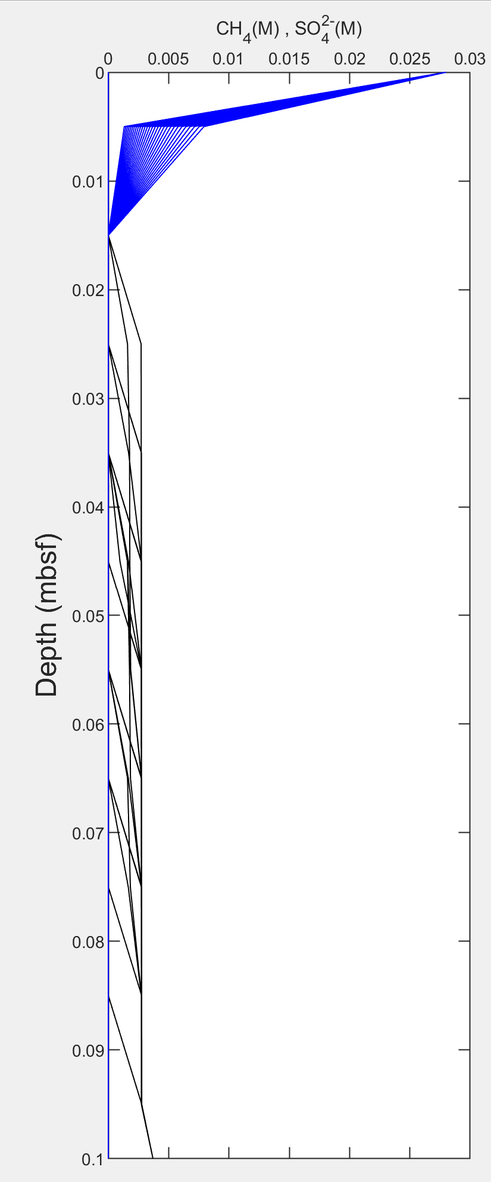
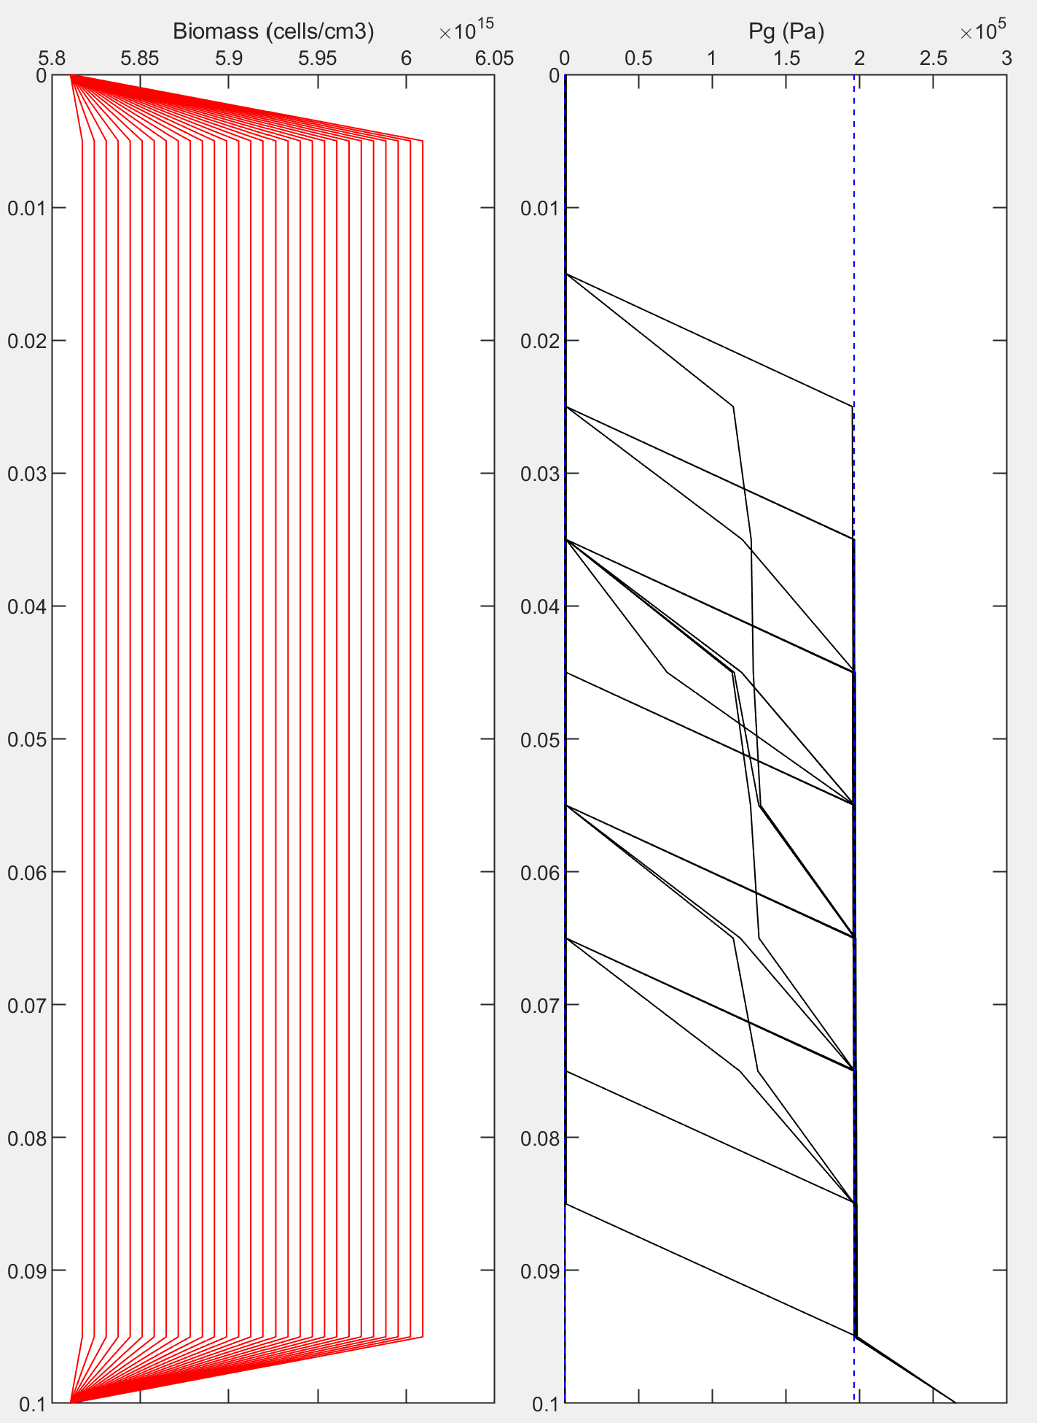
Exploring the efficiency of anaerobic oxidation of methane as a sink to hydrate-sourced methane
Maria De La Fuente Ruiz, Sandra Arndt, Héctor Marín-Moreno, Tim A. Minshull, and Jean Vaunat
BGeosys, Biogeochemistry and Modelling of the Earth System - Department of Geosciences, Environment and Society, Faculty of Sciences (ULB) maria.de.la.fuente.ruiz@ulb.be
Fate of CH4 matters:
AOM converts CH4 into DIC. However, whether the produced DIC reaches the ocean as CO2 (resulting in an acidifying effect) or ALK (yielding a buffering effect) depends on the fate of hydrogen sulfide (H2S), derived from the protonation of AOM-derived sulfide (HS-),the rates of authigenic calcium carbonate (CaCO3) precipitation and the ambient pH. In addition, any CH4 bypassing the AOM sink or escaping the sediment will undergo aerobic oxidation (AeOM), ultimately contributing to ocean acidification.
:EGU 2024 - Vienna, Austria & Online | 14–19 April 2024
Affiliations and Funding:
Main hydrate-related carbon cycle processes and carbon pools in marine sediments (De La Fuente et. al. in prep)
Notes:
The current version of the numerical model focuses on modelling how gas transport and bioenergetic limitations and biomass dynamics influence the efficiency of the AOM

Slide 8
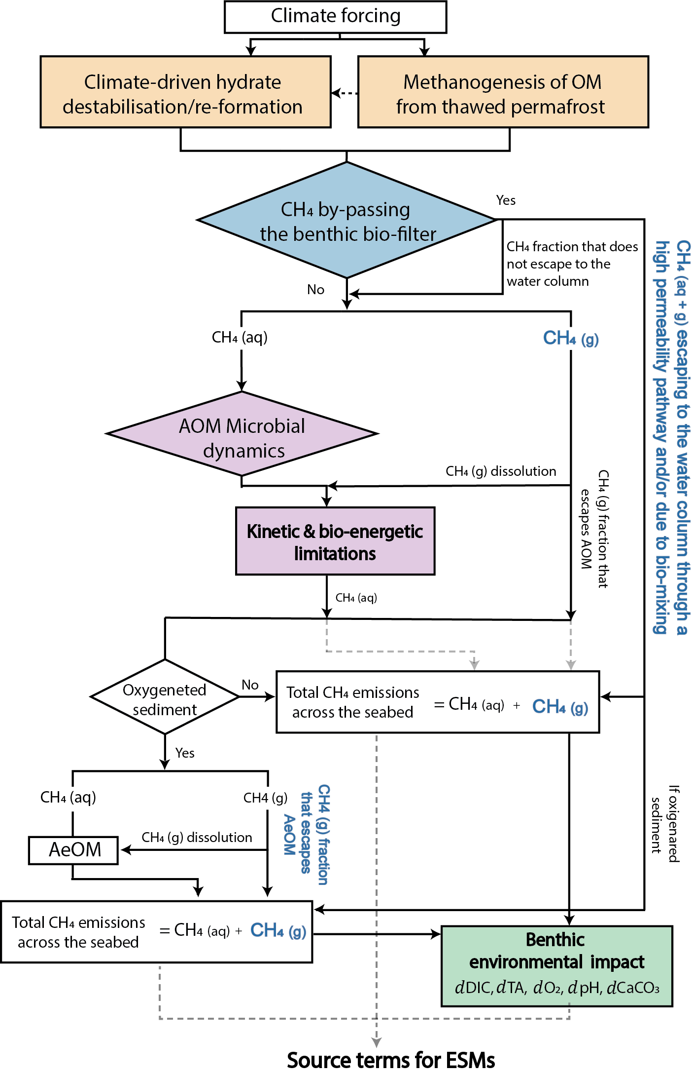
Exploring the efficiency of anaerobic oxidation of methane as a sink to hydrate-sourced methane
Maria De La Fuente Ruiz, Sandra Arndt, Héctor Marín-Moreno, Tim A. Minshull, and Jean Vaunat
BGeosys, Biogeochemistry and Modelling of the Earth System - Department of Geosciences, Environment and Society, Faculty of Sciences (ULB) maria.de.la.fuente.ruiz@ulb.be
The big picture:
Better constraining methane sinks of the released methane due to gas hydrate destabilization reservoirs is key to reduce uncertainties at estimating the global methane budget and predict future climate feedback
AOM is an important barrier for the transfer of methane to the ocean. However, its efficiency (in particular, in response to hydrate destabilization) is still poorly constrained and its benthic biogeochemical impacts are largely overlooked
Reducing uncertainty when modelling the fate of methane associaciated to hydrate destabilization is important to:
(i) Assess how much methane and for how long is injected
into the ocean, and ultimately the atmosphere = crucial for
future climate projections and policies
(ii) Capture the role of AOM as a biogeochemical interface in the
global carbon cycle = potential environmental feedbacks
(impacts on local to regional DIC budgets, ocean acidification,
deoxygenation, and nutrients imbalance)
:EGU 2024 - Vienna, Austria & Online | 14–19 April 2024
Affiliations and Funding:
Main hydrate-related carbon cycle processes and carbon pools in marine sediments (De La Fuente et. al. in prep)
Notes:
The current version of the numerical model focuses on modelling how gas transport and bioenergetic limitations and biomass dynamics influence the efficiency of the AOM

