Slide 1
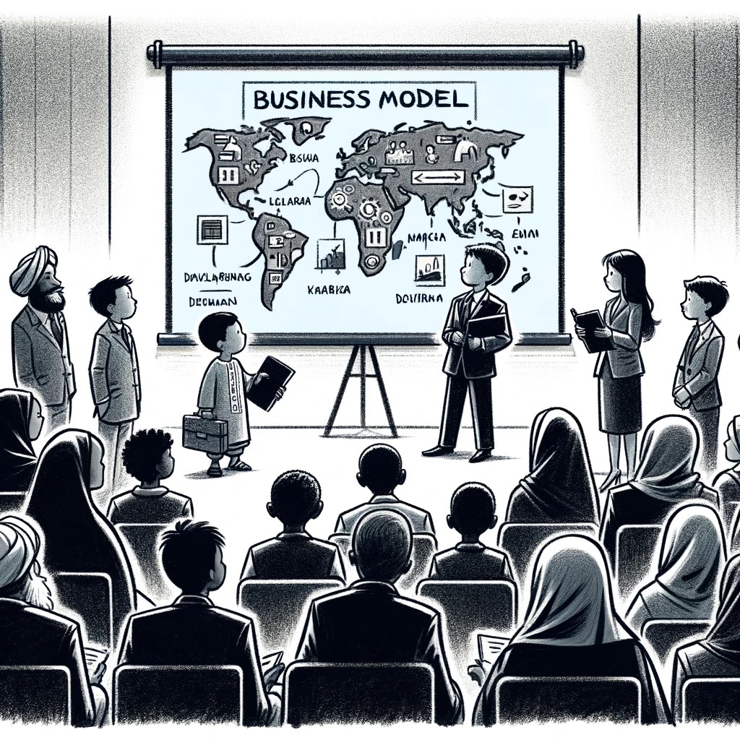
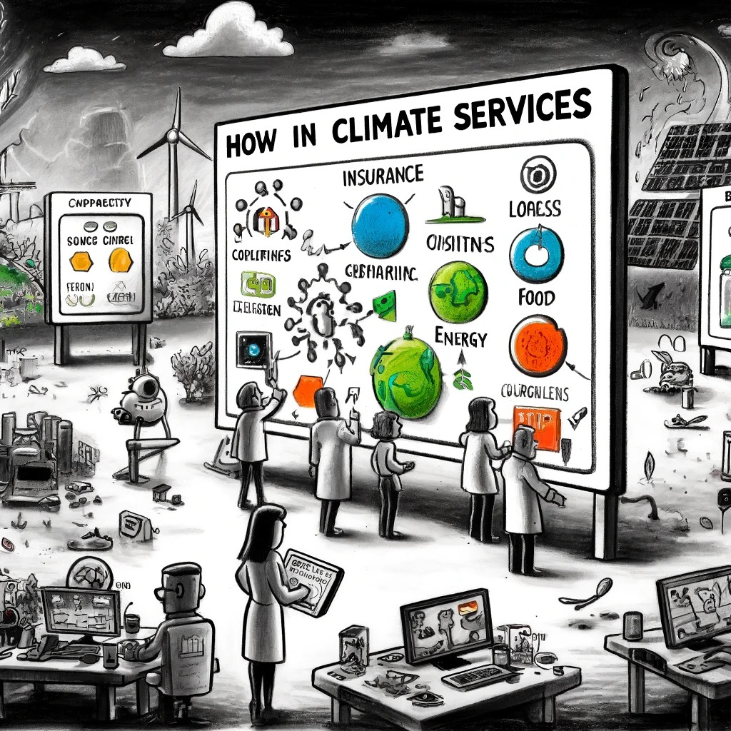
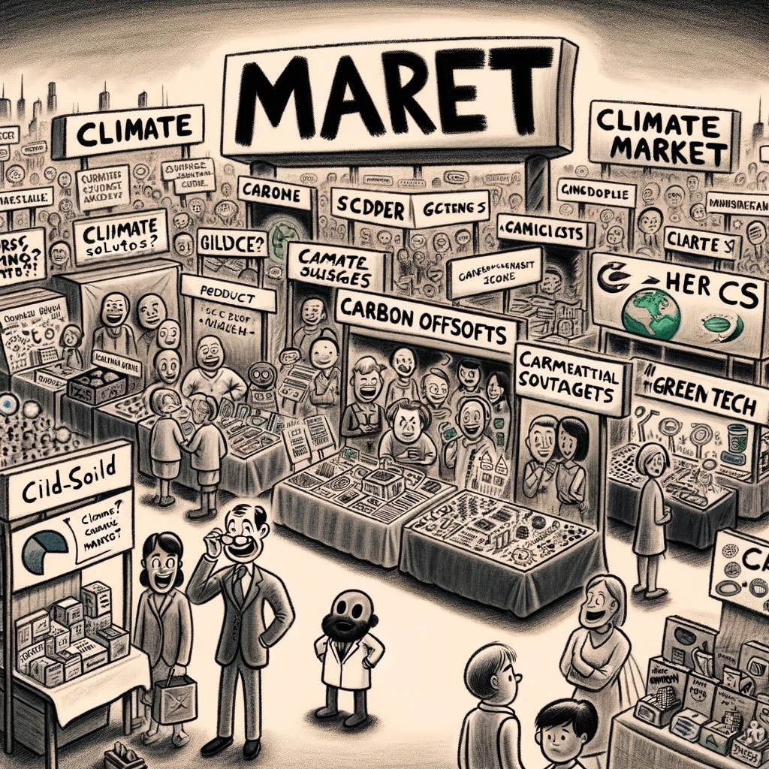
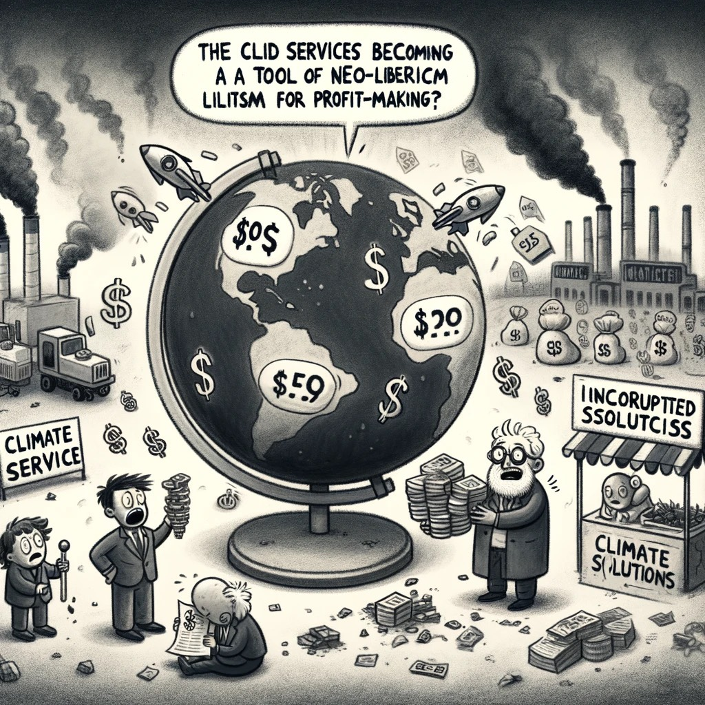
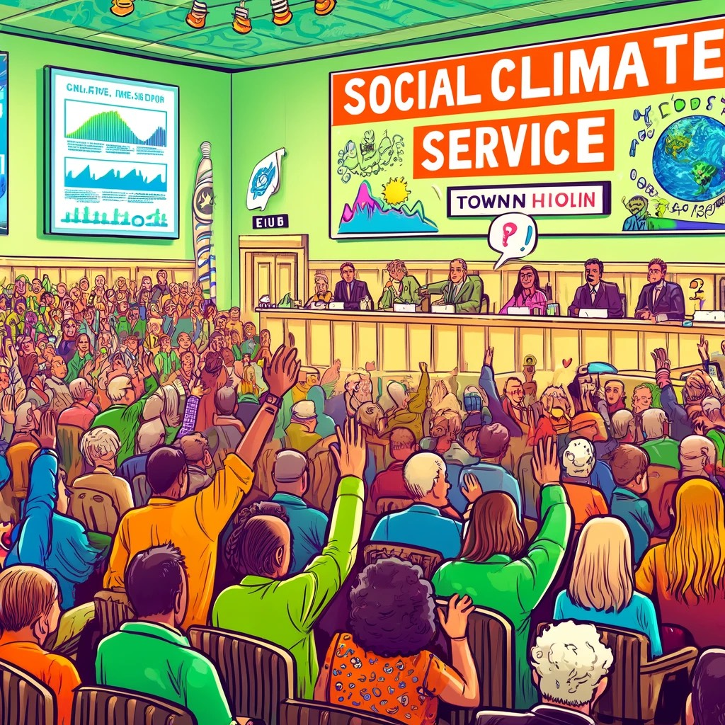
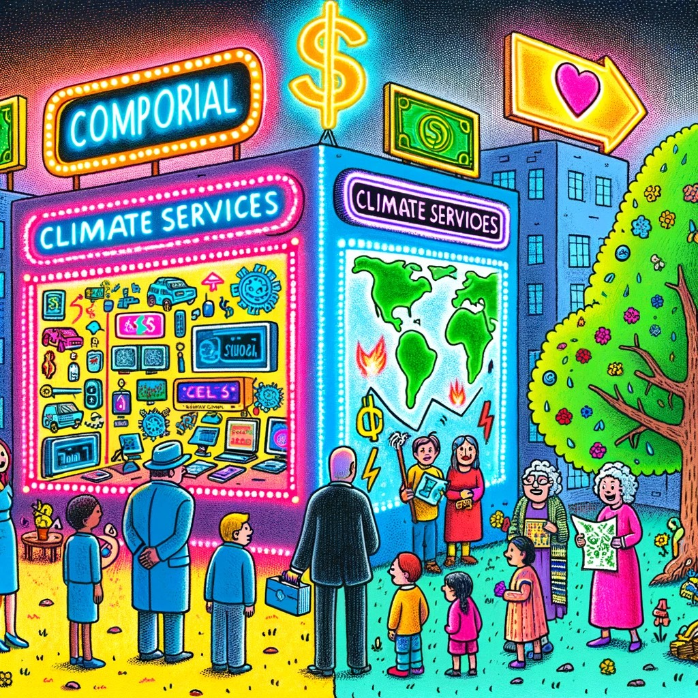
The Evolution of Climate Services:
Shifting Paradigms
from commercial exploitation to
Societal Engagement
Marcello Petitta^{1,2}, Sandro Calmanti³, and Matteo De Felice
¹University of Tor Vergata, Enterprise Engineering, Roma, Italy
²Amigo s.r.l., Roma, Italy
³ ENEA, SSPT-MET-CLIM, Roma, Italy
All images in this presentation were created using DALL-E by OpenAI. Any misspellings in the images are intentional. Please note that these images do not reference any actual facts, individuals, or entities.

Slide 2
Climate Service
The goal of ‘climate services’ is to contribute to adaptation policy by providing ‘actionable information’ about climate conditions to decision-makers.
Transforming complex climate data into accessible information
Helping bridge the existing gap between climate science research and practical policy implementation
CO-CO-CO Co-Design, Co-Development, Co-Production
All images in this presentation were created using DALL-E by OpenAI. Any misspellings in the images are intentional. Please note that these images do not reference any actual facts, individuals, or entities.

Slide 3
What Climate-Service-worLd do you want?
Climate services as business services
Climate Services as Tools for Social Equity and Data Democratization
A Hybrid Approach
All images in this presentation were created using DALL-E by OpenAI. Any misspellings in the images are intentional. Please note that these images do not reference any actual facts, individuals, or entities.

Slide 4
The Evolution of Climate Services:
Shifting Paradigms
from commercial exploitation to
Societal Engagement
Marcello Petitta^{1,2}, Sandro Calmanti³, and Matteo De Felice
¹University of Tor Vergata, Enterprise Engineering, Roma, Italy
²Amigo s.r.l., Roma, Italy
³ ENEA, SSPT-MET-CLIM, Roma, Italy
All images in this presentation were created using DALL-E by OpenAI. Any misspellings in the images are intentional. Please note that these images do not reference any actual facts, individuals, or entities.

Slide 5
Climate Service
The goal of ‘climate services’ is to contribute to adaptation policy by providing ‘actionable information’ about climate conditions to decision-makers.
Transforming complex climate data into accessible information
Helping bridge the existing gap between climate science research and practical policy implementation
CO-CO-CO Co-Design, Co-Development, Co-Production
All images in this presentation were created using DALL-E by OpenAI. Any misspellings in the images are intentional. Please note that these images do not reference any actual facts, individuals, or entities.

Slide 6
Climate Service Market
Focus on ‘boundary organizations’ to translate information between scientists and decision-makers
Climate services language and analysis is saturated with the language of business, markets, and the corporate world.
Most of the funds are still coming from Public Organizations
All images in this presentation were created using DALL-E by OpenAI. Any misspellings in the images are intentional. Please note that these images do not reference any actual facts, individuals, or entities.

Slide 7
Climate Service and large companies
Climate services are now incorporated into large companies in the sector of Energy, Insurance, Food, Consultancy, Finance, etc.
The boundary companies are mainly depending on public funds and tenders
The climate service business model reflects trends towards neo-liberalization as occurred to Academy and Research.
All images in this presentation were created using DALL-E by OpenAI. Any misspellings in the images are intentional. Please note that these images do not reference any actual facts, individuals, or entities.

Slide 8
Crisis of Climate Service Business model?
‘null hypothesis’: what if climate information of the form and scale that policy-makers find useful is not available?
Commercialization: A commercial model for climate services could complicate the application of climate science.
Managing Expectations: There is a risk of setting unrealistic expectations due to the inherent uncertainties in climate predictions.
Access and Equity Issues: Market-driven distribution of climate information may restrict access to those who can afford it, limiting widespread usability.
All images in this presentation were created using DALL-E by OpenAI. Any misspellings in the images are intentional. Please note that these images do not reference any actual facts, individuals, or entities.

Slide 9
Climate Service - New perspectives
Beyond Business: Exploring alternatives to the traditional business and company models for sustainable mechanisms.
Beyond Data: Recognizing that technical climate information it is only the first step of a complex value-chain.
Overlooked Decisions: Addressing the absence of social and individual decision-making processes in current models.
All images in this presentation were created using DALL-E by OpenAI. Any misspellings in the images are intentional. Please note that these images do not reference any actual facts, individuals, or entities.

Slide 10
Social Climate Service
Empowering Communities: Enable social groups to express their climate change concerns.
Interactive Learning: Foster education through social engagement and practical experiences.
Culturally Inclusive Climate Services: Integrate local culture, knowledge, and narratives at the forefront.
Networking in Climate Services: Facilitate connections and relationships among stakeholders.
All images in this presentation were created using DALL-E by OpenAI. Any misspellings in the images are intentional. Please note that these images do not reference any actual facts, individuals, or entities.

Slide 11
What Climate-Service-worLd do you want?
Climate services as business services
Climate Services as Tools for Social Equity and Data Democratization
A Hybrid Approach
All images in this presentation were created using DALL-E by OpenAI. Any misspellings in the images are intentional. Please note that these images do not reference any actual facts, individuals, or entities.

Slide 12
Bibliography
Insights and observations are derived from analyses of the following papers:
Bruno Soares, M., Buontempo, C., 2019. Challenges to the sustainability of climateservices in Europe. WIREs. Clim. Change. 10, e587.
Bruno Soares, M., Dessai, S., 2015. Exploring the use of seasonal climate forecasts inEurope through expert elicitation. Clim. Risk Manage. 10, 8–16.
Porter, J.J., Dessai, S., 2017. Mini-me: Why do climate scientists’ misunderstand usersand their needs? Environ. Sci. Policy 77, 9–14.
Scott Bremer, Anne Bremer, Lisbeth Iversen, Marta Bruno Soares, Jeroen van der Sluijs, Recognising the social functions of climate services in Bergen, Norway, Climate Services, Volume 27, 2022, 100305, ISSN 2405-8807, https://doi.org/10.1016/j.cliser.2022.100305.
Vogel, C., Steynor, A., Manyuchi, A., 2019. Climate services in Africa: Re-imagining aninclusive, robust and sustainable service. Clim. Services 15, 100107.
Webber, S., Donner, S.D., 2017. Climate service warnings: cautions aboutcommercializing climate science for adaptation in the developing world. WileyInterdisc. Rev.: Clim. Change 8 (1), e424
Acknowledgment: This project has received funding from the European Commission’s Horizon Europe Coordination and Support Actions programme under grant agreement No. 101096056 and No. 869575. The European Commission is not responsible for any use that may be made of the information it contains. M.P. thanks the European Union FSE-REACT-EU, PON Research and Innovation 2014-2020 DM1062/2021 for the financial support.

