Slide 1
Assessing The Impact of Land Use Changes on PM_{2.5}Concentrations: A Geographically Weighted Regression Approach
Presentation ID:
PICO spot 3
"EGU General Assembly 2024“
BG8.17 - Urban Ecosystem Dynamics: Challenges and Advances
Rahul Jaiswal¹, Himanshu Shekhar¹, Siddhant Gupta¹, Sunita Verma^{1,2} Swagata Payra³ and Manish Kumar Pandey³
¹ Department of Environment and Sustainable Development, Banaras Hindu University, Varanasi-221105, Uttar Pradesh, India.
² DST-Mahamana Centre of Excellence in Climate Change Research, Institute of Environment and Sustainable Development, Banaras Hindu University, Varanasi, Uttar Pradesh, India.
³Department of Remote Sensing, Birla Institute of Technology, Mesra, Ranchi – 835215, Jharkhand, India.

Slide 2
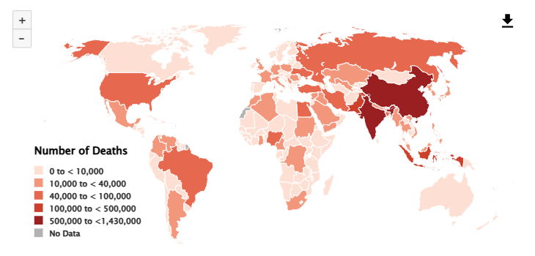
Introduction
Health Impact
Source: State of Global Air/ 2020
PM_{2.5}
Environmental Concerns
Numbers of deaths attributable to PM2.5 in 2019. or scan the QR to explore the data.
Global Relevance
Fig 1. Schematic representation of impacts of PM_{2.5}
Source: State of Global Air/ 2019

Slide 3
Cont….
PM_{2.5}
Land Use Land Cover Change
Urbanization
Commercial activities
Industralization
Emissions
Sources
Fig 2. Schematic representation of the relationship between PM_{2.5} and LULC.

Slide 4
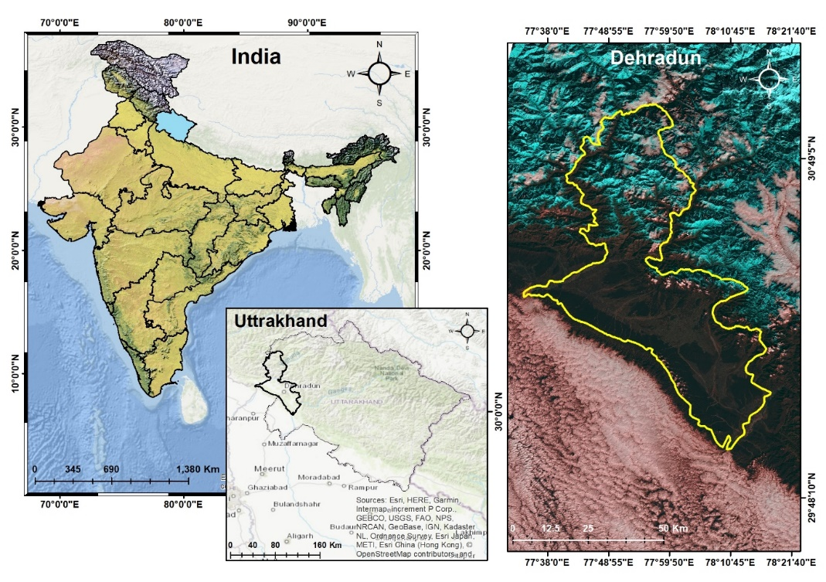
Study Area
Dehradun, one of the cities present right in center of beautiful Himalayas and Shivalik range.
Surrounded by two most powerful river of India i.e., the holy river ganga from the east direction and the Yamuna River from the west side.
It act as gateway of 3rd pole which is Himalayan region.
Fig 3. The location of the Dehradun district in Uttarakhand and the location of the air quality monitoring station.

Slide 5
Methodology
Root mean square error $=\sqrt{\frac{1}{n}\sum_{i=0}^{n}{{(X_{i}−Y_{i})}^{2}}}$
where Xi represents a PM_{2.5} value from the ACAG, and Yi represents a PM_{2.5} value from monitoring stations.
Change in area % = $\frac{{Change in Area 2020}_{f}−{Change in area 2000}_{i}}{{Total area}_{1}}×100$
Fig 4. The analytical framework employed in this research.

Slide 6
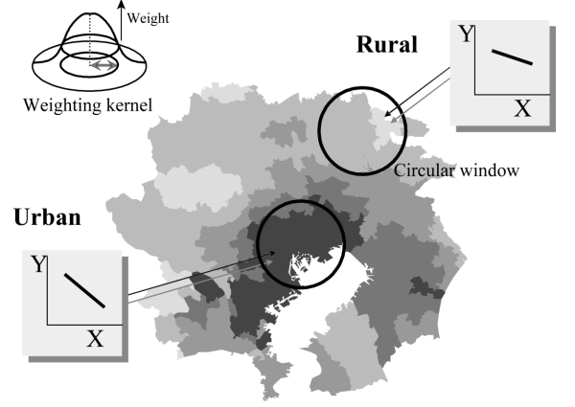
Geographical Weighted Regression (GWR)
To analyze spatially varying relationships between variables.
Different processes generating geographical observations may work under different geographical contexts.
The identification of where and how such spatial heterogeneity in the processes appears on maps is the key in understanding complex geographical phenomena.
A spatial statistical method
A tool to understand spatial patterns, relations or changes
Geographical Weighted Regression
A local regression model
Analyzes datasets for a given questions
Employs kernel function to outline variations
Fig 5. diagram showing the idea of geographically weighted regression
Fig 6. Applications of GWR.

Slide 7
Results
Fig 7. Land use and Land cover maps of different LULC classes in the years 2000 and 2020.
Fig 8. LULC change in percentage 2000 to 2020.

Slide 8
Cont….
Data provided by ACAG (Atmospheric Composition Analysis Group) were generated based on a combination of a chemical transport model, satellite observations and ground-based observations.
Maximum PM_{2.5} Concentration is increased by about 18% from 2000 to 2020
PM_{2.5} Conc.
PM_{2.5} Conc.
Fig 9. 1×1 km grid map of ACAG PM_{2.5} concentration data of Dehradun district in 2000 and 2020 (units: μg/m³ ).

Slide 9
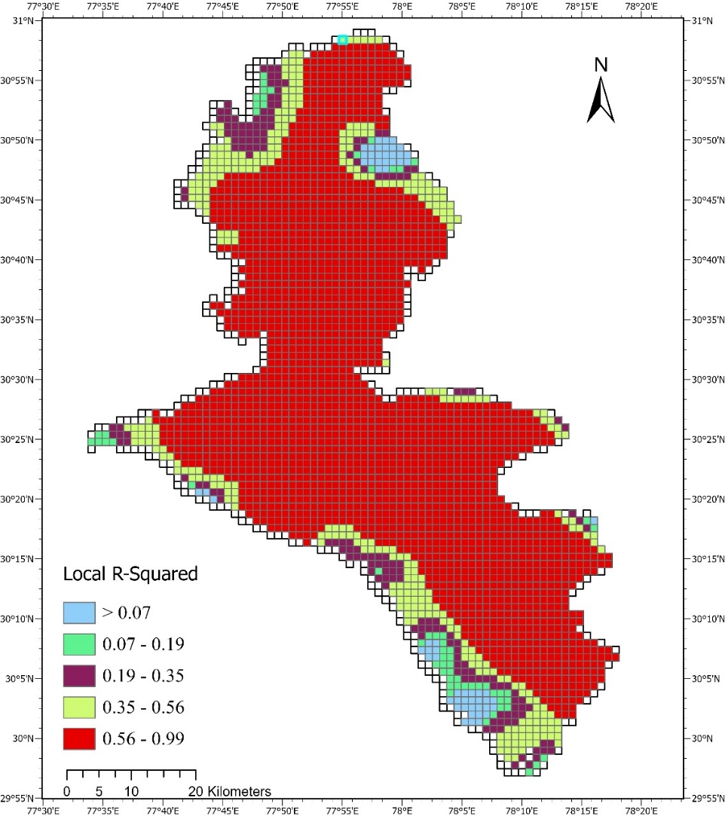
Cont….
Table. PM_{2.5} concentrations of different LULC types (units: μg/m³
S.No. | LULC TYPE | 2000 (PM_{2.5}) |  |  |  | 2020 (PM_{2.5})
 |  | MIN | MAX | MEAN | STD | MIN | MAX | MEAN | STD
1 | Dense Forest | 34.80 | 41.80 | 38.72 | 1.72 | 27.60 | 49.70 | 33.53 | 6.34
2 | Water | 35.40 | 41.60 | 39.09 | 1.64 | 28.30 | 48.60 | 42.31 | 5.04
3 | Barren Land | 34.90 | 41.80 | 37.09 | 1.37 | 27.80 | 47.30 | 30.32 | 2.93
5 | Open Forest | 34.70 | 42.00 | 38.56 | 1.96 | 28.50 | 48.60 | 41.38 | 5.07
6 | Builtup | 35.90 | 41.70 | 40.07 | 1.33 | 28.50 | 49.30 | 42.42 | 4.86
7 | Agriculture | 37.70 | 41.90 | 40.06 | 1.04 | 28.50 | 48.60 | 41.38 | 5.07
GWR analysis shows mean R² value of 0.74 which is showing stable relationship.
Fig 10. Local R² Values from the GWR analysis.

Slide 10
Discussion
Economic development of Dehradun has been mainly based on energy consumption which continues to generate large quantities of emissions.
Different LULC types indicate different human activities such as – build up land represents the highest intensity, agricultural land also intensively affected by human activities as compared to dense and open forests.
Increased human activities increase PM_{2.5} concentration.

Slide 11
References
Bandeira, J. M., Coelho, M. C., Maria Elisa, S., Richard, T. & Carlos, B. Impact of land use on urban mobility patterns, emissions and air quality in a Portuguese medium-sized city. Sci. Total Environ. 409, 1154–1163 (2011).
Nakaya, T., 2015. Geographically Weighted Regression (GWR) Software. GWR 4.0. ASU GeoDa Center website.
Agarwal, A., Soni, K. K., & Rawat, M. S. S. (2019). Monitoring Land Use Land Cover Change for Dehradun District of Uttarakhand from 2009-2019. International Journal, 8(1), 3106-3113. http://dx.doi.org/10.23953/cloud.ijarsg.431
State of global air/2020 https://www.stateofglobalair.org/sites/default/files/documents/2020-10/soga-health-effects-factsheet_0.pdf

Slide 12
Varanasi, India
Thank You!!

