Slide 1
Supplementary material

Slide 2
Presentation file

Slide 3
Introduction
The use of statistical post-processing techniques can enhance the quality of weather forecasts .These probabilistic approaches generally outperform conventional procedures based on simply correcting the bias of forecasts from a single model . However, a comprehensive study highlights the application of artificial neural networks in weather forecasting , thus indicating a promising new avenue for improving forecast accuracy. We introduce a methodology that combines the power of convolutional neural networks (CNN) with the analysis provided by the AROME model. Our aim is to refine the accuracy of surface parameters, such as temperature, humidity, wind speed, and mean sea-level atmospheric pressure (MSLP), while preserving the model’s resolution through integration of the AROME analysis.

Slide 4
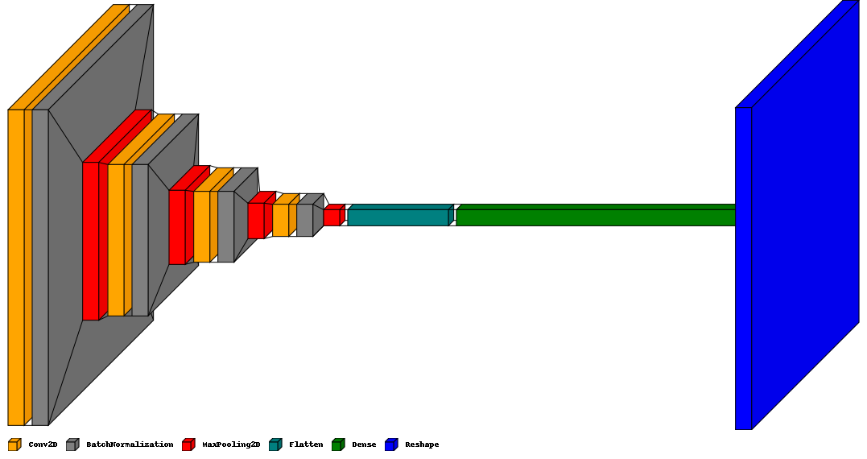
CNN model architecture

Slide 5
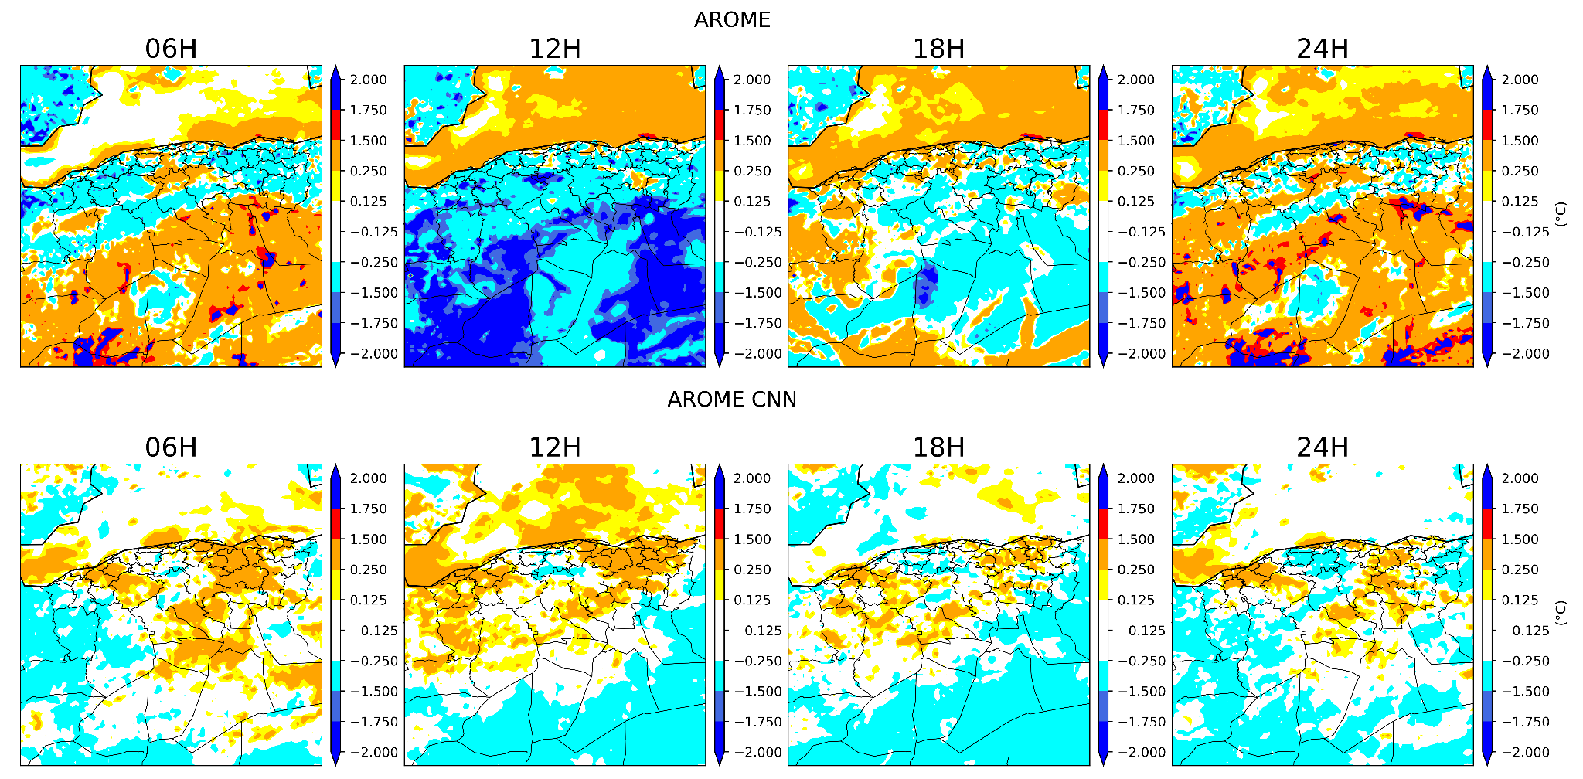

Slide 6
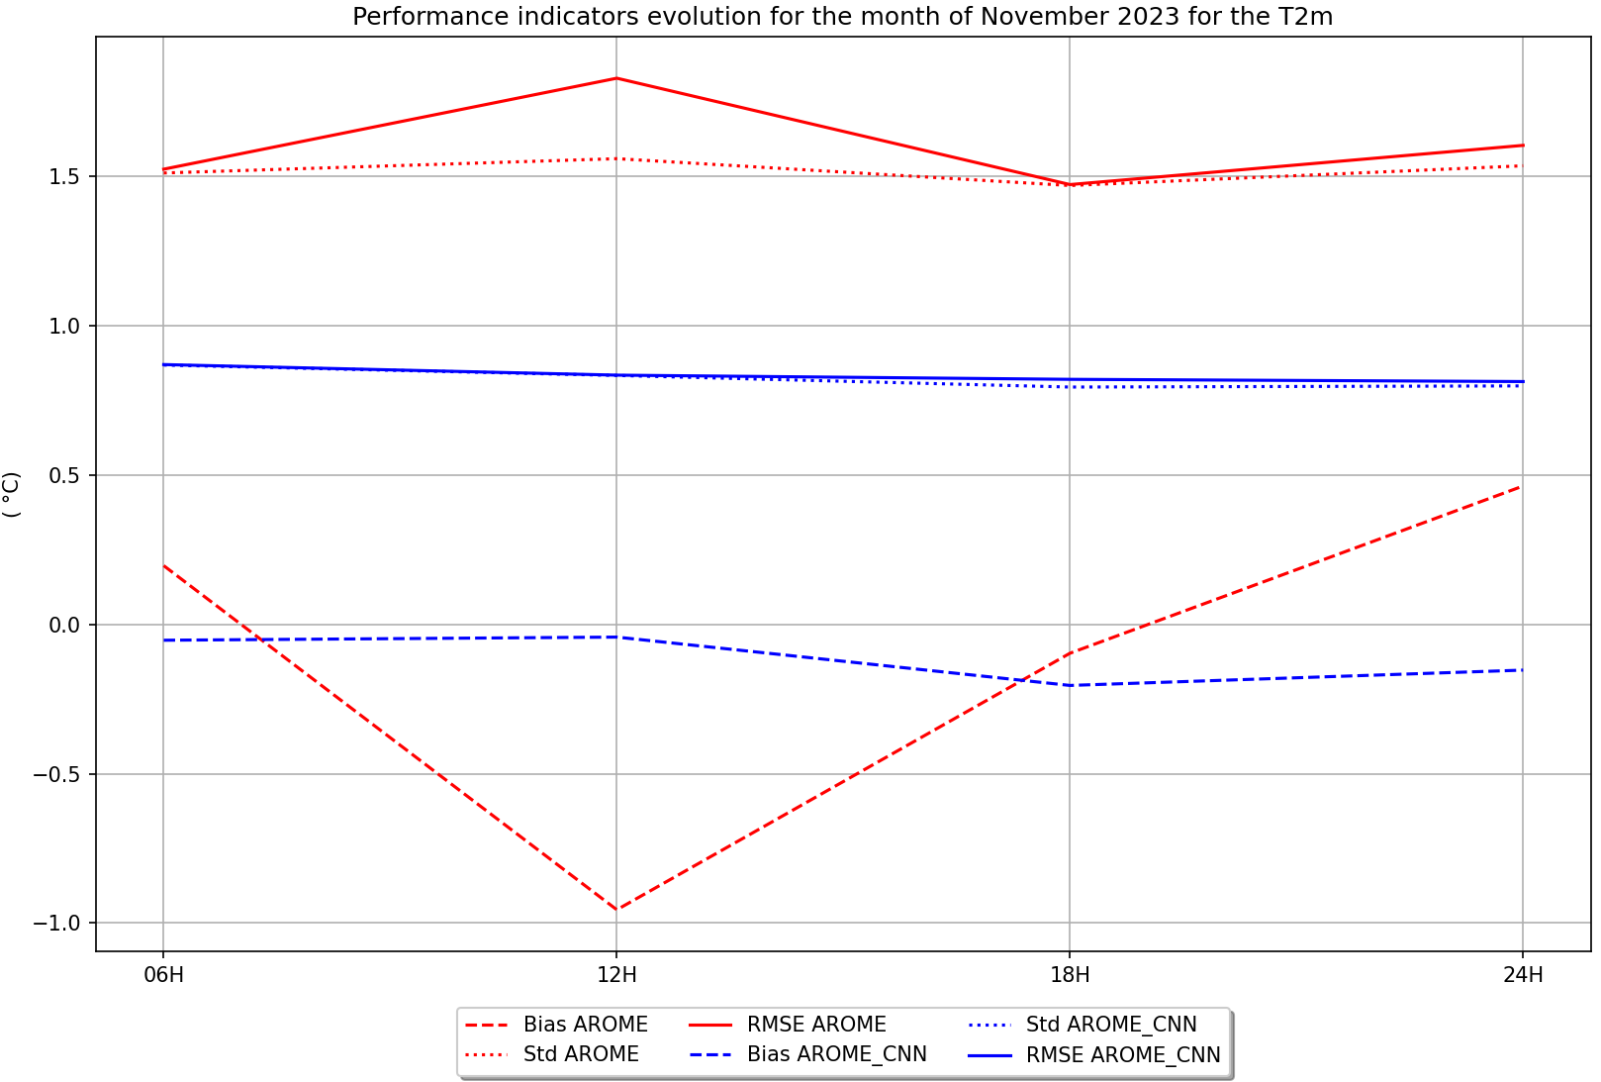

Slide 7
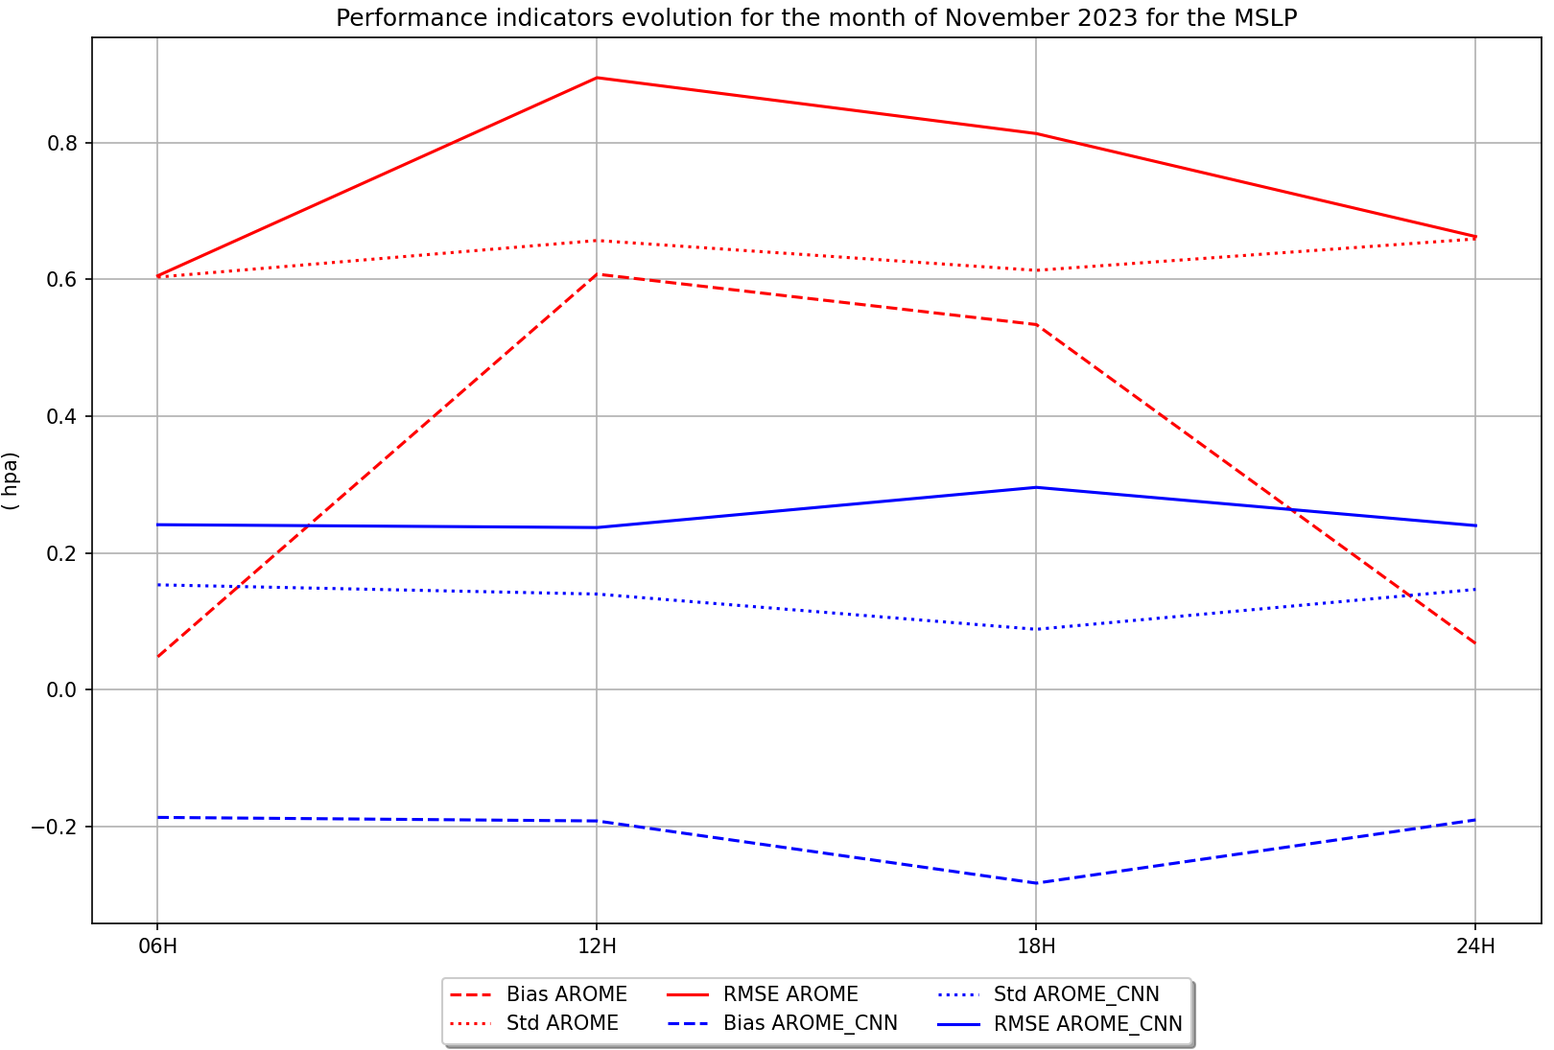

Slide 8
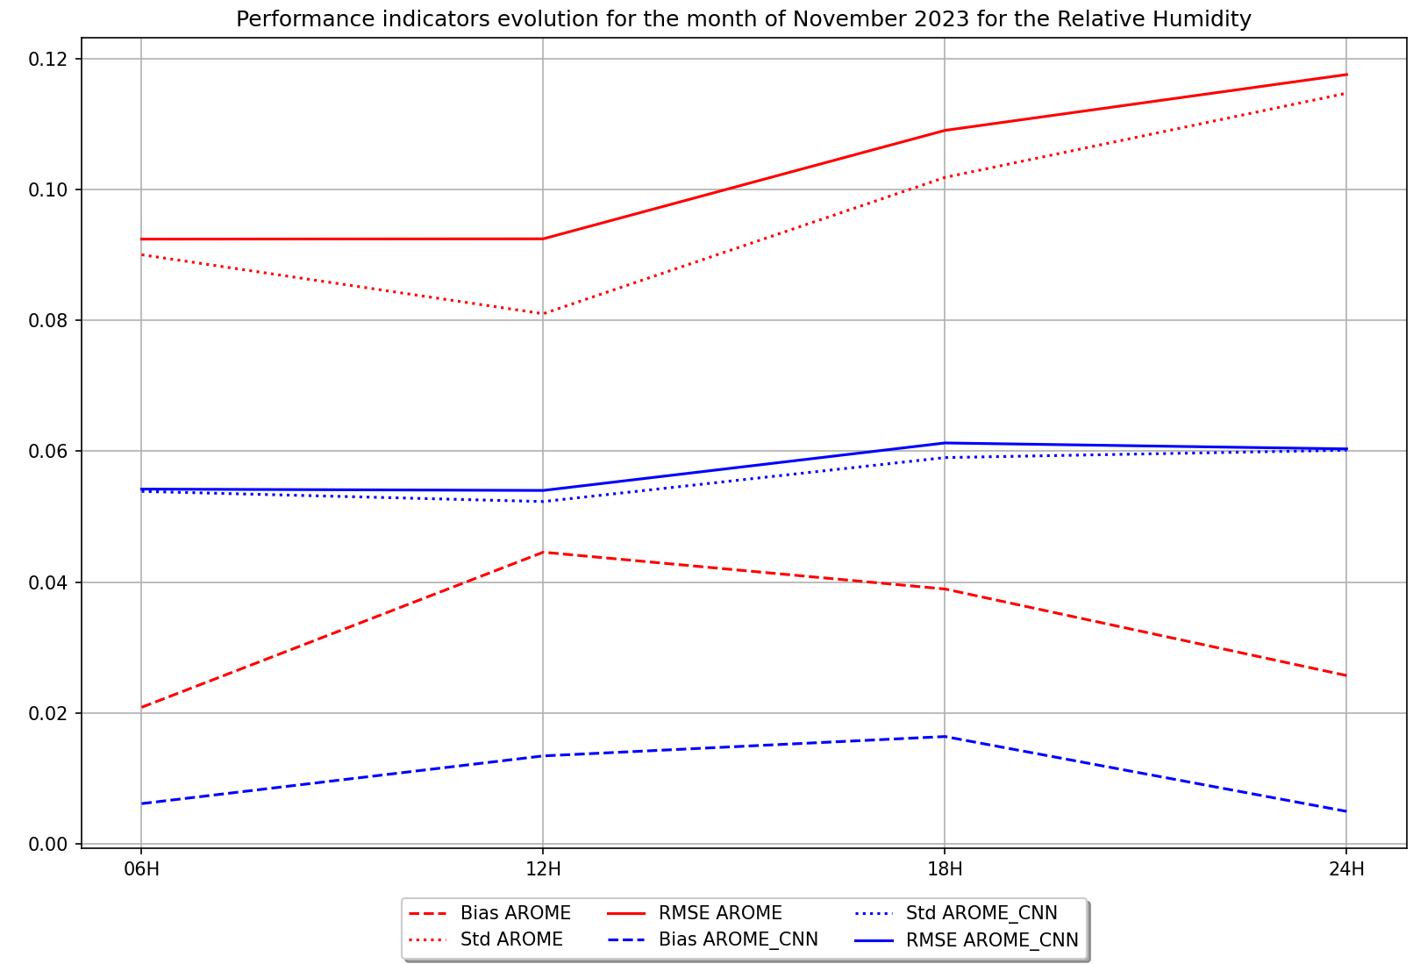

Slide 9
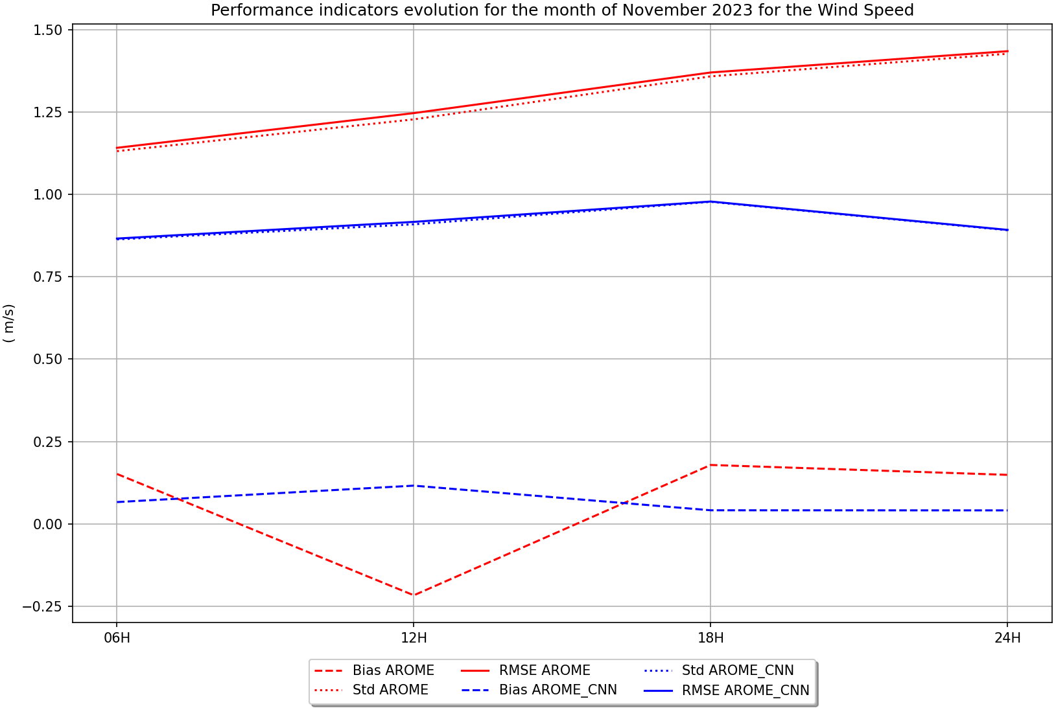

Slide 10
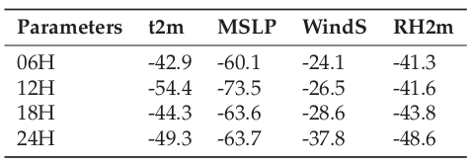
Rate of change of the RMSE expressed as a percentage

Slide 11
Conclusion and outlook
The integration of convolutional neural networks presents a promising frontier for improving the accuracy of weather forecasts. By leveraging the strengths of this approach, we have demonstrated the potential to refine surface parameter predictions while retaining model resolution. In the future, incorporating additional parameters such as altitude-related variables and extending forecast lead times to 48 hours holds great promise for further improving forecast accuracy and reliability. This innovative methodology not only enhances our understanding of atmospheric processes but also provides significant benefits to various sectors that rely on accurate weather information. As we continue to refine and develop these techniques, the future of weather forecasting looks increasingly bright, with broader applications and
more accurate forecasts on the horizon.

Slide 12
References
[1] Gneiting, T. (2014). 719 Calibration of Medium-Range Weather Forecasts.
[2] Medina, H., and Tian, D. (2020). Comparison of probabilistic post-processing approaches for improving numerical weather prediction-based daily and weekly reference evapotranspiration forecasts.Hydrology And Earth System Sciences, 24(2), 1011-1030.
[3] Shrivastava, G., Karmakar, S., Kowar, M. K., and Guhathakurta, P. (2012). Application of Artificial Neural Networks in Weather Forecasting : A Comprehensive Literature Review. International Journal Of Computer Applications, 51(18), 17-29.

