Slide 1
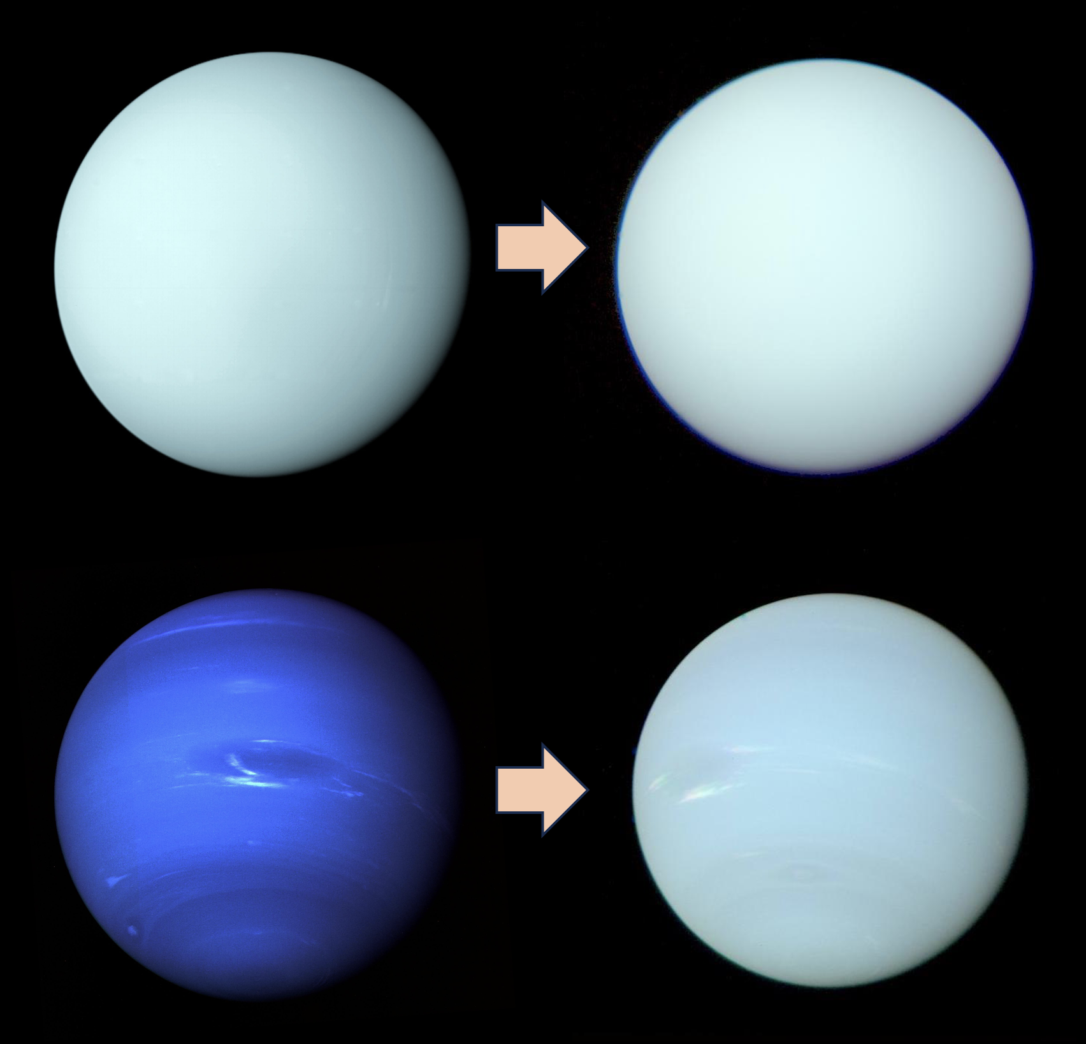
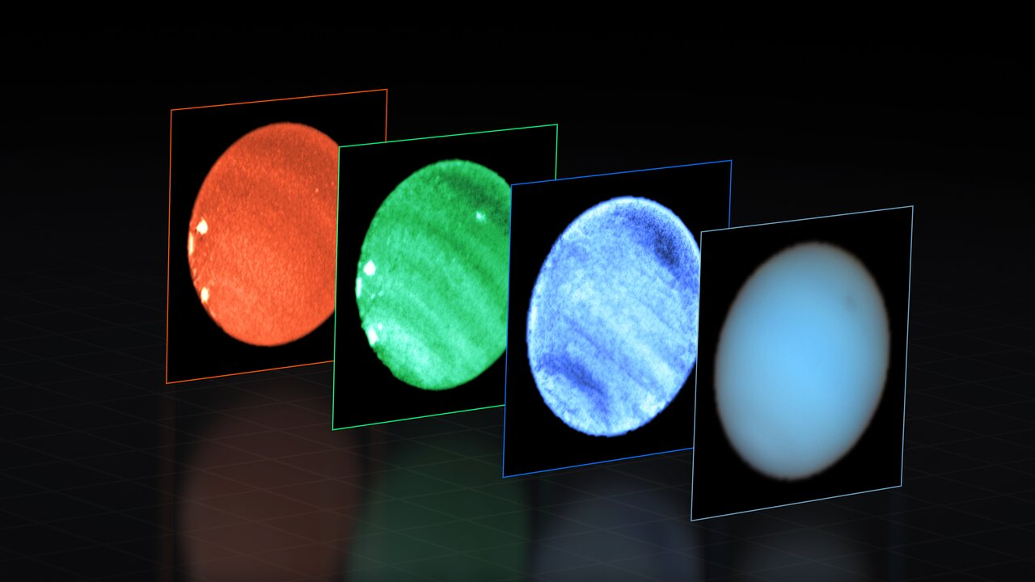
Aerosol layers, clouds, spots and the colours of Uranus and Neptune
P.G.J. Irwin¹, J. Dobinson¹, N.A. Teanby², L.N. Fletcher³, M.T. Roman³, A. Simon⁴, M.H. Wong⁵, G.S. Orton⁶, D. Toledo⁷, S. Pérez-Hoyos⁸
¹U.Oxford, ²U.Bristol, ³U.Leicester, ⁴NASA/Goddard, ⁵U.California/Berkeley, ⁶JPL, ⁷INTA, ⁸U. Basque Country, Bilbao
Notes:
Review of recent advances in our understanding of distribution of volatile gases and aerosols in the atmospheres of the Ice Giants over last 5 years.

Slide 2
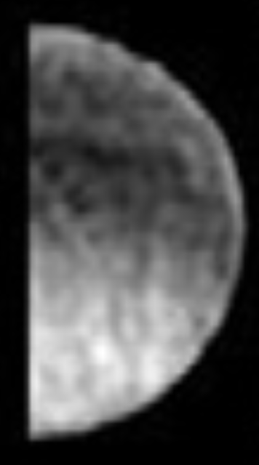
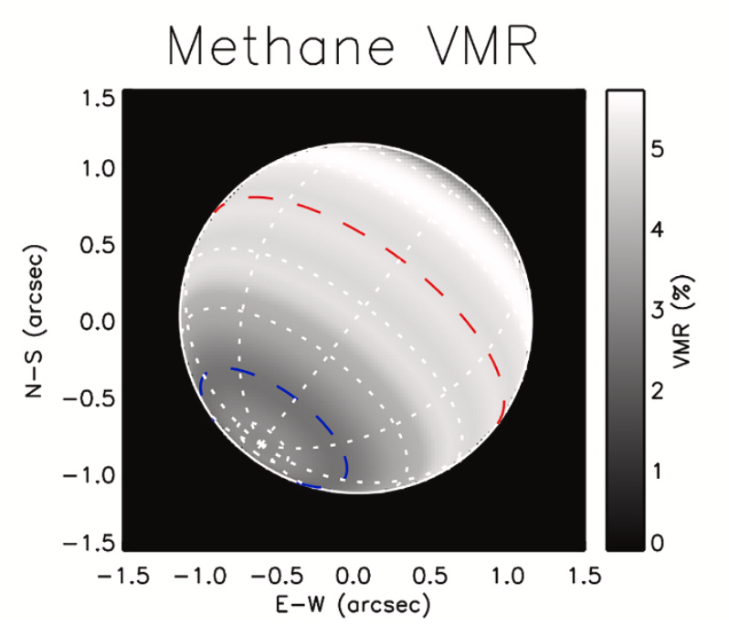
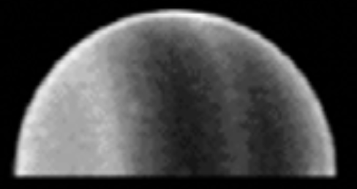
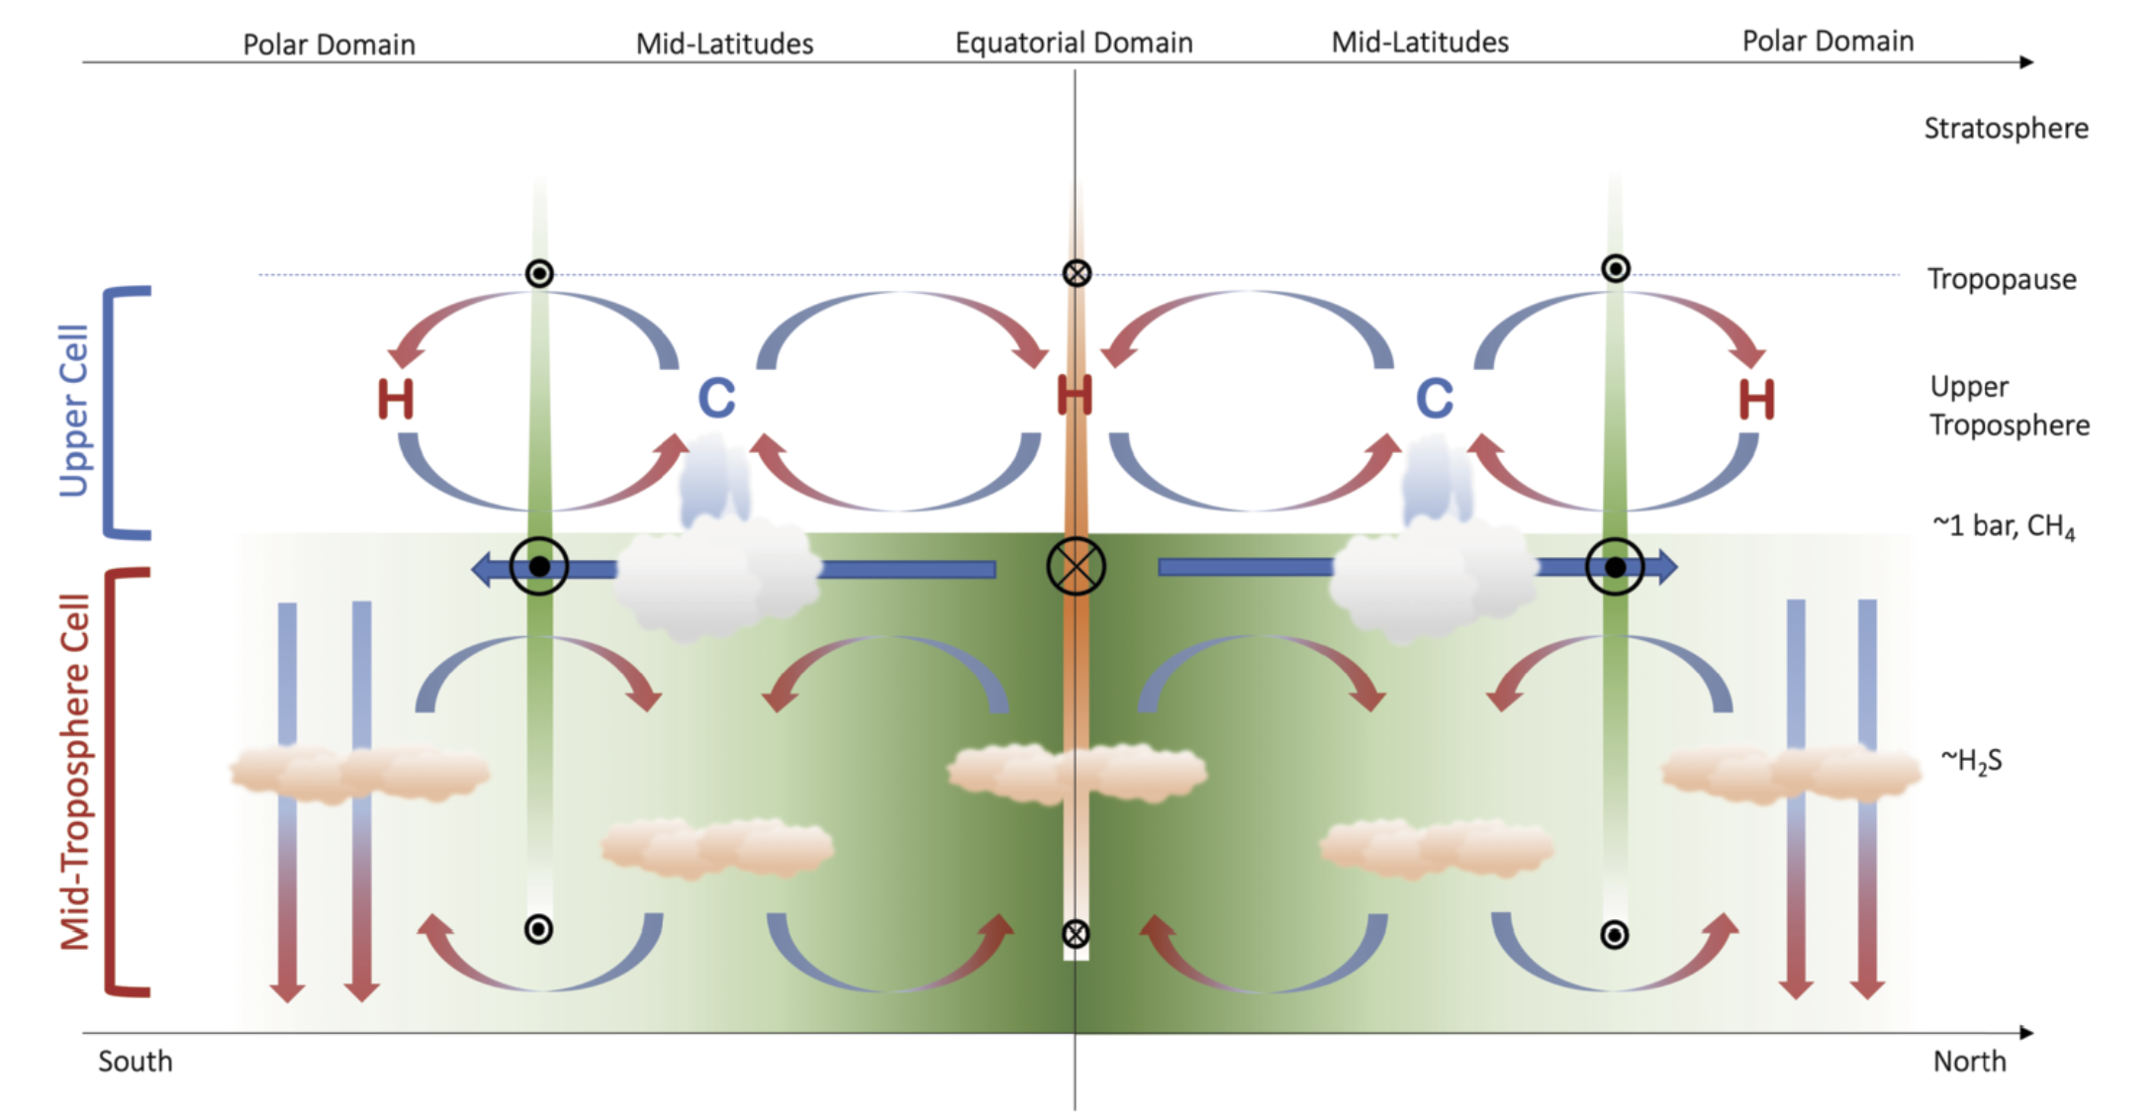
Latitudinal Variation of Methane
Uranus
Neptune
Uranus
Neptune
Karkoschka and Tomasko (2009, 2011) HST/STIS
James et al., (2023) VLT/MUSE
Irwin et al., (2021) VLT/MUSE
Observations at near-IR methane absorbing wavelengths show more reflection at poles.
Once interpreted as being due to higher clouds there
HST/STIS showed that this is actually because methane abundance at poles is ~50% lower than equator
Methane abundance confirmed in VLT/MUSE observations.
Adds to evidence of an ’overturning’ circulation at deep levels, with moist air rising at the equator and descending at poles.
Fletcher et al. (2020)

Slide 3
‘Holistic’ Aerosol Model (Irwin et al., 2022)
Many different models of vertical aerosol profile developed.
Each concentrated on a particular small wavelength range with ad hoc assumptions on scattering properties.
Developed new ‘holistic’ model, simultaneously fitting spectra and limb-darkening from 0.3 – 2.4 microns, with self-consistent scattering model.
Three main aerosol layers:

Slide 4
Colour simulations (Irwin et al., 2022)
Unexpected side result of ‘holistic’ model was realization that colours of Uranus and Neptune were actually quite similar in the early 2000s
Had colours changed since Voyager observations in 1980s?

Slide 5
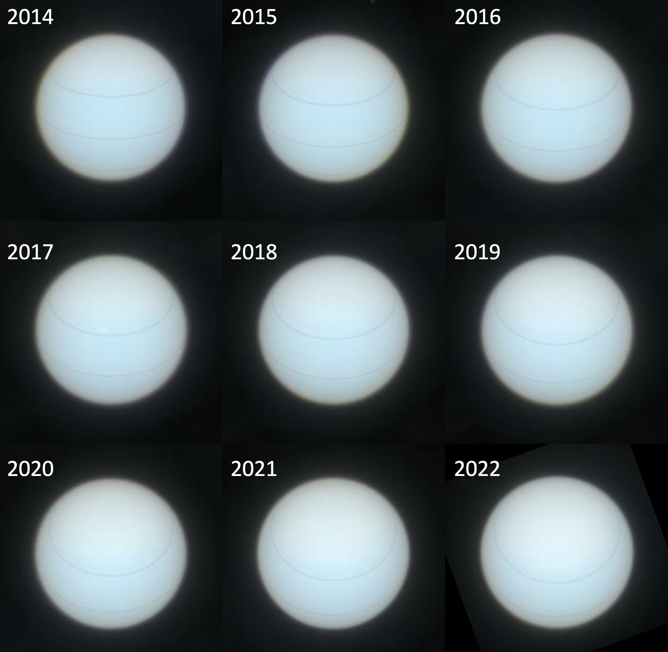
Ice Giant Colours and Seasons (Irwin et al., 2024)
‘Original’ Voyager-2
Colours
Recalculated
Colours
Uranus
Neptune
Colours have not actually changed much since Voyager.
Blueness of Neptune because enhanced colour set was used to highlight dark features.
However, there IS a seasonal change in Uranus’s colour due to the poles swinging towards Earth at solstice and development of polar ‘hood’

Slide 6
Seasonal Change Model (Irwin et al., 2024)
Lowell Observatory record of Blue and Green magnitudes 1950 to 2016. (Lockwood, 2019).
Significant seasonal changes seen at green wavelengths, but much less so at blue wavelengths.
Consistent with addition of bright scattering particles to Aerosol-2 layer in polar regions, combined with lower polar methane abundance.

Slide 7
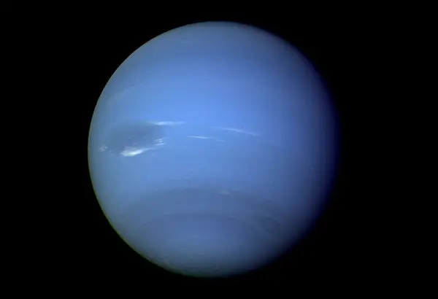
Neptune Dark Spots
Voyager-2/ISS 1989
GDS
HST/WFC3 2020
NDS-2018
One famous discovery of Voyager-2 was the ‘Great Dark Spot’ in Neptune’s atmosphere.
GDS since disappeared, but several others have since been seen in HST imaging.
However, both Voyager-2/ISS and HST/WFC3 limited to imaging in a few wavelengths only, so nature of dark spots was unclear.
In 2018, a new dark spot NDS-2018 (Northern Dark Spot – 2018) was seen by HST.
Won time at VLT/MUSE to make spectral observations in 2019 to measure spectra and try to determine more about nature of NDS-2018.

Slide 8
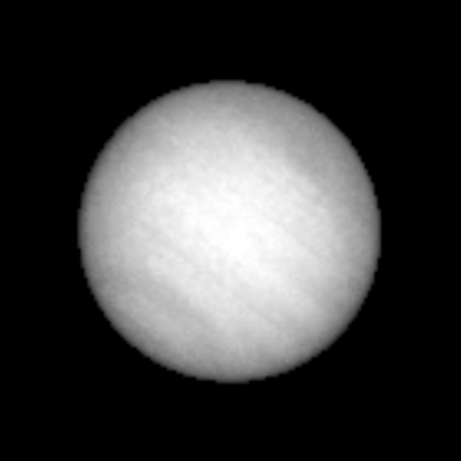
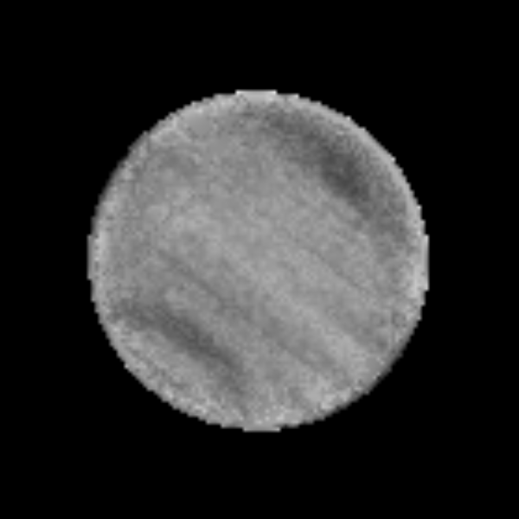
Neptune MUSE 2019 (Irwin et al., 2023)
NDS-2018
Raw Cube Image
Deconvolved and artefacts removed
Deconvolved, flattened and stretched
First detection of a dark spot from the ground.
South Polar Wave
551 nm

Slide 9
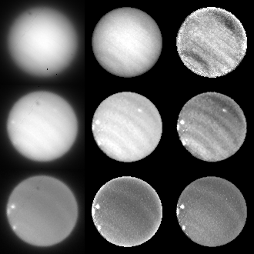
Cloud difference spectra
551 nm
Shallow Bright Spots (SBS)
831 nm
848 nm
Bright at all wavelengths > 700 nm, and shallow methane absorption. Therefore, high altitude.
raw
deconvolved
flattened +
enhanced

Slide 10
Cloud difference spectra
551 nm
Northern Dark Spot 2018 (NDS-2018)
831 nm
848 nm
Only dark at wavelengths < 600 nm, with deep methane bands. Therefore, deep and wavelength-dependent reflectivity.
raw
deconvolved
flattened +
enhanced

Slide 11
Cloud difference spectra
551 nm
Deep Bright Spot 2019 (DBS-2019)
831 nm
848 nm
Only bright in narrow wavelength bands > 700 nm, centred on methane continua. Therefore, deep clouds with wavelength-dependent reflectivity.
raw
deconvolved
flattened +
enhanced

Slide 12
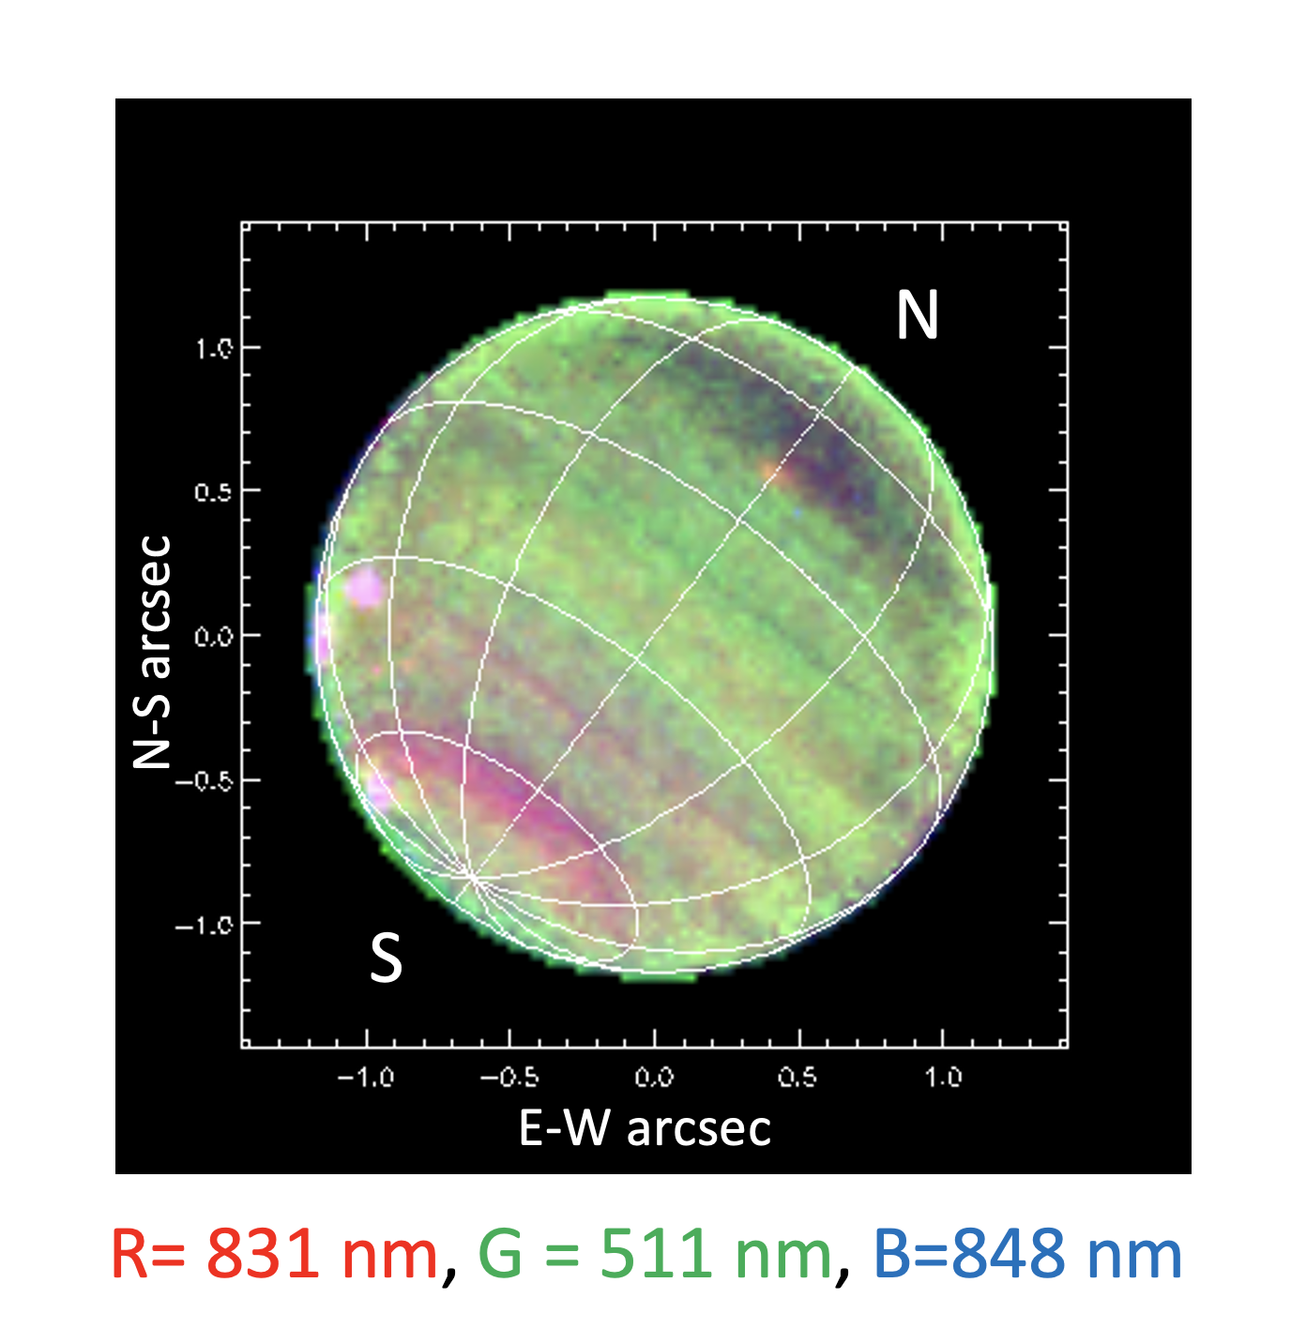
NDS-2018 VLT/MUSE results
First ever spectrum of a dark spot
Spectral signature very distinctive.
Must be deep, i.e., in Aerosol-1 layer
New feature, DBS-2019, seen.
Must be deep, i.e., in Aerosol-1 layer
Both features very different from SBS features near left-hand limb.
Only spectral imaging can tell difference between shallow and deep spots.

Slide 13
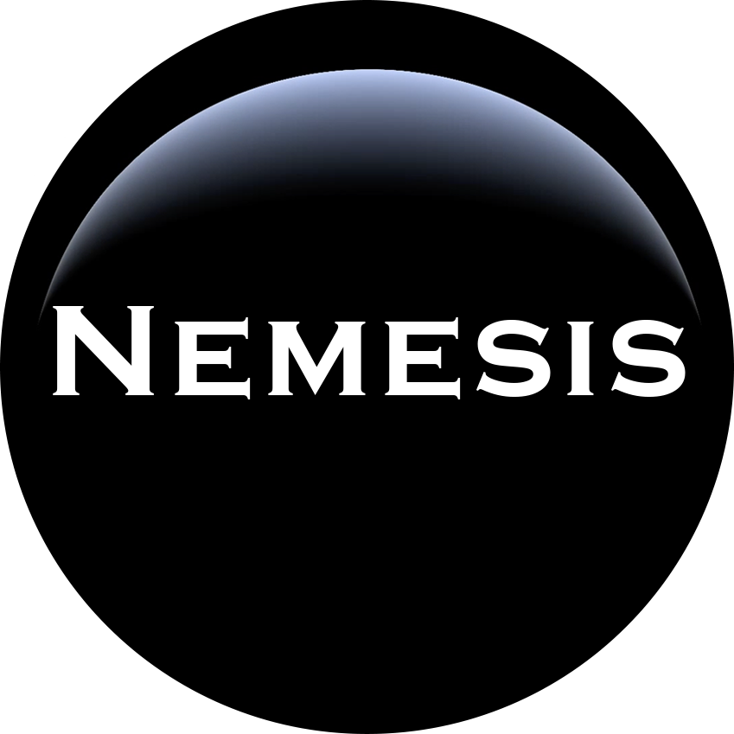
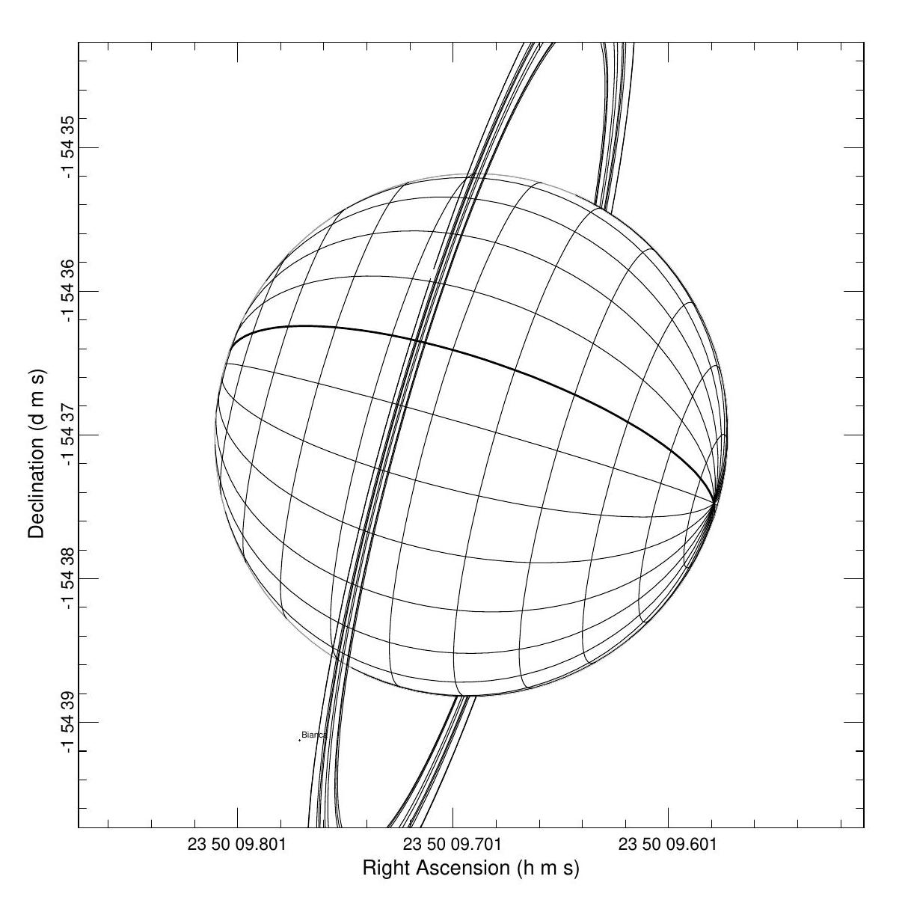
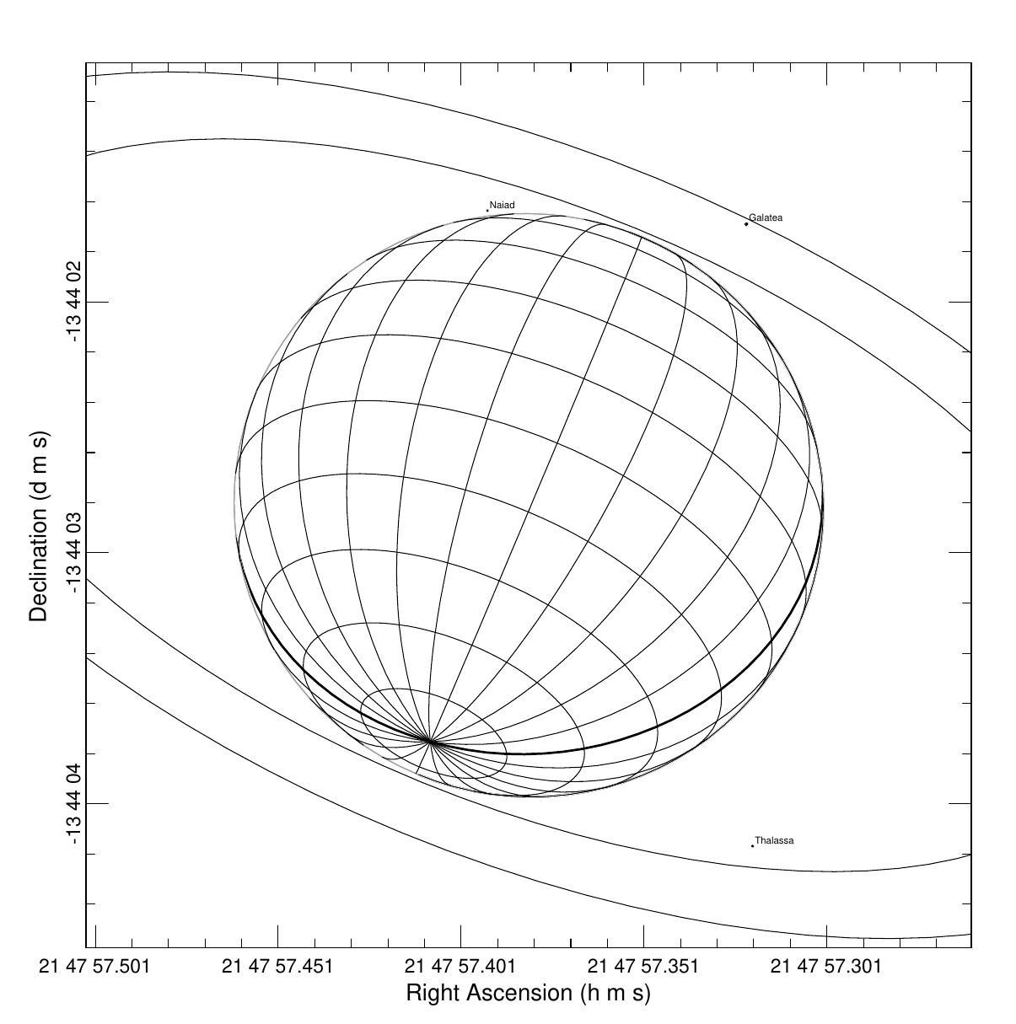
H₂S on Uranus and Neptune – Gemini/NIFS
2009, 2010
S
S
PCA H₂S Component
(Irwin et al., 2019)
Viewing Geometry
H₂S Retrieval on Uranus (Irwin et al., 2018)

Slide 14
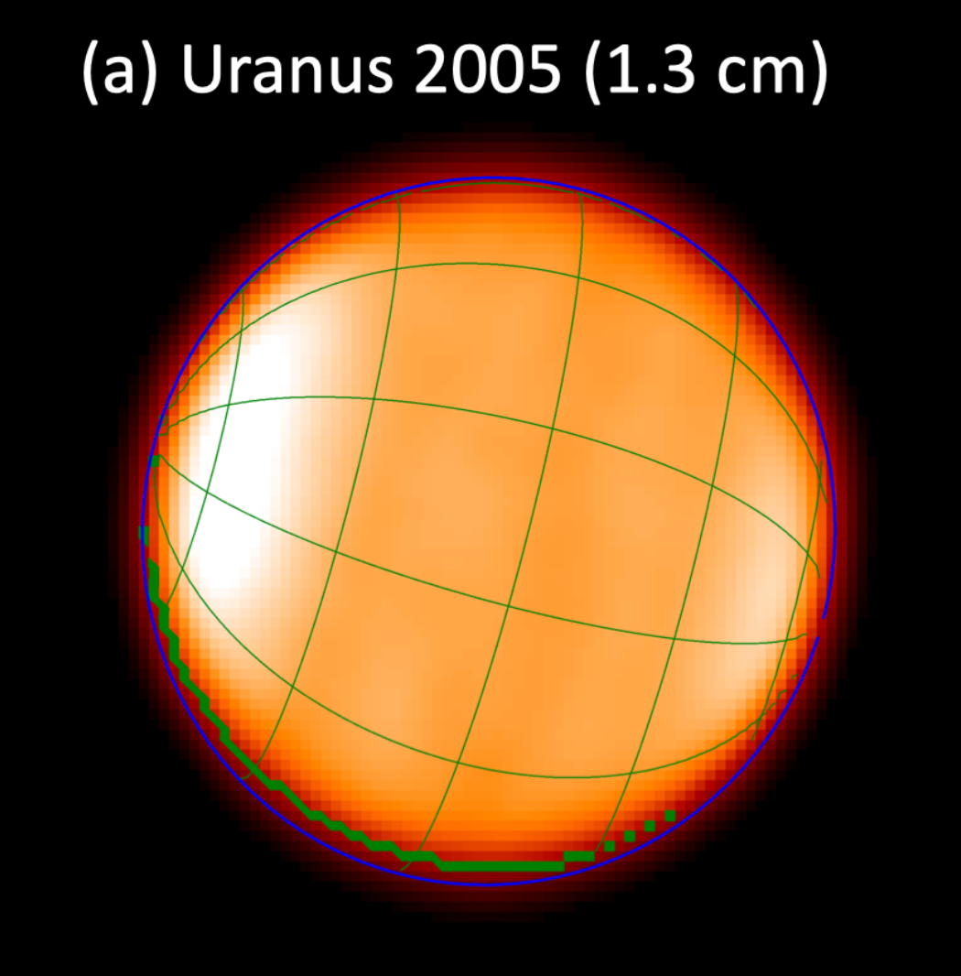
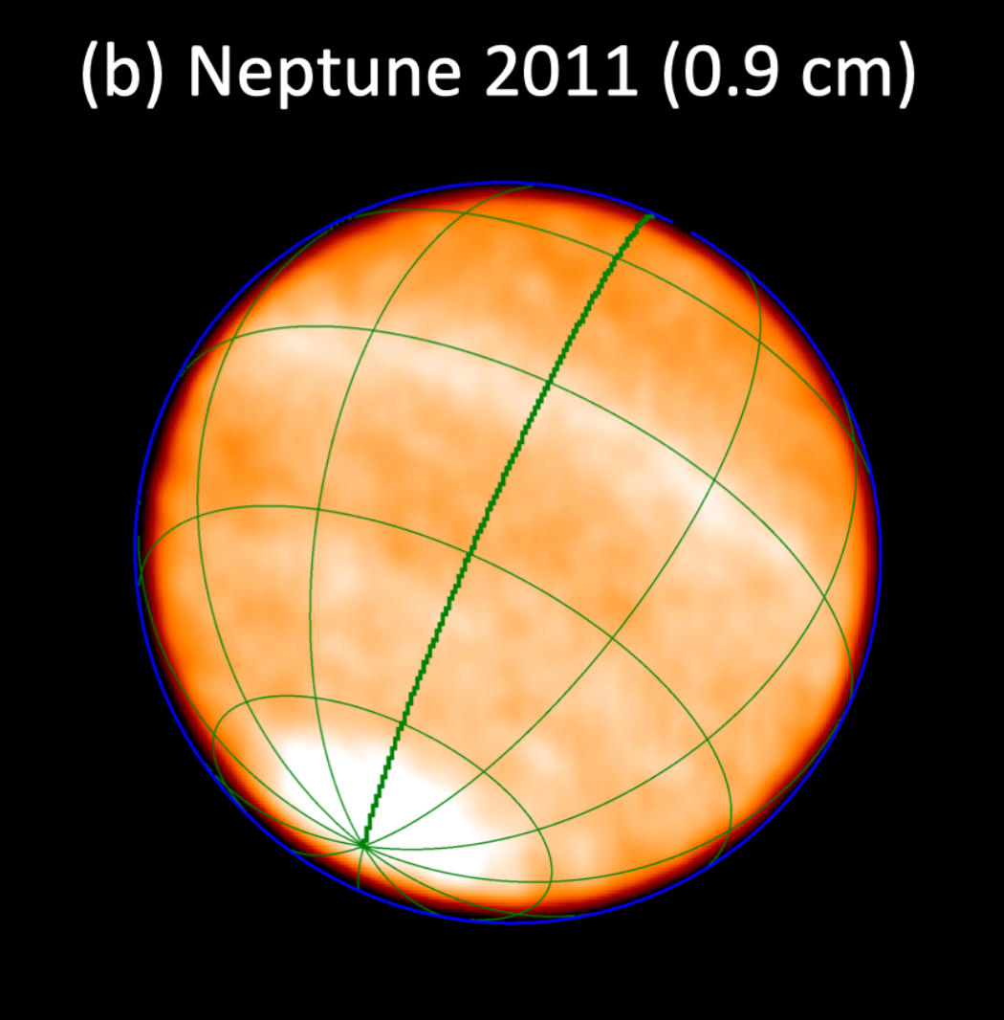
Radio/Microwave brightness temperatures
NIFS H₂S
MUSE CH₄
Radio/microwave NH₃ or H₂S
Uranus
Fletcher et al. (2020):
S
Hofstadter et al.
(VLA)
Neptune
Butler et al. (2012)
(VLA)
S
Brighter radio/microwave areas indicate lower abundance of H₂S and/or NH₃.
Consistent with observed methane variations
Inconsistent with Gemini/NIFS cloud-top H₂S determinations

Slide 15
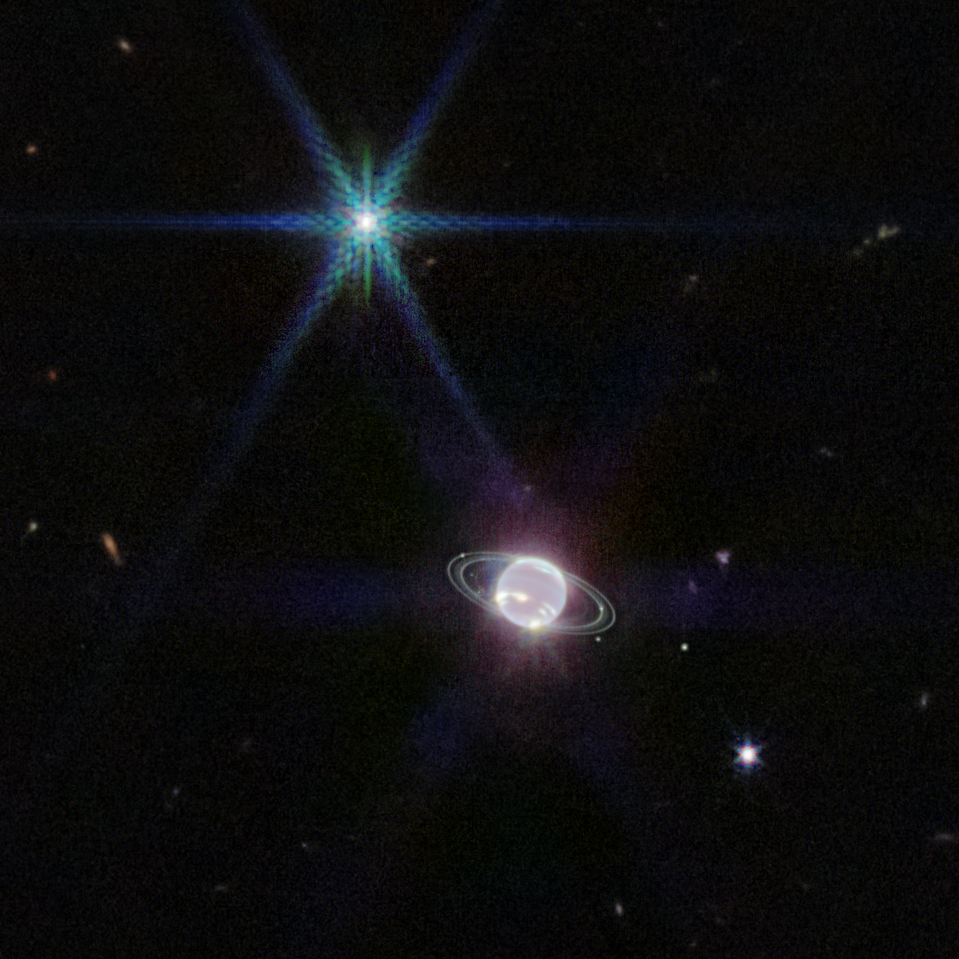
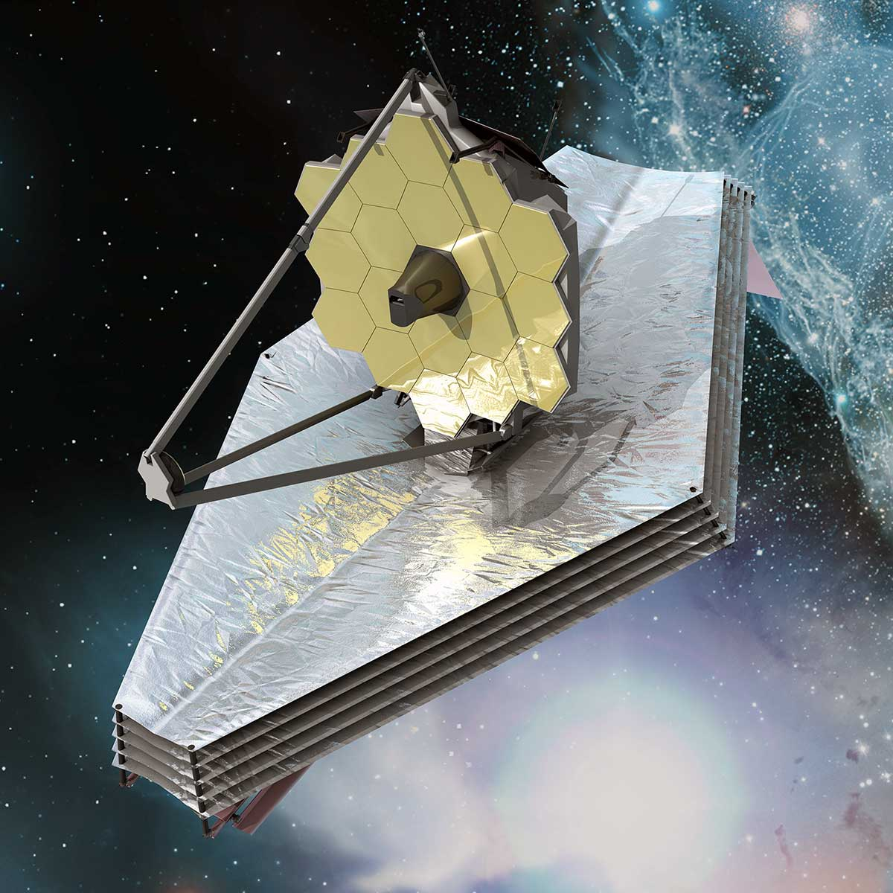
James Webb Space Telescope - JWST
Observations of Uranus and Neptune made with JWST/NIRSpec under GTO programme, from 1.6 – 5.2 μm
Analysis ongoing and papers in preparation (Roman et al.)
‘Holistic’ model has mostly survived, but Aerosol-3 found to be more consistent with a vertically-confined layer near 0.2 bar
Sadly, JWST/NIRSpec observations do not cover 1.5 – 1.6 μm, so we cannot learn more about H₂S variations.
Repeated proposals made for GO time

Slide 16
Conclusions
Latitudinal change of methane abundance, confirmed by VLT/MUSE.
`Holistic’ aerosol model consistent with both planets.
Variations of Aerosol-1 layer (H₂S ice/haze) associated with Neptune’s dark spots, deep bright spots and South Polar Wave .
Changes in Aerosol-2 layer (CH₄ ice/haze) account for colour differences and seasonal variations of Uranus’s polar ‘hood’ and magnitude.
Gemini/NIFS observations near 1.58 μm detected presence of H₂S.
Clear latitude variations seen, but inconsistent with expectations.
Will reanalyse with novel deconvolution method and holistic aerosol.
Will also keep applying for JWST/NIRSpec time!

