Slide 1
Global changes in low-level circulation types under future anthropogenic forcing
https://www.meteo.unican.es/
Juan Antonio Fernández-Granja¹, Ana Casanueva^{2,3,} Joaquín Bedia^{2,3}, Swen Brands^{1,4}, and Jesús Fernández¹
¹Instituto de Física de Cantabria (IFCA), CSIC-Universidad de Cantabria, Santander, Spain
²Departamento de Matemática Aplicada y Ciencias de la Computación, Universidad de Cantabria, Santander, Spain
³Grupo de Meteorología y Computación, Universidad de Cantabria, Unidad Asociada al CSIC, Santander, Spain

Slide 2
AIM OF THE STUDY
How large-scale circulation features of GCMs will evolve along the century under anthropogenic forcing?
Use of JC-WT (Jenkinson and Collison, 1977) to characterize the large-scale circulation into a few patterns.
Calculate the change of the JC-WT frequencies as a function of Global Warming Level (GWL, Gutiérrez et al. 2021).
Analyze whether robust signals of change in the JC-WT frequencies emerge from natural variability.
DATA
Multi-model ensemble of up to 30 GCMs from CMIP5/CMIP6 and RCP8.5 or SSP585.
Variable for GWL: monthly TAS (Surface Tª). Years: 1850-2099.
Variable for JC-WT: 6H SLP (6 hourly sea-level pressure). Years: 1979-2099.

Slide 3
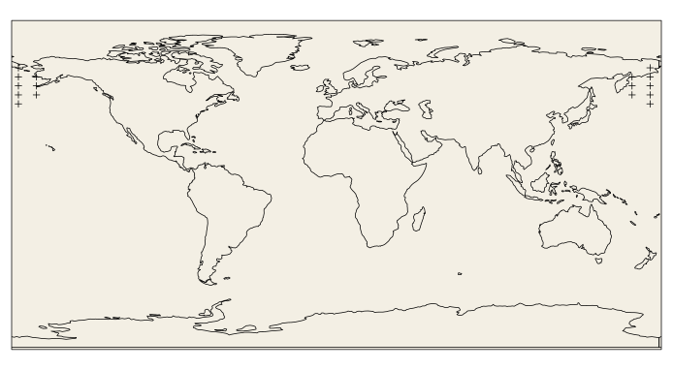
METHODS
JC-WTs: automated equations from the Lamb WTs (Lamb, 1972):
27 circulation types → Aggregated into 11 types (Trigo and DaCAMARA, 2000).
The input cross formed by 16 SLP points is moved⁽¹⁾ → 30 GCMs * 1 JC-WT classification per grid-box in 30º-70º band NH and SH (Jones et al, 2013; Fernández-Granja et al, 2023)
GCMs interpolated to a common 2.5º regular longitude-latitude grid.
JC-WT catalogs for the historical period from Brands 2022 and Brands et al. 2023: 1979-2005 for CMIP5, 1979-2014 for CMIP6.
Changes of the JC-WTs frequencies: Slope of linear regression. Significancy with p-value (> 95%).
Emerge of signals of change: Robustness of the multi-model ensemble as defined in IPCC-WGI AR6 (Gutiérrez et al. 2021, Cross-ChapterBoxAtlas.1)
⁽¹⁾Distribution of the 16 points forming a “cross” and used in the calculation of the JC-WTs for every grid-box from the globe. The cross is displaced.

Slide 4
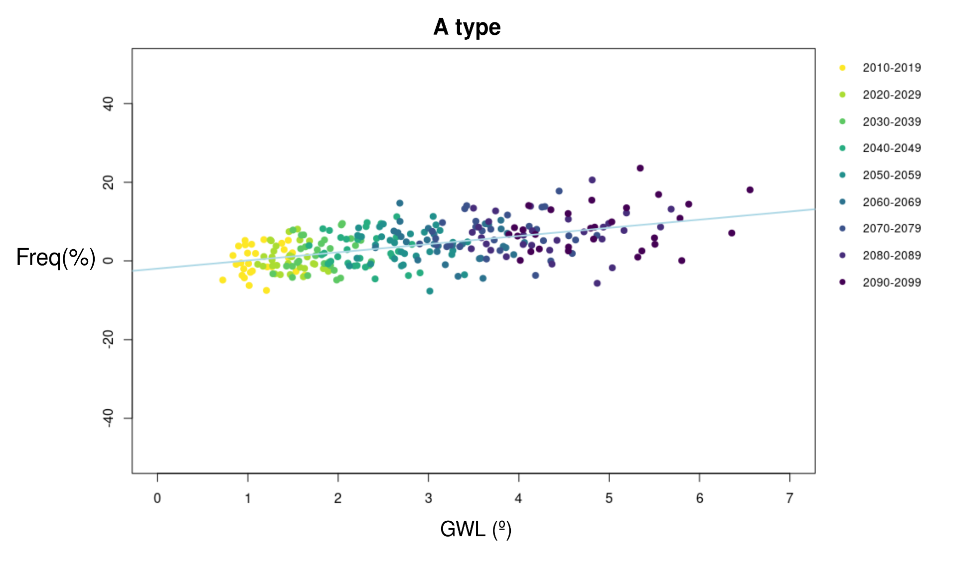
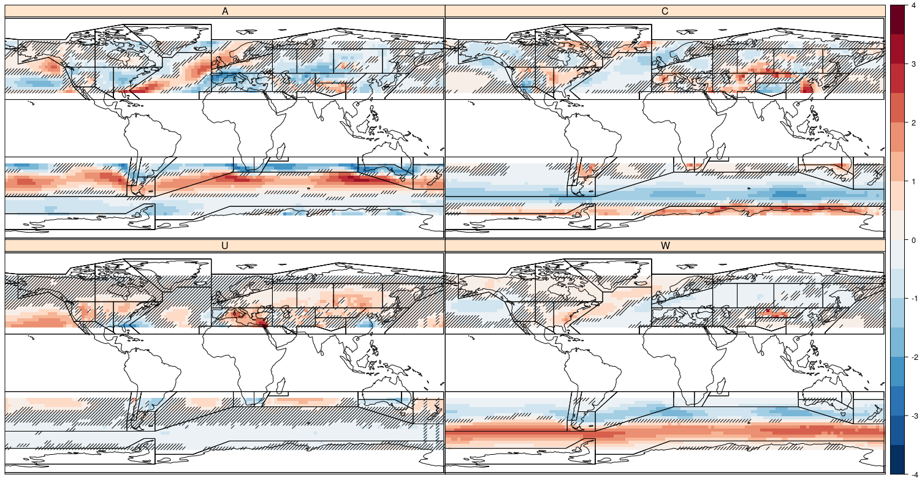
Example grid-box
[50ºN, -17.5ºW]:
RESULTS:
Change of the JC-WT freq. per ºC of GWL in JJA
[% / GWL]
4
3
2
1
0
-1
-2
-3
-4
β = 2.07
R² = 0.27
p.value = 2.81e-20
The changes of JC-WT freq. are generally significant, except for U type (only significant in Mediterranean and Central Asia regions).
A type:
C type:
A type shows opposite slope compared to C type
1 GCM/decade
Strongest changes in NAO (A), MED (U), SOO (A and W).
U type:
W type:

Slide 5
RESULTS:
Change of the JC-WT freq. per ºC of GWL in JJA
[% / ºC]
4
3
2
1
0
-1
-2
-3
-4
The changes of JC-WT freq. are generally significant, except for U type (only significant in Mediterranean and Central Asia regions).
A type:
C type:
A type shows opposite slope compared to C type
Strongest changes in NAO (A), MED (U), SOO (A and W).
U type:
W type:

Slide 6
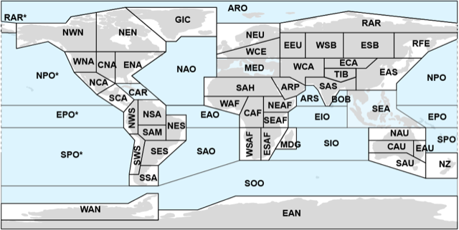
RESULTS:
Change of the JC-WT freq. per ºC of GWL in JJA
[% / GWL]
4
3
2
1
0
-1
-2
-3
-4
The changes of JC-WT freq. are generally significant, except for U type (only significant in Mediterranean and Central Asia regions).
A type:
C type:
Extratropical IPCC regions
A type shows opposite slope compared to C type
Strongest changes in NAO (A), MED (U), SOO (A and W).
U type:
W type:

Slide 7
RESULTS:
Change of the JC-WT freq. per ºC of GWL in JJA
[% / ºC]
4
3
2
1
0
-1
-2
-3
-4
The changes of JC-WT freq. are generally significant, except for U type (only significant in Mediterranean and Central Asia regions).
A type:
C type:
A type shows opposite slope compared to C type
Strongest changes in NAO (A), MED (U), SOO (A and W).
U type:
W type:

Slide 8
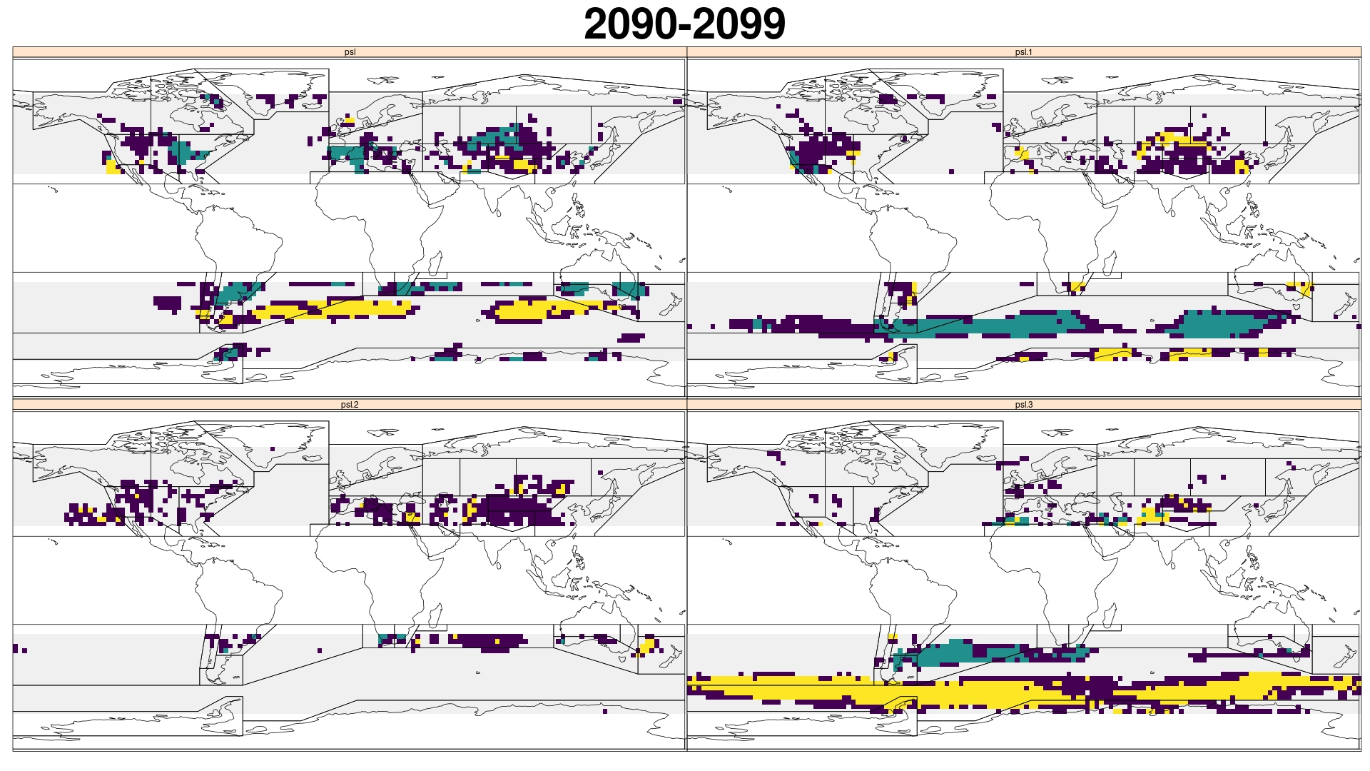
Example grid-box
[50ºN, -17.5ºW]:
RESULTS: When and where does the JJA anthropogenic signal emerge?
[% / GWL]
A type:
C type:
1 GCM/decade ≥ ɣ
U type:
ɣ = 1.645*√(2/10)*σ_{hist}
W type:

Slide 9
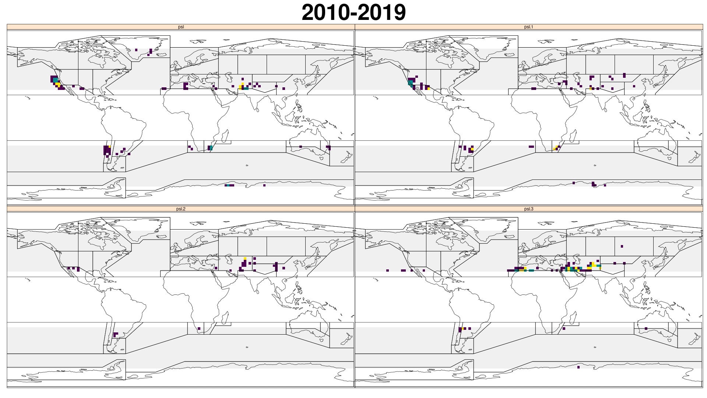
RESULTS: When and where does the JJA anthropogenic signal emerge?
No Signal
Robust signals related with strongest trends.
A type:
C type:
Conflicting
Signal
Positive and negative signals emerge mainly from 2070-2080 decade
Positive
Robust Sig.
Conflicting signals emerge prior to robust signals.
U type:
W type:
Negative
Robust Sig.

Slide 10
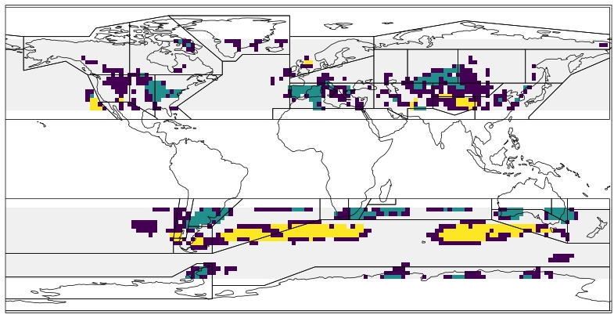
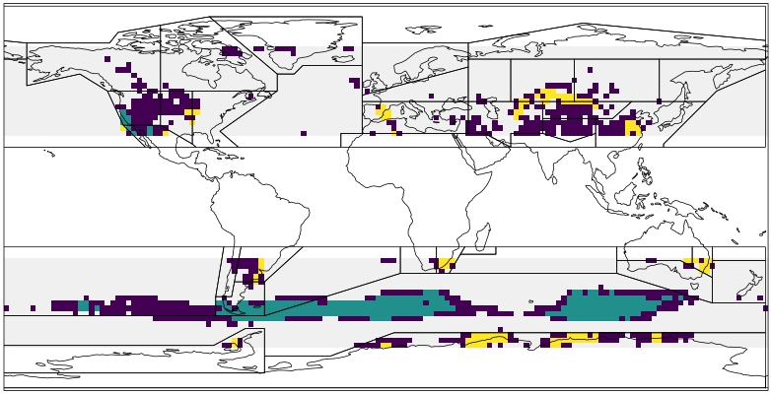
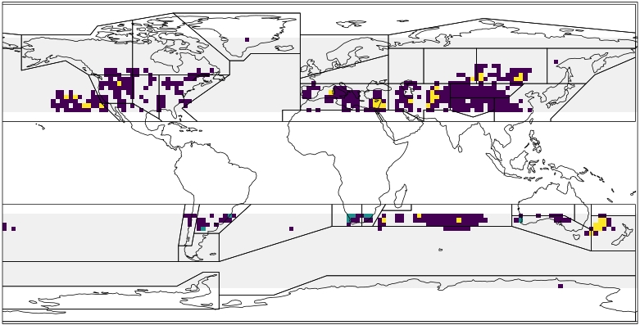
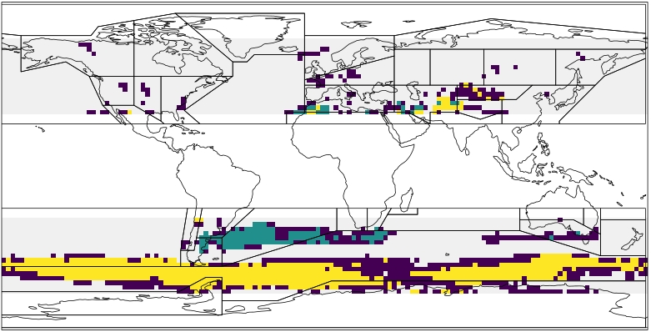
CONCLUSIONS
The Trends of JC-WT in JJA are generally significant, with some strong trends located in important climatic regions.
The Robust signals in JJA are related with the strongest trends, and normally emerge around the 2070s decade.
The JC-WT classification was applied globally, so our findings can inform any climate impact research where changes in large-scale circulation play a fundamental role.
[% / ºC]
2090-2099
4
3
2
1
0
-1
-2
-3
-4
No Signal
A type:
C type:
A type:
C type:
Conflicting
Signal
Positive
Robust Sig.
U type:
W type:
U type:
W type:
Negative
Robust Sig.

Slide 11
AVAILABILITY
REFERENCES
FUNDING
CONTACT
In process: JC-WT catalogs are planned to be submitted to a Zenodo repository and publication of this work is still pending.
[1] Lamb H. (1972) British isles weather types and a register of daily sequence of circulation patterns 1861-1971. Meteorological Office, Geophysical Memoir 116:1–85
[2] Jenkinson, A., Collison, F., 1977. An Initial Climatology of Gales over the North Sea. Technical Report 18. Meteorological Office. Bracknell, UK
[3] Gutiérrez JM, Jones RG, Narisma GT, Alves LM, et. al (2021) Atlas. In: Masson-Delmotte V, et. al (eds) Climate change 2021: the physical science basis contribution of working group I to the sixth assessment report of the intergovernmental panel on climate change. Cambridge University Press, Cambridge, pp 1927–2058. https://doi.org/10.1017/9781009157896.021
[4] Brands, S., 2022. A circulation-based performance atlas of the CMIP5 and 6 models for regional climate studies in the Northern Hemisphere mid-to-high latitudes. Geoscientific Model Development 15, 1375–1411. https://doi.org/10.5194/gmd-15-1375-2022
[5] Fernández-Granja, J. A., Brands, S., Bedia, J., et al (2023) Exploring the limits of the Jenkinson–Collison weather types classification scheme: a global assessment based on various reanalyses. Climate Dynamics. https://doi.org/10.1007/s00382-022-06658-7
[6] Brands, S., Fernández-Granja, J. A., Bedia, J., Casanueva, A., & Fernández, J. (2023). A global climate model performance atlas for the Southern Hemisphere extratropics based on regional atmospheric circulation patterns. Geophysical Research Letters, 50. https://doi.org/10.1029/2023GL103531
[7] Fernandez-Granja, J. A., Casanueva, A., Bedia, J., & Fernandez, J. (2021). Improved atmospheric circulation over Europe by the new generation of CMIP6 earth system models. Climate Dynamics, 56(11), 3527-3540. https://doi.org/10.1007/s00382-021-05652-9
FPI (PRE2020-094728) funded by MICIU/AEI/10.13039/501100011033
CORDyS (PID2020-116595RB-I00): MICIU/AEI/10.13039/501100011033
ATLAS (PID2019-111481RB-I00): MICIU/AEI/10.13039/501100011033
COMPOUND (TED2021-131334A-I00) funded by MICIU/AEI/10.13039/501100011033 & NextGenerationEU/PRTR (Regulation EU 2020/2094)
IMPETUS4CHANGE (Nº 101081555) funded by European Union’s Horizon Europe
PTI-Clima funded by NextGenerationEU/PRTR (Regulation EU 2020/2094)
*juan.fernandez@unican.es
https://www.researchgate.net/profile/Juan-Antonio-Fernandez-Granja

