Slide 1
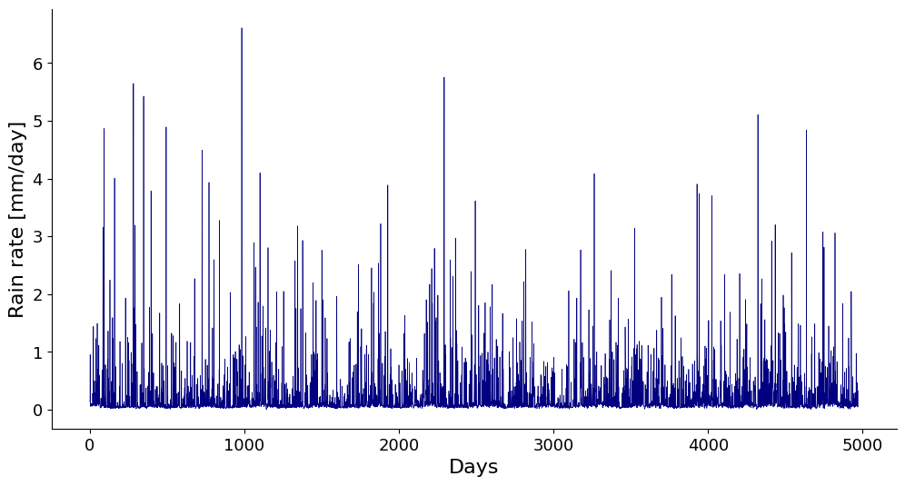
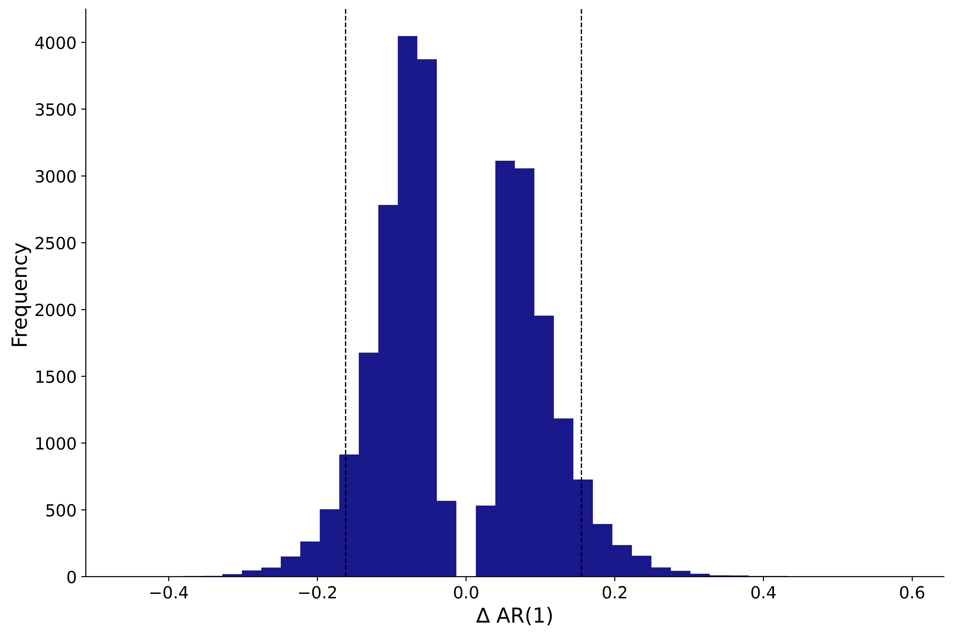
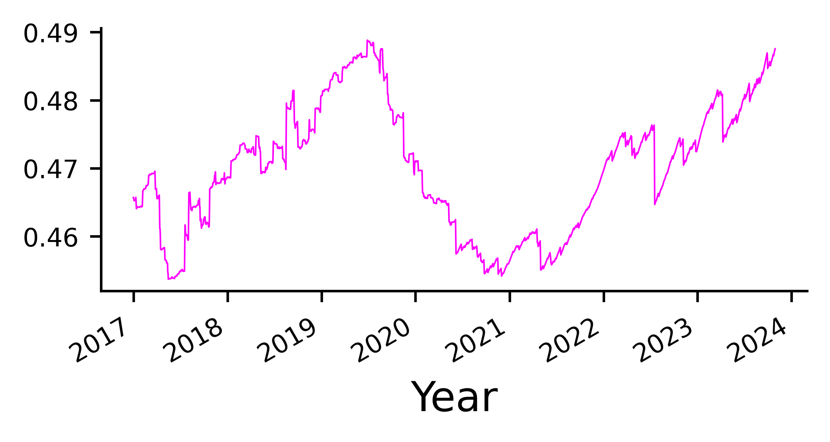
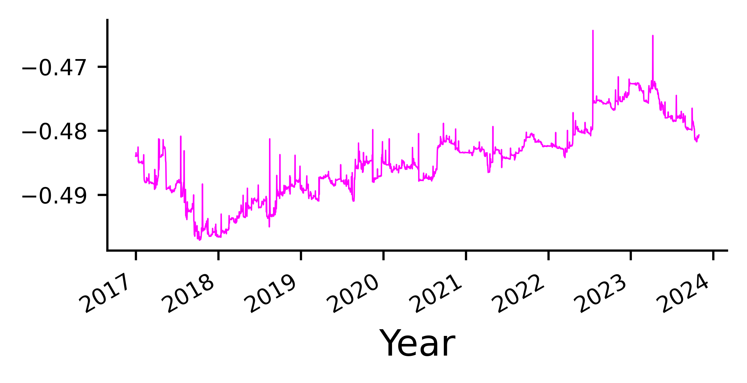
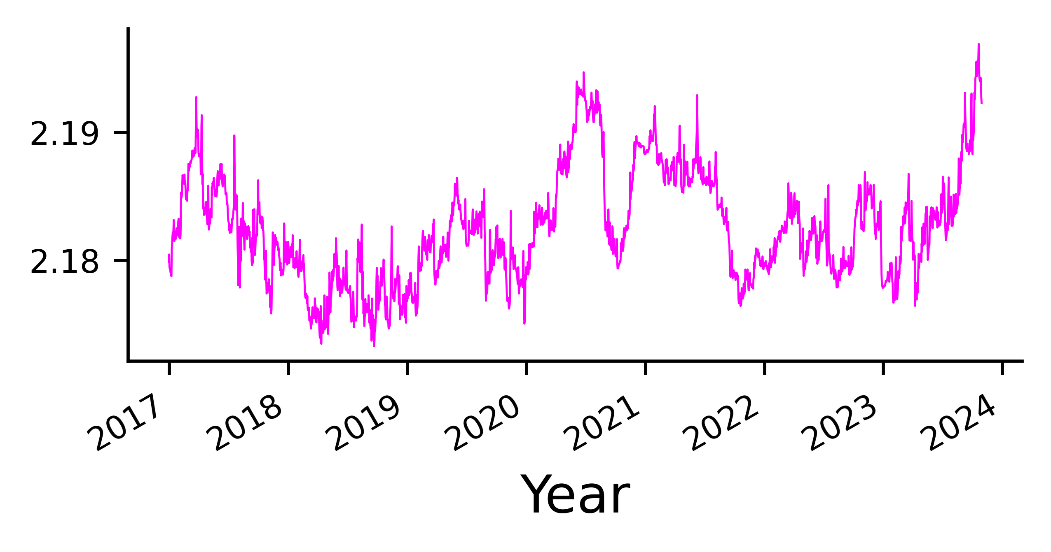
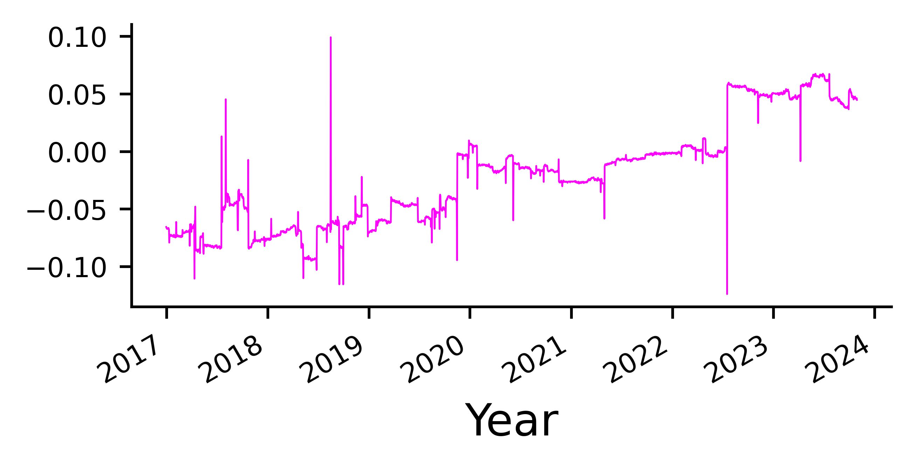
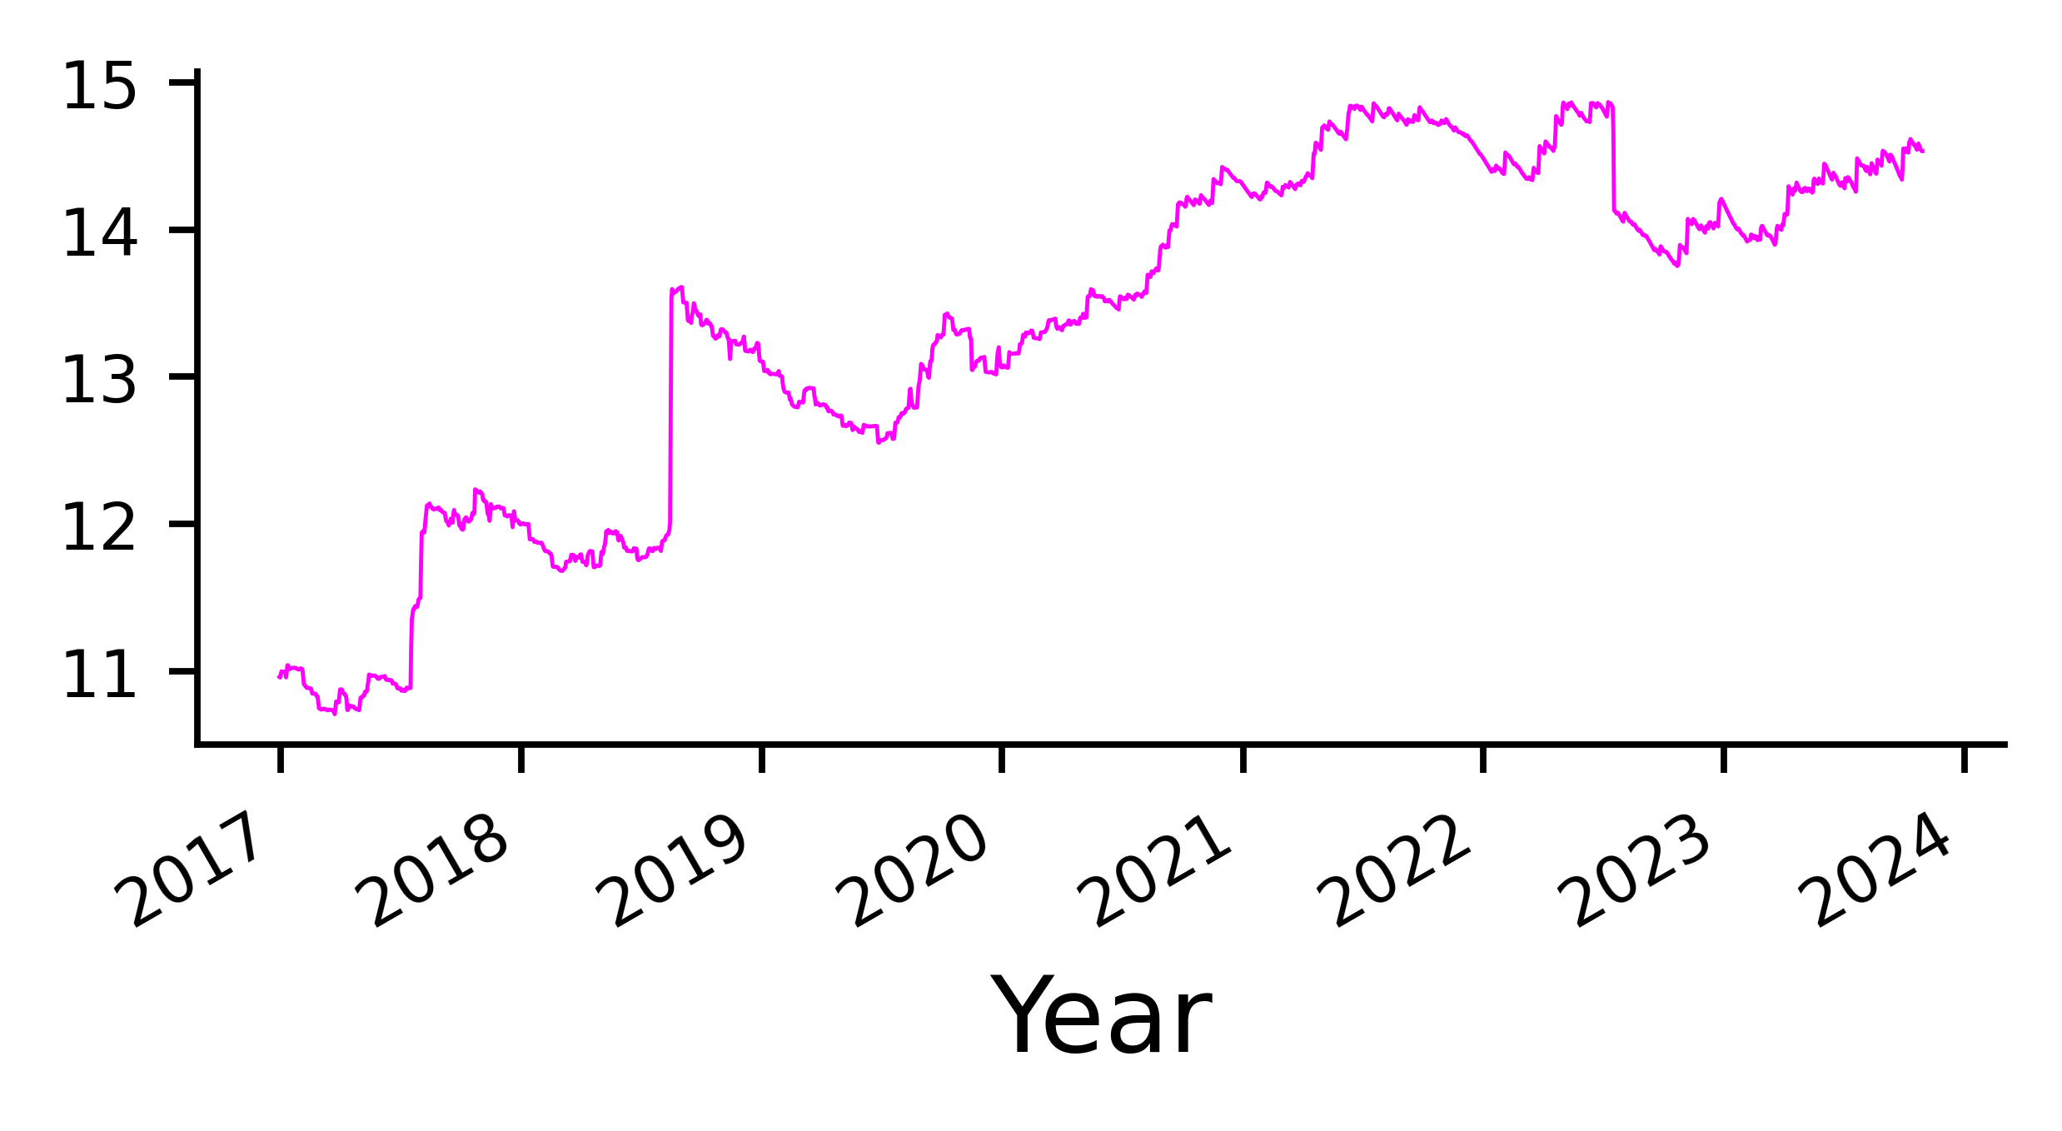
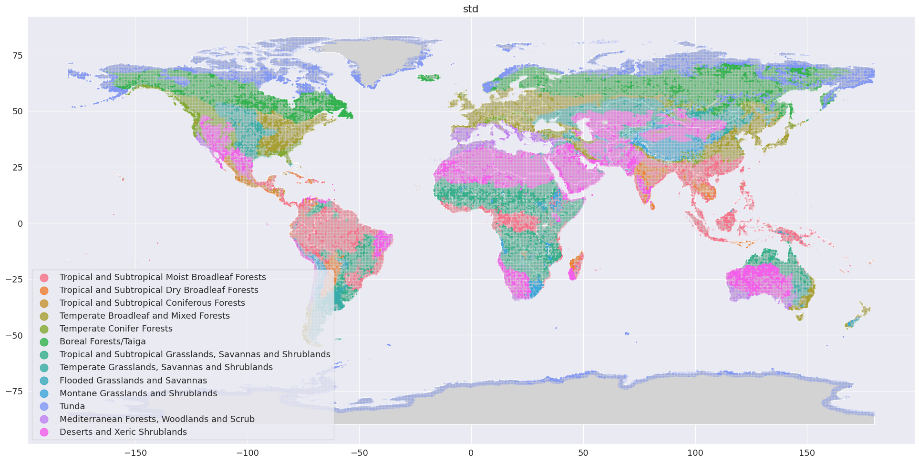
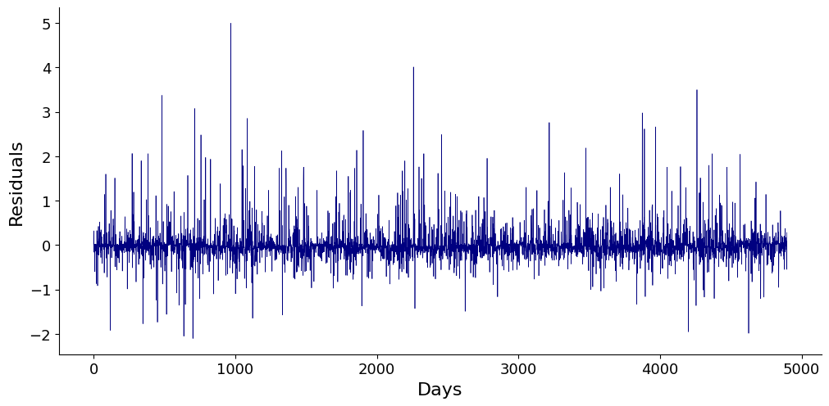
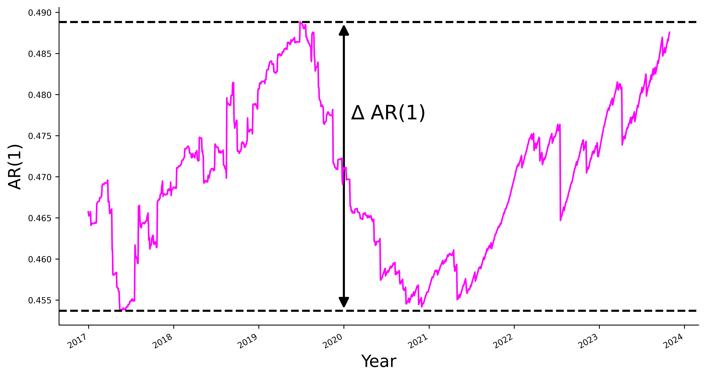
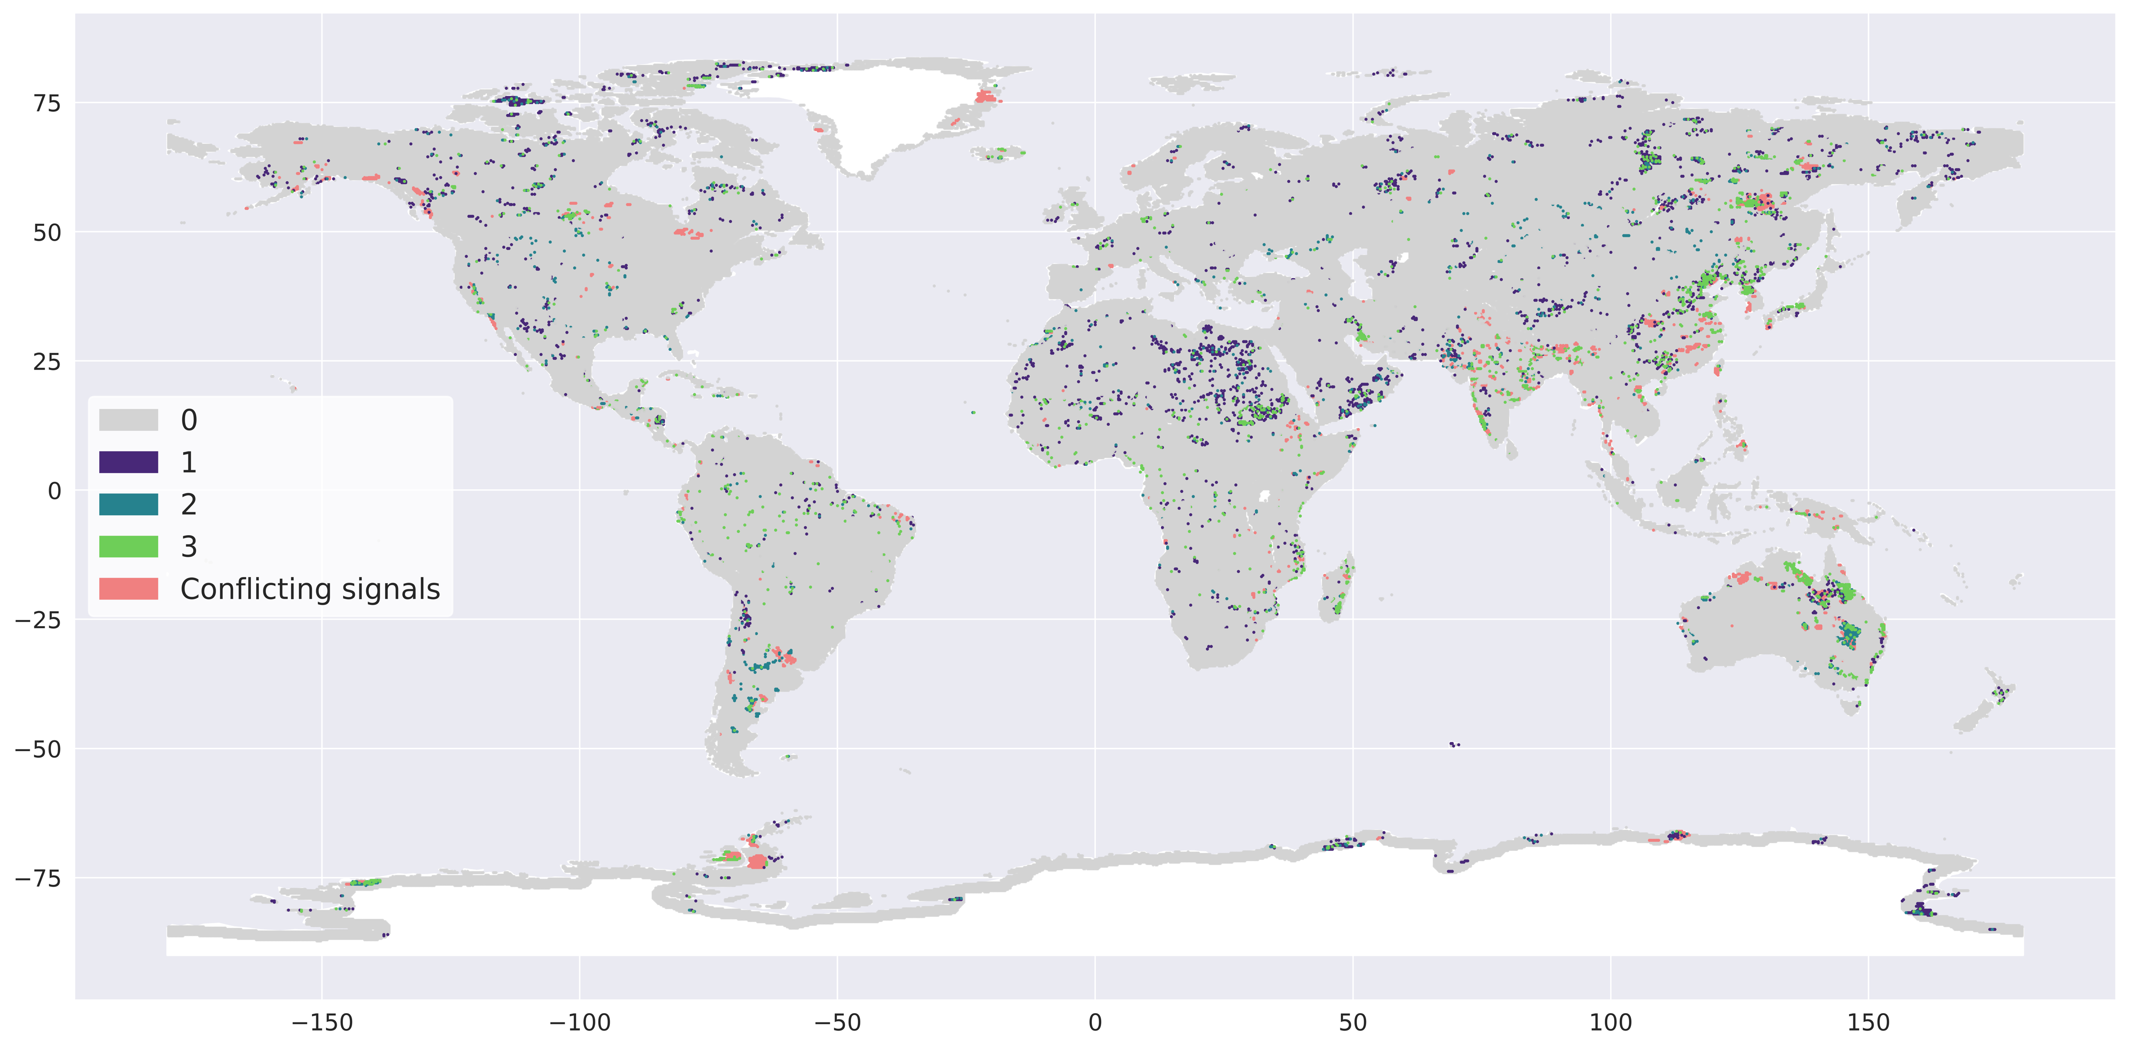
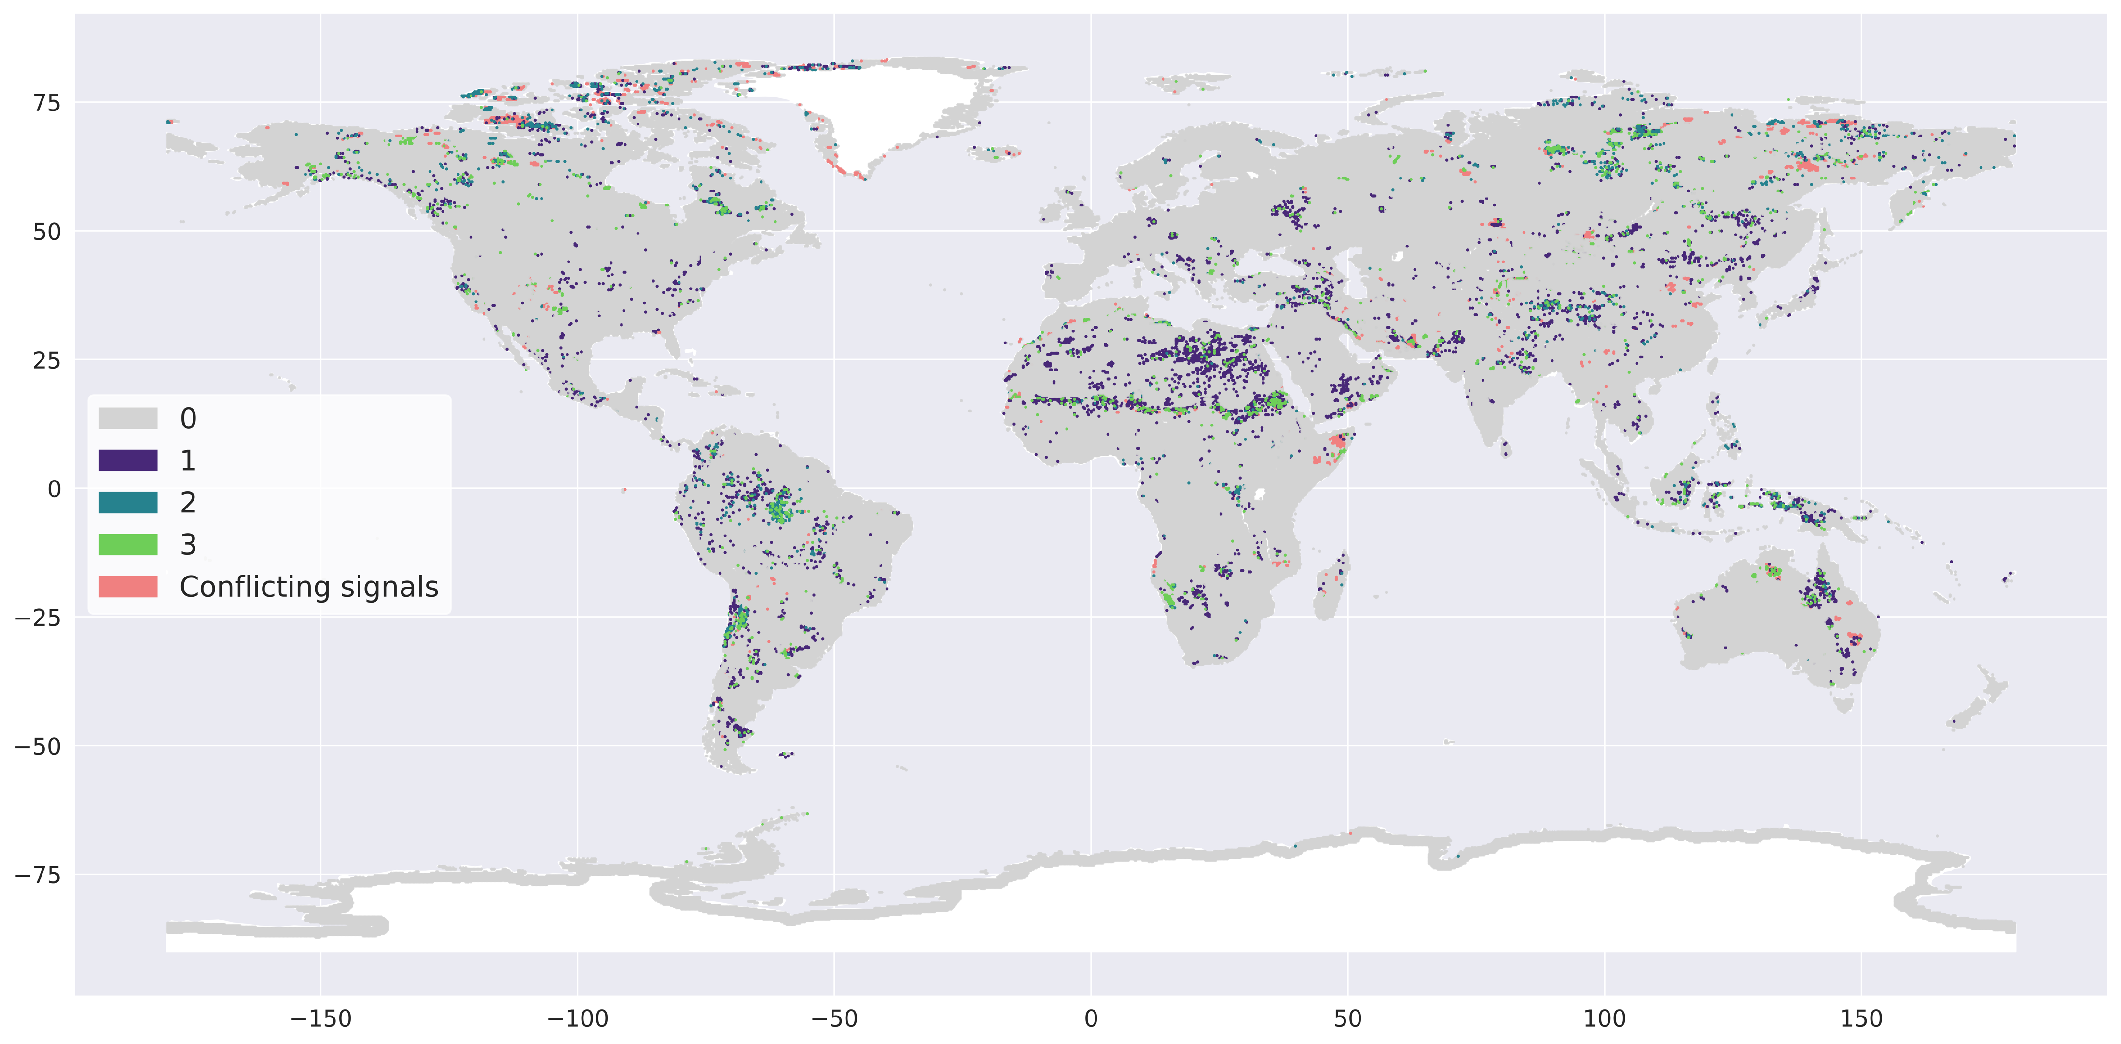
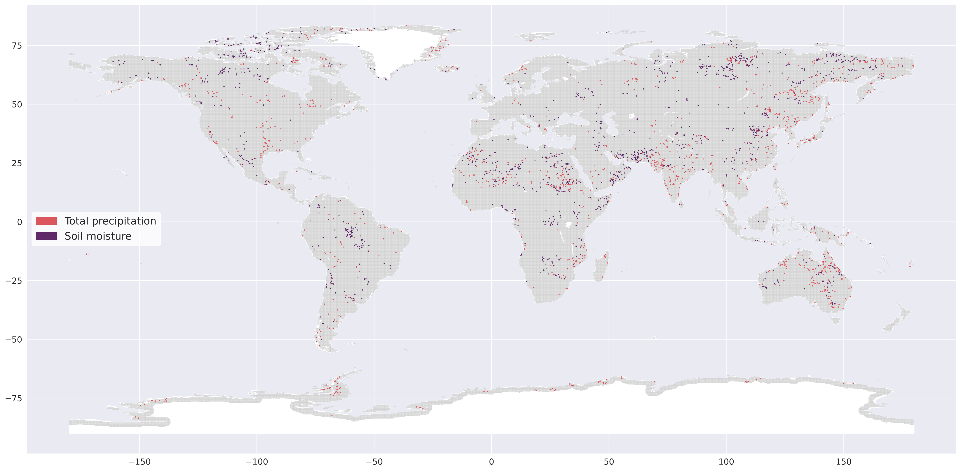
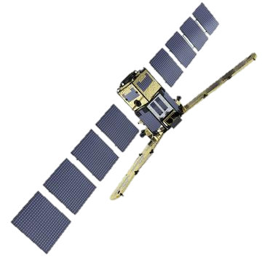
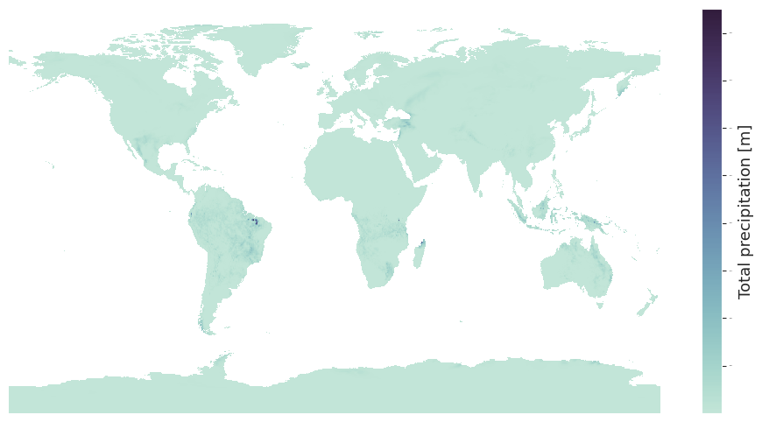
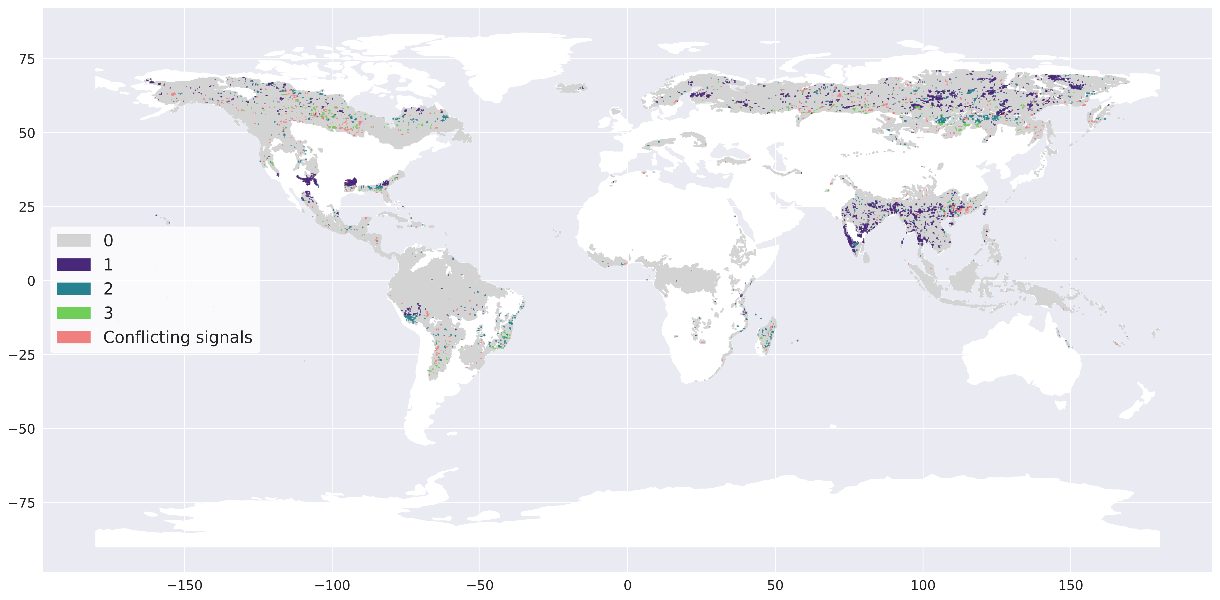
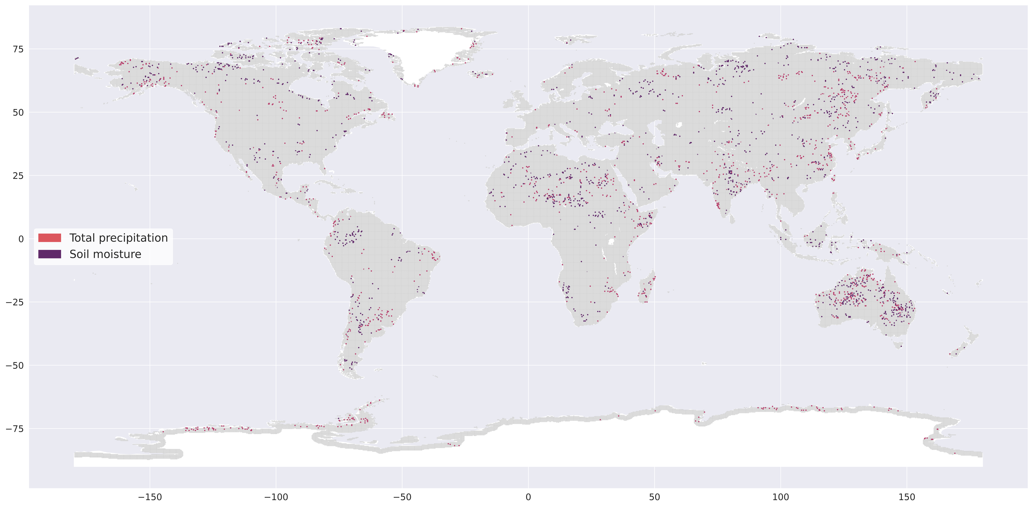
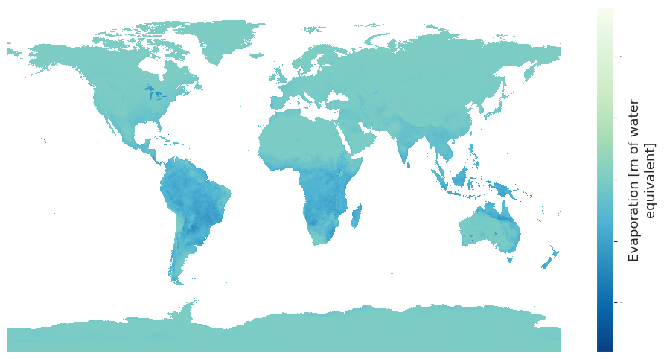
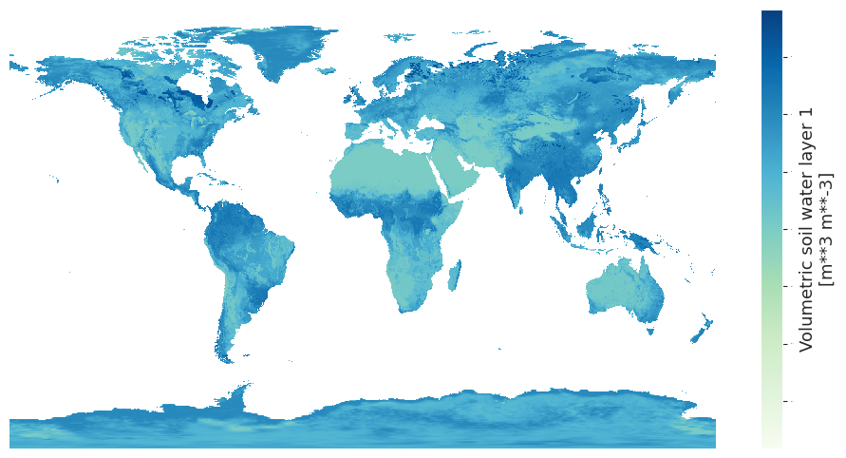
Remote sensing-based detection of resilience loss in the terrestrial water cycle
Romi Lotcheris¹, Nielja Knecht¹, Lan Wang-Erlandsson^{1,2,3}, Juan Rocha^{1,3}
¹ Stockholm Resilience Centre, Stockholm University, Sweden; ² Potsdam Institute for Climate Impact Research, Potsdam, Germany; ³ Anthropocene Laboratory, Royal Swedish Academy of Sciences, Sweden.
EGU 2024
1. Background
3. Data and Methods
5. Preliminary findings
A resilient system is able to absorb and recover from environmental perturbations and disturbances by means of internal feedbacks that maintain its equilibrium state^{1,2}.
As a system loses resilience, this ability to persist in the same dynamic regime becomes compromised, and the system may shift abruptly from one qualitative regime to another, termed a regime shift, critical transition, or tipping event³. Detecting whether the resilience of a system is changing is based on the rationale that the recovery to equilibrium of a system after a disturbance changes as a system loses resilience⁴. Such a change in the recovery time of a system can be measured by changes in the statistical signatures of the state variable time series that arise moving towards a bifurcation point, termed early warning signals (EWS)².
A
SSMI/S Rain Rate Daily, 0.25
B
Early warnings signals
C
SSMI/S showed clear clustering for pixels with increasing and decreasing long term memory. Analysis detected more indicators of CSU than CSD.
Regions with EWS detected for ERA5 tend to have more than one indicator of resilience loss. Fractal dimension generally corresponds with signals of CSD (increasing long-term memory) and CSU (decreasing long-term memory).
Where ERA5 soil moisture exhibits clearer spatial patterns, early warning signals of ERA5 precipitation are more heterogenous, with only some regional consistency.
SSMI/S precipitation:
Strong spatial clustering of decreasing long term memory in Central America and increasing long term memory in South Asia.
Pixels exhibiting multiple EWS in Southern Brazil and boreal forests.
ERA-5:
Soil moisture: CSD and flickering in the Sahel, Amazon, and Andres regions. Northern Boreal Forests and Tundra show conflicting signals, some pixels showing CSD. These regions are largely characterised by decreasing long term memory.
Precipitation: Indian sub-continent and Australia shows pixels with several EWS, particularly in the West, characterized by a mixture of both CSD and CSU, along with conflicting signals.
Future research
Remotely sensed soil moisture resilience loss using SMOS/SMAP.
Comparison with indicators of vegetation resilience (GPP, kNDVI).
Random forest regression analysis of driving variables (ENSO, temperature, LULCC, 10m wind speed, evaporation).
AR(1)
Variance
Fractal dimension
Pixel level thresholds calculated with respect to the biome variable distribution.
Skewness
Kurtosis
The hydrological cycle plays a critical role in regulating the functioning and stability of the Earth system.
Characterised by complex and interdependent coupled systems and feedbacks, the water cycle is dynamically linked to ecosystem processes and vegetation⁵. Rather than an external and abiotic driver, water is an endogenous part of terrestrial ecosystems. Anthropogenic changes have been driving terrestrial resilience loss⁶. Whether the hydrological system is vulnerable to abrupt, irreversible transitions, and how these might be linked to ecosystem resilience, remains an open question.
Through the mutual causal link described above, we hypothesize that changes in ecosystem resilience may be propagated through to the water cycle and detectable in key hydrological variables (soil moisture, precipitation, evapotranspiration).
Through processes like moisture recycling and hydro-ecological regulation, water maintains biomes and sustains biodiversity, and is deeply coupled to human livelihoods. By means of this connectivity, water cycle modifications can propagate and across geographies⁷. This calls for a holistic understanding of the effect of anthropogenic pressures on the water cycle.
Loss
Loss
Detrending and de-seasoning
Detecting resilience loss
Rolling window
Goals
First order global scale assessment of remotely sensed water resilience to identify regions showing symptoms of resilience loss
Comparison with indicators of vegetation resilience (GPP, kNDVI)
Random forest regression analysis of drivers of water resilience loss
4. Results
A
ERA5 Precipitation
B
ERA5 Soil moisture
D
Critical slowing down (CSD)
2. Data
A. Earth observation datasets
We use earth observation and re-analysis datasets of precipitation, soil moisture, and evaporation as state variables, harmonized to 0.25 degrees. Remote sensing products can be the result of combining sensors and outputs from different satellites into a single continuous record. Single-sensor records are preferable to combined satellite products to avoid data artifacts in the higher statistical moments of the time series distribution from changes in sensor measurement noise and radiometric resolution⁸.
6. References
SSMI, SSMI/S
C
SSMI/S F18 Precipitation
Scheffer, M., et al., 2009. Nature 461, 53–59.
Dakos, V., et al. 2015. Phil. Trans. of the Royal Society B: Biological Sciences 370, 20130263.
Dakos, V. & Kéfi, S., 2022. Environmental Research Letters 17, 043003.
Lindegren, M., et al. 2012. PLoS ONE 7, e38410.
Zipper, S.C., et al. 2020. Earth's Future 8.
Rocha, J.C., 2022. Environmental Research Letters 17, 065013.
Wang-Erlandsson, L. et al., 2018. Hydrology and Earth System Sciences 22, 4311–4328.
Tao, S., et al., 2023. Nature Climate Change.
Titus, M. & Watson, J., 2020. Theoretical Ecology 13, 449–457.
SMOS, SMAP
Precipitation
E
Critical slowing down (CSU)
B. Reanalysis datasets
The early warning detection is repeated both for satellite and re-analysis products to assess the sensitivity of the outcomes to the measurement method and data sources.
Evaporation
Soil moisture
Romi Lotcheris
Note: Analysis ongoing
Email: romi.lotcheris@su.se
X: @romlotch
A-C: Pixels where early warning signals indicated resilience loss. Color scale indicates per pixel the number of early warnings detected out of either critical slowing down, critical speeding up, flickering, or an increase in long term memory. A-B: ERA-5 re-analysis data for total precipitation from 1987 to 2023, 0.25 degrees, weekly for precipitation (A) and volumetric soil water content (B). C: SSMI/S F18 precipitation from 2010 to 2023, 0.25 degrees, daily. Note: analysis ongoing.
E: Pixels where early warning signals indicated critical slowing down for ERA-5 total precipitation, and volumetric soil water content. F: Pixels where early warning signals indicated critical speeding up for ERA-5 total precipitation, and volumetric soil water content.
This research is funded by Formas under grant no. 31003917.

