Slide 1
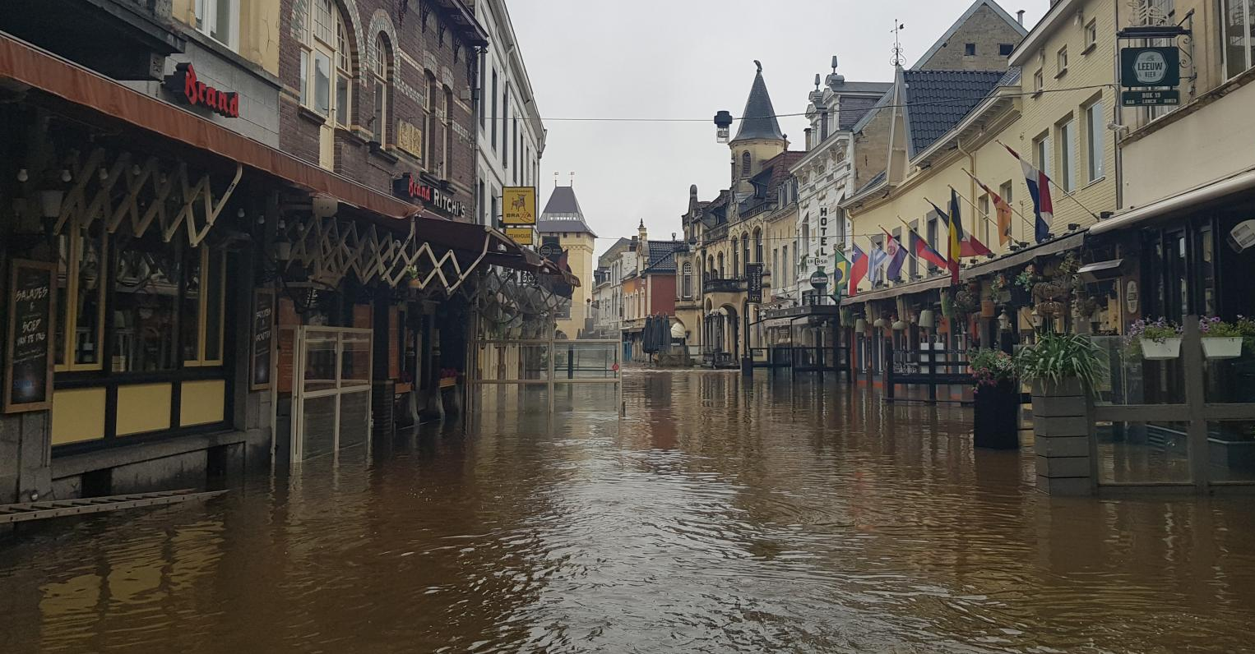
Attribution using analogues: a case study of the Western European flood event of July 2021
Vikki Thompson
Sarah Kew, Sjoukje Philip, Hylke de Vries, Karin van der Wiel, and Izidine Pinto (KNMI)
Dim Coumou, Melinda Galfi, Tamara Happé, and Bram Huis (VU Amsterdam)
Royal Netherlands Meteorological Institute
@ClimateVikki
September 7, 2023
@ClimateVikki
Valkenburg, Limburg. 15th July 2021. (NL Times)

Slide 2
Detection
Attribution using analogues: a case study of the Western European flood event of July 2021
Vikki Thompson
Sarah Kew, Sjoukje Philip, Hylke de Vries, Karin van der Wiel, and Izidine Pinto (KNMI)
Dim Coumou, Melinda Galfi, Tamara Happé, and Bram Huis (VU Amsterdam)
Royal Netherlands Meteorological Institute
@ClimateVikki
September 7, 2023
@ClimateVikki
Valkenburg, Limburg. 15th July 2021. (NL Times)

Slide 3
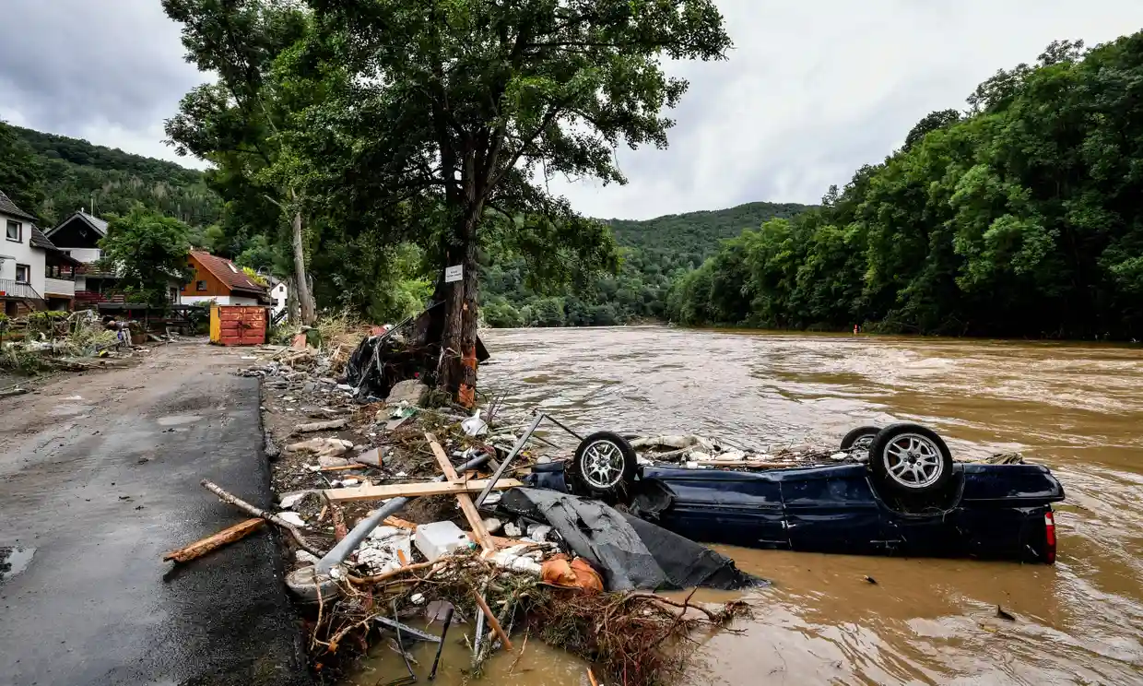
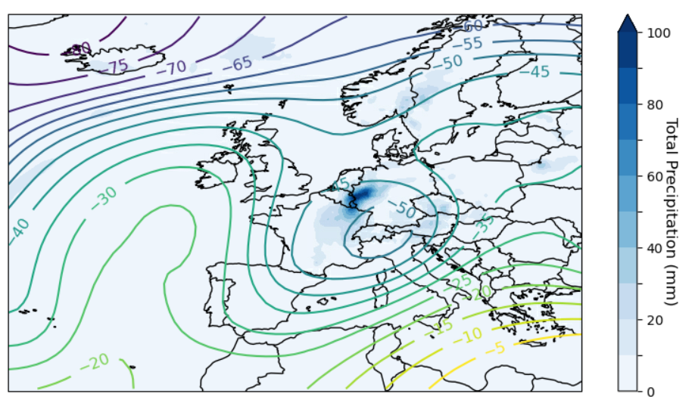
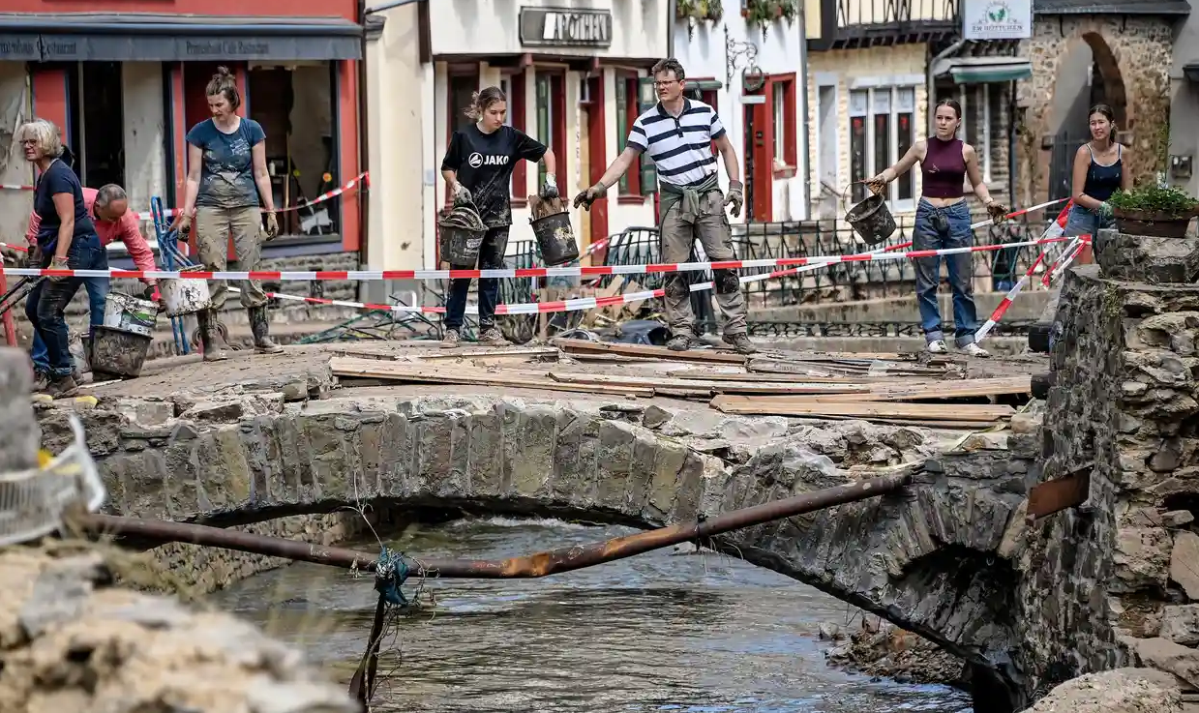
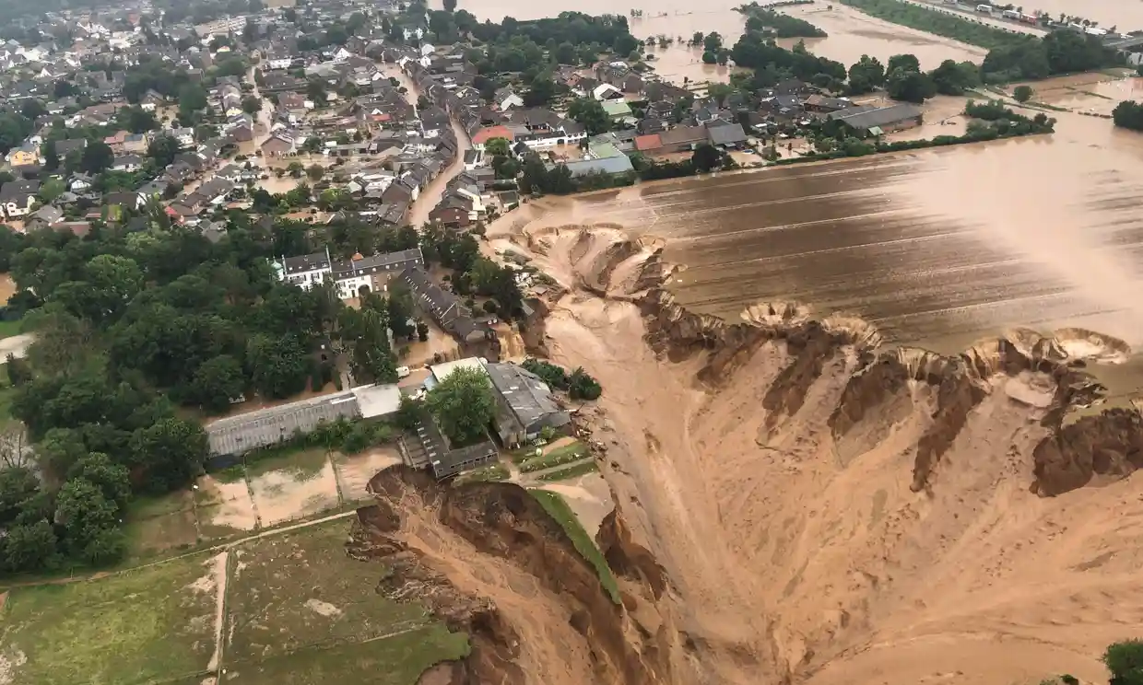
July 14 2021
Image: Copernicus State of the Climate 2022
Images: The Guardian
Notes:
Flooding in western Europe July 2021 – how did it happen?
Unusually heavy rainfall at the start of July causes soil saturation in parts of Belgium and Germany.
Rainfall in the area is in the top 1% of record daily amounts
A slow moving low pressure system carries moist air from an unusually warm Baltic Sea
This system encounters hills on the Belgium-Germany border, releasing the most rain in a single day on record (since 1950)
The already saturated soil is unable to absorb the excess water and severe flooding ensues
Record levels reached – river discharge in places in the Meuze and Rhine catchments reaches a historical maximum since records began in 1991.

Slide 4
July 14 2021
Are summertime cut-off low pressure systems in western Europe increasing in intensity, frequency, or persistence?
Image: Copernicus State of the Climate 2022
Images: The Guardian
Notes:
Flooding in western Europe July 2021 – how did it happen?
Unusually heavy rainfall at the start of July causes soil saturation in parts of Belgium and Germany.
Rainfall in the area is in the top 1% of record daily amounts
A slow moving low pressure system carries moist air from an unusually warm Baltic Sea
This system encounters hills on the Belgium-Germany border, releasing the most rain in a single day on record (since 1950)
The already saturated soil is unable to absorb the excess water and severe flooding ensues
Record levels reached – river discharge in places in the Meuze and Rhine catchments reaches a historical maximum since records began in 1991.

Slide 5
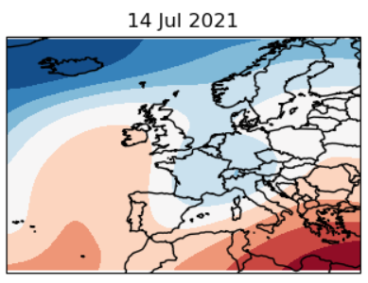
Identifying Flow Analogues
Atmospheric circulation at 250 hPa, represented by streamfunction
EGU 2024 vikki.thompson@knmi.nl

Slide 6
Identifying Flow Analogues
Closest analogues identified using Euclidean Distance
EGU 2024 vikki.thompson@knmi.nl

Slide 7
1993-2022
Deepening Low
1950-1979
For each time period I find the closest 30 analogues and plot a composite (mean of all 30 analogues)
Thompson, V. et al. Changing dynamics of western European summertime cut-off lows (in review)
EGU 2024 vikki.thompson@knmi.nl

Slide 8
1993-2022
Deepening Low
1950-1979
Shifting and Deepening Low
2000-2009
2075-2084
Thompson, V. et al. (in review)
EGU 2024 vikki.thompson@knmi.nl

Slide 9
Typicality: How usual is the dynamical situation.
Measured by distance to closest 30 events
Calculated for the event, and for each of the 30 analogues in each period
Event itself is more typical in present day
Thompson, V. et al. (in review)
EGU 2024 vikki.thompson@knmi.nl

Slide 10
Typicality: How usual is the dynamical situation.
Measured by distance to closest 30 events
Calculated for the event, and for each of the 30 analogues in each period
Event itself is more typical in present day
Distribution of analogues shifts showing days similar to the event become more frequent
Thompson, V. et al. (in review)
EGU 2024 vikki.thompson@knmi.nl

Slide 11
Typicality: How usual is the dynamical situation.
Measured by distance to closest 30 events
Persistence: How long does the event last.
Measured by correlation with day 0 (>0.9)
Calculated for the event, and for each of the 30 analogues in each period
No change in persistence through time
Event itself is more typical in present day
Some observed events have much longer persistence
Distribution of analogues shifts showing days similar to the event become more frequent
Thompson, V. et al. (in review)
EGU 2024 vikki.thompson@knmi.nl

Slide 12
Typicality: How usual is the dynamical situation.
Measured by distance to closest 30 events
Persistence: How long does the event last.
Measured by correlation with day 0 (>0.9)
Calculated for the event, and for each of the 30 analogues in each period
No change in persistence through time
Event itself is more typical in present day
Some observed events have much longer persistence
Distribution of analogues shifts showing days similar to the event become more frequent
Model bias to lower persistence
Thompson, V. et al. (in review)
EGU 2024 vikki.thompson@knmi.nl

Slide 13
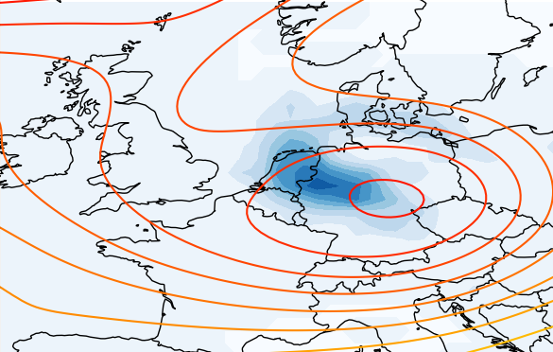
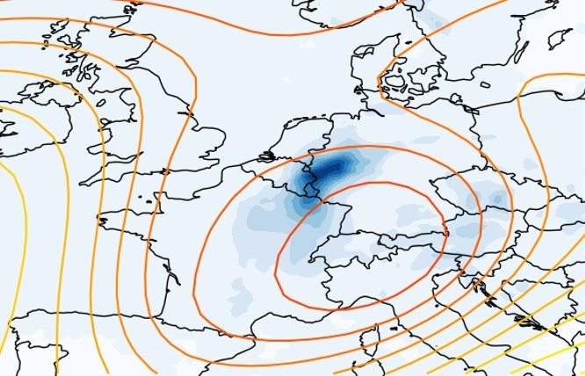
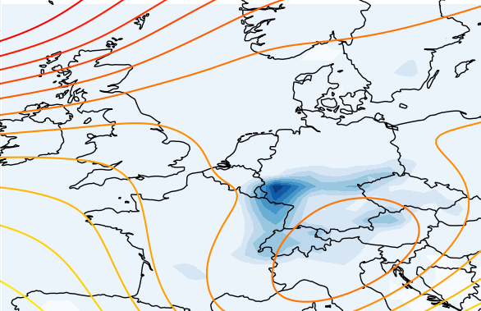
Some (not all) analogues show extreme rainfall in a similar area
14th July 2021 (ERA-5)
Two KNMI-LENTIS present day analogues
Contours of 250 hPa streamfunction
Shading daily maximum rainfall
Thompson, V. et al. (in review)
EGU 2024 vikki.thompson@knmi.nl

Slide 14
So far, I have detected changes between periods, but this does not tell us anything about the cause. We have some preliminary work on attribution, using two different methods...
EGU 2024 vikki.thompson@knmi.nl

Slide 15
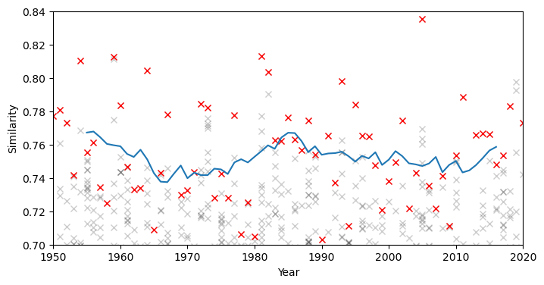
Decadal Trends in Analogue Quality
Similarity:
Measure of how close each day is to the event.
S = 1 – ED / ED_{max}
Take best analogue of each year
Timeseries of 10-year rolling mean
EGU 2024 vikki.thompson@knmi.nl

Slide 16
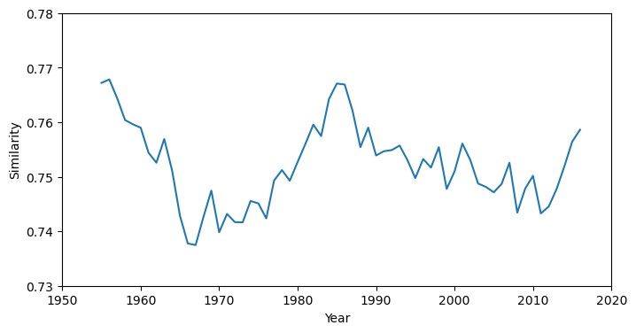
Decadal Trends in Analogue Quality
Assess possible drivers of trends –
climate change or internal variability?
AMV
GMST
EGU 2024 vikki.thompson@knmi.nl

Slide 17
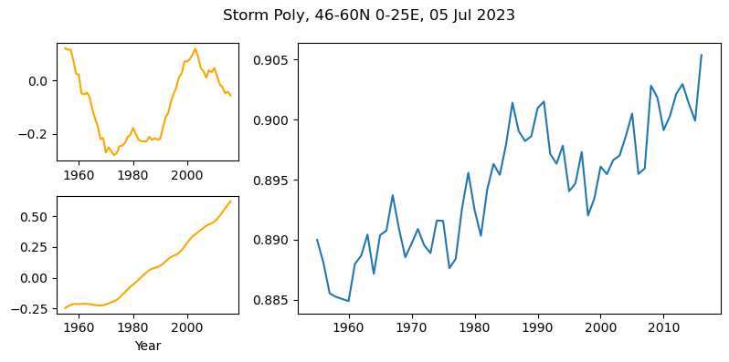
Decadal Trends in Analogue Quality
Storm Babet​
20 Oct 2023​
​
Correlates with AMV (0.53)
AMV
GMST
Storm Poly
5 Jul 2023
Correlates with GMST (0.83)

Slide 18
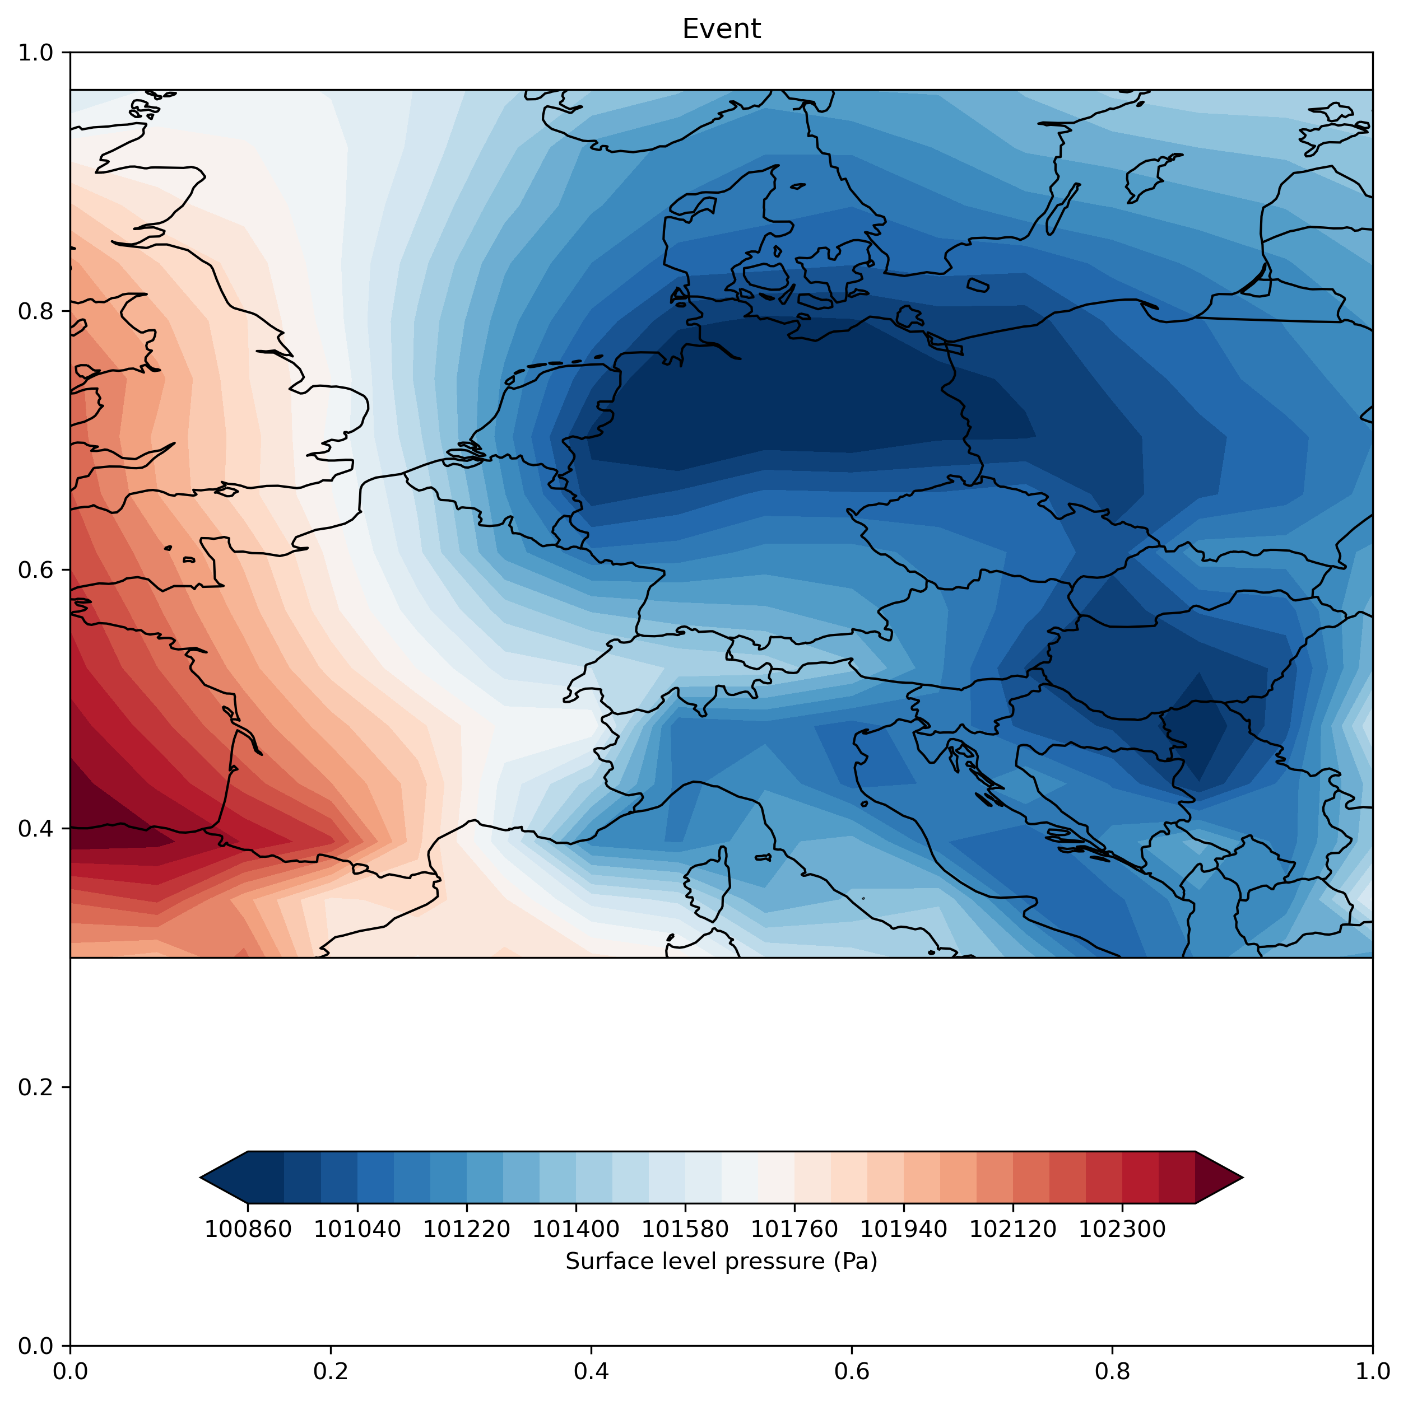
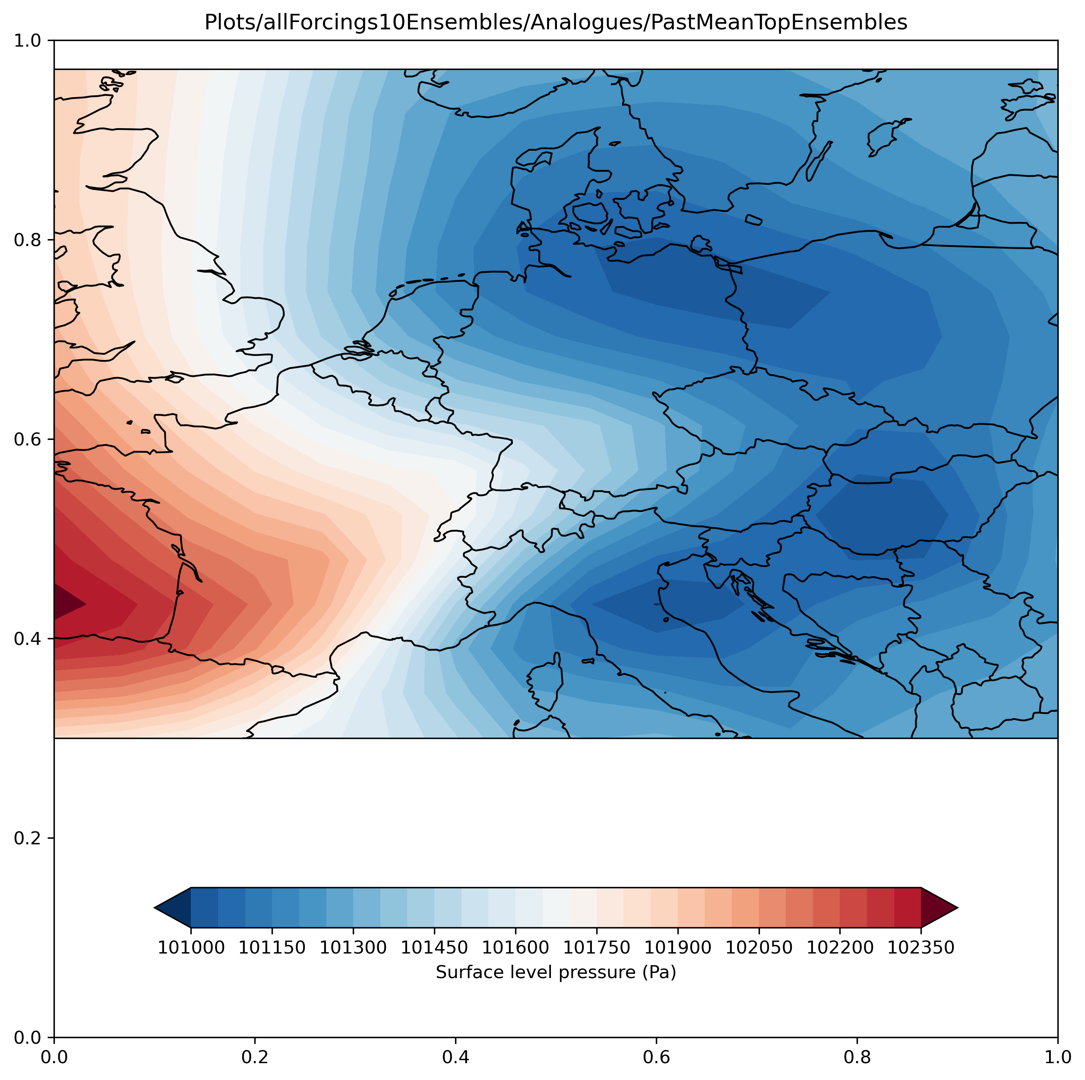
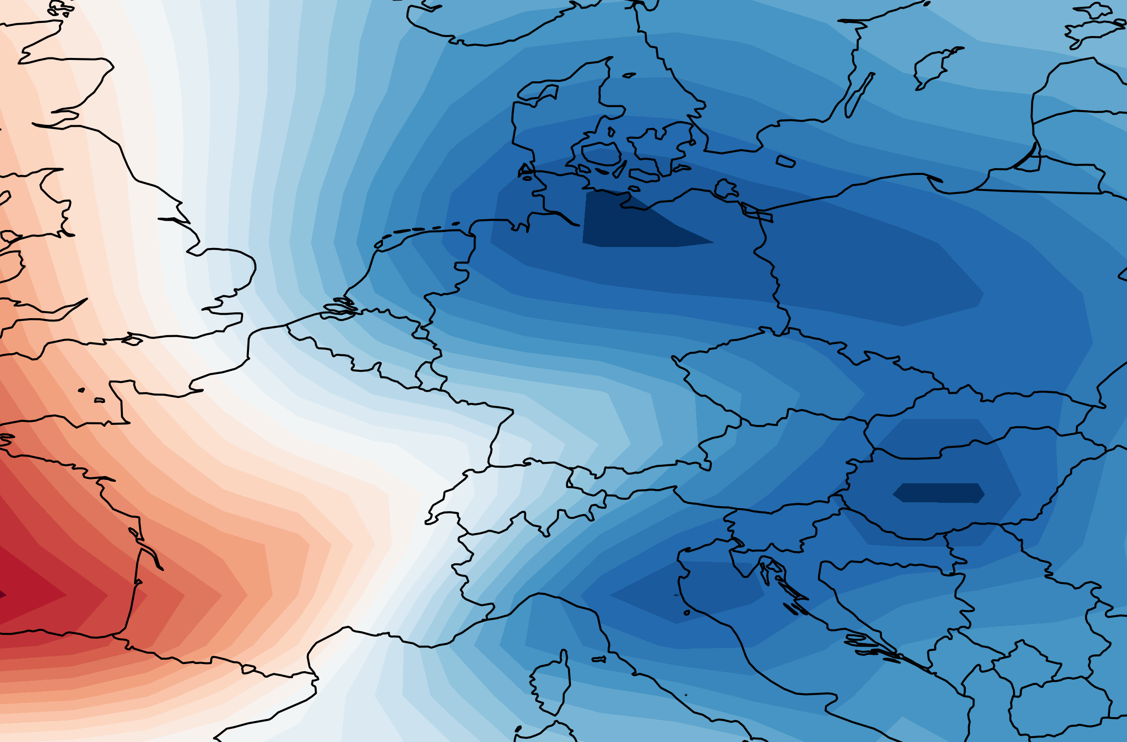
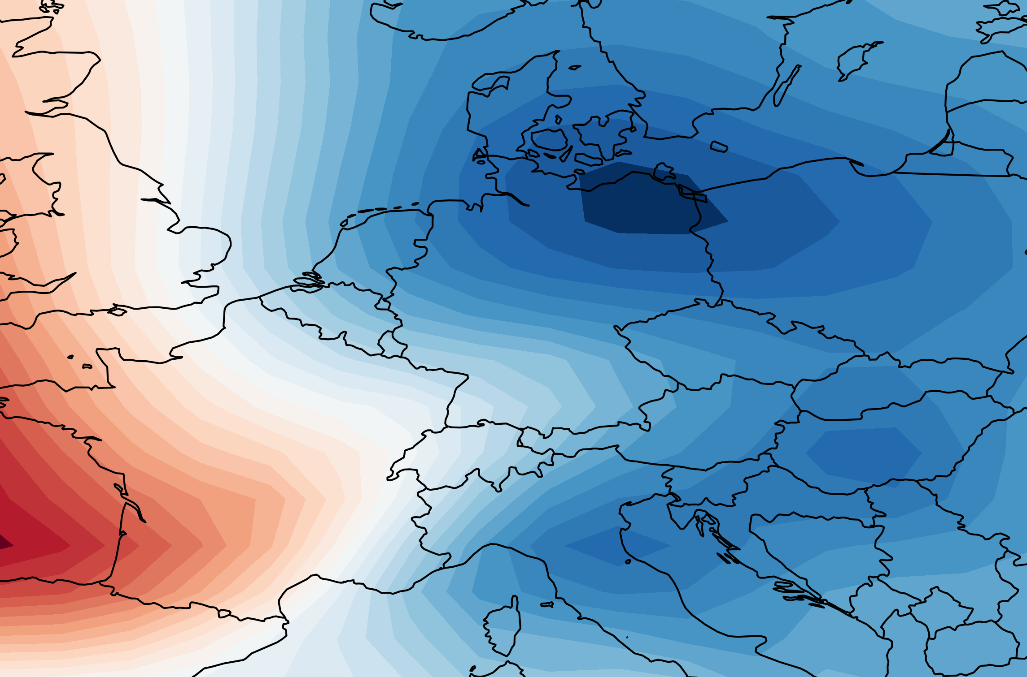
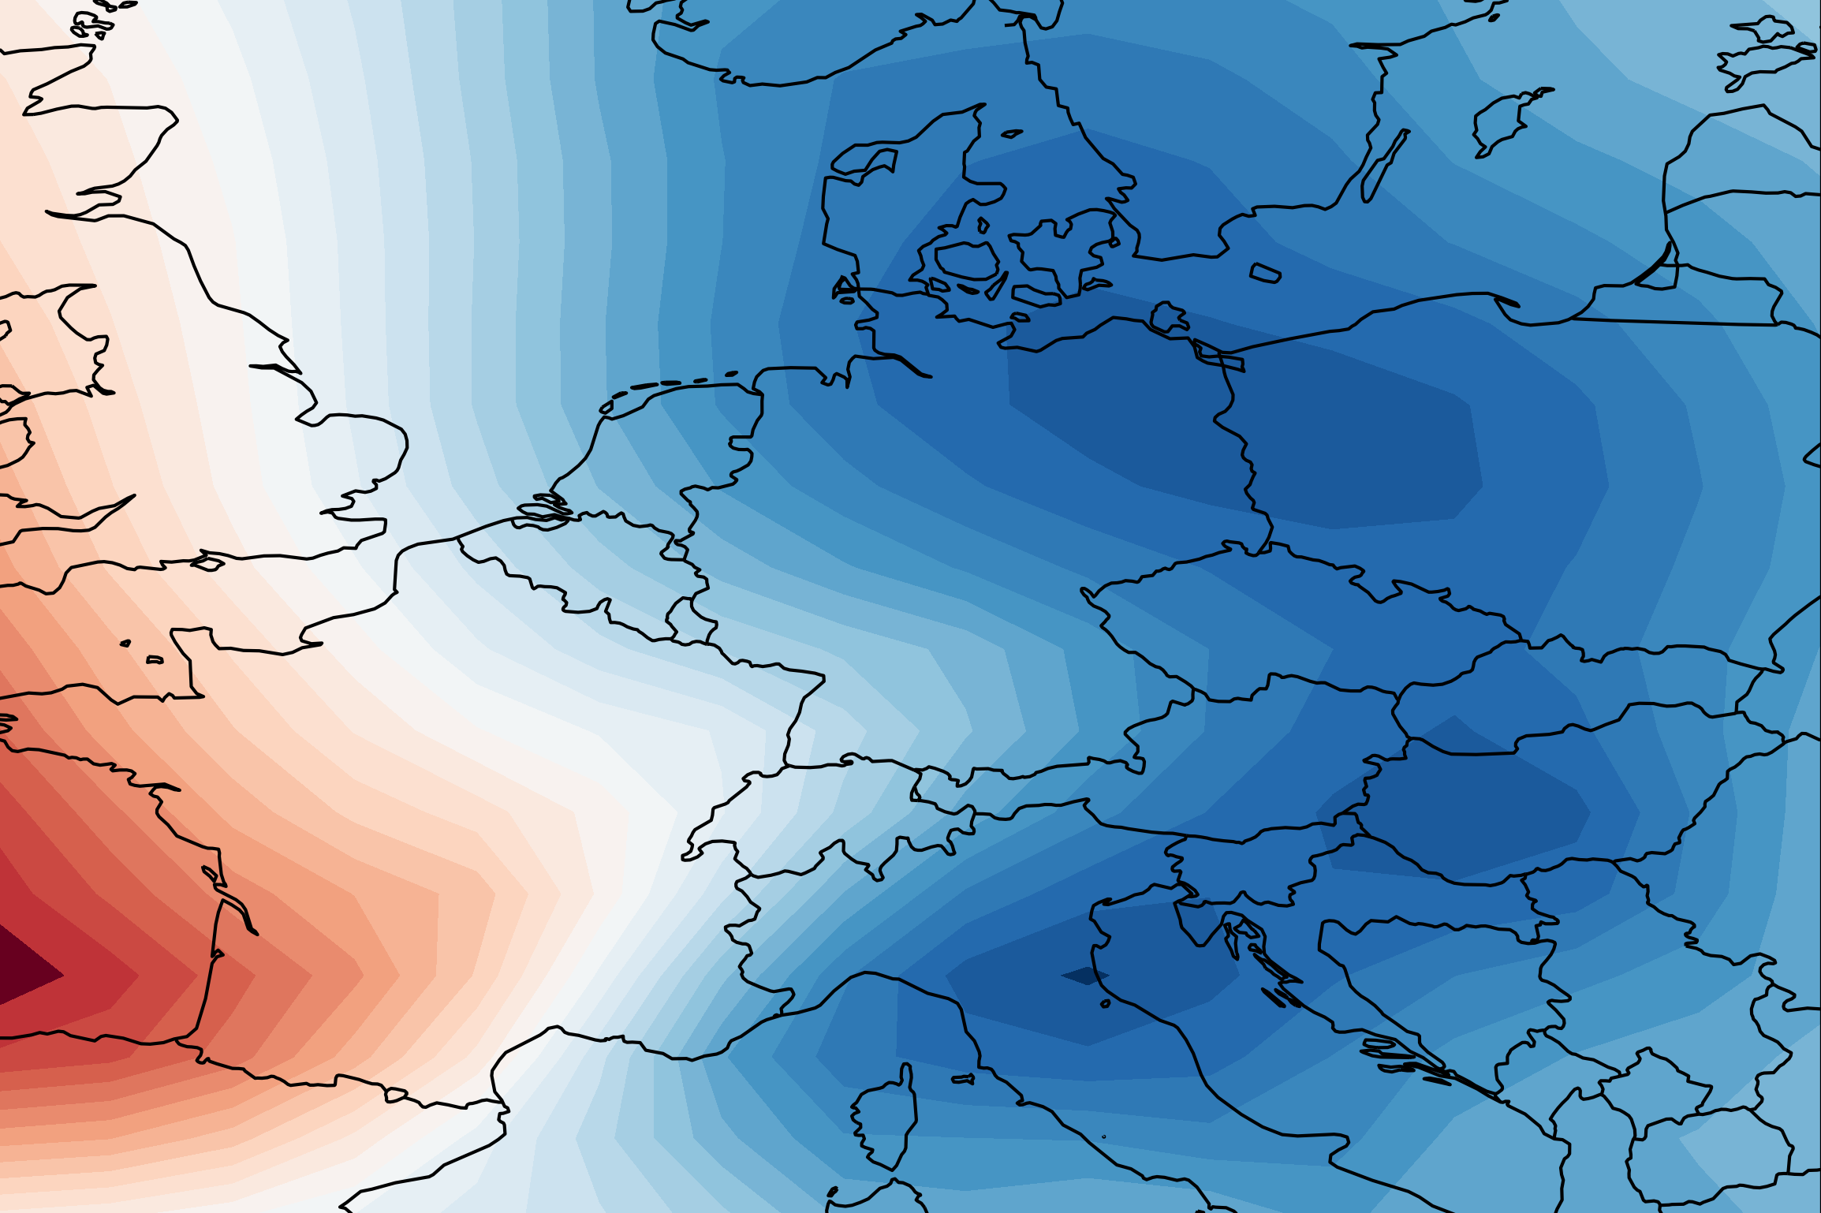
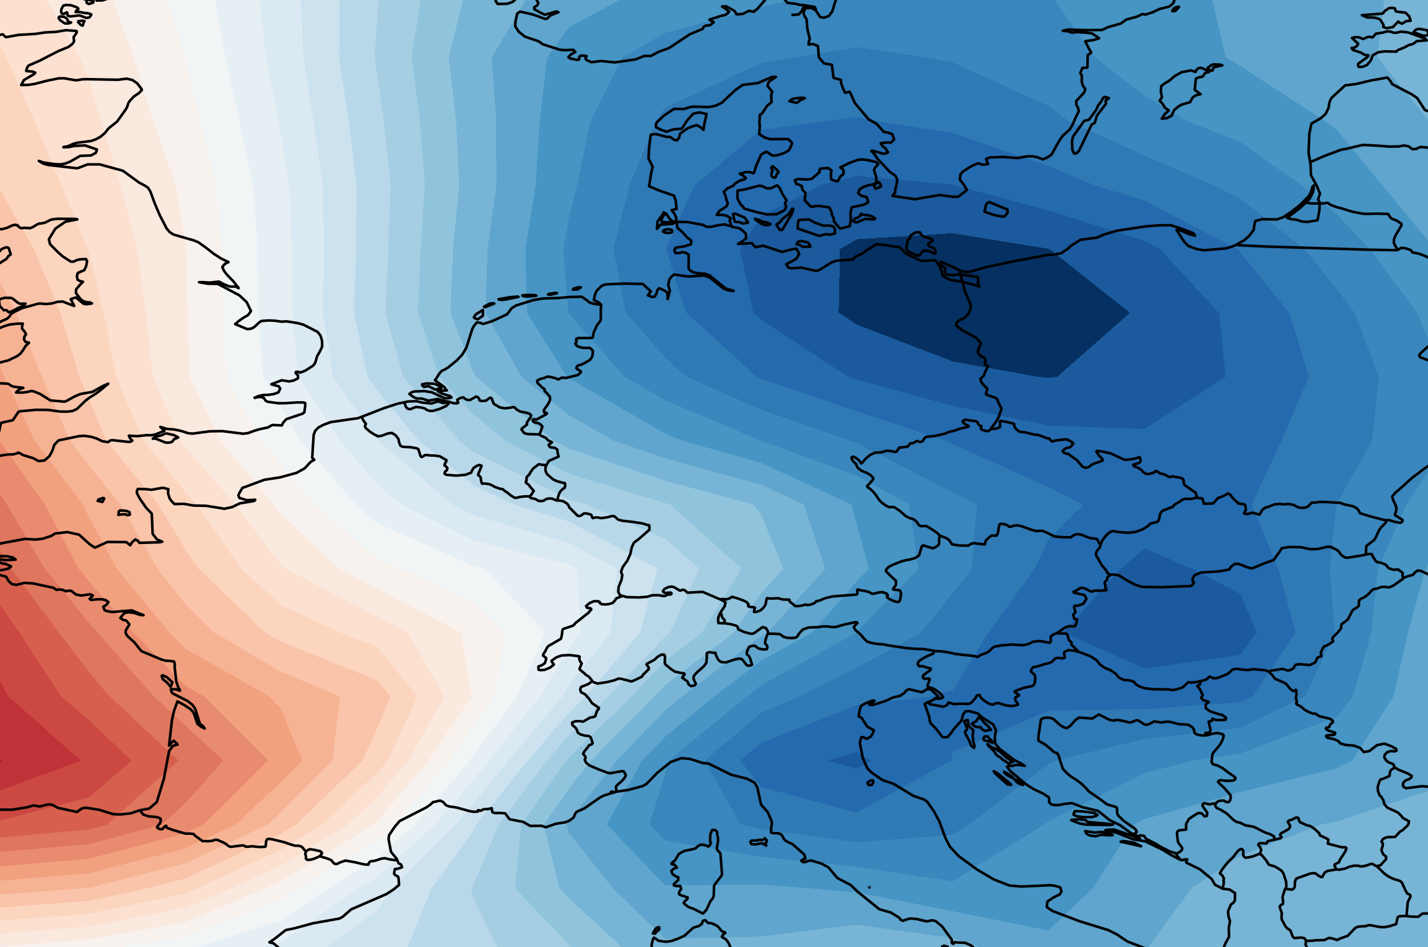
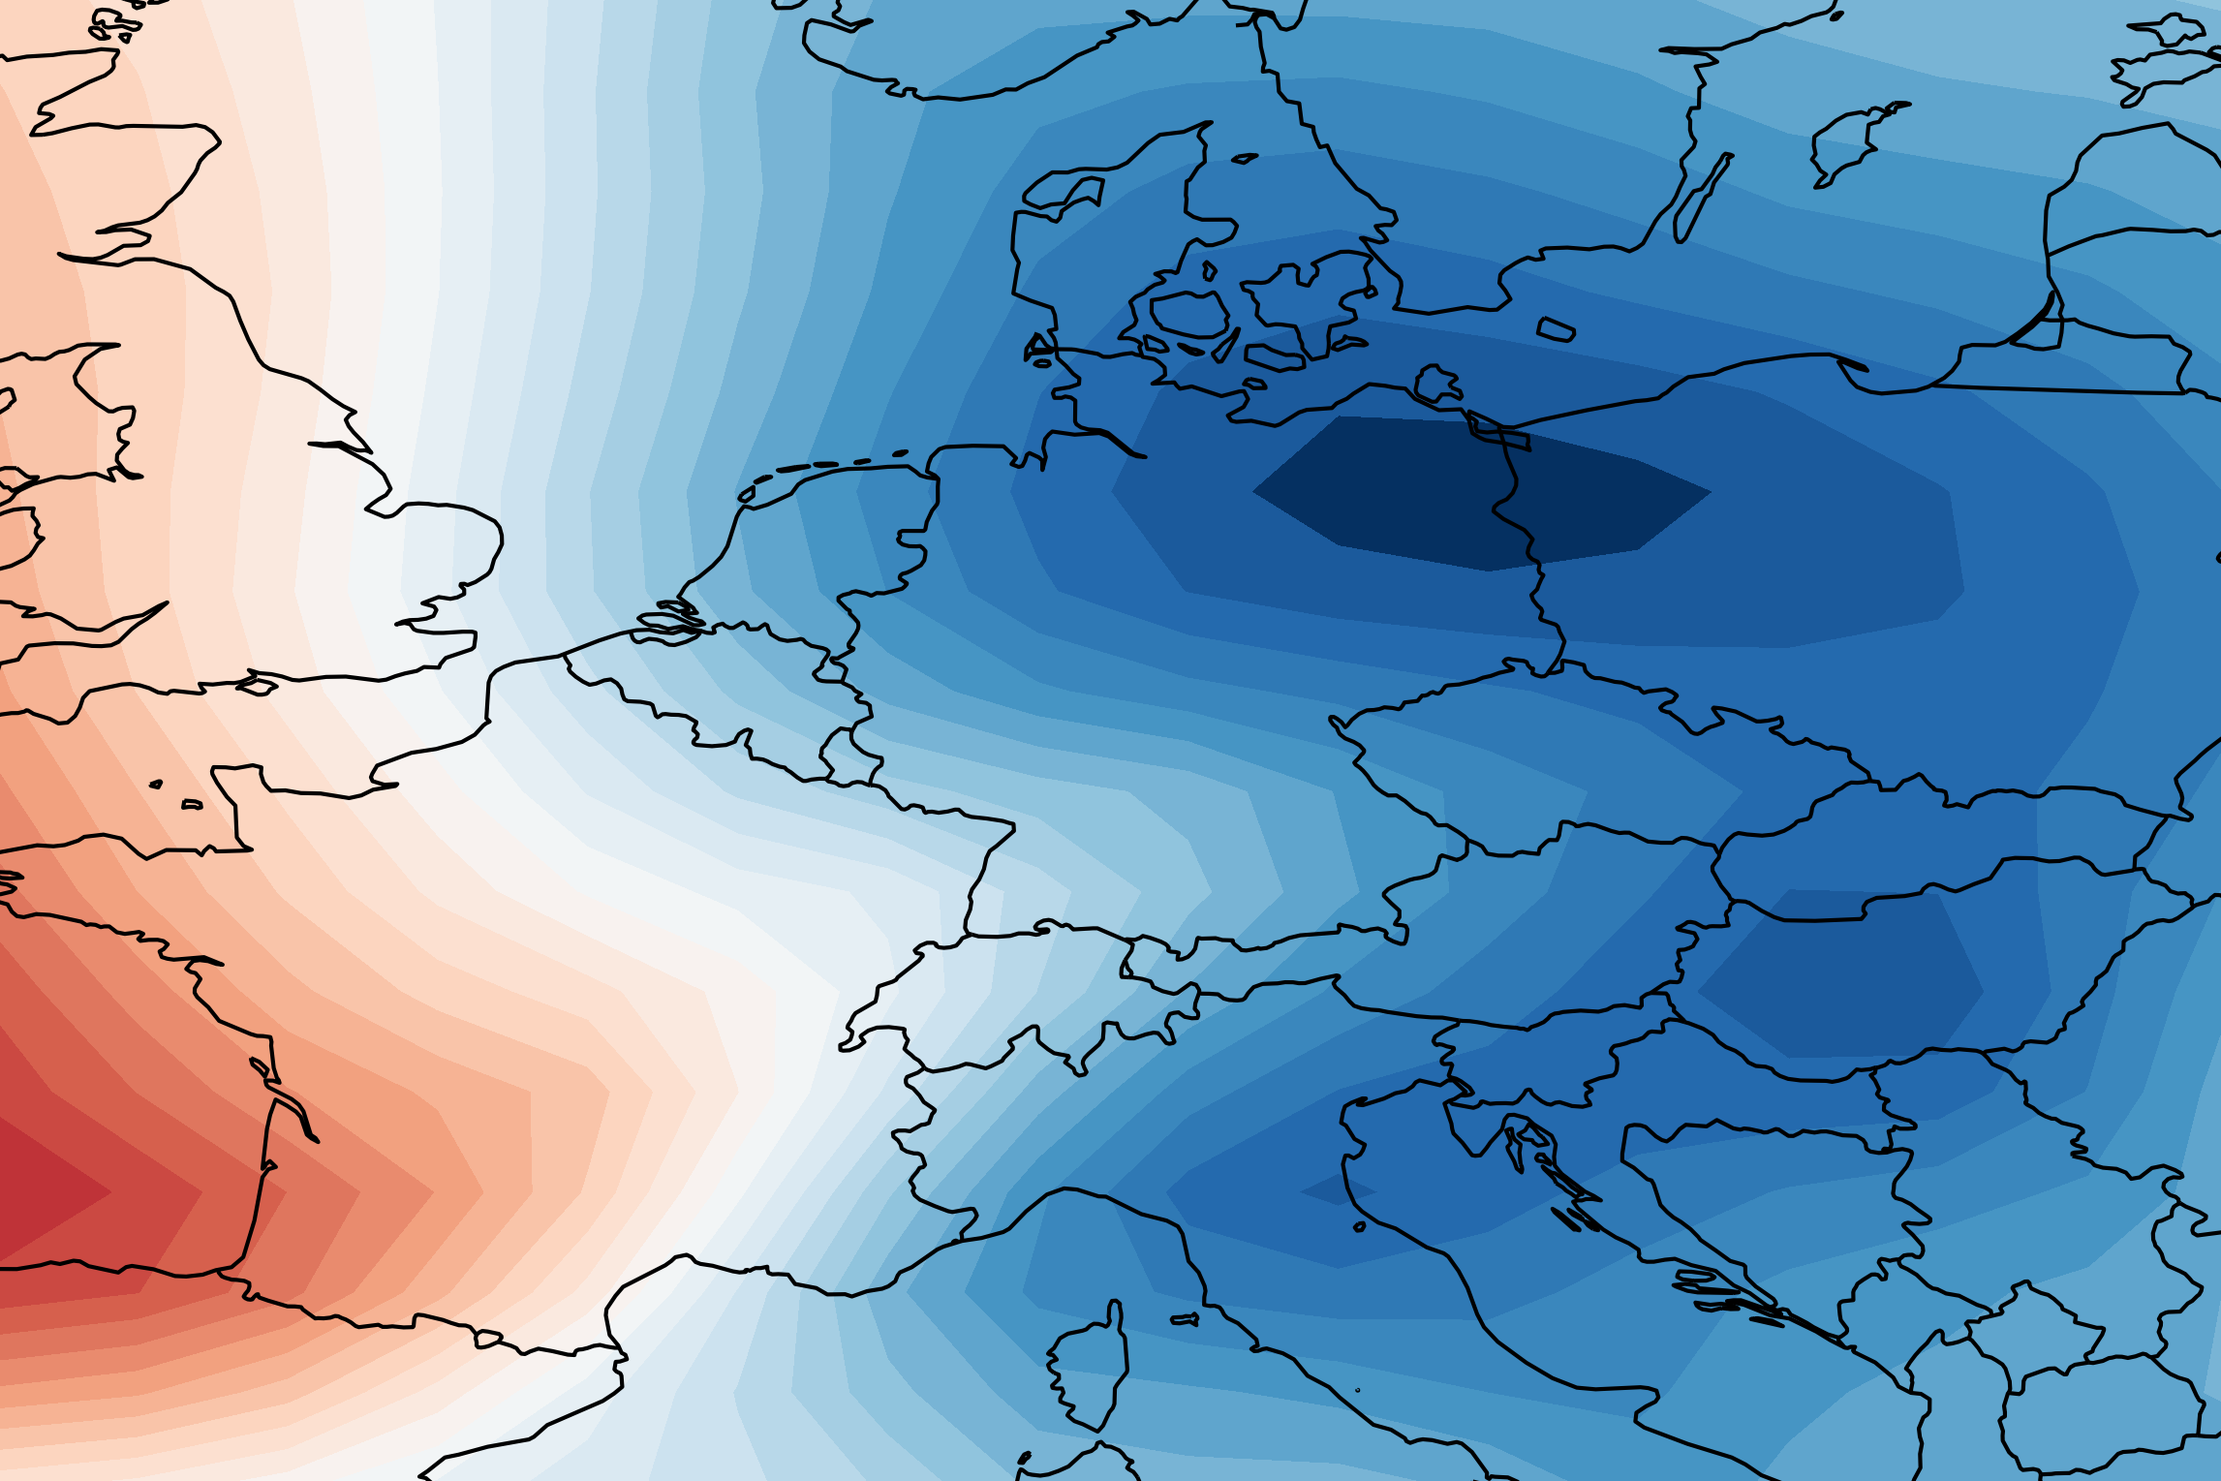
Analogues in Single Forcing Large Ensembles
July 14th 2021
Using a large ensemble of climate model data, HadGEM3 from LESFMIP (Smith et al., 2022)
Analogues identified from SLP field, not streamfunction
Historical
GHG only
AER only
Deepening low in ALL & GHG forcing
ensembles
PAST
GHG simulations show best
analogue quality
PRESENT
EGU 2024 vikki.thompson@knmi.nl

Slide 19
Using atmospheric analogues, I find summertime cut-off lows over Western Europe are getting deeper and happening more often. They can persist much longer than the high impact July 2021 event.
Detection and Attribution
vikki.thompson@knmi.nl
Images: The Guardian
Notes:
Flooding in western Europe July 2021 – how did it happen?
Unusually heavy rainfall at the start of July causes soil saturation in parts of Belgium and Germany.
Rainfall in the area is in the top 1% of record daily amounts
A slow moving low pressure system carries moist air from an unusually warm Baltic Sea
This system encounters hills on the Belgium-Germany border, releasing the most rain in a single day on record (since 1950)
The already saturated soil is unable to absorb the excess water and severe flooding ensues
Record levels reached – river discharge in places in the Meuze and Rhine catchments reaches a historical maximum since records began in 1991.

Slide 20
Using atmospheric analogues, I find summertime cut-off lows over Western Europe are getting deeper and happening more often. They can persist much longer than the high impact July 2021 event.
Detection and Attribution
Investigating decadal trends in analogues may allow the drivers to be identified.
Using large ensemble of single forcing model experiments we hope to identify which forcings are driving the changes.
vikki.thompson@knmi.nl
Images: The Guardian
Notes:
Flooding in western Europe July 2021 – how did it happen?
Unusually heavy rainfall at the start of July causes soil saturation in parts of Belgium and Germany.
Rainfall in the area is in the top 1% of record daily amounts
A slow moving low pressure system carries moist air from an unusually warm Baltic Sea
This system encounters hills on the Belgium-Germany border, releasing the most rain in a single day on record (since 1950)
The already saturated soil is unable to absorb the excess water and severe flooding ensues
Record levels reached – river discharge in places in the Meuze and Rhine catchments reaches a historical maximum since records began in 1991.

