Slide 1
How do the CMIP7 infrastructure plans support the implementation of the IPCC data guidelines?
M. Stockhause¹, M. Mizielinski², A. Pirani³, L. Sitz⁴, A. Spinuso⁵, M. Abdallah⁶, J. Baidya⁶, P. Durack⁷, D. Ellis⁸ ¹German Climate Computing Center (DKRZ), ²MetOffice, ³Centro Euro-Mediterraneo sui Cambiamenti Climatici (CMCC),
⁴Universidad de Cantabria (UC), ⁵Royal Netherlands Meteorological Institute (KNMI), ⁶Intergovernmental Panel on Climate Change (IPCC), ⁷Lawrence Livermore National Laboratory (LLNL), ⁸WCRP CMIP International Project Office (CMIP-IPO)
Acknowledgements: TG-Data, DDC Partners, WGI AR6 TSU, IPCC AR6 WGI Authors, WIP, CMIP6 Modeling Centers, and many more
EGU24, Vienna, Austria, 2024-04-16
doi:10.5194/egusphere-egu24-17356

Slide 2
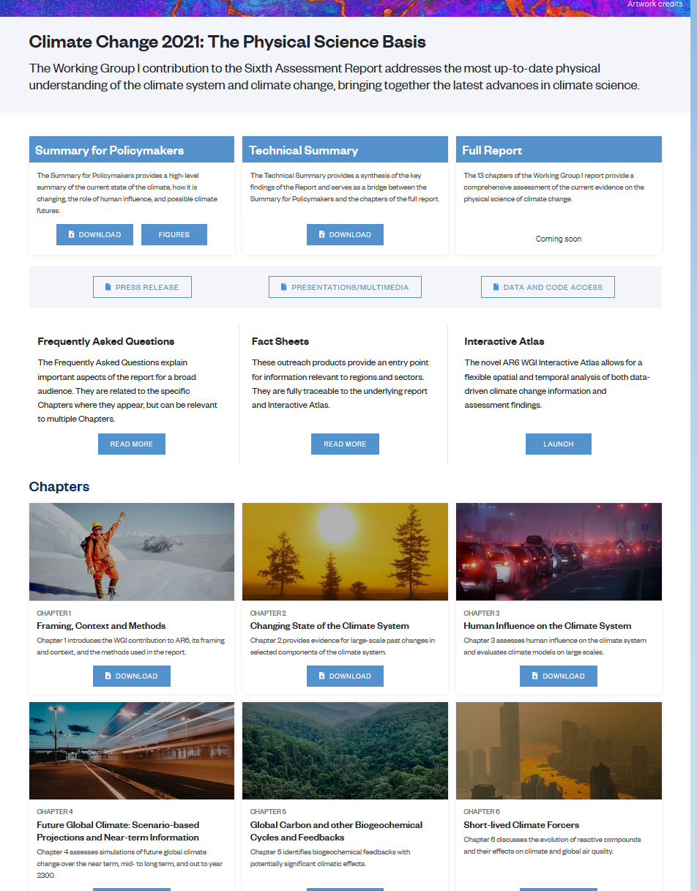
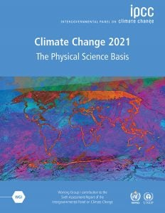
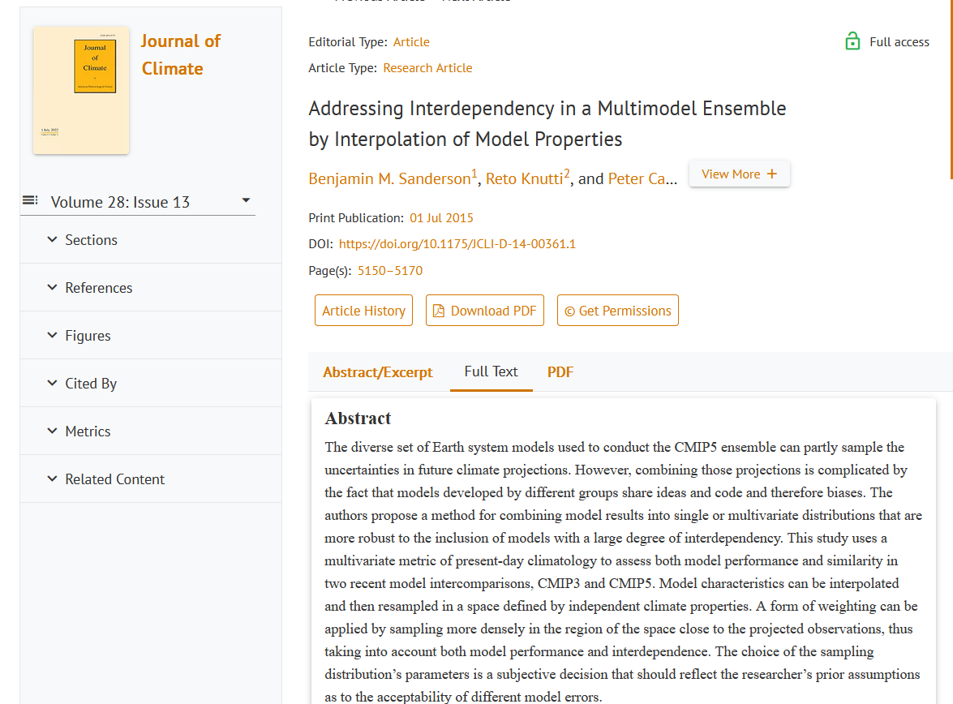
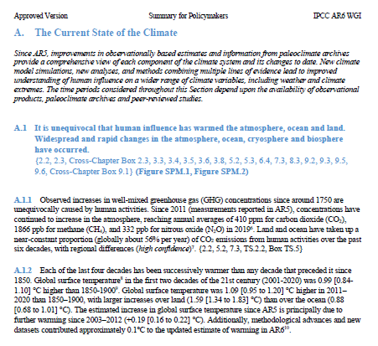
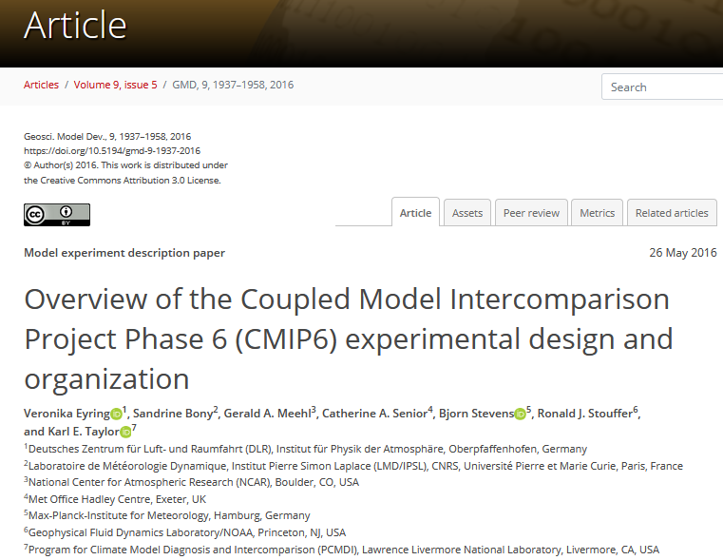
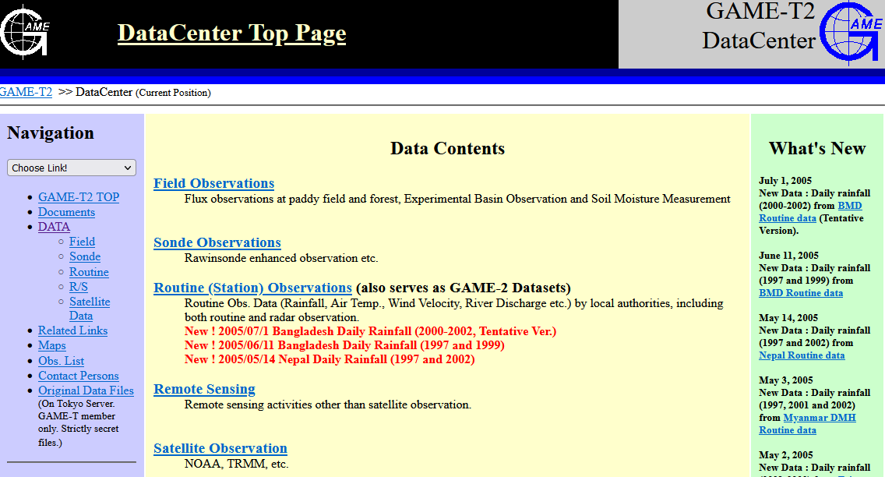
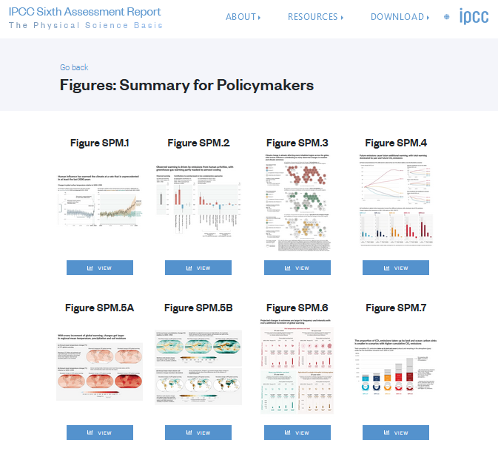
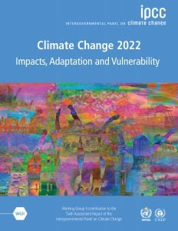
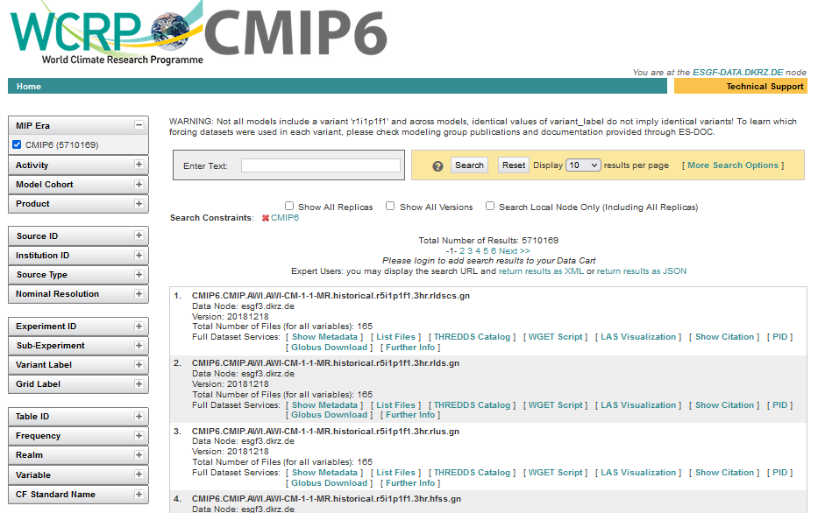
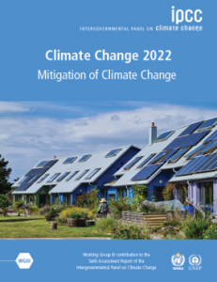
CMIP and IPCC
Research of the WCRP Coupled Model Intercomparison Project (CMIP) has been an important source of information on the latest climate change projections for the IPCC Assessment cycles.
Scientific Information
IPCC WGI AR6
IPCC WGI AR6 - Outputs
IPCC WGI AR6
Peer-reviewed literature
Report
Assessment
Input data
Figures
IPCC WGII/III AR6
Data Analysis through Code
Final/Figure Data
(Provenance Records)

Slide 3
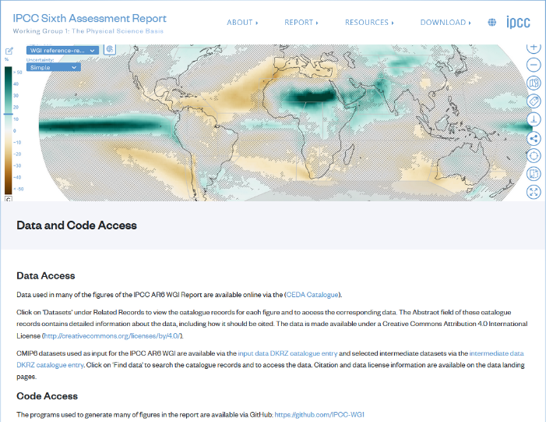
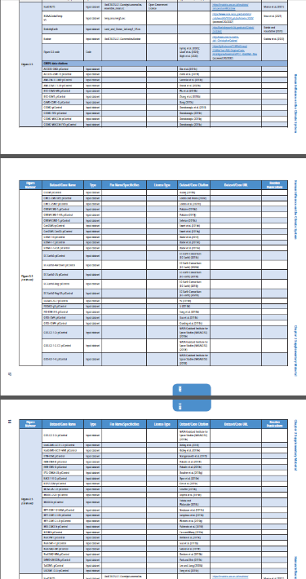
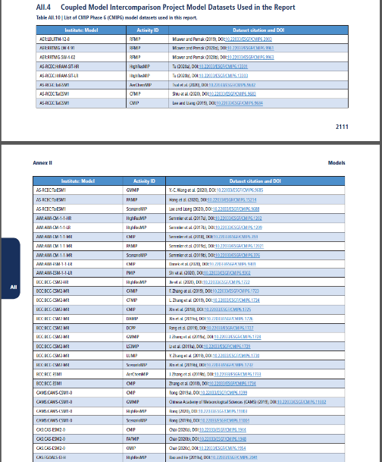
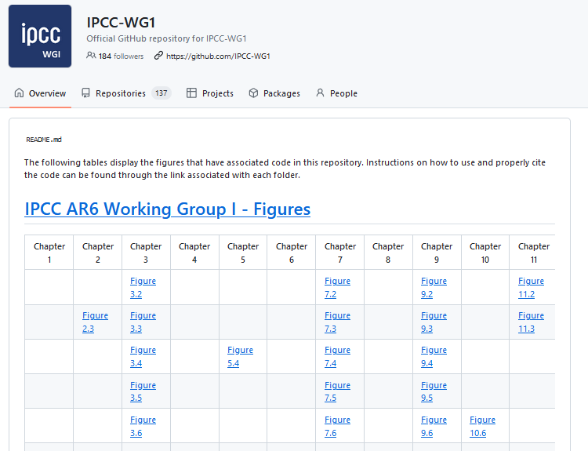
CMIP6 data documentation and traceability in AR6
IPCC WGI enhanced the transparency of the AR6 and enabled the traceability of figures.
General Access to Data and Code:
Supplementary Material of Chapters (PDF, only online)
WGI AR6 Annex II: CMIP6 model information and data references
based on IPCC Authors’ information:
based on CMIP6 CV and CMIP6 Citation Service:
(Provenance Records)

Slide 4
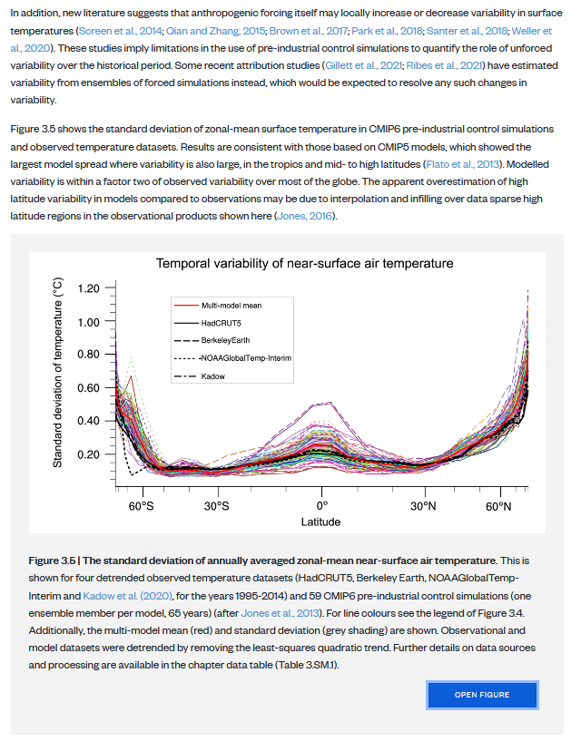
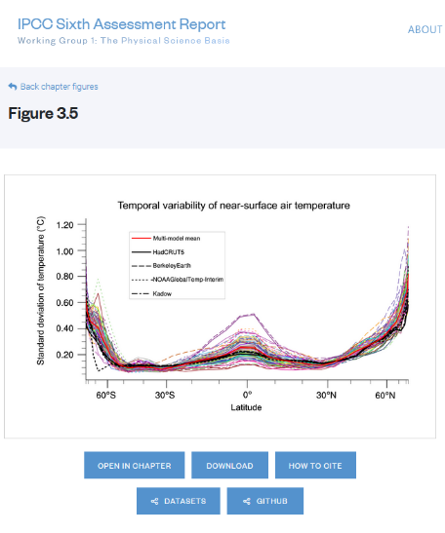
Improved credit assignment and data traceability in AR7
Recommendations for credit assignment and data traceability in AR7:
Figure in AR6 WGI
Credit assignment for CMIP6 input data providers: → Move CMIP data references from table in Annex II in reference list, enabling indexers to provide data impact information
Enable traceability of CMIP6 data used in figures: → Inclusion of a “reliquary” reference in the figure caption and on the figure page, giving access to input data, code and provenance record and enabling credit for the creators of these digital objects (related to the work of the RDA Complex Citation WG)
Figure Page (only online)
→ Provenance records (W3C PROV) can provide all requested information and community tools already provide ca. 90% of this information.
(Provenance Records)

Slide 5
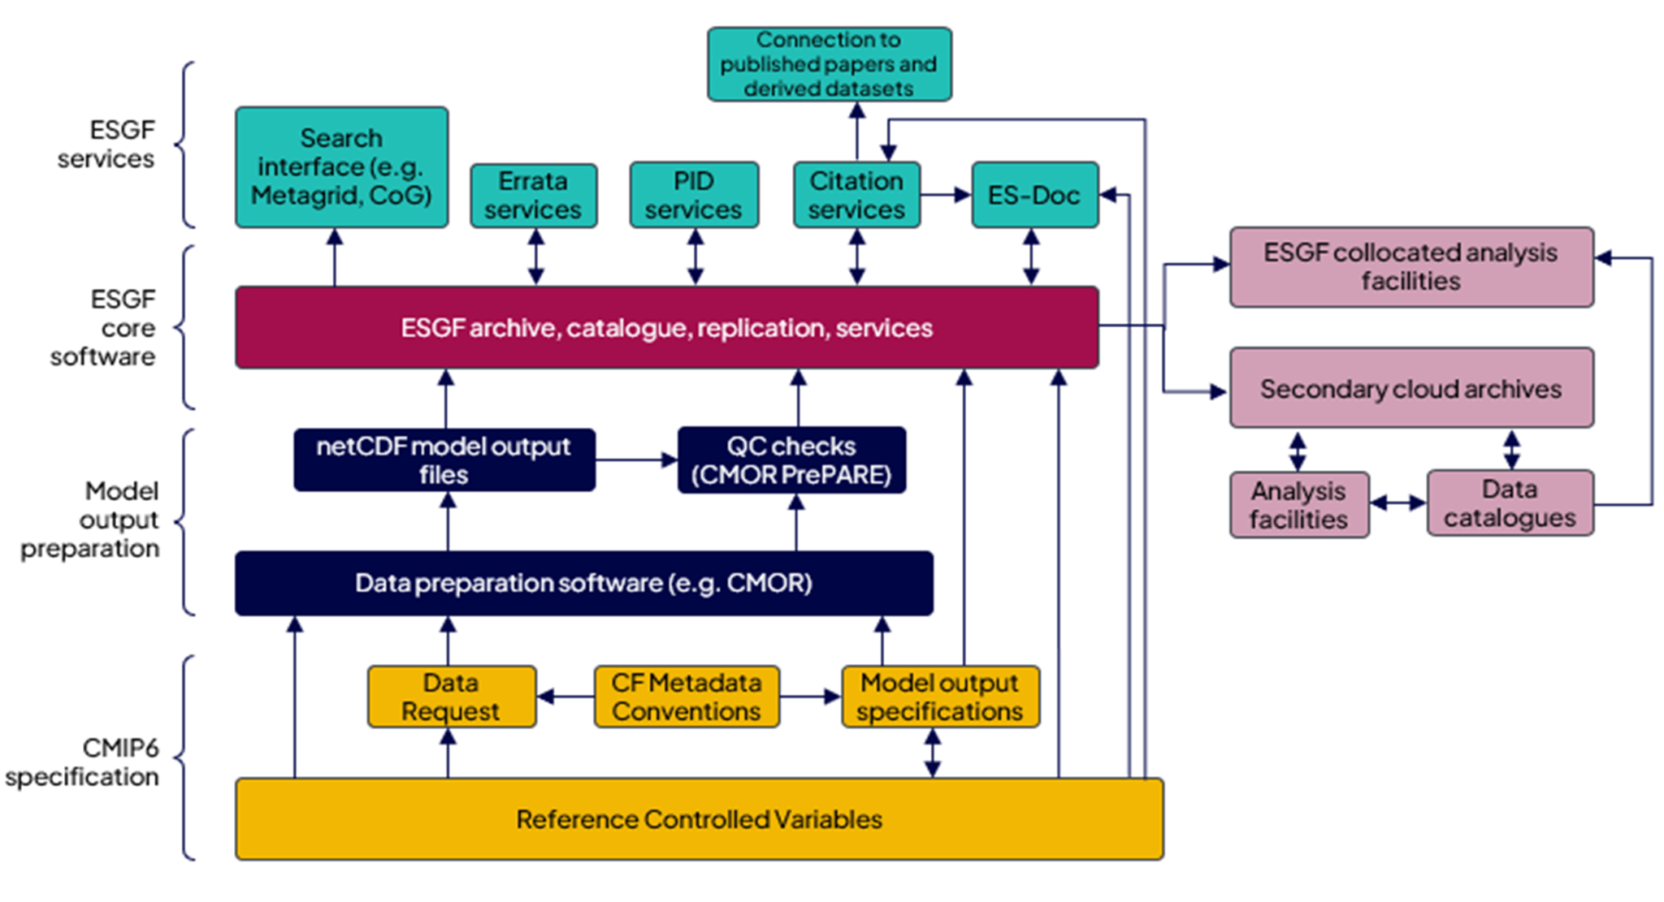
CMIP7 infrastructure plans
CMIP7 plans the consolidation of the existing infrastructure with improvements aiming at more exhaustive of documentations (Errata and ES-DOC) and better integration.
CMIP7 infrastructure expected to be broadly similar to CMIP6, but activities to renew components are beginning
Errata service extended supporting user reported issues (rather than just modeling centers sent reports)
Search interface update plans to integrate errata with search to aid user awareness
Model documentation (ES-Doc) reduced in scope, becomes a prerequisite before ESGF data publication
Data request task team well established
Citation service seeks new resources to support CMIP7
ESGF developed by two projects (US-DoE and European), both working towards updates for CMIP7, but core funding an issue
CMIP6Plus activity will support interim activities before CMIP7 Fast Track is established.

Slide 6
CMIP7 in support of IPCC AR7’s data transparency aim
CMIP7 will provide all information requested by the IPCC data and software guidelines except for unclear future of the Data Citation Service:
basic model documentation available in CV and ES-DOC with optional further information in ES-DOC
errata provision / version information is expected to be more exhaustive than for CMIP6
data citation provision is subject to funding
Remaining challenges in:
Accessing data documentations provided by several CMIP services: CVs, data citation, ES-DOC, errata service… → a central service providing machine-access to all dataset-related information is missing to support figure creation tools in providing all requested information in the provenance records (ESGF index provides access to data, data reference syntax, and data citation information only)
Difficulties in keeping track of updated dataset versions and the cause of updating → notification of new versions with relevant updates is not available

Slide 7
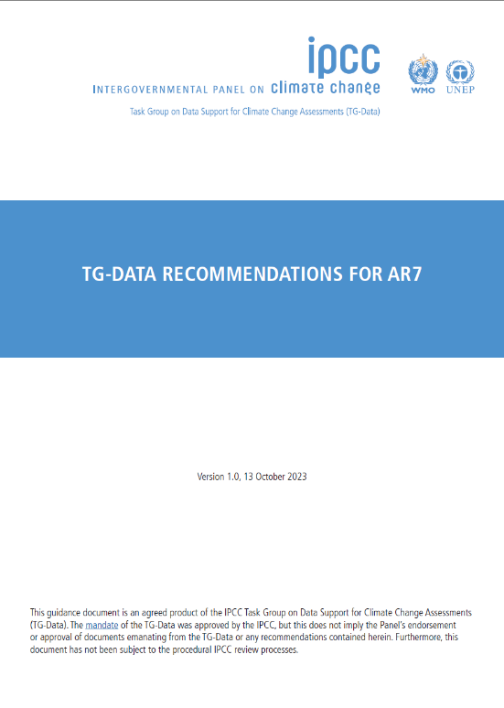
Adjustment of IPCC AR7 process
For a smoother and less cumbersome workflow for IPCC Authors, TSU staff and DDC staff alike, the IPCC AR7 process needs to be adjusted and supported by tools:
Tools supporting IPCC Authors in creating W3C PROV standardized provenance records:
Enable community tools used for figure creation to provide provenance records
Provide simple tool for the creation of provenance records for figures created with other software
IPCC Figure Manager as platform for providing figure information
Tools for extracting information from provenance records for various purposes:
Input data references
Figure creation documentation in “reliquaries” to include in figure captions
Figure dataset and complete metadata provision to dedicated DDC Partner
Input dataset usage and data citation information to dedicated DDC Partner*
Code integration in IPCC’s github repo / Zenodo link
*Might be provided through Scholix or indexers based on “reliquaries” for a successful RDA Complex Citation WG
https://doi.org/10.5281/zenodo.10059282

Slide 8
Achievements and Challenges
Components and concepts are in place for a detailed, reliable and exhaustive documentation of input data usage (including CMIP7) in the IPCC AR7. Challenges lie in the various required adjustments under the current funding constraints.
Technical Adjustments:
CMIP: Easier machine-accessibility of data and related metadata including version, license, citation information
IPCC: Automation of figure creation and data preservation process supported by various tools
IPCC: Provision of CMIP7 data usage information in AR7 for CMIP7
Organizational Adjustments:
IPCC: Inclusion of IPCC data and software guidelines into IPCC procedures and the IPCC AR7 process
CMIP: Inclusion of data and metadata access requirements better into CMIP7 infrastructure development
Communication and Coordination:
IPCC: Early IPCC Author engagement (materials, tutorials)
IPCC: Between WG TSUs and DDC Partners for a better alignment
CMIP: User/IPCC Author engagement (available tools, best practices for data/metadata access and usage)
CMIP - IPCC: Include technical requirements into CMIP – IPCC consultations

Slide 9
References
IPCC WGI AR6 / WGI Software - IPCC TG-Data – IPCC DDC – RDA Complex Citation WG - CMIP
Anna Pirani, Andrés Alegria, Alaa Al Khourdajie, Wawan Gunawan, José Manuel Gutiérrez, Kirstin Holsman, David Huard, Martin Juckes, Michio Kawamiya, Nana Klutse, Volker Krey, Robin Matthews, Adam Milward, Charlotte Pascoe, Gerard van der Shrier, Alessandro Spinuso, Martina Stockhause, & Xiaoshi Xing. (2022). The implementation of FAIR data principles in the IPCC AR6 assessment process. Zenodo. https://doi.org/10.5281/zenodo.6504469
Eyring, V., Bony, S., Meehl, G. A., Senior, C. A., Stevens, B., Stouffer, R. J., and Taylor, K. E.: Overview of the Coupled Model Intercomparison Project Phase 6 (CMIP6) experimental design and organization, Geosci. Model Dev., 9, 1937–1958, https://doi.org/10.5194/gmd-9-1937-2016, 2016
Intergovernmental Panel on Climate Change. (2023). TG-Data Recommendations for AR7 (1.0). Zenodo. https://doi.org/10.5281/zenodo.10059282
Stockhause, M., Pirani, A., Sitz, L., Krüss, B., Pascoe, C., MacRae, M., Anderson, E., & Fisher, E. (2023, October 25). Implementation of the IPCC FAIR Guidelines into the Sixth Assessment Report (AR6): benefit, challenges and recommendations for AR7. International Data Week 2023 (IDW23), Salzburg, Austria. Zenodo. https://doi.org/10.5281/zenodo.10039597
Stockhause, M. (2023, February 28). RDA WG Complex Citation: Use case IPCC. Zenodo. https://doi.org/10.5281/zenodo.7684261
Stockhause, M. and Lautenschlager, M.: Twenty-five years of the IPCC Data Distribution Centre at the DKRZ and the Reference Data Archive for CMIP data, Geosci. Model Dev., 15, 6047–6058, https://doi.org/10.5194/gmd-15-6047-2022, 2022
Martina Stockhause (DKRZ/IPCC DDC)
https://orcid.org/0000-0001-6636-4972

