Slide 1
Implementing the first indirect radiative effect of aerosols in the ECMWF model
EGU General Assembly 2024, Vienna
Session AS3.18 – Atmospheric Composition and Numerical Weather Forecasting
Paolo Andreozzi^{1,2,3,4}, Mark Fielding¹, Robin Hogan¹, Richard Forbes¹
¹ECMWF, Reading/Bonn
²Deutscher Wetterdienst
³Forschungszentrum Jülich
⁴Universität zu Köln
paolo.andreozzi@ecmwf.int

Slide 2
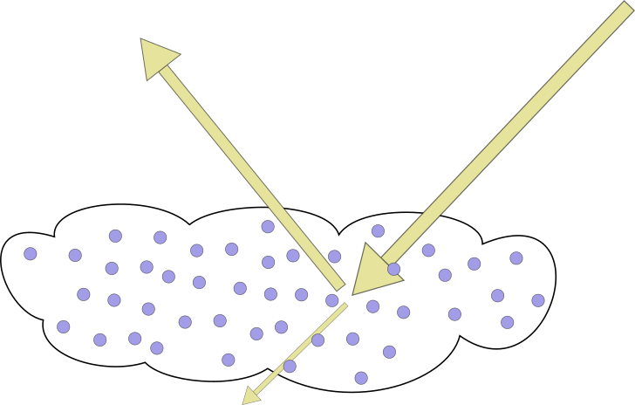
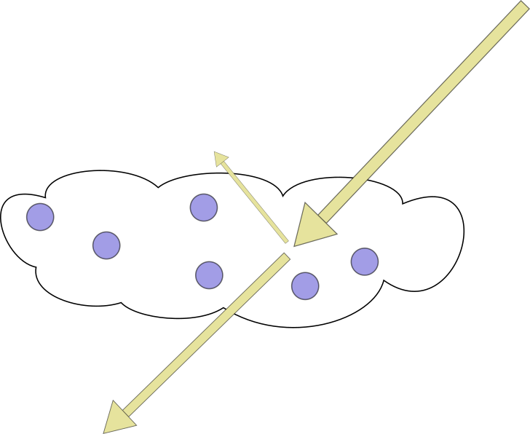
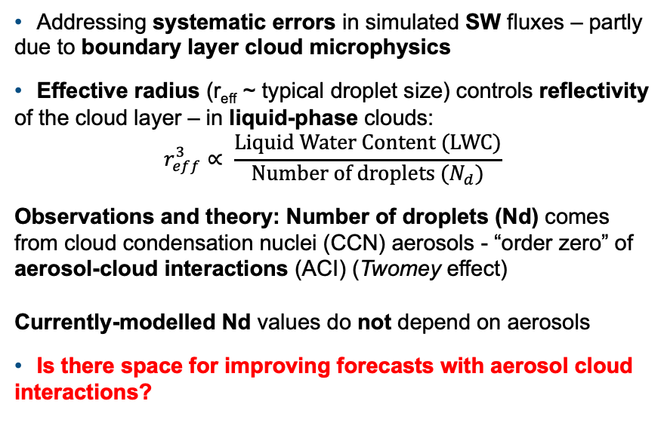
Motivation and background
Observed
Addressing systematic errors in simulated SW fluxes – partly due to boundary layer cloud microphysics
Effective radius (r_{eff} ~ typical droplet size) controls reflectivity of the cloud layer – in liquid-phase clouds:
$r_{eff}^{3}∝ \frac{\text{Liquid} \text{Water} \text{Content}\text{ (}\text{LWC}\text{)}}{{\text{Number} \text{of} \text{droplets} (N}_{d})}$
Observations and theory: Number of droplets (Nd) comes from cloud condensation nuclei (CCN) aerosols - “order zero” of aerosol-cloud interactions (ACI) (Twomey effect)
Currently-modelled Nd values do not depend on aerosols
Is there space for improving forecasts with aerosol cloud interactions?
forecast
Ahlgrimm et al., 2018
Ahlgrimm et al., 2018

Slide 3
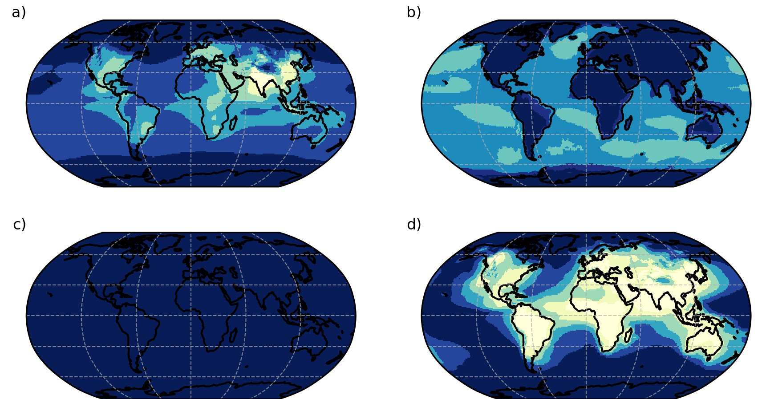
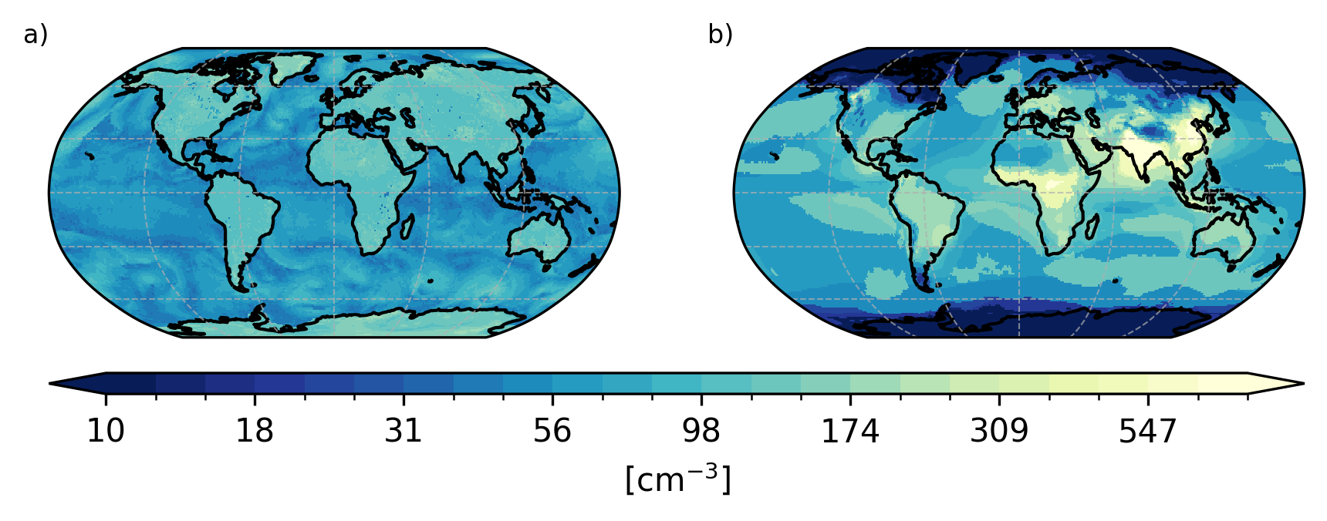
Exploit atmospheric composition for a new ACI scheme
Aerosol representations in the ECMWF IFS*
  Prognostic species and online chemistry (CAMS** air quality monitoring -see Rémy, 2022), too costly for full-resolution forecast
  3D/4D climatology (see Bozzo, 2020) (IFS operations) limited temporal variability but generated from long-term CAMS runs
Current parametrization: Nd for radiation computations are fixed values, r_{eff} does not depend on aerosol fields (Martin, 1994)
New ACI scheme: lookup table to compute cloud droplet numbers (Nd) (Rothenberg, 2016) and r_{eff} from aerosols (prognostic or climatological)
Under the hood: activation is a non-trivial interplay between CCN species!
Simulated CCN concentrations
Sulfates
Sea Salt fine
Simulated Nd in operational IFS
Sea Salt coarse
Organics & BC
Current IFS
Nd from aerosols
* Integrated Forecasting System
** Copernicus Atmospheric Monitoring Service
Nd = Number of droplets
r_{eff} = Effective Radius (typical droplet size)

Slide 4
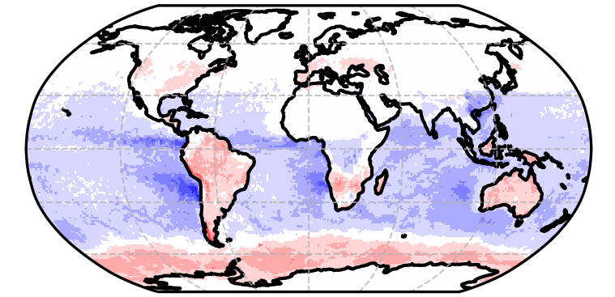
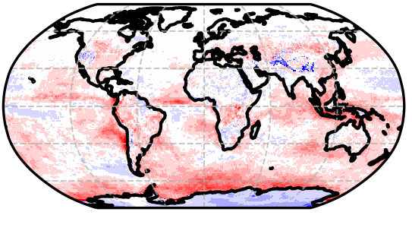
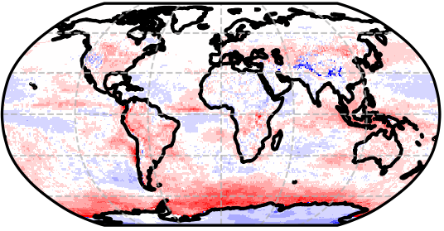
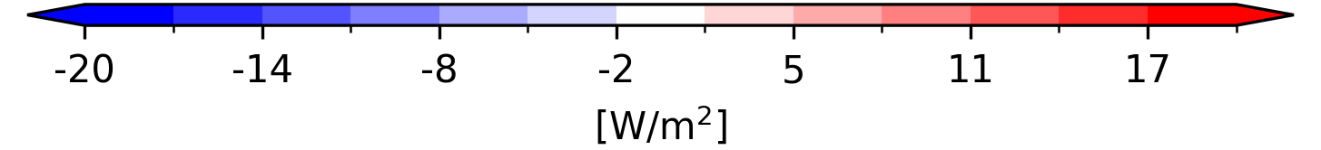
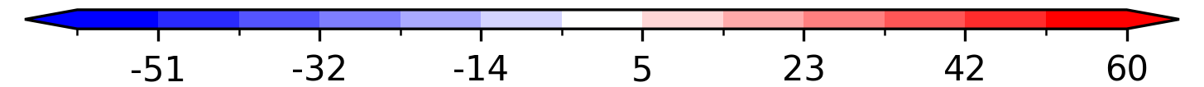
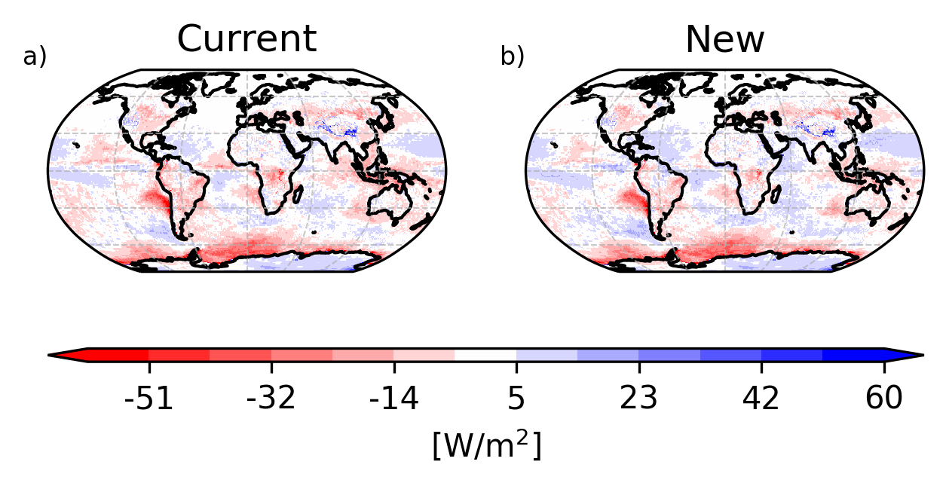
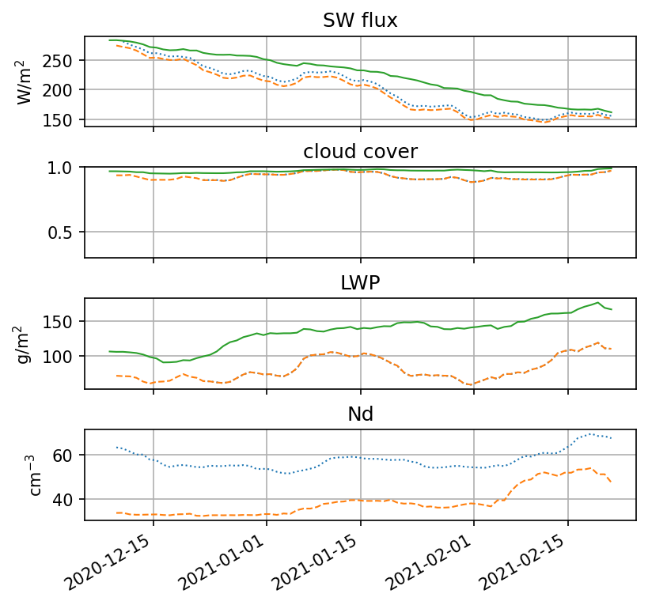
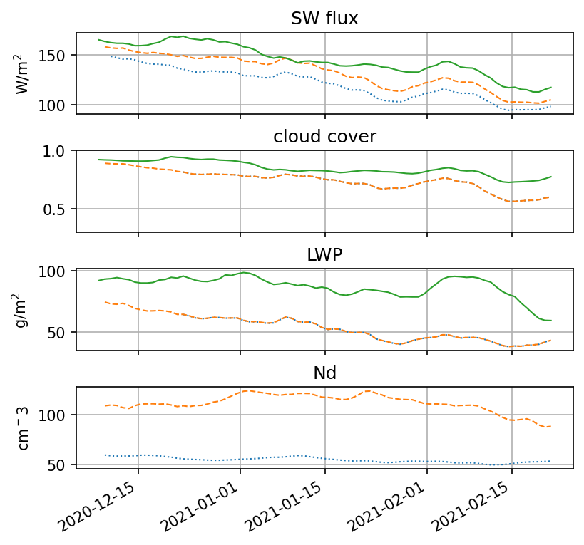
Impact of ACI scheme on SW fluxes - overview
TOA DJF SW bias
IFS minus CERES (day 1)
Bias difference
Current IFS – ACI scheme
Current IFS:
Nd from fixed values
ACI scheme:
Nd from aerosols
DIFFERENCE
Red: Clouds are less reflective with ACI scheme
Blue: Clouds are more reflective with ACI scheme
Impact on fluxes is significant (up to 20 W/m²)
Largely beneficial impact in the subtropical Scu regions
Degradation over the Southern Ocean with very few CCN/Nd: is there the climatology too clean?
BIASES
Red: Clouds are not reflective enough
Blue: Clouds are too reflective
_ CERES SYN
.. Current scheme
-- New scheme

Slide 5
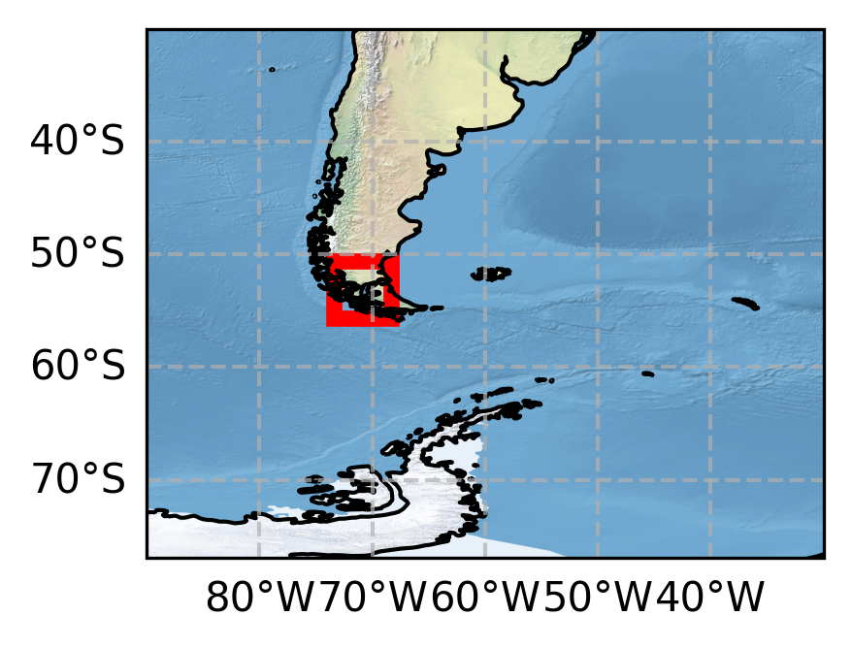
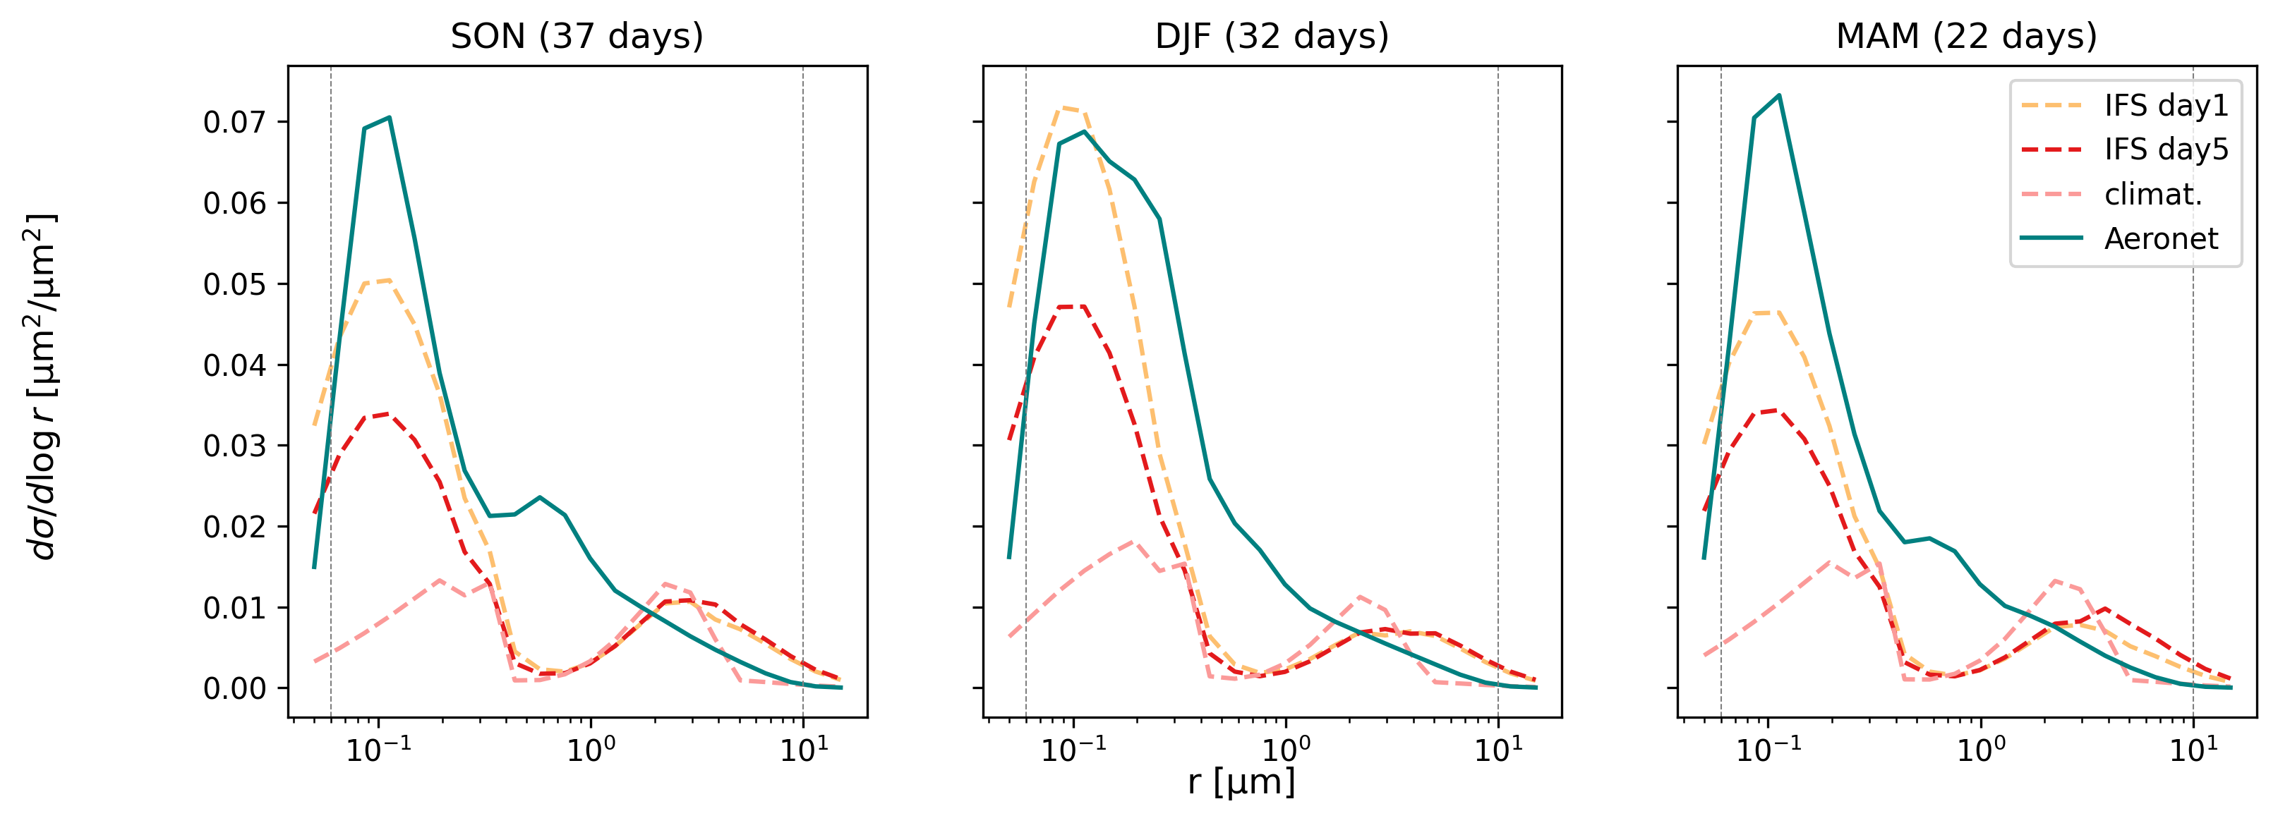
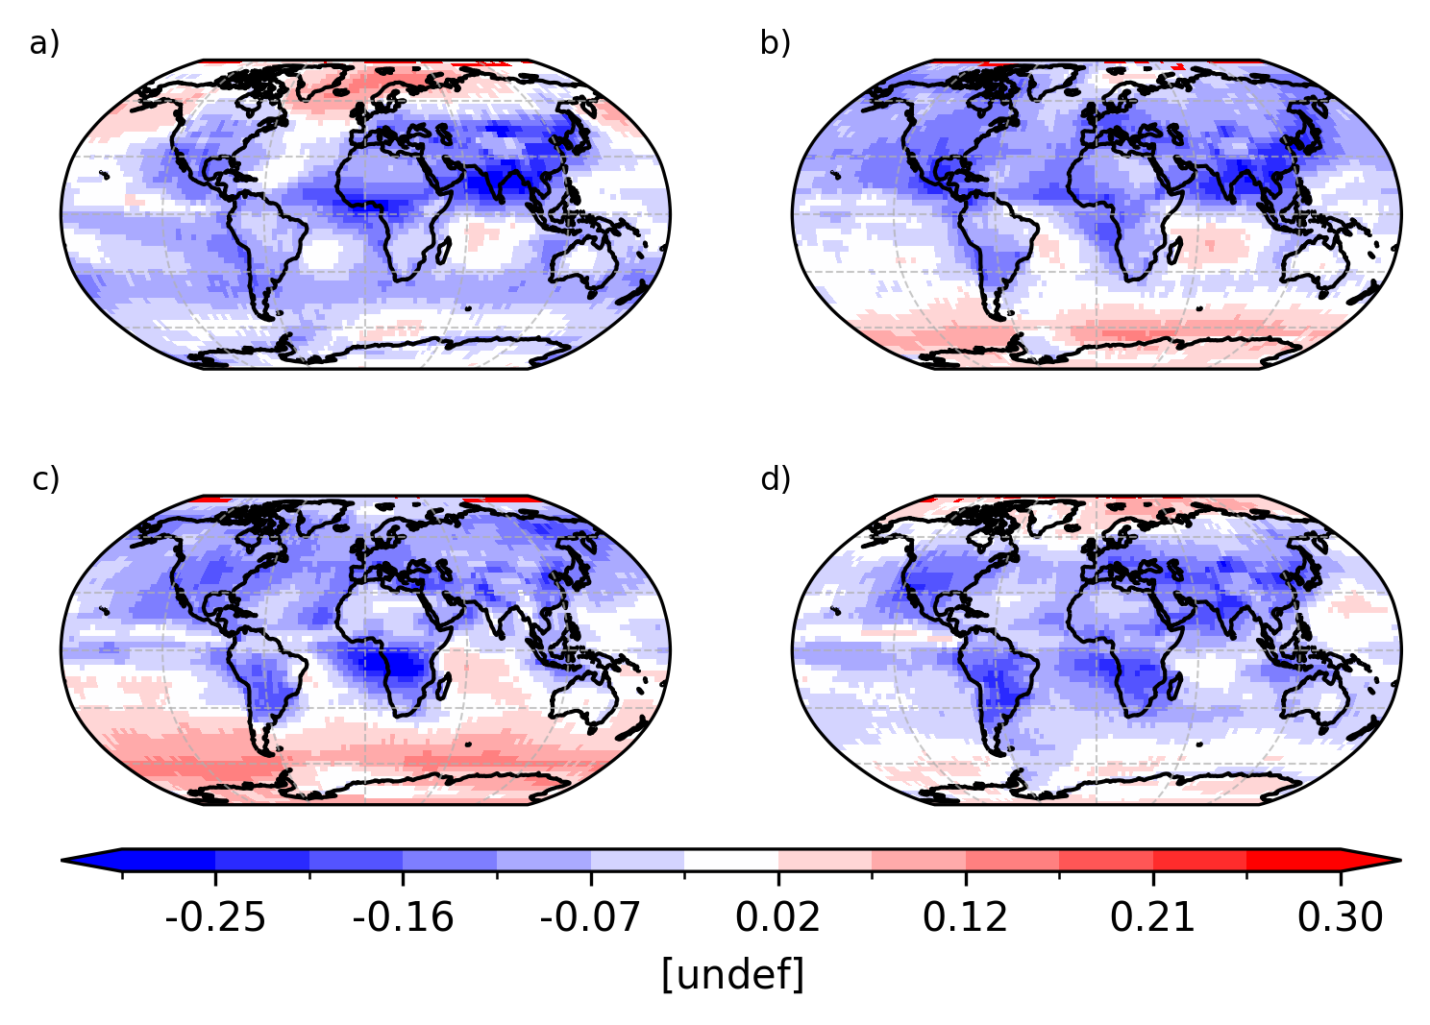
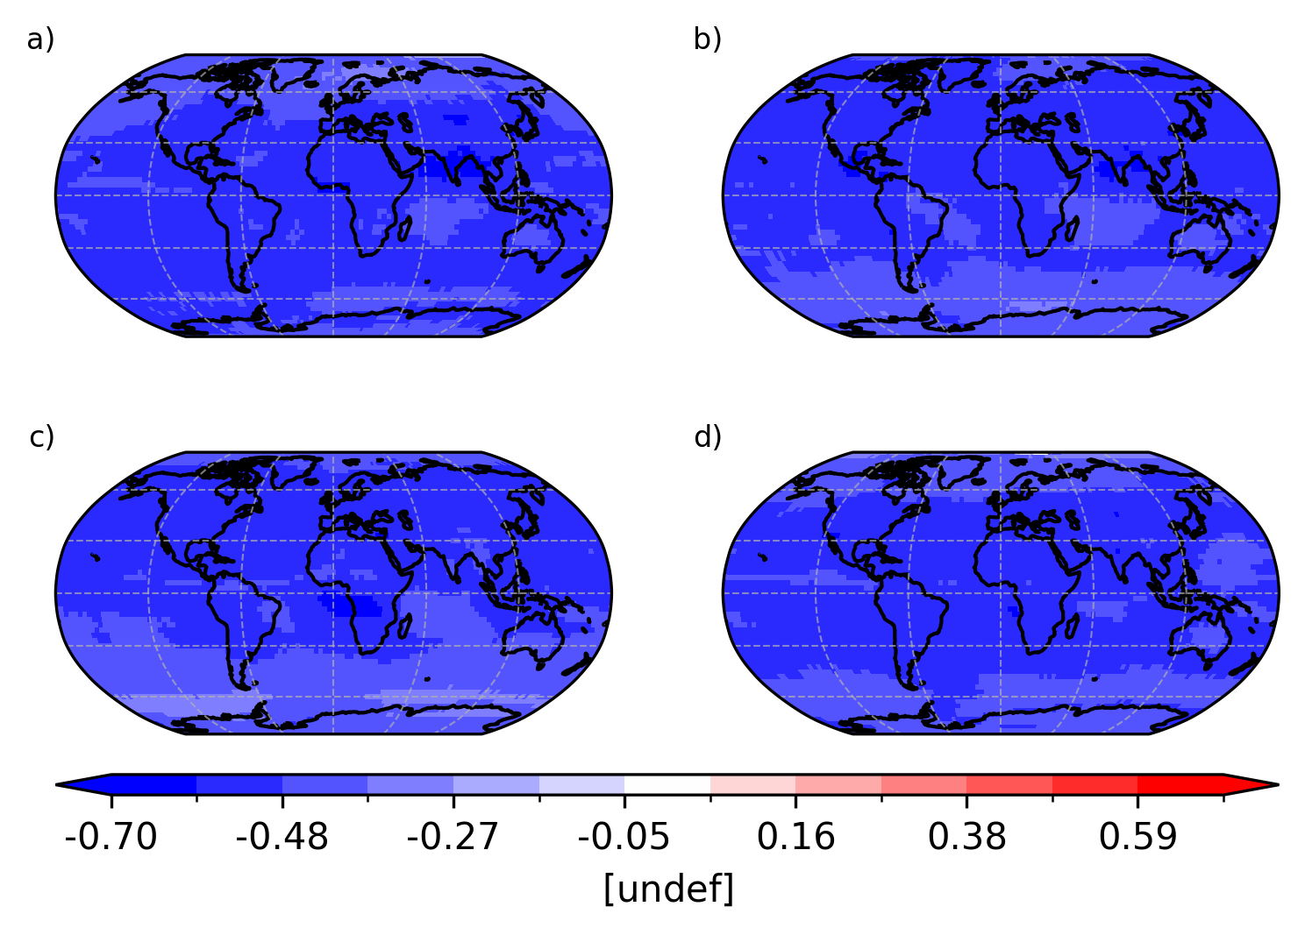
High-latitude aerosols: too few - too large?
Hints from Punta Arenas Aeronet sun photometers
IFS/CAMS forecasts from analysis (assimilation of MODIS AOD) to day 5: systematic decline in AOD* ultimately shaping climatology**
Verification against size distributions (Dubovik and King, 2000) suggest rapid decline in fine modes load. Main suspect: wet deposition
Is the wet deposition of fine continental aerosols (BC and OM) too strong? Potentially large impact on mean state and assimilation background at high latitudes / far from sources
Comparison of the fraction of aerosol dissolved in droplets
Difference between ACI and wet-deposition scheme (DJF)
Using ACI scheme as reference:
Sulfates
Organics & BC
Blue: CCN wet deposition may be overestimated
Red: CCN wet deposition may be underestimated
* Aerosol Optical Depth
** Obtained from free-model runs!

Slide 6
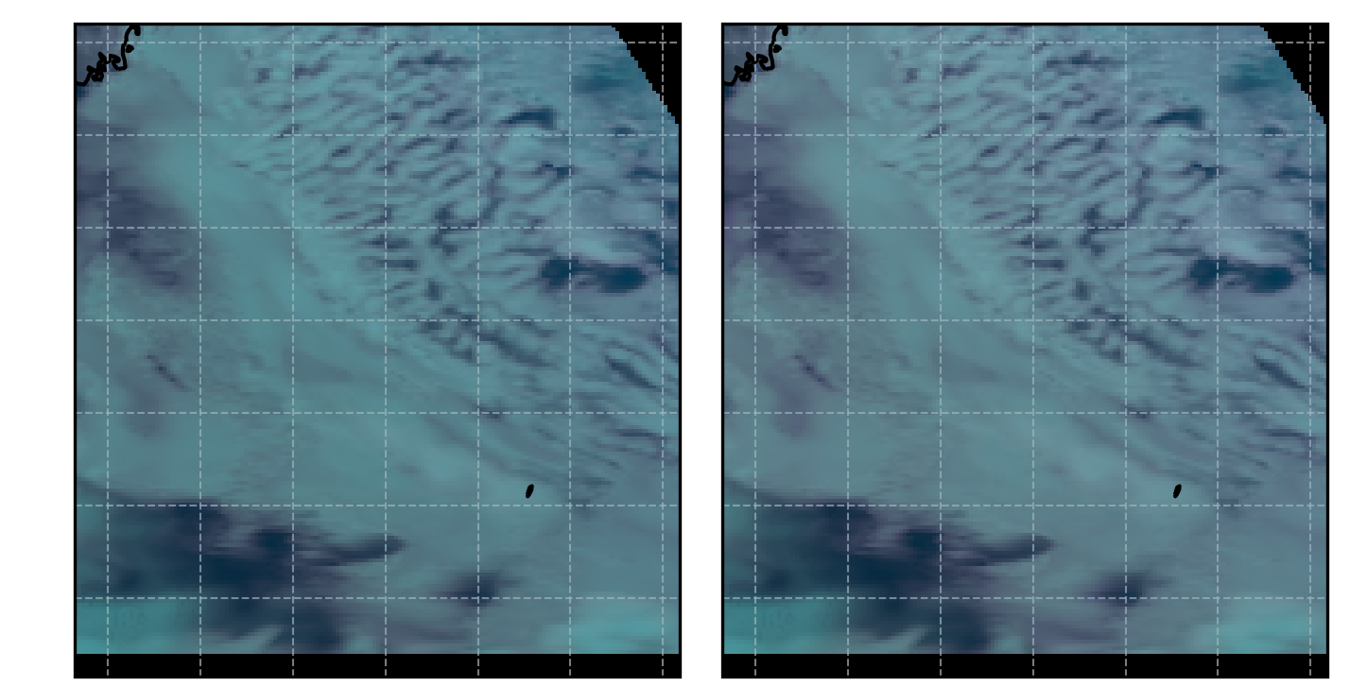
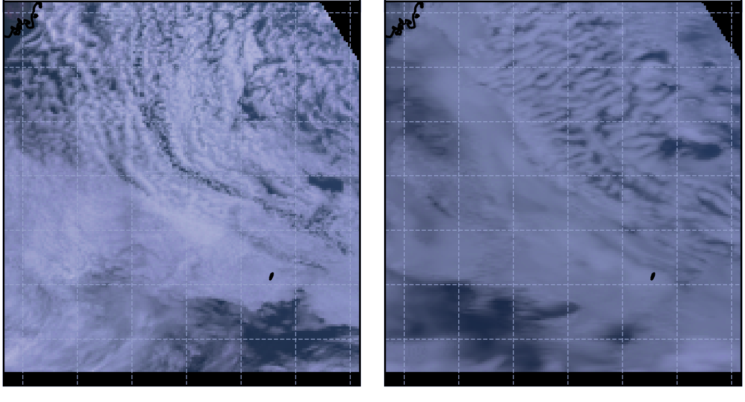
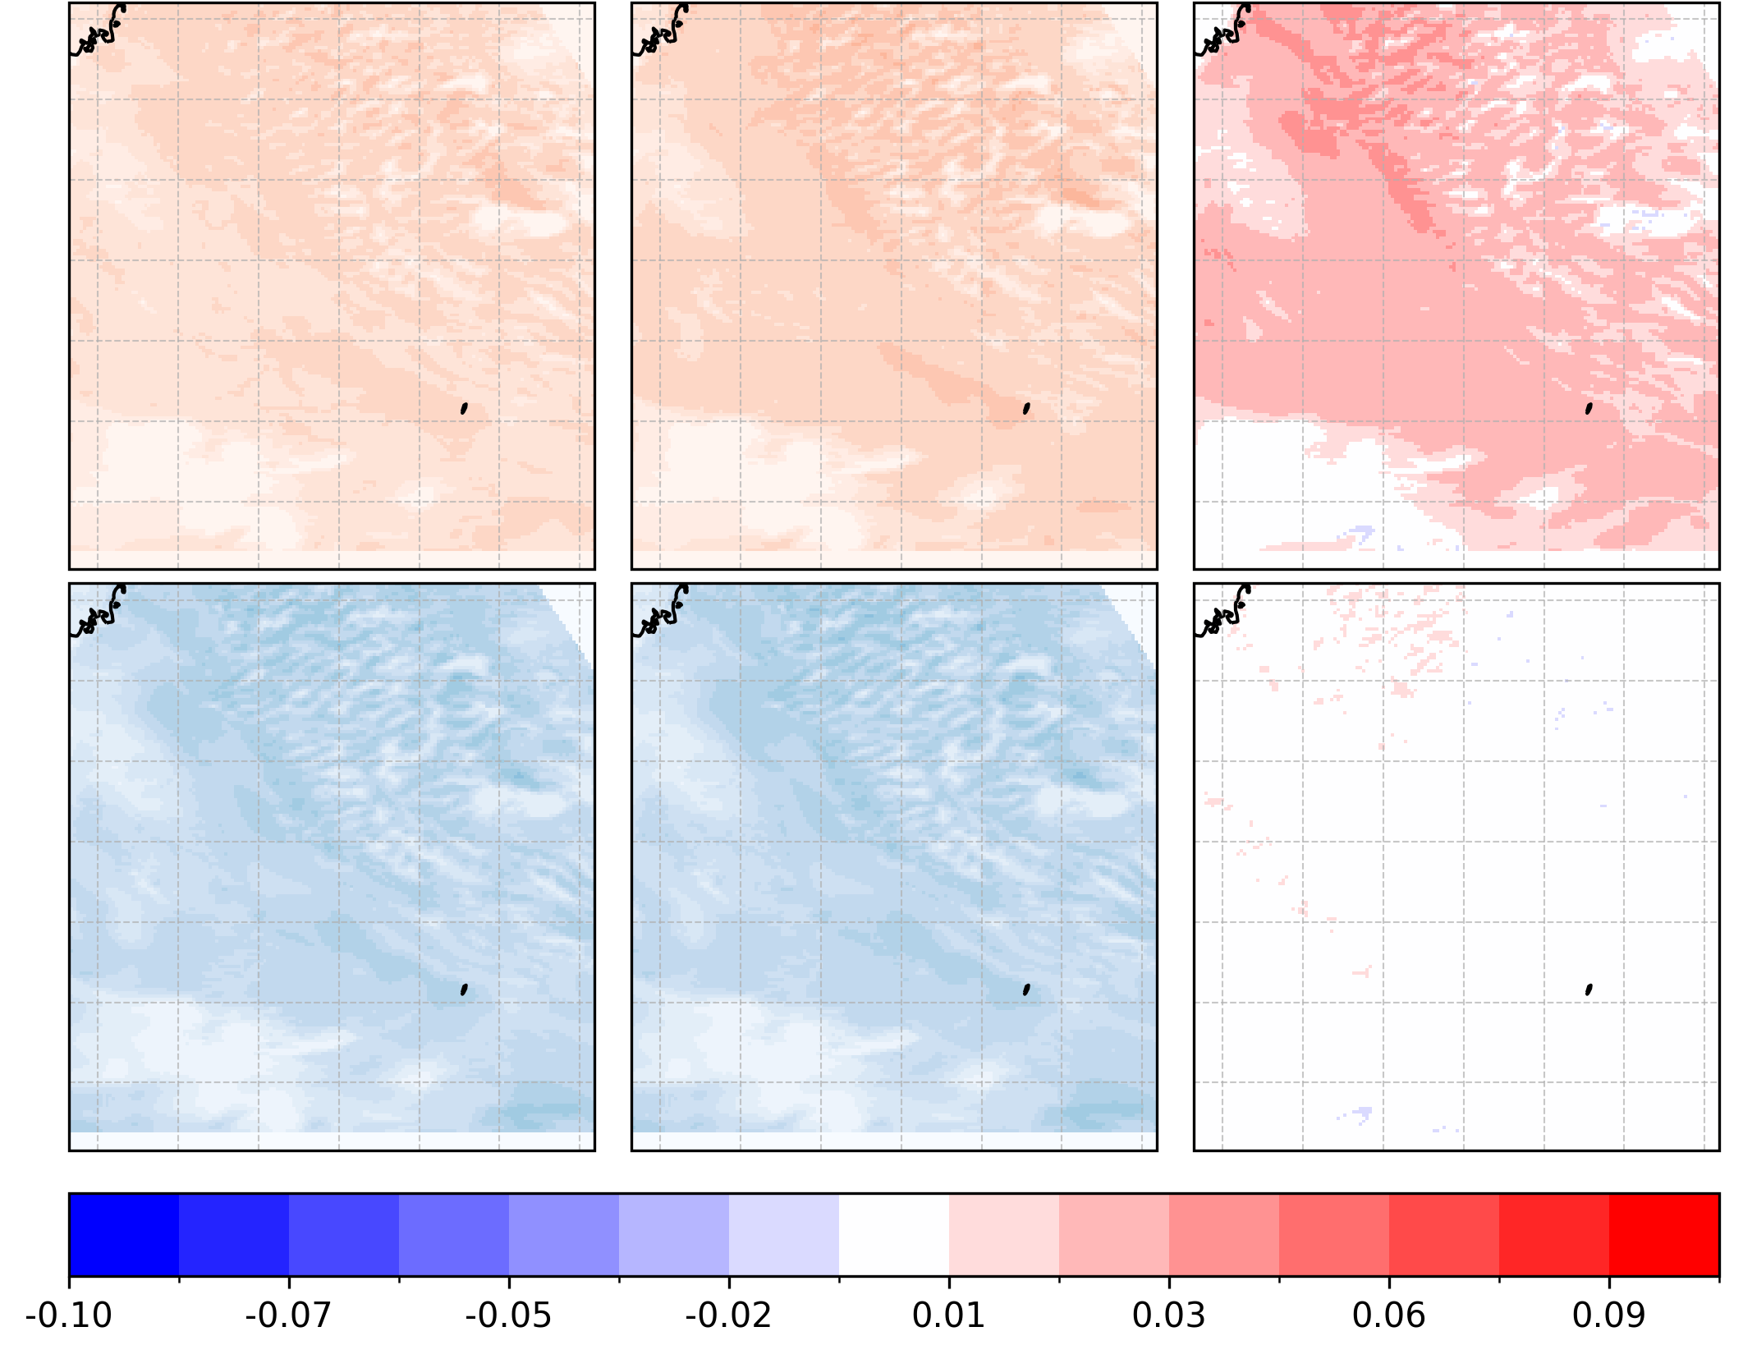

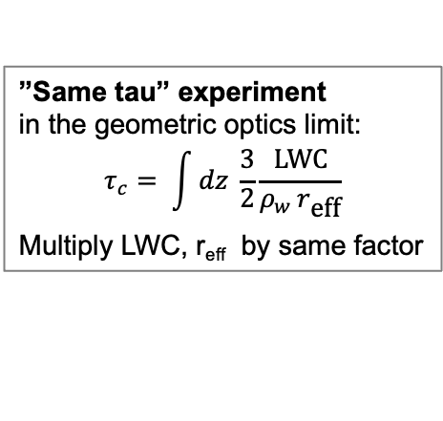
Disentangle cloud macro- and microphysics: possible avenues with spectral verification?
Natural color (SOCRATES campaign region) scene
Seen from MODIS Aqua
Seen from IFS
with ecRad-Flotsam
control
(LWC, r_{eff}) x 0.7
”Same tau” experiment
in the geometric optics limit:
$$τ_{c}= \int{dz \frac{3}{2}\frac{\text{LWC}}{ρ_{w }r_{\text{eff}}}}$$
Multiply LWC, r_{eff} by same factor
R2.2µm,G,B
composite
reflectance change
$$τ_{c}$$
$$ρ_{w}$$
cloud optical thickness
water density
Non-zero in NIR
2.2 µm
Cloud reflectivity controlled by macro- (liquid water profile) and microphysical (Nd, r_{eff} distributions) cloud properties – how to verify them separately?
Asymmetrical response to LWC/r_{eff} changes between VIS and NIR (a model-based illustration of the Nakajima and King, 1990 diagram)
Is satellite verification of stratiform clouds in observation space within reach? Let’s see!
None in VIS
470 nm

Slide 7
Key points
Even ”order zero” aerosol-cloud interactions significantly impact model biases in SW radiation fluxes
Passing information from aerosol to clouds can give hints pointing at possible errors in the aerosol fields
Improving reflectivity ≠ more realistic clouds – but verification in observation space using near-infrared channels is promising
2.2 µm
470 nm

Slide 8
Thank you and references
Ahlgrimm, M., R. M. Forbes, R. J. Hogan, and I. Sandu (Aug. 2018). “Understanding global model systematic shortwave radiation errors in subtropical marine bound-ary layer cloud regimes”. In: J Adv Model Earth Syst 10.8, pp. 2042–2060. doi: 10.1029/2018ms001346.
Bozzo, A., A. Benedetti, J. Flemming, Z. Kipling, and S. Rémy (Mar. 2020). “An aerosol climatology for global models based on the tropospheric aerosol scheme in the Integrated Forecasting System of ECMWF”. In: Geosci Model Dev 13.3, pp. 1007–1034. doi:10.5194/gmd-13-1007-2020.
Dubovik, O. and M. D. King (Aug. 2000). “A flexible inversion algorithm for retrieval of aerosol optical properties from sun and sky radiance measurements”. In: J Geophys Res Atmos105.D16, pp. 20673–20696.
Gryspeerdt, E., D. T. McCoy, E. Crosbie, R. H. Moore, G. J. Nott, D. Painemal, J. Small-Griswold, A. Sorooshian, and L. Ziemba (July 2022). “The impact of sampling strategy on the cloud droplet number concentration estimated from satellite data”. In: Atmos Meas Tech 15.12, pp. 3875–3892. doi: 10.5194/amt-15-3875-2022.
Martin, G. M., D. W. Johnson, and A. Spice (July 1994). “The measurement and parameterization of effective radius of droplets in warm stratocumulus clouds”. In: J Atmos Sci 51.13, pp. 1823–1842. doi: 10.1175/1520-0469(1994)051<1823:tmapoe> 2.0.co;2.
Mulcahy, J. P., D. N. Walters, N. Bellouin, and S. F. Milton (May 2014). “Impacts of increasing the aerosol complexity in the Met Office global numerical weather prediction model”. In: Atmos Chem Phys 14.9, pp. 4749–4778. doi: 10.5194/acp-14-4749-2014.
Nakajima, T. and M. D. King (Aug. 1990). “Determination of the optical thickness and effective particle radius of clouds from reflected solar radiation measurements. part i: theory”. In: J Atmos Sci 47.15, pp. 1878–1893. doi: 10.1175/1520-0469(1990)047<1878:dotota>2.0.co;2.
Palmer, T. N., F. J. Doblas-Reyes, A. Weisheimer, and M. J. Rodwell (Apr. 2008). “Toward seamless prediction: calibration of climate change projections using seasonal forecasts”. In: Bulletin of the American Meteorological Society 89.4, pp. 459–470. issn: 1520-0477. doi: 10.1175/bams-89-4-459.
Rémy, S., Z. Kipling, V. Huijnen, J. Flemming, P. Nabat, M. Michou, M. Ades, R. Engelen, and V.-H. Peuch (June 2022). “Description and evaluation of the tropospheric aerosol scheme in the integrated forecasting system (ifs-aer, cycle 47r1) of ecmwf”. In: Geoscientific Model Development 15.12, pp. 4881–4912. issn: 1991-9603. doi: 10.5194/gmd-15-4881-2022.
Rothenberg, D. and C. Wang (Feb. 2016). “Metamodeling of droplet activation for global climate models”. In: Journal of the Atmospheric 73.3, pp. 1255– 1272. issn: 1520-0469. doi: 10.1175/jas-d-15-0223.1. url: http://dx.doi.org/10.1175/JAS-D-15-0223.1.
UCAR/NCAR-Earth Observing Laboratory (2019). SOCRATES: Low Rate (LRT -1 sps) Navigation, State Parameter, and Microphysics Flight-Level Data. Version 1.3. en. doi: 10.5065/D6M32TM9.
We thank Patric Seifert (TROPOS-de) and Boris Barja (UMAG-cl) for their effort in establishing and maintaining the Punta Arenas observation site.
We thank Raul D’Elia (UNIDEF-ar), Ramiro Gonzales (UVA-sp) and Jonathar Ferrara (SMN-ar) for their effort in establishing and maintaining the Marambio observation site.
Thanks to Leonhard Scheck for the discussions about NIR-VIS reflectance cloud verification!

