Slide 1
Neogene – Quaternary evolution of the northeastern Fram gateway, European Arctic – Preliminary results
DYPOLE – Dynamics of Polar confined basins
Orlando Martínez, Tom Arne Rydningen, Jan Sverre Laberg, Amando Lasabuda, Andreia Plaza-Faverola, Monica Winsborrow
E-mail: orlando.m.bautista@uit.no

Slide 2
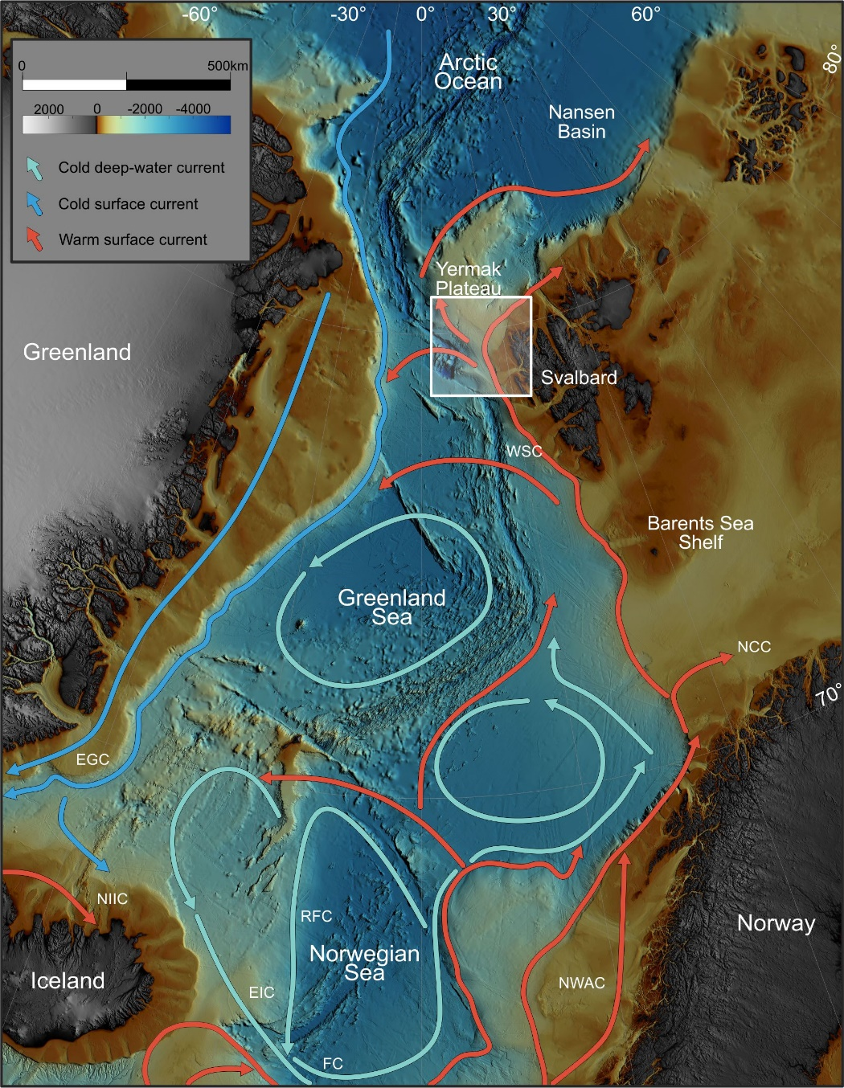
INTRODUCTION
DYPOLE – Dynamics of Polar confined basins
Fram Strait opening (23 -17 Ma)
Water exchange between Atlantic – Arctic ocean
Paleoclimatic implications (North Hemisphere Glaciations)
Paleoarchives and sediment processes:
Along-slope (Contourite drifts)
Down-slope (Prograding fans)
Late Neogene – Quaternary reconstruction
Water masses across the studied margin: WSC – West Spitzbergen Current; EGC – East Greenland Current; NCC - Norwegian Coastal Current; NWAC – Norwegian Atlantic Current; NIIC – North Icelandic Irminger Current; RFC – Recirculated Faroe Current; EIC – East Icelandic Current; FC – Faroe Current.

Slide 3
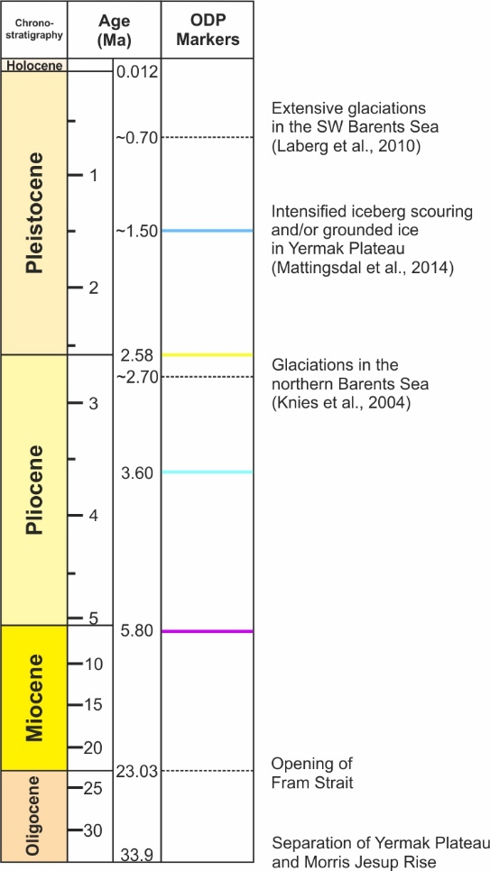
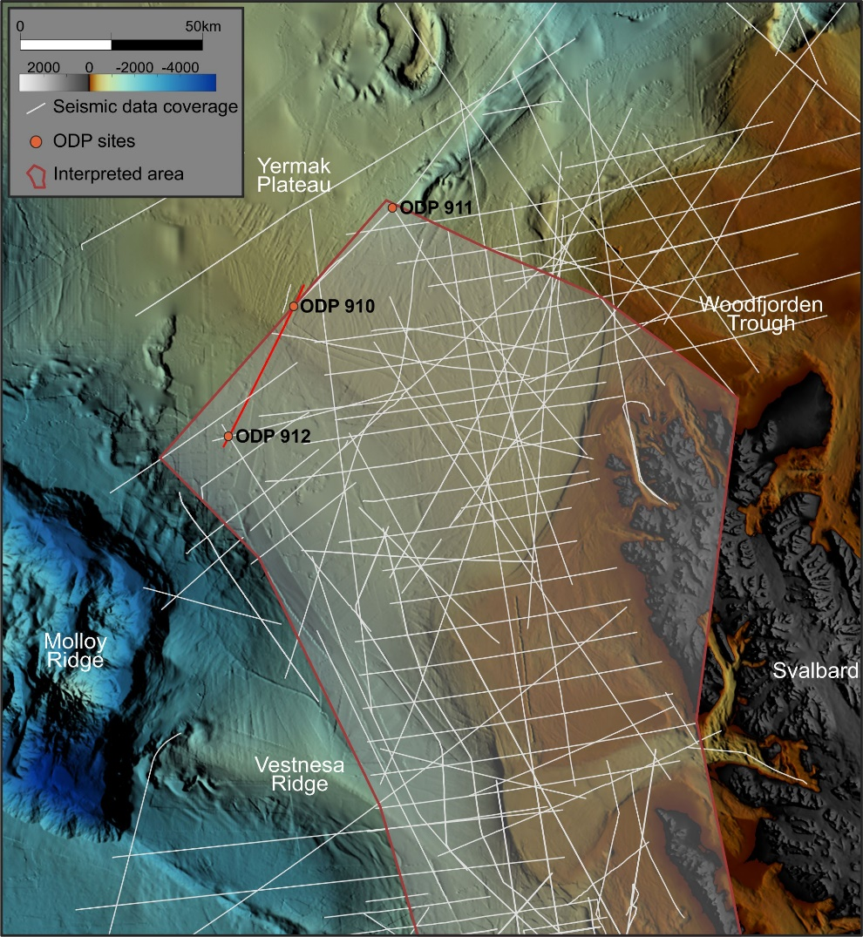
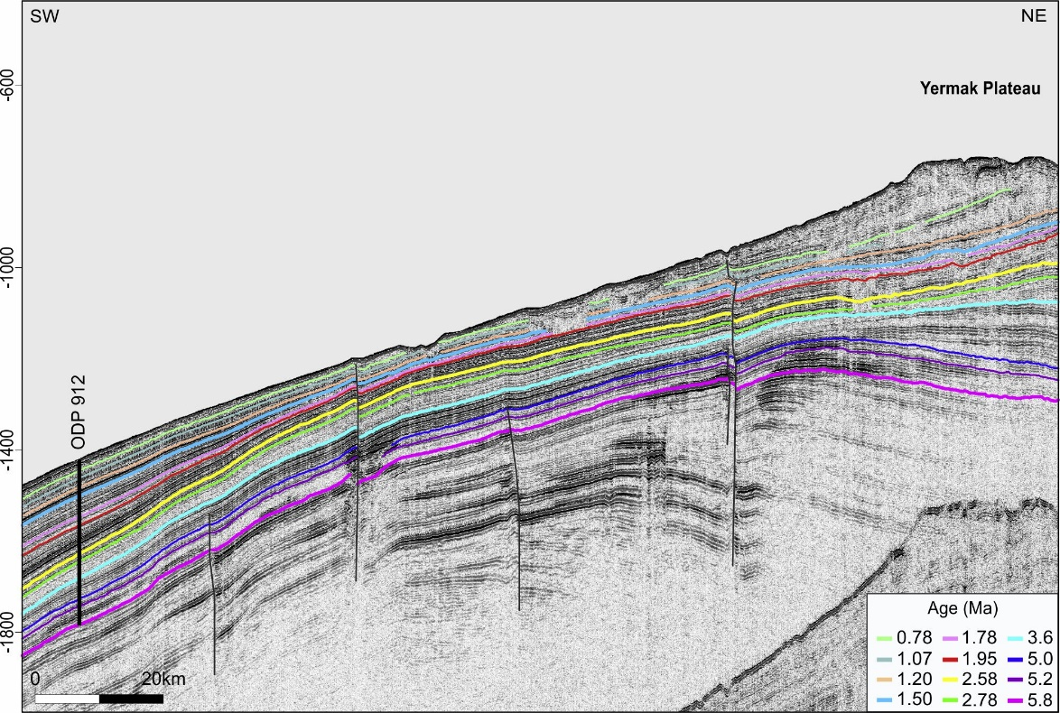
INTRODUCTION
DYPOLE – Dynamics of Polar confined basins
In detailed presentation:
Thickness maps
Regional reconstruction of sediment processes
Seismic data coverage and location of ODP sites.

Slide 4
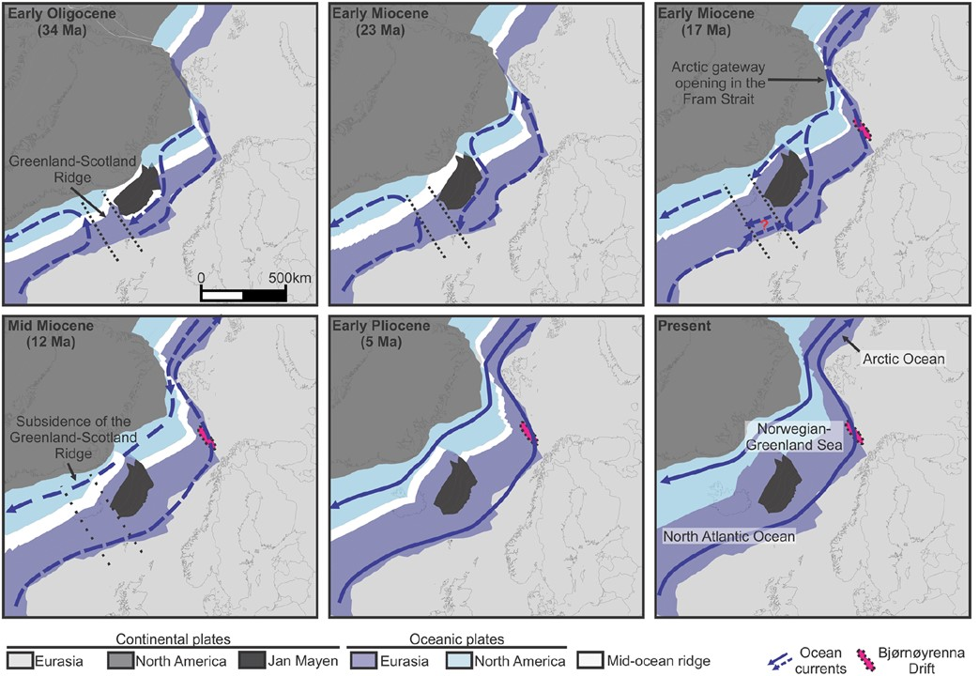
GEOLOGICAL BACKGROUND
DYPOLE – Dynamics of Polar confined basins
Reconstruction of the opening of the Norwegian-Greenland Sea and the Fram Strait gateway. Modified from Rydningen et al. (2020).

Slide 5
GEOLOGICAL BACKGROUND
DYPOLE – Dynamics of Polar confined basins
IODP webinar, 2023

Slide 6
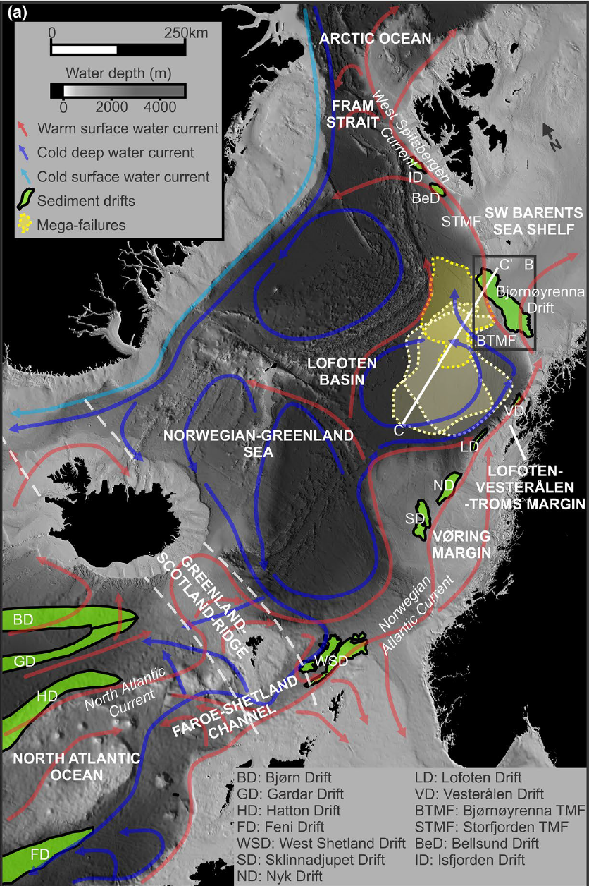
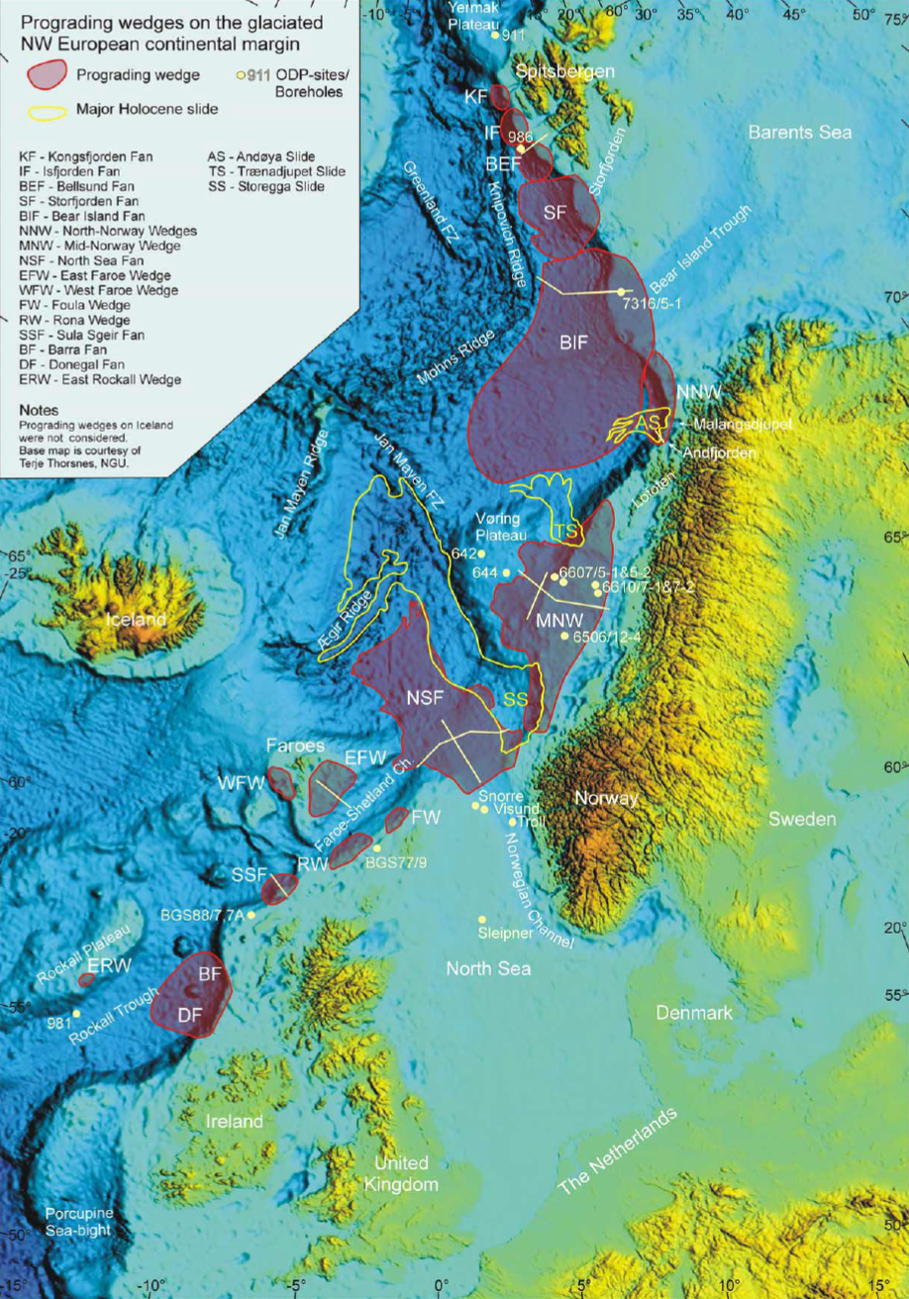
SEDIMENTARY PROCESSES
DYPOLE – Dynamics of Polar confined basins
Along-slope processes
Down-slope processes
Paleoclimatic archives to reconstruct Quaternary development of the continental margin.
Paleoclimatic archives to reconstruct ocean currents and development of the continental margins.
Rydningen et al. (2020)
Dahlgren et al. (2005)
Contourite drifts
Trough mouth fans and prograding wedges

Slide 7
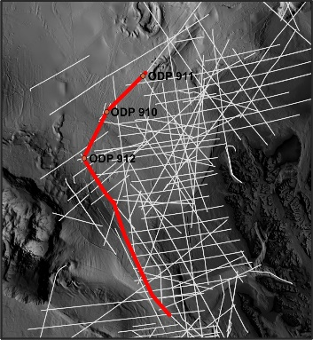
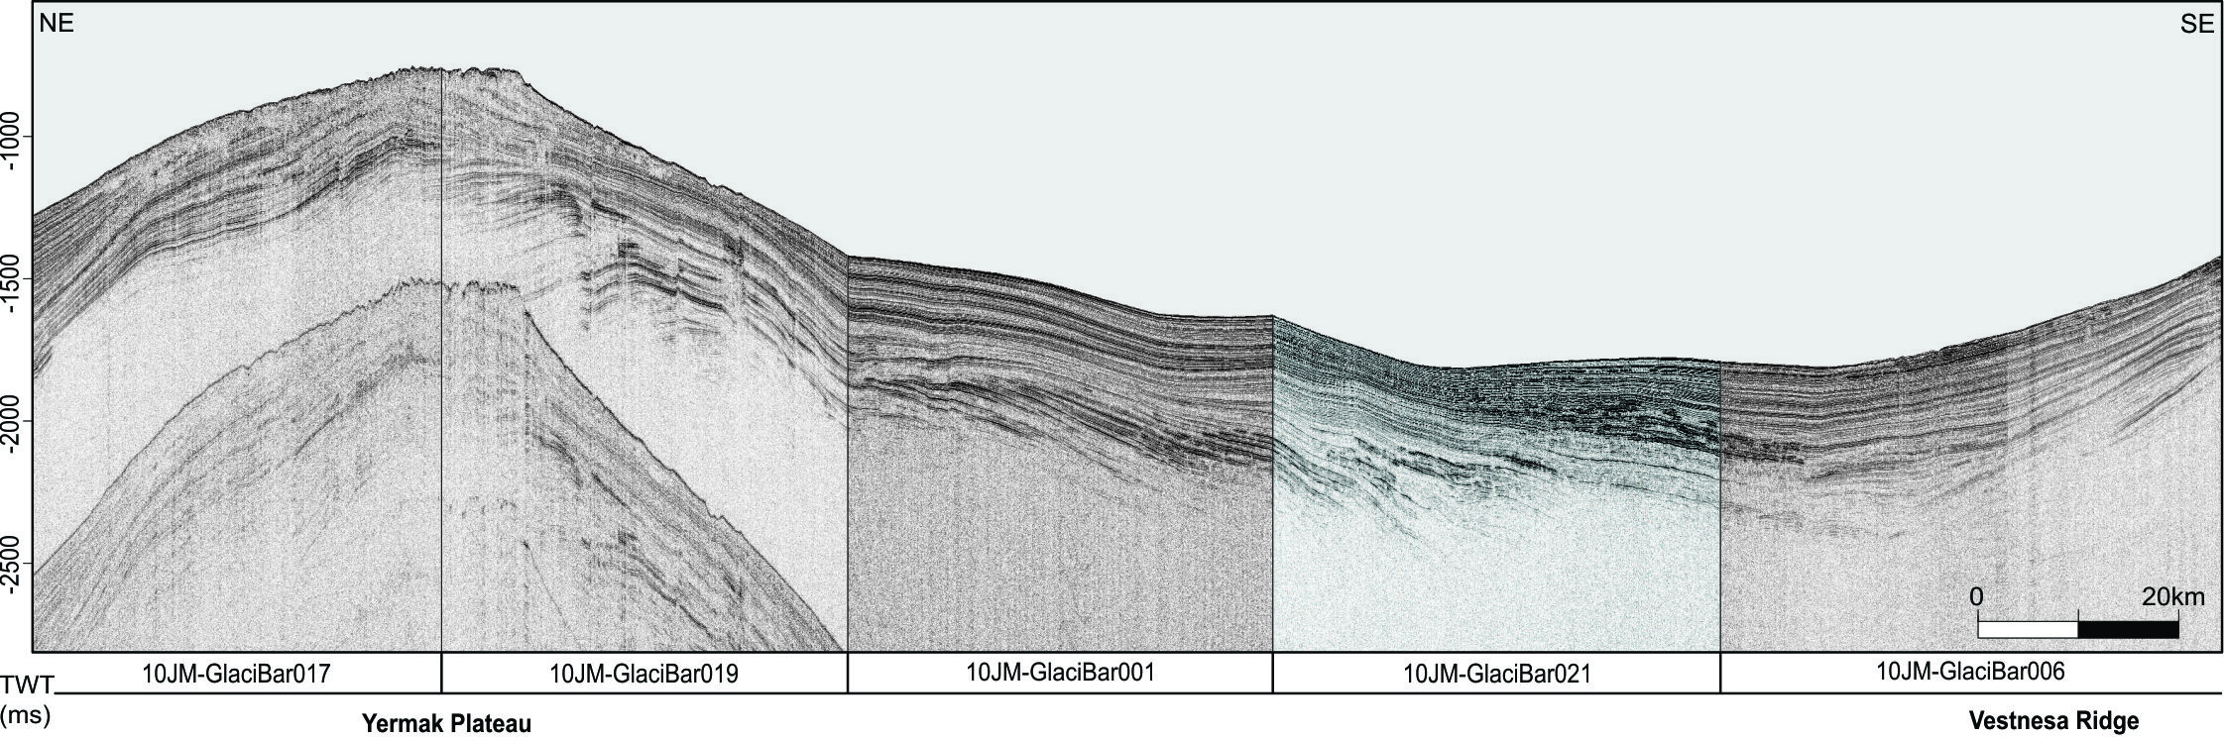
STRATIGRAPHIC FRAMEWORK
DYPOLE – Dynamics of Polar confined basins
ODP chronostratigraphic markers – Profile 1
Composite seismic line across the Yermak Plateau and the northwestern Barents Sea-Svalbard margin displaying interpreted late Cenozoic color-coded reflectors ranging ages from 0.78 to 5.8 Ma. The reflectors are based on Mattingsdal et al. (2014) and were tied to the survey 10JM-GlaciBar.

Slide 8
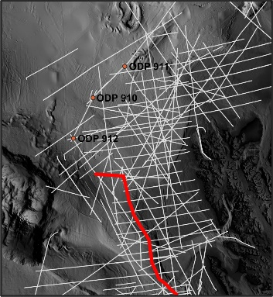
STRATIGRAPHIC FRAMEWORK
DYPOLE – Dynamics of Polar confined basins
ODP chronostratigraphic markers – Profile 2
Composite seismic line across the northwestern Barents Sea-Svalbard margin displaying interpreted late Cenozoic color-coded reflectors ranging ages from 0.78 to 5.8 Ma. Prograding fans Sjubrebanken and Kongsfjorden are interpreted. The reflectors are based on Mattingsdal et al. (2014) and were tied to the surveys UNIS2005 and 09JM_GEO3144.

Slide 9
STRATIGRAPHIC FRAMEWORK
DYPOLE – Dynamics of Polar confined basins
A
B
Youngest part of fan:
~ 1.20 Ma
Onset of fan:
~ 2.78 - 2.58 Ma
A
B
Composite seismic line across the northwestern Barents Sea-Svalbard margin displaying interpreted late Cenozoic color-coded reflectors ranging ages from 0.78 to 5.8 Ma. Prograding fans Sjubrebanken and Kongsfjorden are interpreted. The reflectors are based on Mattingsdal et al. (2014) and were tied to the surveys UNIS2005 and 09JM_GEO3144.

Slide 10
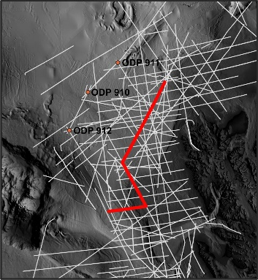
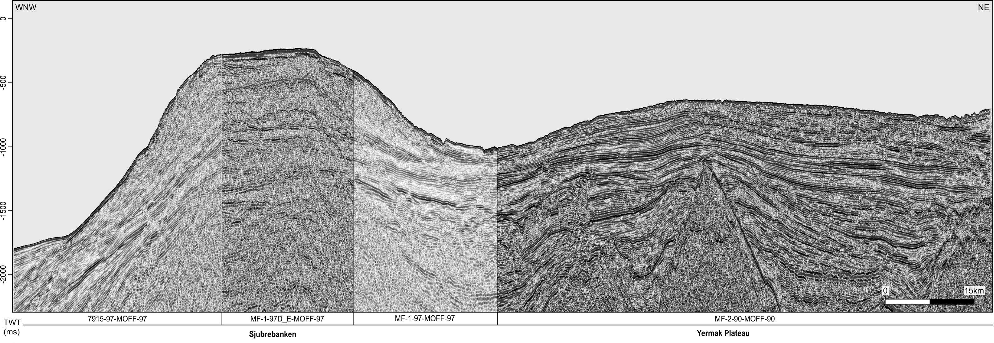
STRATIGRAPHIC FRAMEWORK
DYPOLE – Dynamics of Polar confined basins
ODP chronostratigraphic markers – Profile 3
Composite seismic line across the northwestern Barents Sea-Svalbard margin and Yermak Plateau displaying interpreted late Cenozoic color-coded reflectors ranging ages from 0.78 to 5.8 Ma. Sjubrebanken prograding fan is interpreted. The reflectors are based on Mattingsdal et al. (2014) and were tied to the surveys NPD MOFF 90 and 97.

Slide 11
STRATIGRAPHIC FRAMEWORK
DYPOLE – Dynamics of Polar confined basins
A
B
Youngest part of fan:
~ 1.78 Ma
Onset of fan:
~ 1.20 - 1.07 Ma
B
A
Composite seismic line across the northwestern Barents Sea-Svalbard margin and Yermak Plateau displaying interpreted late Cenozoic color-coded reflectors ranging ages from 0.78 to 5.8 Ma. Sjubrebanken prograding fan is interpreted. The reflectors are based on Mattingsdal et al. (2014) and were tied to the surveys NPD MOFF 90 and 97.

Slide 12
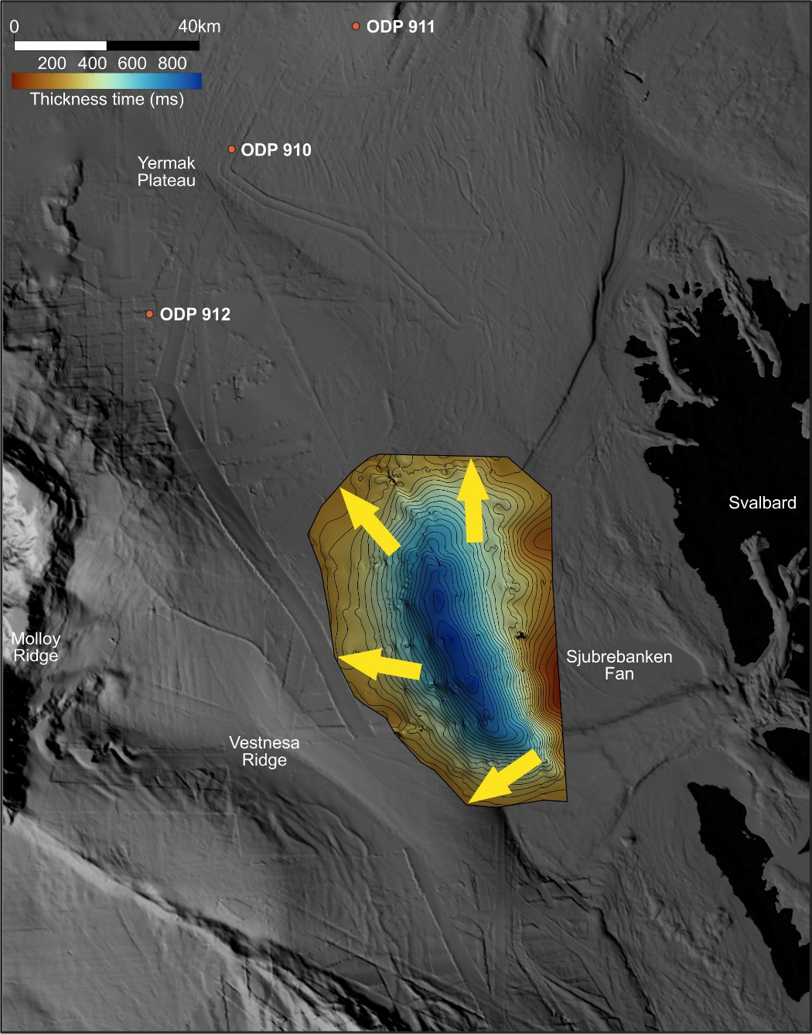
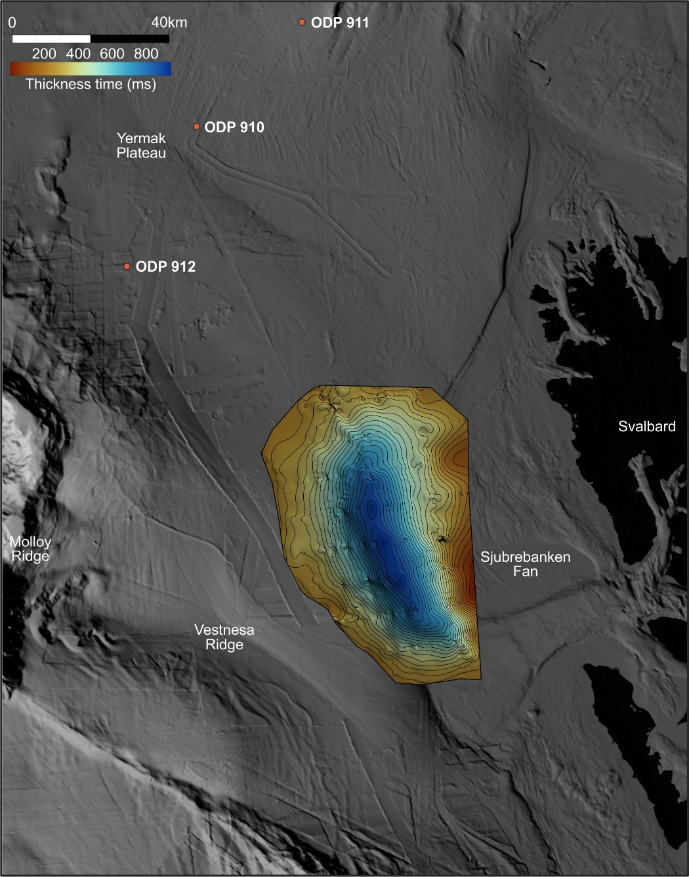
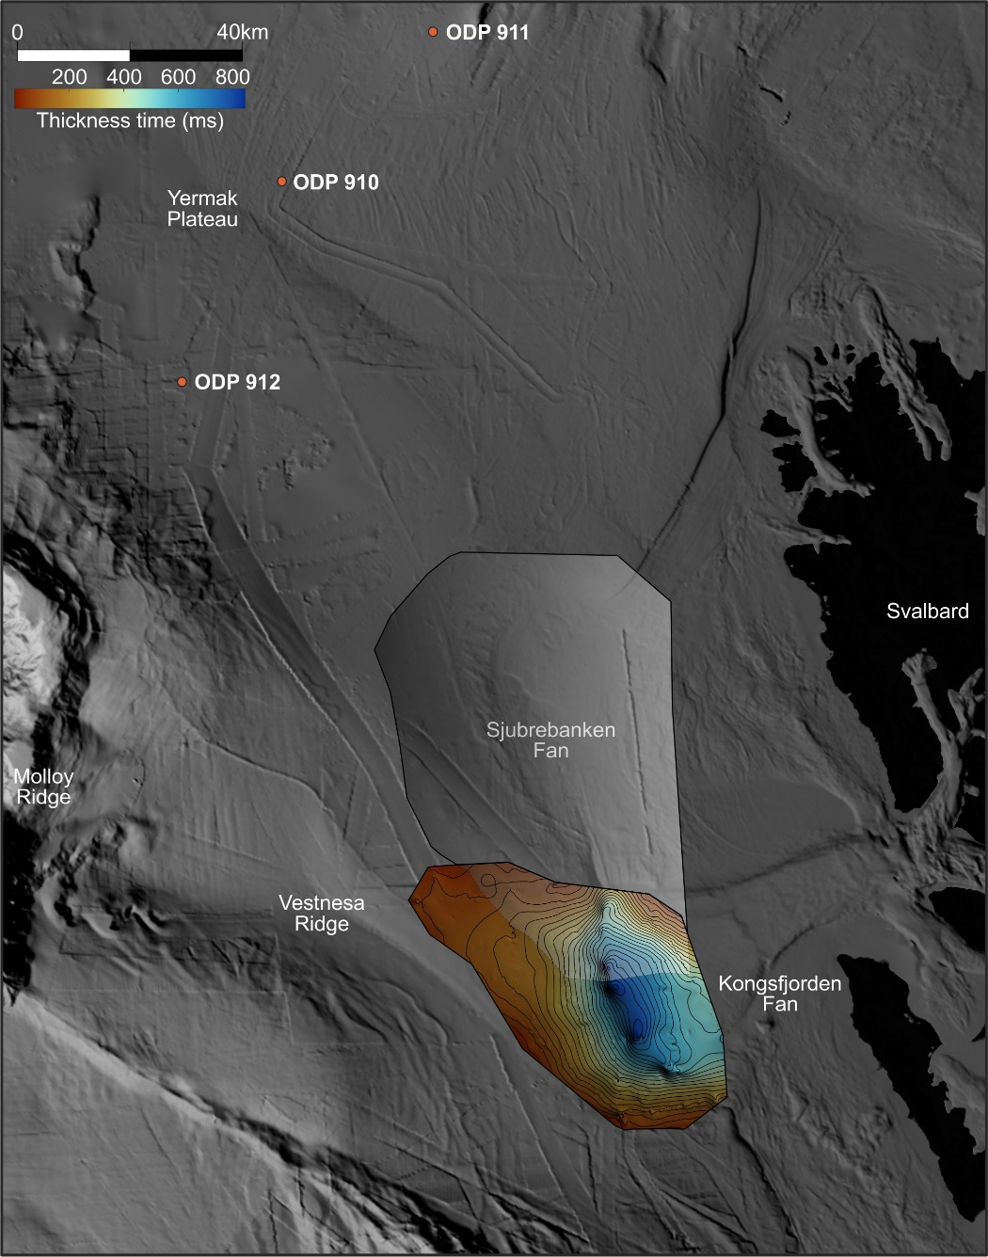
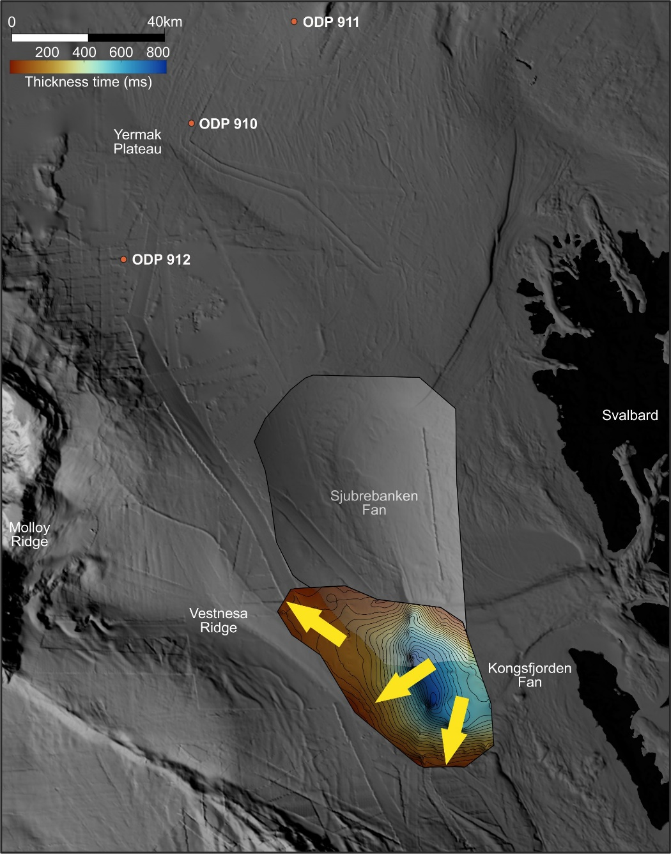
PROGRADING SYSTEMS - sediment thickness
DYPOLE – Dynamics of Polar confined basins
1.20 Ma
1.20 Ma
1.78 Ma
0.78 Ma?
<2.78 Ma ?
1.20 Ma?
1.07 Ma?
Sjubrebanken Fan
Kongsfjorden Fan

Slide 13
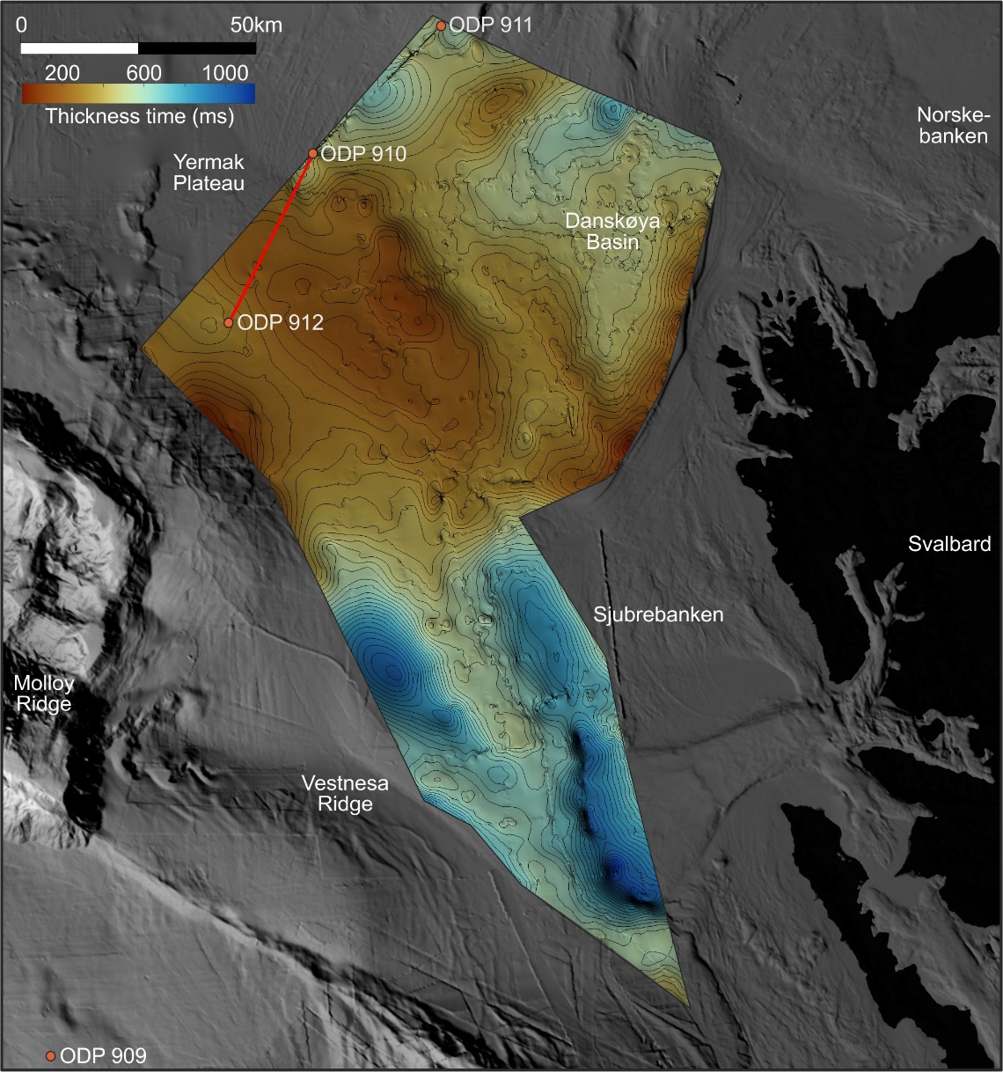
Late Neogene – Quaternary sediments
DYPOLE – Dynamics of Polar confined basins
Regional markers ~1.50, 2.58, 3.6 and 5.8 Ma, were mapped in the study area to reconstruct sedimentary processes and evolution of the study area.
Total late Neogene – Quaternary
sediment thickness

Slide 14
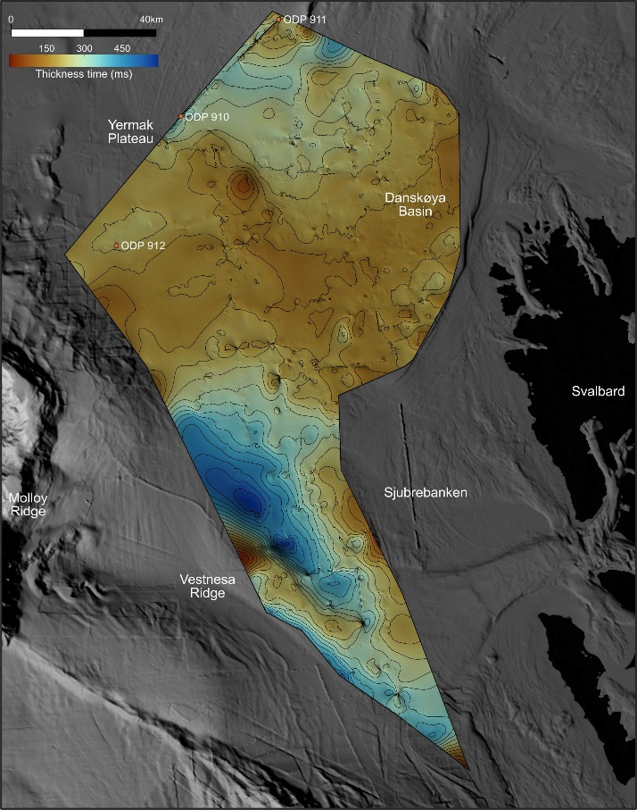
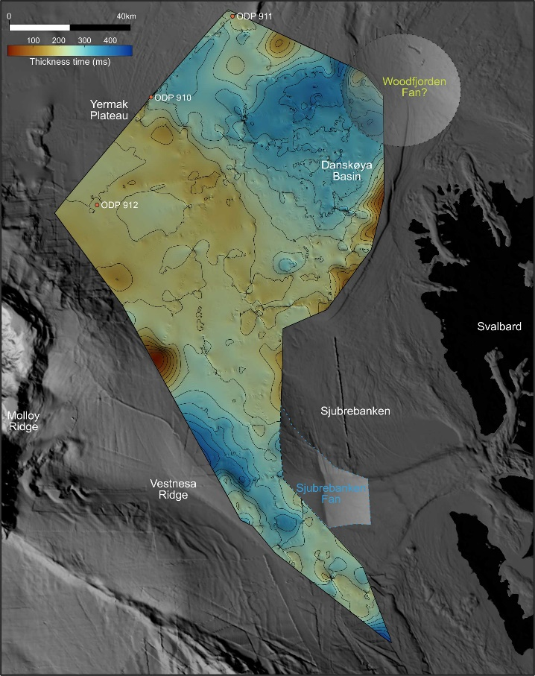
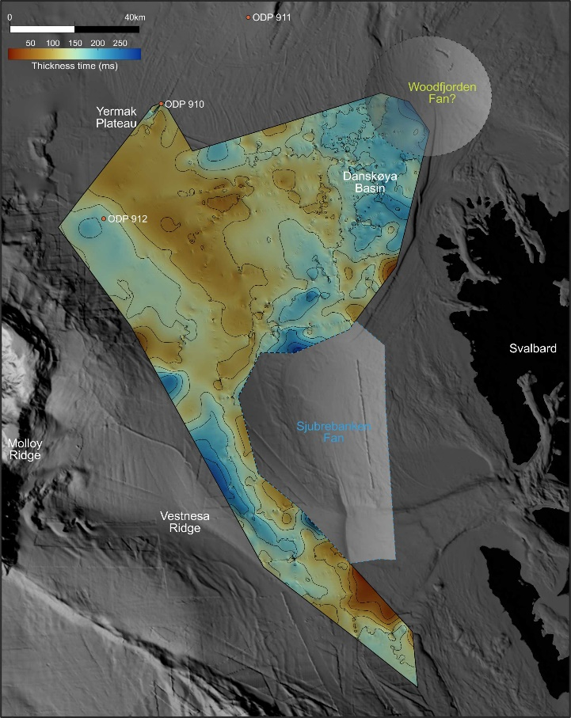
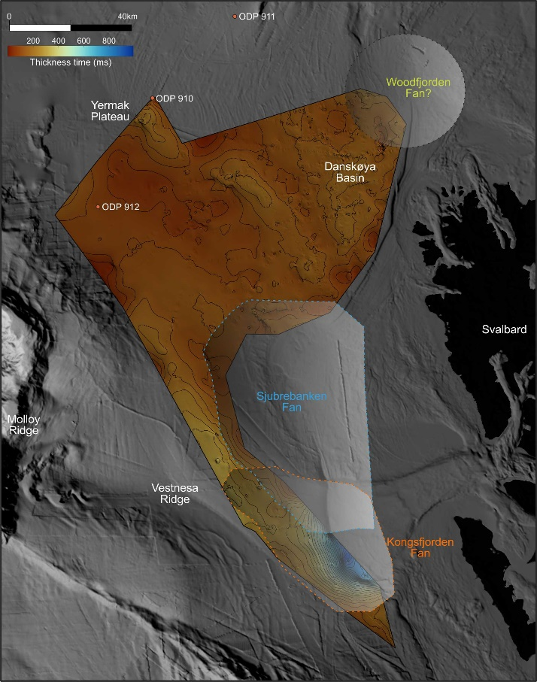
Late Neogene – Quaternary sediments
DYPOLE – Dynamics of Polar confined basins
Sediment thickness reconstruction
Late Miocene – mid Pliocene
(5.8 – 3.6 Ma)
Mid - late Pliocene (3.6 – 2.58 Ma)
Early – mid Pleistocene
(2.58 – 1.5 Ma)
Mid Pleistocene – Present
(<1.5 Ma)

Slide 15
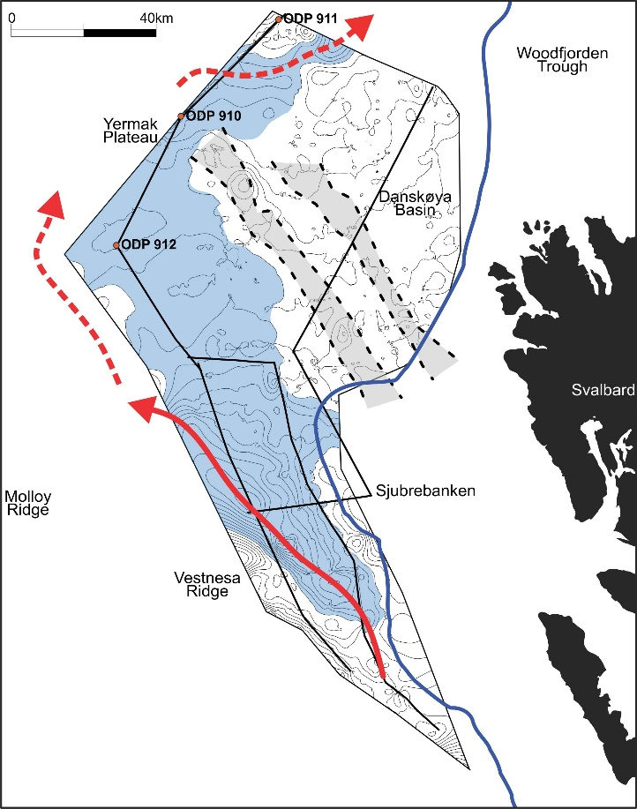
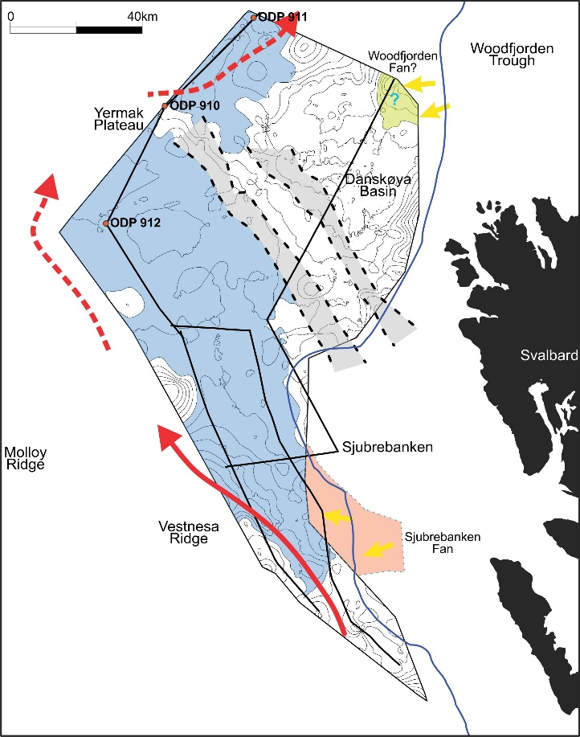
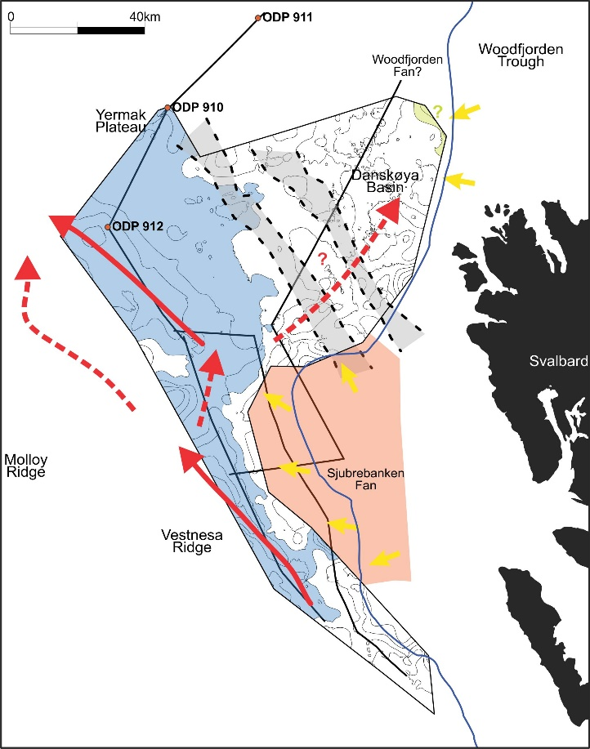
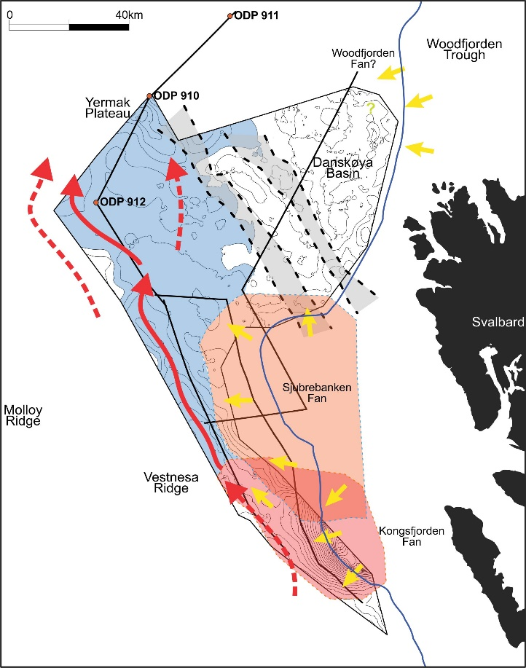
Late Neogene – Quaternary evolution
DYPOLE – Dynamics of Polar confined basins
Late Miocene – mid Pliocene
(5.8 – 3.6 Ma)
Mid - late Pliocene (3.6 – 2.58 Ma)
Early – mid Pleistocene
(2.58 – 1.5 Ma)
Mid Pleistocene – Present
(> 1.5 Ma)

Slide 16
CONCLUSIONS
DYPOLE – Dynamics of Polar confined basins
Alongslope accumulations occurred both along the western Svalbard margin and to the south of the Yermak Plateau throughout the last ~5.8 Ma.
A westward migration of alongslope accumulations to the NE Vestnesa Ridge was identified.
Ocean currents were likely deviated to the west due to downslope accumulations at the western Svalbard margin after ~2.78 Ma.
Glacial fan progradation began approximately ~2.78 Ma, initiating with the building up of Sjubrebanken fan until ~1.20 Ma and subsequently the development of Kongsfjorden fan from ~1.20 to 0.78 Ma.
These findings suggest significant changes in environmental conditions and sediment deposition patterns over the last ~5.8 Ma, influenced by the North Hemisphere Glaciations.
Future work will integrate preliminary results with sedimentary processes in the mid and northern Yermak Plateau and the Woodfjorden Trough.

Slide 17
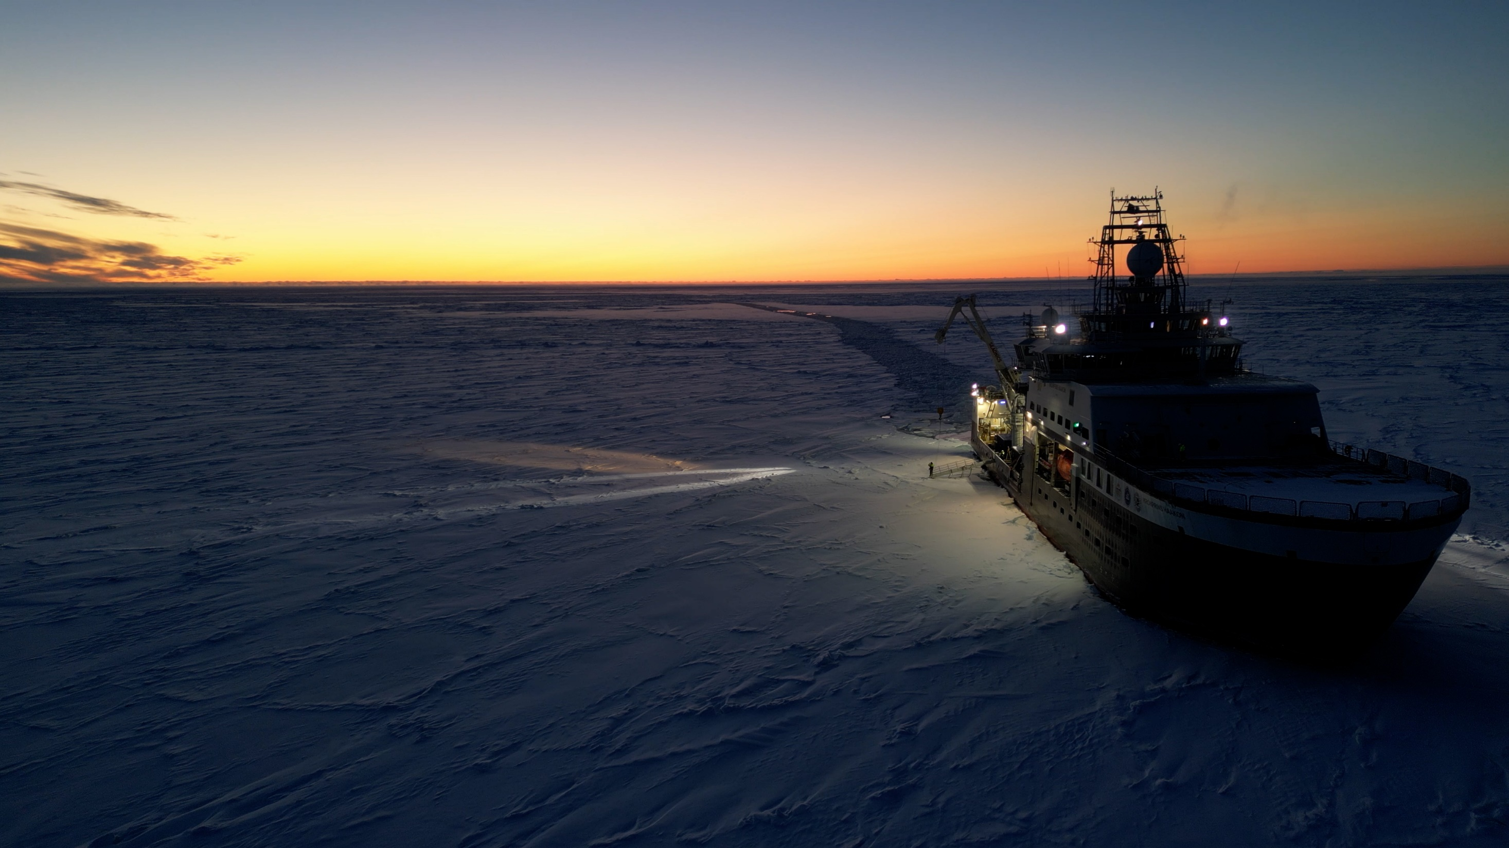
REFERENCES
GEBCO Bathymetric Compilation Group, 2022. The GEBCO_2022 Grid - a continuous terrain model of the global oceans and land. British Oceanographic Data Centre, National Oceanography Centre, NERC, UK. https://doi.org/10.5285/e0f0bb80-ab44-2739-e053-6c86abc0289c.
Mattingsdal, R., Knies, J., Andreassen, K., Fabian, K., Husum, K., Grøsfjeld, K., and De Schepper, S. (2014). A new 6 Myr stratigraphic framework for the Atlantic–Arctic Gateway. Quaternary Sci. Rev., 92, 170–178.
Rydningen, T. A., Høgseth, G. V, Lasabuda, A. P. E., Laberg, J. S., Safronova, P. A., & Forwick, M. (2020). An Early Neogene – Early Quaternary Contourite Drifts System on the SW Barents Sea Continental Margin, Norwegian Arctic. Geochemistry. Geophysics. Geosystems., 21.
Dahlgren, K.I.T., Vorren, T.O., Stoker, M.S., Nielsen, T., Nygård, A., Sejrup, H.P., De Santis, L. (2005). Late Cenozoic prograding wedges on the NW European continental margin: their formation and relationship to tectonics and climate. Marine and Petroleum Geology., 22, 1089-1110.

