Slide 1
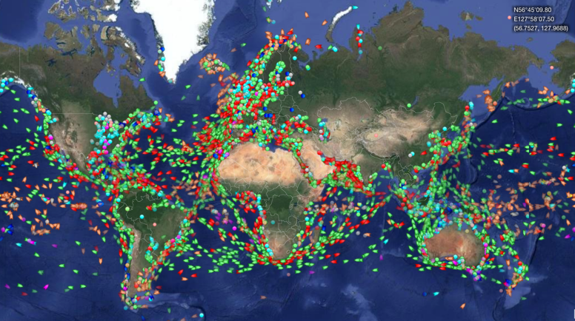
GNSS low-cost prototype on ship for catching tsunami wave propagation
P. Jarrin¹, L. Rolland¹, M. Vidal¹, P. Sakic², F. Leclerc¹, J.-X. Dessa¹
(1) Geoazur, IRD, Université de Nice Sophia-Antipolis, Observatoire de la Côte d’Azur, CNRS, Valbonne, France.
(2) Institut de Physique du Globe de Paris, Université de Paris, Paris, France
ANR-19-CE04-0003

Slide 2
Tsunamis prediction
Mesuring the progress of the tsunami wavefront in real-time
Buoys connected to a pressure sensor in deep ocean
(very expensive and sparse)
Seismometer
v ≃ 800 km/h
10cm-20 m
1cm – 2m
250 km

Slide 3
Tsunamis prediction
Mesuring the progress of the tsunami wavefront in real-time
Ships equipped with low-cost GNSS sensors
GNSS
Seismometer
v ≃ 800 km/h
GNSS
10cm-20 m
1cm – 2m
250 km

Slide 4
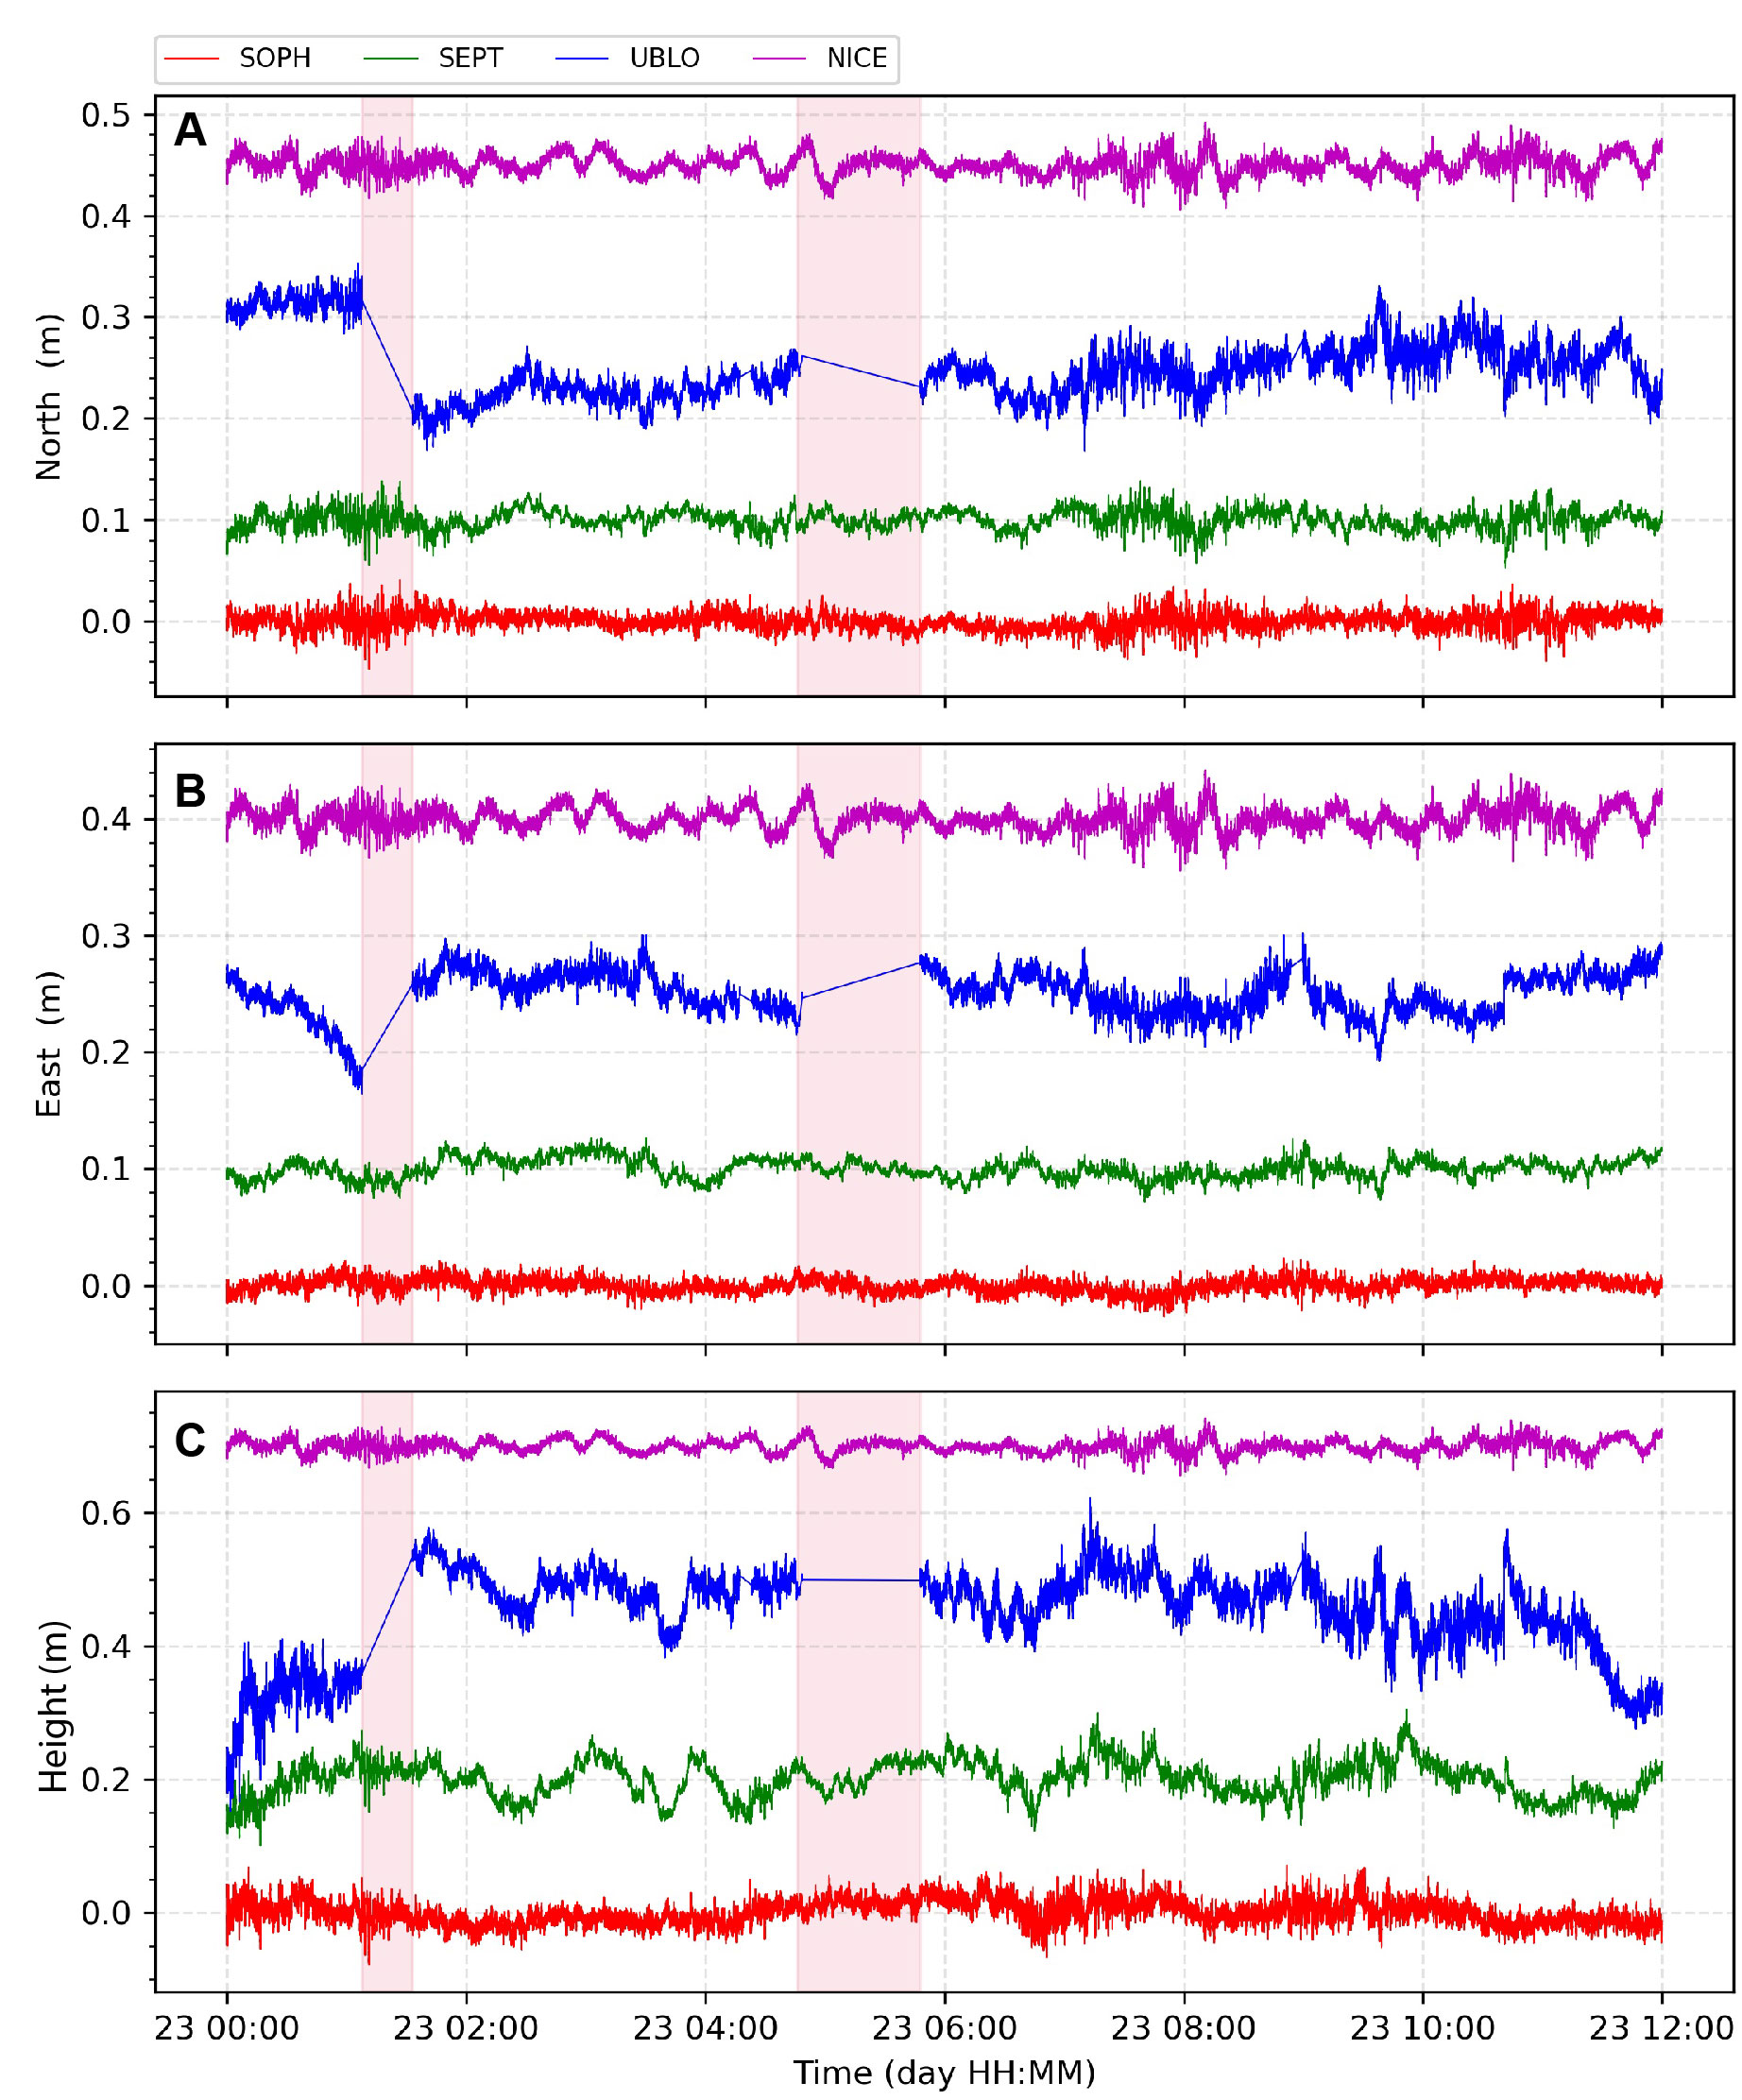
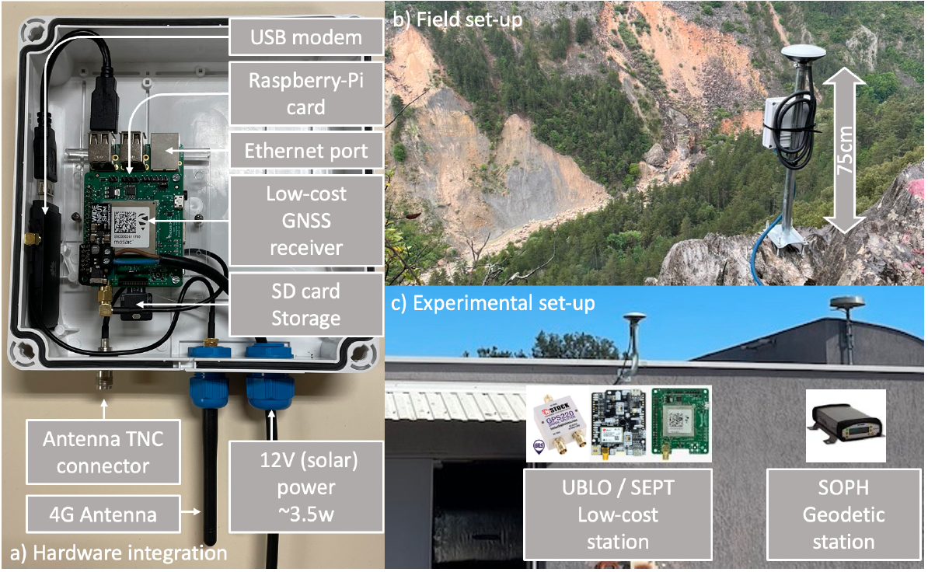
Low-cost dual frequency GNSS prototype
Example: 1-second kinematic solution from low-cost
and high-class GNSS
L’Europe
PQP
Vidal et al. (2024)
Dual frequency mosaic-X5 GNSS receiver, AS ANT3BCAL antenna.
Low-cost GNSS station agrees in accuracy wrt. high-class stations.
Prototype is a reliable instrument to be used in several applications, e.g. crustal deformation, tsunami monitoring, ionosphere monitoring, etc.
Modified after Vidal et al. (2024)

Slide 5
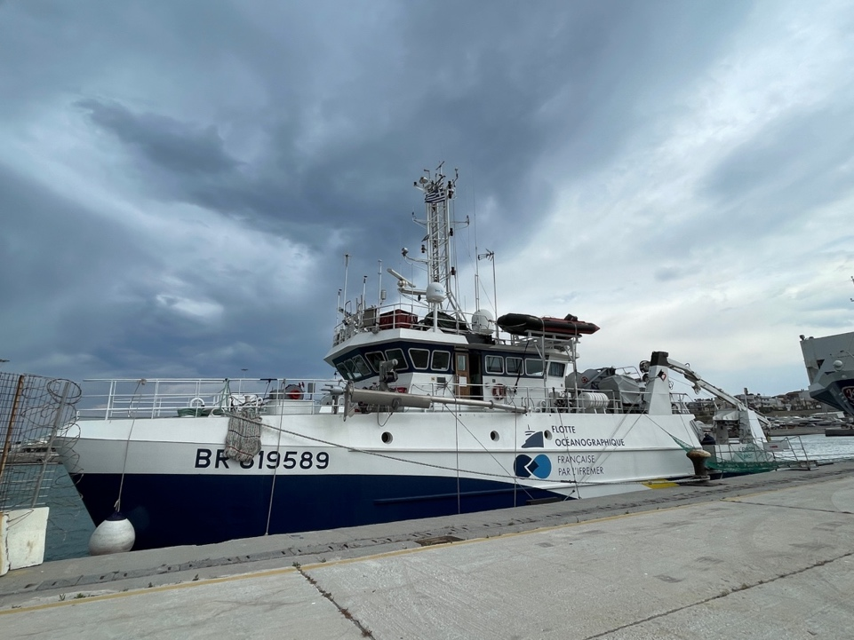
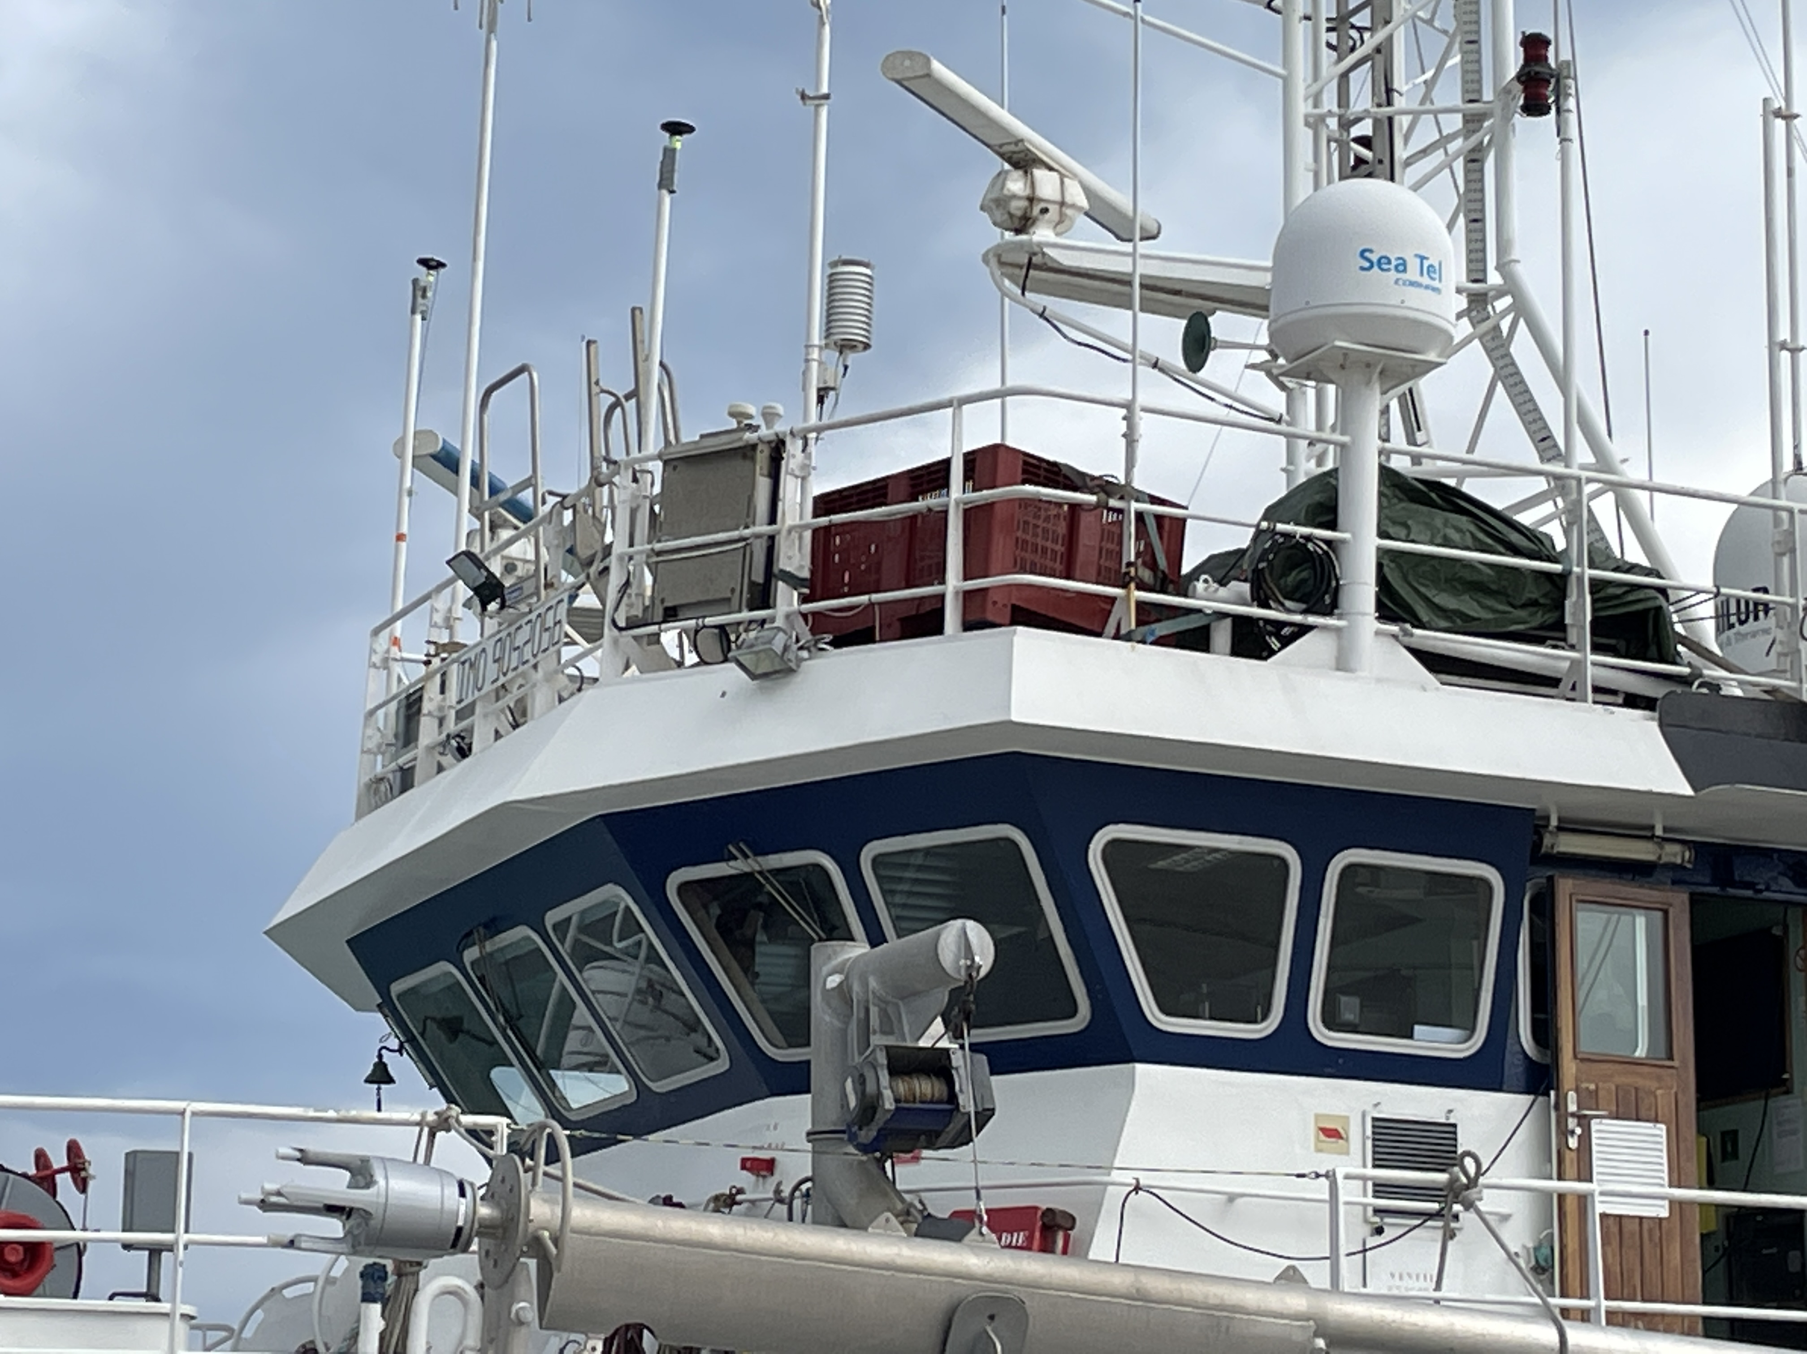
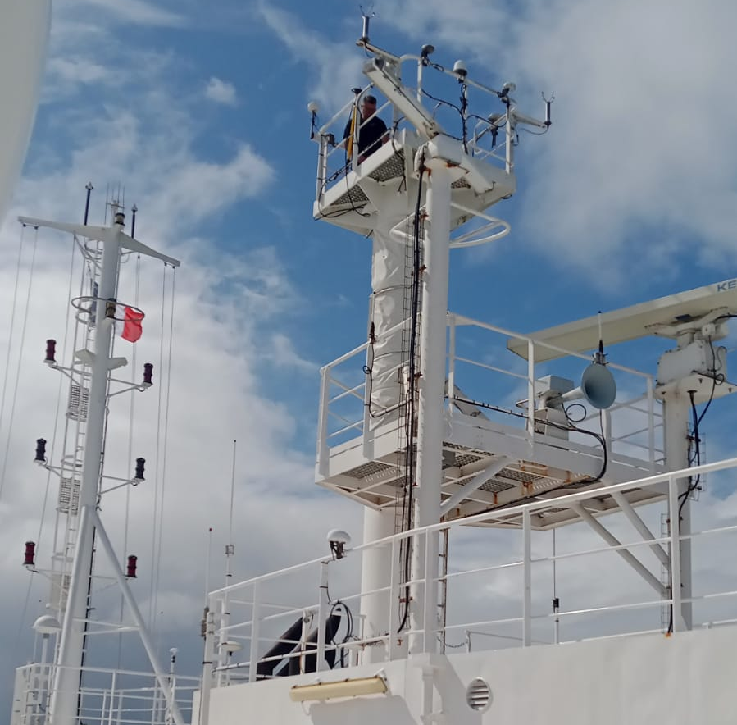
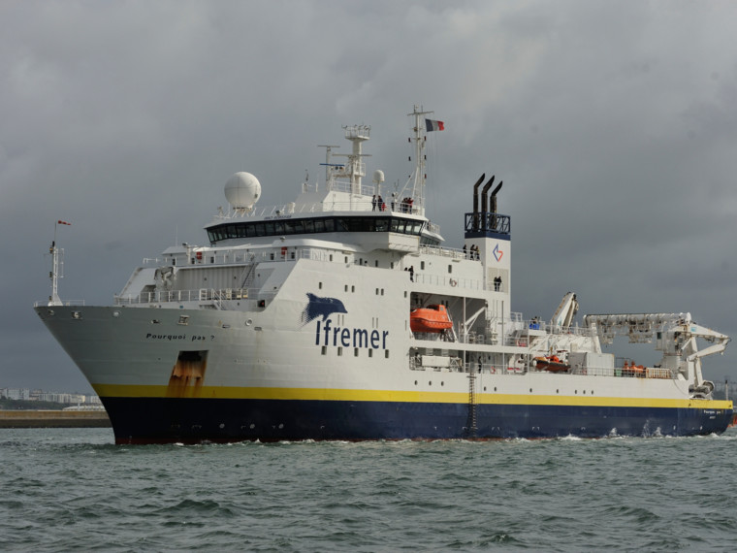
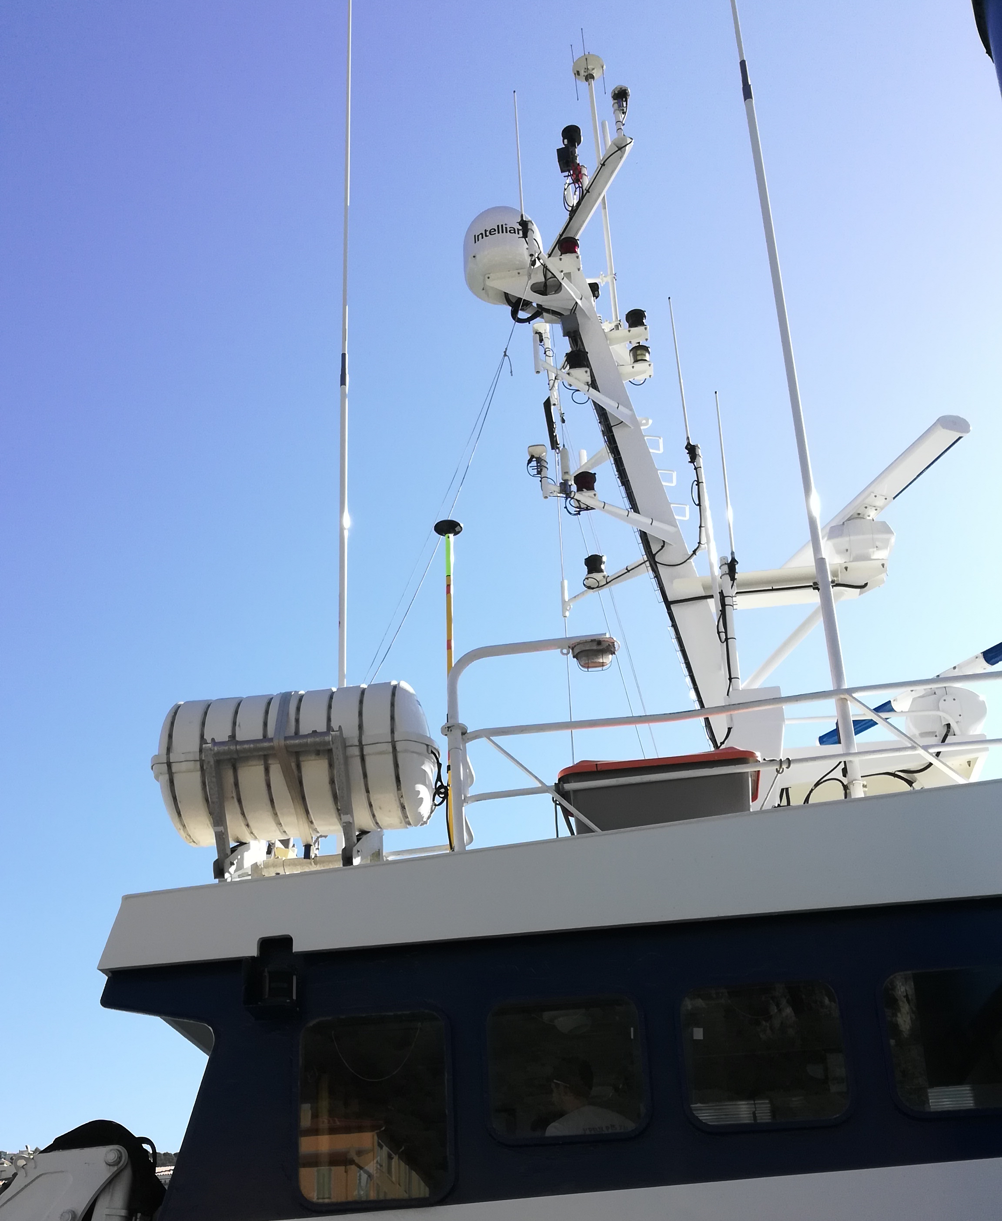
Low-cost Mobile GNSS observations on Ships/Vessel
Summary of sGNSS
Deployment of GNSS stations.
GNSS Antennas anchored on the ships bridge
Survey | Mobile Site | Ship Name | Ship Length m | Obs. Time
Amorgo | GPS1 | L’Europe | 30 | ~3 days
Geonice | GPS2 | Tethys2 | 24.9 | ~10 days
La Plata | GPS3 | Balsamo | ~6 | ~12 hours
Super-M. | GPS4 | Pourquoi Pas (PQP) | 107.6 | ~1 month
L’Europe ship. Courtesy from F. Leclerc
GNSS
Antenna
GNSS
Antenna
GNSS
Antenna
PQP vessel https://www.flotteoceanographique.fr
Tethys2 ship
More GNSS data from ships are welcome !

Slide 6
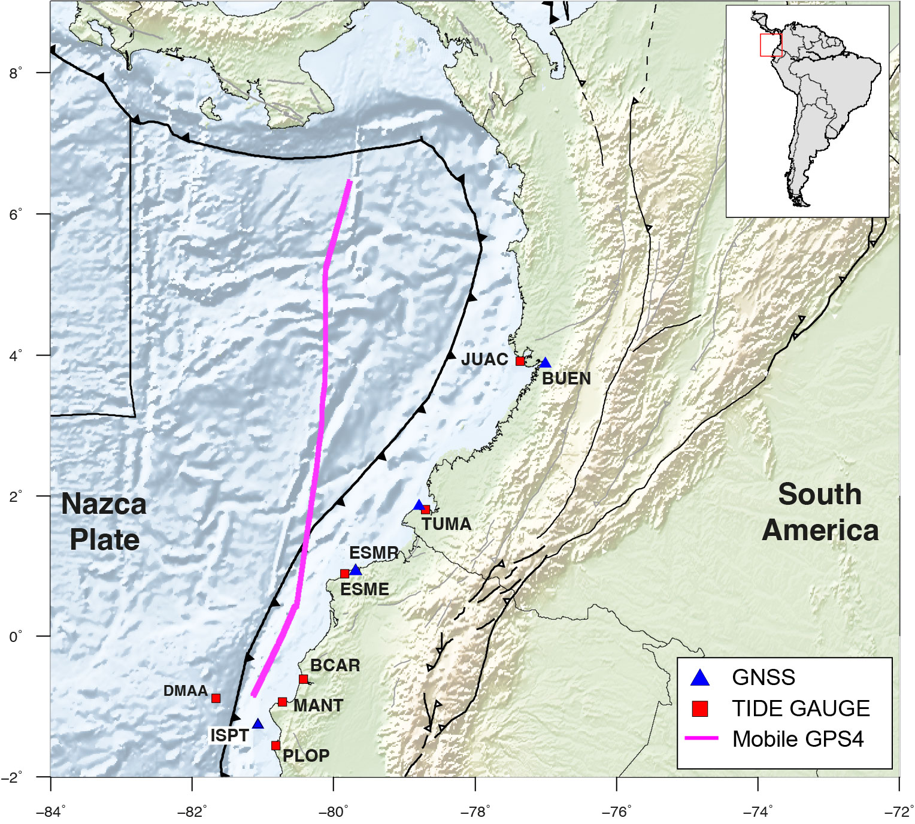
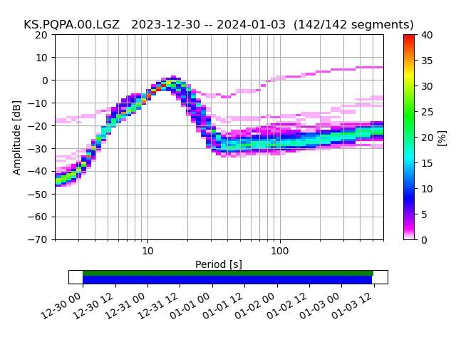
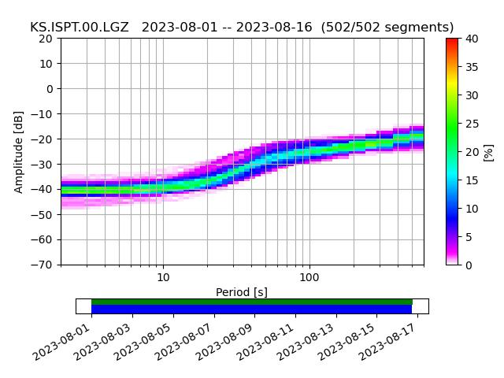
Experiment 4: Multi-GNSS kinematic solution and Noise analysis
Short-term vertical displacements from 5 days of survey (PQP vessel)
Accuracy ~1-meter level.
Short-term vertical displacements from 15 days of cGNSS observations on the Ground-based ISPT site in Ecuador
Accuracy ~4-cm level.
Mobile GPS4
Ground-based ISPT GNSS station
Tsunami window
GPS4
ISPT
20cm
20cm
10cm
10cm
1cm
1cm
Noise in fixed and mobile GNSS is much closer to the ~10‐cm level at periods > 100s
Noise in mobile GNSS increases at periods between 3 and 30s.
0.1cm
0.1cm
Percentage of spectra that fall within a certain power and period bin (PPSD)

Slide 7
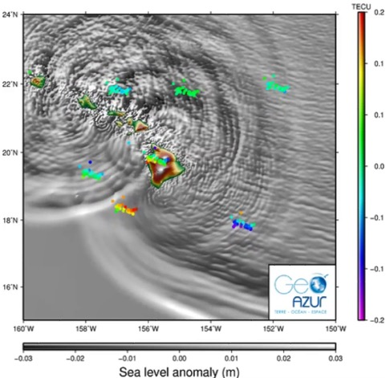
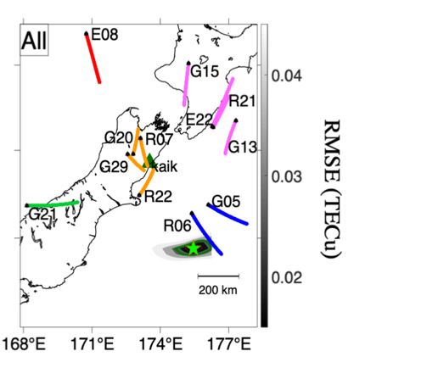
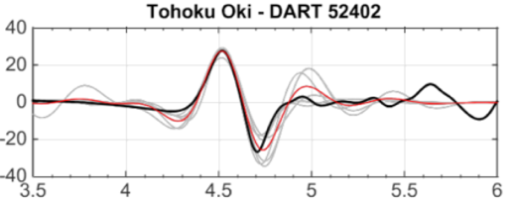
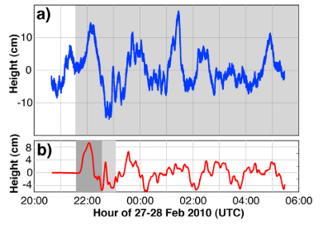
ITEC: Ionospheric Total Electron Content tsunamimeter
2019-2024 (5 years) – ANR and CNES project
L. Rolland, E. Astafyeva, Q. Bletery, P. Coïsson, B. Delouis, C. Maréchal, P. Jarrin, P. Lognonné, D. Mikesell, E. Munaibari, P. Sakic, A. Sladen, C. Twardzik, M. Vidal, F. Zedek
Detect the tsunami signature
Technical and science objectives
Design a tsunami measurement system:
affordable
versatile
easy to deploy over seas
(on buoys and existing ships)
Based on the GPS/GNSS technology (including Galileo) TEC and tsunami wave height measurement
In ionosphere: Haida Gwaii 2012 tsunami
Invert the tsunami height
DART
Inversed dTEC
Averaged inversed dTEC
Invert the deformation zone
With one single GNSS Station
At sea-level: 2010 Maule tsunami
GPS ship data
Δh (cm)
Simulation
Time after earthquake (h)
Rakoto et al. (2018)
Foster et al. (2011)
Zedek et al. (2021)

Slide 8
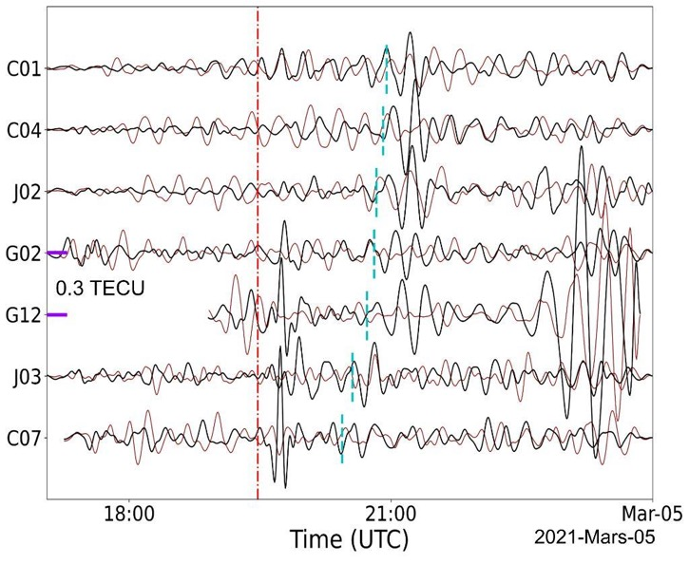
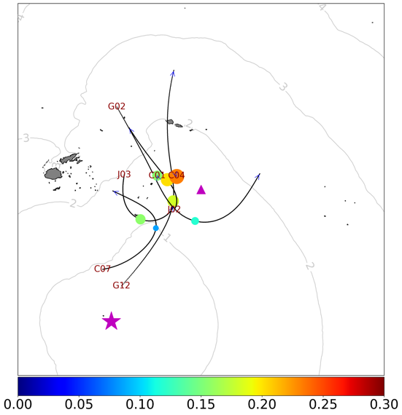
Tsunami detection: Single Receiver Technique (SRT)
Mw8.1 Kermadec earthquake and tsunami (~3cm height at near-field)
Event time
Tsunami arrival
Event day
Event day before
Munaibari et al. (2023)
One single GNSS receiver allows to detect and assess tsunami-induced TEC signatures
https://link.springer.com/article/10.1007/s00024-023-03271-5

Slide 9
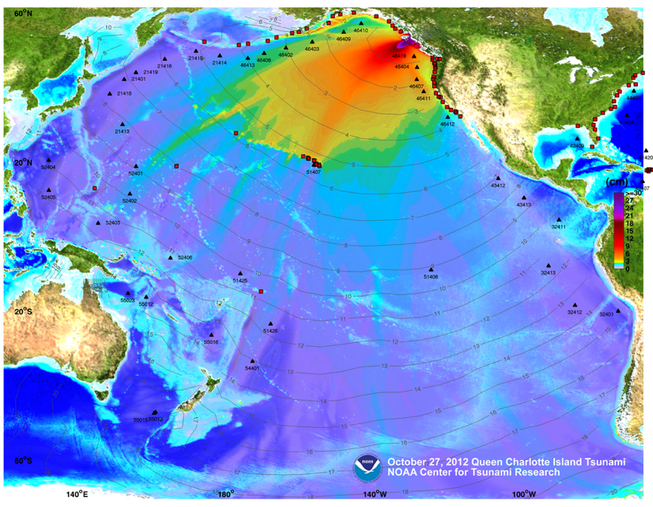
The Haida Gwaii tsunami
2012/10/28, Mw 7.8

