Slide 1
Identifying the Transition Zone between Peat and Mineral Soils Using Airborne Radiometric Data: a national scale case study from Ireland
Supplementary Material
Dave O’Leary^{1,3} (DaveOLearyPhD@gmail.com), J. Connolly², L. Gilet², P. Tuohy³, J. Hodgson⁴, E. Daly¹
¹ Earth and Ocean Sciences and Ryan Institute, College of Science and Engineering, University of Galway, Ireland
² Department of Geography, Trinity College, Dublin, Ireland
³ Animal and Grassland Research and Innovation Centre, Teagasc, Moorepark, Fermoy, Co. Cork, Ireland
⁴ Geological Survey, Ireland (GSI), Booterstown, Blackrock, Dublin, Ireland

Slide 2
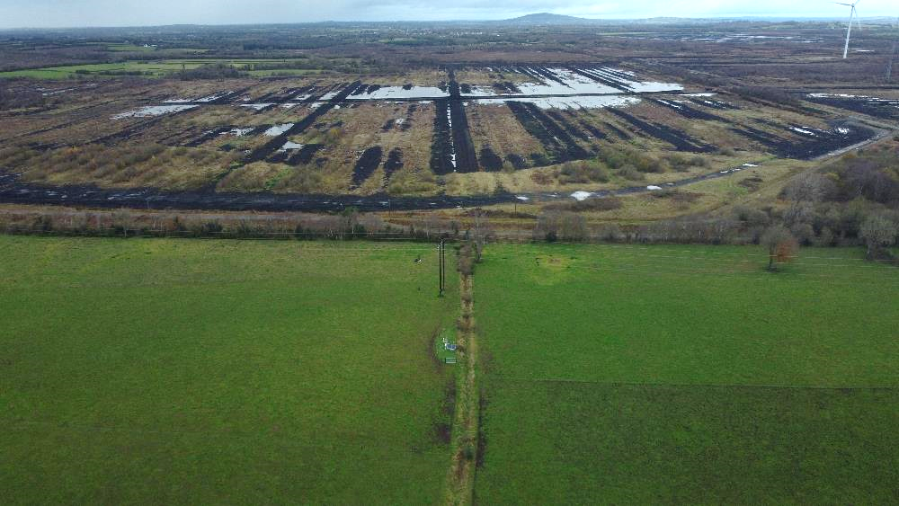
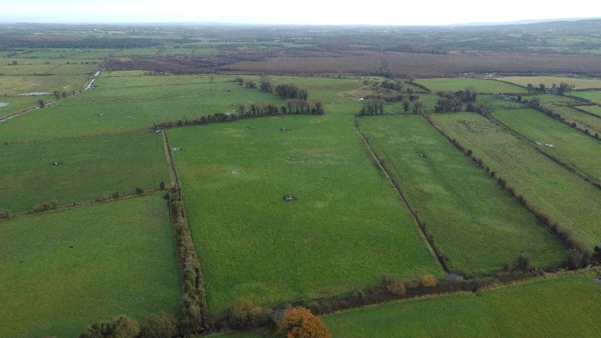
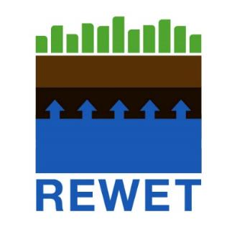
What are transition Zone between Peat and Non-Peat Soils
Round the edge of industrial peat extract sites
Can be a variety of landcover types (grassland, forestry etc.)
But is it a hard boundary or a transitional one? And where is this “transition zone”?

Slide 3
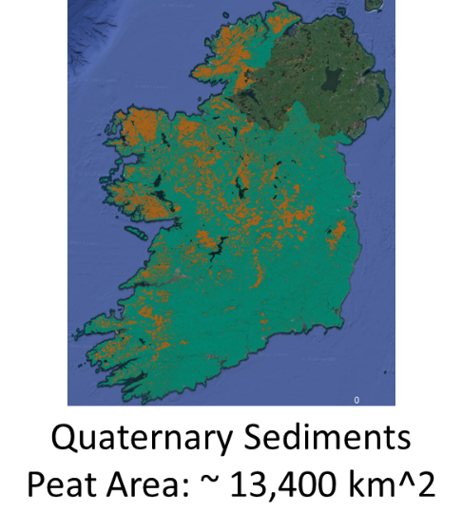
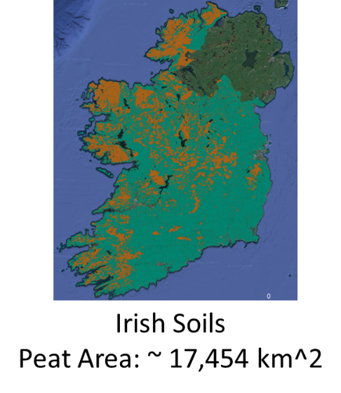
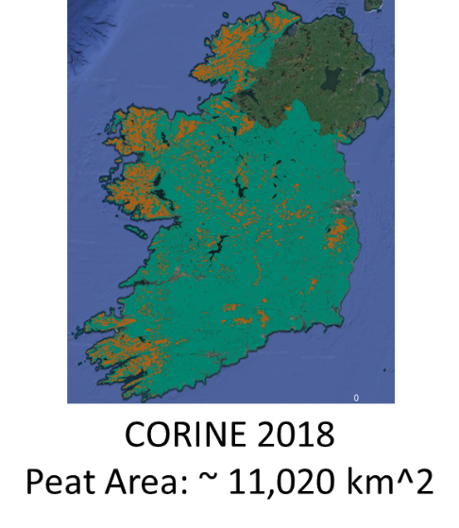
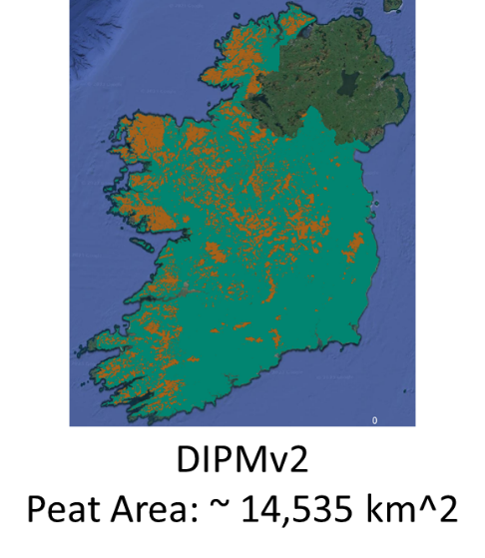
Current peatland databases
Area of Ireland = ~ 69,000 km^2
Peat area estimates vary:
QGM: ~ 19 %
Irish Soils: ~ 25 %
CORINE2018: ~ 16 %
DIPMv2: ~ 21 %
Each database created using different mapping methods

Slide 4
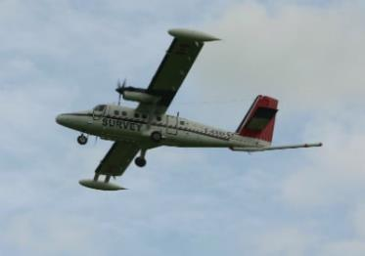
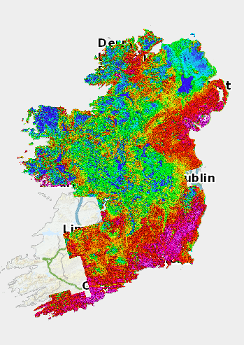
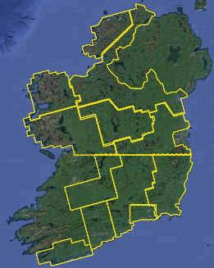
Airborne Geophysics Survey
- Radiometrics
- Airborne EM
- Magnetics
National coverage line spacing 200m
Geochemical Soils survey
- one sample every 4 km²
- baseline chemistry of soil, stream water and stream sediment
Notes:
Moving to Airborne and just showing the range of data that are actually available in Ireland. Showcase for the Tellus Project. My particular focus is on Radiometric data or Gamma Ray spectroscopy .

Slide 5
Notes:
Sticking with Radiometrics/Gamma Ray measurements, here is an overview of how it works for airborne surveys.

Slide 6
Why Radiometric Data?
Very low radiometric signal
High radiometric signal
Low radiometric signal
Peat
Transition Zone
Non-Peat
Bedrock/Underlying Sediments – Radiometric Source
K U Th

Slide 7
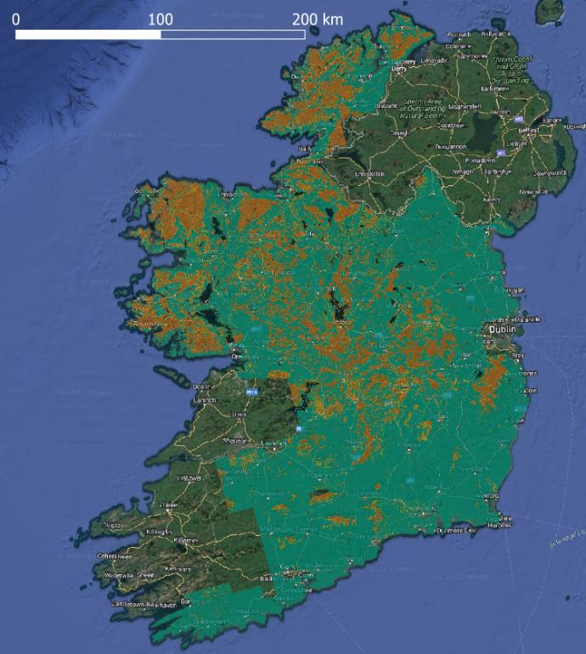
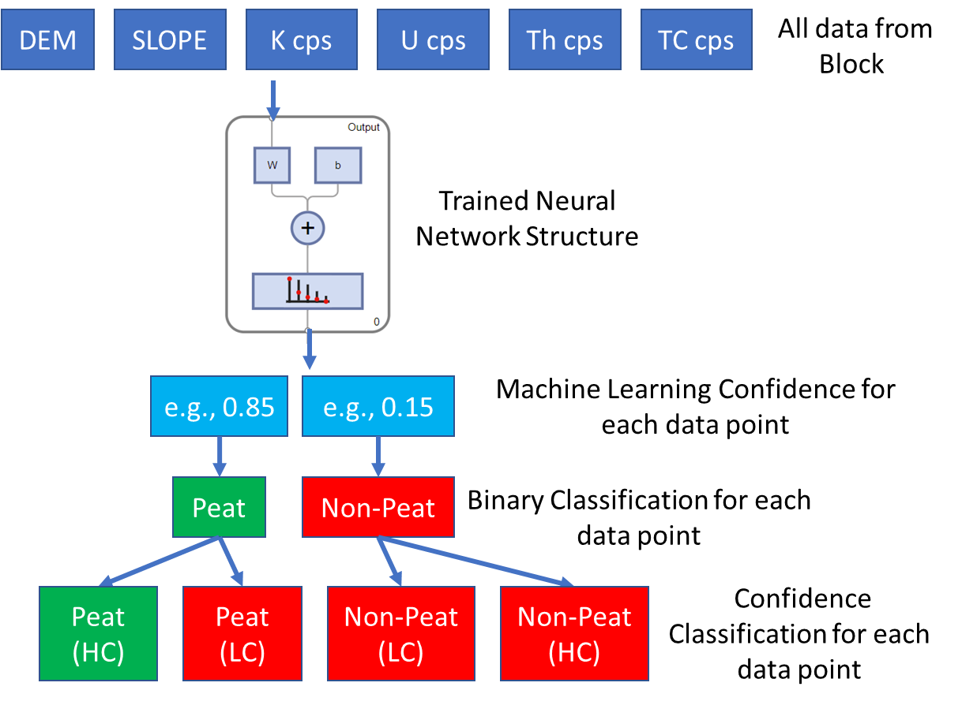
Neural Network National deployment

Slide 8
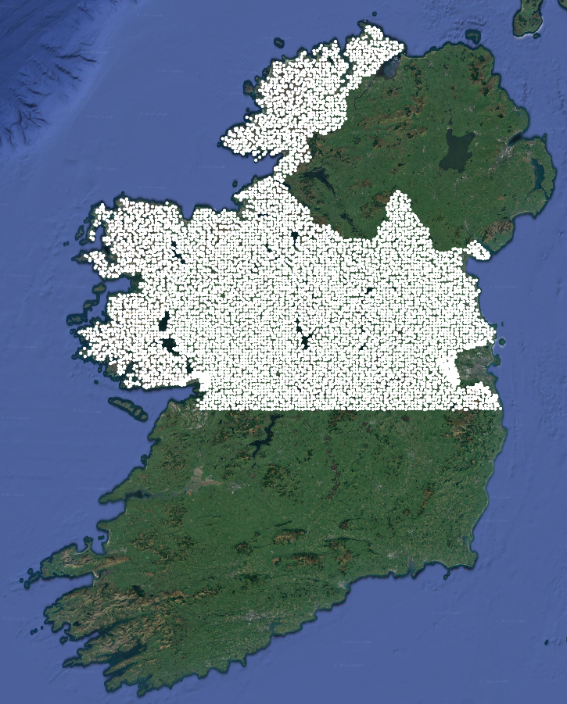
Tellus Geochemistry Data - Validation
Currently 8,695 points publicly available
One measure taken is called Loss on Ignition (LOI) at 20 cm (Shallow) and 50 cm (Deep)
Measures % of organic matter
Geochemical Soils survey
- one sample every 4 km²
- baseline chemistry of soil, stream water and stream sediment

Slide 9
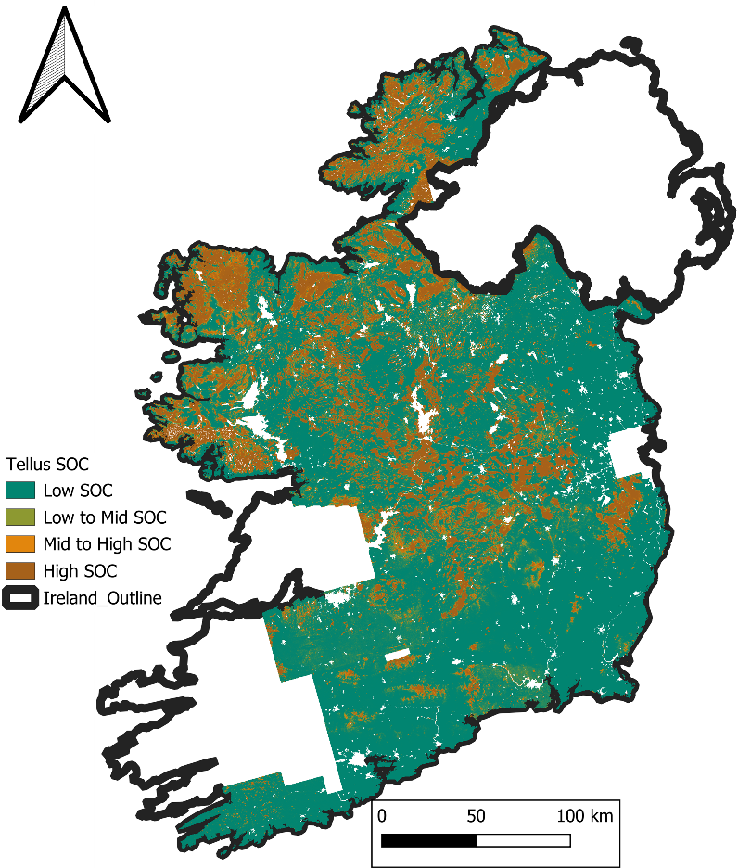
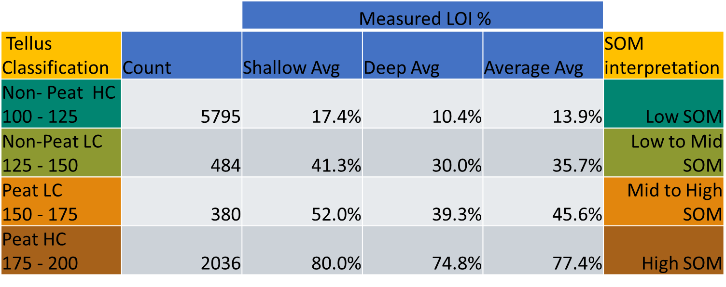
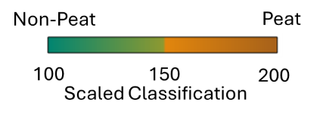
Machine Confidence to Soil Organic Content (SOC)
Soil Organic Content as measured by Tellus LOI %
Table shows average of LOI measurements (Shallow, Deep and Mean) that fa within each Machine Learning Confidence definition
Machine Confidence can be translated to interpreted SOM

Slide 10
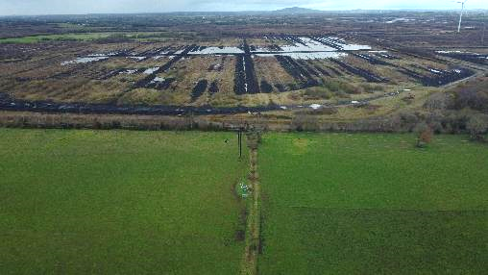
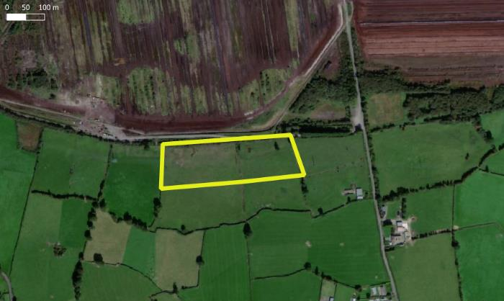
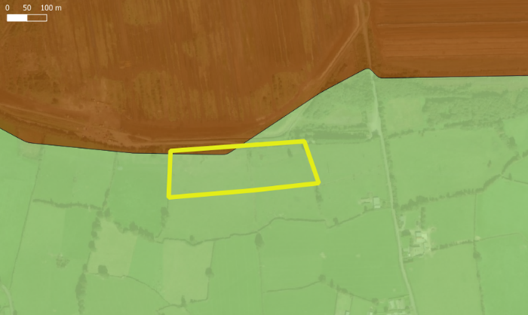
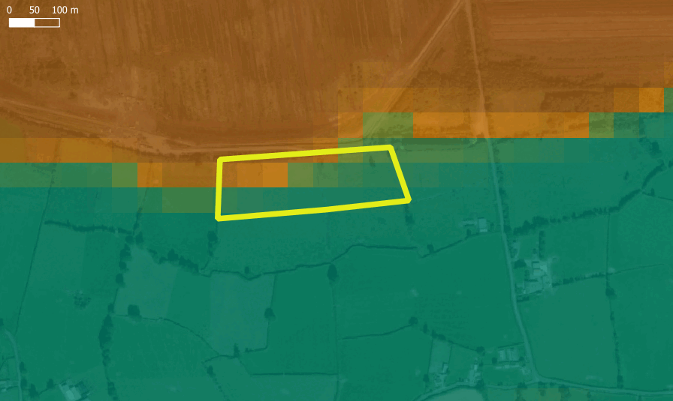
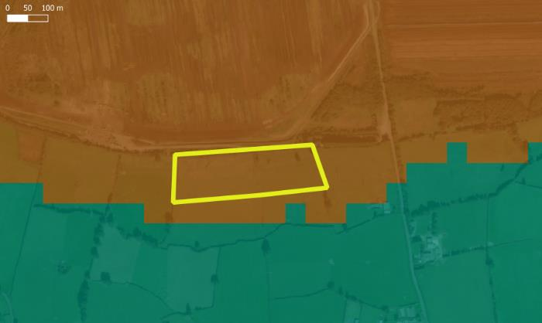
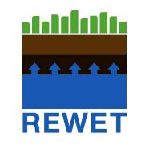
Field Scale Transition zones – ReWET Site 1
Satellite Imagery
CORINE18 LC
Tellus SOC map
Quaternary Map

Slide 11
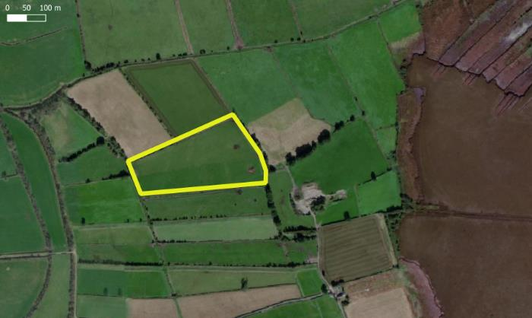
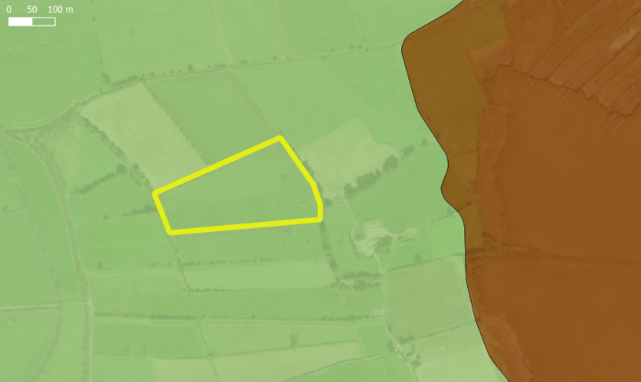
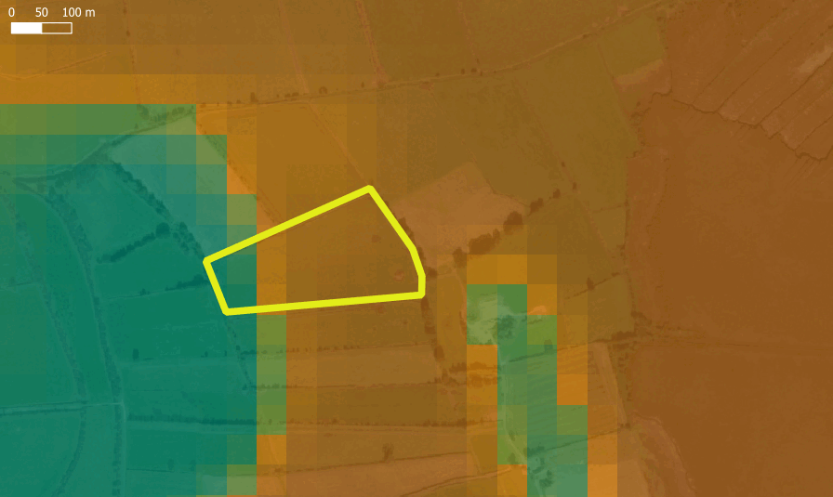
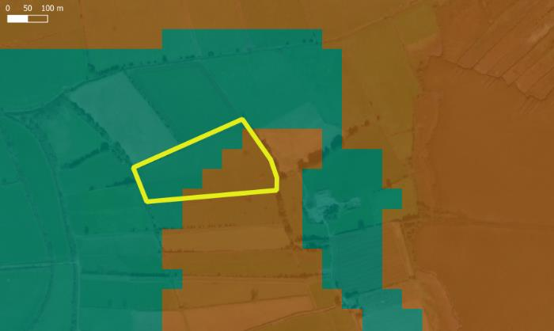
Field Scale Transition zones – ReWET Site 2
Satellite Imagery
CORINE18 LC
Tellus SOC map
Quaternary Map

Slide 12
Thank you
Happy to take any questions
via e-mail (DaveOLearyPhD@gmail.com)
Twitter/X
@BiggusDaveus

