Slide 1
Challenges in analysing and modelling extreme floods: The case study of Ahr catchment
Bora Shehu, Axel Bronstert
University of Potsdam, Institute for Environmental Sciences and Geography
14-19 April 2024
Vienna, Austria

Slide 2
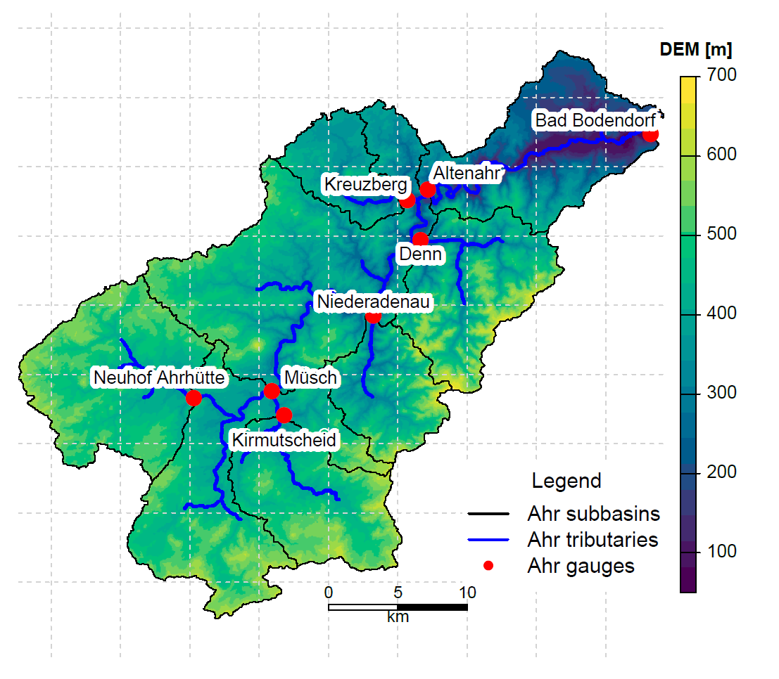
1. Introduction
Motivation:
→ How high were the runoff coefficients for the Ahr 2021 flood?
Challenges:
→ There are many rainfall products that are very different from one another.
→ There are only reconstructed discharge, which are bounded also to uncertainty.
→ Since both rainfall and discharge are uncertain, modelling with Larsim (or any other hydrological model) is challenging.
Fig.1: Ahr catchment and the respective sub-catchments and recording gauges.

Slide 3
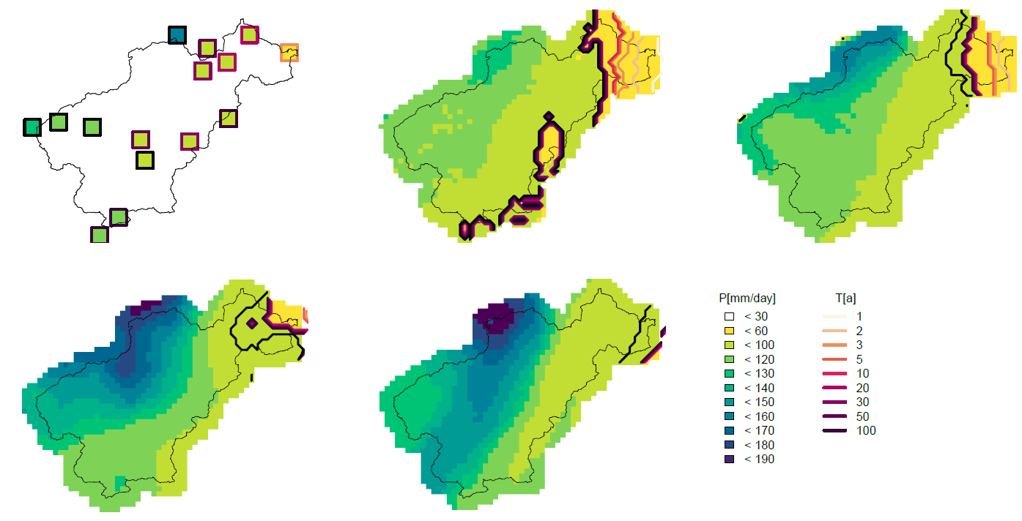
2. Rainfall on 14. July 2021: Volume and Extremity
Stations
Radolan
InterMet
+22%
(0-45%)
Rainfall Products:
Station Product – Weather stations from RLP, NRW and DWD
InterMet Product² – Station interpolation from RLP
Radolan Product³ – the operative radar product of DWD
Uni Stuttgart Product⁴ – interpolation of station + Personal Weather Stations
Uni Bonn Product⁵ – optimised Radar Data
Uni-Stuttgart
Uni Bonn
+42%
(0-90%)
+46%
(20-70%)
Fig.2: Spatial distribution of maximal rainfall volumes for different durations (P[mm]) within the July 2021 event, and the respective return periods as estimated by pixelwise by Kostra 2020¹

Slide 4
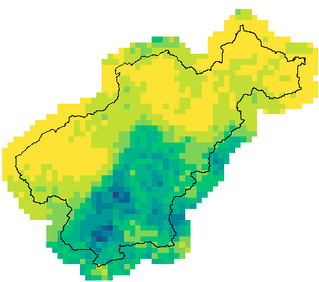
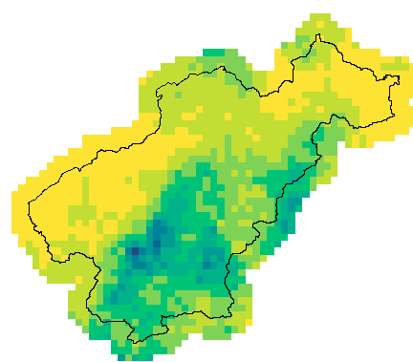
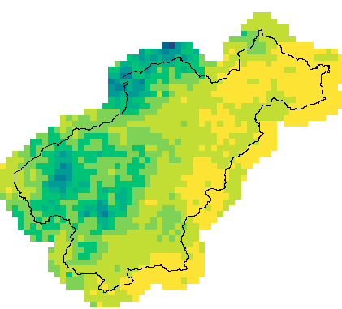
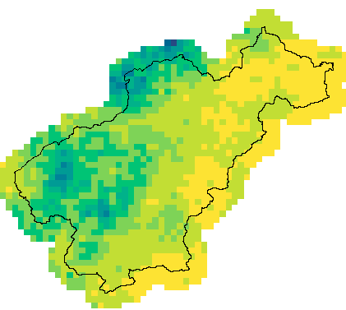
2. Rainfall on 14. July 2021: Uncertainty estimation
Stations
Radolan
Hourly Rainfall Simulation:
→ based on station hourly intensities and radolan as external drift (External drift kriging)
→ variogram from Radolan
→ 100 equiprobable realizations from Sequential Gaussian Simulations (SGS)⁶
Hourly Sequential Gaussian Simulation
Fig.3: Example of equiprobable hourly rainfall fields with sequential Gaussian simulations.
12:00 UTC
18:00 UTC
…
…
Sim 1
Sim 100
Sim 1
Sim 100

Slide 5
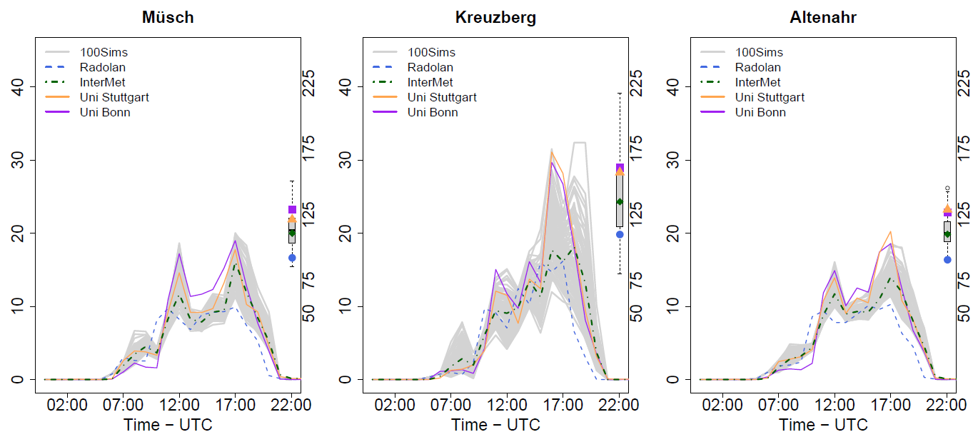
2. Rainfall on 14. July 2021: Catchment-averaged Intensities
Very high uncertainty in Kreuzberg
Uni Stuttgart and Uni Bonn Products are similar to one another.
Rainfall simulation encompass all products
Was there more rainfall in Kreuzberg?
Fig.4: Hourly area averages rainfall intensities (mm/h) for three selected Ahr subcatchment of the 2021 event.

Slide 6
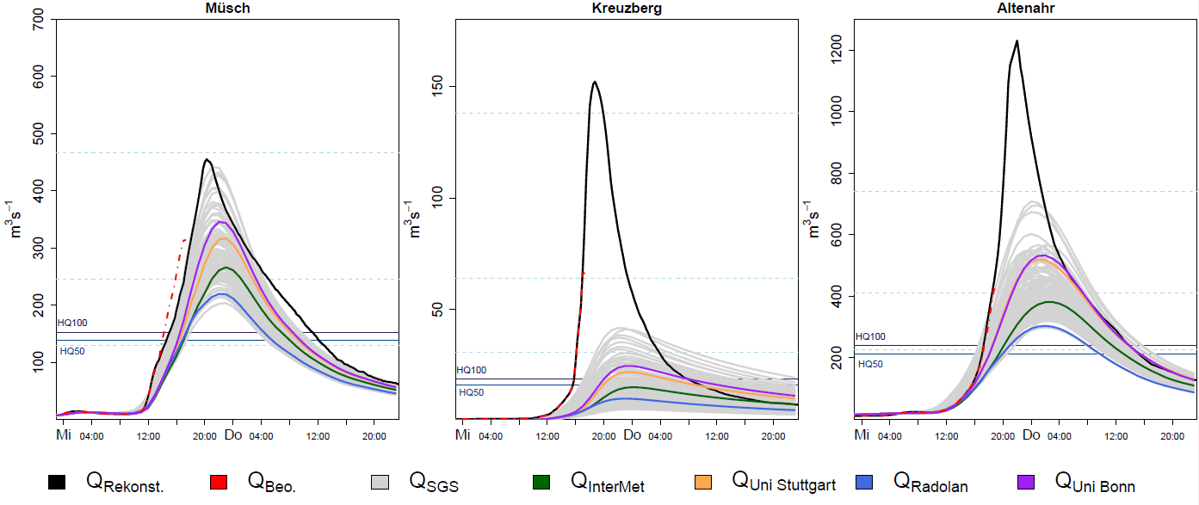
3. Larsim modelled discharges: standard parameter set
Discharge modelled with Larsim Model (Large Area Runoff Simulation Model) operational in France, Germany and Luxemburg
Hourly simulations, semi distributed model (561 sub-catchments with average size 1.6 km²)
Müsch
Kreuzberg
Altenahr
Discharge in Kreuzberg is clearly underestimated.
The three sub-catchments are very sensitive to the rainfall input.
Discharge from Uni Stuttgart and Uni Bonn are similar to one another with exception of the Kirmutscheid.
All simulated discharges in Altenahr are higher than the HQ100.
Fig. 5: Larsim simulated discharge (m³/s) with the standard parameter set (operational for the 2021 event) and different rainfall products.

Slide 7
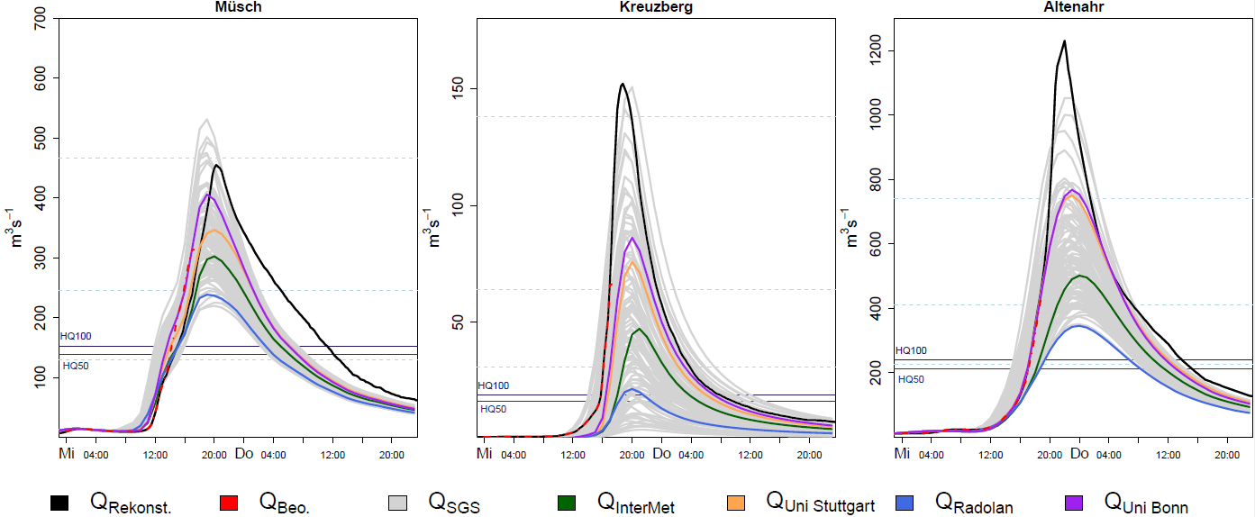
3. Larsim modelled discharge: parameter set calibrated for July 2021 Event
Parameter set (mainly influencing runoff generation – separating direct from surface runoff) calibrated in hindcast for July 2021 event.
Müsch
Kreuzberg
Altenahr
Discharge in Kreuzberg agrees better with the reconstructed data
The Uni Bonn Product shows the best agreement.
There are few simulated rainfall that agree better with the reconstructed discharge.
Fig. 6: Larsim simulated discharge (m³/s) with the calibrated parameter set (for the July14th 2021 event) and different rainfall products.

Slide 8
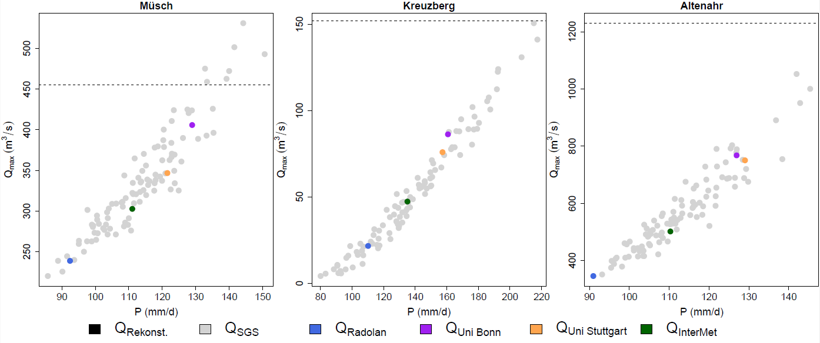
3. Larsim modelled discharge: parameter set calibrated for July 2021 Event
Müsch
Kreuzberg
Altenahr
→ Was there actually more rainfall?
… or….
→ Was the field capacity and soil moisture are actually lower than estimated / expected?
… or ….
→ Are the discharge peaks actually smaller than first estimated?
Fig. 7: Maximal Larsim modelled discharge (m³/s) with the calibrated parameter set and different rainfall products versus total rainfall volume of the different rainfall products.

Slide 9
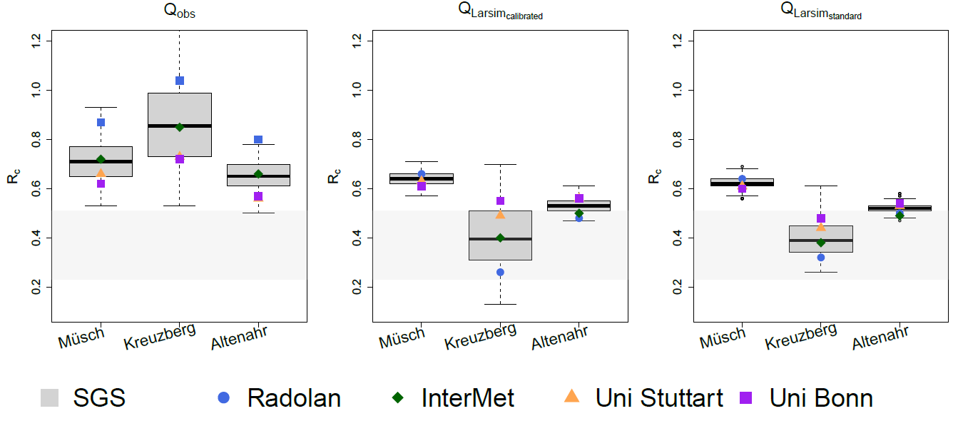
4. Runoff coefficients: observed vs Larsim modelled
Fig.8: Calculated runoff coefficients from various precipitation products and the reconstructed data as a reference for the direct runoff - left, from the direct runoff simulated with Larsim (calibrated parameter set) - middle figure, and from Larsim (standard parameter set) - right.
Due to an underestimation of rainfall (possible over estimation of discharges) we obtain unrealistic values above 1
Larsim models generally lower runoff coefficients than observed

Slide 10
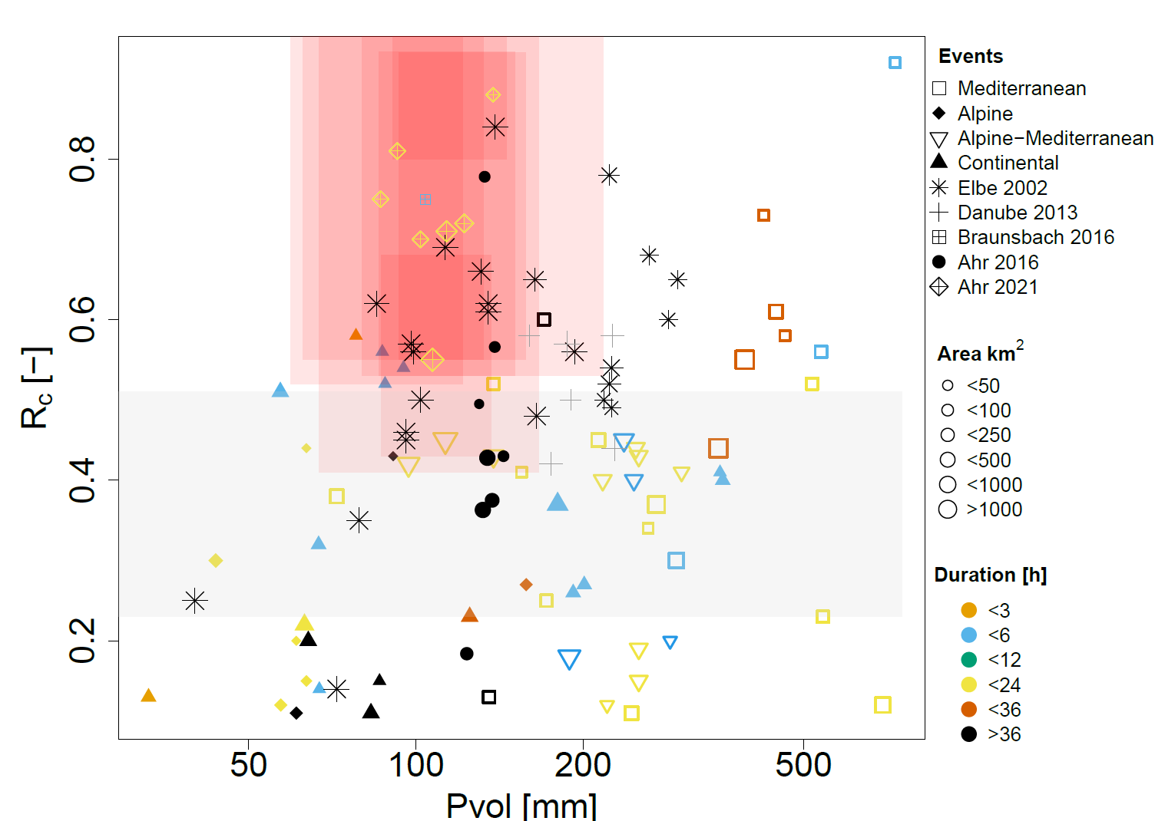
4. Runoff coefficients: comparison with other events in Europe
Fig. 9: Runoff coefficient vs. precipitation amount for various flood events in Europe⁷ (taken from Marchi et al. 2010), and the Ahr floods of 2016 and 2021.
The red colour shows the uncertainty range of the calculated runoff coefficients for the Ahr flood 2021, and the grey colour shows the expected runoff coefficients on wet soils according to Marchi et al. 2010.
⁸
⁹
¹⁰

Slide 11
5. Closing remarks
Due to the uncertainties in precipitation and runoff, estimating the runoff coefficient for the 2021 event is difficult.
The runoff coefficients for the Ahr flood in July 2021 are estimated to be between 0.4 and 0.8, which is higher than the flood in June 2016 and the average values for European floods.
Was there actually more precipitation or should we consider further changes in the model or should we consider to reduce the reconstructed discharge data?
Another
Ahr Flood
Case Study

Slide 12
Thank you!
Any questions or comments?
We acknowledge the help from:
Norbert Demuth, Sven van der Heijden and Michael Göller from Landesamt für Umwelt, Rheinland-Pfalz, for supplying the measured and reconstructed discharge data, as well as the rainfall products and catchment characteristics.
Kai Gerlinger from Hydron GmbH who provided to use the Larsim model and the calibrated parameter set specifically for the 2021 event.

Slide 13
Literature
¹Haberlandt, U., Shehu, B., Thiele, L., Willems, W., Stockel, H., Deutschländer, T., Junghänel, T., Ostermöller, J. (2023): Methodische Untersuchungen für eine Neufassung der regionalisierten Starkregenstatistik KOSTRA-DWD. Hydrologie & Wasserbewirtschaftung, 67, (3), 138-150. DOI: 10.5675/HyWa_2023.3_1
²DWD (2020): RADOLAN Kurzbeschreibung – Radargestützte Analysen stündlicher Niederschlagshöhen im Echtzeitbetrieb für Deutschland (RADOLAN) und Mitteleuropa (RADOLAN-ME), Deutscher Wetterdienst, Offenbach am Main.
³Hinterding, Angela; Kühne, Sven; Slptsov, Boris (2000).: Integration wissensbasierter Methoden und geostatistischer Verfahren zur räumlichen Interpolation. In: Wasser und Boden, 52. Jg. (2000), H. 3, S. 18-21.
⁴Bárdossy A. et. al. (2022): Projektbericht – Verbesserung der Abschätzung von Gebietsniederschlägen mittels opportunistischer Niederschlagsmessungen am Beispiel des Ahr-Hochwassers im Juli 2021. Hydrologie und Wasserbewirtschaftung 66 Jg. Heft 4, 208-214.
⁵Chen, J., R. Reinoso-Rondinel, S. Trömel, C. Simmer, and A. Ryzhkov, 2023: A Radar-Based Quantitative Precipitation Estimation Algorithm to Overcome the Impact of Vertical Gradients of Warm-Rain Precipitation: The Flood in Western Germany on 14 July 2021. J. Hydrometeor., 24, 521–536, https://doi.org/10.1175/JHM-D-22-0111.1.
⁶Pebesma, E. J. and Wesseling, C. G.: Gstat: A program for geostatistical modelling, prediction and simulation, Comput. Geosci., 24, 17–31, https://doi.org/10.1016/S0098-3004(97)00082-4, 1998.
⁷Marchi, L., Borga, M., Preciso, E., Gaume, E. (2010). Characterisation of selected extreme flash floods in Europe and implications for flood risk management, Journal of Hydrology, 394 (1–2), 118-133, doi: j.jhydrol.2010.07.017.
⁸Blöschl, G., Nester, T., Komma, J., Parajka, J., and Perdigão, R. A. P. (2013). The June 2013 flood in the Upper Danube Basin, and comparisons with the 2002, 1954 and 1899 floods, Hydrol. Earth Syst. Sci., 17, 5197–5212, https://doi.org/10.5194/hess-17-5197-2013.
⁹Sächsisches Landesamt für Umwelt und Geologie (2004): Ereignisanalyse, Hochwasser August 2002 in den Ostergebirgsflüssen. Artikelnummer: L II-1/26, Mai 2004.
¹⁰Bronstert, A., Agarwal, A., Boessenkool, Crisologo, I., Fischer, M., Heistermann, M., Köhn-Reich, L., López-Tarazón, J. A., Moran, T., Ozturk, U., Reinhardt-Imjela, C., Wendi, D. (2018). Forensic hydro-meteorological analysis of an extreme flash flood: The 2016-05-29 event in Braunsbach, SW Germany, Science of The Total Environment, 630, 977-991, https://doi.org/10.1016/j.scitotenv.2018.02.241.

